Slide 1
From hair loss to hair growth
Oral Minoxidil: A new hope!
Prof. Dr. Tariq Rashid

Slide 2
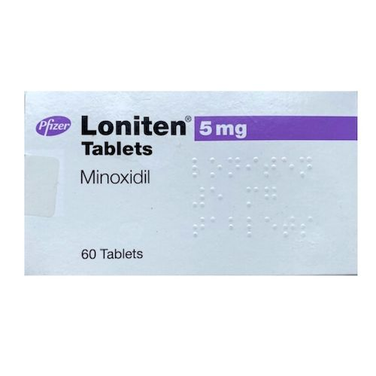
Oral Minoxidil:
Introduction:
A potent arteriolar vasodilator
Used to treat severe, refractory hypertension
Recently used for treating different hair disorders (off-label use).

Slide 3
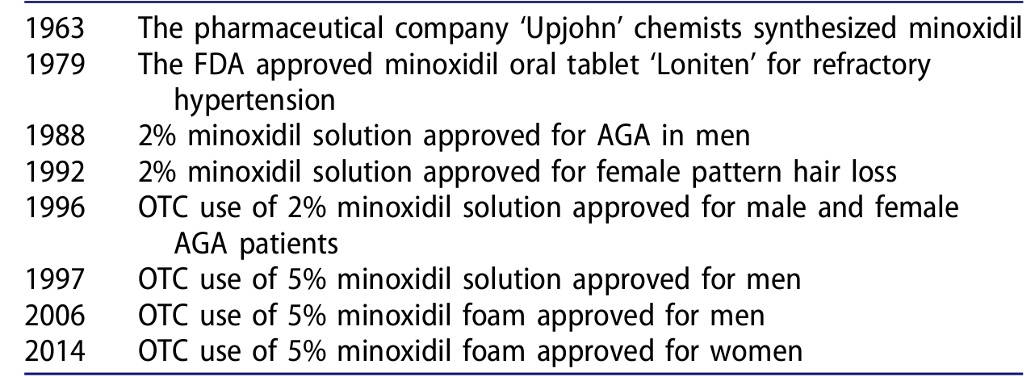
Timeline of Minoxidil approval in USA:

Slide 4
Indications of ORAL Minoxidil in Tricology:
FDA Approved: NONE
Off label indications:
Non scarring alopecia:
Androgenetic alopecia
Alopecia areata
Telogen effluvium
Traction alopecia
Chemotherapy induced alopecia
Loose anagen syndrome
Monilithrix
Scarring alopecia:
Lichen planopilaris
Central centrifugal scarring alopecia
Frontal fibrosis alopecia

Slide 5
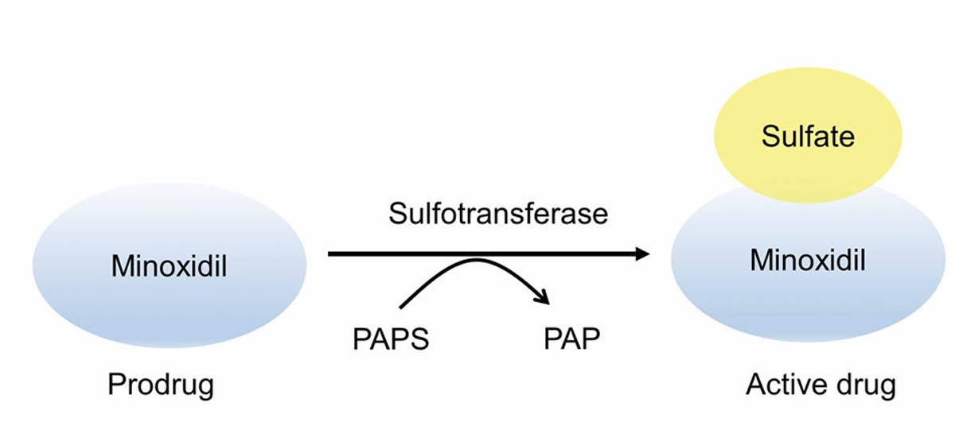
Mechanism of action:
Minoxidil is a pro-drug.

Slide 6
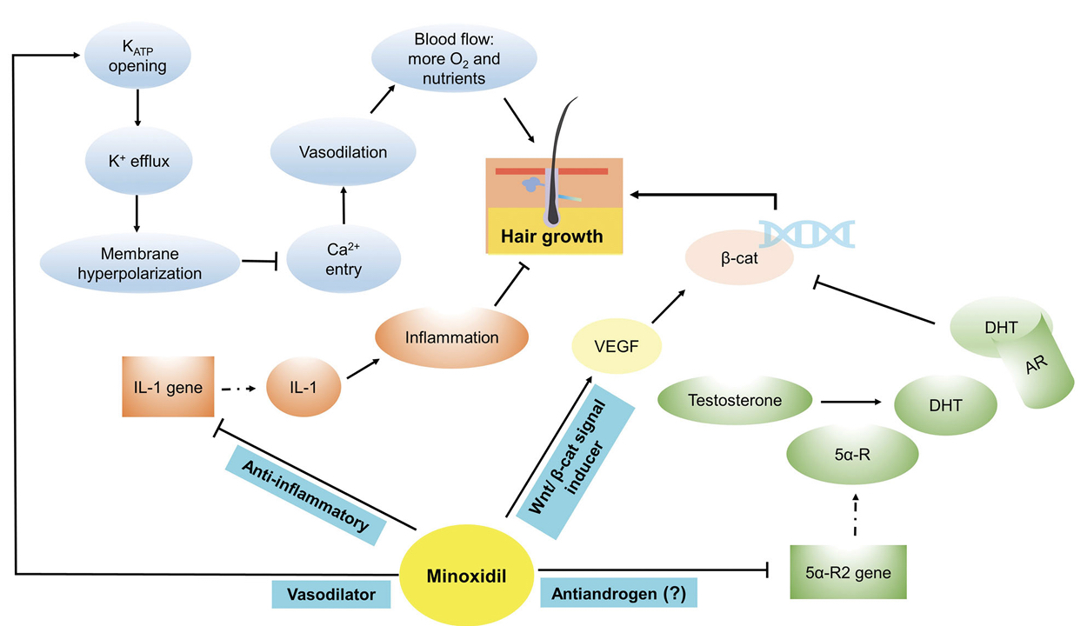
Mechanism of action:

Slide 7
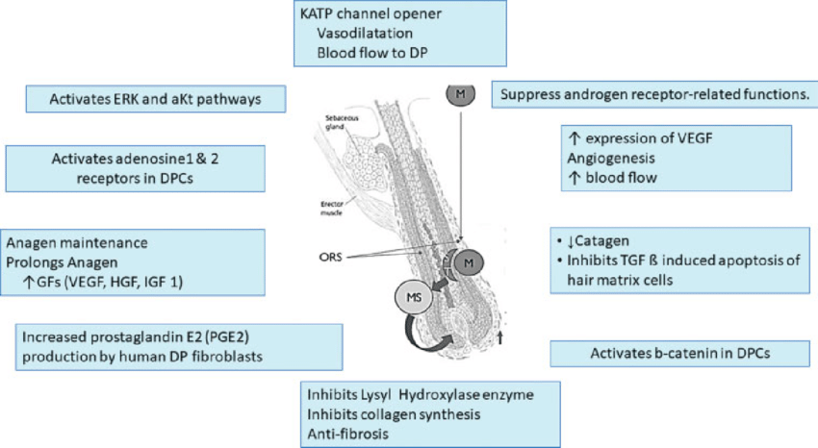
Mechanism of action:

Slide 8
Clinical Pharmacology:
Pharmacokinetics:
Bioavailability: 90%
Protein binding: None
Peak effect: 2-3 hours
Duration: Up to 2-5 days
Metabolism: ~90%, primarily via glucuronidation in liver
Half life elimination: 3.5-4.2 hours
Excretion: Urine (12% as unchanged)

Slide 9
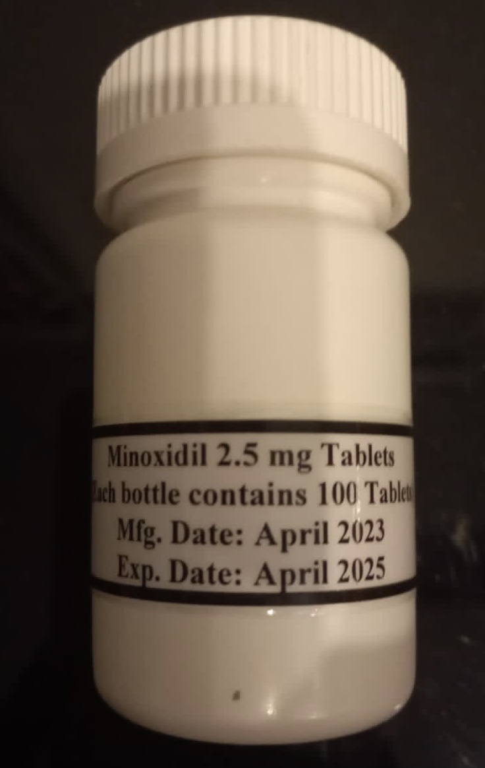
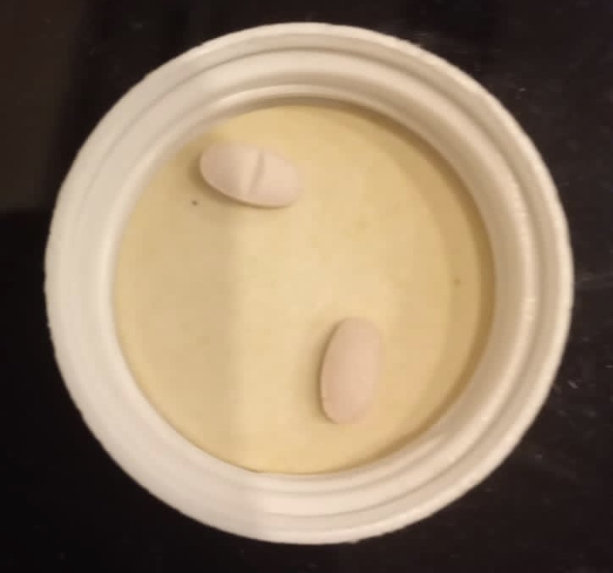
Oral Minoxidil in Pakistan:
Tablet (Minoxidil Oral): 2.5 mg

Slide 10
Optimal dose & Administration:
Low dose oral minoxidil (0.25 mg-5 mg daily)
Low dose oral Minoxidil (LDOM) 0.25-5 mg has been used off label to treat alopecia.
Variable strengths of oral minoxidil has been used in various forms of alopecia with variable results.
Initial hair growth observed at 2 months.
Maximal response achieved by 4 months.

Slide 11
Dose titration:
Dosage schedule | Female | Male
Initial Dose | 0.5 mg/day | 2.5 mg/day
Increment (every 3 months) | 0.25 mg/ day | 1.25 mg/day
Maximum Dose | 2.5 mg/day | 5 mg/day

Slide 12
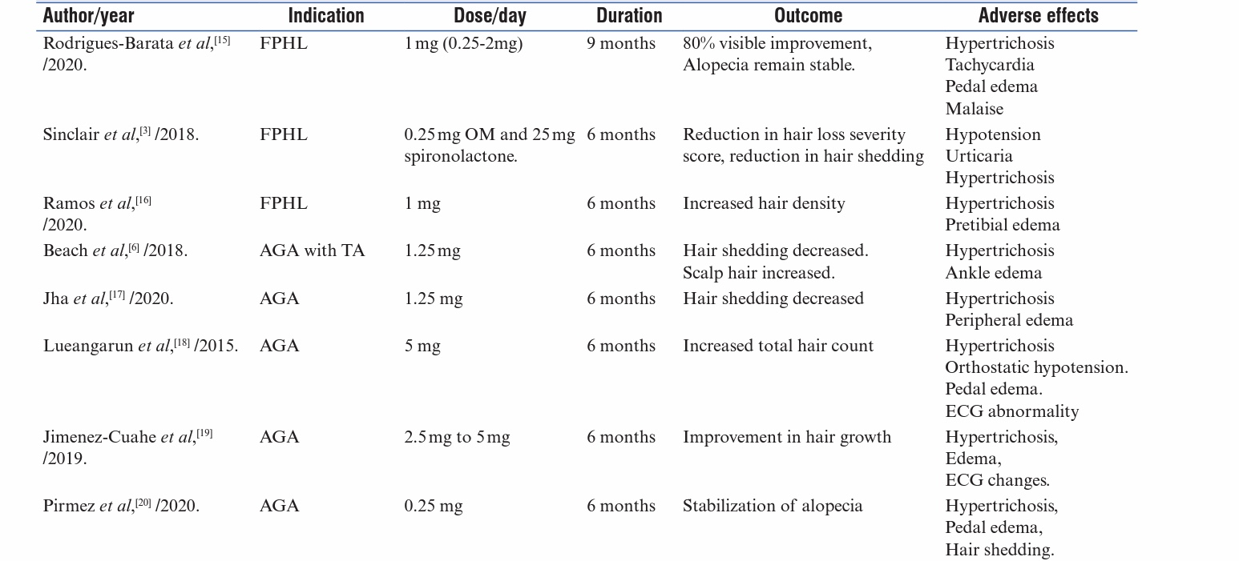
Different studies on LDOM in trichology:

Slide 13
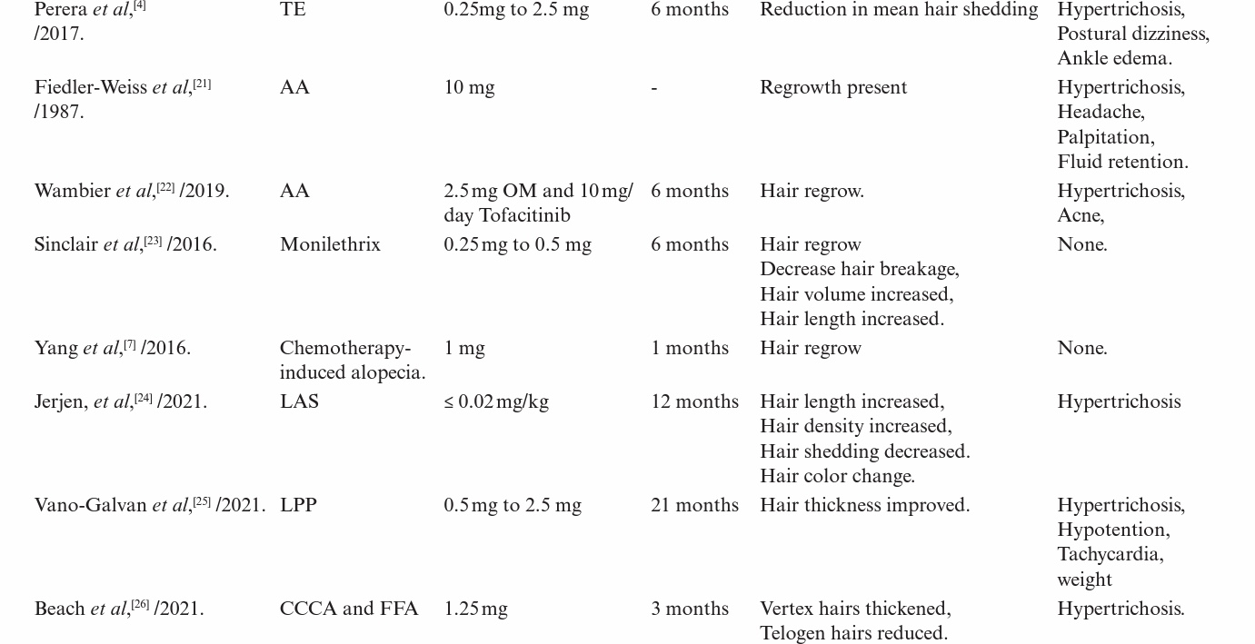
Different studies on LDOM in trichology:

Slide 14
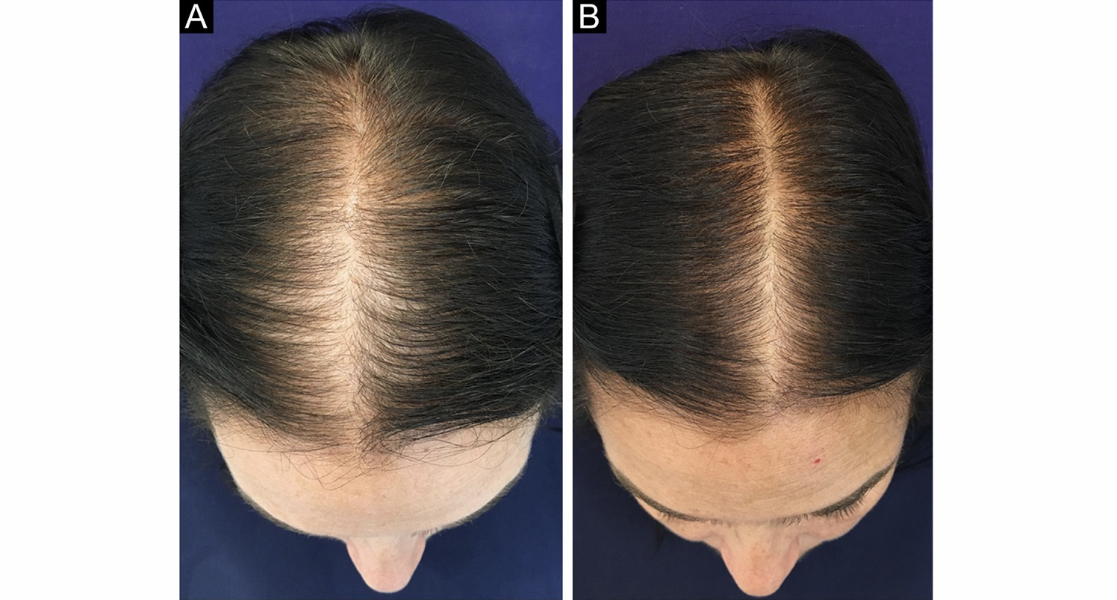
Before & 6 months after treatment photographs with 1mg/day OM in FPHL

Slide 15
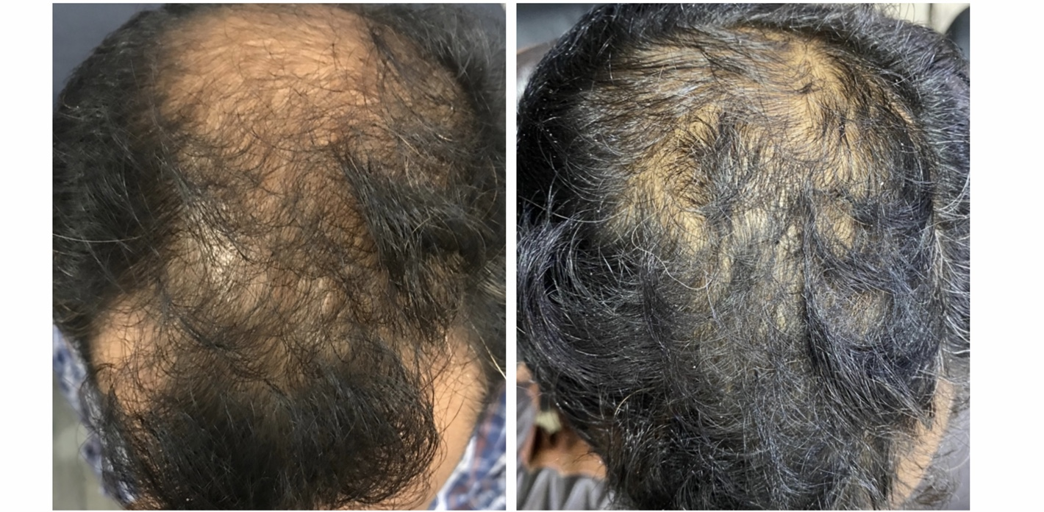
Before and 6 months after treatment photographs with 1.25 mg/day OM in AGA

Slide 16
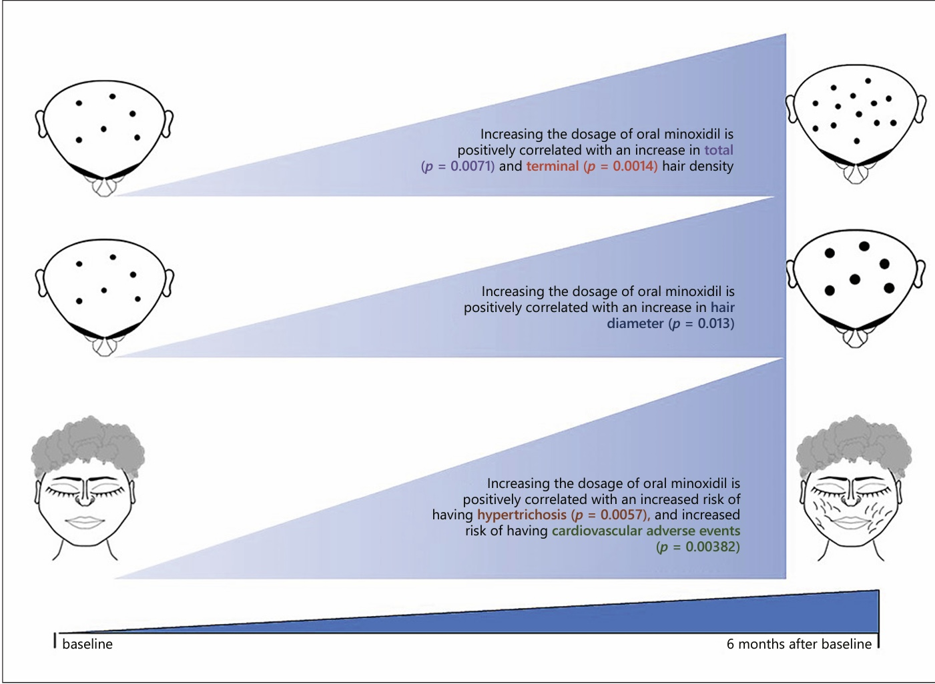
Positive correlation between dosage, efficacy and side effects:

Slide 17
Pre treatment assessment:
Pulse rate & blood pressure
Blood urea nitrogen & serum creatinine
Serum electrolytes
Aspartate aminotransferase (AST) & Alanine amonotransferase (ALT)
Chest X ray (rarely) to look for cardiommegaly
ECG (unnecessary at dose of <5 mg/day; a low threshold for patients with cardiovascular risk factors)

Slide 18
Ongoing monitoring parameters:
Keep record of pulse rate & blood pressure monitoring.
Sign/symptoms of angina, pericardial effusion/ tamponade.
Fluid & electrolyte balance and body weight
Examining routine laboratory values during treatment is generally not recommended.
Any test that is abnormal at time of initiation should be repeated.
Considered safe in females with child bearing potential.

Slide 19
Contraindications:
Absolute contraindications:
Phaeochromocytoma
Hypersensitivity to any of ingredients
Relative contraindications:
Hypotension
Cardiac comorbidities
Pregnancy and lactation
Advanced hepatic or renal impairment

Slide 20
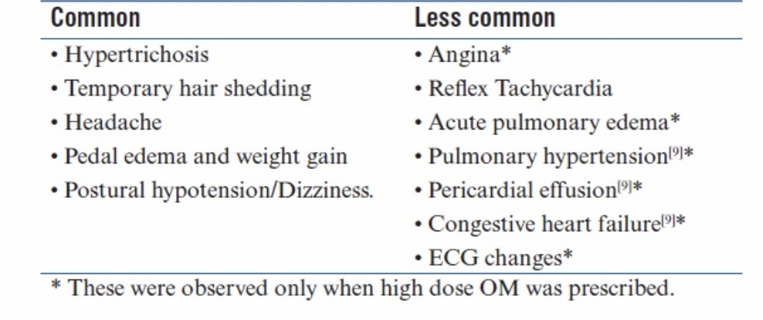
Adverse effects:
Dose dependant relation

Slide 21
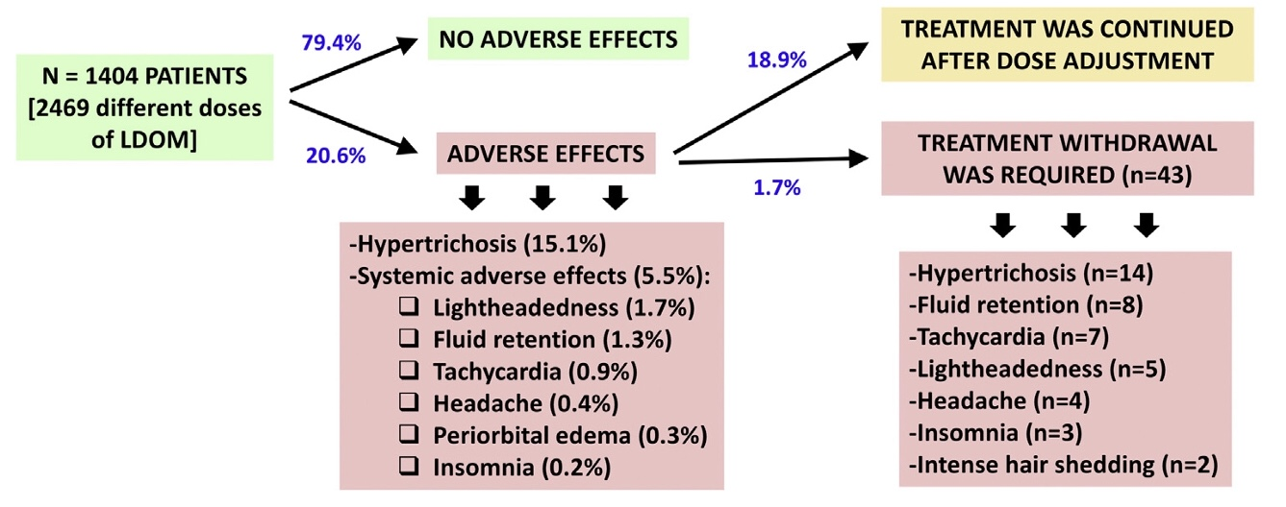
Adverse effects (Conti…)

Slide 22
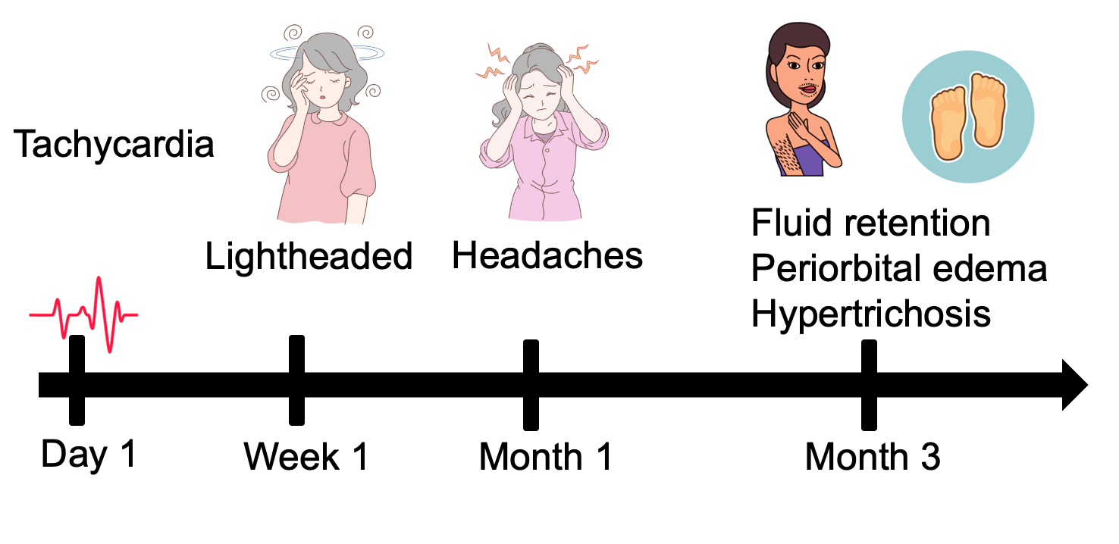
Timeline of adverse event occurance:

Slide 23
Adverse events (Conti…):
Hypertrichosis:
Dose | Risk of hypertrichosis
0.25 mg | 4%
1.25 mg | 37.5%
5 mg | 93%
Most common adverse effect.
A dose dependent relation has been observed.
Reversible on discontinuation.
May occur due to error in dosage (cutting the tablet by patient or by compounding pharmacy).
At present, 2.5 mg tablet is available in Pakistan.

Slide 24
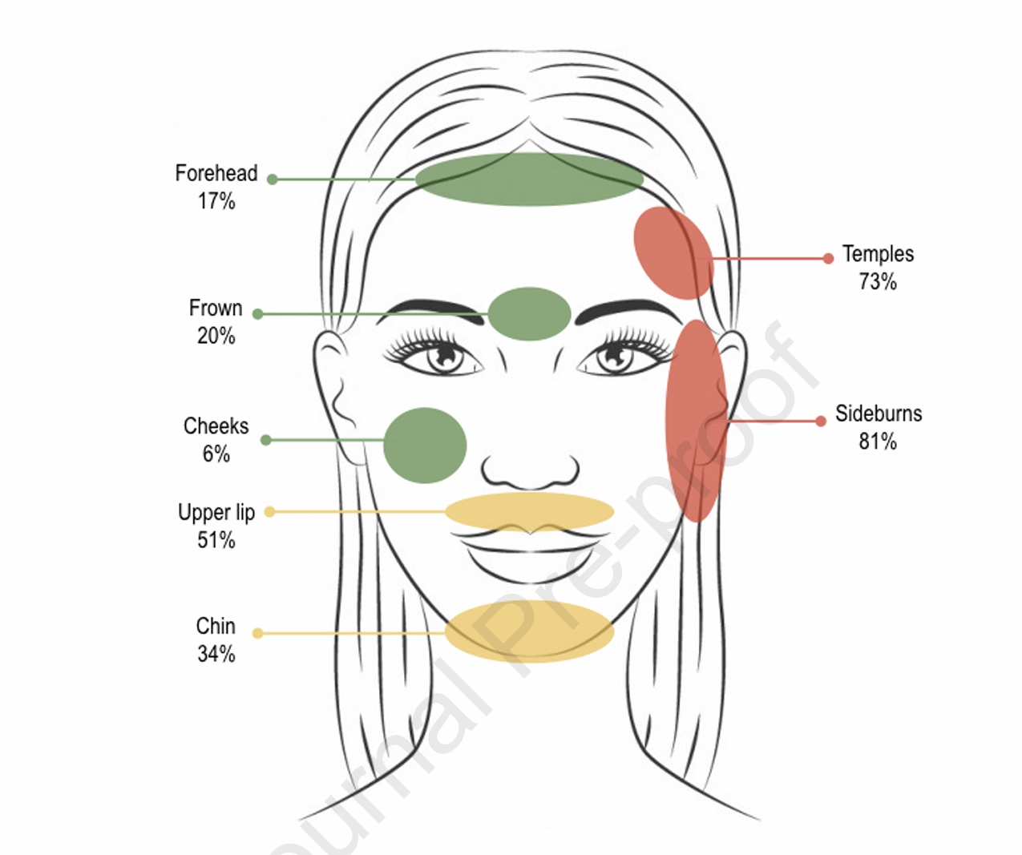
Hypertrichosis:
Characterisation:
Hypertrichosis is patterned:
Sideburns (81%)
Temple (73%)
Forearm (63%)
Upper lip (51%)
Chin (34%)

Slide 25
Management of hypertrichosis:
Start therapy with low dose (0.5 mg/day in females).
Increase the dose after 3 months.
Reduce the dose if hypertrichosis is bothersome for patient.
Every other day administration is associated with lower risk.
Can be managed with hair removal (laser, shaving, waxing, plucking, bleaching)
May combine LDOM with anti-androgens (spironolactone in females).

Slide 26
Management of lightheadedness:
Take LDOM at bedtime.
Getting up slowly from lying/sitting position.
Increase daily fluid intake.
Adjust dose of anti-hypertensive drug, if taking (by general practitioner).

Slide 27
Management of other adverse events:
Tachycardia:
Avoid caffeine
Beta blockers
If persistent refer to cardiologist.
Fluid retention/Per-orbital oedema:
Limit salt intake
Diuretics e.g; Furosemide (in male & female)
Spironolactone (in females)
Headache:
Simple analgesics (Paracetamol, NSAID)
Insomnia:
Sleep strategies/relaxation
Pharmacotherapy (by general practitioner)

Slide 28
Advise to patients on Oral Minoxidil:
Reduce salt intake to <2 gm/day.
Take LDOM at bedtime.
Keep record of pulse rate and blood pressure.
Reduce intake of caffeine containing products.
Counsel regarding risk of tachycardia and postural hypotension.
Report back immediately if experience shortness of breath or chest pain.

Slide 29
Use in Pregnancy & Lactation:
Pregnancy:
Pregnancy category C drug
Risk of neonatal hypertrichosis
Lactation:
Excretion in breast milk has been reported
Breast feeding isn’t recommended.

Slide 30
Use in Geriatrics & paediatric:
Geriatrics:
Use with caution in elderly
Initiate at lowest dose
Monitor closely
Paediatrics:
To date, no guidelines available regarding ideal dose or age limit in children.
LDOM has been used in children for loose anagen syndrome at dose of 0.5 mg/day with good response and no adverse effects.
Extremely low doses (0.2-0.5 mg/day) can be used in particular situations.

Slide 31
Special warning/Precaution:
Alert: US Boxed warning
Sinus tachycardia may increase oxygen demand and exacerbate angina.
May cause pericarditis or pericardial effusion leading to cardiac tamponade (an idiosyncratic reaction).

Slide 32
Drug interactions:
Salicylates/Aspirin: Inhibits sulfotransferase activity leading to decreased activity of LDOM.
Cyclosporine: Severe hypertrichosis (Risk C: Monitor therapy)
Guanethidine: An anti-hypertensive drug; precipitates orthostatic hypotension.

Slide 33
Why Oral Minoxidil is preferred?
Comparison to Topical Minoxidil:
Oral administration is more convenient than topical.
Topical application is operator dependent (some areas of scalp may be missed)
LDOM circumvents local side effects of topical therapy (irritation and allergic contact dermatitis).
Altered hair texture with topical application.
Greater improvement than topical, due to greater bioavailability with oral administration.
LDOM is effective in patient who failed to respond to topical minoxidil.

Slide 34
5 C’s of Oral Minoxidil:
5 Practical advantages of oral minoxidil
Convenience
Cosmesis
Cost effectiveness
Co-therapy
Compliance
Additional 2 C’s observed in different studies are:
Complicated
Crown effect

Slide 35
Why Oral Minoxidil is preferred?
Comparison to oral finestride:
Oral finasteride use is limited by its side effects:
Sexual adverse effects in males
Teratogenicity in females
Post finasteride depression syndrome
Controversial effects on prostate gland

Slide 36
Combination therapy with Minoxidil:
LDOM can be combined with other topical and systemic therapies for alopecia.
Currently, data is available on combination of LDOM with spironolactone (for female pattern hair loss) and tofacitinib (for alopecia areata).

