Slide 1
MELANOMA SURGERY
Dr Anum Mushtaq Khan
PGR DERMATOLOGY

Slide 2
Biopsy
Thinner melanomas have better prognosis and survival outcomes.
Most melanomas are patient-detected, but physician-detected lesions tend to be thinner.
Any pigmented lesion suspicious clinically (change in size, color, border, etc.)
Biopsy aims: confirm diagnosis, assess depth (Breslow), ulceration, margins
Notes:
Gold standard: narrow-margin (1–3 mm) complete excision of entire lesion.Perform as elliptical or punch biopsy to full dermal depth (≥2 mm).Preserve lymphatic drainage if SLNB may be needed.

Slide 3
Types of Biopsy
Excisional biopsy (preferred): full thickness, narrow margin (1–3 mm)
Incisional / punch biopsy: for large lesions or in difficult anatomical sites
Shave or superficial biopsies: generally discouraged as they may under‐sample
Notes:
For large or complex lesions: perform incisional or punch biopsy through the thickest or darkest area.Use dermoscopy or confocal microscopy to select area.Sampling error possible; complete excision later required for microstaging.

Slide 4
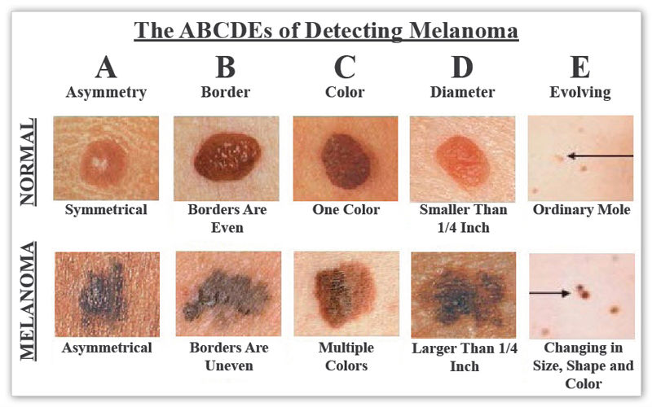
ABCDE OF MELANOMA

Slide 5
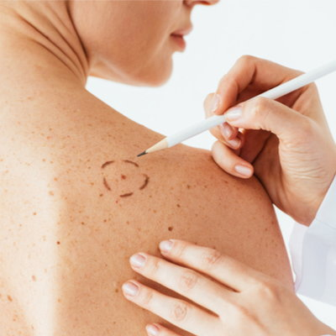

UGLY DUCKLING SIGN
One mole among many that sticks out & looks different.

Slide 6
Key Histopathological Parameters
Breslow thickness (nearest 0.1 mm).
Ulceration status.
Margins (peripheral & deep).
Mitotic rate per mm².
Lymphovascular invasion, microsatellitosis, regression
Clark level (for ≤1 mm lesions).

Slide 7
Wide Local Excision (WLE)
After initial biopsy, the scar (or biopsy site) becomes the target for definitive excision
Aim: to remove residual tumor + margin of normal tissue
Margins depend on tumor thickness / risk group
Depth: down to but not necessarily through fascia (unless risk factors)
Notes:
Prevents local recurrence by removing residual microscopic disease.Performed after diagnosis confirmation.Excessive margins → increased morbidity; too narrow → recurrence risk.

Slide 8
Recommended Surgical Margins (Peripheral)
Tumor Thickness | Recommended Margin*
Melanoma in Situ | 0.5cm – 1cm
Breslow ≤ 1.0 mm | 1 cm
Breslow 1.01 – 2.0 mm | 1–2 cm
Breslow > 2.0 mm | 2 cm

Slide 9
Melanoma in Situ Management
Standard margin: 0.5–1 cm.
If histologic regression present, consider 1 cm.
Regression may conceal previous invasion → wider clearance advised.

Slide 10
Lentigo Maligna Melanoma
Occurs on sun-damaged head and neck skin.
Ill-defined margins, subclinical extension.
Management options:
Standard excision with delayed closure.Mohs micrographic surgery with immunostaining.
Staged excision (slow Mohs) with permanent section control.

Slide 11
Sentinel lymph node biopsy
Identifies occult nodal metastasis — most common first spread site.
Tracers: radiocolloid + blue dye injected intradermally.
Technique
Inject tracer at primary site.Node identified via probe or imaging (SPECT/CT).
Node excised and examined (H&E + immunohistochemistry).
Notes:
Perform concurrently with WLE to preserve true lymphatic mapping. SLN status = strongest independent prognostic factor.Speaker Notes:SLNB improves staging accuracy, not overall survival; helps identify high-risk patients for adjuvant therapy.

Slide 12
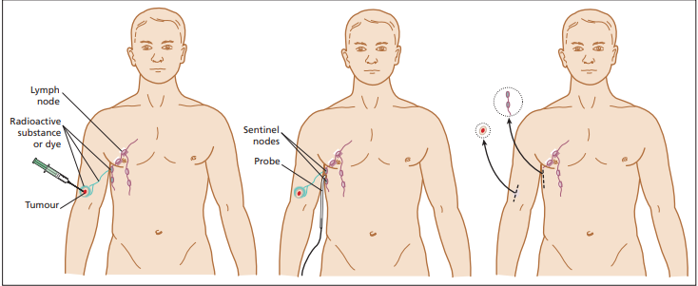
Notes:
) Sentinel lymph node biopsy allows detection of melanoma micrometastases in regional lymph nodes. Radioactive tracer and dye are injected intradermally at the primary melanoma tumour site and follow the lymphatic drainage pathway to the first, or sentinel, regional lymph node. Intraoperatively, a probe is used to detect the target node, which is then surgically excised for pathological evaluation. C

Slide 13
Sentinel lymph node biopsy patient selection
All melanomas ≥1.0 mm Breslow depth.
Consider for 0.8–1.0 mm with ulceration or high mitotic rate.
Consider T1b lesions( decision based on risk, comorbidities and patient age)
Not recommended for in situ or <0.8 mm lesions.
Notes:
young age as a continuous variable centred around 40–45; the presence of angiolymphatic invasion, ulceration or increased mitotic rate as a continuous variable starting at 1/mm2 ; a positive deep margin usually on shave biopsy such that the true Breslow depth is unknown; and dermal regression to 1 mm thickness [

Slide 14
MANAGEMENT
MANAGEMENT
Systemic
Immunotherapy*
Targeted therapy
Surgery
Surgical excision
Therapeutic Total lymh node dissection
Chemotherapy
Radiotherapy
BRAF inhibitor
Dabrafenib
MEK inhibitors Trametinb
C-KIT inhibitors Imatinib
*Interferon alfa 2b
PD-L1: atezolizumab
PD-1 :antagonist
pembrolizumab ,nivolumab
Notes:
After TLND there are 3 options ..a) adjuvant interferons( b)observe (c) add new drugs

Slide 15
Systemic Treatment of Melanoma

Slide 16
Introduction
Last decade: dramatic shift
Oncolytic , immune-directed & targeted agents.
Traditional chemotherapy largely obsolete.
Aim: durable remission
Notes:
Most treatment options for advanced melanoma, adjuvant or neo adjuvant setting.

Slide 17
1. Treatment options in local and systemic therapy of melanoma
Notes:
Previously only interferon and chemo

Slide 18
a. Local therapies
Surgery- first option in isolated melanoma recurrence
Oncolytic virus therapy
Talimogene Iaherparepvec (Tvec) (herpes simplex virus).
- For stage 3 or 4 melanoma
Intralesional administration- ACTS by producing GM-CSF gene cause local cell destruction (anti tumor effect)
Notes:
Tissue sampling important for genetic profiling and assessment of specific markers like pdl1(programmed cell death protein 1). Results imp for furher systemic tx
For locaLLY advanced melanoma with injectable lesions/ stage 3 or 4 melanoma (unresectable , injectable) with limited visceral disease.
. Iv every 2 weeks survival improved . s/e fever fatigeu chills

Slide 19
3. Radiotherapy: in inoperable desmoplastic melanoma/ after nodal dissection .
-for palliation or nodal control.
Indicated in patients with multiple or large lymph node metastasis, extra nodal involvement, symptomatic or brain metastasis
4. Electrochemotherapy (ECT): local control for ulcerating metastases by using bleomycin
5. Isolated Limb Perfusion (ILP): regional control for limb-confined disease or after surgical resection in adjuvant setting
Notes:
3. To prevent local recurrence
4. Small elecric used to increase chemotherapeutic drug uptake into tumor
5. Anticancer agents injected into extremity like tnf a or melphalan

Slide 20
Treatment algorithm of advanced melanoma in a tertiary referral centre

Slide 21
b. Immunotherapy
Checkpoint inhibitors
Gold standard treatment for advanced melanoma
Immune checkpoints regulate T-cell activity.
Tumor cells exploit CTLA-4 and PD-1 pathways for immune evasion.
Blocking these pathways restores cytotoxic activity.
Notes:
Interferons previously but now no longer used due to side effecte at high doses like ac constitutional symptoms , ch fatigue , myelosuppression, hepatotoxicity, neurological and psychiiatric s/e.
+ve or _ve regulators of immune ssystem , prevent autoimmune reaction. Overacting and destroying healthy cells of body

Slide 22
Major immune checkpoint inhibitors
CTLA-4 inhibitor: Ipilimumab.
PD-1 inhibitors: Nivolumab, Pembrolizumab.
PD-L1 inhibitor: Atezolizumab.
CTLA-4 acts early (priming phase), PD-1 acts later (effector phase); combination enhances T-cell activation.
Notes:
CTLA-4 acts early (priming phase), PD-1 acts later (effector phase); combination enhances T-cell activation.

Slide 23
Combination immunotherapy
With radiotherapy
-In settings of mixed tumor response/ mets in critical locations like brain, bone
With virotherapy
-improve efficacy of anti-PD-1 (presence of at least one injectable tumor lesion.
Nivolumab + Ipilimumab: highest response
Newer combination: PD-1 + LAG-3 inhibitors (Nivolumab + Relatlimab). More efficient less toxicity
Notes:
s/e radionecrosis

Slide 24
Immune-Related Adverse Events
Dermatologic: rash, vitiligo.
GI: colitis, diarrhea.
Endocrine: thyroiditis, hypophysitis.
Pulmonary: pneumonitis.
Managed with corticosteroids, immunosuppressants if severe.

Slide 25
c. Targeted therapy
BRAF inhibitors (vemurafenib, debrafenib, encorafenib
MEK inhibitors (tremetinib, cobimetinib)
-used in BRAF and MEK mutated melanoma
Block tumor proliferation in few days so first line option in aggressive disease
with
high tumor burden
elevated LDH , fast growth, visceral involvement including brain and live mets
Notes:
Selective kinase inhibitors BRAF mutation in ~50% of cutaneous melanoma.BRAF activates MEK → ERK → cell proliferation.Dual inhibition (BRAF + MEK) improves efficacy, reduces resistance.

Slide 26
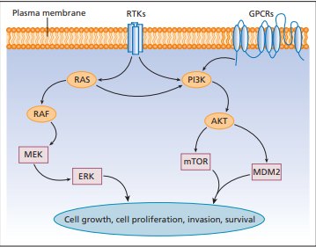
MPAK pathway

Slide 27
BRAF/MEK inhibitor combinations
Combination | Response Rate | Key Adverse effects
Dabrafenib + Trametinib | ~70% | Pyrexia
Vemurafenib + Cobimetinib | ~65% | Photosensitivity
Encorafenib + Binimetinib | ~65% | GI upset
Notes:
Combinations increase survival and decrease cutaneous toxicity (e.g., keratoacanthomas)

Slide 28
KIT, NRAS, and GNAQ Mutations
KIT mutations: in mucosal/acral melanomas; respond to imatinib/nilotinib.
NRAS mutations: ~20% cases; MEK inhibitors show limited benefit.
GNAQ/GNA11: uveal melanoma; trials ongoing.

Slide 29
d. Role of chemotherapy
Agents: dacarbazine, temozolomide, nab-paclitaxel.
Low response (~10–15%), short duration.
Now considered only when patients are ineligible for modern systemic agents.

Slide 30
2. Therapeutic approach for systemic management of melanoma
Notes:
Aim: achieve long term remission and cure of melanoma
Tumor tissue should be tested for presence or absence of driver mutation and PD-L1 expression

Slide 31
a. Neoadjuvant Systemic Therapy
For stage III with bulky nodal disease.
Early data: increased pathological response and improved resectability.
Ongoing trials with PD-1 ± CTLA-4 blockade.
Emerging field — aims to downstage before surgery and reduce relapse risk.

Slide 32
b. Adjuvant Therapy Post-Surgery
Indicated for resected stage III or IIB/C.
PD-1 inhibitors (Nivolumab/Pembrolizumab): improved RFS.
Dabrafenib + Trametinib: for BRAF-mutant stage III.
Significant reduction in recurrence risk — now standard of care.

Slide 33
c. Systemic Therapy for Metastatic Disease
First line: PD-1 inhibitors ± CTLA-4.
For BRAF-mutant: targeted therapy as alternative or sequential option.
T-VEC for injectable cutaneous lesions.
Choice depends on mutation status, disease burden, and urgency of response

Slide 34
Triplet Therapy (Targeted + Immunotherapy)
Atezolizumab + Vemurafenib + Cobimetinib.
15.1 months vs 10.6 with targeted therapy alone.
Emerging approach; may offer benefit for BRAF-mutant cases but needs toxicity vigilance.

Slide 35
Special circumstances
Brain metastasis: Combination immunotherapy + stereotactic RT.
Mucosal/Uveal melanoma: often resistant; trials exploring KIT/MEK inhibitors.

Slide 36
Cutaneous Adverse Reactions
Vitiligo-like depigmentation, lichenoid and psoriasiform eruptions.
Indicates immune activation and correlates with good prognosis.
Common but manageable; dermatologists play a key role in recognizing and treating

Slide 37
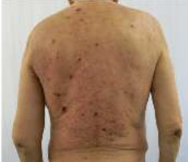
Lichenoid drug eruption

Slide 38
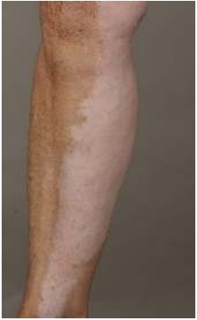
Vitiligo like depigmentation

Slide 39
Monitoring and Follow-Up
Imaging every 3–6 months (CT/MRI/PET).
Monitor endocrine, hepatic, and renal function during therapy.
Long-term surveillance due to late recurrences.

Slide 40


