Slide 1
Skin Disorders in Diabetes Mellitus
Dr abdul hadi
Resident family medicine
Akuh, (global physician program)

Slide 2
Introduction:
Diabetes mellitus, is a group of common
endocrine diseases characterized by sustained high blood sugar levels.
Diabetes is due to either the pancreas not producing enough insulin, or the cells of the body becoming unresponsive to the hormone's effects.

Slide 3
Types of diabetes:
Diabetes is classified loosely into four types:
Type 1: insulin dependent; usually juvenile onset, associated with
human leukocyte antigen (HLA) -DR3, and -DR4 and diabetes-associated autoantibodies,
Type 2: generally non-insulin dependent; usually adult onset and
associated with other features of the metabolic syndrome such as
obesity.
Secondary diabetes: iatrogenic or associated with pancreatic,hormonal and genetic disease.
Gestational diabetes: associated with pregnancy.

Slide 4
Affects of Diabetes on skin:
Diabetes mellitus can affect the skin by various pathophysiological processes.
Vascular damage:
Leg ulceration
Wet gangrene of the foot.
Erysipelas-like reaction.
Diabetic dermopathy.
Rubeosis.

Slide 5
Neurological damage:
Diabetic foot.
Diabetic foot ulcer.
Obesity, hyperlipidaemia and the metabolic
Syndrome:
Acanthosis nigricans.
Skin tags.
Eruptive xanthomas of the skin.
The metabolic syndrome.

Slide 6
Treatment-related skin manifestations:
Insulin lipodystrophy.
Allergic reactions to insulin and glucose monitors.
Allergic reactions to oral hypoglycaemic drugs.
Disease associations and genetic syndromes:
Reactive perforating collagenosis (folliculitis).
Autoimmune disease.
Genetic and other systemic diseases.

Slide 7
Miscellaneous disorders:
Granulomatous disorders.
Stiff skin and joints.
Pruritus.
Diabetic bullae.
Other associations.
infections

Slide 8
Vascular Damage:
Accumulationof advanced glycation end-products (AGEs) due to
glycaemia and oxidative stress is thought to be pivotal.
Hyperglycemia induced cascade of metabolic events leads to endothelial proliferation,
thickened basement membrane with deposits of periodic acid–Schiff (PAS) stain-positive material,
and narrowing of arterioles, capillaries and venules
.Microangiopathy is responsible for the retinopathy, nephropathy and probably also neuropathy
anddiabetic dermopathy.

Slide 9
Leg Ulceration
Leg and foot ulcers may result from vascular and neurological damage, causing:
Impaired blood flow and autonomic neuropathy.
This leads to poor circulation, tissue hypoxia, chronic inflammation, and impaired healing,
Worsened by elevated glucose.
Management includes debridement, off-loading, revascularization, and antimicrobial therapy if infection is present .

Slide 10
Wet gangrene of the foot:
In diabtics a sudden loss of perfusion to the already compromised cutaneous microcirculation (e.g. due to local infection or heart failure) may result in a wet necrotic area.
This differs fromthe dry peripheral gangrene seen in arteriopathies.
It is a late manifestation of diabetic microangiopathy

Slide 11
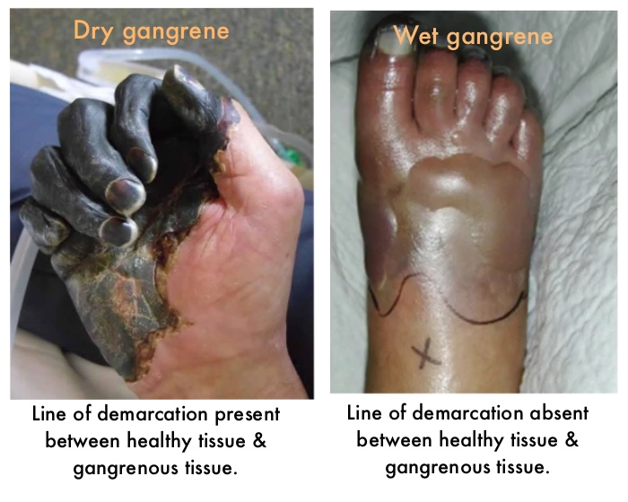

Slide 12
Erysipelas-like reaction:
Non-infectious skin condition mimicking erysipelas (bacterial infection).
Often seen in patients with poorly controlled diabetes.
Clinical Features:
Red, swollen, warm skin with sharp borders (usually on the lower legs).
Can be associated with pain, fever, and systemic symptoms.
Pathogenesis:
Thought to be caused by microvascular damage, inflammation, and immune dysfunction in diabetes.
Non-infectious, but may be mistaken for an infection.
Management:
Focus on blood sugar control and symptomatic treatment.
Corticosteroids or NSAIDs may be used for inflammation.
In rare cases, antibiotics may be prescribed to rule out infection.

Slide 14
Diabetic dermopathy:
Dull-red papules on shins,(shin spots) forearms, thighs
producing a superficial scale and, ultimately, atrophic
brown scars.
Common (10% of diabetics), marker for complications such as retinopathy,
nephropathy and neuropathy.
Pathologically, there is hyperpigmentation of the epidermal basal layer, deposition of
haemosiderin and melanin in the dermis and arteriolar basement
membrane thickening.

Slide 15
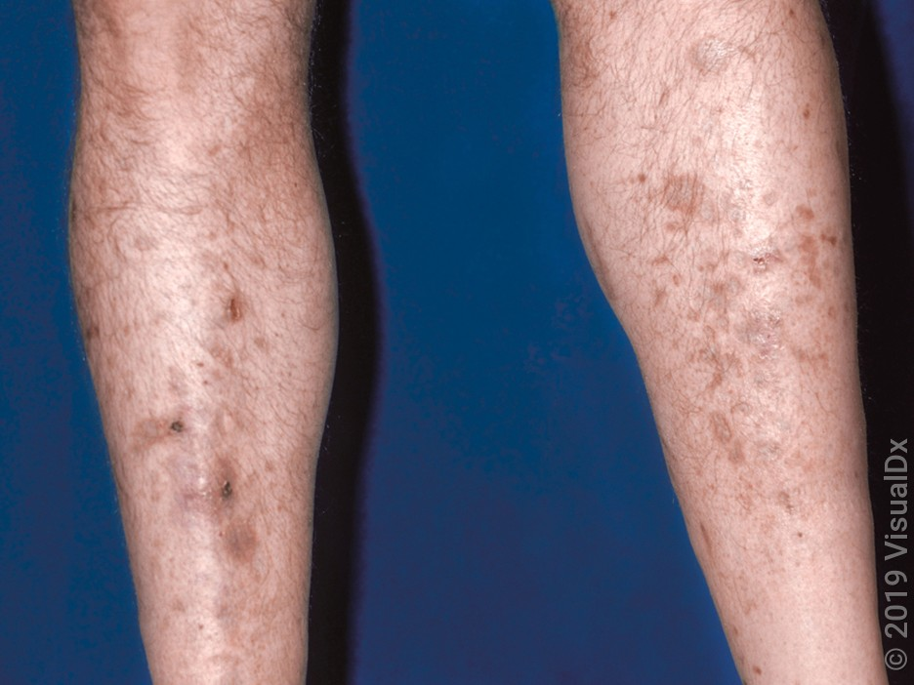
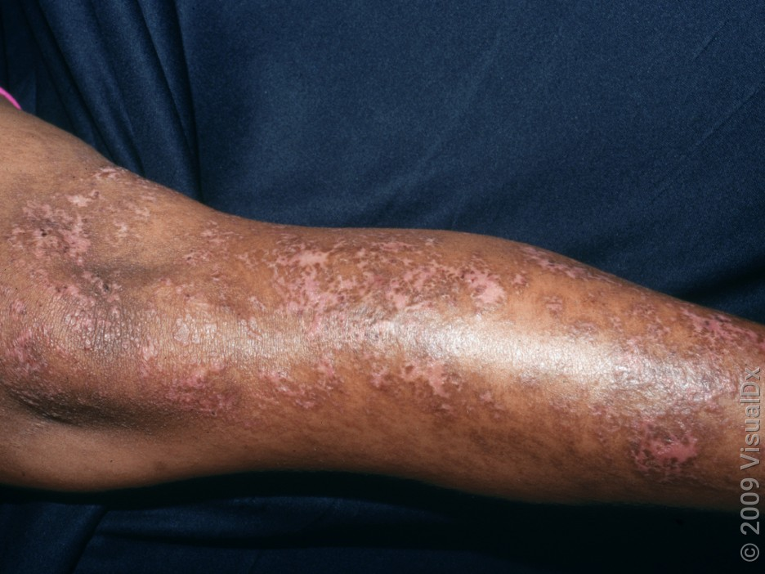
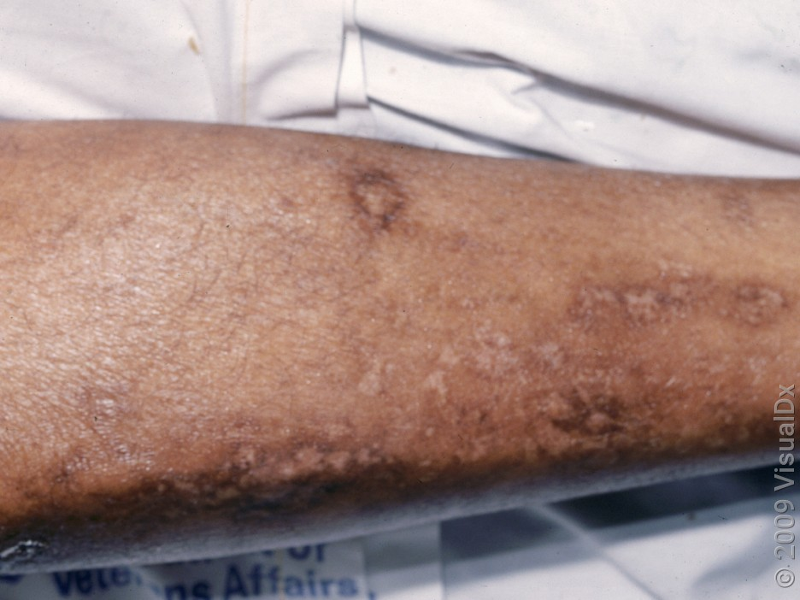
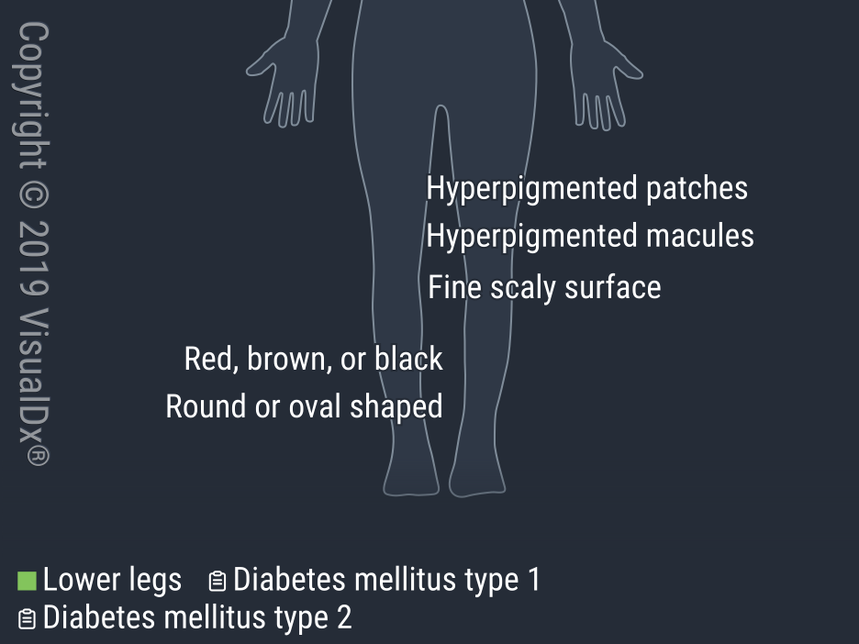
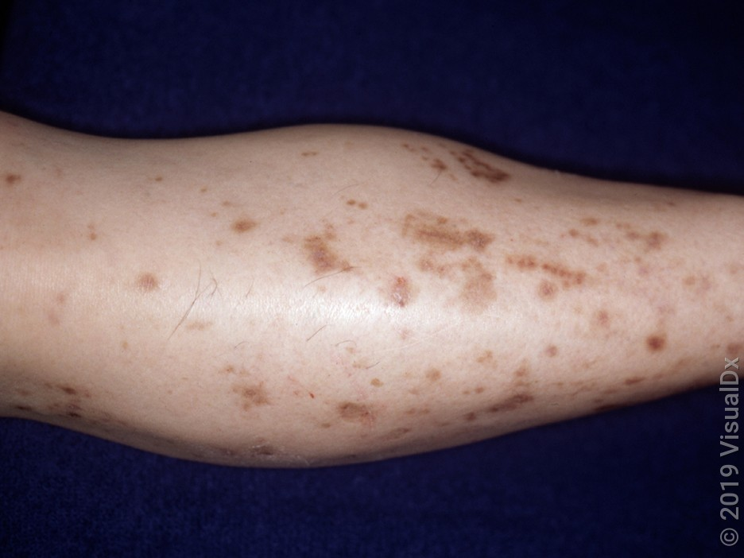

Slide 16
Rubeosis:
This peculiar rosy reddening of the face, and sometimes of the hands and feet, in longstanding diabetes has been attributed to microangiopathy or decreased vascular tone.
A flushed appearance that's more noticeable in people with lighter skin
Prevalence of less than 10%
Look for other microangiopathic complications of diabetes, such as retinopathy, neuropathy, and nephropathy.
No definitive treatment.

Slide 17
Neurological damage:
Prevalence: 50% of diabetics develop chronic, symmetrical, length-dependent sensorimotor polyneuropathy.
Cause: Damage to endoneurial microvessels, poor glycaemic control, AGE deposition, and inflammation.
Symptoms: Numbness, tingling, aching, burning in legs (worse at night).
Advanced Features: Autonomic dysfunction, impaired sweating, compensatory sweating, oedema, redness, and atrophy.

Slide 18
Diabetic foot:
Diabetic Charcot arthropathy:
Presentation: Warm, swollen, red foot/ankle, often resembling cellulitis.
Cause: Motor, sensory, and autonomic neuropathy leading to painless, degenerative joint destruction.
Contributing Factors: Circulatory abnormalities, unprotected trauma, abnormal pressure points.
Outcome: Joint dislocation, fusion, fractures, bone resorption, and foot deformities (e.g., hammer toes, pes cavus).
Prevention: Proper foot care to avoid perforating ulcers.

Slide 19
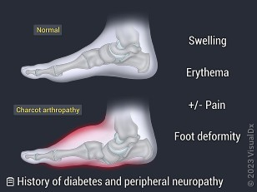
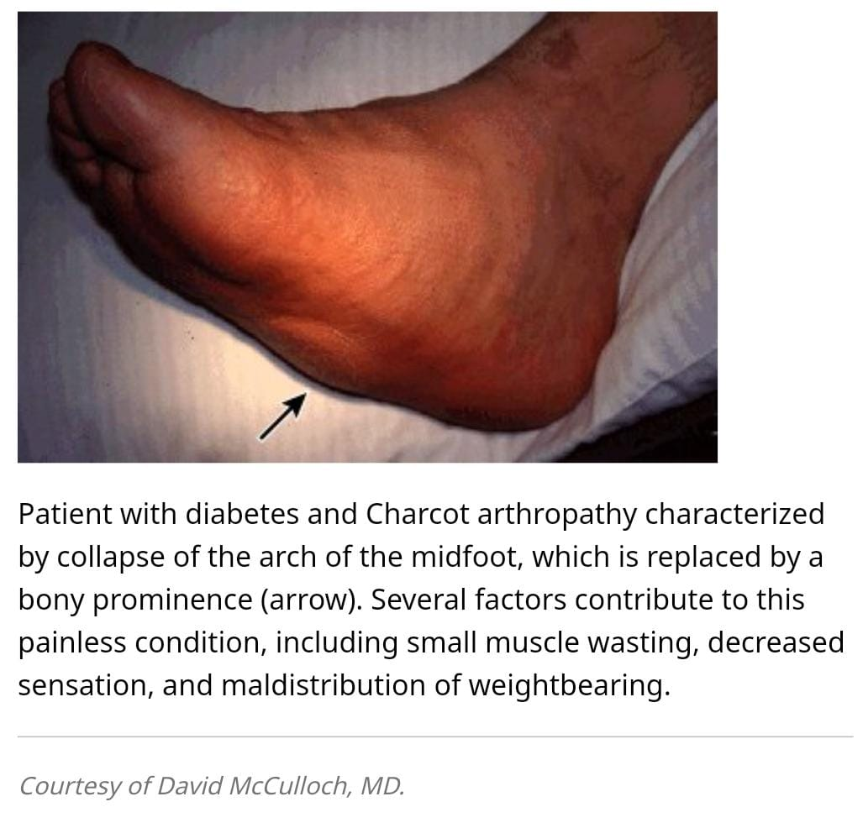

Slide 20
Diabetic foot Ulcer:
The lifetime risk for a patient with diabetes of developing a foot ulcer is estimated to be 15% although it may be higher.
Painless and slowly penetrating ulcer of the sole and of other pressure sites is suggestive of diabetic neuropathy.
The ulcer is circular and punched out in shape, occurring in the middle of a callosity.
An initial subepidermal haemorrhagic bulla may give rise to discoloration of the surrounding skin.

Slide 21
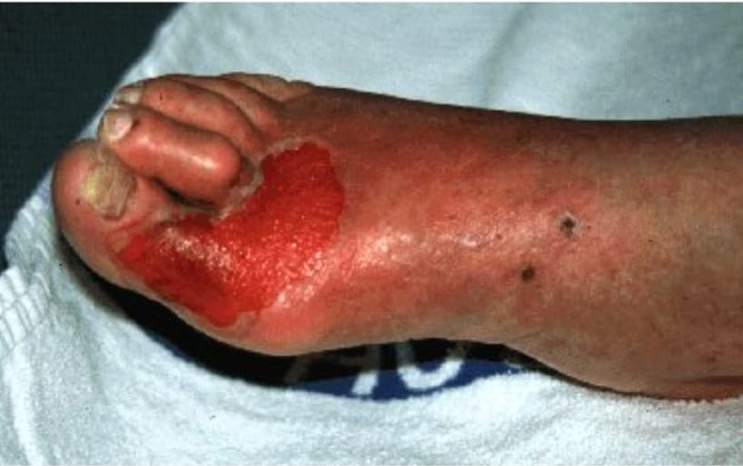
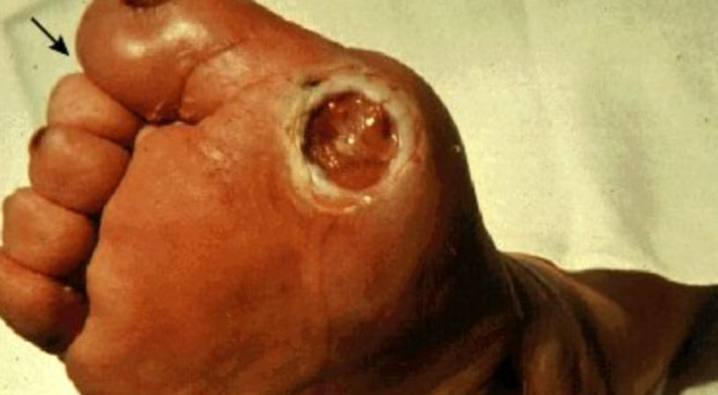
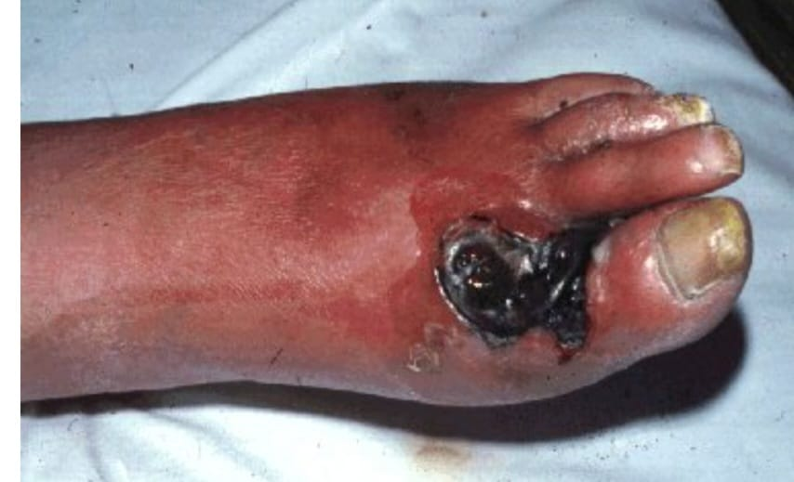
Foot from a diabetic patient showing a superficial ulcer that involves a partial thickness of the skin but no involvement of the underlying tissues
Foot from a diabetic patient with a penetrating neuropathic ulcer that is not associated with abscess formation or bone involvement
Foot from a diabetic patient with an ulcer that extends to the deep layers with signs of local infection, cellulitis, and necrosis

Slide 22
Management:
Prevention: Digital thermography for early detection of raised foot temperature in Charcot arthropathy or cellulitis.
Management: Multidisciplinary approach, including revascularisation, offloading pressure (footwear, crutches), and surgery (arthroplasty, ulcer excision, grafting).
Team Involvement: Endocrinologist, neurologist, podiatrist, orthotics, surgeons (orthopedic, vascular, plastics), infectious disease specialist, diabetic foot nurse.
Local Treatment: Debridement, pressure off-loading, infection treatment, and dressings (no significant evidence for newer dressings

Slide 23
Infections:
Increased risk of skin, soft tissue, and fungal infections, especially in type 2 diabetes.
Common Infections: Recurrent erysipelas, Candida (mucous membranes, nail folds, balanitis), and phimosis in poorly controlled diabetes.
Rare Infections: Fournier gangrene, melioidosis, and potential link with SGLT2 inhibitors.
Serious Infection: Pseudomonas ear infection can lead to severe complications (bone, nerve, artery invasion, high mortality).

Slide 24
Obesity, hyperlipidaemia and the metabolic syndrome:
Acanthosis nigricans:
Smooth, velvety, hyperkeratotic, hyperpigmented skin, commonly in obese type 2 diabetics, especially affecting flexures.
Associated Features: Skin tags are also common.
Other Conditions: Seen in malignancy and syndromes linked to insulin resistance (e.g., leprechaunism, Rabson–Mendenhall, Prader–Willi).
Pathophysiology: Likely due to stimulation of insulin-like growth factor 1 receptors on fibroblasts and keratinocytes in the skin.
The typical patient will be obese, with a tendency toward developing type II diabetes.
The development of AN in a nonobese adult is suggestive of internal malignancy

Slide 25
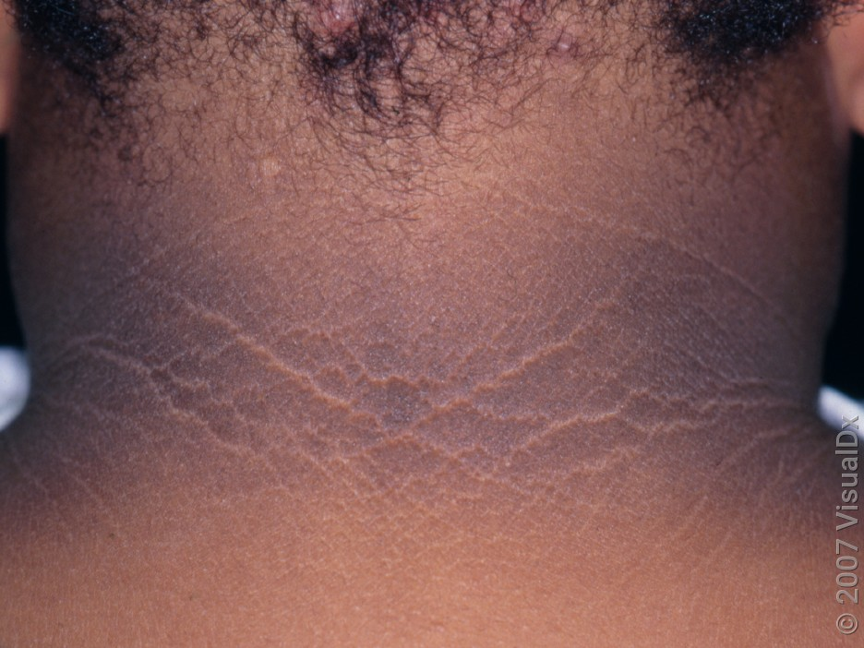
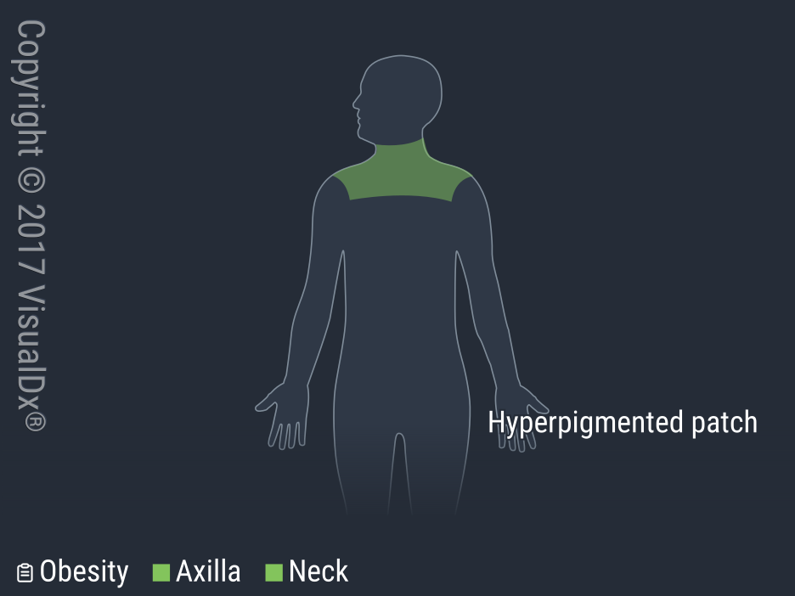
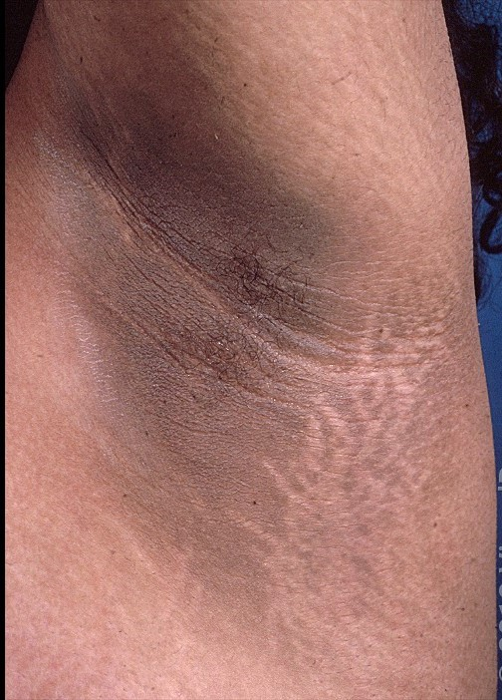
Acanthosis nigricans.

Slide 26
Acrochordon (Skin Tags)
Acrochordons, also known as skin tags or fibroepithelial polyps, are common benign cutaneous growths.
They present as small, skin-colored or brown, soft papules and are most commonly found in areas of frequent friction such as the eyelids, neck, axillae, and inguinal area.
Usually asymptomatic but can become irritated by clothing or jewelry. Occasionally, skin tags twist upon their own stalk, which leads to strangulation of their blood supply and spontaneous necrosis of the skin tag.
Treatment: If skin tags become symptomatic or cosmetically concerning for the patient, they can be removed by mechanical snipping (fine iris or Gradle scissors), shave excision, cryotherapy, or electrodesiccation.

Slide 27
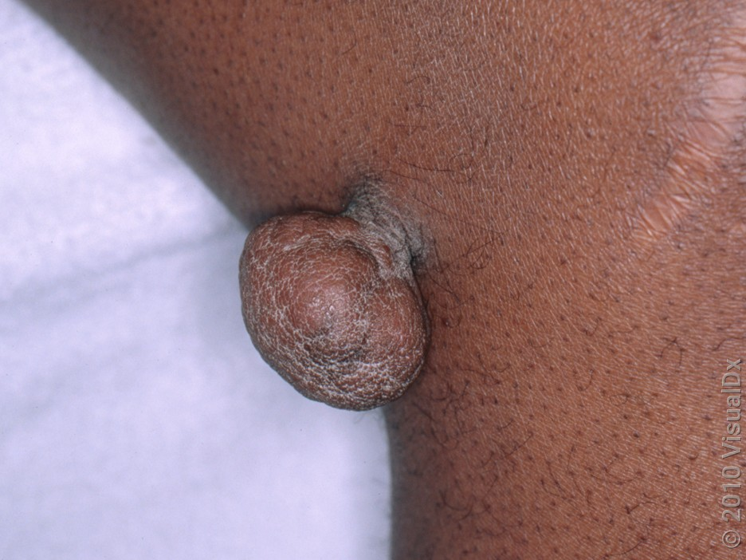
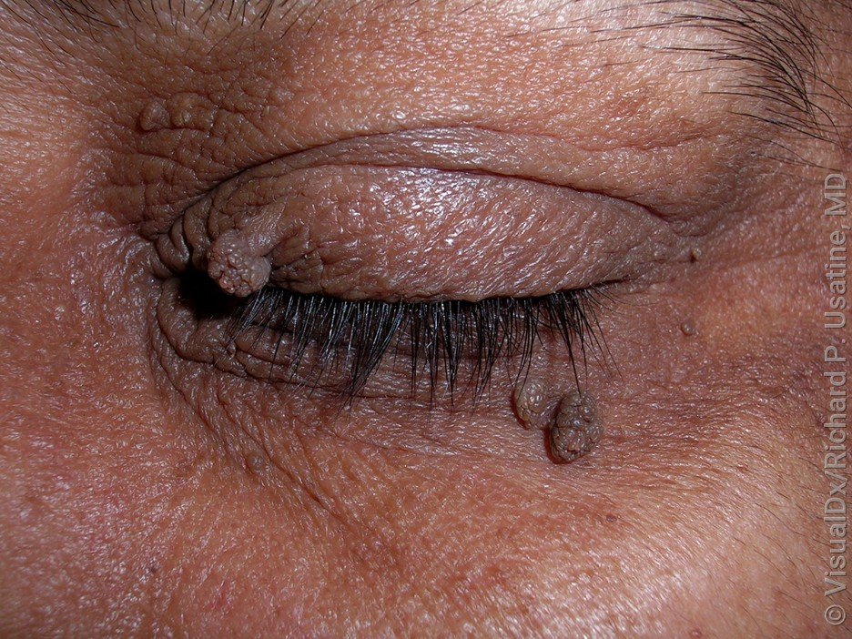
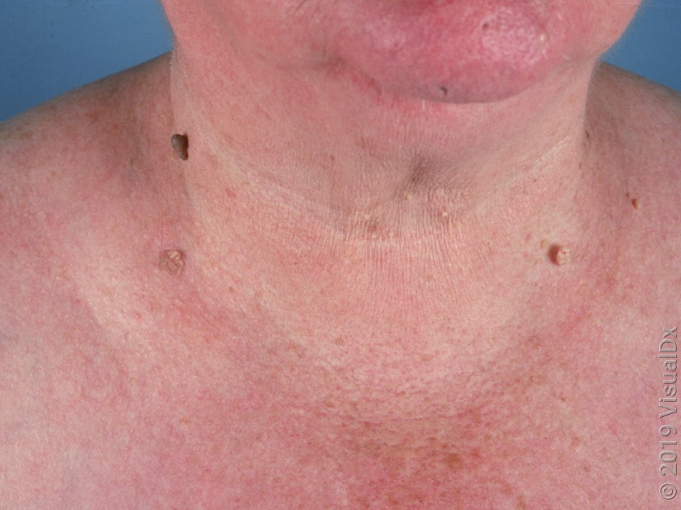
Skin tags:

Slide 28
Eruptive xanthomas of the skin:
Eruptive xanthomas may develop quite dramatically in diabetic patients with hyperlipidaemia,
They are accumulations of lipid-laden macrophages that present abruptly as pruritic, small, yellow-to-orange papules.
most commonly scattered over the buttocks and extensor surfaces of extremities.
Acutely, variable amounts of pruritus or pain may be present.
Triglyceride levels in patients with eruptive xanthomas often exceed 3000-4000 mg/dL. Hypertriglyceridemia in the range of 1500 mg/dL or greater can also lead to pancreatitis.

Slide 29
Dome-shaped, firm, grouped, erythematous-to-yellow papules on the extensor surfaces of the extremities, the buttocks, and scattered on the trunk. Often, there are several dozen to hundreds of lesions.
Diagnostic Pearls:
Lesions are often in the same stage of development, and onset is rapid.
Koebner phenomenon (appereance of new lesion on previously unaffected areas)has been reported with eruptive xanthomas.
The skin lesions usually resolve within 6 months with appropriate treatment.
Differentials:
Granuloma annulare
Molluscum contagiosum
Xanthoma disseminatum should be considered in children

Slide 30
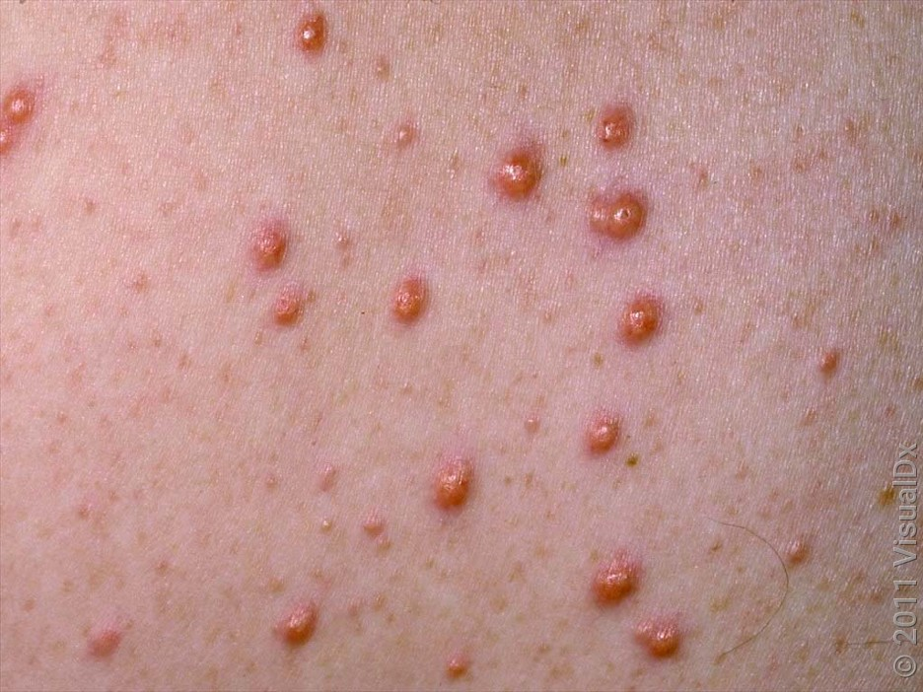
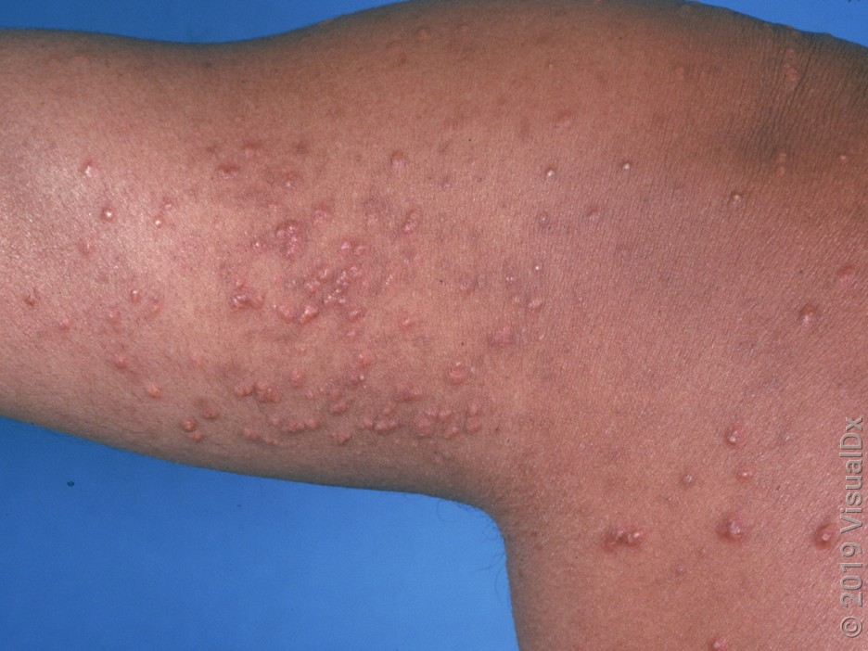
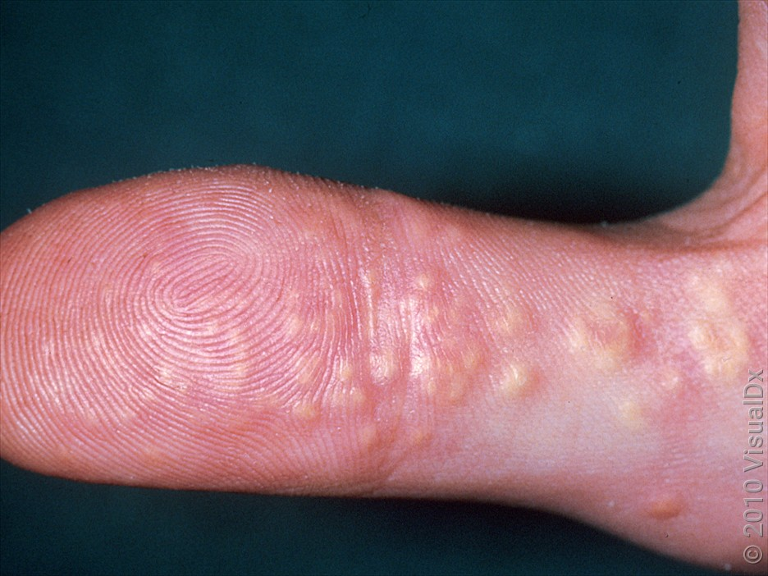
Eruptive xanthomas of the skin
Myriads of smooth, fairly monomorphic, yellowish, orange and reddish papules, on the arm and upper back.
close-up of multiple smooth, reddish papules with yellow centers
Multiple yellow papules on the thumb

Slide 31
Treatment-related skin manifestations.
Insulin lipodystrophy:
Both atrophy and hypertrophy can occur even with newer synthetic insulins.
Lipohypertrophy: Affects nearly two-thirds of patients, often due to not rotating injection sites; can impair insulin absorption and worsen blood sugar control.
Lipoatrophy: Linked to an immunological reaction, less common with synthetic insulins (1-2% of cases).

Slide 32
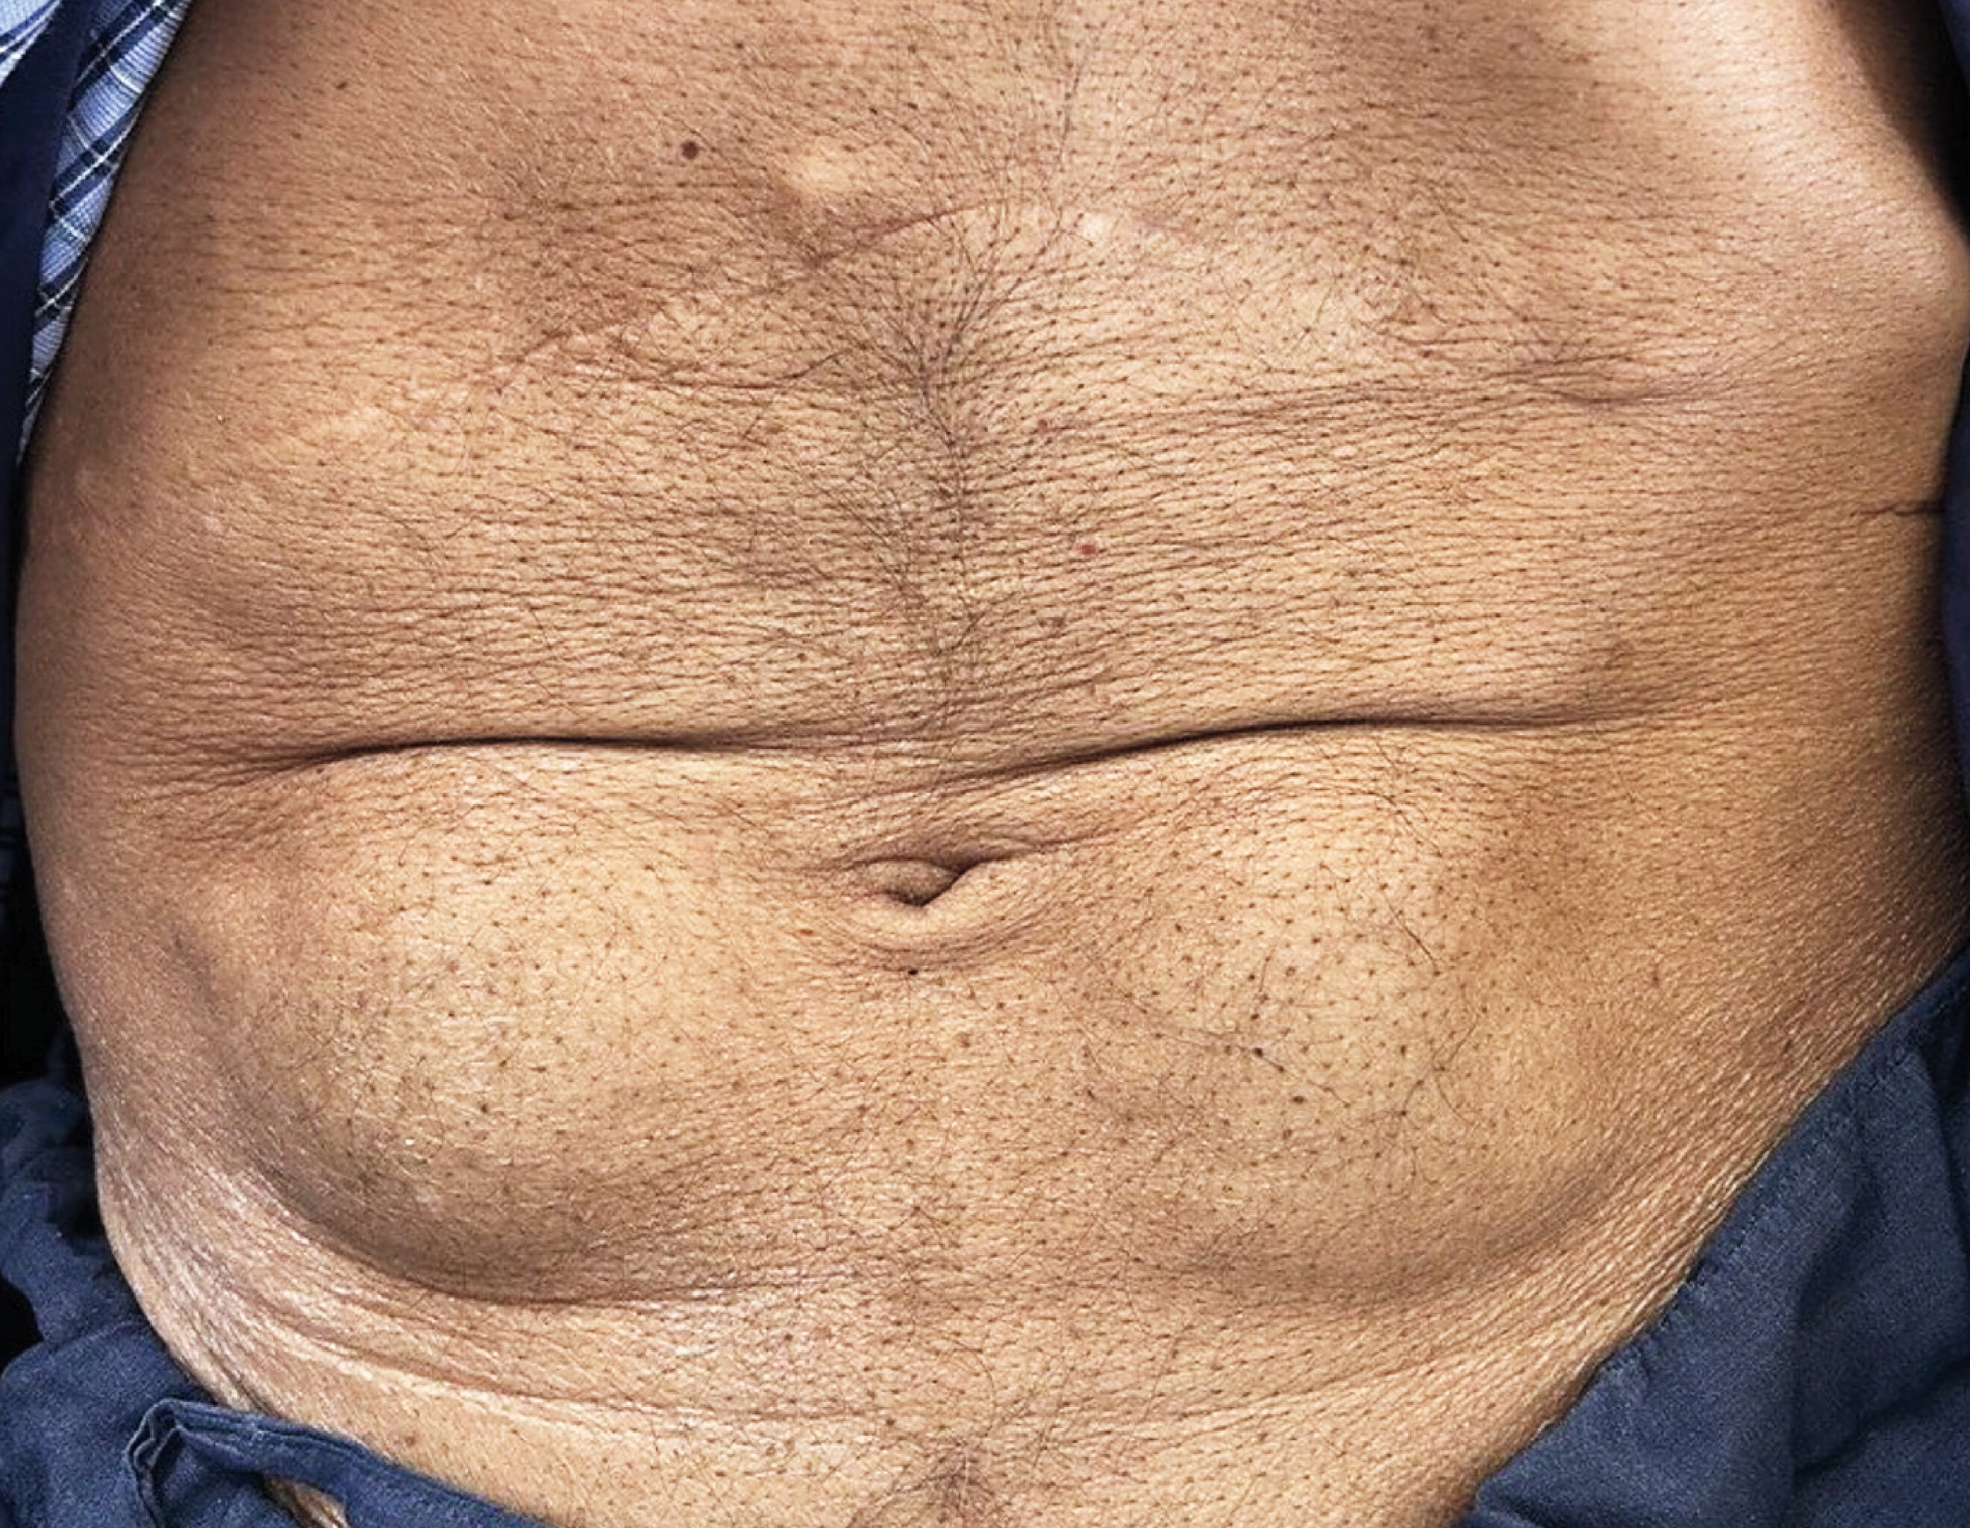
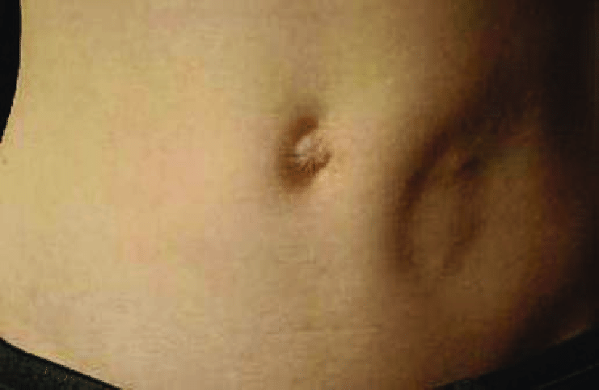
Insulin liphypertrophy
lipoatrophy

Slide 33
Allergic reactions to insulin and glucose monitors
Insulin & Analogues: Urticaria, painful nodules, granulomas.
Continuous Insulin Pumps: Possible contact dermatitis due to acrylates, epoxy resin, glue, and nickel.
Glucose Monitors: Allergies to isobornyl acrylate affecting some models

Slide 34
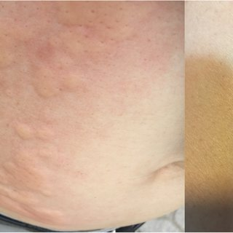
Allergic reactions to insulin

Slide 35
Disease associations and genetic syndromes
Reactive perforating collagenosis (folliculitis):
This has been reported in patients with diabetes with and withoutrenal insufficiency.
It is attributed to glycation of collagen and minor injuries such as pressure or scratching.
Initial Appearance: Skin-colored papule (1-3 mm), reaching 6 mm in 1 month.
Regression: Spontaneous within 6-8 weeks, leaving hypopigmentation or slight scarring.
Advanced Lesions: Central keratotic plug, bleeding if removed.
New lesions may appear, often linearly arranged.
Pruritus: Severe itching, with periods of remission and exacerbation

Slide 36
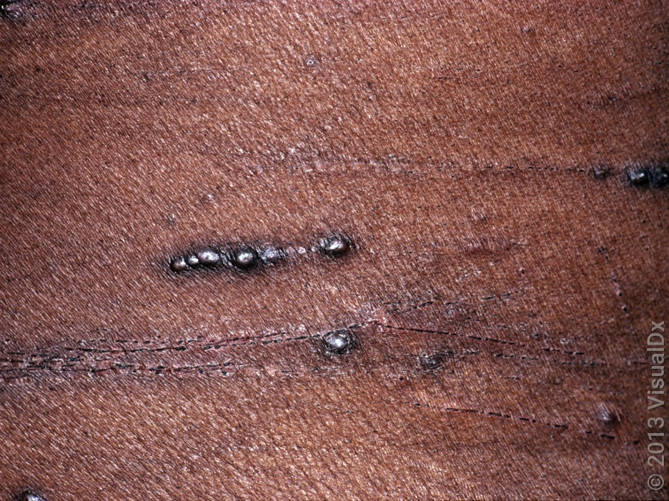
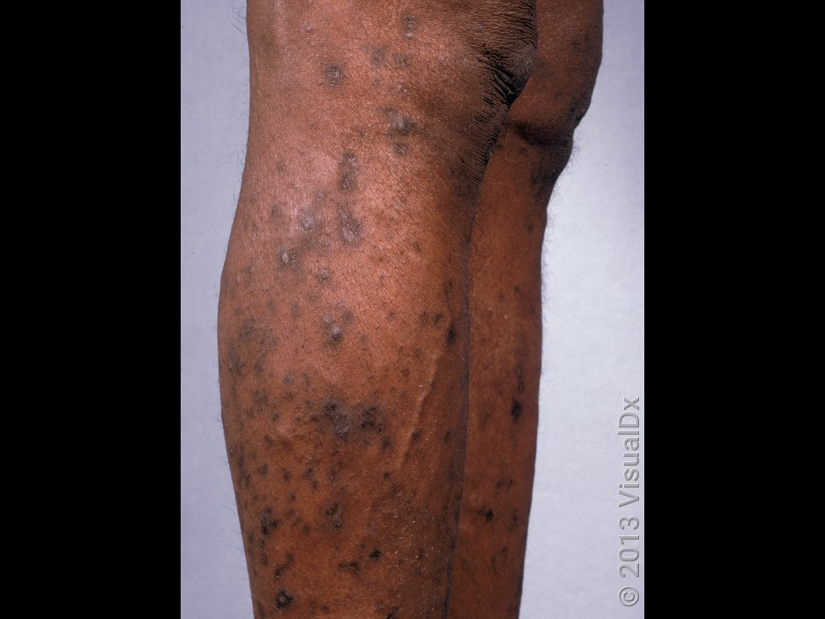
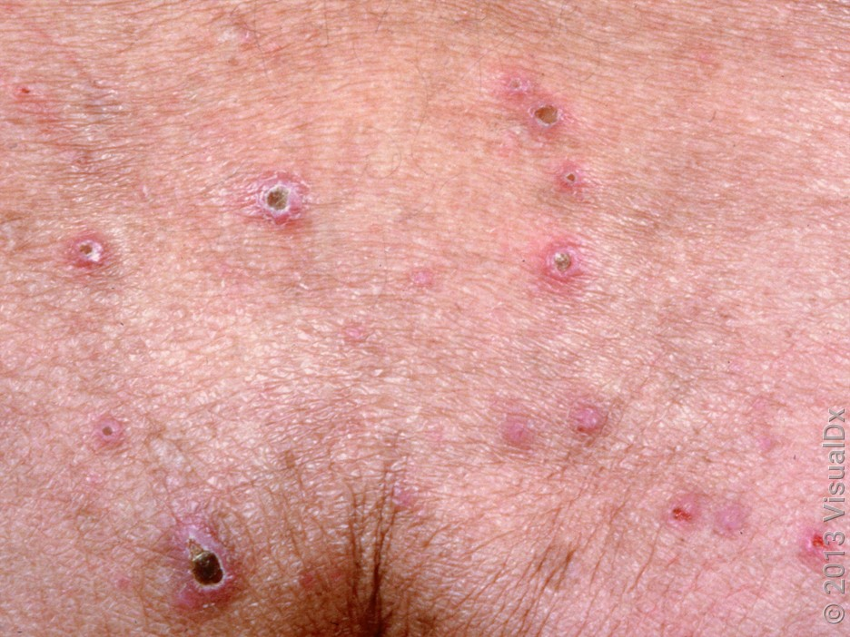
Reactive perforating collagenosis (folliculitis):
A close-up of linear arrays of dark brown keratotic papules and some crusted linear excoriations.
Many deep brown papules, some with central thick crusts, on the legs.

Slide 37
Granulomatous disorders
Necrobiosis lipoidica:
Prevalence: NLD is a recognized diabetic skin disorder
Recent study shows only 22% of NLD patients develop diabetes or impaired glucose tolerance over 15 years.
Overall Occurrence: NLD is rare in the general diabetic population (0.3%). although it may be seen in 2–3% of type 1 diabetes.
Importantly, NL may be the first sign of diabetes in a patient with no previous diagnosis.
NL typically presents in the third decade of life and later in patients without diabetes.
There are documented cases of pediatric onset as well. It is 3 times more common in women than in men and has no known racial predilection.

Slide 38
Etiology: Linked to microangiopathy, glycoprotein & immunoglobulin deposition, and abnormal collagen production.
Appearance: Yellow, red, or brown atrophic plaques with telangiectasias and a violaceous rim, typically on the pretibial surface.
Atypical Locations: Face, trunk, upper extremities.
Progression: Lesions enlarge slowly over months/years, starting as asymptomatic papules.
Symptoms: Pruritus, dysesthesia, or pain as lesions progress, ulceration, or trauma exacerbation may occur.

Slide 39
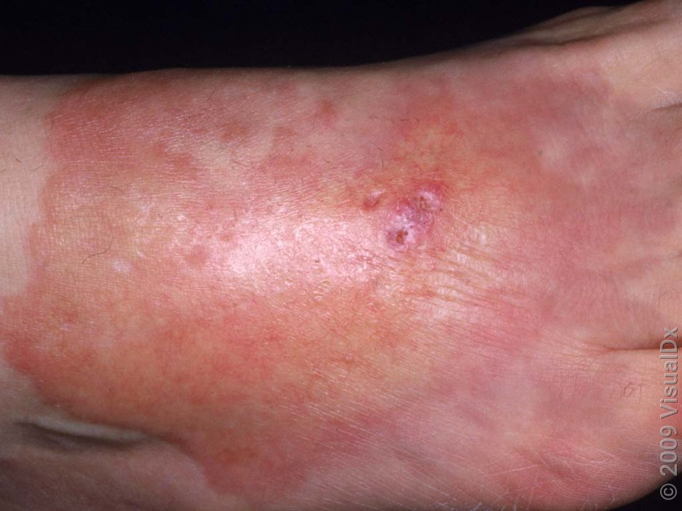
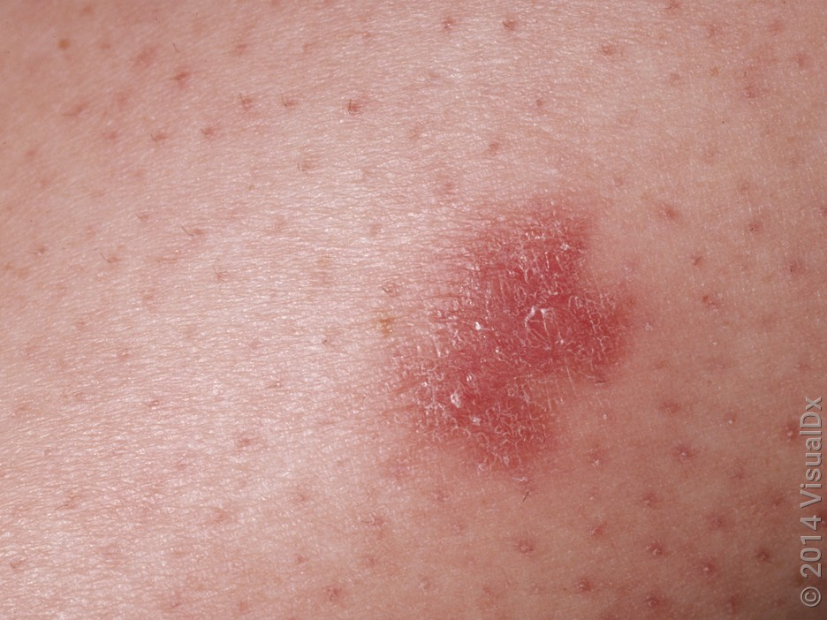
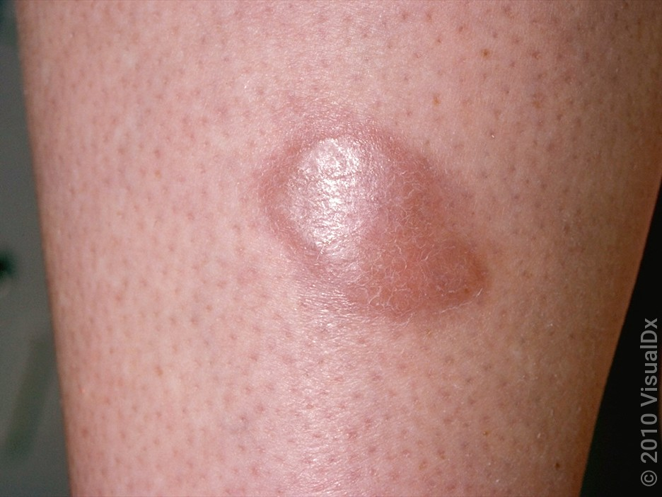
Necrobiosis lipoidica
A large shiny, pink plaque with a central yellowish portion with tiny ulcers and scattered telangiectasias over the dorsal foot.
A close-up of a deep red plaque with overlying fine white scale.
A shiny, reddish plaque on the shin.

Slide 40
Granuloma annulare:
Nature: Benign granulomatous inflammatory disorder of the dermis or subcutis.
Appearance: Small dermal papules forming smooth, annular plaques, usually on extremities.
Symptoms: Often asymptomatic or mildly pruritic; appearance may cause distress.
Demographics: More common in women (2:1 ratio), with two-thirds of cases in patients under 30.
Course: Typically resolves spontaneously; some cases may be persistent or recurrent.
Associated Conditions: Linked to diabetes, thyroid disease, dyslipidemia, malignancy, and infections.

Slide 41
Diagnostic Pearls:
The ring-shaped or arc-like lesions do not scale.
The absence of scale or surface change is a crucial finding in differentiating GA from other annular eruptions such as tinea corporis.
When stretched, larger lesions show individual papules in a ring, and smaller annular lesions have a small central dell, or depression.
Differential Diagnosis :
Tinea corporis Lichen planus – annular variantErythema migrans ( Lyme disease ) Sarcoidosis
Subacute cutaneous lupus erythematosus Annular elastolytic giant cell granuloma Interstitial granulomatous dermatitis

Slide 42
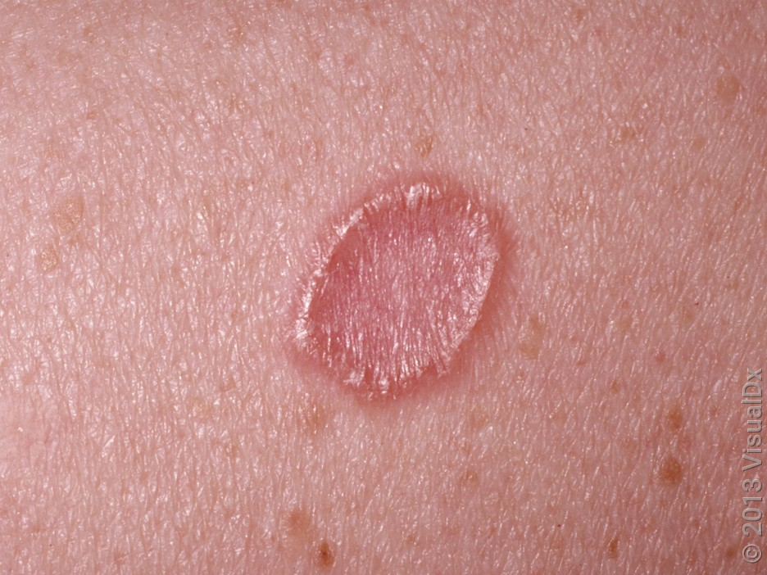
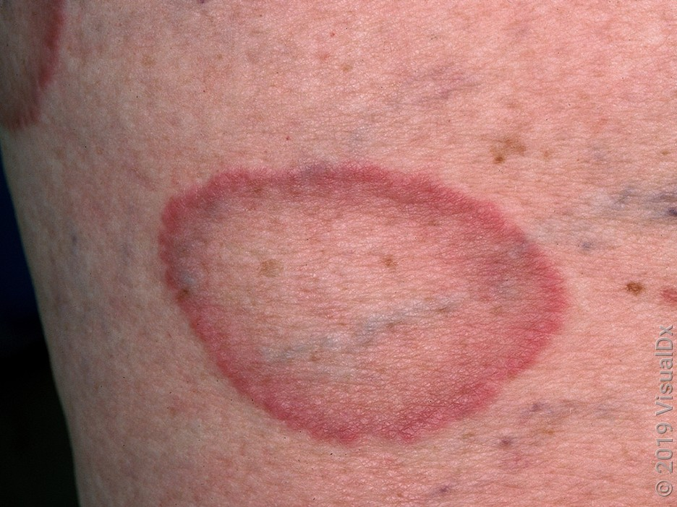
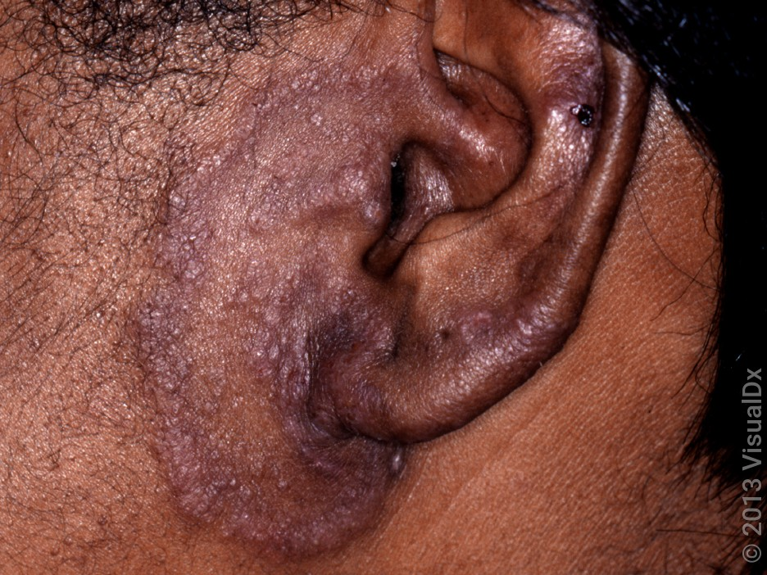
A close-up of a red-brown annular plaque without scale
A close-up of an erythematous annular plaque without scale.
An annular, violaceous, smooth plaque at the preauricular area.

Slide 43
Annular elastolytic giant cell granuloma
(Actinic granuloma)
It is a rare disorder of connective tissue affecting the head and neck areas that is most commonlyassociatedwith diabetes in up to 40% of cases.
Prevalence: Rare, more common in middle-aged women with lighter skin.
Lesion Appearance: Annular, erythematous, photodistributed plaques with raised borders and atrophic centers.
Symptoms: Usually asymptomatic, may appear suddenly and persist from months to years.
Pathophysiology: Hypothesized to be triggered by solar radiation or heat altering elastin peptides, leading to granuloma formation and destruction of elastic fibers.

Slide 44
Classification: Some consider it a distinct disorder, while others view it as a variant of granuloma annulare.
Variants:
Generalized variant – Annular plaques or papules involving both sun-exposed and covered areas. It has an indolent course with a gradual dissemination and enlargement of existing lesions with eruption of new lesions over time
Papular variant – Papular lesions instead of annular plaques.

Slide 45
Annular elastolytic giant cell granuloma
Diagnostic Pearls:
Suspect actinic granuloma in the differential diagnosis of an annular lesion in a middle-aged woman, especially on sun-exposed areas. Perform a skin biopsy for a definitive diagnosis.
Differential Diagnosis:
Differential Diagnosis
Interstitial granulomatous dermatitis
Cutaneous leishmaniasis
Tinea corporis

Slide 46
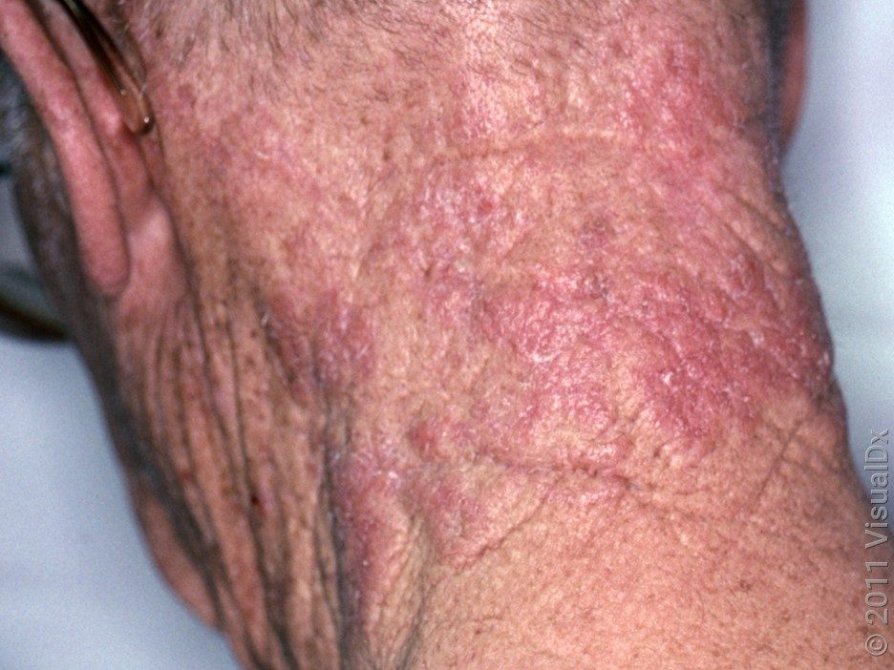
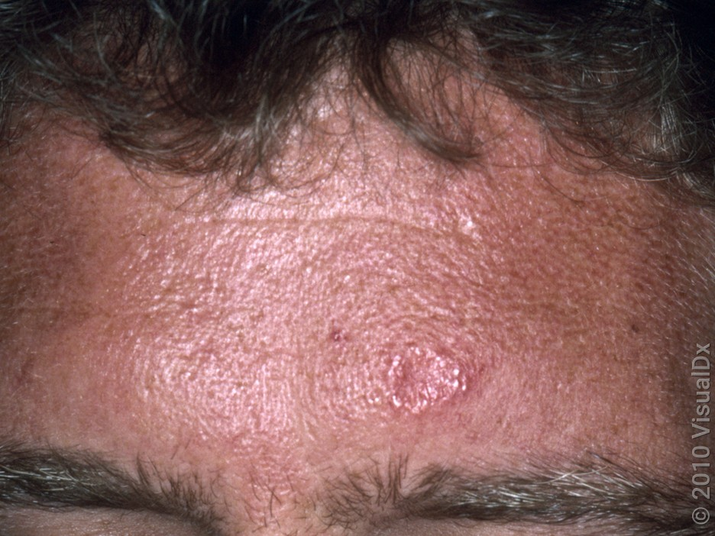
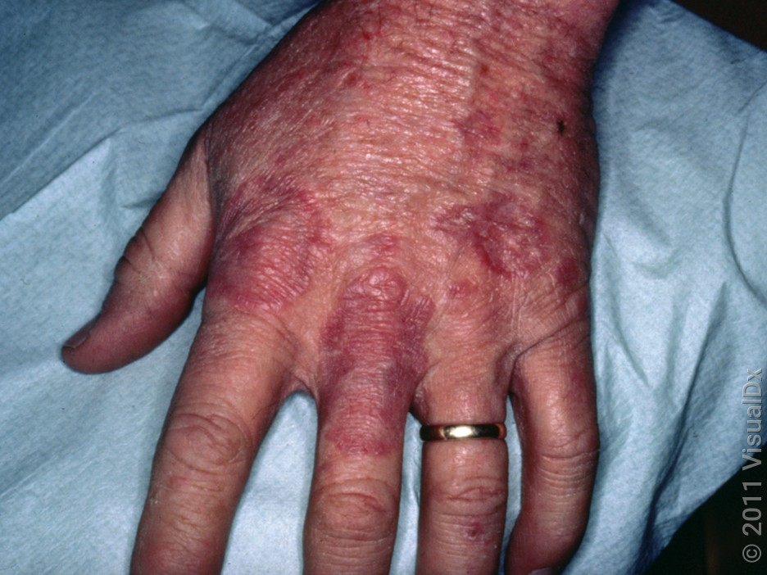
Annular elastolytic giant cell granuloma
mooth reddish and red-brown plaques, some annular, on the posterior neck.
An annular pinkish plaque on the forehead.
Smooth pink papules and plaques on the dorsal hand

Slide 47
Stiff skin and joints:
Pathophysiology:
Due to irreversible cross-linking of collagen, accumulation of AGEs (e.g., carboxymethyl lysine, pentosidane), and activation of RAGE receptors, leading to inflammation and fibrosis.
Diabetic Control: Improved management may help reduce symptoms.
Aspirin: Reduces glycoxidative damage, but effects are slow.
Physiotherapy: Helps maintain mobility.
Other treatments: Uncertain benefit: Phototherapy, photophoresis, radiotherapy, prostacyclin, high-dose penicillin, ciclosporin, factor XIII, sorbinol.

Slide 48
Cheiroarthropathy:
Appearance: Waxy, tight skin on the backs of the hands and limited joint mobility (e.g., ‘prayer sign’).
Prevalence: Initially reported in type 1 diabetes, but also found in type 2 diabetes.
Indicator of: Underlying microvascular changes, neuropathy, retinopathy, and stiff cervical joints.
Clinical Consideration: Stiff cervical joints may complicate intubation during anesthesia
Management: Treatment Glycemic control to improve blood sugar levels, Non-steroidal anti-inflammatory drugs (NSAIDs), Physical therapy, and Corticosteroid injections

Slide 49

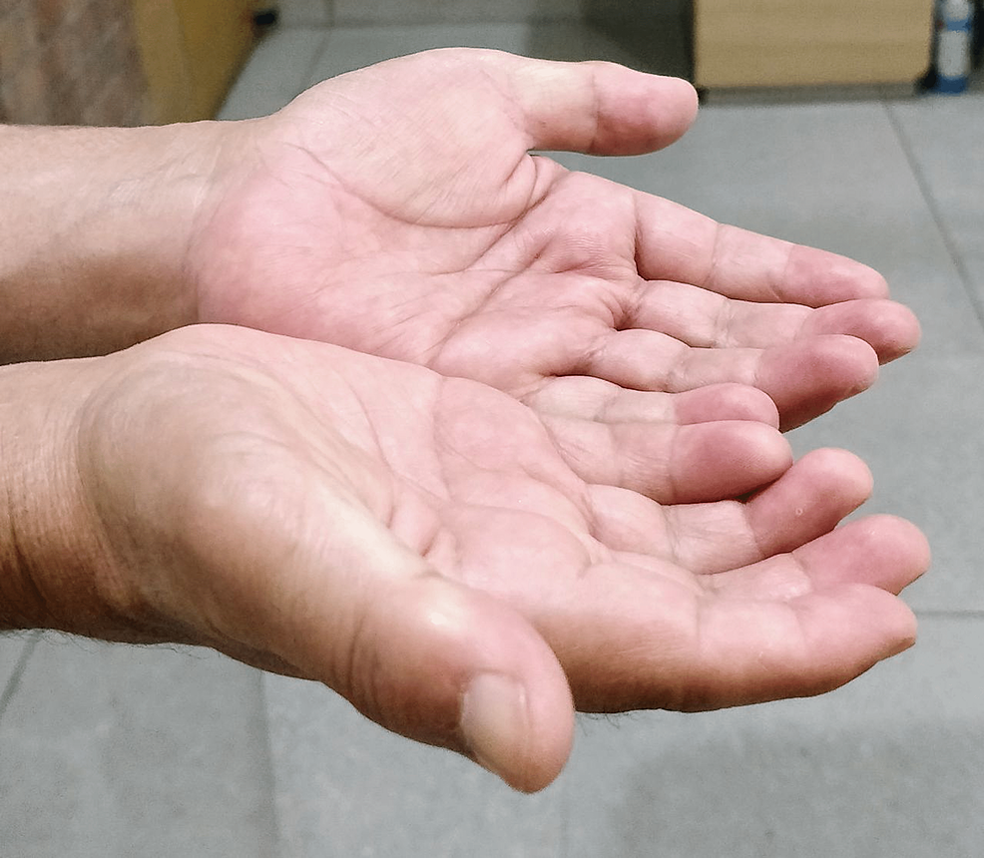
Diabetic Cheiroarthropathy in Type 1 Diabetes Mellitus
Prayer sign due to diabetic cheiroarthropathy

Slide 50
Finger pebbles ( Huntley's papules)
Appearance: Multiple, grouped, minute papules on the extensor surface of the fingers, near knuckle pads or periungual region.
Prevalence: More common in diabetes, but not exclusive to it.
Distinction: Different from knuckle pads, may occur with or without acanthosis nigricans.
DDX:
Knuckle Pads: Thickened skin over knuckles, distinct from finger pebbles but may appear similar.
Morphea: Localized scleroderma presenting with waxy, thickened skin.
Acanthosis Nigricans: Hyperpigmented, velvety plaques often associated with insulin resistance

Slide 51
TREAMENT:
Topical treatments are usually ineffective.
People with very dry skin may benefit from 12% ammonium lactate cream

Slide 52
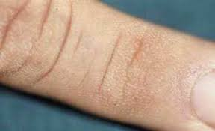
Finger Pebbles

Slide 53
Scleroedema diabeticorum:
Appearance: Ill-defined skin induration, typically on the neck and upper back.
Prevalence: Most common in overweight adults with type 2 diabetes.
Course: Essentially permanent, does not respond to treatment.
Symptoms: Painless with minimal morbidity.
Uncertainty: Debate exists about whether it represents a separate condition or a variant of other diabetic skin changes.

Slide 54
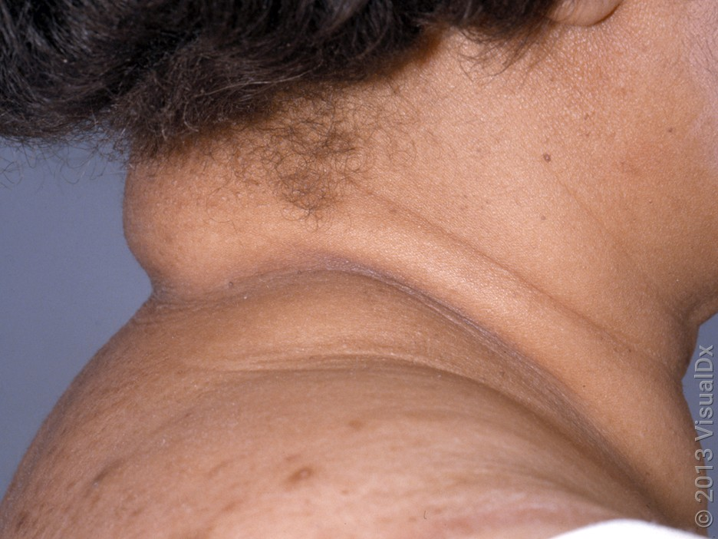
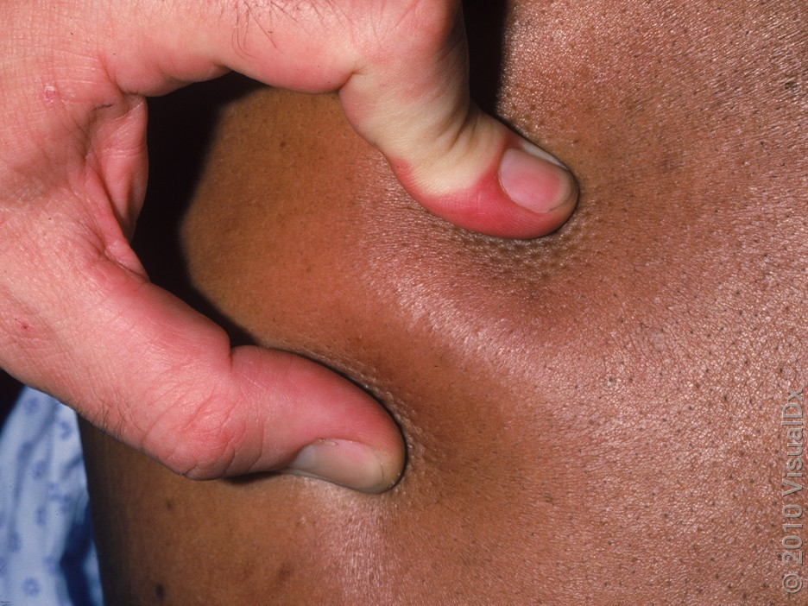
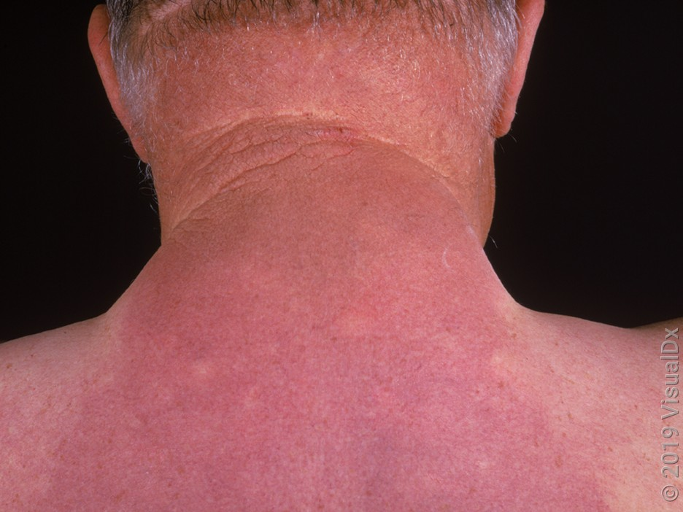
A broad violaceous plaque that was firm and indurated on palpation on the back and neck of a diabetic patient.
A close-up of firm, indurated skin.

Slide 55
Diabetic bullae:
Prevalence: Affects ~0.5% of people with diabetes (type 1 and type 2)
Pathogenesis: Unknown, but co-occurrence with neuropathy and nephropathy suggests underlying microangiopathy.
Lesion Characteristics: Noninflammatory bullae that develop rapidly, often on the feet.
Symptoms: Mostly asymptomatic or mild burning/discomfort; large bullae may impair shoe-wearing and mobility.
Course: Often seen in long-standing, uncontrolled diabetes, but can occur in those with optimal glycemic control.
Resolution: Bullae typically resolve without scarring, but recurrence is common.

Slide 56
Demographics: Average age of onset is 55 years; male-to-female ratio is 2:1
Diagnostic Pearls:
An abruptly appearing noninflammatory vesicle or bulla on the lower extremity of a patient with diabetes, with a conspicuous absence of trauma to the area, is suggestive of the diagnosis.
Nikolsky and Asboe-Hansen signs will be negative.
Note that the fluid is more viscous compared with the fluid seen in friction blisters.

Slide 57
Differential Diagnosis:
Stasis dermatitis with bullae
Insect bite reaction
Bullae secondary to lymphedema
Contact dermatitis with bullae – blisters may be linear
Poison ivy dermatitis

Slide 58
Management Pearls:
There is no consensus on optimal treatment of BD. On the lower extremities of patients with diabetes, wound care is essential to prevent secondary infections such as osteomyelitis. Early involvement of a wound care team may be beneficial.
Many patients have nephropathy or neuropathy; patients should be routinely screened for microscopic proteinuria along with assessment of peripheral neuropathy.
Evaluation by ophthalmology may also be warranted.

Slide 59
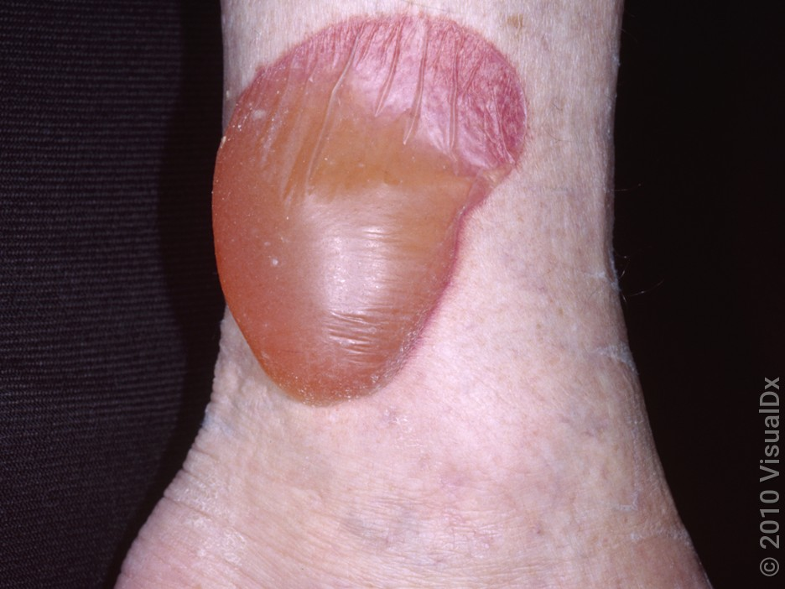
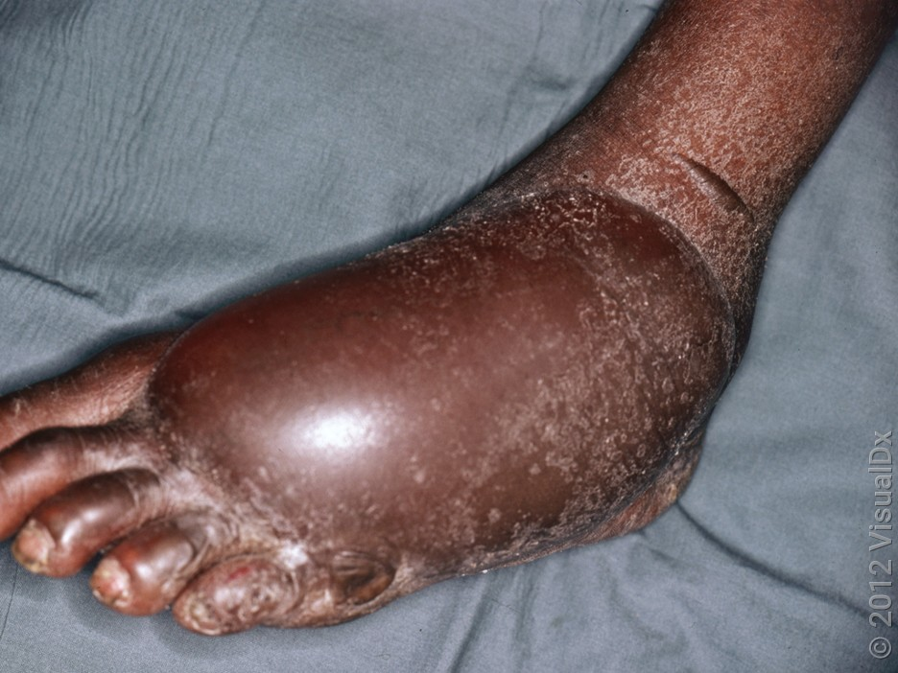
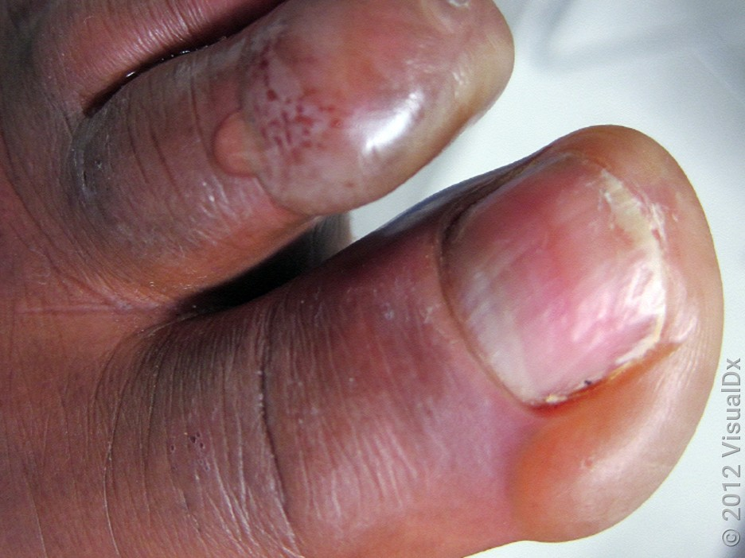
Tense vesicles, one weeping, on the toes.
A tense and flaccid bulla filled with serosanguinous fluid near the ankle.
A giant, tense bulla on the dorsal foot.

Slide 60
Other associations:
Calciphylaxis: Indirect association with diabetes, often linked to diabetic nephropathy.
Nephrogenic Fibrosing Dermopathy: Possible link to diabetic nephropathy, but recent literature questions this connection.
Yellow Skin and Nails: More common in diabetic patients, possibly related to carotene.
Lichen Planus: Evidence for a connection with diabetes is conflicting.

Slide 61
Reference:
UpToDate ©
Rook's Textbook of Dermatology 10th Edition
visualDX

Slide 62
THANKS.

