Slide 1




Slide 2
Autoinflammatory diseases presenting in skin
By Dr Nadia rajpar
d.derm

Slide 3

Learning objectives
Concepts of autoinflammation vs autoimmunity
Classification of autoinflammatory syndromes
Identification points in each diseases.

Slide 4
Outline
Defination
Classification
Genetic basis
Clinical features
Investigation
Treatment
summary

Slide 5
Autoinflammatory vs autoimmune diseases
autoinflammatory
autoimmune
  Innate or natural immunity
  Immediate response
  No association with mhc ii
  Innate immune cells drive disease activity
  Defect in increased secreation of il-1b
  Acquired or adaptive immunity
  Delayed response
  Mhc class ii associated susceptibilities
  Autoreactive t and b cells drive diseases activity

Slide 6
Innate immunity
First line defense
Rapid
Cannot bind to self antigens
Cellular component: macrophages, neutrophils, Nk cells, mast cells
Noncellular component:cytokines il-1, il-10, il-12, ifn alpha and ifn beta
Notes:
Rapid within minutes to hours.
Present since birth.

Slide 7
Defination
Abnormal activation of the innate immune system
Resulting in recurrent inflammation
Patient present with fever and rash.
Two broad category
1)hereditary monogenic
2)complex and polygenic
Notes:
Neutrophilic urticarial dermatosis is most typical dermatological presentation.
Skin biopsy is helpful and demonstrates the nature of the inflammatory infiltrate which can provide some guidance to treatment.

Slide 8
HEREDITARY MONOGENIC AUTOINFLAMMATORY SYNDROMES
Typically present in early childhood
Characterised by unprovoked episodes of recurrent inflammation.
Inflammatory flares can occur in many organs, especially the skin, joints, eyes and serous membranes.
Genetic abnormality predisposes the affected individual to activation of the innate immune system.
Markers of autoimmunity are absent.

Slide 9
Hereditary monogenic autoinflammatory syndromes
Hereditary periodic fever
Autoinflammatory diseases with granuloma
Autoinflammatory syndromes with pustulosis
Type 1 interferonopathies
Behcet disease-like or inflammatory bowel disease-like autoinflammatory syndromes
Miscellaneous monogenic autoinflammatory syndromes

Slide 10
Complex and polygenic autoinflammatory diseases prresenting with urticarial or maculopapular rash
schnitzler syndrome
Adult onset still disease
Systemic onset juvenile idiopathic arthritis
Synovitis, acne, pustulosis, hyperostosis and osteitis syndrome
Yao syndrome

Slide 11
Hereditary periodic fevers
Cryopyrin associated periodic syndrome
Tumour necrosis factor associated periodic syndrome
Familial mediterranean fever
Pyrin associated autoinflammation with neutrophilic dermatosis
Mevalonate kinase deficiency with recurrent fever and hyper IgD syndrome

Slide 12
Cryopyrin-associated periodic syndrome (caps)
IL-1β is a major pro-inflammatory cytokine and the key mediator of the CAPS..
The syndrome includes three partially overlapping diseases.
1) familial cold autoinflammatory syndrome (FCAS),
2)Muckle–Wells syndrome (MWS)
3)Chronic infantile neurological cutaneous and articular syndrome(CINCA)/ neonatal onset multisystem inflammatory disease(NOMID)

Slide 13
Pathophysiology
Autosomal dominant disorders
Associated with missense mutations in the NLRP3/CIAS1 gene encoding a death domain protein known variously as NLRP3, NALP3 or cryopyrin.
This protein is expressed in epithelial cells of the skin and mucosa, granulocytes, dendritic cells and in T and B lymphocytes.
Pathogen-associated molecular patterns (PAMPs) induce association of NLRP3 with other members of the death domain superfamily to form a cytosolic protein complex inflammasome.
Notes:
An inflammasome is a multiprotein complex in the innate immune system that activates inflammatory responses and cell death.Inflammasomes are activated when the body detects microbial patterns or danger signals, and they play a crucial role in the body's defense against foreign pathogens and tissue damage. CompositionInflammasomes are made up of a sensor protein, inflammatory caspases, and sometimes an adapter protein. ActivationWhen activated, inflammasomes trigger the maturation of proinflammatory cytokines like interleukin-1β (IL-1β) and IL-18. Role in diseaseInappropriate activation of inflammasomes can lead to uncontrolled tissue responses that contribute to diseases.There are several types of inflammasomes, including NLRP1, NLRP3, IPAF, and AIM2. Each type has a different composition and function:NLRP3: Lacks a CARD and can't recruit pro-caspase-1 without the adaptor molecule ASC.
Pathogen-associated molecular patterns (PAMPs) are molecular structures or molecules that are shared by most pathogenic bacteria and some viruses.
They are recognized by pattern recognition receptors (PRRs) in the innate immune system of plants and animals, which allows the immune system to identify pathogens and protect the host from infection.

Slide 14
This results in activation of caspase 1, which cleaves biologically inactive pro-IL-1β into biologically active IL-1β. It also upregulates NFκB expression and thereby increases IL-1 gene expression and overproduction of IL-1β protein.
All patients with CAPS have a persistent neutrophilia, chronic anaemia and raised acute phase proteins.
Notes:
The NLRP3 gene codes for cryopyrin, a protein that forms inflammasomes, which are intracellular protein complexes. Mutations in the NLRP3 gene prevent the autoinhibition of cryopyrin, which leads to the spontaneous activation of the inflammasome. This results in the overproduction of interleukin-1 (IL-1), which plays a major role in the onset and progression of CAPS.

Slide 15
Histopathology
an urticarial rash with a neutrophilic intravascular, perivascular, peri-eccrine and interstitial infiltrate on histopathological evaluation is typical.
intravascular accumulation of neutrophils in enlarged dermal vessels is characteristic of CAPS

Slide 16
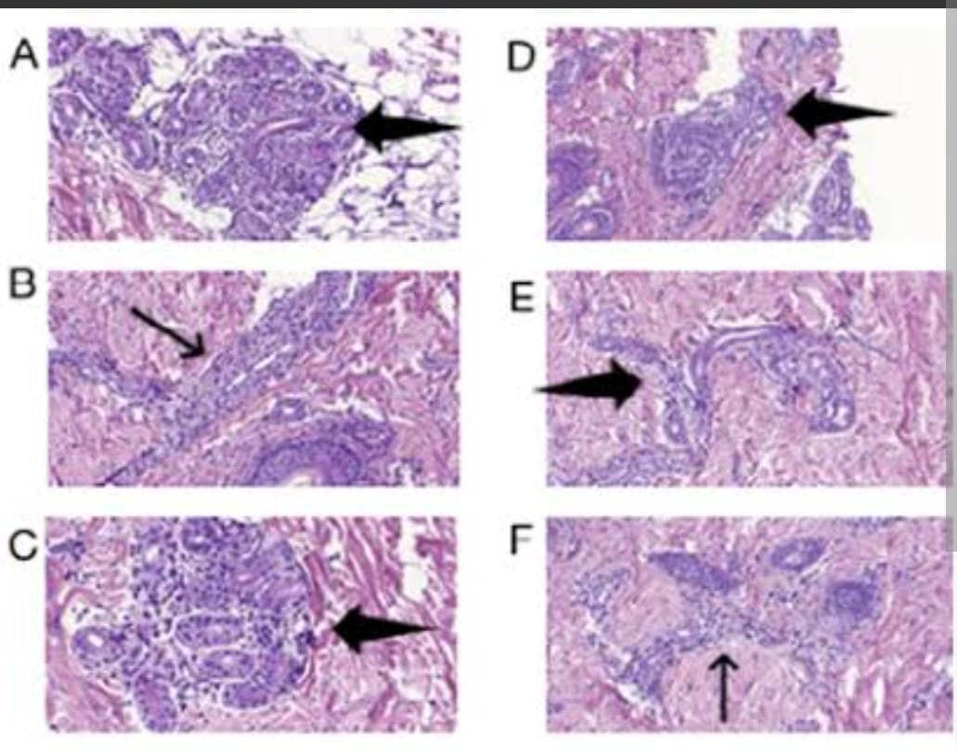

Slide 17
Clinical features
Start in newborn or early infancy.
Flares are triggered by exposure to cold in fcas milder in mws while continuous in cinca.
A non-itchy symmetrical urticarial rash without angio-oedema as fever and malaise develop.
Site: trunk and limbs

Slide 18
familial cold autoinflammatory syndrome
rash, fever, conjunctival redness, joint pain, intense fatigue, thirst and transpiration occurring 1–2 hour after exposure to cold.
flare lasts up to 24 hours.
FCAS is the least severe disease.

Slide 19
Muckle wells syndromde
Cold dependency of flares is less marked.
Sensorineural hearing loss
Polyarthritis
AA amyloidosis

Slide 20
Chronic infantile neurological cutaneous and articular syndrome(CINCA)/ neonatal onset multisystem inflammatory disease(NOMID)
Most severe CAPS syndrome
Characterised by continuous flares with neutrophilic aseptic meningitis, dysmorphism, mental retardation, sensorineural deafness and deforming arthropathy.
Children present in the first few weeks of life with urticated erythematous papules and plaques, often in a figurate pattern.
Lesions feel tight and warm but not pruritic.
facies is characteristic, with frontal bossing, midfacial hypoplasia and saddle nose.

Slide 21
Arthralgia progress to a large joint polyarthritis with joint enlargement and loss of function.
Radiologically :- abnormal endochondral ossification, leading to calcified masses in the joints.
The risk of renal impairment from amyloidosis is greatest in these patients.

Slide 22
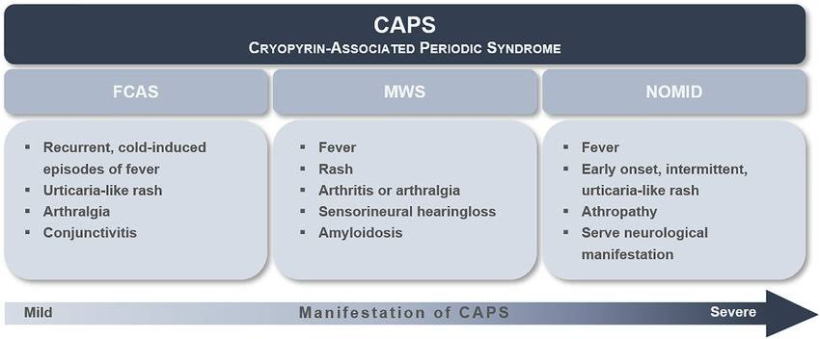

Slide 23
investigation
Diagnosis is based on typical clinical.
01
Genetic mutation:- An autosomal dominant mutation in the NLRP3/CIAS1 gene.
02
Cold stimulation tests (ice cube, immersion) can be negative, as exposure to cold air is the usual trigger.
03
Regular high frequency audiograms and eye examinations are necessary (Muckle–Wells phenotype).
Notes:
Typical clinical finding is helpful if these are supported by eurofever/printo classification criteria.

Slide 24
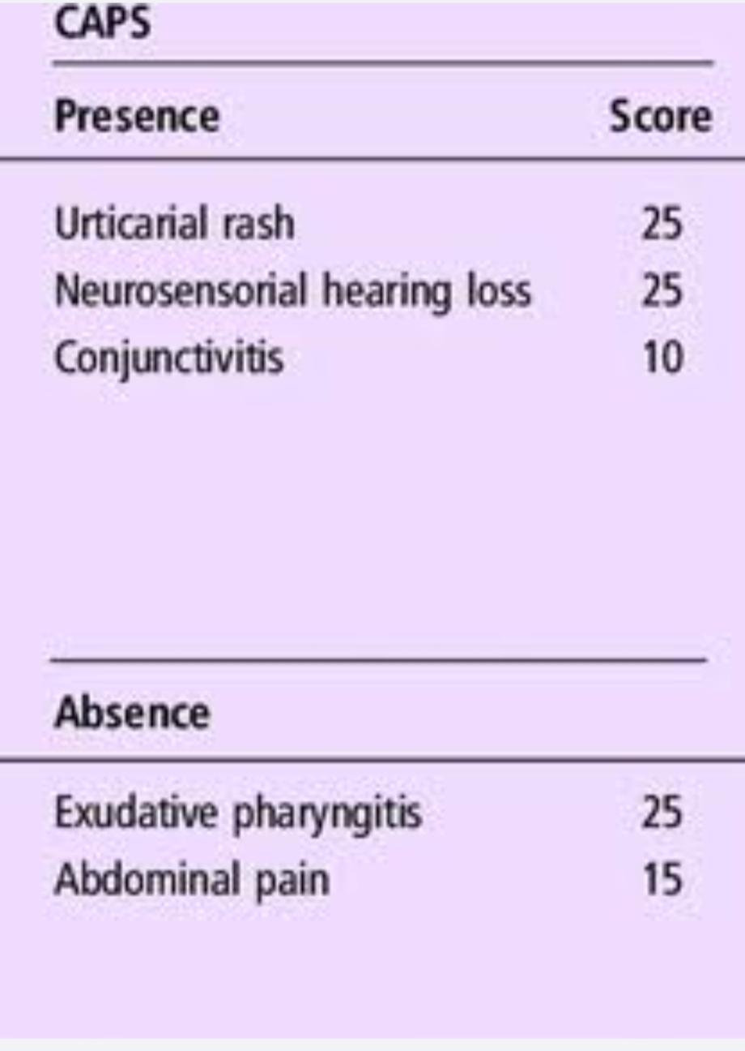

Slide 25
Differential diagnosis
In newborns
severe systemic disorder and urticarial rash, NLRC4-AID (presence of IBD and MAS)
NOCARH (neonatal onset of pancytopenia, autoinflammation, rash and episodes of haemophagocytic lymphohistiosis) .
In children
cold-induced urticaria: NLRP12-AID
NLRC4-AID
PLAID (PLC gamma 2-associated antibody deficiency and immune dysregulation).

Slide 26
management
Cold avoidance
Anti-IL-1 (anakinra)

Slide 27
Tumour necrosis factor associated periodic syndrome (traps)
An autosomal dominant disorder.
More common monogenic autoinflammatory syndromes.
Caused by mutations which affect the ability of the tumour necrosis factor (TNF) receptor to bind circulating TNF.

Slide 28
pathophysiology
TRAPS is associated with mutations in the gene for TNF receptor superfamily 1A (TNFRSF-1a).
Intracellular accumulation of misfolded mutant protein leads to endoplasmic reticulum stress and enhanced inflammatory responses through activation of various immune pathways.
Notes:
These mutations cause the TNFR1 protein to fold incorrectly, trapping it within the cell and preventing it from interacting with tumor necrosis factor (TNF).
The misfolded proteins clump together and trigger inflammation

Slide 29
histopathology
A deep perivascular monocytic infiltrate is characteristic.
Perivascular and interstitial mononuclear cell infiltrate with CD68+ histiocytes and CD3+ lymphocytes in TRAPS

Slide 30
Clinical features
manifests in childhood or adolescence.
episodes of fever lasting 1–3 weeks.
associated with abdominal or chest pain, myalgia, arthralgia, conjunctivitis and periorbital oedema.
A migratory redness is present in 60–80% of patients.
Usually only one anatomical area is affected in any single episode.

Slide 31
Red macules and patches coalesce and expand centrifugally into extensive oedematous dermal plaques.
overlie an area of local muscle tenderness, representing inflammation extending from muscle to skin.
most commonly on the extremities,

Slide 32
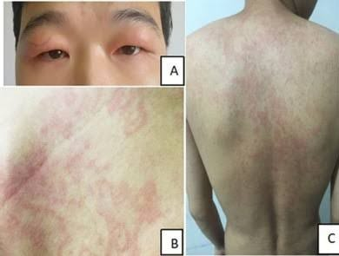

Slide 33
Other skin manifestations resemble urticaria, hereditary angio-oedema or erysipelas.
Residual ecchymoses may be noticed after resolution.
Arthralgia may occur, but rarely progresses to a destructive arthritis.

Slide 34
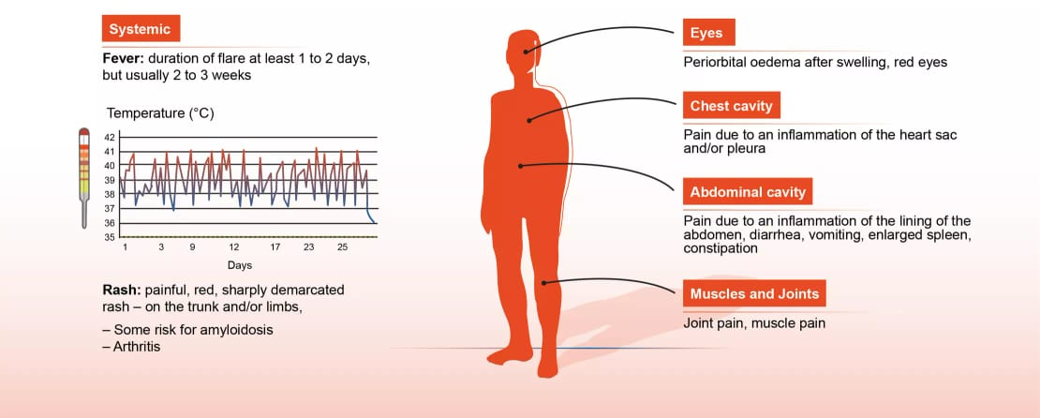

Slide 35
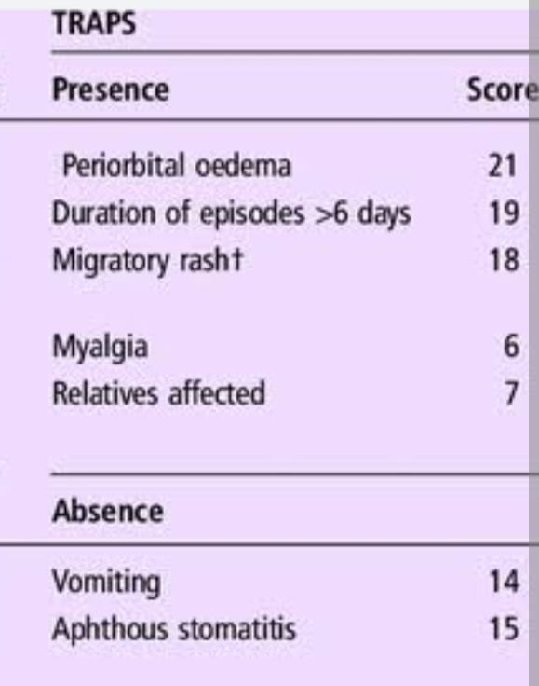
investigation
Diagnosis relies on the typical clinical feature.
the Eurofever/ printo classification criteria are helpful In detecting autosomal dominant mutations in the TNFRSF1A gene

Slide 36
management
Steroid on demand
Anakinra
Etanercept

Slide 37
Familial Mediterranean fever
Mutations in the MEFV gene, which encodes for pyrin.
Enhanced IL-1β production.
FMF is usually an autosomal recessive disorder related to gain of function mutations in the MEFV gene.
MEFV encodes pyrin, which probably plays an important role in the modulationofcaspase1,andthustheproductionofIL-1β and IL-18.
Rare dominant mutations exist
Notes:
Pyrin

Slide 38
Histopathology
A sparse neutrophilic infiltrate in the upper dermis is the hallmark of the erysipelas-like erythema (ELE) of FMF.
Leukocytoclasia can be present but without significant vasculitis.
Histiocytes and eosinophils can also be present.

Slide 39
Clinical features
Childhood or early adulthood and generally before the age of 30.
Recurrent flares of fever, abdominal pain, sometimes mimicking an acute abdomen, pleurisy and large joint arthritis lasting between 1 and 3 days.
Skin involvement is absent in more than5 0% of patients.
Most typical cutaneous finding is the so-called ELE (erysipelas like erythema)

Slide 40
Sites :- localised to the distal lower limbs, typically in the peri malleolar area or the dorsum of the foot.
Unilateral or bilateral and symmetrical
Fever can be present.
ELE usually regresses spontaneously within 3 days, especially with bed rest.
Patients with ELE usually have a more severe disease.

Slide 41
Other cutaneous manifestations of FMF
Acute scrotal inflammation.
Localised redness of the face or of the palmoplantar regions with secondary desquamation.
Non-vasculitic purpura on the face, trunk and extremities or vasculitic purpura related to IgA vasculitis (Henoch–Schönlein) or polyarteritis nodosa.
Patients with FMF are at increased risk of vasculitis

Slide 42
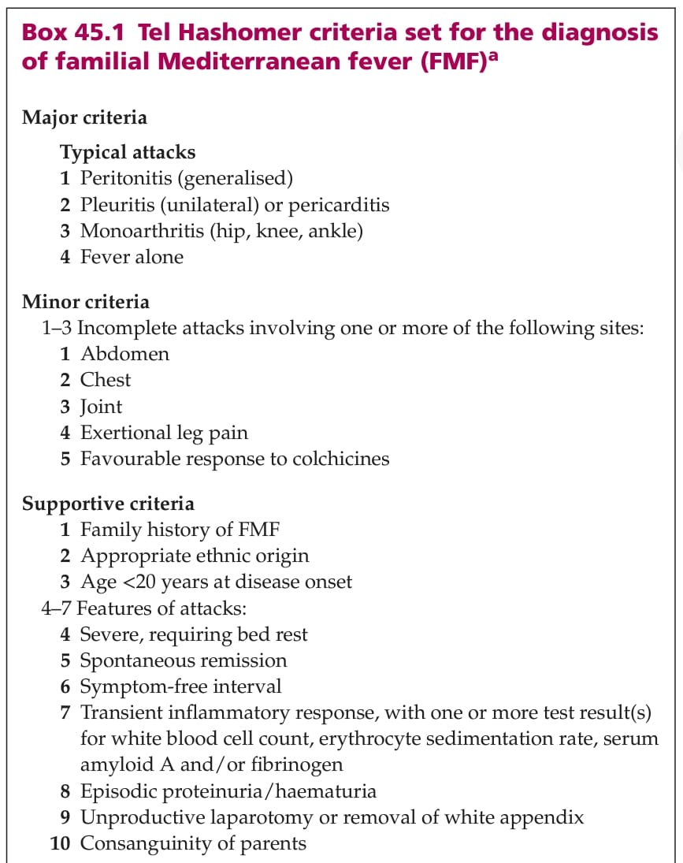

Slide 43
≥1 major criteria, or ≥2 minor criteria.
≥1 minor criterion plus ≥5 supportive criteria.
≥1 minor criterion plus ≥4 of the 5 supportive criteria.
Typical attacks are defined as recurrent (≥3 of the same type), febrile (rectal temperature of 38∘C or higher) and short (lasting between 12 h and 3 days).

Slide 44
Incomplete attacks are defined as painful and recurrent attacks that differ from typical attacks in one or two features, as follows:
(1) the temperature is normal or <38∘C.
(2) the attacks are longer or shorter than specified (but not shorter than 6 h or longer than a week).
(3) no signs of peritonitis are recorded during the abdominal attacks.
(4) the abdominal attacks are localised.
(5) the arthritis is in joints other than those specified. Attacks are not counted if they do not fit the definition of either typical or incomplete attacks.

Slide 45
Investigations
Autosomal recessive MEFV gene mutation
Rare dominant variant also exist.

Slide 46
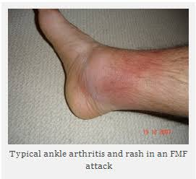

Slide 47
management
Colchicine
The major risk is the development of inflammatory AA amyloidosis but this risk can be largely prevented by continuous treatment with colchicine.
Anti-IL-1(e.g Anakinra)

Slide 48
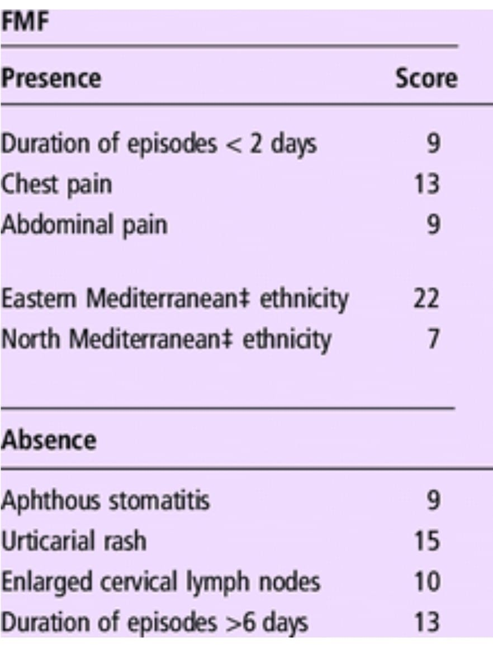
EUROfever printo criteria

Slide 49
Pyrin-associated autoinflammation with neutrophilic dermatosis (PAAND)
Autosomal dominant disorder caused by mutations in the same MEFV gene that is mutated in FMF, leading to activation of the pyrin inflammasome.
childhood onset with fever that can last several weeks.
Joint and muscle pain.
Skin lesions and increase in acute phase reactants.

Slide 50
Aseptic neutrophilic dermatoses: pyoderma gangrenosum, pustules, aseptic skin abscesses, acne, hidradenitis suppurativa, neutrophilic panniculitis.
Inflammatory (AA) amyloidosis can be a serious complication.
Treatment relies on anakinra
In case of poor response TNF inhibitors or IL-6 inhibitors.

Slide 51
Mevalonate kinase deficiency with recurrent fever and hyper-IgD syndrome
Mutations in the mevalonate kinase (MVK) gene may result in a partial or complete inability to metabolise mevalonic acid.
MVK plays a key role in the biosynthesis of cholesterol and non-sterol isoprenoids.
Shortage of isoprenoids is associated with a predisposition to inflammatory attacks.
An autosomal recessive.

Slide 52
Partial MKD is associated with recurrent fevers and usually but not always with overproduction of immunoglobulin D (HIDS).
Complete deficiency (MVK activity <1%) induces mevalonic aciduria.
a severe form of MKD associated with dysmorphism, growth retardation, neurological impairment, recurrent febrile flares and early death if untreated.
treatment relies on bone marrow transplantation

Slide 53
Clinical features
Presents in infancy and almost always before 3 years of age.
Recurrent flares of 3–7 days duration .
Fever, chills, headache, polyarthralgia, abdominal pain with diarrhoea and bilateral cervical tender lymphadenopathy.
Enlargement of the axillary or inguinal lymph nodes and spleen occurs less frequently.
Immunisation, surgery, trauma and stress are classic triggering factors

Slide 54
frequency of flares diminishes in adulthood.
An increase of acute phase reactants is observed during the inflammatory flares.
Increased IgA and IgD levels are characteristic although not specific
IgD levels can be normal.

Slide 55
Clinical features
Aphthous stomatitis is the most common mucocutaneous manifestation 60%.
red macules, maculopapular rashes (sometimes referred to as morbilliform), urticaria, purpura and erythema nodosum.
Macules, papules and plaques are intermittent and sometimes painful.
Lesions are usually fixed not migrating.
Pigmentary sequelae can persist after redness has cleared.
Site:-The trunk, extremities, buttocks and face can be involved.
Telangiectasia has been reported in two patients, but neither type nor anatomical site was specified

Slide 56
Complications
Amyloidosis is a very rare complication.
increased risk of severe infection (especially pneumococcal).
macrophage-activating syndrome.
an increased risk of renal angiomyolipoma

Slide 57
Investigation
presence of mevalonate aciduria with increased excretion of mevalonic acid during attacks.
Diagnosis is supported by the Eurofever/printo classification criteria.

Slide 58
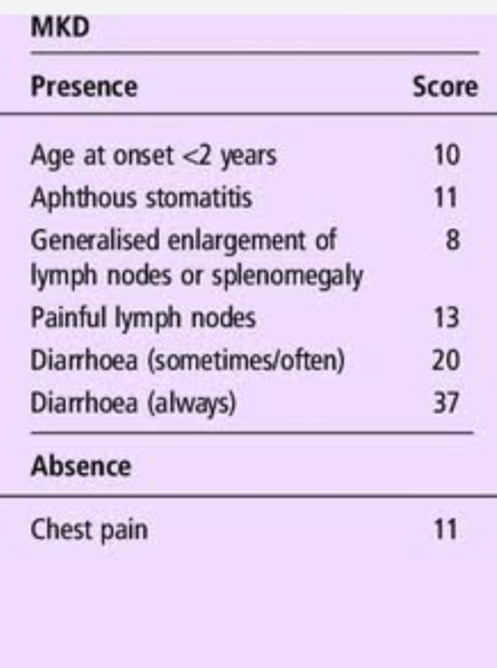

Slide 59
management
Steroids on demand
Anti-TNF
Anti-IL-1
Anti-IL-6

Slide 60
Autoinflammatory diseases with granuloma
1) Autoinflammatory granulomatosis of childhood (Blau syndrome).
2) Autoinflammation and PLC gamma 2-associated antibody deficiency and immune dysregulation (APLAID).
3) PLC gamma 2-associated antibody deficiency and immune dysregulation (PLAID)

Slide 61
Autoinflammatory granulomatosis of childhood (Blau syndrome)
Rare autosomal dominant multisystem disorder is a monogenic autoinflammatory disorder.
Mutations in the pattern recognition receptor gene NOD2 (CARD15).
Familial granulomatous disorder characterised by early-onset chronic granulomatous arthritis, uveitis and rash appeared simultaneously.
Early-onset sarcoidosis.
Confirmed by detecting mutations in the NOD2 (CARD15) gene.

Slide 62
Pathophysiology
NOD2 is a member of a family of pattern recognition receptors involved in innate immune defence against invading pathogens.
Mutations responsible for this disorder confer gain of function.
promoting inflammation and ultimately increasing activation of NFκB and release of a range of inflammatory cytokines including IL-1β, IL-6 and IFN gamma( key mediator of the disease).
Notes:
Gain-of-function mutations are also known as “activating mutations”.
The gene’s product is expressed at the wrong time, location, or at abnormally high levels

Slide 63
Clinical features
Early onset, usually before 4 years of age.
Chronic granulomatous polyarthritis and a rash.
Arthritis affects principally the peripheral joints (wrists, knees, ankles and proximal interphalangeal joints) and may be accompanied by tenosynovitis.
Cystic swelling on the dorsal side of the wrists or the ankle is highly characteristic.
Uveitis develops in 80% of cases at a median age of about 4 years.

Slide 64
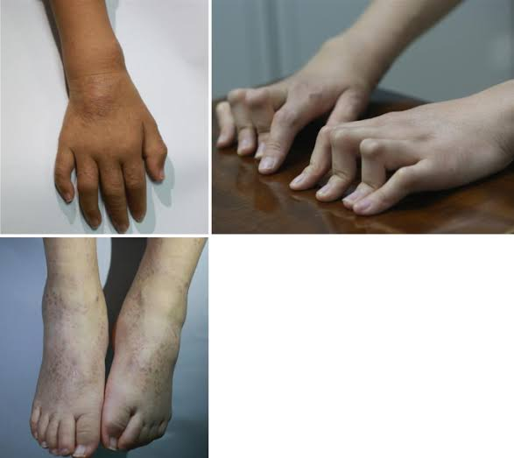
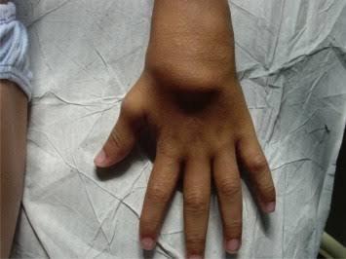

Slide 65
The rash presents during the first 10 years of life.
A widespread papular eruption.
Primary lesion is a discrete skin-coloured or slightly yellowish to red-brown coloured papule measuring 1–5mm in diameter.
First involve the face and extremities, and later spread to the trunk.
Fade spontaneously then recur and can leave pitted scars as a result of follicular atropho-derma.

Slide 66
Histopathology
Non-caseating granulomatous inflammatory infiltrate located in the adventitial dermis.
Ichthyosiform skin changes,
erythema nodosum
leukocytoclastic vasculitis

Slide 67
Complication:-
Joint destruction and blindness can occur.
MANAGEMENT:-
Steroids
Anti-TNF

Slide 68
Autoinflammation and PLC gamma2-associated antibody deficiency and immune dysregulation (APLAID)
Autosomal dominant disorder
Mutations in the PLCγ 2 gene resulting in hyperactivation of the PLCγ2 pathway.
Early-onset blistering skin lesions.
Eye inflammation (conjunctivitis, episcleritis, uveitis).
IBD.
Interstitial pneumonitis.
Cutis laxa-like lesions have been reported.

Slide 69
Joint pain
Recurrent upper airway infection
Related to humoral immunodeficiency with almost absent switched memory B cells.
Early-onset papules that evolve to pustular or vesiculobullous blistering lesions with crusts that can mimic epidermolysis bullosa,
Boggy pustular masses, especially on the back of the hands, that ulcerate and evolve with time to plaques, sometimes with cribriform scarring.

Slide 70
Histopathology
Infiltrated lesions can show an interstitial granuloma annulare rich in neutrophils.
Leukocytoclasia
Transepidermal elimination of basophilic material through follicular channels.
Mucin is present in the areas of degenerated collagen.

Slide 71
management
Steroids
Anakinra
IgIV

Slide 72
PLC gamma 2-associated antibody deficiency and immune dysregulation (PLAID)
Autosomal dominant disorder due to mutation of PLCγ 2.
Early-onset pruritus, red macules and urticaria after generalised exposure to cold air or evaporative cooling.
a negative cold stimulation time test.
Vesiculobullous eruptions in the first days of life on the colder areas of the body such as the tip of the nose, the ears and the fingers, sometimes evolving into crusted ulcerations, can occur.

Slide 73
The lesions usually resolve spontaneously but in a few patients the rash worsens with time and leads to destruction of ear and nose cartilage.
Plaques and nodules sparing the warmer regions of the body.
Can also involve the mucosa.
Immunologic abnormalities are often present: antibody deficiency, recurrent infections, autoimmune disease (vitiligo, Hashimotos thyroiditis) and symptomatic allergic disease (rhinitis, asthma).

Slide 74
Histopathology
urticarial lesions shows a slight increase in dermal mast cells.
Plaques reveals sarcoid type granulomas or diffuse granulomatous inflammation of the dermis.
Management
Avoiding cold temperatures
Glycopyrrolate
IgIV

Slide 75
Autoinflammatory syndromes with pustulosis
1) Deficiency of interleukin 1 receptor antagonist (DIRA).
2) Deficiency of interleukin 36 receptor antagonist (DITRA).
3) Pyogenic sterile arthritis, pyoderma gangrenosum and acne syndrome (PAPA).

Slide 76
Deficiency of interleukin 1 receptor antagonist
An autosomal recessive disorder.
Deficiency of the naturally occurring antagonist of the IL-1 receptor (IL-1Rn)
The result is an excess of IL-1-mediated inflammation.
Neonates with aseptic pustular dermatitis.
Multifocal osteomyelitis and periostitis.
Fever is usually absent.
Acute phase reactants are elevated during flares.

Slide 77
Grouped pustules appear on a red base in the newborn or within the first 3 weeks these may then develop yellowish crusts.
The lesions can be localised or widespread, including face and scalp involvement.
Bullae with hypopyon can be present.
The skin may become diffusely red and ichthyotic with diffuse desquamating scales.
Oral mucosa and nails can be affected, with pitting and onychomadesis.

Slide 78
One child also developed pyoderma gangrenosum . Late-onset forms (adolescence) have been reported.

Slide 79
Investigations
Diagnosis relies on clinical finding.
Radiological findings (widened ribs and clavicles, osteolytic lesions of the long bones).
detecting a homozygous or compound heterozygous loss of function mutation in the IL-1RN gene.

Slide 80
Management
Anakinra
Anti-TNF

Slide 81
Deficiency of interleukin 36 receptor antagonist (DITRA)
Severe early-onset pustular psoriasis.
homozygous or compound heterozygous mutations in the gene encoding IL-36 receptor antagonist, IL36RN.

Slide 82
Pyogenic sterile arthritis, pyoderma gangrenosum and acne syndrome (PAPA)
Rare autosomal dominantpustular autoinflammatory disorder affecting principally the skin and joints.
Mutations in the PSTPIP1 gene.
The PSTPIP1 gene encoded protein binds to pyrin and exerts a dominant negative effect on its activity.

Slide 83
pyoderma gangrenosum (PG)/acne syndromes.
PASH (Pyoderma gangrenosum, Acne, Hidradenitis Suppurativa)
PAPASH (PASH with pyogenic arthritis)
PsAPASH (PASH with psoriatic arthritis)
PASS (PG, acne, seronegative spondyloarthritis with or without hidradenitis suppurativa)
PAC (PG, acne, ulcerative colitis)
PAMI (PSTPIP1-associated myeloid-related proteinaemia inflammatory syndrome).
They should nosologically be considered as PAPA spectrum disorders.

Slide 84
Early childhood with a recurrent painful sterile pauciarticular non-axial arthritis occasionally resulting in significant joint destruction.
Precipitated by trauma.
By puberty, joint symptoms tend to subside while skin manifestations predominate.
Pyoderma gangrenosum is variable.
pathergy may occur.
Notes:
Pauciarticular means affecting four or fewer joints.

Slide 85
PAPA should be considered in every patient with a familial history of pathergy and/or pyoderma gangrenosum.
Hidradenitis suppurativa may also be associated.
PAAND can mimick PAPA syndrome.
Investigation.
Typical presentation
Genetic testing for mutations in the PSTPIP gene.
Management.
Anti-TNF
Anti-IL-1
Notes:
PAAND mimic PAPA

Slide 86
Type 1 interferonopathies
Aicardi-Goutières syndrome (AGS).
proteasome associated autoinflammatory syndromes (PRAAS).
1)CANDLE (Chronic atypical neutrophilic dermatosis with lipodystrophy and elevated temperature)
2)SAVI (STING-associated vasculopathy with onset in infancy)

Slide 87
Manifestations
Calcifications of basal ganglia (AGS).
Interstitial lung disease (SAVI).
Muscle involvement, glaucoma, glomerular nephropathy, lymphopenia.
CRP levels are usually normal \ mildly elevated.
Autoantibodies can be present.
Irreversible end-organ damage is common.

Slide 88
Skin manifestations
cold-sensitivity with inflammatory (e.g. chilblains)
vasculopathic (e.g. telangiectasia, violaceous skin areas evolving into ulceration and necrosis)
changes in cold-exposed areas (fingers, toes, tip of the nose, ears) that can progress to tissue loss and scarring.
Neutrophilic panniculitis .
Interferonopathies involve mainly small vessels, while medium-sized vessels are involved in DADA2.

Slide 89
Aicardi-Goutières syndrome (AGS)
Six recessively inherited (TREX1, SAMHD1, RNASEH2A, RNASEH2B, RNASEH2C, ADAR1).
one dominantly inherited (IFIH1) monogenic disorders.
Characterised by inflammation affecting particularly the brain and the skin.
Recessive AGS (e.g. TREX1, SAMHD1)can give rise to dominant familial chilblain lupus erythematosus.

Slide 90
Severe forms of AGS mimic TORCH.
Signs include neonatal encephalopathy with severe developmental delay.
Axial hypotonia, peripheral hypertonia with spasticity.
Microcephaly, progressive cerebral atrophy and basal ganglia calcif ications.
Fever and hepatosplenomegaly, as well as abnormal liver tests.
Lymphocytosis with elevated IFN α level in an aseptic cerebrospinal fluid.

Slide 91
Signs of autoimmunity such as arthritis, presence of antinuclear antibodies, lymphopenia and thrombocytopenia.
skin findings are highly suggestive: acral redness, red papules and plaques typical of chilblains on hands, feet, ears; more rarely are necrotic acral lesions, Raynaud phenomenon and livedo reticularis.

Slide 92
AGS-6 is caused by homozygous \compound heterozygous mutations in ADAR1, the gene involved in dyschromatosis symmetrica hereditary.
AGS-7 is caused by mutations in IFIH1....overlapping features with Singleton–Merten syndromes and at least in one family multiple lentigines were part of the clinical spectrum

Slide 93
Investigation.
Diagnosis relies on clinical findings.
high interferon levels in cerebrospinal fluid and confirmed by genotyping.
Management
JAK inhibitors
Reverse transcriptase inhibitors

Slide 94
STING-associated vasculopathy with onset in infancy( SAVI)
A dominant disorder caused by gain of function mutations in stimulator of interferon cGAMP interactor 1 or STING1 (formerly TMEM173).
Neonatal-onset of recurrent fever with rash.
Failure to thrive and interstitial lung disease that can progress to end-stage respiratory failure(high mortality rate).
Arthralgia and arthritis are common.
During flares, acute phase reactants are elevated.
Patients have autoantibodies, such as ANA, ANCA and antiphospholipid antibodies.

Slide 95
Skin signs
violaceous, scaly and atrophic skin areas, that can ulcerate and/progress to necrosis of the extremities, the cheeks, the ears and the nose.
Telangiectatic erythema, acral cyanosis or livedoid erythema in cold-sensitive areas are other typical manifestations.
Livedo reticularis, Raynaud phenomenon, periungual erythema are also present.
Digital gangrene and nasal perforation can occur.
Vesicles or blisters can appear on cold-exposed sites.
Localised/ generalised pustules.

Slide 96
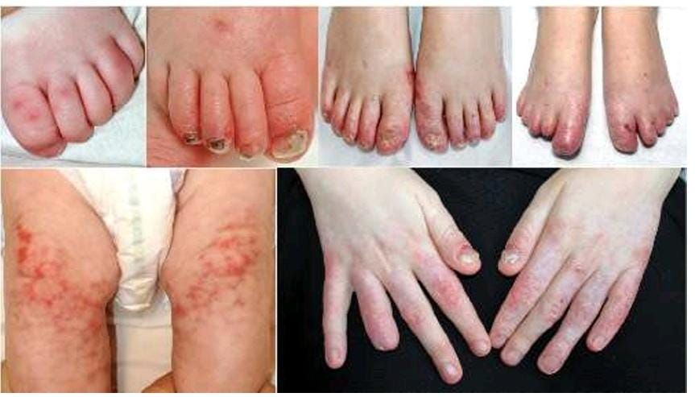

Slide 97
Oral ulcers, Nails can become dystrophic and alopecia areata may occur.
Skin lesions can evolve to definitive damage of the fingers and the toes with amputation, as well as tissue loss and scarring of the ears and the nose.
Face,:- redness in the cold-sensitive areas (tip of the nose and on the middle part of the cheeks, below the malar area).
STING1 mutations also account for isolated lung fibrosis and isolated familial chilblain lupus.

Slide 98
Histopathology:-
prominent dermal inflammatory infiltrate with leukocytoclastic vasculitis and microthrombotic angiopathy of small dermal vessels.
Investigations
Diagnosis on clinical, biological and imaging findings and genotyping.
Management
JAKinhibitors

Slide 99
Chronic atypical neutrophilic dermatosis with lipodystrophy and elevated temperature(CANDLE)
Autosomal recessive syndrome.
Characterised by abnormal signalling in the interferon pathways.
It is due to mutation in the PMSB8 gene.
PMSB8 mutation is also found in the JMP syndrome (joint contractures, muscle atrophy, microcytic anaemia and panniculitis-induced childhood-onset lipodystrophy), which shares clinical features with CANDLE.
PMSB4, PSMB9,PSMA3 and POMP are other proteasome genes identified as causing PRAAS/CANDLE

Slide 100
MD9L-SAAD is a newly recognised type1 interferonopathy with a dermatological presentation similar to CANDLE, but with a more severe interstitial lung disease, B and NK-cell cytopenia.
Immunohistochemistry reveals the mononuclear cell component is either myeloperoxidase positive, Leder staining positive (naphthol AS-D chloroacetate esterase or specificesterase,whichspecificallyidentifiescellsofthegranulocyte lineage from the early promyelocyte stage to mature neutrophils) or CD68+ and CD163+ and was thus interpreted as being composed of immature neutrophils/myeloid precursors and activated macrophages. This infiltrate is admixed with eosinophils.

Slide 101
Histopathology
a dense dermal infiltrate of mononuclear cells with mature and immature neutrophils with karyorrhexis.
Mononuclear cells found atypical with large vesicular elongated or kidney-shaped nucleus.
Scant eosinophilic cytoplasm and
Frequent mitotic figures.

Slide 102
Clinical features
Present in early life with recurrent fever, rash and arthralgia or arthritis.
First develop within 2 or 3 weeks of birth but then continue episodically during the first year of life.
violaceous or red, often annular and oedematous plaques on the face and trunk and over the interphalangeal joints.
Resolves with purpura or pigmentation.
Children develop persistent violaceous periorbital oedema and swelling of the fingers and toes reminiscent of perniosis.

Slide 103
Recurrent episodes of panniculitis evolve to lipoatrophy.
Thickened lips, hypertrichosis, mouth ulcers and muscle atrophy.
Enlarged lymph nodes, spleen and/or liver with abnormal liver function tests.
Chondritis and episcleritis, aseptic meningitis, parotiditis.
Basal ganglia calcification can occur.
Acute phase reactants are raised and liver and muscle enzymes are elevated.
Without treatment, up to 50% of patients die before adulthood.
Risk development of muscle atrophy, cardiac arrhythmias and dilated cardiomyopathy.

Slide 104
Investigations:-
Genetic testing for mutations in the PMSB8
Proteasome genes
Imaging of the basal ganglia for calcification.
Management:-
First-line treatment should include JAK inhibitors.

Slide 105
Behçet disease-like or inflammatory bowel disease-like autoinflammatory syndromes.
Monogenic autoinflammatory disorders with features suggestive of early-onset Behçet disease or IBD.
Mucocutaneous manifestations include aphthous stomatis and numerous aseptic neutrophilic infiltrates: pustules, Sweet syndrome, pyoderma gangrenosum, as well as early-onset periorificial redness with fissuring.

Slide 106
Includes:-
Haploinsufficiency of A20.
RELA haploinsufficiency.
NLRC4-associated autoinflammatory disease.
Nuclear factor kappa light-chain enhancer of activated B-cells1(NFkb1)-autoinflammatory disease.
ADAM17 deficiency.
IL-10 signalling disorders (IL-10/IL-10R colitis).

Slide 107
Haploinsufficiency of A20 (HA20)
HA20 is a dominant disorder caused by mutations in the TNFAIP3 gene encoding protein A20 leading to increased NFkB signalling .
The clinical triad of orogenital ulcers, ocular inflammation and non-deforming polyarthritis is characteristic.
Recurrent fever, hepatosplenomegaly, gastrointestinal ulcers, serositis, pharyngitis, retinal vasculitis and central nervous system vasculitis.
Acute phase reactants are elevated during flares.
Age of onset is usually before 10

Slide 108
Autoimmune diseases can occur: cytopenia, type 1 diabetes, Hashimoto thyroiditis, glomerulonephritis, interstitial lung disease.
Systemic autoimmune diseases, such as systemic lupus erythematosus, can also occur.
Autoantibodies can be present.

Slide 109
Dermatological manifestations
Oral and genital ulcerations, as well as gastrointestinal ulcerations.
Numerous neutrophilic aseptic dermatoses can occur: pustules, abscesses, erythema-nodosum-like lesions.
Pathergy can be present.
Histopathology of skin lesions is a neutrophilic dermatosis and mucin deposition.

Slide 110
Management.
Colchicine
Thalidomide
Steroids
Methotrexate
TNFα-inhibitor
IL-6 inhibitors

Slide 111
RELA haploinsufficiency
#dominant disorder caused by mutations of RELA encodes RelA, a subunit of NFκB.
Patients have a Behçet disease-like presentation similar of A20 (TNFAIP3) haploinsufficiency, with mucosal ulceration, IBD, fever and elevated acute phase reactants.
Oral and genital ulcers are the most common dermatological manifestation.
Treatment with steroids and TNF inhibitors is efficient for the autoinflammatory variant.

Slide 112
NLRC4-associated autoinflammatory disease.
Autosomal dominant disorders is related to gain of function mutations in NLRC4.
Activation of the NLRC4 inflammasome and increased secretion of active IL-1β and IL-18.
It is characterised by extremely high IL-18 levels.
It includes NLRC4-associated macrophage activating syndrome (NLRC4-MAS) and familial cold autoinflammatory syndrome 4 (FCAS4).

Slide 113
NLRC4-MAS is a multisystemic disease starting early in life with chronic IBD (AIFEC: autoinflammation and infantile enterocolitis) that usually subsides over time.
Patients can have severe inflammation with signs similar to CINCA/NOMID and they are prone to develop MAS.
FCAS4 is very similar of FCAS with urticaria, arthralgia, ocular inflammation and fever after exposure to cold stimuli. Painful nodules can occur on lower extremities, especially in adult patients.

Slide 114
Urticarial lesions reveals a lymphohistiocytic infiltrate, different from the neutrophilic infiltrate seen in CAPS.
Biopsy of a nodular lesion reveals a deep dermal and subcutaneous septal and lobular lymphohistiocytic infiltrate.
Management
NSAID
Steroids
Anakinra
IgIV
Cyclosporine
Severe disease: Recombinant IL-18 binding protein
IFNγ-inhibitor

Slide 115
Nuclear factor k light-chain enhancer of activated B-cells1(NFk1)-autoinflammatory disease.
Synonyms.
Familial autoinflammatory necrotising fasciitis.
Autosomal dominant disorders due to NFκB1 mutations, encoding p105, resulting in increased expression of IL-1 and sometimes TNF and IFN gamma.
Behçet-like disease, or a necrotising neutrophilic dermatosis similar of postoperative pyoderma gangrenosum.
Manifestations of immune deficiency and autoimmunity start in infancy and include recurrent respiratory tract infections with bronchiectasis, diarrhoea, lymphadenopathy, splenomegaly, thyroiditis, and autoimmune cytopenias.

Slide 116
Dermatological manifestations
Behçet-like variant are aphthae of the oral and genital mucosa, as well as ulcerations of the oesophagus.
Pathergy can be present.
Aseptic necrotising-fasciitis-like lesions characterise the patients with FANF.
They have hypogammaglobulinaemia , deficient production of specific antibodies, and decreased classed-switched memory B cells.
mutations in NFκB2.
Immune deficiency treatment includes antibiotics and intravenous immunoglobulins.
Behçet-like manifestations are treated like classic Behçet disease, with potential utility of IL-1 and TNF-inhibitors.

Slide 117
ADAM17 deficiency.
Synonyms.
Inflammatory skin and bowel diseases, neonatal, 1
Extremely rare recessive disease related to ADAM17 mutations encoding TNF-α converting enzyme.
Affected patients have neonatal onset of IBD, mild cardiomyopathy and rashes.
Skin findings include pustules, peri-orificial redness with fissuring and evolution to exfoliative dermatitis. Hair was reported as fragile, nails are thickened and paronychia common. Skin infections were reported as frequent and overall prognosis as good.
Histopathology reveals a perifollicular and epithelial T-cell infiltrate.

Slide 118
IL-10 signalling disorders (IL-10/IL-10R colitis).
Synonyms
Inflammatory bowel disease 28, early onset, autosomal recessive •
Inflammatory bowel disease 25, early onset, autosomal recessive
Patients often have folliculitis, perianal abscesses and enterocutaneous fistula.
Treatment of choice is haematopoietic stem cell transplantation.

Slide 119
Miscellaneous monogenic autoinflammatory syndromes.
1) CCAAT enhancer binding protein e(C/EBPe-associated autoinflammation and immune impairment of neutrophils (CAIN).
2) Cleavage resistant RIPK1-induced autoinflammatory syndrome.
3) Deficiency of adenosine deaminase 2.
4) HOIL-1 deficiency.
5) Majeed syndrome.
6) NLRP1-associated autoinflammation with arthritis and dyskeratosis.
7) Neonatal onset of pancytopenia, autoinflammation, rash and episodes of haemophagocytic lymphohistiosis (NOCARH) syndrome.
8) Otulin-related autoinflammatory syndrome.
9) Periodic fever, immunodeficiency and thrombocytopenia syndrome.
10) Sideroblastic anaemia with B-cell immunodeficiency, periodic fevers and developmental delay (SIFD).
11) VEXAS (vacuoles, E1 enzyme, X-linked, autoinflammatory, somatic) syndrome.
12) Vibratory urticaria.

Slide 120
CCAAT enhancer binding protein epsilon(C/EBPe-associated autoinflammation and immune impairment of neutrophils (CAIN).
CAIN is a recessive disorder caused by gain of function mutations in CEBP epsilon encoding C/EBPe, a transcription factor expressed in myeloid and lymphoid lineage, that regulates cellular differentiation and function of late myeloid lineage as well as the inflammasome.
It starts after adolescence with recurrent attacks of abdominal pain, fever and an increase in acute phase reactants lasting 4–5 days.
Flares recur every 2– 4 weeks.

Slide 121
Dermatological findings
Crater-like buccal ulcerations, pyoderma gangrenosum, purulent paronychia with lymphangitis and recurrent skin abscesses.
The disease is characterised by neutrophil dysfunction, hyposegmented neutrophils, recurrent abscesses, mild bleeding (epistaxis, haematomas after needle sticks) and recurrent fever.
Recurrent purulent skin, and mucosal and upper respiratory tract infection and recurrent aseptic abscesses. Other findings include episcleritis, myalgia, joint pain, pleurisy and aphthous colitis.

Slide 122
management
Treatment modalities are not defined but if neutrophil modulators such as dapsone or colchicine are not effective, IL-1 inhibitors could potentially be helpful.

Slide 123
Cleavage resistant RIPK1-induced autoinflammatory syndrome
Synonyms
Autoinflammation with episodic fever and lymphadenopathy (AIEFL)
CRIA syndrome is a dominant disorder related to RIPK1 mutations resulting in early-onset fever occurring every 2–4 weeks, of 1–7 days duration, continuing through adulthood, with enlarged lymph nodes, and hepatosplenomegaly.
Fever can reach temperatures as high as 41∘C with chills, headaches and hallucinations.
Joint pain and gastrointestinal symptoms (abdominal pain, nausea, diarrhoea, constipation, loss of appetite, weight loss) are common.
Oral ulcerations.
Tocilizumab is the treatment of choice.

Slide 124
Deficiency of adenosine deaminase 2 (DADA2)
Recessive disorder
Hypomorphic mutations in ADA2 (CECR1) encoding ADA2, a growth factor in the myeloid lineage promoting differentiation into anti-inflammatory macrophages.
ADA2 also plays a role in the homeostasis of endothelial cells and its deficiency promotes vascular damage.
Starts early in life (about 80% before age 10).
DADA2 can be considered as a monogenic variant of polyarteritis nodosa.

Slide 125
Clinical features
Persistent and/or recurrent fever, livedo and/or nodules, and ischaemic and/or haemorrhagic stroke.
Vasculitis and inflammation can affect multiple organs, which causes intestinal, cardiac, hepatological, neurological and renal manifestations.
Acute phase reactants are increased in about 50% of patients.
Haematological manifestations: hypogammaglobulinaemia, marrow aplasia, pure red cell aplasia, immunethrombocytopenia and neutropenia.
Immunodeficiency, and some patients will present as common variable immunodeficiency.
Lymphoproliferation with generalised lymphadenopathy and splenomegaly.

Slide 126
Skin manifestations
Most common feature of DADA2, present in 75%ofpatients.
Livedo reticularis or more often livedo racemosa is a typical manifestation.
Digital necrosis and skin ulcers, Raynaud phenomenon, aphthous ulcers and poorly described rashes.
Biopsy:-Interstitial infiltrate of neutrophils and macrophages, with perivascular T cells without vasculitis.
Non-granulomatous vasculitis of small and medium-sized vessels in the skin.
Management:- TNFα-inhibitor and HSCT

Slide 127
HOIL-1 deficiency
Recessive disorder caused by HOIL-1 mutations, encoding Hoil-1, a component of linear ubiquitin chain assembly complex (LUBAC).
Combine an immune deficiency syndrome with recurrent bacterial infections and an autoinflammatory syndrome with recurrent fever, failure to thrive, gastrointestinal symptoms (diarrhoea with blood and mucus), lung involvement and lymphadenopathy.
Cutaneous manifestations are erythroderma and exfoliative dermatitis as well as eczema and oral ulcerations.

Slide 128
Majeed syndrome.
Synonyms
Chronic recurrent multifocal osteomyelitis, congenital
Dyserythropoietic anaemia, and neutrophilc dermatosis
Rare autosomal recessive monogenic autoinflammatory disorder related to germline LPIN2 mutations.
Chronic recurrent multifocal osteomyelitis (CRMO) is associated with dyserythropoietic anaemia and a neutrophilic dermatosis resembling Sweet syndrome.
IL-1 inhibition is treatment of choice.

Slide 129
NLRP1-associated autoinflammation with arthritis and dyskeratosis.
Synonyms
Autoinflammation with arthritis and dyskeratosis
NAIAD can be caused by mutations of the NLRP1 gene, encoding NLRP1, a key inflammasome in the skin.
Clinical features
Vitamin A deficiency is common.
CRP is elevated during flares.
low titre antinuclear antibodies,.
elevated titres of IgA, IgG or IgE, neutrophilia, and a high transitional B-cell level are present.

Slide 130
Dermatological findings
Diffuse xerosis with multiple minute digitate keratosis covering extensive areas of limbs, shoulders and flanks, with brownish purple pigmented macules with indistinct edges present in the area of keratotic lesions.
Symmetric tender warty keratotic lesions on soles and in the larynx.
comedo-like papules and vermiculated atrophic scars on the cheeks.
perifollicular cylindrical keratotic sheaths (hair casts) on hair of the vertex and occipital region.

Slide 131
Histopathological :- acanthosis with scattered to confluent dyskeratotic keratinocytes of the supra-basal layers.
The granular cell layer is completely replaced by dyskeratotic keratinocytes.
Investigation.
Diagnosis relies on clinical features and genotyping.
Management
Treatment relies on acitretin and anakinra.

Slide 132
Neonatal onset of pancytopenia, autoinflammation, rash and episodes of haemophagocytic lymphohistiosis (NOCARH) syndrome.
Mutation in the cell division cycle 42 (CDC42) gene.
Associates neonatal onset of persistent fever, rash, hepatosplenomegaly, pancytopenia, transaminitis and persistently elevated markers of inflammation.
High ferritin and IL-18 levels are found.
Most patients have mild dysmorphism (frontal bossing, hypertelorism, nasal bridge depression).
The eruption is urticarial with petaloid and/or polycyclic confluence of lesions.

Slide 133
Histopathology :- perivascular lymphocytic and neutrophilic infiltration.
The disease is severe with no established treatment.
IL-1 inhibition was very efficient in a few patients and IFN gamma inhibitors could be helpful.

Slide 134
Otulin-related autoinflammatory syndrome.
Synonyms
Autoinflammation, panniculitis and dermatosis syndrome (AIPDS).
ORAS is a rare recessive autoinflammatory disease related to mutations in the OTULIN/FAM105B gene encoding otulin.
Early-onset fever, failure to thrive, joint and abdominal pain, diarrhoea, lymphadenopathy and elevated acute phase reactants.
Cutaneous manifestations include red plaques and nodules, pustules and lipoatrophy.
Untreated, ORAS can be fatal.
TNF inhibitors are a very efficient treatment.

Slide 135
Periodic fever, immunodeficiency and thrombocytopenia syndrome.
Synonyms
Lazy leukocyte syndrome
Periodic fever, immunodeficiency and thrombocytopenia (PFIT) syndrome is a recessive disorder caused by WDR1 gene mutations, encoding WDR1 which regulates actin assembly.
It is characterised by recurrent fever, oral ulcers, intermittent thrombocytopenia and immune deficiency.
Flares of fever last 3–7 days.
Recur with a periodicity of 6–12 weeks.

Slide 136
Raised acute phase reactants, leukocytosis, hyperferritinaemia and thrombocytopenia are present during the flares.
WDR1-deficient patients include intellectual impairment, recurrent infections.
abnormal herniation of nuclear lobes in the neutrophils on blood smear and aberrant T-cell activation and B-cell development.
Oral ulcers are the most typical dermatological manifestation.
very severe and induce microstomia because of scarring.
Poorly described skin ulceration resembling pyoderma gangrenosum.

Slide 137
Associated with an enhanced risk of malignancy, especially myelodysplasia and acute leukaemia.
IgIV and antibiotics are administered for recurrent infections.
Haematopoietic stem cell transplantation could be the treatment of choice for some patients.

Slide 138
Sideroblastic anaemia with B-cell immunodeficiency, periodic fevers and developmental delay (SIFD).
Recessive disorder caused by mutations of TRNT1, encoding the nucleotidyl transferase enzyme.
Manifestations include recurrent fever, failure to thrive, developmental delay, diarrhoea, vomiting and sideroblastic anaemia, cataract and sensorineural deafness.
Hypogammaglobulinaemia is usually present.

Slide 139
Dermatological manifestations
Oral ulcers, red nodules and plaques on the trunk and limbs.
Biopsy revealed neutrophilic infiltrates of the deep dermis and the hypodermis, with enlarged septa.
Numerous atypical myeloid cells can be present raising the question of leukaemia cutis.
Partial response was reported with TNF inhibitors.

Slide 140
VEXAS (vacuoles, E1 enzyme, X-linked, autoinflammatory, somatic) syndrome.
An acquired autoinflammatory syndrome with mutation in UBA1.
an X-chromosome gene encoding ubiquitin-like modifier-activating enzyme 1 (UBA1).
Clinical features
late-onset systemic inflammatory disease in men.
Fever, elevated concentrations of C-reactive protein and haematological abnormalities, isolated macrocytosis or thrombopenia.
Vacuoles are present in the bone marrow.

Slide 141
Most patients go on to develop an overt myelodysplastic syndrome.
Some have polyarteritis nodosaor giant cell arteritis.
Thromboembolic complications are common.
Cutaneous expression of VEXAS are relapsing polychondritis, Sweet syndrome and interstitial granuloma annulare.
VEXAS syndrome in every adult man with otherwise unexplained systemic inflammation and minor haematological abnormalities such as macrocytosis and/or thrombopenia.

Slide 142
The diagnosis can be confirmed by demonstrating a pathogenic mutation in the UBA1 gene.
Management.
Extremely resistant to treatment and the disease is often exacerbated by IL-1 inhibitors.
Corticosteroids, anti-IL-6 and azacytidine are the treatments of choice.

Slide 143
Vibratory urticaria.
Autosomal dominant vibratory urticaria related to ADGRE2 mutations .
it is also an autoinflammatory disorder.
One of the most serious complications is recurrent angioedema of the hypopharynx related to snoring.

Slide 144
COMPLEX AND POLYGENIC AUTOINFLAMMATORY DISEASES PRESENTING WITH URTICARIAL OR MACULOPAPULAR RASH

Slide 145
1) Schnitzler syndrome
2) Adult-onset Still disease.
3) Systemic-onset juvenile idiopathic arthritis.
4) Synovitis, acne, pustulosis, hyperostosis and osteitis syndrome.
5) Yao syndrome

Slide 146
Schnitzler syndrome
Acquired autoinflammatory disorder manifesting usually in an adult patient typically aged 50 years or older.
Chronic urticarial eruption with a persistently raised monoclonal IgM.
Plus at least two of the following features:
1) recurrent fever above 40∘C
2) bone or joint pain (especially over the ilium or tibia)
3) lymphadenopathy
4) hepatomegaly or splenomegaly
5) neutrophilia, elevated acute phase reactants or abnormal bone imaging (e.g. osteocondensation, particularly around the knee joint).
Although arthralgia is common, arthritis is rare.

Slide 147
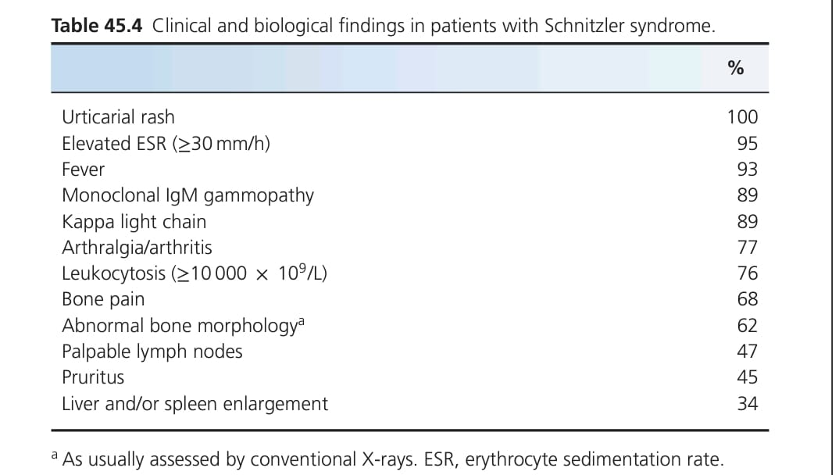

Slide 148
Pathophysiology.
1) Strong clinicopathological similarities with CAPS.
2) High spontaneous and lipopolysaccharide-induced IL-1 release from peripheral blood mononuclear cells of affected patients.
3) Dramatic and immediate responsiveness to IL-1 inhibitors
Histopathology
This shows a mainly interstitial neutrophilic skin infiltrate.

Slide 149
Clinical features
A recurrent urticarial rash is usually the first sign.
First complain of bone and/or joint pain.
Skin lesions include non-pruritic macules, papules or plaques, particularly on the trunk.
Most patients will also develop fever.
Immunoelectrophoresis is then mandatory.
The rash is typically NUD. Validated diagnostic criteria (the Strasbourg criteria) underline the diagnostic importance of the neutrophilic skin infiltrate.

Slide 150
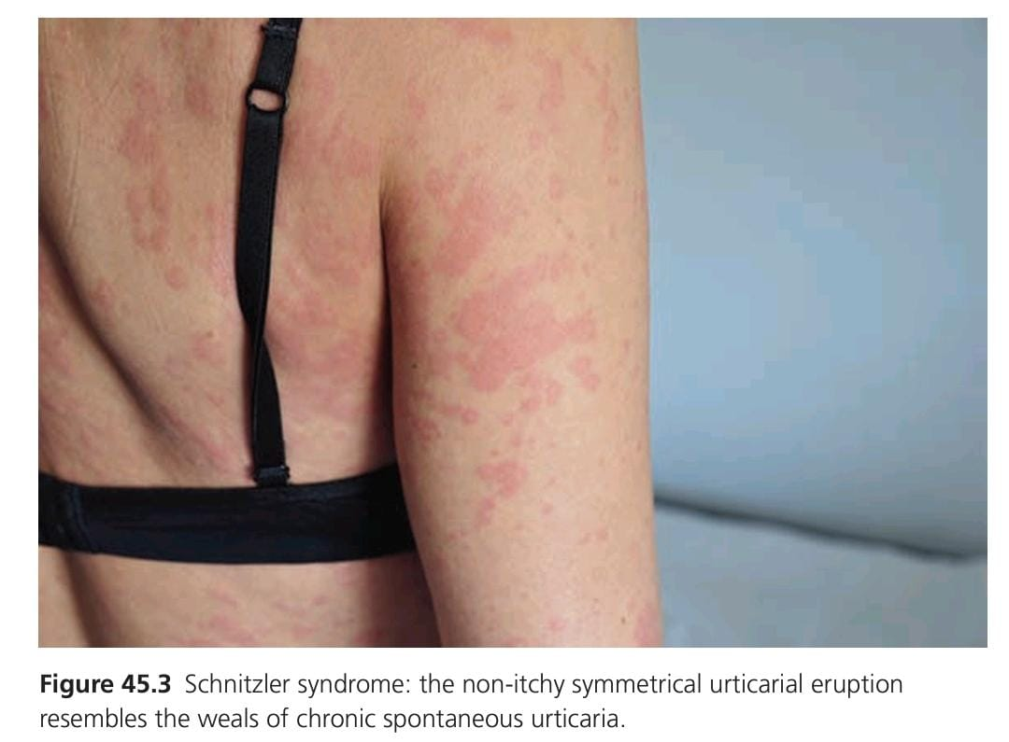

Slide 151
Schnitzler syndrome should be suspected in any patient with a recurrent urticarial rash and/or fever and/or fatigue and/or general malaise and/or increase in acute phase reactants and/or joint and/or bone pain and/or enlarged lymph nodes, liver or spleen and/or a neutrophilic infiltrate on biopsy.
Immunoelectrophoresis is then mandatory.
An IgG variant of Schnitzler syndrome has been reported but whether it is true Schnitzler syndrome is a matter of debate.

Slide 152
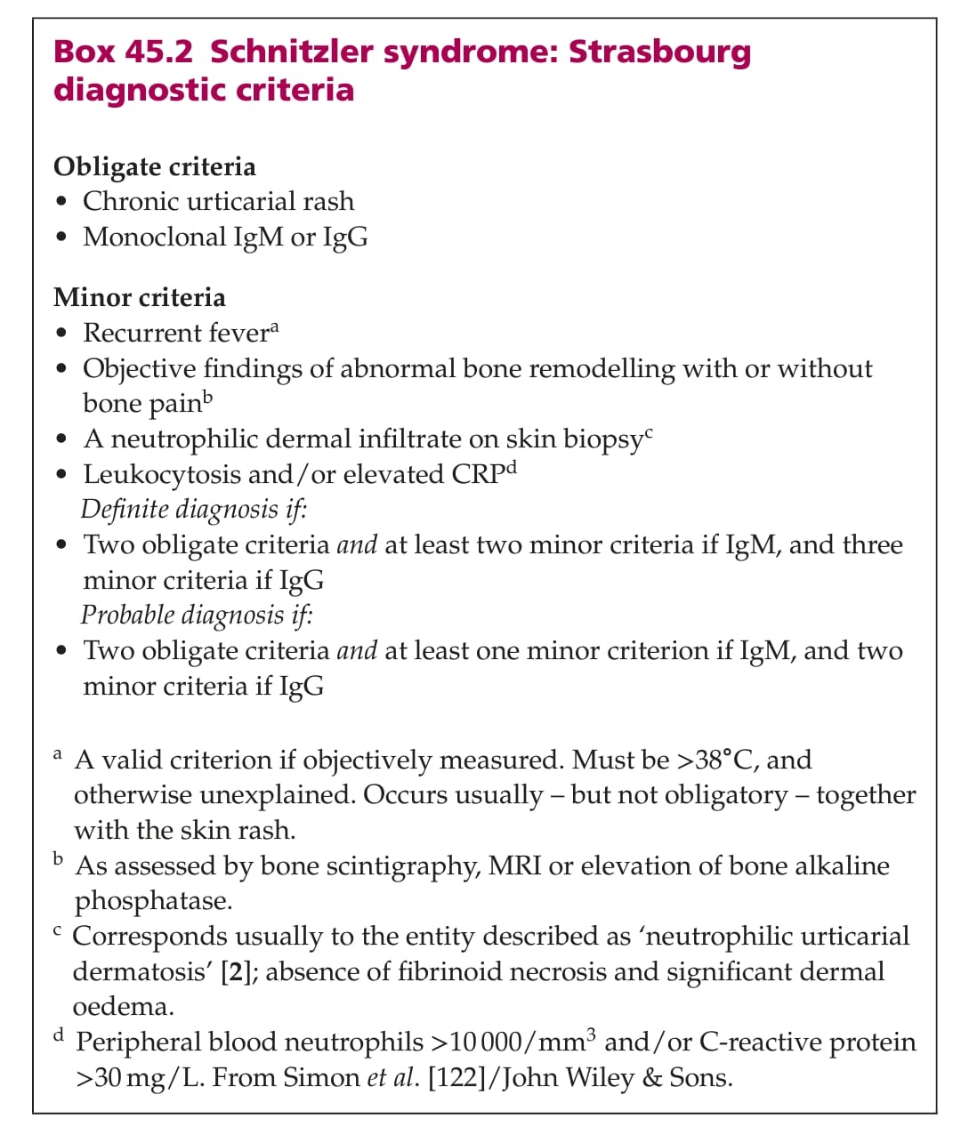

Slide 153
Differential diagnosis
Systemic adult-onset Still disease....usually have a very high ferritin concentration and lack a monoclonal gammopathy.
Hypocomplementaemic urticarial vasculitis
Cryoglobulinaemia
CAPS syndrome should be ruled out in younger patients or patients with eye or ear involvement.

Slide 154
Disease course and prognosis.
Frequency and intensity pain, rash and fever, as well as persistent elevation of acute phase reactants, determine the severity of the disease.
Refractory inflammatory anaemia and AA amyloidosis are severe complications of Schnitzler syndrome.
Between 15% and 20% of patients will develop a B-cell lymphoproliferative disorder, a percentage close to patients with monoclonal IgM gammopathies in general.
Prognosis depends on the development of AA amyloidosis or haemoproliferative disorder.

Slide 155
co-morbidities
autoimmune peripheral neuropathy.
C4 deficiencies.
nodular regenerative hyperplasia of the liver.
pancreatitis
pseudoxanthoma elasticum.
impairment of renal function.
antiphospholipid antibodie.
hearing loss.

Slide 156
Management
Patients with altered quality of life or persistent inflammation (CRP >30mg/L) should be treated with anti-IL1 agents, e.g. anakinra.

Slide 157
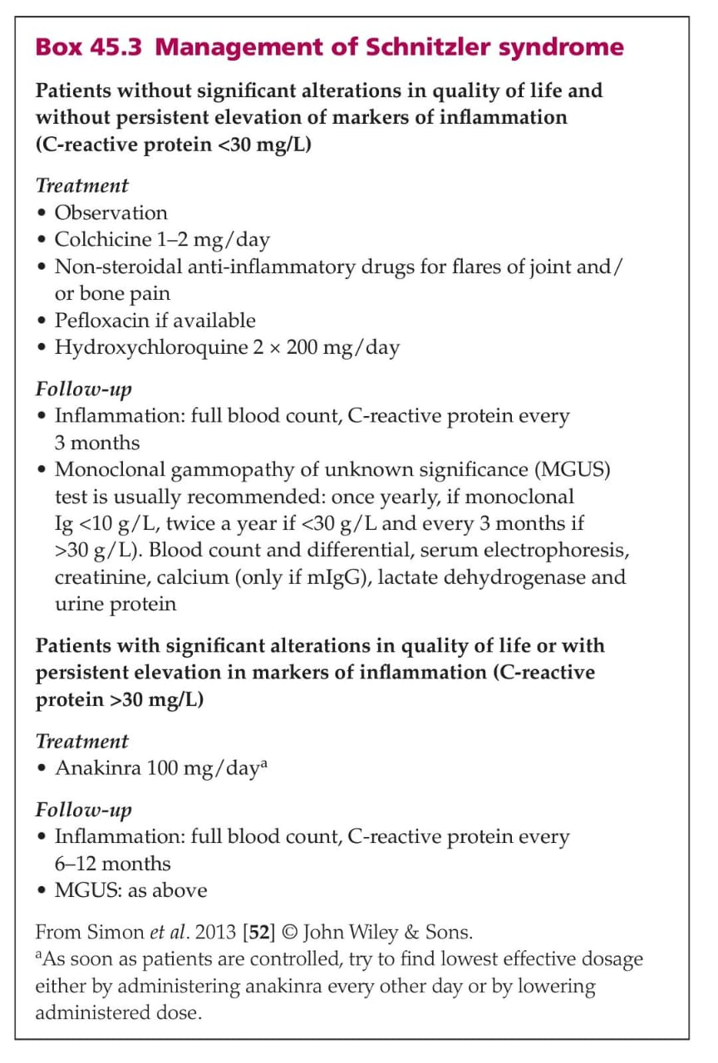

Slide 158
Adult-onset Still disease
Synonyms
Wissler–Fanconi syndrome
Adult-onset Still disease (AOSD) is rare.
It occurs in young to middle-aged adults with 75% of cases presenting before the age of 50years.
Present with intermittent episodes of high fever (>39∘C) for at least a week.
severe pharyngitis, lymphadenopathy, arthralgias and a salmon-coloured maculopapular exanthem, which typically appears with the onset of fever in the evenings and decreases in the morning.
Arthritis is generally less prominent in AOSD than in systemic onset juvenile idiopathic arthritis (SoJIA).

Slide 159
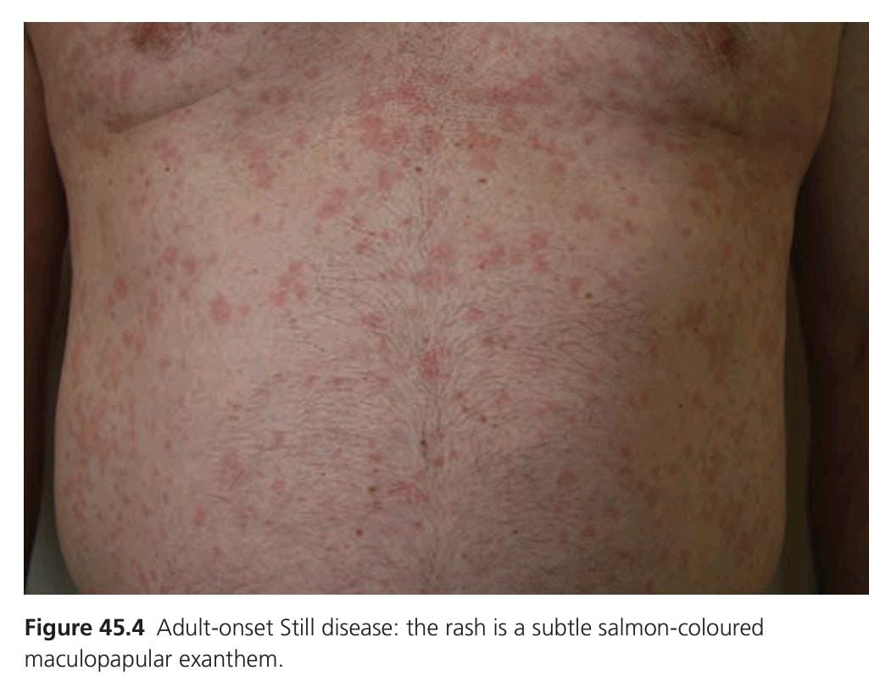

Slide 160
Two phenotypes in adults
The classical systemic febrile form, a more indolent variant has been described in which arthritis predominates.
A variant in which more persistent pruritic papules and plaques develop on the trunk, neck, face or extensor limbs has also been described. Such persistent lesions, qualified or atypical , have been associated with a worse prognosis

Slide 161
Persistent eyelid oedema sometimes mimicking dermatomyositis and flagellate lesions are other rare manifestations.
Histopathological changes of lesions are characterised by an interstitial and perivascular neutrophil-dominant mixed infiltrate or a mild lymphocytic infiltrate, possibly depending on timing of biopsy.
In the case of persistent lesions, epidermal involvement is frequent (acanthosis, spongiosis and superficial necrotic keratinocytes).
A neutrophil leukocytosis is present during the attacks

Slide 162
Very high serum ferritin levels (approximately 1000μg/L) help to distinguish this rare entity from other complex autoinflammatory syndromes, urticarial vasculitis and infectious disease.
Treatment relies on corticosteroids, methotrexate and IL-1 and IL-6 antagonists.

Slide 163
Systemic-onset juvenile idiopathic arthritis
Synonyms
Still disease
Systemic-onset juvenile idiopathic arthritis (SoJIA) occurs in children.
The presentation is similar to AOSD with spiking fevers and a maculopapular rash, but the occurrence of arthritis is a mandatory diagnostic criterion.
The lack of autoantibodies or HLA associations suggests that SoJIA is a polygenic autoinflammatory disease rather than an autoimmune disorder.
A monogenic autosomic recessive form of SoJIA with an underlying mutation in LACC1 has been described . Its protein product regulates metabolism within macrophages

Slide 164
Histopathology
Skin biopsy reveals a perivascular and interstitial dermal infiltrate of neutrophils and monocytes.
Clinical features
High spiking fever once or twice daily associated with equally evanescent salmon pink macules on the trunk and lower legs.
There may be a history of sore throat, arthralgia or serositis.

Slide 165
Laboratory investigations reveal neutrophilia, raised ferritin and abnormal liver function tests.
Oligo- or polyarthritis may antedate other symptoms.it is slowly progressive.
Macrophage activating syndrome and severe lung involvement with alveolar proteinosis and/or endogenous lipoid proteinaemia are serious complications.
In children, more persistent pruritic papules and plaques develop on the trunk, neck, face or extensor limbs. These may be urticated or violaceous .

Slide 166
Histologically, a dyskeratotic keratinocytes is seen in the stratum corneum.
Management
Methotrexate is mainstay of management of juvenile idiopathic arthritis, although blockade of IL-1 and IL-6 with drugs such as anakinra or tocilizumab is especially valuable.
Macrophage activation syndrome is a potentially fatal complication of Still disease.
Expansion of haemophagocytic macrophages and lymphocyte activation leads to a cytokine storm, which requires steroids, cyclosporine and specific anticytokine therapy such as IL-1 or IL-18 blockade and/or JAK inhibitors.

Slide 167
Synovitis, acne, pustulosis, hyperostosis and osteitis syndrome.
Synonyms
Synovitis, acne, pustulosis, hyperostosis and osteitis (SAPHO) syndrome.
Pustulopsoriatic hyperostotic spondylarthritis
Together with CRMO, it resembles monogenic syndromes such as Majeed syndrome but no genetic basis has been determined as yet.
Female children and young adults are predominantly affected.

Slide 168
Clinical features
Skin manifestations are commoner in adults than in children.
A neutrophilic palmoplantar pustulosis is the commonest dermatosis.
Acne conglobata, acne fulminans and hidradenitis suppurativa occur predominantly in men.
Pyoderma gangrenosum and Sweet syndrome are rare.
Associated IBD and systemic features such as fever in around 10% of patients.

Slide 169
Bone pain can be severe and recurrent, often worse at night.
The sternoclavicular joint is most affected, although it can involve other sites such as the thoracic spine and mandible.
Long bone involvement is commoner in children, whereas adults may develop synovitis at remote sites. There may be associated soft-tissue swelling and redness, raising the possibility of a suppurative osteomyelitis.
Radiological features show osteosclerosis with cortical thinning and a narrowed medullary canal with blurring and irregularity of the external surface.
Bone histology reveals a sterile inflammatory infiltrate.

Slide 170
Treatment of the musculoskeletal symptoms includes non-steroidal anti-inflammatory drugs, corticosteroids and bisphosphonates (intravenous pamidronate).
Several biological agents have been used to good effect, including anti-TNF and anti-IL-1 drugs and more recently ustekinumab (anti-IL-12/IL-23),
Anti-IL-17 and JAK inhibitors.

Slide 171
Yao syndrome
Synonyms
NOD2-associated autoinflammatory disease.
Recurrent fever, fatigue, rash, polyarthritis (hip, ankle, shoulder, wrist), sicca syndrome (without anti-SSA/SSB antibodies), serositis and abdominal pain or diarrhoea.
The skin findings are pruritic or non-pruritic macules, patches, papules or plaques on the face, trunk and extremities, and oedema of lower extremities.
Biopsy reveals a spongiotic dermatitis with a moderate perivascular lymphohistiocytic dermal infiltrate. Treatment relies on topical or low dose oral corticosteroids. Some variants in the NOD2 gene seem to confer susceptibility.

Slide 172
SUMMARY
How to differenciate auto inflammatory disorder
FMF- abdominal pain /erysipellas like swelling
TRAPS- long duration of flare
MVK -triggered by vaccination
FCAS -triggered by cold
MWS -sensorineural deafness
CINCA -continuois fever

Slide 173
SUMMARY
PAPA -Pathergy
CANDLE -lipoatrophy
DIRA- Pustules osteolytic bone leisons
BLAU SYNDROME -sarcoidosis like
Schnitzler -persistant urticarial rash
CINCA -dysmorphia aseptic menningitis
Deforming arthro pathy
TRAPS -periorbital swelling with chest and abdominal pain

Slide 174
MCQS

Slide 175
A 25 years old Male presented with focal swelling and erythema over lateral malleolus of left foot for 6 days , patient has same episode of swelling 2 months ago which subsided with bed rest,on systemic inquiry pt has history of recurrent fever, abdominal pain ,chest pain and arthritis. On the basis of above findings u made diagnosis of FMF, which of the following included in major criteria of tel hashomer criteria??
A) recurrent episodes of fever
B) recurrent episode of serositis or peritonitis
C) favourable response with colchicine
D) positive family history of FMF in 1st degree relatives
E) eryseplas like erythema

Slide 176
A 7 years old child presented with 12 days history of fever,diarrhea,chest pain, myalgia and skin lesion. On cutaneous examination erythematous patches over bicep region with local tenderness over muscle. She had similar attacks in past and positive family history of similar condition. biopsy shows perivesicular and interstitial mononuclear cell infiltrates. on the basis of above findings what will be treatment option?
A)Cyclosporine
B) high dose steroids
C) Colchicine
D) methotrexate
E) tetracycline

Slide 177
A 3 year child presented with fever and rash for 12 days. On cutaneous examination discrete skin colored papules arranged in linear array ,some of them confluent and showing pitted scars ,on further examination his joints are swollen and tender.skin biopsy showing non castrating granuloma with poor lymphocytes infiltrate. Which of the following is indicator of above disease?
A) It if autosomal recessive multi system disorder
B)mutation of CARD15 indicates loss of function leading to increased basal NFKB
C)uveitis develops in 80% of cases
D) disease is usually present in adulthood
E) Colchicine is main drug and should be indicated

Slide 178
54 years old female presented with recurrent episodes of fever,arthralgia myalgia and urticaiated and non pruritus rash. On systemic examination 2 axillary lymph nones palpable and palpable liver and spleen.labs shows hb-10.2, TLC 15000/cmm ESR 32mm/h CRP 38 mg
What will be treatment option of above condition?
A) obsevation
B) colchicine
C) pefloxcine
D)Anakinra
E)hydroxycloroquine

Slide 179
KEY
C
B
C
D

Slide 180


