Slide 1
Dna repair disorders with cutaneous features
PRESENTER : DR . AQSA
DERMATOLOGY RESIDENT (FCPS)

Slide 2
DISEASES WITH DNA REPAIR DEFECTS
Xeroderma Pigmentosum
Cockanye syndrome
Trichothiodystrophy syndrome
Ataxia Telangiectasia (LOUIS-BAR SYNDROME )
Fanconi Anemia

Slide 3
Causes of dna damage
ENDOGENOUS FACTORS ( CELLULAR METAOLIC PROCESSES )
Mismatch DNA base
Hydrolysis
Oxidation
Alkylation
EXOGENOUS FACTORS (ENVIROMENTAL )
Ultraviolet Radiations
Ionizing Radiations
Chemical Agents

Slide 4
Dna repair system
Mismatch repair system
Base excision repair system
Nucleotide excision repair system
Double –strand break repair system

Slide 5
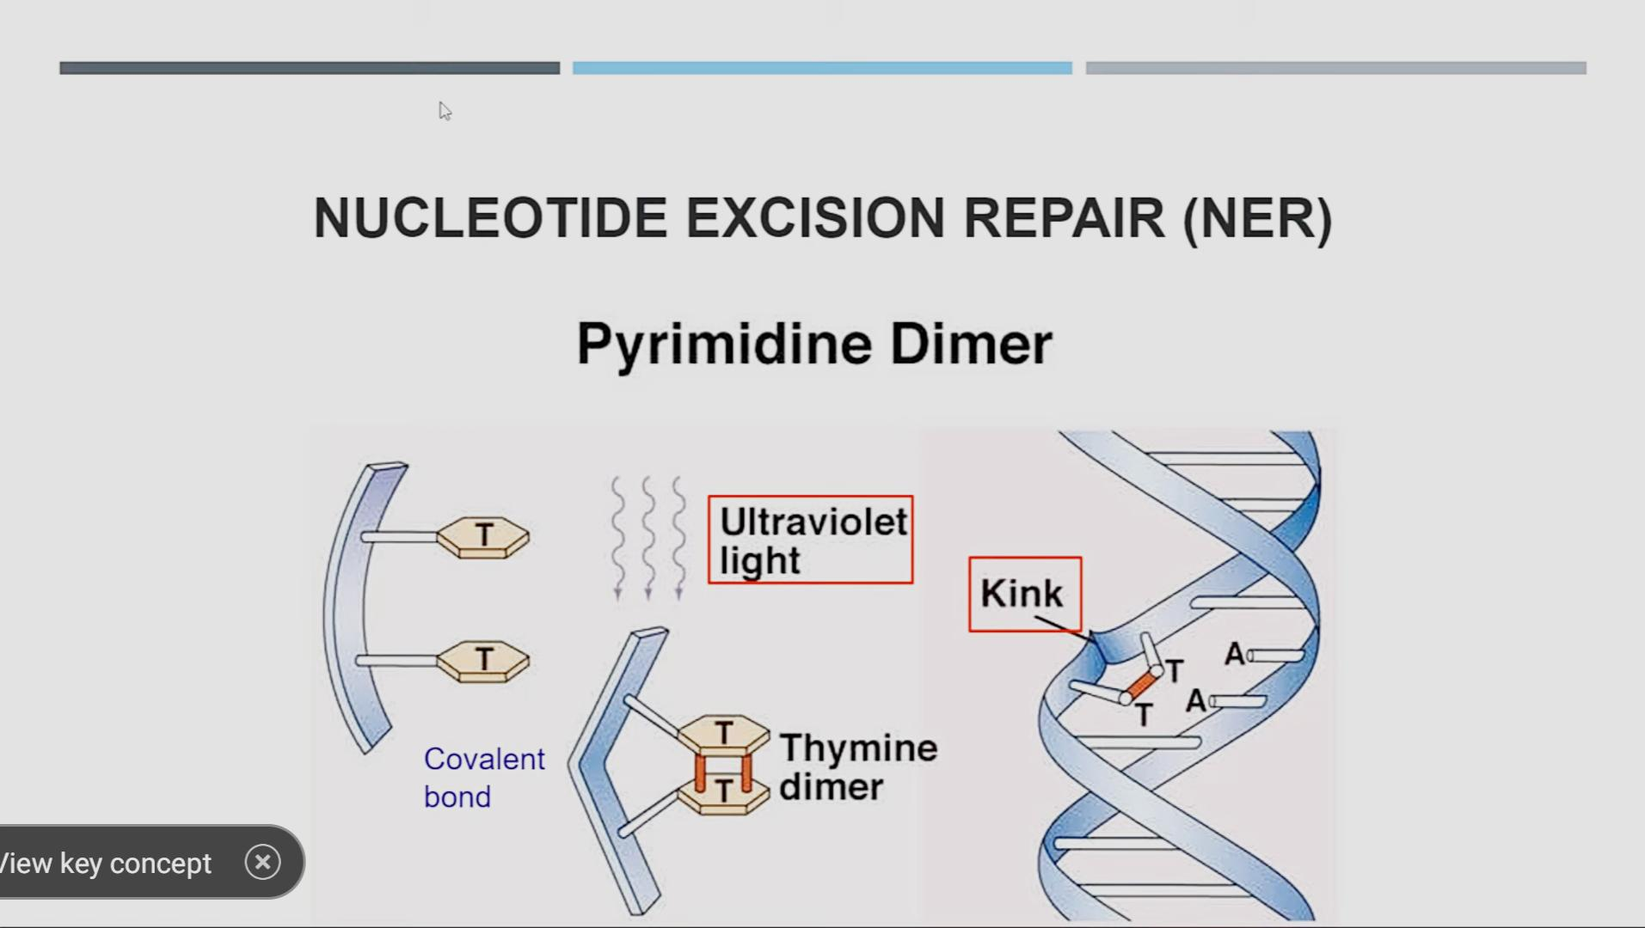
Nucleotide excision repair system

Slide 6
Genes in ner system
There are two pathways in NER
Global genomic pathway
Transcribed –coupled pathway

Slide 7
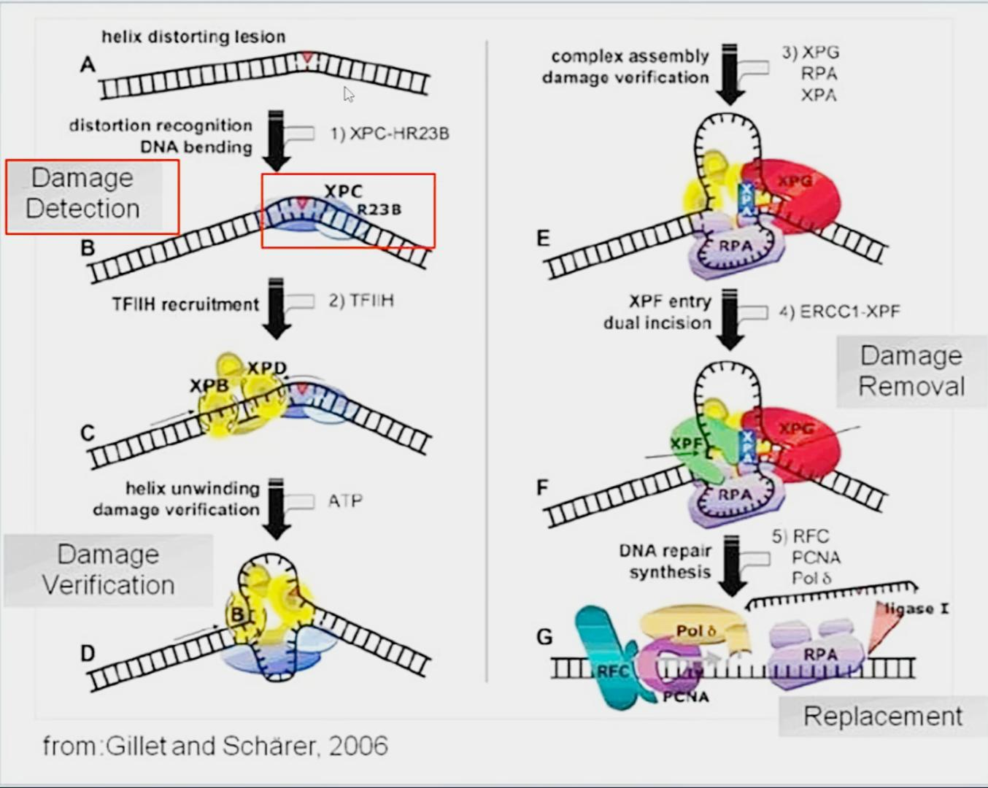
Nucleotide excision repair system
(GLOBAL ENPMIC PATHWAY)

Slide 8
Important genes
XPC and XPE(DDB2) : damage recognition (global genomic pathway )
CSA(ERCC6) and CSB(ERCC8) : damage recognition (transcribed coupled pathway )
XPB(ERCC3) and XPD(ERCC2) : confirms the damage and apart two strands of DNA .
XPA : damage verification
XPF(ERCC4) and XPG(ERCC5) : remove damaged part from DNA strand
XPV(POLH) : replication of new DNA

Slide 9
Defects in DNA repair pathways results in a number of disorders , many with skin involvement , commonly photosensitivity , skin cancers and premature ageing

Slide 10
Xeroderma pigmentosum
Definition : It is a rare autosomal recessive disorders of DNA repair.
Characterized by progressive pigmentory changes at exposed sites , an increased risk of UVR- induced skin and mucous membrane cancers .
Severe photosensitivity in about 50% .
And neuro-degeneration in approximately 30%.
It is divided into 8 complementation groups XP-A to XP- and XP-V (variant)

Slide 11
Epidemiology
Recent survey in western Europe suggests an incidence of approximately 2.3per million live birth
The incidence of xeroderma pigmentosum in japan is significantly higher then western countries , with the majority belonging to the XP-A complementation group
The prevalence is higher in north Africa and middle east , especially in communities in which consanguinity is common
85% of XP families in the maghreb region (Algeria , Tunisia and morocco ) carried a founder mutation in XP-C gene

Slide 12
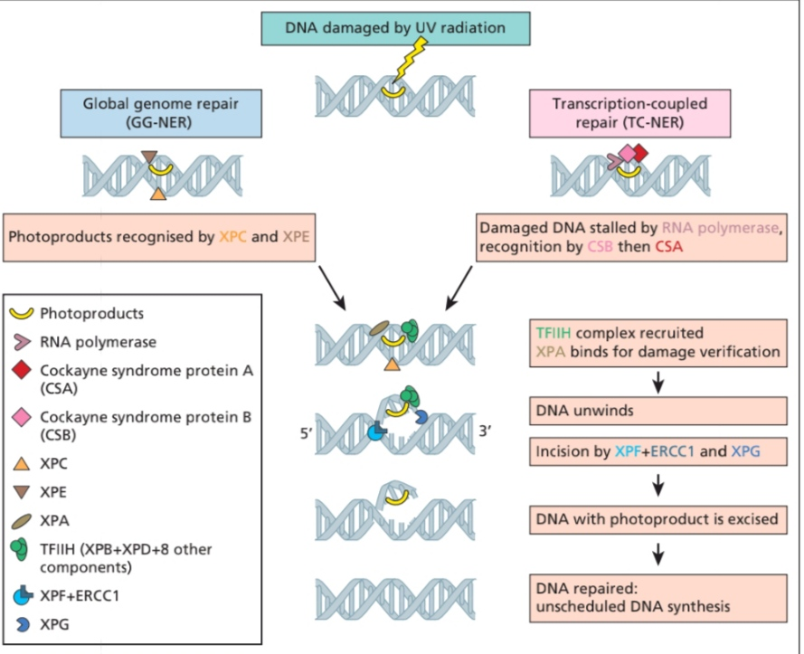
PATHOPHYSIOLOY

Slide 13
Clinical features
The clinical manifestations , severity of disease and age of onset are in part dependent on the cumulative UVR exposure , the complementation groups and the precise nature of the pathogenic mutations .

Slide 14
Exaggerated sunburn and pigmentory changes :
Acute and severe sunburn on minimal sun exposure.
Which takes weeks to resolve.
Only 50% with XP , presents with severe and prolonged sunburn reactions.
Remaining 50 present with lentigines and hypopigmented macules at sun exposed sites , initially on face and dorsum of hands .
Patients with complementation groups XP-A , XP- B, XP-D , XP-F and XP-G suffer from severe sunburn reaction.
Where as those in groups XP-C,XP-E and XP-V have normal sunburn reactions for skin type .

Slide 15
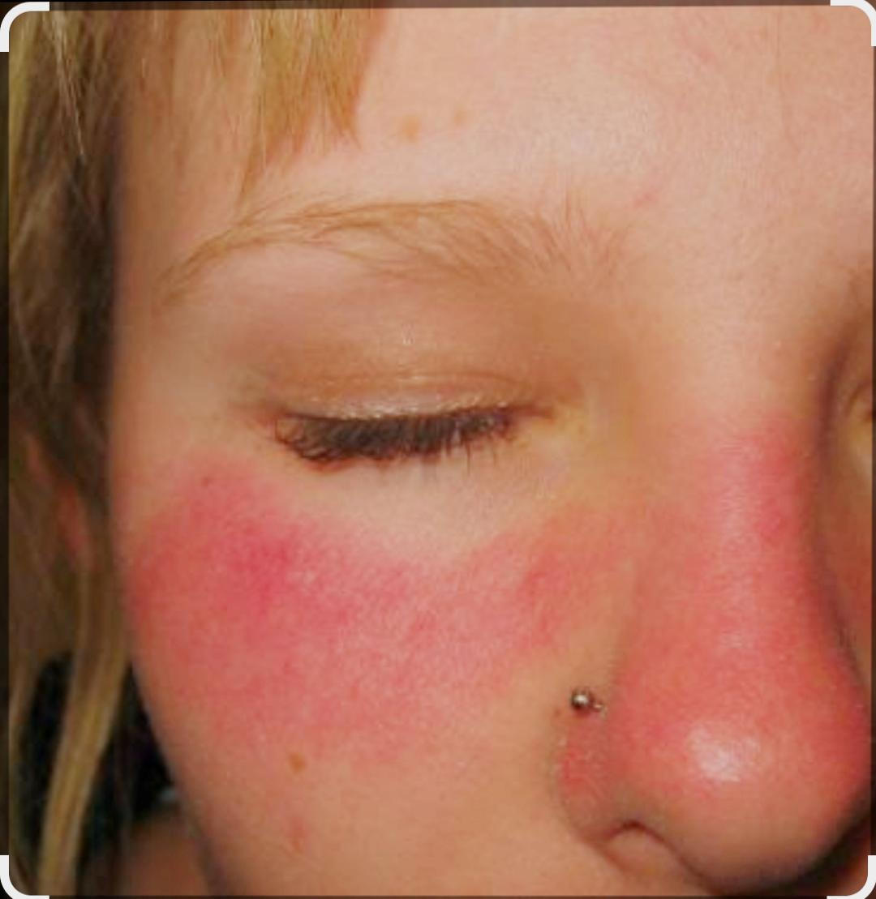
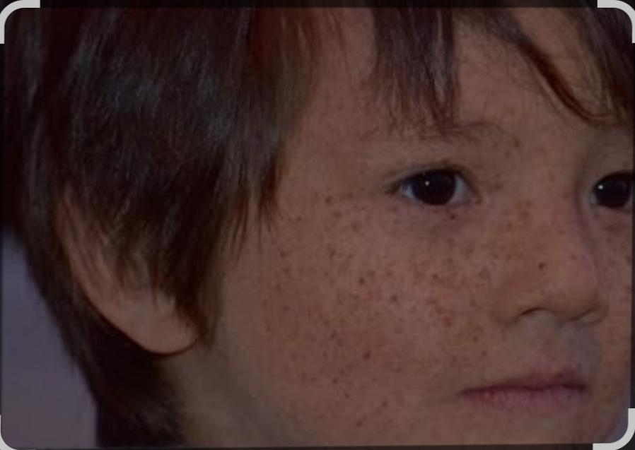

Slide 16
SKIN CANCERS
The molecular defects in XP cells result in abnormal recognition and repair of UVR – induced DNA damage and subsequently increased induction of UVB signature mutations in the sun exposed skin of affected individuals .
This increased mutation frequency is likely to account for the pigmentory changes and the skin cancers in XP patients
OTHER MALINANCIES : patients with XP are potentially at higher risk of smoking –induced lung cancers , because DNA damage caused by carcinogens in cigarette smoke (benzopyrene ) is repaired by NER system .
Patients with XP have 50 fold increase in cancers of brain , including medulloblastoma , glioblastoma , spinal cord astrocytoma , and schwannoma

Slide 17
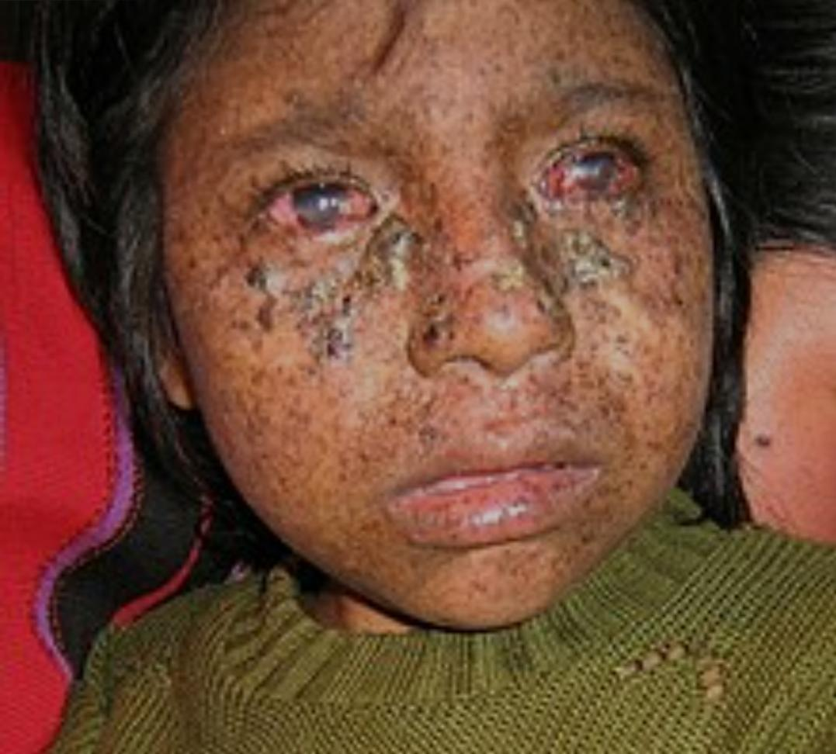

Slide 18
OCCULAR MANIFESTATIONS :
Affects eyelids , periocular skin .
The ocular surface (conjunctiva and cornea ) can be involved , resulting in dryness , conjunctival injection and inflammation.
As well as development of premature pinguecula and pterygia.
Prolonged corneal exposure can lead to corneal scarring and visual impairment
Photophobia is also common and often earliest presenting symptom .

Slide 19
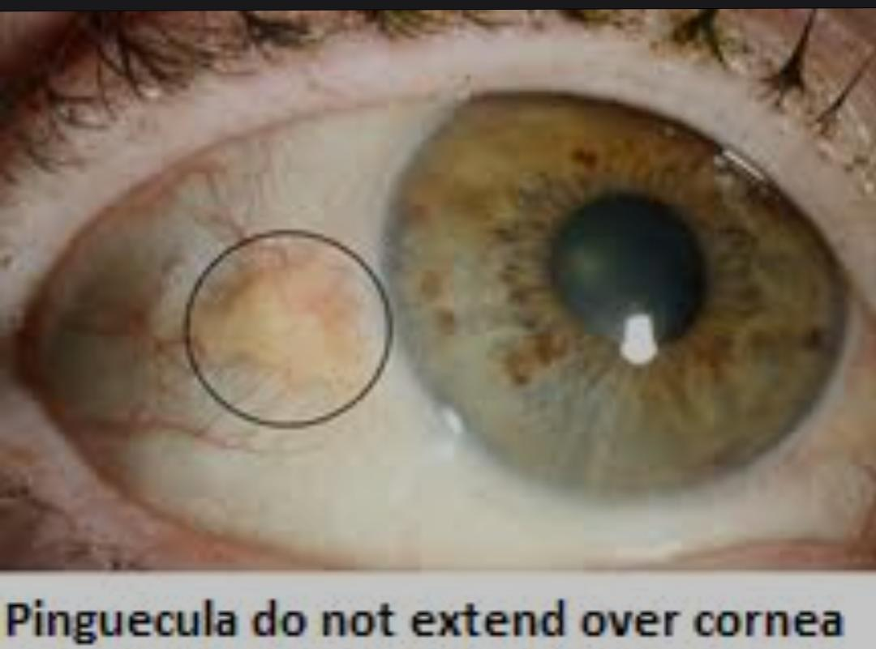
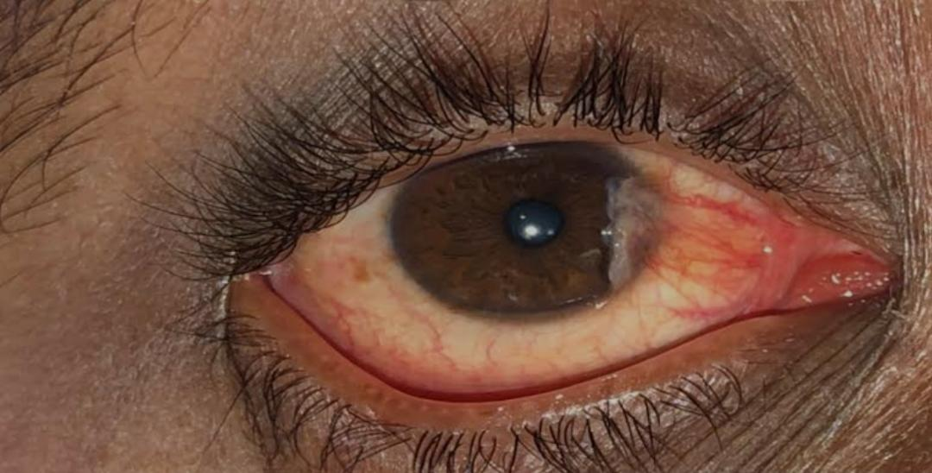

Slide 20
NEURO-DEGENRATION
Approximately 30% patients with XP will develop neurodegeneration .
XP-D,XP- F and XP-G have an increased susceptibility whereas ,
XP-C,XP-E and XP-V patients have not been reported to develop neurodegeneration
Typically present before age of 2 years , first symptom observed by parents is mild cognitive impairment , usually when child starting school
Cerebellar signs ( commonly dysarthria and difficulties in balance followed by ataxia and areflexia ) manifests usually between 4 to 16 years of life .
Progressive microcephaly , sensorineural deafness may also develop .
Eventually become wheel-chaired and bedbound , years before death
Nerve conduction study : motor and sensory neuropathy
MRI : atrophy of brain with dilatation of ventricles and secondary thickness of skull bones

Slide 22
Clinical variants
XERODERMA PIMENTOSUM VARIANT : 20% patients have XP-V
Often diagnosed after the ae of 30, once patient has developed multiple skin cancers ..
XERODERMA PIGMENTOSUM/COCKAYNE SYNDROME COMPLEX : rare autosomal recessive disorders .
Characterized by cutaneous features of XP together with systemic and neurological features of cockayne syndrome .
XERODERMA PIGMENTOSUM /TRICHOTHIODYSTROPHY: phenotypic features of TTD with clinical and cellular findgins of XP.

Slide 23
Investigations
In most cases, a clinical diagnosis can be made .
The diagnosis can be confirmed by cellular tests for defective DNA repair .
Most commonly used test is measurement of unscheduled DNA synthesis in cultured skin fibroblast . (established by a 4mm punch biopsy taken from an unexposed area of skin )
Fibroblasts are UV irradiated in a petri dish , and UDS can be measured by either autoradiography or liquid scintillation counting or more recently using fluorescence assay.
A reduced levels of UDS confirms the diagnosis .

Slide 24
Investigations
XP-V patients do not show defects in UDS as NER is unaffected.
However , it is has seen empirically that caffeine specifically sensitizes XP-V cells to killing by UVR.
To diagnose XP-V cells, cultures are exposed to UVR, incubated in caffeine for few days and their viability is seen.

Slide 25
Management
The mainstay of management is the avoidance of UVR exposure from sunlight via application of high factor sunscreen , UVR- protecting clothing , hats, gloves and sunglasses and UVR- locking windows /films at homes and cars .
Vitamin D supplements , as it’s deficiency is common .
Smoking is prohibited .
Topical 5-fluorouracil and imiquimod (chemotherapy agents ) useful in early and premalignant lesions .
Retinoids may have role in prevention of skin cancers .
Mohs micrographic surgery may e considered for facial lesions .

Slide 26
Disease course and prognosis
There is no cure for XP.
Median age of death is 32 years .
Skin cancers and neuro-degeneration are main causes of death .
Sun avoidance and regular follow-up to asses and treat any skin cancer increases life expectancy .

Slide 27
Differential diagnosis
Cockanye syndrome
Trichothiodystrophy
Cerebro-oculo-facio-skeletal syndrome
UV-sensitive syndrome

Slide 28
Cockayne syndrome
DEFINITION : rare autosomal recessive disorder of DNA repair.
Characterized by short stature , postnatal growth failure ,photosensitivity , a distinctive facial appearance , ocular defects, premature aging and progressive neurological dysfunction associated with extensive demyelination .
Divided into two three clinical types : depending on clinical severity .
Type 1 : symptoms usually appear during first year of life .
Type 2 : early onset cases with severe symptoms .
Type 3 : late onset cases with milder symptoms

Slide 29
PATHOPHYSIOLOY
Results from mutations in one of two genes , ERCC8(CSA) and ERCC6(CSB).
CSA 20% , CSB 80% .
These involved in transcribed – coupled sub pathway of NER .

Slide 30
Clinical features
Cutaneous photosensitivity
Skin is dry and thin .
Hair is often sparse and is sometimes prematurely grey.
No incidence of skin cancer .
Characteristic bird-like facies ( prognathism , enophthalmia, a prominent thin nose , large ears and loss subcutaneous fat)
Progressive postnatal growth failure, short stature , microcephaly , cognitive decline , choreoathetosis , hydrocephalus and spasticity .

Slide 31
Clinical features
Sensorineural deafness and skeletal abnormalities with flexion deformity
Ophthalmological problems ( retinal degeneration , cataracts and optic atrophy leading to vision loss )
Failure to thrive and growth difficulties are among the most consistent features

Slide 32
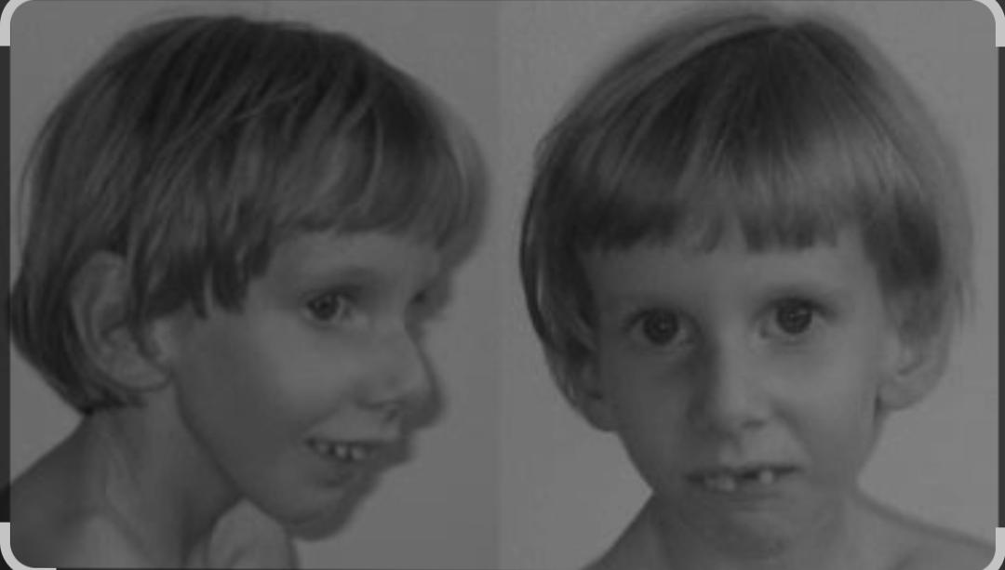

Slide 33
Clinical variants
CEREBRO-OCULO-FCIO-SKELETAL SYNROME (COFS)
Rare recessive disorder of DNA repair .
Constitutes the prenatal extreme form of CS .
Mutations : ERCC6 ( CSB) , ERCC2( XPD ) , ERCC5 ( XPG), ERCC1 and are designated as COSF1 ,COSF 2, COSF 3 And COSF4 respectively.
Characterized by congenital microcephaly, congenital cataract , microphthalmia, arthrogryposis , severe developmental delay , growth delay and facial dysmorphism , peripheral neuropathy, sensorineural deafness and pigmentory retinopathy can be observed.
Photosensitivity is an inconstant feature .
Prenatal diagnosis is suspected by presence of cataracts , arthrogryposis and microcephaly in anomaly scan
And confirmed by examination of DNA repair in the chorionic villi or amniotic cells .

Slide 34
Clinical variants
UV-SENSITIVE SYNDROME: rare autosomal recessive disorder.
Mutations : ERCC6 and ERCC8 which are designated as UVSS1 and UVSS2 respectively .
More recently UVSSA which is designated as UVSS3 have een reported in some cases .
Characterized by sensitivity to UVR but without any increased risk of skin cancers or evidence of neurological disease .

Slide 35
investigations
Diagnosis is made by presence of clinical features .
can be confirmed by cellular tests for defective DNA repair , specifically TC-NER for which skin biopsy is taken .
Deficient TC-NER results in a prolonged inhibition of RNA synthesis.
Therefore CS cells after UV irradiation results in reduced levels of RNA synthesis .
Brain imaging : can reveal cerebral and cerebellar atrophy , diffuse myelination anomalies and calcification of basal ganglia
Prenatal diagnosis can be made by amniocentesis and chorionic villus samples .

Slide 36
Management
Management is purely supportive and requires multidisciplinary approach .
Such as clinical genetics , ophthalmology, neurology , dermatology and physiotherapy input is involved in management of CS .
Avoid UVR to prevent photosensitivity
Vit. D supplements given
And appropriate genetic counselling should be given

Slide 37
Disease course and prognosis
There is no cure of CS
Type 1 commonly die before the end of second decade
Type 2 have worse prognosis
Type 3 often sursive into adulthood
Median age at death is 12.5 years

Slide 38
Differential diagnosis
Progeria
Xeroderma pigmentosum
COSF SYNDROME
UVSS

Slide 39
trichothiodystrophy
DEFINITION : rare autosomal recessive disorder of DNA repair .
Multisystem disorder.
Characterized by short , brittle , Sulphur deficient hair with pattern of alternating light and dark tiger bands under polarized light microscopy , along with photosensitivity , ichthyosis , developmental delay and short stature .
Others includes hematological abnormalities , skeletal abnormalities and maternal pregnancy complications .

Slide 40
Pathophysiology
TTD is divided into two subunits ( photosensitivity and non photosensitivity) with different genetic mutations
Mutations of photosensitive TTD : ERCC2 (XPD), ERCC3 (XPB) , GTF2H5
These genes are subunits of the TFIIH complex in the NER pathway .
Mutations in these subunits can affect DNA repair and transcription .
And mutations in MPLKIP (TTDN1) have been found in some cases of non photosensitive TTD.

Slide 41
Clinical features
CUTANEOUS FEATURES :
Short , brittle , Sulphur deficient hair with a pattern of alternating light and dark bands under polarized light microscopy .
Photosensitivity in 50% patients with severe and exeerated sun burn reactions.
Ichthyosis , dry skin and collodion membrane at birth.
Nails may be brittle and onychodystrophy.

Slide 42
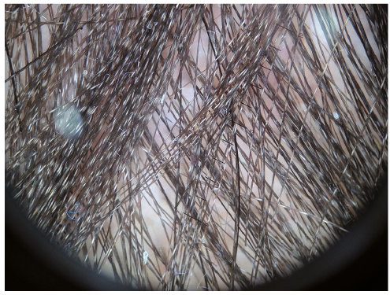
Dark and light bands of hair shaft under polarized light
This Photo by Unknown Author is licensed under CC BY-NC

Slide 43
Clinical features
OTHER COMMON FEATURES :
Developmental and intellectual delay (85% cases )
Short stature (73% )
Facial dysmorphism ( microcephaly , large ears and microganthia )
Ocular abnormalities in 50% of cases (congenital cataracts , nystagmus and strabismus )
Joint abnormalities with contractures and dislocations
Skeletal abnormalities ( axial osteosclerosis , distal osteopenia )
Hematological abnormalities : anemia , neutropenia , leading to severe and recurrent infections in first year of life .

Slide 44
Clinical features
PRENANCY COMPLICATIONS :
Occurs in 30% of cases.
Intrauterine growth retardation
Pre-eclampsia and eclampsia
Low birth weight and premature birth (before 37 weeks of gestation )

Slide 45
Investigations
Diagnosis is made by clinical features
The diagnosis is confirmed by cellular tests ( reduced levels of UDS )

Slide 46
Management
Management requires multidisciplinary approach
Infections should be treated aggressively as mortality from infections is significant
Sun protection is advised .
Genetic counselling should be given to parents

Slide 47
Disease course and prognosis
No cure of TTD
Median ae of death reported is 3 years with pneumonia and other infections being the main cause of death .

Slide 48
Ataxia telangiectasia (louis-bar syndrome )
Rare autosomal recessive disorder of DNA repair
Multisystem disorder characterized by ataxia and mucocutaneous telangiectasia.
Gene mutation : ATM gene is involved , ATM protein kinase plays a key role in the control of double strand break DNA repair

Slide 49
Clinical features
First clinical manifestation is progressive cerebellar degeneration , starting at first year of life .
Initially telangiectasia appears in conjunctiva .
Premature greying of hairs
Café-au lait spots
Pigmentary changes , including poikiloderma
Others : immunodeficiency with increased susceptibility , hypogonadism , insulin resistance , predisposition to cancer

Slide 50
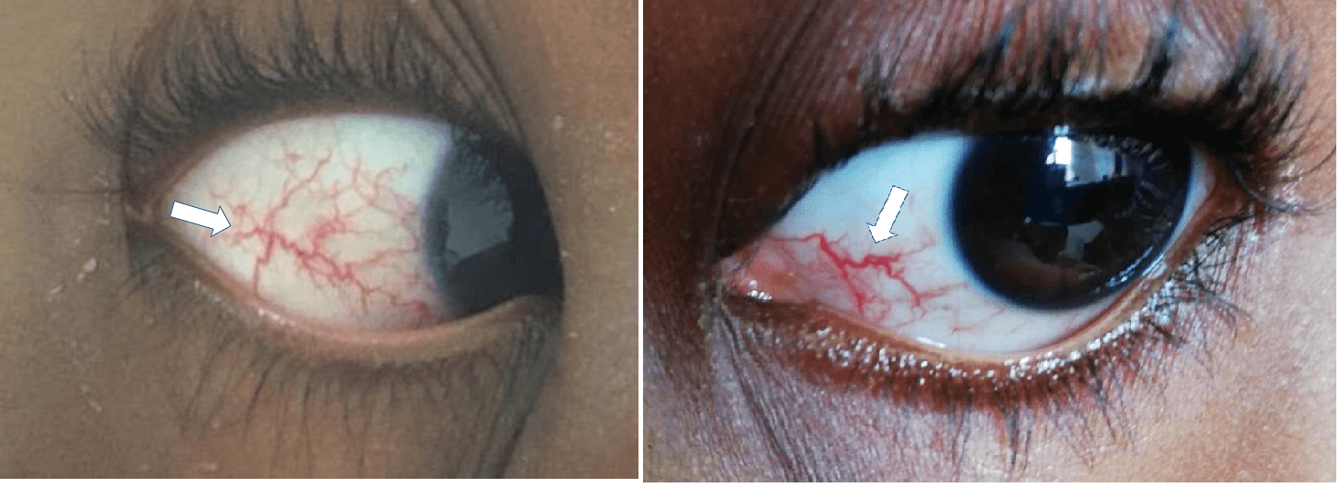
Conjunctival telangiectasia
This Photo by Unknown Author is licensed under CC BY-SA-NC

Slide 51
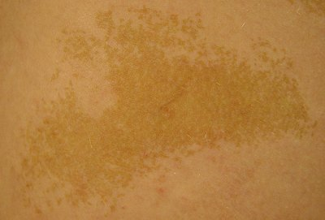
Cafe –au-lait spot
This Photo by Unknown Author is licensed under CC BY-SA

Slide 52
Management
Management is symptomatic
Involves multidisciplinary approach
Early treatment of infections
Prognosis is poor because of severe respiratory infections , progressive neuro-degeneration and increased risk of cancers

Slide 53
Fanconi anemia
Autosomal recessive disorder .
Is clinically heterogenous
Mutations : Mutations in FA genes, such as FANCA, FANCC, FANCD2, and others, lead to impaired DNA repair mechanisms.
Two –thirds of patients are born with congenital malformations of the kidneys , heart and skeletal ( absent or abnormal thumbs and radii)

Slide 54
Clinically features
Cutaneous abnormalities : reticulate or patchy hyper or hypopigmentation and café au lait spots .
Viral warts
Typical facial appearance : small head , eyes and mouth
Hearing loss
Hypogonadism and infertility
Bone marrow failure , usually presents in first year of life
Tumors : lymphomas , esophageal cancer , basal cell and squamous cell carcino mas of head and neck , liver and brain tumors

Slide 55
Management
Management is supportive
Hematopoietic stem cell transplant is curative for hematological manifestations

Slide 56
Muir – torre syndrome
It is rare autosomal dominant disorder of DNA repair .
Characterized y the occurnce of sebaceous gland neoplasms and keratoacanthomas .
Associated with one or more visceral malignancies , in particular gastrointestinal and genitourinary
Result from mutations in mismatch repair genes (MSH-2 , MLH-1 and MH-6 )

Slide 57


