Slide 1


Slide 2
Genetic Disorder Of Pigmentation
DR ABDUL QAYOOM
Resident Dermatologist

Slide 3
Basic Concepts
Melanocytes: Pigment producing cells which derived from neural crest ectoderm during embryonic development. Melanocytes migrate to skin, hair follicle inner ear,eye
Primary fuction is to synthesize and transfer melanin to adjacent Keratinocytes.
Melanosomes: specialized organelles, produce by melanocytes, in which melanin pigment is synthesized and stored.

Slide 4
MELANIN
Primary pigment,determines the color of skin,hair,and eyes
Tyrosine – tyrosinase –melanin- this occurs in the melanosomes of melanocyte.
Then the melanosomes are transferred from the melanocyte to a group of keratinocytes called the epidermal melanin unit.
Variations in skin color is related to the number of melanosomes, and the degree of melanization.
Melanin has protective role against UV rays and the development of ocular strctures and pathways.

Slide 5
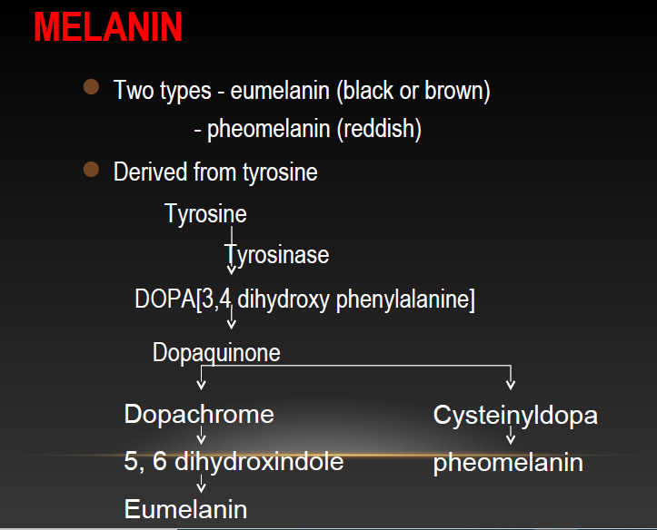

Slide 6
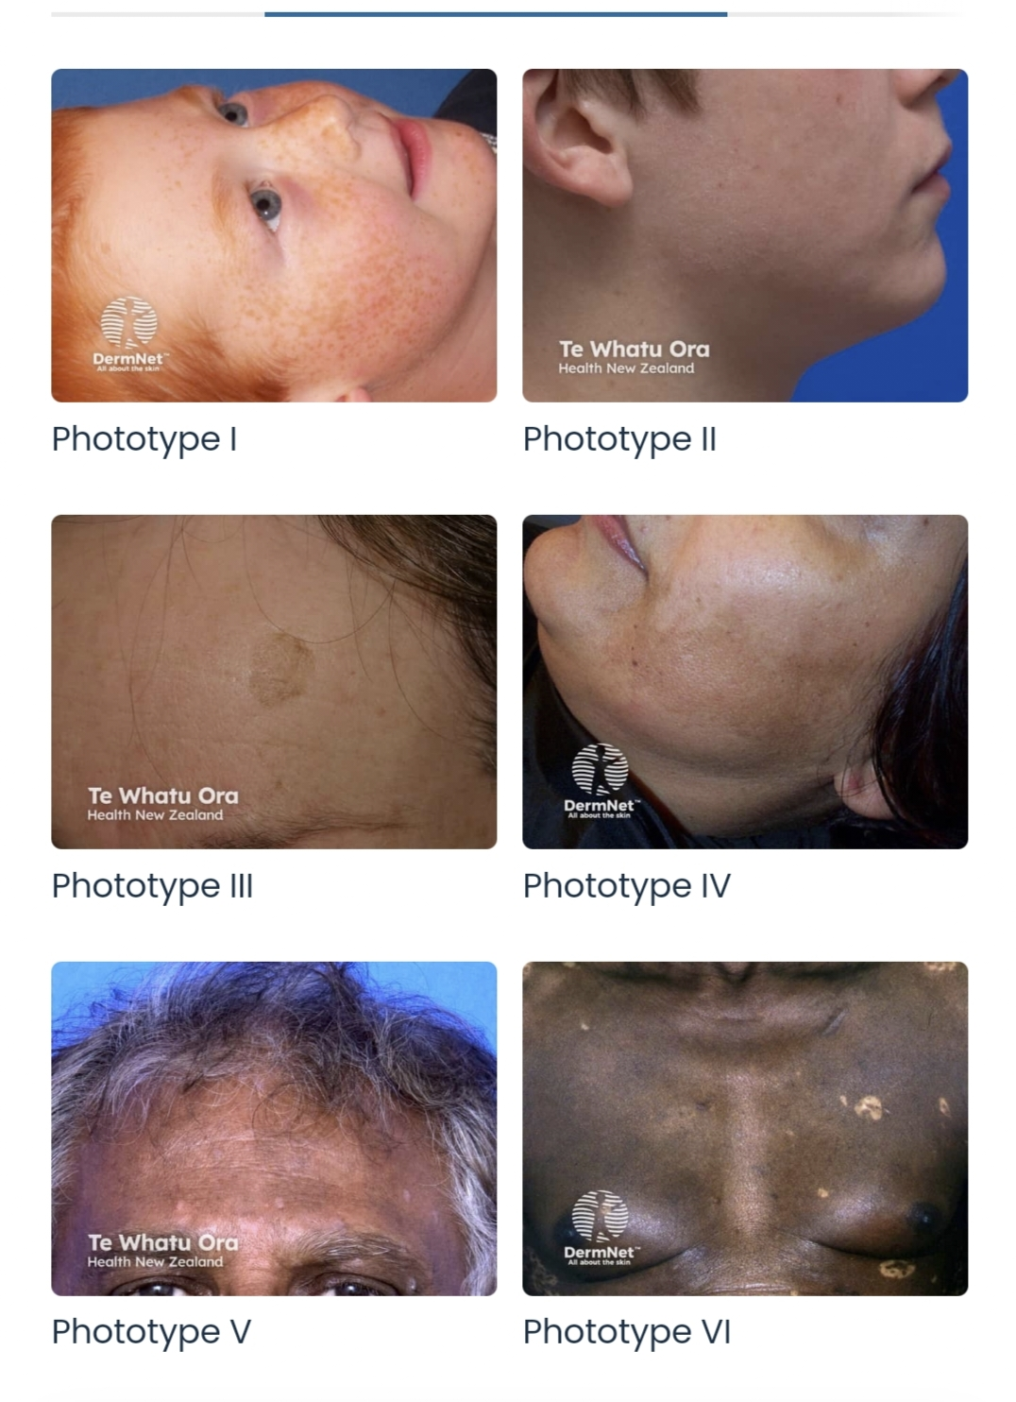
Skin colour variation
Constitutive pigmentation
Refer to amount of melanin pigmentation that is genetically determined.
Facultative pigmentation
Inducible pigmentation result from sun exposure or other influences includings drugs.

Slide 7
Classification of genetic disorder of pigmentation
Classified into three groups
1 Disorders of Hypopigmentation
2 Disorders of Hyperpigmentation
3 Dyschromatosis

Slide 8
Disorders of Hypopigmentation
Piebaldism
Is a rare autosomal dominant trait characterized by well-demarcated irregular hypopigmented macules.
Epidemiology
The incidence of Piebaldism is estimated at fewer than 1 in 20000.
Both sex are equally affected.
No population is spared.

Slide 9
Pathophysiology
Mutation in KIT gene encoding c-KIT, a membranal tyrosine kinase receptor.
Mutation in KIT result in impaired migration of melanocytes to the skin.
Piebaldism can also be caused by mutation in SNAI2.

Slide 10
Clinical Features
White forlock with V-shaped area of leukoderma (typical feature).
Hypopigmented lesions particularly on upper chest, abdomen, and mid portion of limbs and rarely on chin.
The hands, feet and back remain normally pigmented.
Small spots of hyperpigmentation within hypopigmented lesions.
Isolated poliosis and hypopigmentation can suggest number of conditions that affecting pigmentation (Alopecia, vitiligo, Tuberus sclerosis, Waardenburg syndrom, naevus depigmentosus.

Slide 11
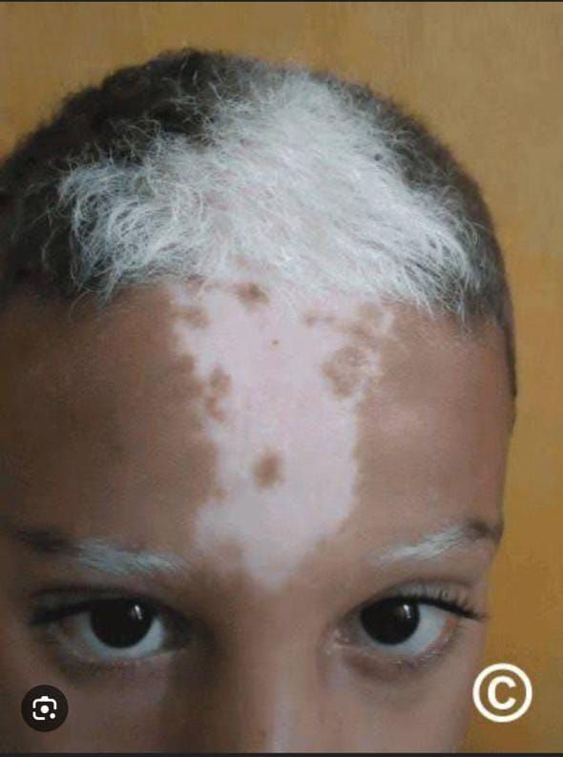
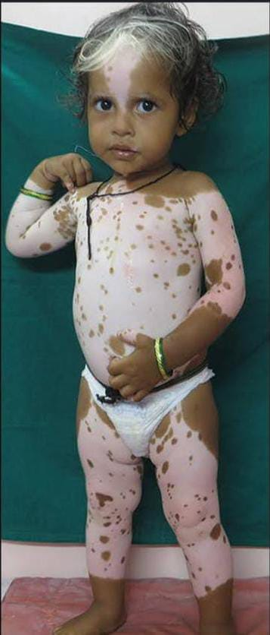

Slide 12
Extracutaneous Manifestations
The disease is usually not associated with extracutaneous manifestations, however mental retardation and deafness have been reported in the contest of large deletion.
Difference between Piebaldism and Vitiligo
Neonatal presence of white patches.
Hyperpigmented patches.
Lesions remain stable throughout life.

Slide 13
Investigations
Disease will be suspected clinically at birth or soon after birth.
Genetic testing will confirm the diagnosis.
Treatment
Sun protection is recommended to protect the amelanotic areas from burning.
Epidermal cell or skin grafting have been successfully tried in piebaldism.

Slide 14
Waardenburg Syndrome
Introduction and general description
It is an autosomal dominant genetic disorder characterized by piebaldism and sensorineural deafness.
Molecular classification is used ( WS1-4 ) based on the mutant gene.
It is an autosomal dominant condition except for the recessive WS4 with an estimated incidence of 1 in 20000-40000.

Slide 15
Types of Waardenburg Syndrome
WS Type 1:- It is caused by mutation in the PAX3 gene.
Clinical Features:- it is characterized by following features
White forelock, alopecia, hypopigmented patches.
Dystopia canthorum.
Hetrochromia irides associated with deafness noted in one third to one half of cases.
Dysmorphic features including broad nasal root and synophrys.

Slide 16
WS Type 2 (Klein-WS) :- it is an autosomal dominant inherited trait caused by mutation in MITF gene and SNAI2 gene.
Clinical Features:- clinical signs are similar to those seen in WS Type 1 except for
Absence of facial dysmorphism, dystopia canthorum and high frequency of deafness and heterochromia.

Slide 17
WS Type 3:- mutation in PAX3 gene.
It is a rarer than other types.
Clinical Features:- same clinical manifestations as type 1 in association with musculoskeletal anomalies.
WS Type 4( Shah-WS):-
is inherited in a autosomal recessive fashion caused by mutation in 3 genes ( EDNRB, EDN3, SOX10).
Clinical Features:- White forelock and is accompanied by Hirschprung disease.

Slide 18
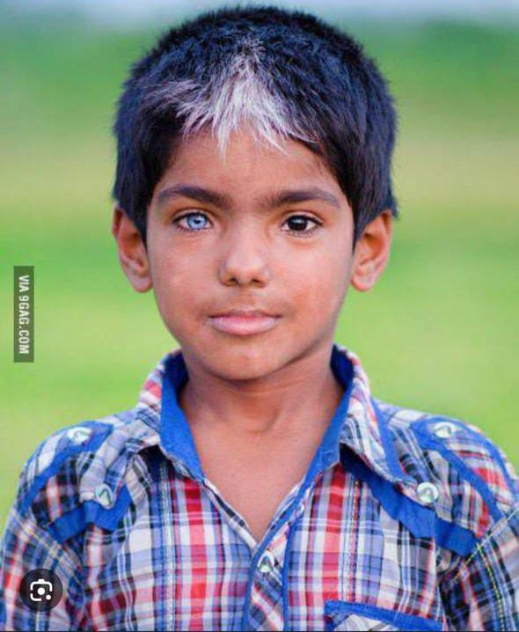
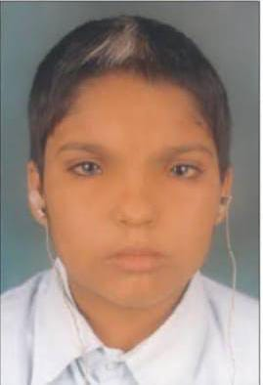

Slide 19
Management
Management of the hearing loss associated with WS1 depends on its severity.

Slide 20
Oculocutaneous Albinism
Definition:- OCA is a rare genetic disorder characterized by generalized depigmentation of the skin, hair and eye, and by ophthalmolgical anomalies caused by deficiency in melanin biosynthesis.
Epidemiology
Most frequent form of diffuse hypopigmentation world wide with prevalence 1/20000.
OCA1 most frequent form world wide.
OCA2 most frequent form in African.

Slide 21
Pathophysiology
Deficiency of melanin biosynthesis.
Melanocytes normally present and distributed.
Ophthamological anamolies associated with albinism is due to Melanin deficiency.

Slide 22
Molecular classification and genetics
A molecular classification is used (OCA1-7) on mutant genes.
OCA type 1 ...............Mutation in TYR(Tyrosinase -ve)
OCA type 2.................Mutation in OCA2
OCA type 3.................Mutation in TYRP1
OCA type 4..................Mutation in MATP
OCA type 5..................gene still remain to be identified.
OCA type 6..................Mutation SLC45A2
OCA type 7...................Mutation in LRMD5.

Slide 23
Clinical Featurea
Hypopigmentation of skin,hair,eyes but its degree varies with the type of albinism.
Ocular findings:
Photophobia is prominent.
Reduced visual acuity.
Refractive errors and color vision impairment.
Nystagmus.
strabismus.

Slide 24
Clinical variants
OCA Type 1:( Tyrosinase Negative)
Complete absence of pigmentation with white hair and pink skin.
No tendancy to tan.
Sever visual impairments(photophobia, sever nystagmus, refractive errors.
Other Types (Tyrosinase Positive)
Pigmentation is variable
Hair colour may range from white to blond to light brown.
pigmentation can increase with age.
Visual acuity improves with age and less sever nystagmus.

Slide 25
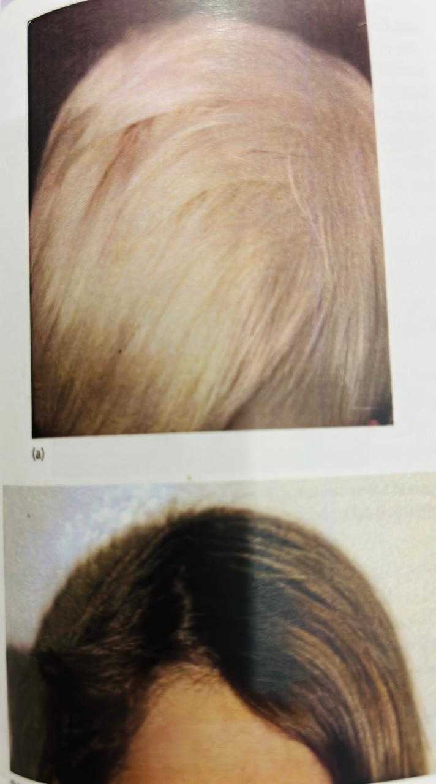
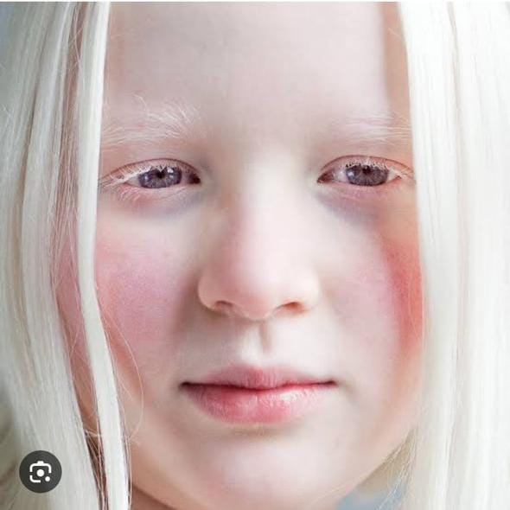

Slide 26
Differential Diagnosis
Differntial diagnosis to be considered in case of ocular and cutaneous hypopigmentation includes
Histidinaemia
Homocystinuria
Phenylketonuria
Hermansky-Pudlak syndrome
Chediak-Higashi syndromes
Cross syndrome

Slide 27
Complications
Squamous cell carcinoma
Melanoma (far less common)
Disease Course and Prognosis
Lifespan in patient with OCA is normal.
Skin cancer may occur and regular skin checkups should be offered.
Development, intelligence and fertility are normal.

Slide 28
Investigations
Diagnosis based on hypopigmentation of skin and hair and ophthalmologic manifestation
Opthalmological examination include,
Optic coherence tomography(OCT)
Electrophysiological testing.
Genetics study.
Management
Sun protection is mandatory to avoid skin burn and skin cancer.
Early referral to an ophthalmologist.

Slide 29
Harmansky-pudlak syndrome
Introduction and general description
Harmansky-pudlak syndrome is a rare type of OCA associated with a haemorrhagic diathesis. The disorder is rare except in Puerto Rico.
Pathophysiology
The disease results from abnormal biogenesis of lysosome- related organells with impaired melanosome maturation and absent dense bodies in thrombocytes.

Slide 30
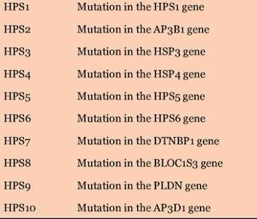
Genetics

Slide 31
Clincal Features and Complications
All subtypes of the syndrome share common clicnical features includings
Decrease pigmentation of eyes,hair and skin.
Easy bruisablity and bleeding tendency.
Pulmonary Fibrosis and colitis.

Slide 32
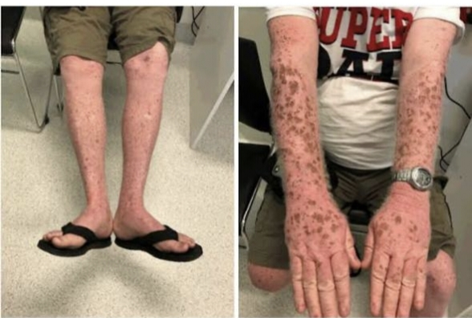

Slide 33
Investigation
The diagnosis may suspected on clinical grounds when child present with hypopigmentation with bleeding tendency.
Electrone mirocscopy of platelets shows absence of dense body.
PFTs and CT scan for pulmonary fibrosis.
Genetic studies to identify the gene.
Treatment
Sun protection.
Referral for specialist assessment.
Platelets transfusion before surgical procedures.
Genetic counselling.

Slide 34
Chediak-Higashi syndrome
Definition:
It is rare automosal recessive disorder characterized by hypoigmentation of skin and eye,
immunodefiiency and neurological symptoms.
Pathophysiology
The disesase is caused by mutation in LYST gene, encoding lysosomal traffing regulator protein.
The melanocytes contain giant pigment granules which arise by a autophagocytosis and defective fission of large melanosomes.

Slide 35
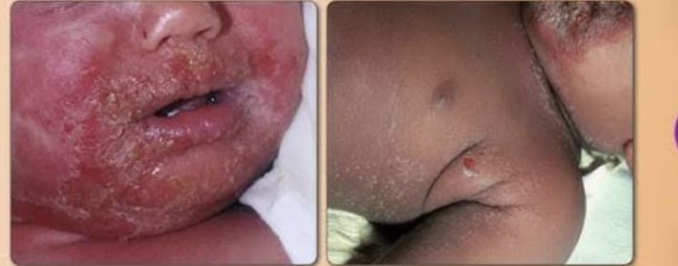
Clinical Features
Clinical criteria for OCA combined with significant history of pyogenic infection.
Neurological Manifestation Includes (Cranial nerve palsies, decreased deep tendon reflex, tremor and abonormal gait), can appear any time from child hood to early adulthood.
Complication:Haemophagocytic lymphohistiocytosis.

Slide 36
Investigation
Giant inclusions seen in leukocytes (first line diagnostic test).
Light mircroscopy of hairs shows pigment clumping.
Gentic testing for LYST gene.
Management
Only curative treatment is bone marrow transplantation.
A case of complete remission after a combination therapy with rituximab and ciclosporin has been reported.
Antibiotic to treat infection.

Slide 37
Griscelli-prunieras syndrome
Introduction and general description:
It is a rare autososmal recessive disorder that associates hypopigmentation, characterized by a silvery-grey hair and the occurence of either a primary neurological impairment or immnune disorder.
Pathophysiology
All genetics alteration associated with the syndrome is result in defective transport of melanosomes and consequently abnormal accumulation of melanosomes in melanocytes.

Slide 38
Classification and clicnical features.
There are three types of Griscelli-prunieras syndrome.
Type 1
Result from mutation in MYO5A,encoding myosin 5a.
It is associatedd with neurological dysfunction, Symptoms includes( paralysis, tremors, developmental delay).
Type 2
Mutation in the RAB27A gene
Patients develope haemophagocytic lymphohistiocytosis.
Type 3
Mutation in MLPH gene, ecoding melanophilin.
Only associates with partial albinism.

Slide 39
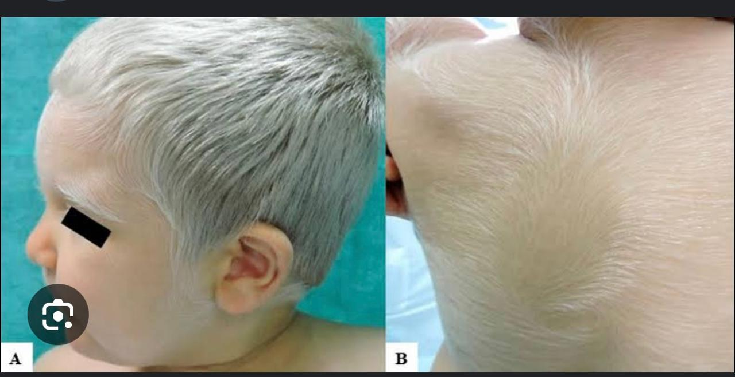

Slide 40
Disorders of Hyperpigmentation

Slide 41
INCONTINENTIA PIGMENTAI
Incontinentia pigmenti (IP) : is a rare X‐linked dominant multi systemic ectodermal dysplasia that is usually lethal in males and that presents classically in females with skin lesions, teeth abnormalities, alopecia, nail dystrophy, and ocular and neurological findings.
Epidimology
Birth prevelance is 0.6-0.7/1000000.
Female to male ratio is 20:1.

Slide 42
PATHOPHYSIOLOGY
IP is caused by mutations of the IKBKG gene encoding the nuclear factor (NF)‐κB essential modulator (NEMO)
The IKBKG gene is involved in inflammation,immunity,cell survival, and other pathways.

Slide 43
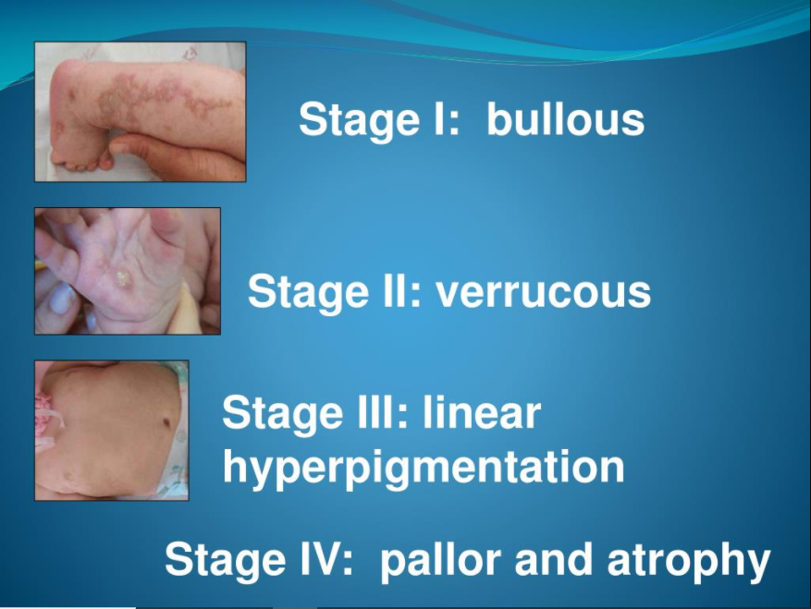

Slide 44
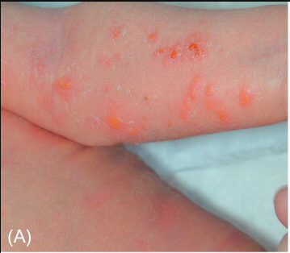
BULLOUS STAGE I
IP cutaneous findings typically present perinatally with an erythematous vesicular rash followingBlaschko’slines.
May last from few weeks to a few months.

Slide 45
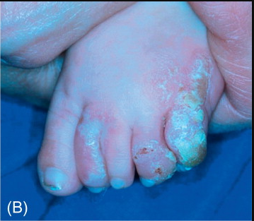
VERRUCOUS STAGE II
Stage I evolves to a verrucous stage II, occurring mainly on the limbs characterized by hypertrophic wart like lesion.

Slide 46
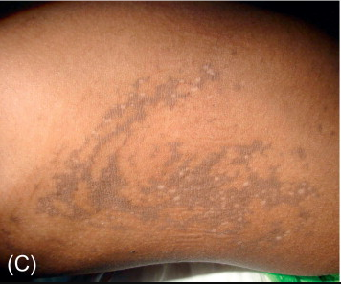
Stage III HYPERPIGMENTATION
Stage III hyperpigmented streaks and whorls along Blaschko’s lines begin within a few months and fade in adolescence.

Slide 47
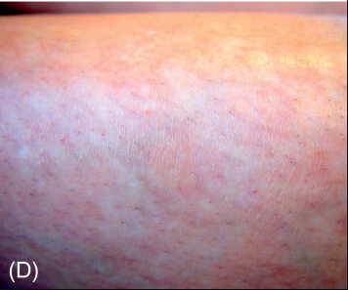
PALLOR AND ATROPHY
Stage IV patients have pale, hairless atrophic linear streaks or patches mostly on the lower extremities at adolescence.

Slide 48
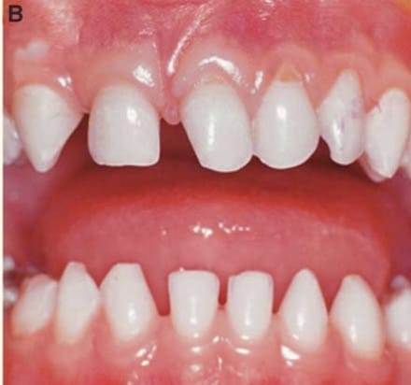
Other Organs Findings
Teeth:
Delayed dentition.
Malformed cone-shaped teeth.
Nails:
Onychodystrophy.
Hair:
Cicatricial alopecia.
Eyes:
Retinal neovascularization.
CNS:
Seizures and Microcephaly.

Slide 49
DIFFERENTIAL DIAGNOSIS
STAGE 1 | Bullous impetigo Epidermolysis bullosa Herpes or varicella zoster
STAGE 2 | Warts Epidermal nevus syndrome
STAGE 3 | Linear and whorled naevoid hypermelanosis
STAGE 4 | scarring

Slide 50
Complications
Life expectancy is normal. Patients without neonatal CNS abnormalities typically have normal physical and cognitive development.
Treament
No specific treatment is available for IP. Symtomatic treatment is standard management of blisters and regular check up to opthomologist, neurologist and orthodontist.

Slide 51
Linear and whorled naevoid hypermelanosis
Benign skin condition characterized by the onset in infancy of hyperpigmented regions that follow the lines of Blaschko's on the trunk and limbs. The soles, palms, face and mucous membranes are spared.

Slide 52
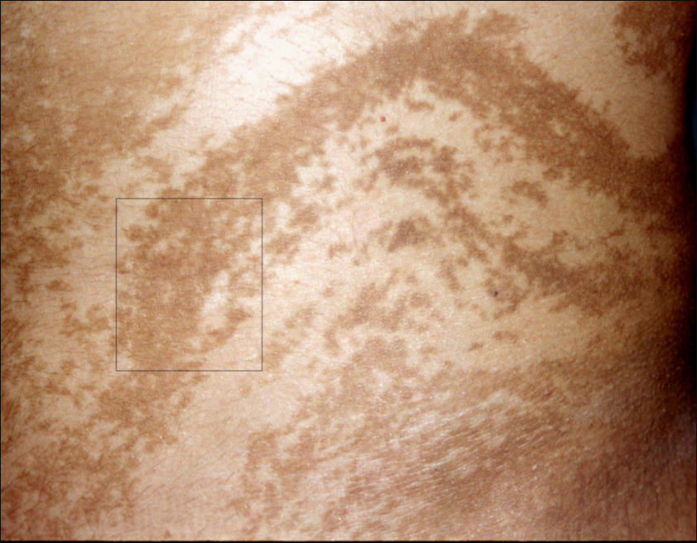

Slide 53
DESCRIPTION
No extradermal features although the condition has been rarely associated with cardiovascular, neurological and musculoskeletal abnormalities.
This phenotype is the reverse of hypomelanosis of Ito.
Mosaic chromosomal abnormalities have been detected .
The phenotype of either hyper‐ or hypopigmentation following Blaschko lines is the result of cutaneous mosaicism.

Slide 54
DYSKERATOSIS CONGENITA
DKC is a disease with a highly variable phenotype that is classically defined by reticulated skin pigmentation, nail dystrophy and leukoplakia of the oral mucosa often undergoing malignant transformation.

Slide 55
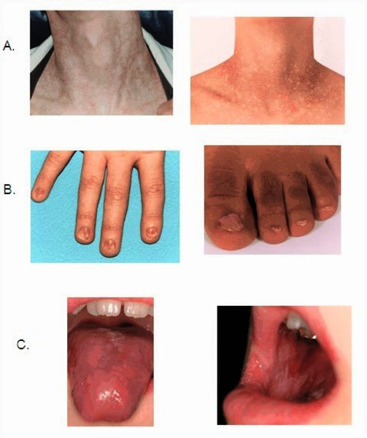

Slide 56
INHERITANCE
DKC is a genetically heterogeneous disorder, showing autosomal recessive, autosomal dominant and X‐linked inheritance.
The disease is caused by mutations in multiple genes coding for proteins involved in telomere function and maintenance.

Slide 57
SITES
The pigmentary change may be limited to the neck, upper chest and proximal parts of the limbs initially, but within affected areas the involvement is always diffuse.

Slide 58
COMPLICATIONS
Bone marrow failure
Hematological malignancies
Epithelial malignancies
Diagnosis
Mainly based on Haematological anamolies, especially pancytopenia.

Slide 59
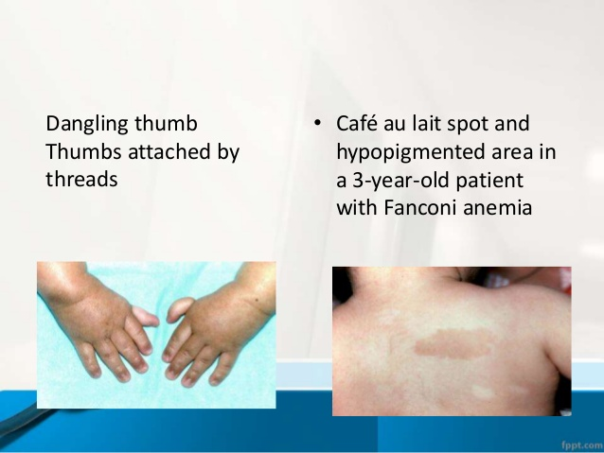
DIFFERENTIAL DIAGNOSIS
FANCONI ANEMIA:
A clinically and genetically heterogeneous disorder that causes genomic instability. Fanconi anemia is also sometimes associated with pigmentation anomalies including reticulated pigmentation and cafe‐au‐lait spots.

Slide 60
Naegeli–Franceschetti–Jadassohn syndrome and dermatopathia pigmentosa reticularis
These two diseases are closely related autosomal dominant ectodermal dysplasia syndromes that are both caused by mutations specifically located at the start of the KRT14 gene sequence.
These mutations result in haploinsufficiency for keratin 14 and are associated with increased susceptibility of keratinocytes to proapoptotic stimuli.

Slide 61
COMBINE FEATURES
These two diseases clinically share complete absence of dermatoglyphics
A reticulate pattern of skin hyperpigmentation mainly involving the trunk and face.
palmoplantar keratoderma.
abnormal sweating.
plantar bullae in early childhood.
Dental anomalies
Nail dystrophy.

Slide 62
Distinctive Features of Naegeli-Franceschetti-jadassohn syndrome.
1.Complete absence of dermatoglyphics
2.Reticulate hyperpigmentation of skin that tends to slowly disappear with age.
3.Diminished sweating.
4.Moderate hyperkeratosis of palms and soles.
Distinctive Features of Dermatopathia pigmentosa reticularis.
1.Life long persistence of skin hyperpigmentation.
2.Non-cicatrial alopecia.
3.Onychodystrophy.

Slide 63
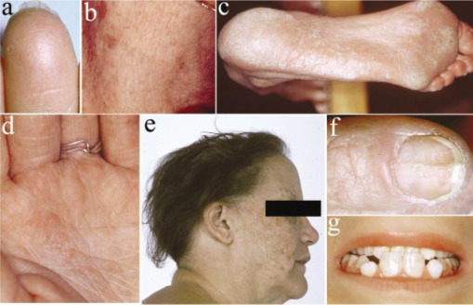

Slide 64
Dowling–Degos disease
Dowling–Degos disease is an autosomal dominant form of reticulate pigmentary genodermatosis with variable penetrance that was first described by Dowling.

Slide 65
CLINICAL FEATURES
The reticulate pigmentation usually has a flexural distribution.
Comedo like lesions on the neck and pitted perioral acneform scars.
Onset is usually post pubertal and the reticulate hyperpigmentation is progressive and disfiguring.
No abnormalities of the hair or nails have been reported.
Generalized Dowling–Degos disease can also occur, with numerous hyperpigmented or erythematous macules and papules on the neck, chest and abdomen.

Slide 66
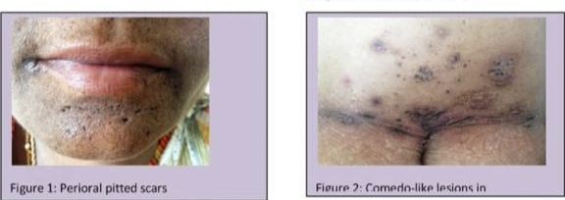
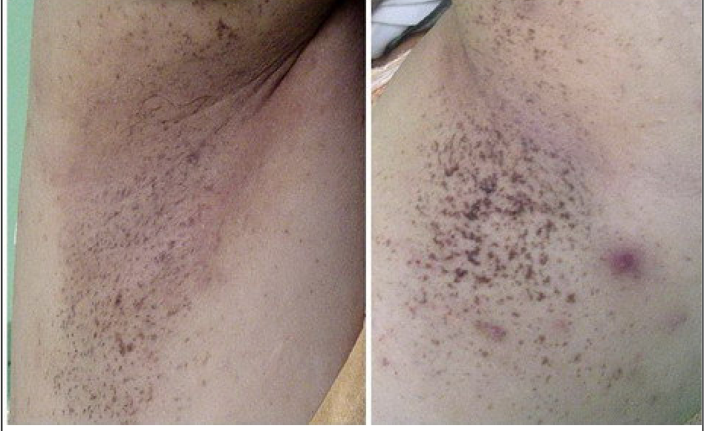
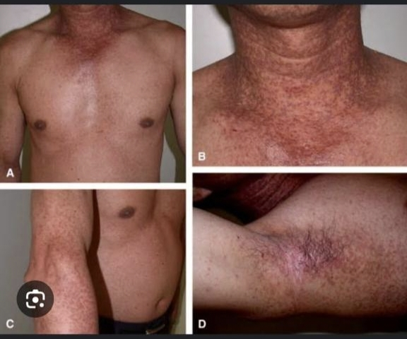
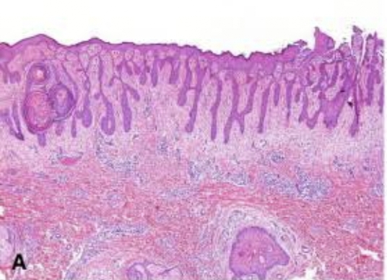

Slide 67
GENETICS
Flexural/Localised Dowling Degos Disease:
Mutation affecting the KRT5 gene.
Generalised Dowling Degos disease:
Multiple genes are Involved namely as following
POFUT1, POGLUT1.
Galli-Galli disease:
Feautures acantholysis on histology in addition to clinical and histological signs of DDD, shown same mutations in KRT5.

Slide 68
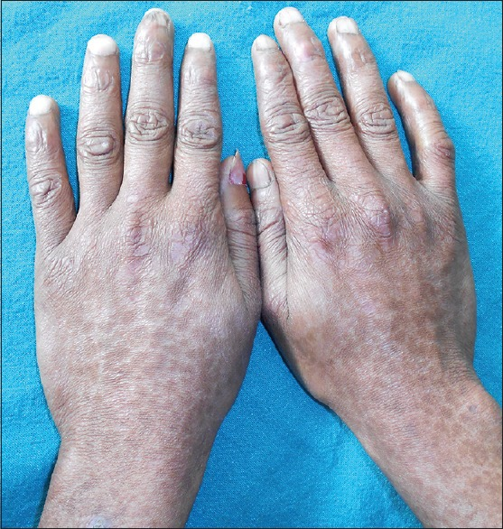
Reticulate acropigmentation of
Kitamura
autosomal dominant pattern of inheritance caused by mutations in ADAM10 gene

Slide 69
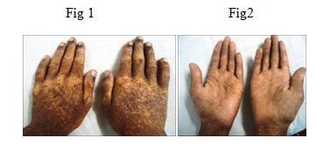
CLINICAL FEATURES
Reticulate hyperpigmented atrophic macules on the dorsa of the hands.
Pits’ on the palms and soles in the first or second decade of life.
The macules gradually darken and tend to spread to the proximal regions of the extremities with progression of the eruptions that stops in middle age.

Slide 70
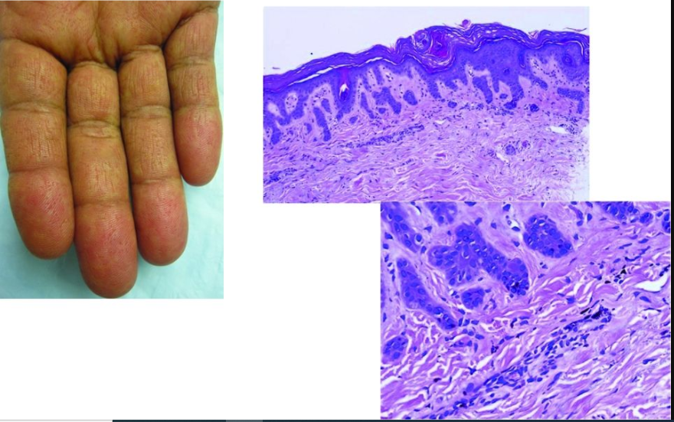
HISTOPATHOLOGY
The pigmented lesions show pigmentation in the tip of rete ridges with thinning of the epidermis, elongation and thinning of the rete ridges, and slight hyperkeratosis without parakeratosis.

Slide 71
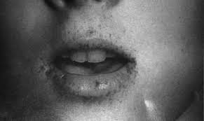
Peutz–Jeghers–Touraine syndrome
It is a rare autosomal dominant disorder characterized by GIT polyps in association with pigmentation that affecting skin and mucous membrane.

Slide 72
CLINICAL FEATURES
Melanocytic macules especially on lips but can also be seen on buccal mucosa and digits.
Usually appear before the age of 5 years.
Hamartomas GIT polyps occur later on in life associated with abdominal pain and bleeding.
intussussception and intestinal obstruction fairly common complication.
Ovarian cell, Breast and pancrease tumor may also be associated.

Slide 73
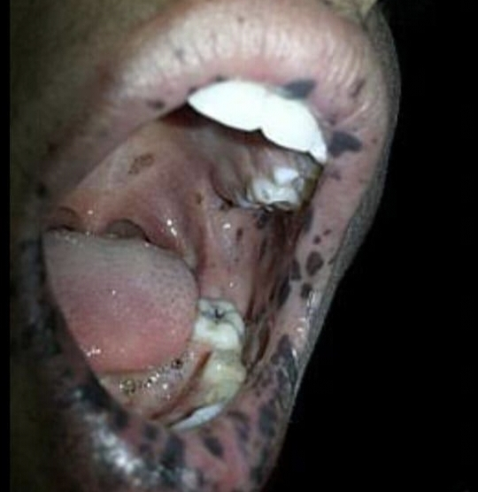
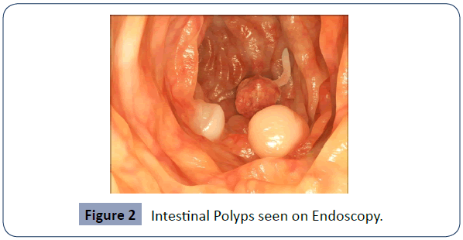

Slide 74
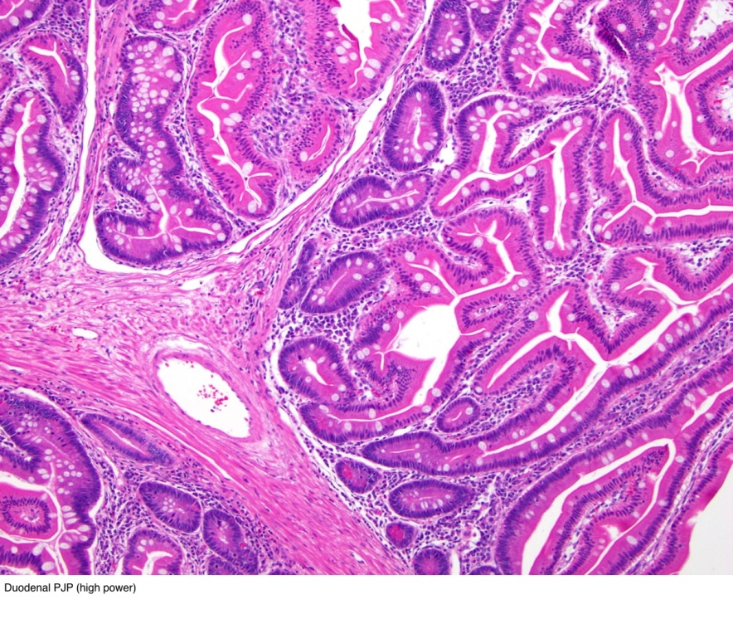
HISTOPATHOLOGY
Increased number of melanocytes with long dendrites filled with melanosomes, but few melanosomes in keratocytes, suggesting a pigment block.

Slide 75
GENETICS
The disorder is due to mutations in the serine threonine kinase ( STK11 ) gene.
The key factor may be reduced appoptosis,or programmed cell death, in affected cells.

Slide 76
Dyschromatosis symmetrica hereditaria
Characterized by freckle‐like pigmented macules on the face associated with small hyper‐ and hypopigmented macules affecting the back of the hands and feet.

Slide 77
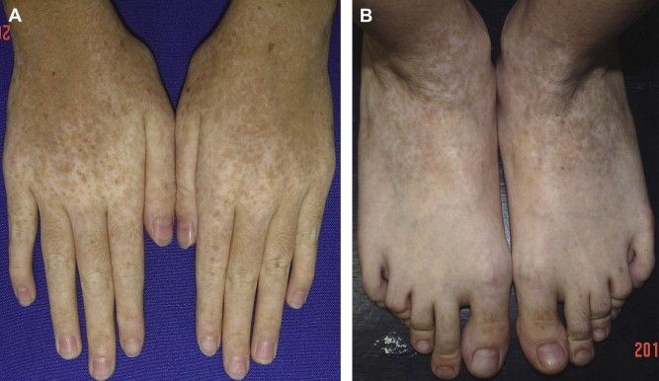

Slide 78
GENETICS
Dyschromatosis symmetrica hereditaria has a dominant pattern of inheritance and is caused by a heterozygous mutation in the ADAR1 gene .

Slide 79
Dyschromatosis universalis hereditaria
Dyschromatosis universalis hereditaria (DUH) is a rare autosomal genodermatosis characterized by hyper‐ and hypopigmented macules distributed over the entire surface of the skin.
The lesions usually appear in infancy or early childhood.
Involvement of the palms or soles is unusual.
Abnormalities of the hair and nails have also been reported.
DUH has been associated with neurological, ophthalmological and haematological complications.

Slide 80
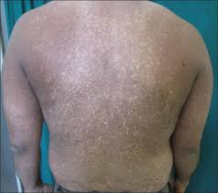
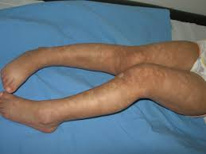
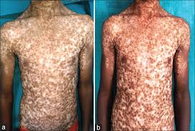

Slide 81


