Slide 1
HEPATITIS INFECTIONS
Dr. Imran Khan

Slide 2
Viral hepatitis infections may commonly be associated with a cutaneous eruption during the acute disease.
The immune responses that can be triggered by the persistent infection may also lead to a variety of immune‐driven skin disorders.

Slide 3
HEPATITIS B
Hepatitis B is a vaccine-preventable liver infection caused by the hepatitis B virus (HBV).
Hepatitis B is spread when blood, semen, or other body fluids from a person infected with the virus enters the body of someone who is not infected.
The incubation period is about 75 days (30–180).

Slide 4
PATHOLOGY
Hepatocyte damage can be caused directly by viral infection but is more commonly due to the immunological response by cytotoxic lymphocytes to the virally infected cells

Slide 5
CAUSATIVE AGENT
HBV is a partially double-stranded DNA genome virus of the Hepadnaviridae family
transmitted by blood or blood products or by sexual contact.
Initial infection is usually not symptomatic, but 1-2% of people will develop liver failure early after their initial infection.
A similar number will develop chronic infection, which can lead to cirrhosis or liver cancer (25-40%).
HBV may also result in kidney disease (glomerulonephritis

Slide 6
PRESENTATION
Serum sickness‐like syndrome with immune complex hypersensitivity (type 3 hypersensitivity
Urticaria, angioedema, vasculitis, petechiae, palpable purpura, and erythema multiforme‐like lesions can develop
Occasionally can present as maculopapular rash, lichenoid eruptions, and erythema nodosum

Slide 7
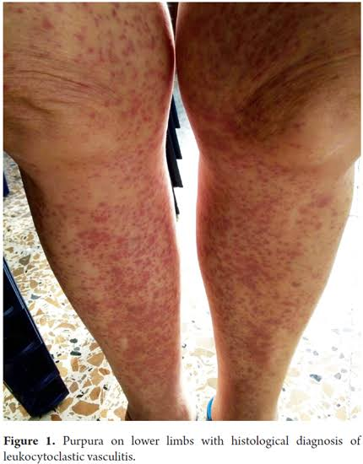
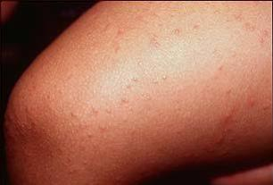

Slide 8
CLINICAL VARIANTS
Lichen planus
Gianotti–Crosti syndrome
An increased risk of squamous cell carcinoma of the skin

Slide 9
MANAGEMENT
Prophylaxis
Three doses of recombinant surface antigen vaccine.
Post‐exposure treatment
  Infants born to highly infectious (HBeAg positive) HBV‐carrier mothers
  - Unimmunized people
  In those who have failed to respond to the vaccine after accidental exposure (e.g. needlestick injuries) consists of a combination of hyperimmune globulin and vaccination

Slide 10
FIRST LINE
usually just supportive but if fulminant hepatic damage occurs, or for chronic hepatitis B, antiviral therapy can be considered
Antivirals currently in use include
  Interferons the nucleoside analogues lamivudine, telbivudine and entecavir, and the nucleotide analogues adefovir and tenofovir.
Treatment of chronic HBV with an antiviral agent possibly in
combination with immunosuppression can lead to clearance of HBV‐associated polyarteritis nodosa or leukocytoclastic vasculitis

Slide 11
HEPATITIS C
This is a major cause of acute and chronic liver disease worldwide.
Skin manifestations can occur in up to 17% of those infected

Slide 12
CAUSATIVE ORGANISM
Small enveloped single‐stranded positive sense RNA virus and a member of the Flavivirus family

Slide 13
CLINICAL FEATURES
Vasculitis
Urticaria
Erythema multiforme
Erythema nodosum
In 75%, infection can become chronic leading to hepatitis, less frequently cirrhosis and rarely hepatoma.

Slide 14
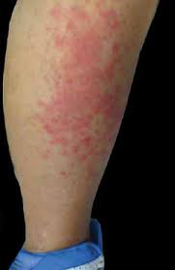
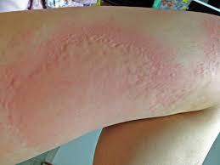

Slide 15
PREVENTION OF HEPATITIS C
There is no vaccine for HCV.
Avoid risky behaviours such as sharing needles or personal items such as toothbrushes and razors

Slide 16
TREATMENT OF HEPATITIS C
If acute hepatitis C does not resolve within 2 to 3 months, it should be managed with drug therapy.
Various treatments are available to treat chronic HCV infection.
They include:
  Pegylated interferon and ribavirin
  Boceprevir
  Ledipasvir with sofosbuvir
  Paritaprevir with ritonavir and ombitasvir
  Dasabuvir and ribavirin

Slide 17
PARVOVIRUS INFECTION
Parvovirus B19 was the only member of the Parvovirus family known to infect humans

Slide 18
ERYTHEMA INFECTIOSUM
Erythema infectiosum (also known as fifth disease) is usually a benign childhood condition characterized by a classic slapped-cheek appearance
It results from infection with human parvovirus (PV) B19, an erythrovirus.

Slide 19
CLINICAL PRESENTATION
Rose‐red papules on the cheeks ‘slapped cheek’ appearance.
There is often perioral pallor. During the next 2–4 days, maculopapules appear on the proximal extremities and extend distally to the hands and feet and proximally to the trunk, often forming a lace‐like pattern.
The palms and soles may be involved, and acral lesions may be petechial
There may be dark‐red macules on the buccal and genital area

Slide 20
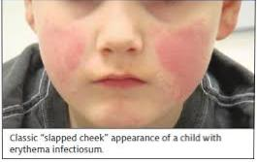

Slide 21
MANANGEMENT
Usually mild and self‐limiting,
No specific treatment is needed.
In pregnant women, rapid diagnosis is essential.
In immunosuppressed or haematological disease such as sickle cell disease, review for bone marrow failure is needed.

Slide 22
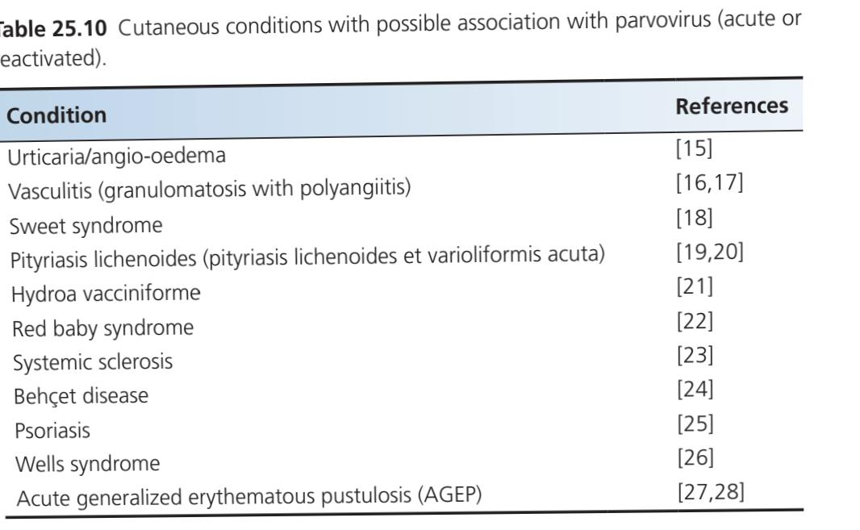

Slide 23
HUMAN RETROVIRUS INFECTION
Human retroviruses are single‐stranded RNA viruses that replicate following DNA production via reverse transcription. The
DNA becomes incorporated within the host cell DNA and is then known as a provirus.
Infections cases have arisen following cross‐species transfer from monkeys to human.

Slide 24
SUBTYPES
At least six different subtypes of HTLV‐1, A–G, have been identified by molecular sequence analysis.
Subtype A is more widely distributed in the world,
HTLV 1 with an aggressive form of adult T‐cell leukaemia (ATL) that had been described in Japan
This disease is also referred to as ATL–lymphoma (ATLL) because it usually begins as a lymphoma which progresses to a late leukaemia phase

Slide 25
HTLV‐1 has been associated with a chronic neurological disease – HTLV‐1 associated myelopathy/tropical spastic paraparesis
HTLV‐2 is endemic in intravenous drug abusers throughout the Western hemisphere.
HTLV‐2, ‐3 and ‐4 have not yet been conclusively linked to any human disease.

Slide 26
TRANMISSION
The major route of transmission of HTLV‐1 is from infected mother to child via breast milk, with a 25% chance of the baby becoming infected.
Horizontal spread is by sexual transmission (mainly from male to female) and by blood

Slide 27
INFECTIVE DERMATITIS ASSOCIATEDD
WITH HTLV‐1
Infective dermatitis associated with HTLV‐1 is an inflammatory disease of childhood which develops in a minority of individuals with HTLV‐1 infection.
The onset is most frequent between the age of 2 and 3, but can be as early as a few months or as late as age 11 years

Slide 28
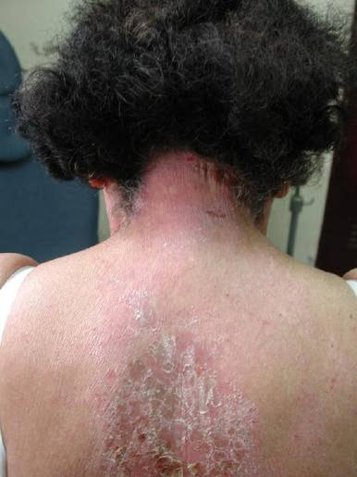
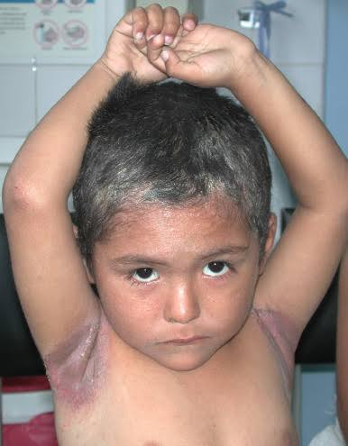

Slide 29
CLINICAL FEATURES
The dermatitis is often most marked on the scalp, around the ears and the nares, in the axillae and groin, and on the neck.
There is often erosions and creating especially around the nostrils
There may be a watery nasal discharge.
Blepharitis and conjunctivitis are very common.
The dermatitis is mild to moderately pruritic, and lichenification is not a significant feature.

Slide 30
DIFFERENTIAL DIAGNOSIS
Seborrhoeic dermatitis,
Atopic eczema

Slide 31
INVESTIGATION
HTLV‐1 associated infective dermatitis is suspected, serology or PCR for HTLV‐1 should be performed.
Skin swabs to confirm bacterial infection and guide antibiotic therapy are needed.
Infection with Staphylococcus aureus or Streptococcus is very common especially in the skin around the nostrils.

Slide 32
TREATMENT
Symptomatic treatment of the dermatitis with emollients and
Application of mild to moderate potency topical steroids is of use

Slide 33
ALL INSECT‐BORNE AND
HAEMORRHAGIC FEVERS
Viral haemorrhagic fevers (VHFs) are caused by viruses from four different families:
  Arenaviridae
  Bunyaviridae,
  Filoviridae
  Flavivirida
The insect‐borne viruses of the family Togaviridae cause a variety of infections which are less severe than VHFs.

Slide 34
The VHFs are all severe, multisystem diseases in which vascular damage and haemorrhage are frequent and prominent features.
Most of these viruses cause zoonotic infections, the human being an accidental host, but person to person transmission also occurs.
Thrombocytopenia is present in all VHFs

Slide 35
ARENAVIRUS INFECTION
There are two groups of arenaviruses that cause severe VHF in humans – Old World and New World viruses . Another arenavirus
Lymphocytic choriomeningitis virus, causes a meningoencephalitis, not VHF.
Contact with urine or other secretions from infected animals can lead to human disease after an incubation period of 1–3 weeks.

Slide 36
LASSA FEVER
Lassa fever is a viral haemorrhagic fever that is primarily transmitted to humans via contact with food or household items contaminated with urine or faeces from Mastomys rats.
Mastomys natalensis, a common rodent in West African villages
The incubation period of Lassa fever is 7–18 days.

Slide 37
CLINICAL FEATURES
Fever, malaise,headache and nonproductive Cough
A maculopapular or petechial rash over the face, arms and thorax may be seen in white‐skinned individuals
In black Africans. There is usually joint, retrosternal and lumbar rpain with a developing painful sore throat.
Conjunctivitis and periorbital oedema are common.
High grade fever

Slide 38
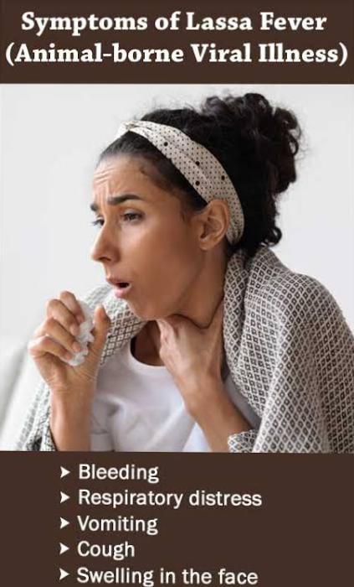
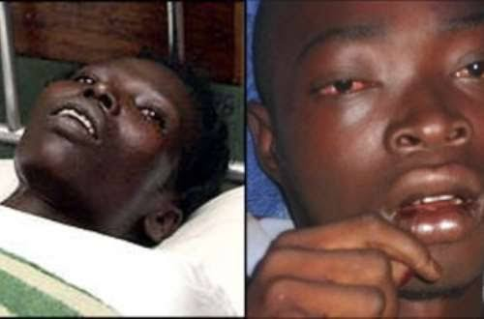

Slide 39
INVESTIGATIONS
Diagnosis is usually made by ELISA

Slide 40
MANAGEMENT
Post‐exposure prophylaxis with oral ribavirin is recommended to reduce risk of severe infection.
Intravenous ribavirin is an effective antiviral drug in Lassa fever, especially if given within 6 days of the onset of illness

Slide 41
LUJO VIRUS HEMORHAGIC FEVER
Lujo hemorrhagic fever (LHF) is a viral disease accompanied with fever, headache, vomiting, diarrhea, arthralgia, myalgia and numerous signs of hemorrhagic syndrome
Also known as Zambian haemorrhagic fever

Slide 42
CLINICAL FEATURES
Presents at 1–2 weeks,
After an incubation period of 1–2 weeks the illness starts with fever, headache and myalgia.
A morbilliform eruption, widespread but mainly affecting the face and trunk, can be accompanied by facial swelling.

Slide 43
MANAGEMENT
First line
General supportive measures with fluid balance and blood transfusions.
Second line
Ribavirin may be of use

Slide 44
EBOLA VIRUS DISEASE
Ebola virus disease (EVD), formerly known as Ebola haemorrhagic fever, is a rare but severe, often fatal illness in humans.
The virus is transmitted to people from wild animals and spreads in the human population through human-to-human transmission.
Suspected cases must be isolated and extreme care taken to avoid spread to family, health care workers and other contacts.
Virus excretion continues for days to weeks in survivors
All items contaminated with body fluids should ideally be incinerated or disinfected thoroughly.
Ribavirin has no effect on filoviruses, so the only treatment available is supportive.

Slide 45
YELLOW FEVER
Yellow fever virus infection causes general malaise, fever, headache, musculoskeletal aches and nausea
The virus is transmitted by the Aedes mosquitoes.
Prophylactic vaccination is with the live attenuated vaccine

Slide 46
DENGUE
Also known as break‐bone fever
Dengue is perhaps the most important mosquito‐borne virus disease in humans, affecting 50–100 million people annuall world wide
The virus is spread via mosquitoes, mainly Aedes aegypti
Dengue fever starts after an incubation period of 3–14 days

Slide 47
CLINICAL FEATURES
Presents with fluctuating fever with nausea, vomiting, headache, joint and bone pain and severe backache.
Rash develops on the third to fourth day of the fever in about half the patients. There may be general-ized erythema, or maculopapular and can be itchy.
It may start on the legs and spread caudally or on the chest and trunk and spread to the face, arms and legs

Slide 48
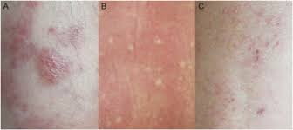
The rash fades as the fever subsides (day 7) but can pass through a phase with petechiae on the arms and legs due to mild thrombocytopaenia.
In dark‐skinned people the rash is frequently not visible.
Mucosal involvement with oro‐pharyngeal or conjunctival injection is seen in about 30%.

Slide 49
EARLY WARNING SIGNS
Early warning signs of development of severe dengue include abdominal pain, persistent vomiting, oedema, lethargy, hepatomegaly and increasing haematocrit with decreasing platelet count

Slide 50
INVESTIGATIONS
RT‐PCR in the acute phase or by serological studies on acute and convalescent sera.

Slide 51
TREATMENT
First line
There is no specific antiviral treatment, so management is symptomatic and supportive. Aspirin and non‐steroidal anti‐inflamma-tory drugs are avoided due to the risk of bleeding.
Paracetamol can be used as an antipyretic and analgesic.
Second line
In dengue haemorrhagic fever/dengue shock syndrome, oral and intravenous fluids must be managed carefully to balance fluid lost through vascular leakage.

Slide 52
TOGAVIRUS INFECTION
The viruses of this genus are mostly mosquito borne and include the equine encephalitis viruses and many others of limited geographical distribution causing febrile illness in humans

Slide 53
SINDBIS VIRUS
The Sindbis virus can be regarded as the prototype togavirus causing a mosquito‐borne viral fever.
Also known as Ockelbo disease (Sweden), Pogosta disease and Karelian fever (Finland)
There is no specific treatment for the virus infection but rest and pain control are advised.

Slide 54
CHIKUNGUNYA FEVER
Chikungunya means ‘bending up’ which reflects the severe joint pains that are a major feature of this virus infection.
Chikungunya virus (CHIKV) is spread by mosquitos either directly or between humans or via monkey intermediate hosts.
The virus can transmit vertically from mother to child.
The Aedes aegypti and Aedes albopictus mosquitoes are the most common vectors

Slide 55
MANAGEMENT
The risk of infection in endemic areas can be reduced by mosquito control.
Non‐steroidal anti‐inflammatory drugs can help the arthralg

Slide 56
ROSS RIVER VIRUS
Spread to humans by a variety of mos quito species.
The infection is characterized by polyarthritis, rash and general malaise
Treatment is supportive
Mosquito control is important in endemic areas.

Slide 57
RUBELLA
Characterised by rash, swollen glands and fever.
The disease is usually mild and of little significance unless you are pregnant.
Infection of a pregnant woman (congenital rubella syndrome) commonly results in miscarriage, stillbirth, or birth of an infant with major birth abnormalities.

Slide 58
CAUSATIVE ORGANISM
Rubella is caused by the rubella virus, in the Rubivirus genus.
In typical cases the incubation period is between 12-23 days

Slide 59
DISEASE COURSE & PROGNOSIS
By the third day the rash on the trunk has cleared and by the fourth the eruption on the limbs has also faded.
The rash may be absent in some 40% of cases.

Slide 60
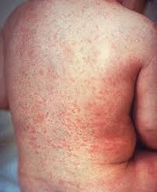
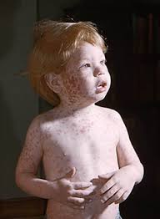

Slide 61
MANAGEMENT
Active immunization by inoculation with live attenuated rubella virus
A Preschool booster of MMR is also recommended.

Slide 62
HERPANGINA
Also called mouth blisters is a painful mouth infection caused by coxsackieviruses.
Mainly affects children aged 1–10 years but may occur in adults, most common in summer and autumn
Associated diseases of Herpangina commonly occurs together with hand, foot and mouth disease.
Causative organisms The most commonly isolated viruses are: coxsackie viruses, group A (species CV‐A2, ‐A5, ‐A6, ‐A9, ‐A10, ‐A16) and group B (CV‐B3, ‐B4), echoviruses (E‐6, E‐9) and enterovirus 71 (EV71)

Slide 63
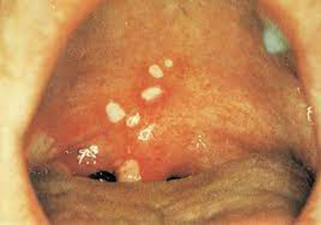
DISEASE COURSE & PROGNOSIS
The vesicles erode into shallow ulcers, which enlarge for 2 or 3 days and heal in 4 or 5 days
Complete recovery is expected within 7 days.

Slide 64
CLINICAL FEATURES
Low-grade fever
Headache
Mild pink eye (redness or swelling of the white of the eye)
General discomfort
Swollen and enlarged lymph nodes.
Cough
Runny nose

Slide 65
MANAGEMENT
Management is supportive.
Topical anaesthetic, such as lidocaine gel, can help when ulceration is making swallowing difficult

Slide 66
GIANOTTI-CROSTI SYNDROME
Papular acrodermatitis of childhood
Papular infantile acrodermatitis
Self‐limiting cutaneous reaction usually to a viral infection,
Erythe-matous papules appear on the limbs and face, occurring mainly in children.

Slide 67
PATHOPHYSIOLOGY
The epidermis shows spongiosis
Some acanthosis and parakeratosis.
There is a patchy, perivascular, mainly lymphocytic infiltrate in the dermis lesions.
The majority of the early cases reported had hepatitis B infection

Slide 68
CLINICAL FEATURES
Over the course of 3 or 4 days, a profuse eruption of dull red, flat‐topped papules develops first on the thighs and buttocks, then may extend down the legs to the extensor aspects of the arms, and finally the face.
There may be a few short‐lived lesions on the trunk.
The distribution is often asymmetrical

Slide 69
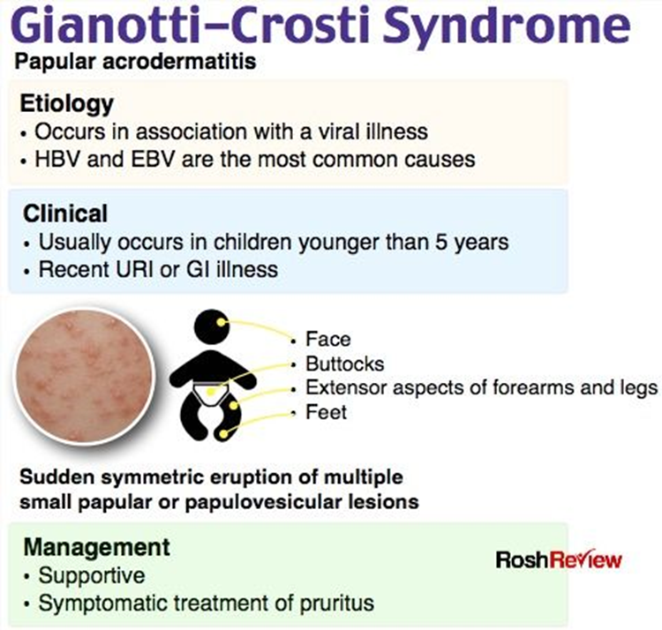

Slide 70
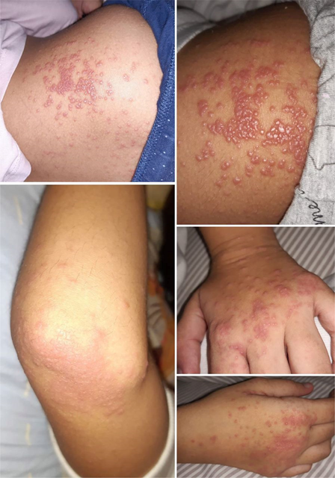
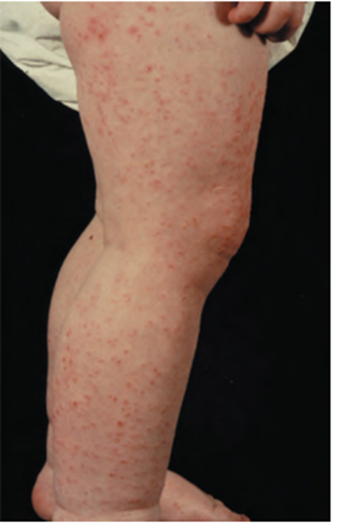

Slide 71
MANAGEMENT
There is no specific treatment
Emollients or topical steroids can give symptomatic relief.In recurrent or severe cases, ribavirin can be considered

Slide 72
MEASLES
Measles is an acute viral respiratory illness.
It is characterized by a prodrome of fever (as high as 105°F) and malaise, cough, coryza, and conjunctivitis -the three “C”s -, a pathognomonic enanthema (Koplik spots) followed by a maculopapular rash . The rash usually appears about 14 days after a person is exposed.

Slide 73
PATHOLOGY
Shortly after the rash appears, measles virus causes a transient depression of the T‐cell mediated immune responses
This can persist for 1–2 months.
The anergic mechanism may permit the invasion of the brain by measles virus which later produces subacute sclerosing panencephalitis.

Slide 74
CAUSATIVE ORGANISM
The measles virus is a morbillivirus, of the Paramyxoviridae family

Slide 75
CLINICAL FEATURES
Measles develops through distinct clinical stages.
Incubation period
Ranges from 7–14 days (average 10–11 days).
The patient usually has no symptoms.
Some may experience symptoms of primary viral spread (fever, spotty rash, and respiratory symptoms due to virus in the bloodstream) within 2–3 days of exposure.

Slide 76
Prodrome
Generally begins 10–12 days after exposure.
Presents as fever, malaise, and loss of appetite, followed by conjunctivitis (red eyes), cough, and coryza (blocked or runny nose).
2–3 days into the prodromal phase, Koplik spots appear.
Prodromal symptoms usually last for 2–5 days but in some cases may persist for as long as 7–10 days.

Slide 77
Exanthem (rash)
Flat red spots ranging from 0.1–1.0cm in diameter appear on the 4th or 5th day following the start of symptoms.
This non-itchy rash begins on the face and behind the ears. Within 24–36 hours it spreads over the entire trunk and extremities (palms and soles
The rash begins to fade 3–4 days after it first appears. It fades first to a purplish hue and then to brown/coppery coloured lesions with fine scales.

Slide 78
Recovery
A cough may persist for 1–3 weeks.
Measles-associated complications may be the cause of persisting fever beyond the 3rd day of the rash.

Slide 79
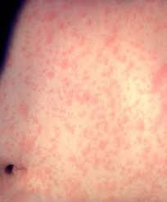

Slide 80
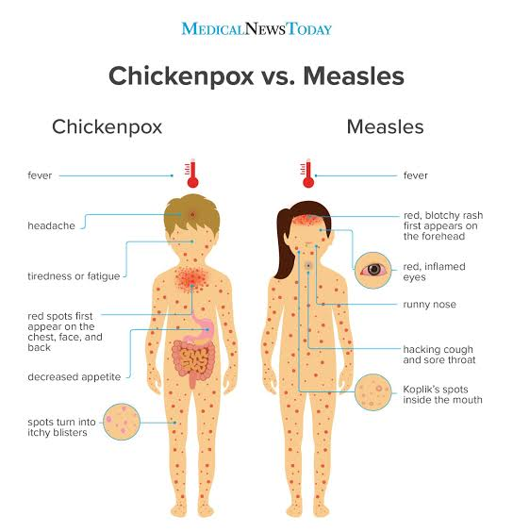

Slide 81
INVESTIGATIONS
Specific measles IgM antibodies are usually detectable in serum or saliva 3 or 4 days after the appearance of the rash
Maximum titesrs of IgG are reached 2–4 weeks late

Slide 82
TREATMENT
The vaccine is available as a single vaccine, but is used more
commonly as the triple vaccine (MMR) or as the newer quadruple vaccine which includes varicella.

Slide 83
First line
The patient should be confined to home and bed and given symptomatic treatment. Antibiotics may be required to control secondary bacterial complications.
Second line
Children with measles, especially in areas of high mortality, should be given vitamin A (two doses of 200 000 IU)
Third line
Measles pneumonia may be helped by ribavirin

Slide 84
Hand, foot and mouth disease
finition and nomenclature
An acute infection caused by coxsackievirus infection leading to
mild malaise, oral ulcers and hand and foot vesicular eruption.
ausative organisms
Outbreaks have most commonly been caused by CV‐A16

Slide 85
Clinical feature:-
Lesions on the dorsal and palmar surfaces of the hands and feet
Small vesicles and ulcers in and around the mouth, palate, and pharynx
Red macules and papules on the buttocks and sometimes on the arms. Lesions can also occur on the genitalia
Management:-
Supportive. Severe cases with neurological symptoms may be
treated with intravenous immunoglobulin .
Vaccines against EV71 are in development.
Antiseptic mouthwashes, topical and oral analgesics help relieve pain due to oral ulcers.

Slide 86
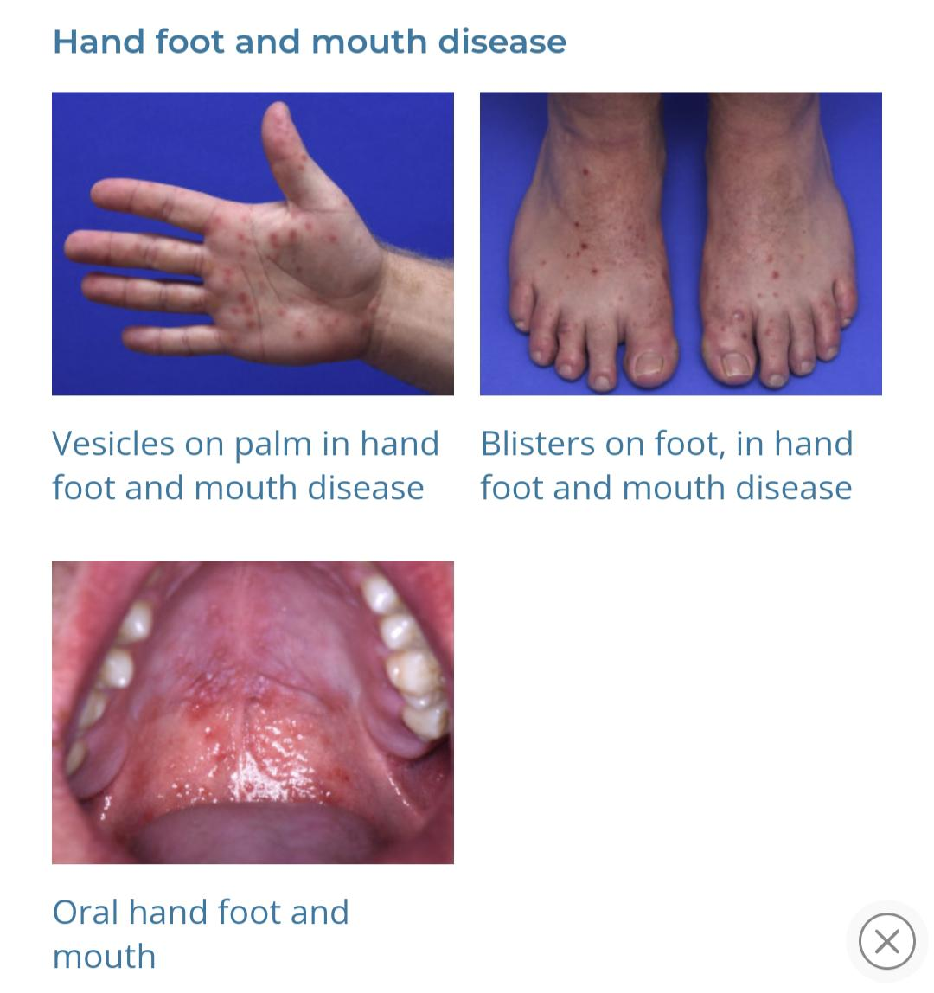

Slide 87
Papular‐pruritic gloves and socks syndrome
It presents as an acute acral dermatosis, occurring predominantly in young adults.
Epidermal acanthosis and patchy basal cell degeneration with subepidermal oedema and a patchy mixed inflammatory cell infil-trate and extravasated red blood cells are seen
Causative organisms
Parvovirus B19 infection is the most commonly associated infection

Slide 88
Clinical features
Presentation
The hands, wrists, feet and ankles are intensely pruritic and are affected with macular and papular erythema and associated oedema.
The cutaneous features are frequently accompanied by oral inflammation with petechiae, vesicopustules and ulceration
antiviral IgM is usually detectable at the time of the eruption and IgG is detectable La
Treatment is supportive.

Slide 89
antiviral IgM is usually detectable at the time of the eruption and IgG is detectable La
Treatment is supportive.

Slide 90
PITYRIASIS ROSEA
Pityriasis rosea is an acute self‐limiting disease, probably infective in origin, affecting mainly children and young adults ansymptterized by a distinctive skin eruption and minimal constitutional symptoms
It is characterised by a large circular or oval "herald patch", usually found on the chest, abdomen, or back
Most cases of pityriasis rosea occur between the ages of 10 and 35 years and it is uncommon, but not unreported, in infancy, early childhood or old age

Slide 92
PATHOLOGY
The eruption has been reported during immunosuppressive treatment with oral corticosteroids and after bone marrow transplantation but it is not a common rash seen in such situations.
A pityriasis rosea‐like reaction has been reported for several Drugs

Slide 93
In the epidermis, spongiosis, vesicles, and patchy parakeratosis are common.
Some apoptotic keratinocytes may be seen in the upper epidermis.
The upper dermis shows mild papillary edema, and a mononuclear cell perivascular infiltrate with the focal invasion of inflammatory cells into the epidermis, where they may form pustules, mainly subcorneal
The infiltrate comprises mainly CD4+ helper T lymphocytes but also Langerhans cells. HLA‐DR antigens are expressed on the keratinocyte surface
Occasional dyskeratotic keratinocytes are seen, sometimes adjacent to a Langerhans cell.

Slide 94
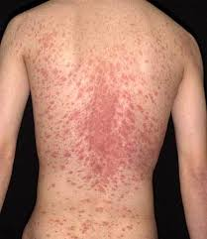
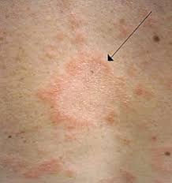

Slide 95
CAUSATIVE ORGANISM
Involvement of two herpesviruses, HHV‐6 and HHV‐7, has been suggested as a cause for the eruption.

Slide 96
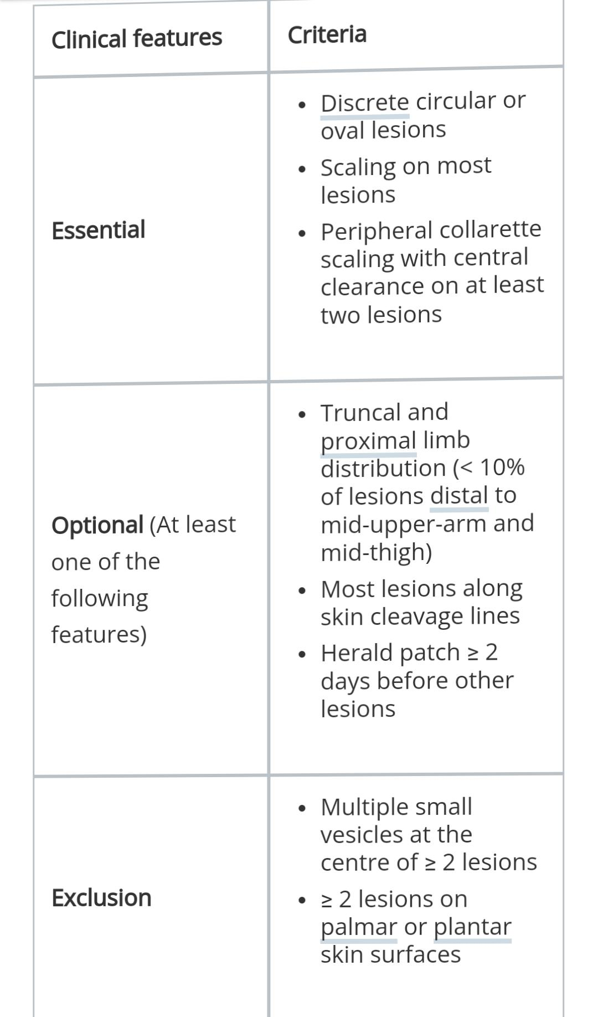

Slide 97
What is the differential diagnosis for pityriasis rosea?
Lichen planus
Psoriasis
Pityriasis rubra pilaris
Erythema multiforme
Guttate psoriasis
Secondary syphilis
Pityriasis alba
Seborrheic dermatitis
Tinea corporis
Tinea versicolor

Slide 98
MANAGEMENT
The common asymptomatic and self‐limiting cases require no treatment.
First line
If itch is troublesome, or the appearance distressing, a topical steroid, usually of moderate potency or UVB, can be helpful.

Slide 99
Second line
Trials of antiviral drugs are reported
The standard dose regimen of aciclovir (400 mg five times a day for a week) or higher doses (800 mg five times daily for 1 week), used early after the onset of the eruption, may lead to a more rapid resolution of skin lesions
The use of oral erythromycin antibiotic (1 g four times a day for 2 weeks for adults) was reported to clear the disease within 2 weeks of treatment

Slide 100


