Slide 1
URTICARIA
ANGIOEDEMA WITHOUT WEALS
&
URTICARIAL VASCULITIS
DR MAHWISH HASSAN
RESIDENT DERMATOLOGY
CHK

Slide 2
CONTENTS
URTICARIA
  Introduction
  Pathophysiology
  Classification
  Investigation and management
ANGIOEDEMA WITHOUT WEALS
  Definition
  Classification
  Investigation and Management
URTICARIAL VASCULITIS
  Clinical features
  Investigation and management
Notes:
CONTENTS OF TODAYS PPT INCLUDE
DETAIL DISCUSSION ON
URTICARIA
ANGIOEDEMA WITHOUT WEAL
URTICARIAL VASCULITIS

Slide 3
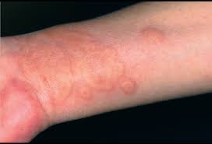
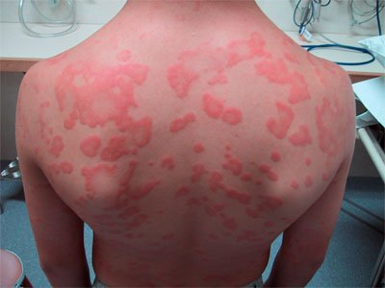
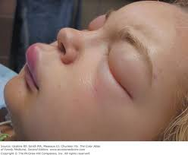
URTICARIA
URTICARIA
A disease that may present with:
Short lived itchy weals,
angioedema or both.
Spontaneous or inducible
Notes:
THE TERM URTICARIA IS BEING USED TO DESCRIBE…
IT MAY BE..
THERE MAY BE OVERLAP BETWEEN PATTERNS OF URTICARIA

Slide 4
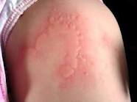
WEALS
URTICARIA
Transient, well-demarcated
Superficial pink or pale
Swellings of the dermis
Reversible exudation of plasma in the skin
Fade, usually within hours, without leaving a mark
Very itchy associated with surrounding flare.
Notes:
A WEAL IS A DESCRIPTIVE TERM FOR….
DUE TO REVERSIBLE EXUDATION…
WEALS ARE USUALLY VERY ITCHY AND ASSOCIATED WITH A SURROUNDING RED FLARE WHEN THEY ARISE

Slide 5
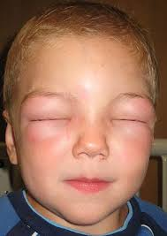
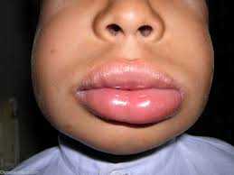
ANGIOEDEMA
URTICARIA
  Deep swellings of the dermis, subcutaneous or submucosal tissues
  Usually painful
  Poorly defined and normal in colour
  Last longer than weals
Notes:
ANGIO EDEMA IS A DESCRIPTIVE TERM FOR…..
PAINFUL RATHER THAN ITCHY

Slide 6
ANAPHYLAXIS
URTICARIA
  Sudden, severe, life threatening, systemic reaction
  Often involving the skin due to mast cell mediator release
  May be allergic or non-allergic

Slide 7
PATHOPHYSIOLOGY
URTICARIA
Immunological or non immunological stimuli
Degranulation of cutaneous mast cells
Release of mast cell mediators
Vasopermeability & vasodilation of dermal and subcutaneous vasculature
Notes:
URTICARIA IS A MAST CELL DRIVEN DISEASE.
A RANGE OF IMMUNOLOGICAL AND NON IMMUNOLOGICAL STIMULI CAUSES DEGRANULATION OF CUTANEOUS MAST CELLS

Slide 8
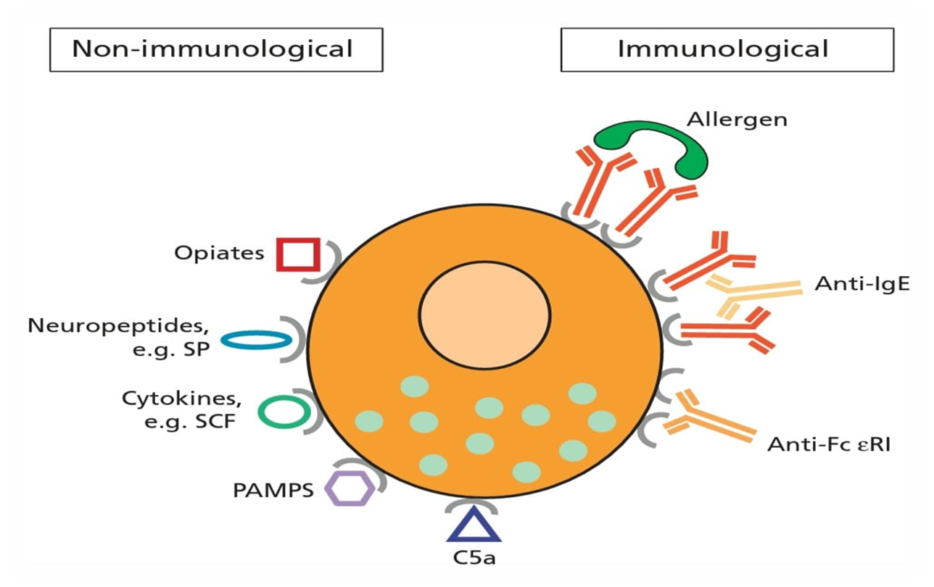
PATHOPHYSIOLOGY
URTICARIA
Notes:
Allergic reaction occurs when antigen/allergen comes in contact with B cell.. This interaction trigers the production of IgE Abs
Making them sensitive for subsequent exposure.
HISTAMINE is the major preformed mediator in most patients.
preformed TNF ALPHA upregulates adhesion molecules with recruitment of acute inflammatory cells like neutrophils and eosinophils in to the weal.
basophils basically contribute to prolongation of the weal response by releasing histamine after weal initiation.
other cytokines are also involved.
IL8 and IL10 have been found in acute urticaria

Slide 9
PATHOPHYSIOLOGY
URTICARIA
H1 Receptors
H2 Receptors
  Itching
  Flare
  Erythema
  Wealing
  Erythema
  Wealing
Notes:
ACTIVATION OF H1 RECEPTORS INDUCES
WHEREAS ACTIVATION OF H2 RECEPTORS CAUSES …. BUT NOT ITCH OR FLARE.
H 3 RECEPTORS IDENTIFIED IN THE NERVOUS SYSTEM AS INHIBITORY AUTORECEPTORS
H 4 RECEPTORS ACTIVATION LEADS TO SCRATCHING BEHAVIOUR IN MICE

Slide 10
CLASSIFICATION
URTICARIA
Spontaneous Urticaria (ordinary urticaria)
  Acute
  Intermittent
  Chronic
Inducible Urticaria (physical and contact)
  Mechanical
  Thermal
  Solar
  Aquagenic
  Contact
Notes:
URTICARIA CAN B CLASSIFIED EITHER INTO SPON OR INDUCUBLE..
THE SPON URTICARIA OR ORDINARY CAN BE ACUTE I,.E RESOLVING IN LESS THAN SIX WEEKS
CAN BE INTERMITTENT
OR CHRONIC LASTING FOR 6 WEEKS OR MORE
WHEREAS INDUCIBLE URTICARIA OR PHYSICAL & CONTACT MAY BE INDUCED BY

Slide 11
Spontaneous urticaria

Slide 12
CLINICAL PRESENTATION
SPONTANEOUS URTICARIA
Itchy red macules develop into weals
Pale to pink oedematous, raised areas of skin
Anywhere, including scalp, palms and soles
Rounded, annular, serpiginous and bizzare pattern
Bullae may form (intense edema)
Notes:
CLINICALLY SPON URTICARIA IS CHARACTERIZED BY
WITH PALE TO
AND RED FLARE
OCCURING ANYWHERE
OF VARYING SIZES AND SHAPE
LIKE
AND BULLAE MAY BE FORMED WHEN THERE IS INTENSE EDEMA

Slide 13
CAUSES OF ACUTE SPONTANEOUS URTICARIA
SPONTANEOUS URTICARIA
Idiopathic
Infections
  Viral: URTI, hepatitis B and C, EBV
  Bacterial: streptococcus pyogens
  Parasitic: anisakis simplex
Allergic
  Foods: cow’s milk, egg, nuts, seed
  Drugs: B lactam
  Stings: bees, wasp venom
  Other: Blood products, Vaccines, latex
Non-allergic
  Histamine liberators: morpheine, codiene, atracurium
  Pseudo allergic reactions
Notes:
NON ALLERGIC
MAST CELL HISTAMINE RELEASE IS NON IMMUNOLOGICAL AND MAY OCCUR AFTER FIRST EXPOSURE
EXAMPLES INCLUDE CODIENE,MORPHINE,NEUROMUSCULAR BLOCKING AGENTS SUCH AS ATRACURIUM AND ANTIBIOTICS SUCH AS POLYMYXIN AND VANCOMYCIN
PSEUDO ALLERGIC : INCLUDES RXN BY NSAIDS OR ASPIRIN AS THEY INHIBIT THE COX 1 PATHWAY OF ARACHIDONIC ACID METABOLISM
PROINFLAMMATORY LIPOXYGENASE PATHWAY PRODUCTS LEUKOTRIENE C4, D4 AND E4 ARE GENERATED WITH INHIBITION OF
PROSTAGLANDIN E2,WHICH IS INHIBITORY FOR MAST CELL DEGRANULATION

Slide 14
CAUSES OF CHRONIC SPONTANEOUS URTICARIA
SPONTANEOUS URTICARIA
Idiopathic
Infections
  Dental sepsis
  Sinusitis
  UTI and gall bladder infection
  H.pylori infection of the stomach
  Ancylostoma and strongyloides worms infestatrion
Autoimmune
Pseudoallergy
  Natural salicylates
  Amines
  Spices
  Food additives
  Green teas
  Alcohol

Slide 15
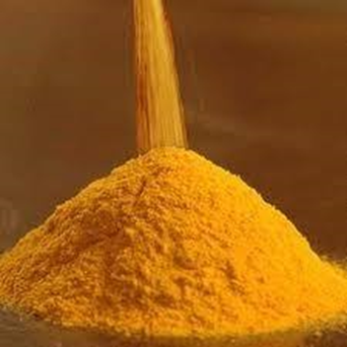
AGGRAVATING FACTORS
SPONTANEOUS URTICARIA
Physical
  Pressure
  Overheating
Infections
  URTI
Drugs
  Nsaids (commonly)
  Opiates (rarely)
Premenstrual period
Stress
Dietary pseudoallergens
Notes:
Natural salicylates
Histamine
Food additives
Spices
Alcohol

Slide 16
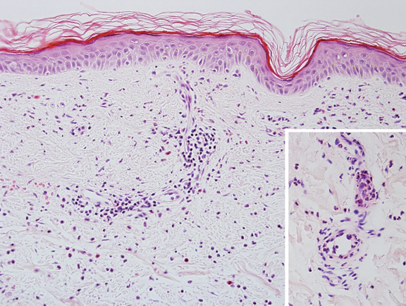
HISTOPATHOLOGY
SPONTANEOUS URTICARIA
Vascular & Lymphatic Dilatation
Oedema
Increase dermal mast cells
Perivascular Infiltrates
  Lymphocytes
  Neutrophils
  Eosinophils
Notes:
HISTOLOGY OF WEALS IS USUALLY NON SPECIFIC SHOWING
HISTOLOGY OF WEAL SHOWING….
BIOPSIES ARE PERFORNED IF INDIVIDUAL WEALS ARE PERSISTENT & THEY MAY SHOW FEATURES OF DELAYED PRESSURE URTICARIA OR URTICARIAL VASCULITIS

Slide 17
ASSOCIATED DISEASES
SPONTANEOUS URTICARIA
Acute
  Upper respiratory infections (47%)
Chronic
  Thyroid disease
  Other organ specific autoimmunity (vitiligo, pernicious anemia)
  Coeliac disease
  H.pylori
  Dental and candida infections
  Malignancy

Slide 18
Inducible urticaria

Slide 19
INDUCIBLE URTICARIA
INDUCIBLE URTICARIA
A subgroup of urticaria in which a specific stimulus induces reproducible wealing.
Accounts for 19% of urticaria
Usually occurs within minutes and persisit for less than 30-60 mins
Angio-edema and systemic reactions may occur
Notes:
INDUCIBLE URTICARIA ARE BASICALLY
THIS FEATURE IS THE BASIS OF DIAGNOSIS AND CLASSIFICATION
….MAY OCCUR FROM MEDIATOR RELEASE IF THE PATIENT IS SENSITIVE OR THE STIMULUS IS GREAT

Slide 20
Classification of inducible urticaria
INDUCIBLE URTICARIA
Mechanical
Thermal
Cholingeric urticaria
(sweating induced)
Others
Notes:
INDUCIBLE URTICARIAS MAY BE CLASSIFIED INTO:
WILL DISCUS EACH OF THESE 1 BY 1
INDUCIBLE URTICARIA MAY OCCUR IN COMBINATION WITH CHRONIC SPONTANEOUS URTICARIA
for example delay pressure urticaria often occur in pts with csu

Slide 21
URTICARIA DUE TO MECHANICAL
FORCES
INDUCIBLE URTICARIA
Dermographism
Delayed Pressure Urticaria
Vibratory Angioedema

Slide 22
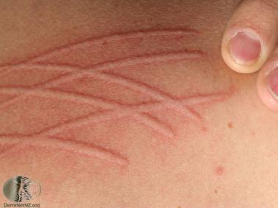
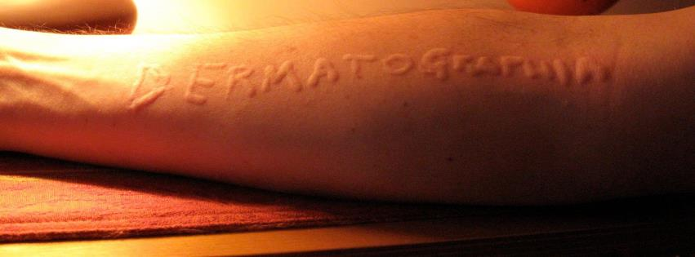
SIMPLE DERMOGRAPHISM
INDUCIBLE URTICARIA:
MECHANICAL
Triple response
  Local erythema
  Edema
  Flare
  Commonly seen in chronic urticaria
Notes:
THERE IS A TRIPLE REPONSE OF LOCAL ERYTHEMA DUE TO CAPILLARY VASODILATION
FOLLOWED BY EDEMA AND A SORROUNDING FLARE
DUE TO AXON REFLLEX INDUCED DILATATION OF ARETRIOLES AFTER STROKING THE SKIN.
THIS IS KNOWN AS SIMPLE DERMOGRAPHISM

Slide 23
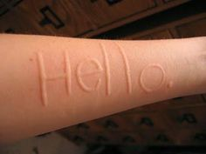
SYMPTOMATIC DERMOGRAPHISM
INDUCIBLE URTICARIA:
MECHANICAL
Wealing and itching at sites of trauma
Itching disproportionately severe compared with wealing
Notes:
PT MAY COMPLAINT OF WEALING AND ITCHING AT SITES OF TRAUMA,FRICTION WITH CLOTHING OR SCRATCHING T
SYMPTOMATIC DERMOGRAPHISM CAN OCCUR AT ANY AGE

Slide 24
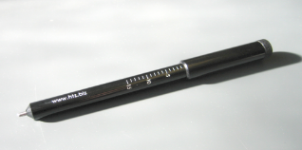
DIAGNOSIS
INDUCIBLE URTICARIA:
MECHANICAL
Stroking the skin at a tip pressure of less than 36g/mm2 induces a linear itching weal within 10 min
Notes:
SYMPTOMATIC DERMOGRAPHISM IS EASILY DIAGNOSED BY USING A CALIBRATED INSTRUNMENT ,
THIS CALIBERATED INSTRUMENT
SMOOTH BLUNT OBJECT ON THE UPPER BACK SKIN

Slide 25
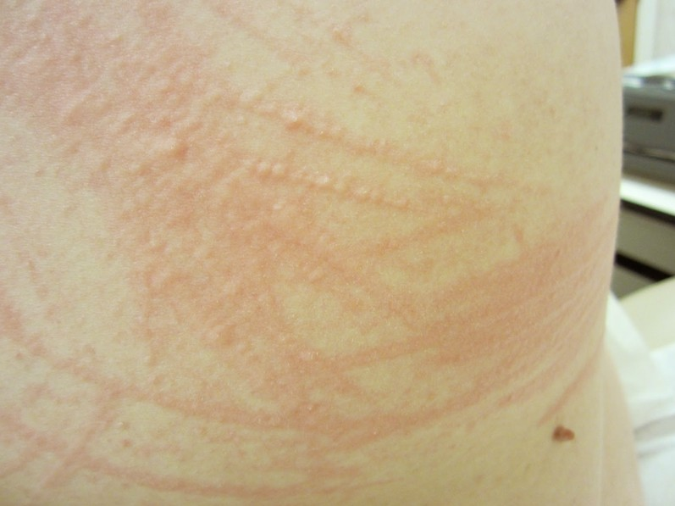
INDUCIBLE URTICARIA:
MECHANICAL
Red Dermographism
  Repeated rubbing is needed to induce punctate weals
Cholinergic Dermographism
  Erythematous line studded with punctate weals characteristic of cholinergic weals
  Seen in some patient with
  cholinergic urticaria
Notes:
IN RED
WHEREAS IN CHOLINERGC URTICARIA

Slide 26
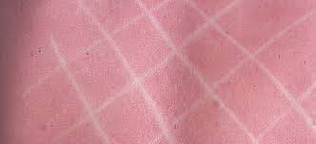
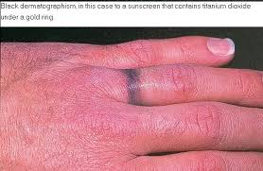
INDUCIBLE URTICARIA:
MECHANICAL
Delayed dermographism
  After normal fading of triple response, or an immediate dermographic response
  weal returns in same site and is usually tender persist for upto 48 hrs
White dermographism
  Due to capillary vasoconstriction following
  light stroking of the skin
Black dermographism
  Discoloration of skin after pressure
  from metallic object
Notes:
It should b noted that not all forms of dermographism are urticaria

Slide 27
DELAYED PRESSURE URTICARIA
INDUCIBLE URTICARIA:
MECHANICAL
Wealing at sites of sustained pressure
30 min to 9 hrs, usually 4-8 hrs and lasts 12-72 hrs
Weals occur frequently:
  Under tight clothing
  Hands after manual work
  Lower back and buttocks after sitting
  Feet after walking
May be itchy, tender or painful
Notes:
UNCOMMON,
THE CONDITION MAY BE MISTAKEN FOR URTICARIAL VASCULITIS OR ANGIOEDEMA

Slide 28
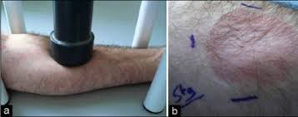
DIAGNOSIS
INDUCIBLE URTICARIA:
MECHANICAL
  Dermographometer set at 100g/mm3 for 70 sec
  Weighted rods 1.5cm diameter with 2.5kg anterior thigh (20 min)
  Read after 2-6 h and the following day

Slide 29
VIBRATORY ANGIOEDEMA
INDUCIBLE URTICARIA:
MECHANICAL
Any vibratory stimulus such as
  Jogging, vigorous toweling or using lawnmowers
  localized red itchy swelling
  Minutes lasting less than few hours
If stimulus is severe, generalized erythema and headache may occur
Notes:
ANOTHER FORM OF MECHANICALY INDUCED URTICARIA IS VIB ANGIEDEMA
WHICH IS VERY RARE FORM OF URTICARIA
ANY VIBRATORY STIMULUS SUCH AS JOGGING,VIGOROUS TOWELLING OR USING LAWNMOWERS
INDUCES A LOCALISED RED ITCHY SWELLING WITHIN MINUTES AND LASTING LESS THAN A FEW HRS BUT IF THE STIMULUS IS SEVERE ,GENERALISED ERYTHEMA AND HEADACHE MAY OCCUR

Slide 30
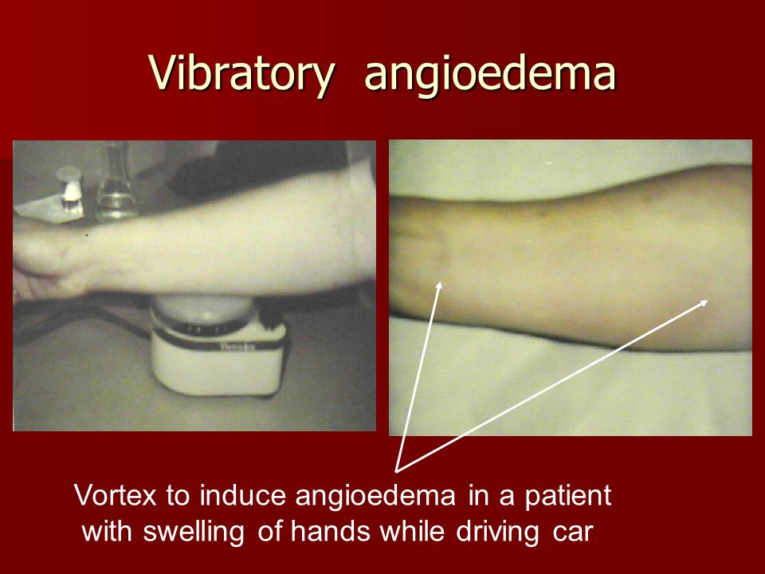
Vibratory angioedema can be reproduced using laboratory vortex mixer
INDUCIBLE URTICARIA:
MECHANICAL
DIAGNOSIS
Notes:
Other vibrator stimulus like jogging on the spot

Slide 31
THERMAL INDUCED URTICARIS
INDUCIBLE URTICARIA:
THERMAL
Cholinergic Urticaria
Heat Contact Urticaria
Cold Contact Urticaria
Notes:
Or thermal induced urticaria

Slide 32
CHOLINERGIC URTICARIA
INDUCIBLE URTICARIA:
THERMAL
  Characteristic small weals appear in association with sweating
  Stimulation of sweating by rise in core temperature, emotion or gustatory stimuli
  Stimulation of cholinergic postganglionic sympathetic nerve supply to sweat gland
  Lesions are itchy persist for few min to hour or two
  Typically occurs in adolescents and often atopics
Notes:
…WEALING OCCURS ON STIMULATION OF SWEATING BY RISE…..
IT IS THOUGHT TO BE RELATED TO STIMULATION OF THE CHOLINERGIC…
LESIONS INCREASE IN NUMBER AFTER EXERCISE

Slide 33
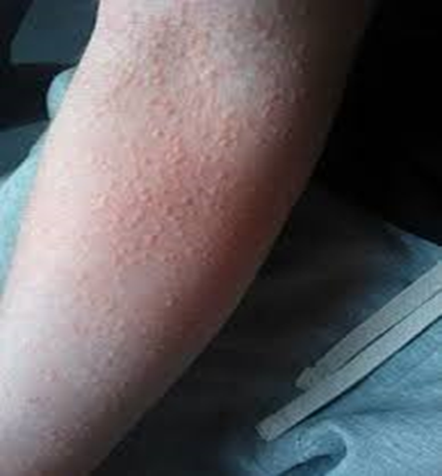
DIAGNOSIS
INDUCIBLE URTICARIA:
THERMAL
  Hot bath or shower at 42C
  Exercise in warm environment to the point of sweating
  Aim to bring out sweat, read after 5-10 min
Notes:
THE DIAGNOSIS OF CHOLINERGIC URTICARIA IS BEST CONFIRMED BY PROVOCATION,
WITH THE APPEARANCE OF
TYPICAL ITCHY WEALS ON AN ERYTHEMATOUS BACKGROUND AFTER WARMING.
FOR EXAMPLE IN A HOT BATH AT

Slide 34
HEAT CONTACT URTICARIA
INDUCIBLE URTICARIA:
THERMAL
Rarest form of urticaria
Warming at 38-44C for 2-5 min
Induces wealing, lasts for 1 hr
Treated with antihistamines or tolerance by repeated exposure to heat may be helpful.
Notes:
RAREST FORM OF INDUCIBLE URTICARIAS
.LOCALISED WARMING OF THE SKIN
AT TEMPERATURE FROM 38-44 C FOR 2-5 MINS INDUCES WEALING AT THE TEST SITE LASTING 1 HR.
TREATED WITH ANTIHISTAMINES OR INDUCTION OF TOLERANCE BY REPEATED EXPOSURE TO HEAT MAY B HELPFUL

Slide 35
COLD CONTACT URTICARIA
INDUCIBLE URTICARIA:
THERMAL
most common type of cold urticaria
Cold water bathing risks anaphylaxis and drowning
Treatment with low sedation antihistamines
Repeated and gradual exposure to cold to induce tolerance
Notes:
COLD URTICARIAS ENCOMPASSES A VARIETY OF SYNDROMES IN WHICH COLD INDUCES URTICARIA

Slide 36
Primary cold contact
INDUCIBLE URTICARIA:
THERMAL
IMMEDIATE :
  Commonest form
  Frequently affects young adults
  Preceded by nonspecific URTI, infectious mononucleosis, or insect bites
  Ithing and wealing occur on cold exposure within min and last upto 1 hr
DELAYED :
  Wealing occurs after a delay of hours
  Rare form
Notes:
VARIETY OF COLD CONTACT URTICARIAS
PRIMARY : INCLUDES IMMEDIATE AND DELAYED ONSET COLD CONTACT URTICARIAS
DERMOGRAPHISM AND CHOLINERGIC URTICARIA ARE FREQUENTLY ASSOCIATED WITH COLD URTICARIA.
COLD WINDS,COLD RAINS ,COLD LIQUIDS ARE TIGGERS.
FLUSHING,PALPITATION,HEADACHE,WHEEZING,LOSS OF CONCIOUSNESS AND DROWNING OCCUR AFTER COLD BATH

Slide 37
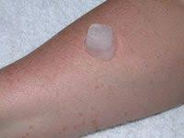
DIAGNOSIS
INDUCIBLE URTICARIA:
THERMAL
Application of melting ice cube in thin plastic bag for 5-20 min
  Usually on volar forearm
  Read after 10min
  TempTest for 5 min , read at 10 min
Notes:
TEMPTEST® PROVIDES TEMPERATURES OF 4°- 44° C AND TRANSFERS TO THE PATIENT’S SKIN BY PLACING THE INNER FOREARM ON AN U SHAPE ALUMINUM STENCIL ON THE DEVICE FOR 5 MINUTES.
THE U-STENCIL INDICATES THE TEMPERATURE RANGE CONTINUOUSLY. BY THIS METHOD IT IS POSSIBLE EASILY TO SPECIFY AND ASSET AT WHICH THRESHOLD TEMPERATURE
(COLD URTICARIA IS INDICATED BY HIGHEST TEMPERATURE AND HEAT URTICARIA BY LOWEST TEMPERATURE) WHEALS ARE TRIGGERED.

Slide 38
Secondary cold contact
INDUCIBLE URTICARIA:
THERMAL
Secondary to cryoproteins
Associated with other manifestations : Raynaud phenomenon, purpura or skin necrosis
Cryoglobulinemia may be idiopathic or occur in Collagen Vascular Disease, CLL, Myeloma & Infectious Mononucleosis
Notes:
COLD URTICARIA SECONDARY TO CRYOPROTIENS IS RARE.
ASSOCIATED WITH OTHER MANIFESTATIONS SUCH AS RAYNAUD PHENOMENON,PURPURA OR SKIN NECROSIS.COLD URTICARIA

Slide 39
Systemic cold urticaria
INDUCIBLE URTICARIA:
THERMAL
Widespread wealing in response to cooling of core body temperature
Local ice cube test negative
Testing performed by placing the patient in cold room at 4C for 30 min
Notes:
IN GENERALIZED REFLEX COLD URTICARIA,
WIDESPREAD WEALING OCCURS IN RESPONSE TO COOLING OF THE CORE BODY TEMPERATURE BUT
A LOCAL ICE CUBE TEST IS NEGATIVE

Slide 40
OTHER TYPES OF INDUCIBLE URTICARIA
Solar Urticaria
Aquagenic Urticaria
Contact Urticaria
( allergic and non allergic )

Slide 41
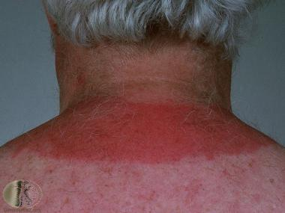
Solar urticaria
OTHER INDUCIBLE URTICARIA
Weals develop at site of exposure
to visible long or short UV radiation
Within minutes
Fade within 2 hrs
May be idiopathic or secondary to porphyria
Notes:
WEALS DEVELOP AT THE SITE OF EXPOSURE TO VISIBLE LONG OR SHORT UV RADIATIONS WITHIN MINUTES AND IT IS USUALLY FADE WITHIN 2 HRS.
.IT MAY B IDIOPATHIC OR SECONDARY TO PORPHYRIAS
IN CONTRAST TO PLE IN WHICH URTICATED LESIONS APPEAR HOURS LATER AND LAST FOR DAYS

Slide 42
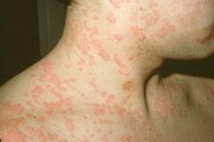
Aquagenic urticaria
OTHER INDUCIBLE URTICARIA
Contact with water produce eruption
Irrespective of temperature
Resembling cholinergic urticaria
Notes:
CONTACT WITH WATER AT ANY TEMPERATURE INDUCES AN ERUPTION RESEMBLING CHOLINERGIC URTICARIA,
ALTHOUGH THE WEALS ARE FEW IN NUMBER AND ARE SORROUNDED BY A WIDE FLARE.
OTHER URTICARIA THAT CAN ALSO BE INDUCED BY WATER
SUCH AS COLD URTICARIA, DERMOGRAPHISM, CHOLINERGIC URTICARIA MUST BE EXCLUDED

Slide 43
Contact urticaria
OTHER INDUCIBLE URTICARIA
ALLERGIC:
Percutaneous or mucosal penetration of an allergen to which the individual has already specific IgE
Type 1 hypersensitivity response provoked
Resulting in immediate, localized weal and flare
Resolving within 2 hours
Notes:
TYPE 1 HYPERSENSITIVITY RESPONSE INVOLVING MAST CELL DEGRANULATION WITH HISTAMINE RELEASE
WEAL AND FLARE OR EVEN ANAPHYLAXIS IF THE INDIVIDUAL IS EXTREMELY SENSITIVE
COMMONEST CAUSES ARE FOOD SUCH AS NUTS ,FISH AND FRUITS

Slide 44
Contact urticaria
OTHER INDUCIBLE URTICARIA
NON-ALLERGIC:
Direct injection of vasoactive chemicals by plants or animals
Reaction may take upto 45 minutes to develop
Due to prostaglandin D2 formation rather than histamine release

Slide 45
OTHER INDUCIBLE URTICARIA
Non-allergic
(non immunologiocal)
Allergic (immunological)
Cow’s milk
Kiwi fruit
Peanuts
Sesame seeds
Spices
Celery
Saliva, Urine
Moths/catterpillars
Fragrance & latex
Histamine liberators: Cobalt &dimethysulfoxide
Fragrance: Balsam of Peru
Bleaching agent: ammonium persulphate
Preservatives: Benzoic acid & Sorbic acid
Vasoactive: Jellyfish & Nettle stings
Flavouring agents: cinnamic acid

Slide 46
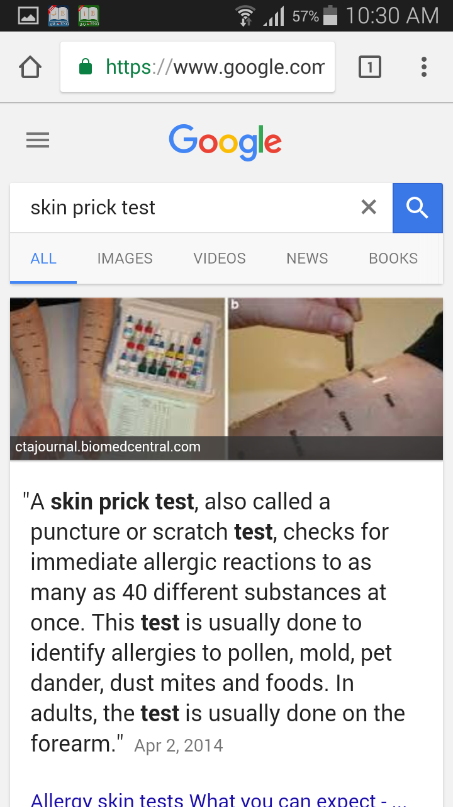
Diagnosis
OTHER INDUCIBLE URTICARIA
The forearm is coded with a skin marker pen corresponding to the number of allergens being tested
A drop of allergen solution
is placed
A small prick through the drop is made
Observe skin reactions in 20–30 minutes.
Notes:
DIAGNOSIS OF CONTACT URTICARIA IS MADE BY SKIN PRICK TESTING
WITH FRESH FRUITS
AND IMMUNOCAP FLOUROIMMUNOASSAY

Slide 47
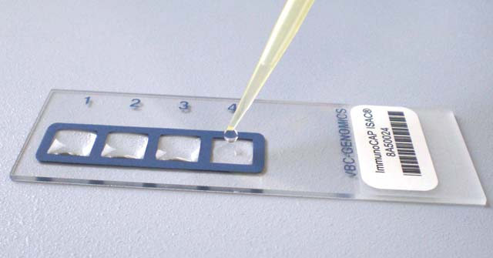
Diagnosis
OTHER INDUCIBLE URTICARIA
Immunocap Fluroimmunoassay measures allergen specific IgE in human serum.
Notes:
ANOTHER METHOD OF DX IS BY IMMUNOCAP FLUROIMMUNOASSAY The ImmunoCAP ISAC 112 is a fluoro-immunoassay that allows detection of specific IgE to 112 molecular components from 51 allergenic sources.

Slide 48
DIFFERENTIAL DIAGNOSIS
DIFFERENTIAL DIAGNOSIS
Urticarial Vasculitis
Papular Urticaria.
Schnitzler Syndrome
Acute Contact Dermatitis
Angioedema
Erythema multiforme

Slide 49
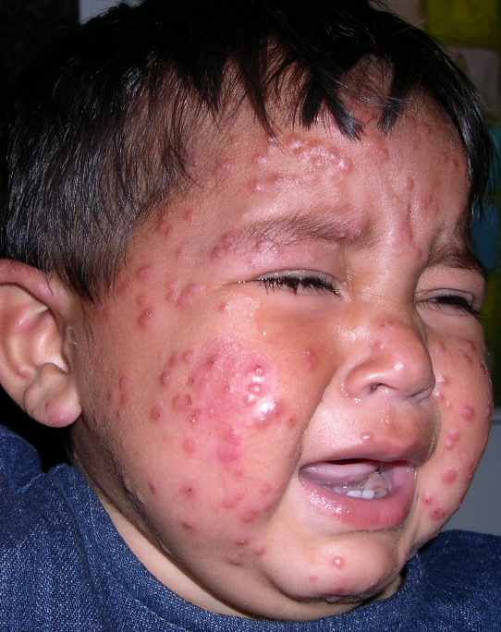
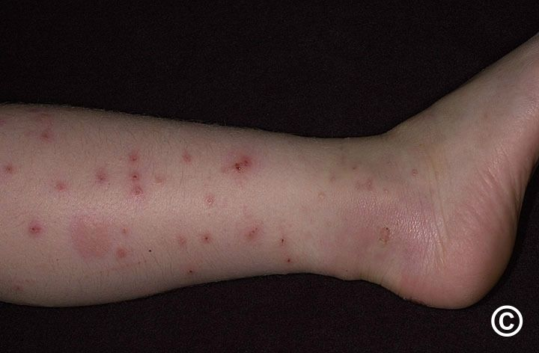
PAPULAR URTICARIA
DIFFERENTIAL DIAGNOSIS
After insect bite
Weals & papules on exposed parts
Lesions last for days or weeks

Slide 50
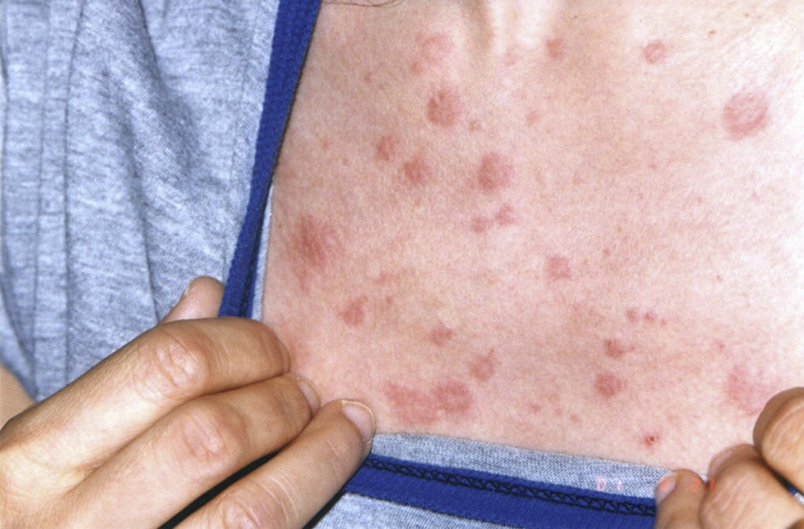
SCHNITZLER SYNDROME
DIFFERENTIAL DIAGNOSIS
Recurrent urticarial rash
Non pruritic
Resolve with hyper pigmentation
Fever, bone and joint pain
Lymphadenopathy

Slide 51

ERYTHEMA MULTIFORME
DIFFERENTIAL DIAGNOSIS
Target Lesion
Mucosal involvement
Acral distribution

Slide 52
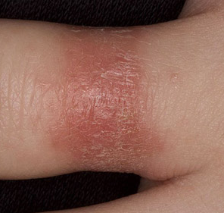
CONTACT DERMATITIS
DIFFERENTIAL DIAGNOSIS
Localized oedema, inflammation
and vesiculation
Burning/stinging sensation
Mostly known cause

Slide 53
DIAGNOSIS
URTICARIA:DIAGNOSIS
Clinical history
Investigations
Notes:
INFORMATION SHOULD B OBTAINED REGARDING THE ONSET, DURATION AND COURSE OF THE DISAESE.
SYSTEMIC INQUIRY SOULD B DONE
FAMILY HISTORY OF ATOPY, AUTOIMMUNITY, OR ANGIOEDEMA MAY B RELEVANT
ALSO DRUG HISTORY INCLUDING NSAIDS

Slide 54
INVESTIGATIONS
URTICARIA:INVESTIGATION
ACUTE
Infection:
Throat swab if pharyngeal symptoms
Other appropriate samples for suspected viral or bacterial infection
Drugs : Withdraw suspected drugs
Foods: Investigate for IgE sensitization (skin prick tests or ImmunoCAP where appropriate)
Notes:
INVESTIGATION IN ACUTE SPONTANEOUS URTICARIA
ARE CARRIED OUT TO FIND THE CAUSE OF
CAUSATIVE INFECTION
OFFENDING DRUG
FOODS

Slide 55
INVESTIGATIONS
URTICARIA:INVESTIGATION
CHRONIC
H1 Antihistamine Responsive:
CBC, ESR
Optional tests for extensive work‐up when other tests non‐revealing
25‐hydroxycholecalciferol (vitamin D)
• D‐dimer
• 3‐week trial of a low pseudoallergen diet
H1 Antihistamine Unresponsive
Thyroid autoantibodies
Thyroid function tests
Additional tests dependent on clinical presentation
C4 complement (angio‐oedema without weals)
Helicobacter pylori
• Stool for ova, cysts and parasites (foreign travel)
• Chest X‐ray (if lymphoma considered)

Slide 56

MANAGEMENT
URTICARIA: MANAGEMENT
General Measures:
        Minimize heat/cold
        Decrease stress
        Avoid Aspirin/other drugs
        Avoid food additives/preservatives
        Wearing of loose fitting clothing
        Application of soothing creams with menthol
Notes:
Includes gen measures like

Slide 57
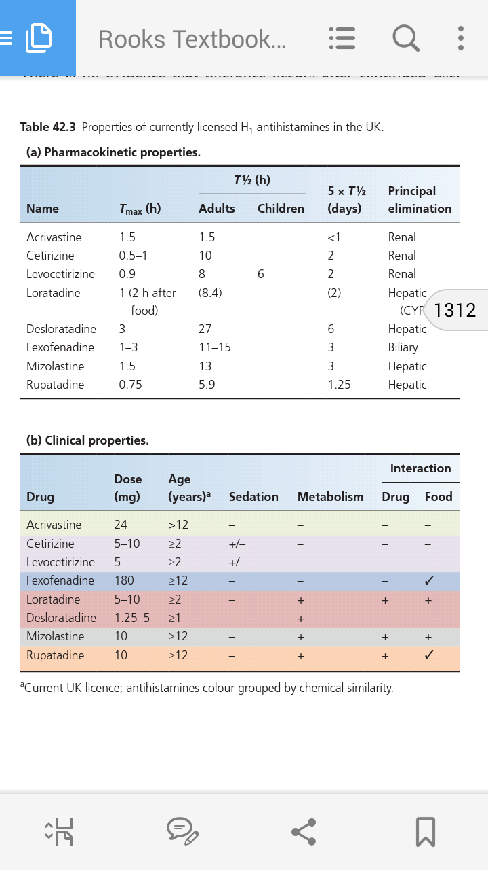
1ST LINE
(H1 ANTIHISTAMINES)
URTICARIA: MANAGEMENT
Notes:
DEPENDING UPON THE RESPONSE OF PREVIOUS MEASURES
DRUG THERAPY MAY BE 1ST, 2ND OR 3RD LINE
H1 ANTIHISTAMINES ARE FIRST LINE TREATMENT OF ALL TYPES OF URTICARIA…
THEY ARE RAPIDLY ABSORBED REACHING PEAK SERUM CONCENTRATION IN 1-3 HRS
THE SECOND GENERATION ANTIHISTAMINES ARE PREFERABLE BCOZ OF LOW SEDATION AND MINIMAL ANTICHOLINERGIC SIDE EFFECTS.RARELY ANTIHISTAMINE APPEAR TO MAKE URTICRIA WORSE

Slide 58
2ND LINE THERAPY
URTICARIA: MANAGEMENT
TARGETED THERAPY
  Prednisolone ( Severe Urticaria mostly in urticarial vasculitis & delayed pressure urticarial)
  Leukotriene Receptor Antagonist ( In Aspirin Sensitive Urticaria, Delayed Pressure Urticaria & autoimmune urticaria)
  Danazol (Refractory Cholinergic Urticaria)
  Sulphasalazine And Dapsone (Delayed Pressure Urticaria)
  Narrow Band Phototherapy (Symptomatic Dermographism)
  Cold Desensitization (Cold Contact Urticaria)
Notes:
ORAL CORTICOSTEROIDS ARE EFFECTIVE IN SEVERE URTICARIA AT HIGH DOSES EG: 0.5 MG/KG/DAY
DANAZOL MORE LIKELY TO BE TOLERATED IN MEN THAN WOMEN BECAUSE IT POTENTIALLY HAS UNWANTED VIRILIZING EFFECTS
EMERGENCY TX OF HISTAMINERGIC NON HEREDITARY ANGIOEDEMA CAUSING RESPIRATORY EMBARASSESMENT FROM OROPHARAYNGEAL-LARYNGEAL ANGIOEDEMA IS I/M EPINEPHRINE
IT ACTS BY RAPIDLY VASOCONSTRICTION & BY STABILIZING MAST CELLS THROUGH B ADRENOCEPTOR STIMULATION

Slide 59
3RD LINE THERAPIES
URTICARIA: MANAGEMENT
  Plasmapheresis
  IV IG infusion at 0.4g/kg/day for 5 days
  Ciclosporin 2.5 - 3.5 mg/kg/day for 1 – 3 months
  Tacrolimus
  Mycophenolate mofetil
  Omalizumab (anti IgE)
IMMUNOMODULATORS
Notes:
FOR PTS WITH SEVERE UNREMITTING SPONTANEOUS URTICARIA
NOT RESPONDING TO CONVENTIONAL THERAPY,
IMMUNOMODULATPR THERAPY CAN BE HELPFUL
HAVE BEEN TESTED IN SMALL UNCONTROLLED TRIALS

Slide 60
ANGIOEDEMA

Slide 61
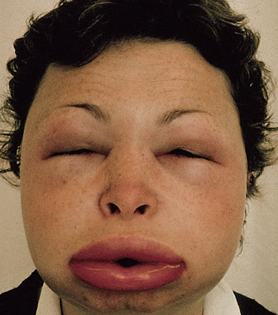
ANGIOEDEMA
ANGIOEDEMA
Deep, localized, self-limiting swelling
Skin and submucosal tissues
Temporary increase in vascular permeability
Vasoactive mediators
Lips, eyelid and genitalia most often involved
Notes:
ANGIOEDEMA IS A DEEP LOCALISED SELF LIMITING SWELLING
OF SKIN AND SUBMUCOSAL TISSUES
DUE TO TEMPORARY INCREASE IN VASCULAR PERMEABILITY
RESULTING FROM VASOACTIVE MEDIATORS

Slide 62
ANGIOEDEMA
ANGIOEDEMA
WITHOUT WEALS
WITH WEALS
Hereditary angioedema
Bradykinin mediated
Uncommon presentation
Fatal laryngeal obstruction
Bowel obstruction, may present as acute abdomen
Spontaneous or inducible urticaria
Mast cell mediator
Common presentation
May occur without weals
Affects skin and oropharynx
Bowels are never affected
Notes:
ANGIOEDEMA WITHOUT WEALS SHOULD BE CONSIDERED SEPERATELY FROM ANGIEDEMA WITH WEALS.
ANGIOEDEMA WITHOUT WEALS IS BRADYKININ INDUCED ANGIOEDEMAS INCLUDING HAE
WHERE AS ANGIOEDEMA WITH WEALS FALLS WITHIN THE SPECTRUM OF SPONTANEOUS AND INDUCIBLE URTICARIAS

Slide 63
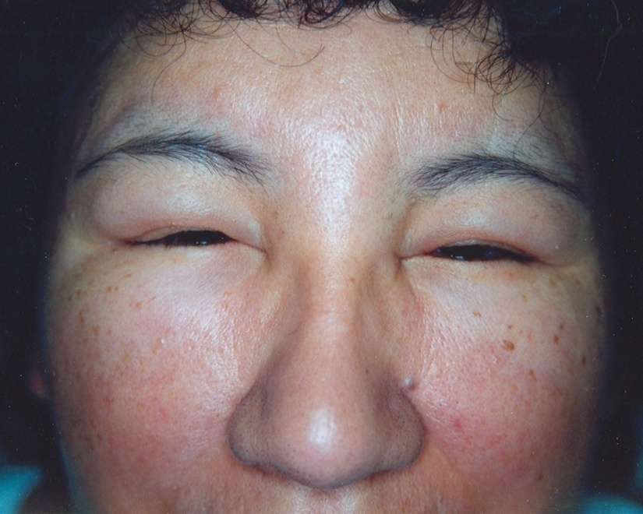
CLASSIFICATION
ANGIOEDEMA WITHOUT WEALS
Hereditary Angioedema
Acquired Angioedema
Notes:
ARE CLASSIFIED EITHER INTO
OR

Slide 64
HEREDITARY ANGIOEDEMA
ANGIOEDEMA WITHOUT WEALS
Bradykinin mediated
  C1 estrase inhibitor deficiency
  Impaired function
Notes:
and is usually linked to C1 estrase inhibitor deficiency
or
impaired function

Slide 65
HEREDITARY ANGIOEDEMA
ANGIOEDEMA WITHOUT WEALS
Rare disorder <2%
Autosomal dominant pattern
Mutation in gene encoding C1INH (SERPING1)
Recurrent swellings of the skin and mucosa
Solitary and painful
They seldom itch
Notes:
ACCOUNTING FOR LESS THAN 2 % OF ALL CASES OF ANGIOEDEMA WITHOUT WEALS
25 % OF CASES RESULT FROM MUTATION OF GENE ENCODING C1INH (SERPING 1)
MAY OCCUR SPONTANEOUSLY OR AFTER TRAUMA,DENTAL TRAUMA AND INTUBATION

Slide 66
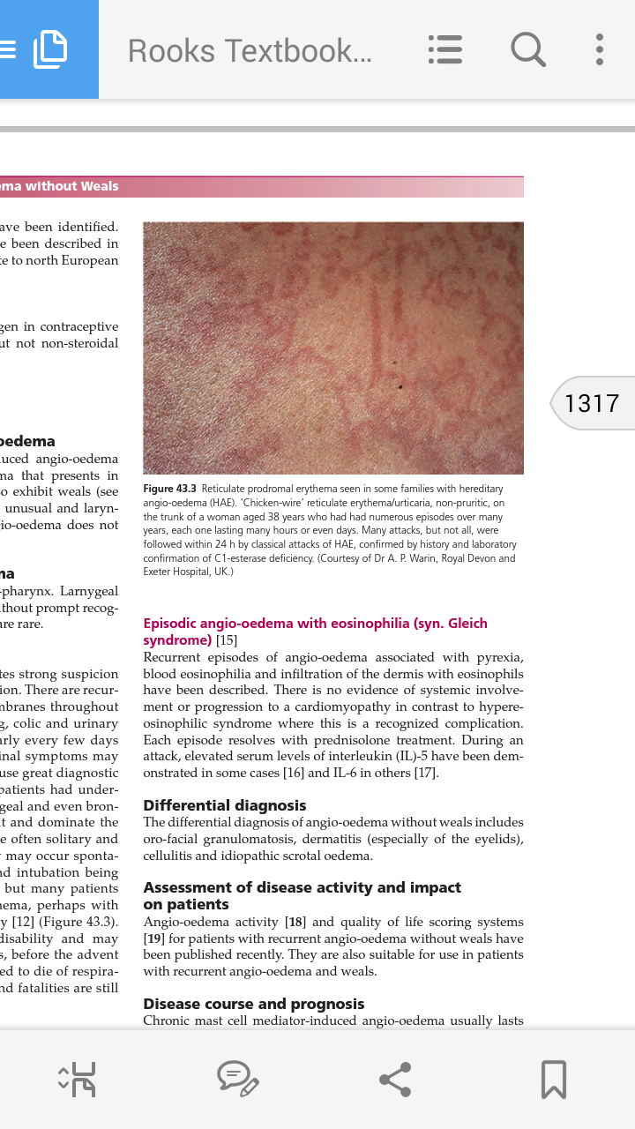
HEREDITARY ANGIOEDEMA
ANGIOEDEMA WITHOUT WEALS
Reticulate erythema with minimal edema
Pharyngeal, laryngeal, bronchial involvement
Associated with nausea, vomiting, colic and urinary symptoms
Notes:
MANY PTS MAY DEVELOP RETICULATE ERETHEMA WITH MINIMAL EDEMA
AND THERE MAY B SIGNIFICANT
PHARYNGEAL , LARYNGEAL AND BRONCHIAL INVOLVMENT
CHICKEN WIRE RETICULATE ERYTHEMA ON THE TRUNK

Slide 67
HEREDITARY ANGIOEDEMA
ANGIOEDEMA WITHOUT WEALS
Divided into three types
Type I HAE
  Reduce C1INH
Type II HAE
  Normal or raised but dysfunctional C1INH
Type III HAE
  Normal levels of immunochemical and functional C1INH and is diagnosed mainly on positive family history
Notes:
A THIRD TYPE OF HAE WAS INITIALLY REFERRED AS ESTROGEN DEPENDENT ANGIOEDEMA
SINCE THE CASES WERE EXCLUSIVELY IN WOMEN BUT LATER CASE REPORTS WERE ALSO FOUND IN MEN..
THESE ANGIEDEMAS ARE LIFELONG
WITH VARIATION IN ACTIVITY
CORRESPONDING TO ENVIRONMENTAL FACTORS,DRUGS,ESPECIALY EXOGENOUS ESTROGENS AND ACE INHIBITORS AND ENDOGENOUS FACTORS LIKE PUBERTY AND PREGNANCY

Slide 68
ACQUIRED ANGIOEDEMA
ANGIOEDEMA WITHOUT WEALS
Acquired C1INH deficiency
Drug induced (ACE inhibitor)
Idiopathic non-mast cell mediator-induced angioedema
Notes:
ACQUIRED ANGIOEDEMA IS EITHER MAST CELL MEDIATED IN PTS WITH URTICARIA
BRADYKININ MEDEIATED IN PTS WITH ANGIOEDEMA DUE TO ACQUIRED C1 ESTRASE INHIBITOR DEFICIENCY
ACE INHITOR INDUCED ANGIOEDEMA
AND IDIOPATHIC NON MAST CELL MEDIATOR INDUCED ANGIOEDEMA

Slide 69
C1 estrase inhibitor
ANGIOEDEMA WITHOUT WEALS
Natural inhibitor of activated component of complement,
kallikrein, fibrinolytic and coagulation systems
Activation of each of these systems release
vasoactive peptides like bradykinin
Release of bradykinin increases permeability of vascular tissue causing angioedema

Slide 70
ACE INHIBITOR INDUCED ANGIOEDEMA
ANGIOEDEMA WITHOUT WEALS
  Reduced ACE → reduced bradykinin metabolism
  Develop within 3 wks of treatment
  Women and elderly
  Face and oropharynx
  Laryngeal involvement may be life threatening
  Remits after discontinuation of ACEi but it may takes 6 months to subside
Notes:
ACE INHIBITORS MAY CAUSE ANGIOEDEMA BY INBITING ACE RESULTING IN REDUCED BRADYKININ METABOLISM.
MOST CASES DEVELOPS WITHIN 3 WEEKS OF COMMENCING TREATMENT BUT CAN OCCUR ANY TIME .
IT AFFECTS PREDOMINANTLY THE FACE AND OROPHARYNX.
SYMPTOMS MAY B SEVERE AND LARYNGEAL INVOLVEMENT MAY B LIFE THREATENING

Slide 71
ANGIOEDEMA DUE TO ACQUIRED C1 INH DEFICIENCY
ANGIOEDEMA WITHOUT WEALS
  Two types are recognized:
  Type1: Lymphoproliferative disease
  Type 2: Autoantibodies against C1INH
Notes:
TYPE 1 IS DUE TO CONTINUOUS ACTIVATION OF COMPLEMENT BY LYMPHOPROLIFERATIVE DISEAS, INCLUDING PARAPROTIENIMEA DUE TO INCRSED CATABOLISM OF C1INH
TYPE 2 IS DUE TO AUTOANTIBODIES THAT RECOGNIZE C1INH AND INACTIVATE IT WITHOUT TRIGGERING ITS TARGET PROTEASES.
BOTH FORMS HAVE REDUCE ANTIGENIC AND FUNCTIONAL C1INH
TREATMENT OF UNDERLYING LYMPHOPROLIFERATIVE DISORDER MAY LEAD TO RESOLUTION OF TYPE 1 ACQUIRED C1INH DEFICIENCY

Slide 72
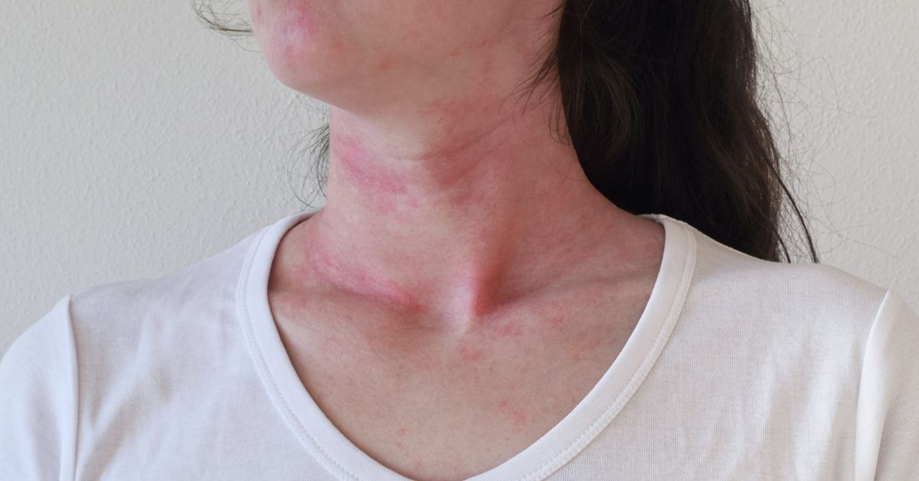
CLINICAL VARIANTS
ANGIOEDEMA WITHOUT WEALS
CLARKSON SYNDROME
(SYSTEMIC CAPILLARY LEAK SYNDROME)
  Dramatic recurrent episodes of exudation of fluid into various organs and may involve skin
  IgG paraproteinemia
  Mortality high
Notes:
CLARKSON SYNDROME IS ALSO KNOWN AS SYSTEMIC CAPILLARY LEAK SYNDDROME
GLIECH SYNDROME ALSO KNOWN AS EPISODIC ANGIOEDEMA WITH EOSINOPHILIA

Slide 73
CLINICAL VARIANTS
ANGIOEDEMA: WITHOUT WEALS
GLEICH SYNDROME
(EPISODIC ANGIOEDEMA WITH EOSINOPHILIA)
  Recurrent episodes of angioedema
  Pyrexia
  Blood eosinophilia
  Infiltration of dermis with eosinophils
Notes:
ALSO KNOWN AS

Slide 74
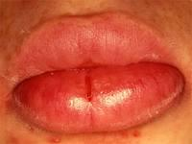
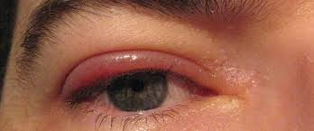
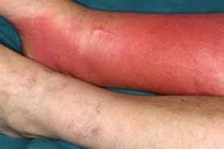
DIFFERENTIAL DIAGNOSIS
ANGIOEDEMA WITHOUT WEALS:DIFFERENTIAL DIAGNOSIS
Oro-facial granulomatosis
Eyelid dermatitis
Cellulitis
Idiopathic scrotal edema

Slide 75
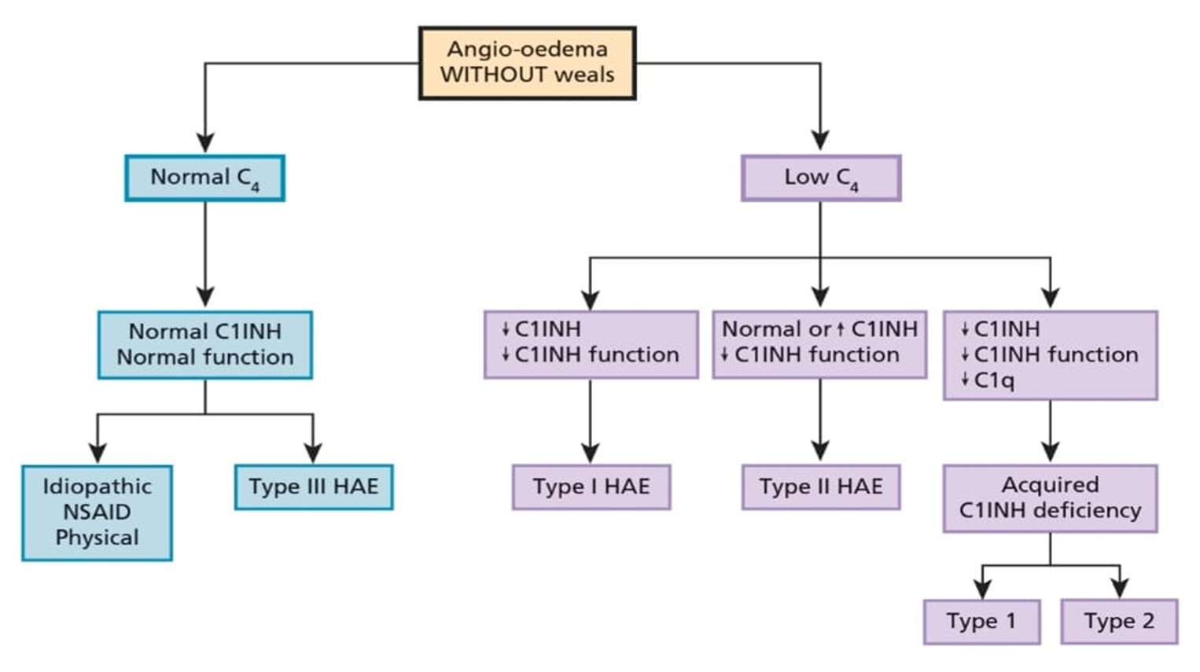
INVESTIGATIONS
ANGIOEDEMA WITHOUT WEALS:INVESTIGATION
C4 complement is good screening blood test
Should be < 30 % of mean normal in affected person
Functional C1INH
Notes:
IN PATIENT WITH MAST CELL ACTIVATION INDUCED ANGIOEDEMA , SPONTANEOUS AND INDUCIBLE FORMS SHOULD BE CONSIDERED..
THAY CAN OCUUR IN THE SAME PATIENTS
SEVERE INFLAMMATORY DISORDERS SHOULD B RULED OUT BY CHECKING CRP AND A WHITE BLOOD DIFFERENTIAL
C4 COMPLEMENT IS A GOOD SCREENING TEST FOR HAE TYPE 1 AND TYPE 2 ESPECIALLY DURING ATTACKS
MEASUREMENT OF FUNCTIONAL C1INH IS NECESSEARY TO DIAGNOSE THYPE 2 HAE

Slide 76
MANAGEMENT
ANGIOEDEMA WITHOUT WEALS:MANAGEMENT
Mast Cell Mediated Angioedema
  H1-Anti histamines (non-sedating 2nd generation )
  Omalizumab (anti IgE)
  Epinephrine in anaphylaxis
Notes:
MANAGEMENT OF MAST CELL MEDIATED INDUCED ANGIOEDEMA IS
ESSENTIALLY THE SAME AS FOR CHRONIC SPONTANEOUS URTICARIA PTS WITH WEALS
PATIENT MAY HAVE PHARYGEAL SYMPTOMS

Slide 77
MANAGEMENT
ANGIOEDEMA WITHOUT WEALS:MANAGEMENT
Bradykinin mediated Hereditary angioedema
Emergency management
  Purified plasma derived C1INH I/V 20units/kg
  Recombinant C1INH
  Icatibant (bradykinin receptor 2 antagonist)
  Ecallantide (kallikerin inhibitor)
  FFP containing C1INH
Notes:
PPD DERIVED C1INH GIVEN BY BOLUS IV INFUSION IN A DOSE OF 20 UNITS/KG
HAS BEEN THE PRIMARY TREATMENT FOR ORO-FACIAL OR LARYNGEAL EDEMA AND ABDOMINAL COLIC IS RECOMMENED.
SYMPTOM RELIEF SHOULD BE SEEN WITHIN 30 -90 MINS AND
MAY TAKE 6-8 HRS FOR COMPLETE RESOLUTION

Slide 78
MANAGEMENT
ANGIOEDEMA WITHOUT WEALS:MANAGEMENT
Short Term Prophylaxis of HAE
  Plasma derived C1INH
Long Term Prophylaxis of HAE
  Plasma derived C1INH
  Danazol/ stanozolol
  Tranexemic acid
Notes:
STEROIDS STIMULATE PRODUCTION OF THE DEFICIENT INHIBITOR BY THE LIVER UNDER CONTROL OF THE REMAING FUNCTIONING C1INH ALLELE IN HETROZYGOTES

Slide 79
MANAGEMENT
ANGIOEDEMA WITHOUT WEALS:MANAGEMENT
Aquired C1INH deficiency
Emergency management
Plasma derived C1INH
Icatibant
Prophylaxis
Plasma derived C1INH
Tranexamic acid
Anabolic steroids
Rituximab
Notes:
FOR ACEI ANGIOEDEMAS STOP ALL ACE INHIBITORS

Slide 80
URTICARIAL VASCULITIS

Slide 81
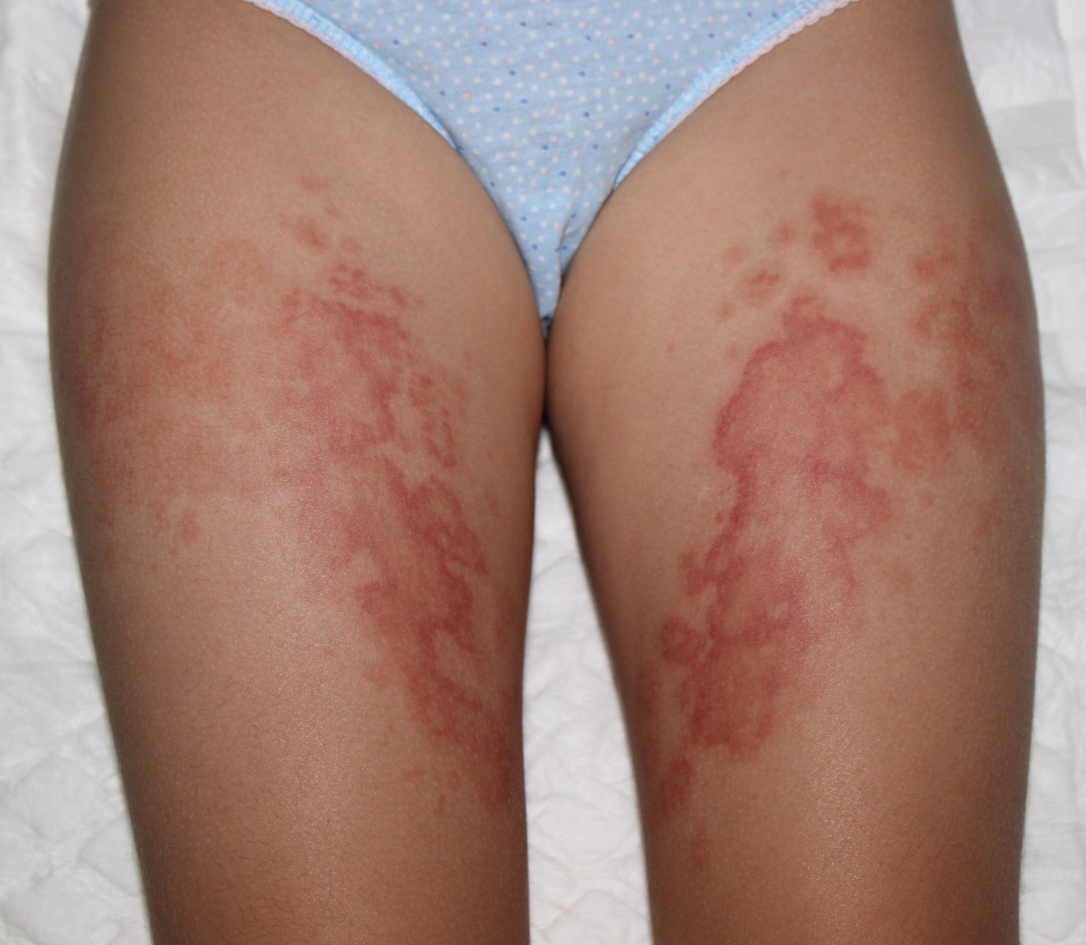
URTICARIAL VASCULITIS
URTICARIAL VASCULITIS
It is characterized clinically by urticarial lesions
Occurs in about 1-20% of patients with a chronic urticarial illness
Histological evidence of leucocytoclastic vasculitis
Affects predominantly post capillary venules in the superficial dermis
Notes:
IT IS A RARE DISEASE
CHARACTERIZED CLINICALLY BY URTICARIAL LESIONS
WITH HISTOLOGICAL EVIDENCE OF LEUCOCYTOCLASTIC VASCULITIS…
IT OCCURS WITH PEAK INCIDENCE IN 4TH DECADE..
WOMENS ARE MORE OFTEN AFFECTED

Slide 82
ASSOCIATED DISEASES
URTICARIAL VASCULITIS
Connective tissue diseases (SLE , Sjogren disease)
Chronic hepatitis B and C, infectious mononucleosis and lyme borreliosis
Serum sickness
Haematological disorders & Malignancies
Schnitzler syndrome, Muckle-wells syndrome and Cogan syndrome
Notes:
SEVERAL DISEASES ARE ASOOCIATED WITH URTICARIAL VASCULITIS.
HEMATOLOGICAL DISORDERS SUCH AS ESSENTIAL CRYOGLOBULINEMIA AND ITP AND
MALIGNANCIES SUCH AS HODGKIN LYMPHOMA,ACUTE MYELOGENOUS LEUKEMIA,IMMUNOGLOBULIN A MYELOMA.
COGAN SYNDROME IS CHARACTERIZED BY INTERSTITAL KERATITIS, AUDIOVESTIBULAR DISTURBANCES AND SYSTEMIC VASCULITIS

Slide 83
PATHOPHYSIOLOGY
URTICARIAL VASCULITIS
Circulating immune complexes
Complement activation via the classical pathway
Mast cell activation, production of pro-inflammatory cytokines
Endothelial cell activation and damage
Inflammatory cell infiltrate, neutrophil karyorrhexis and fibrin deposition
Notes:
is incompletely understood but several factors
play important role in pathogenesis including

Slide 84
CLINICAL VARIANTS
URTICARIAL VASCULITIS
Hypocomplementaemic Urticarial Vasculitis
Normocomplementaemic Urticarial Vasculitis
Notes:
SERIAL TESTING OF SERUM COMPLEMENT LEVELS OVER TIME IS IMPORTANT
FOR DISTINTION BETWEEN THESE 2 VASCULITIS.

Slide 85
Hypocomplementaemic Urticarial Vasculitis: Diagnostic Criteria
URTICARIAL VASCULITIS
Biopsy proven vasculitis
Arthralgia or arthritis
Uveitis or episcleritis
Recurrent abdominal pain
Glomerulonephritis
Decreased C1q or presence of anti-C1q autoantibodies
Notes:
DISTINCT CLINICAL SYNDROME
IDENTIFIED IN ABOUT 5 % OF PTS WITH URTICARIAL VASCULITIS
WITH THE FOLLOWING DIAGNOSTIC CRITERIA.
NOT ALL SYSTEMIC FEATURES ARE REQUIRED TO MAKE A DIAGNOSIS

Slide 86
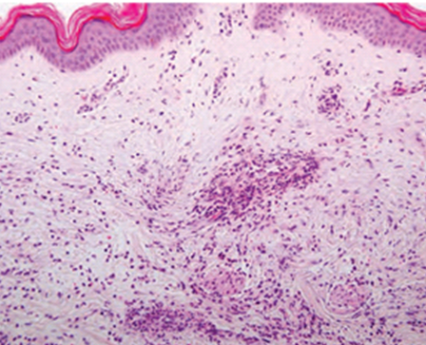
HISTOPATHOLOGY
URTICARIAL VASCULITIS
Endothelial cell damage and swelling and loss of integrity of vessel wall
Fibrin deposits in postcapillary venules
Neutrophil-predominant perivascular infiltrate with leucocytoclasis
Erythrocyte extravasation
IgG and IgM and C3 within and around the vessels of lesion at DEJ is a common feature
Notes:
CLASSICAL HISTOLOGICAL FEATURES OF FULLY DEVELOPED URTICARIAL VASCULITIS SHOWS
IGG IGM AND C3 ……IN HYPOCOMPLEMENT URTICARIAL VASCULITIS
NEUTROPHILIC PREDOMINENCE IN HUV.
LYMPHOCYTIC PREDOMINANCE IN LESIONS OLDER THAN 48 HRS

Slide 87
CLINICAL FEATURES
URTICARIAL VASCULITIS
Recurrent painful weals lasting > 24 hrs
Leaving residual hyperpigmentation
Livedo reticularis, Raynaud phenomenon, Bullous lesions
Angioedema
Arthralgia and joint stiffness
Gastrointestinal features , pulmonary symptoms, lymphadenopathy , spleenomegaly and hepatomegaly
Notes:
OTHER CUTANEOUS SIGNS INLUDE
ALSO COMPLAIN ABOUT FATIGUE MALAISE OR FEVER .
PT MAY ALSO COMPLAIN OF ARTHRALGIA N JOINT STIFNES
ALONGWITH
GASTROINTESTINAL FEATURES INCLUDES NAUSEA,VOMITING,ABDOMINAL PAIN,INETSTINAL BLEEDING AND DIARREHEA.
PULMONARY SYMPTOMES INCLUDES COUGH,DYSPNEA AND HEMOPTYSIS..SOME PTS DEVELOPS TRANSIENT OR PERSISTENT MICROSCOPIC HEMATURIA.
RARELY NEUROLOGICAL FEATURES..THERE IS ALSO AN ASSOCIATION OF CARDIAC VALVULOPATHY ,JACCOUD ARTHROPATHY WITH HUVS

Slide 88
COMPLICATIONS
URTICARIAL VASCULITIS
Renal involvement (microscopic hematuria and proteinuria)
Chronic obstructive pulomonary disease
Connective tissue diseases
Haematological malignancies
Chronic hepatitis B and C infections
Notes:
PTS MAY PRESENT WITH RENAL INVOLVEMENT.
COPD IS CONSIDERED TO A LIFE THREATENING COMPLICATION..
CTD ,HEMATOLOGICAL MALIGNANCIES AND CHRONIC HEP B AND C ARE OTHER COMPLICATIONS

Slide 89

INVESTIGATIONS
URTICARIAL VASCULITIS
INITIAL WORK-UP
Lesional skin biopsy (diagnostic)
Full blood count
ESR
Biochemical profile
C3 ,C 4 complements
Urine analysis
Anti extractable nuclear antigens
Hepatitis B and C serology
Circulating immune complexes
ANA
Notes:
THE WORKUP DEPENDS ON THE PT HISTORY AND EXAMINATION

Slide 90
INVESTIGATIONS
URTICARIAL VASCULITIS
EXTENDED WORK-UP
Direct IMF studies of skin biopsy
CH50, anti-C1q antibodies
Cryoglobulins
24 hr urine protein and creatinine clearance
Serum protien electrophoresis
CXR , lung function tests
Assesment of visual acquity and slit lamp examination
Notes:
Extended work up dependent on the clinical presentation

Slide 91
MANAGEMENT
URTICARIAL VASCULITIS
Second Line
Dapsone 75-100 mg/d
Colchicine 1-1.5 mg/d
HCQ 400 mg/d
Prednisolone 40 mg/d
First Line
H1 antihistamines (non-sedating)
NSAIDS
Notes:
MANAGEMENT IS BASED ON CASE REPORTS ,SMALL PT SERIES AND NON CONTROLLED STUDIES

Slide 92
MANAGEMENT
URTICARIAL VASCULITIS
Third Line
Azathioprine
Ciclosporin
Mycophenolate mofetil
Methotrexate
Intravenous immunoglobulins
Cyclophosphamide
Interleukin antagonists
Omalizumab
Notes:
OPTIONS INCLUDED IN 3RD LINE DRUG THERAPY ARE

Slide 93


