Slide 1
Urticaria and Angioedema

Slide 2
Definition
Urticaria is characterised by weals (hives) or angioedema (swellings, in 10%) or both (in 40%).
A weal is a descriptive term for transient, well‐demarcated, superficial pink or pale swellings of the dermis due to reversible exudation of plasma in the skin that fade, usually within hours, without leaving a mark
Angioedema is deeper swelling within the skin or mucous membranes and can be skin-coloured or red

Slide 3
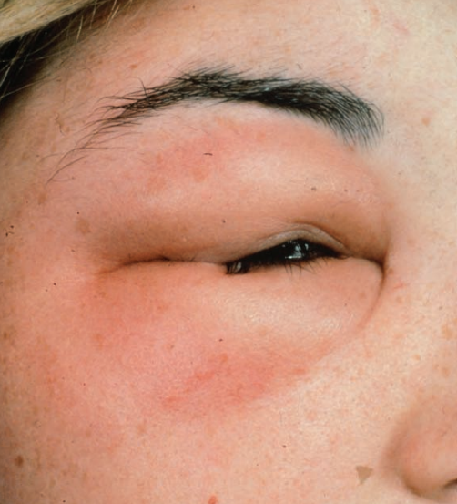
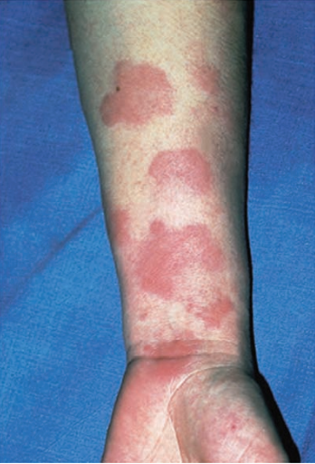

Slide 4
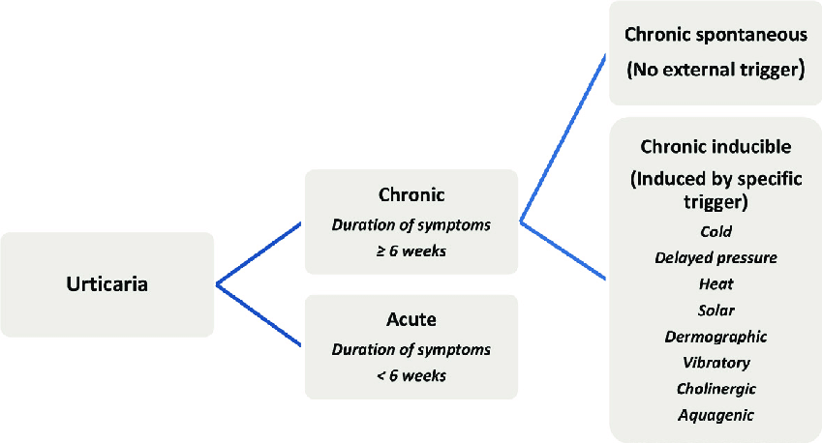
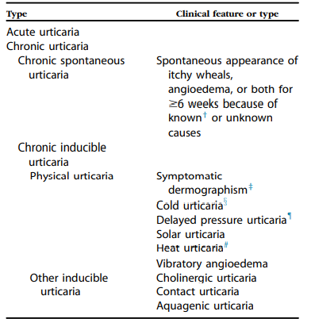
Classification
Notes:
intermittent

Slide 5
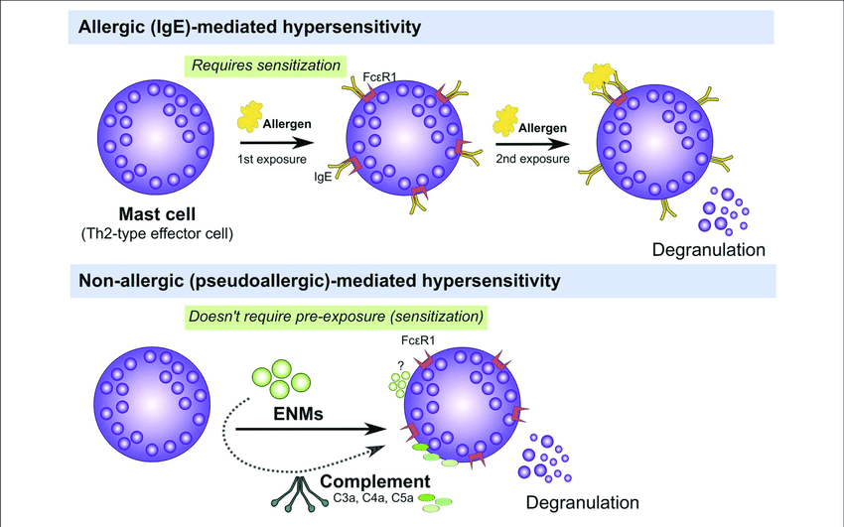
Pathophysiology

Slide 6
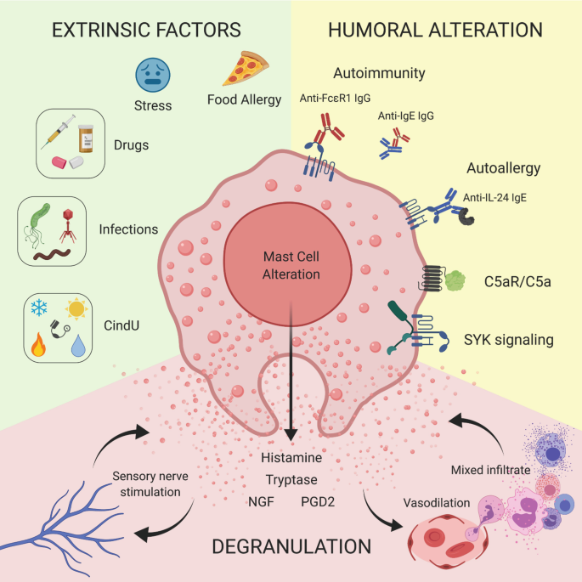
Other mediators include prostaglandin D2 and platelet‐activating factor.
Preformed tumour necrosis factor (TNF)‐α
Increased peripheral blood levels of interleukin 8 (IL‐8) and IL‐10
Tryptase can induce mast cell degranulation and cleave C3 to C3a and C3b. C3a can activate mast cells, and C3b can activate the alternative complement pathway.
Notes:
predominantly of helper T lymphocytes [53,54] with a TH0 cytokine profile expressing mRNA for interleukin (IL)‐4, IL‐5 and interferon‐γ (IFN‐γ)

Slide 7
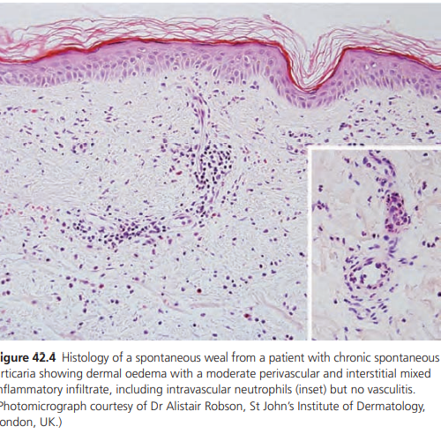
Histology
Neutrophils are especially prominent in acute urticaria, in contrast to DPU, where the main infiltrate is composed of eosinophils in the reticular dermis
Notes:
The histology of weals is usually non‐specific, with vascular and lymphatic dilatation, oedema and a variable perivascular cellular dermal infiltrate consisting of lymphocytes, neutrophils and eosinophils

Slide 8
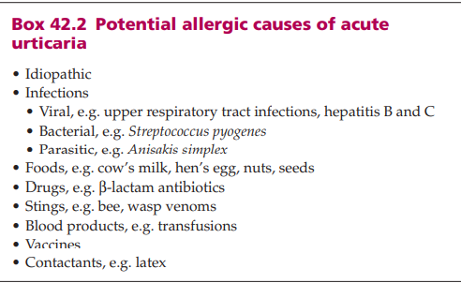

Slide 9
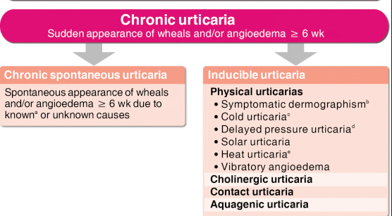
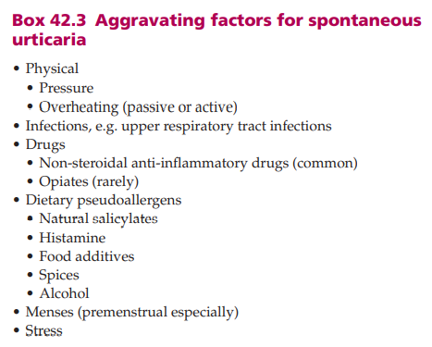
Notes:
dental sepsis, sinusitis, urinary tract and gallbladder infections
Genetics There is a highly significant linkage of human leukocyte antigen (HLA) DRB1*04 (DR4) and its associated allele DQB1*0302 (DR8) with histamine‐releasing autoantibody‐positive chronic spontaneous urticaria [59]. Polymorphisms of the FcεRIα promoter [60] and leukotriene C4 synthetase genes [61] have been associated with aspirin‐sensitive urticaria.
‘angioneurotic oedema’,-stress

Slide 10
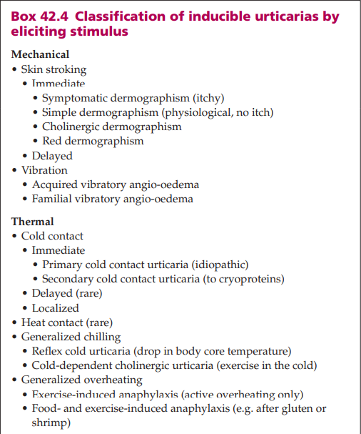
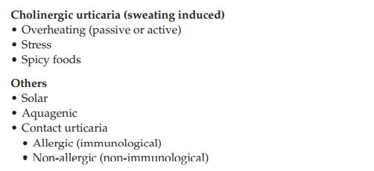

Slide 11
Chronic autoimmune urticaria (antibody associated urticaria)
About one-third to one-half of patients with CSU show a positive response against their own serum (positive autologous serum skin test [ASST]
There seems to be an increased risk for thyroid disorders (hypothyroidism more often than hyperthyroidism), diabetes mellitus type I, systemic lupus erythematous, and rheumatoid arthritis in patients with CaU
There is also an increased frequency of human leukocyte antigen subtypes DRB*04 (DR4) and DQB1*04 (DQ8) among patients with CaU

Slide 12
Clinical Features
Spontaneous urticaria-
Itchy red macules develop into weals consisting of pale to pink, oedematous, raised areas of the skin often with an initial surrounding red flare.
They may occur anywhere on the body, including the scalp, palms and soles, in variable numbers and sizes, ranging from a few millimetres to lesions covering large areas, and of varying shapes including rounded, annular, serpiginous and bizarre patterns due to confluence of adjacent lesions

Slide 13
Very rarely, bullae may form when oedema is intense.
Patients tend to rub rather than scratch, so excoriation marks are unusual
Weals may be more pronounced in the evenings or premenstrually.
Around 50% of patients with spontaneous urticaria describe angio‐oedema associated with wealing at some time of the illness and about 10% describe angio‐oedema without weals.
It may last from hours to days and the swellings resolve

Slide 14
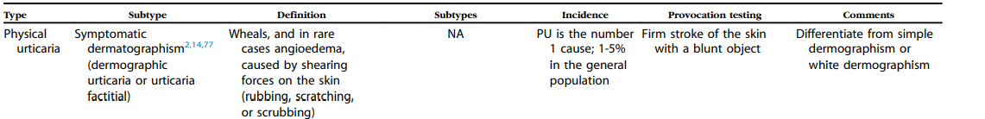
Inducible urticaria-
Notes:
Applied for 30-60 mints

Slide 15
Physical urticarias
Dermographism –
This includes the following.
1.Symptomatic dermographism (factitious urticaria). The triple response of local erythema due to capillary reflex‐induced dilatation of arterioles after stroking the skin vasodilatation, followed by oedema and a surrounding flare due to axon , first described by Lewis.
This is known as simple dermographism.

Slide 16
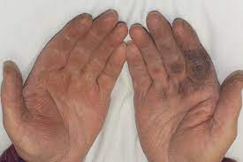
2.Other forms of dermographism.
Cholinergic dermographism is seen in some patients with cholinergic urticaria, whose dermographic response consists of an erythematous line studded with punctate weals characteristic of cholinergic weals.
Delayed dermographism is rare. After normal fading of the triple response or an immediate dermographic response, a weal returns in the same site, but is usually tender and persists for up to 48 h.
White dermographism (due to capillary vasoconstriction following light stroking of the skin) occurs normally, particularly pronounced in atopic eczema.
Black dermographism is discoloration of the skin after pressure from a metallic object.

Slide 17
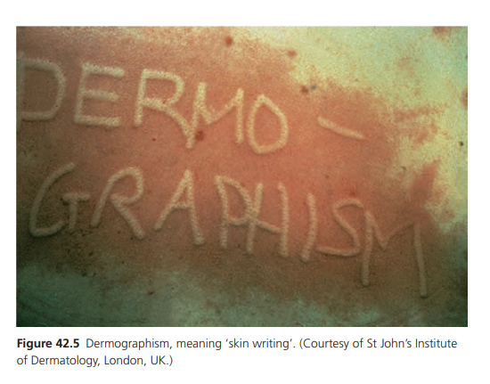
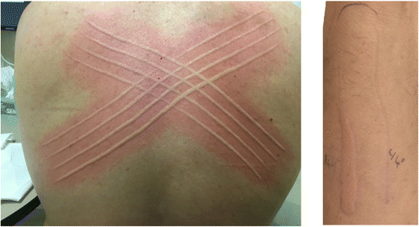

Slide 18
Delayed pressure urticaria
Delayed pressure urticaria in its predominant form is uncommon (2% of urticarias)

Slide 19
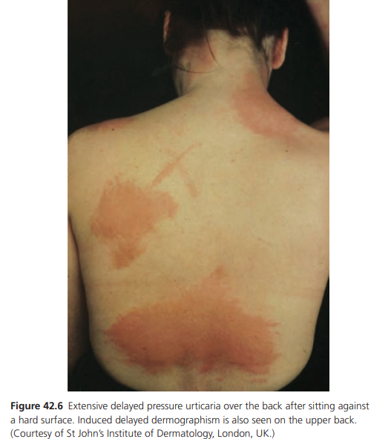
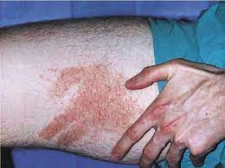

Slide 20
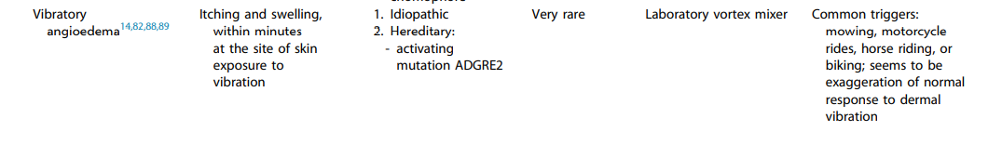
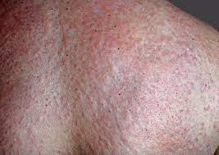
Vibratory angio‐oedema

Slide 21
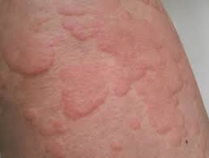
Temperature‐dependent urticaria
Heat contact urticaria This is one of the rarest forms of inducible urticaria
Localized warming of skin at temperatures from 38 to 44°C for 2–5 min induces wealing at the test site lasting 1 h. Treatment with antihistamines or induction of tolerance by repeated heat exposure may be helpful .

Slide 22
Cold contact urticaria Cold urticaria encompasses a variety of syndromes in which cold induces urticaria
Idiopathic cold contact urticaria is the most common, comprising 96% of a series of cold urticaria patients , while others are rare.
It is important to warn against cold water bathing due to the risk of anaphylaxis and drowning.
Treatment with low‐sedation antihistamine is helpful.
Induction of tolerance by repeated graduated exposures to cold can be helpful for selected patients , but it is time consuming and not always effective.

Slide 23
Primary cold contact urticaria This includes the following.
Immediate. This is by far the commonest form, occurring at any age but most frequently in young adults. It may be preceded by non‐specific upper respiratory tract viral infections, infectious mononucleosis or insect bites.
Itching and wealing of the skin occur on cold exposure within minutes and last up to 1 h.
Cold winds and cold rain are particularly effective stimuli. Sometimes, the mouth and pharynx may swell after drinking cold liquids.
Systemic symptoms include flushing, palpitations, headache, wheezing and loss of consciousness, and drowning has occurred after cold water bathing

Slide 24
Delayed. This form, where wealing occurs after a delay of hours after cold contact, is very rare . A familial form has been reported
Secondary cold urticaria-. Cryogobulinaemia
Systemic cold urticaria In generalized reflex cold urticaria, widespread wealing occurs in response to cooling of the core body temperature, but a local ice‐cube test is negative .
Testing is performed by placing the patient, in lightweight clothes, in a cold room at 4°C for 30 min. In cold‐induced cholinergic urticaria, additional exercise is necessary in the cold room to induce weals.
Familial cold autoinflammatory syndrome This rare form is inherited as an autosomal dominant trait and is now known to be caused by the same gene mutation as Muckle– Wells syndrome . The ice‐cube test is negative

Slide 25
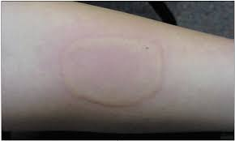
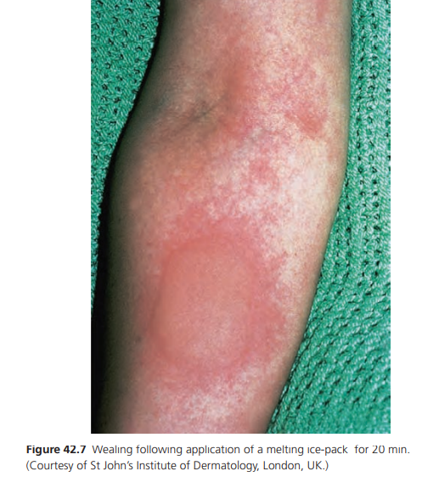
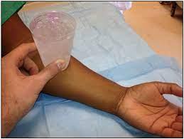
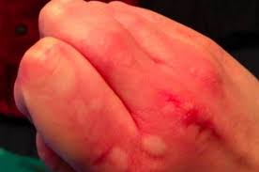

Slide 26
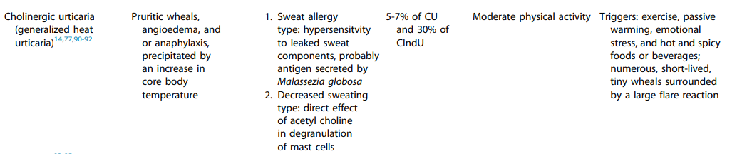
Cholinergic urticaria

Slide 27
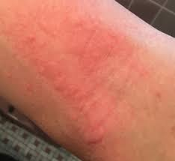
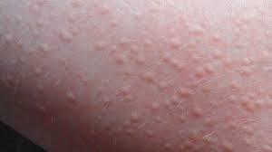

Slide 28
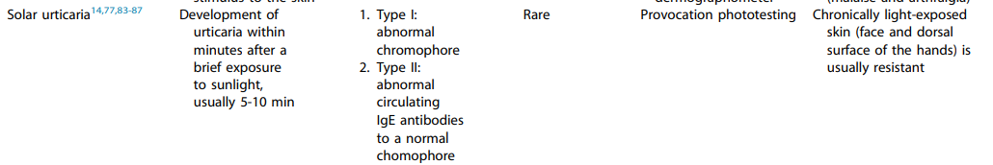
Solar urticaria
Notes:
secondary to porphyrias

Slide 29
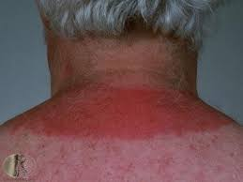
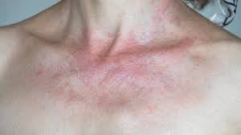

Slide 30
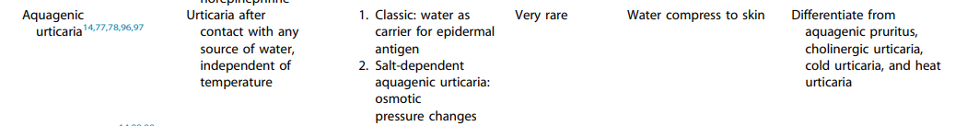
Aquagenic urticaria

Slide 31
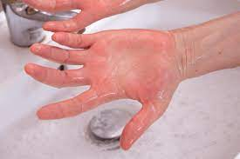
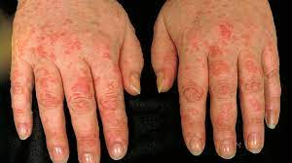

Slide 32
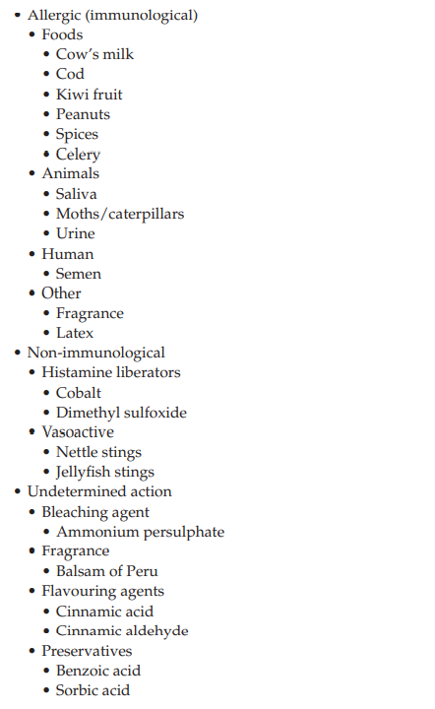
Contact urticaria
Patients with CU show activation of the extrinsic pathway of the coagulation and fibrinolysis cascade, both of which correlate with disease exacerbation

Slide 33
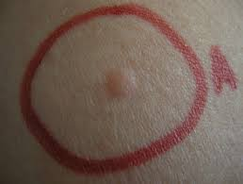
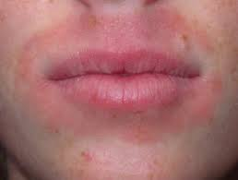

Slide 34
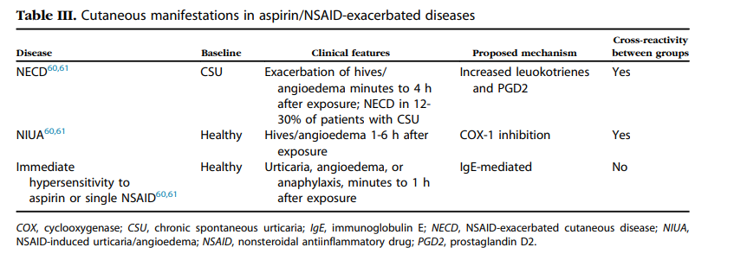

Slide 35
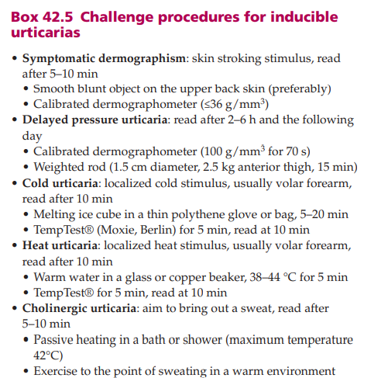
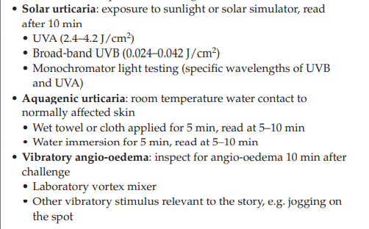
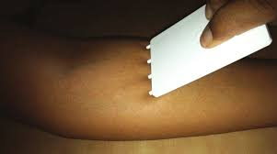

Slide 36
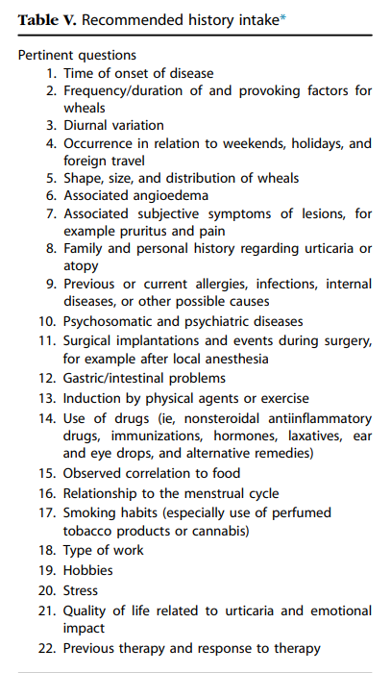
History

Slide 37
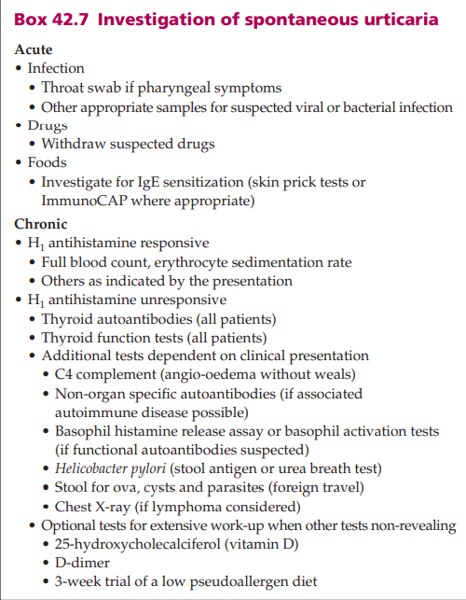

Slide 38
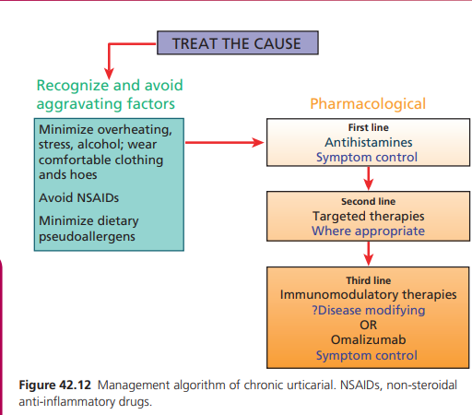
Management

Slide 39
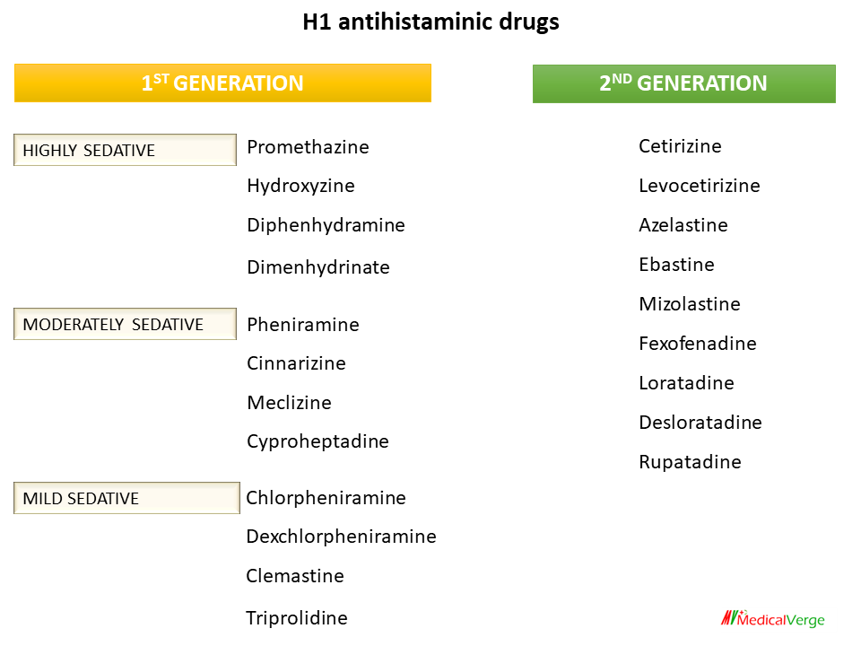
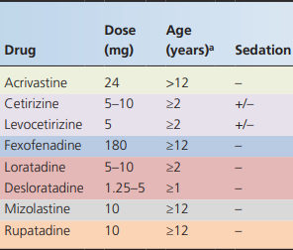
The use of classical antihistamines is limited by their side effects, including sedation, anticholinergic properties and paradoxical excitation in children
Notes:
Very rarely, antihistamines appear to make urticaria worse. This has been reported anecdotally with cetirizine but clinical experience suggests that most if not all antihistamines may be implicated in those who are affected
Cetirizine (adult dose 10 mg/day), Fexofenadine (adult dose 180 mg/day,Loratadine (adult dose 10 mg daily),

Slide 40
Combination approach
If one antihistamine does not work it is worth trying another.
Although it used to be common practice to recommend additional sedating antihistamines at night when sleep was disturbed, there is evidence that this is no more effective than increasing the dose of a second‐ generation antihistamine and may cause unwanted sedation the following day
A combination of an H1 antihistamine with an H2 antagonist may be more effective than H1 antihistamines alone in some patients although there is little evidence from published trials to support this.
Use of ranitidine (adult dose 150 mg twice a day) is preferable to cimetidine, which has more antiandrogenic side effects and potential drug interactions.
Increasing the dose of second‐generation H1 antihistamines up to fourfold above licence in adults when lower doses do not provide adequate symptom control has become common practice.

Slide 41
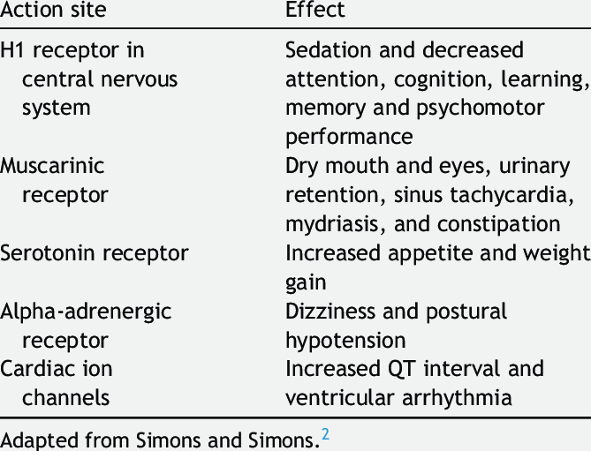
Side effects
Mizolastine, which also undergoes limited conversion by hepatic CYP3A4, is able to block HERG1 channels to some degree. Its use with drugs that prolong the Q–T interval – such as amiodarone, quinidine and neuroleptic drugs and tricyclic antidepressants – and with electrolyte disturbance should be avoided
terfenadine and astemizole have been withdrawn from the market.
Notes:
HERG1 gene encoding the major K+ cardiac repolarization channels offers a molecular understanding of the cardiotoxic properties of terfenadine and astemizole, prolong the Q–T interval – such as amiodarone, quinidine and neuroleptic drugs and tricyclic antidepressants – and with electrolyte disturbance should be avoided

Slide 42
Second line therapies (targeted therapy)
Oral corticosteroids are effective in severe urticaria at high doses, e.g. prednisolone 0.5 mg/kg/day
Leukotriene receptor antagonists,Sulphasalazine { decreased leukotriene and prostaglandin production}, and dapsone {decreased synthesis of leukotriene B4 and prostaglandin E2, and interference with CD11b }have been shown to benefit aspirin‐sensitive urticaria and may be of value in delayed pressure urticaria and autoimmune urticaria when added to antihistamines [145].
Doxepin, a tricyclic antidepressant with H1 and H2 antihistaminic activity, has been used at night in a starting dose of 10–30 mg
Danazol may be beneficial for patients with refractory cholinergic urticaria
Tranexamic acid may suppress non‐histaminergic idiopathic angio‐oedema
Colchicine has the capability to inhibit histamine release and interleukin-1. Colchicine is dosed at 0.3 to 0.6 mg twice daily.
Notes:
montelukast, zafirlukast and 5- lipoxygenase-inhibitor zileuton.

Slide 43
Phototheraphy
Narrow‐band phototherapy may help some patients especially those with symptomatic dermographism although controlled studies are needed.
Cold desensitization has been shown to be effective for well‐ motivated patients with cold contact urticaria

Slide 44
Third line therapies (immunomodulatory)
Plasmapheresis improved six out of eight such patients with autoimmune urticaria for 3–8 weeks only , highlighting the likely relevance of functional autoantibodies to disease activity.
Intravenous immunoglobulin (IVIG) infusions, at 0.4 g/kg/day for 5 days (total 2 g), improved nine out of 10 patients, two of whom remained clear for 2 years
Ciclosporin at 2.5–3.5 mg/kg/day for 1–3 months improved or temporarily cleared the majority of patients with severe urticaria and its efficacy has been confirmed in a randomized placebo‐controlled study at 4 mg/kg/day for 4 weeks

Slide 45
Fourth line treatment XOLAIR®
Three large phase III studies of omalizumab (anti‐IgE) have shown very good results in H1 antihistamine unresponsive chronic spontaneous urticaria
by preventing IgE binding to the high-affinity Ig E receptor FcεRI, as well as downregulating these receptors on mast cells and basophils, which may reduce their activation and release of bioactive mediators.
300 mg per month and continuing for 4 to 6 months

Slide 46
Antihistamines in special situations
Pregnancy Antihistamines cross the placenta. There is no reliable evidence that they are teratogenic, but they should be avoided in pregnancy and particularly in the first trimester if possible. If it is not possible, then chlorphenamine is often chosen based on its long availability and excellent safety record
Children The management of urticaria in children is largely the same as for adults
sgAH rather than fgAH should be used because of the latter’s sedating effects, and corticosteroids should be avoided or used for short periods of time
Elderly fgAHs are more lipophilic, which means they can cross the blood brain barrier. In addition, they tend to be anticholinergic, antiserotonergic, and antidopaminergic, which can cause or worsen urinary retention, arrhythmias, peripheral vasodilatation, postural hypotension, tachycardia, and mydriasis.
sgAHs do not cross the blood brain barrier and are therefore a better choice

Slide 47
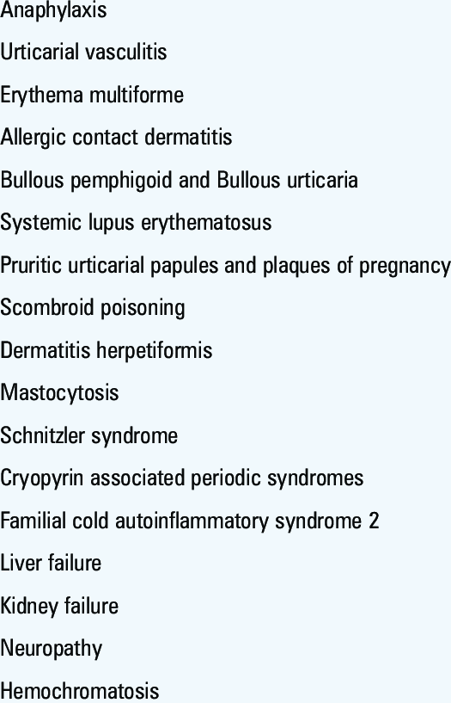
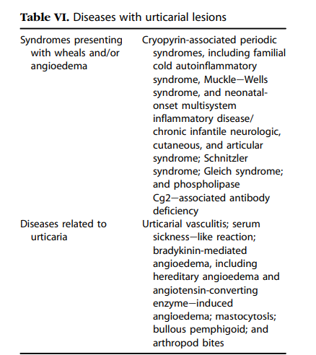
Differentials

Slide 48
Angioedema
Angio‐oedema involves the subcutaneous and submucosal tissues, rather than the dermis. Almost any part of the body may be involved, but the most common sites are the lips , eyelids and genitalia due, in part, to the laxity of the dermal and subcutaneous tissues at these sites.
The tongue and pharynx may also be affected, but this is much less common in mast cell mediator‐induced angio‐oedema than bradykinin‐ induced angio‐oedema. Individual lesions may be either single or multiple and may appear suddenly. Itching is often absent. The lesions last from a few hours to several days

Slide 49
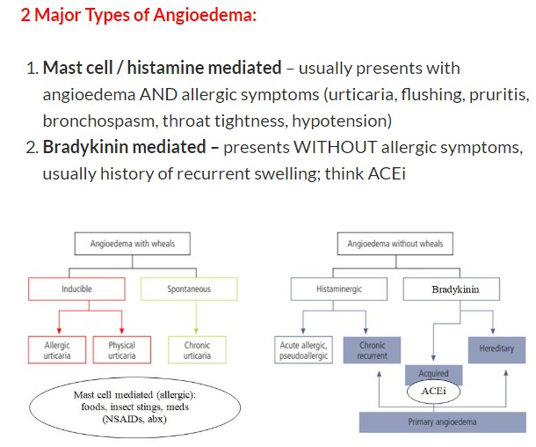
Angio‐oedema without weals

Slide 50



Slide 51
Incidence and prevalence
Mast cell mediator‐induced angio‐oedema is by far the commonest presentation of angio‐oedema without weals, representing up to 10% of patients with spontaneous urticaria.
ACE inhibitor‐ induced angio‐oedema affects up to 1% of patients on treatment with a 3.5–4.0‐fold higher incidence in those with an Afro‐Caribbean ethnicity.
HAE affects approximately 1 : 50 000 of the general population

Slide 52
Mast cell mediator‐induced angio‐oedema
The presentation of mast cell mediator‐induced angio‐oedema without weals is the same as angio‐oedema that presents in patients with spontaneous urticaria who also exhibit weals
Oro‐pharyngeal involvement is unusual and laryngeal oedema is exceptional. Abdominal angio‐oedema does not occur.

Slide 53
Hereditary angio‐oedema
This is a rare disorder, accounting for less than 2% of all cases of angio‐oedema without weals. A family history is usually, but not always, apparent since up to 25% of cases appear to result from a de novo mutation of the gene controlling C1INH (SERPING1).
Over 75% of patients with HAE will have had their first attack by the age of 15 years although onset may be delayed until adult life
Patients with HAE types I and II are deficient in a natural inhibitor of C1INH, which is made, under genetic control, in the liver.
It has an autosomal dominant pattern of inheritance
A third type of HAE has been described recently that was initially referred oestrogen‐dependent angio‐oedema,normal C1INH
Complement C 4 may be used as an initial screening test
Notes:
C1-inhibitor is a protease inhibitor. Its main function is the inhibition of the complement system to prevent spontaneous activation but also as the major regulator of the contact system

Slide 54


Slide 55
Hereditary angio‐oedema
The clinical picture of HAE usually facilitates strong suspicion of the diagnosis before laboratory confirmation.
There are recurrent swellings of the skin and mucous membranes throughout life, often associated with nausea, vomiting, colic and urinary symptoms.
These attacks may occur regularly every few days or weeks, or may be less frequent.
Abdominal symptoms may occur in the absence of skin changes and cause great diagnostic diffiulty.
Pharyngeal, laryngeal and even bronchial involvement, are especially significant and dominate the prognosis.

Slide 56
The skin and mucosal lesions are often solitary and may be painful.
They seldom itch and they may occur spontaneously or after trauma; dental trauma and intubation being especially hazardous.
Weals do not occur, but many patients exhibit a rather distinctive reticulate erythema, perhaps with minimal oedema, which occurs prodromally
Some patients have a relatively minor disability and may improve over many years. In other families, before the advent of modern therapy, over 20% of patients used to die of respiratory obstruction before early middle age, and fatalities are still at risk of occurring

Slide 57



Slide 58
Angio-oedema due to acquired C1INH deficiency
Two types are recognized.
Type 1 is due to continuous activation of complement by lymphoproliferative disease, including paraproteinaemia due to increased catabolism of C1INH.
Type 2 is due to autoantibodies that recognize C1INH and inactivate it without triggering its target proteases.
Both forms will have reduced antigenic and functional C1INH levels.
Contrasting with the hereditary forms, patients with the acquired variant are older at presentation, predominantly male, and have a predilection for the face, but also the abdomen and genitalia

Slide 59
ACE inhibitor‐induced angio‐oedema
ACE inhibitors may cause angio‐oedema by inhibiting ACE resulting in reduced bradykinin metabolism. Most cases develop within 3 weeks of commencing treatment, but can occur at any time, even more than 10 years after starting.
It is a class effect seen with all ACE inhibitors and, only occasionally with angiotensin receptor blockers. Angio‐oedema affects predominantly the face and oropharynx. Symptoms may be severe, and laryngeal involvement may be life threatening. Abdominal symptoms are rare

Slide 60



Slide 61

Clinical variants
Systemic capillary leak syndrome (syn. Clarkson syndrome)
This is a rare syndrome in which there are dramatic recurrent episodes of exudation of fluid into various organs and may involve the skin.
Angio‐oedema has been reported.
A severe shock‐like state may ensue and the eventual mortality
is high.
There is an immunoglobulin G (IgG) paraproteinaemia

Slide 62

Gleich syndrome
Episodic angio‐oedema with eosinophilia
Recurrent episodes of angio‐oedema associated with pyrexia, blood eosinophilia and infiltration of the dermis with eosinophils have been described.
There is no evidence of systemic involvement or progression to a
cardiomyopathy in contrast to hypereosinophilic syndrome where
this is a recognized complication.
Each episode resolves with prednisolone treatment.
During an attack, elevated serum levels of interleukin (IL)‐5 have
been demonstrated in some cases and IL‐6 in others

Slide 63
Differential diagnosis
The differential diagnosis of angio‐oedema without weals includes oro‐facial granulomatosis, dermatitis (especially of the eyelids), cellulitis and idiopathic scrotal oedema.
Disease course and prognosis Chronic mast cell mediator‐induced angio‐oedema usually lasts for several months to years. Spontaneous resolution is the rule.
HAE is lifelong with variations in activity corresponding to environmental factors, lifestyle, drugs (especially exogenous oestrogens and ACE inhibitors) and endogenous factors (e.g. puberty and pregnancy). The main risk of HAE is suffocation and death .
Treatment of the underlying B‐cell lymphoproliferative disorder may lead to resolution of type 1 acquired C1INH deficiency.
ACE inhibitor‐induced angio‐oedema remits after discontinuation of the drug but may take up to 6 months to subside after stopping

Slide 64

Investigations

Slide 65

Management
Non‐sedating, second‐generation H1 antihistamines are the first line treatment. They should be used on a daily basis until spontaneous remission. Higher than standard doses (up to fourfold) may be required to achieve sufficient protection
. Omalizumab (anti‐IgE) is licensed in Europe and the USA for the use of antihistamine refractory cases of chronic spontaneous urticaria and should be considered as third line treatment

Slide 66
HAE
H 1 antihistamines, steroids and epinephrine are ineffective for HAE or acquired C1INH deficiency.
Oestrogen therapies, such as the oral contraceptive pill, and ACE inhibitor may induce or exacerbate HAE and should be avoided.

Slide 67
Emergency treatment of hereditary angio‐oedema
Purified plasma‐derived C1INH (pdC1INH) given by bolus intravenous infusion per body weight has been the primary treatment for oro‐facial or laryngeal oedema and abdominal colic for three decades.
Twenty units/kg body weight is now recommended.
Symptom relief should be seen within 30–90 min of infusion but it may take 6–8 h for complete resolution.
C1INH is also available as a recombinant product prepared from the milk of transgenic rabbits
Icatibant, a bradykinin receptor 2 antagonist, is now also available and may be the treatment of choice since it is given by subcutaneous injection and has similar efficacy to C1INH concentrate .
A kallikrein inhibitor, ecallantide, is available only in the US.
Fresh frozen plasma, containing C1INH can be given in an emergency if other products are unavailable.

Slide 68
Short‐term prophylaxis of hereditary angio‐ oedema
Plasma‐derived C1INH concentrate should be given shortly before medical procedures involving trauma, especially dental work or intubation during general anaesthetic .
For relatively minor dental procedures, such as dental cleaning, ensuring availability of pdC1INH should be sufficient.
Anabolic steroids and plasmin inhibitors may also be used for short‐term prophylaxis, for example 48 h before and 2–5 days after dental surgery

Slide 69
Long‐term prophylaxis of hereditary angio‐ oedema
Plasma‐derived C1INH replacement therapy, where it is available, is the preferred prophylactic treatment for patients with frequent attacks.
Twice‐weekly intravenous infusions (1000 units) are sufficient in most patients to greatly reduce or completely prevent the occurrence of attacks.
Attenuated androgens/anabolic drugs such as danazol and stanozolol are often used in adults but may not work or be tolerated, especially by women in whom androgenic side effects including menstrual irregularities, acne and hirsutism may be unacceptable.
The usual starting doses are danazol 100–200 mg daily or stanozolol 1.0–5.0 mg daily
Epsilon aminocaproic acid (not available in the UK), 12–18 g daily, or the related plasmin inhibitor, tranexamic acid 2.0–4.5 g daily, has been found to help some patients, but these drugs are contraindicated by a past history of thrombosis or inherited thrombophilia

Slide 70
Treatment of acquired C1‐esterase inhibitor deficiency
Icatibant and C1INH are the treatment of choice. Danazol is helpful in some cases, but not the autoantibody type which also fails to respond to replacement therapy but may be helped by tranexamic acid and corticosteroids.
Rituximab has been reported to give longlasting improvement

Slide 71


