Slide 1
TUMOURS OF SKIN APPENDAGES
DR MARIA GUL
RESIDENT DERMATOLOGY

Slide 2
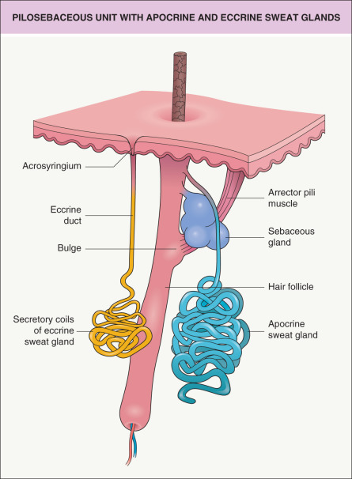
The pilosebaceous apparatus can be divided into the hair follicle, the adjacent sebaceous gland and in some body sites the apocrine glands. Small strips of smooth muscle, the arrector pili muscle, are also found in association with these structures.

Slide 3
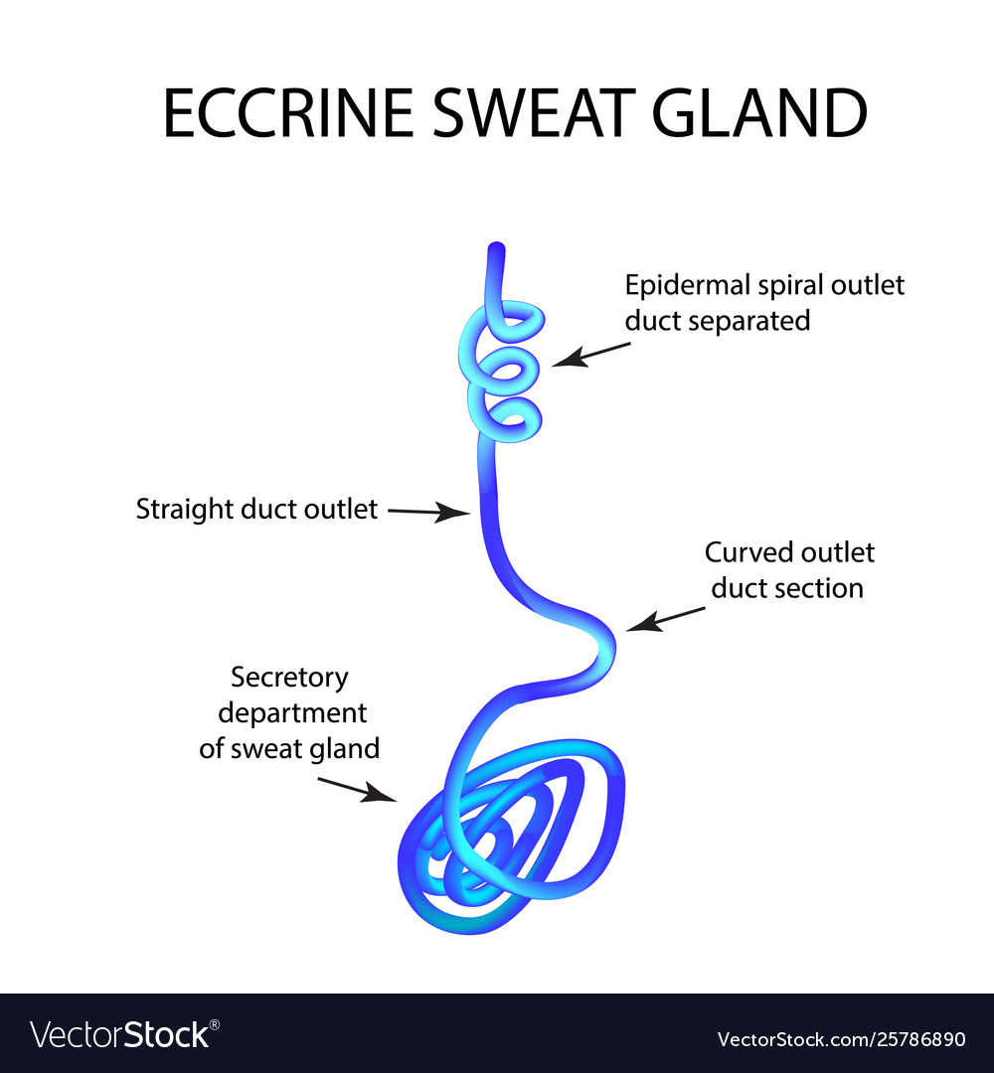
The eccrine sweat glands are found on all body sites and consist of a double-layered, deeply situated secretory struture and more superficial excretory duct winding through the dermis and spiralling through the epidermis to reach the surface of the skin.

Slide 4
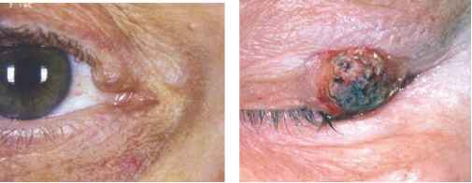
Inverted follicular keratosis
A localized area of hyperkeratosis found in association with the pilosebaceous orifice, considered as a variant of seborrheic keratosis
The pathological features show an endophytic lesion connected to the infundibulum of the hair follicle. Irritated keratinocytes form whorls of cells, so-called ‘squamous eddies’, and keratin cysts.
All of these features comes in differential diagnosis of squamous cell carcinoma,especially on small biopsies.

Slide 5
This lesion presents as a solitary papule on the head and neck area. It may reach a considerable size, inflamed and pruritic.
The lesions recur
Management
Local surgical excision is generally needed, for both diagnostic and therapeutic purposes.

Slide 6
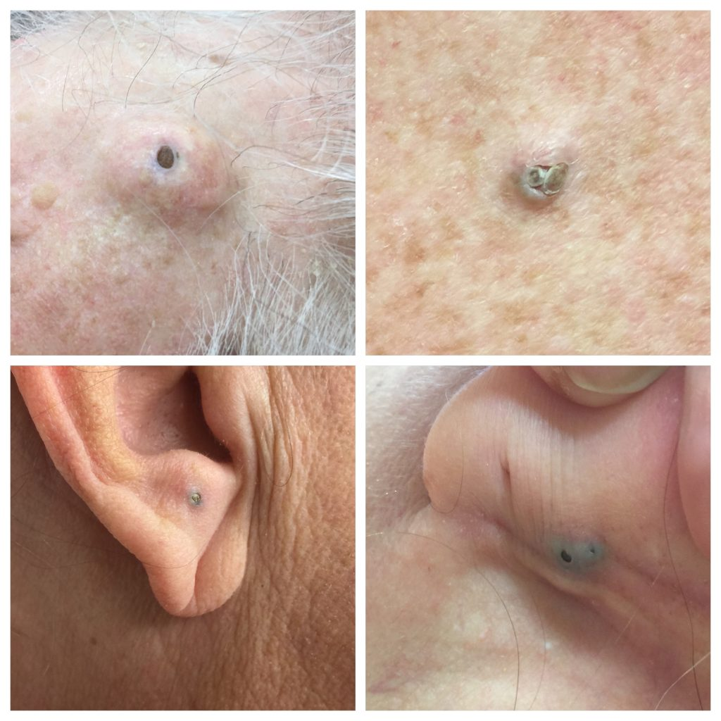
Dilated pore of winer
An area of expanded follicular infundibulum with a dilated poral opening extending down to subcutaneous fat
There is a wide, crater-like cavity, from which acanthotic areas of follicular epithelium radiate
Rarely associated with trichoblastoma, basal cell carcinoma or squamous cell carcinoma

Slide 7
The pore is a comedo-like lesion found mainly on the head and neck area
Management
No treatment is required except when persistently inflamed or for cosmetic reasons.
Treatment options include ammonium lactate lotion to evacuate the keratin plug, cosmetic strips and topical application of retinoids.Laser therapy or surgical excision may be used on more resistant cases.

Slide 8
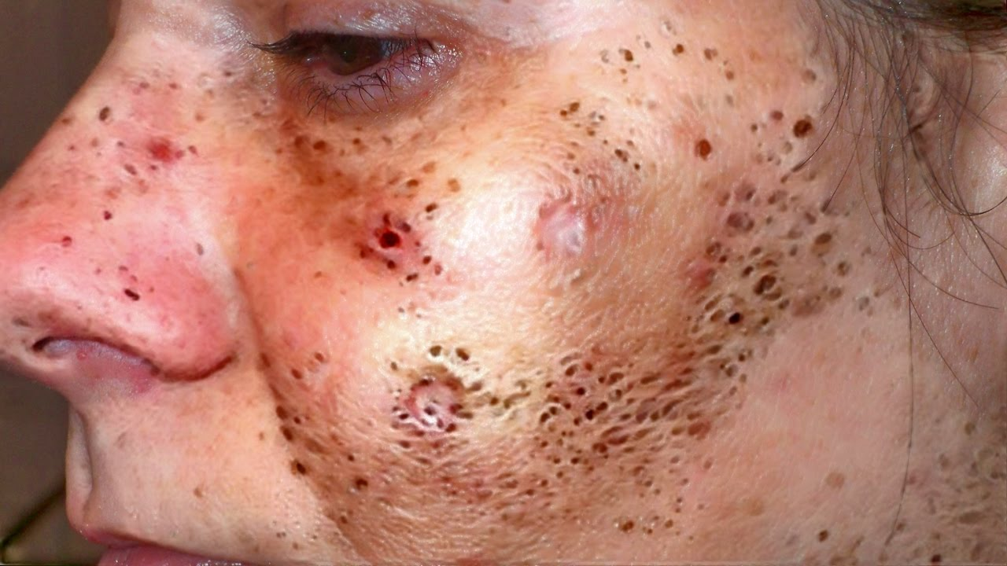
Comedo naevus
A rare abnormality of the follicular infundibulum present as a group of comedo-like lesions. It is a rare type of epidermal naevus and is a part of the naevus comedonicus syndrome
Pathology
It is a rudimentary pilosebaceous follicle with a large overlying keratin-filled crater.The surface of the keratinous material Oxidizes to give the comedone-like appearanc.

Slide 9
These lesions are rare and are seen mainly on the head and neck area can occur on other sites.
They appear as a cluster of comedones or as a single giant lesion
Management
Treatment options are for cosmetic reasons or in complicated cases,include topical therapy, laser, and surgery.

Slide 10
Proliferating trichilemmal tumour
A tumour of external root sheath usually arising in a pre-existent pilar cyst .
Pathology
Tumour lobules are cystic and composed of pale squamous cells with mild atypia. The surrounding stroma may be fibrotic with inflammation consisting of lymphocytes and plasma cells
Foreign-body granulomatous reaction may be seen in areas where cystic structures have ruptured
Cholesterol clefts and areas of calcification may also be seen.

Slide 11
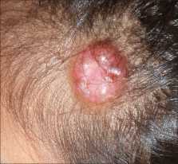
History and presentation
The tumour presents as a rapidly growing large nodule, commonly on the head and neck area followed by the trunk
An association with a naevus sebaceous is seen. Some lesions are very large and may be More than 10 cm in diameter.
The history of rapid expansion frequently gives rise to concern about malignancy.

Slide 12
Disease course and prognosis
Local recurrence takes place
In malignant proliferating trichilemmal tumour metastases may occur,leading to death.
Management
Complete excision is necessary.
Radiotherapy and or chemotherapy in case of malignant tumour.

Slide 13
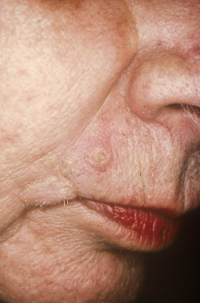
Trichilemmoma
This lesion is derived from proliferation of the external root sheath of the hair follicle.
Patients with Cowden syndrome or multiple hamartoma and neoplasia syndrome have large number of trichilemmomas and are associated with a very high incidence of breast, thyroid and gastrointestinal carcinomas.

Slide 14
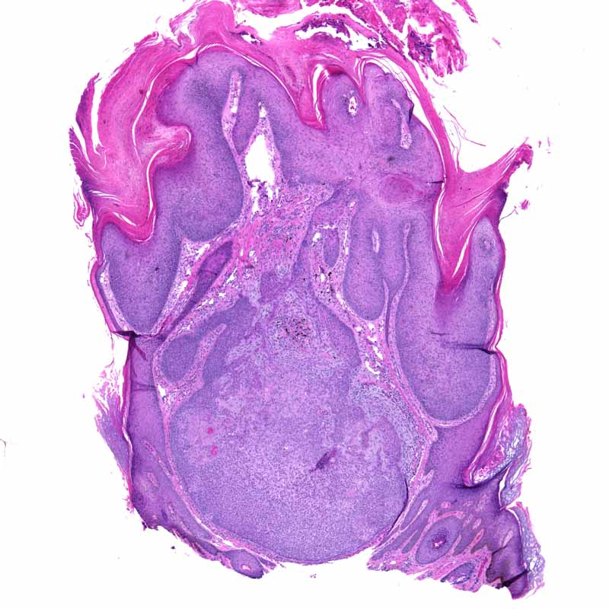
Pathology
These lesions are well-circumscribed lobular tumours extending down from the epidermis and often connected to a hair follicle.
Tumour cells display prominent clear cytoplasm secondary To the deposition of glycogen
The presence of glycogen can be confirmed with a positive periodic acid–Schiff(PAS)stain, which Becomes negative after treatment with diastase.

Slide 15
Clinical features
Clinically, these lesions are small non-specific papules on facial skin; the diagnosis of multiple trichilemmomas should stimulate a search for other evidence of Cowden syndrome. This includes a characteristic ‘cobblestone’ appearance of the oral epithelium,multiple skin tags, squamous papillomas and sclerotic fibromas(storiform collagenomas).
Disease course and prognosis
The lesion although benign can recur if treated by shave biopsy.
Management
simple surgical excision, carbon dioxide laser ,tissue ablation.

Slide 16
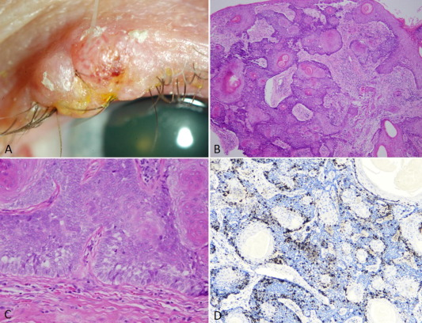
Trichilemmal carcinoma
A rare tumour often underdiagnosed, with low metastatic potential, usually arising in sun-exposed skin of the elderly. Most cases are diagnosed as squamous cell carcinomas without further qualification.

Slide 17
Pathology
These lesion( in situ) involving predominantly the epidermis and neighbouring hair follicles.
Tumour cells are squamoid and lobules may have a surrounding PAS-positive membrane, and there is central trichilemmal (abrupt)keratinization.
There is a high mitotic rate,with abnormal mitoses present.
Most malignant cutaneous Tumours with clear-cell change are squamous cell carcinomas.

Slide 18
History and presentation
This lesion presents as a solitary expanding often ulcerating lesion on the face.
Clinically, it may be misdiagnosed as a basal cell carcinoma.
Trichilemmal Carcinoma may arise from a trichoblastoma , naevus sebaceous and has been described in settings of solid-organ transplantation.
Disease course and prognosis
These lesions represent low-grade carcinomas with rare recurrence and extremely low metastatic potential.
Management
Surgical excision with clear margins is the treatment of choice.

Slide 19
HAMARTOMAS AND HAIR GERM TUMOURS AND CYSTS
Eruptive vellus hair cyst
Occlusion and cystic dilatation of vellus hair follicles.
They are more frequent in patients with pachonychia congenita
Pathology
Cysts are located in the mid-dermis, and are lined by squamous epithelium. They contain vellus hair and keratin debris. Biopsies from some lesions show features indistinguishable from steatocystoma,with absence of vellus hairs.

Slide 20
History and presentation
These present as small red or brown papules on the chest, usually multiple, with some lesions showing features of eruptive vellus hair cysts, and some showing features of steatocystoma.
lesions have been reported in chronic renal failure an association with lowe syndrome, attention deficit hyperactivity disorder, syringomas has been described.
Dermoscopy may be Useful in reaching a diagnosis, as lesions display an erythematous Maroon halo with occasional irregular radiating capillaries at the Periphery and the vellus hairs can be identified opening onto the epidermis.

Slide 21
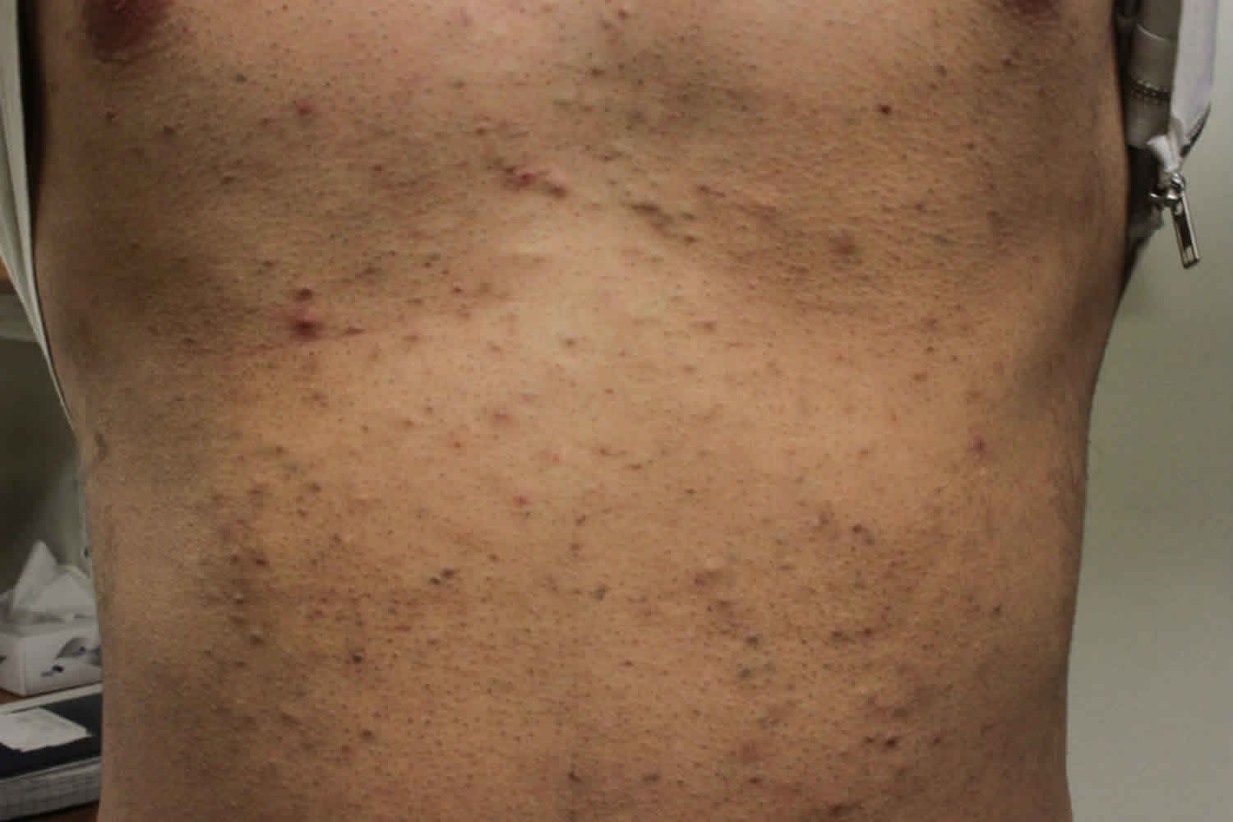
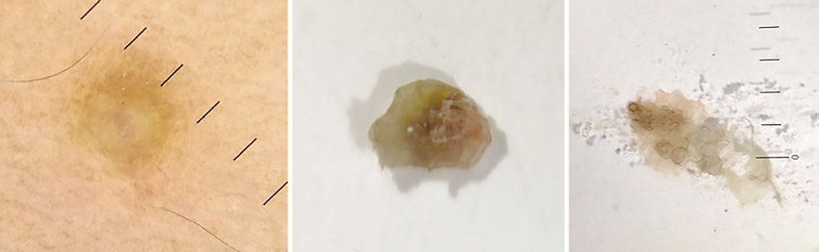

Slide 22
Management
includes topical retinoids, Curettage and laser therapy
Pulsed carbon dioxide laser is useful for facial lesions but this treatment may induce hypertrophic scarring if used for truncal lesions.
Erbium : YAG laser However can be used on facial lesions.

Slide 23
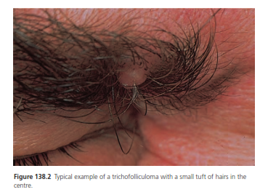
Trichofolliculoma
This lesion is regarded as a hamartoma of the pilosebaceous follicle, which results in several hairs being formed within the follicular opening and all protruding onto the epidermal surface from a pilosebaceous orifice.

Slide 24
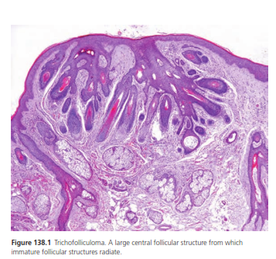
Pathology
There are dilated and abnormally large pilosebaceous canal containing numerous poorly formed hairs, with several pilosebaceous-like structures opening into the canal.
Malignant change can occur
The so-called folliculo sebaceous cystic hamartoma is variant of trichofolliculoma.

Slide 25
Clinical features
Trichofolliculoma shows a predilection for the head and neck particularly the face
Tumours can present in the vulva other unusual sites including the upper extremities,External ear. Clinically,lesions can be recognized as Small raised nodules with two or three hairs protruding Together In a small tuft
Disease course and prognosis
The lesion is benign.recurrence may occur in exceptional cases.
Management
Simple surgical excision is the treatment of choice.

Slide 26
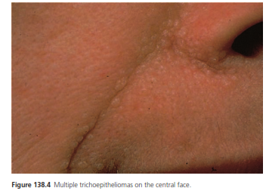
Trichoepithelioma
A hamartoma of the hair germ composed of immature islands of basaloid cells with focal primitive follicular differentiation and induction of a cellular stroma.

Slide 27
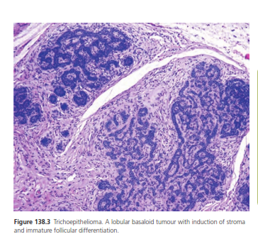
Pathology
The lesions consists of lobules of small dark basaloid cells, often with a degree of Peripheral palisading surrounding a central area of eosinophilic amorphous material
There is frequently a strong resemblance to basal cell carcinoma, and at times differentiating between the two can be very difficult.However,the stroma In trichoepithelioma is distinctive in that it contains clefts, with an Absence of retraction artefact between tumour cells and the surrounding stroma.

Slide 28
History and presentation
The presentation of a solitary lesion is that of a smooth nodule,usually on the face, which clinically resembles a non-ulcerated basal cell carcinoma.
multiple small pearly lesions are seen mainly on centrofacial skin.
Individual tumours reach a limiting size, but the numbers may increase over the years.

Slide 29
Management
The treatment modalities used are
surgical excision
curettage, cryotherapy and dermabrasion.
High-energy pulsed carbon dioxide laser.

Slide 30
Desmoplastic trichoepithelioma
A slowly expanding plaque containing structures differentiating towards the superficial part of the hair follicle and regarded as a hamartoma
The lesions is benign

Slide 31
Pathology
Three features that characterize this lesion are large numbers of small keratin-filled cysts, strands and ribbons of small dark epithelioid cells, and a dense fibrous stroma surrounding the first two structures.
Perineural extension may be a feature.
striking palisading of the basal cell carcinoma is absent.

Slide 32
Lesions are found mainly on the face and have a depressed centre and a raised rolled edge in many cases, causing clinical confusion with basal cell carcinoma.
Dermoscopic features have been described in a case and consist of a well-defined ivory-white lesion with marked arborizing telangiectasia
Management
Local excision is effective in the majority of cases. Alternative
methods include curretage and electrodissection.

Slide 33
HAIR MATRIX TUMOURS
Pilomatricoma
  A benign tumour considered to be a hamartoma of the hair matrix composed of cells resembling those of the hair matrix and cortex and inner root sheath. The cells usually undergo ‘mummification’.
  Association with myotonic dystrophy, Turner syndrome and Rubinstein–Taybi syndrome have been described.

Slide 34
Pathology
The tumour is situated in the dermis, and is well-circumscribed
The outer cells are small,basophilic having rounded nuclei. Normal mitotic figures can usually be seen and are often numerous. The cytoplasm is scanty and the cell margins indistinct, but intercellular connections can be seen.

Slide 35
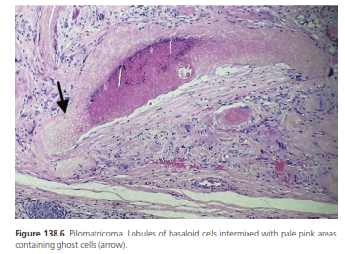
Towards the centre of the mass, the cytoplasm becomes more abundant and eosinophilic. The nuclear outline persists, but the chromatin is sparse and clumped in dark granules; when all basophilic material disappears, a mummified ‘ghost cell’ remains.
The central areas often calcify, and calcium can be demonstrated in the basophilic areas of the tumour

Slide 36
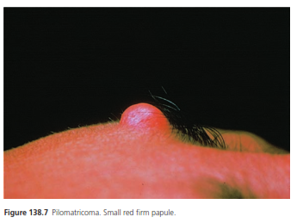
Clinical features
The lesion is usually a solitary, deep, dermal or subcutaneous tumour 3–30 mm in diameter situated on the head, neck or upper extremities.
The skin over the tumour is normal and the lesion has a firm to stone-hard consistency and a lobular shape on palpation.
ulcerated lesions may show transepithelial elimination
Some cases associated with hypercalcaemia and high levels of parathyroid hormone have been reported.

Slide 37
Disease course and prognosis
The lesion is benign but there is a tendency for local recurrence.Malignant changes can occur in large pilomatricomas.
Management
Local excision is required for benign lesions. Wider excision will be needed if malignancy is suspected.

Slide 38
Pilomatricarcinoma
Is the malignant counterpart of the pilomatricoma, possessing metastatic potential.
Pathology
Malignant tumours usually have a very large predominant basaloid component, an infiltrative growth pattern and extensive necrosis
There are numerous mitotic figures,and both lymphatic and vascular invasion may be seen.

Slide 39
Clinical features
The lesion presents as a rapidly expanding firm nodule. Most tumours develop on the head and neck followed much less frequently by trunk
It can present denovo or on a longstanding benign pilomatricoma.
Pilomatric carcinomas are locally aggressive with a tendency to recur There may be metastases to distant organs such as the lungs, bone and lymph nodes
Management
Wide local excision is usually curative, but follow-up is required because of the possibility of metastatic spread.

Slide 40
Trichodiscoma
The clinical appearance of the trichodiscoma is that of multiple discrete flat-topped papules 2–3 mm in diameter.They occur mainly In the central area of the face.

Slide 41
Trichodiscoma
Pathology
A discrete but non-encapsulated area of myxoid, poorly cellular stroma with focal collagen deposition is seen in the dermis,associated with a proliferation of blood vessels, some of which are thick-walled.
Trichodiscomas and trichofolliculomas usually show histological overlap.

Slide 42
Multiple trichodiscomas, trichofolliculomas and acrochordon-like lesions as well as perifollicular fibromas have been described as part of the Birt–Hogg–Dubé syndrome.
This syndrome is and autosomal dominant genodermatosis also associated with lung cysts, spontaneous pneumothorax and renal neoplasms.
Management
It is excised for cosmetic reasons. In Birt–Hogg–Dubé syndrome follow-up is advisable as the risk for developing renal tumours increases with age.

Slide 43
Perifollicular fibroma
A cutaneous hamartoma of unknown aetiology that shows differentiation in the connective tissue sheath of the hair follicle.
Mostly it consists of small firm papules either flesh coloured or pink usually on the face and neck.
Other sites may be affected. Association with colonic polyps has been described and it is known as Hornstein–Knick-enberg syndrome.

Slide 44
Sebaceous adenomas and sebaceomas
Benign tumours composed of incompletely differentiated sebaceous cells of varying degrees of maturity.Sebaceous adenoma and sebaceoma are described together,as they do not have distinctive clinical features although histological separation is possible.

Slide 45
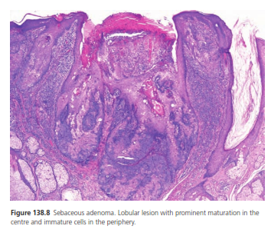
Pathology
The tumours are multilobular and usually connected to the epidermis.The lobules are well defined,composed of variable numbers of small basophilic immature cells peripherally and Larger cells – mature sebaceous cells in center – containing cytoplasmic fat globules.

Slide 46
Mitotic figures are frequent in the immature sebaceous cells, and this feature should not be regarded as evidence of malignancy.
Larger and deeper tumours with cystic degeneration usually represent sebaceomas. The cystic space contains abundant holocrine (sebaceous) material. These cystic sebaceous tumours are a marker for the mismatch, repair-deficient subtype of Muir–Torre syndrome,which has a high risk of internal malignancies.

Slide 47
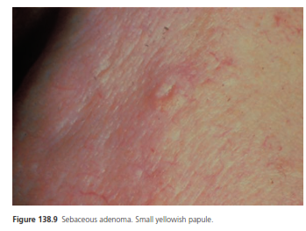
Clinical features
Tumours are usually rounded, raised and either sessile or some what pedunculated. They are normally less than 10 mm in diameter, but older lesions may form plaques or ulcerate.
The colour is fleshy or of a waxy yellowish hue, and the surface may be papilliferous.The common situation is the face Or scalp, and it may occur on the eyelid.

Slide 48
The lesion is benign. The risk of local recurrence is low.
Management
The best treatment is surgical excision.

Slide 49
Sebaceous carcinoma
A malignant tumour composed of cells showing differentiation toward sebaceous epithelium.
The tumour has been reported following radiodermatitis, and in a patient with multiple arsenical skin cancers.

Slide 50
Pathology
Usally sheets or lobules separated by fibrovascular stroma
Dermal based tumor with focal connection to epidermis of follicular epithelium
Can be rounded nodular aggregates or cystic comedo type necrosis
Pagetoid invasion of overlying epidermis may be seen
Classified as poorly,moderately or well differentiated.
The tumor cells are basaloid with foci of sebocytic differentiation.
Sebocytes are large cells with a multivacuolated clear cytoplasm.

Slide 51
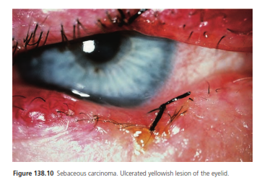
History and presentation
The tumour is solitary, firm, sometimes translucent and covered with normal or slightly verrucose epidermis. The colour may be yellow or orange. The face and scalp are the commonest sites, especially the eyelid. The tumor is slow growing.
Some tumours grow rapidly and invade early, but metastasis is uncommon.
Management
Complete surgical excision is required. Mohs microsurgery may be the treatment of choice.

Slide 52
APOCRINE GLAND TUMOURS
Apocrine hidrocystoma
A lesion produced by cystic dilatation of apocrine secretory glands.

Slide 53
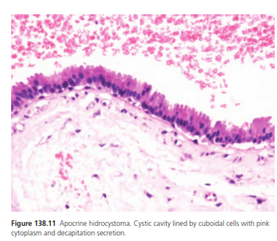
Pathology
Large cystic cavities are found in the dermis. Commonly, the cyst is punctured and has collapsed before fixation. The cavities are lined by cuboidal or high-columnar apocrine secretory cells and a peripheral layer of myoepithelial cells.
Papillary projections or solid buds of secretory cells may break the Smooth contour of the cyst lining. The secretory cells may contain pigment.

Slide 54
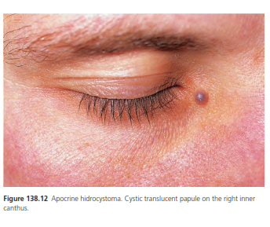
Clinical features
The lesions are solitary or multiple, well-defined,dome-shaped, translucent nodules.
The surface is smooth and the colour varies from a skin colour to greyish or blue-black; pigmentation.
The commonest site is around the eye, particularly lateral to the outer canthus

Slide 55
The lesion must be differentiated from basal cell carcinoma,which, is usually of a firmer consistency,less regular in its surface contour,and has surface telangiectases
Management
The tumour is cured by surgical removal, which is also needed for diagnosis.
Multiple lesions have been treated successfully with trichloroacetic acid

Slide 56
Syringocystadenoma papilliferum
The lesion is commonly seen on the scalp in association with an organoid naevus (naevus sebaceous), and showing differentiation in an apocrine pattern.

Slide 57
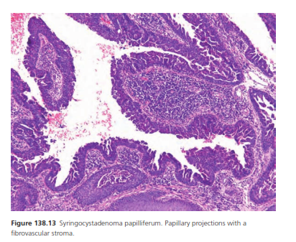
PATHOLOGY
The epidermal surface shows papillomatous expansion, and from these areas cystic invaginations are seen. The cystic structures are lined by papillae that have a lining of a double layer of columnar epithelium, which shows an apocrine pattern of secretion.

Slide 58
Clinical features
There is frequently a history of papillomatous expansion of a small pre-existing lesion at or around puberty and lesions often occur in a pre-existing organoid naevus.
The lesion is composed of multiple warty papules, some of which are translucent and pigmented .Tumours may be seen in other locations including vulva,external ear,lower leg,scrotum and breast.

Slide 59
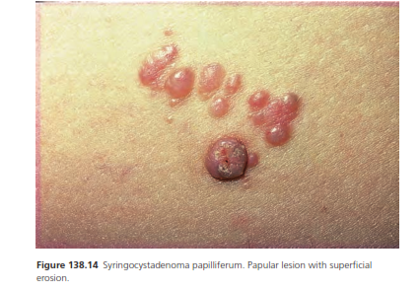

Slide 60
Disease course and prognosis
The lesion is benign. Occasionally, basal cell carcinoma, a squamous cell carcinoma or a ductal carcinoma develops on a pre-existing syringocystadenoma papilliferum.
Management
Surgical excision is recommended, both to confirm the diagnosis and for cosmetic reasons.

Slide 61
Hidradenoma Papilliferum
A skin tumour of the ano-genital area of adult females composed of frond-like papillae lined by apocrine epithelium.
Pathology
The tumour is well circumscribed and located just below the skin surface. It is usually spherical in shape and enclosed by compressed connective tissue stroma.

Slide 62
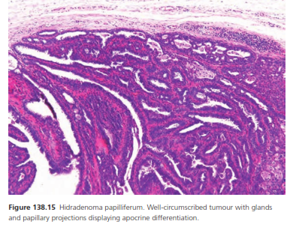
Pathology
Lesions are composed of slender fronds of connective tissue lined by one or two layers of epithelial cells and partly of glandular tissue.

Slide 63
clinical feature
Lump in vulval or perianal area which may be symptomless,tender or laibal to bleed.
They may feel firm,soft or even cystic.
Commonest site is labium majus,but may occur on vulva,perianal area,eyelids,nose,arms and chest.
Sometimes epithelial surface will ulcerate and tumor form a reddish brown papillary mass,which may be suspected of being malignant.

Slide 64
Lesion is benign.
Management
Simple excision is curative.

Slide 65
Erosive adenomatosis of the nipple
A complex benign tumour arising from the lactiferous ducts of the
Nipple.
Pathology
The lesion consists of tubules, with an inner layer of columnar
cells and an outer layer of cuboidal myoepithelial cells.
A major feature is the presence of superficial keratocysts lined by both
squamous and columnar epithelium, and fillled with keratin flakes
and an eosinophilic material,With in some cysts or ducts,forigen body gaint cell may be seen.

Slide 66
Clinical feature
The condition may start with a blood-stained serous discharge, and the nipple may be enlarged, eroded, crusted or eczematous.
There may be a small nodule on the nipple, and the symptoms may be worse in the premenstrual phase.
The condition is commonly misdiagnosed as Paget disease or eczema.
Management
Excision including local, partial, complete resection of nipple.
Cryosurgery
Mohs surgery.

Slide 67
ECCRINE GLAND HAMARTOMAS AND TUMORS
Eccrine Hidrocystoma
A tumour produced by mature deformed eccrine sweat units, whose secretions dilate the ducts. Lesions are usually situated on the face and are often multiple.
It has two types
the Smith type, which is the most prevalent and presents with a solitary lesion,
Robinson type consisting of multiple lesions

Slide 68
Pathology
The lesions are multilocular lined by two layers of cells. The inner layer of cells is columnar and the outer layer consists of elongated myoepithelial cells
In case with prominent dilatation, the epithelium appears flattened.
Clinical features
The lesions are mostly present on cheeks and eyelids. They are cystic, often blue in colour and there is frequently a history of enlargement when the skin is exposed to heat and flattening of the lesion when the skin is exposed to cold.
Administration of atropine causes disappearance of cyst.

Slide 69
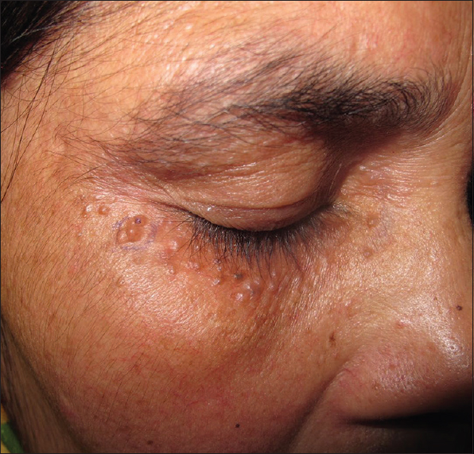
Clinical features
The lesions are mostly present on cheeks and eyelids.
They are cystic, often blue in colour and there is frequently a history of enlargement when the skin is exposed to heat and flattening of the lesion when the skin is exposed to cold.
Administration of atropine causes disappearance of cyst

Slide 70
The lesions are benign.
Management
Treatment may consist of topical atropine or scopolamine but this is usually discontinued due to side effects.
Other treatment modalities are Electrodesiccation,carbon dioxide laser and pulse dye laser.

Slide 71
Hidroacanthoma Simplex
An intraepidermal tumour derived from the eccrine duct epithelium, which could be considered an intradermal eccrine poroma.
Pathology
Nests of clearly discrete small rounded cells are seen within the normal epidermal cells. They are smaller and more cuboidal than surrounding keratinocytes and are rich in glycogen and the glycolytic enzymes.
These lesions may be confused with intraepidermal or clonal seborrheic keratosis.

Slide 72
History and presentation
Hidroacanthoma simplex is a verrucous plaque or ring with a hyperkeratotic usually brown surface. It often mimics a flat seborrheic keratosis.
The limbs are more likely to be involved than the head or trunk.
Management
Excision is recommended for diagnosis and management.

Slide 73
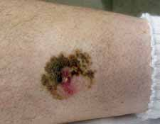
Hidroacanthoma simplex on lower limb

Slide 74
Eccrine poromas
A tumour derived from the intraepidermal eccrin duct ,all poromas have been regarded as eccrine,but some of the lesions may show apocrine differenciation
Pathology
There are clear margin between adjacent normal epidermal keratinocytes and smaller cuboidal cells, usually with darker nuclei protruding down into the underlying dermis.
The cells are similar to those seen in dermal ductal tumors.

Slide 75
Clinical features
The lesions are found on the palms and soles in contrast to other skin appendage tumours which tend to be concentrated around the head and neck area.
They are exophytic lesions, pink or red in colour, and may reach 1–2 cm in diameter.
Occasional lesions are pigmented and look similar to pigmented basal cell carcinoma under dermoscopy
Exceptional examples of poroma have been reported in a naevus sabeceous,mycosis fungoides after electron beam therapy,after radiotherapy,lymphoproliferative disorders,hydrotic ectodermal dysplsias.

Slide 76
The lesion is benign.
Management
Benign eccrine poromas are treated by surgical excision.

Slide 77
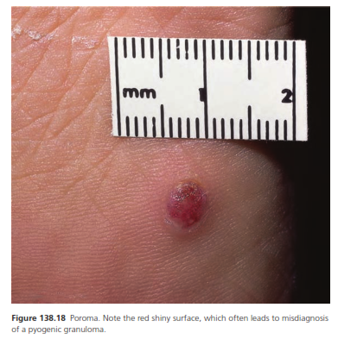

Slide 78
Syringoma
A benign skin tumour composed of sweat ducts that is usually multiple develop during adult life.
It appears at adolescence and further lesions may develop during adult life.
Pathology
Most are lined by a double layer of cells similar to those that line normal eccrine ducts.
Collections of convoluted and cystic ducts are seen in the upper half of the dermis.

Slide 79
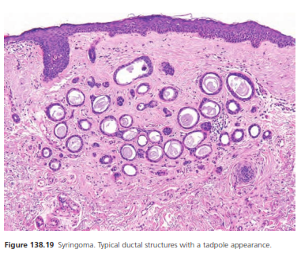
Patholog
A characteristic feature is the tail-like strand of cells projecting from one side of the duct into the stroma,giving a resemblance to a tadpole or comma

Slide 80
Clinical features
The individual small dermal papules are skin coloured, yellowish but sometimes appear translucent and cystic.
The surface may be rounded or flat-topped and the outline sometimes angular.
They vary in size from1mm to 5 mm.
The front of the chest, face and neck are the chief areas affected. A few lesions are usually found on the eyelids when the cheeks are involved
Eruptive syringomas have a predilection for the neck, chest, abdomen, pubic area and more rarely on the buttocks.

Slide 81
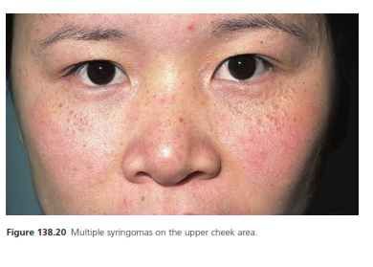
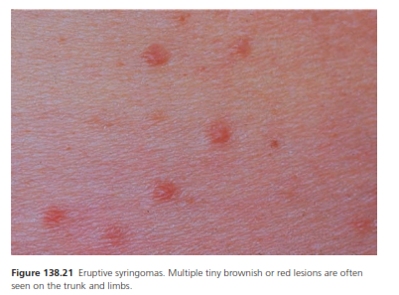

Slide 82
Syringomas are seen in patients with Down syndrome.
Multiple syringomas have also been reported during radiotherapy for breast cancer and disappear after cessation of radiotherapy.
The lesions are benign.
Management
The main reason for treatment is cosmetic. Careful destruction with diathermy can produce good cosmetic results.
Lesions treated with carbon dioxide laser may recur.

Slide 83
Hidradenoma
Are tumours of sweat gland origin.These tumours can show either eccrine or apocrine differentiation.
Pathology
The tumour may connect with the epidermis.
It is composed of two cell types –Polygonal cells, whose glycogen content may give the cytoplasm clear appearance
elongated, darker and smaller cells, which occur at the periphery.
Cuboidal or columnar cells are seen lining duct-like spaces and clefts.

Slide 84
Clinical features
The tumours are firm dermal nodules, 5–30 mm in size, and may be attached to the overlying epidermis, which can be either thickened or ulcerated .
Growth is slow and there may be a history of serous discharge.
The lesions are usually solitary and are most likely to be found on the scalp, face, anterior trunk and proximal limbs.
Ulcerated lesions may resemble basal cell carcinoma.

Slide 85
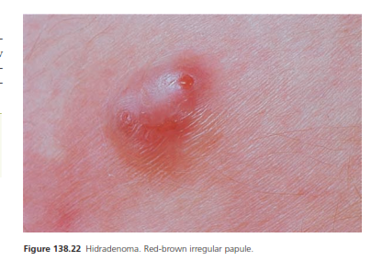

Slide 86
Disease course and prognosis
The lesions are usally benign.
Lympatic invasion and regional lymph nodes metastasis may occure in tumor that are histologically benign.
Management
Surgical excision will cure benign lesions. Long follow-up is suggested for histologically benign lesions which shows lymphatic Invasion or lymph node metastasis.In these patients staging should also be performed.

Slide 87
Cylindroma
A skin tumour showing sweat gland origin with a characteristic histology that usually manifests as nodules or tumours of the scalp

Slide 88
Pathology
The tumours are composed of closely set mosaic-like masses (‘jigsaw-puzzle’ appearance) and columns of cells that are invested by a hyaline basal membrane of variable thickness.
Thin bands of stroma separate tumour lobules from one another. The cells are of two types:
one large,with a moderate amount of cytoplasm and a vesicular nucleus.
the other small, with little cytoplasm and a compact nucleus.

Slide 89
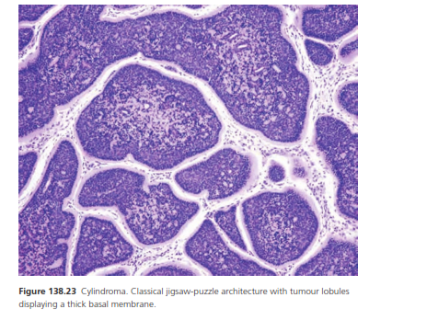

Slide 90
History and presentation
The tumours are frequently multiple, smooth, firm, pink to red in colour and pedunculated.
5 cm or more in diameter.The commonest site is the scalp and adjacent skin.
Tumours on the scalp may be almost hairless when pedunculated,but the smaller lesions form dermal nodules with little loss of overlying hair.
Rare lesions may occur in association with Brooke–Spiegler syndrome

Slide 91
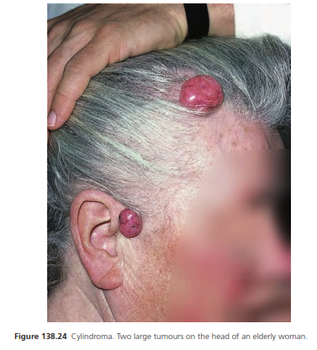

Slide 92
Differential diagnosis
Tricholemmal cyst if multiple
Trichoepithelomas
Steatocytomas
Basal cell carcinomas
Management
Surgery is the treatment of choice. Extensive involvement of the scalp may require wide excision and replacement of the whole area by a graft
Topical salicylic acid has been used in patients with multiple cylindromas

Slide 93
Spiradenoma
A benign tumour of sweat gland lineage, which is usually solitary and is distinguished by its histology
Pathology
The tumour is lobular, with two cell types;
Larger paler cells may be grouped around lumina, and smaller darker cells form the periphery.
Small tubular structures or cystic spaces may occur,and large thin-walled dilated vascular channels are also present. Degenerative changes in old tumours are often present
Haemorrhage and ischaemic necrosis as a result of degeneration often obscure the histological

Slide 94
Pathology
Malignant transformation may occur in long standing tumors.
In malignant spiradenoma four general patterns have been described;
1) malignant neoplasm arising from pre-existing benign spiradenomas,
2) cylindromas
3)spiradenocylindromas
4) high rate of p53 expression

Slide 95
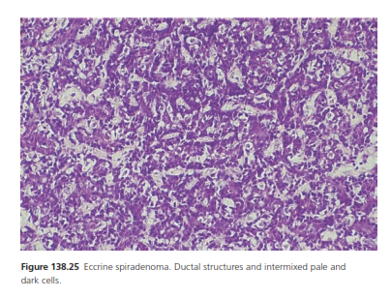
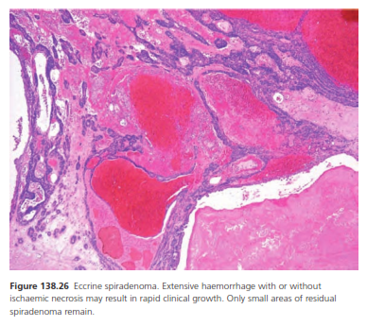

Slide 96
Clinical features
The lesion is usually solitary and painful and consists of a firm rounded bluish dermal nodule 3–50 mm in diameter .The usual site is on the front of the trunk and proximal limbs.
Rare sites include the vulva, breast and external ear.
Multiple neoplasms in a linear or zosteriform distribution may also be seen and congenital tumor followed Blaschko lines on face has been reported.
Management
Surgical excision should be complete, as there may be recurrence.

Slide 97
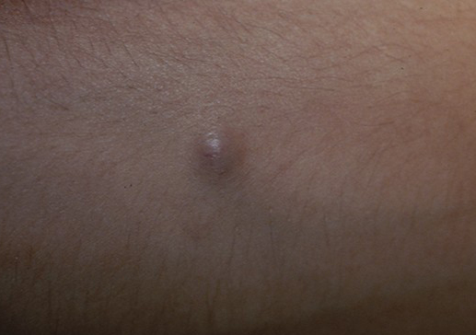
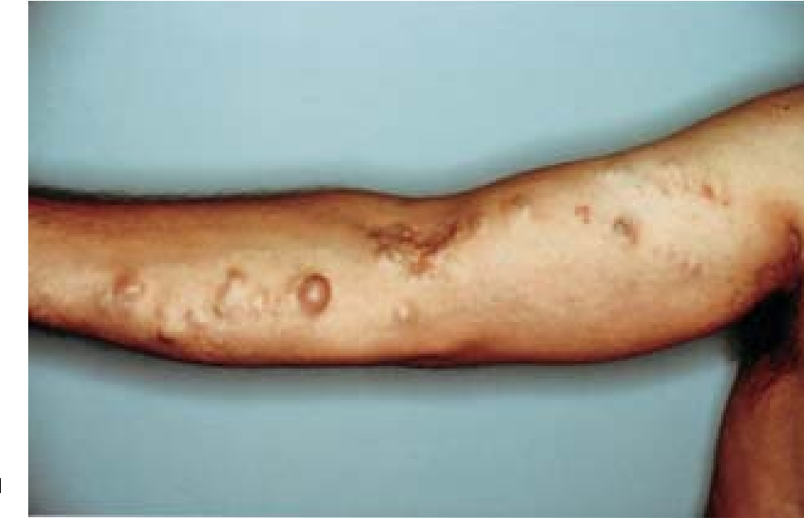

Slide 98
Paget disease of the nipple
A progressive, marginated, scaling or crusting of the nipple and areola due to invasion of the epidermis by malignant cells, which originats from an intraductal carcinoma of the breast.
Paget disease arises from apocrine duct-derived epithelial cells.
Overexpression of ras P21 has been demonstrated in mammary and extramammary Paget disease.

Slide 99
Pathology
The epidermis is thickened, with papillomatosis, enlargement of the interpapillary ridges and hyperkeratosis or parakeratosis on the surface
Within the epidermis, characteristic Paget cells are dispersed between the prickle cells. They Vary in number,and when profuse the Malpighian layers may be Disrupted and the surface covered by a crust.
Both the cells and their nuclei are rounded; the nuclei are vesicular or hyperchromatic with a high nuclear/cytoplasmic ratio. The cytoplasm is PAS positive and diastase resistant.
Staining with antibodies to CEA is also positive

Slide 100
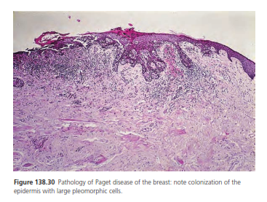
Pathology
The main pathological challenge is to distinguish Paget disease from malignant melanoma,presenting in the nipple. Paget disease cells will be CEA positive, EMA positive and Cam 5.2 positive, while those of melanoma will be positive for melanocytic markers.

Slide 101
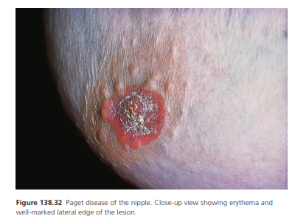
Clinical feature
The early changes may be minimal, with a small, crusted and intermittently moist area on the nipple giving a brownish stain on clothing, or producing itching, pricking or burning sensations.
Less often, there is a serous or blood-stained discharge from the nipple, or a lump may be noticed in the breast.
Itching may be a prominent symptoma subjacent mass or a lump deeper in the breast may be felt.
The nipple itself may be retracted and mass or a lump deeper in breast tissue may be felt.

Slide 102
Differential diagnosis
Eczema of the nipple
Bowen diseas
superficial Basal cell carcinoma
Psoriasis
Erosive adenomatosis of the nipple
Management
All patients should have a mammogram or ultrasound to establish whether or not there is deeper pathology.
In patients with no evidence of an underlying breast carcinoma, conservation therapy should be done with or without radiotherapy according to the presence or absence of an invasive component
Sentinel lymph node Biopsy is performed in cases with an invasive component
Surgery should always include the whole of the nipple–areolar complex

Slide 103
Extramammary Paget disease
Resemble Paget disease clinically and histologically,but occurring in sites rich in apocrine glands, such as the vulva, ano-genital region and axilla
75% of cases, extramammary Paget disease arises as a primary intraepidermal neoplasm, possibly from apocrine gland ductal cells or from keratinocyte stem cells.
In the remaining 25% of cases, an underlying primary adenocarcinoma is found.

Slide 104
Pathology
The changes in the epidermis are similar to Paget disease.
The cells stain positively for acid as well as neutral mucopolysaccharides.
They may contain melanin granules.
Immunohistochemistry shows cells positive for CEA and Cam-5.2 and other low-molecular-weight keratins such as CK7 and CK8/18
Cytokeratin 20 tends to be positive in lesions associated with an internal gastrointestinal tumour.

Slide 105
History and presentation
The margin is sharp, rounded and slightly raised, and encloses an area that is pink or red.
The surface may be scaly, and small greyish crusts may cover erosions.
Itching is a prominent feature and there may be excoriations or lichenification.
The commonest area involved is the vulva followed by the perianal area, which is more frequently affected in men than women
Lymph node or distant metastases can occur.

Slide 106
Differential diagnosis
eczema
intertrigo
pruritus vulvae
Bowen disease is usually more raised and verrucous
Superficial basal cell carcinoma has a thread-like margin.
Bowen disease of the mucosal surfaces.
Disease course and prognosis
Local recurrence is common, even in cases with a wider excision Poor prognosis is associated with depth of invasion and with elevated serum levels of CEA.

Slide 107
Management
If an underlying malignancy Is present,it should be excised together with all clinically abnormal epithelium.
If no underlying malignancy is detected on careful examination, the entire affected area of epithelium should be excised.
Photodynamic therapy
Use of topical imiquimod
Radiotherapy as an adjunct to surgical therapy or alternative therapy in elderly patient.

Slide 108


