Slide 1
PRINCIPLES OF SKIN SURGERY
DR ZAINAB QADIR
RESIDENT DERMATOLOGY
PNS SHIFA

Slide 2
BIOPSY TECHNIQUES
▶ A.INCISIONAL AND EXCISIONAL ELLIPTICAL BIOPSY
▶ B.PUNCH BIOPSY
▶ C.SHAVE BIOPSY

Slide 3
A.INCISIONAL AND EXCISIONAL ELLIPTICAL BIOPSY
▶ INCISIONAL BIOPSY….Surgical procedure in which cut is made through skin to remove sample of abnormal tissue or part of lump or suspicious area.
▶ EXCISIONAL BIOPSY……An entire lump or an entire area of abnormal tissue is removed.

Slide 4
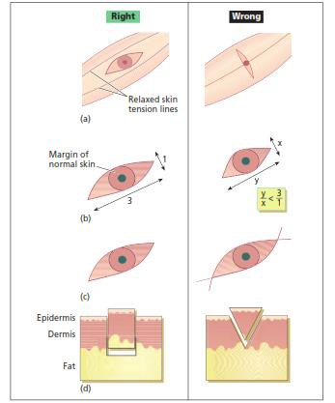
Principles of elliptical excision.
The ellipse is designed to follow skin-crease lines
(a), and should be approximately three times as long as it is wide
(b). Ensure that an appropriate margin of normal skin is also excised
(c). At the ends of the ellipse, hold the blade vertically so that the incision lines do not cross over
(d). The blade should be held at 90° to the skin when cutting the ellipse so that the wound has vertical sides down to fat.Do not bevel the blade towards the specimen as this makes the wound more difficult to close and may cut into the dermal component of the lesion

Slide 5
Performing the biopsy.
▶ The incision
▶ The scalpel blade
single,continuous.
Aligned at 90deg
▶ Excision direction is best assessed
▶ The incision line
Patient standing or seated upright
Meet neatly
.
▶ Ellipse is gently pulled away skin hook or fine-toothed forceps.
▶ Undermining of the edges is required Tension-free wound closure and allow optimal wound edge eversion.
▶ The wound should be closed layered fashion utilizing both subcutaneous and surface sutures.

Slide 6
▶ EXCISIONAL SKIN BIOPSY
INDICATIONS
▶ Benign and malignant cutaneous tumors
▶ Lesions or inflammatory processes that are in deep dermis or subcutaneous fat.

Slide 7
▶ PREOP PREPARATION
▶ SURGEON PREPARATION
▶ Competent enough for surgery
▶ Fully immunized against hep B and C
▶ Surgical gloves and eye protection
▶ PATIENT PREP.AND CONSENT
▶ Introduce yourself .Explain risks,benefits,and possible complications of procedure to the patient
▶ Informed consent and documentation in the chart
▶ Patient should be in reclined,comfortable position that he or she can maintain during entire procedure.Palpation is important
▶ Mark the surgical excision margin with the surgical marking pen(2mm margins for bengin and 4mm for BCC/SCC)
▶ Clean the skin with alcohol swab ,chlrohexidine or pyvodine

Slide 8
PROCEDURE
▶ Inject 1% lignocaine with adrenaline subcut around the margins of excision.Wait atleast 5 mins
▶ A number 15 blade is most commonly used to make two hemi-elliptical incisions perpendicularly through the skin into the subcutaneous tissues.
▶ TAKE CARE….
The length of wound should be atleast three times its breadth
The angles at the end should not exceed 30 deg,
Incisions should not cross each other at either end(fishtailing)
▶ Once incised, the ellipse of tissue is held firmly but gently with either fine- toothed Forceps or a skin hook, and separated base ideally using sharp and blunt dissection with curved tissue scissor(sub fat is imp..H/P plus good wound closure)
▶ For standard histological processing, the specimen should be placed in a formaldehyde–saline specimen bottle, clearly labelled with the patient’s details.

Slide 9
▶ For immunoflouroscence studies specimens are placed in michels medium(transport
medium)that can preserve tissue for upto 5 days
▶ Use electrocautry or electrodessication to stop bleeding.
▶ Close the epidermis with either interrupted sutures or running suture.
▶ Margins should be carefully approximated
▶ Place sterile petroleum jelly over the excision site and cover with the an adhesive bandage.

Slide 10
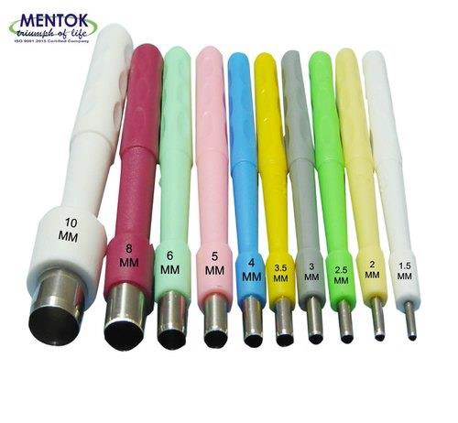
B.PUNCH BIOPSY
▶ Produces core of skin down to the fat,is quick and easy to perform and leaves only a small wound.
▶ Disposable and reusable 2–8 mm diameter punches are available.
▶ Excise naevi on the trunk
▶ Can be left for healing with secondary intention(collagen matrix dressing)

Slide 11
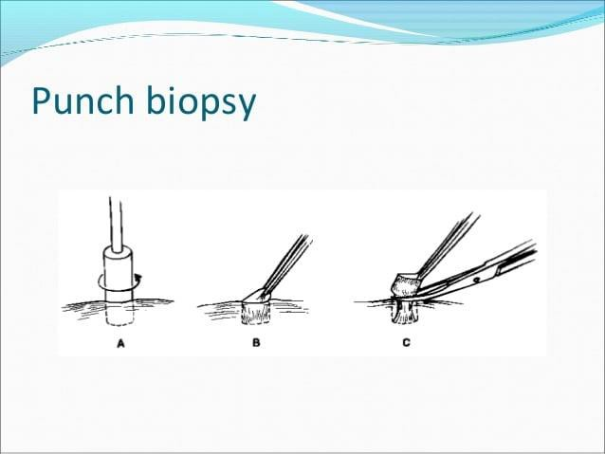
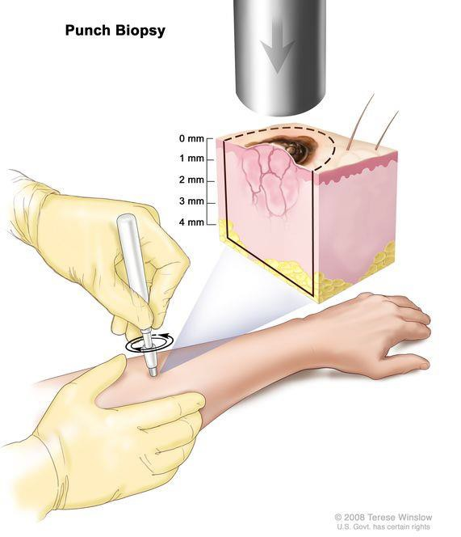

Slide 12
Disadvantages of punch biopsy
▶ Potential for sampling error
▶ Skin Tumours the risk associated with breaching the dermis and the Potential For tumour implantation.
▶ Depth control in critical sites
▶ Difficulty In Stopping Bleeding if small arteriole is punctured at the base of the wound(Constant pressure for 10 to 15 mins)

Slide 13
SHAVE BIOPSY
▶ Simple ,rapid and effective method for Superficial,benign and
protuburent lesions

Slide 14
Dermatosis of epidermis and superficial dermis,Easy and quick for solid tumours than incisional biopsy that would need to be sutured.
Not suitable for deep tumour like melanoma(full thickness excisional biopsy)
Prepare skin
▶ Local anesthesia to elevate lesion
▶ Use #15 blade or razor blade or dermablade
▶ Excise the lesion level or minimally depressed in relation to surrounded skin
▶ Achieve hemostasis by pressure or electrodessication or topical agent (aluminium chloride,monsel solution, silver nitrate)
▶ Submit for pathology
▶ Takes 2..3 weeks to heal.

Slide 15
Surgical needles and suture materials
▶ An ideal suture material would have high tensile strength, handle
easily,provide good knot security and cause no tissue reaction.
Skin sutures are of two main types:
▶ Absorbable
▶ Non-absorbable

Slide 16
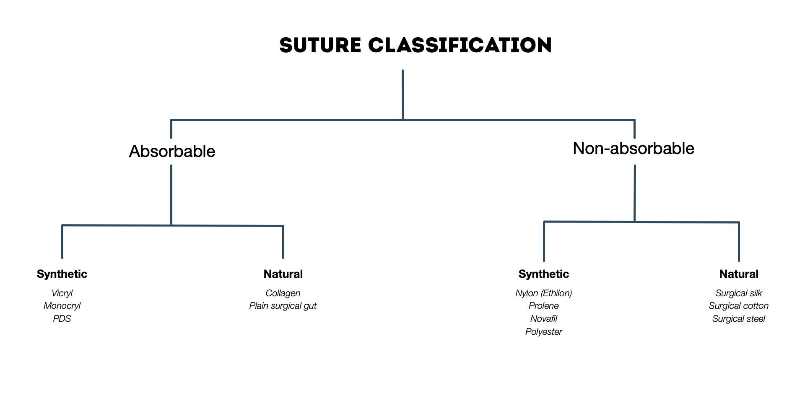

Slide 17
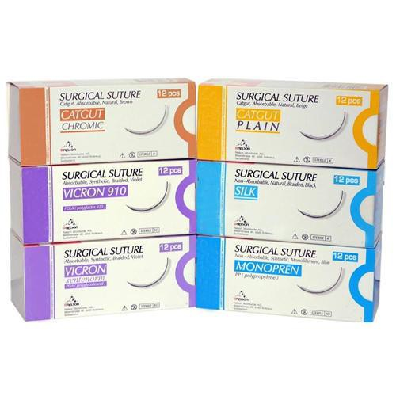
▶ The gauges normally used for skin surgery range from 3/0 (strong) to 6/0 (fine), with suture selection depending on the wound size, anatomical site and surgeon preference.

Slide 18
▶ Suture techniques
▶ Simple interrupted
▶ Continuous suture
▶ Burried dermal suture,
▶ Horizontal mattress sutures
▶ Vertical mattres sutures
▶ Pulley suture ,purse string suture

Slide 19
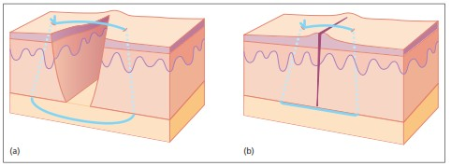
▶ Simple interrupted suture
▶ The simple interrupted suture penetrates the skin surface on one side of the wound, passes under the dermis of both sides and exits on the other side and is tied securely with a surgical knot.
▶ Tention should be sufficient to hold the wound edges together but not too tight to impair the microcirculation.

Slide 20
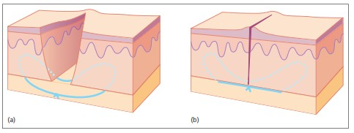
▶ Buried dermal suture
▶ Suture passes from The Dermis of one side to the dermis of the other side of the wound and Is buried Beneath the Skin surface.
▶ this type of suture provides support for the wound for several
weeks whilst the wound regains its strength.

Slide 21
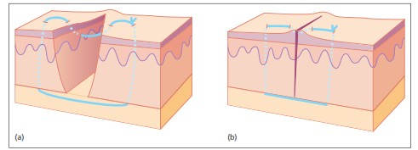
▶ Vertical mattress suture(far far near near suture)
▶ The needle is introduced 5-10mm from the wound edge and the deep bite of tissue is taken before exiting the skin in the same position on the opposite wound edge
▶ Particularly useful where greater amount of tention is there and where there is thin and fragile skin

Slide 22
HORIZONTAL MATTRESS SUTURE
▶ The needle is inserted through the skin on one side of the wound at a distance from the edge ,it passes underneath to the opposite side,emerges and is reinserted a little further laterally and passes back under the wound to emerge on the opposite side.

Slide 23
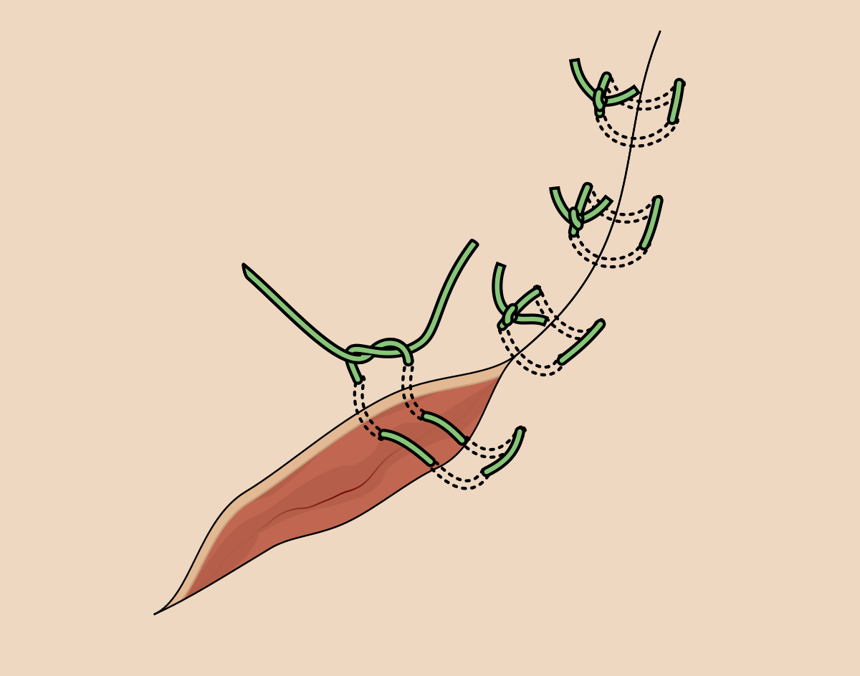
Horizontal mattress suture

Slide 24


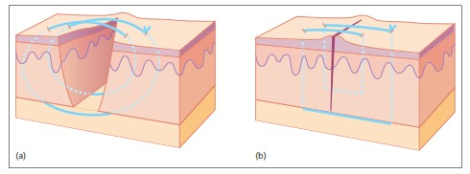
▶ PULLEY SUTURE
▶ The needle takes a large bite from the skin of one side of the wound, passes to take a small bite from the opposite side, returns to take a small bite from the original side and then passes to take a large bite from the opposite side before being tied.

Slide 25
PURSE STRING SUTURE
▶ A very useful way of reducing the size of the wound
▶ Particularly useful for large necrotic or infected tumours where
exact nature of tumour and adequacy of excision is in question
▶ After excision lesion is closed with an absorbable suture along the margins taking bites into the dermis,suture is tightened drawing the edges together
▶ Temporary skin distortion that disappears with healing within 6 to 8 weeks

Slide 26
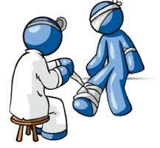
▶Wound Dressings

Slide 27
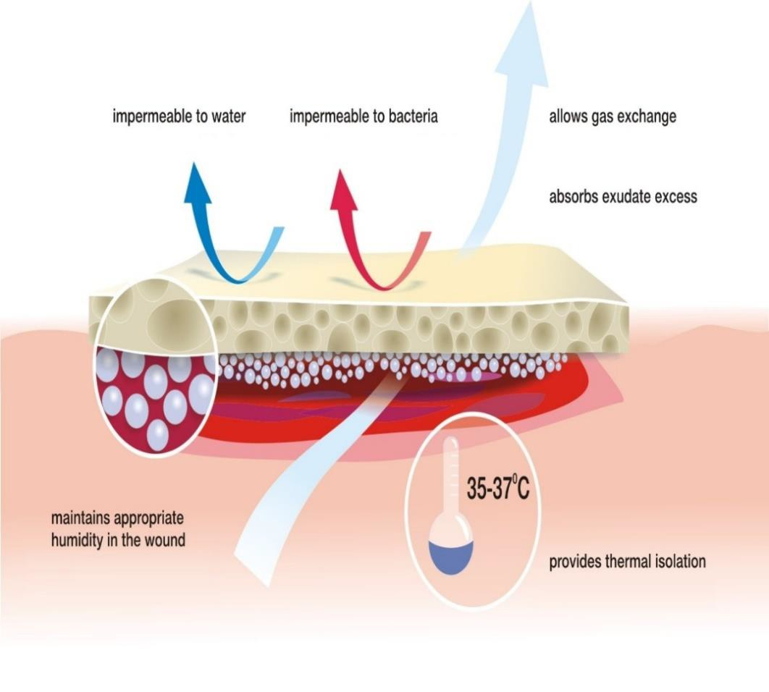
▶Characteristics of ideal dressing
▶ Mechanical and bacterial protection
▶ Moist environment at wound site
▶ Gaseous and fluid exchange
▶ Non adherent to the wound
▶ Non toxic, non sensitizing, and non allergic
▶ Well acceptable to the patient
▶ Cost effective

Slide 28

Cont……
▶ Highly absorbable
▶ Absorb wound odour
▶ Sterile
▶ Easy to use
▶ Require infrequent changing
▶ Available in a suitable range of forms and sizes

Slide 29
CLASSIFICATION:
Dry dressings
Moisture-keeping dressings
Bioactive Dressings
Skin Substitutes (Advanced Dressings)

Slide 30
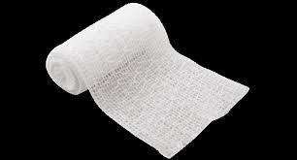
Dry dressings
▶ Commonly available
▶ Absorb exudate
▶ Adherent to granulation tissue
Examples:
▶ Gauze and bandages
▶ Membranes and films
▶ Foams
▶ Tissue adhesives

Slide 31
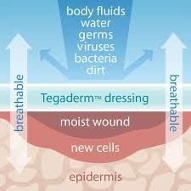
Moisture keeping dressings
▶ Non adherent
▶ Fast healing
▶ Do not break granulation tissue on removal
▶ Less painful

Slide 32
Cont….
Examples:
▶ Pastes, creams and ointments
▶ Non permeable, semipermeable membranes or films
▶ Hydrocolloids
▶ Hydrogels

Slide 33
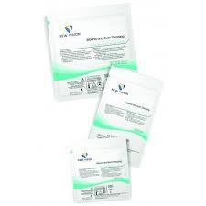
Bioactive dressings
▶ Enhance granulation tissue formation
▶ Reduce slough formation
▶ Inhibits bacteria
▶ Some provide growth factors

Slide 34
Cont…
Examples:
▶ Antimicrobial dressings
▶ Single-component biologic dressings
▶ Combination products

Slide 35
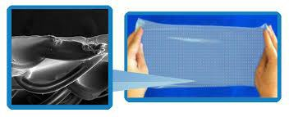
Skin Substitutes
▶ Heterogeneous group of wound coverage materials
▶ Helps in wound closure
▶ Replace the functions of the skin

Slide 36
Cont…
EXAMPLES:
▶ Epidermal substitutes (autologous or allogenic)
▶ Acellular skin (dermis) substitutes
(allogenic or xenogenic)
▶ Autologous and Allogenic skin
▶ Skin substitutes containing living cells

Slide 37
Commonly used dressings
▶ Gauzes
▶ Bead dressings
▶ Silicone dressings
▶ Antimicrobial
▶ enzymatic
▶ Foams
▶ Polymeric films
▶ Tissue adhesives
▶ Tulles
▶ Hydrocolloids
▶ Hydrogels

Slide 38
Skin Grafts
Dr Zainab qadir

Slide 39
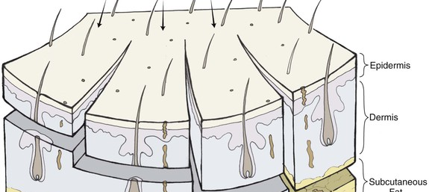

Slide 40
Types
Full‐thickness skin grafts
Composite grafts
Split‐thickness skin graft

Slide 41
Full‐thickness skin grafts
Cosmetically preferred
Strength of the repair
The donor and graft sites should match for skin thickness, adnexal structures, surface markings, weathering and texture.

Slide 42
INDICATION
Small avascular areas less than 1 cm
larger areas with good blood supply as the metabolic demands of the additional adnexal structures of FTSG increase the likelihood of necrosis

Slide 43
Donor site
Any site with matching and ‘spare’ skin is a potential donor site. Common donor sites
Skin behind and in front of the ear
the nasolabial fold
upper eyelid
inner aspect of the upper arm
supraclavicular fossa

Slide 44
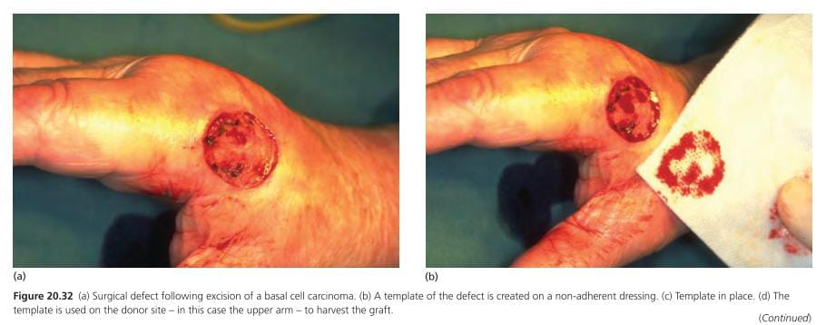

Slide 45
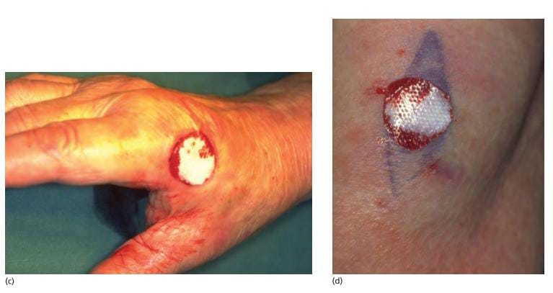

Slide 46
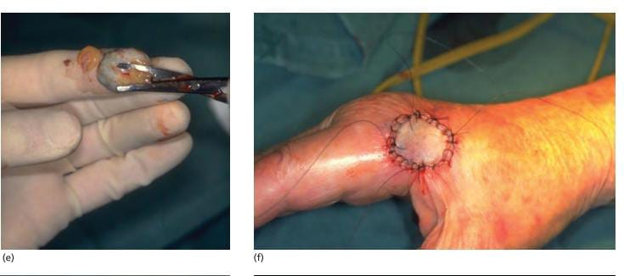

Slide 47
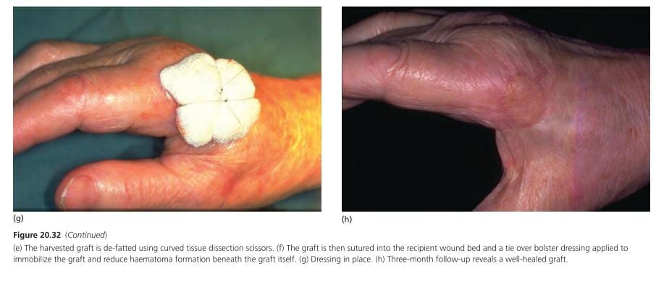

Slide 48
Graft failure
infection
Poor blood supply
Faulty technique

Slide 49
Skin graft contract i.e ectropion
Grafts should be oversized by 10–25%
Depressed graft scar
Graft elevation by autograft fat injection
Delayed grafting enables deeper defect to fill up by granulation tissue

Slide 50
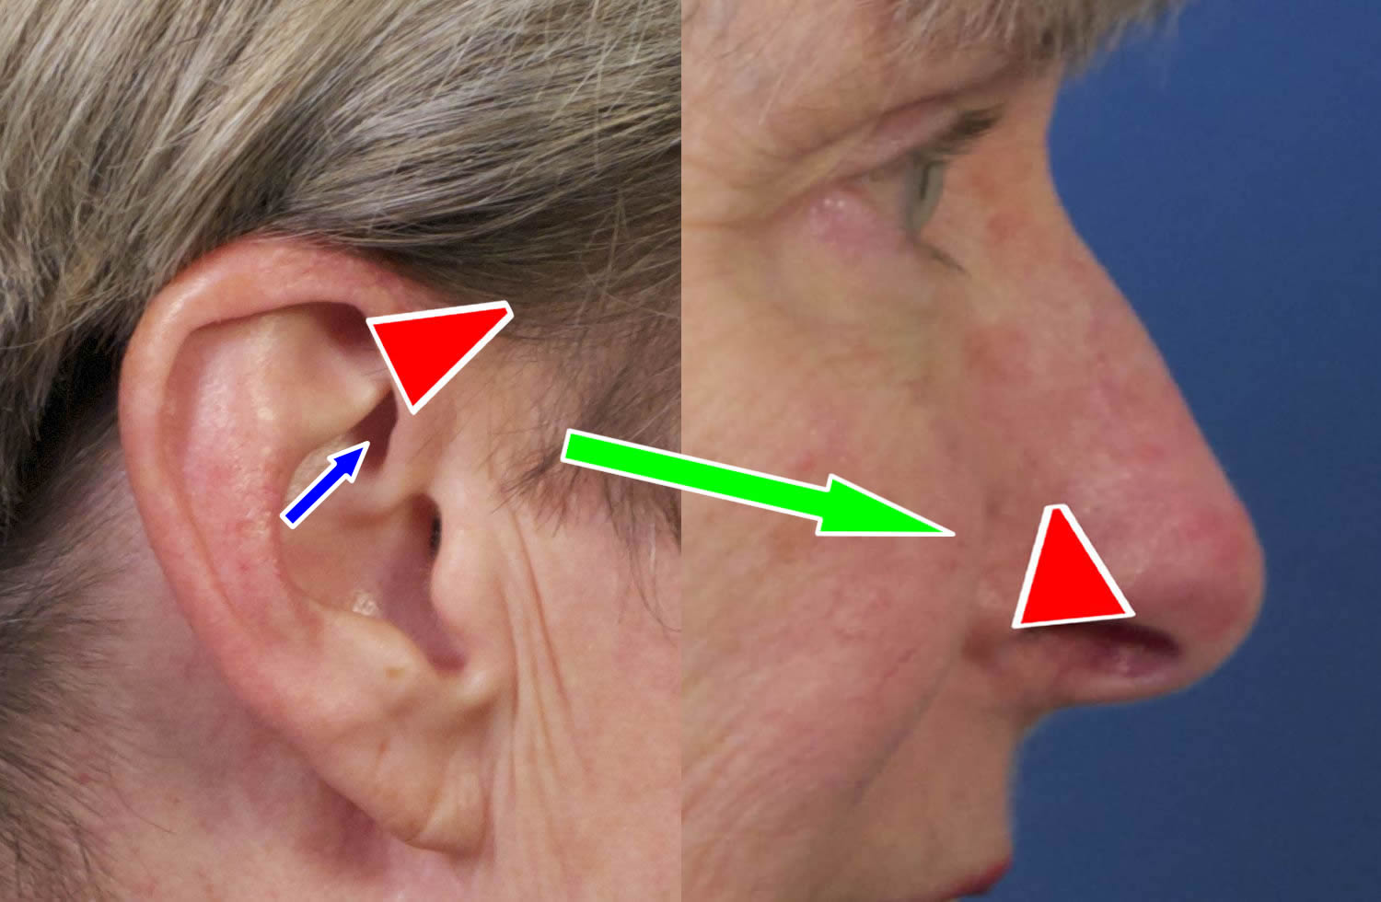
Composite grafts
Comprises two or more germ layers i.e skin and cartilage,survival is unpredictable. Indicated for Nose, ear and periocular defects.
They contract less, induce new cartilage formation and maintain their thickness and epidermal appendage

Slide 51
Split‐thickness skin graft
Cover very large wounds as the skin is thin and relatively transparent.
Size is not limited by the amount of donor skin that can be harvested
Donor skin site will re-epithelialize by regeneration from retained adnexal remnants.

Slide 52
Indication
Cover tumor excision sites where the adequacy of excision cannot be guaranteed at the time of surgery, because recurrence is more easily identified through the thinner graft than it would be after full‐ thickness or flap closure.
Chronic ulcer
Extensive burn

Slide 53
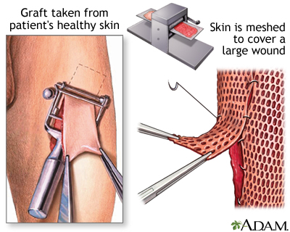

Slide 54
Common donor site
upper thigh, and less frequently the upper outer arm and anterior abdominal wall.
Disadvantage
Relatively poor cosmetic result and greater graft shrinkage

Slide 55
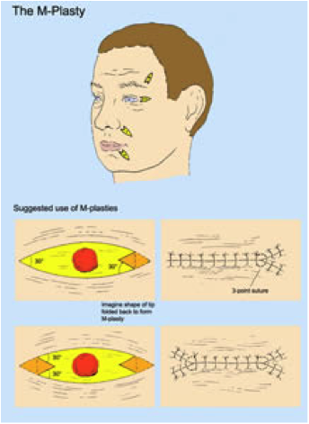
INDICATION:- When one end of an elliptical excision will cross an important anatomical or cosmetic line.
It will reduce the overall length of excision by bringing the apex of the excision back within the original area to be excised

Slide 56
Z‐plasty
It is used to improve the functional and cosmetic appearance of scars.
Redirect a scar into better alignment with a natural skin fold or the lines of least skin tension.
Contracted scars may be lengthened with this technique.

Slide 57
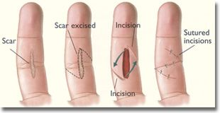

Slide 58
Wedge excision – lip, eyelid and ear
Inherent tissue elasticity of these structures allows considerable defects to be repaired by direct closure without distorting the free margins of these structure.

Slide 59
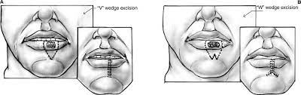
Wedge excision
LIP
Defects smaller than one‐third of the lip length can be closed directly following a wedge excision,
To avoid excessive distortion Wedge‐ plasty correction can be done on the lower lip

Slide 60
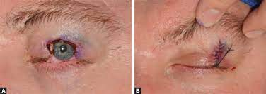
Wedge excision
EYELID
On the eyelid, defects of up to 50% can be closed directly, using a pentagonal wedge technique .

Slide 61
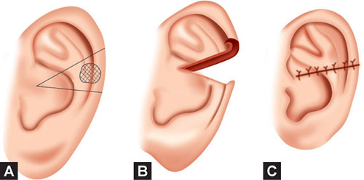
Wedge excision
EAR

Slide 62
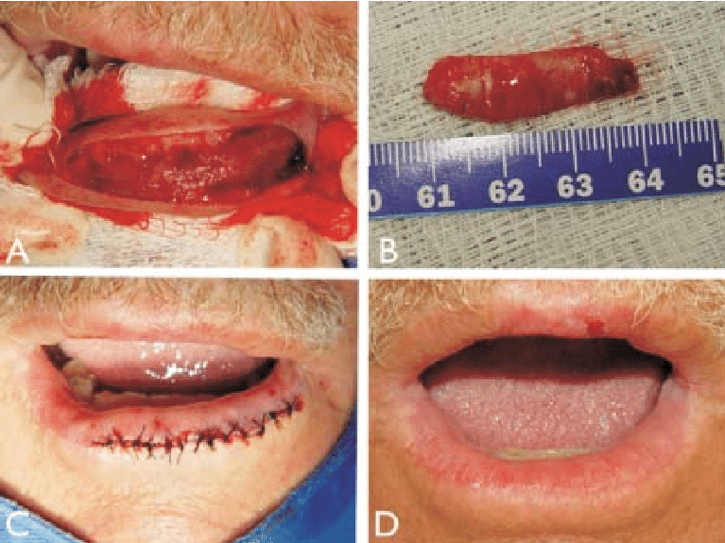
Vermilionectomy
It refer to mucosal advancement .
The vermilion, usually of the lower lip, is excised, principally because of actinic damage, and replaced by lip mucosa pulled forward and sutured at the vermilion skin border.

Slide 63
‘Dog‐ear’ repair (tricone repair, standing cutaneous deformity repair)
length to width ratio of an excision is insufficient to prevent the skin at the poles from bulging outwards when the opposing skin edges are brought together.
It occur with limited laxity or movement in the surrounding tissues.
Excisions where the angle at the apex exceeds 30° are also liable to produce dog ears.

Slide 64
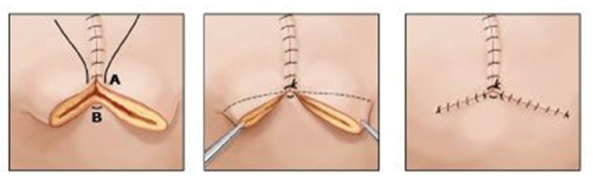
The excess skin of the dog ear can be removed by converting it into a T‐plasty or an M‐plasty. This is a useful technique when the length of the wound cannot be extended

Slide 65
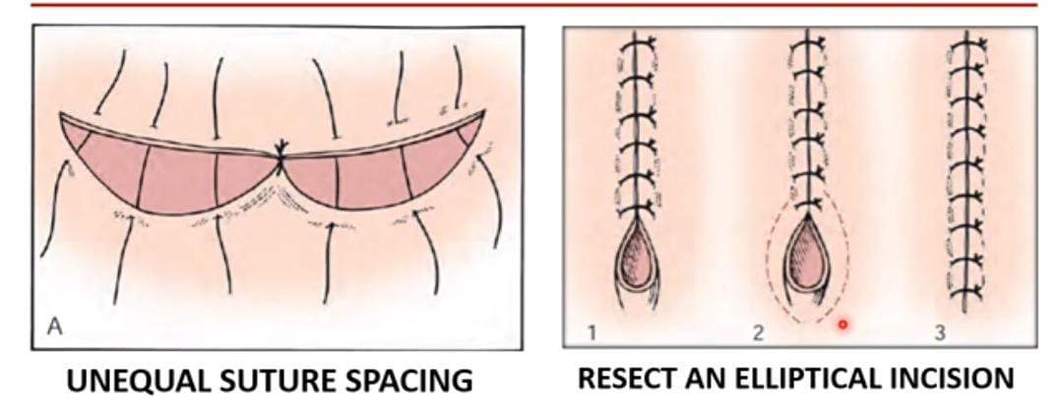
The excision can be extended and the overlapping skin excised.

Slide 66
Relaxing incisions
It increases skin mobility
Multiple small full‐thickness incisions are made parallel to the skin edge at the site of greatest wound tension.
These allow the skin to stretch like a meshed graft, resulting in small elliptical defects which heal by second intention.

Slide 67
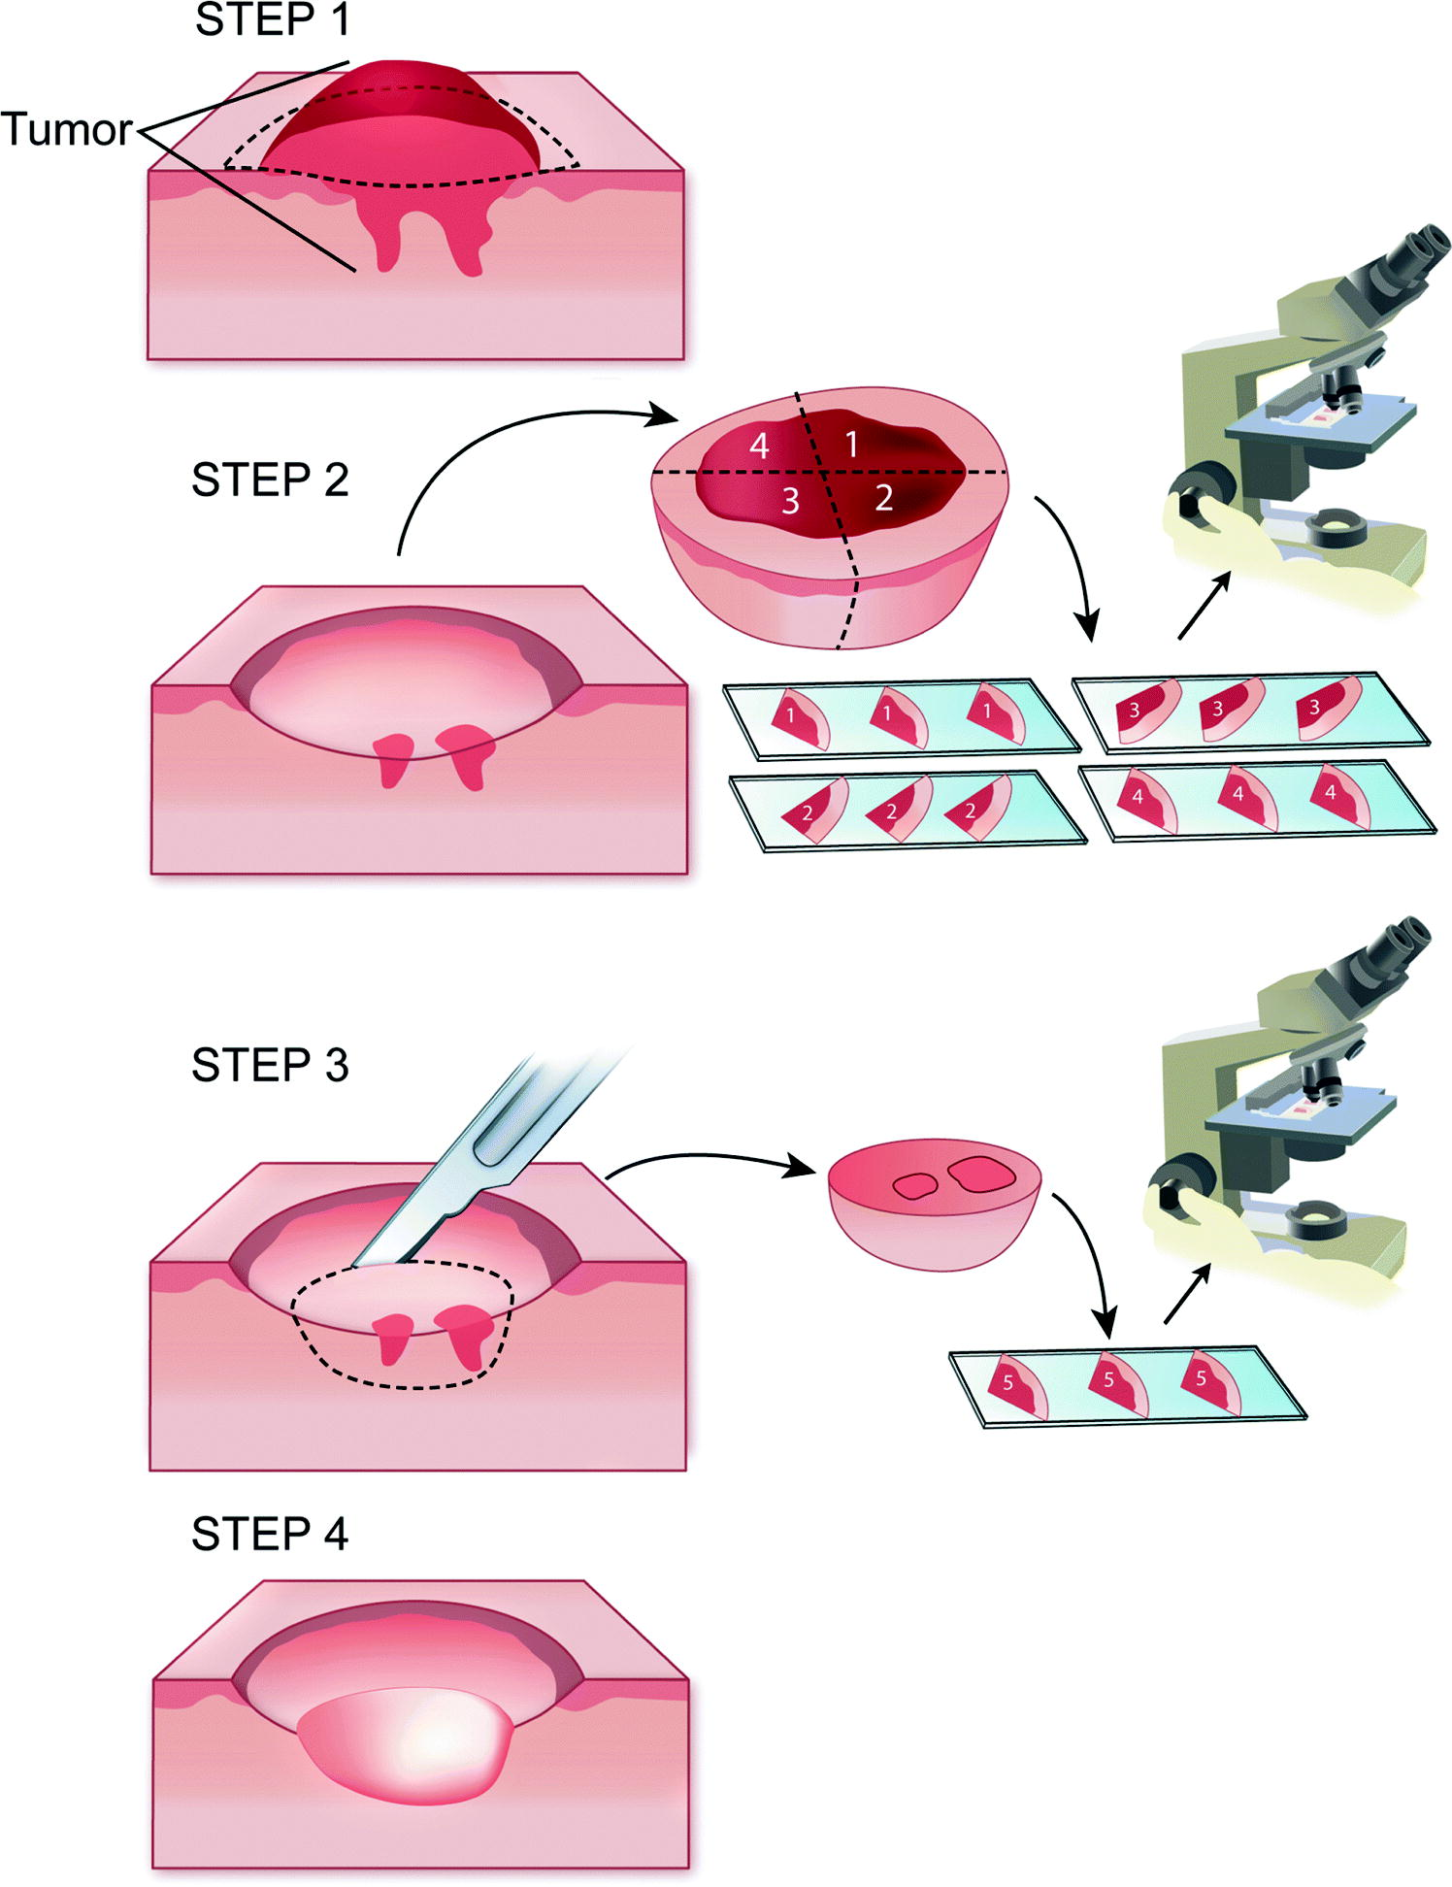
Mohs micrographic surgery

Slide 68
‘Gold standard’ for facial basal and cutaneous squamous cell carcinoma.
Mohs introduced three features that remain fundamental to the success of the modern technique:
Tissues were sectioned and examined in a horizontal plane.
Excised specimens were marked and colour coded using a novel technique.
A mapping process was used to accurately identify the location of residual tumour which could then be excised with further cycles of treatment.

Slide 69
Tumours treated by Mohs micrographic surgery
Common
BCC and SCC
Less common
Melanoma in situ/lentigo maligna
Dermatofibromasarcoma protuberans
Microcystic adnexal carcinoma
Sebaceous carcinoma
Extramammary Paget disease

Slide 70
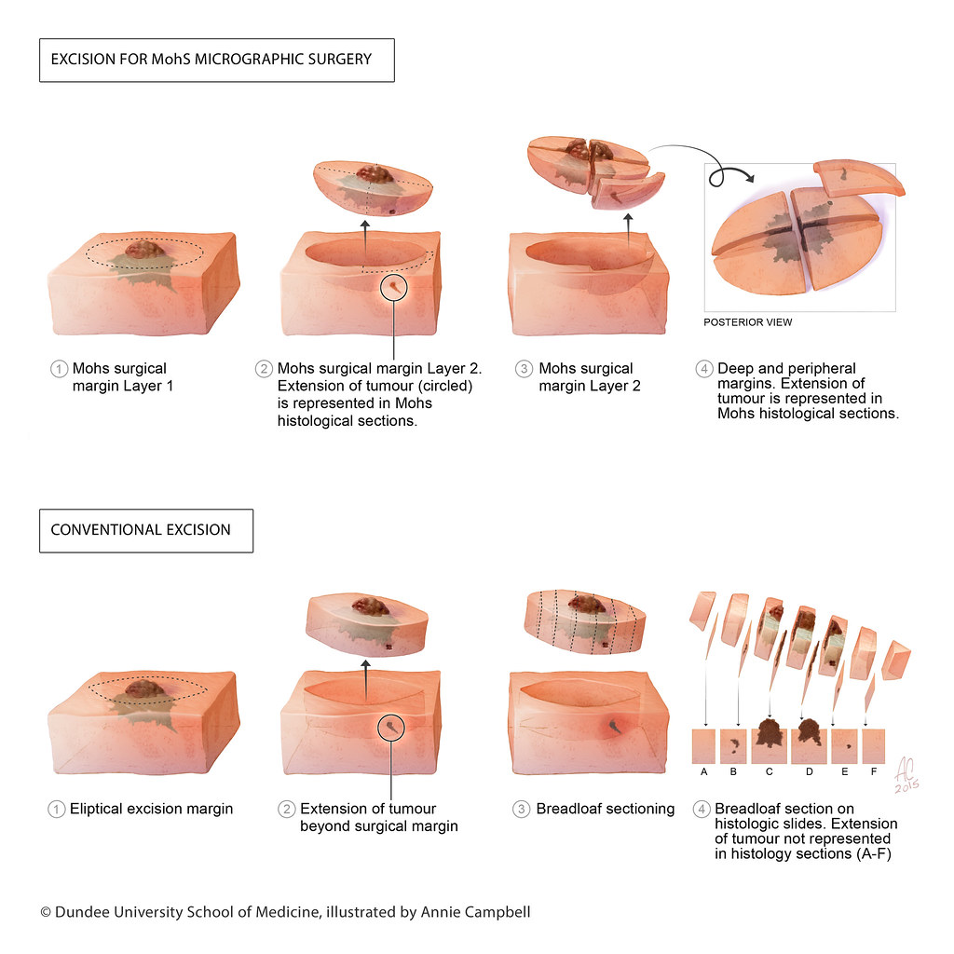

Slide 71
Traditional surgery
Mohs
Remove predetermined margin of clinically normal skin from around and underneath the cancer, and generally wider and deeper margins.
It is followed by immediate reconstruction of the wound, with histological examination of the surgical margins occurring days later
MMS does not rely upon clinical estimation as the true extent of the cancer is revealed as the technique proceeds through the number of stages required to clear the tumour
It allows intraoperative histological examination to establish complete tumour removal on the day of surgery.

Slide 72
It relies upon histological evaluation of the surgical margins using vertically orientated tissue sections (‘bread‐loafing’) which has been estimated to have a sensitivity no greater than 44% as it involves assessment of <1% of the entire surgical margin.
It involves the surgeon, pathologist and possibly an anaesthetist.
Horizontally orientated tissue sections used in MMS are designed to allow microscopic examination of theoretically nearly 100% of the true surgical margin.
MMS is performed by the Mohs surgeon who also acts as anaesthetist, pathologist and reconstructive surgeon

Slide 73
Criteria for high‐risk lesions that can be managed without the use of Mohs micrographic surgery

Slide 74
Size >2 cm lesions
Site i.e perioral, periorbital, perinasal and periauricular areas where a combination of a high cure rate and maximal preservation of normal tissues and structures is vital
Lesions with very poorly defined clinical borders
Recurrent disease
Histologically incompletely excised lesions
Aggressive growth patterns, perineural spread

Slide 75
Curettage

Slide 76
Types of basal cell carcinoma (BCC) that should not be treated by curettage.
Large tumours ≥2 cm diameter
Scar produced by curettage is cosmetically unacceptable
Recurrence of the tumour has an unacceptable risk of further morbidity
Morphoeic , infiltrating or basosquamous BCCs
Recurrent tumours, Ill-defined tumours
Tumours penetrating muscle, fat, bone, etc.

Slide 77
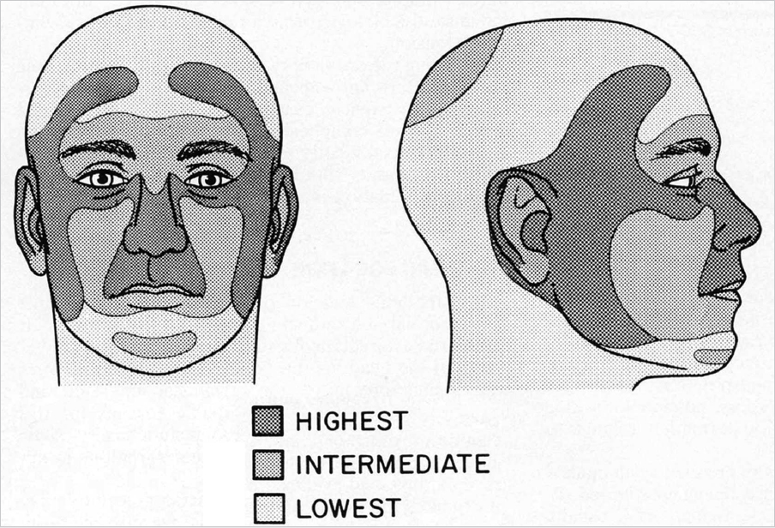
Sites to avoid curettage and cautery of basal cell carcinomas
Sites with high recurrence after all treatment modalities
nose nasolabial fold around eye ear scalp

Slide 78
Sites where curettage is technically difficult
Hair-bearing scalp
lip
eyelid

Slide 79
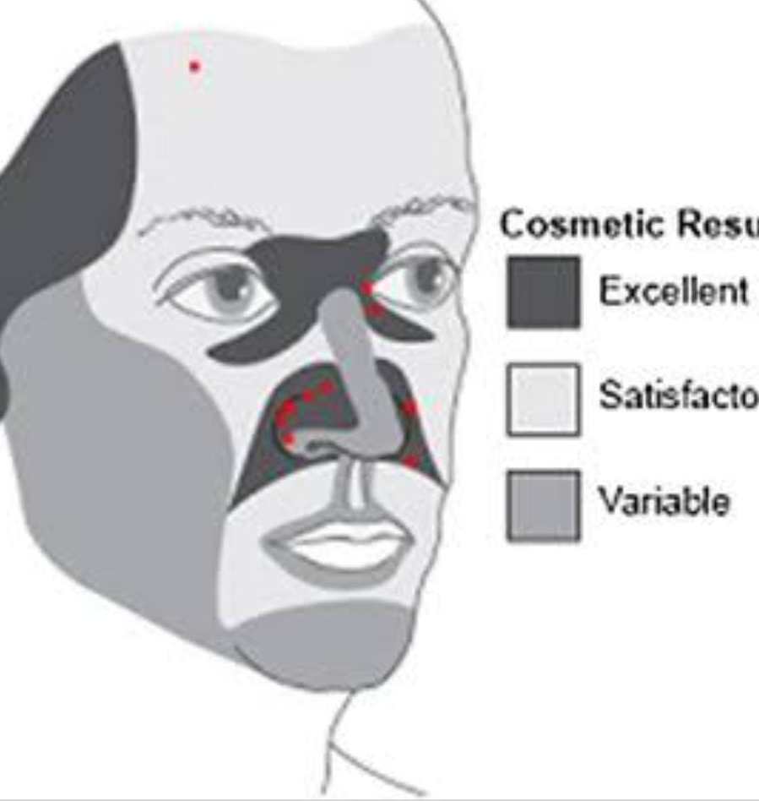
Sites associated with poor cosmesis after curettage
Vermilion border
Alar rim
nose tip
chin

Slide 80
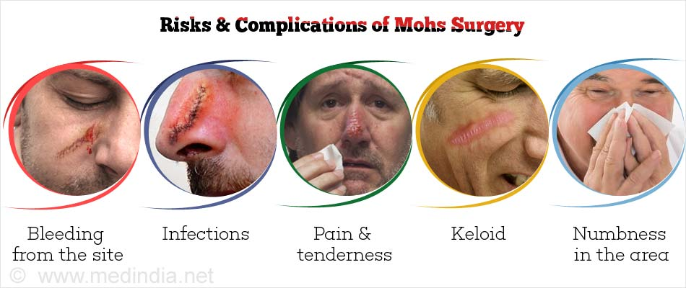

Slide 81
Results
With MMS, a 98–99% 5‐year cure rate for basal cell carcinoma and a 94.4% 5‐year cure rate for squamous cell carcinomas was reported by Mohs himself

Slide 82
Electrocautery and electrosurgery

Slide 83
Electrocautery
Cautery is the application of heat to living tissue.
In electrocautery the metal element or burner is heated by the passage of electricity and the hot element is applied to the skin or lesion to be treated.
It is common to heat the element until red‐hot to sterilize the tip before use, but the tip should be allowed to cool before applying to the skin.

Slide 84
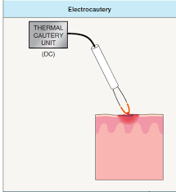

Slide 85
The most effective technique is to apply the element to the skin surface and move it around in a rotating motion whilst triggering the current and watching carefully for the first indication of tissue coagulation.
No electricity passes through the patient and so electrocautery is completely safe in patients with implanted cardiac devices.
it may ignite inflammable liquids, vapours and gases and even dry cotton gauze so care must be taken to exclude these from the operative field.
Notes:
Whilst heating the element may sterilize the tip, the body of the
element remains cooler and may carry a risk of cross‐contamination
from patient to patient. It is therefore desirable to use a newly sterilized
or sterile disposable element for each new patient.

Slide 86
Electrosurgery
Electrosurgery, also known as radiosurgery, radiofrequency surgery or surgical diathermy, is a technique by which heat is created in tissues by the passage of high frequency alternating current.
Frequencies from 0.3 to 5.0 MHz are used for electrosurgery because at these higher frequencies the muscle does not react and fibrillation does not occur.
Notes:
Frequencies above 5.0 MHz propagate like radio-waves; this makes them unpredictable in their effect and unsuitable for electrosurgery.

Slide 87
There are two ways of delivering electrosurgical current to the skin: monopolar and bipolar.
Two types of electrical contact with the patient Monoterminal and Biterminal.
Two different types of electrosurgical generator ground (earth) referenced and isolated machines.
And a number of electrosurgical techniques including electrosection, fulguration, electrodessication and electrocoagulation and different types of electrosurgical currents.

Slide 88
Bipolar biterminal electrosurgery
In this mode, two active electrodes of equal size are used, the most common being the insulated tips of bipolar forceps.
This gives a very precise coagulation confined to the target tissue.
These machines are good at detecting the presence of moist tissue and delivering a coagulating current until the tissue is perfectly coagulated and haemostasis achieved.

Slide 89
Electrosurgical currents
There were two original types of electrosurgical generator: a spark‐gap machine that produced an intermittent, highly dampened, electrical discharge in pulses, and a vacuum oscillator which produced a continuous sine wave.
The intermittent pulse produced good tissue coagulation, whereas the continuous sine wave cut the tissue like a knife

Slide 90
Electrosurgical effects:
Electrosection
Electrosurgery may be used to cut tissue. The optimal setting would use a fine monopolar electrode and a constant sine wave electrosurgical current.
Electrosection may be used to remove excess tissue in rhinophyma although ablative laser therapy may also be Successfully employed to treat this condition

Slide 91
Fulguration
The term ‘fulguration’ (‘fulgur’ = lightning) refers to the technique whereby a monopolar electrode is held just above the skin surface and a train of sparks strikes the surface, often causing a blackened non‐conductive char. In order to create sparks, the electrosurgery machine must have an output with a sufficiently high voltage.
Despite the frequent production of a blackened char, fulguration has an extremely shallow superficial effect and is a useful way of producing haemostasis following shave excisions and curettage without damaging underlying tissues.
Notes:
increased tissue charring and lateral tissue damage, and

Slide 92
Electrodessication
Electrodessication creates an intense but superficial coagulation and dehydration of tissue. This occurs when a monopolar electrode is held in direct contact with the skin surface. The resulting layer is a poor electrical and thermal conductor, and insulates the deeper tissues from further damage.

Slide 93
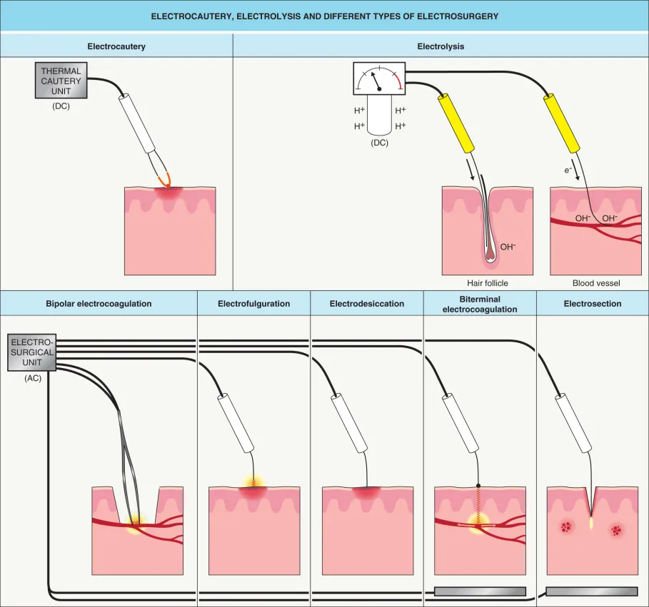

Slide 94
Electrocoagulation
Electrocoagulation occurs when tissue is heated sufficiently to denature its protein. The active electrode is held in good contact with the tissue to be treated, and a relatively low current is applied to the tissue for several seconds. The depth of coagulation depends on the duration of the current rather than its magnitude.

Slide 95
vrcxszx
Shave excision and electrosurgery of a rhinophyma. (a) This disfiguring rhinophyma was reduced in size, and (b) the nose shape recreated by shave excision and electrodesiccation of the bleeding surface under local anaesthetic, (c) resulting in an acceptable cosmetic result at 4 months.

Slide 96
Hazards and risks of electrosurgery
Fire:
Electrosurgery may ignite inflammable liquids, vapours and gases.
Electrical safety
There should be no liquids in proximity to the equipment.
Many electrosurgical machines have in‐built safety features and will not work unless correctly set up and with a patient return electrode attached to the patient when this is required.

Slide 97
Cryosurgery
Liquid nitrogen is the most effective and most studied cryogen.
Cryotherapy is believed to cause cell death in four ways:
1 -Ice crystals formed in the cell damage cellular components.
2 -Uneven intracellular ice formation during freezing leads to osmotic differences arising during thawing, which in turn causes cell disruption.
3 -Cold injury to small blood vessels results in ischaemic damage.
4- Immunological stimulation produced by the release of antigenic
components results in cell damage.

Slide 98
Liquid nitrogen can be applied using cotton‐ wool swabs dipped into the liquid. However, a liquid nitrogen spray can is easier for application.
cryotherapy has been used to treat a wide range of skin lesions.
The correct technique and freeze times are required to produce results similar to those described in published studies.

Slide 99
Side effects
Cryotherapy pain is significant but usually transient, and tissue swelling is common.
Haemorrhagic blisters
Skin necrosis is a desirable in treatment of neoplastic.
Hypopigmentation/hyperpigmentation
Nerve damage resulting in paraesthesiae, distal anaesthesia and motor paralysis.

Slide 100
Caustics
Provide a simple and readily available means of destroying many superficial skin lesions.
The operator should be well acquainted with the action and degree of penetration of individual caustics.

Slide 101
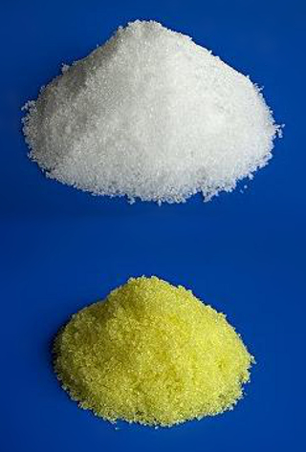
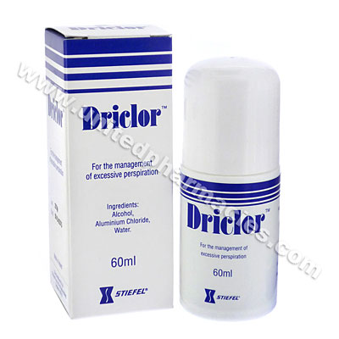
Aluminium chloride hexahydrate
A 20% solution (Driclor®; Anhydrol Forte®), usually applied on a cotton‐bud, is a very useful styptic for superficial wounds such as those following shave excision.
Ferric subsulphate (Monsel’s solution) is widely used but may leave a pigmented scar.

Slide 102
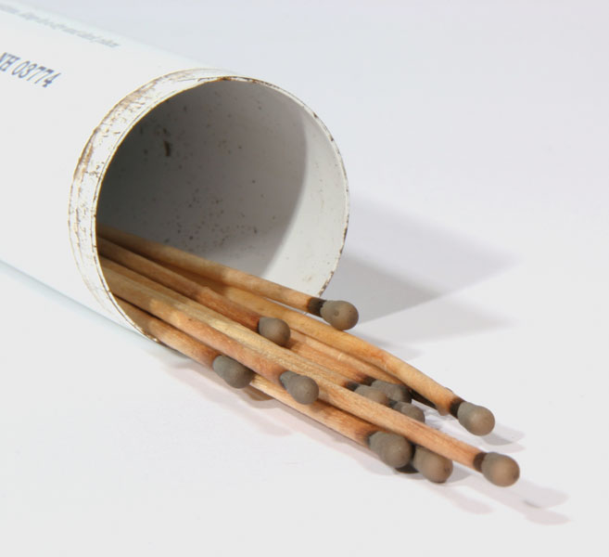
Silver nitrate
This is used in the form of a pencil or as a strong solution to suppress exuberant granulation. It is haemostatic and may be used to arrest bleeding after curettage. Repeated use tends to lead to unsightly staining of the skin.

Slide 103
Trichloroacetic acid
This is an effective haemostatic caustic, which has many uses.
The 30–50% concentration can be used as a styptic, and may be employed in conjunction with superficial curettage in the treatment of solar keratoses, seborrhoeic warts, etc.
Trichloracetic acid 35% is used for its destructive effect on the epidermis and may be a useful treatment for xanthelasmas and actinic lentigines. It must be applied with great care, however, especially around the eyes.
Excess sebum should first be removed using detergent or isopropyl alcohol. Trichloroacetic acid should then be applied with an ‘almost dry’ cotton applicator.

Slide 104
Intralesional corticosteroid therapy
Aqueous suspensions of triamcinolone acetonide (10 mg/mL (Adcortyl®) and 40 mg/mL (k-kort) are available and can be diluted with saline or lidocaine.
Triamcinolone acetonide 10 mg/mL is sufficient for all conditions except keloids, for which the more potent preparation is required in order to achieve the desired degree of collagen resorption.
The amount injected normally ranges from 0.1 to 0.5 mL of 10 mg/mL solution, depending on the size and nature of the lesion.
The injection should be given using a 27–30 gauge needle deep in the dermis when possible, to minimize the risk of collagen atrophy.

Slide 105
The manufacturers recommend that no more than 30 mg of triamcinolone acetonide should be given in one session, with a maximum of 5 mg at any one site. (Steroid equivalence: 5 mg prednisolone = 4 mg triamcinolone = 20 mg hydrocortisone.)
serious adverse effects may result from intravascular injection. The avoidance of intravascular injection is especially important when injecting lesions around the forehead – where accidental intra-arterial injection and retrograde flow of a bolus of particles may result in retinal artery occlusion and blindness.
Notes:
1mg triamcinolone =0.8 mg prednisolone

Slide 106
Indications:
Intralesional triamcinolone therapy is used for inflammatory acne cysts, lichen planus, lichen simplex, cutaneous lupus erythematosus, chondrodermatitis, orofacial granulomatosis, granuloma annulare, psoriasis and nail psoriasis, alopecia areata and many other steroid‐responsive conditions

Slide 107
Plasma cortisol levels are suppressed for a few days by 20 mg of intralesional triamcinolone acetonide given into various sites; higher doses suppress cortisol levels for longer.

Slide 108
Intralesional therapies for skin malignancies
Surgical excision is the treatment of choice for skin malignancy, but in exceptional circumstances, intralesional chemo‐ or immunotherapy may be considered.
The agents that have been used most frequently are methotrexate, 5‐fluorouracil, bleomycin and various forms of interferon.

Slide 109
Miscellaneous surgical procedures and techniques
Curettage
Curettage can be used to treat benign lesions as well as small lower risk squamous cell carcinoma in situ (Bowen disease), basal cell carcinoma and squamous cell carcinoma.
Disposable ring curettes are now the most commonly employed in practice. They come in ring sizes ranging from 2 to 7 mm and contain a sharp (cutting) edge on one side enabling a clean plane of cleavage.

Slide 110
Ring curette. (a) Curettage of a small nodular basal cell carcinoma (BCC) on the forehead using a ring curette. (b) Haemostasis with bipolar diathermy. (c) Wound bed post treatment.

Slide 111
Haemostasis for open wounds:
Bleeding from open wounds can be stopped readily using an absorbable haemostatic dressing such as Surgicel® (glucosic copolymer), Kaltostat® (calcium alginate), Oxycel® (oxidized cellulose) or Gelfoam® (porous gelatin matrix), although the mechanism of action of these agents is poorly understood.
Chemical haemostatic agents are effective on oozing skin wounds, for example after curettage and shave excision, but are ineffective in the presence of arterial or arteriolar bleeding, and should not be used in sutured wounds as they cause cell death, which predisposes to infection.

Slide 112
Snip excision
Small tags can be snipped off with a pair of sharp scissors without the need for local anaesthetic. The tag should be pulled away from the skin with dissecting forceps and snipped off at its base: bleeding, if any, usually stops spontaneously.

Slide 113
Management of specific conditions
Epidermoid cysts:
Epidermoid cysts are lined by a keratinizing epithelium, which produces the cheesy keratinous contents. Patients may request excision if they are disfiguring, cause discomfort or are repeatedly infected.
Freely mobile cysts can be easily shelled out through the smooth tissue plane that separates the very thin cyst wall from the surrounding tissue, although at this plane the cyst wall is easily punctured and must be handled gently. In all cases, the entire cyst wall and punctum should be removed

Slide 114
To avoid long scars, very large cysts can be decompressed via a 4‐mm punch biopsy before excision.
The wound is either left to heal for 4–6 weeks before definitive removal of the shrunken cyst or an attempt can be made to pull the cyst inside out through the circular wound using artery forceps

Slide 115
Lipomas
Simple skin incision and lipoma excision ensures complete removal but produces a large scar. Scar size can be minimized by breaking up the lipoma into smaller fragments using blunt‐ended forceps or a needle‐holder inserted via a 4–6‐mm punch biopsy wound made over the centre of the lipoma.
The fragmented contents can then be squeezed out through the small wound.

Slide 116
Pigmented lesions
Common and blue melanocytic naevi, pigmented basal cell carcinomas, seborrhoeic keratoses and dermatofibromas are usually easily recognizable to the trained eye, although diagnostic difficulties occasionally occur. Dermoscopy can provide a valuable non‐invasive diagnostic adjunct
When diagnostic doubt persists, and especially when malignancy is suspected, the lesion should be excised and submitted for histopathological examination.

Slide 117
Minor skin lesions: mollusca, milia and comedones
An orange stick can be used to apply small quantities of a caustic agent precisely to a skin lesion. When 90% liquid phenol is used to treat mollusca contagiosa or small cysts, the orange stick tip may need to be sharpened so that it just fits the cavity being treated.
Mollusca can be squeezed to express the cellular debris from the centre of the lesion before phenol application. The tip of the orange stick is dipped into the phenol, any excess wiped off, and the stick is then placed in the centre of the lesion and gently twisted.

Slide 118
Multiple small facial epidermoid or acne cysts can be treated using the blunt end of an orange stick, dampened with trichloroacetic acid or phenol. The cyst is incised, the contents expressed and trichloroacetic acid or phenol carefully applied to the cyst lining using an orange stick. No dressing is required, but a local anaesthetic is necessary.
Milia are tiny, keratin‐filled, epithelial‐lined cysts with no connection to the overlying skin. They can be removed via a small skin incision made with a sterile venesection needle.

Slide 119
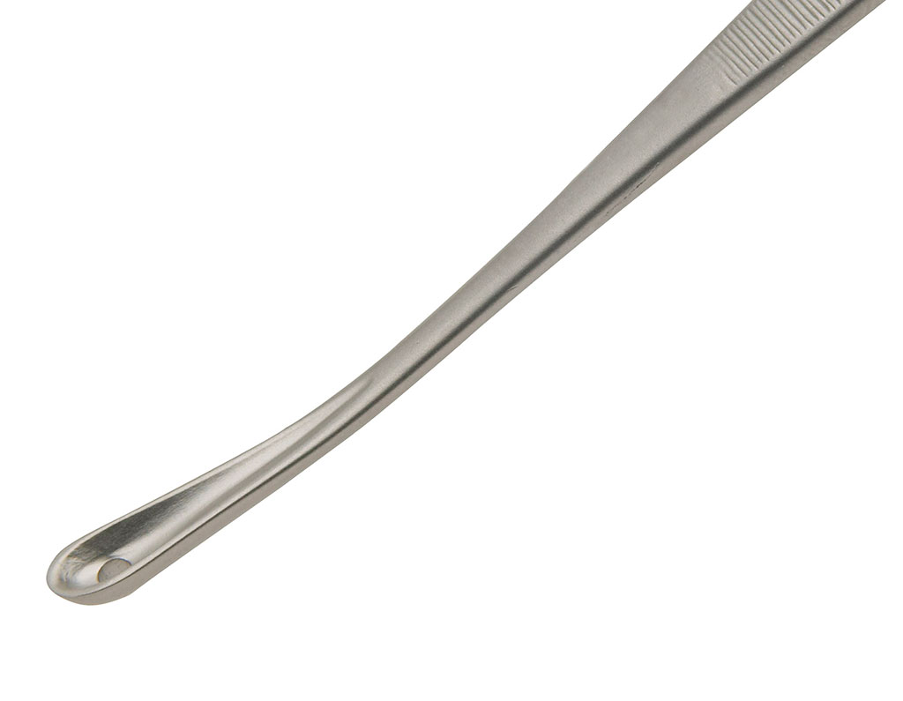
Comedones may be emptied using a comedo expressor, a metal instrument with a small cup‐shaped end in the centre of which is a small hole.

Slide 120
FLAPS
DR ZAINAB QADIR
RESIDENT DERMATOLOGY
PNS SHIFA

Slide 121
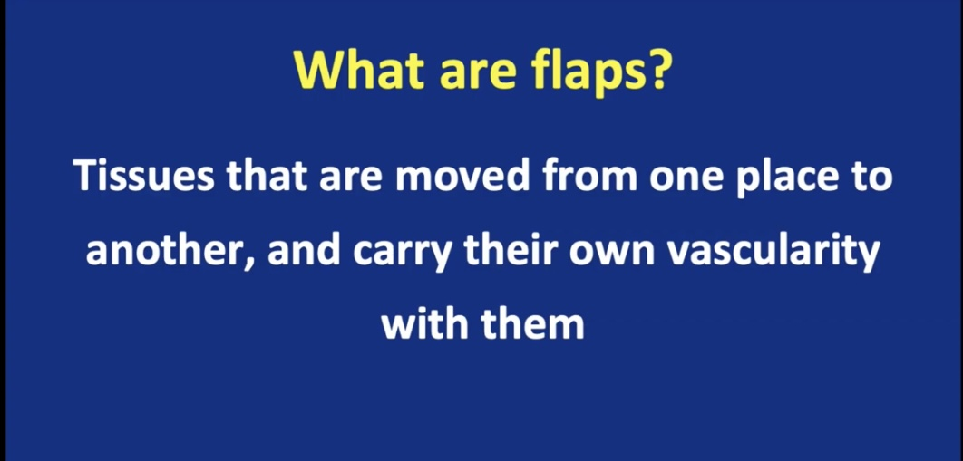

Slide 122
DEFINITION:
A flap is a full‐thickness piece of skin moved to cover a defect where the proximal portion, or pedicle, remains attached to the original site while the distal portion is moved to cover the defect.
BLOOD SUPPLY: PEDICLE.
DERMATOLOGISTS: Local flaps performed under local anaesthesia.
Notes:
The pedicle is sometimes based on a portion of skin which remains attached to the origin and sometimes, as in an island pedicle flap, the skin is entirely detached and the blood supply comes from the underlying subcutaneous tissue or muscle.

Slide 123
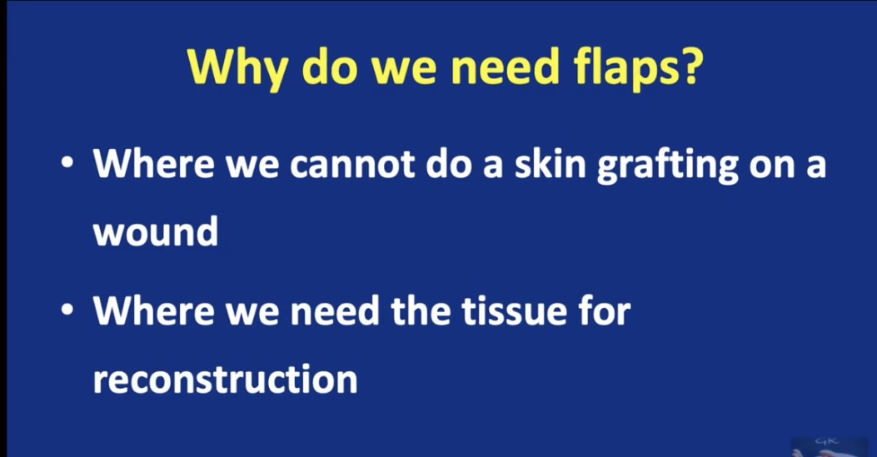

Slide 124
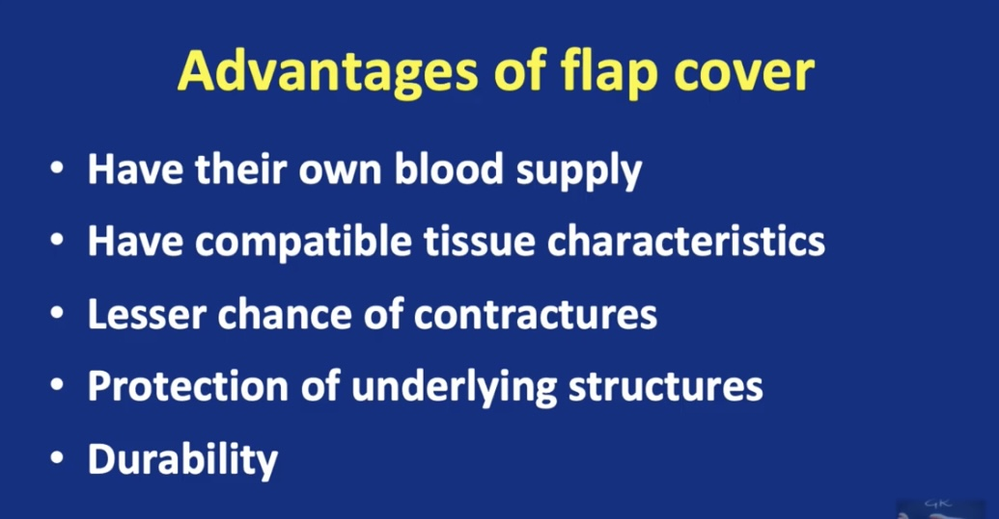

Slide 125
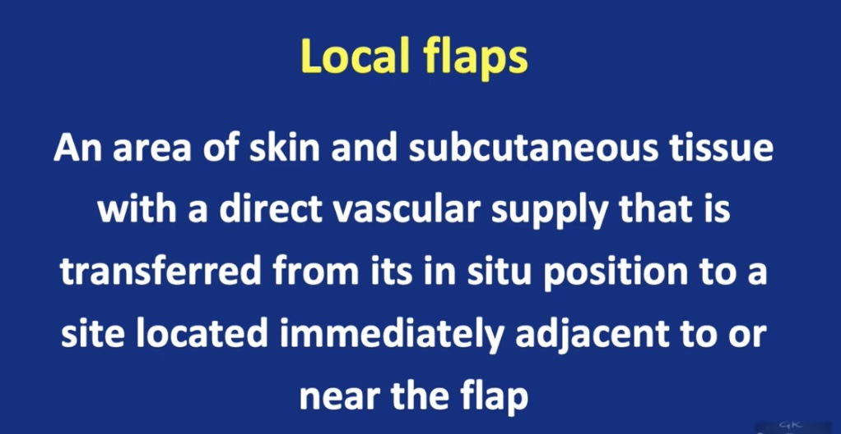

Slide 126
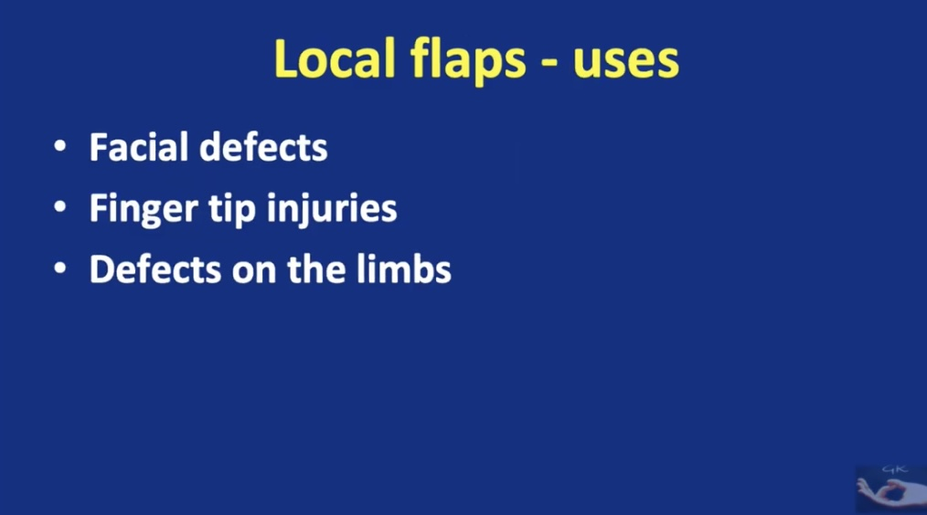

Slide 127
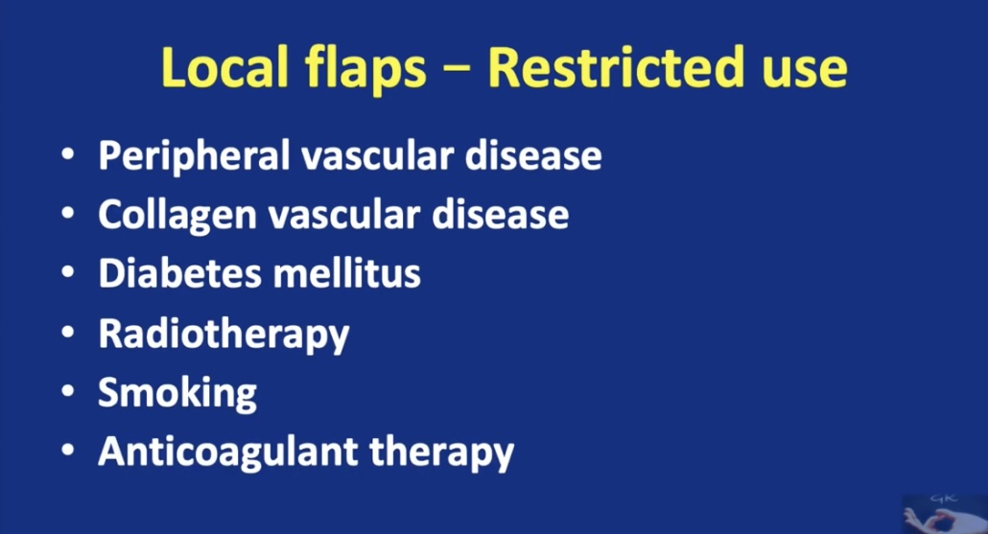

Slide 128
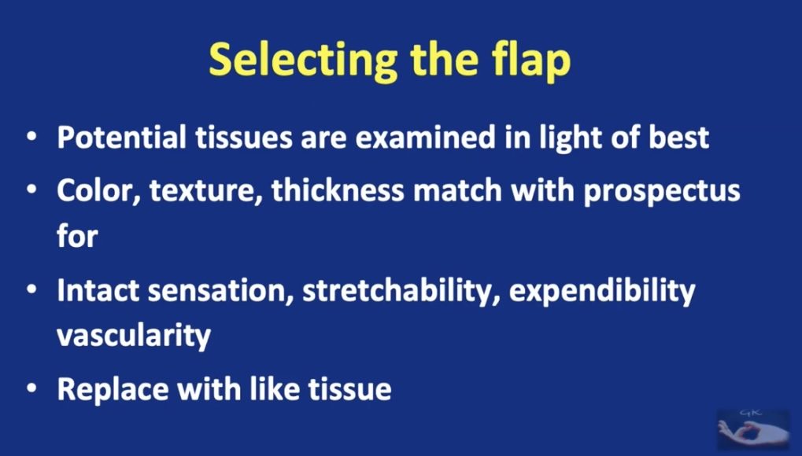

Slide 129
DISTANT FLAPS: Tunnelled subcutaneously, with a long muscle pedicle attached over long distances; for example, from the anterior chest wall skin to the head and neck.
FREE FLAPS: harvesting of, a piece of forearm skin with an attached artery and vein; these vessels must then be anastomosed onto named vessels at the recipient site before the skin can be used to repair the defect.
RANDOM PATTERN FLAPS: where the blood supply is inherent in the skin being moved, but also perform axial pattern flaps which obtain their blood supply from named artery; the median or paramedian forehead flap, based on the supratrochlear artery being the most common.

Slide 130


Slide 131


Slide 132


Slide 133
Advancement flaps:
Advancement flaps move skin in a generally linear direction utilizing laxity in adjacent tissues to close the defect.
Tissue movement may be mostly from one side of the defect as in a Burow’s advancement flap or a U‐plasty or from two sides as in an H‐plasty or O‐T flap.
Tension vectors occur in the direction of closure of the primary defect.

Slide 134


Slide 135



Slide 136



Slide 137


Slide 138


Slide 139



Slide 140


Slide 141


Slide 142


Slide 143


Slide 144


Slide 145
Rotation flaps:
Rotation flaps involve the motions of both advancement and rotation on a pivot point on a broad pedicle.
Mobility may be limited, and long incisions and extensive undermining may be required to mobilize sufficient tissue; the secondary defect is closed last.
Tension vectors occur in the direction of closure of the primary defect.

Slide 146


Slide 147
Types:
1. single rotation (nasal side wall rotation,tenzel rotation,mustarde flap
2.single rotation with a back-cut (hatchet flap)
3. double rotation (o to z plasty)
4. double rotation ( o to w plasty-peng flap)

Slide 148

DOUBLE
ROTATION
O To Z PLASTY

Slide 149


Slide 150



Slide 151


Slide 152
Transposition flaps:
Transposition flaps can utilize tissue that is not immediately adjacent to the defect and thus offer great variety.
Tension vectors occur in the direction of closure of the secondary defect, allowing for redirection of tension vectors.
Pushed rather than pulled into the defect.
MOST WIDELY USED

Slide 153


Slide 154


Slide 155
TYPES(transposition)
1. SINGLE (LIMBERG)
2. DOUBLE (BILOBED)
-WEBSTER 30 VARIENT
-DUOFOURMENTAL VARIENT
-BILOBED FLAP
-TRILOBED FLAP

Slide 156


Slide 157


Slide 158
Pedicle flap:
Pedicle flaps:
Island pedicle flaps (also known as V to Y flaps):
Island pedicle flap derives its nutritional support from the attached subcutaneous and muscle tissue.
Island pedicle flap is a one‐stage procedure.
Interpolation flaps:
Its vascular supply from a skin and subcutaneous tissue pedicle.
Involves the creation of a bridge‐like skin pedicle; this remains attached for 2–3 weeks at both the donor and defect site whilst the donor skin establishes ‘its own’ blood supply at the defect site.
Notes:
Recent reports, however, advocate pedicle division at 1 week to also be effective with no adverse effect on functional or aesthetic outcomes.

Slide 159

Pedicle flap(V to Y)

Slide 161


Slide 162


Slide 164


Slide 165
COMPLICATIONS:
Ischaemic necrosis→ excessive tension resulting from poor design or limited flap mobility.
Secondary infection→ if the flap has a poor blood supply.
Cigarette smokers are more likely to suffer from flap or graft necrosis than non‐smokers→ reversed if smokers significantly reduce cigarette consumption 2 days before and 7 days after surgery.

Slide 167
Thank you

