Slide 1
CHAPTER 151
The Skin And Disorders Of
The Respiratory System
By Dr. Uroosa Saleem
FCPS Resident Dermatology
PNS Shifa Karachi

Slide 2
There are diverse groups of diseases that may affect both skin and respiratory system.
The mucosa of the upper respiratory tract may be affected in a range of infective and allergic disorders.
s
r
e
Drugs
Infections
&
infestations
Inflammatory
Conditions that affect the skin
and
Respiratory system
Congenital
&
inherited
Infiltrations
&
metabolic
Miscellaneous

Slide 3
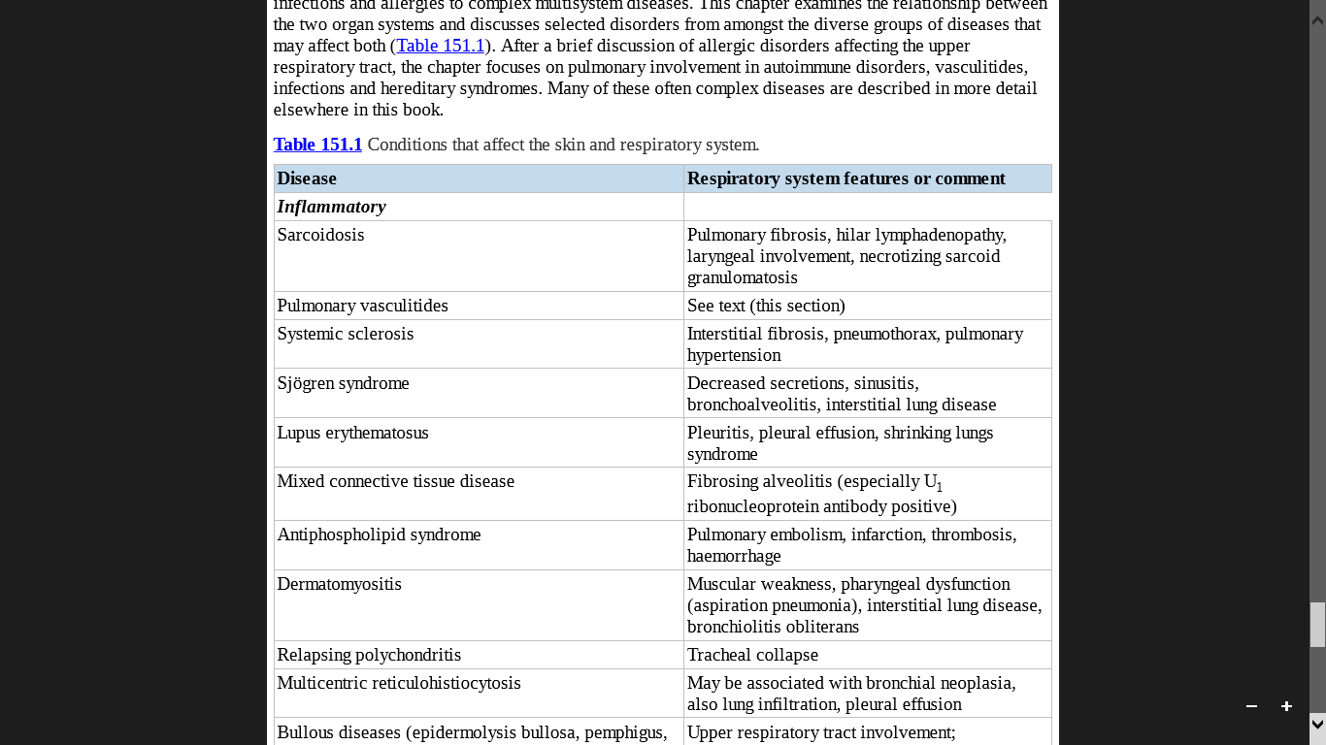

Slide 4
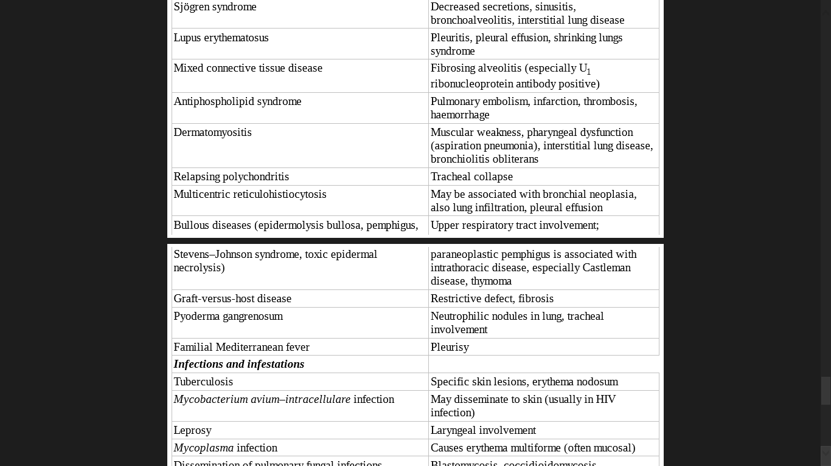

Slide 5
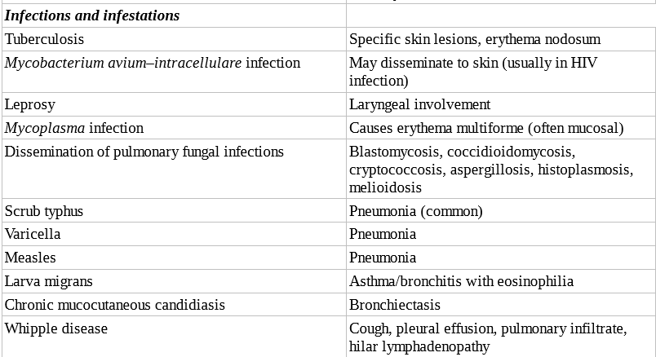

Slide 6
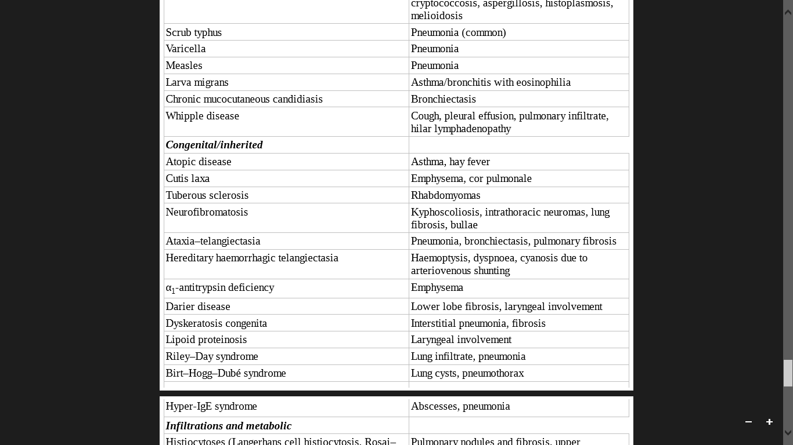

Slide 7
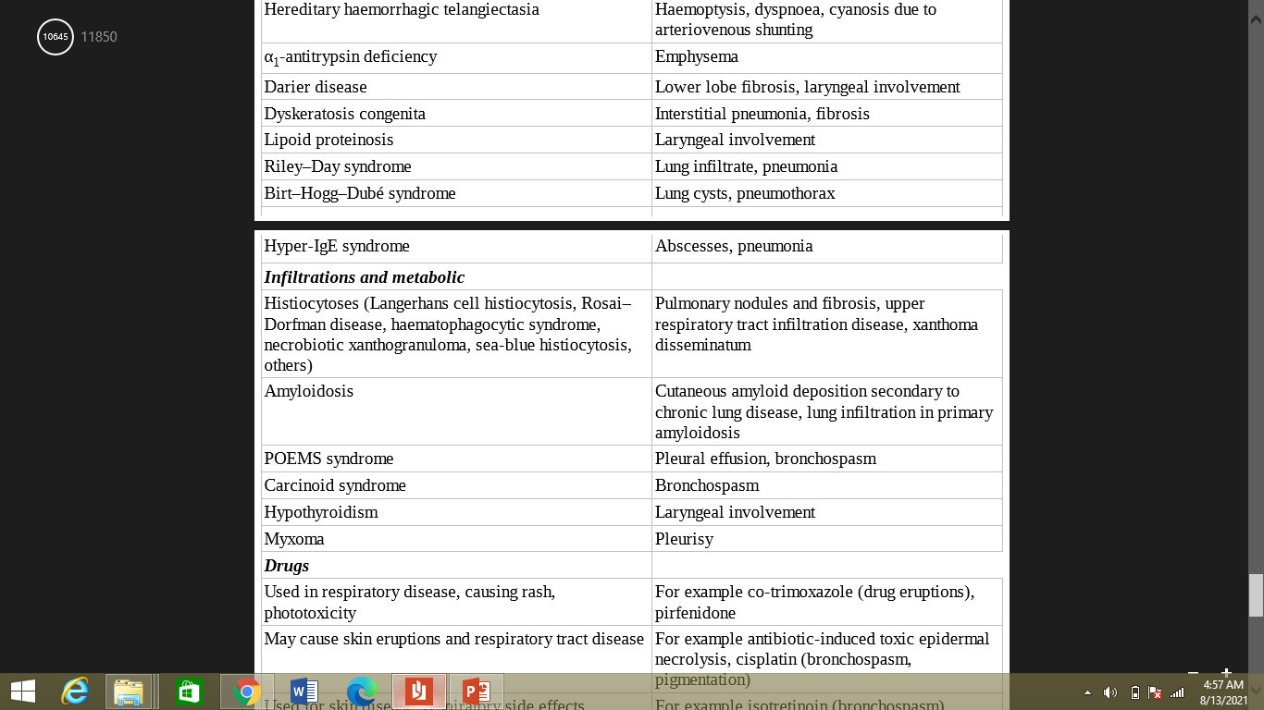

Slide 8
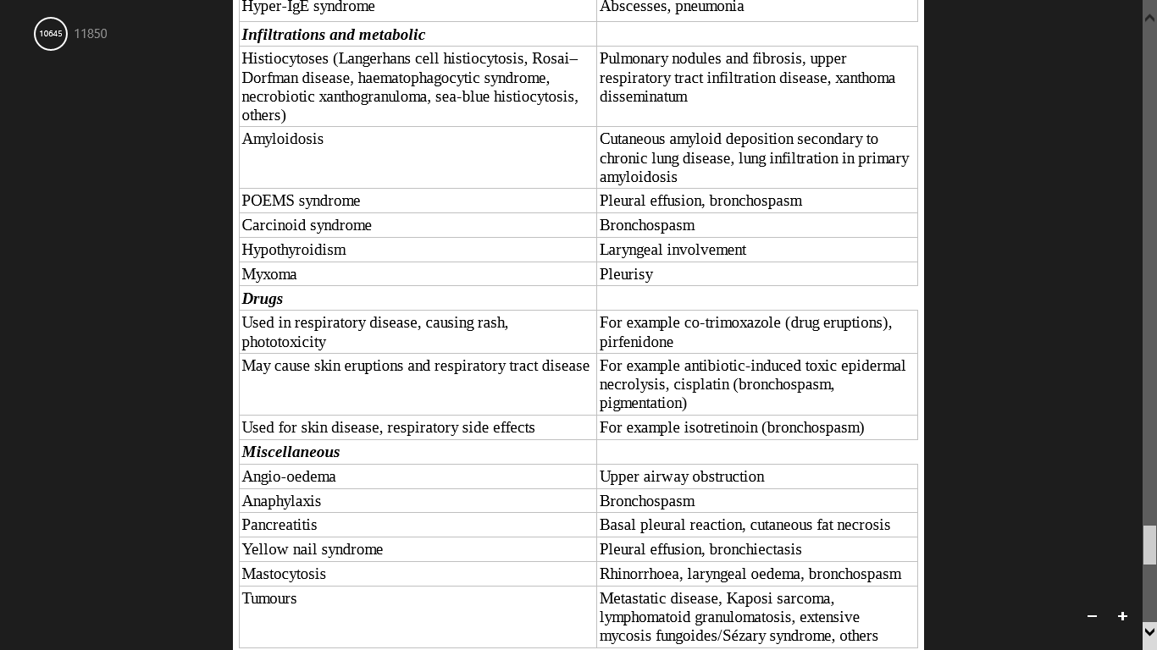

Slide 9
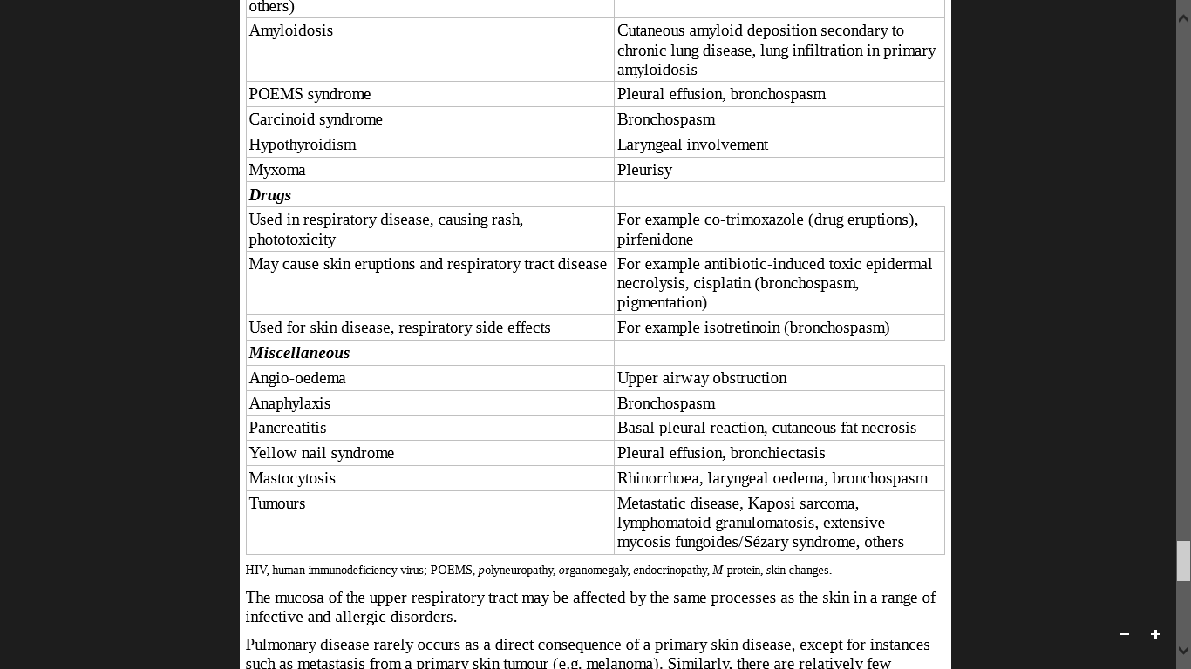

Slide 10
ALLERGIC DISORDERS
The respiratory system is frequently involved in type I allergic sensitization.
Atopic disorders
(e.g atopic eczema)
Allergic rhinoconjunctivitis and allergic asthma.
Urticaria
Angio-oedema, life-threatening pharyngeal and laryngeal oedema.
IgE-mediated anaphylaxis.

Slide 11
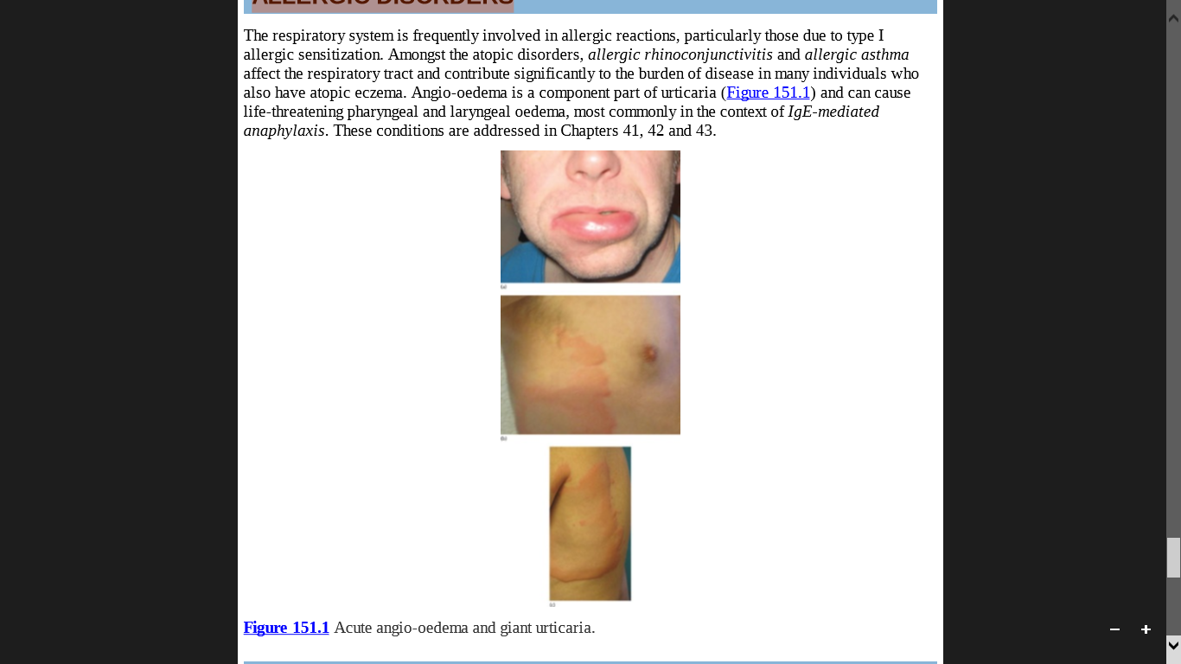

Slide 12
AUTOIMMUNE DISORDERS
Interstitial lung disease and pulmonary vascular disease leading to pulmonary hypertension.
In addition, bronchiectasis, Pneumothorax, pleural effusion, respiratory muscle involvement and ‘splinting’ of the chest by sclerotic skin may all occur.
SYSTEMIC SCLEROSIS
SYSTEMIC LUPUS ERYTHEMATOSUS
Involves all compartments of the respiratory tract (pleura, parenchyma, vessels and airways).
Can follow an acute or chronic course.

Slide 13
MIXED CONNECTIVE TISSUE DISEASE
Pleuritis, pulmonary hypertension or interstitial lung disease.
ANTIPHOSPHOLIPID SYNDROME
Pulmonary embolism, haemorrhage, infarction and hypertension as well as thrombosis of the lung vessels.
Can affect the small airways but may also present with interstitial lung disease .
SJÖGREN SYNDROME

Slide 14
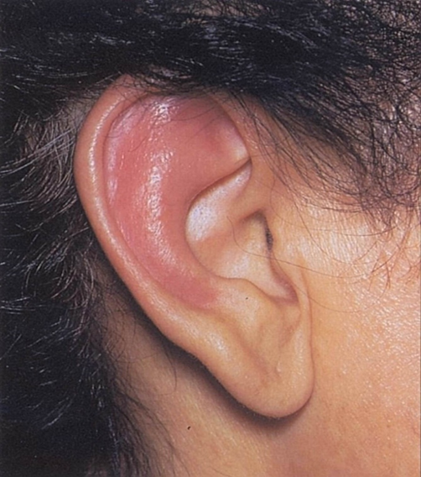
Autoantibodies against type II collagen.
Dyspnoea, inspiratory stridor, Inflamed nasal and auricular cartilages , with nasal obstruction, arthropathy and a high ESR.
The noncartilaginous lobe of the ear is classically spared.
RELAPSING POLYCHONDRITIS

Slide 15
Three main mechanisms that provide a link with respiratory disease.
Dermatomyositis may occur as a consequence of bronchial carcinoma.
Muscular weakness due to myositis may affect either the intercostal and thoracic musculature, or the larynx and pharynx
Interstitial lung disease or bronchiolitis obliterans may occur
DERMATOMYOSITIS

Slide 16
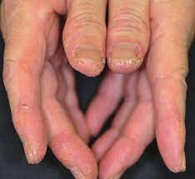
The lung disease is typically associated with the presence of histidyl tRNA synthetase (Jo-1) antibody
The antisynthetase syndrome consists of dermatomyositis (or polymyositis) with interstitial lung disease, arthritis and Raynaud phenomenon.
Antisynthetase antibodies is also associated with the clinical entity of ‘mechanics’ hands’ in dermatomyositis, characterized by hyperkeratotic skin on the lateral aspects of the fingers.

Slide 17
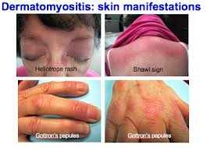

Slide 18
VASCULITIS
The major pulmonary vasculitides belong either to the group of small-vessel vasculitis or variable-vessel vasculitis
Granulomatosis with polyangiitis (GPA)
Antineutrophil cytoplasmic antibody (ANCA) associated vasculitis
Eosinophilic GPA (EGPA /
Churg Strauss syndrome)
Small-vessel vasculitis
immune complex SVV
Microscopic polyangiitis (MPA).
Variable-vessel vasculitis
Behçet disease

Slide 19
SMALL-VESSEL VASCULITIS
Granulomatosis with polyangiitis
Characterized by Necrotizing granulomatous vasculitis of the upper and lower respiratory tracts, necrotizing glomerulonephritis, and disseminated vasculitis of various organs.
ANCAs directed against proteinase 3 are found in 40–95% of cases.
Skin lesions are present in 30–60% of patients, including vasculitis with purpura, subcutaneous nodules and ulcers

Slide 20
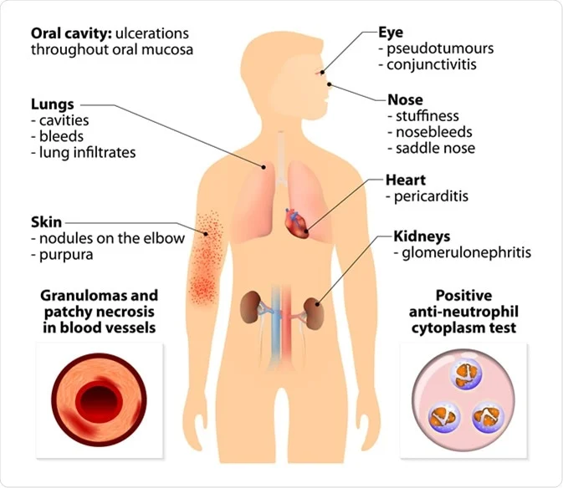

Slide 21
Prognosis is poor in patients with lung or renal disease.
Chronic nasal staphylococcal carriage is also associated with a poorer prognosis and a higher relapse rate
Diffuse alveolar haemorrhage, due to extensive pulmonary capillaritis, is a life-threatening complication of GPA.

Slide 22
Eosinophilic granulomatosis with polyangiitis
(Churg–Strauss syndrome)
Comprises rhinitis, asthma, pneumonitis, fever, malaise, eosinophilia (usually over 10%) and widespread vasculitis, which may cause skin lesions, neuropathy and cardiac or, less commonly, renal disease.
Cutaneous lesions (occur in up to 70% of patients) and include palpable purpura and nodular lesions
ANCAs are not present in all cases of EGPA.
ANCAs detected in EGPA are directed against myeloperoxidase in 32–92% of cases

Slide 23
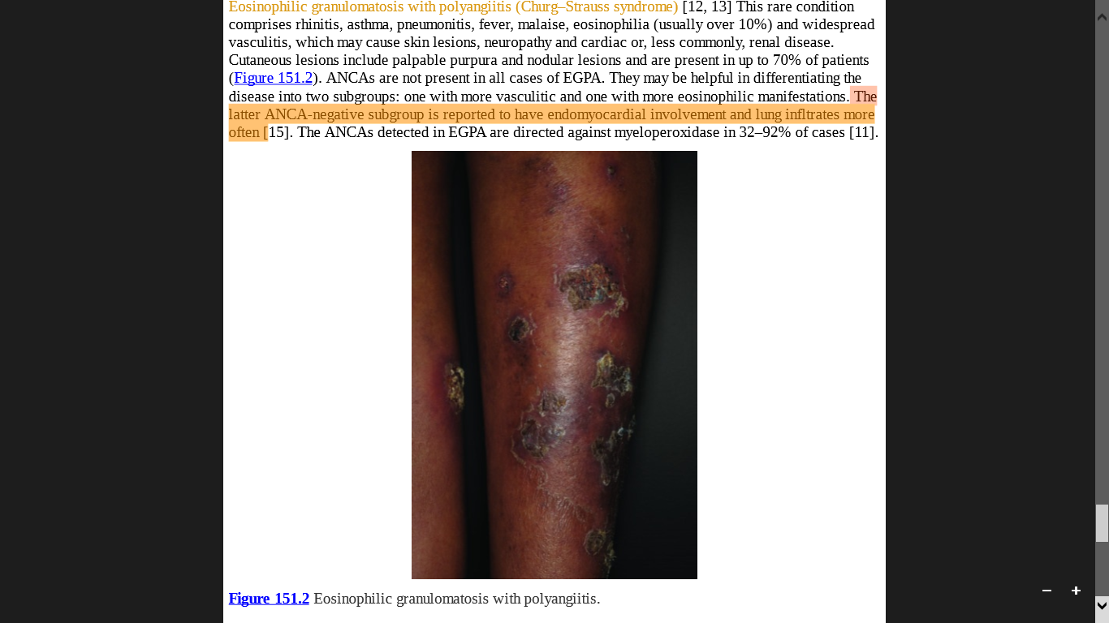
two subgroups:
With more vasculitic manifestations
With more eosinophilic manifestations
The latter ANCA-negative subgroup is reported to have endomyocardial involvement and lung infltrates more often.

Slide 24
Microscopic Polyangiitis
Necrotizing form of vasculitis that predominantly affects small vessels: arterioles, venules and capillaries
Lung involvement is reported in 20–60% and symptoms are dyspnoea, cough and haemoptysis.
Skin involvement in 40–70% of cases (leukocytoclastic angiitis, palpable purpura, levedo reticularis, skin ulcerations, necrotizing nodules, digital ischemia).
ANCAs against myeloperoxidase (MPO-ANCA) can be found in up to 80% of patients.

Slide 25
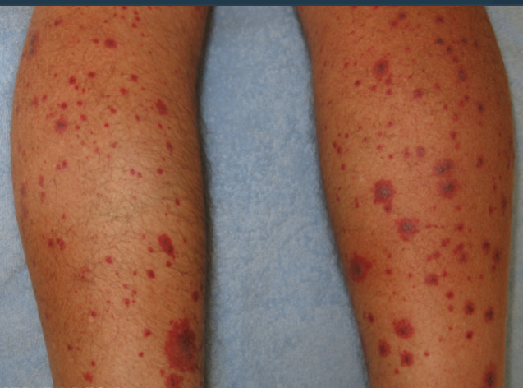
leukocytoclastic angiitis

Slide 26
Immune complex small vessel vasculitis
Vessel wall deposits of immunoglobulin and complement factors that predominantly affect the small vessels (Pathognomonic )
Urticarial vasculitis
In urticarial vasculitis, pulmonary involvement is common and comprises pleuritic and obstructive lung disease
Subgroup
Cryoglobulinaemic vasculitis
IgA vasculitis
(Henoch–Schönlein purpura)

Slide 27
VARIABLE-VESSEL VASCULITIS
Behçet disease
Triad of:
Recurrent painful genital ulcer,
Ophthalmic lesions: anterior or posterior uveitis, hypopyon or retinal vasculitis.
Skin & mucous membrane manifestations: erythema nodosum like lesions, pseudofolliculitis or papulopustular or acneiform lesions,
painful oral lesions(aphthous or herpetiform)..70% of cases.
Pulmonary involvement can be classified into three groups:
Pulmonary artery aneurysm
Parenchymal changes.
Subgroup of diverse pulmonary disorders including pleural effusion.
Thrombophlebitis may be a marker for an increased risk of pulmonary artery aneurysm.

Slide 28
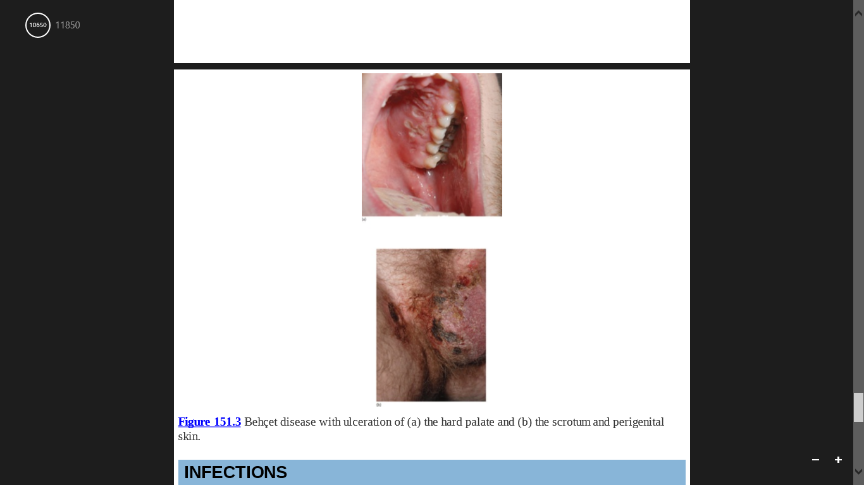

Slide 29
INFECTIONS
Numerous infections may involve both the respiratory tract and the skin:
Many viral infections Upper and sometimes lower respiratory tract
symptoms in association with either a non-specific
exanthema or with erythema multiforme
Mycoplasma infection Stevens–Johnson syndrome.
Psittacosis (ornithosis) Erythema nodosum and erythema multiforme.
.

Slide 30
Tuberculosis Non-specific reactions such as erythema
nodosum or erythema multiforme, and
specific skin lesions such as lichen scrofulosorum,
Bazin disease and papulonecrotic tuberculide.
Several systemic mycoses Non-specific reactions including erythema
multiforme and erythema nodosum, or specific
lesions caused by haematogenous dissemination.
Other mycoses may have primary cutaneous lesions with occasional spread to internal organs, including the lung (e.g. sporotrichosis).

Slide 31
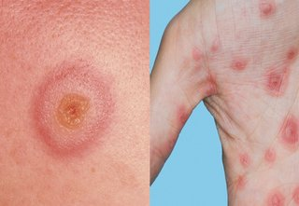
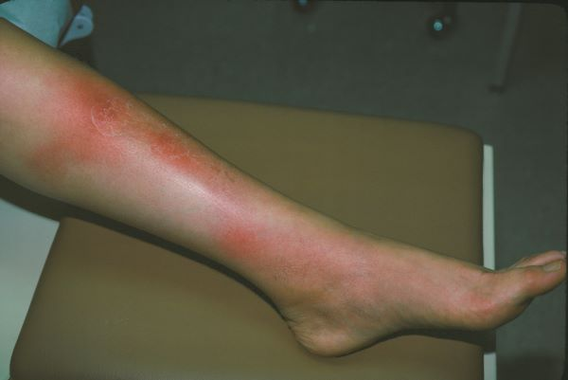
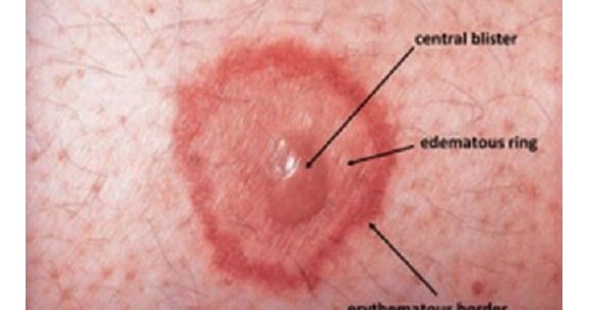
Erythema multiforme
Erythema nodosum

Slide 32

CONGENITAL AND INHERITED DISORDERS/GENETIC SYNDROMES
Tuberous sclerosis
Intrathoracic, intra-abdominal or retroperitoneal diffuse plexiform neurofibromas can compromise pulmonary function.
Neurofibromatosis-1
α1-antitrypsin deficiency
Fibrosis affects mainly the lower lobes whereas bullous changes may occur in the upper lobes
In adult female patients, numerous small cysts, that represent lymphangioleiomyomatosis occurs.
Pleural effusions have been reported.
ZZ genotype, links cutaneous panniculitis with emphysema and hepatic cirrhosis

Slide 33

acute episodes of bronchopneumonia with profuse mucous secretion causing dyspnoea.
Familial dysautonomia
Ataxia–telangiectasia
(louis Bar Syndrome)
Birt–Hogg–Dubé syndrome
Skin changes include multiple excoriations, and erythematous mottling associated with fever and sweating
‘chest–abdomen’sign present.
Recurrent pneumonia, bronchiectasis and pulmonary fibrosis.
Lung cysts and pneumothorax.

Slide 34
OTHER SYSTEMIC DISEASES
Acute sarcoidosis (Löfgren syndrome) Hilar lymphadenopathy
occurs with
erythema nodosum
Chronic sarcoidosis Pulmonary involvement is the major feature
Sarcoidosis
Necrotizing Sarcoid Granulomatosis
Nodular pulmonary infiltrate is typical as well as local pleural thickening or effusion.
Extrapulmonary involvement may be ophthalmological (uveitis) but other organs including the skin may be involved, erythema nodosum or necrosis due to arteritic vascular occlusion.

Slide 35
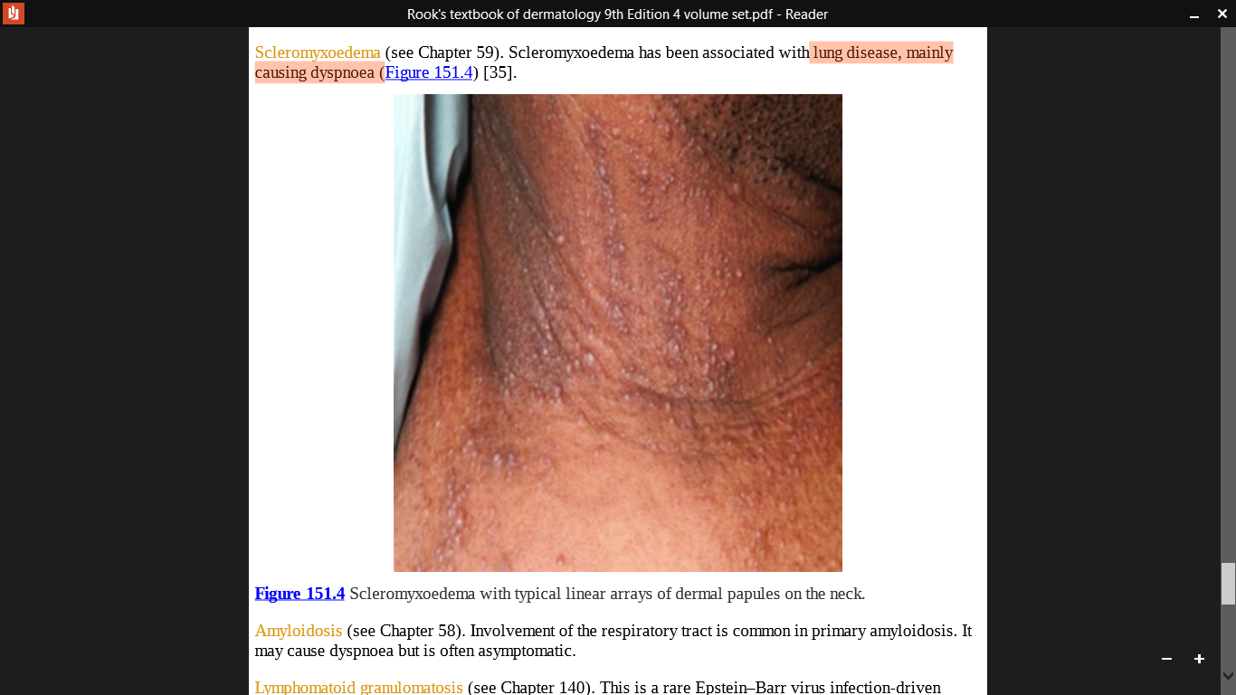
Associated with pleural effusion.
Also occur as a paraneoplastic phenomenon.
Multicentric Reticulohistiocytosis
Scleromyxoedema
lung disease, mainly causing dyspnea.

Slide 36
Amyloidosis
Respiratory involvement is common in primary amyloidosis.
It may cause dyspnea but is often asymptomatic.
Epstein–Barr virus infection-driven lymphoproliferative disease.
Radiology shows multiple small nodules that affect periphery of the lower lung fields.
Cutaneous lesions are present in 25–50% of cases, typically on the extremities, and consist of infiltrated flat or nodular lesions that may become necrotic and ulcerated.
Lymphomatoid Granulomatosis
Yellow Nail Syndrome
Associated with a diverse array of respiratory abnormalities including dyspnea or cough, pleural effusion, bronchiectasis and chronic sinus and lung infections

Slide 37
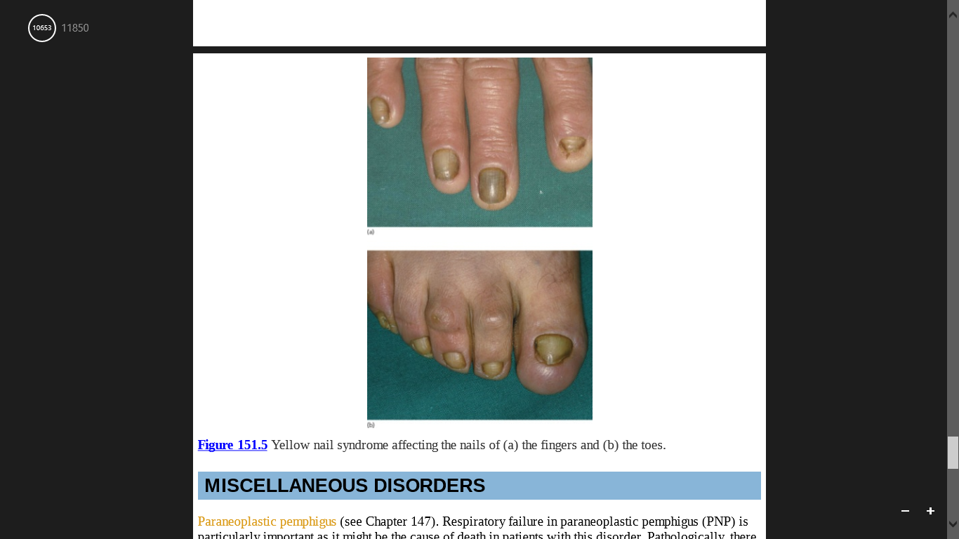

Slide 38
MISCELLANEOUS DISORDERS
Paraneoplastic Pemphigus (PNP)
Respiratory failure in PNP is particularly important as it might be the cause of death in patients with this disorder
Autoantibody-mediated damage,
CD8+ T-lymphocytes may also play a key role.
Ectopic expression of desmoglein 3 and other epidermal antigens might explain the pulmonary involvement.
Direct immunofluorescence of bronchial mucosal biopsies may demonstrate linear deposition of IgG and complement in the lamina propria.

Slide 39
Hoarseness As A Sign Of Systemic Disease
A range of inherited or acquired bullous diseases may affect the pharyngeal or laryngeal mucosa, for example mucous membrane pemphigoid, in which chronic inflammation may predispose to carcinoma of the larynx.

Slide 40
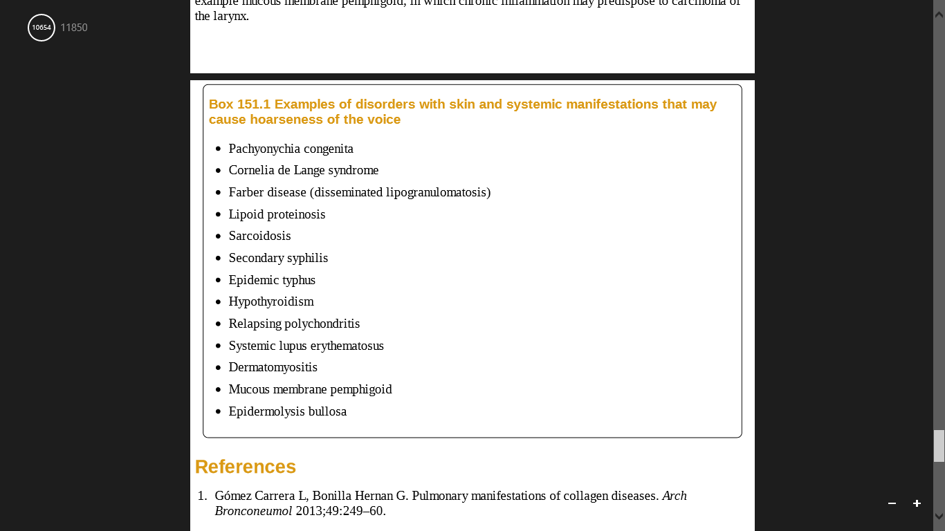

Slide 41
