Slide 1
Chapter # 150
THE SKIN AND DISORDERS OF THE
HEART
Dr Uroosa Saleem
Resident Dermatology
PNS Shifa Karachi.

Slide 2
There are several diseases in which both cardiac and skin involvement may be found. Most of these are part of a syndrome or are systemic disorders affecting other organs as well.
s
f
r
Drugs
e
Inflammatory diseases, connective tissue disease, vasculitis
Congenital/inherited
Deposition, metabolic & endocrine disorders
CONDITIONS THAT AFFECT THE HEART AND SKIN
Infections
Miscellaneous

Slide 3
CONGENITAL/INHERITED
DISEASE | MAIN CARDIAC FEATURE AND/OR COMMENTS
Ehlers–Danlos syndrome | Dilated main vessels, mitral or tricuspid insufficiency, cardiac/vascular rupture (type IV)
Cutis laxa | Early CAD, aortic aneurysm, mitral valve prolapse
Marfan syndrome | Aortic aneurysm, aortic regurgitation, mitral valve prolapse or regurgitation
Pseudoxanthoma elasticum | Arterial calcification, CAD, mitral valve prolapse
Werner disease | Early CAD
Progeria | Early CAD
Cockayne syndrome | Early CAD

Slide 4
Cornelia de Lange syndrome | Septal defects, persistent ductus arteriosus, pulmonary stenosis
Fabry disease | Conduction defects, arrhythmias, hypertension, left ventricular hypertrophy, mitral valve prolaps
RASopathies:Noonan syndrome | Pulmonary stenosis, septal defects, hypertrophic cardiomyopathy, aortic abnormalities, other features
Noonan syndrome with multiple lentigines (LEOPARD syndrome) Neurofibromatosis | ECG abnormalities (various forms of heart block), pulmonary stenosis, also subaortic stenosis and hypertrophic cardiomyopathy Hypertension (renovascular or phaeochromocytoma)
Rubinstein–Taybi syndrome Tuberous sclerosis | Tuberous sclerosis Aortic coarctation, persistent ductus arteriosus, pulmonary stenosis, septal defects. Cardiac rhabdomyomas.
Incontinentia pigmenti | Patent ductus arteriosus, tricuspid insufficiency
Alagille syndrome | Pulmonary artery hypoplasia/stenosis
Di George syndrome | Tetralogy of Fallot, aortic arch defects.

Slide 5
Lymphoedema–distichiasis syndrome | Tetralogy of Fallot, patent ductus arteriosus
Naxos disease | Arrhythmogenic right ventricular cardiomyopathy
Chromosomal syndromes Carney complex | Various, includes Down syndrome, Turner syndrome, trisomy 13, trisomy 18.

Slide 6
INFLAMMATORY DISEASES, CONNECTIVE TISSUE DISEASE, VASCULITIS
Systemic lupus erythematosus | Vegetations (especially mitral, Libman–Sacks endocarditis), pericarditis, myocarditis, aortic/mitral regurgitation
Neonatal lupus erythematosus | Neonatal heart block (various patterns), septal defects, persistent ductus arteriosus, tricuspid/mitral insufficienc
Systemic sclerosis | Pericarditis and effusion, conduction defects, myocardial fibrosis, cardiomyopathy, cor pulmonal
Limited systemic sclerosis (CREST) | Pulmonary hypertension
Polyarteritis nodosa | Coronary artery vasculitis, ECG abnormalities, hypertension
Behçet disease | Pericarditis, pulmonary and coronary artery aneurysm
Antiphospholipid syndrome | Vegetations, valvular heart disease, coronary artery thrombosis, pericardial effusion, CCF
Degos disease | Pericarditis, pericardial effusion

Slide 7
Eosinophilic granulomatosis with polyangiitis (EGPA; former Churg– Strauss syndrome) | Pericarditis, cardiac fibrosis, pericardial effusion.
Granulomatosis with polyangiitis (GPA) | Cardiomyopathy
Cholesterol emboli | Coronary artery occlusion
Other vasculitides | Coronary artery vasculitis
Dermatomyositis | Conduction defects, arrhythmias, cardiomyopathy, CCF, (rarely) pulmonary hypertension
Relapsing polychondritis | Mitral or aortic insufficiency, dissecting aortic aneurysm, pericarditis, myocardial ischaemia, heart block, aortitis
Rheumatic fever | Mitral and aortic valve disease
Kawasaki disease | Conduction defects, coronary artery aneurysms, pericardial effusion, cardiomegaly

Slide 8
Multicentric reticulohistiocytosis | Pericarditis, cardiomegaly, CAD, CCF
Hypereosinophilic syndrome | Eosinophilic endomyocarditis, valvular scarring, CCF, restrictive cardiomyopathy
Sarcoidosis | Conduction defects, arrhythmias, CCF
Reactive arthritis | Conduction defects, aortic regurgitation

Slide 9
DEPOSITION, METABOLIC AND ENDOCRINE DISORDERS
Amyloidosis | Conduction defects, cardiomegaly, CCF
Haemochromatosis | Arrhythmias, cardiomyopathy, CCF
Wilson disease | Arrhythmias, cardiomyopathy
Mucinoses: scleromyxoedema | Cardiomyopathy, CCF
Hyperlipidemia's | CAD
Diabetes | CAD, cardiomyopathy
Hyperthyroidism | Tachycardia, atrial fibrillation, mitral regurgitation
Hypothyroidism | Bradycardia, CAD, pericardial effusion

Slide 10
Acromegaly | Left ventricular hypertrophy, CCF.
Carcinoid syndrome | Tricuspid or pulmonary stenosis, right heart failure .
Phaeochromocytoma | Variable heart rate, hypertension/hypotension.
Mastocytosis | Tachycardia, hypotension, arrhythmia, angina.
Homocystinuria | Atherosclerosis.
Embolic diseases: | --
Infective endocarditis | Vegetations, valvular incompetence.
Cholesterol emboli | Usually from proximal arteries rather than cardiac .
Atrial myxomas | --

Slide 11
INFECTIONS
Lyme disease | Myocarditis, heart block.
Syphilis | Aortitis, aortic aneurysm, aortic and mitral regurgitation, obstructed coronary arteries .
Varicella | Myocarditis.
Septicaemia | Pustules, infarcts, disseminated intravascular coagulopathy .
Congenital rubella | Pulmonary artery and valve stenosis, patent ductus arteriosus .
Whipple disease | Pericarditis, myocarditis, valve deformity (especially mitral valve endocarditis) .

Slide 12
DRUGS
Used in cardiology, causing rash | Amiodarone (photosensitivity, pigmentation).
Cardiotoxic and cause skin eruptions | Doxorubicin (cardiotoxic, anagen effluvium, pigmentation)
Used for skin disease, cardiovascular side effects | Ciclosporin (hypertension).
Teratogenic, causing both skin and cardiac defects | Alcohol, phenytoin, retinoids.

Slide 13
MISCELLANEOUS
Earlobe crease | CAD
POEMS syndrome | Cardiac failure
Mycosis fungoides, Sézary syndrome | Heart is infiltrated in advanced disease
Kaposi sarcoma | Heart is commonly involved
Diffuse neonatal haemangiomatosis | High-output cardiac failure
Erythroderma, any cause | High-output cardiac failure
Pacemaker reactions | Infection, contact dermatitis, mechanical issues
Clubbing of nails | Cyanotic congenital heart defects
Red lunulae | Occur in CCF

Slide 14
SKIN SIGNS OF CARDIAC DISEASE
Dermatological consequences of cardiac disease include skin colour changes such as
Cyanosis,
Erythema due to secondary polycythaemia,
Finger clubbing ,
A visible pulsation of the nail bed in time with the pulse sign of aortic regurgitation due to the wide pulse pressure in this disorder (Quincke pulsation).

Slide 15
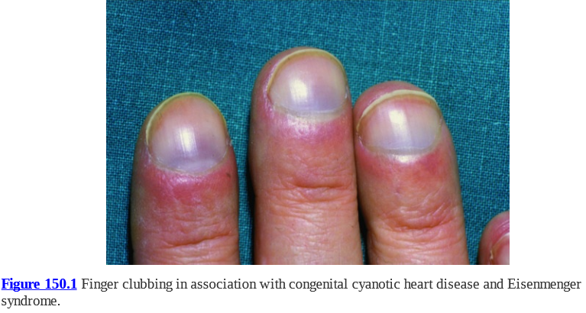

Slide 16
HEREDITARY SYNDROMES
FABRY DISEASE
Rare inherited sphingolipidosis.
Cardiac involvement may be manifest as arrhythmias, hypertrophic cardiomyopathy, valvular abnormalities and coronary artery disease.
The cutaneous features include angiokeratoma corporis diffusum (small, dark red spots on the skin) and hypohidrosis or anhidrosis etc.

Slide 17
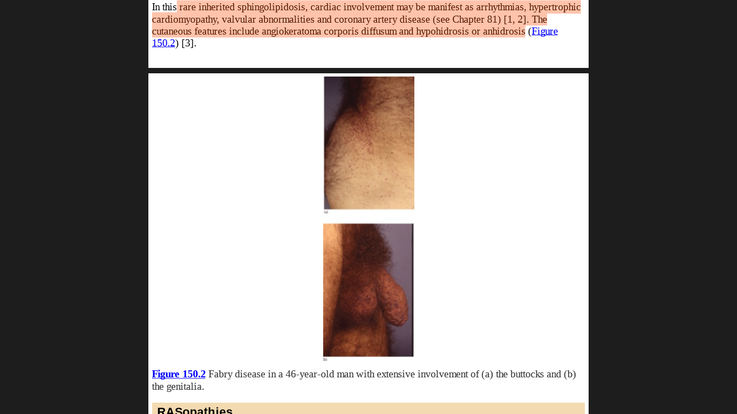
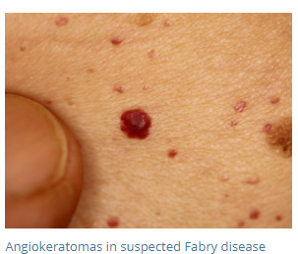
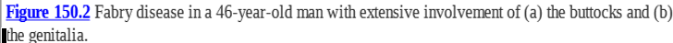

Slide 18
RASopathies
A number of genetic syndromes have been summarized under the term RASopathies. Amongst them are the
Noonan syndrome
Noonan with multiple lentigines syndrome/ LEOPARD syndrome/multiple lentigines syndrome.
Costello syndrome,
Cardiofaciocutaneous syndrome and
Neurofibromatosis-1
HCM, PS and ASD
Widespread lentigines,
Electrocardiographic abnormalities,
Ocular hypertelorism,
Pulmonary stenosis,
Abnormal genitals,
Retardation of growth and
Deafness

Slide 19
Common feature is mutations in the rat sarcoma–mitogen-activated protein kinase (Ras-MAPK) signal transduction pathway are pathogenic and lead to the development of cardiac and cutaneous malformations.

Slide 20
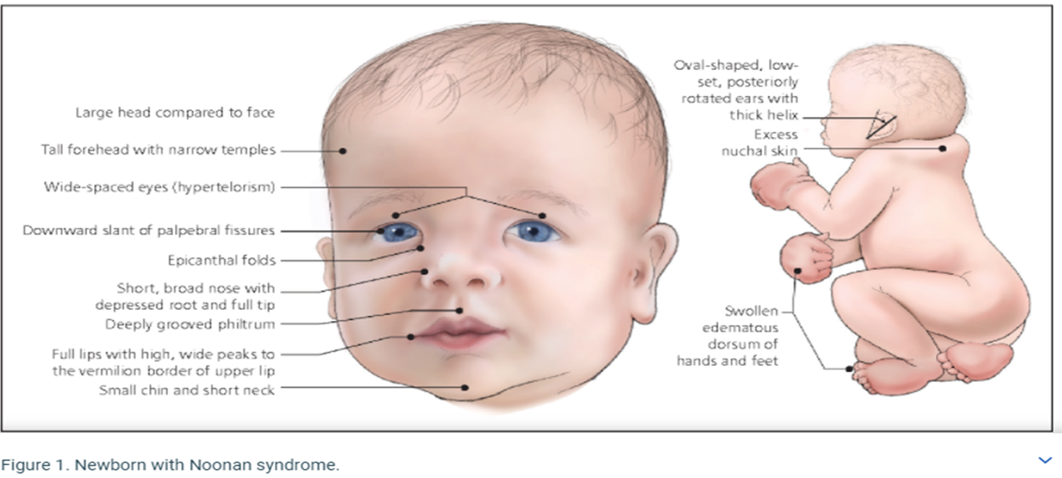

Slide 21
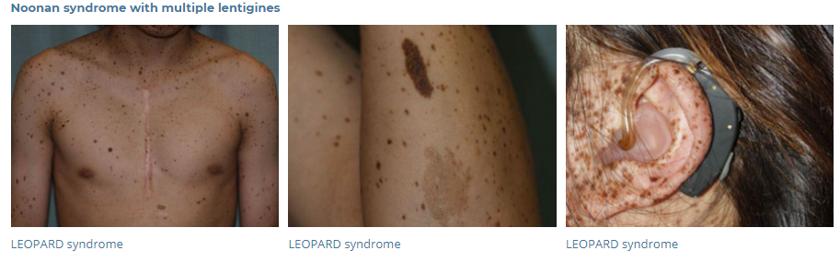

Slide 22
Carney complex/ LAMB/NAME syndrome:
LAMB syndrome (lentigines, atrial myxoma, mucocutaneous myxoma, blue naevi)
NAME syndrome (blue naevi, atrial myxoma, myxoid neurofibromas, ephelides).
Autosomal dominant with incomplete penetrance.
Mutations in the PRKAR1A gene (protein kinase, cAMP-dependent, regulatory, type I, alpha).

Slide 23
Characterized by:
Recurrent mucocutaneous myxomas (eyelids, external ear, breast and oro-pharynx),
Pigmented skin lesions (blue naevi, café-au-lait macules and lentigines).
Endocrine over activity and neoplasms (e.g. growth hormone-producing adenoma often with acromegaly, Sertoli cell tumours, Cushing syndrome and 70% of patients have myxomatous cardiac tumours).

Slide 24
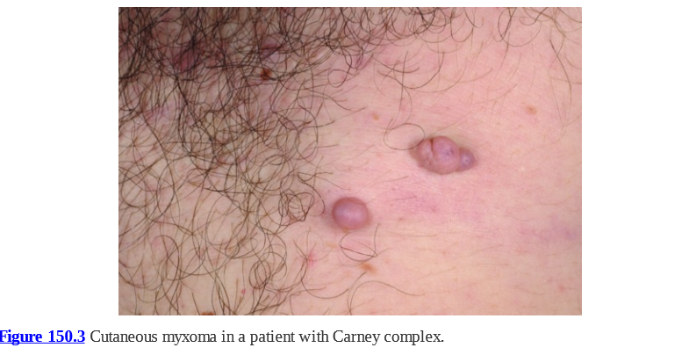

Slide 25
CARDIAC INVOLVEMENT IN DERMATOSES OR SYSTEMIC DISEASES WITH SKIN FEATURES
INFLAMMATORY DISORDERS
Sarcoidosis
Mixed connective
tissue disease
Clinically significant pericarditis, myocarditis and pulmonary hypertension
Dermatomyositis
Congestive heart failure, coronary artery disease or conduction abnormalities.
25% of patients have heart involvement.
Sudden death due to conduction defects and ventricular arrhythmias

Slide 26
Systemic lupus erythematosus
pericarditis, a high prevalence of atherosclerosis and an increased risk of myocardial infarction.
Neonatal lupus erythematosus
Congenital atrioventricular block (AVB), most common.
Systemic sclerosis
Cardiac involvement is poor prognostic factor.
Mothers of affected children generally express the 52 and 60 kDa anti-SS-A (Ro) antibodies, even if they have no other features of LE.
Other include valve defects, cardiomyopathy or myocarditis.
Pericarditis, pericardial effusion, arrhythmias, myocardial fibrosis, conduction system defects, endothelial damage to coronary arteries and heart failure due to pulmonary arterial hypertension

Slide 27
Antiphospholipid syndrome
50% of patients have valvular heart disease, either vegetations or thickening.
Vasculitides
(i) Small vessel vasculitis (granulomatosis with polyangiitis (GPA), eosinophilic GPA (EGPA))..
Amyloidosis
Features of cardiomyopathy such as congestive heart failure, low voltage on an ECG and conduction disturbances. Cutaneous signs, macroglossia and demonstration of amyloid deposition on skin histology
The mitral valve is most frequently affected.
Increased incidence of atherosclerosis, coronary artery disease and myocardial infarction.
(ii) Medium vessel vasculitis (polyarteritis nodosa, Kawasaki disease)
(iii) large-vessel vasculitis (temporal arteritis, Takayasu arteritis)
Cardiac involvement is frequent in primary amyloidosis.

Slide 28
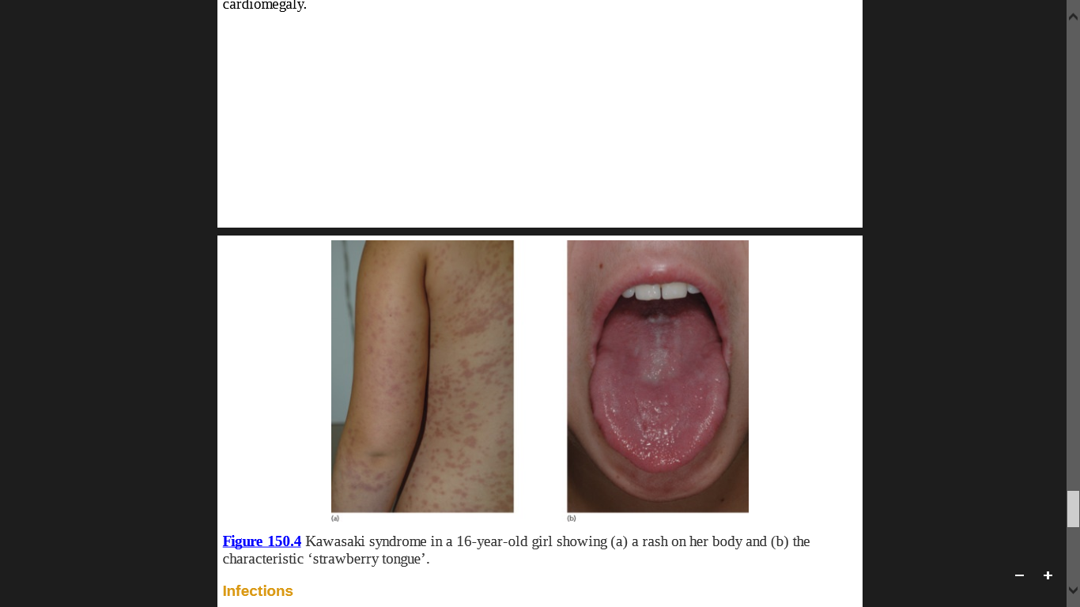
Kawasaki disease
(mucocutaneous lymph node syndrome)
Acute febrile disease principally of infants and children.
Due to immune-mediated medium-vessel vasculitis that affects the coronary arteries.
C/F: are prolonged fever and signs of acute inflammation.
Coronary artery aneurysms, myocardial infarction, conduction defects, pericardial effusion and cardiomegaly.

Slide 29
INFECTIONS
Infective Endocarditis
Occurs in patients with a past history of heart disease (rheumatic fever, congenital heart disease, degenerative valve disease, heart valve operation), intravenous drug use or recent dental surgery.
Up to 80% of cases are caused by staphylococcal or streptococcal infection.

Slide 30
Cutaneous lesions represent either septic emboli or immune complex disease due to circulating bacterial antigens.
The skin lesions may be purpuric, pustular or erythematous.
Splinter haemorrhages of the nail fold or nail bed occur as well as conjunctival and palatal petechiae.
Osler's nodes are small, tender, red papule situated mainly on the distal finger and toe pads.
Janeway lesions are faint, red, macular lesions on the thenar and hypothenar eminences.

Slide 31
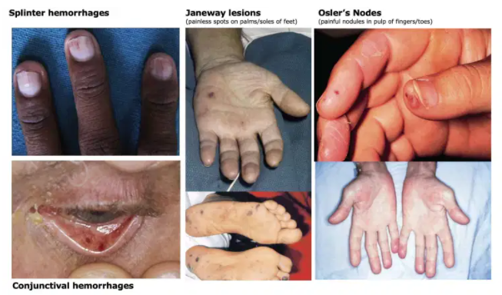

Slide 32
Rheumatic Fever
Complication of streptococcal infection.
It causes arthritis, carditis, neuromuscular disease (e.g. Sydenham chorea, muscle weakness) and cutaneous lesions (e.g erythema marginatum and subcutaneous nodules on the extensor surface of the extremities, particularly near the joints).
Cardiac features include valvular disease, pericarditis, myocarditis and congestive heart failure.

Slide 33
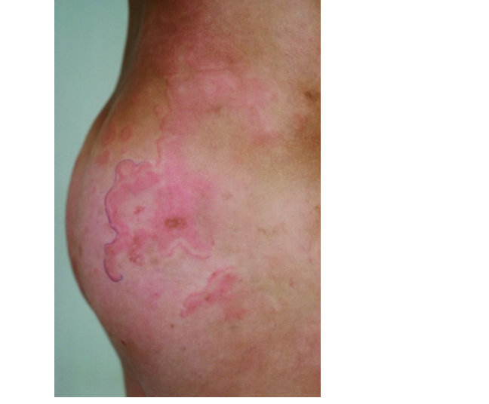
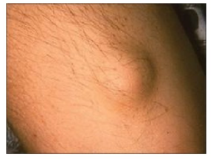
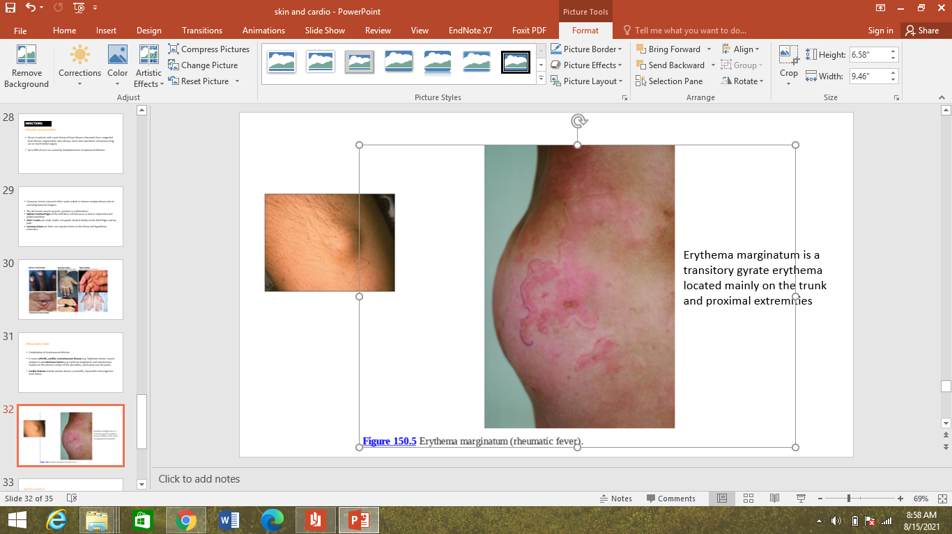
Erythema marginatum is a transitory gyrate erythema located mainly on the trunk and proximal extremities
Subcutaneous nodule

Slide 34
MISCELLANEOUS
Coronary Artery Disease
Premature ageing syndromes such as progeria and Werner syndrome.
Pseudoxanthoma elasticum
Xanthelasma or xanthomas due to hyperlipidaemia
Diagonal earlobe skin crease (Frank's sign)
Coronary artery disease and ischaemic
heart disease
Premature atherosclerotic vascular disease
Coronary artery disease
Coronary artery disease

Slide 35
Skin Problems Related To Cardiac Pacemakers And Implantable Defibrillators.
Cutaneous reactions over the site of implanted cardiac pacemakers are:
Infections or mechanical problems (erosions, extrusions, capsular contracture, exposed generator or electrodes, bronchopleural cutaneous fistulae) which respond to antibiotics or altered positioning of the pacemaker.
Contact dermatitis from implanted cardiac rhythm devices.
Allergy to cobalt, epoxy resin, mercury, nickel and titanium can also occur.

Slide 36


