Slide 1
CHAPTER 149
The Skin And Endocrine Disorder
By Dr Uroosa Saleem
FCPS Resident Dermatology
PNS Shifa, Karachi

Slide 2
Biological Basis Of Dermatoendocrinology
‘Hormones’ are relatively stable secreted molecules that are released into the Bloodstream to reach and modulate the function of distant tissue targets.
This ‘endocrine’ secretory activity is distinguished from
‘Paracrine’ hormone secretions Targets adjacent cells.
‘Autocrine’ signaling Auto stimulation of a cell with a hormone
released by that cell.
‘intracrine’ signaling Hormone does not leave the cell that has
produced it and acts intracellularly.

Slide 3
Endocrine signaling operates along several central axes through which the brain controls key functions of ‘professional’ endocrine glands. The most familiar of these are:
Hypothalamopituitary– adrenal (HPA).
Hypothalamopituitary–thyroid (HPT) axes.
Central nervous system (CNS) controlled signaling axes dominated by prolactin, catecholamines or acetylcholine, etc

Slide 4
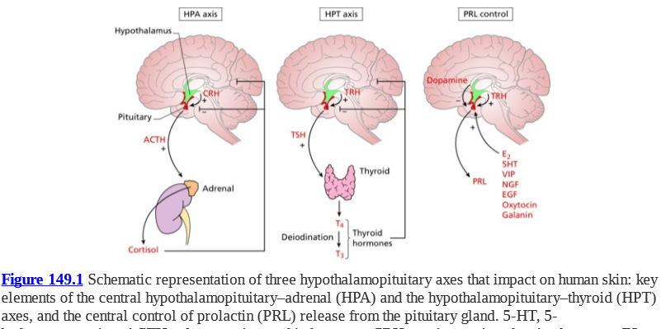

Slide 5
Hormone imbalances within these central axes lead to excessive or insufficient serum levels of key hormones. Peripheral tissues such as the skin will be affected provided that they express cognate hormone receptors.
Such imbalances can result from a wide range of disorders including
hormone-secreting tumours.
Autoimmune attack directed at endocrine glands resulting in either failure of or excessive hormone secretion.
Biochemical abnormalities.
environmental or nutritional signals.
Drugs.
Psychological and emotional stress.
The physiological consequences of puberty, menopause or ageing on systemic hormone levels.

Slide 6
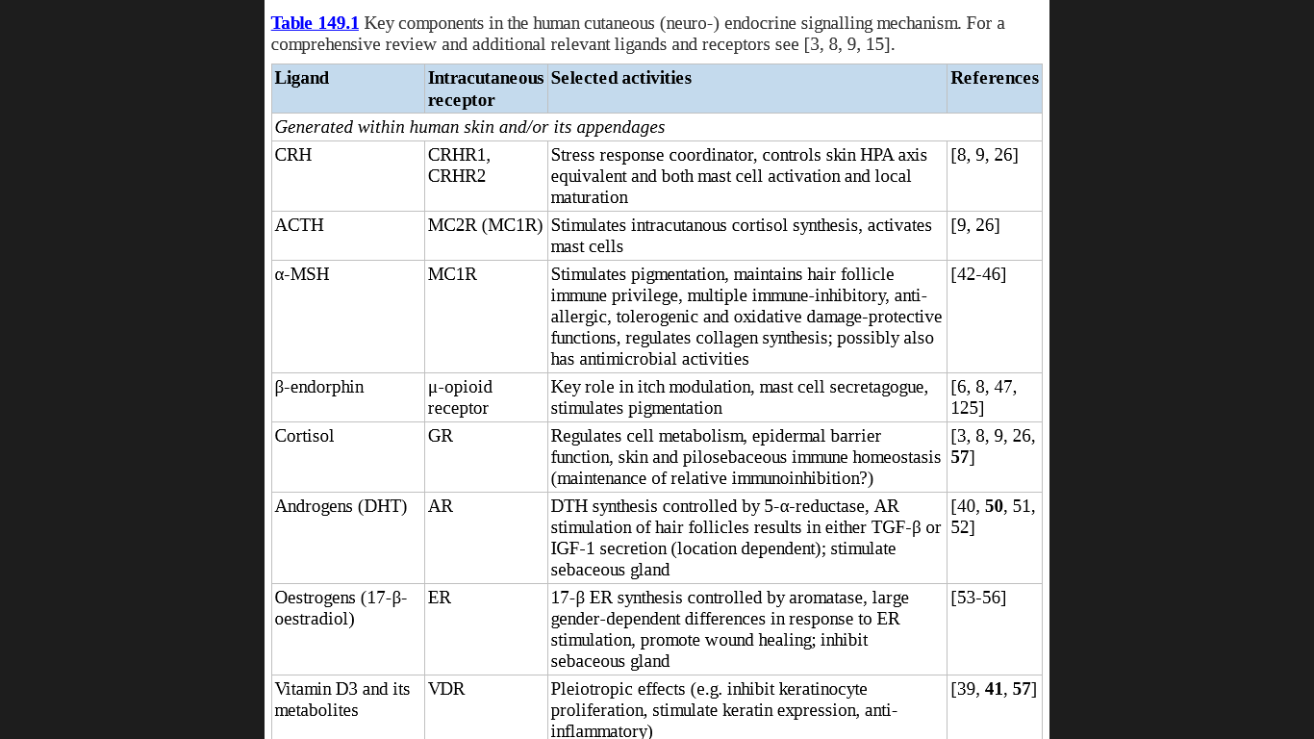

Slide 7
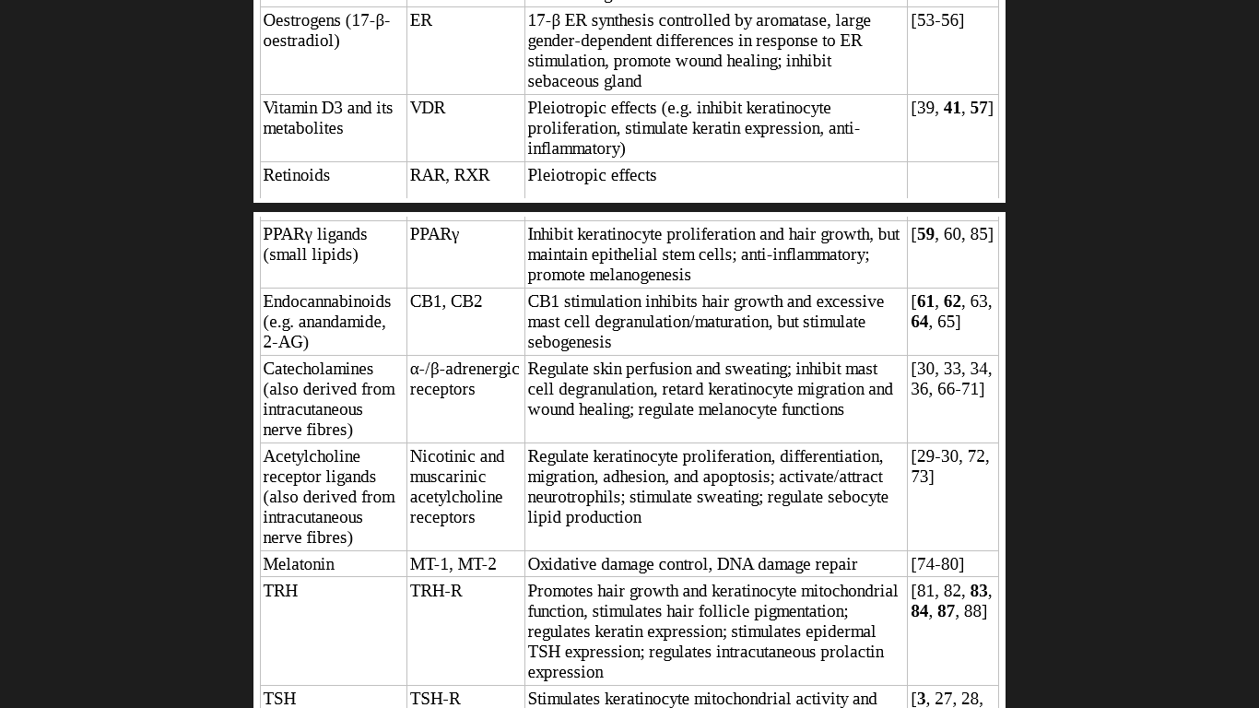

Slide 8
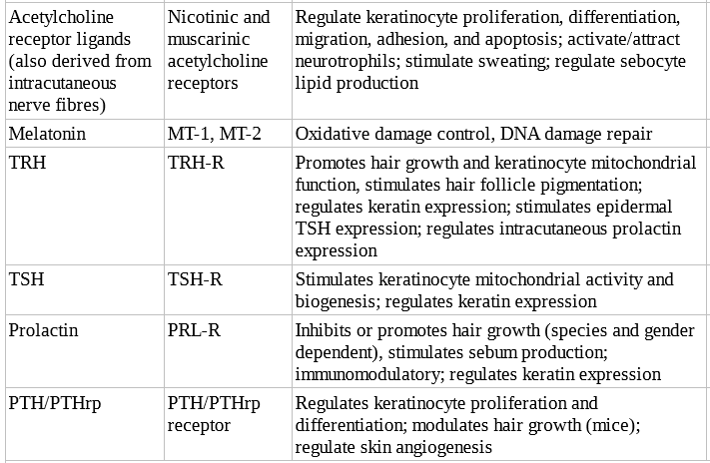

Slide 9
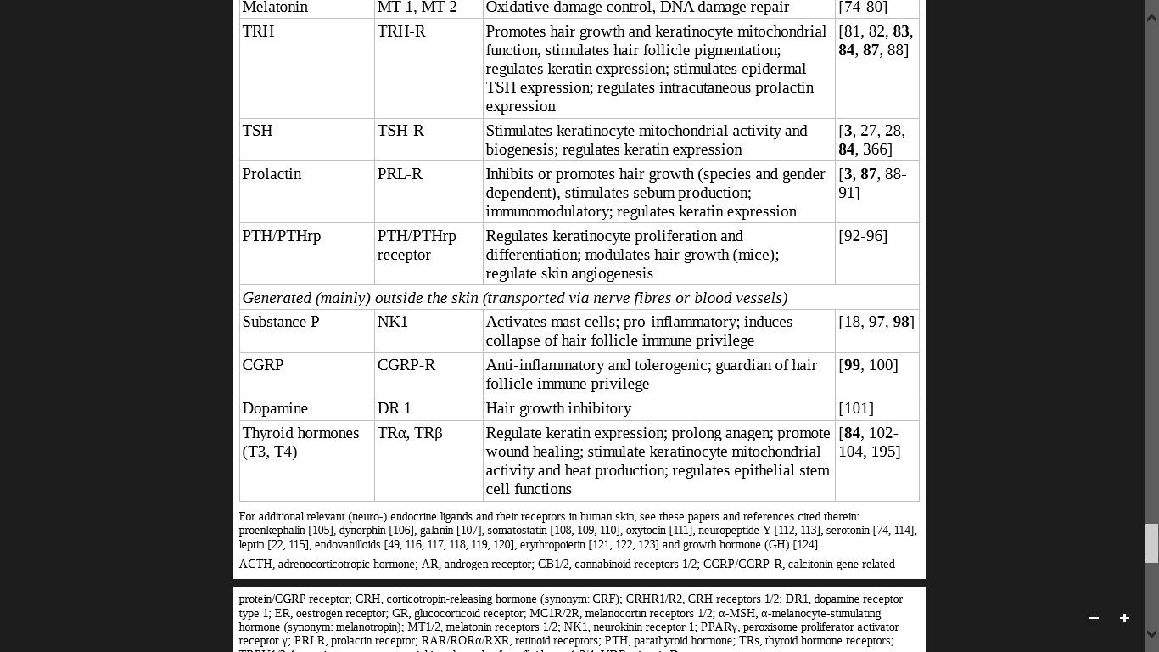

Slide 10
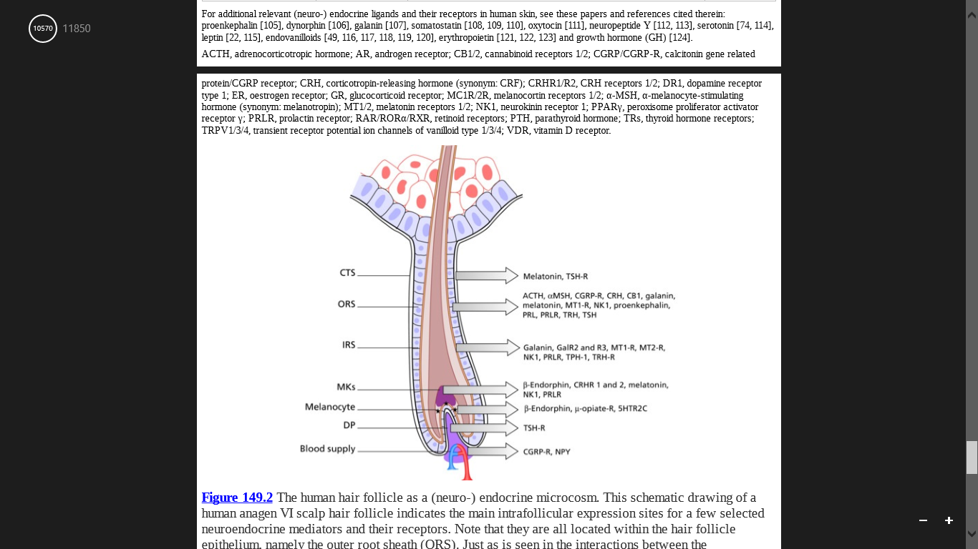
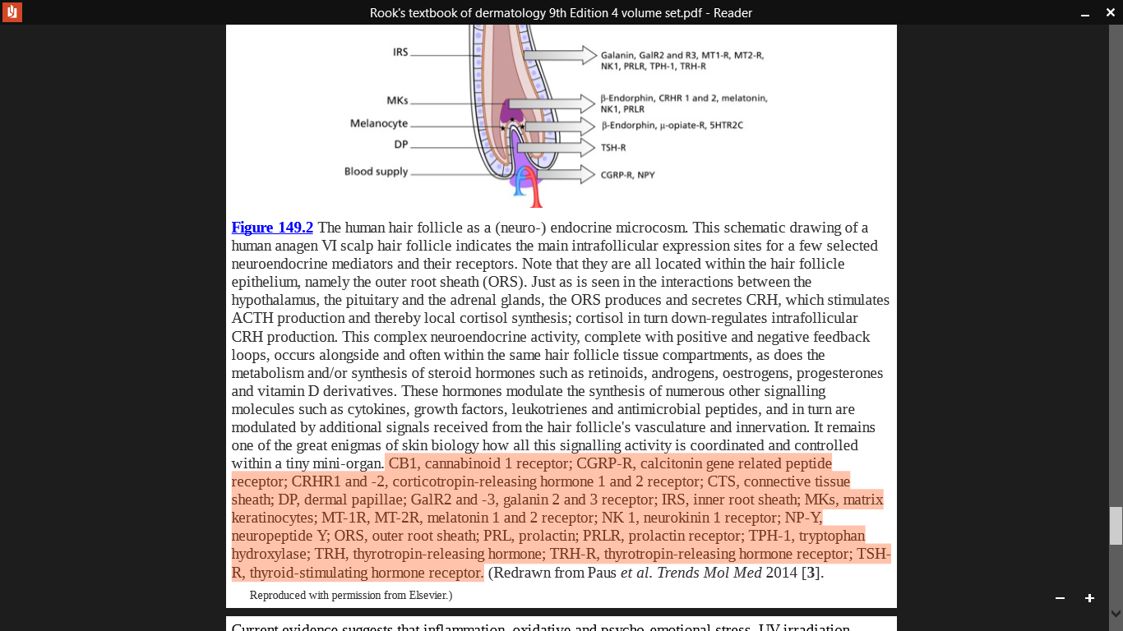
CB1, cannabinoid 1 receptor; CGRP-R, calcitonin gene related peptide receptor; CRHR1 and -2, corticotropin-releasing hormone 1 and 2 receptor; CTS, connective tissue sheath; DP, dermal papillae; GalR2 and -3, galanin 2 and 3 receptor; IRS, inner root sheath; MKs, matrix keratinocytes; MT-1R, MT-2R, melatonin 1 and 2 receptor; NK 1, neurokinin 1 receptor; NP-Y, neuropeptide Y; ORS, outer root sheath; PRL, prolactin; PRLR, prolactin receptor; TPH-1, tryptophan hydroxylase; TRH, thyrotropin-releasing hormone; TRH-R, thyrotropin-releasing hormone receptor; TSHR, thyroid-stimulating hormone receptor.
Main intrafollicular expression sites for a few selected neuroendocrine mediators and their receptors

Slide 11
Human epidermal and hair follicle keratinocytes, sebocytes and subcutaneous adipocytes are recognized as potent sources of steroid and peptide hormones as well as of a growing list of neuromediators .
Complex neuroendocrine activity, complete with positive and negative feedback loops, occurs alongside and often within the same hair follicle tissue compartments.
These hormones modulate the synthesis of numerous other signalling molecules such as cytokines, growth factors, leukotrienes and antimicrobial peptides, and in turn are modulated by additional signals received from the hair follicle's vasculature and innervation.

Slide 12
Skin As (Neuro-) Endocrine Organ
Human skin, contain integral functional equivalents of the HPA axis (CRH → ACTH → cortisol) and key elements of the HPT axis (TRH→TSH).
Human skin and its pilosebaceous units and sweat glands also produce range of steroid and peptide hormones, ranging from vitamin D, androgens, oestrogens and retinoids to erythropoietin, and classical neuro-hormones such as CRH, TRH, TSH, ACTH, α-MSH, βendorphin and other opioids, melatonin and prolactin, along with multiple other neuromediators; this is complemented by lipid mediators such as endocannabinoids and endovanilloids, which exert neuromediator and many other functions.

Slide 13
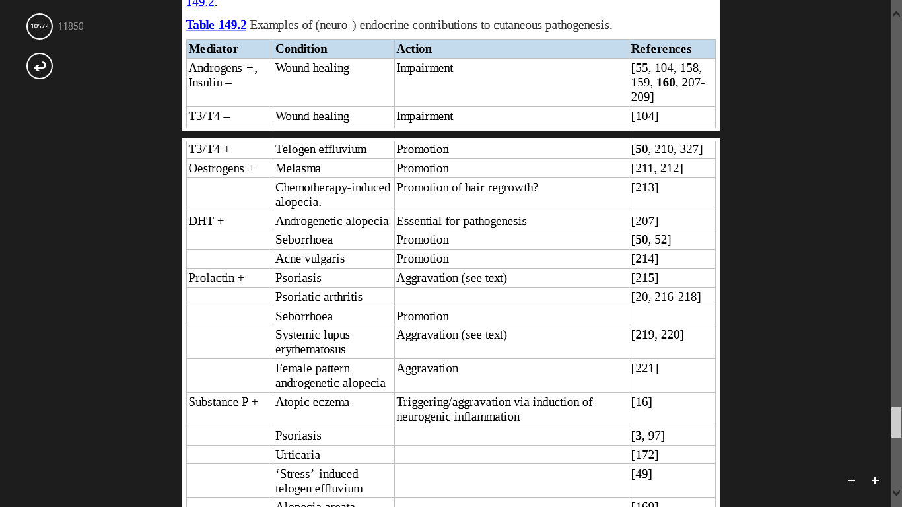

Slide 14
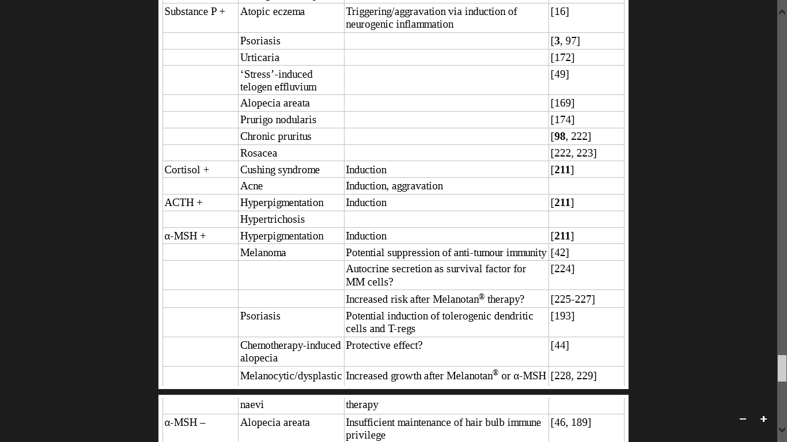

Slide 15
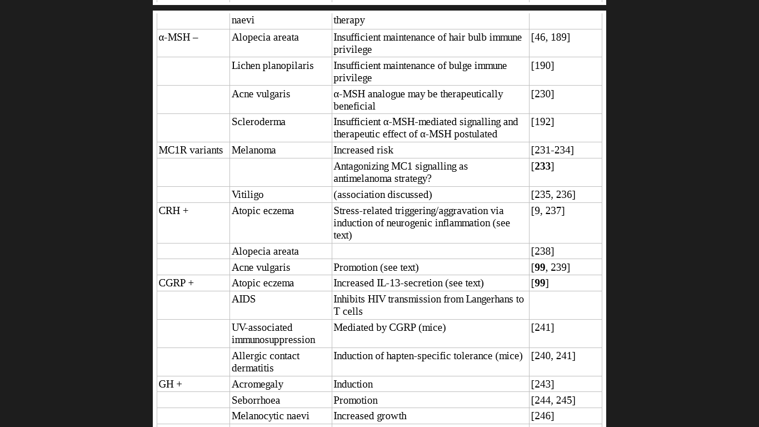

Slide 16
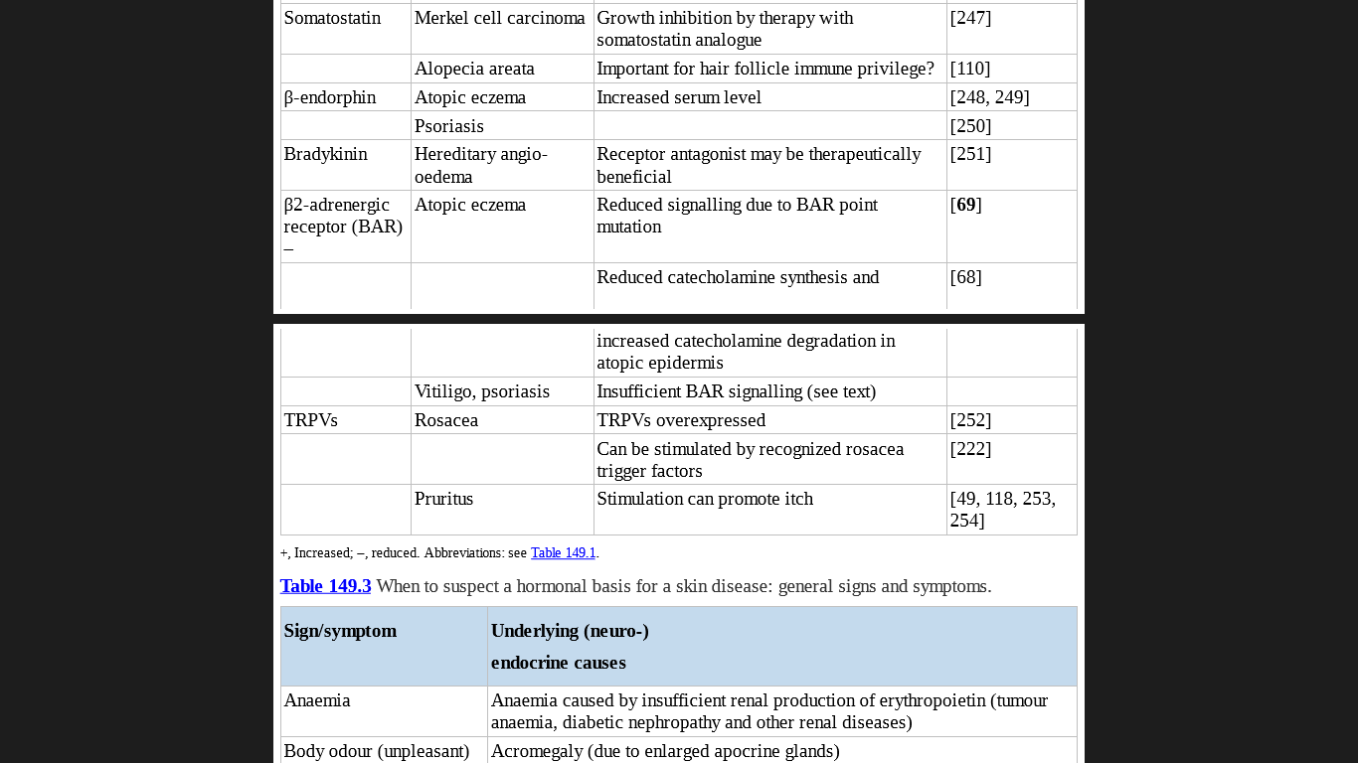

Slide 17
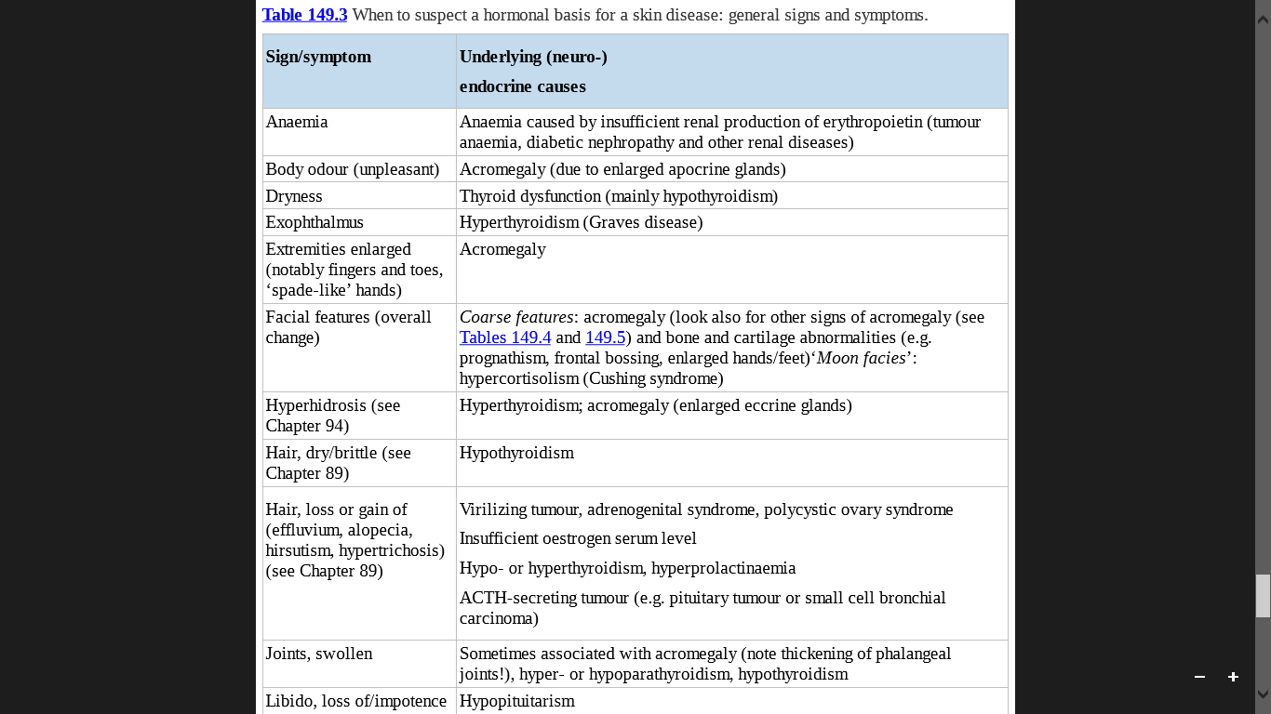
When To Suspect A Hormonal Basis For A Skin Disease: General Sign And Symptoms

Slide 18
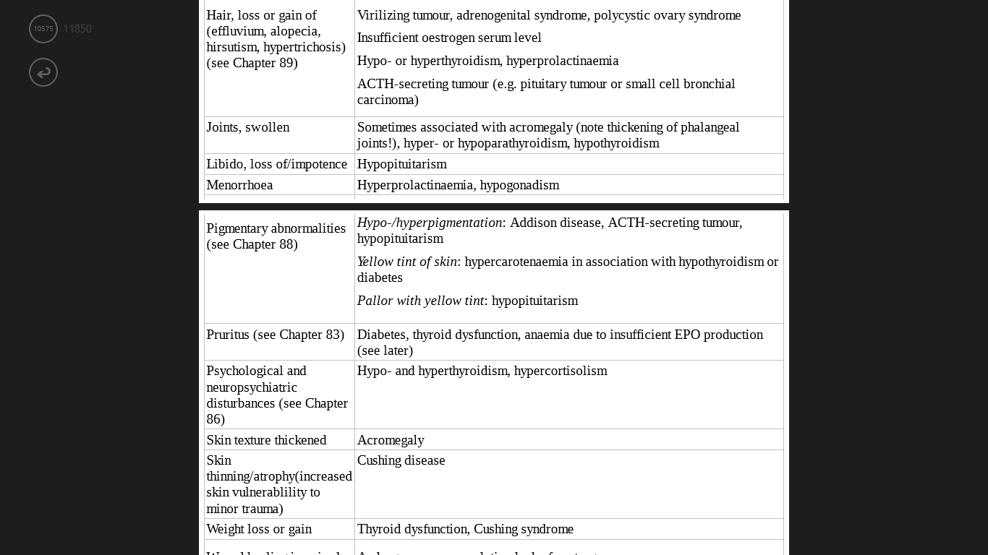

Slide 19
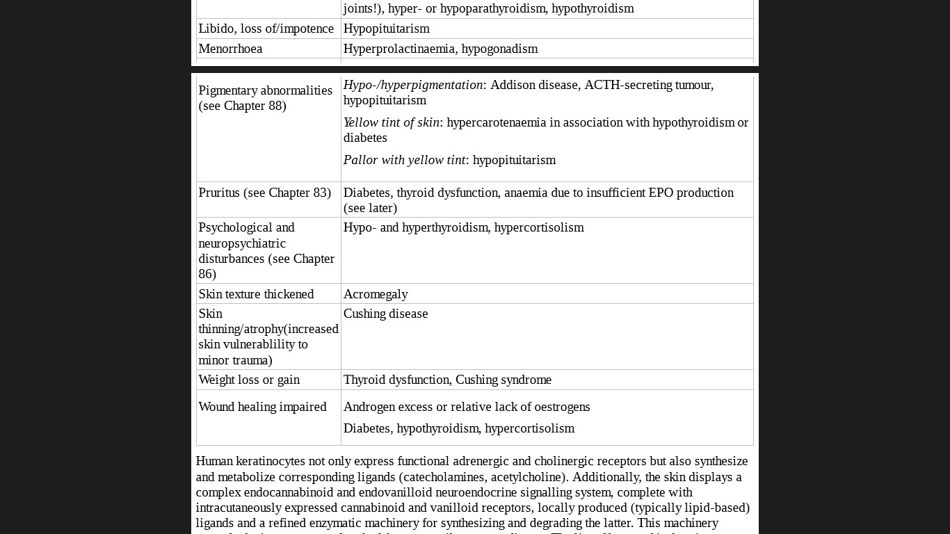

Slide 20
Skin As A Hormone Target
Dermatoendocrinological considerations are inescapable in routine dermatological practice as:
Key dermatological symptoms and signs such as pruritus, flushing, erythema, eczema and wealing, and skin barrier function, wound healing, hair growth, pigmentation are greatly influenced by the intracutaneous endocrine signalling mechanism.
The intraepithelial endocrine and neuroendocrine signalling milieu that is created under physiological circumstances in human epidermis and hair follicles is probably predominantly immuno-inhibitory and this may well be a fundamental prerequisite for skin homeostasis.

Slide 21
The skin's response to excessive or deficient systemic hormone levels is greatly influenced by underlying systemic and local factors, ranging from UV exposure, humidity, barrier function via inflammation and microbiological colonization of the skin to a patient's psychoemotional status, medication and concomitant chemical or physical skin trauma.
Stress-associated neuropeptides such as substance P may even modulate the composition of the skin microbiome.
Ageing of the human organism is associated with significant changes in systemic hormone levels, particularly in circulating androgens and oestrogens.

Slide 22
Neuroendocrine Stress Response Systems In Human Skin
The importance of hormones is further underscored when considering the role of psychoemotional stress as a triggering or aggravating factor in common dermatoses such as psoriasis, atopic eczema, urticaria, nodular prurigo, lichen planopilaris or alopecia areata etc
Pro-inflammatory activities of skin mast cells assume a ‘central switchboard’ role in neurogenic skin inflammation.
Psychoemotional stress can up-regulate the intracutanous generation of stress-response hormones
provoke or exacerbate skin inflammation
Mast cell degranulation
Stress associated mediators
e.g. CRH, ACTH, NGF, substance P
(act as secretagogues)
Neuropeptite-releasing sensory neuron
Synthesize substance p
& transport it via sensory nerve fibres to the skin

Slide 23
Basics Of Clinical Dermatoendocrinology
How to evaluate a patient for a suspected (neuro-)endocrine disorder)
Hormones control or influence general body characteristics such as height, weight, body contour and posture, mood, agility, nervousness, hair phenotype, and also food and fluid intake.
Being alert to changes in such general characteristics will therefore greatly help to identify a potential endocrinological dimension in patients presenting with a skin complaint.

Slide 24
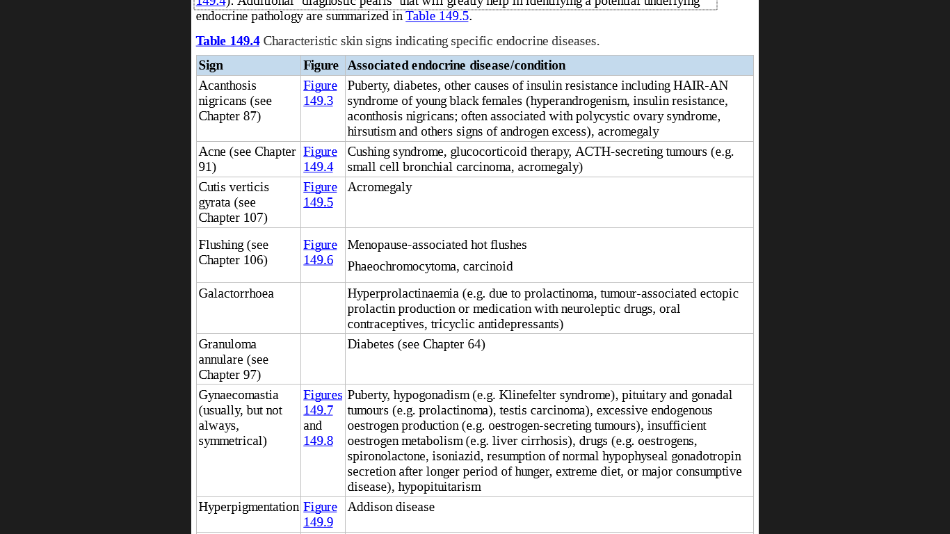
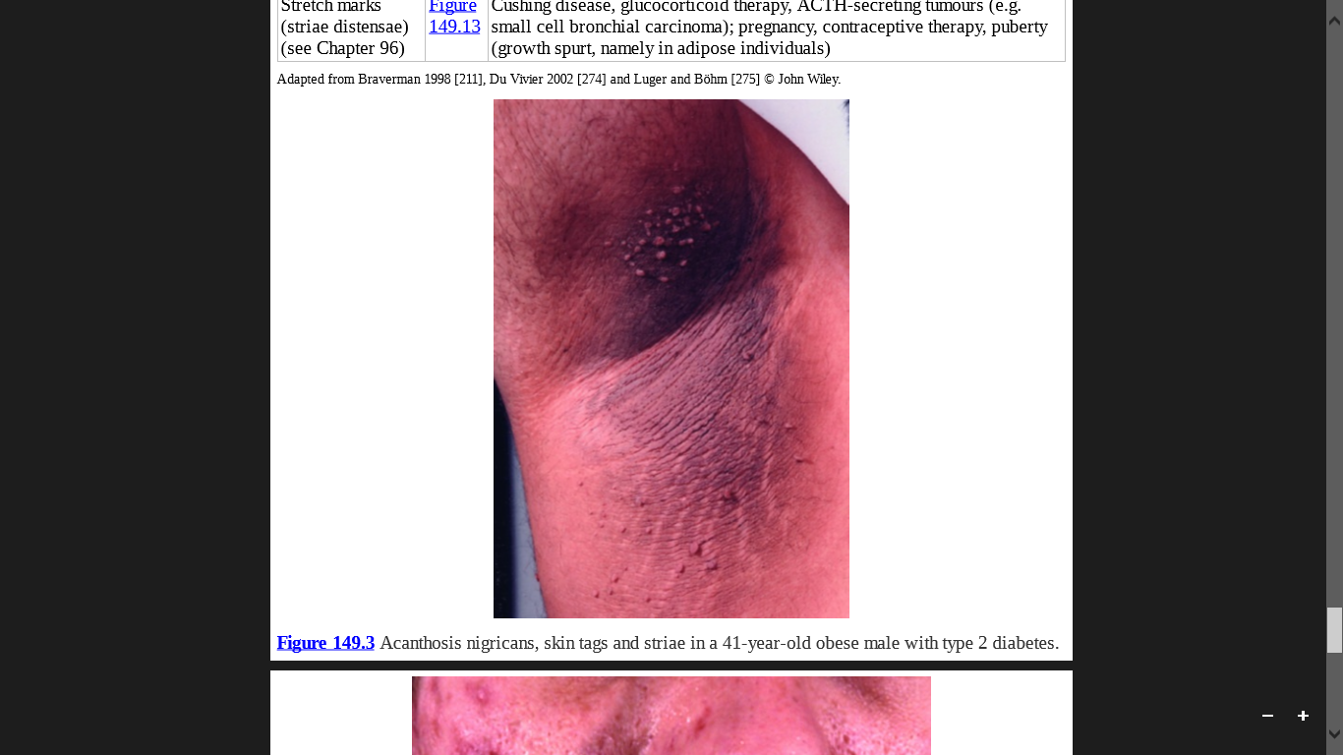

Slide 25
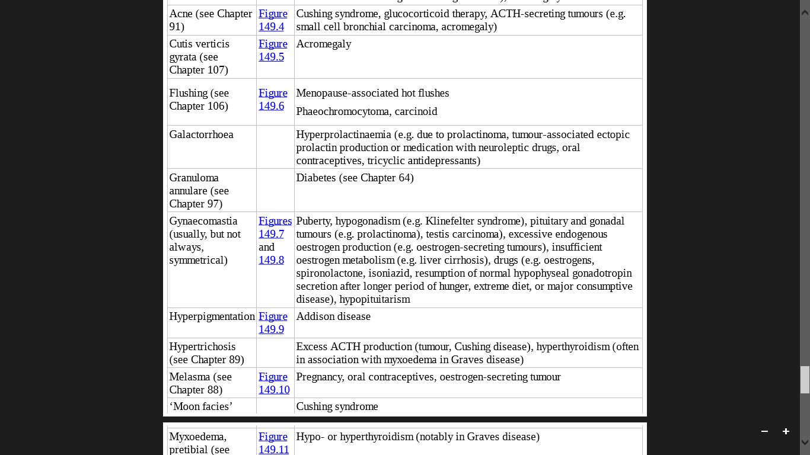
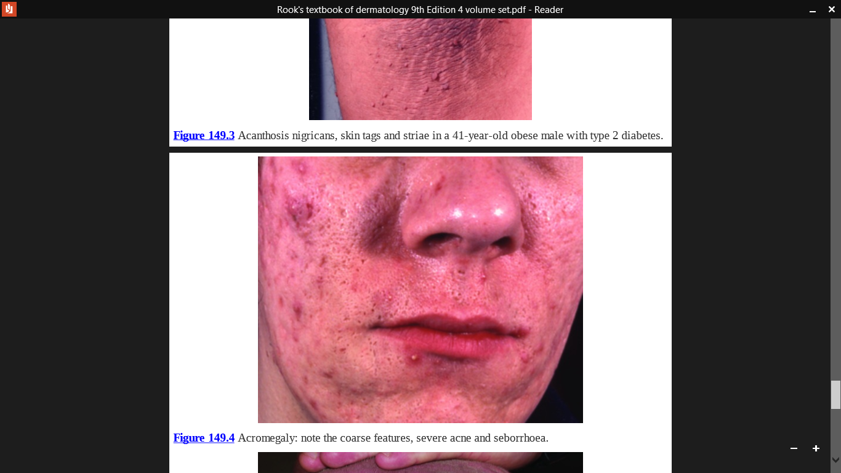

Slide 26
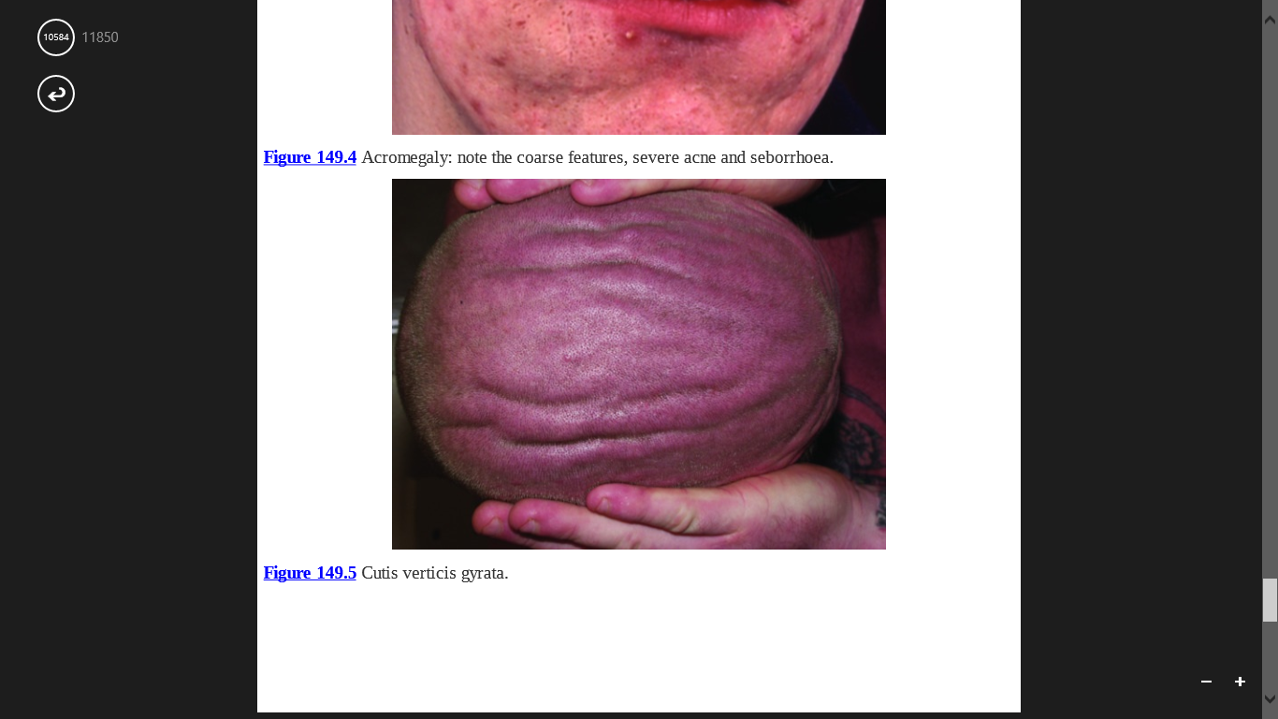

Slide 27
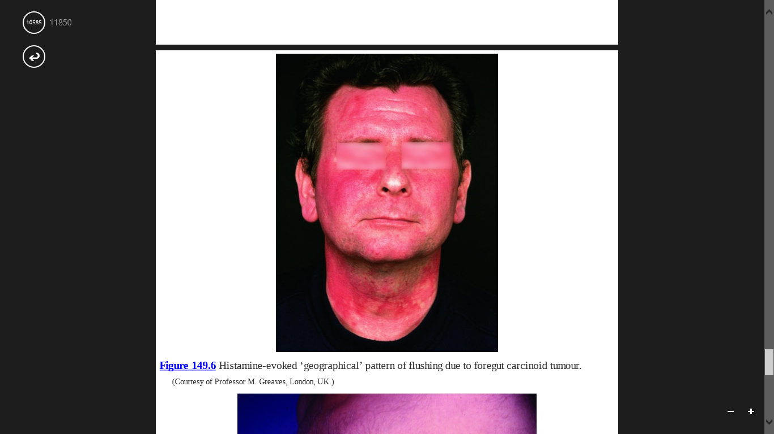

Slide 28
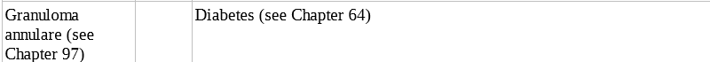

Slide 29
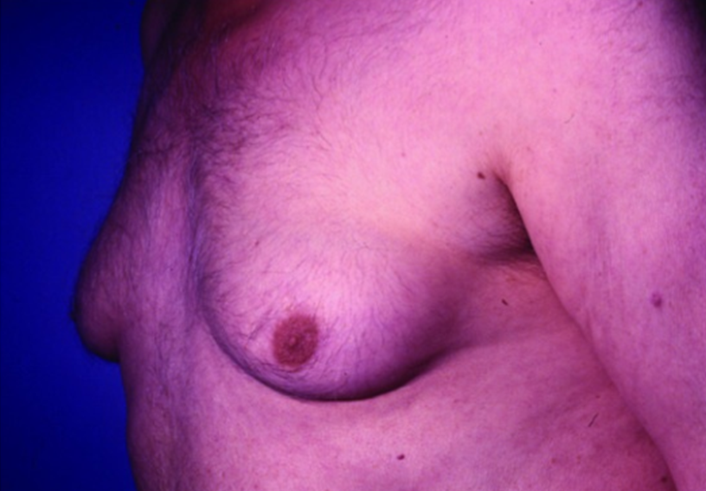
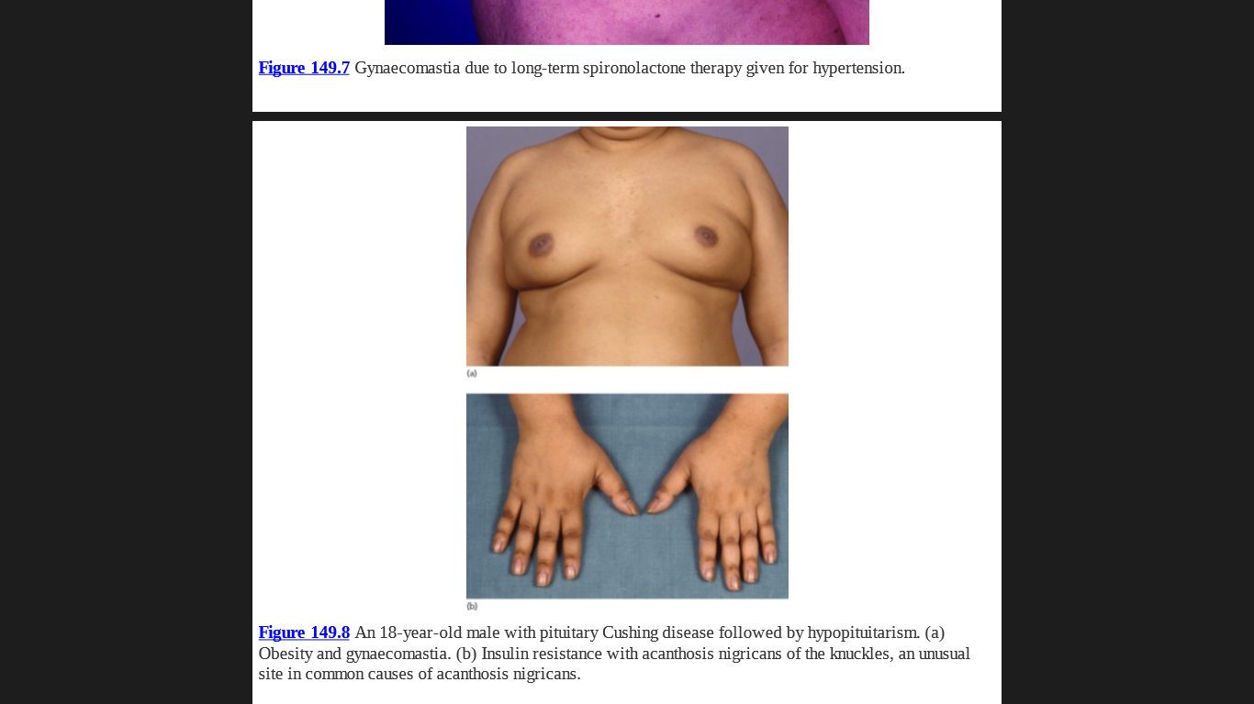
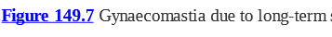


Slide 30
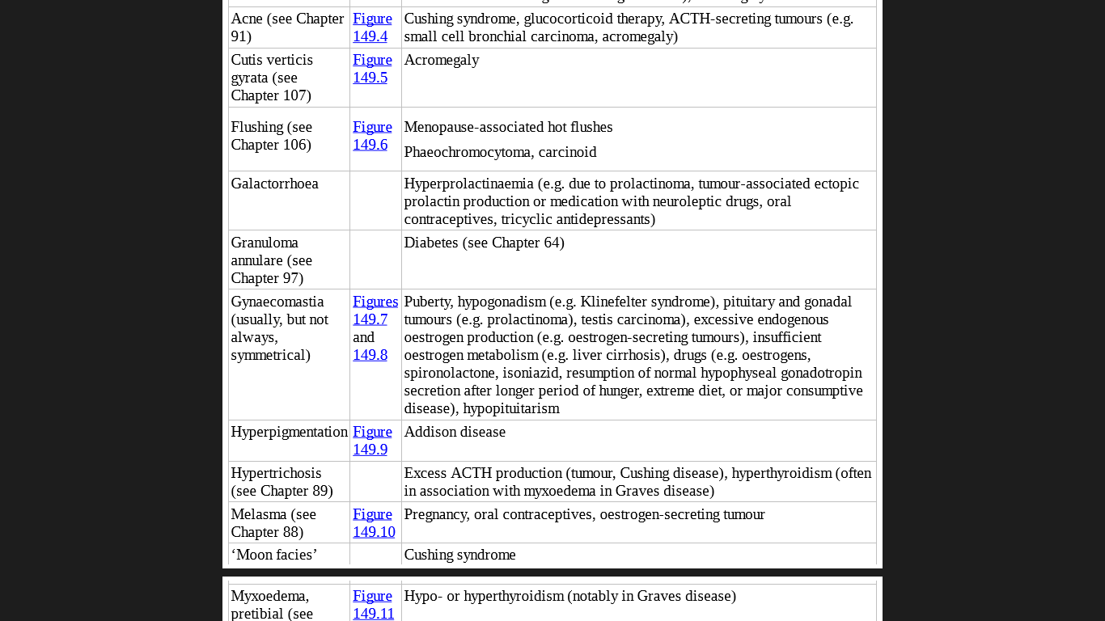
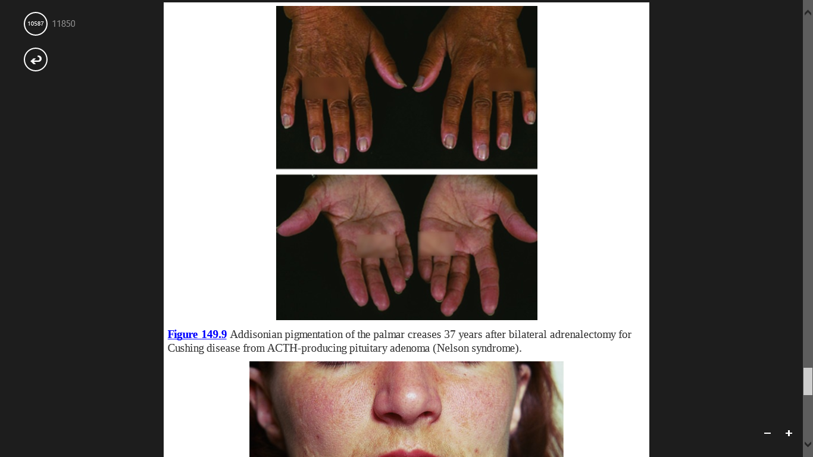

Slide 31
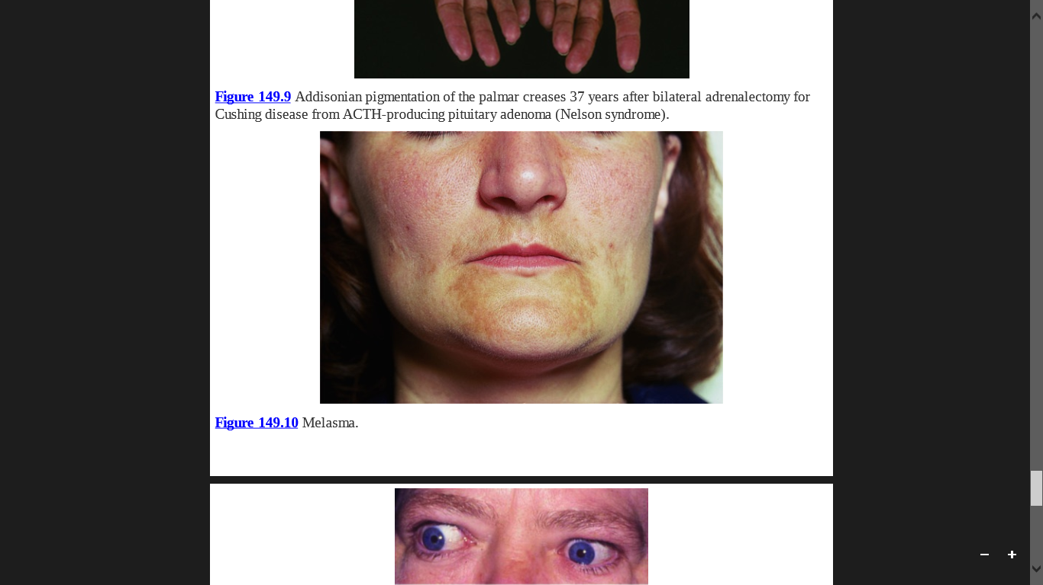

Slide 32
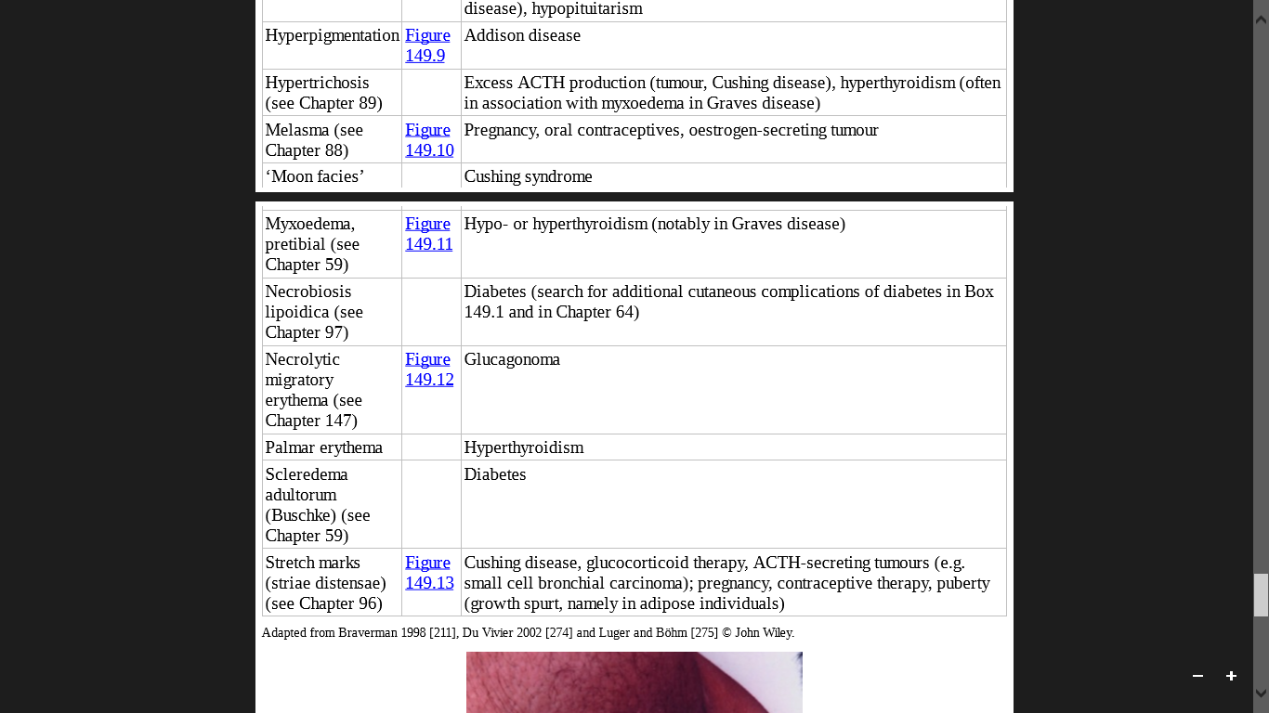
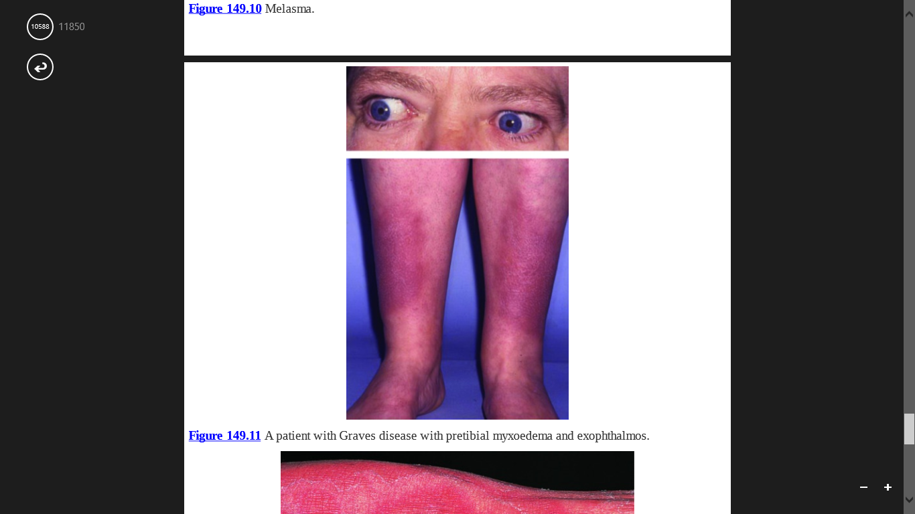

Slide 33
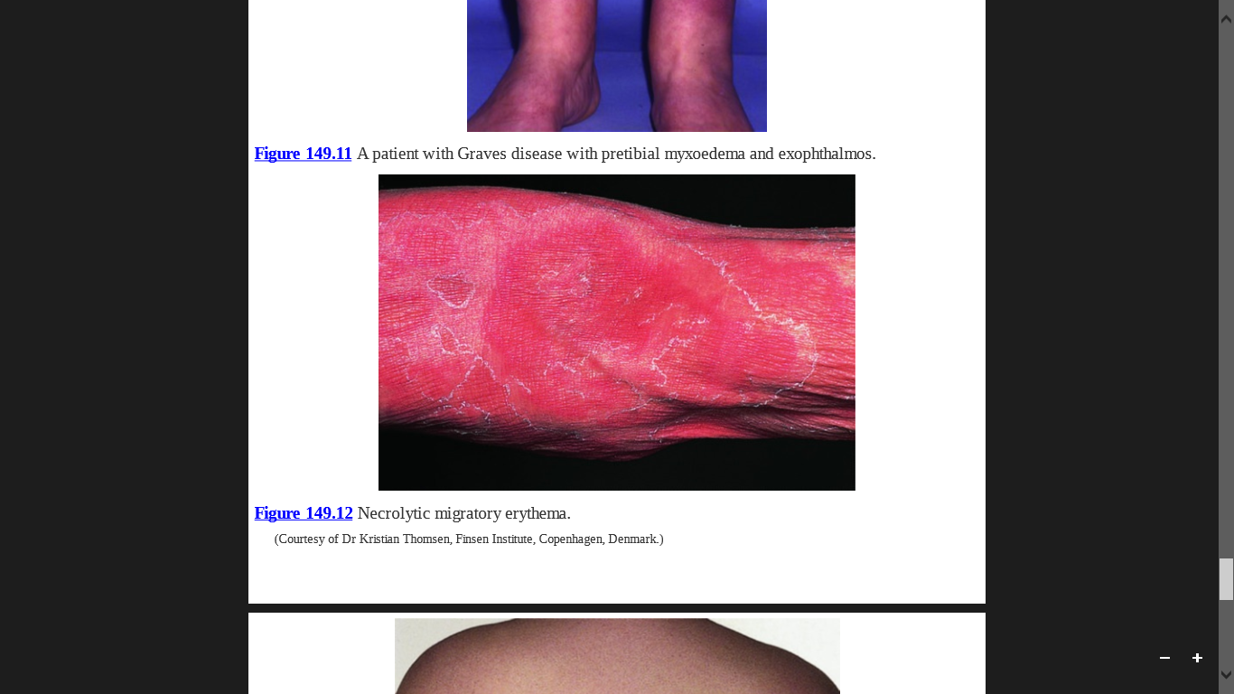

Slide 34
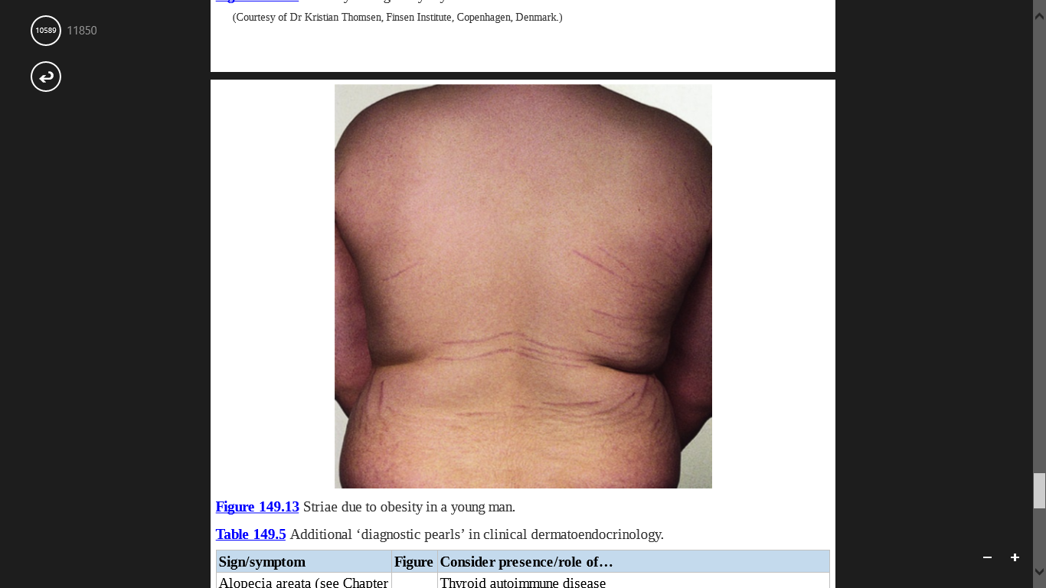

Slide 35
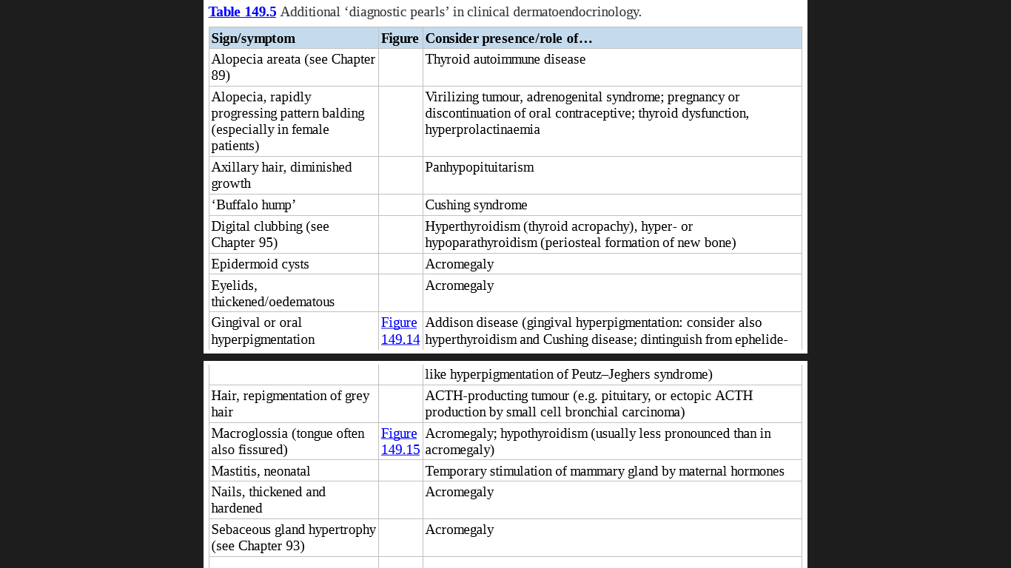

Slide 36
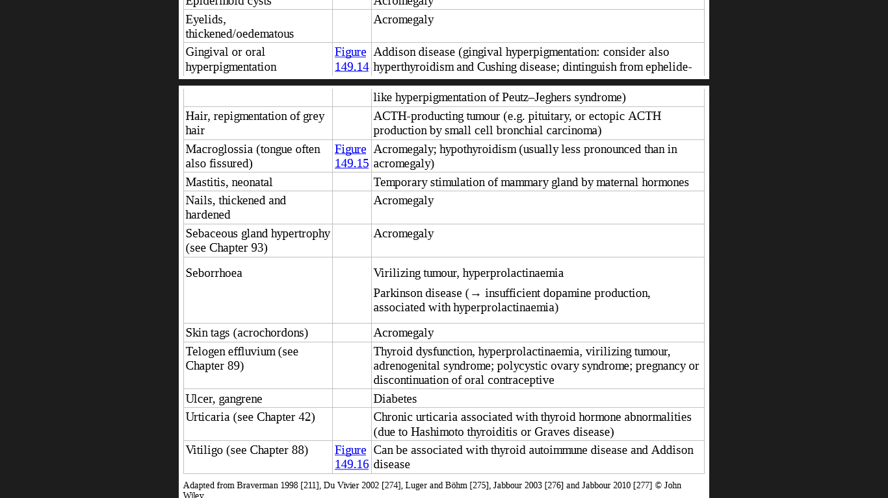
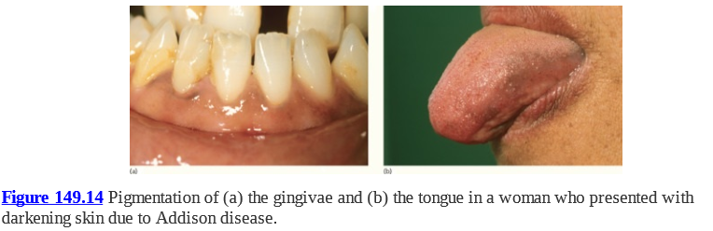

Slide 37
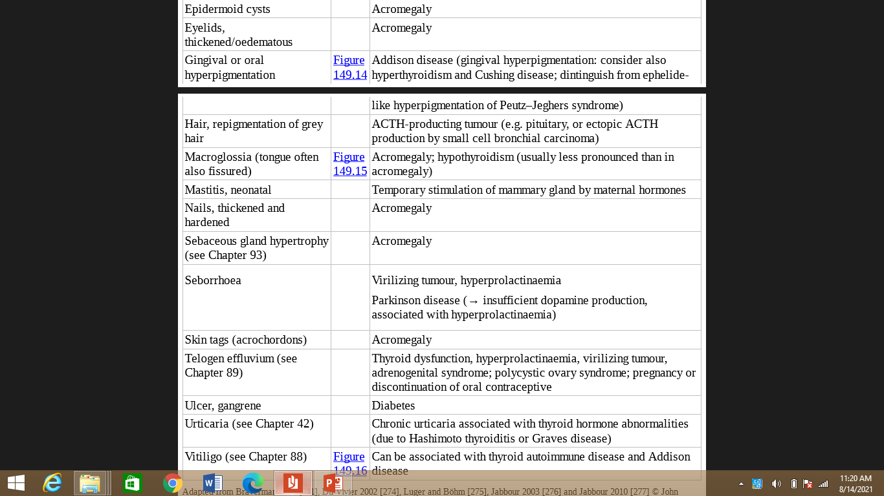
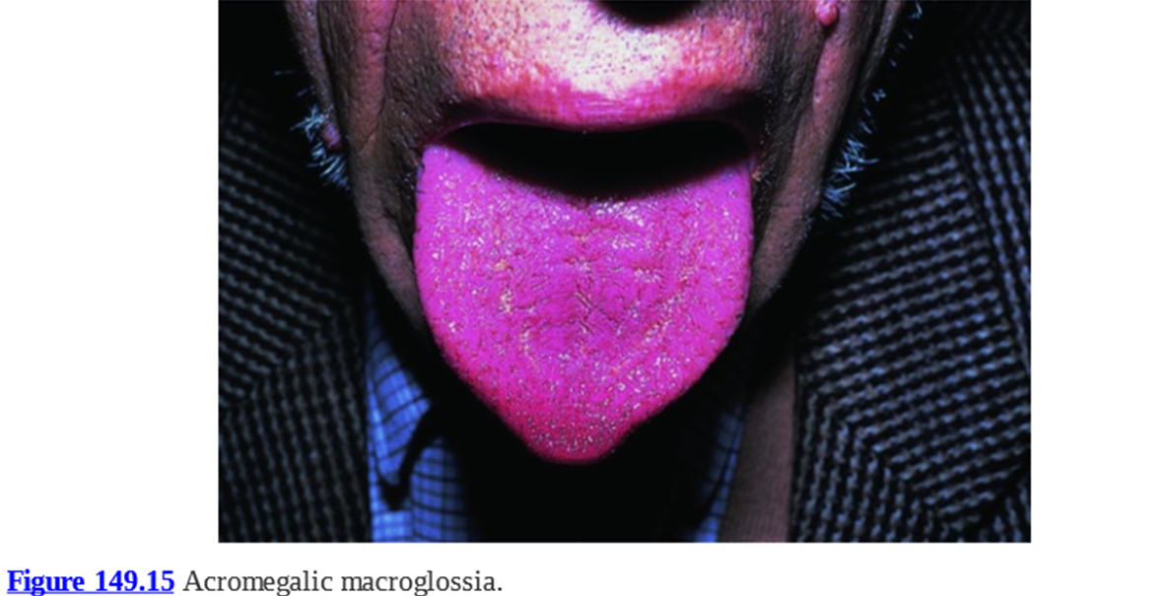

Slide 39
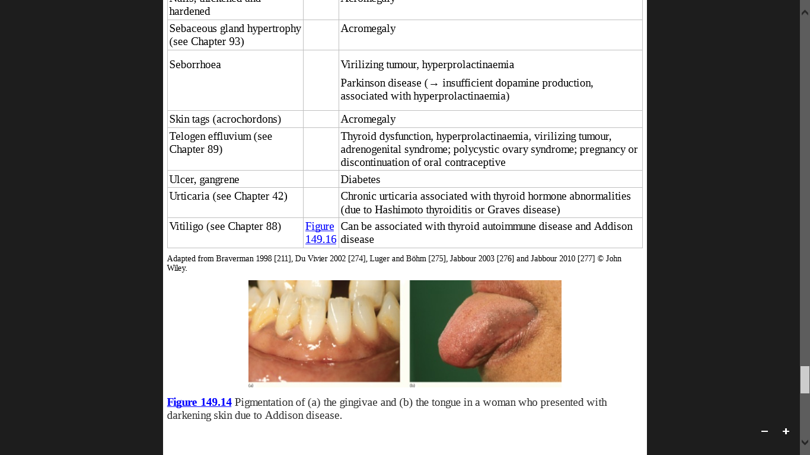
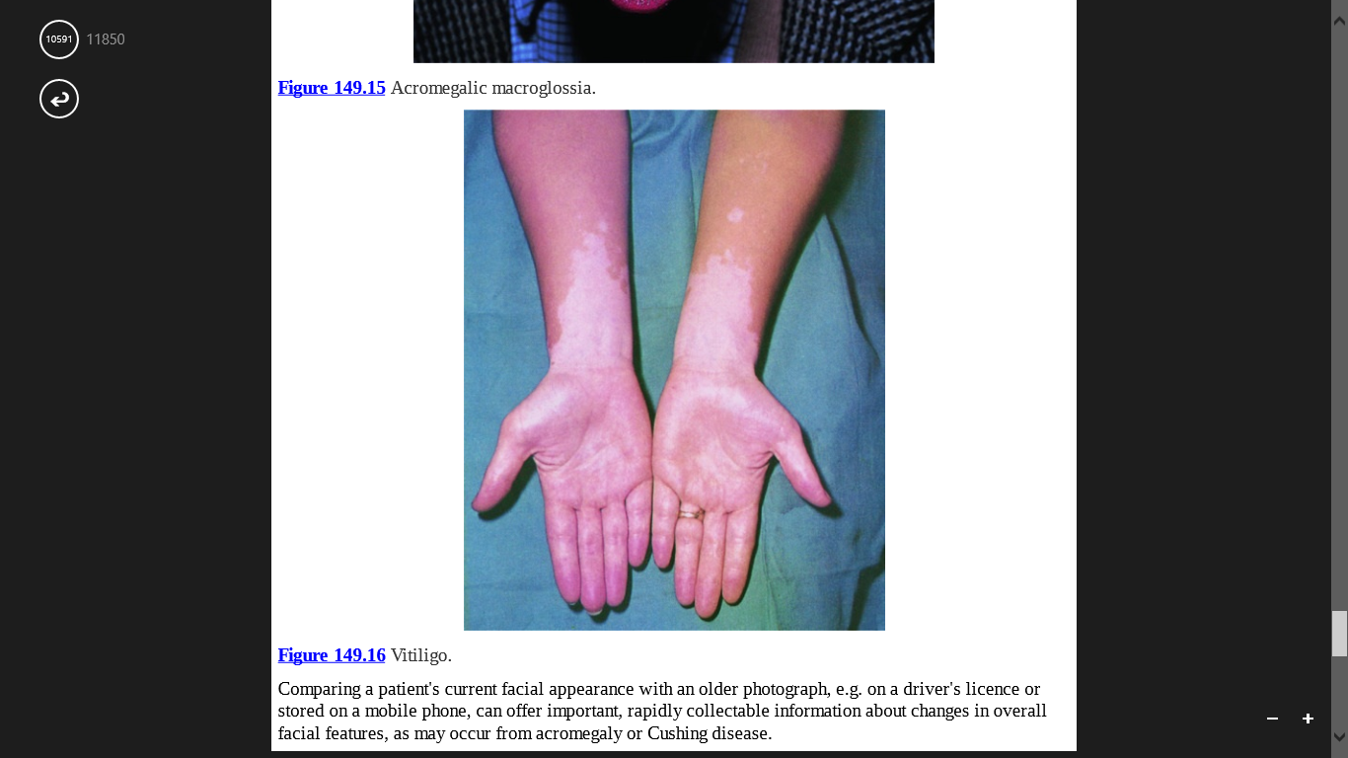

Slide 40
Systematic review of clinical dermatoendocrinology
HYPOPITUITARISM
Inherited or acquired insufficiency of pituitary hormone production.
Can result from different causes like:
Congenital defects in POMC synthesis or processing.
Traumatic brain injury.
Ionizing irradiation.
Tumours (e.g. metastases, craniopharyngioma, adenomata, Langerhans cell histiocytosis).
Infection (e.g. tuberculosis, syphilis)
Sarcoidosis
Postpartum pituitary necrosis (Sheehan syndrome)

Slide 41
Once hypopituitarism is clinically suspected, it is diagnostically important to identify which pituitary hormone(s) is/are deficient.
Classically, the absence of melanotropic neurohormones (e.g. ACTH, α-MSH) results in pale hypopigmented skin, with a yellowish tint.
GH (STH) and/or prolactin deficiency gives rise to structural skin changes, e.g. overall skin thinning and reduced sebum and sweat secretion.
Rarely, gynaecomastia can be a result of secondary hypopituitarism, as in the sarcoidosis.
Reduced collagen synthesis has also been seen in patients with hypopituitarism.
Patients of congenital POMC deficiency are often red-haired, pale skin and early onset of obesity.

Slide 42
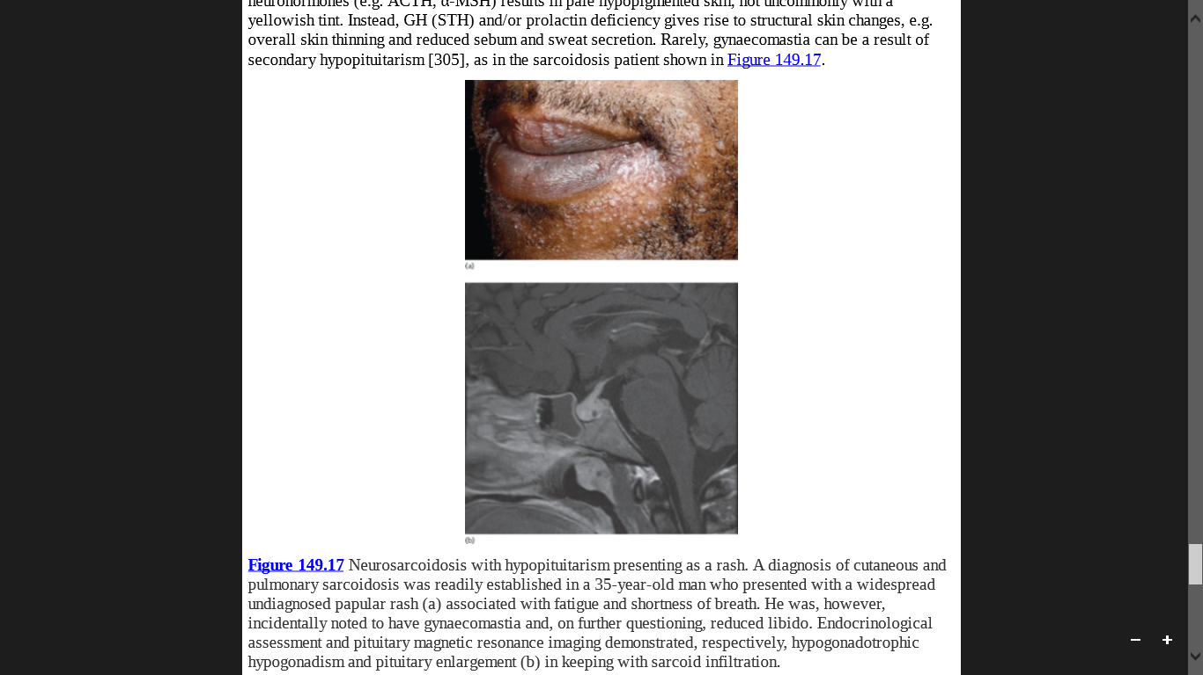

Slide 43
HYPERPITUITARISM
The major diseases resulting from hyperpituitarism are
Acromegaly.
Hyperprolactinaemia.
Cushing disease.

Slide 44
Acromegaly
Adenoma of the anterior pituitary secretes excessive GH, leading to a secondary rise in IGF-1 serum and tissue levels.
The clinical consequences depend upon whether this condition starts during childhood, adolescence or adulthood.
Characterized by excessive growth of acral cartilage and skin with prominent epidermal hyperplasia and dermal glycosaminoglycan accumulation.
External manifestations include progressive enlargement of earlobes and fingers, increasingly coarse facial features with a prominent chin and large frontal skin folds (‘thinker's folds’), which may be associated with cutis verticis gyrate.
Other characteristic changes include hypermelanosis, hypertrichosis, seborrhoea, thickened finger- and toenails, acanthosis nigricans, hyperhidrosis and macroglossia

Slide 45
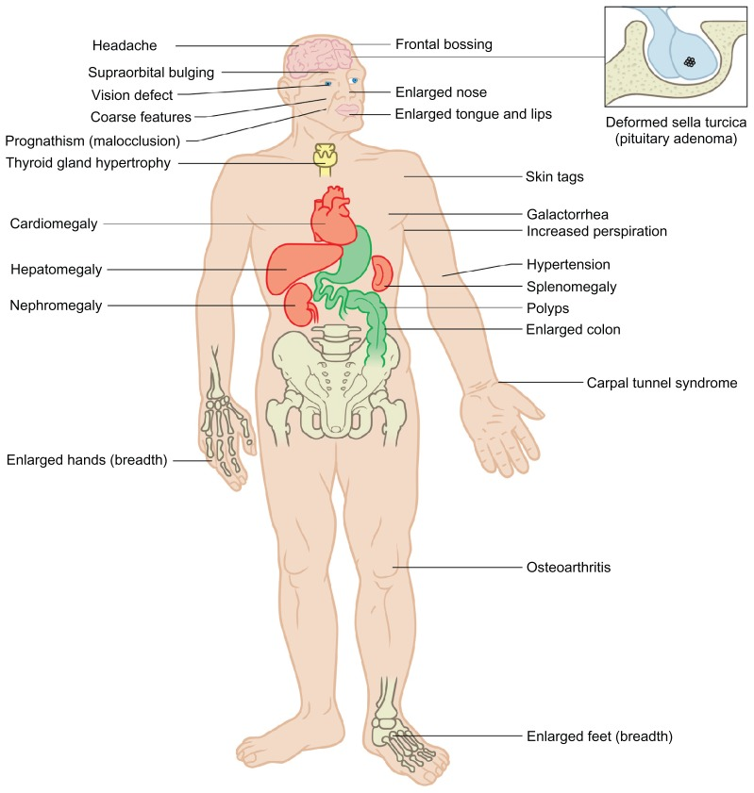

Slide 46
Treatment options for acromegaly includes:
Neurosurgery.
Radiotherapy.
GH antagonists (e.g. pegvisomant),
Somatostatin analogues (e.g. octreotide).
Dopaminergic agents (e.g. bromocriptine, cabergoline) may partially reverse the cutaneous phenomena induced by long-term exposure to excessive GH serum levels

Slide 47
Hyperprolactinaemia
Results either from:
A prolactin-secreting micro-or macroadenoma of the anterior pituitary gland.
Drugs (e.g. phenothiazine, dopamine antagonists, oestrogens, morphine derivates, H2-antagonists and neuroleptic agents)

Slide 48
In women, it is typically associated SAHA syndrome (seborrhoea, acne, hirsutism and androgenetic alopecia). SAHA can also be associated with ovarian and adrenal dysfunction.
Almost pathognomonically, hyperprolactinaemia can induce galactorrhoea in both men and women, usually along with gynaecomastia in men.
Prominent effects on the pilosebaceous unit and the mammary gland includes modulation of keratinocyte and sebocyte proliferation, differentiation and apoptosis to the regulation of cytokine secretion and keratin expression, including the promotion of keratin 15 expression, a key epithelial stem cell marker.

Slide 49
Cushing Disease
ACTH-producing tumour, either in the anterior pituitary or in an extrapituitary location where the tumour (most frequently small cell bronchial carcinoma) engages in ectopic ACTH production.
The associated skin phenomena are dominated by the pigmentary effects of ACTH and the hypercortisolism induced by the chronically elevated serum cortisol level.

Slide 50
ADRENAL HYPERFUNCTION
There are three forms of adrenal hyperfunction.
Hypercortisolism (Cushing syndrome).
Hyperaldosteronism.
Congenital adrenal hyperplasia.

Slide 51
Hypercortisolism (Cushing syndrome)
Result from Systemic or occasionally
extensive topical glucocorticoid therapy
Iatrogenic (mostly)
Cushing disease (Less commonly)
ACTH-​producing tumours
CRH-producing hypothalamic tumours
Carney syndrome
Autoimmune stimulation of adrenal ACTH receptors (MC2R) by autoantibodies
(Very rarely)

Slide 52
Carney syndrome is to be distinguished from the Carney complex,
an exceptionally rare, dominantly inherited syndrome associated with multiple endocrine neoplasias, endocrine overactivity, and spotty skin hyperpigmentation that also shows ACTH-independent Cushing features resulting from a mutation in the PRKAR1A gene
The dermatological manifestations of hypercortisolism include:
Facial and neck changes due to altered subcutaneous fat distribution (‘moon face’, ‘buffalo hump’),
Generalized hypertrichosis.
Acne.
Consequences of increased collagen breakdown, namely skin fragility, stretch marks, vascular fragility with resulting purpura and impaired wound healing.
It also induce diabetes, thus adding to the spectrum of diabetes associated skin phenomena

Slide 53
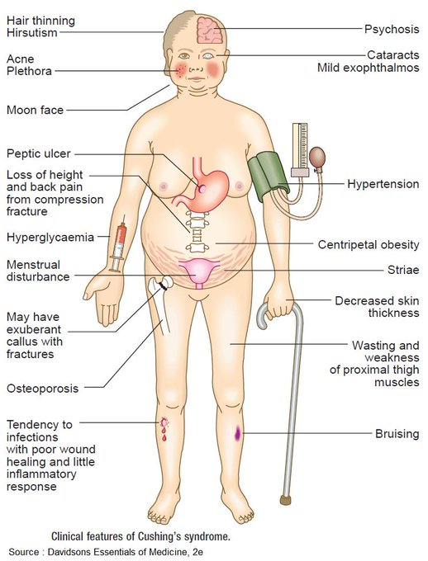

Slide 54
Hyperaldosteronism
Hyperaldosteronism (Conn syndrome) should also affect human skin, which expresses the aldosterone receptor However, prominent skin signs or symptoms have not yet been described in individuals with hyperaldosteronism.
Congenital Adrenal Hyperplasia/Adrenogenitalsyndrome
Due to an inherited deficiency of 21hydroxylase due to mutations in the CYP21 gene.
Cortisol precursor 17-hydroxyprogesterone cannot be metabolized to cortisol but is shunted towards enhanced androgen production instead.
This results in virilization with associated skin signs including acne and hirsutism.
ACTH levels are increased and this may result in hypermelanosis, especially of the buccal mucosa, lips and genitalia.

Slide 55
Adrenal insufficiency (Addison disease)
Important causes are:
Autoimmune disease (autoimmune adrenalitis)
Suppression of ACTH secretion following long-term glucocorticoid therapy.
Infectious diseases (tuberculosis, systemic fungal infection)
In early-onset obesity that is not otherwise explained, adrenal insufficiency should be considered as a potential cause as this may indicate a rare loss-of-function mutation in POMC, the precursor hormone from which ACTH is produced enzymatically

Slide 56
Hyperpigmented palmar skin creases but also affects intertriginous skin, external genitalia, nail beds, oral mucosa and lips.
Hypermelanosis due to compensatory pituitary (and possibly intracutaneous) oversecretion of ACTH or its enzymatic cleavage product, α-MSH, is a prominent component of Addison disease.
If Addisonian pigmentation presents in association with vitiligo or, rarely, alopecia areata , it is reasonable to assume that it is due to autoimmune adrenalitis.
Patients presenting with generalized hyperpigmentation of unclear origin should have serum ACTH and mineralocorticoid function checked without delay for undiagnosed primary adrenal insufficiency.

Slide 57
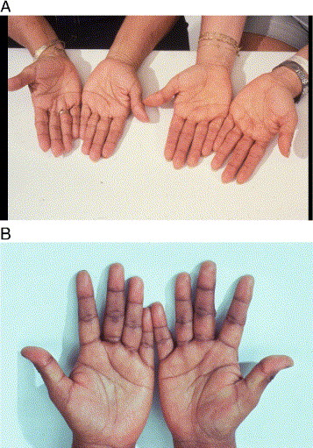
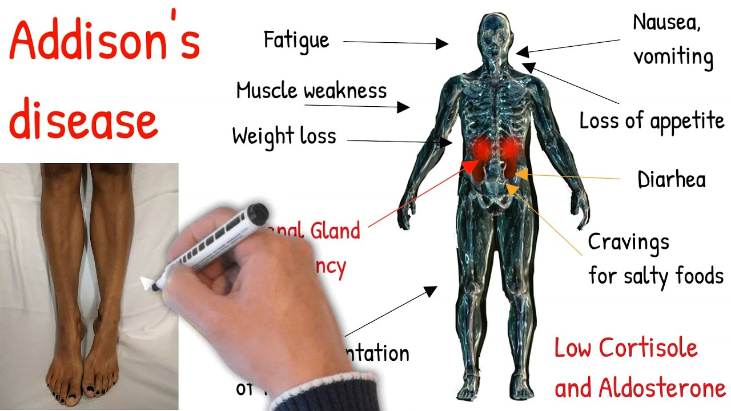

Slide 58
Hyperandrogenism
The testes (and to a minimal extent ovaries) are the primary site of testosterone synthesis, androgens are also produced in the adrenal glands.
The main adrenal androgens are dehydroepiandrosterone (DHEA) and androstendione
Biologically most important enzymatic processes involved are the conversion of testosterone to DHT by 5-α-reductase and the metabolic conversion of androgens to 17-β-oestradiol.

Slide 59
causes of hyperandrogenism are:
Exogenous androgen use or abuse (e.g. anabolic steroids)
CAH,
Polycystic ovary syndrome with the production of androgens by ovarian theca cells is the most frequent cause of hyperandrogenism in women.
Acromegaly,
Cushing disease,
Androgen-secreting (virilizing) tumours of the ovary or adrenal gland, and hyperprolactinaemia.

Slide 60
The cutaneous hallmarks of hyperandrogenism are seborrhoea, severe acne, hirsutism, telogen effluvium and female or male pattern balding, late-onet acne in women, Other signs of virilization (e.g. male habitus in women, deepening of the voice, clitoral hypertrophy).
A full endocrinological assessment should however be undertaken without delay.
Whether or not antiandrogenic therapy is indicated in patients with hyperandrogenism requires careful consideration.
Androgen suppression, e.g. via administration of a gonadotropin-releasing hormone antagonist, may also improve microvascular dilation in polycystic ovary syndrome.

Slide 61
Hypoandrogenism
Caused by:
Castration, tumours, antiandrogen therapy, genetically deficient androgen production (e.g. Klinefelter syndrome) or defective androgen receptor-mediated signalling
If uncorrected hypoandrogenism occurs before puberty, it will manifest as eunuchoid habitus, with undeveloped male body habitus, minimal or absent male secondary hair and no acne during puberty
If it occurs after puberty, there is a slow progressive loss of male secondary sexual characteristics and androgenetic alopecia does not progress.
As androgen deficiency is usually corrected in male patients, one dermatologically important point is that replacement therapy is not infrequently carried out too aggressively, so that features of hyperandrogenism can develop.

Slide 62
Hyperoestrogenism
Oestrogen-producing tumours are the most common and most serious causes of hyperoestrogenism. Besides oral contraceptives and excessive consumption of phyto-oestrogens.
Classical skin signs are melasma, spider telangiectases and increased susceptibility to Candida vulvovaginitis.
While girls can undergo precocious puberty, boys develop gynaecomastia.
Much more rarely erythema nodosum, porphyria cutanea tarda, pemphigoid gestationis and systemic lupus erythematosus can be seen

Slide 63
Hypo-oestrogenism
It is a natural consequence of the menopause or due to ovariectomy.
Result in female pattern balding. Sometimes this female variant of androgenetic alopecia may follow the male pattern or can also show a mixed phenotype, i.e. with features of both male and female pattern balding .
Genital pruritus and burning mouth syndrome, seborrhea is another dermatological manifestation of hypo-oestrogenism. If these occur concomitantly with osteoporosis, typical menopausal mood swings, paroxysmal hyperhidrosis and flushing, a clinical working diagnosis of hypo-oestrogenism is easily reached.
Hypo-​oestrogenism is a state that justifies consideration of hormone replacement, even by dermatologists. The potential benefits of this have to be carefully balanced against the long-debated, potentially serious adverse effects of oestrogen therapy.

Slide 64
Phaeochromocytoma
A potentially life-threating catecholamine-secreting endocrine neoplasm of the adrenal medulla.
It is Bilateral or may be ectopic.
10–15% of cases it is malignant.
Clinical presentations include: hypertension, paroxysmal hypertensive crises, headaches, tremor, palpitations, anxiety).
Its skin manifestations may not be obvious: hyperhidrosis, paroxysmal facial pallor, and sometimes aggravation of pre-existing Raynaud phenomenon.
Dermatologists should be alert for such systemic signs in patients with these cutaneous features, particularly if they have neurofibromatosis type I, which conveys an increased risk of developing phaeochromocytoma.

Slide 65
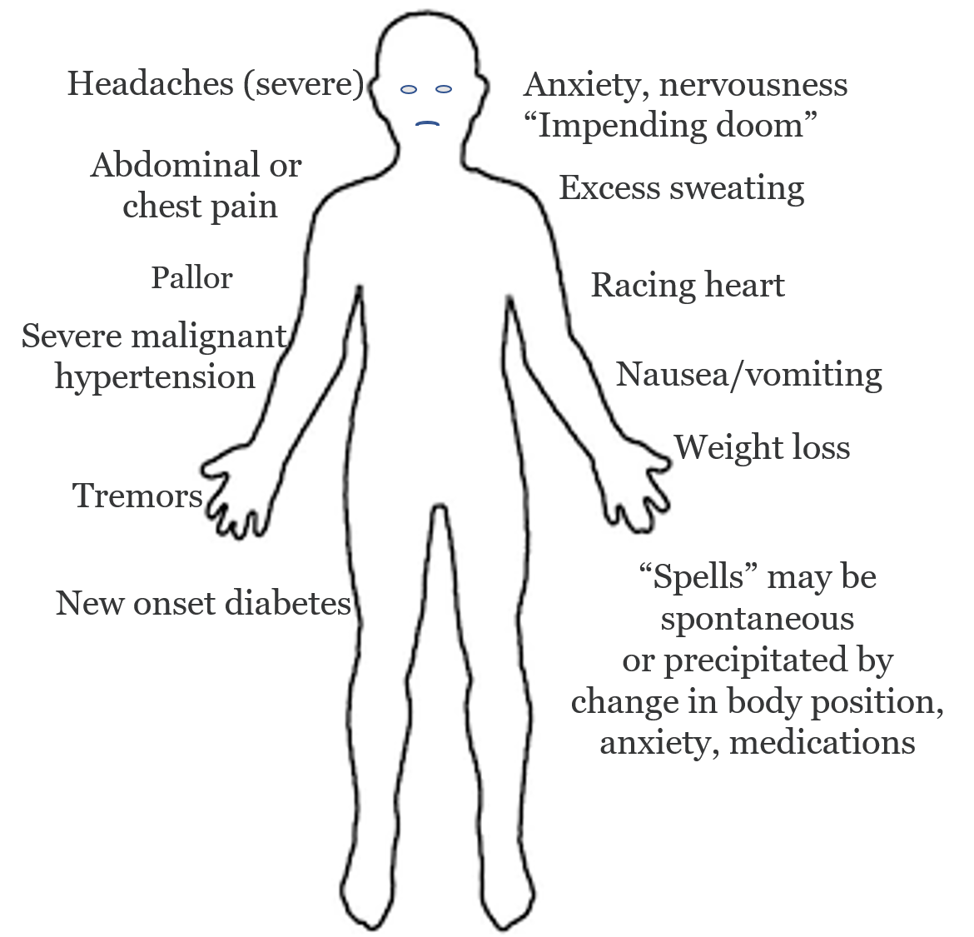
hyperhidrosis, paroxysmal facial
aggravation of pre-existing
Raynaud phenomenon,

Slide 66
Carcinoid Syndrome
Malignant neoplasm of specialized serotonin-​producing epithelial cells of the small intestine.
Presents as paroxysmal flushing of the face and upper torso.
These flushes, which may be triggered by psychoemotional stress, hot drinks or spicy food, often generate a sensation of rapidly ascending heat, which may be accompanied by wheezing and/or diarrhea.
It is assumed that not only the neurotransmitter serotonin but also neuropeptides such as substance P and bradykinin are involved in inducing these signs and symptoms.
Flushing reportedly occurs in less than 25% of patients absence of flushing does not rule out the diagnosis.

Slide 67
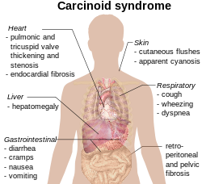
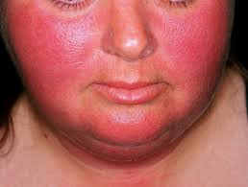

Slide 68
Glucagon and glucagonoma
A neoplasm which typically arises from α-cells of the pancreas and secretes excessive amounts of glucagon.
Pathognomonic dermatological presentation of glucagonoma is Necrolytic migratory erythema.
The associated cutaneous histopathological findings (intercellular epidermal oedema together with hydropic degeneration of epidermal keratinocytes.
Besides surgery, somatostatin analogues usually improve the skin eruption.

Slide 69
Glucagon-like peptide-1 (GLP-1) is a gut hormone which has affinity for specific GLP-1 receptors present particularly in the pancreas and the brain.
Amongst other actions, GLP1 inhibits secretion of glucagon, enhances glucose-dependent insulin secretion and induces a feeling of satiety.
Synthetic GLP-1 receptor agonists are now employed for treating type 2 diabetes.
Possible role of GLP-1 in human skin, especially since psoriatic lesions can show increased expression of GLP-1 receptors.

Slide 70
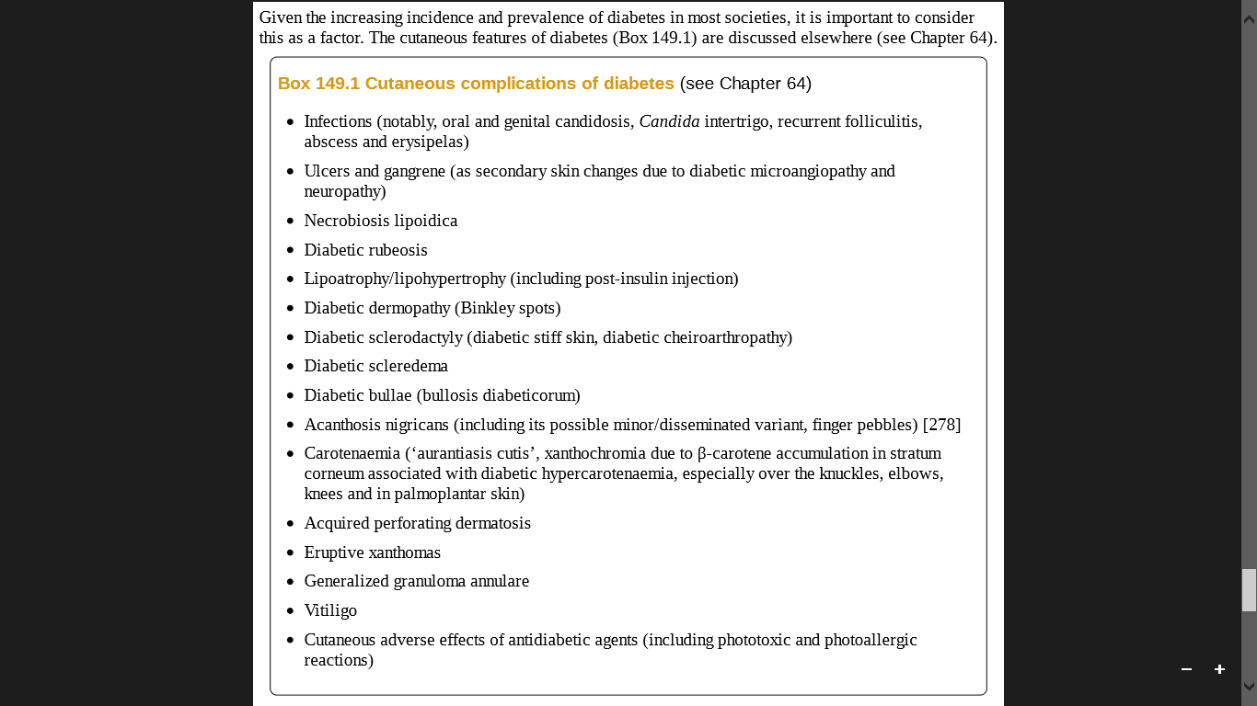
Diabetes Mellitus

Slide 71
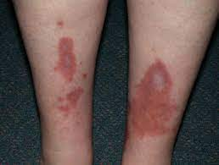
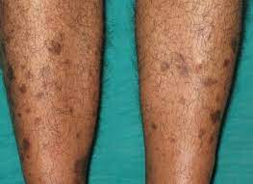
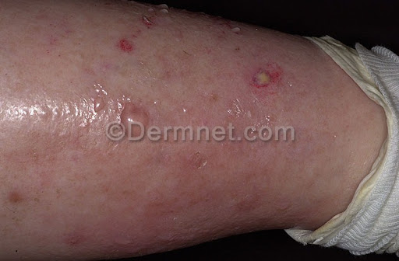



Necrobiosis lipoidica
Diabetic dermopathy
small lesions or spots on the skin
Diabetic bullae
Diabetic rubeosis/Rubeosis iridis, is when, blood vessels develop on the anterior surface of the iris in response to retinal ischemia
Diabetic Scleroderma
Carotenaemia

Slide 72
Hyperthyroidism
Pretibial myxoedema, weight loss, hyperhidrosis and an increased state of nervousness quickly indicate hyperthyroidism.
Most frequently results from Graves disease.
Postpartum thyroiditis also manifests initially as hyperthyroidism, which is then followed by hypothyroidism.
In Graves disease, Intradermal TSH receptors may provide the main inciting autoantigen. In any case, the stimulation of TSH receptors expressed by skin fibroblasts may induce the characteristic increased production and deposition of glycosaminoglycans responsible for pretibial and eyelid myxedema as well as exophthalmos.
Glycosaminoglycans can also induce both hypertrichosis and alopecia.

Slide 73
Hypothyroidism
The combination of dry skin, telogen effluvium, brittle hair, pallor, weight gain, increased tiredness and decreased alertness is suggestive of hypothyroidism
Along with lateral sparseness of the eyebrows (the sign of Hertoghe) and a yellowish hue of the skin due to β-carotene accumulation (aurantiasis cutis). If these are accompanied by carpal tunnel syndrome, ptosis and brittle, slow-growing nails, this further indicates the presence of hypothyroidism.
Apart from pretibial myxedema a more generalized myxedema may also be present, often most prominently on the face, giving it a waxen appearance.
Iatrogenic hypothyroidism occurs following thyroid surgery, thyroid radiation or thyrostatic drug
therapy. Recently, bexarotene, a second line therapy for cutaneous T-cell lymphoma, can induce
significant hypothyroidism

Slide 74

Hypothyroidism
Hyperthyroidism

Slide 75
Thyroid hormone receptors are abundantly expressed in human skin and hair follicles.
Thyroid hormone effects on keratinocyte proliferation and keratin expression,
intracutaneous regulation of neuro hormone production and hair follicle epithelial stem cell functions, stimulation of hair follicle pigmentation, keratinocyte energy
metabolism and wound healing

Slide 76
Hyperparathyroidism
Primary hyperparathyroidism autonomous parathormone-secreting adenoma
Secondary hyperparathyroidism vitamin D deficiency or from disturbances of the
calcium-phosphate balance, especially in patients
with chronic kidney disease. This predisposes to
calciphylaxis (calcific uraemic arteriolopathy),
Calciphylaxis is characterized by widespread vascular calcification and thrombotic occlusion of cutaneous blood vessels with resultant extensive tissue necrosis. It is a frequent complication of ESRD.

Slide 77
Hypercalcaemia that is associated with hyperparathyroidism causes only mild pruritus and/or skin dryness or no dermatological signs and symptoms at all
Rarely, hyperparathyroidism may result in metastatic calcification in the dermis and subcutis & is commoner in patients with renal failure and typically presents as firm papules, nodules or plaques, particularly around large joints or flexural sites.

Slide 78
Hypoparathyroidism
Predominantly arise as surgical complication following thyroidectomy.
Clinically most obvious from the characteristic resultant tetanic muscle cramps.
Hair and nail growth disorders and skin dryness are the most frequently associated dermatological phenomena.
‘Dry, rough skin, coarse, brittle hair; and lusterless distally split nails’ are frequently encountered.

Slide 79


