Slide 1
rosacea

Slide 2
DEFINITION
The term ‘rosacea’ encompasses a spectrum of changes that occur mainly in the facial skin but may also involve the eyes.
Common feature is the presence of facial erythema variably associated with the:
• Facial vascular changes: subtype 1 (erythematotelangiectatic rosacea).
• Inflammatory lesions: subtype 2 (papulopustular rosacea).
• Hypertrophic changes: subtype 3 (phymatous rosacea).
• Ocular involvement: subtype 4 (ocular rosacea).
3. Rosacea is a chronic disorder with fluctuating severity.
4. Affects predominantly fair‐skinned individuals in middle age.

Slide 3
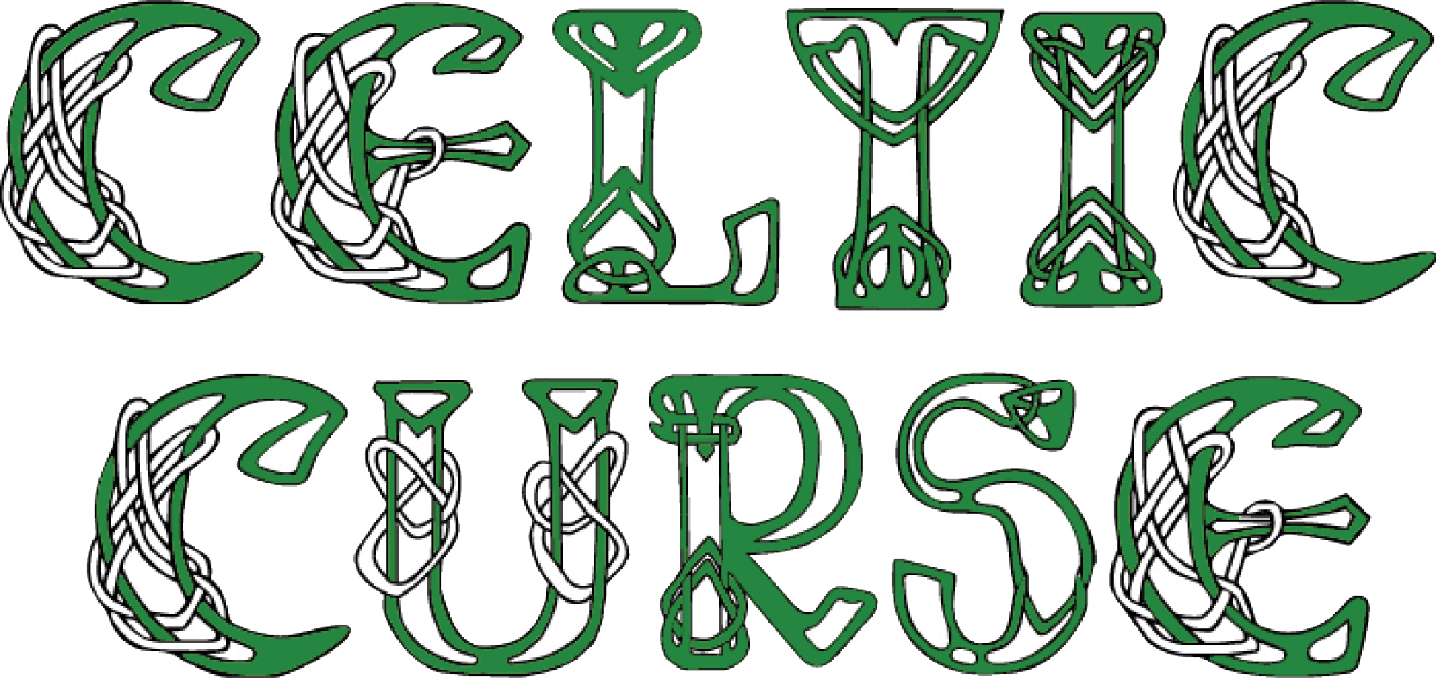
Male patients are said to develop more severe rosacea than women and are much more likely to develop rhinophyma than females.
Curse of the Celts

Slide 4
Associations
Facial seborrhoeic dermatitis.
Migraine, depression and carcinoid syndrome
Possible role of Helicobacter pylori infection of the stomach.
A recent report indicated that more than 50% of rosacea patients (mostly patients with ETTR) who were evaluated with a lactulose breath test showed evidence of small intestine bacterial infection. Treatment with rifaxin (a non‐absorbed antibiotic acting locally within the intestine) resulted in significant improvement of the rosacea in the majority of these patients

Slide 5
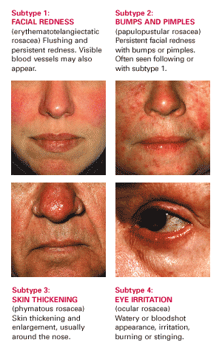

Slide 6
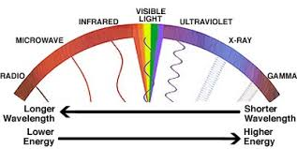

Pathogenesis
It is unlikely that a single pathophysiological pathway is responsible for the diverse clinical features seen in patients with the different subtypes of rosacea.
The role of ultraviolet light in the causation of rosacea has been repeatedly suggested and is supported by the facial distribution (mainly on the convexities) and its occurrence on the bald (exposed) scalp of male patients.
Actinic elastosis is a prominent finding in facial skin biopsies from patients .

Slide 7
The innate immune response in rosacea appears to be altered.
Increased Toll‐like receptor 2 (TLR2) activity, increased protease activity and cathelicidin production (LL‐37) potentiates to increase angiogenesis, leukocyte chemotaxis production and extracellular matrix production.
This pathophysiological mechanism is most likely to apply to patients with PPR

Slide 8
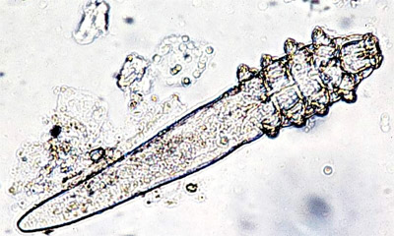
Demodex mite proliferation in the pilosebaceous follicles of the face has also been suggested as a possible aetiological factor in the cutaneous and ocular inflammation seen in patients with PPR
These mites may also play a role in the modulation of the host innate immune system described above, as has been shown by other microorganisms in the skin microbiome .
Evidence to support the role of Demodex in the pathogenesis of rosacea include the following observations: (i) 1% ivermectin cream was significantly more effective than the cream vehicle in reducing numbers of inflammatory skin lesions in two large studies of PPR ; (ii) the use of topical calcineurin antagonists and systemic epidermal growth factor (EGF) inhibitor medications have been reported to result in rosacea‐like dermatoses and an increased Demodex mite population

Slide 9
Alterations in the cutaneous microenvironment in patients with rosacea such as changes in lipid profile, cutaneous pH or skin barrier function may facilitate an overgrowth of commensal organisms, which may then trigger a host immune reaction once a critical level is reached.
It has been suggested that the phymatous changes of PR may be brought about by the up‐regulation of fibrosis‐promoting matrix metalloproteinases as a result of increased mast cell numbers and keratinocyte and macrophage activation .

Slide 10
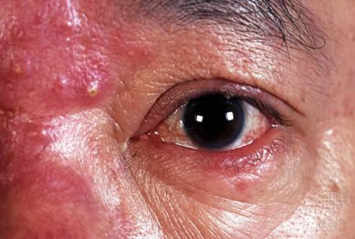
OCULAR ROSACEA
The pathogenesis of OR seems to be closely associated with
meibomian gland dysfunction. A consistent finding is a reduced tear break‐up time in patients with rosacea as a result of inadequate lipid components of the tear film.
Meibomian cysts (usually painless),representing chronic inflammation of the meibomian glands, may appear in crops.
It has been suggested that Demodex mite infestation may play a role in the initiation of inflammatory ocular changes that occur in these modified sebaceous glands of the eyelid.
This hypothesis is supported by the presence of mites in the collarettes and sleeves of keratin at the bases of the lashes, indicating a possible common aetiological link between cutaneous and ocular rosacea

Slide 11
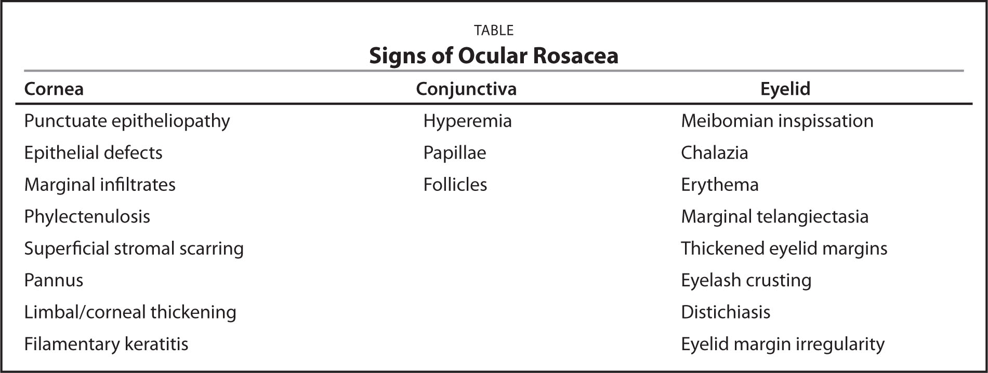

Slide 12
ORGANISMS POTENTIATING ROSACEA
A recent review of the microorganisms that might potentially induce rosacea has identified several possible candidates including
Staphylococcus epidermidis
Chlamydophila pneumoniae
Demodex‐associated bacterium Bacillus oleronius.

Slide 13

BACILLUS OLERONIUS
Bacillus oleronius, isolated from a mite retrieved from a patient with rosacea, triggered a proliferative response in peripheral blood mononuclear cells of 73% of patients with PPR but only 29% of controls , indicating a prior sensitization in PPR patients.
Reactivity was associated with reduced sebum secretion and a higher density of Demodex mites in facial skin .

Slide 14
Other Factors
Although up to 25% of patients with rosacea have a positive family history, no rosacea‐specific genes have yet been identified.
Increased environmental temperature and dietary factors (ingesting hot liquids, spicy foods, large meals, alcohol, etc.) are often cited as potentially exacerbating rosacea. These elements may cause a transient increase in facial erythema and exacerbate a flushing tendency (predominantly in ETTR), but there is no evidence that they worsen the inflammatory lesions of PPR or the phymatous or ocular changes of PR and OR, respectively.
In a UK retrospective database review, smokers were shown to be at a lower risk of developing rosacea than non‐smokers.

Slide 26
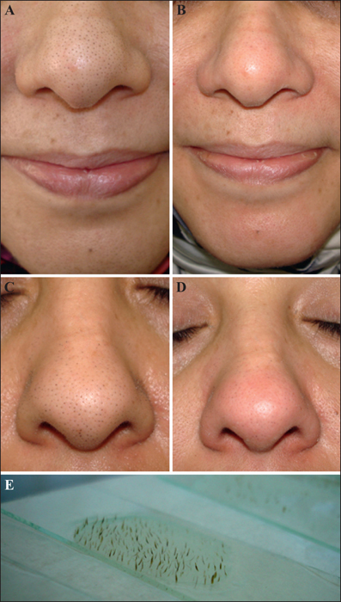
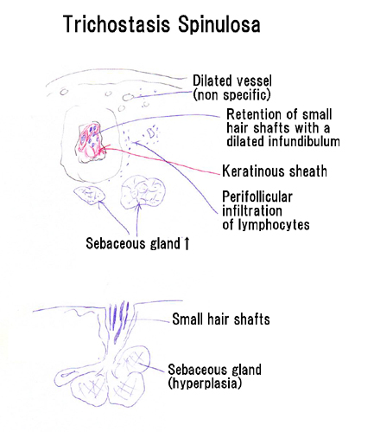
TRICHOSTASIS SPINULOSA

Slide 27
In trichostasis spinulosa (TS), clusters of vellus hairs become embedded within hair follicles, with resultant dark, spiny papules on the face or trunk. Trichostasis spinulosa frequently is discovered as an incidental finding, and often it is confused with keratosis pilaris or acne comedones.
Trichostasis spinulosa results from successive production and retention of vellus telogen club hairs from a single hair matrix in a follicle. Hyperkeratosis plugs the follicle and results in the retention of the vellus hairs in the obstructed follicular infundibulum. The precise cause of this phenomenon remains undetermined.

Slide 28
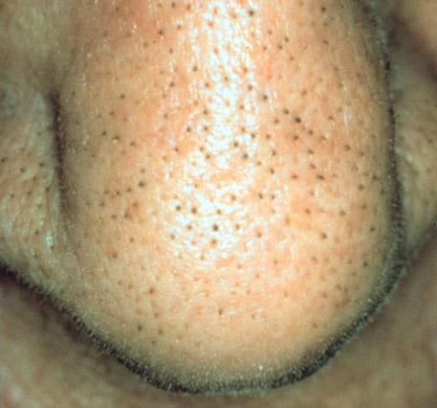
Pertinent physical findings of trichostasis spinulosa are limited to the skin. Because spinous plugs may be inapparent to the naked eye, examination of suspected lesions under a hand lens or with a dermatoscope is recommended.
Lesions typically appear as dark, follicular plugs or papules. The lesions may have protruding tufts or spines of fine hair that can easily be removed with a comedo extractor or small-toothed forceps without discomfort to the patient. The horny plugs are soft and contain 5-25 hairs per plug. Scales may sometimes be present. Note the image below.

Slide 29
Lesions may occur anywhere on the body, but they characteristically appear on the face, especially the nose, and the upper part of the trunk and arms, especially the interscapular area. Lesions less typically appear on other areas of the head, neck, and cheeks.
Lesions are characteristically less than or equal to 1 mm.
Lesions characteristically are black.

Slide 30
Various explanations for the hyperkeratosis and plugging of the follicular apparatus are proposed. Internal mechanisms, such as endocrine or metabolic disturbances, are suggested. Widespread trichostasis spinulosus has been reported with renal failure. External mechanisms include the use of irritating soaps or paraffin-containing creams and prolonged exposure to dust, hydrocarbons, or industrial oils. Trichostasis spinulosa has also been associated with prolonged use of clobetasol. [2]
Some consider trichostasis spinulosa to be a variant of the comedonal lesions of acne; they note the similar distribution of lesions and the rarity of trichostasis spinulosa among preadolescent patients.
Microorganisms are also suggested to have a causative role. Propionibacterium acnes and Pityrosporum species are implicated as possible organisms.

Slide 31
Treatment
Treatment for trichostasis spinulosa (TS) is usually administered for cosmetic purposes. The individual plugs of impacted hairs may be removed by means of the following:
Tweezing with forceps
Pressure expression with a comedone extractor
Use of depilatory wax, adhesive strips, or laser depilation
Laser treatment with a 755-nm long-pulsed alexandrite laser may also be considered.
Emollients and keratolytics may also be helpful. After the apparent lesions are removed, topical retinoic acids can be used to help prevent future lesions.

