Slide 1
POIKILODERMA SYNDROMES
Dr Zahra Nigar
RESIDENT DERMATOLOGY
CMH ABBOTTABAD

Slide 2
OUTLINE
Definition
Clinical Features
Types
Investigation
management

Slide 3
LEARNING OBJECTIVES
What is poikiloderma
Syndromes associated
Clinical Features
Investigation
Management

Slide 4
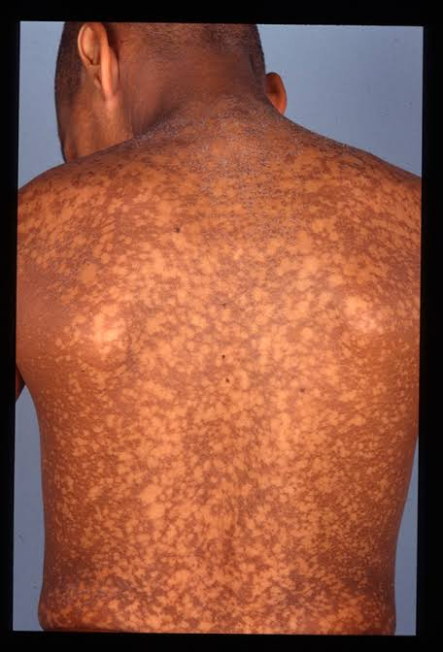
Definition
Poikiloderma is defined as :
The constellation of skin atrophy
hypo and hyper pigmentation
Telangiectasia

Slide 5
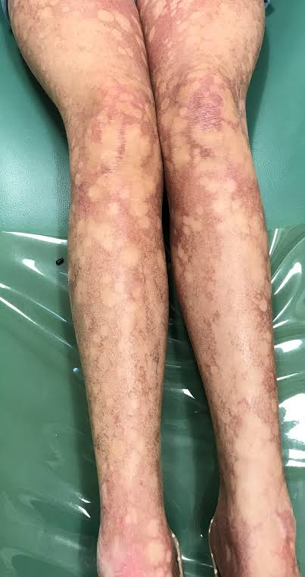

Slide 6
Syndromes with Poikiloderma
Dyskeratosis congenita
Rothmund-Thomson syndrome
Piokiloderma with neutropenia, Clericuzio Type
Hereditary fibrosing poikiloderma with tendon contractures,myopathy and pulmonary fibrosis
Acrokeratotic poikiloderma of Weary
Kindler Syndrome
Bloom Syndrome

Slide 7
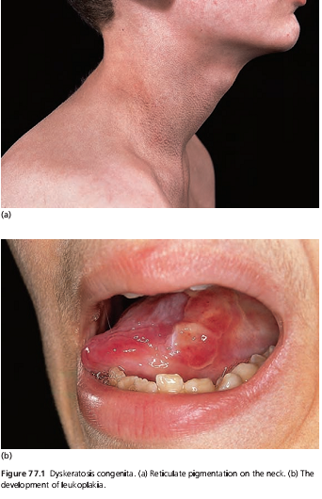
DYSKERATOSIS CONGENITA
Rare inherited disorder characterized by
Mucocutaneous triad of
  Reticulate pigmentation & atrophy of skin
  Nail dystrophy
  Leukoplakia
Bone marrow failure and predisposition to
malignancy

Slide 8
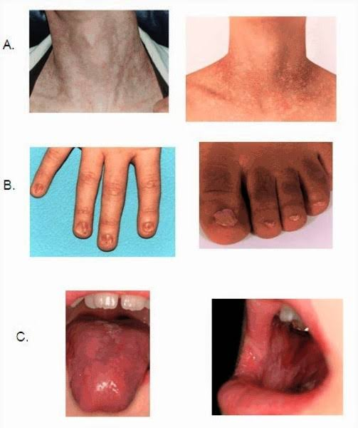

Slide 9
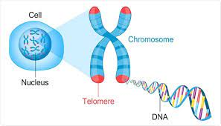
GENETICS
All forms of DKC arise from mutations in genes involved in maintaining telomere length during cell division
Telomeres are structures composed of tandem nucleotide repeats and protein complex at the ends of chromosomes that are required to maintain chromosomal integrity
Determined by an X-linked recessive gene, localized to Xq28

Slide 10
CLINICAL FEATURES
AGE:
Median age of diagnosis is 15 years
Nail changes:
  First to appear, between ages of 5 and 13 years, nails become dystrophic and shed.
  Recurrent episodes of suppurative paronychia

Slide 11
Pigmentary changes:
Fine reticulate, grey brown pigmentation
most conspicuous on neck and thighs.
The skin is atrophic and telangiectasia are numerous
HAIR:
Canities and cicatricial alopecia have occasionally been noted

Slide 12
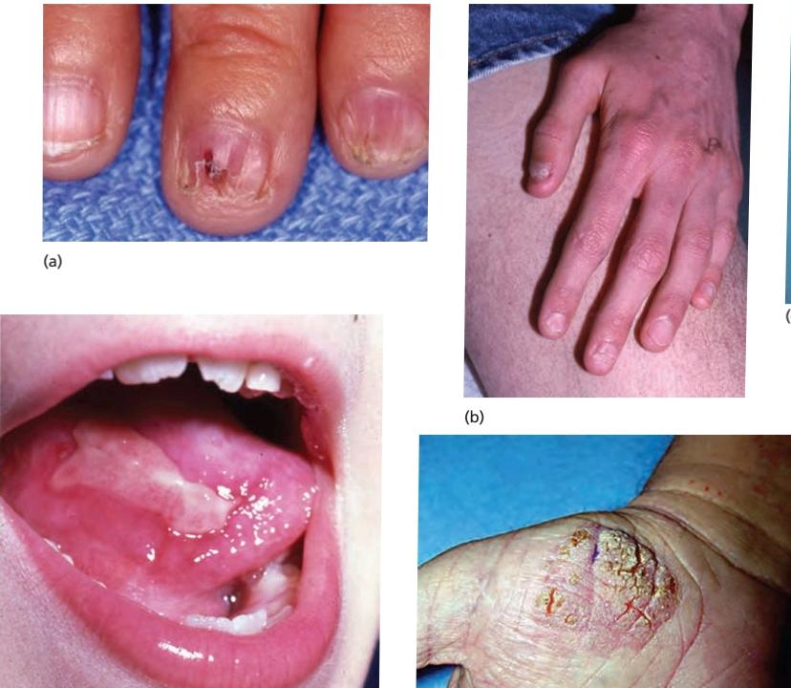
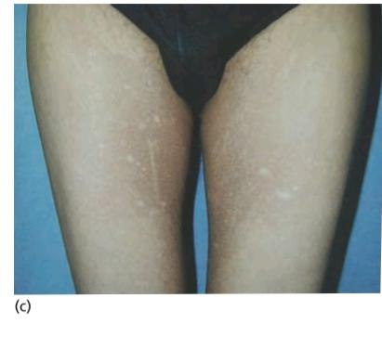

Slide 13
TEETH:
Tend to be defective and irregularly implanted
Periodontalbdisease and early carries
Mucous membranes:
Small erosions and blisters of lingual and buccal mucous membranes are succeeded by irregular patches of leukoplakia
Similar changes on the tarsal conjunctiva may obiliterate lacrimal puncta
GIT and urogenital mucous membranes
anorectal,oesophageal or uretheral leukoplakia produces stenosis

Slide 14
DEVELOPMENTAL DELAY:
Growth and psychomotor development may be delayed
Osteoporosis can occur
Immunodeficiency ,IUGR, microcephaly
Cerebellar hypoplasia and intracranial calcifications have been reported

Slide 15
Hoyeraal-Hreidarsson syndrome:
severe form of DKC
With DKC1 ,TERT, TINF2, or RTEL1 gene mutation
Revesz syndrome:
variant of DKC
Nail dystrophy
Fine hair
Cerebellar hypoplasia
Exudative retinopathy
Growth retardation
Bone marrow hypoplasia

Slide 16
HAEMATOLOGICAL ABNORMALITIES
Bone marrow failure in DKC is high (93% pts in 1 series)
Pancytopenia was the cause of death
Myelodysplasia and AML have been reported

Slide 17
MALIGNANCY
Carcinoma in areas of leukoplakia is high
Fatal between of 30 and 50 years
Other neoplasms:
Pancreatic carcinoma and Hodgkin disease

Slide 18
PROGNOSIS
Poor as a result of blood dyscrasia or carcinoma
Individulas with TINF2 mutations and with X-linked DKC1 mutations tend to have more severe and early onset disease

Slide 19
INVESTIGATIONS AND DIAGNOSIS
Personal and family history
Complete blood count-bianuallyy
Bone marrow biopsy-annually
Ultrasound Abdomen
Pulmonary Function tests-annually
Skin cancer screening
Bone density assessment
Telomere length assay-flow cytometry,FISH
Molecular analysis

Slide 20
MANAGEMENT
Aplastic anemia:
Treated with anabolic steroids oxymethalone
Allogenic bone marrow transplantation in bonemarrow failure
GCSF improve haematological parameters in short term
Retinoids
Cause regression of lesions in leukoplakia and reduce the incidence of malignancy

Slide 21
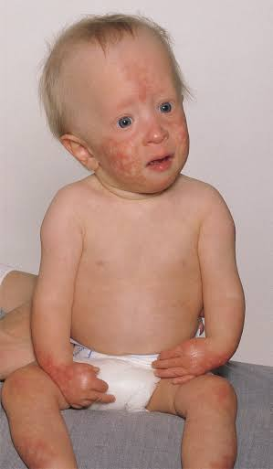
ROTHMUND-THOMSON SYNDROME
Rare autosomal recessive disorder
Early onset poikiloderma
Skeletal abnormalities
short stature
premature aging
Increased susceptibility to malignancy

Slide 22
Patients are small stature
Slender delicate limbs
Small hands and feet and short fingers
Bird like features with saddle nose
Hypogonadisim
Hyperparathyroidism
Individuals with RTS have normal intelligence

Slide 23
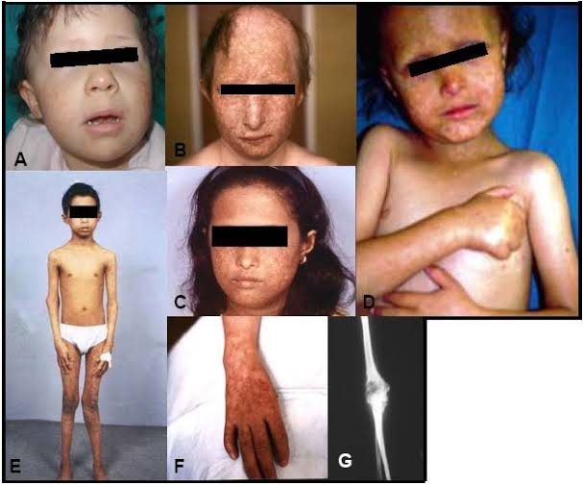

Slide 24
GENETICS
Mutations in DNA Helicase gene
RECQL4 on chromosome 8
The RECQL4 is essential for
  initiation of DNA replication
  necessary for efficient removal of UV- induced DNA damage.
Reduced DNA repair capacity and increased sensitivity to UVC

Slide 25
Classification
classified on the presence or absence of RECQL4 mutation
RTS TYPE 1:
  Poikiloderma
  juvenile cataracts
  No gene defect
RTS TYPE 2:
  poikiloderma
  increased risk of osteosarcomas
  RECQL4 mutation

Slide 26
RECQL4 mutations in other disorders with clinical overlap with RTS
BALLER GEROLD SYNDROMES:
crainosynostosis, radial defects and poikiloderma
RAPADILINO SYNDROME:
growth retardation, bony abnormalities and increased risk of malignancy but not poikiloderma

Slide 27
CLINICAL FEATURES
CUTANEOUS MANIFESTATION:
Skin appear normal at birth
Lesions develop between 3rd and 6th month, sometimes as late as second year
Diffuse erythema succeeded by combination of atrophy, telangiectasia, pigmentation and depigmentation
The cheeks are first and most severely involved
Light sensitivity

Slide 28
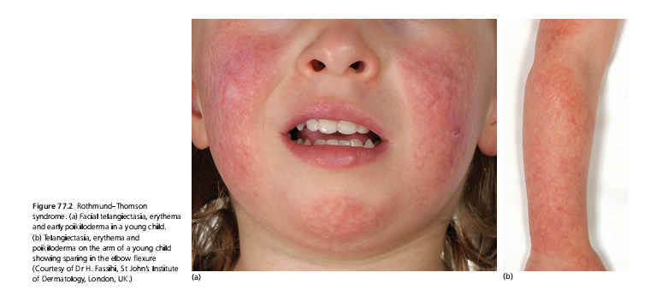

Slide 29
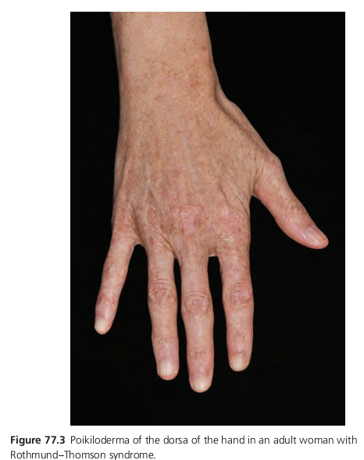

Slide 30
KERATOSIS:
develop on exposed skin
squamous cell or basal cell carcinoma may develop in keratosis
HAIR:
scalp hair, eyelashes, eyebrows, pubic and axillary hair are sparse or absent
EYE:
bilateral cataracts by 4th and 7th year in 10-40 % 0f cases

Slide 31
SKELETAL ABNORMALITIES:
Radial ray defect, may present as “thumb hypoplasia”
with abnormal radial head
Or complete absence of radius
Osteosarcoma in 32% of cases
radial defect in 20% of cases

Slide 32
MANAGEMENT
Photo protection
Careful supervision for the detection of malignancy
Retinoid for cutaneous changes
Telangiectasia can be treated with vascular pulsed dye laser

Slide 33
PROGNOSIS
Normal life expectancy if no malignancy

Slide 34
POIKILODERMA WITH NEUTROPENIA
CLERICUZIO TYPE
Autosomal recessive
Erythematous rash
Evolving into poikiloderma & paraonychia
Associated with :
Neutropenia
Respiratory infections
Susceptibility to develop myelodysplasia and leukemia

Slide 35
CUTANEOUS MANIFESTATIONS:
Starts in the first 6th month of life
Erythematous
eczematous & ichthyosiform changes on limbs
Spreading more centrally & being replaced by poikiloderma
Photosensitivity
Early onset paronychia
Palmo-plantar keratoderma

Slide 36
ACROKERATOTIC POIKILODERMA OF WEARY
Autosomal dominant
The main clinical features are
  Generalized poikiloderma with accentuation in flexures
  Sparing of face,scalp and ears
  Linear hyper keratosis
  Sclerosis of flexures
  Tissue calcinosis
  Raynaud’s Phenomena
  Cardiac abnormalities

Slide 37
Sclerosis of palms and soles
linear hyperkeratosis
And sclerosing of the flexures.
Finger clubbing
Tissue calcinosis
Raynaud phenomenon
Cardiac abnormalities

Slide 38
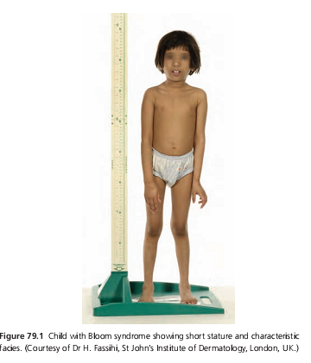
BLOOM SYNDROME
Autosomal recessive
Gene RECQL3 Lies on chromosome 15q26
Telangiectatic facial erythema
Short stature
Abnormal immune response
Predisposition to malignancy
  AML
  Internal malignancy
  Cutaneous malignancy

Slide 39
Clinical features
Telangiectatic erythema
Red macule or plaques most numerous on ‘butterfly’ area
Scaling after exaerbation after sun exposure
Narrow ,slender delicate facies
Relatively prominent Nose
Long limbs with large hand & feet
Reduced subcutaneous fat
Birth weight is low

Slide 40
Contt…
Testicular atrophy is common
T-cell & B-cell immunodeficiencies may occur
No impairments of neurological development
Increased incidence of type || Diabetes

Slide 41
Management
Early diagnosis is important
Genetic testing for RECQL3 mutations
Awareness of the possible malignancies
Photoprotection
Regular screening for diabetes & malignancies
Treatment for diabetes
Prenatal testing

Slide 42
Bloom syndrome
Rothmund-Thomson syndrome
Genetics : RECQL4
Short stature ,short limbs & short fingers
Saddle nose with poikilodermatous changes predominantly over the cheeks “bird like”
Cataracts
Less risk of malignancy
Thumb hypoplasia
Associated with osteosarcoma
Prognosis –normal if no malignancy
RECQL3
Long limbs with large hand & feet
Prominent nose, small jaw and predominantly telengictatic rash in malar distrubtion “butterfly rash”
No cataracts
Increase risk of malignancy
Syndactly
Associated with type || diabetes
Death in early childhood because of malignancy

Slide 43
Thank you ☺

