Slide 1
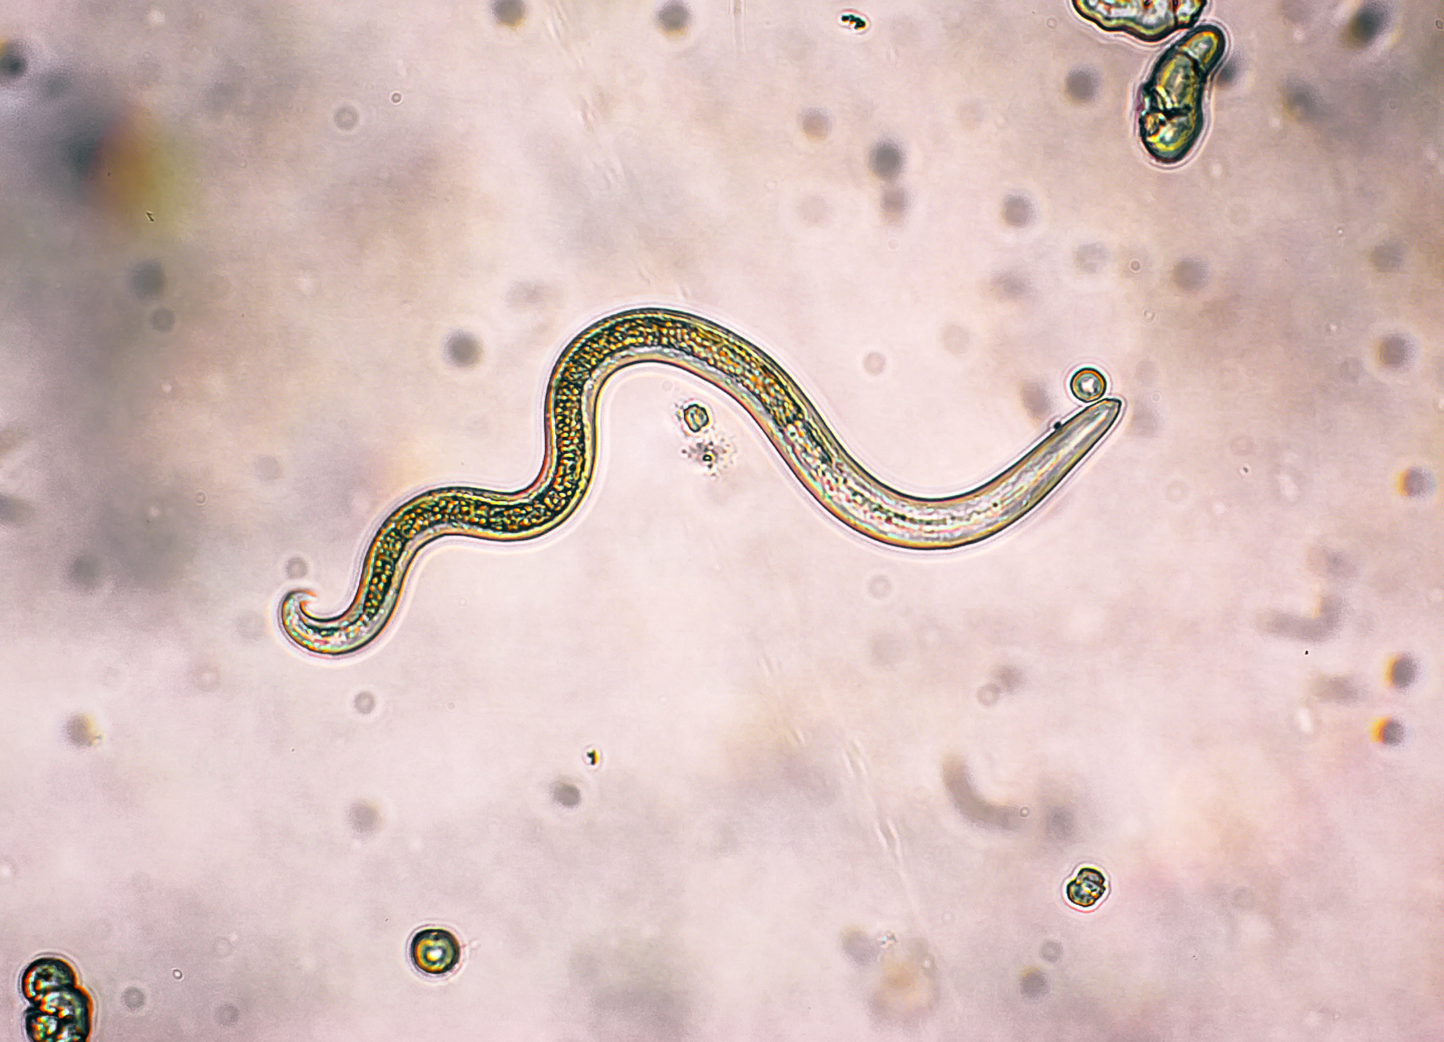
Parasitic Diseases

Slide 2
Introduction
A parasite is an organism that lives on or in a host organism and gets its food from or at the expense of its host.

Slide 3
Classes of Parasites
There are three main classes of parasites that can cause disease in humans:
helminths
protozoa
ectoparasites.

Slide 4
Helminths
Helminths are parasitic worms that can infect humans and other animals.
There are three types of helminths:
roundworms (nematodes)
flukes (trematodes)
tapeworms (cestodes)
Notes:
Today we will discuss nematodes and trematodes

Slide 5
Content of today
Infection with human nematodes
Onchocerciasis,
Streptocerciasis,
Lymphatic filariasis,
Loiasis,
Dracunculiasis,
Enterobiasis,
Ancylostomiasis,
Strongyloidiasis,
Infection with nematodes of other animals,
Cutaneous larva migrans,
Visceral larva migrans,
Gnathostomiasis,
Dirofilariasis,
Trichinosis,

Slide 6
Onchocerciasis
Onchoceriasis, also known as ‘river blindness’ is caused by the filarial nematode, Onchocerca volvulus.
The blackfly vector breeds near fast‐flowing rivers and streams.
The disease is second in the world to trachoma as an infectious aetiology of blindness
Synonyms and inclusions
River blindness
Onchocerca volvulus
Blinding filariasis
Robles disease

Slide 7
Pathophysiology
Mature worms and microfilariae are found in granulomatous dermal nodules (onchocercal nodules),
Mostly on scalp of their hosts
but can be near bony prominences on trunk and limbs or in the natal cleft.
The nodules measure 3–35 mm in diameter
Microfilariae migrate mainly in the dermis
perivascular reaction with mononuclear cells and eosinophils, . At its severest, this is accompanied by marked acanthosis and hyperkeratosis

Slide 8
Clinical feature
1. Acute papular onchodermatitis | Widespread itchy eczema with multiple small itchy papules become vesicles and pustules. The face, trunk, and extremities are often affected.
2. Chronic papular onchodermatitis | Severely itchy rash with scattered flat-topped papules and areas of hyperpigmentation. The shoulders, buttocks, and extremities are typically affected. The most common pattern of skin disease.
3. Lichenified onchodermatitis | Thickened scaly and hyperpigmented itchy plaques. The lower extremities are commonly affected, and lymph nodes are often enlarged.

Slide 9
Clinical feature and classification
4. Onchocercal atrophy | Large areas of wrinkled thin, dry inelastic skin. Commonly affects buttocks and lower back.
5. Onchocercal depigmentation | Also called “leopard skin”. Areas of pigment loss (leukoderma), with islands of normally pigmented skin surrounding hair follicles. Often affects the shins in a symmetrical pattern and is not usually itchy.
6. Palpable onchocercal nodules (oncocercoma) | Subcutaneous lumps found over bony prominences contain the adult worms. The subcutaneous nodules range in size from a few millimetres to several centimetres, and each contains 2 to 4 adult worms that can reach a length of 80 cm.

Slide 10
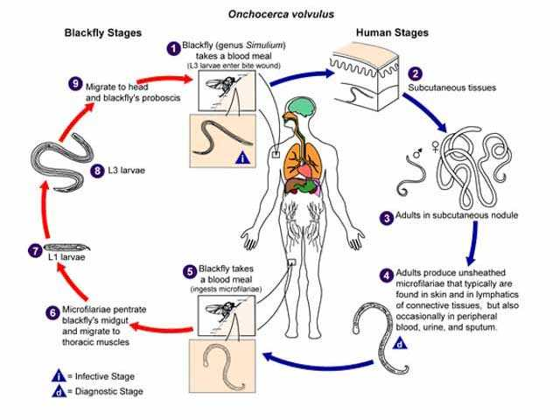

Slide 11
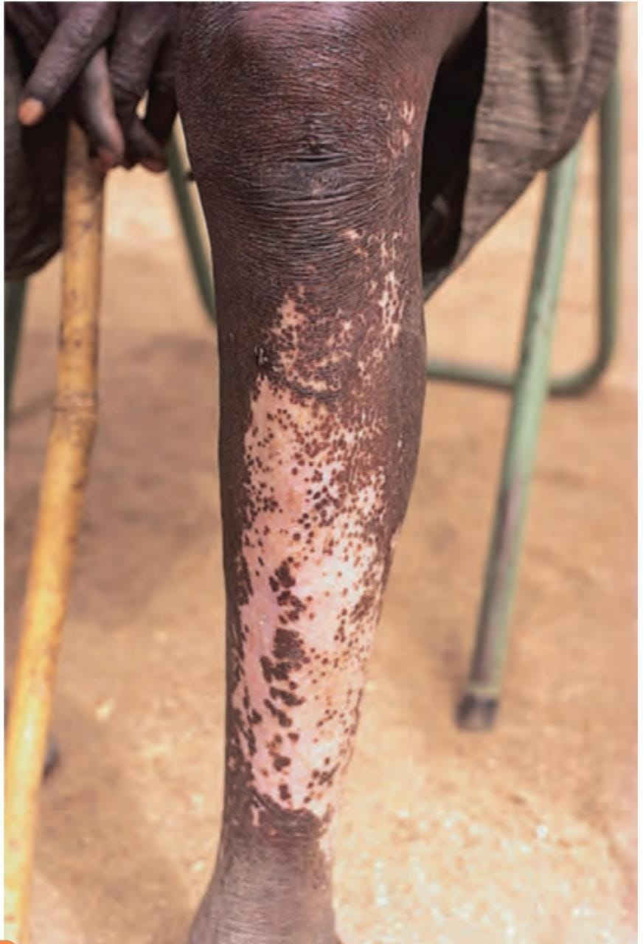
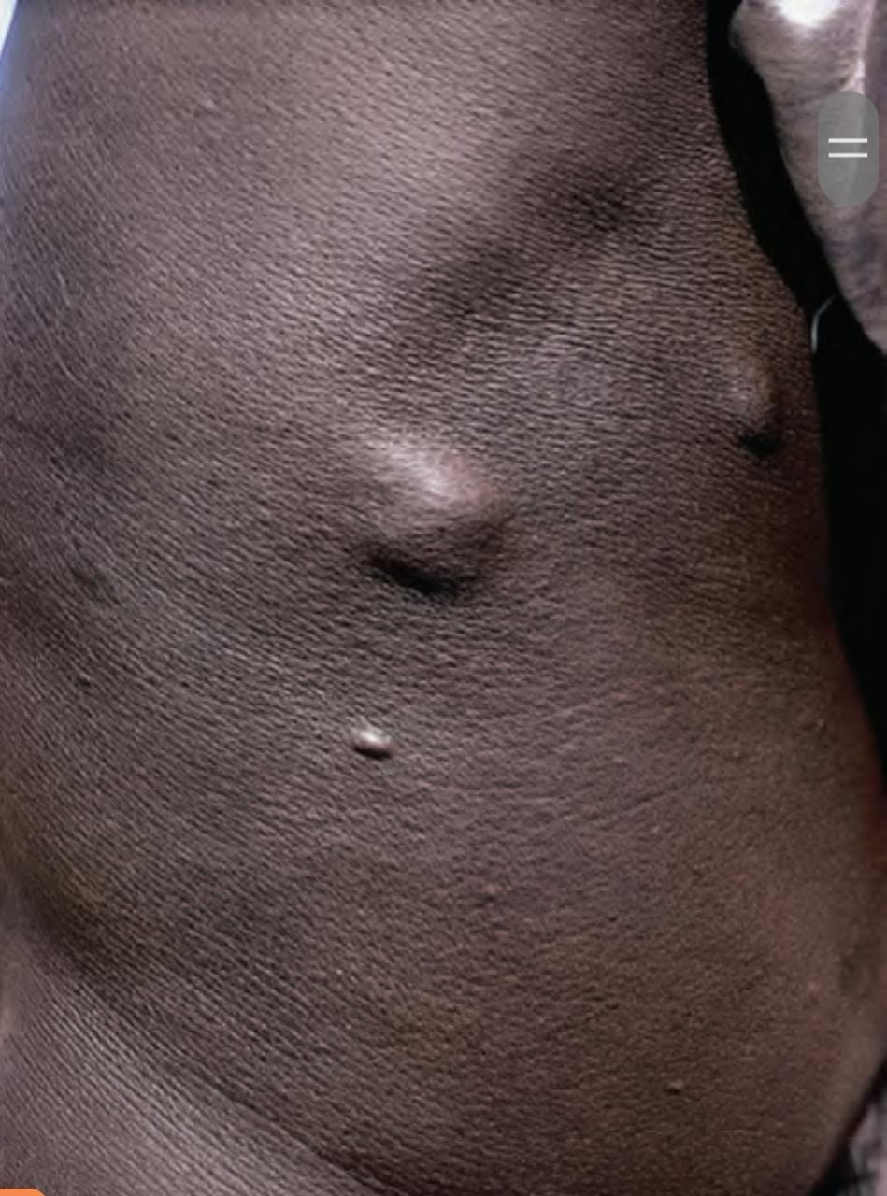
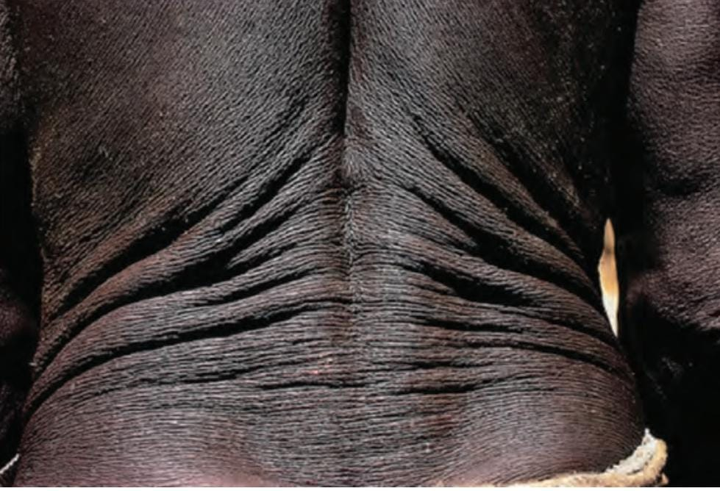
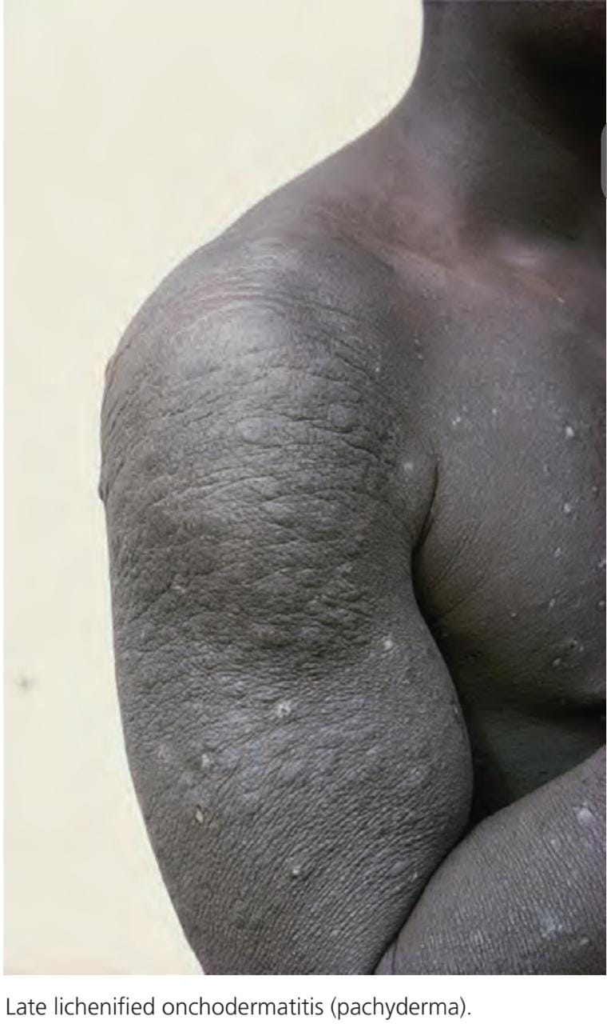
Notes:
Ist leopard skin 2nd nodule 3rd lizard like skin 4th lichenification

Slide 12
Eye symptoms
. Early symptoms include
Inflammation and bleeding
itching,
redness,
pain,
photophobia.
Delayed
chronic keratitis
sclerositis
Blurring of vision,
night blindness,
glaucoma,
visual field loss,
eventually blindness

Slide 13
Diagnosis
Nodular biopsy
Identifying microfilariae in six skin snips dropped into normal saline and examined microscopically
polymerase chain reaction (PCR)
enzyme‐linked immunosorbent assay (ELISA) is positive in 60–90% of cases.
Detection of antibodies against O. volvulus in blood samples

Slide 14
Managment
First line
•Doxycycline, 100 mg every day PO × 6 weeks,
Second line
•Ivermectin 100–200 μg/kg, retried every 6–12 months until asymptomatic
Third line
• Suramin, nodulectomy

Slide 15
Streptocerciasis
Streptocerciasis is an infection caused by the filarial nematode, Mansonella streptocerca.
The disease causes a subcutaneous filariasis, with Loa loa
Onchocerca volvulus being the other two causes in humans nematode,

Slide 16
Cont…
Pathophysiology
Adult worms reside in the dermis of the upper trunk and shoulder region
microfilariae are found in the skin
Clinical presentation
Mostly asymptomatic
Pruritus
Rash
Lichenoid papules
Hypo pigmented macules
Sec enlargement of lymph nodes

Slide 17
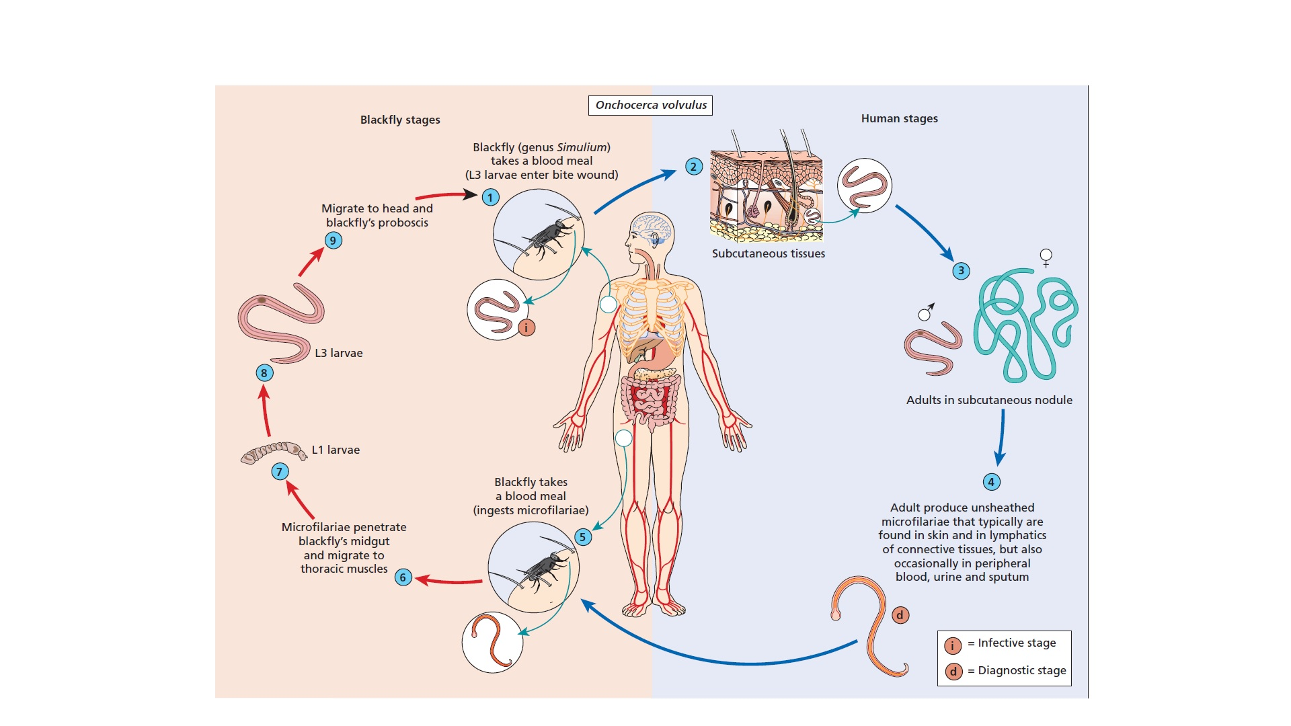
Notes:
Life cycle

Slide 18
Cont..
Investigation
skin biopsy(skin snip may have microflariae)
microfilarial tip may curl in a typical ‘shepherd’s crook’ appearance.
Management
First line
  • Diethylcarbamazine 6 mg/kg/day for 12 days
Second line
  • Ivermectin (150 μg/kg single dose

Slide 19
Lymphatic flariasis
causative organism
Wuchereria bancrofti, (common)
Brugia malayi
Brugia timori,
Synonyms and inclusions
• Tropical elephantiasis
Epidemiology
The areas with the highest incidence of infection are South‐East Asia and sub‐Saharan Africa

Slide 20
Pathophysiology
presence of adult worms in the lymphatics
lymphatic obstruction.
Leakage of lymph causes to tissue damage.
their entrapment in the lungs may cause tropical pulmonary eosinophilia
Transmission
by anthropophilic mosquitoes of the genera
Culex,
Aedes,
Mansonia
Anopheles

Slide 21
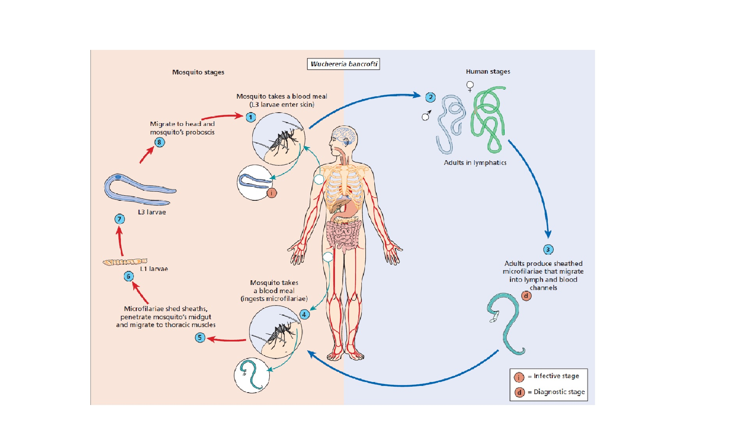
Notes:
Life cycle

Slide 22
Clinical features
The first signs are often
  swelling,
  Tenderness
  erythema on the arms, legs or scrotum.
  fixed nodules and urticaria
  Cellulitis,
  In the severest form, it presents with fever and sweats
  Painful enlargement of lymph nodes, particularly the inguinal
  Complications
  orchitis,
  hydrocele
  scrotal oedema
  recurrent epididymitis

Slide 24
Cont…
Investigations
  Skin biopsy
  Microscopy
  PCR
  ELISA

Slide 25
  Treatment ladder
  First line
  •Diethylcarbamazine 200 mg PO every 12 h × 12 days, repeat 10 days later. Note: contraindicated in patients co‐infected with onchocerciasis. In patients with both diseases, a severe inflammatory response can occur
  Second line
  • Ivermectin 0.15–0.2 mg/kg PO × 1 dose (treatment of choice for patients with concurrent onchocerciasis)

Slide 26
LOASIS
Causative organism
filarial nematode Loa loa,
Transmission
bite of a Chrysops fly.
Synonyms and inclusions
• Calabar swellings
• Fugitive swellings
• Loa loa filariasis
• African eye worm

Slide 27
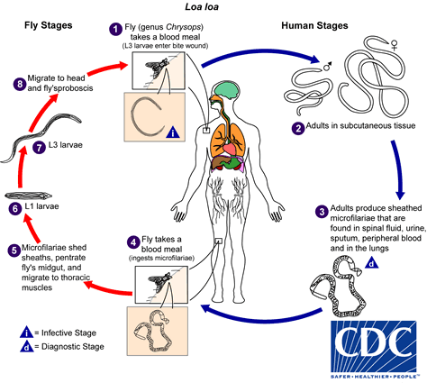
Pathophysiology
Notes:
Life cycle

Slide 28
Areas involved
Symptoms
Effects connective tissue
  Fingers
  Trunk
  Scalp
  Ligual frenulum
  Penile skin
  Eyelids
  Conjunctive
  Anterior chamber of eye
Prickinng
Itching
Creeping sensation
May b symptomless
Calabar swelling
Notes:
Calabar .. Reaction to the metabolites of dead worms mostly involes heands and arms

Slide 29
Pictures
conjunctiva
calabar

Slide 30
Complications
  Calcification of worms
  Enchaphalitis
  Meningitis
  Glomarulonephritis
  Treatment ladder
  First line
  • Diethylcarbamazine 9 mg/kg/day orally in three doses for 21 days
  Second line
  • Albendazole 200 mg twice daily PO × 21 days
  Third line
  • Ivermectin 200 μg/kg PO × 2 days

Slide 31
Dracunculiasis
Introduction
chronic infection of humans
  nematode, Dracunculus medinensis
  longest nematodes infecting humans
  Mature female worms migrate along subcutaneous tissue, forming a painful ulcerating blister.
  Synonyms and inclusions
  • Dracontiasis
  • Guinea worm
  • Medina worm
  • Dragon worm

Slide 32
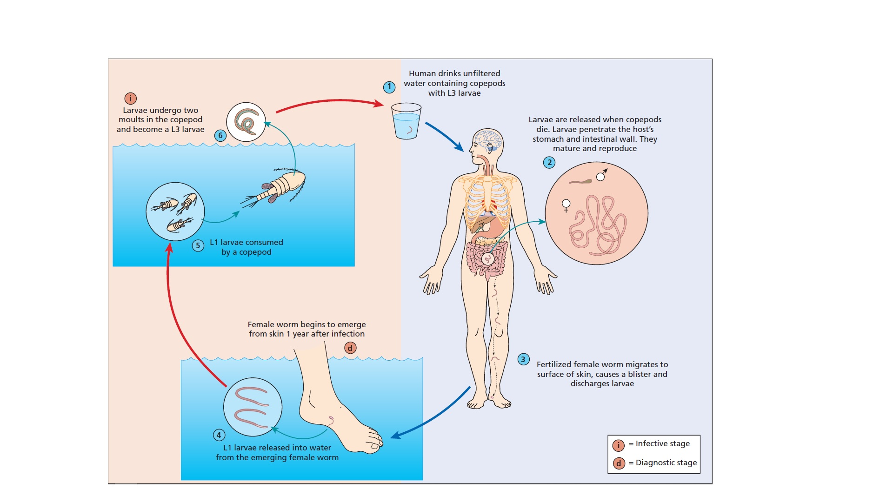
Notes:
Life cycle

Slide 34
Clinical features
Generalized symptoms
fever
pruritis
urticaria
dyspnea
diarrehea
Skin manifestations
small papules
vesicles
burst over 4 to 5 days to forms ulcers
localized itching followed by emergence of female worms

Slide 35
Investigations
Microscopy
Radiography
Eosinophilia on CBC
Management
TT injection
Oral metronidazole
local antiseptics
Manual removal of the worm

Slide 36
Enterobiasis (Pinworm)
most common parasitic infection in the world
Causative agent
roundworm Enterobius vermicularis.
Usually a childhood disease.
it can range from asymptomatic to causing severe anal and perianal itching.
Synonyms and inclusions
• Pinworm
• Threadworm
• Seatworm
• Oxyuriasis
Notes:
t is prevalent in both temperate and tropical climates, and is associated with crowding and poverty
5 to 10 years of age

Slide 37
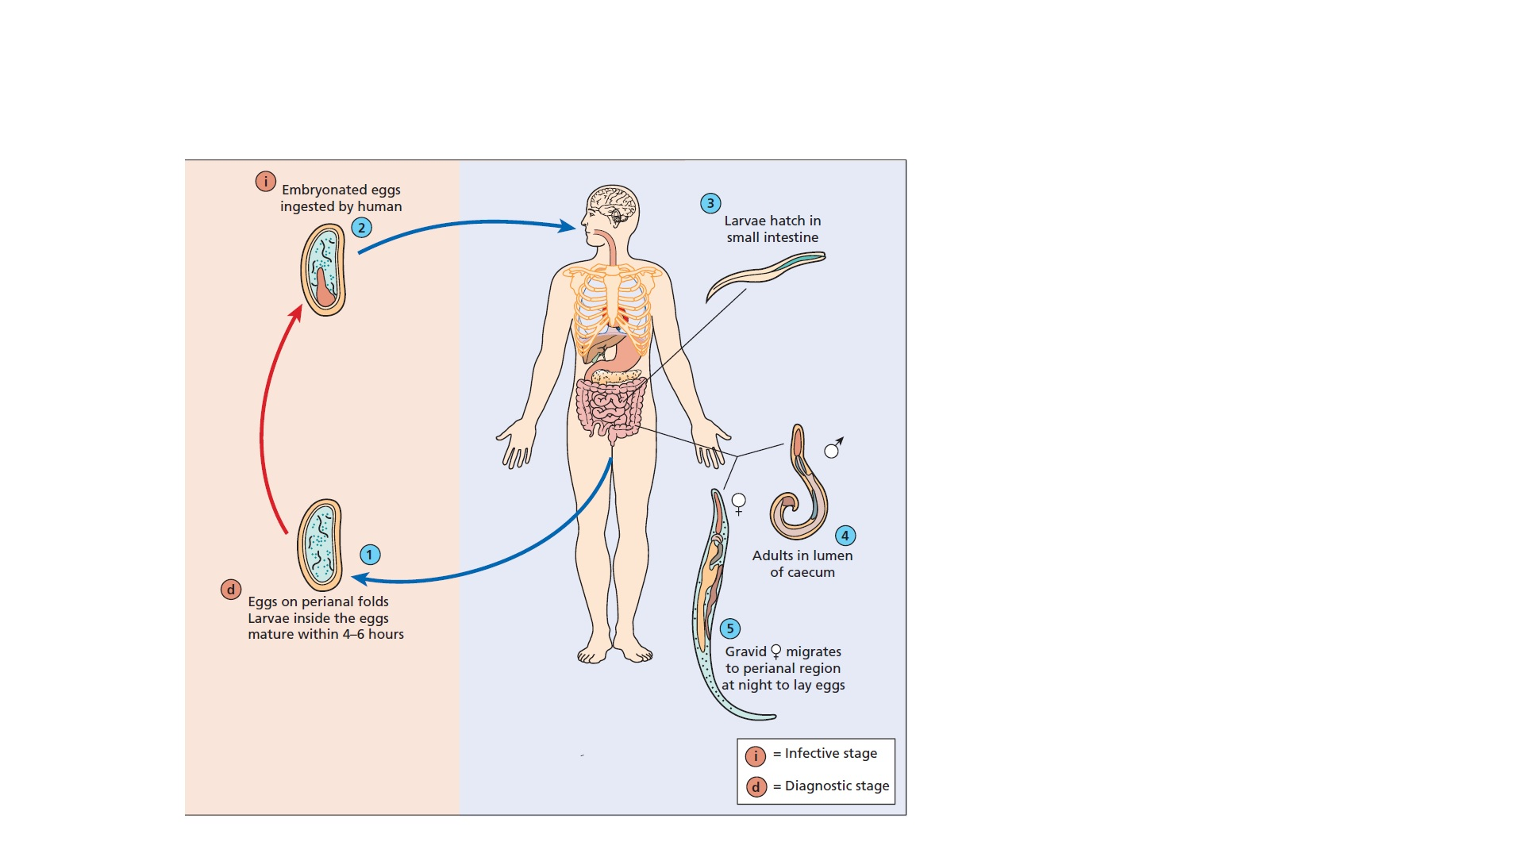
Notes:
Life cycle

Slide 38
Clinical features
  Anal and perianal pruritis
  Sleeplessness
  Iritibility
  Perianal intertrigo
  Naucturia
  Infected excoriation
  Localised urticarial
  Vulval irritation
  Mucoid discharge
  Peritonitis

Slide 39
    Diagonsis
    seeing the 10‐mm long female worms on the perineum at night, on toilet paper or in the stools
    adhesive cellulose tape test
    Treatment ladder
    First line
    • Albendazole, 400 mg orally for 1 day, then repeat dose in 2 weeks
    • Mebendazole 100 mg orally for 1 day, then repeat dose in 2 weeks Second line
    • Pyrantel pamoate: dose varies per weight (11 mg/kg; maximum 1 g); one time, then repeat dose in 2 weeks
    Third line
    • Ivermectin 0.2 mg/kg twice a day for 10 days

Slide 40
Ancylostomiasis
‘Ground itch’, ‘dew itch’ and ‘uncinarial dermatitis’
variable and transient eruption due to skin penetration by larvae of the hookworms
Synonyms and inclusions
• Hookworm disease
• Tunnel disease
• Miner’s anemia
• Ground itch
• Dew itch
• Uncinarial dermatitis

Slide 41
Causative organisms
• Ancylostoma duodenale.
• Necator americanus.
• Strongyloides stercoralis (roundworm).
Notes:
N. americanus 0.03 mL of blood
per worm per day and A. duodenale 0.2 mL

Slide 42
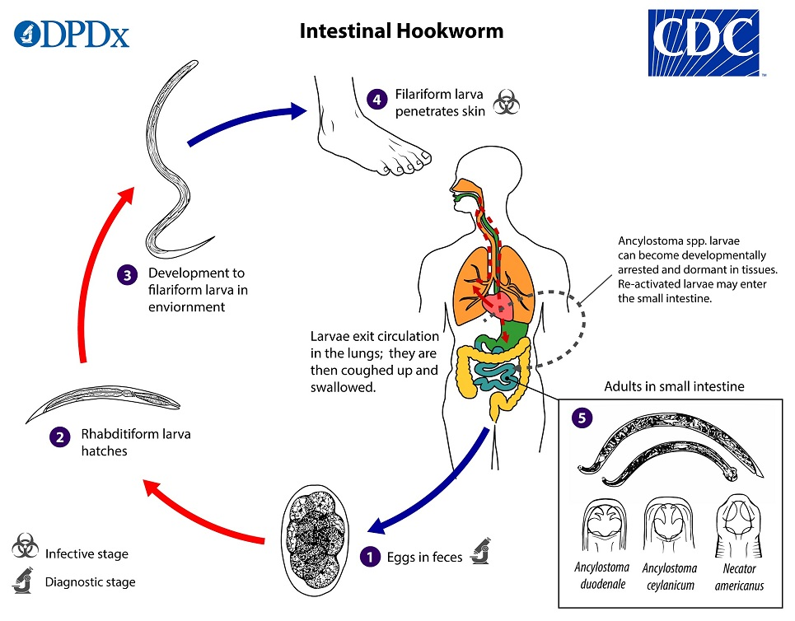

Slide 43
Clinical Features
Itch
severe pruritus
erythema and often a papular or papulovesicular rash
Urticaria
Larva passing through lungs
cough
wheeze
dyspnea
Adultworms in the gut
  abdominal pain
  diarrhoea
  melaena
Notes:
Iron def anemia . Pallor oedema

Slide 44
Clinical variants
• Loeffler syndrome
Investigation
clinical
radiological
Treatment ladder
• Albendazole (400 mg PO × 1) [8]
• Mebendazole 100 mg twice daily × 3 days
• Pyrantel pamoate (11 mg/kg/day for 3 days)
Notes:
Ivermectin has poor efficacy against hookworm.
Oral iron is given for iron deficiency.

Slide 45
Strongyloidiasis
infection of the gastrointestinal tract
Parasitic round worm Strongyloides Sterconalis
Synonyms and inclusions
• Strongyloidal ground itch
• Larva currens

Slide 46
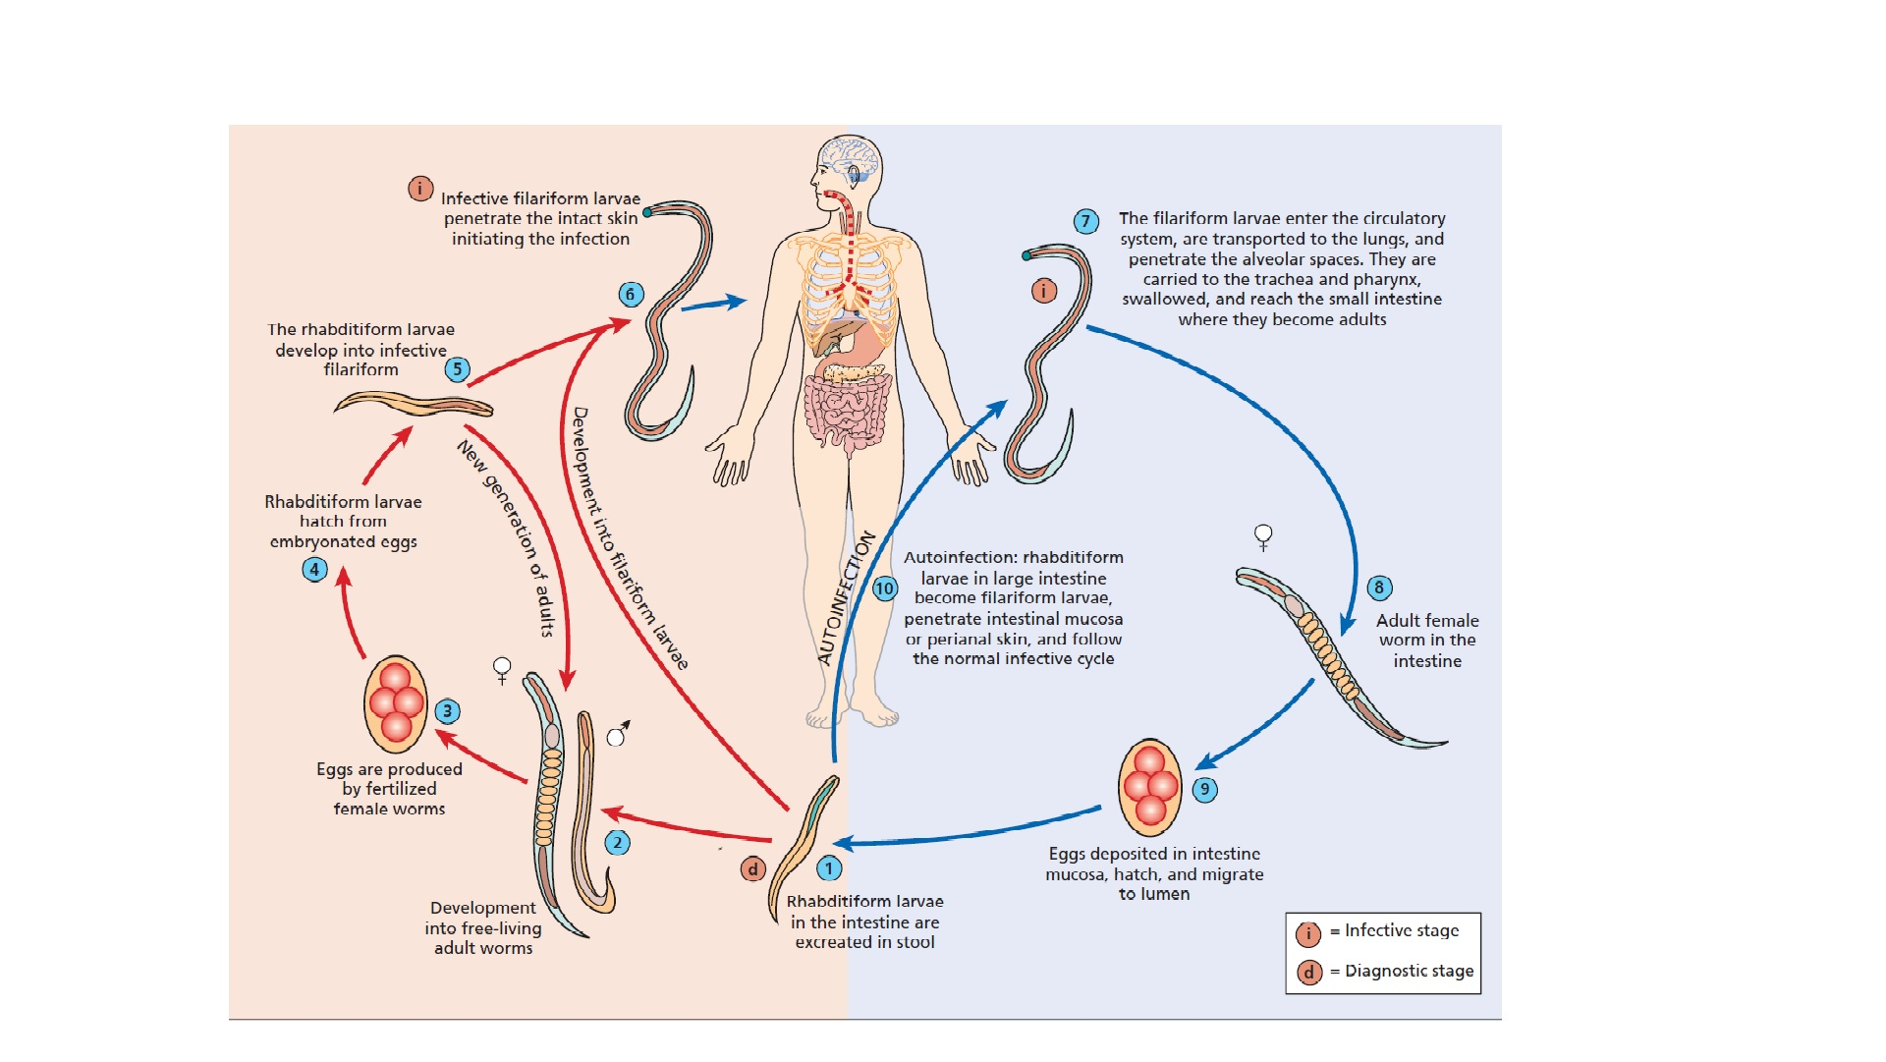

Slide 47
Clinical features
  Pruritus
  Abdominal pain
  Weight loss
  Urticarial weal and flare of migrating subcutaneous larvae
Notes:
Tracks seen between nipples and knees
May b linear or serpiginous

Slide 48
Complications
Heavy infection causes severe
  diarrhoea, with fluid and electrolyte loss
  Fever, abdominal distension, cough, dyspnoea, mental changes and unconsciousness may develop Shock
  Cough, dyspnoea and chest signs suggest pneumonia
Notes:
This severe syndrome may
occur in patients who are immunosuppressed by corticosteroid
drugs, lymphoma, leukaemia, infection with HIV

Slide 49
Investigation
  Stool examination
  Strongyloides antibody tests
  Examine samples of Jejunal juice (string test)\
  Hyperinfection
    Eosinophilia +
    Malabsorption +

Slide 50
Management
Ivermectin in a single oral dose of 200 μg/kg body weight, to be repeated on day 2 or day 14, is the treatment of choice .
Albendazole is also effective in a dose of 400 mg/day for 3–7 days, is free of toxicity.
For cases of hyperinfection, ivermectin is given
daily until symptoms resolve.
Notes:
Fecal sample for larvae after 3 and 6 months

Slide 51
Cutaneous larva migrans
distinctive cutaneous eruption that has numerous causes
the lesions creep or migrate
due to the presence of moving parasites in the skin
Synonyms and inclusions
• Creeping eruption
• Sand worm eruption
• Plumber’s itch
• Duckhunter’s itch

Slide 52
Causative organisms [1]
• Ancylostoma brasiliense.
• Ancylostoma caninum.
• Ancylostoma ceylonicum.
• Unicararia stenocephala.
• Bubostumum phlebotomum.
Environmental factors
Sandy, warm, moist, shaded areas
Notes:
Children in sandpits .. Plumbers … farm workers …. Gardenren seabather

Slide 53
Clinical features
pruritic erythematous papules
Wandering thread like line (3mm wide )
exceedingly itchy, slightly raised,flesh‐coloured or pink, and forms bizarre, serpentine patterns.
The disease is self‐limiting.
Differential diagnosis
larva currens (‘running larva’) of strongyloidiasis.
Notes:
They can
then lie quiet for weeks or months, or immediately begin creeping
activity with the production of a wandering thread‐like
line about 3 mm wide. This is exceedingly itchy, slightly raised,
flesh‐coloured or pink, and forms bizarre, serpentine patterns.

Slide 55
Diagnosis
classic clinical picture is easily recognized
may be atypical, hidden by vesicles and scaling, or spoiled by scratching and secondary infection
Biopsy
Treatment ladder
First line
• Ivermectin 200 μg/kg orally once daily for 1 or 2 days
Second line
• Albendazole 400 mg orally for 3 days

Slide 56
Visceral larva migrans
non‐human and human helminths may be found migrating in human organs at some stage of their life cycle
Synonyms and inclusions
• Toxocariasis

Slide 57
Pathophysiology
  the second‐stage larvae migrate from the intestine to most parts of the body
Causative organisms
  • Toxocara canis.
  • Toxocara cati.
  • Toxocara malayensis
  the common roundworms of dogs, cats and wild carnivores
Notes:
liver, lungs,
muscles and brain where they eventually die in eosinophilic
granulomas.

Slide 58
Clinical features
Persistent eosinophilia
cough and dyspnoea,
      failure to gain weight, muscle pains and
      fever
SKIN MANIFESTATIONS
Generalized pruritus
urticarial or papular eruptions
Migrating panniculitis
Notes:
SELF LImiting

Slide 59
Complications
the infection can present as ocular toxocariasis.
larva causes an ocular granuloma simulating neoplasm

Slide 60
Investigation
  biopsy of the liver
  Fluorescent antibodies
  ELISA
Treatment ladder
First line
• Albendazole 800 mg PO twice daily × 2 weeks
• With prednisolone if clinically warranted
Second line
• Mebendazole 200 mg PO twice daily ×5 days
Third line
• Diethylcarbamazine 4 mg/kg/day × 21 days

