Slide 1
SKIN AND DISORDERS OF MUSCULOSKELETAL SYSTEM
DR.MUHAMMAD UMAIR

Slide 2
REACTIVE ARTHRITIS
INFECTIVE ARTHROPATHIES
Palmoplantar pustulosis and psoriasiform hyperkeratosis keratoderma blennorhagicum develop in around 15% of men with the syndrome.
Mouth erosions, geographic tongue and circinate balanitis are common features

Slide 3
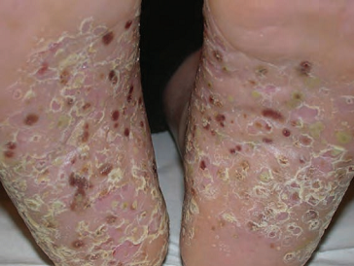
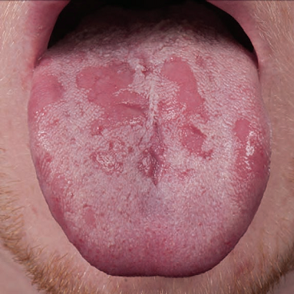
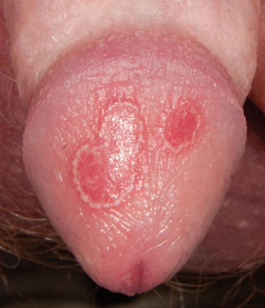

Slide 4
VIRAL ARTHROPATHIES
Rubella and parvovirus B19 are the most commonly implicated viruses in self‐limiting arthritis
Rubella , a maculopapular rash spreads cephalocaudally, followed or preceded by occipital lymphadenopathy and arthralgia in up to 50%
Parvovirus B19 is associated with erythema infectiosum (fifth disease), characterized by
  ‘slapped cheek’ erythema on the face
  and a reticulate erythema of the trunk and limbs

Slide 5
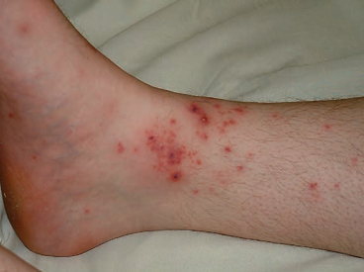
BACTERIAL ARTHROPATHIES
SEPTIC ARTHRITIS
BRUCELLOSIS
LYME DISEASE
SYPHILIS
KAWASAKI DISEASE
WHIPPLE DISEASE
MENINGOCOCCAL ARTHRITIS
  widespread macular erythema and tender papular, nodular or pustular lesions, which may become purpuric
GONOCOCCAL ARTHRITIS
  Papular and vesicular lesions, often periarticular, may be misdiagnosed as papular lupus erythematosus

Slide 6
MYCOBACTERIAL INFECTIONS
  LEPROSY
    Extension of skin lesions on the fingers and toes can give rise to a dactylitis with leprous periostitis and eventually osteomyelitis.
    Chronic nerve damage leads to muscle deformity and joint contracture with eventual joint destruction.
  TUBERCULOSIS
    Characteristically involves the spine, and may present to the dermatologist as a paravertebral abscess (Pott disease)

Slide 7
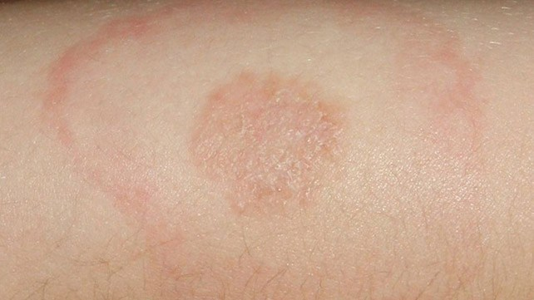
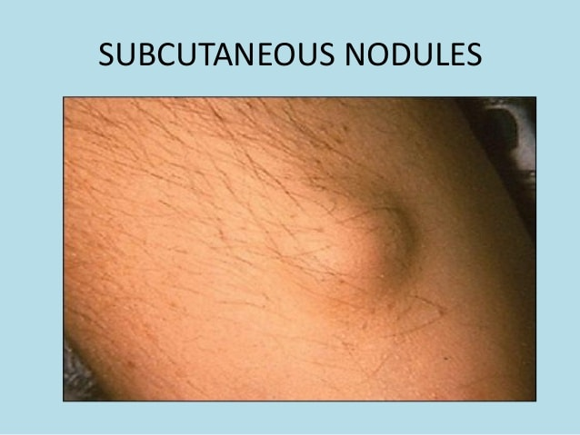
RHEUMATIC FEVER
  Characteristic urticated annular skin lesions erythema marginatum, predilection for the trunk and proximal limbs
  Subcutaneous nodules occuring in crops, typically on the extensor aspects of the limbs
  Impetiginized Scabies is a major risk factor for rheumatic fever and post‐streptococcal glomerulonephritis
Notes:
comprise one of the major criteria for the diagnosis of rheumatic fever

Slide 8
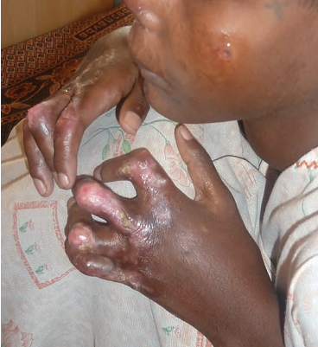
OTHER INFECTIVE ARTHROPATHIES
DISSEMINATED FUNGAL INFECTION
MYCETOMA
POST KALA AZAR DERMAL LEISHMANIASIS
  associated with arthralgia and joint contracture

Slide 9
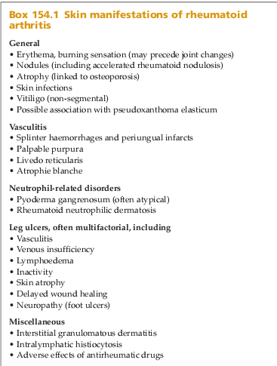
INFLAMMATORY ARTHROPATHIES
RHEUMATOID ARTHRITIS & SKIN

Slide 10
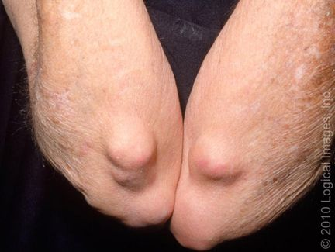
RHEUMATOID NODULES
  Skin‐coloured subcutaneous nodules, occur in over 20% of patients, especially in men and in seropositive disease
  Usually asymptomatic, and found over extensor surfaces and sites of repetitive trauma
  Nodules in lung parenchyma (Kaplan syndrome).

Slide 11
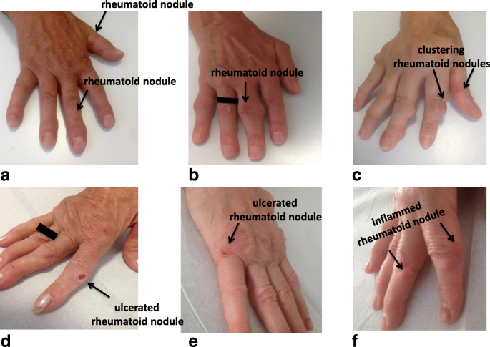
  DDs: knuckle pads, subcutaneous sarcoid and subcutaneous granuloma annulare
  Wax and wane with treatment; Some drugs may exacerbate nodulosis Eg. MTX, Anti TNF agents, Lefulonamide
Notes:
Accelerated rheumatoid nodulosis

Slide 12
RHEUMATOID VASCULITIS AND CUTANEOUS ULCERATION
  Presents as splinter haemorrhages and periungual infarcts, palpable purpura, livedo reticularis and atrophie blanche
  Pyoderma gangrenosum associated with RA
  Chronic leg ulcers attributed to arterial occlusion due to vasculitis, venous insufficiency, lymphedema, ‘inactivity ulcers’ linked with immobility, poor wound healing and thin skin

Slide 13
RHEUMATOID NEUTROPHILIC DERMATOSIS
  Presents as urticaria‐like papules and plaques, often symmetrically on the trunk and limbs
  Tense bullae may occur on the lower legs
  Responds to dapsone
ATROPHIC SKIN
  The skin on the dorsa of the hands become thin, loose, smooth, inelastic and transparent owing to structurally abnormal skin collagen

Slide 14
CUTANEOUS ADVERSE REACTIONS TO
ANTIRHEUMATIC THERAPIES
NSAIDs & ALLOPURINOL
  NSAIDs are photosensitizing, and can induce photo‐onycholysis
  A pseudoporphyria, clinically resembling porphyria cutanea tarda, is seen with naproxen
  Fixed drug eruptions are associated with some NSAIDs and may induce urticarial lesions
  Cross‐reaction with octocrylene, a sunscreen ingredient, is often seen with ketoprofen photosensitivity

Slide 15
ANTIMALARIALS
  Exacerbation of psoriasis
  Lichenoid drug reactions,
  Acute generalized exanthematic pustulosis
  DRESS syndrome.
Sulfasalazine
  DRESS
  Photosensitizer and can induce or exacerbate lupus erythematosus
Corticosteroids.
  Atrophogenic effects
  Cushingoid features
  acneform eruption

Slide 16
D‐penicillamine
  can induce lupus or a lichenoid reaction,
  associated with a pseudoxanthoma elasticum‐like syndrome
TNF- α INHIBITORS
  induce an eruption clinically and histologically resembling psoriasis: adalimumab is a major culprit .
  responds to topical therapy or on changing to another biological agent.

Slide 17
SKIN CANCER PROMOTION
Non‐melanoma skin cancer is commoner in rheumatoid patients
  Multiple eruptive squamous cell carcinomata occurred in a patient on abatacept
  Multiple eruptive keratoacanthomata associated with leflunomide
  Lymphomatoid papulosis attributed to adalimumab
  Multiple basal cell carcinomas developed in the skin overlying sites of radiotherapy for ankylosing spondylitis many years after irradiation

Slide 18
SARCOIDOSIS
Acute synovitis is common in Löfgren syndrome, an acute variant of sarcoidosis with erythema nodosum and bilateral hilar lymphadenopathy on chest X‐ray
Chronic sarcoid dactylitis; fingers and toes become sausage shaped with spindling
Sacroiliitis and spondyloarthritis
Methotrexate is beneficial for both cutaneous lesions and inflammatory joint disease

Slide 19
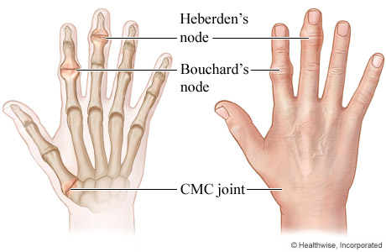
OSTEOARTHRITIS
HEBERDEN AND BOUCHARD NODES:
  Heberden nodes are bony outgrowths affecting distal interphalangeal joints
  Bouchard nodes affecting the proximal interphalangeal joints
  Asymptomatic, insidious onset and commoner on the dominant hand

Slide 20
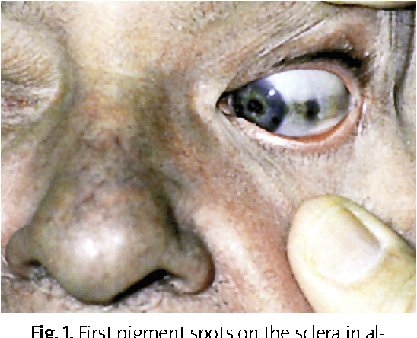
ALKAPTONURIA
Deposition of homogentisic acid in connective tissue (ochronosis)
causing a grey‐black pigmentation
most noticeable in ear and nose cartilage
eventually results in calcification of intervertebral discs and osteoarthritis (knee)

Slide 21
GOUT
Acute gout presents as a mono-arthritis, classically affecting the metatarsophalangeal joint of the great toe
TOPHACEOUS GOUT:
  A tophus is a dense aggregate of monosodium urate crystals presenting as a papule or nodule in the skin.
  Predilection for the pinnae, elbows and Achilles tendons
  ulcerate and become secondarily infected

Slide 22
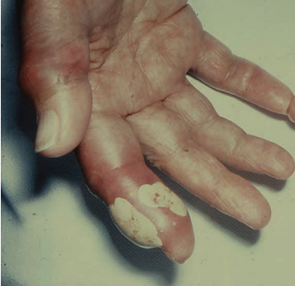
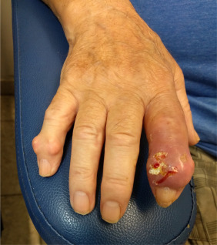
  DDs: Rheumatoid nodules, neurofibromata and xanthomata
  Allopurinol is associated with DRESS, SJS and TEN

Slide 23
ACNE
Severe acne is associated with joint symptoms and arthritis
Acne conglobata has been linked to sacroiliitis. Asymmetrical peripheral arthritis can also be present
Isotretinoin therapy is commonly associated with arthralgia and myalgia and may precipitate acute sacroiliitis. Prolonged isotretinoin therapy is associated with spinal hyperostosis.

Slide 24
INFLAMMATORY CHONDROPATHIES
RELAPSING POLYCHONDRITIS
• Recurrent bilateral chondritis of the pinnae.
• Chondritis of the nasal cartilage.
• Chondritis of the respiratory tract.
• Ocular inflammation, including conjunctivitis, scleritis, episcleritis or uveitis.
• Cochlear or vestibular lesions.
• Seronegative non‐erosive inflammatory arthritis.
Three or more of these features are required for the diagnosis

Slide 25
ETIOLOGY
  Th1‐mediated disease
  Antibodies to type II collagen
ASSOCIATED CONDITIONS
  Rheumatoid arthritis,lupus erythematosus, vasculitis, Behçet disease, Hashimoto disease, ulcerative colitis, Crohn disease, psoriasis, glomerulonephritis, Sjögren syndrome, thymoma, ankylosing spondylitis, myeloproliferative disorders and following intravenous injections

Slide 26
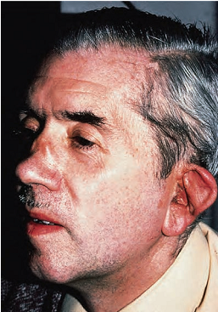
CLINICAL FEATURES
Acute stage,
  red swollen and tender ear
  Sparing of the ear lobule
  Floppy ear (the ‘forward listening’ ear)
  Thinning of the cartilage with prominent vasculature (the ‘blue ear’ sign)
Nasal obstruction and a saddle‐nose deformity
Small joint arthritis
Respiratory embarrassment and recurrent infection
episcleritis, conjunctivitis and iritis, scleromalacia, keratoconjunctivitis sicca or chorioretinitis

Slide 27
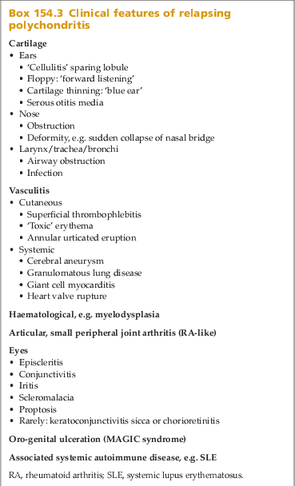

Slide 28
The course of the disease is variable with frequent relapses
Disease is a source of discomfort and disfigurement rather than a threat to life
A characteristic biochemical finding is the increased urinary excretion of acid mucopolysaccharides during each relapse
Fluorine‐18 deoxyglucose uptake is increased in affected cartilage on PET/CT; this is a useful investigation to determine the extent of cartilage involvement

Slide 29
DIAGNOSIS AND TREATMENT
Diagnosis is made by biopsy and appropriate radiology
Acute relapse → steroids(30 mg/day prednisolone)
  Indomethacin, dapsone and Colchicine
  Methotrexate, ciclosporin
Pulsed intravenous cyclophosphamide for renal disease
IVIG and anti‐TNF antagonists such as adalimumab
Other cytokine modulators include rituximab and tocilizumab
Autologous stem cell transplantation
Surgical reconstruction of the nose or larynx

Slide 30
MAGIC SYNDROME
Overlap syndrome with features of both relapsing polychondritis and Behçet disease
MAGIC (mouth and genital ulcers with inflamed cartilage)
Aortic valve disease and aneurysmal aortitis have been associated with the syndrome
Treatment
  Dapsone, steroids and pentoxifylline.
  Infliximab in severe case

Slide 31
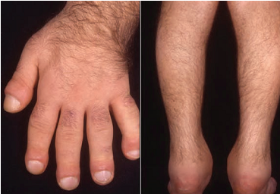
MISCELLANEOUS DISORDERS INVOLVING
THE SKIN AND MUSCULOSKELETAL SYSTEM
Pachydermoperiostosis
  Digital clubbing
  Cylindrical thickening of legs and forearms
  Hypohidrosis
  Seborrhoea
  Sebaceous gland hyperplasia
  Folliculitis.
  Arthritis with florid knee effusions.
  Thickened skin on the forehead
  Carpal and tarsal tunnel syndrome
  Chronic leg ulceration
  Calcification of the Achilles tendon

Slide 32
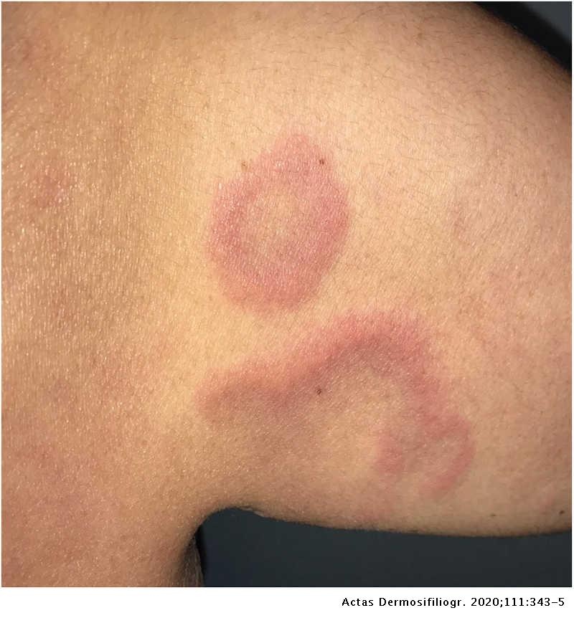
Interstitial granulomatous dermatosis
  Skin‐coloured, erythematous or violaceous papules, linear bands or plaques develop symmetrically on the lateral aspects of the trunk, proximal thighs or axillae.
  Painful or pruritic

Slide 33
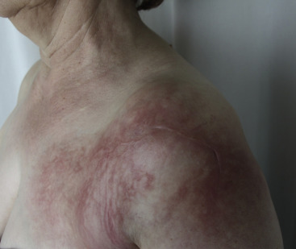
Intralymphatic histiocytosis
  Asymptomatic poorly demarcated erythematous plaques or livedo reticularis like lesions develop near an elbow or knee with overlying verrucous change
  Respond to simple pressure bandaging

Slide 34
Mastocytosis
Multicentric reticulohistiocytosis

Slide 35
THANKS

