Slide 1
MALIGNANT MELANOMA
OF SKIN
BY
DR. MARYAM FAISAL
PG. D.DERM

Slide 2
OUTLINES
DEFINITION
INCIDENCE
ETIOLOGY
RISK FACTORS
GROWTH PHASES OF PRIMARY MELANOMA
CLINICAL VARIANTS
STAGING
DIAGNOSIS
BCQs
SUMMARY

Slide 3
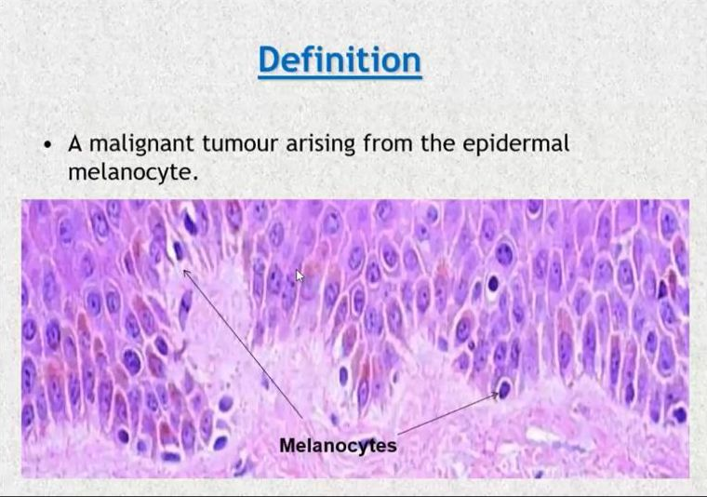

Slide 4
INCIDENCE
Most commonly seen in Australia & New Zealand
Race:
Common in whites than in blacks.
Sex:
Common in men than women (1.2:1).
Age:
Melanoma may occur at any age
Average age is 57 years

Slide 5
ETIOLOGY
Genetic Factors
  - Inheritance of mutations in the CDKN2A gene on chromosome 9
- Cutaneous response to sun
Skin type 1 most vulnerable
Environmental Factors
    - Sun Exposure
    - Sun beds & therapeutic UV
    - Free Redicals

Slide 6
ETIOLOGY
Familial melanoma
  Any family history increases risk of melanoma.
  Presence of Mole syndrome or FAMMM syndrome
(familial atypical multiple mole melanoma syndrome)

Slide 7
ETIOLOGY
PRE-EXISTING LESIONS
  BENIGN NEVI – UPTO 20 - 25%
  CONGENITAL MELANOCYTIC NEVI – 4-19%
  ATYPICAL NEVI – ACT BOTH AS PRECURSER AS WELL AS A MARKER FOR DEVELOPMENT OF MALIGNANT MELANOMA.
  MAY ARISE AS DE-NOVO

Slide 8
RISK FACTORS
Exposure to ultraviolet radiation (UVR) is a critical factor
  Both UVA and UVB are potentially carcinogenic
  Suppression of the immune system of the Skin
  Damage of melanocyte DNA.
  Induction of melanocyte cell division

Slide 9
RISK FACTORS
Phenotypic risk factors
    Increased numbers of melanocytic naevi.
    High density of freckles
    Blue Eyes
    Red Hairs
Notes:
Greater than 50 nevi, 2 mm or greater in diameter

Slide 10
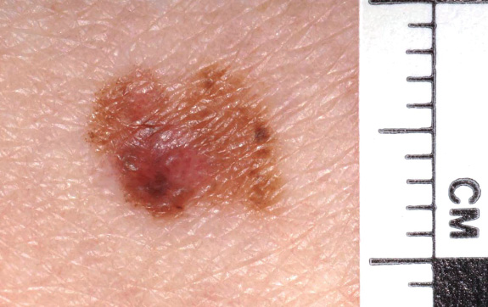
Growth phases of primary melanoma
In situ disease
Proliferation of melanocytes limited to epidermis
  May last for period of years.
  Before they Invade the Dermis
Radial growth phase melanoma
    Evolution from in. situ to invasive disease
    Still unlikely to metastasize
    Melanocyte proliferation to some dermal cells

Slide 11
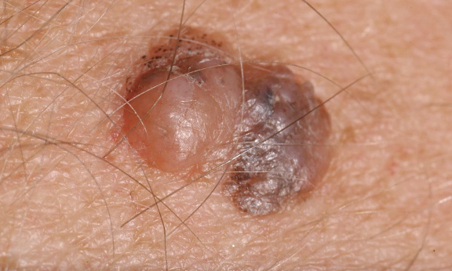
Growth phases of primary melanoma
Vertical growth phase melanoma
Growth of malignant cells with in the dermis.
Tumor have acquired
    -Capacity for growth
    -Capacity for invasion of vessels &
    other tissues

Slide 12
Clinical Variants
1- Superficial Spreading Melanoma
2- Nodular Melanoma
3- Lentigo maligna melanoma
4- Acral lentiginous Malignant Melanoma
5- Subungual Melanoma
6- Mucosal Melanoma

Slide 13
Superficial spreading melanoma
Most commonest type – 70%
Usually presents in the 4-5 decade
Typical site, leg-female and back-male
Prolonged intraepidermal radial growth
Pagetoid spread of malignant melanocytes.
vertical invasion of the dermis may occur

Slide 14
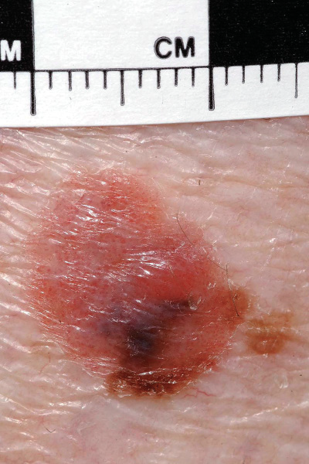
Superficial spreading melanoma

Slide 15
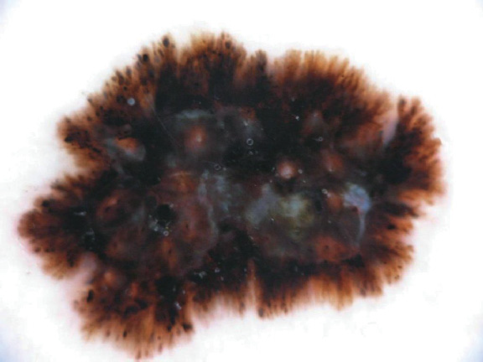
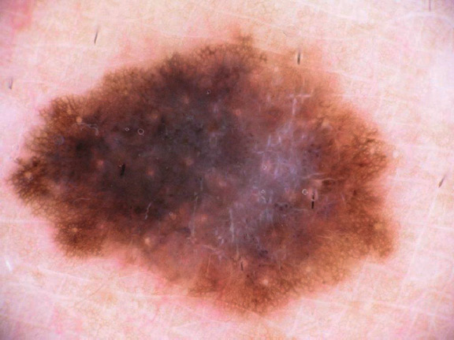
Superficial spreading melanoma
Abnormal Pigment network
& Irregular Structure
Notes:
The dermoscopic appearance of superficial spreading melanoma showing

Slide 16
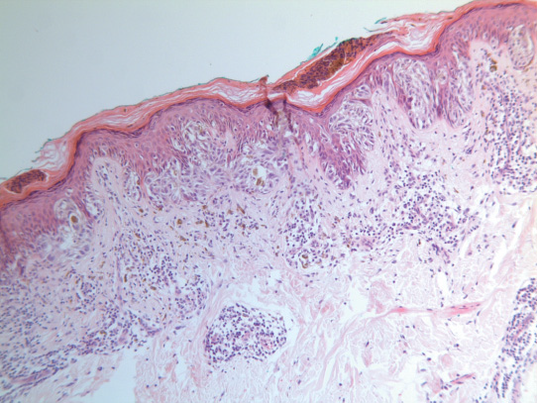
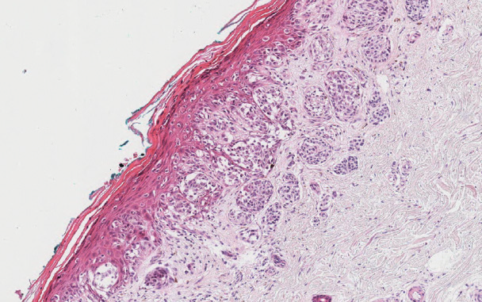
Superficial spreading melanoma
In situ Melanoma
Dermal nests of tumor cells

Slide 17
Differential diagnosis
Benign naevi
-smaller than melanoma
- Have a regular, oval or circular outline.
Seborrhoeic keratoses
-Dull, nonreflective lesions
-Have a hyperkeratotic surface
-Tendency to crumble.

Slide 18
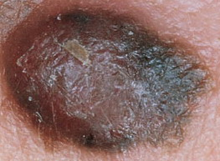
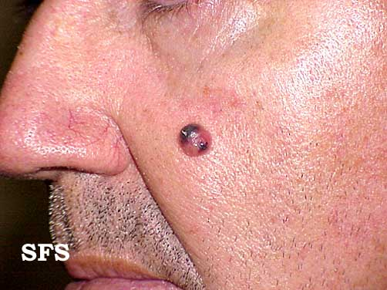
Nodular melanoma
Usually Presents in 5th to 6th Decade
Commonly occurs on trunk
Males > Females
Shows vertical growth phase from beginning
present as thicker tumors.
Poor Prognosis
Notes:
Lesions grow rapidly hence present as thicker tumors.

Slide 19
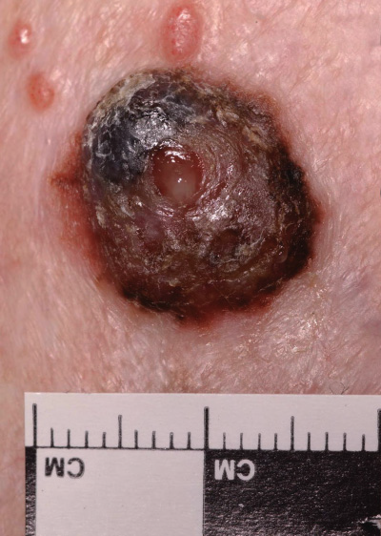
Nodular melanoma
Dome-shaped, polypoid or pedunculated structure.
Raised, red central area
Peripheral brown ring of melanin

Slide 20
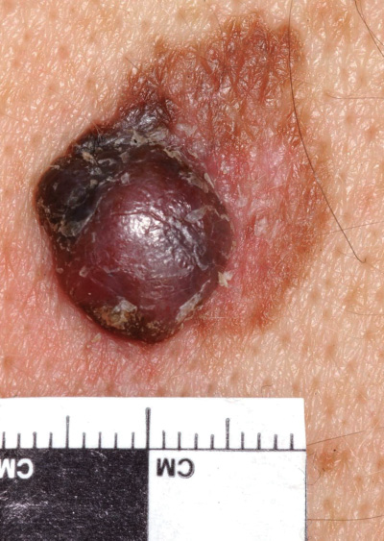

Nodular melanoma

Slide 21
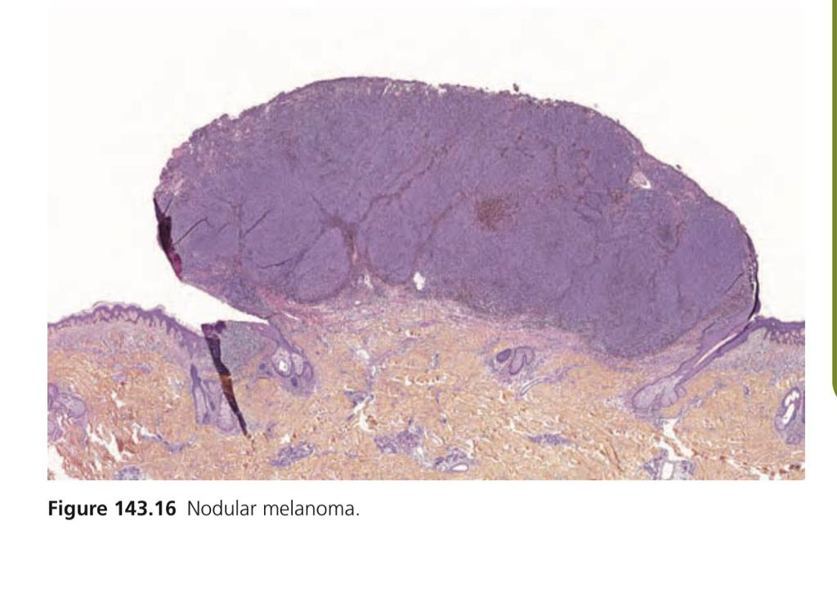

Slide 22
Differential diagnosis
Angioma
Pigmented basal cell carcinoma.
Histiocytoma
Dermatofibroma

Slide 23
Lentigo maligna melanoma
Also called Hutchinson’s melanotic freckle
Usually presents in the 6th to 7th decade
Accounts 10% of cases of melanoma
Commonly occurs on the exposed sites e.g nose temple and forhead
Mostly seen in outdoor workers
Horizontal growth phase (Cont’d)

Slide 24
Lentigo maligna melanoma
Initially flat, brown or black
May have areas of hypo pigmentation.
Irregularly shaped lesion.
Grow slowly.
Central regression
Invasive melanoma may develop in upto 5% of cases.
Notes:
Arise from a lentigo maligna precursor lesion (Hutchinson’s melanotic freckle).

Slide 25
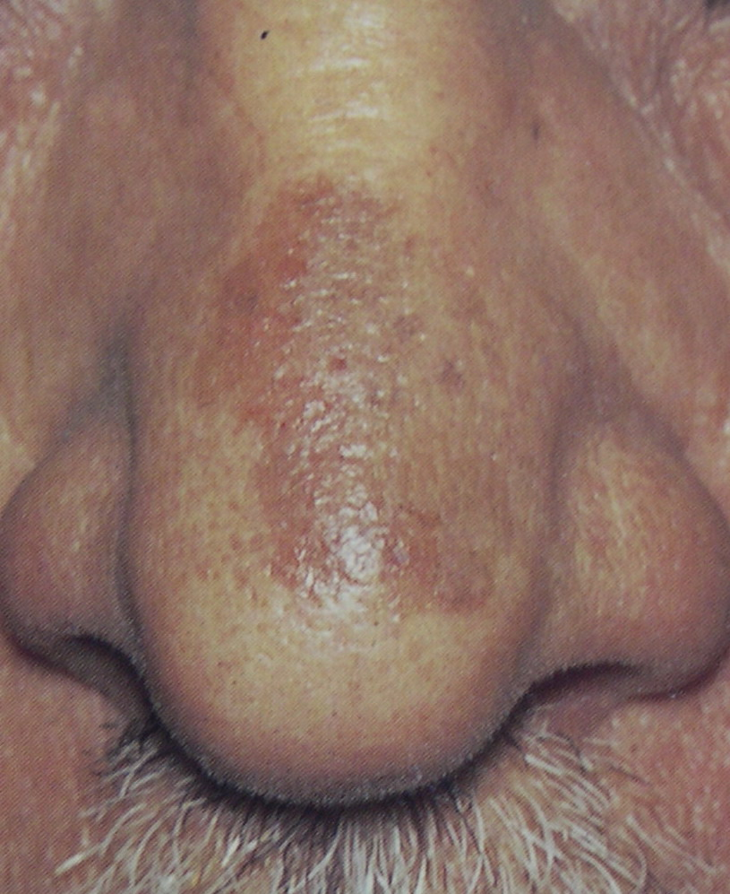
Lentigo maligna melanoma

Slide 26
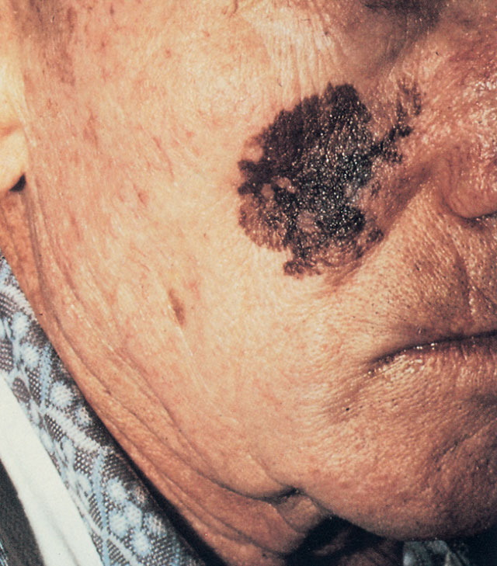
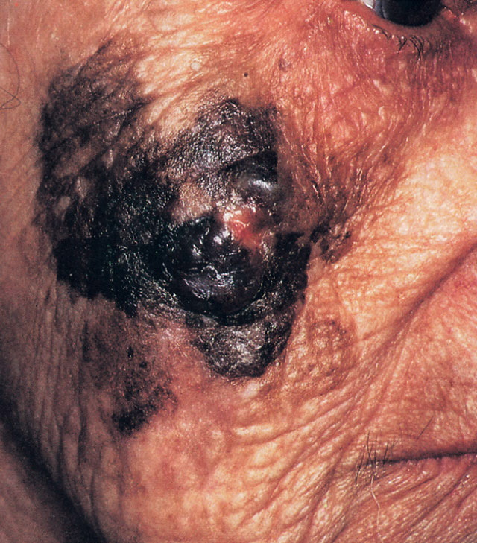
Lentigo maligna melanoma

Slide 27
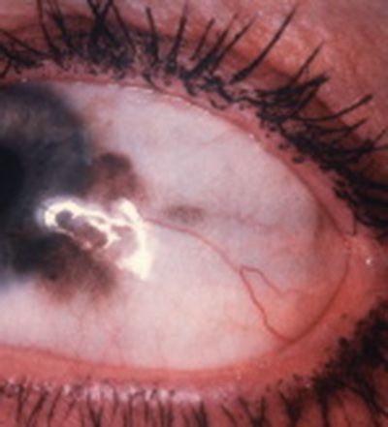
Primary Acquired Melanoma(PAM)
In situ component of Lentigo Melanoma
Arise in conjunctiva
Typically presents as irregular pigmentation at the limbus of the eye

Slide 28
Acral lentiginous melanoma PalmoplantarMalignant Melanoma
Comprises 10% of all melanomas on white skin
Over 60-72% on darker-skinned peoples.
Mainly on the sole of the foot
Palm of the hand
Large, macular initially
Invasive, raised tumour in later stages
Notes:
LMMs arise from a lentigo maligna precursor lesion (Hutchinson’s melanotic freckle).

Slide 29
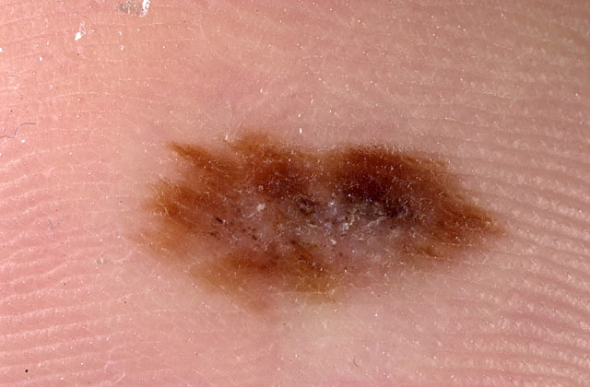
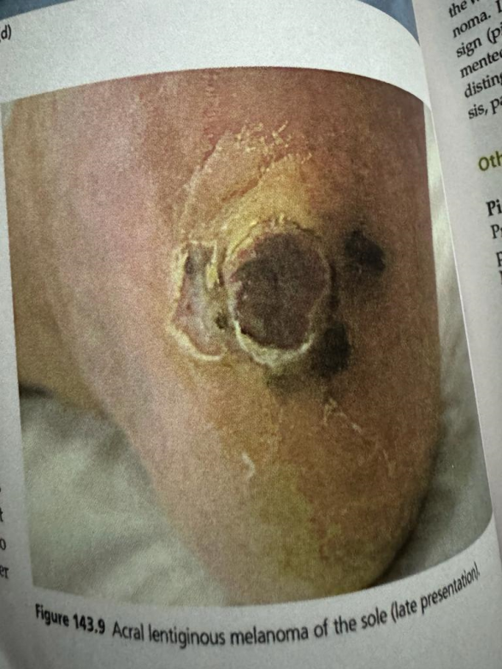
Acral lentiginous melanoma
Early presentation
Late presentation

Slide 30
Acral lentiginous melanoma
Pathology
Epidermis
-Areas of lentiginous change.
- Basal keratinocytes are replaced by malignant melanocytes.
-Presence of skip areas of normal epidermis
-Dermis
-Inflammatory flare of lymphoid cells.

Slide 31
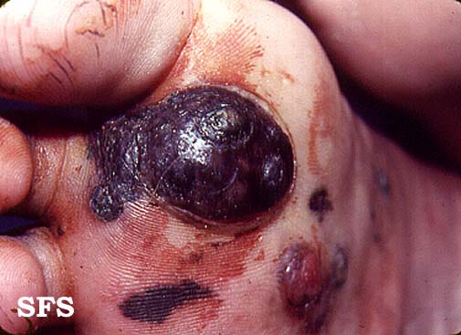
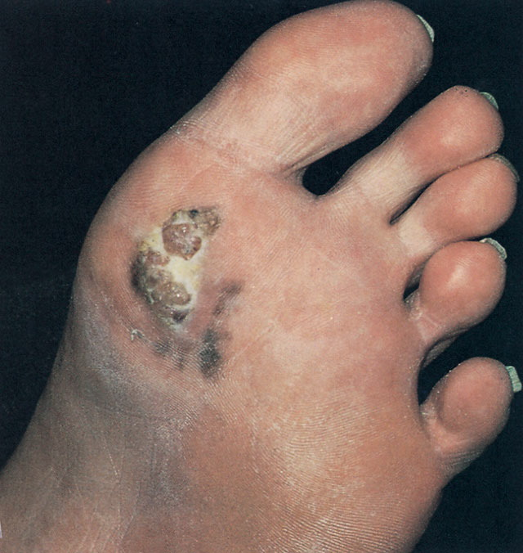
Acral lentiginous melanoma

Slide 32
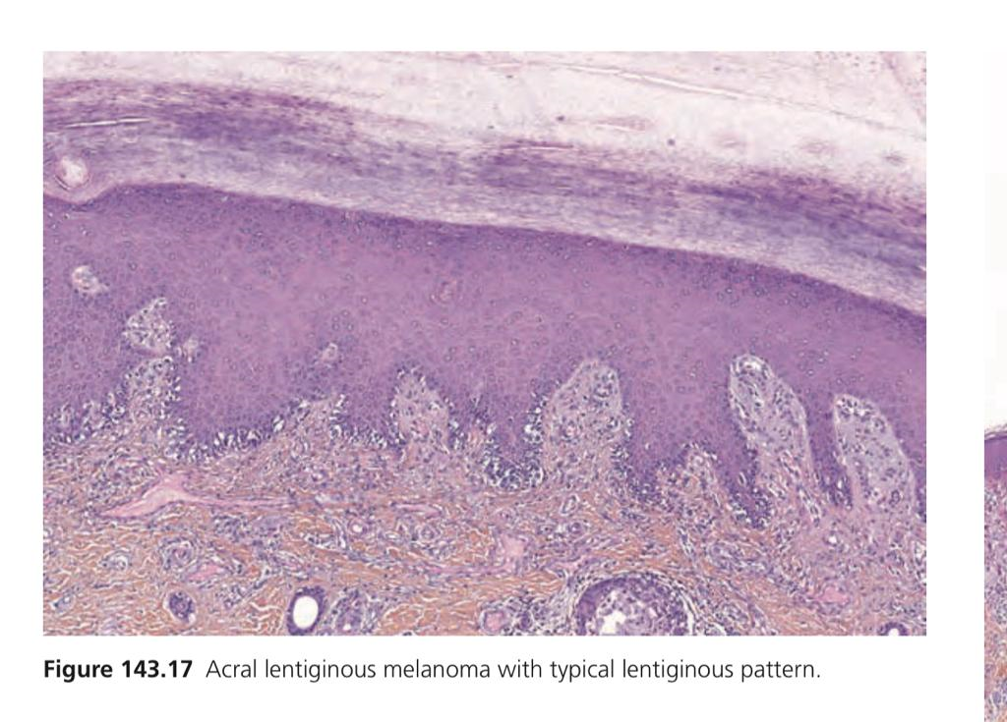

Slide 33
Subungual Melanoma
Most common on the thumb & great toe.
Comprises 2-3% in white skin but higher proportion in dark skin
Trauma may play a role in their etiology.
Arise from the nail matrix.
Classical presentation
-New, linear, pigmented band.
-Along the length of the nail.
-Fissured nail

Slide 34
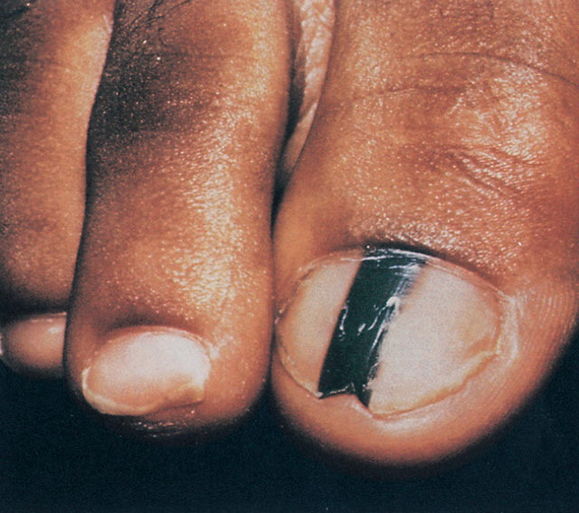
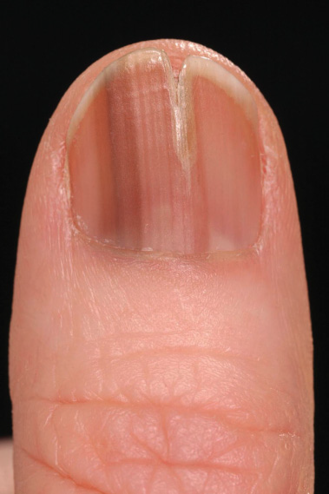
Subungual Melanoma

Slide 35
Hutchinson’s Sign
Pigmentation in the adjacent skin & inflammatory or pigmented paronychia.

Slide 36
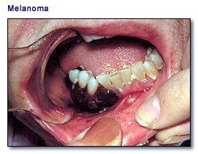
Mucosal Melanoma
Rare , Oral cavity,Genital mucosa and perianal area.
Appear in 7th decade
Most common presenting feature
Extensive,irregular
Macular pigmentation.
Extend laterally for years

Slide 37
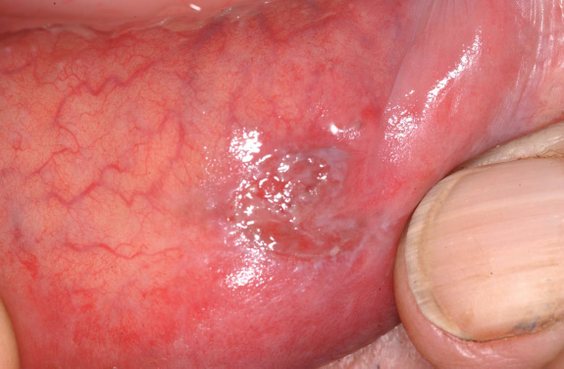
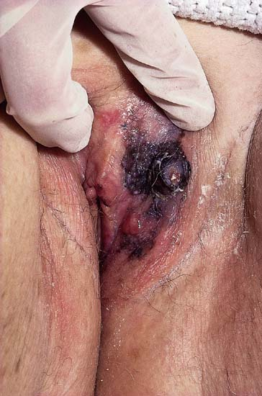
Mucosal Melanoma
Melanoma arising on the buccal mucosa
Deeply invasive Vulvar melanoma.

Slide 38
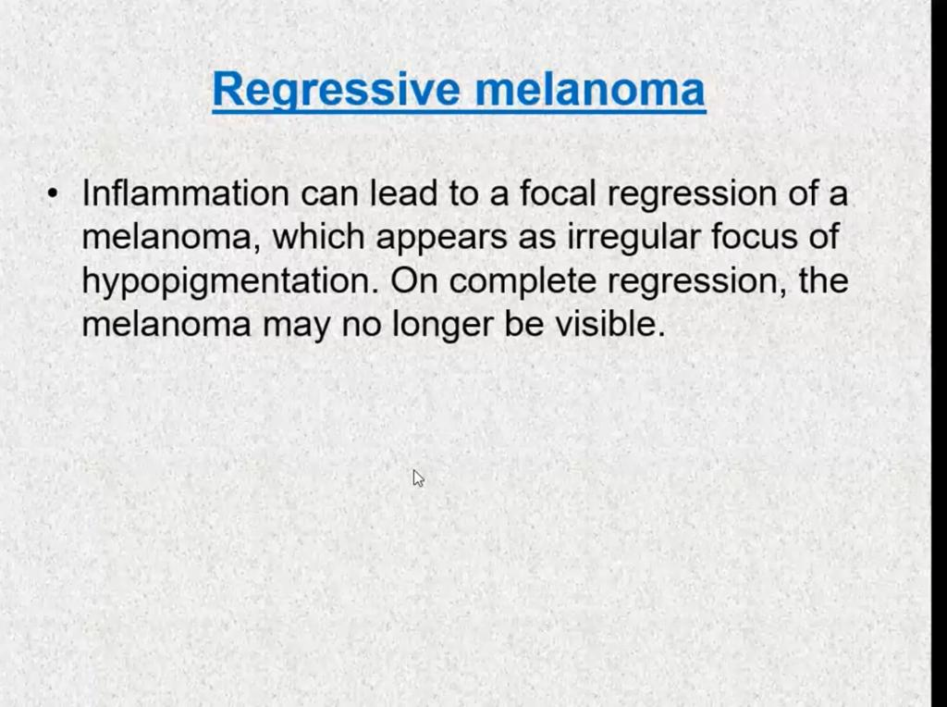

Slide 39
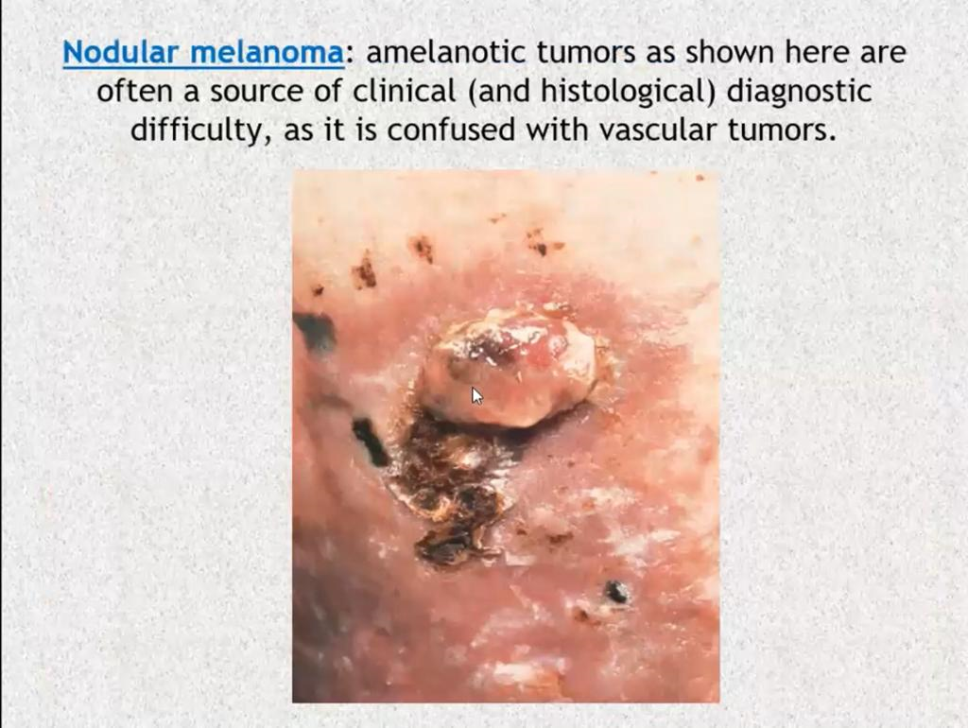

Slide 40
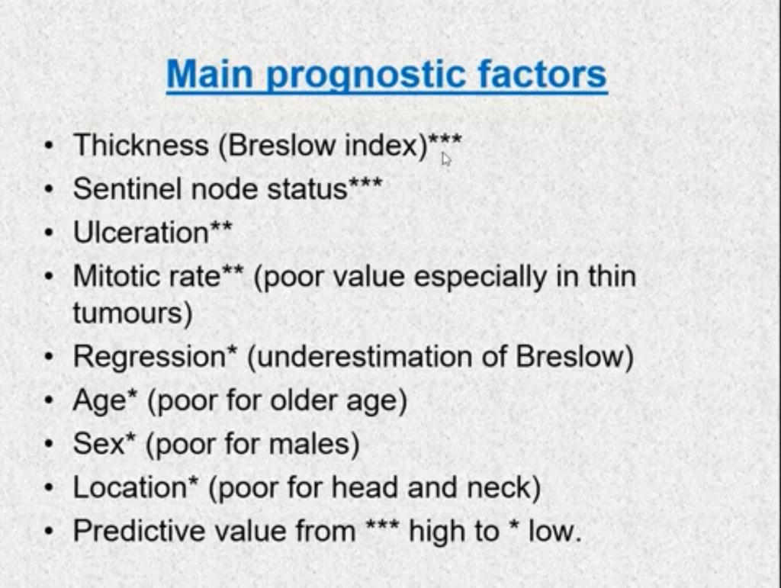

Slide 41
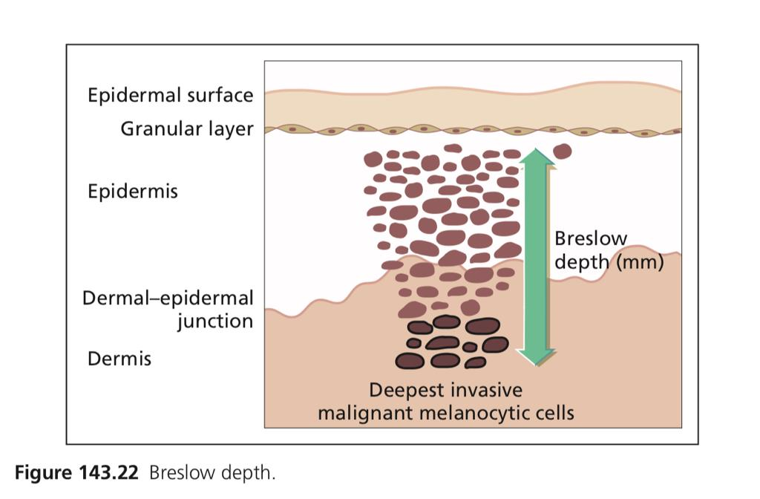

Slide 42
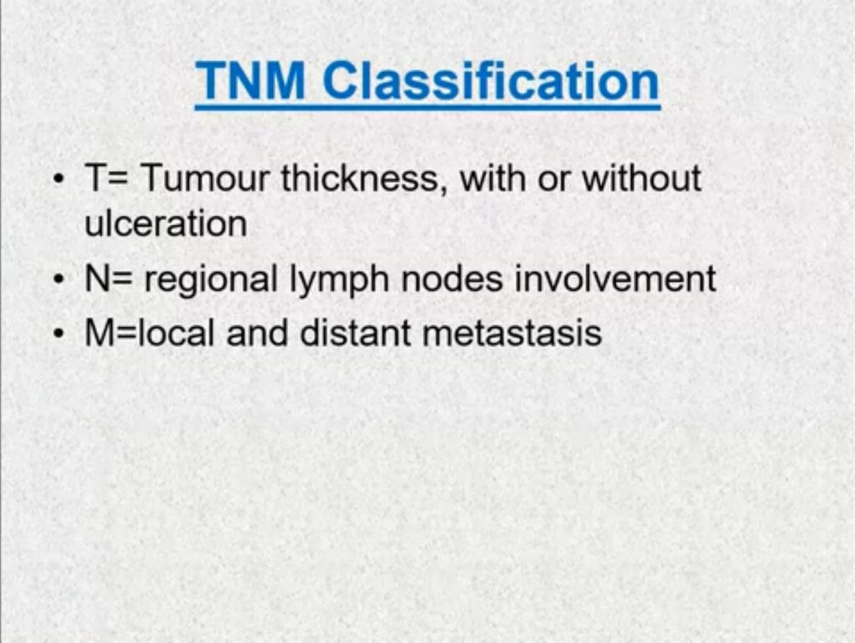

Slide 43
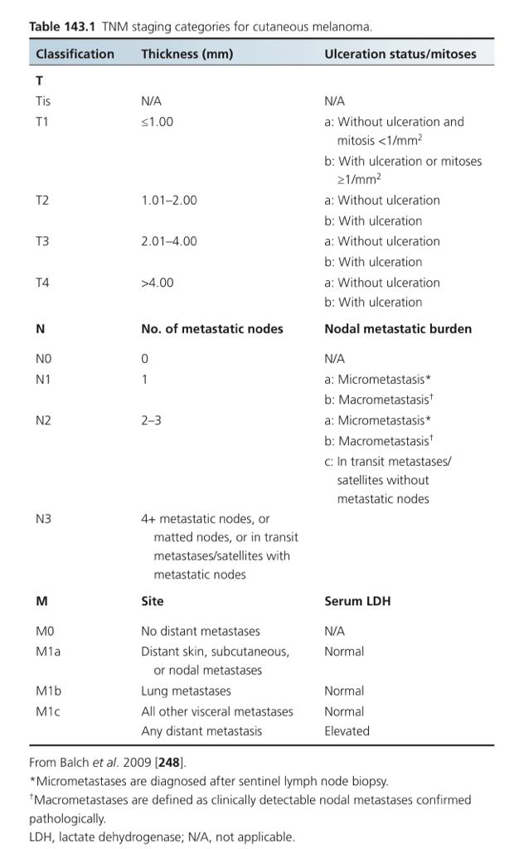

Slide 44
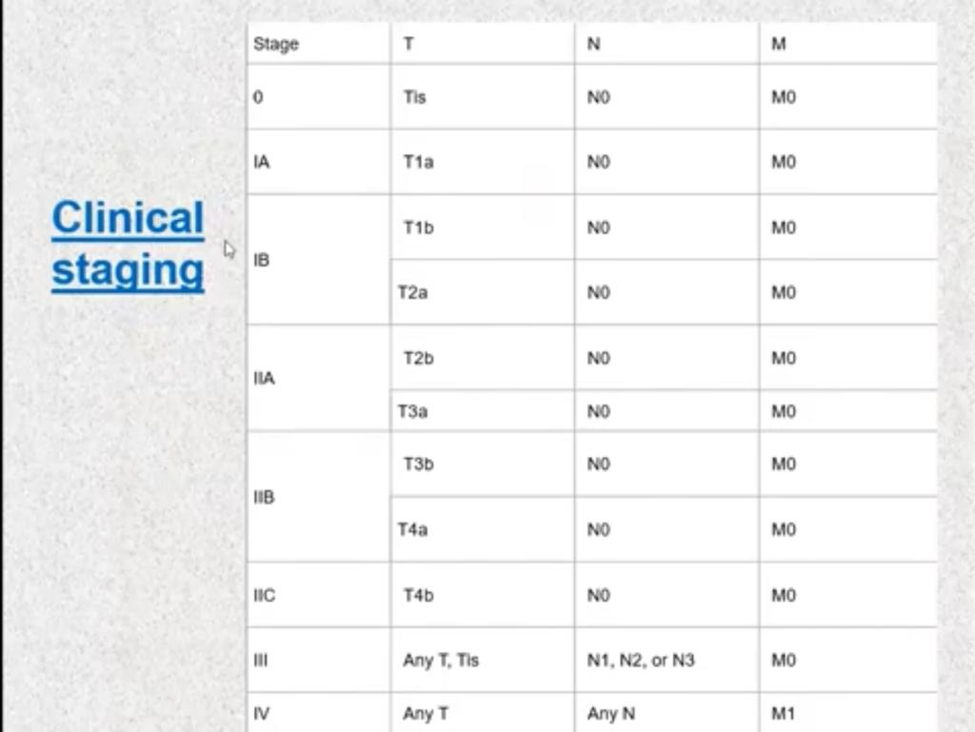

Slide 45
Diagnosis
A-CLINICAL ( or by Dermoscopy)
B-BIOPSY (INCISIONAL/EXCISIONAL)
  Incisional for LMM +Large lesion on face
  Excision Biopsy for remaining melanomas
  C-IMMUNOHISTOCHEMISTRY
    ANTIBODIES TO S 100 PROTIENS
    ANTIBODIES NK1 C3
    ANTIBODIES HMB 45

Slide 46
Diagnosis
Clinically two diagnostic systems
1-American ABCD categories
2-Glasgow seven point check-list.

Slide 47
DIAGNOSIS
The ABCD
  A - Asymmetry
  B - Border irregularity
  C - Color
  D - Diameter more than 1 cm.
  The Glasgow seven point check list
  MAJOR CHECKS
  Change in size
  Change in shape.
  Change in color.
  MINOR CHECKS
  Size more than 5 mm
  Inflammation
  Oozing and bleeding
  Mild itch or altered sensation
Notes:
1-melanoma lesion more likely to be asymmetric
2-(melanoma more likely to have irregular borders
3-(melanoma more likely to be very dark black or blue and have variation in color than a benign mole, which more often is uniform in color and light tan or brown)

Slide 48
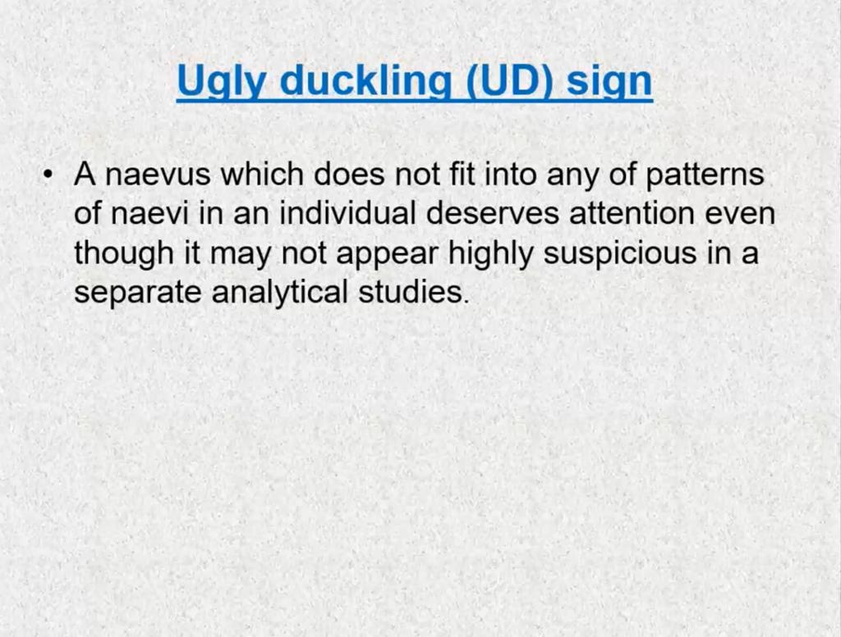

Slide 49
DIAGNOSIS
Sentinel node biopsy (SLNB)
-Biopsy of 1st draining LN
-lymphoscintigraphy is used to identify the lymphatic drainage pattern.
-Injecting radiolabelled colloid / blue dye

Slide 50
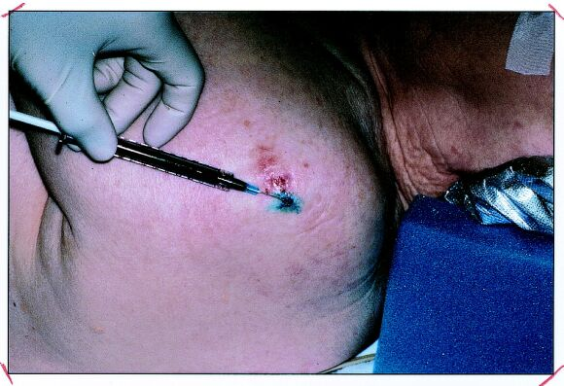
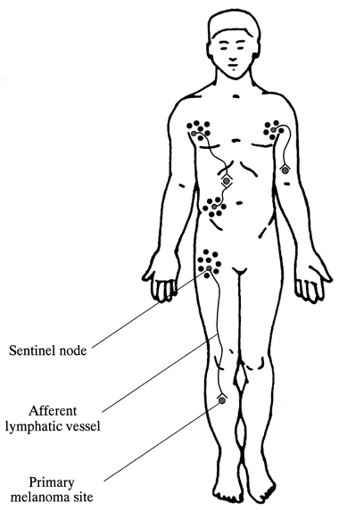
Sentinel node biopsy (SLNB)

Slide 51
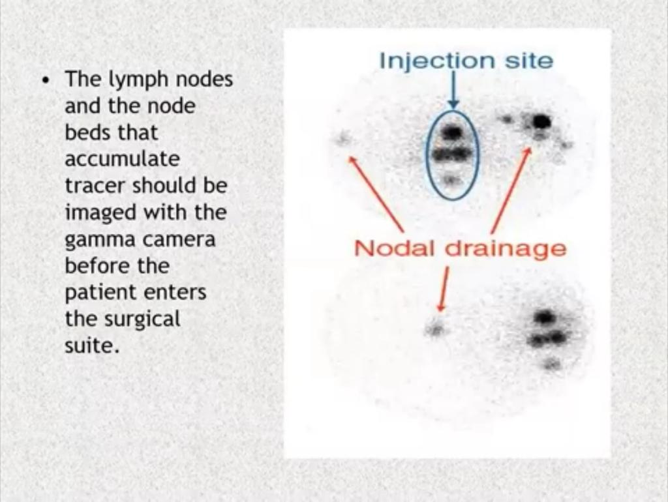

Slide 52
FOLLOW UP
  Three main purposes of follow up
  1-To detect any local recurrence around the scar
2-To palpate the local draining nodes
3-To examine the rest of the skin for a second primary melanoma
  3 monthly follow up for 3-5 years

Slide 53
PROGNOSIS
PROGNOSIS – 5 YEARS SURVIVAL
STAGE I &II – 80%
STAGE III – 35%
STAGE IV – 10%
Melanoma diagnosed during pregnancy have extremely poor prognosis due to the rapid development of metastases.

Slide 54
SUMMARY
Malignant tumour from epidermal melanocyes.
White skin populations are more affected than black.
Risk factors include sun exposure and UV rays.
Accounts 4 % of total skin cancers.
Commonly a tumour of old age .
Usually have four common clinical variants.
Diagnose clinically with the help of dermoscopy.
Treatment is mainly surgical excission on early stages.
Adjuvant chemotherapy is reserved for advanced cancers.

Slide 55
References
Roots text book of dermatology
Dermnet
Dermatology online teaching

Slide 56
BCQs
A 51-year-old male presented with a hyperpigmented macule on his left heel of the foot. Histopathological examination confirmed the diagnosis of melanoma. He had previous history of Psoriasis for which he has been taking PUVA therapy. His dermatologist told him that PUVA therapy can be a risk factor for developing melanoma.After how many sessions of PUVA, there is an increased risk of developing melanoma?
250 sessions in lifetime
250 sessions in 1 year
250 session in 10 years
200 session in lifetime
200 session in 1 year

Slide 57
BCQs
A 57-year-old female presented with a hyperpigmented macular lesion on her back measuring 2x3 cm. Histopathological examination confirmed the diagnosis of superfical spreading melanoma.Which of the following is not a poor prognostic marker in melanoma?
А. Breslow thickness of 2 mm
B. Female gender
С. Lesion on scalp
D. Regression figures
E. Ulceration

Slide 58
THANK YOU

