Slide 1


Slide 2
LYMPHOEDEMA
Dr. sania butt
pgr dermatology

Slide 3
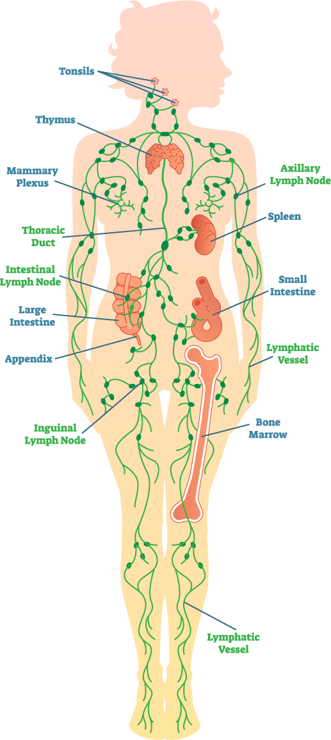
Definition
Lymphedema is an abnormal collection of protein rich fluid in the interstitium resulting from obstruction of lymphatic drainage.

Slide 4
Pathophysiology
Any edema is due to capillary filtration overwhelming the lymph drainage.
If there is increased microvascular filtration its relative, if failure in lymph drainage its absolute lymphatic failure (lymphedema).
Lymphatic aplasia, hypoplasia, valvular insufficiency, obliteration/disruption of lymphatic vessels and primary decreased lymphatic contractility are the causes.
Lymphostasis and accumulation of lymph, interstitial fluid, proteins and glycosaminoglycans takes place within the skin and subcutaneous tissue.
It stimulates collagen production by fibroblasts, disruption of elastic fibers, and activation of keratinocytes, fibroblasts and adipocytes where skin thickening and subcutaneous tissue fibrosis is the result.

Slide 5
Lymphedema can be localised or diffuse
Localised include
1. Scar lymphoedema
2. Solid facial/eyelid oedema in patients with phymatous rosacea
3. Pendulous swelling and masses in morbidly obese patients
4. Anogenital fibroepithelial polyps (large firm skin tags)
5. Non-pitting genital swelling in Crohn disease
6. Swelling around arthritic joints

Slide 6
Diffuse can be primary or secondary
Primary;
Congenital lymphedema
Lymphedema praecox
Lymphedema tarda
Secondary;
Obstruction by mass Filariasis
Postsurgical Silica
Complication of cancer Post infection fibrosis
Massive obesity Trauma
Radiotherapy Reduced mobility

Slide 7
Primary Lymphoedema
Lymphoedema arising from an intrinsic abnormality of the lymph conducting pathways is referred to as primary lymphoedema.
congenital (present at or very soon after birth)
praecox (presenting before age 35 years)
tarda (presenting after age 35 years)

Slide 8
Inherited forms of lymphoedema where the gene is known
1. Milroy’s disease
A failure of lymphangiogenesis due to inactivation of VEGFR-3 appears to be responsible for the autosomal dominant inheritance of Milroy’s disease
Swelling which is confined to below the knee, often brawny with little pitting. Hydrocoele and superficial vein incompetence can occur.

Slide 9
2. Lymphoedema–distichiasis syndrome
It is a congenital anomaly in which accessory eyelashes occur along the posterior border of the lid margins in the position of the Meibomian glands.
Autosomal dominant Mutations in FOXC2 (MFH-1)
Lymphoedema develop in fifth decade. The lymphatic abnormality occurs due to lymph reflux with an increased number of lower-limb lymph vessels.
Other features include ptosis, congenital heart defects and varicose veins.

Slide 10
3. Hypotrichosis–lymphoedema–telangiectasia syndrome
Bilateral lymphoedema of the legs, hypotrichosis, telangiectasias and angiomata limited to acral regions.
Mutations in SOX18 transcription factor (responsible for inducing differentiation of lymphatic endothelial cells)

Slide 11
4. Incontentia pigmenti
Hypohidrotic ectodermal dysplasia with immune deficiency, recurrent infections and lower-limb lymphoedema developing at a few weeks of age.
Mutation in NEMO (NFκB essential modulator)
Lymphangiomatous malformation.

Slide 12
Other germline forms of lymphoedema
1. Meige’s disease
Adolescent females
Swelling mild, rarely extends above the knee and bilateral.
Distal lymphatics hypoplasia with proximal collectors remaining patent.
2. Turner’s syndrome
Absence of one X chromosome.
Early spontaneous abortions in 95%
webbed necks and peripheral oedema
On prenatal USG, cystic hygroma, chylothorax, ascites and hydrops fetalis can be detected.

Slide 13
3. Noonan’s syndrome
Short stature, ptosis, low-set ears, posterior hairline, neck webbing and congenital cardiac anomalies (typically pulmonary stenosis)
Mutations in PTPN11
4. Hennekam lymphangiectasia–lymphoedema syndrome
Intestinal lymphangiectasia with severe lymphoedema of the limbs, genitalia and face, with mental retardation.
Flat face, flat nasal bridge, epicanthic folds, hypertelorism, tooth abnormalities and small ears
Autosomal recessive

Slide 14
5. Cholestasis–lymphoedema syndrome (Aagenaes’s syndrome)
Jaundice evident soon after birth, recurrent.
Oedema of the leg, due to hypoplasia of the lymph vessels.
6. Microcephaly lymphoedema–chorioretinal dysplasia
An autosomal dominant syndrome in which microcephaly and lymphoedema are linked to chorioretinopathy.
7. Pes cavus and lymphedema
Hypoplasia of leg lymphatics.
8. Yellow nail syndrome
The evidence that YNS is inherited is unsubstantiated

Slide 15
Other genetic forms of lymphoedema
1. Klippel–Trenaunay syndrome
The commonest type, lymphoedema may be the presenting abnormality.
Limb overgrowth, cutaneous angiomas and venous disease may develop.
2. Proteus syndrome
Protean abnormalities
Asymmetrical overgrowth of almost any part of the body, macrodactyly.
Verrucous epidermal naevi, angiomas and lymphangiomatous swelling also occur.
Germ-line mutations in PTEN

Slide 16
3. Maffucci’s syndrome
Dyschondroplasia with haemangioma
Venous cavernous malformations in infancy, but cavernous lymphangiomas are also often seen, giving rise to limb swelling.
Hard nodules arise from the bones, especially of the fingers and toes; pathologically enchondromas and radiologically translucent.
High malignant potential.
4. Amniotic bands lymphoedema
Congenital lymphoedema associated with amniotic bands.

Slide 17
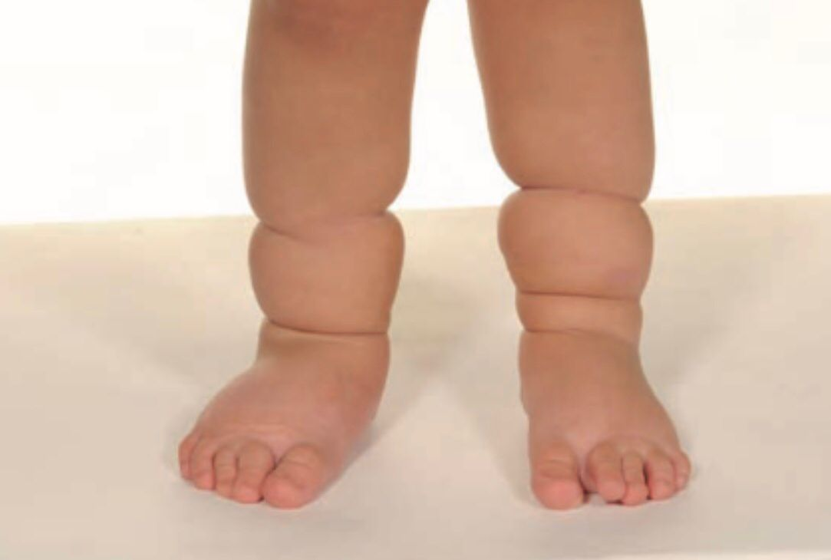
Lymhoedema as a result of amniotic band constriction
Amniotic band syndrome occurs as a result of in utero circumferential entrapment of fetal parts by fibrous amniotic bands formed during rupture of amnion.
It leads to circumferential limb constrictions, paeudosyndactyly, intrauterine amputation, umbilical cord constrictions.
Impairment of lymphatic drainage leads to lymphedema, constriction of vascular supply leads to necrosis and congenital abnormalities.
Strongly associated with club foot, also with cleft lip/ palate, club hand, hamangioma.
Prenatal US (swelling but not bands), 3D US and MRI
Surgical release with Z-plasty procedure, release of constriction is not complete so degree of lymphatic drainage remains.

Slide 18
SECONDARY
1. Cancer Treatment; Surgery, Radiotherapy
2. Tumour; Kaposi’s sarcoma, Infiltrative cancer, Lymphoma, Relapsed tumour
3. Infection; Filariasis, Lymphangitis, lymphadenitis, Cellulitis, Tuberculosis, Lymphogranuloma inguinale, Lice
4. Inflammation; Lymphatic occlusion, Podoconiosis, Pretibial myxedema, Dermatitis, e.g. hand eczema, Rheumatoid arthritis, Psoriasis, Rosacea/acne
5. Granulomatous disease; Orofacial granulomatosis, Crohn’s disease, Sarcoidosis
6. Vascular; Venous disease, Post-thrombotic syndrome, Venous leg ulcers
7. Trauma
8. Surgery; Lymphadenectomy, Vein harvesting, Femoropopliteal bypass
9. Self-harm; Tourniquet application, Intravenous drug abuse
10. Accident; Degloving injury, Burns

Slide 19

Clinical features
Fever, chills, generalized weakness
Chronic swelling
Fatigue
Feeling of tightness and heaviness
Altered sensation, such as pins and needles, shooting pains or feeling of heat
Joint discomfort
Changes in temperature
Reduced range of movement
Recurrent infections
Pshycosocial impact

Slide 20
Localised lymphoedema
Breast lymphoedema
Massive localized lymphoedema

Slide 21
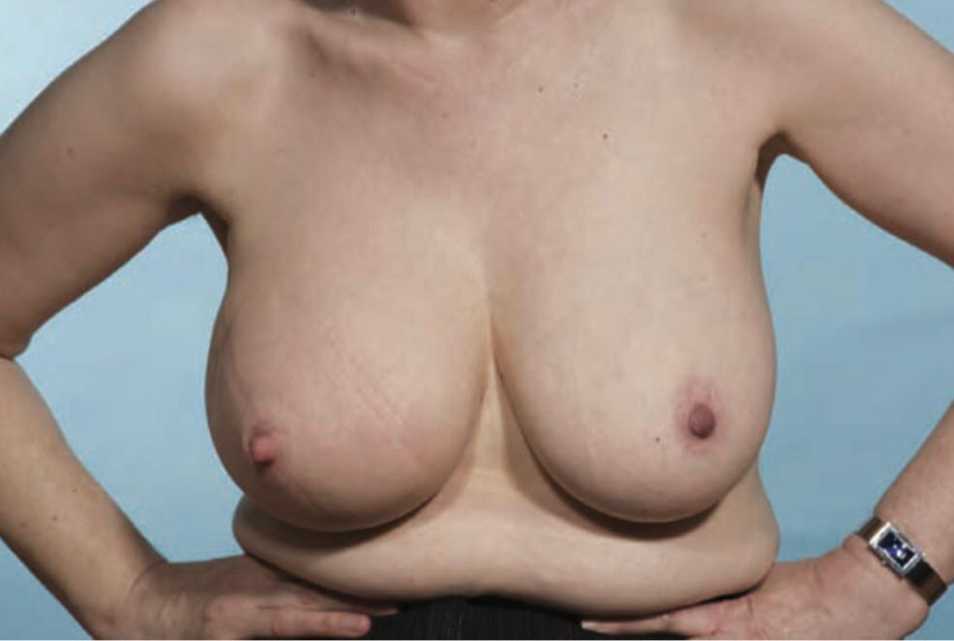
Breast lymphedema
Due to axillary lymphadenectomy, triggered by cellulitis
Breast swelling, heaviness, indentations from bra, pain, tenderness
Pitting, peau d’orange
Breast US
Sports bra, massaging, swimming, manual drainage, mastectomy last resort

Slide 22
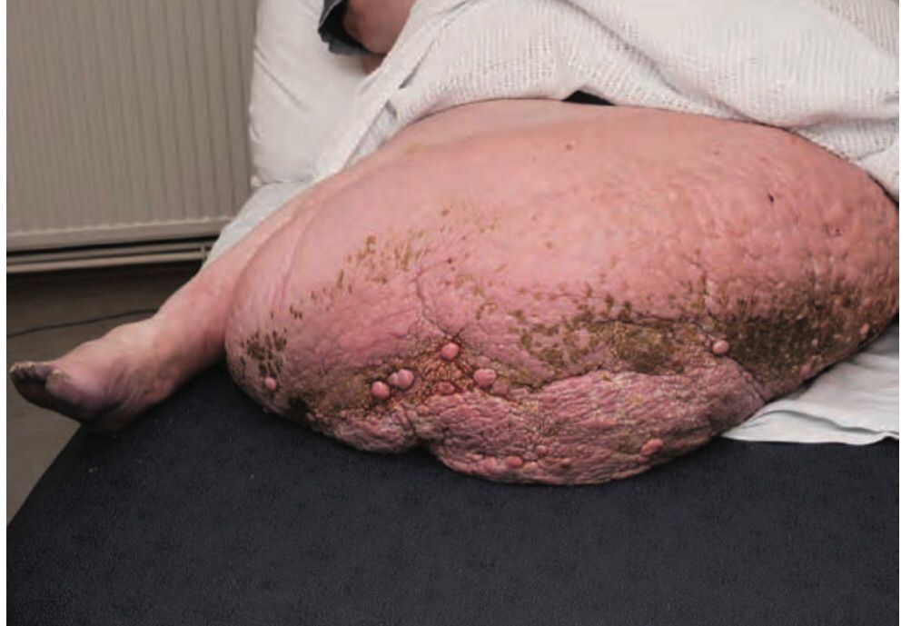
Massive localized lymphedema
Benign lymphoproliferative soft tissue overgrowth in morbidly obese patients (tumor like)
Heavy, polypoid like, elephantiasis skin changes
MRI; oedema within mass and along s/c septae
Compression bandaging, IV antibiotics then surgical resection with reconstruction

Slide 23
Secondary Lymphoedema associated with infection
Recurrent cellulitis
Lymphatic filariasis

Slide 24
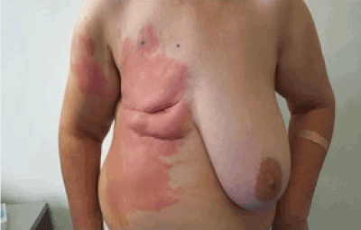
Recurrent cellulitis (erysipelas)
Systemic S/S
Increased swelling
Raised inflammatory markers
Polymorphic rash
Clinical diagnosis, blood neutrophilia, raised CRP, C/S
Systemic antibiotics, long term prophylaxis
Treat lymphoedema

Slide 25
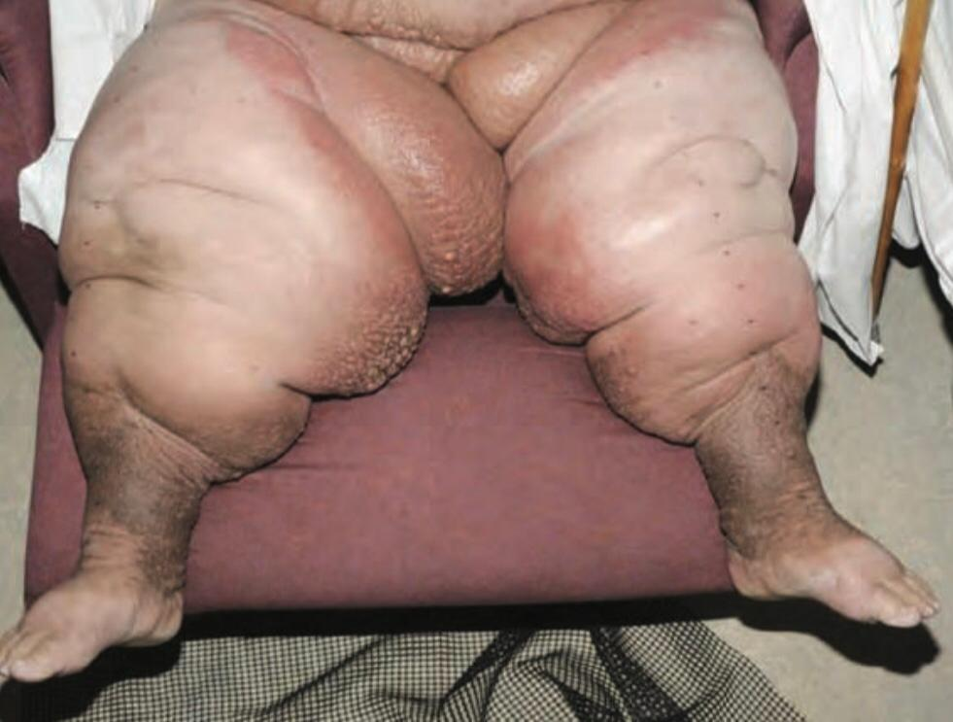
Lipodermatosclerosis (chronic cellulitis)
Inflammation of skin and s/c tissues due to fluid congestion
No S/S of infection
Bilateral, redness, oedema, warmth, pain, tenderness, no itching
No response to antibiotics
Response to legs elevation
Eventually brown, inverted champagne bottle
Clinical diagnosis
Compression therapy

Slide 26
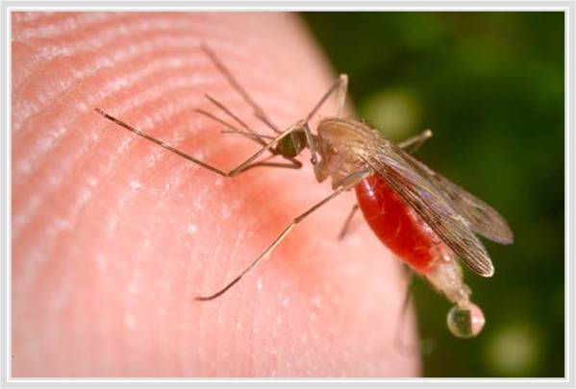
Lymphatic filariasis
It is the largest cause of lymphoedema.
Organism; W. bancrofti, B. malayi, B. timori.
Repeated mosquito bites are required to acquire LF.
Acute adenolymphangitis (most common, sudden fever, painful lymph nodes, lymphangitis, transient oedema), Hydroceles (in tunica vaginalis), Lymphoedema (initially intermittent, pitting later becomes persistent, fibrotic), Elephantiasis, Chyluria rare (reflux of intestinal lymph into renal lymphatic vessels).
Adult live worms enter lymphatic vessels, release irritant toxins, cause dilatation of lymph vessels surrounding the worm, results in obstruction of lymphatic flow hence lymphoedema occurs.
Adult dead worms within lymphatic vessels induce granuloma formation thus causing lymph flow obstruction.

Slide 27
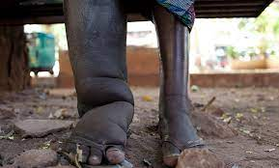
Doppler US (to detect motile adult worms), nocturnal PBS (stained with Geimsa or H&E), PCR and rapid antigenic assays.
Lifestyle modification; footwear and hygiene, prevention of mosquito bites
Drug regime for LF is 400mg albendazole with either i) 6mg/kg diethylcarbamazine citrate (DEC) or ii) 150microg/kg ivermectin once a year for 5 years with coverage of 65% of total at risk population

Slide 28
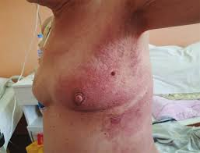
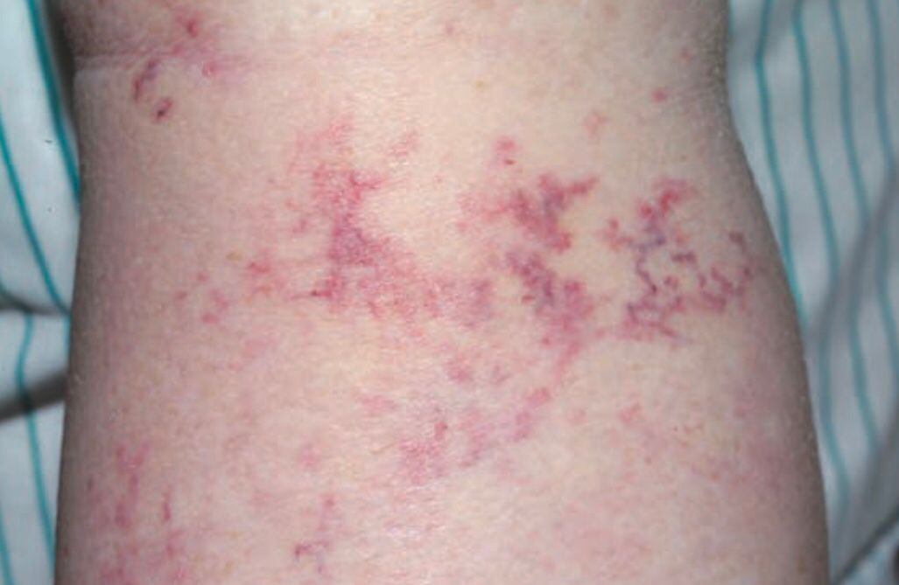
Cancer related lymphedema
Due to surgical lymphadenectomy, radiation therapy, chemotherapy
Extensive lymph node involvement
Carcinoma erysipeloides; cancer cells infiltrate dermal lymphatics, network of telengiectatic vessels
Breast CA related lymphedema; blockage of lymph vessels causing swollen red breast, called inflammatory
For relapse; PET/CT, skin biopsy for mets
CA treatment alongwith lymphedema treatment

Slide 29
Lymphoedema due to inflammation
Podoconiosis
Pretibial myxoedema

Slide 30
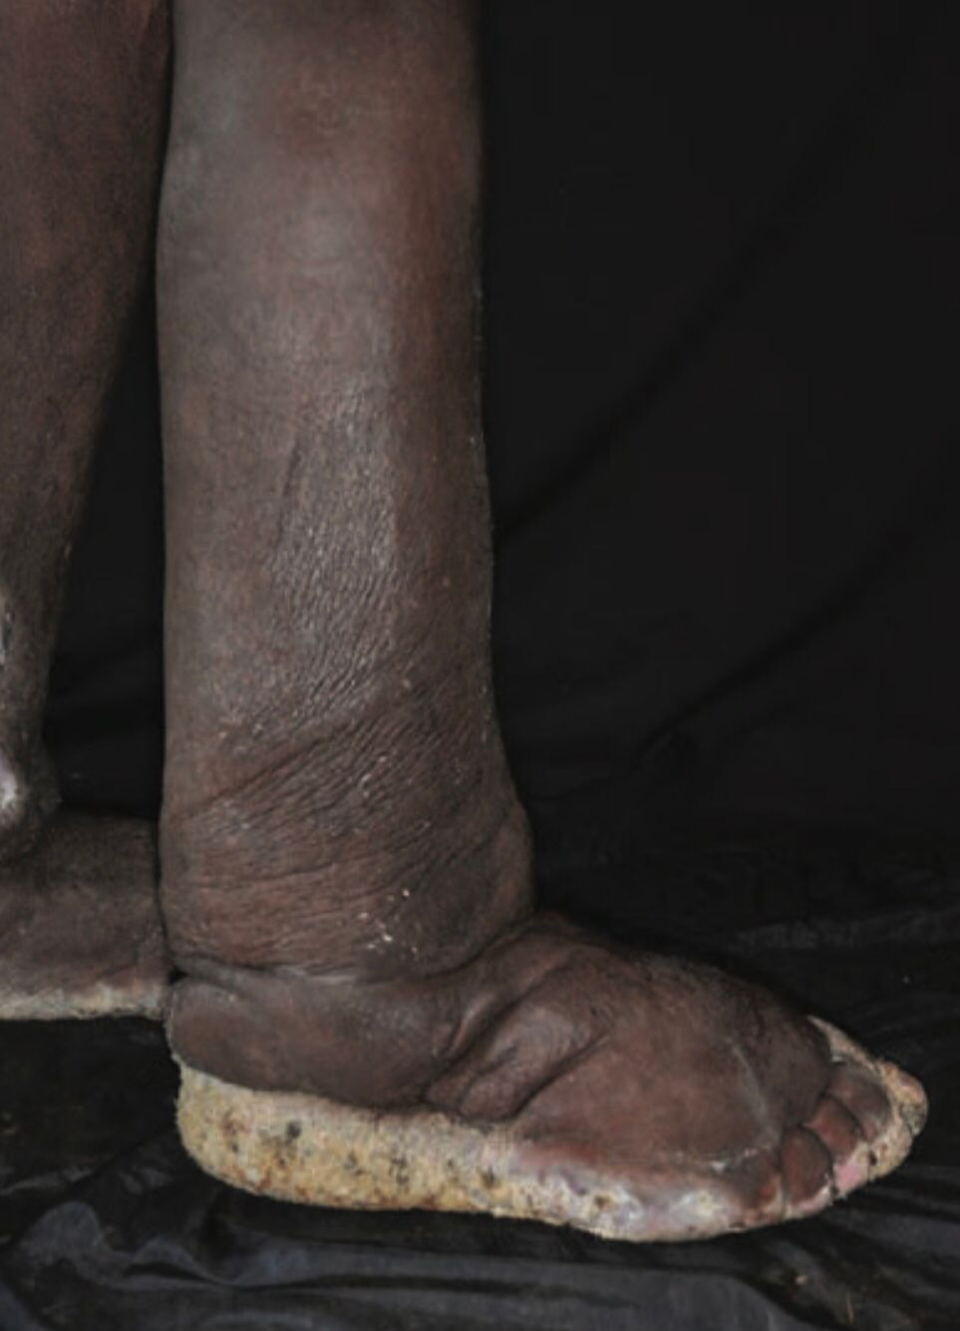
Podoconiosis
B/L lymphedema as a result of prolonged exposure to irritant mineral rich soils at high altitudes which cause inflammatory response resulting in lymphatic drainage.
Barefoot living, farmers, genetic susceptibility
Prodromal pruritis and burning, B/L lymphedema of foot and ankle, lymphorrhoea, elephantiasis, mossy foot, recurrent cellulitis
D/Ds filariasis, Kaposi sarcoma, leprotic lymphedema
Primary prevention, foot hygiene, compression bandaging

Slide 31
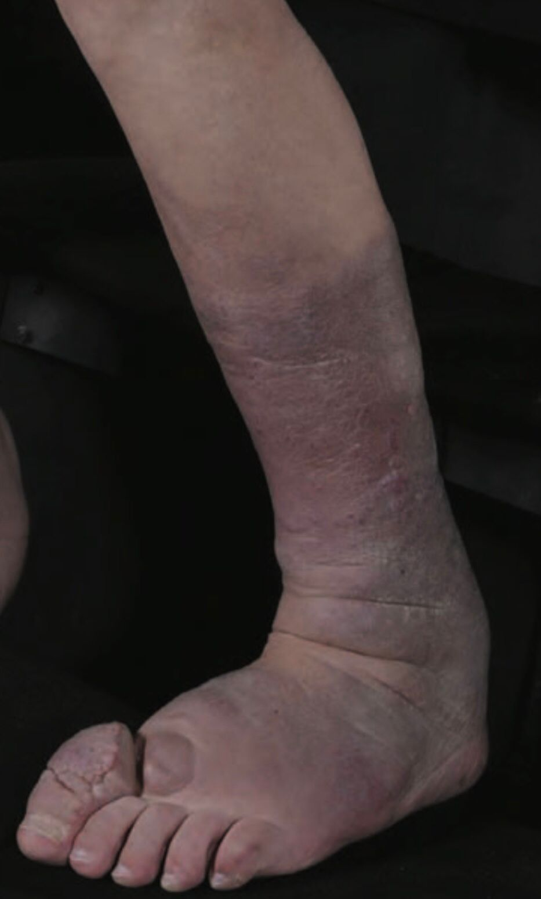
Pretibial myxoedema
Cutaneous mucinosis, occurs in association with Graves disease, results from accumulation of hyaluronic acid and other GAGs secreted by fibroblasts stimulated by TSHR antibodies, obstruction of dermal lymphatics by mucin results in lymphoedema.
S/S; firm, non-pitting indurated nodules and plaques on pretibial regions and feet, rarely on other sites triggered by trauma. Flesh colored or yellowish brown hue, mild are asymptomatic, may be pruritic. In severe, lesions coalesce to give entire extremity enlarged verruciform appearance. Functional impairment or secondary lymphoedema may occur.
Diagnosis is clinical, no need of skin biopsy or lymphatic studies.
For symptomatic; potent topical steroid under occlusion at night, compression therapy for lymphoedema.

Slide 32
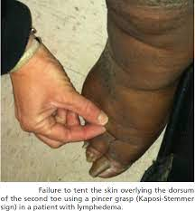
Chronic edema (venous and drug induced)
Lymphedema not respond to elevation or diuretics
Drugs include Ca channel blockers, corticosteroids, taxanes, NSAIDs, clonidine, morphine, gabapentin, olanzapine, pramipexole, thiazolidinediones
Solid as well as fluid component so brawny edema NO Pitting
BNP, or proBNP, plasma albumin, local inflammation

Slide 33
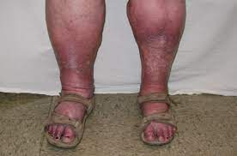
Phleboedema and mixed lymphovenous disease
Mixed lymphovenous disease
Mixed aetiology swelling of (mostly) lower limb due to chronic venous and lymphatic insufficiency
Pitting oedema
H/O varicose veins, DVT, heart failure, sleep apnoea, obesity or infirmity
If lymphedema predominate, induration, nonpitting, Kaposi stemmer sign
Elephantiasis
Recurrent cellulitis
Venous duplex US, venography

Slide 34
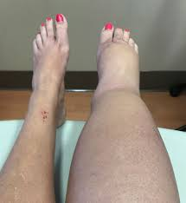
Chronically swollen leg
Persistent swelling not responding to elevation, diuretics
Recurrent cellulitis
Asymmetrical
Hyperkeratosis, elephantiasis
Kaposi stemmer sign pathognomonic
Induration or brawny due to fat and fibrosis
BNP, Imaging, lymphoscintigrapgy, venous duplex US, skin biopsy

Slide 35
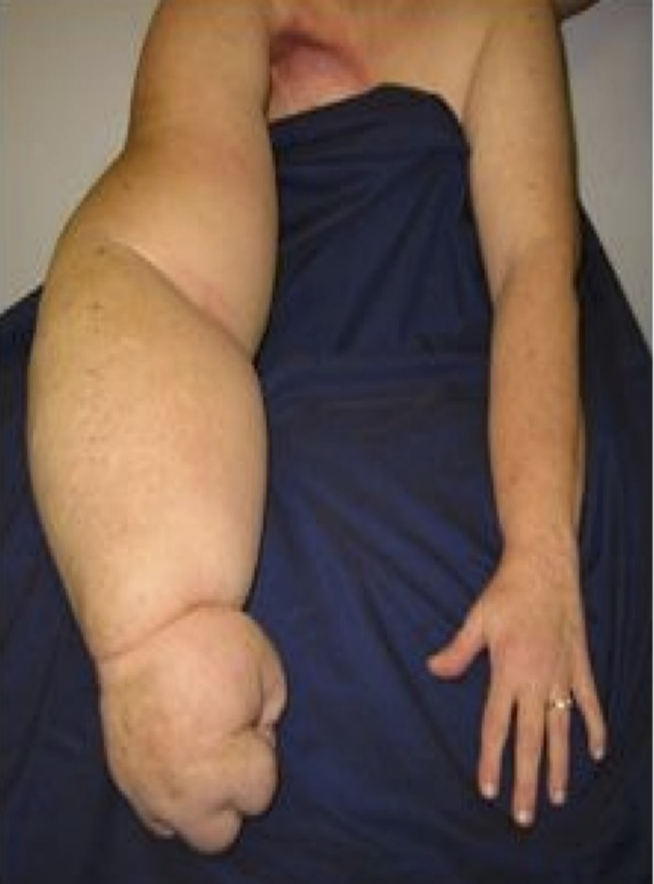
Swollen arm
Oedema due to lymphatic insufficiency or venous obstruction or overgrowth of tissue
Recurrent herpes simplex, chronic hand dermatitis, RA, PsA
In advance cases, fatty or firm
Skin thickened so opaque (decreased visibility of S/C veins)
Rule out venous flow obstruction (discolored painful arm), overgrowth (birthmark), MSD, infection, trauma, neoplasm, allergic reaction
Clinical diagnosis, rule out CA relapse by imaging, lymphoscintigraphy, venous duplex US, venography, MRI

Slide 36
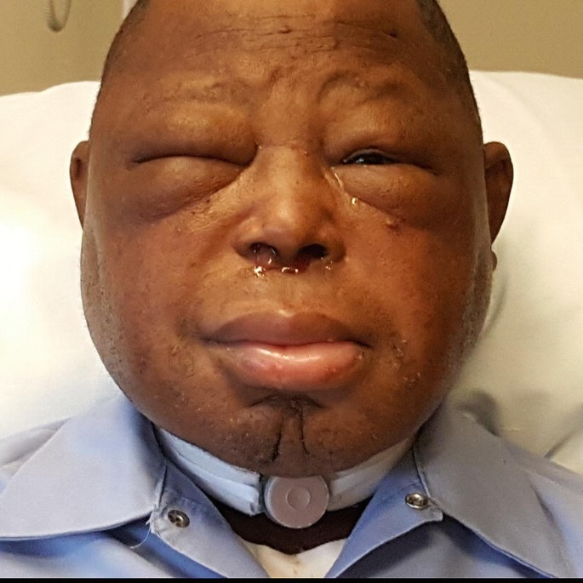
Swollen face, head and neck
Head and neck CA or its surgery or radiotherapy, recurrent angioedema, cellulitis
Angiosarcoma, Kaposi sarcoma
Upper or lower lip oedema; vascular anomaly, OFG, sarcoidosis, infective cheilitis, lip fillers
Eyelids; DM, graves disease, rosacea/acne
Ear; rosacea, psoriasis, eczema, cellulitis, pediculosis, trauma
Extension within mouth causes scrotal tongue
Skin biopsy for granulomatous disease, lymphoscintigraphy, MRI, CT
Treat underlying cause, enhance lymph flow via massage and facial exercises

Slide 37
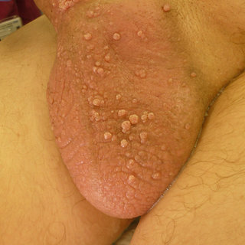
Swollen genitalia and mons pubis
Primary; B/L lymphatic flow obstruction
Secondary; CA infiltration, traumatic or surgical scarring, obesity, granulomatous like Crohn disease, HS, filariasis, LGV, donovanosis
Hyperkeratosis and papillomatosis
Lymph congestion causing lymph blisters when rupture lymphorrhea; risk of CD and cellulitis
Expansion of congested dermal lymphatics; lymphangiectasia
Mons pubis lymph edema; dome shaped swelling with peau d’orange
Rule out systemic edema, hydrocele, inguinal hernia
Skin biopsy for granulomatous disease, lymphoscintigraphy, MRI, CT, complement fixation test for filariasis

Slide 38
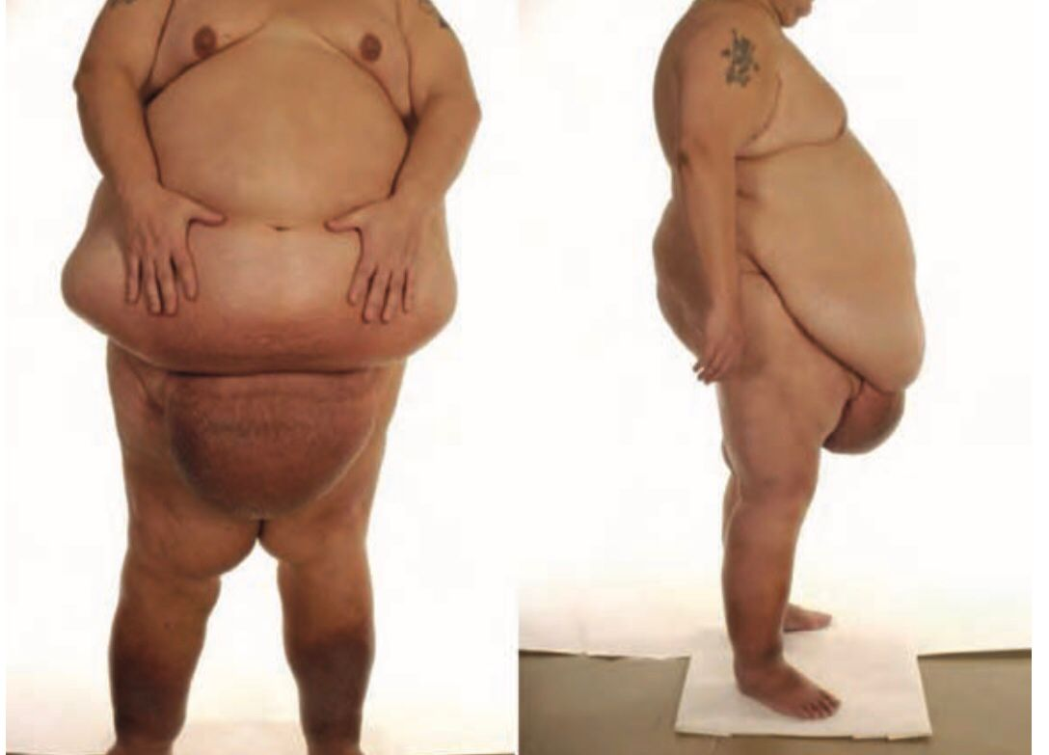
Abdominal wall lymphedema
If B/L compromise of ilioinguinal lymph drainage or pendulous obese abdomen
Swlling, discomfort, h/o CA treatment, obesity, cellulitis
Pinching; more solid than fat
Fibrosis; induration
Complications; hyperkeratosis, papillomatosis, elephantiasis nostras verrucosa, cellulitis, LDS

Slide 39
Lymphatic malformations
Lymphangioma circumscriptum
Lymphangiectasia

Slide 40
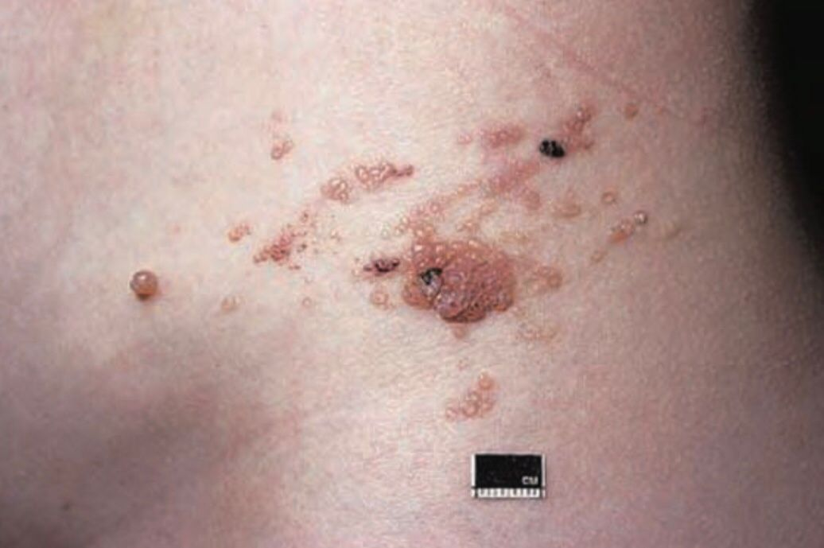
Lymphangioma circumscriptum
Lymphatic malformation that is localized to an area of skin or s/c tissue
At birth or during childhood, appears as fluid filled vesicles (frogspawn) that bulge on skin surface
Warty appearance
Sites; axillary folds, shoulders, flanks, proximal limbs, perineum
Lymphorrhea or local cellulitis
D/Ds vascular malformations, hamartomas, tumors
Biopsy and staining with CD31 and D2-40, duplexUS (for flow), MRI (for extent and extension into tissue elements)
Sclerotherapy mainstay for macrocystic, bleomycin for microcystic

Slide 41
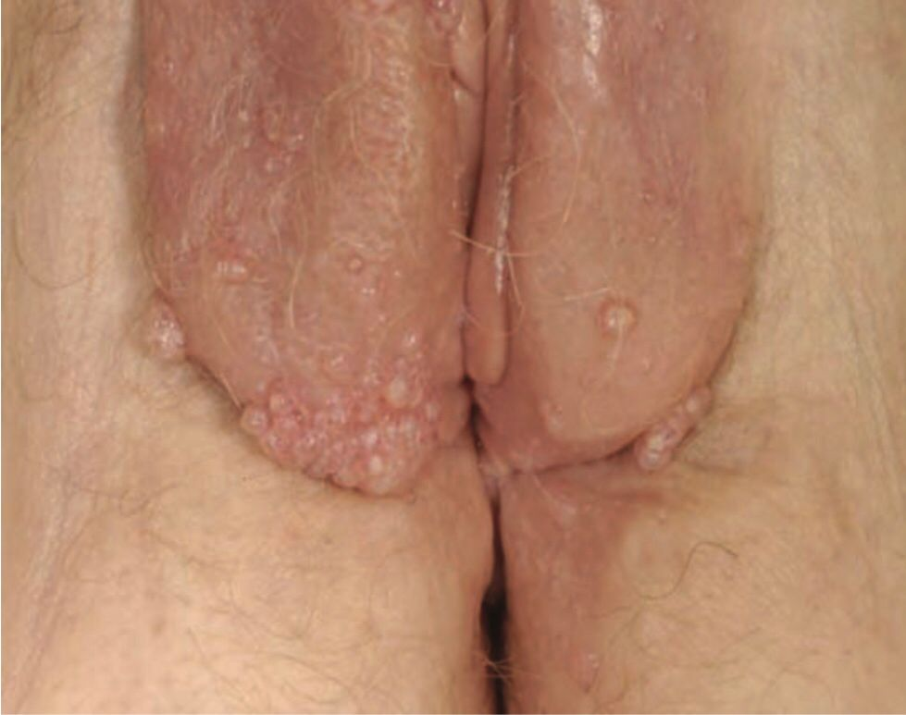
Lymphangiectasia
Lymphangiectasia means distension, expansion or dilataion of a lymph vessel.
Damage to lymphatic vessels leads to obstruction of lymph drainage causing expansion of lymhatic vessels.
Causes; ilioinguinal block dissection, pelvic CA surgery and radiotherapy, recurrent or chronic infections (scrofuloderma, HS, scleroderma, keloid, repeated trauma, penicillamine dermopathy).
Clear fluid filled blisters to smooth flesh colored papules or nodules, oozing lymph. Genital lesions may become hyperkeratotic.
D/Ds Warts, MCs
Biopsy with D2-40 stain
Control infection, reduce lymphedema, for lymph blisters laser or diathermy may be used.

Slide 42
Differential Diagnosis
Lipoedema
Obesity related lymphedema
Yellow nail syndrome

Slide 43
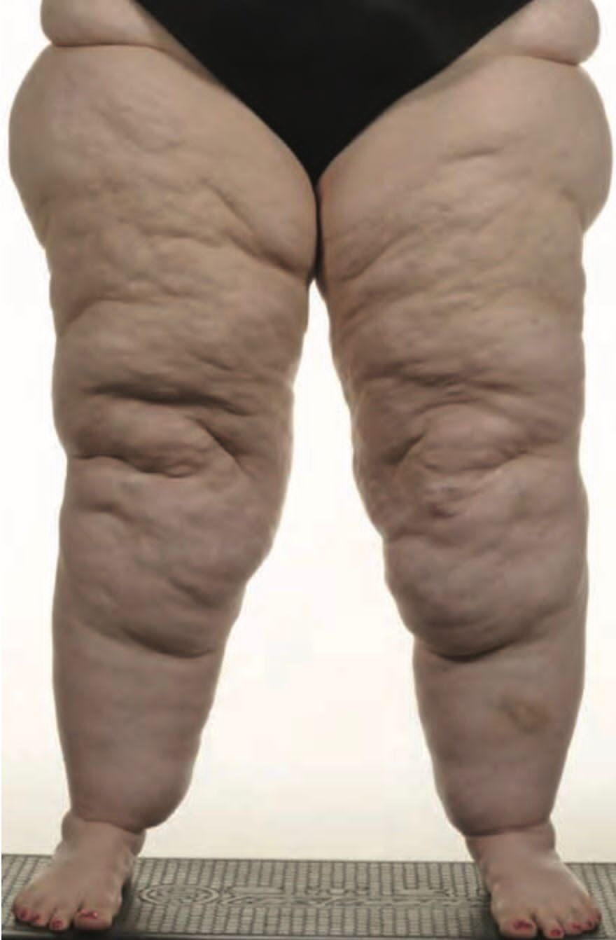
Lipoedema
In women, at time of hormonal change
B/L symmetrical, minimal inovolvement of feet
Minimal pitting edema
Pain, tenderness, easy bruising
Persistent enlargement despite elevation of extremities or weight loss
Doughy consistency
Subclinical reduction in lymphatic function
Tx; Liposuction

Slide 44
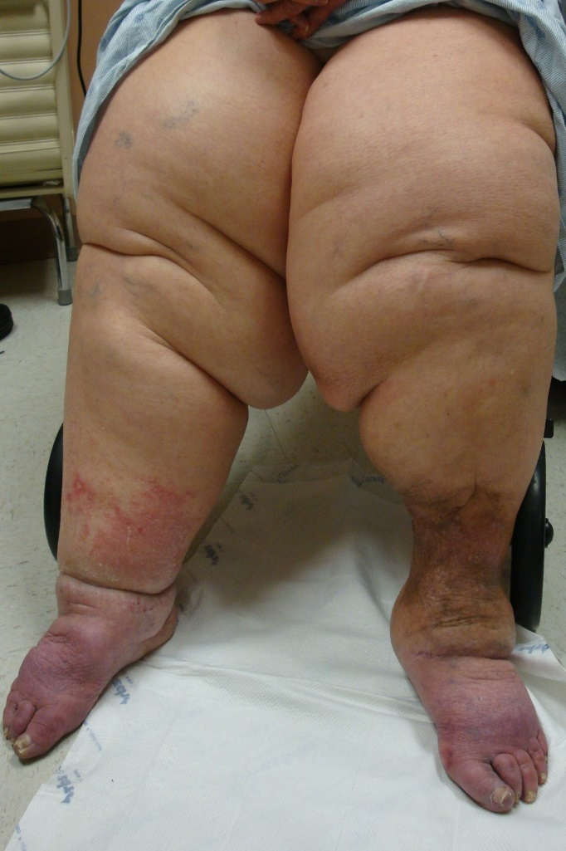
Obesity related lymphedema
Poor mobility (to stimulate lymph drainage)
Venous hypertension due to dependency and pendulous abdomen obstructing venous drainage in thighs
Sleep apnoea syndrome
Drug; Ca channel blockers
Comorbs; heart failure, post thrombotic syndrome
Skin changes of LDS and elephantiasis
Rule out systemic causes
BNP, plasma protein, D-dimers

Slide 45
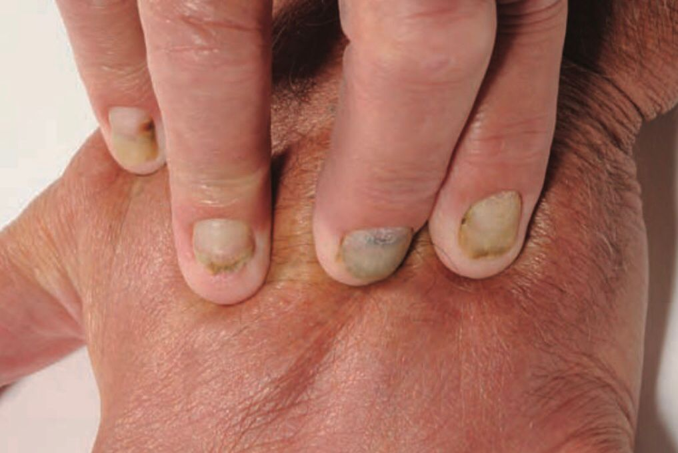
Yellow nail syndrome
Triad of Lymphedema, Respiratory disease and Yellow dystrophic nails.
Nail changes include yellow green discoloration, overcurvature, onycholysis, nail palte remains smooth translucent (in fungal infections nails are friable)
Resp; chronic sinusitis, bronchiectasis, pleural effusion
Diagnosis is clinical
For pleural effusion; pleurodesis and decortication/pleurectomy
For nails; vitamin E (evidence base is weak)

Slide 46
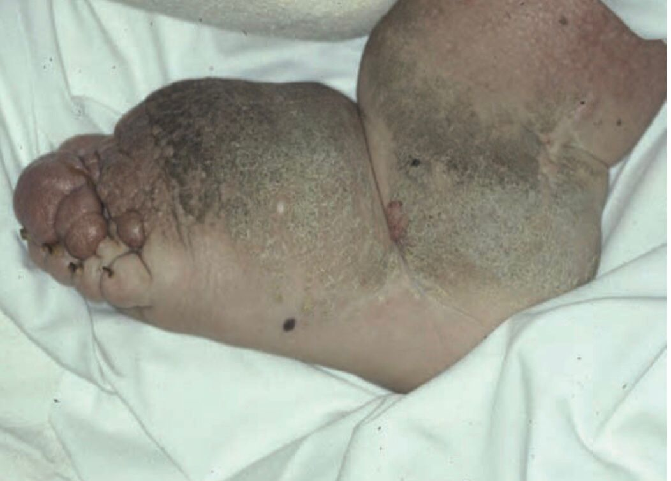
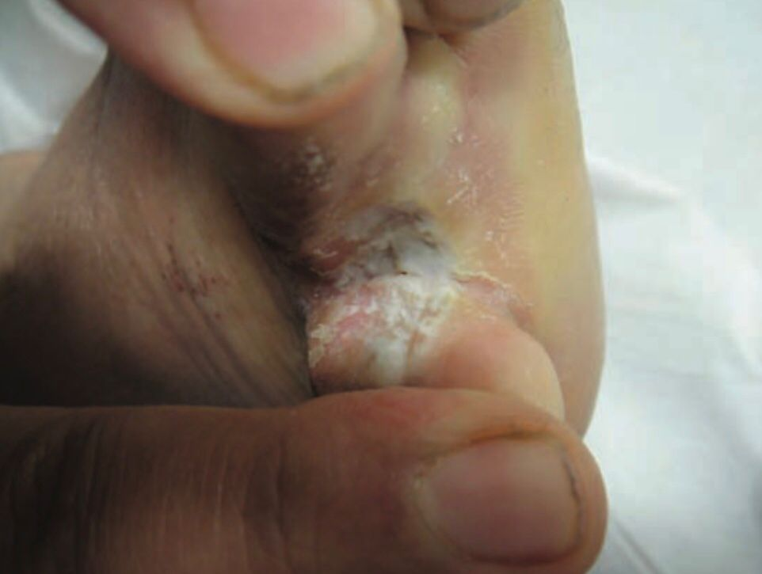
Complications
1. Swelling
Pain, discomfort, functional impairment
2. Skin changes
Elephantiasis (hyperkeratotic warty epidermis, thick dermis, cobblestone), lymphorrhea, lymphangiectasia
3. Infection
Cellulitis, tinea pedis, opportunistic infections
4. Psychosocial issues
Personal and professional life affected
5. Malignancy
Through immunodeficiency of compromised drainage (particularly angiosarcomas)
6. Miscellaneous
Xanthomas, bullous pemphigoid, TEN, atypical neutrophilic dermatosis, severe necrotizing fascitis

Slide 47
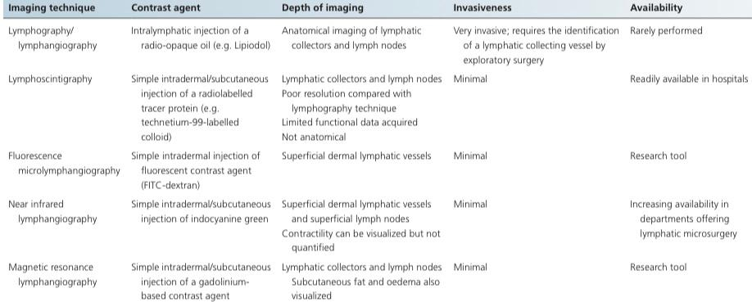

Slide 48
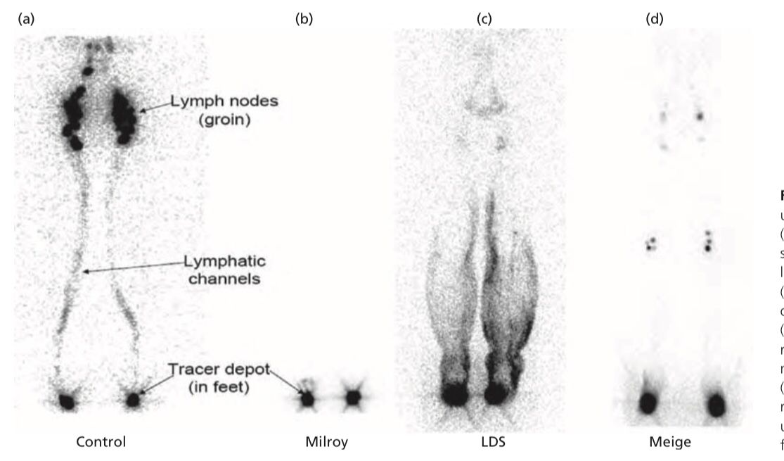
Lymphoscintigraphs

Slide 49
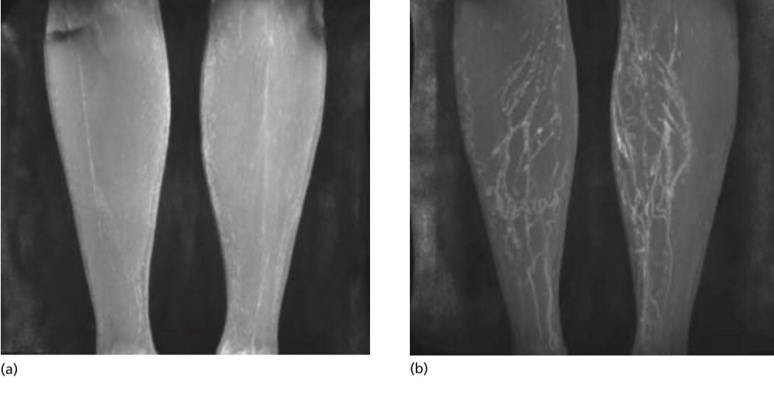
Magnetic resonance lymphangiographs

Slide 50
Histopathological investigation of the lymphatic system
For distinction between lymphatic and blood vessels in skin biopsy
made by specific lymphatic markers:
D2-40 (podoplanin)
Prox-1 and VEGFR-3
these stain lymphatic but not blood vessels.

Slide 51
Management
Medical assessment
If systemic causes have lead to or coexist, treatment of medical condition must be undertaken.
Physical therapies
1. Care of skin and prevention of infection
Emollients
For tinea pedia; terbinafine cream for 2 weeks followed by alcohol wipe.
For deep cracks; regular toilet followed by potassium permanganate soak.
For hyperkeratosis; 5% salicylic acid ointment.
For elephantiasis skin changes; long term compression.
For prevention of infection; care of skin, good hygiene, control of tinea pedis and good antisepsis following wounds.

Slide 52
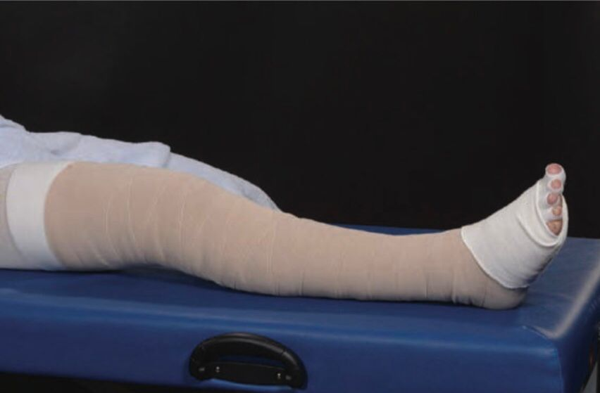
2. Exercise
Dynamic muscle contractions (isotonic exercises) encourage both passive and active phases of lymph drainage.
Overexertion and excessive static (isometric) exercise increase blood flow, which tends to increase oedema.
3. External compression
It acts as a counterforce to striated muscle activity and so generate higher tissue pressures during contractions that provides the most powerful stimulus to lymph drainage.
Bandaging suitable for limbs reduction also for restoring shape.
Pneumatic compression therapy can be used to reduce limb volume but not preferred as swelling recurs.

Slide 53
4. Massage (manual lymphatic drainage therapy)
A technique of re-routing accumulation of lymph from the swollen region via collateral lymphatic pathways to lymphatic basins that are able to drain normally.
Expensive
5. Breathing, postural exercise
These are important for clearance of lymph from the thorax and abdomen.
Weight loss is also beneficial in morbid obesity as excessive weight impair lymph drainage.
6. Intensive and maintenance treatment
Intensive therapy, comprising a 2-4 week course of daily skin care, MLD, multilayer bandaging and exercises.
Then maintenance with hosiery.

Slide 54
7. Pharmacological therapies
Diuretics alone results in minimal improvement in lymphoedema as they reduce blood volume.
Studies have shown that tranmitted VEGFC can restore lymphatic network in defective area, human trials have yet to be commenced.
Surgical Options
1. Excisional methods
These have been employed previously regardless of underlying cause but now rarely used due to post op complications.
Sistrunk procedure: Removal of longitudinal ellipse of skin and S/C tissue down to deep fascia. Removal of additional tissue (Homans procedure), circumferential excision and skin grafting (Charles procedure) or in rolling of skin flap (Thompson buried dermis flap operation) can be done.
It is done for volume reduction in genital or eyelid lymphoedema or cases where alternative options are lacking.
No improvement in lymph drainage.
Complications: Skin transplant necrosis, poor cosmesis, worsening lymphoedema distal to surgical site.

Slide 55
2. Lymphatico-venous anastomosis surgery
LVA is done under local anaesthesia, supermicrosurgical technique to anastomose distal dermal lymphatic vessels with adjacent venules.
New procedure so lack of long term data, but low complications (lymphatic vessel occlusion can occur due to thrombus in venule).
3. Lymphatico-lymphatic anastomosis surgery
To avoid coagulation of blood, lymphatics connected to lymphatic system itself.
Again lack of long term data.

Slide 56
4. Lymph node transfer surgery
Autologous transplantation of normal lymphatic tissue within a local or free flap to a site deficient in lymph nodes and vessels.
Results are encouraging but lack if long term data.
It can not be done in primary lymphoedema as they may not have normal lymph nodes, also in CA related lymphoedema donor site lymphatic dysfunction occured.
5. Liposuction
Excess adipose tissue will not respond to decongestive treatments or anastomosis surgery.
Liposuction is used as adjunct in patients compliant to wear lifelong compression garments, creates significant volume reduction.

Slide 57
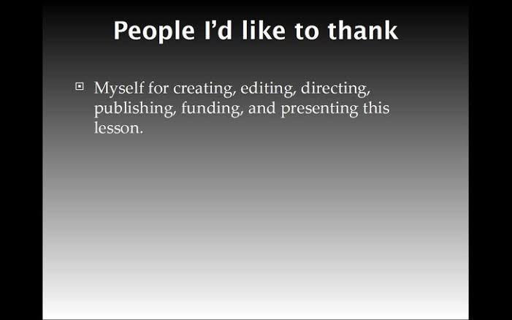

Slide 58


