Slide 1
leprosy

Slide 2
1.Whats the key features of tuberculoid .. borderline n lepromatous leprosy on history?
2.histopath findings of histoid leprosy n Lucio reaction?
3.which index is used to monitor disease activity?
4.what r different characteristic lesions in leprosy?
5.wt other drugs can b used in enl other than conventional drugs?

Slide 3
1. Key feature of tuberculoid borderline and lepromatous leprosy on hx –
  Tuberculoid - few number of lesions, asymmetrical, well defined, hypopigmented / copper colored, insensitive, anhidrotic, loss of hair,peripheral nerve enlargement
  Borderline - punched out, lesions in more in number, similar to tuberculoid at BT pole, similar to lepromatous at BL pole
  Lepromatous- hundreds of lesions, symmetrical, vague edges, late loss of sensations and sweating, macules, papules,plaques, nodules
2. Histopath of histoid leprosy –
  elongated or spindles shaped histiocytes and bacilli within them are longer than normal
  Histopath of lucio reaction - deep cutaneous vasculitis

Slide 4
3. Index used to monitor disease activity - morphological index - % of solid staining bacilli in a stained smear, variable indicator of response to treatment, shows early signal of drug resistance
4. Different characteristic lesions in leprosy - hypopigmented macules and patches, copper colored patch, infiltrates plaques and nodules, leonine facies
5. What other drugs can b used in ENL other than conventional drugs- steroids , thalidomide, clofazimine, colchicine

Slide 5
1- whats difference between lucio leprosy and lucio phenomenon
2- difference between relapse and reaction
3- difference between reversal reaction and enl reaction.
3- difference between lagopthalmos of bell' palsy and lagopthalmos of leprosy.
4- whats difference between nerve involvement of diabetes and leprosy?
5- whats frozen hand??

Slide 6
Q. Difference between lucio leprosy and lucio phenomenon ?
  Lucio leprsoy is a diffuse form of leprosy ,found in Mexico and Central America Diffuse skin thickening ,(no skin lesions ),madarosis ,sensory loss Unlike LL no eye involvement,no motor nerve involvement
  Lucio phenomenon;occurs in lucio leprosy ,manifestations include purpuric macular and large necrotic ulcers with bizzare angulated borders occurring on lower legs
Q. difference between relapse and reaction(enl )
  Relapse few lesions asymmetrical , Reaction ,enl lesions occur on crops disappear after few days ,are blanchable
  smear from enl lesions contain few granular bacilli while those from relapse contain large number of bacilli
  In enl increase in esr ,increased number of leukocytes while in relapse they are normal

Slide 7
Q. difference between reversal reaction and enl ?
  Reversal reaction :delayed type hypersensitivity;existing lesions enlarge ,become erythematous ,edematous ,along with severe neuritis No systemic disturbance
  On h/p edema ,reduced bacilli,increase number of lymphocytes,epitheloid cells
  ENL (type 3 reactions ;deposition of immune complexes )New lesions form in crops ,blanchable ,disappearConstitutional symptoms ,fever ,conjunctivitis,iritis myosotis ,arthlralgias ,swollen nodes etcH/p edema ,neutrophils and sometimes vasculitis
Q, Lagopthalmos of Bell’s palsy vs leprosy ??
  Bell’s palsy in leprsoy in mainly due to involvement of zygomatic branch of facial nerve that supplies lower lid (anatomically lies in cooler area )

Slide 8
Q.difference between nerve involvement of diabetes and leprosy ??
  In both glove and stocking anasthesia but in leprosy it can be patch in initial phase coz of preference of m Leprae for cooler sites
  Deep tendon reflex’s lost in diabetes and not in leprosy
Frozen hand
  varying degrees of the syndrome commonly complicate reactional states in leprosy. Oedema of the hand is a constant feature, and the following 4 principal factors are considered in turn: (i) slowed circulation of arm and hand; (ii) immobility of the shoulder; (iii) flexed position of the wrist; and (iv) extended position of the metacarpophalangeal joints. A report is then given of a study of 48 upper extremities in 25 patients undergoing leprosy reactions, and emphasis is laid on the danger of prolonged oedema causing hand deformity as a result of scarring and contraction of ligaments, tendons, synovial membranes and joint capsules

Slide 9
1.Classification of leprosy according to WHO.
2.what is facies leprosa?
3.What is pyridine extractibility?
4.What is difference between trachoma pannus and pannus formed in leprosy?
5.kidney involvement in leprosy?6.Cause of death in leprosy?

Slide 10
WHO classification
  Tuberculoid leprosy(TT)
  Borderline tuberculoid(BT)
  Midborderline(BB)
  Borderline lepromatous(BL)
  Lepromatous leprosy(LL)
What is facies leprosy
  Leonine facies:morphological manifestation of diffuse dermal infiltration of the face.papules n modules fusing together into plaques resulting into grooves n fissures on the face esp on forehead , madarosis, saddle nose deformity create the leonine face appearance

Slide 11
Q3 What is pyridine extractability
  Pyridine is heterocyclic compound similar to benzene with one methine group replacing the nitrogen atom,it extracted from agrochemicals,pharmaceuticals and vitamins,previously extracted from coal tar
Q4Diff between trachoma pannus n leprosy pannus
  Trachoma pannus caused by infiltration of ChlamydiaSubepithelial infilteration and vascularization of peripheral cornea contiguous with limbus along with increase goblet cells,lacrimal gland n sac infiltration
  Pannus in leprosy: stromalInfiltration of mycobacterium leprae extending from limbus to central cornea,deep vascularization of cornea,cornea thickened due to excessive infiltration,vision severely affected

Slide 12
Kidney involvement in leprosy
  Amyloidosis
  Glomerulonephritis
  Nephrosclerosis
  Tubulointerstialnephritis
  Granulomas
Q6Causes of death in leprosy
  Suicide
  CVD
  Multi organ failu

Slide 13
1)dds of leonine facies
2)rehabilitation in leprosy
3)2nd line drugs of leprosy
4)indications of clofazimine
5)treatment of relapse

Slide 14

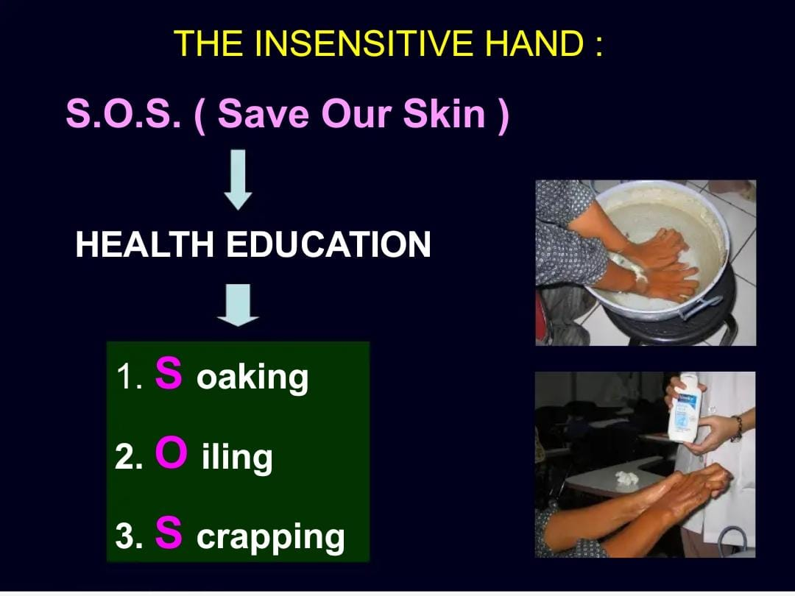

Slide 15
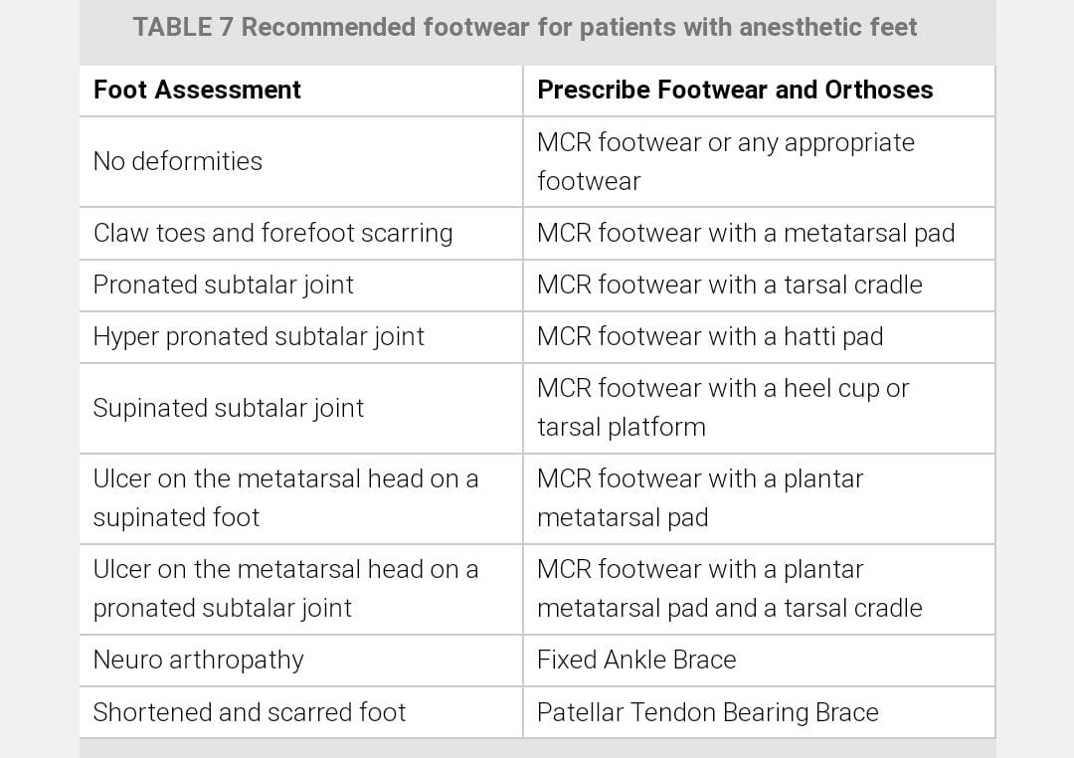
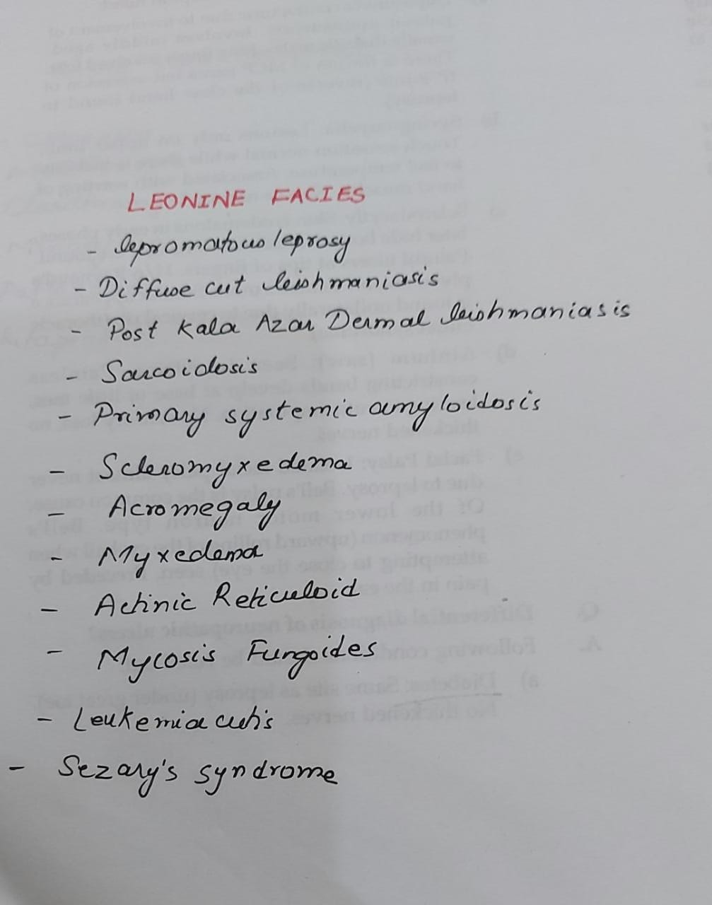

Slide 16
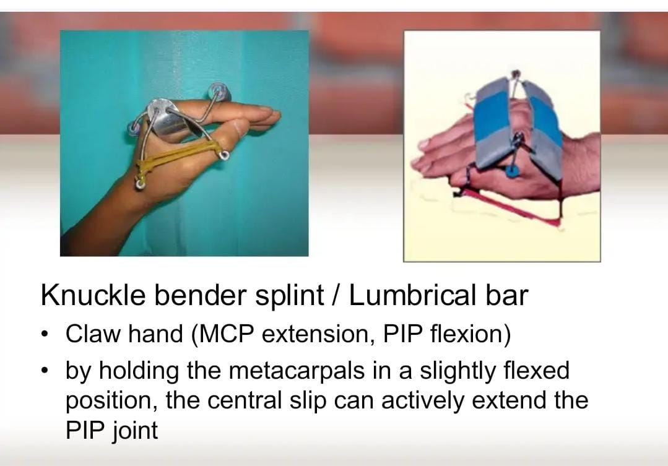
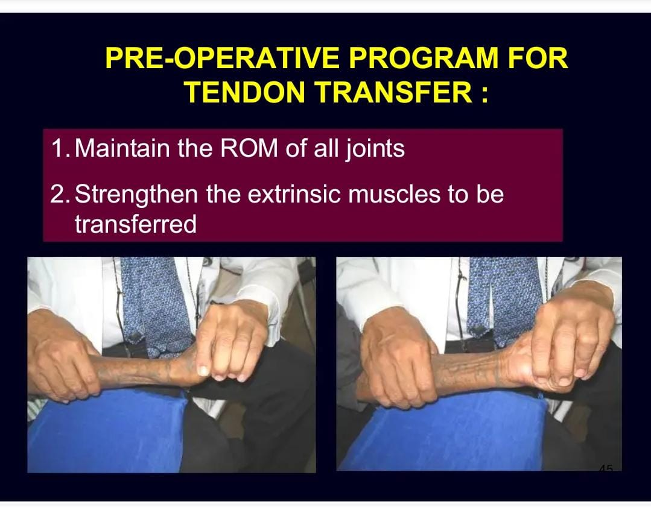

Slide 17
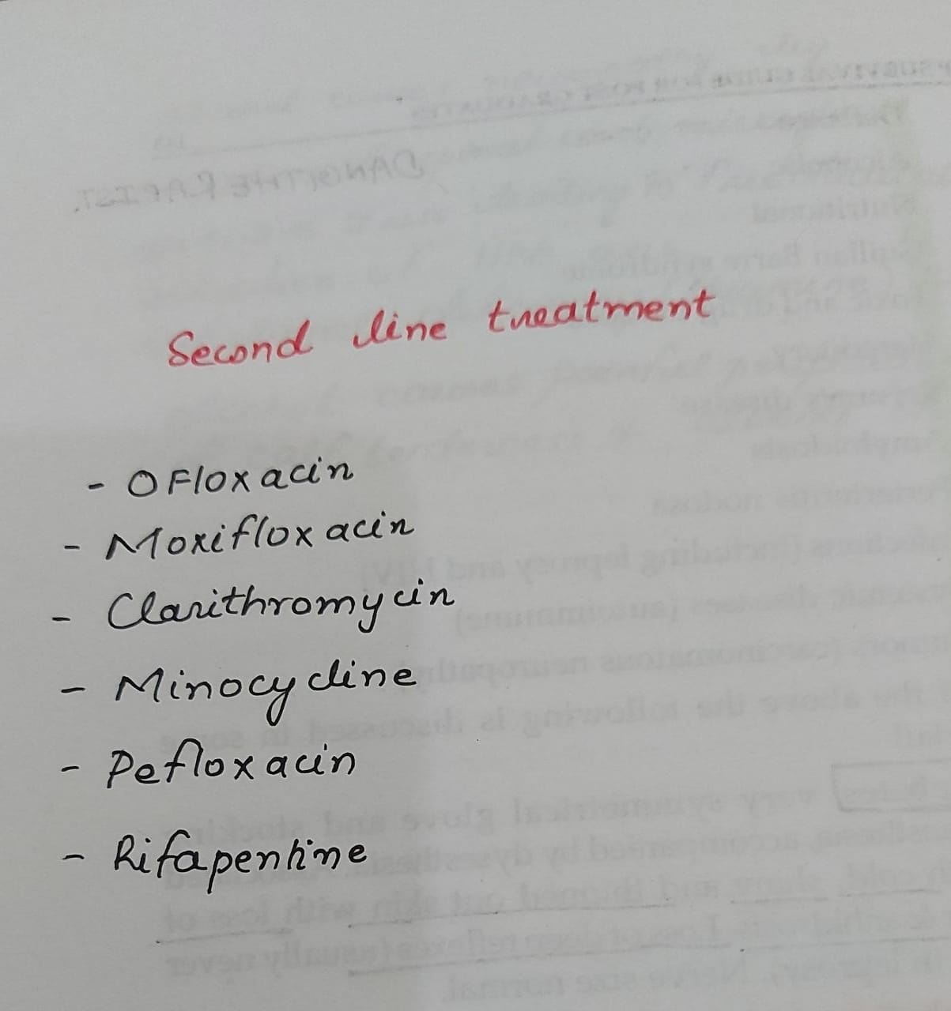


Slide 18
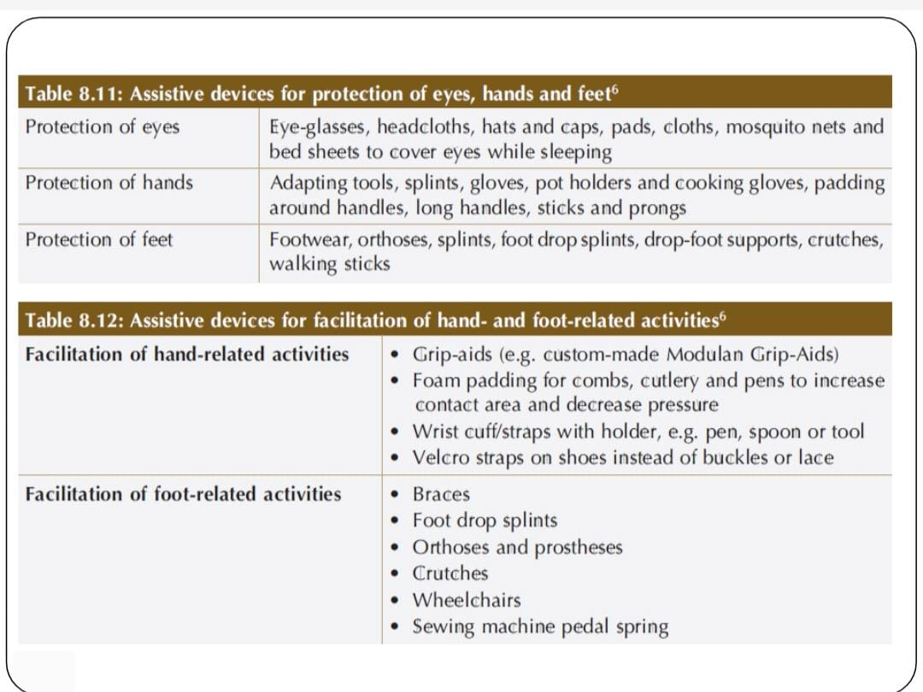
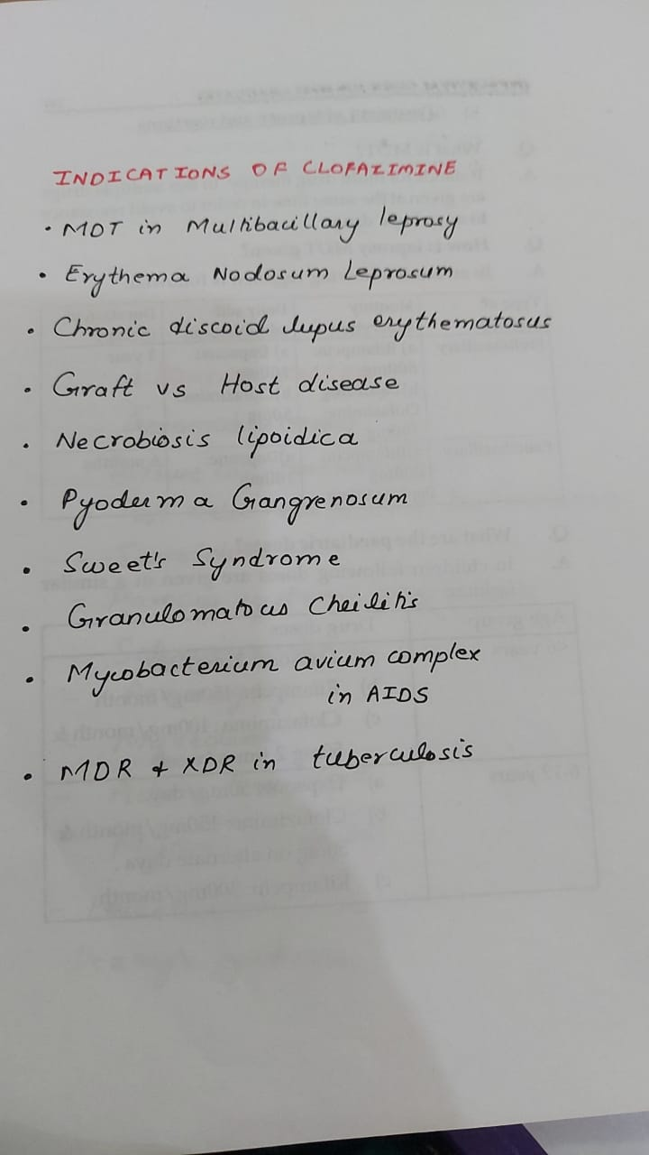

Slide 19
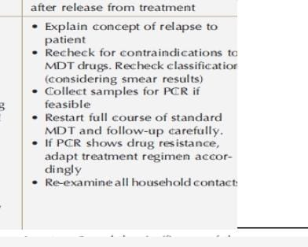

Slide 20
1.What is treatment failure
2.what is relapse and recurrence
3.What are persisters
4.Difference between zn and modified zn
5.What is histoid leprosy

Slide 21
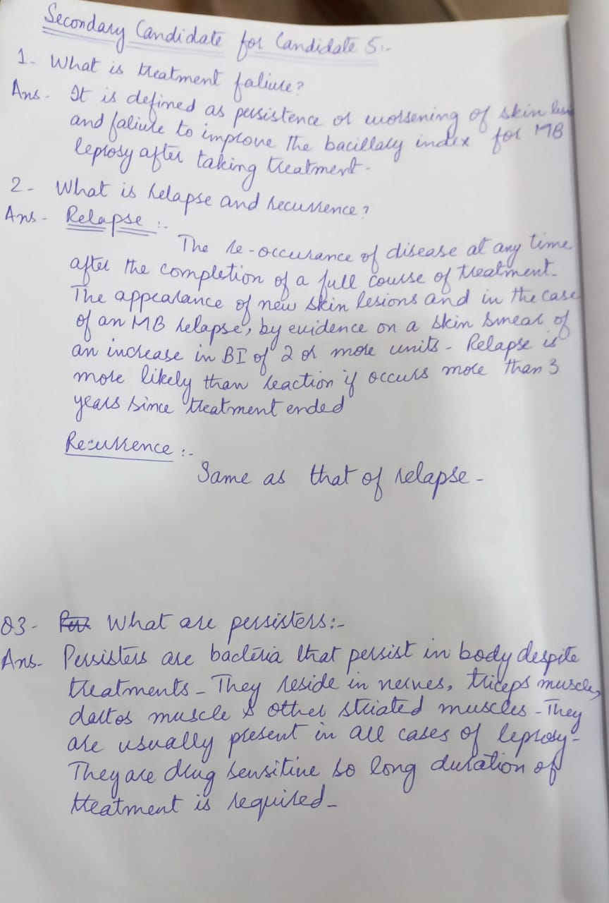
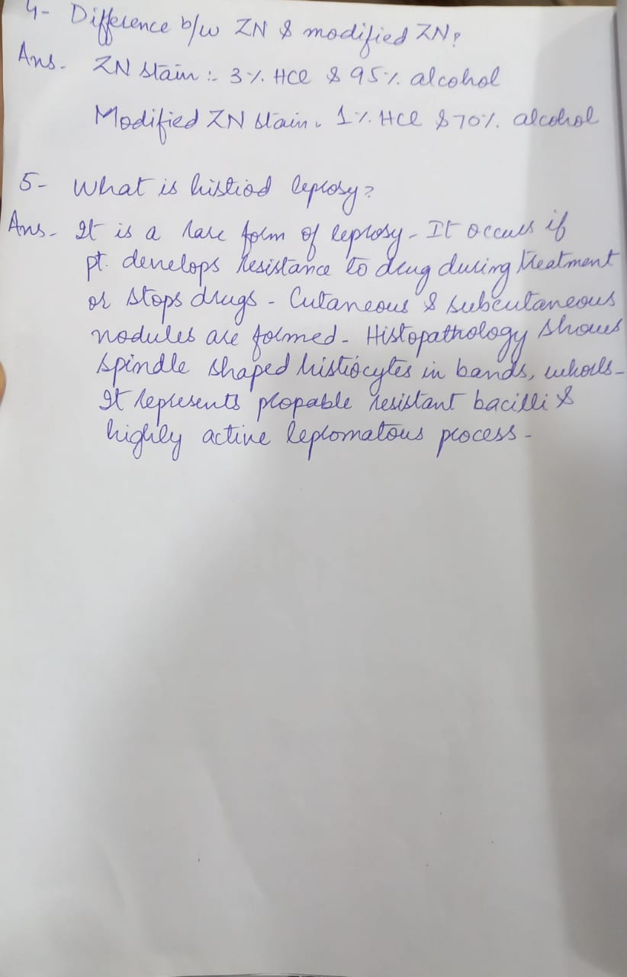

Slide 22
1. Serological test for leprosy and its significance?
2. How to clinically differentiate 5th and 7th nerve damage during eye examination?
3. What are the leprosy endemic areas in pakistan?
4. Recent most leprosy stats as of year 2019 or 2020. New cases?
5. What are the causes of abdominal pain in leprosy patient.?

Slide 23
How to differentiate between 5th and 7th nerve palsy clinicaly
tested with a wisp of cotton wool; absence of the reflex is indicative of damage to the trigeminal nerve (5th cranial nerve).
The corneal reflex is a reliable measure of afferent trigeminal V1 and efferent facial nerve VII fibers (a V–VII reflex) and is present at infancy. Lightly touching the cornea with a tissue or cotton swab induces a rapid bilateral blink reflex. According to traditional teachings, unilateral trigeminal nerve dysfunction (i.e. in the ipsilateral brainstem, V1, or V2 divisions) prevents both eyes from blinking after stimulation of the ipsilateral cornea, whereas unilateral facial nerve dysfunction prevents the ipsilateral eye from blinking when its cornea is stimulated, although the contralateral eye blinks normally.
59 Uncommonly in leprosy, there may
be bilateral facial nerve palsy.60

Slide 24
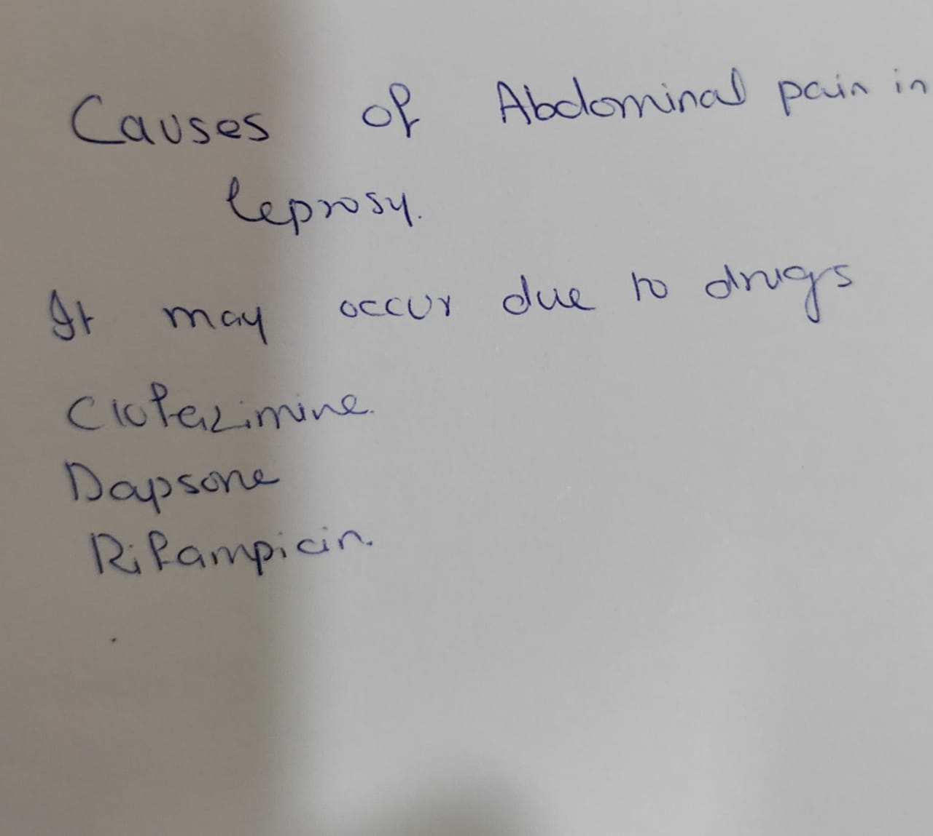
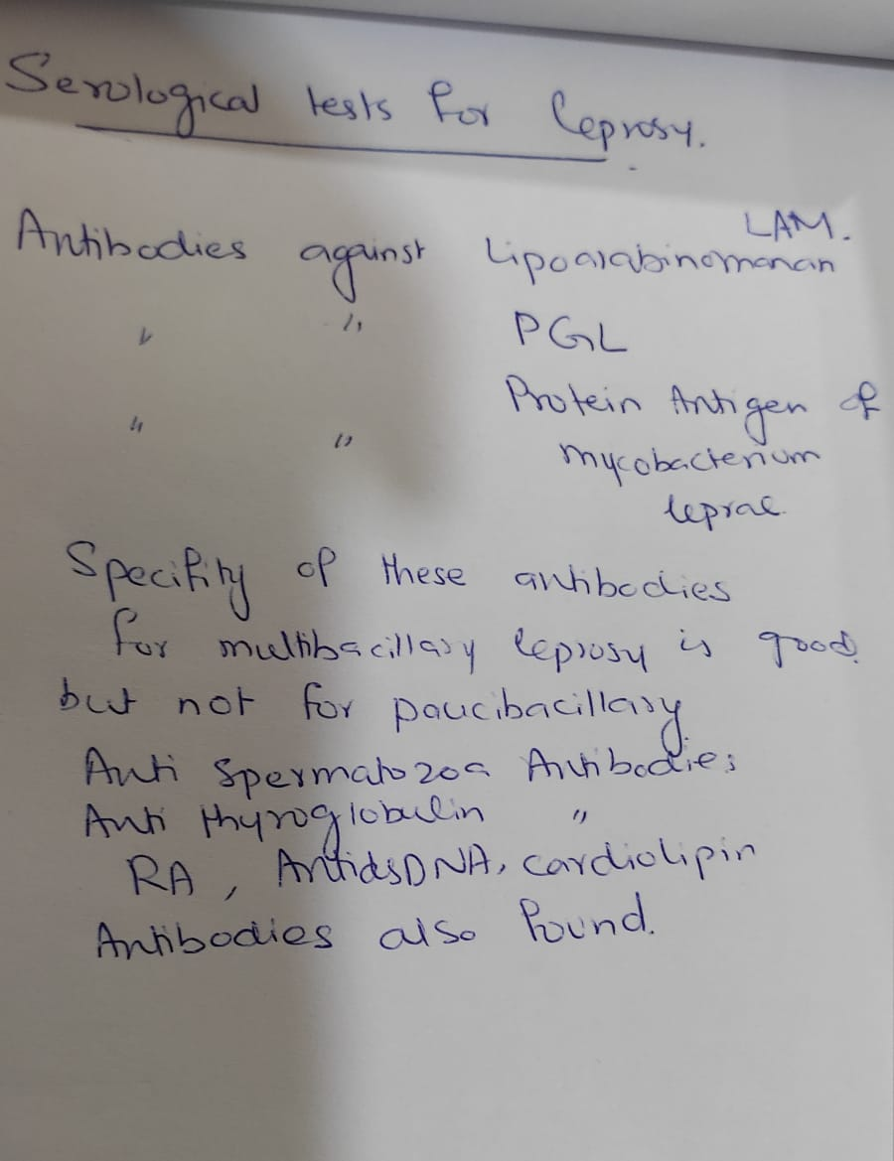

Slide 25
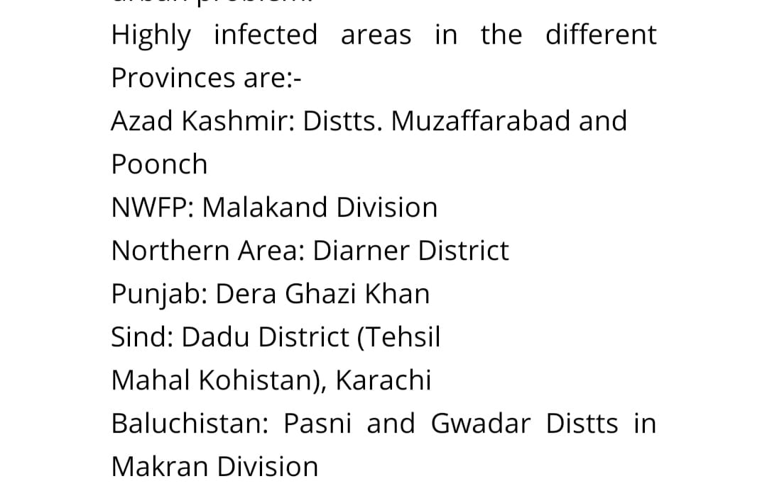
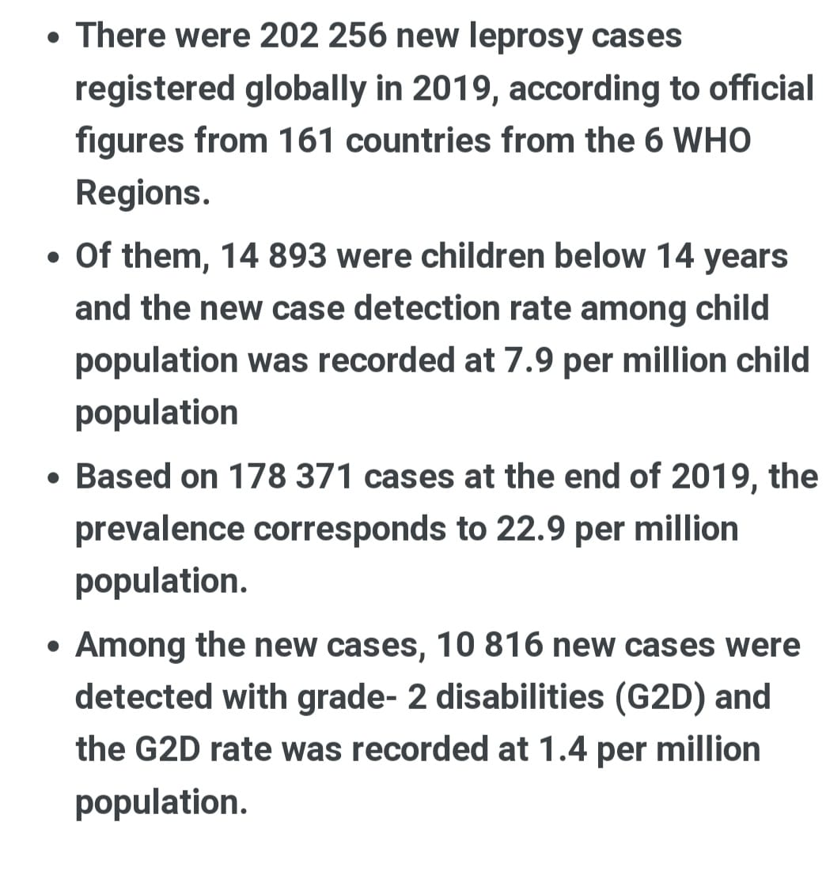

Slide 26
1. What is difference between Polar and Non polar Leprosy ...?
2. pTT, sTT, pLL and sLL stand for and differences...?
3. What are the causes of Ulcer in Leprosy ...?
4. Complete management of Ulcers in Leprosy..?
5. What are the treatment regimens and its duration for PBC and MBC Leprosy according to new WHO guidelines ..?

Slide 27
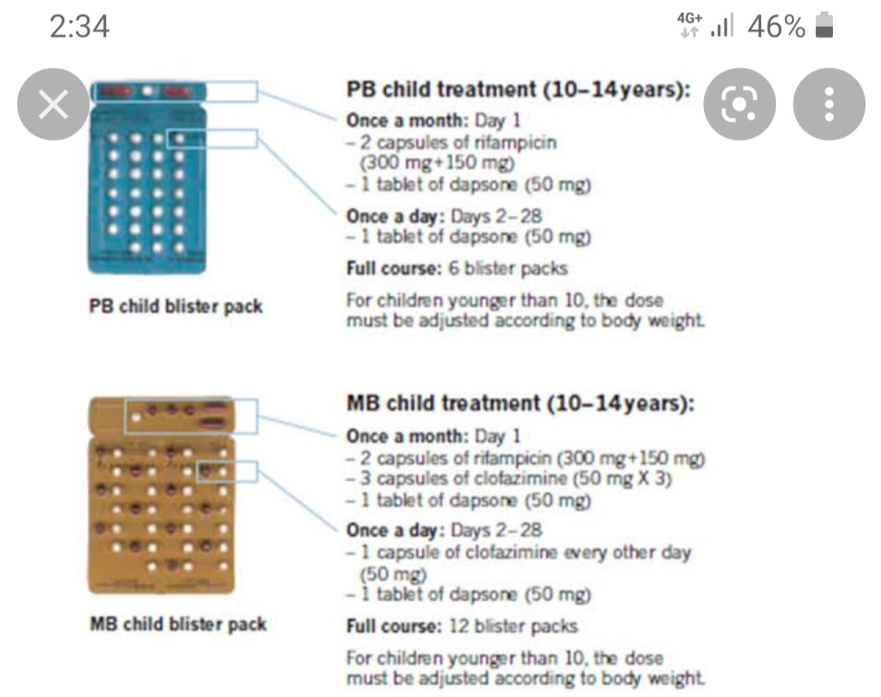
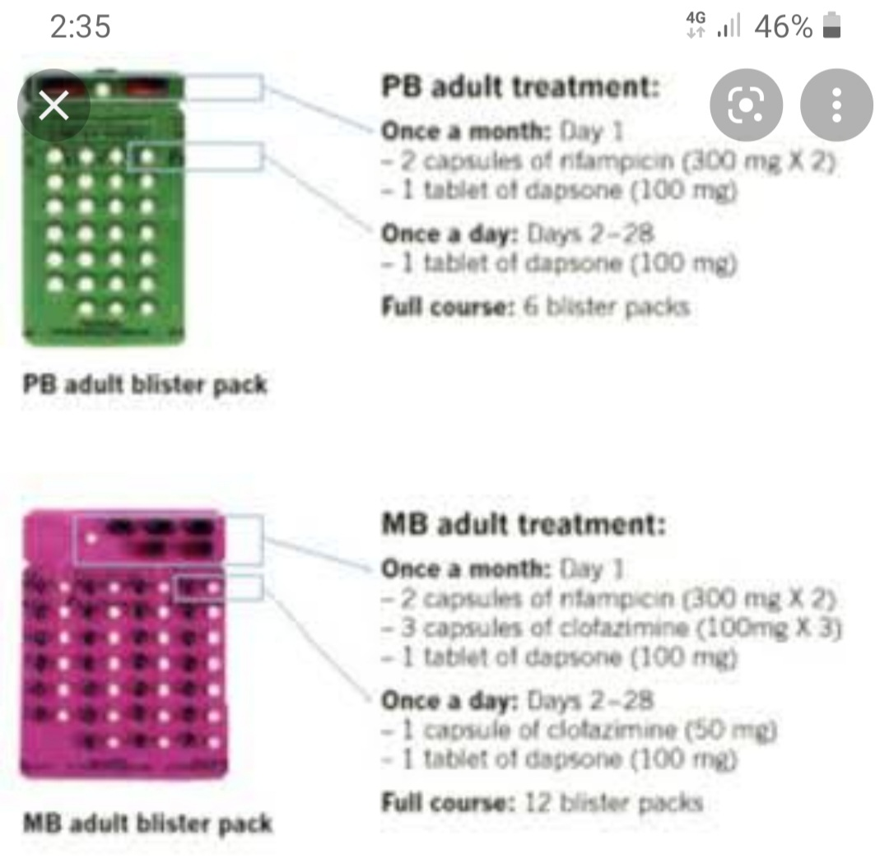

Slide 28
1:recent advances in monitoring of leprosy
2:diference between mitsuda and Fernandez reaction
3:what is lazarine leprosy
4:why rifampicin is given monthly rather than daily.
5:how to differentiate leprosy neuropathy from other causes of neuropathy.

Slide 29
1- PCR ,interleukin 10 ,anti PGL 1
2- mitsuda measures at 4 to 5 wks ,in which lepromin A antigen used and it is papulonecritic reaction Fernandes reaction observe at 48 hrs ,with dharmindara lepromin and eythema and induration was observe
3- lazarine leprosy ,severe widespread ulcering phenomenon in leprosy ,2 types of ulcers are formed wither C's of increase load of bacilli ,like in LL and cz of immune modulation in tuberculoid leprosy ,other cause is neuropathic ulces
5 - Rifampcin is bactericidal and main drug of leprosy it's one dose kill all ,and to avoid emerging resistance .

Slide 30
1. WHY LEPROSY PATIENT HAS HOARSNESS OF VOICE?
2. DD OF ABDOMINAL PAIN IN LEPROSY PATIENT?
3. WHAT ARE BONY CHANGES IN LEPROSY?
4. WHATS FIXED STEROID PROTOCOL FOR TYPE 1 AND 2 REACTIONS?
5. WHAT ARE DIFFERENT TESTS FOR ACCESSING ULNAR NERVE FUNCTION?
6. WHATS DIFFERENCE BETWEEN RELAPSE AND DRUG RESISTANCE?
7. HOW M.LEPRAE REACHES NERVE?
8. WHATS EFFECT OF LEPROSY OVER TESTIS?
9. WHAT ARE EAR CHANGES IN LEPROSY?
10. WHATS DIFFERENCE BETWEEN PRIMARY TUBERCULOID AND 2NDRY TUBERCULOID LEPROSY?

Slide 31
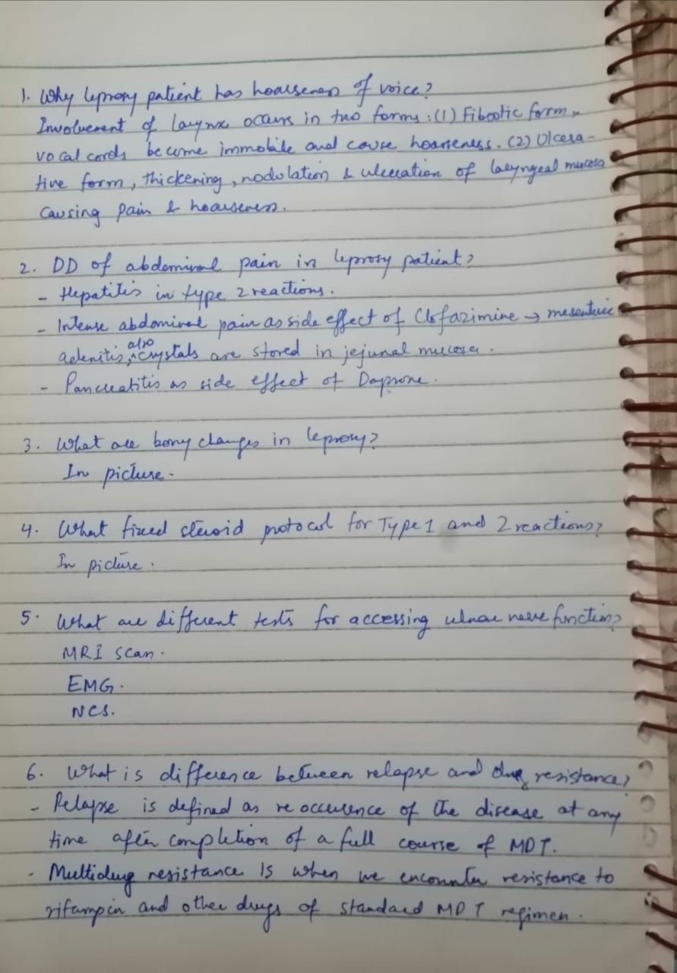
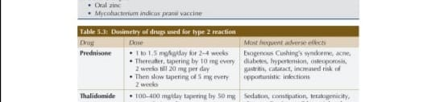

Slide 32
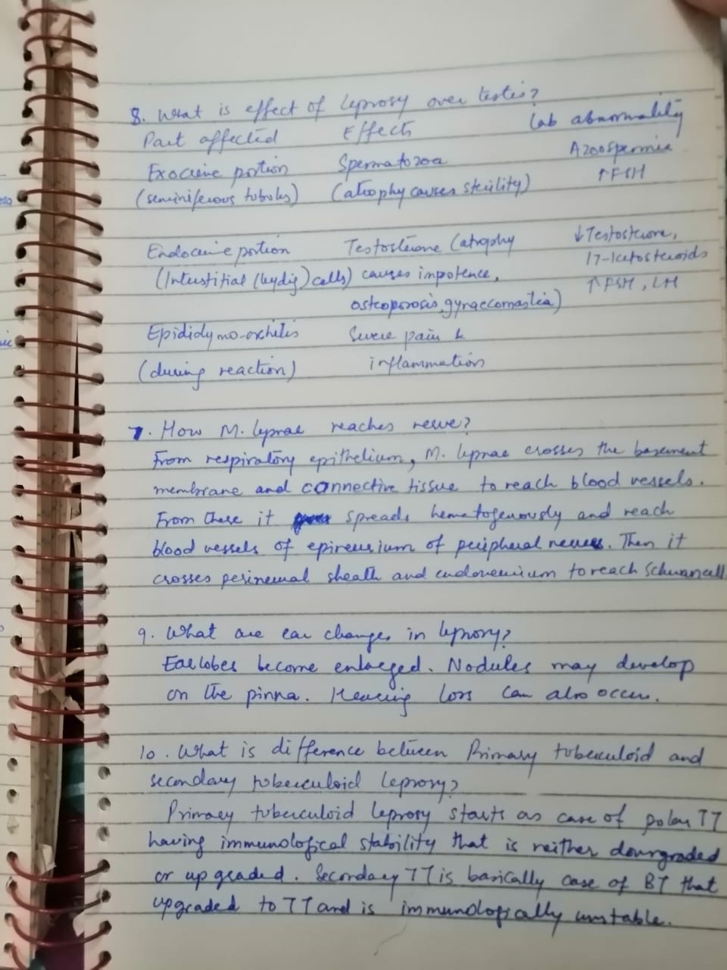
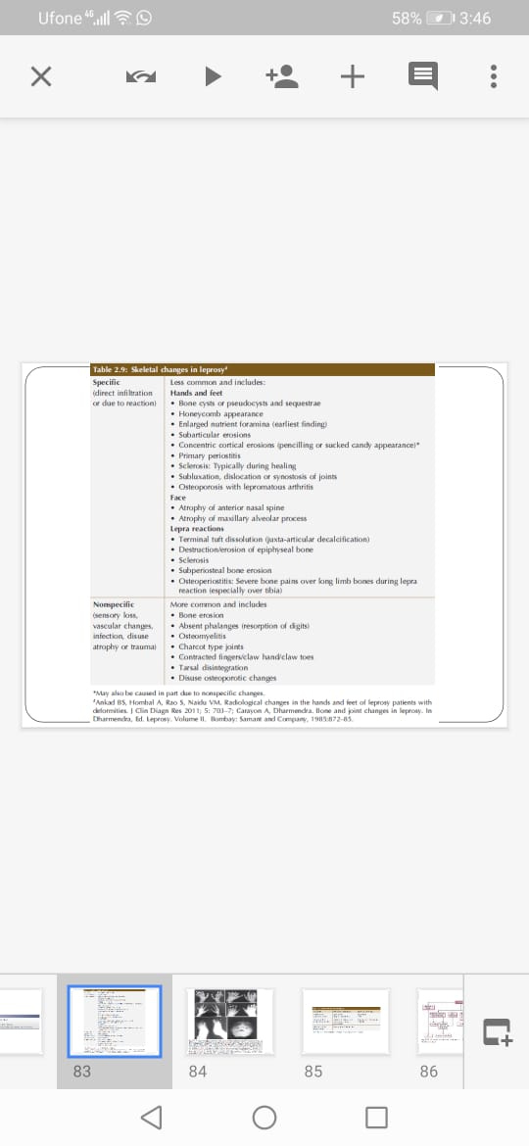

Slide 33
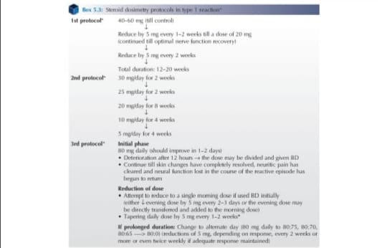

Slide 34
11.Which organs in leprosy are spared?
12.What are persisters and where they lie?
13.WHATS WHO GRADING FOR DISABILITY IN LEPROSY?
14.WHAT ARE ADVANTAGES OF WHO CLASSIFICATION OVER RIDLEY CLASSIFICATION?
15.WHATS NELP CLASSIFICATION OF LEPROSY?
16.TYPES OF ANEMIAS SEEN IN LEPROSY?
17. WHY BLISTER IS FORMED IN.LEPROSY?
18. WHAT ARE NAIL CHANGES IN LEPROSY?

Slide 35
Q. Which organ in Leprosy are spared?
  Ans. Scalp,hair,flexures,brain,spinal cord, female reproductive system.
Q. Nail findings in leprosy.
  Ans.nail changes are due to trauma, neuropathy,drugs taken for treatment, vascular impairment and lepra reactions. These include hematoma, pterygium subungus, oncychogryphosis, onycholysis, longitudinal ridges, beau's line, koilonychia etc
Q.NLEP classification of leprosy?
  National leprosy Eradication program classification based on skin smear. Negative smear lesions are classified as Paucibaccillary and Smear Positive are classified as Multi bacillary

Slide 36
Q. Blisters are formed due to burn /trauma sec to neuropathy, reactions in leprosy, can be infective or diabetic bullae.Couldn't found WHO grading disability.. seniors please guide
Q.What are causes of Anemia in leprosy:
  1. Iron deficiency
  2. Anemia of chronic disease
  3. Hemolytic anemia d/t treatment
Q.What are persisters and where they reside?
  Persisting organisms or "persisters" consist of permanently or partially dormant organisms that have the capacity to survive in the host despite adequate chemotherapy. They have been identified in immunologically favorable sites such as dermal nerves, smooth muscle, lymph nodes, iris, bone marrow and liver. These organisms, which are responsible for relapse, are present in about 10% of the MB patients, and their proportion may be higher in cases with higher BI.
  Advantage of WHO classification over Ridley's classification is that it is more practical to start and monitor treatment as it divided into Paucibaccillary and multibacillary.

Slide 37
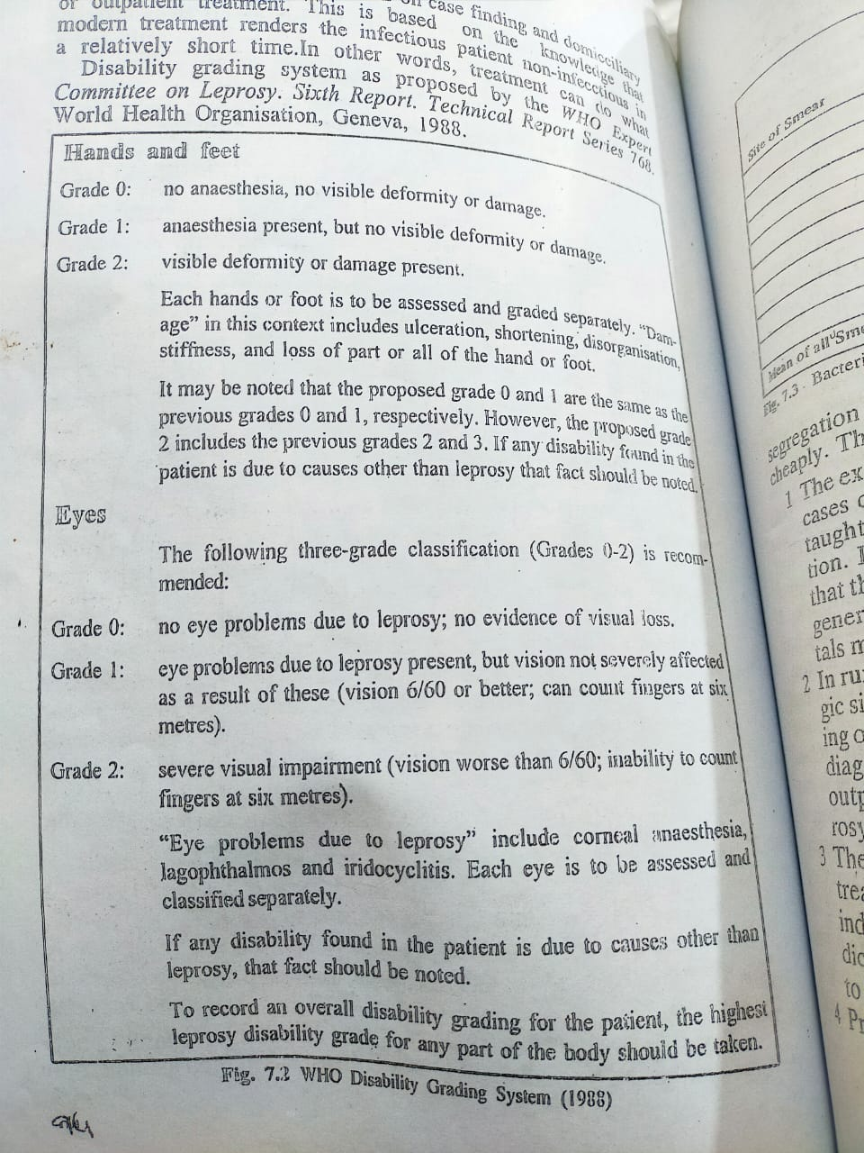

Slide 38
1-difference between neuropathy of leprosy and due to thalidomide How asses clinically
2-Exercises for lagophthalmos
3-role of immunotherapy in leprosy
4-which serology test for leprosy as well PCR available in pak
5- is slit skin smear should advise in PNL and can be positive in pure neural leprosy??

Slide 39
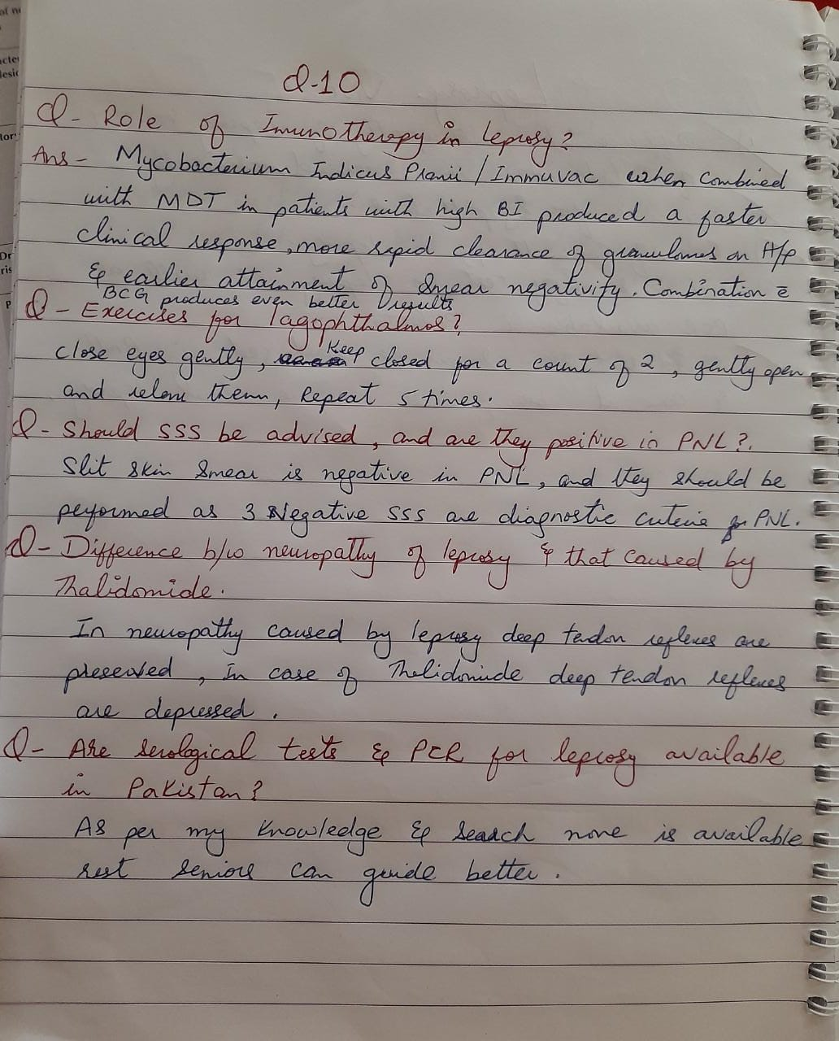

Slide 40
1.Eye findings in leprosy
2.various indices for leprosy with significance
3.stains used for mycobacterium leprae.
4.pathophysiology of nerve involvement in leprosy.
5.hx of leprosy in URDU.

Slide 41
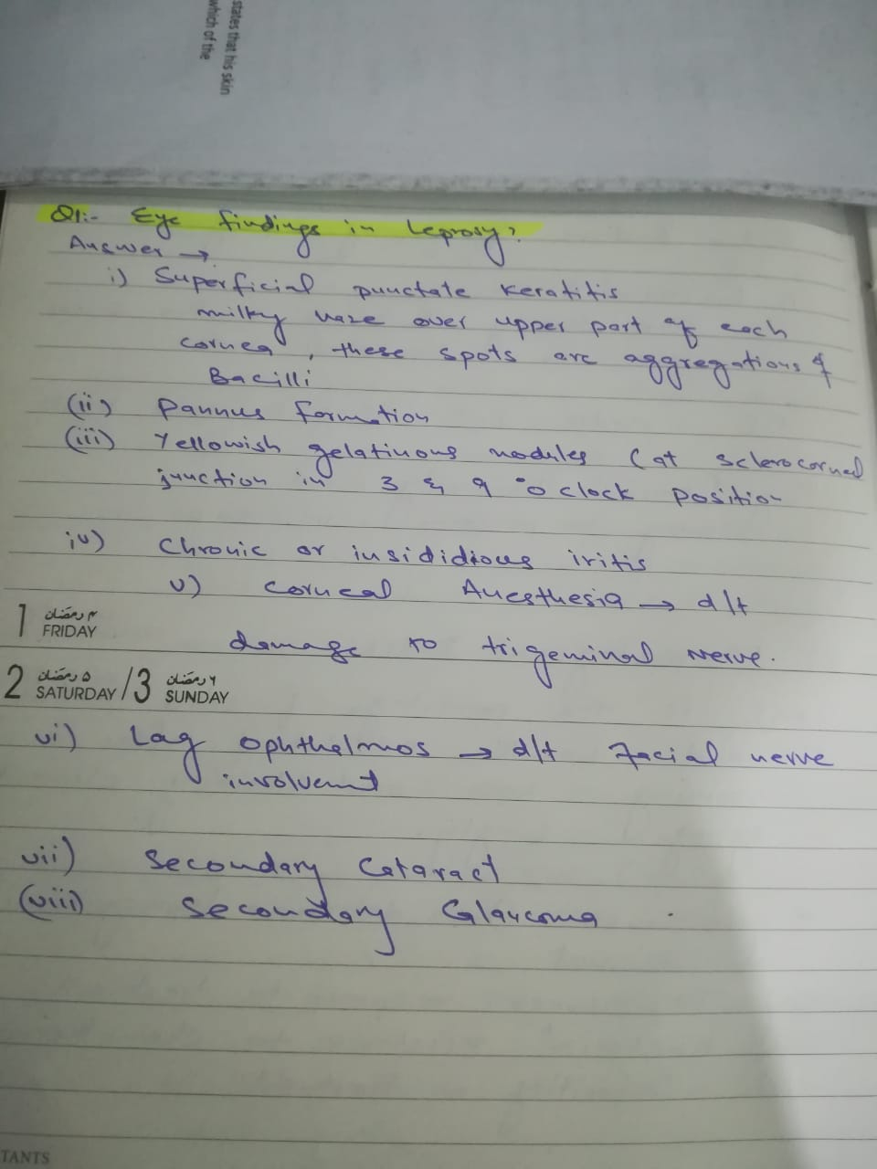
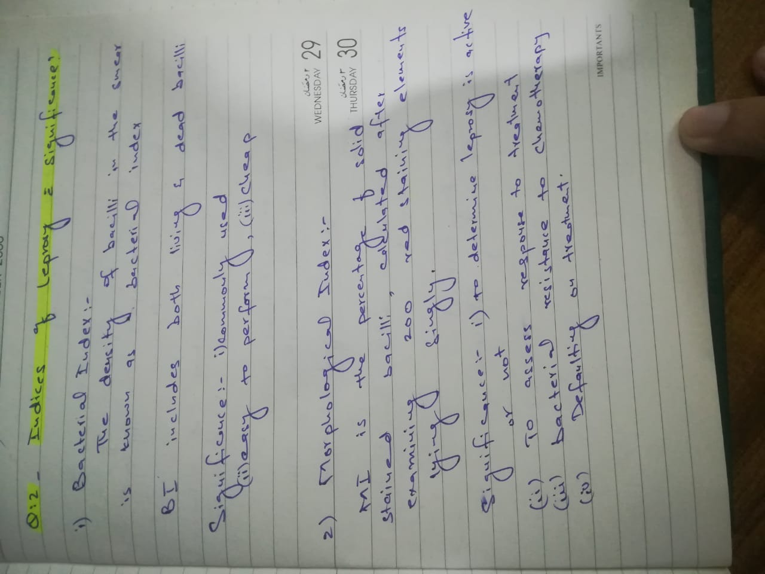

Slide 42
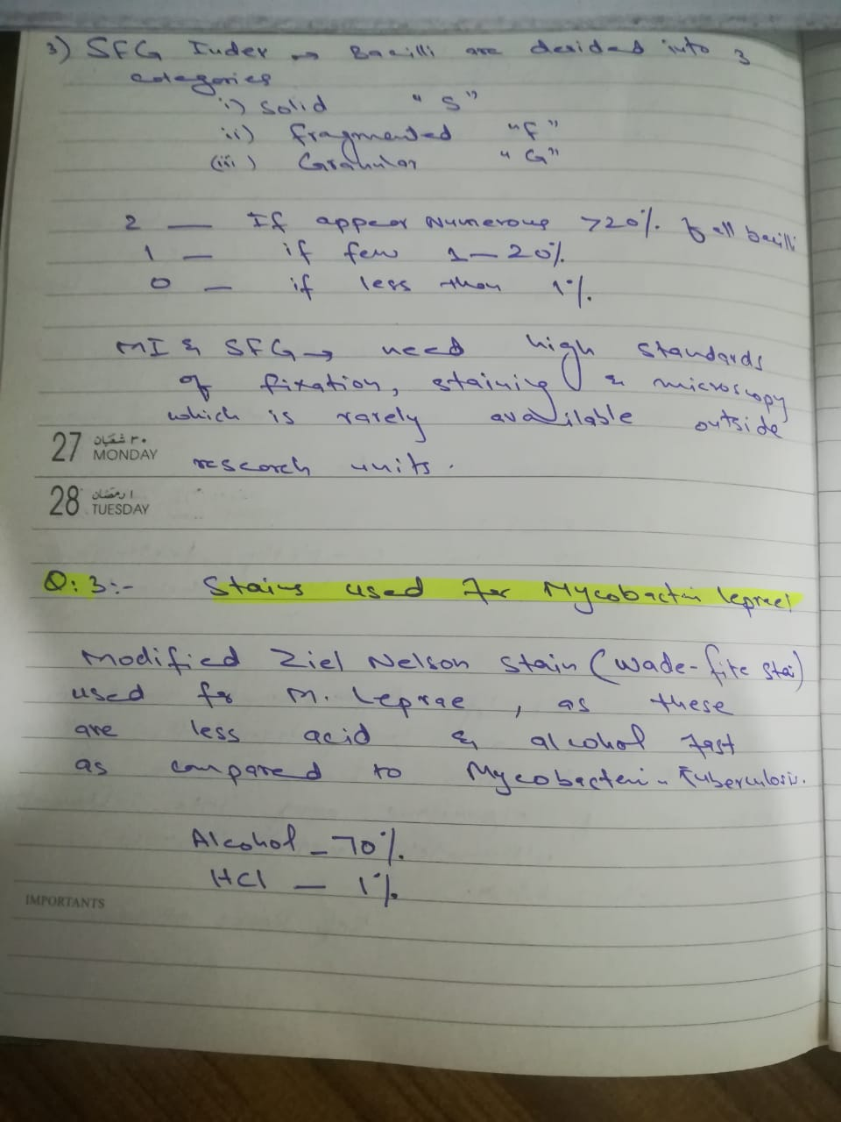
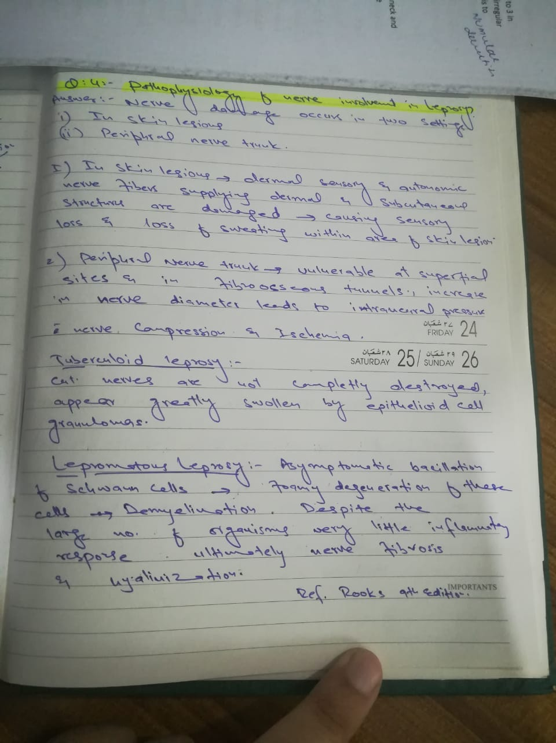

Slide 43
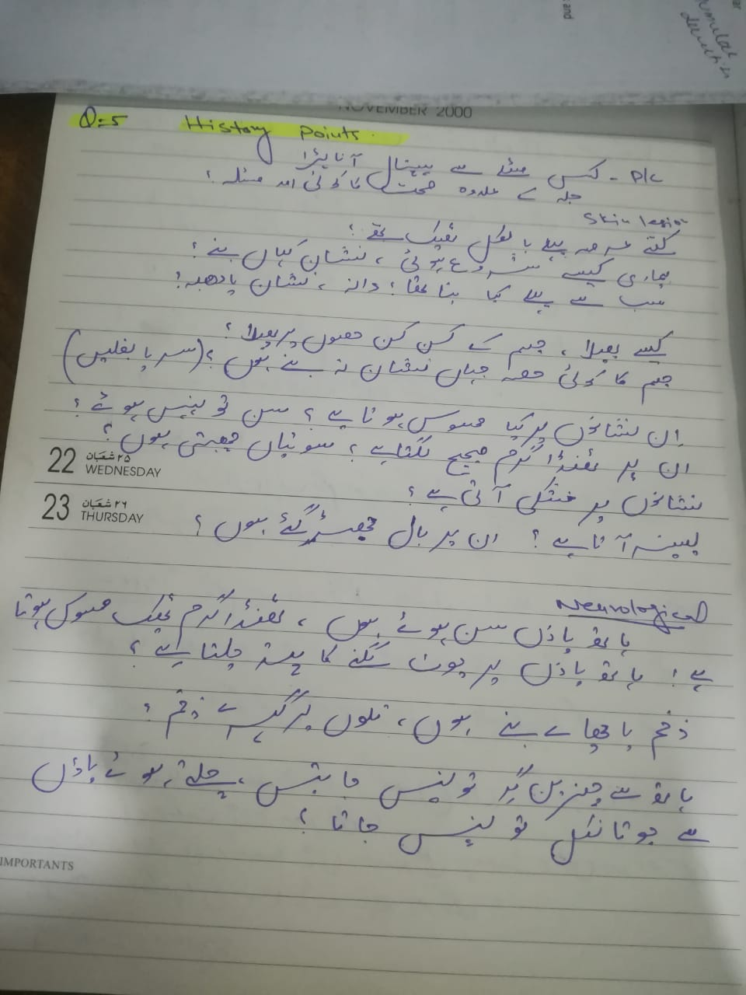
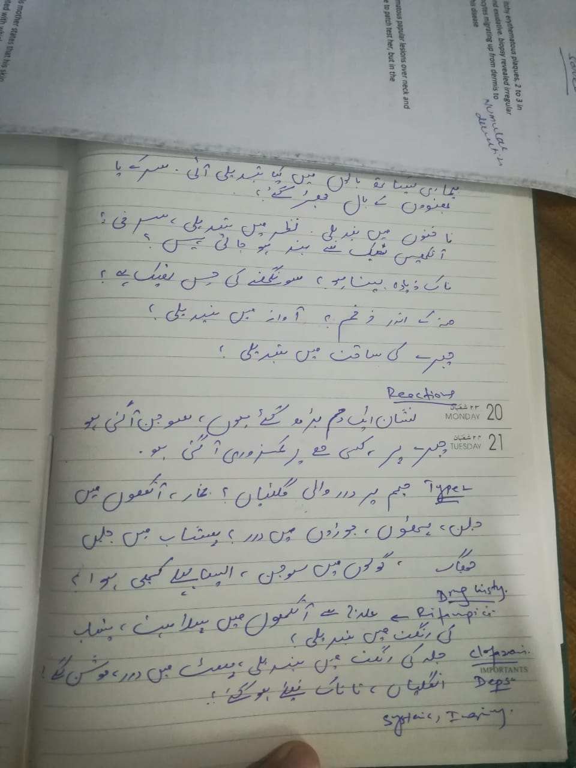

Slide 44
1 What is the difference between relapse of leprosy and reactivation of leprosy ?
2 How does hiv affect leprosy ?
3 Differentials of hypoesthetic infiltrated plaques?
4 How to differentiate inderminate leprosy from other hypopigmented macules since inderminate leprosy is normoesthetic with negative lepromin test and has negative slit skin smear for AFB
5 Define walk of a PT who has damaged common peroneal nerve

Slide 45
