Slide 1
Inherited Acantholytic Disorders
Dr Reesham Zulkiffal Bhatti

Slide 2
DARIER DISEASE
DEFINITION:
Darier disease is an autosomal dominant genodermatosis characterized by a chronic eruption of keratotic papules, the histology of which shows acantholysis and dyskeratosis
Synonyms and inclusions
Darier-white disease
Keratosis follicularis
Notes:
It was previously called keratosis follicularis . It is incorrect because the scaly papules do not arise from hair follicles. In this there are scaly crusted papules in seborrhic distribution and in skin folds.
Genodermatosis is a hereditary skin disease with three inherited modes including single gene inheritance, multiple gene inheritance and chromosome inheritance

Slide 3
Intoduction and description
DD was 1st described by Darier and White in 1889
Mode of inheritance
Skin manifestation
Nails
Palmoplanter abnormalitis
Mucosal involvement
histology
Extra cutaneous manifestations
Treatment
Notes:
New mutations are common and follow naevoid distribution
Chronic and recurrent focal and aggregated keratotic papules in teens and adults in seborrhic areas
Oral retiniods mainstay of rx
Blaskho normal cell developtment. They are patterns disticnt from other morphological lines or dermatomes. They are invisible but become apparent when disease of skin or mucous menifest themselves
along these lines. Vshape over uper spine. S hape on abd. U shape on breast.
Naevus latin for maternal impression or birth mark.
DD was 1st described by Darier and White in 1889
Autosomal dominant
Keratotic papules in seborrhic areas
Nails
Palmoplanter abnormalitis
Mucosal involvement
Suprabasal acantholysis with overlying dyskeratosis
Neuropsychiatic diseases
Topical antimicrobials and corticosteroids
Oral retiniods

Slide 4
Epidemiology
Prevalence
Gender
age group
penetrance
Lesions
Notes:
Penetrance is complete in adults [4] although phenotypic expression may be variable with some patients featuring nail changes only [
In some families plane wart‐like keratoses, known as acrokeratosis verruciformis (AKV), predominate [8,10,11].
Acrokeratosis verruciformis is a rare genodermatosis that usually develops in childhood and is characterized by verrucous papules on the dorsum of the hands and feet
Verruca is like wart
Acro meaning high
1:100000 and 1:30000 northern european
Men and women equally affected
Early teens upto 6th or 7th decade
Comp penetrance
Acrokeratosis verruciformis

Slide 5
Pathophysiology
Didodered cell adhesion and differentiation
Lacunae appear suprabasally the extent throughout malpighian layer
Dyskeratotic cells
Corps ronds
grains
Hyperkeratotic startum corneum
Notes:
Lacuna means pit or hole. Hollowed out spaces in stratum spinosum
acantholysis is loss of coherence between epidermal cells due to breakdown of intercellular bridges
the Immunohistochemistry shows desmosomal components diffusely distributed in the cytoplasm of acantholytic cells, and their intra‐ and extracellular domains are dissociated [15–17]. Ultrastructurally, tonofilaments separate from the desmosomes with aggregation of keratin filaments around the cell nucleus [18].
Corps ronds refer to cells with small pyknotic nuclei, a perinuclear clear halo and eosinophilic cytoplasm. Pyknotic is condensed chromatin of nucleus undergoing apoptosis
Grains are compressed cells with elongated nuclei seen in the stratum corneum and granular layer (Figures 4 and 5).

Slide 6
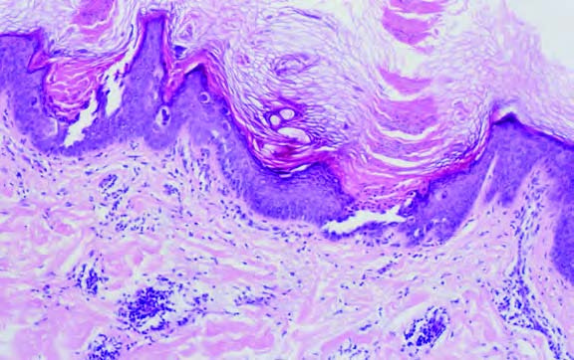
Notes:
Histology of Darier disease demonstrating: (a) acantholysis with suprabasal clefting;

Slide 7
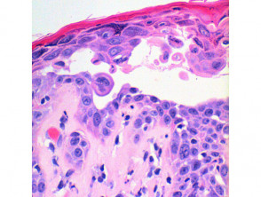
Notes:
. Dyskeratosis of the keratinocytes is seen, with two notable changes described. Corps ronds refer to cells with small pyknotic nuclei, a perinuclear clear halo and eosinophiliccytoplasm (Figures 4 and 5).
Grains are compressed cells with elongated nuclei seen in the stratum corneum and granular layer (Figures 4 and 5).
The overlying epidermis exhibits compact orthokeratosis, which can form a prominent focal plug.

Slide 8
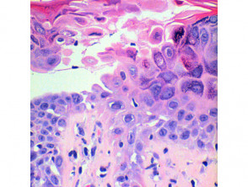

Slide 9
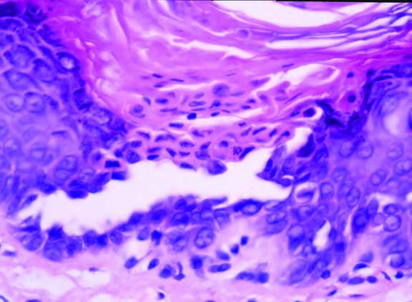
Notes:
n close up, rounded dyskeratotic cells with eosinophilic cytoplasm (corps ronds) and hyperkeratosis with pyknotic retained nuclei (grains).

Slide 10
Mutation of ATP2A2 gene
SERCA2 sacro endoplasmic reticulum calcium ATPase type 2
Influx of Ca
SERCA2b maj isoform in epidermis
Increase cytoplasmic calcium and reduced ER calcium
Disrupt intracellular calciumm signalling
Disrupts transport of adhesion molecules to the cell membrane
Inc calcium causes TRPC1 to admit extracellular calcium
Reduced ER calcium interferes with protein folding
Notes:
The abnormal gene in Darier disease has been identified as ATP2A2, found on chromosome 12q23-24.1. This gene codes for the SERCA enzyme or pump (SarcoEndoplasmic Reticulum Calcium-ATPase) that is required to transport calcium within the cell. The exact mechanism by which this abnormal gene causes the disease is still under investigation but it appears that the way in which skin cells join together may be disrupted. The skin cells (keratinocytes) stick together via structures called desmosomes and it seems the desmosomes do not assemble properly if there is insufficient calcium.

Slide 11
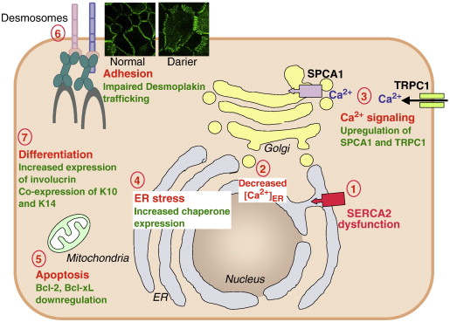
Notes:
ER Ca2+ interferes with correct protein folding, sorting and post‐translational modification by the molecular chaperones calreticulin and calnexin
Reduced expression of antiapoptotic proteins of the Bcl‐2 gene family, although pos- sibly secondary to other changes, may contribute to apoptosis
Finally, dyskeratosis in DD has been thought to reflect a form of apoptosis [18], although conversely it has also been suggested that the antiapoptotic effect of up‐regulated TRPC1 contributes to abnormal keratosis [
Notwithstanding these in vitro findings, the pathogenesis of DD remains puzzling. The gene is widely expressed, yet the phenotype is primarily or wholly cutaneous
SERCA2a is expressed in slow‐twitch skeletal and cardiac muscle [27,29] whereas SERCA2b and SERCA2c are more widely expressed. A fourth isoform exists in muscle [30]. SERCA2b is the major isoform in the epidermis [31,32].

Slide 12
Clinical features
Age
Course
aggravating factors
Notes:
Peaks onset between 6 to 20
Infants and old age
Chronic relapsing course
Spontaneous remission
Aggrevating factors: friction, heat, sweating, sunlight

Slide 13
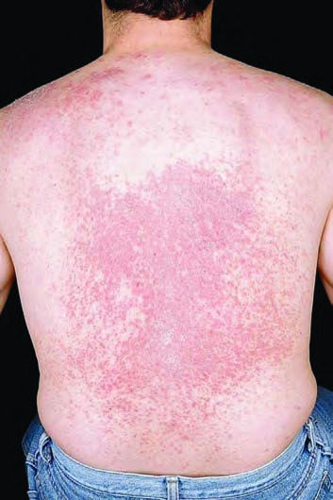
Notes:
Discrete or confluent rough, greasy, skin‐coloured or yellowish‐ brown papules are commonest on the seborrhoeic areas of the trunk, face, scalp margins, temples, ears, scalp, neck and flex- ures: the perineum, axillae and groin
Hair growth un effected

Slide 14
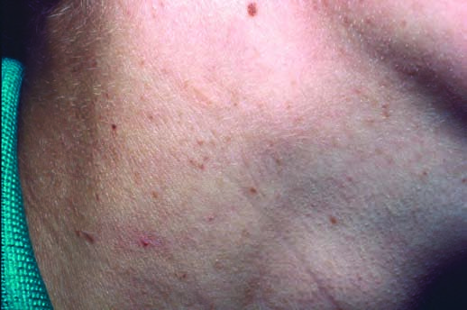
Notes:
early keratotic papules developing on the sun‐exposed skin of the neck of a 9‐year‐old girl;

Slide 15
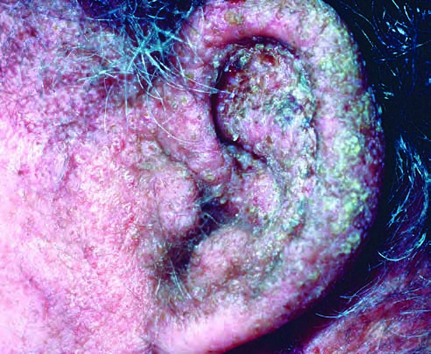
Notes:
confluent lesions on the ear of a 57‐year‐old man.

Slide 16

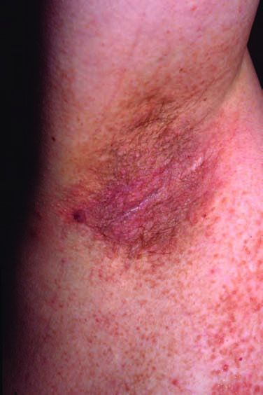
Notes:
Coalescing papules, particularly in the axillae, perineum, groin and natal cleft, may form irregular, warty, fissured plaques
sometimes becoming vegetating and malodorous

Slide 17
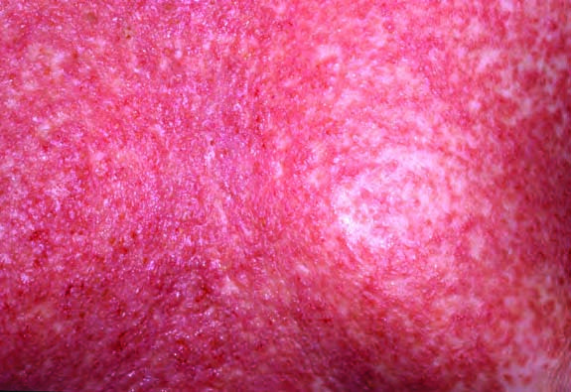
Notes:
confluent inflamed and eroded lesions of the chest

Slide 18
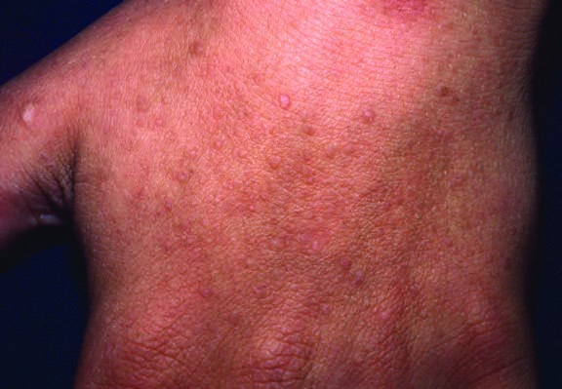
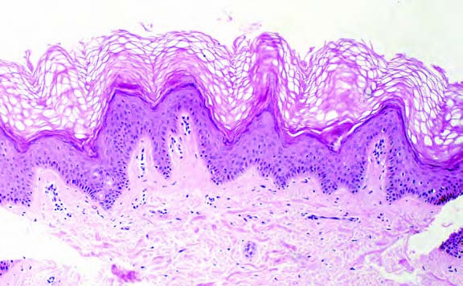
Notes:
Acrokeratosis verruciformis, plane wart‐like lesions best seen by transverse illumination, are commonest on the dorsal hands but can be detected in other sites

Slide 19
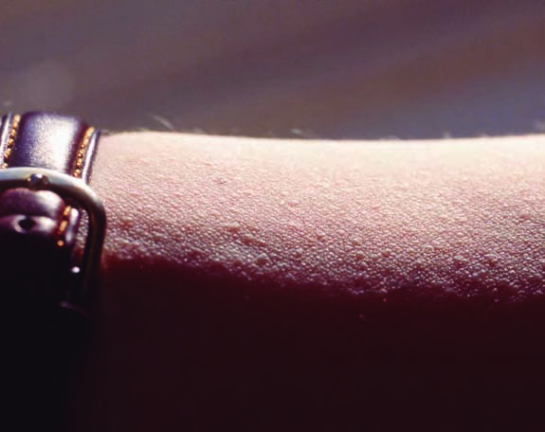
Notes:
similar lesions on the forearm of a 31‐year‐old woman; a

Slide 20
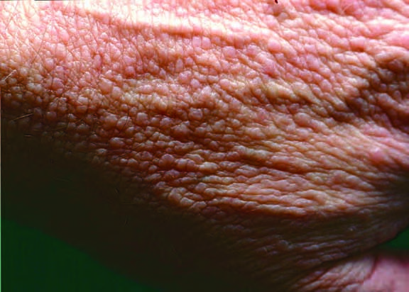
(c)
(d)
Notes:
multiple AKV lesions best detected with oblique illumination in a 45‐year‐old man

Slide 21
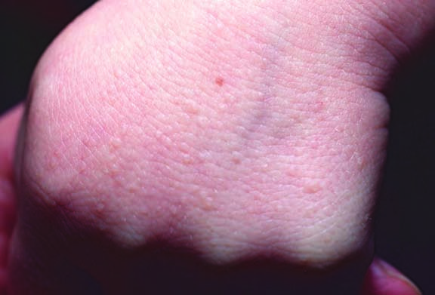
(e)
Notes:
the hand of a 4‐year‐old boy with molecularly confirmed DD.

Slide 22
Notes:
‘church spire’ pattern of hyperkeratosis on biopsy

Slide 23


Slide 24
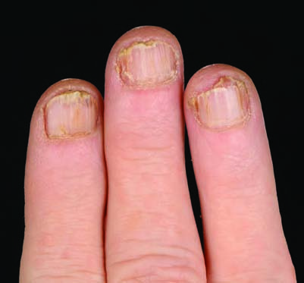
Notes:
fraragile nails with longitudinal splitting and terminal notching
Nail fragility, painful longitudinal splits or distinctive red and white longitudinal bands terminating in V‐shaped nicks are typical
Over time nails may become severely dystrophic.

Slide 25
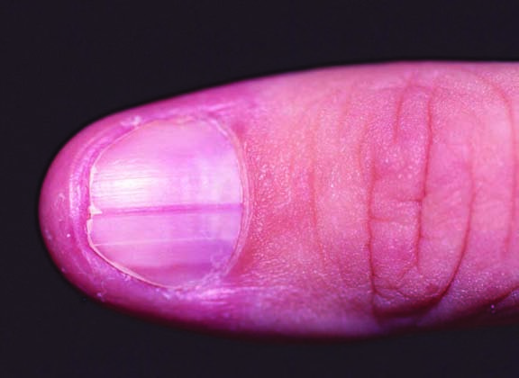
Notes:
early nail changes in a 28‐year‐old woman showing a fine white band and a longitudinal red band terminating in a notch.

Slide 26
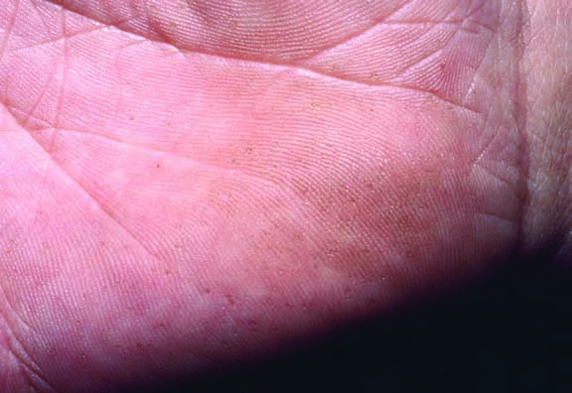
Notes:
Palmoplantar lesions of Darier disease: (a) pitting in a 15‐year‐old boy;
Focal palmoplantar lesions, pits (Figure 66.6) or keratoses are common, occasionally causing a more diffuse keratoderma. Filiform keratoses have been noted (finger like projections)

Slide 27
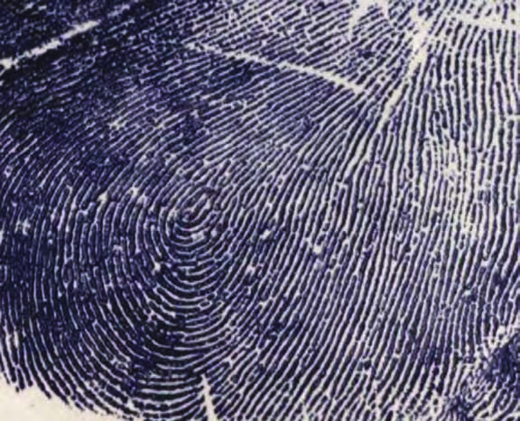
Notes:
palm print demonstrating interruptions to the print pattern

Slide 28
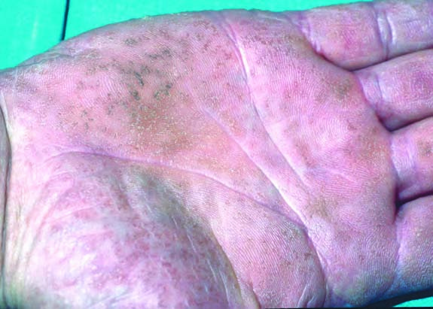
Notes:
keratotic and pitted lesions in a 57‐year‐old man.

Slide 29
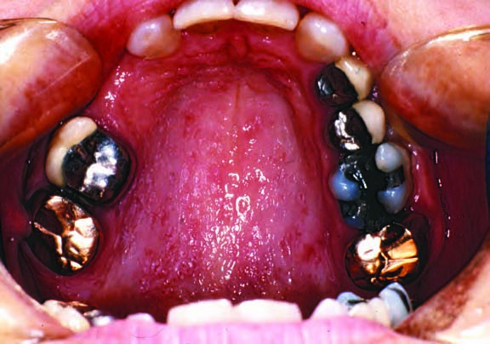
Notes:
Oral mucosal involvement in Darier disease: (a) umbilicated (Typically, there are solitary or multiple discrete, skin coloured, dome shaped papules with central umbilication and cobblestone papules in a 31‐year‐old woman
Mucosal involvement presents with white umbilicate or cobblestone papules (Figure 66.7). Oral, oesophageal, cervical and rectal mucosa may be affected [69–77]. Oral lesions are most com- mon on the palate [69,78–82]. Confluent buccal lesions may resem- ble leukoplakia. Salivary duct occlusion and recurrent sialadenitis is recognized [81,83–85].

Slide 30
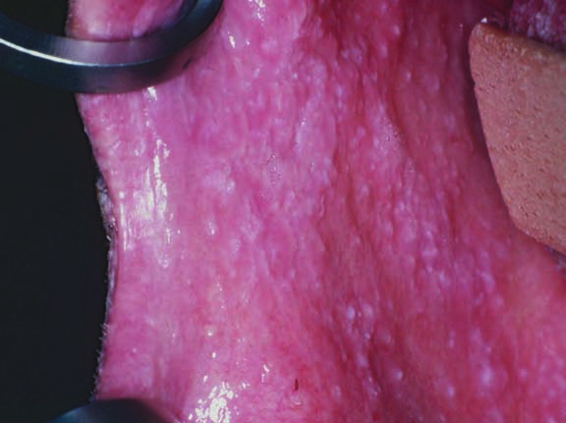
Notes:
confluent buccal lesions in a 51‐year‐

Slide 31
Occular manifestation
Chronic blepharitis
Corneal erosions
Endophthalmitis
Seborrhic debris on eyelids
Notes:
Ocular manifestations include hyperkeratotic plaques and seborrhoeic debris at the eyelid margin with typical histological changes [86,87]. The chronic blepharitis is associated with dry eye syndrome and corneal erosions [88] and endophthalmitis follow- ing cataract surgery has been reported [89,90]. A variety of corneal abnormalities may occur [91,92].

Slide 32
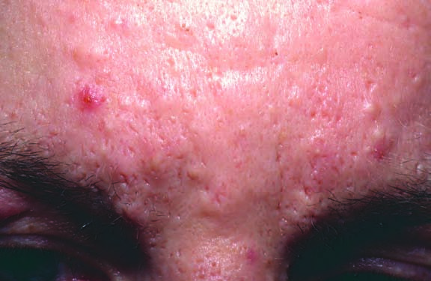
(b)
Notes:
Patients may have multiple come- dones or nodulocystic acne with typical DD histology, causing deep pitted scars

Slide 33
Types
Eroded or hyper keratotic plaque
Bullous or vesiculobullous disorder

Slide 34
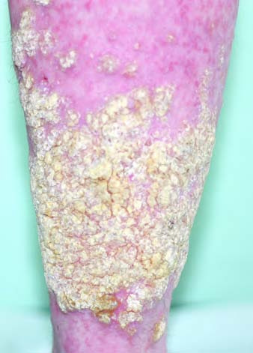
Eroded or hyperkeratotic plaque
Notes:
cornifying plaques on the lower legs; (b) multiple comedones and deep pitted scars;

Slide 35
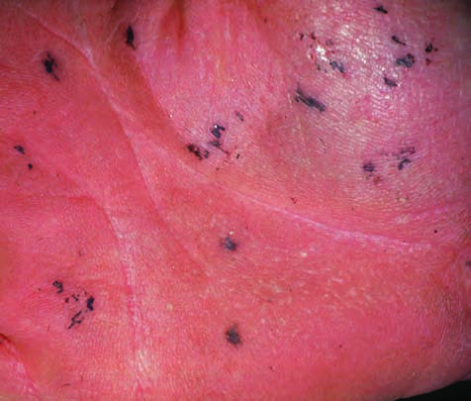
Notes:
Palmoplantar haemorrhagic macules with irregular margins (Figure 66.8c) [22,108–112] occur consistently within families and may be due to specific mutations
haemorrhage into palmoplantar lesions of DD is found with specific ATP2A2 mutations

Slide 36
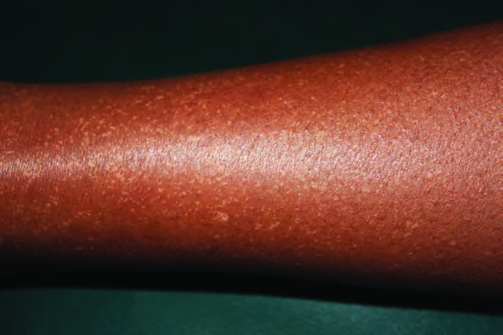
Notes:
Guttate leukoderma: (a) hypopigmented macules and papules in pigmented skin
Pigmented papular lesions of the trunk resembling Grover disease have been described [114]. In racially deeply pigmented skin, focal lesions also produce gut- tate leukoderma rain drop like hypopigmented lesions – confetti‐like hypopigmented macules and papules (Figure 66.9a) [115–119]; similar lesions in light skin are sometimes detectable (Figure 66.9b).

Slide 37
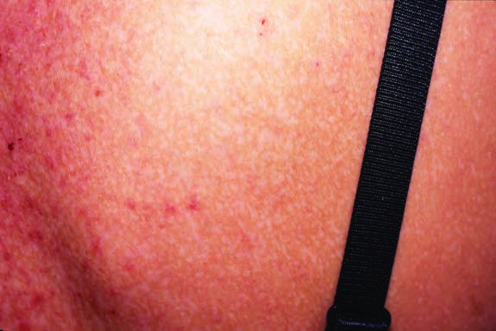
Notes:
similar lesions on the back of a 31‐year‐old white woman.

Slide 38
Effect on quality of life
Extensive, malodorous and painful skin in DD impacts on social interaction, work or school. The extent of skin area affected and clinical severity have a negative impact on health‐related quality of life

Slide 39
Differential diagnosis
Seborrhic dermatitis
Hailey hailey diease
Dowling–Degos disease
Acanthosis nigrans
pemphigus vulgaris/vegetans
Pyoderma vegetans
AKV or plane warts
Grover diease
Galli–Galli disease
Notes:
Dowling-Degos disease is a rare genetic disease of the skin that presents in adult life with pigmentation, particularly in the folds of the skin. It is also known as ‘pigmented reticulate anomaly of the flexures’. It is important to distinguish this from acanthosis nigricans, which can be a skin sign of internal diseases.
Erosive, bullous or hypertrophic lesions of the flexures clinically and histologically overlap with HHD, but other cuta- neous evidence of DD is often present elsewhere; HHD usu- ally presents later [120]
Acanthosis nigricans is a skin condition characterised by a velvety papillomatous overgrowth of the epidermis. Darkening and thickening (hyperkeratosis) of the skin occurs mainly in the flexural areas, particularly the axillae, groins, inframammary regions, and the neck.
DD is often suggested by pathologists in cases of transient or persistent acantholytic dermatoses (Grover disease) [124,125], but the clinical presentation and absence of family history or supportive signs may help to distinguish this. ATPA2 mutations are not found
Galli–Galli disease, which presents with acantholytic flexural papulovesicules or freckles, is an allelic variant of Dowling–Degos disease (MIM: 179850) due to mutation in KRT5 encoding keratin 5 [127–130].

Slide 40
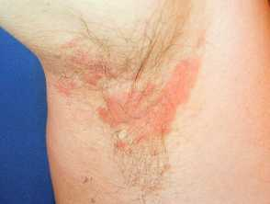
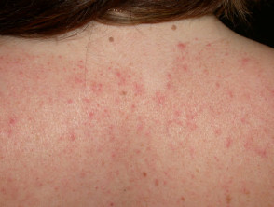
Seborrhic dermatitis
Notes:
DD may resemble seborrhoeic dermatitis, particularly in the scalp, or acne, and nail and hand signs may help to distinguish these.

Slide 41
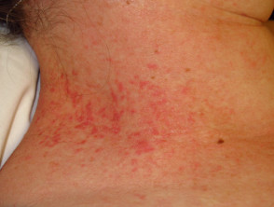
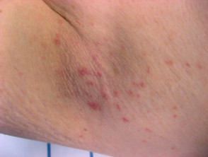
Dowling degos disease
Notes:
Dowling-Degos disease is a rare genetic disease of the skin that presents in adult life with pigmentation, particularly in the folds of the skin. It is also known as ‘pigmented reticulate anomaly of the flexures’. It is important to distinguish this from acanthosis nigricans, which can be a skin sign of internal diseases.
Dowling–Degos disease and acanthosis nigricans present with pigmented flexural lesions and conflu- ent reticulate papillomatosis with flat lesions mainly limited to the upper trunk.

Slide 42
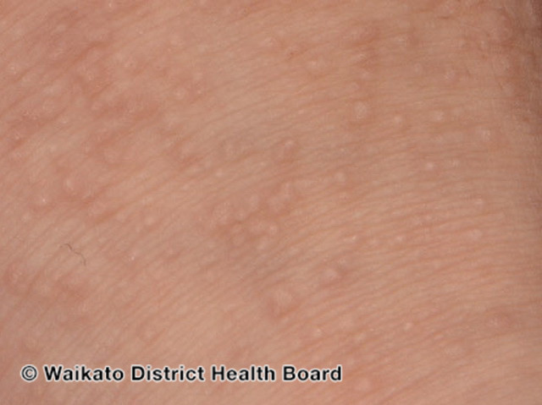
Acrokeratosis verruciformis
Notes:
Acral papules can resemble plane warts or AKV, which may in any case be allelic to DD

Slide 43
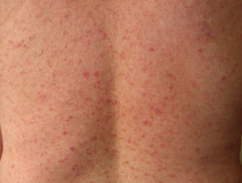
Grover disease
Notes:
Acantholysis is an incidental feature of many other epider- mal disorders. DD is often suggested by pathologists in cases of transient or persistent acantholytic dermatoses (Grover disease)
but the clinical presentation and absence of family history or supportive signs may help to distinguish this.

Slide 44
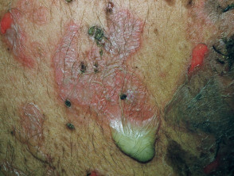
Pemphigus vulgaris
Notes:
Erosive or bullous flexural DD may sug- gest pemphigus vulgaris/vegetans or pyoderma vegetans.

Slide 45
Classification of severity
Grade 0: subclinical
Grade i: mild
Grade II: moderate
Grade III: sever
Notes:
Grade 0: subclinical; the typical rash is absent or subtle and
asymptomatic but associated features such as acrokeratoses or nail dystrophy are present. This grade is usually only recog- nized in the context of a family history.
Grade I: mild; localized keratotic papules occupy up to 10% of affected areas (e.g. trunk or flexures) and may give rise to pru- ritus or mild irritation. Many cases of naevoid DD fall into this group.
• Grade II: moderate; extensive papular and subconfluent lesions with crusting or secondary infection affect 10–30% of the affected area, or there is extensive and symptomatic papular flexural involvement.
Grade III: severe; widespread confluent, crusted, eroded or bul- lous rash affects >30% of the trunk or confluent eroded or hyper- keratotic disease of the limbs or flexures.

Slide 46
Complications and co-morbidities
Impetiginization and eczematization
Infections
Carcinoma
Paget disease
xtracutaneous manifestions
Drugs
Notes:
Impetiginization and eczematization are common, and patients have an increased susceptibility to infection with herpes sim- plex (Figure 66.11), herpes zoster or cowpox; severe infections may be disseminated or fatal [149–155]. There is conflicting evi- dence regarding cell‐mediated immunity defects in DD [156–159] and there may be an increased risk of chronic pyogenic infection [160]. There are reports of squamous cell carcinomas of the skin or
mucosa [161–166] and mammary Paget disease [167], but the true incidence is not known. Bone cysts have been recorded [168–170]. Despite the importance of SERCA2a in the heart, there is no evi- dence of a general cardiac dysfunction in DD [171,172].
Neuropsychiatric features, including depression, bipolar dis- order, epilepsy and intellectual difficulties have been reported in
association with DD [6,7,39,173,174]. It has been suggested that the accumulation of mutant protein aggregates in neurons could provide a mechanism for these features [55]. ATP2A2 has been excluded as a common susceptibility gene for bipolar disorder, but co‐segregation of closely linked loci may explain families in whom the disorders are associated [175–180]. Lithium may exacerbate cutaneous disease, possibly by suppressing levels of epidermal SERCA2 [181–184].

Slide 47
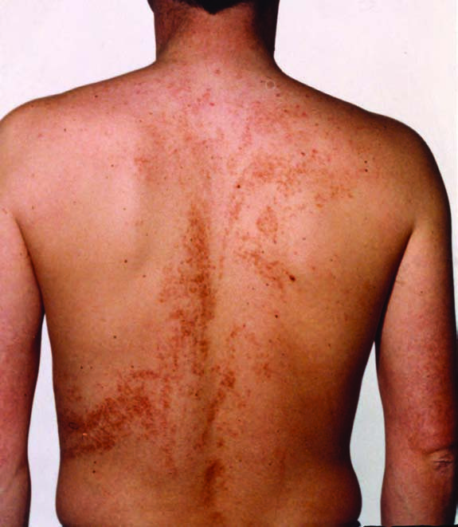
Notes:
Epidermal naevus following the lines of Blaschko; the clinical and histological appearances are those of Darier disease.

Slide 48
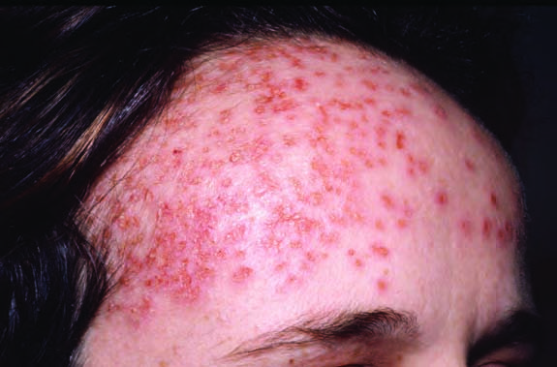
Notes:
Herpes simplex superinfection of skin lesions in a patient with Darier disease.

Slide 49
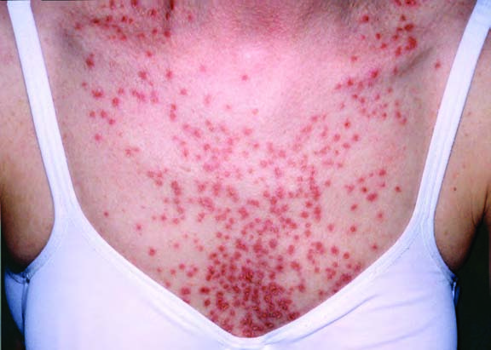

Slide 50
Disease course and prognosis
DD has a chronic, relapsing course, with unpredictable severity. It can both improve and deteriorate in old age

Slide 51
Investigations
Clinically
Gene sequencing
Genetic counselling
Cultures
Notes:
The disorder is usually diagnosed clinically, with histological confirmation. No specific systemic features need be sought in the absence of symptoms. Commercial ATP2A2 gene sequenc- ing is available, but is not generally needed for genetic coun- selling, and molecular diagnosis in presymptomatic children has no specific implications for care. In symptomatic or overtly infected lesions, specimens should be taken for bacteriologi- cal culture, and virological or fungal investigations should be considered in exacerbations or treatment‐resistant disease. A high index of suspicion of herpes simplex superinfection should be maintained, even in the absence of apparent vesicle formation.

Slide 52
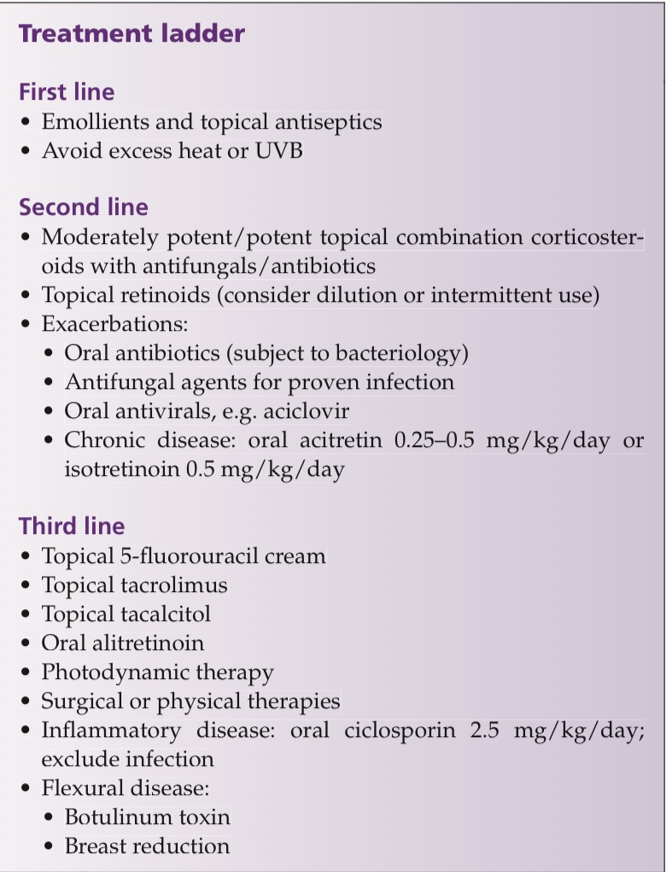
Notes:
Mild disease may only require emollients, including those with urea or lactic acid to minimize hyperkeratosis, sim- ple hygiene to prevent secondary infection, and avoidance of excessive heat or sun [186]. Topical antiseptics such as chlorhex- idine skin cleanser or potassium permanganate baths, and top- ical antibiotics and antifungals may be used to prevent or treat secondary infection. Long‐term oral antibiotics are not generally recommended.
In acute, symptomatic and inflammatory disease, topical corticosteroids are commonly used. In general, potent or even highly potent steroids are necessary and are often combined with topical antimicrobials.
Chronic use of potent topical corticosteroids should be avoided, especially in the flexures. Infected exacerbations are most commonly due to staphylococ- cal infection and short courses of appropriate oral antibiotics may be necessary. In view of the risk of multiresistant Staphylo- coccus aureus, microbiological investigation and advice is recommended. There is no evidence regarding long‐term anti- biotic use.
Herpes simplex infection complicating DD needs urgent oral or parenteral antiviral agents such as aciclovir [151]. Cidofovir has been used in cutaneous cowpox infection [155].
A variety of topical retinoids have been reported as effective [187–192]. Topical tacalcitol helped one case, but calcipotriol irritated eight of 12 patients [193]. Indeed many topical agents prove to be an irritant, but Oster‐Schmidt [190] reported success with tazarotene in aqueous dilution to 0.01%; intermittent use
has also been suggested [185].
The topical immunosuppressive agents tacrolimus and pimecrolimus have been used [194–196] but herpesvirus infection must first be excluded. Topical 5‐fluo- rouracil was apparently effective in a few patients [197–201] but the effect may be transient [201]. 5 fu is an anticancer med
Oral retinoids are the mainstay of treatment of severe disease. Acitretin 0.25–0.5 mg/kg/day or isotretinoin 0.5 mg/kg/day reduce hyperkeratosis and malodour [202–205].
Oral alitreti- noin may provide an alternative to acitretin, and may be use- ful in women of child‐bearing potential [207–209].
Ciclosporin has no effect in chronic stable disease but has been reported to be effective in severe inflammatory or eczematized epi- sodes [210–212] and vulval disease [213].
UVB phototherapy or psoralens and UVA are probably ineffective and risk exacerbat- ing the disease. Four of six patients benefited from photody- namic therapy [214,215], but this provoked a flare in another case [216].
Physical therapies used to treat localized disease include excision and grafting, electrodessication, dermabrasion and ablative laser therapy [99,185,217–223].
Botulinum toxin can be considered to reduce maceration in flexural disease [224–226] and breast reduction has been used for inframam- mary disease [227].

Slide 53
Hailey hailey disease
Definition and nomenclature
Hailey–Hailey disease is an autosomal dominant genodermatosis characterized by erosions and blistering, most prominently in the flexures and sites of friction or trauma
Synonyms and inclusions
• Familial benign chronic pemphigus
Notes:
The word 'pemphigus' takes its root from the Greek word 'pemphig', which literally means pustule
Unrelated to pemphigus vulgaris, Hailey-Hailey disease is not an autoimmune condition and has a differing prognosis.

Slide 54
Introduction and general description
First described by hailey brothers in 1939
Presentation
Sites
Histology
Penetrance
Course
Treatment
Notes:
Introduction and general description
The disorder, first described by the Hailey brothers in 1939, typically presents as erosions and blistering, maceration and commonly secondary infection, affecting flexures and sites of friction [120,228]. axilla, inframam- mary or abdominal folds, groin or perineum, lesions show fissuring and erosion with macerated epidermis progressing in more severe cases to vegetations
Histology of lesions shows widespread acan- tholysis with minimal dyskeratosis.
A family history is often obtained but the disorder is not fully penetrant and in mild cases may never be diagnosed. Unlike darier where there was a comp penetrance
HHD follows a chronically relapsing course.
It is generally managed with a combination of simple measures, topical and oral antimicrobials, topical corti- costeroids and oral retinoids.

Slide 55
Epidemiology
Incidence and prevalence
An incidence of one in 50 000 has been reported, although HHD is probably under‐recognized.
Notes:
Benign familial pemphigus usually appears in the second to fourth decade, although it can occur at any age. It then tends to persist life-long. It can affect people of all races.

Slide 56
Histology
Keratinocyte adhesion disorder
Dilapidated brick wall
Mild dyskeratosis
Notes:
Hailey–Hailey disease is a disorder of keratinocyte adhesion [229]. Histology of lesional skin from HHD demonstrates widespread partial loss of cohesion between suprabasal keratinocytes, or acan- tholysis, said to resemble a ‘dilapidated brick wall’ (Figure 66.12). Acantholytic clefts and bullae form suprabasally, and may contain floating clusters of loosely coherent cells. Adherens junctions may allow keratinocytes to continue to adhere [230]. Mild dyskeratosis may be present.

Slide 57
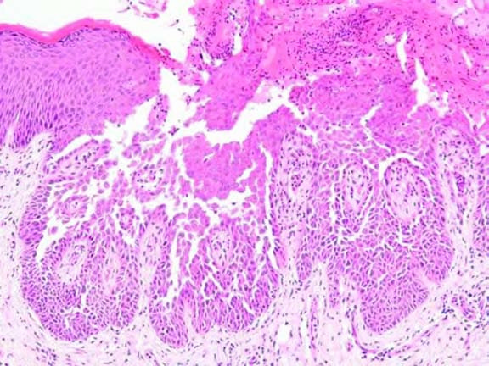
Notes:
Lesional skin in Hailey–Hailey disease shows prominent acantholysis throughout the spinous layer, giving a so‐called ‘dilapidated brick wall’ appearance. There is overlying scale and crust, but little dyskeratosis. (Courtesy of Professor R. A. J. Eady, St John’s Institute of Dermatology, London, UK.)

Slide 58
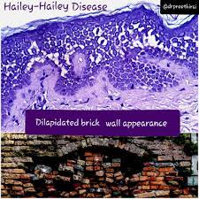

Slide 59
Pathology
HHD is due to mutations in ATP2C1
Chromosome 3q21-24
Encodes SPCA1
On golgi apparatus
Reduced calcium sequestration in golgi apparatus
defective degradation of misfolded ER proteins
trafficking of desmoplakin and desmoglein 3 to the cell membrane is reduced
Triggers reduced SPCA 1
Notes:
Benign familial pemphigus is an inherited skin disorder, although occasionally sporadic cases arise without a family history. The defect responsible has now been identified on a gene called ATP2C1 found on chromosome 3q21-24. This gene codes for the protein SPCA1 (Secretory Pathway Calcium/manganese-ATPase), a calcium and manganese pump. The skin cells (keratinocytes) stick together via structures called desmosomesand it seems the desmosomes do not assemble properly if there is insufficient calcium.
The genetic defect in benign familial pemphigus causes the skin cells to become unstuck from one another. Normally the cells are packed together tightly in much the same way as bricks and mortar. Patients with Hailey-Hailey disease have defective ´mortar´ and the cells fall apart, like a dilapidated brick wall.
This is the calcium pump of the Golgi apparatus membrane, analogous in structure and function to the SERCA pumps in the ER, although only one Ca2+ or Mn2+ is transported per cycle.
The disease is likely to be due to haplo- insufficiency: most mutations are predicted to result in reduced or absent expression of SPCA1 or affect highly conserved, function- ally critical domains. There appears to be no consistent genotype/ phenotype correlation.
Calcium sequestration into the Golgi is reduced in HHD keratinocytes
Additional factors such as heat, friction or infection are clearly required to trigger the clini- cal disorder, as presentation is late and localized. In vitro studies
PART 6: GENETICS
suggest that proinflammatory cytokines such as interleukin 6 (IL‐6) and IL‐8 may regulate ATP2C1 gene expression, and trig- gers such as UVB may reduce SPCA1 to critical levels [249–251]. The reduction of ATP2C1 mRNA expression by UVB irradiation in keratinocytes was prevented by retinoids, corticosteroids, ciclosporin, tacrolimus and vitamin D3 [250,251].

Slide 60
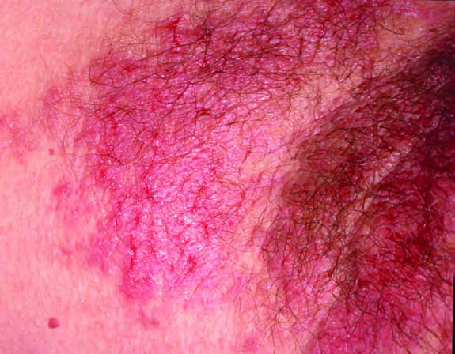
Clinical features
painful, pruritic and often
malodorous lesions of flexures or other sites of friction
Notes:
typical fissured plaque in the axilla
HHD may be localized or generalized, occasion- ally causing erythroderma
In the axilla, inframam- mary or abdominal folds, groin or perineum, lesions show fissuring and erosion with macerated epidermis progressing in more severe cases to vegetations.

Slide 61
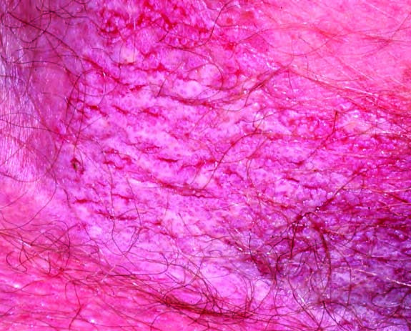
(b)
(d)
Notes:
inflamed, macerated and fissured lesions of the groin in a 40‐year‐old man;

Slide 62
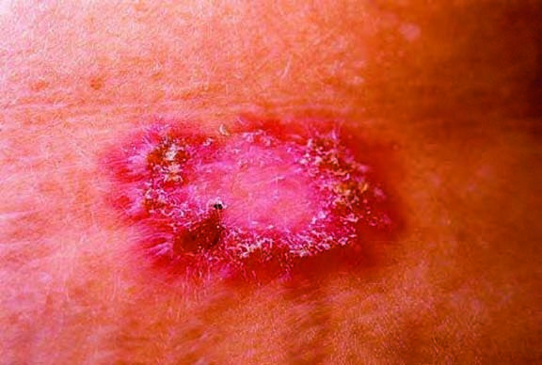
Notes:
annular plaque with a crusted rim (courtesy of Professor R. A. J. Eady, St John’s Institute of Dermatology, London, UK); and (d)
Less occluded areas, such as truncal or neck lesions, are more likely to show vesicop- ustules or flaccid bullae, but may simply be crusted erosions resembling discoid eczema, or annular plaques with periph- eral scales (Figure 66.13c, d), often with post‐inflammatory hyperpigmentation

Slide 63
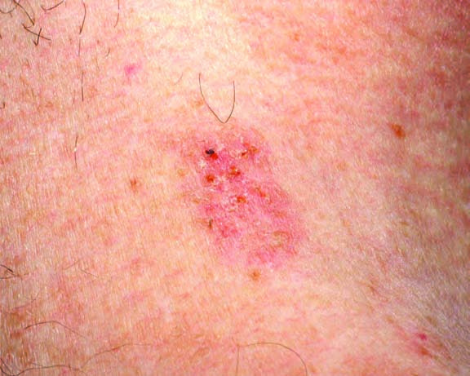
Notes:
indeterminate lesion resembling discoid eczema.

Slide 64
Precipitating factors
Sweating
Friction
Infection
Contact allergy
Adhesive dressing
Electrocardio gram electrodes
UV irradiation
Scabies
Notes:
Common precipitating factors include heat, sweating, friction and infection. Other reported triggers
include contact allergy, adhesive dressings or electrocardio- gram electrodes, UV irradiation and scabies

Slide 65
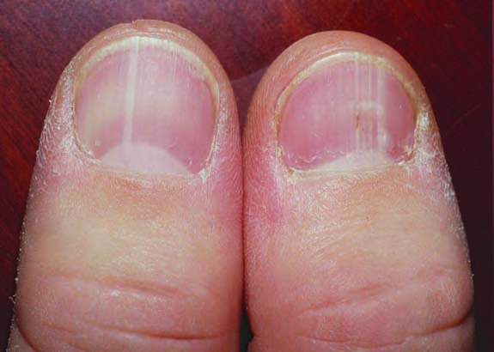
Nail changes
Linear white bands (longitudinal leukonychia) are present in the nails of some patients but without the nail fragility of Darier disease
Notes:
Extra‐epidermal lesions in patients with Hailey–Hailey disease: (a) linear white bands in the nails; terminal notches of Darier disease are not found;
Extra‐epidermal lesions in patients with Hailey–Hailey disease: (a) linear white bands in the nails; terminal notches of Darier disease are not found;

Slide 66
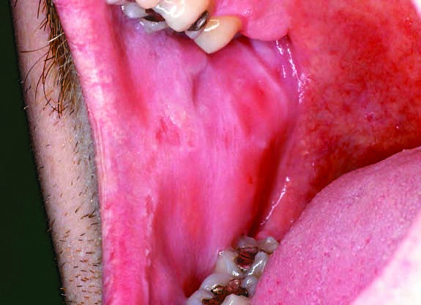
Painless oral erosions
Notes:
Oral (Figure 66.14b), conjunctival, oesophageal or vaginal involvement are rarely described, usually in association with trauma or infection [120,267–271]. Even mild disease has been shown to reduce quality of life, and flexural or groin involvement can be particu- larly disabling [93].

Slide 67
Differential diagnosis
isolated intertriginous erosions
Seborrhic eczema OR Psoriais
Non occluded areas
Tinea corporis OR Discoid eczema OR Autoimmune pemphigus
Hhd vesicles
Herpes simplex
Bullous lesions
EM OR TEN
DD
Notes:
The diagnosis of HHD is often delayed or missed [120,255,279]. Isolated intertriginous erosions suggest flexural seborrhoeic eczema or psoriasis, with bacterial or fungal superinfection, which may indeed be present, but the presence of fissures may be a clue. In non‐occluded areas, lesions resemble tinea corporis or discoid eczema, or autoimmune pemphigus. HHD vesicles may mimic herpes simplex, which may also complicate the disorder [280–285]. Apparent response to antibacterials and/or topical corticosteroids can further delay diagnosis. Severe bullous and erosive lesions can suggest erythema multiforme or even toxic epidermal necrolysis [254]. Hypertrophic or vegetating flexural HHD overlaps clini- cally and histologically with flexural DD. Typical papular or nail lesions of DD elsewhere may help to differentiate the disorders. Similarly, in pemphigus vegetans, the presence of oral lesions may aid distinction. Hypertrophic vulval HHD may mimic viral warts [123,286] or vulval intraepithelial neoplasia [120,287]. Reported reactions to adhesive dressing mimicking contact allergy may be due to HHD [259]. Clinically, the presence of longitudinal leu- konychia may help to diagnose HHD [120,262,263]. Histology, including immunofluorescence, may be necessary to exclude auto- immune pemphigus. DD typically shows less marked acantholy- sis and more dyskeratosis, but the distinction may not be easy in the presence of florid and superinfected flexural disease.

Slide 68
Classification of severity
Grade 0: subclinical
Grade I: mild disease
Grade II: moderate
Grade III: severe
Notes:
Grade 0: subclinical; an obligate carrier in a family, with no
apparent disease or nail lesions only.
• Grade I: mild disease; localized (e.g. perineal or axil-
lary) and intermittent lesions responding to simple topical
therapies.
• Grade II: moderate; chronic lesions at two or more body sites
(e.g. axillary and groins) or locally severe and refractory to topi-
cal treatment.
• Grade III: severe; extensive or chronically disabling disease
despite topical and systemic treatment.
In Burge’s study [120], although criteria were not defined, 20 of 58 patients had mild, 36 moderate, and two severe disease.

Slide 69
Complications and co-morbidities
Infections
bacterial
fungal
viral
Cancer
Allergic contact dermatitis
Notes:
Secondary bacterial and candidal infections are common [279,288], and unrecognized tinea may be present. Herpes simplex should
PART 6: GENETICS
be suspected, especially for painful or disseminated exacerbations [281]. Human papillomavirus (HPV) may be present in verrucous perineal lesions [289,290]. Squamous cell carcinoma reported in association with HHD may be related to HPV carriage [291–294] but HPV was not detected in a case associated with the use of topi- cal tacrolimus [295]. As with any chronic dermatosis, the possibil- ity of allergic contact dermatitis should be considered [296,297]. Affective disorder has been found to co‐segregate in three families with HHD [298–300].

Slide 70
Disease course and prognosis
Hailey–Hailey disease pursues a chronic relapsing and remitting course but may improve in old age

Slide 71
Investigations
Skin biopsy
Cultures
Gene sequencing > not needed
Genetic counselling > not needed
Notes:
Skin biopsy demonstrates the characteristic features described above. Swabs for bacterial, fungal and viral culture or other investigation should be taken to exclude complicating infection. Sequencing of the responsible gene, ATP2C1, is not generally needed for diagnosis or genetic counselling, but is available com- mercially.

Slide 72
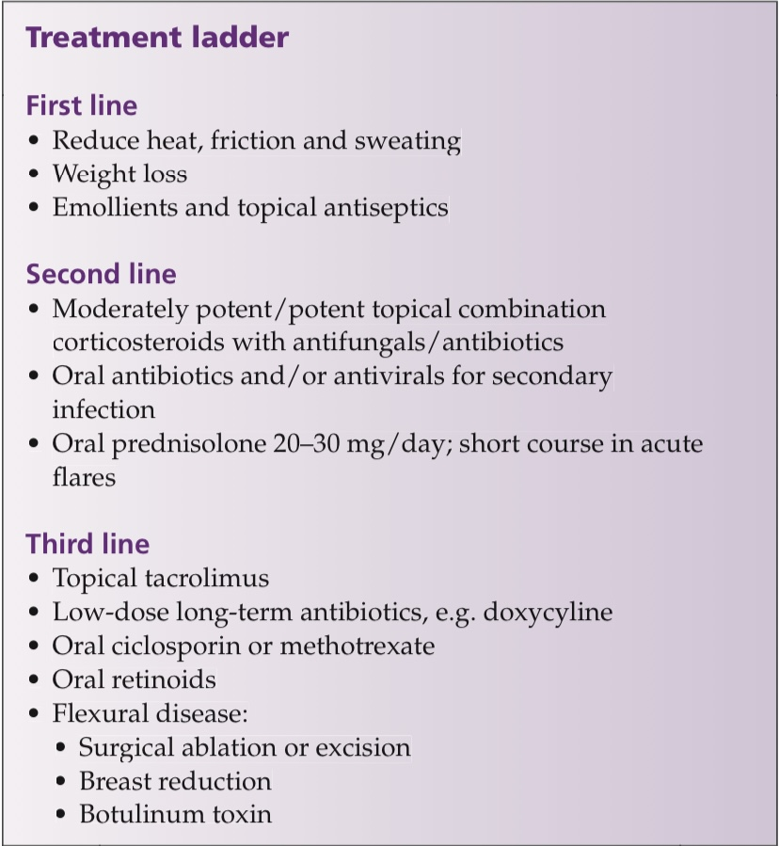
Notes:
General measure :
Basic measures include loose clothing, absorbent pads in flexures and, where appropriate, weight loss. Emollients and antimicrobial agents may in theory prevent exacerbations
Topical steroids and antimicrobials :
Potent or highly potent topical corticosteroids can be effective, especially combined with antibacterial/antifungal agents. Their prompt and early use for exacerbations is recommended [120] but extended treatment should be avoided because of the risk of cutaneous atrophy, especially in the flexure
Antibiotics:
Topical anti- microbial agents used have included tetracyclines, fusidic acid or imidazoles. Broad spectrum agents such oral flucloxacillin, eryth- romycin or tetracyclines may be helpful but skin swabs for bacte- rial, fungal and yeast culture, and viral polymerase chain reaction (PCR), are important in guiding treatment
Antivirals :
Painful, recalcitrant disease may indicate superinfection by herpes simplex and sys- temic antiviral treatment should be considered if PCR results are not promptly available. Analgesia, even oral morphine in severe disease, is necessary.
3rd line:
Successful topical use of tacrolimus has been reported sev- eral times [303–307], although it may be an irritant [308]. Her- pes simplex and other infections should be excluded, and one patient treated with topical tacrolimus developed a vulval squamous cell carcinoma [295]. Other topical agents reported to help include calcitriol and tacalcitol [309–311], and in a sin- gle case 5‐fluorouracil [312]. The ability of gentamicin to induce readthrough of nonsense mutations in ATP2C1 has been dem- onstrated in vitro but its relevance to patient care is unp
Oral treatments:
The evidence base for systemic agents is also limited, but systemic cortiocosteroids are useful for acute severe inflamma- tory disease [252,255,314]. Oral acitretin [288,315–318] or ali- tretinoin [319], ciclosporin [320–324], methotrexate [325,3
Remission:
dapsone [327–329] and calcitriol [330] have all been reported to help. It is recommended that systemic agents be withdrawn when control is achieved. Le Saché‐de Peufeilhoux et al. [331] found that long‐term oral doxycycline helped six patients, including two sustained remission. sustained remission following a course of oral terbinafine. The authors speculated that the benefits were due to non‐antibiotic effects of the respective drugs.
Biologics:
The biological agents etaner- cept [333] and alefacept [334] have been used with success in single cases.
Physical intervention:
Physical interventions reported include ablative treatments such as cryosurgery [252], dermabrasion [335–339], electrodessi- cation [340], various forms of laser therapy [220,341–346] and argon plasma coagulation [347]. A novel treatment, cold atmos- pheric argon plasma, may also be effective
Surgical excision:
Surgical excision of flexural disease, with or without grafting [349–352], and breast reduction for inframammary disease [353] have been reported. Superficial radiotherapy has had mixed results [354,355], and electron beam therapy [356] has also been advocated. Axillary or inframammary use of botulinum toxin can reduce sweating
Phototherapy:
Suberythemal UVB controlled both psoriasis and HHD in one case [360], despite ultraviolet light usually exacerbating HHD [361]. Photodynamic therapy is painful and has variable outcomes [362,363].

Slide 73
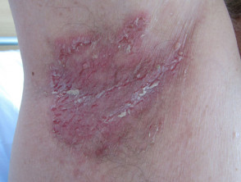
HHD axilla

Slide 74
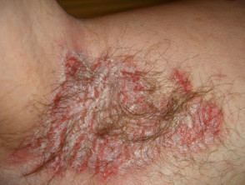
HHD axilla

Slide 75
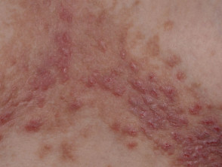
HHD chest

Slide 76
Thankyou!

