Slide 1
Immunological reactions to drugs

Slide 2
DRUG REACTION
A drug reaction is a skin condition—such as an itchy or tender bump, rash, or blister—that develops when the body reacts adversely to medication.
an immune-mediated response to a drug agent in a sensitized patient

Slide 3
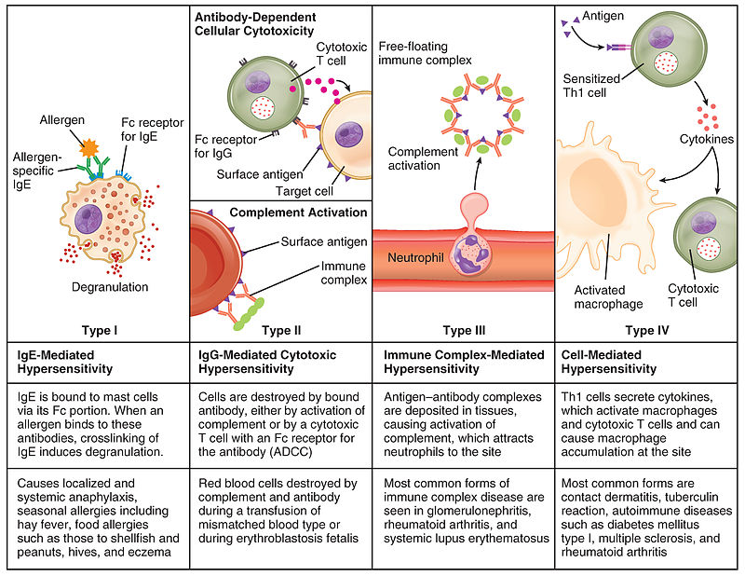
Hypersensitive reactions

Slide 4
IgE‐mediated drug hypersensitivity
Type I hypersensitivity reactions involve the activation of tissue mast cells and blood basophils when IgE molecules bound to their surface become linked together by an allergen

Slide 5
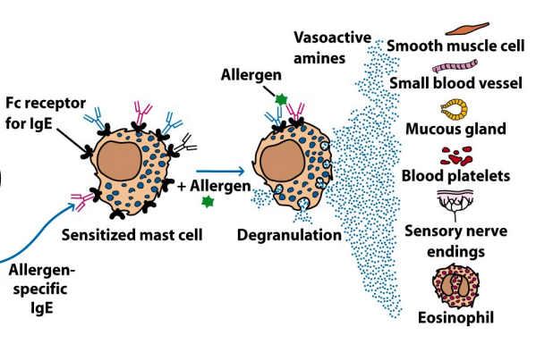

Slide 6
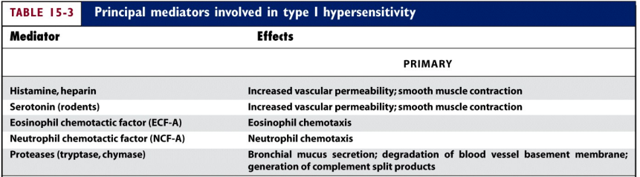
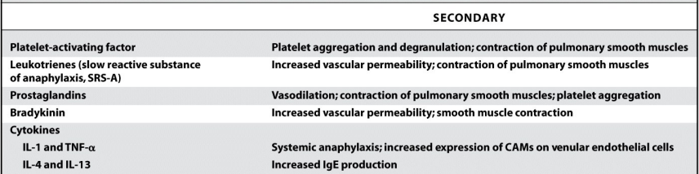

Slide 7
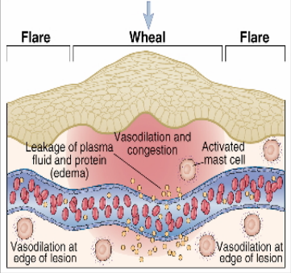

Slide 8
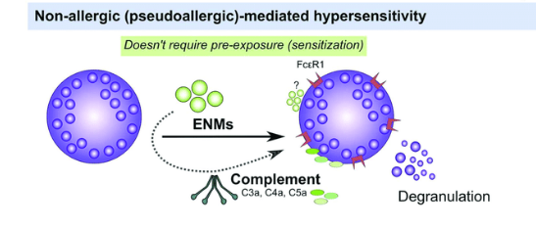
non IgE mediated drug allergy

Slide 9
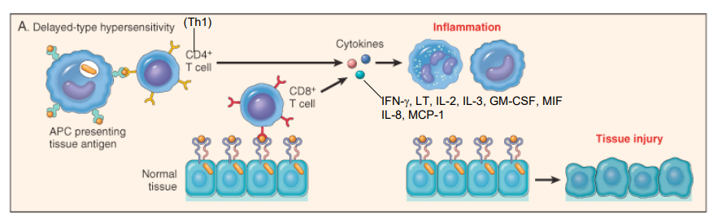
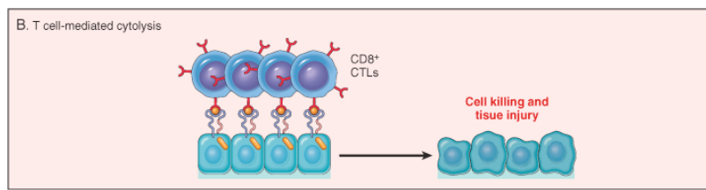
Type IV hsr
Delayed hypersensitivity reaction occurs 48–72 hours after exposure to the allergen. This reaction does not involve antibodies.

Slide 10
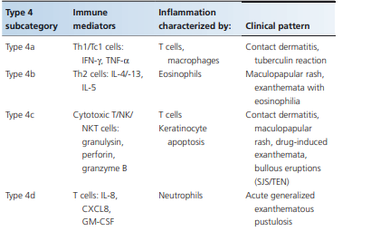

Slide 11
Adverse drug reaction (ADR)
The World Health Organization defines an ADR as “any response to a drug which is noxious and unintended, and which occurs at doses normally used in man for prophylaxis, diagnosis, or therapy of disease, or for the modification of physiological function.”

Slide 12
Benign Cutaneous Adverse Reactions to Drugs
Drug‐induced exanthem/pruritus/eczema
Symmetrical drug‐related intertriginous and flexural exanthem
Drug‐induced urticaria, angio‐oedema and anaphylaxis
Drug‐induced serum sickness‐like reaction
Lichenoid drug eruption
Fixed drug eruption
Drug‐induced pityriasis rosea/Drug‐induced erythema nodosum/Drug‐induced acneform eruptions,

Slide 13
Drug exanthem
Exanthematous reactions are the most frequent presentation of non‐immediate (non‐immunoglobulin E (IgE)) drug allergy
can occur after almost any drug at any time up to 3 weeks, but usually 1–2 weeks after administration
Resembles the classic morbilliform rash but without enanthem.

Slide 14
Clinical variations
scarlatiniform, rubelliform,
profuse eruption of small pink papules
large macules, polycyclic and gyrate erythema, reticular eruptions and sheet‐like erythema
The trunk and extremities are usually involved,
face is typically spared. Palmar and plantar lesions may occur, and sometimes the eruption is generalized.
Purpuric lesions, especially on the legs, and erosive stomatitis may develop. There may be relative sparing of pressure areas.

Slide 15
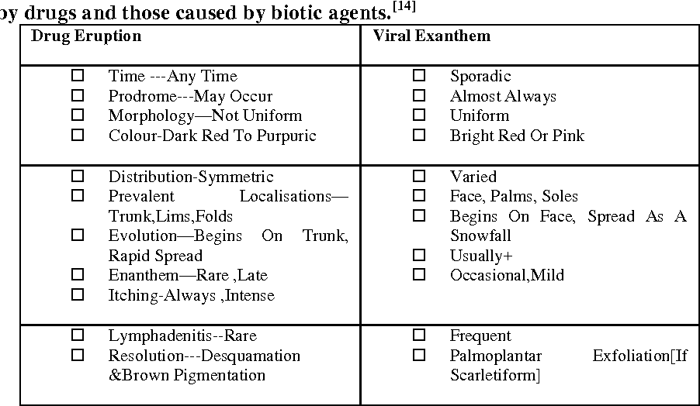

Slide 16
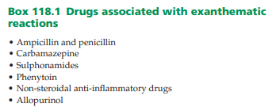

Slide 17
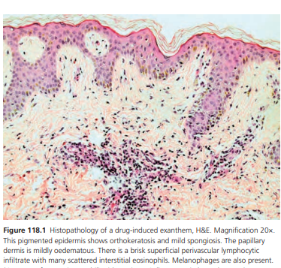
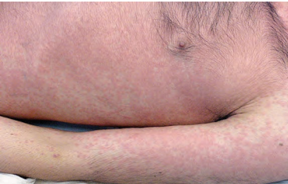

Slide 18
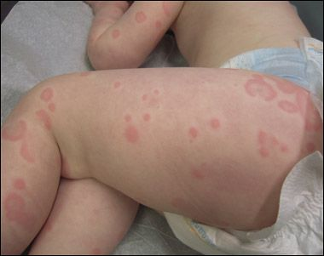
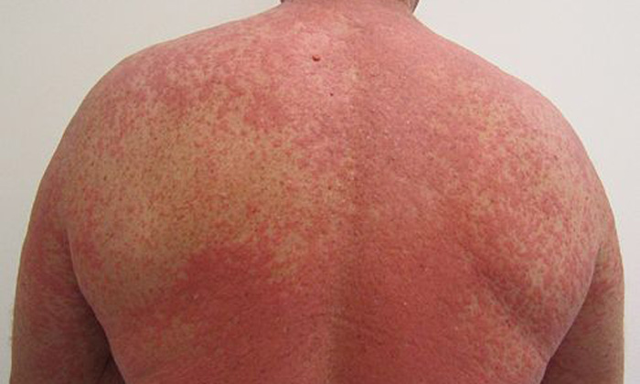
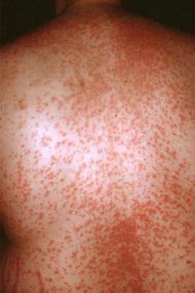

Slide 19
Disease course
If the drug is continued, the rash may:
Resolve despite continued exposure to the drug
Persist without change
Progress to erythroderma

Slide 20
Investigations
Blood tests to exclude organ dysfunction and haematological abnormalities associated with DRESS are important.
Viral serology/polymerase chain reaction (PCR) may be useful to exclude viral infections.
Skin histology is not routinely done

Slide 21
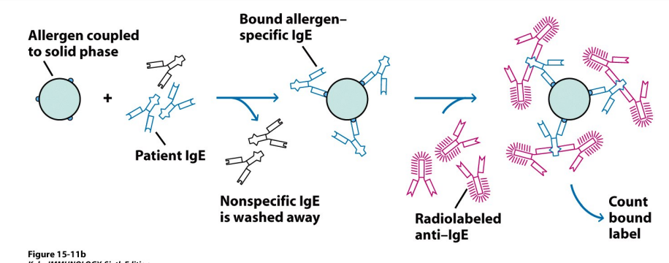
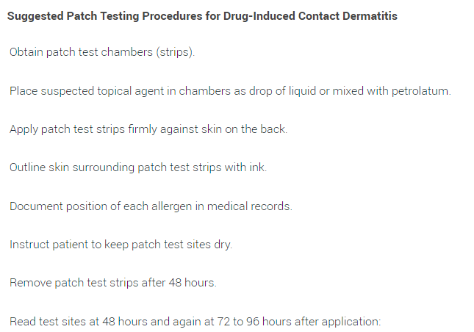
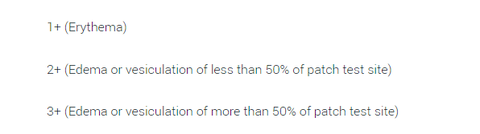
RAST –
radioallergosorbent
PATCH test

Slide 22
Management
Cessation of the culprit drug is essential.
On withdrawal of the drug, maculopapular drug eruptions usually fade with desquamation, sometimes with post‐inflammatory hyperpigmentation

Slide 23
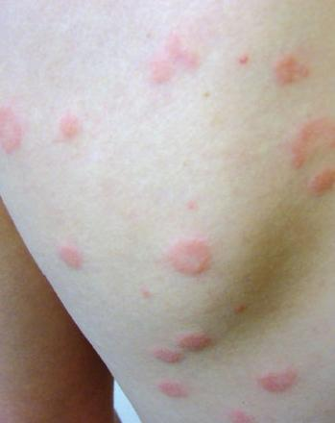
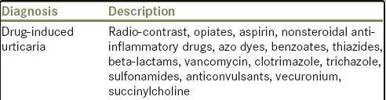
Drug‐induced urticaria, angio‐oedema and anaphylaxis
Urticaria, angio‐oedema and anaphylaxis arise within 24–36 h of drug ingestion at the first occasion.
On re‐challenge lesions may develop within minutes.
Angiotensin‐converting enzyme (ACE) inhibitors can cause angio‐oedema which is bradykinin mediated rather than histamine dependent and will therefore not respond to antihistamines
The most frequent drug causes of anaphylaxis are antibiotics (usually β‐lactams) and NSAIDs

Slide 24
Drug induced pruritus
secondary
Biochemical profile
Direct skin damage/hypersensitive effects
Neuronal/CNS involvement
primary

Slide 25
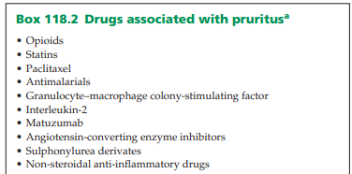
Hydroxyethyl starch (HES) is used for colloid fluid replacement in some settings and has been associated with chronic pruritus in approximately one third of patients.

Slide 26

Opioids can induce mast cell degranulation and histamine release causing an itchy urticarial rash
medullary dorsal horn

Slide 27
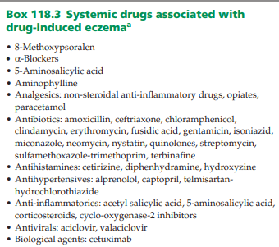
Drug‐induced eczema
A patient sensitized to a drug may develop an eczematous reaction when the same drug, or a chemically related one, is subsequently administered systemically
Patients with contact allergy to parabens may develop systemic eczema on exposure to drugs containing parabens as a preservative
The latency from drug initiation to onset of eczema typically occurs at 7–14 days.
The eruption tends to be symmetrical, and may involve first, or most severely, the site(s) of the original dermatitis, before becoming generalized

Slide 28
Symmetrical drug‐related intertriginous and flexural exanthem
Previously, such cases were called drug‐induced baboon syndrome
a type IV delayed hypersensitivity reaction
infiltration of CD4+ T cells in the dermis.
gluteal region, thighs and other intertriginous areas such as the axillae, knees, elbows and neck.

Slide 29
Clinical features
The latency from drug intake to the onset of SDRIFE ranges from hours to a few days
Diagnostic criteria: (i) exposure to a systemically administered drug;
(ii) sharply demarcated erythema of the gluteal/perianal area and/or V‐shaped erythema of the inguinal area;
(iii) involvement of at least one other intertriginous/flexural location;
(iv) symmetry of the affected areas; and
(v) absence of systemic symptoms and signs

Slide 30
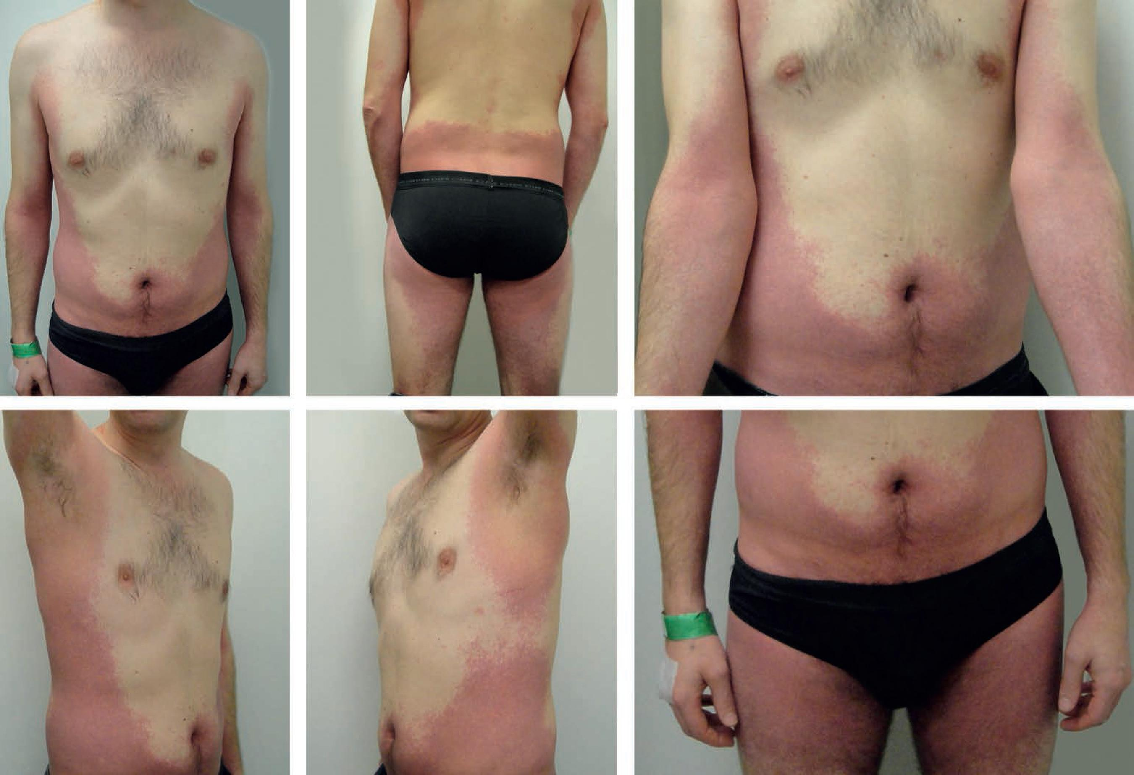

Slide 31
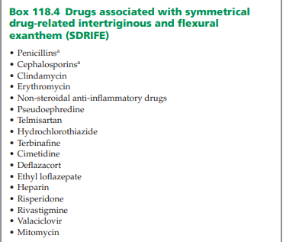

Slide 32
Drug‐induced serum sickness‐like reaction
Drug‐induced serum sickness‐like reactions (SSLR) are characterized by a clinical triad of fever, rash and arthralgias/arthritis.
The primary lesions of SSLR are urticarial weals which
are migratory and pruritic
Some lesions may have purpuric or dusky centres and
may be mistaken for erythema multiforme.

Slide 33
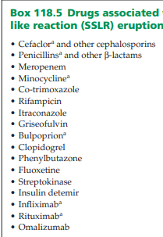
Facial and periorbital oedema may coexist.
No mucosal membranes are involved
Joints of the hands and feet are also often affected;
associated symptoms include arthralgia, swelling,
warmth
and decreased range of movement .
Systemic involvement of the kidneys and liver is rare,
in contrast to true serum sickness

Slide 34
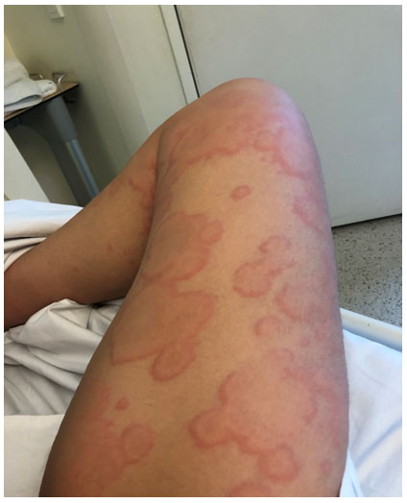
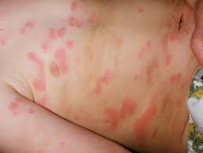
Differential diagnosis include urticarial vasculitis, Still disease, Schnitlzer syndrome, human parvovirus B19 infection, Kawasaki disease and hereditary autoinflammatory diseases
Cutaneous and musculoskeletal manifestations resolve on drug withdrawal. Typical median duration of rash and joint symptoms are 5 and 3 days, respectively

Slide 35
Lichenoid drug eruptions
Lichenoid drug eruptions may present as a variety of clinical patterns including LP and LE. It has been suggested that the different clinical patterns reflect lymphocyte ‘cell rich’ (e.g. LP) and ‘cell poor’ (e.g. LE) lichenoid patterns
Drug‐induced LP reactions represent approximately 10% of all LP cases. Approximately 10% of all cutaneous LE cases are mediated by drugs.

Slide 36
PATHOLOGY
they may develop as a result of autoreactive T cells directed against a drug–major histocompatibility complex (MHC) antigen complex, such that keratinocytes and Langerhans cells are viewed by the immune system as ‘non‐self’.
Genetic factors have been strongly linked with drug‐induced lupus such as hydralazine (73% HLA‐DR4) and minocycline (HLA‐DQB1)

Slide 37
LP vs Drug induced LP
Extensive rash distributed symmetrically over the trunk and limbs
Photodistribution – the rash is predominantly in areas exposed to the sun
The rash may be scaly resembling eczema or psoriasis
Wickham striae are usually absent
Nail and mucous membrane (e.g., mouth) involvement is uncommon (oral lichen planus)
More likely to leave marked pigmentation after the active rash has cleared.

Slide 38
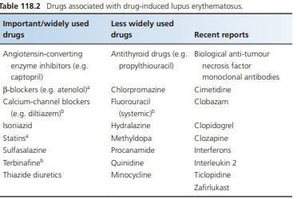
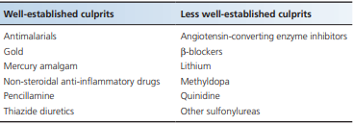

Slide 39
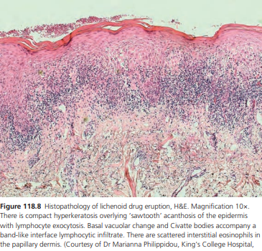
H/P
only distinguishing histological characteristics of drug‐induced LP, as opposed to non-drug LP, were a higher frequency of necrotic keratinocytes (in clusters), and infiltrating plasma cells and eosinophils

Slide 40
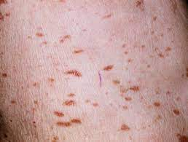
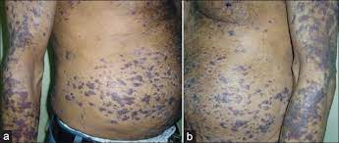
CLINICALLY

Slide 41
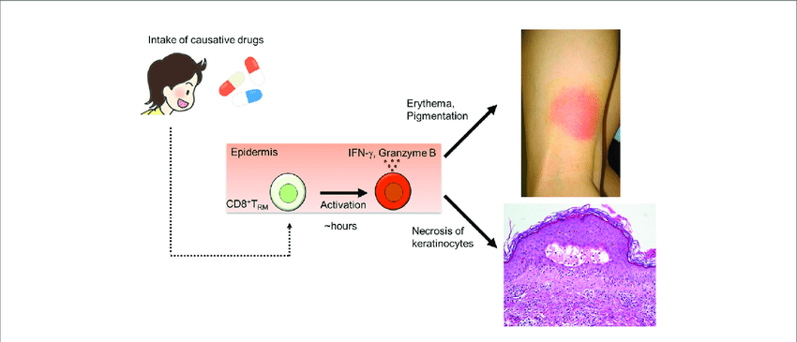
Fixed drug eruption
is a cutaneous adverse drug reaction characterized by recurrent well‐defined lesions occurring in the same sites each time the offending drug is taken
FDE typically presents 30 min to 8 h after drug exposure.

Slide 42
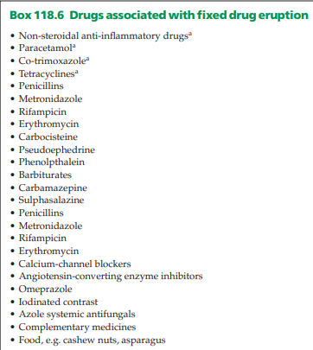
HLA-A30 with cotrimoxazole-induced fixed drug eruption

Slide 43
clinically
the most common form is the localised pigmenting type; other presentations include bullous (localised or generalised), mucosal, non-pigmenting, or generalised.
Commonly affected sites include the lips, genitals, palms and soles; 5% of cases may have an exclusive mucosal involvement
NSAID‐induced FDE affecting the genitals and lips; tetracycline‐ and trimethoprim/sulfamethoxazole‐induced FDE affecting the genitals; metamizole‐induced FDE of the trunk and extremities; and carbocysteine‐induced FDE of the face

Slide 44
Generalised bullous fixed drug eruption
Rare variant
Recurrent episodes with onset within 24 hours of drug exposure
Numerous large blisters and erosions with normal skin between typically affecting <10% of the skin surface
Relative sparing of mucosal surfaces
Lesions are not targetoid
Fever, malaise and arthralgia may be associated
Resolves with post-inflammatory hyperpigmentation.

Slide 45
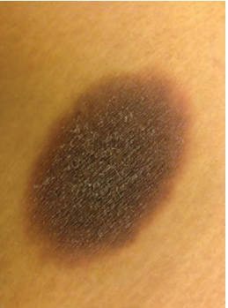
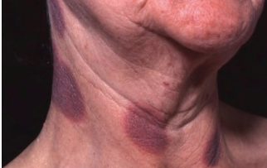
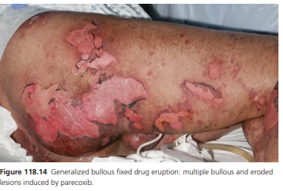
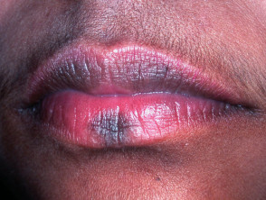

Slide 46
Disease course and prognosis
The majority of FDE is self‐limiting with an excellent prognosis.
Post‐inflammatory hyperpigmentation can be prominent and persist for several months after the acute episode.
In GBFDE, the mortality is approximately 20%. Patients with GBFDE require the same level of treatment and care as for SJS and TEN

Slide 47
Toxic erythema of chemotheraphy
toxic reactions that is characterized by areas of painful erythema (and oftentimes edema) which usually involve the hands and feet, intertriginous zones (eg, axillae, groin), and, less often, the elbows, knees, and ears.The eruptions may have a bullous component,are self-limited,and often resolve with desquamation and postinflammatory hyperpigmentation.

Slide 48
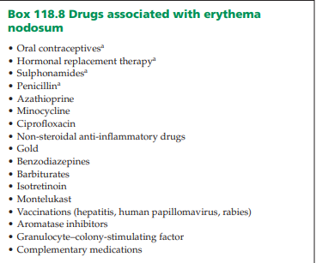
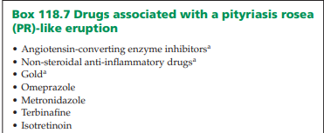
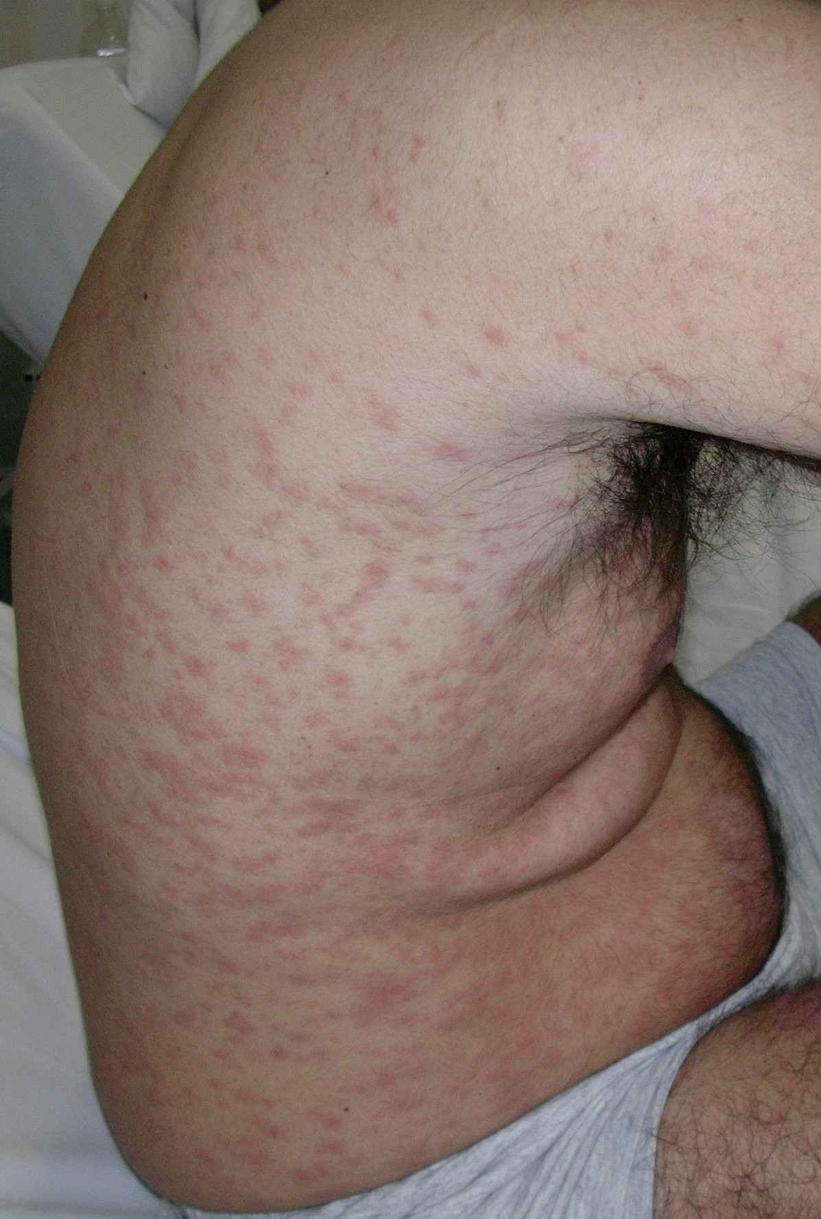
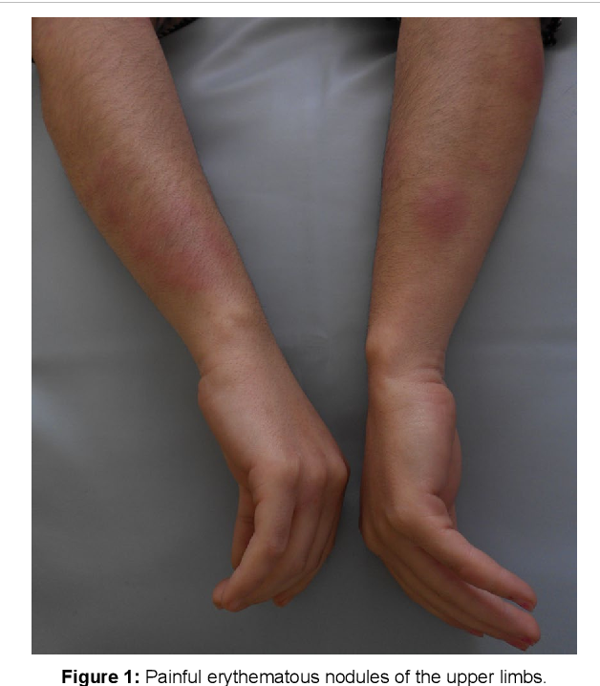
Misc.

Slide 49
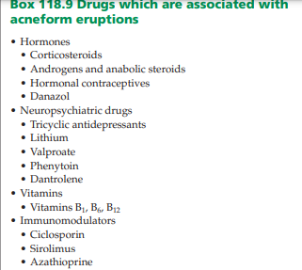
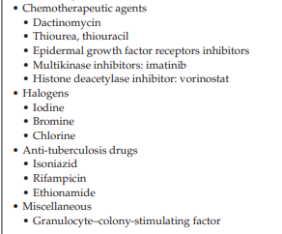
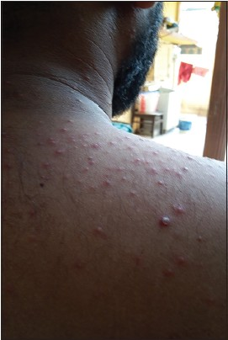

Slide 50
references
file:///E:/Last%20windows/dermatology/books/Rooks%20Textbook%20of%20Dermatology,%204%20Volume%20Set.9E.2016.UnitedVRG.HTD.pdf
https://www.ncbi.nlm.nih.gov/pmc/articles/PMC3423598/#:~:text=Immunological%20reactions%20to%20drugs%2C%20also,abnormal%20response%20to%20the%20drug.
https://njms.rutgers.edu/sgs/olc/mci/prot/2009/Hypersensitivities09.pdf
https://www.researchgate.net/figure/IgE-allergic-vs-non-IgE-pseudoallergic-mediated-activation-of-mast-cells-Mast_fig1_339271117
https://dermnetnz.org/topics/allergies-explained
https://dermnetnz.org/topics/drug-eruptions
https://dermnetnz.org/topics/drug-hypersensitivity-syndrome
https://dermnetnz.org/topics/serum-sickness
https://dermnetnz.org/topics/fixed-drug-eruption
https://dermnetnz.org/topics/lichenoid-drug-eruption
https://dermnetnz.org/topics/morbilliform-drug-reaction
https://www.aafp.org/afp/2003/1101/p1781.html

