Slide 1
Immunobullous Disorder

Slide 3
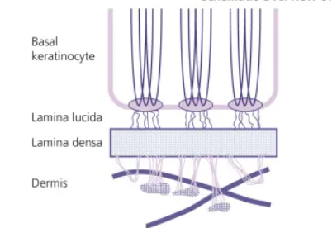
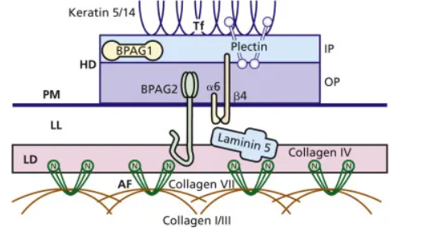

Slide 4
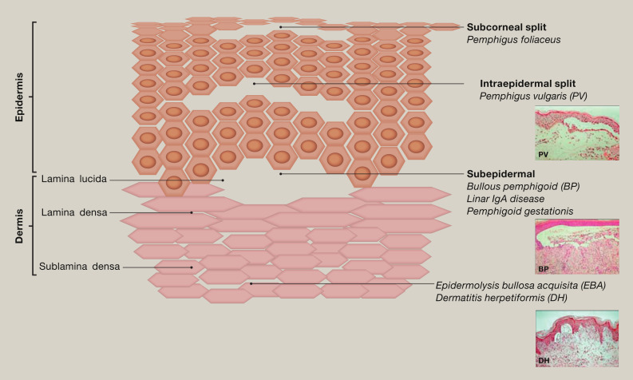

Slide 5
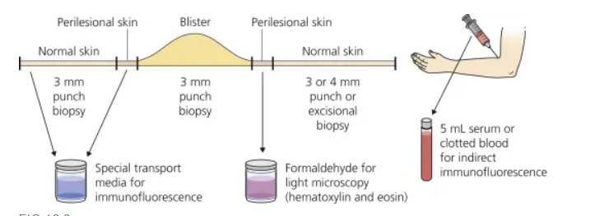

Slide 6
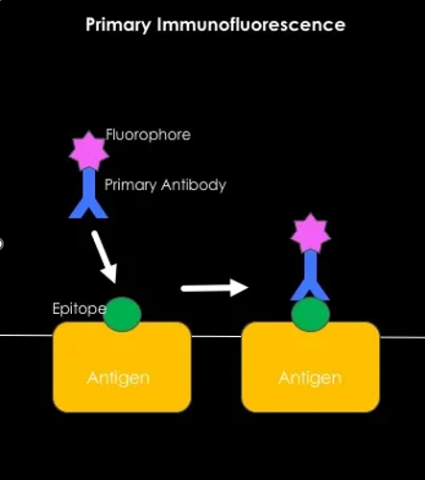
application of antibody–fluorophore conjugate molecules to samples of patient tissue obtained from biopsies. These antibody–fluorophore conjugates target abnormal depositions of proteins in the patient’s tissue.

Slide 7
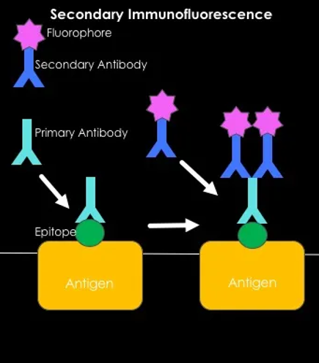
Unlabelled primary antibodies (used as a marker for cancer, diabetes and Alzheimer disease) from the patient serum bind to the target molecule in pre-prepared tissue samples.
Secondary antibodies (used as a marker for HIV), conjugated with a fluorescent dye such as fluorescein isothiocyanate (FITC), bind to the primary antibody.
When exposed to light, the fluorescent dye is excited and emits a wavelength that can be seen with a fluorescent microscope
Notes:
Idf detect circulating autoantibodies in patient serum.

Slide 8
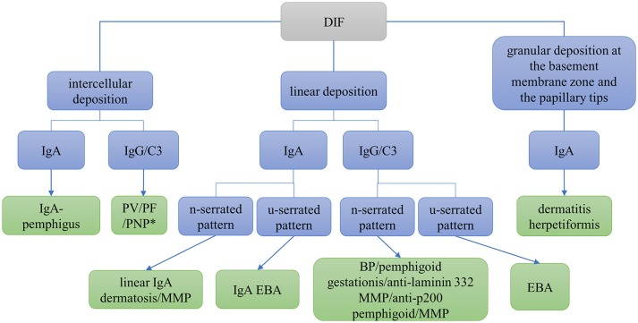

Slide 9
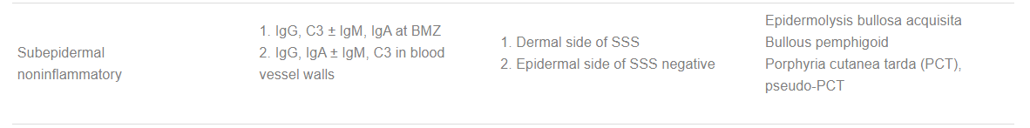
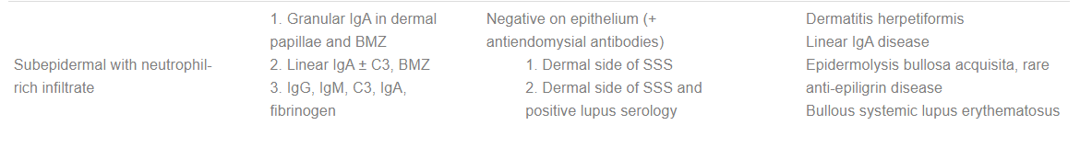

Slide 10
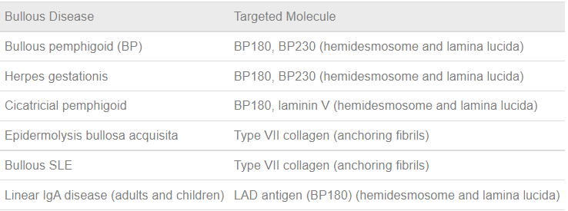
Notes:
DH epidermal transglutaminase

Slide 11
Linear IgA disease/• Chronic bullous disease of childhood
Linear IgA disease (LAD) is the most frequent autoimmune blistering disease in infants and children
This subepidermal blistering disease
predominant binding of IgA along the DEJ
there being two peaks of onset, below the age of 5 and between the age of 60 and 65 years

Slide 12
Target antigen
The major target antigen is the ectodomain of BP180
Zone et al. reported a 97 kDa protein in the extract of human epidermis and dermis termed the linear IgA bullous dermatosis antigen (LABD97) and Marinkovich et al. described a 120 kD antigen referred to as linear IgA antigen 1 (LAD‐1)
Later, it became clear that both antigens represent C‐ terminal portions of BP180

Slide 13
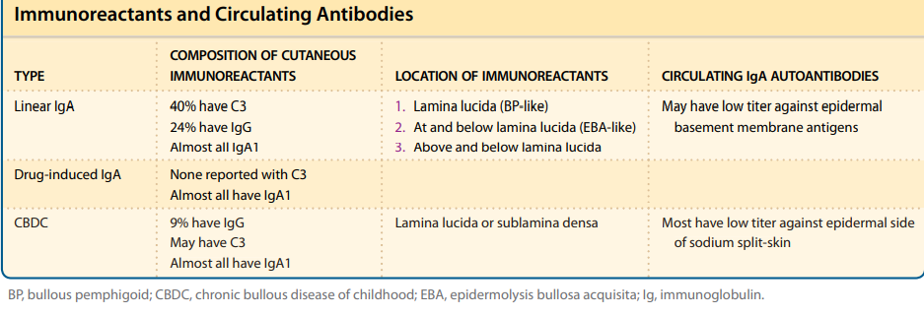
Notes:
igA bullous dermatosis
Bp 180,230,laminin 332 type 7 collagen

Slide 14
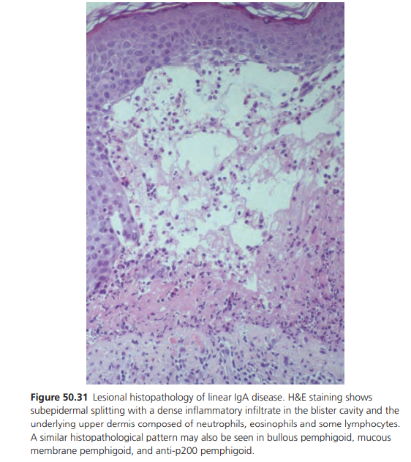
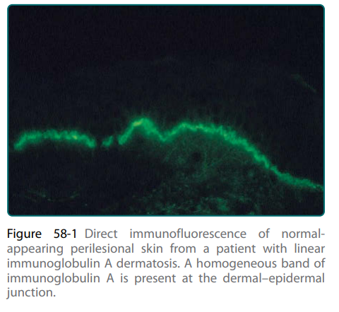

Slide 15
Clinical features
Tense blisters, vesicles and annular erythema are the clinical hallmarks.
Frequently, blisters are arranged annularly, a formation referred to as ‘crown of jewels’, and mucous membrane lesions are present.
Skin lesions have the same morphology in children and adults; however, they arise more abruptly in children and sites of predilection are different

Slide 16
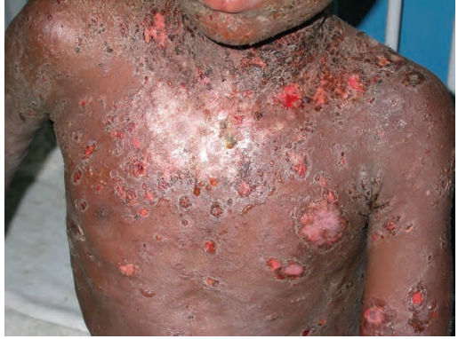
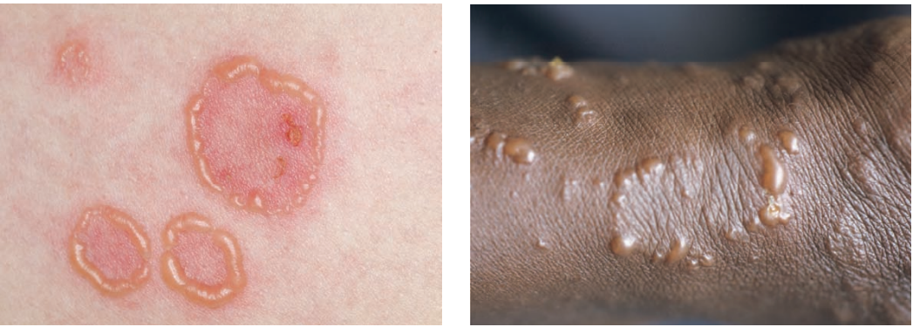

Slide 17
Drug-induced IgA disease usually resolves on withdrawal of the offending drug. Drugs that may be implicated include:
Vancomycin (most frequently associated drug)
Non-steroidal anti-inflammatories eg, diclofenac, naproxen
Captopril
Trimethoprim + sulphamethoxazole
Amiodarone
Furosemide
Ciclosporin
Glibenclamide
Lithium
Penicillins
Cephalosporins (cefalosporins)

Slide 18
Disease course and prognosis
Patients with LAD almost always respond well to treatment. Relapses may occur over the next 2–4 years but are usually less severe than the initial disease episode.
Most children go into complete remission within 2 years of disease onset and only very rarely the disease persists after puberty.
Drug‐induced LAD usually heals within 4–8 weeks after discontinuation of the drug. Some cases, however, have persisted for months

Slide 19
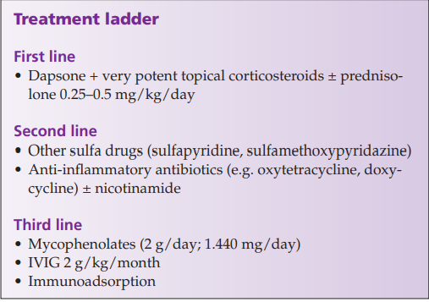

Slide 20
Anti‐p200 pemphigoid
Anti‐p200 pemphigoid is a distinct subepidermal bullous skin disease characterized by autoantibodies against a 200 kDa protein (p200) of the DEJ detected by Western blotting
synthesized by both keratinocytes and dermal fibroblasts
recombinant C terminus of laminin γ1
Notes:
. Laminins are extracellular matrix glycoproteins and major constituents of basement membranes

Slide 21
Associated diseases
Psoriasis was associated in about 30% of the published cases, almost all of them were Japanese
Mean age 50 to 91 years

Slide 22
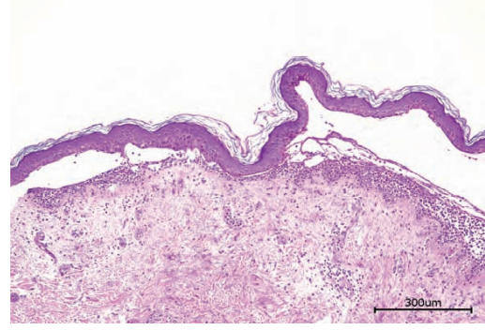
Pathology
As in all pemphigoid diseases, the histopathological hallmark of a lesional biopsy is the subepidermal split accompanied by the accumulation of neutrophils in the upper dermis
microabscesses may develop at the tips of dermal papillae.

Slide 23
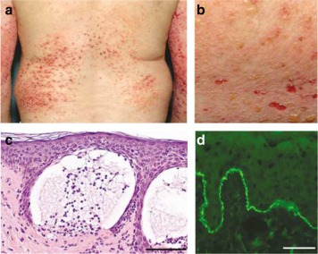
Notes:
Floor. tissue‐bound autoantibodies can be visualized by direct IF microscopy of a perilesional biopsy as linear deposits of IgG at the DEJ.
Pattern analysis reveals an n‐serrated pattern.

Slide 24
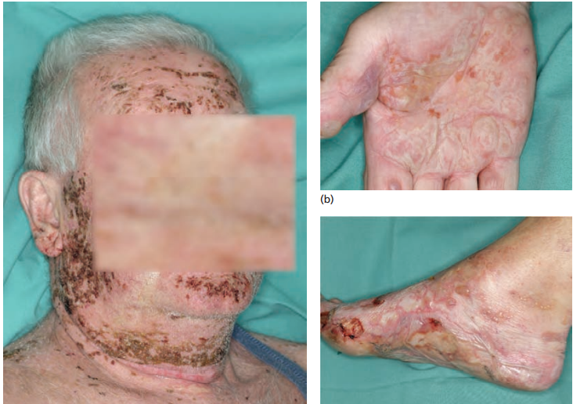

Slide 25
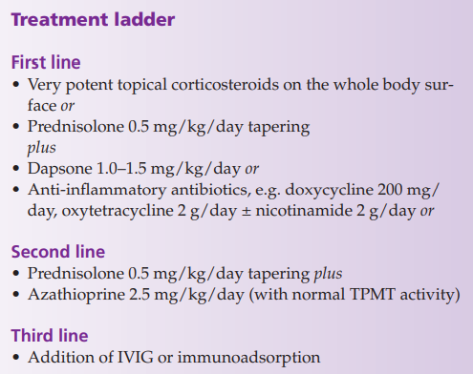

Slide 26
EBA
is a clinically heterogeneous subepidermal blistering disease defined by autoantibodies against type VII collagen BP180, BP230, laminin 332 and the p200 antigen
igA anti VII collagen
The disease occurs at any age with reported mean ages of disease onset of 44 and 54 years .
A considerable number of patients (estimated at 5%) are children and adolescents
Penicillin, vancomycin in conjunction with gentamycin, UV radiation and contact allergy to metals have been implicated as precipitating factors
Notes:
Scarring milia formation

Slide 27
clinical criteria for EBA including:
(i) negative family or personal history for skin blistering;
(ii) adult disease onset;
(iii) skin lesions that resemble hereditary dystrophic EB; and
(iv) the exclusion of all other bullous diseases

Slide 28
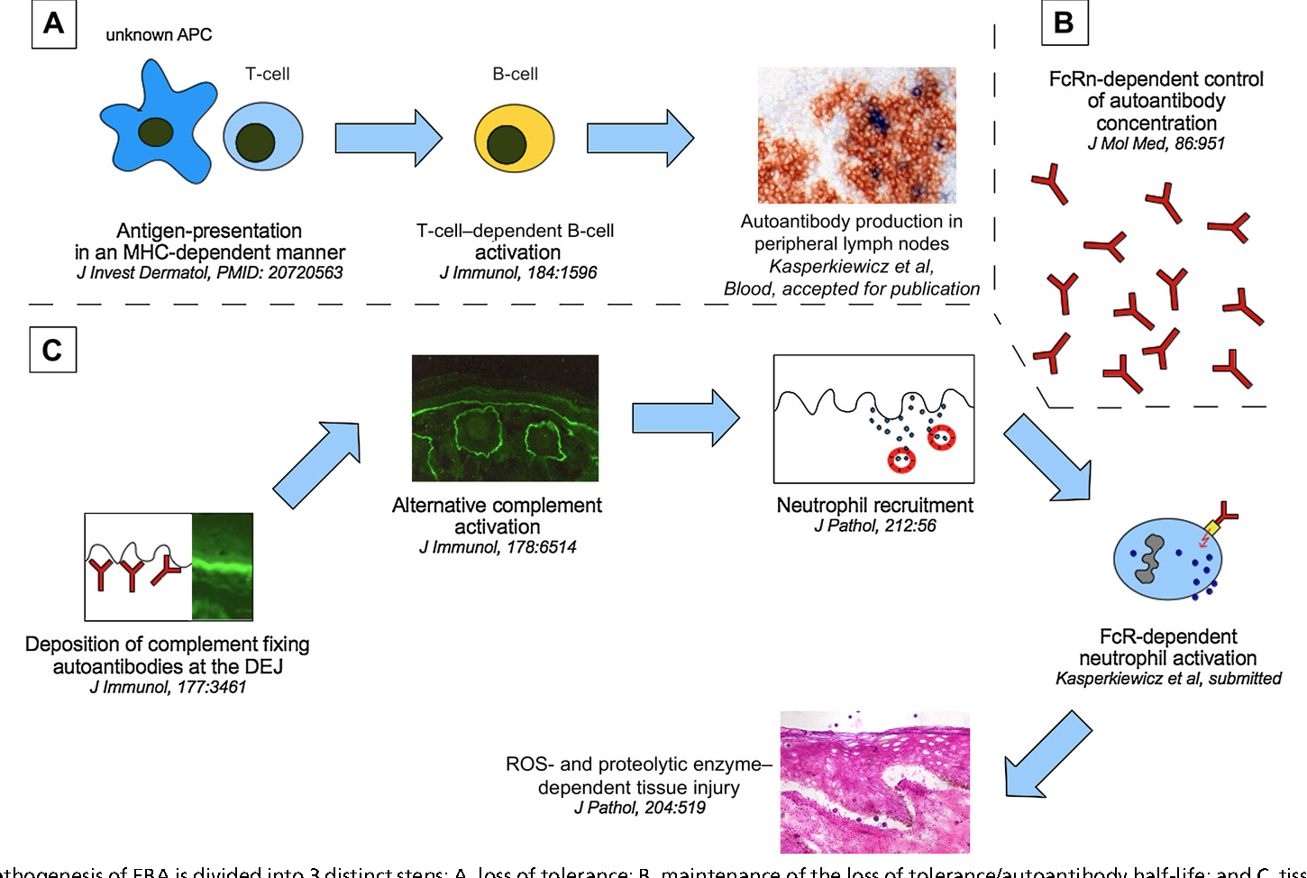
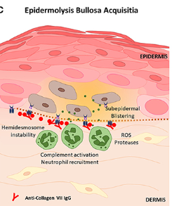
Notes:
Predisposing factors Penicillin, vancomycin in conjunction with gentamycin, UV radiation and contact allergy to metals have been implicated as precipitating f

Slide 29
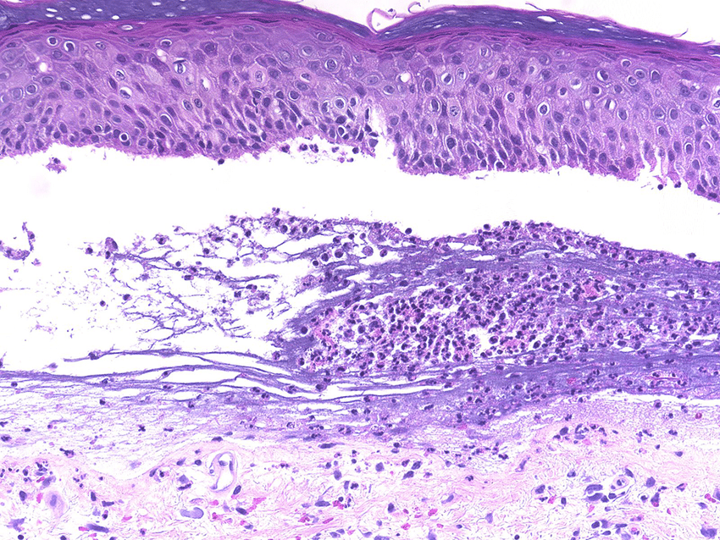

Slide 30
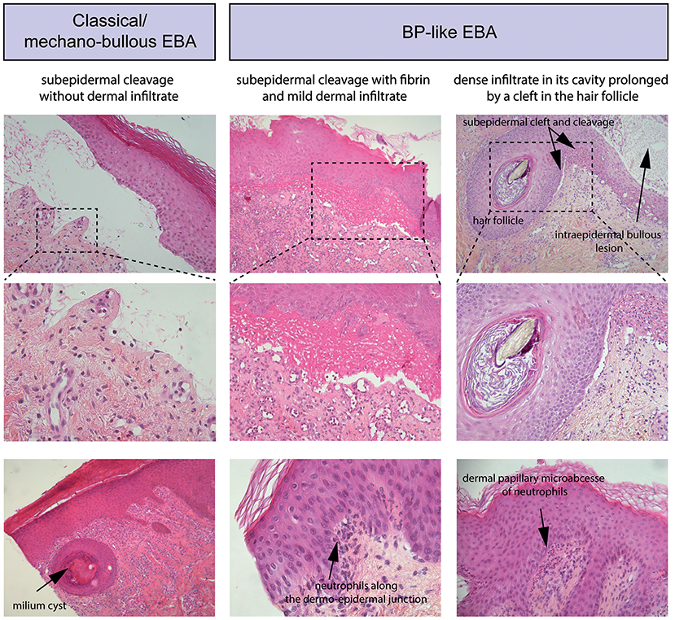
Notes:
classical or mechanobullous form
inflammatory variant that mimics BP, LAD or MMP
inflammatory infiltrate in the dermis is variable, scarce in the mechanobullous variant and dense with predominant neutrophils, eosinophils, monocytes and lymphocytes reminiscent of BP in the inflammatory subtype

Slide 31
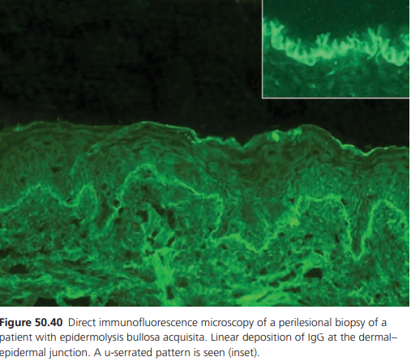
linear deposits of IgG and/or C3 at the DEJ.
By a 600‐fold magnification the linear binding
shows an u‐serrated pattern with a grass‐like
appearance of Ig deposits

Slide 32
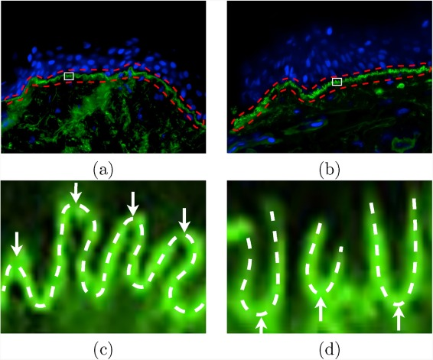

Slide 33
Classic mechanobullous type
mimics dystrophic hereditary EB when it is severe and porphyria cutanea tarda when it is mild
Inflammatory variant
resembles other pemphigoid diseases such as BP (in about half of EBA patients), MMP (in 5–10%), and LAD (in 5–10%) [
Clinical characteristics are skin fragility, erosions, blisters, crusts and scars on trauma‐prone areas such as the hands, knuckles, elbows, knees and toes .
Scarring alopecia and nail loss may occur

Slide 34
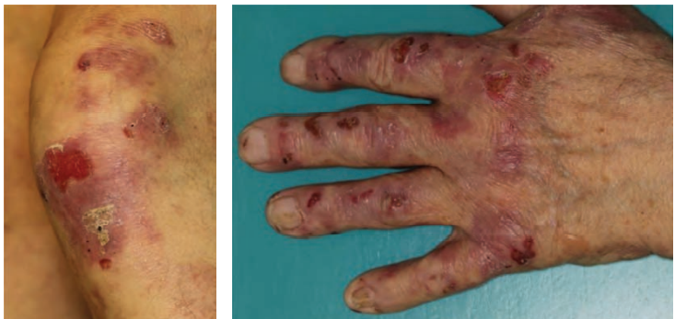

Slide 35
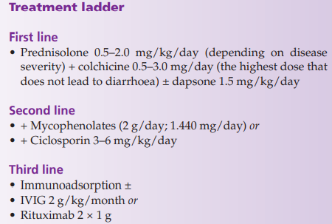
The US‐American colleagues Gürcan and Ahmed emphasized that the benefit of systemic corticosteroids is low in EBA and proposed the following algorithm:
• In limited disease or paediatric patients: dapsone, colchicine, dapsone + colchicine + low‐dose prednisolone, IVIG and/or rituximab.
• For moderate or mucocutaneous disease: dapsone, IVIG, rituximab, IVIG + rituximab (without financial restrictions);

Slide 36
Bullous systemic lupus erythematosus (BSLE)
is an autoimmune subepidermal blistering disease that occurs in patients with SLE .
Most BSLE patients have antibodies against type VII collagen and were designated as type I BSLE.
Type II BSLE is characterized by antibodies against other antigens of the DEJ .
As in SLE, BSLE typically affects women with an African background in the third decade.

Slide 38
Predisposing factors
Precipitating factors have only been described in individual patients and comprise drugs (hydralazine, penicillamine, methimazole) and UVB radiation

Slide 39
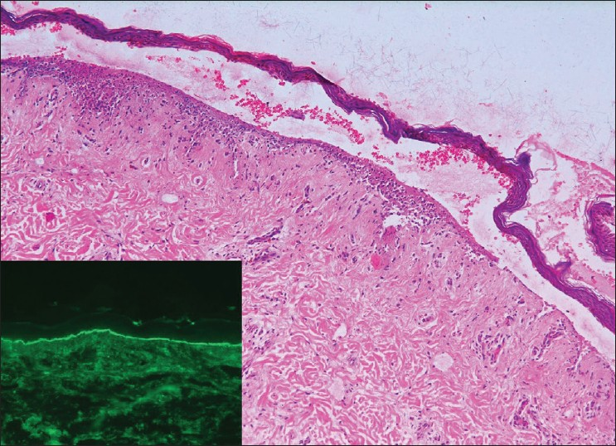
Histopathological
Pathology findings are relatively
uniform and resemble dermatitis
herpetiformis with subepidermal
splitting, a dense neutrophil
‐dominated infiltrate in the
upper dermis sometimes
accumulating in microabscesses
of the papillary tips, and dermal
oedema
Notes:
Basal layer vacuolization characteristic for cutaneous LE is not present
Additional linear or granular labelling of IgM, IgA, and/or C3 at the DE is found in about 70–80% of the biopsies [38]. In the major BSLE form (type I), an u‐serrated staining pattern is seen [

Slide 40
Presentation
Primary lesions comprise tense vesicles and bullae with a clear or haemorrhagic content on otherwise normal or erythematosus skin and annular or targetoid configuration may arise.
Lesions are usually generalized with predilection for sun‐exposed areas, neck, upper trunk and proximal extremities.
In contrast to other pemphigoid diseases, the face is relatively often affected and in some patients the only site of manifestation

Slide 41
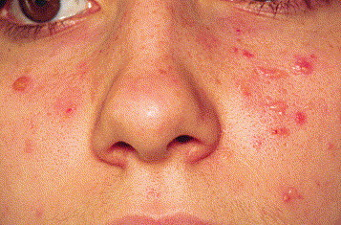
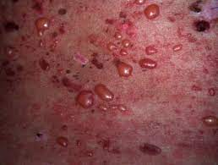

Slide 42
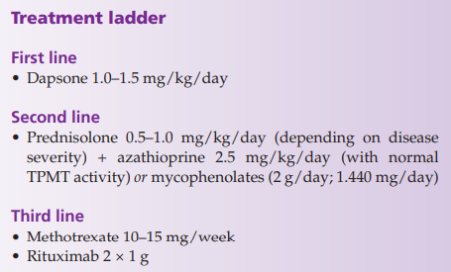
BSLE usually completely regresses with no further flares irrespective of the disease activity of the systemic disease

Slide 43
Lichen planus pemphigoides
Lichen planus pemphigoide always arises in conjunction with lichen planus and
(i) affects relatively young patients (average disease onset in the forties);
ii) mainly arises on the extremities;
(iii) preferentially targets C‐terminal epitopes within the immunodominant NC16A domain; and
(iv) tends to be less severe adults and children

Slide 44
As in BSLE, it may be speculated that the chronic interface dermatitis typical for lichen planus may trigger the immune response against BP180.
This hypothesis is supported by the notion that lichen planus pemphigoides only remits after lichen planus lesions are sufficiently controlled.
Diagnosis is made by the presence of tense blisters also outside of lichen planus lesions and the detection of linear deposits of IgG and/or C3 at the DEJ by direct IF microscopy of a perilesional biopsy and circulating IgG antibodies against BP180 NC16A.
Treatment requires therapy of lichen planus to avoid further stimulation of the anti‐DEJ autoimmune process.

Slide 45
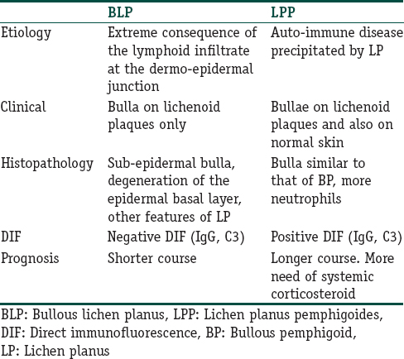
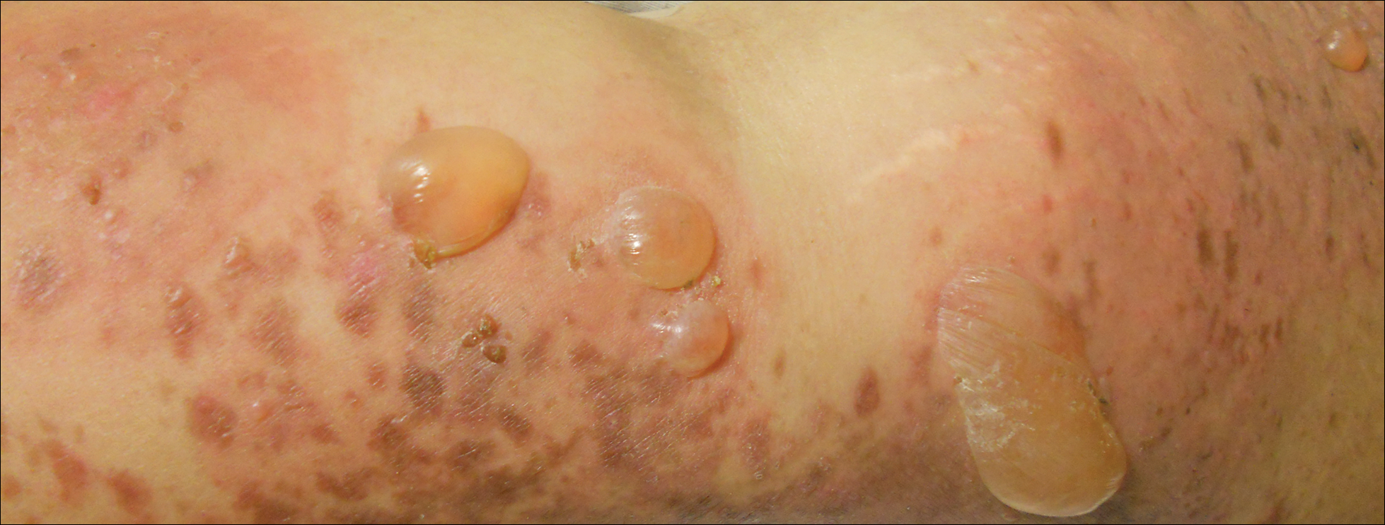

Slide 46
Cicatricial pemphigoid
The term cicatricial pemphigoid has previously been applied to patients who are now classified as MMP.
only used for the rare clinical variant of a pemphigoid disease in which mucous membranes are not predominantly affected and skin lesions heal with scarring.
In cases of a u‐serrated pattern by direct IF microscopy or serum autoantibodies against type VII collagen, the patient would be classified as having EBA .

Slide 47
Brunsting and Perry
In 1957, described a group of patients without mucous membrane involvement who developed subepidermal blisters, erosions haemorrhagic crusts and atrophic scars on the head and neck .
The disease is common in middle‐aged and elderly populations. Skin lesions are characteristically confined to the head, neck and upper trunk.
Mucous membranes can also be involved, however not predominantly .
Direct IF microscopy shows linear deposits of IgG and/or C3 at the DEJ.

Slide 48
several target antigens including type VII collagen, BP180, BP230, laminin 332 and desmoplakin .
Type VII collagen is the most frequent target antigen, therefore representing a localized form of EBA in these patients .
In line with this, in most patients with Brunsting–Perry pemphigoid, electron microscopy revealed split formation below the lamina lucida.
In individual patients, disease of with trauma and the combination of furosemide intake and sun exposure.

Slide 49
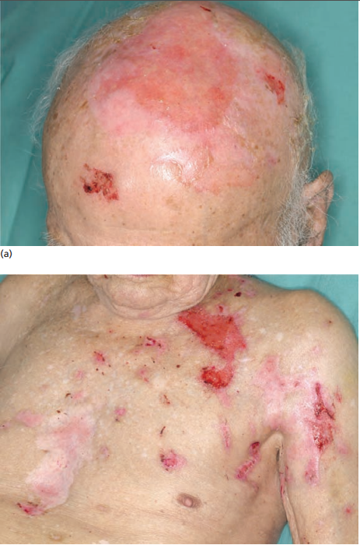
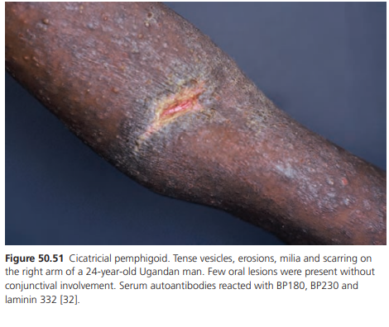
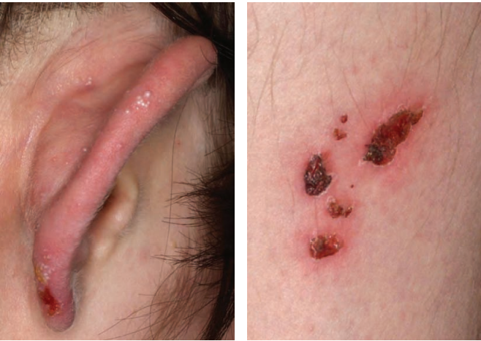
DDs squamous cell carcinoma
basal cell carcinoma
pyoderma
erosive pustulosis of the scalp
dermatitis artefacta.

Slide 50
Treatment usually comprises topical corticosteroids. Good responses to topical tacrolimus and the combination of topical corticosteroids with colchicine or dapsone have been reported

Slide 51
Dermatitis herpetiformis/Duhring–Brocq disease
is a chronic, intensely pruritic, skin condition associated with gluten‐sensitive enteropathy. It results in deposition of IgA antitransglutaminase autoantibodies in the dermal papillae which lead to neutrophil infiltration and blister formation
Onset is most commonly in adult life, typically in the fourth decade
It is largely a condition of people of northern European descent and is most uncommon in Asian and African populations,
Asian patients with dermatitis herpetiformis tend to have a distinct fibrillar pattern of IgA deposition in the skin and only very rarely associated with GSE

Slide 52
Associations
vitiligo
small bowel lymphoma
autoimmune thyroid disease
type 1 diabetes
Addison disease
Notes:
DH is a rash that affects about 10 percent of people with celiac disease.
More than 90% of patients with dermatitis herpetiformis have an associated gluten-sensitive enteropathy upon endoscopic examination

Slide 53
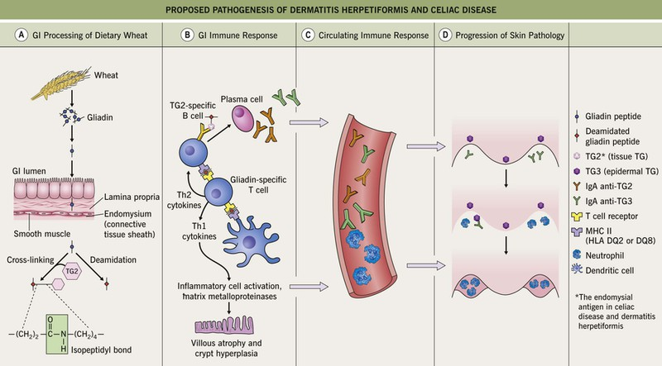

Slide 54
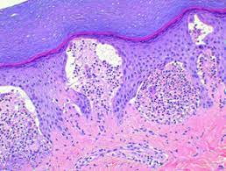
Histology
The histopathology of an intact vesicle in dermatitis herpetiformis demonstrates subepidermal blister formation with neutrophils located at the tips of the dermal papillae.
There is frequently perivascular inflammatory cell infiltrate. Because vesicles may not survive the pruritus, clefting may not be seen

Slide 55
Predisposing factors
dietary gluten and its constituent gliadin .
HLA‐DQ2
iodine exposure aggravates
tobacco smoking, which may ameliorate it

Slide 56
History
The principal symptom of patients with dermatitis herpetiformis is itch.
Patients report a rash, most typically over the extensor surfaces of the elbows, knees, buttocks and scalp.
There may also be symptoms of associated disorders such as GSE, with bloating, diarrhoea and other gastrointestinal complaints or of other autoimmune diseases including hypothyroidism

Slide 57
Presentation
The characteristic lesions of dermatitis herpetiformis are grouped erythematous papules and vesicles located over extensor sites .
Because the condition is so pruritic, intact vesicles are rarely seen and the patient may simply present with excoriations .
Lesions tend to be symmetrical and heal without scarring.
Patients may develop punctate purpura on the palms and soles.
Mucosal change may occur , and dental abnormalities have been reported, particularly enamel pits
Notes:
1st degree relative

Slide 58
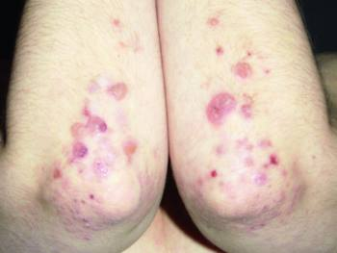
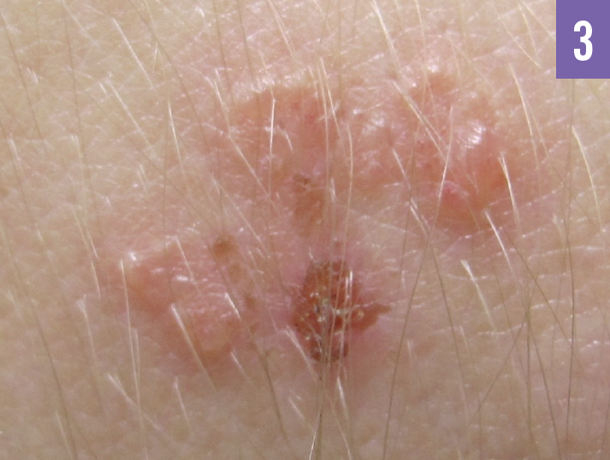

Slide 59
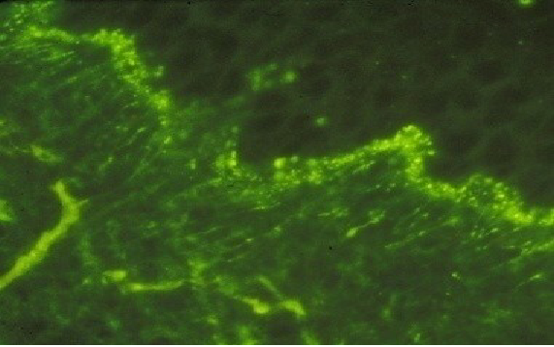
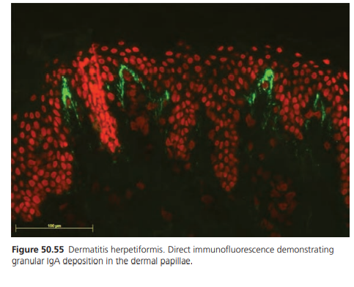
Direct IF samples are best taken from perilesional skin as characteristic changes may be lost in lesional tissue.
The diagnostic finding is that of deposition of IgA in the papillary dermis in a granular or fibrillar pattern

Slide 60
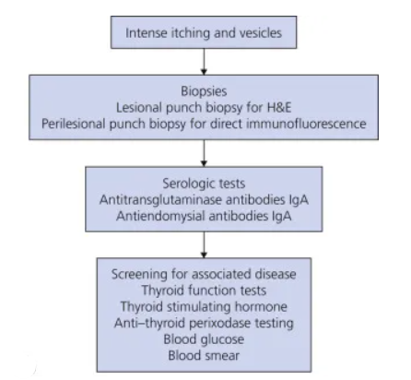

Slide 61
Disease course and prognosis
Dermatitis herpetiformis is a chronic disease that requires patients to adopt a long‐term gluten‐free diet. Those that are able to do this, and respond, seem to have excellent long‐term survival [9] and are able to decrease or discontinue dapsone treatment.
Whilst the disease is a chronic one, remission is recognized, and seems to be more common in adult patients over the age of 40 years

Slide 62
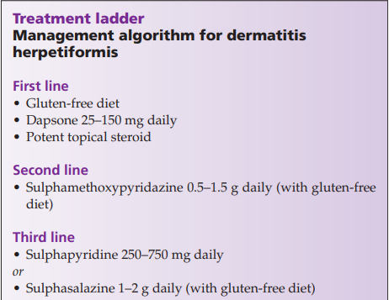

Slide 63
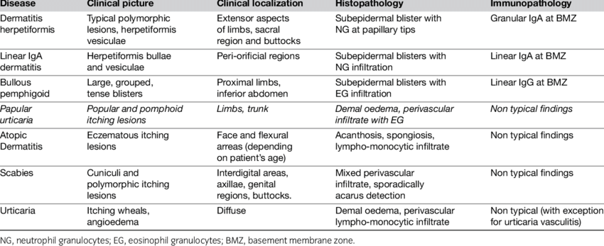

Slide 64


