Slide 1
icthysosis

Slide 2
Ichthyosis is a condition that causes widespread and persistent thick, dry, "fish-scale" skin

Slide 3
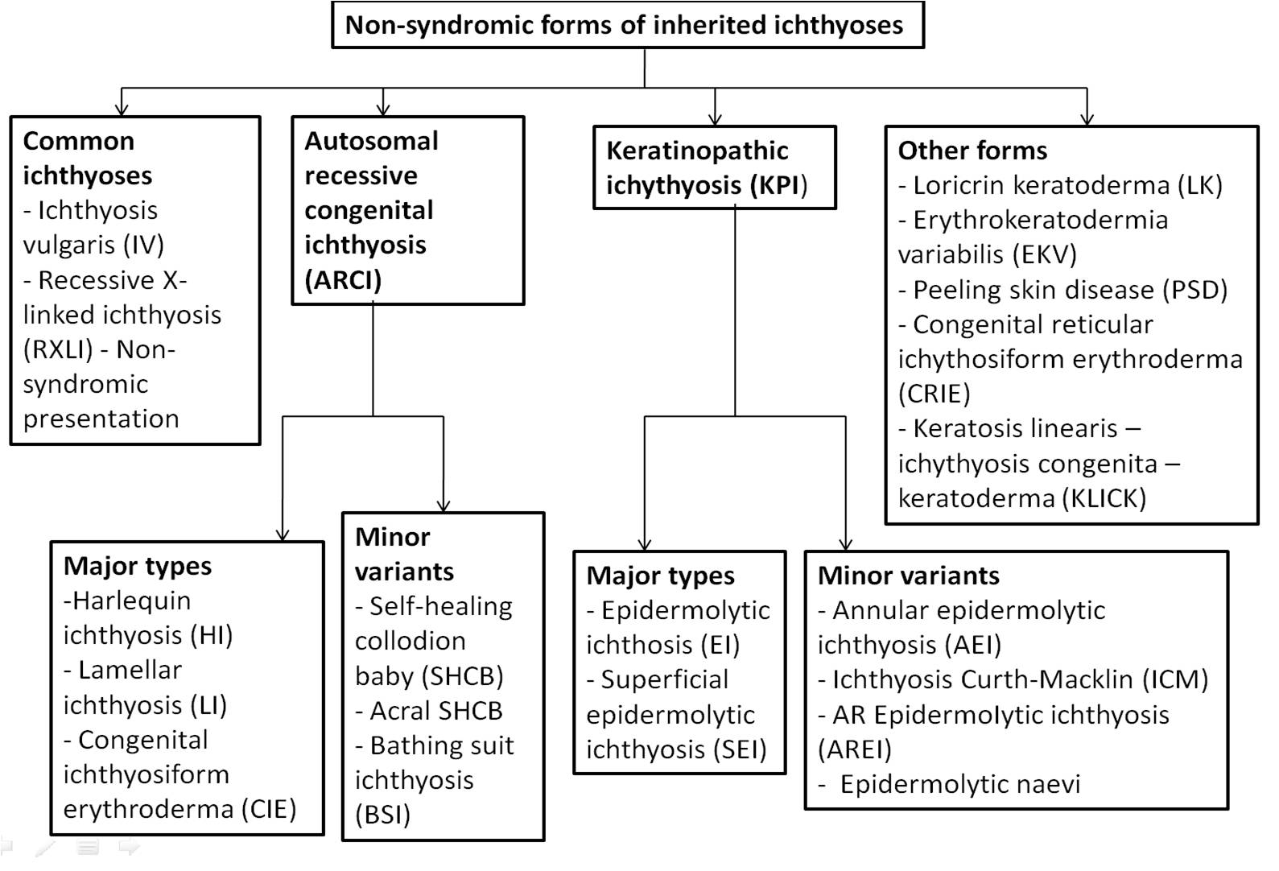

Slide 4
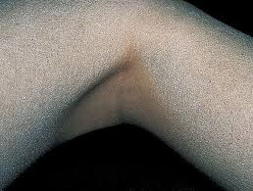
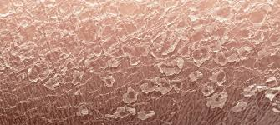
ICTHYOSIS VULGARIS
AD
FLG mutation
Dec in st coreum hydration,Inc in TEWL,dec in NMF
Develops in 1st months and small grey scales in 3 months
Flexures spared and accentuation of palmer creases
Absent granular layer

Slide 5
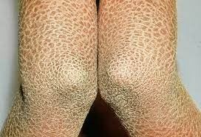
Recessive x linked icthyosis
Steroid sulphatase def,STS gene
Inc cholesterol sulphate inhibits proteases like kallikrein 5 and 7 that are vital for degradation of corneodesmosomes.
RETENTION HYPERKERATOSIS

Slide 6
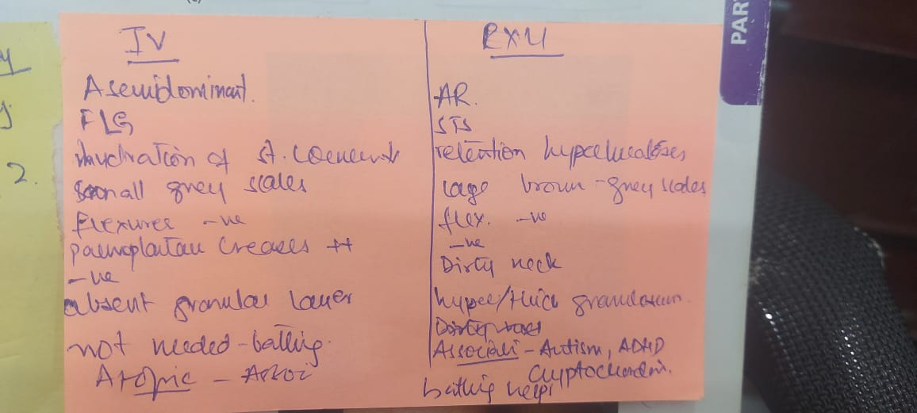

Slide 7
Ar cong icthyosis
Harlequin ithyosis
Colloidan baby
Bathing suit
Lamellar’
Congential icthyosisform erythoderma
Self improving cong icthyosis
Self healing colloidan baby

Slide 8
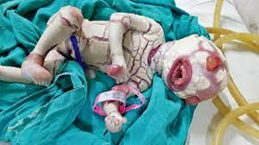
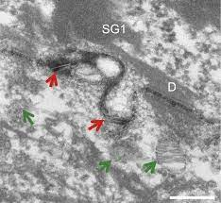
Harlequin icthyosis
Devastating type
ABCA12 Gene defect
Retention hyperkeratosis
Armour like skin,b/l etropion and eclabium
Resp prob is the major cause of death
Electron microscopy irregular lamellar bodies extruded as vesicular structures is diagnostic
lamellar bodies (otherwise known as lamellar granules, membrane-coating granules (MCGs), keratinosomes or Odland bodies) are secretory organelles in keratinocytes in the skin.

Slide 9
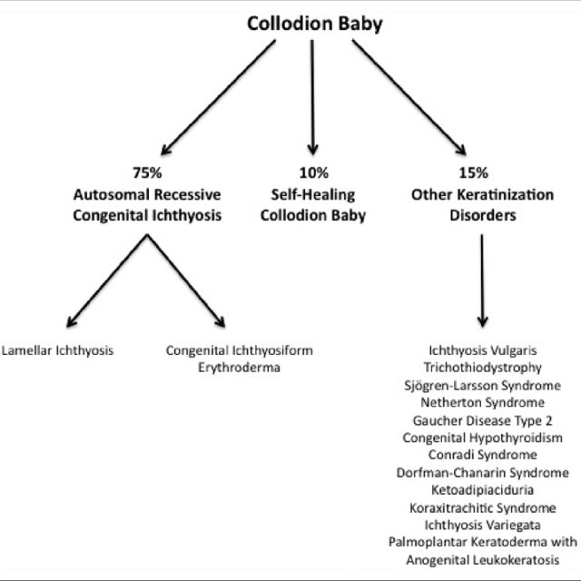
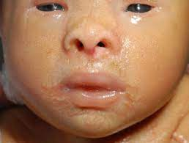
Colloidan baby

Slide 10
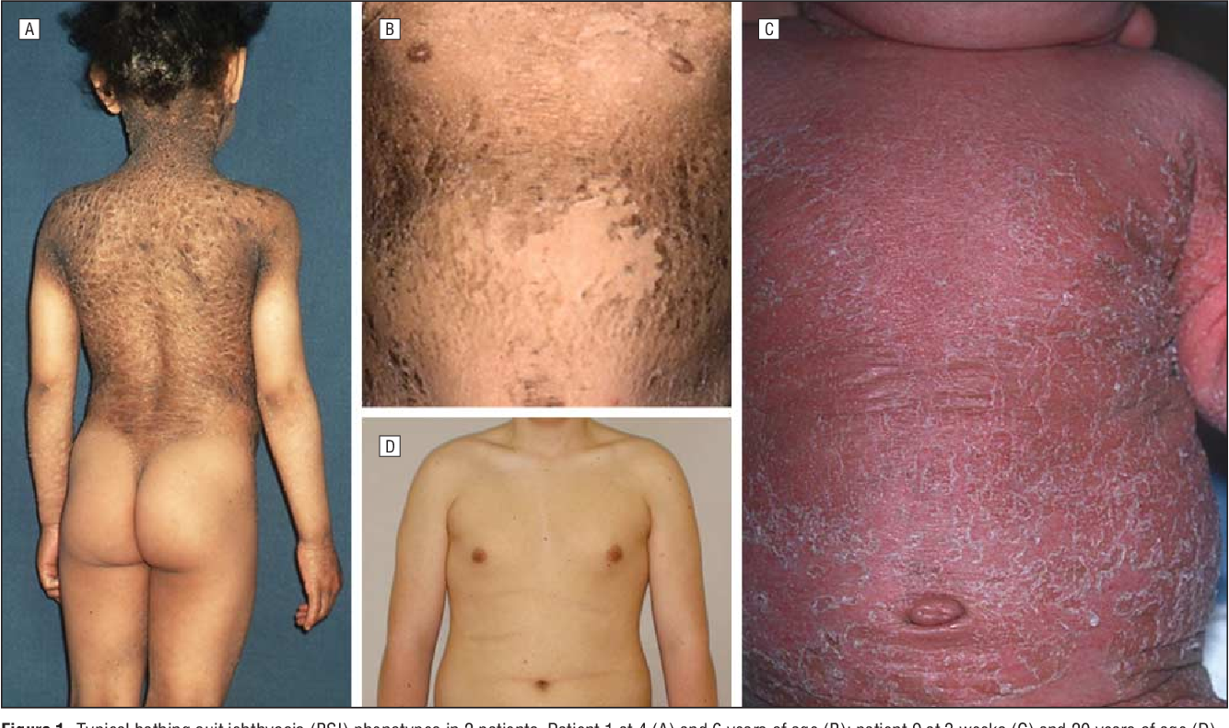
Bathing suit icthyosis
TGM1 mutations

Slide 11
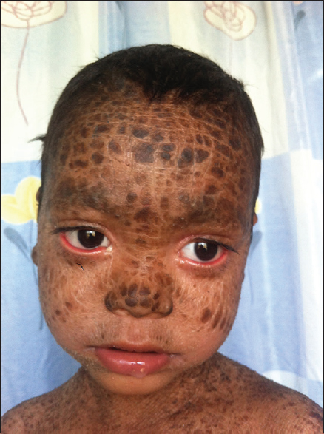
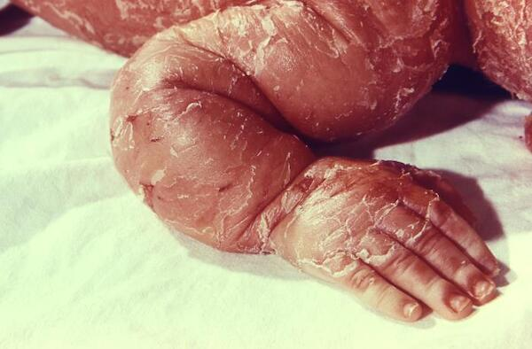
Lamellar and cie
TGM1
LIPOXYGENASE E3 AND 12B
NIPAL4
CYTOCHROME P450
LIPN

Slide 12
Keratinopathic icthyosis
Erythoderma,scales and erosions
Keratin 1,10,2 involved
Includes
Epidermolytic/bullous icthysioform erythoderma
Superficial EI
Annular EI
Cong reticulate icthysioform erythoderma
Icthyosis curth macklin

Slide 13
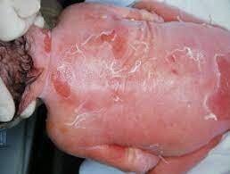
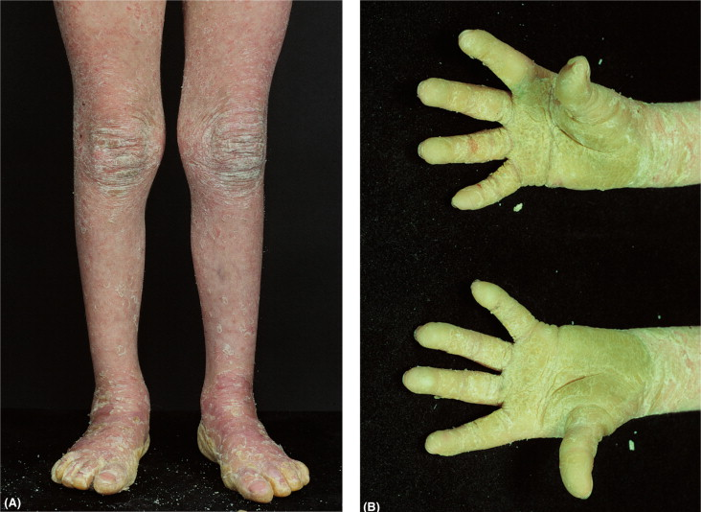
Bullous CIE
EI
Infant brule
Within first few weeks blisters resolve and hyperkeratosis develops
Axilla,elbows and flexors
Krt10 mut plams n soles are spared
RETINOIDS MAY WORSEN THESE CONDITIONS

Slide 14
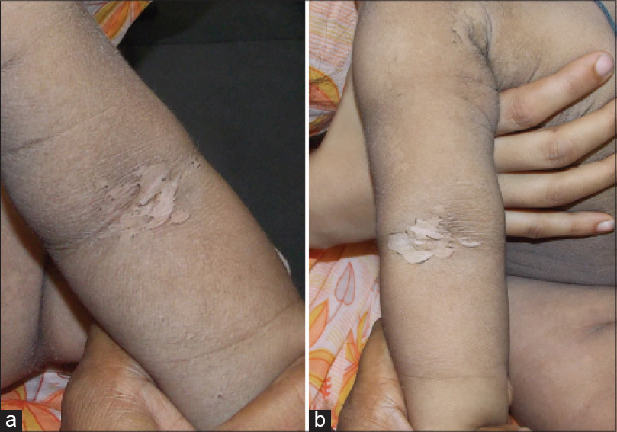
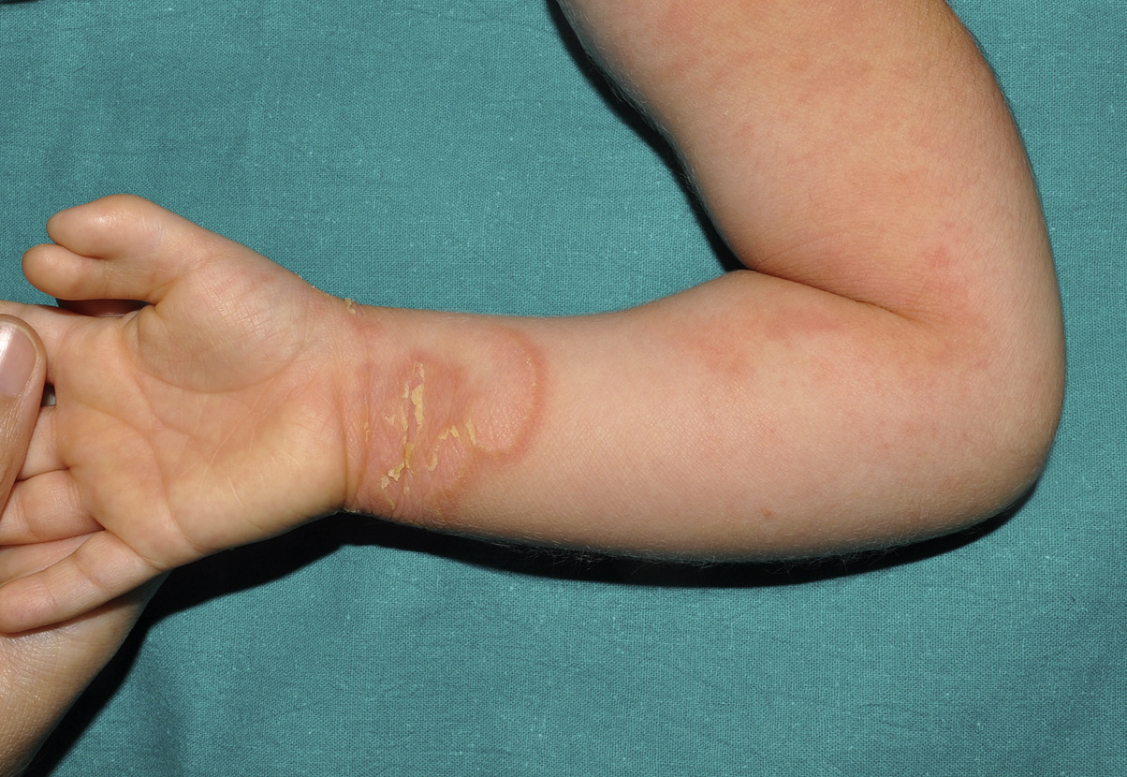
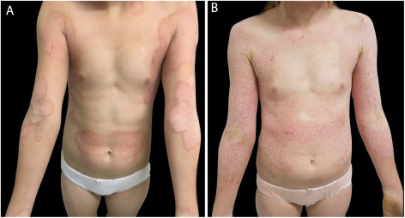
Superficial ei/annular ei

Slide 15
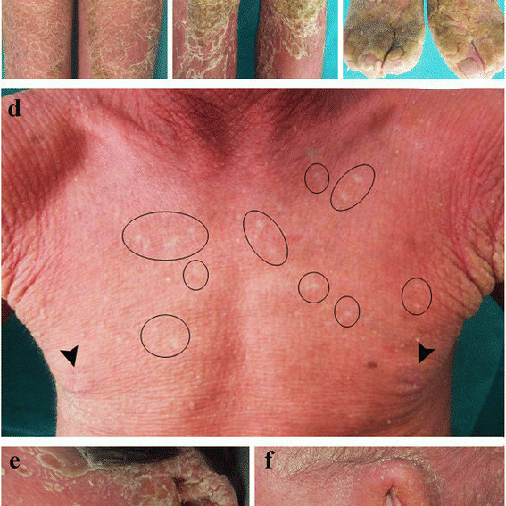
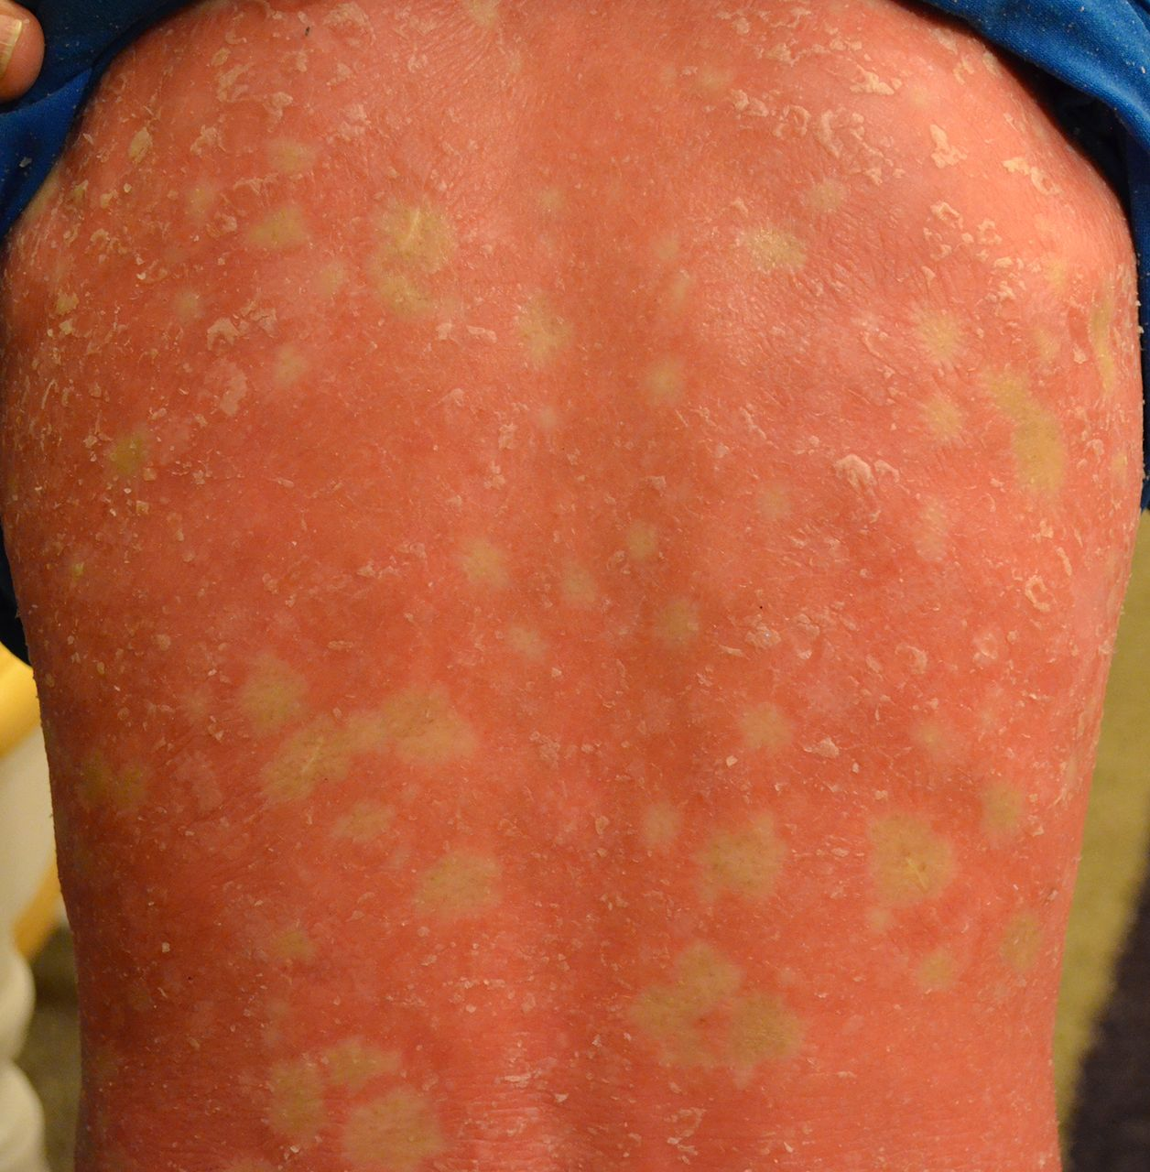
Cong reticular icthysiform erytoderma

Slide 16
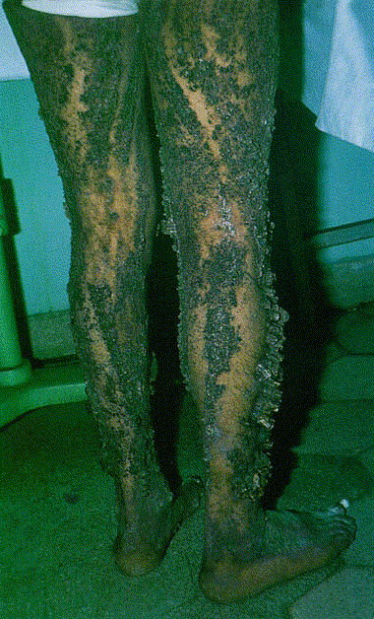
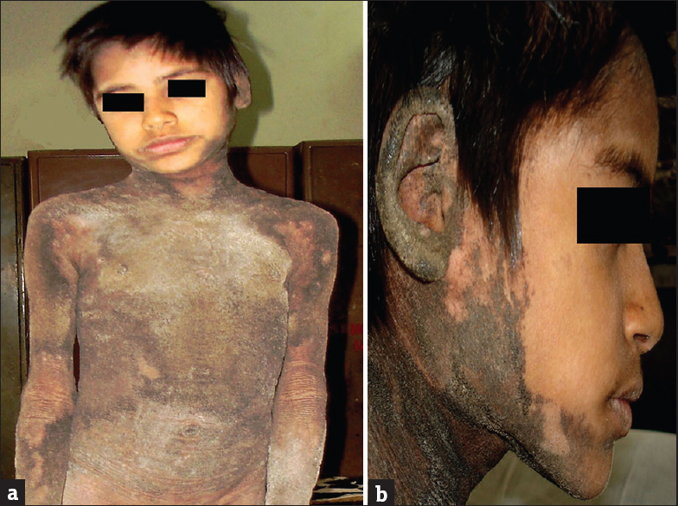
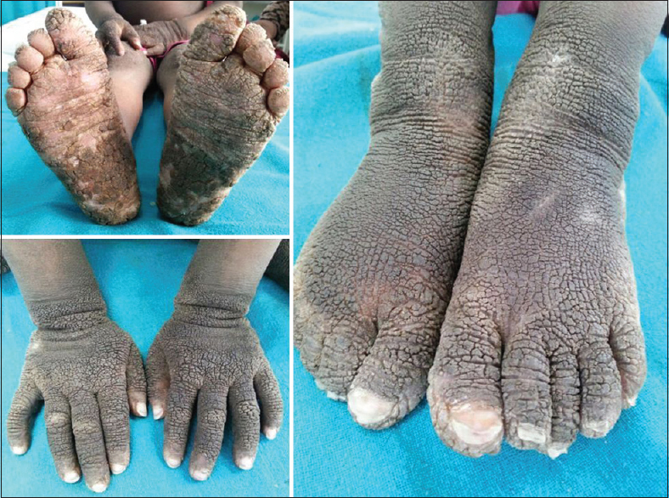
Icthyosis curth macklin

Slide 17
erythokeratoderma
Erythrokeratoderma is an umbrella term for a group of rare genetic skin disorders characterized by well-demarcated plaques of reddened, dry and thickened skin.
localized./gen erythema and hyperkeratosis
Includes
EK Variablis
Prog sym acrokeratoderma
Exfoliative types others including KLICK
Treatment is with acitretin

Slide 18
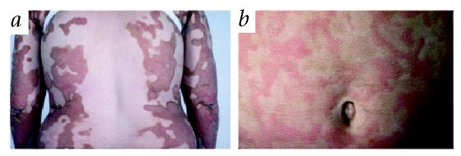
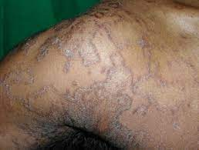
Ek variablis
AD
Mel de Costa syndrome
Polycylic erythematous scaling and keratoderma

Slide 19
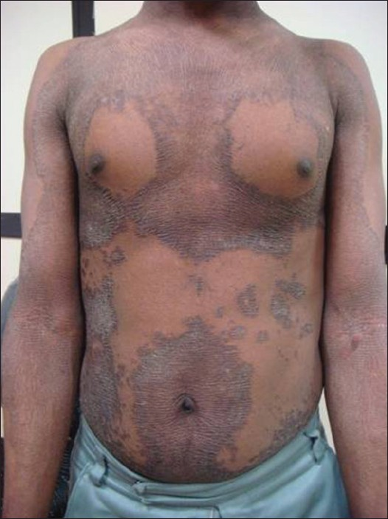
Prog sym ekv

Slide 20
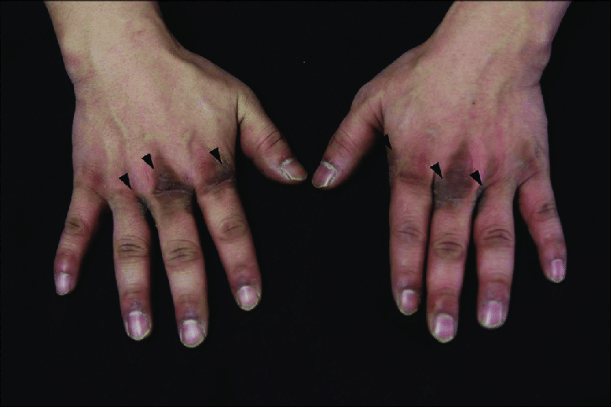
Sym acrokeratoderma
Whitish hyperkeratosis of back of hands,fingers,wrist after immersion in water for 5 mints, reminsceint of aquagenic keratoderma

Slide 21
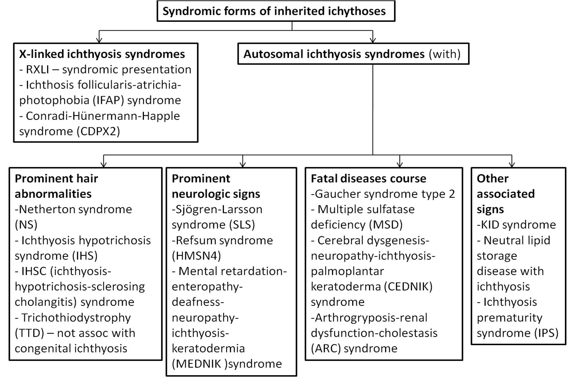
X LINKED
EXFOLIATIVE
NEURO ICTHYOTIC

Slide 22
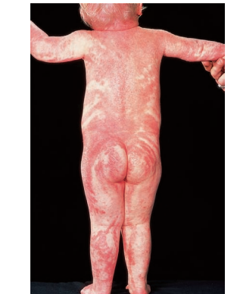
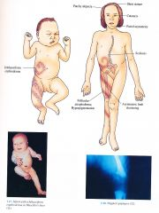
X LINKED-
CHOLESTROL DEFECT
Happle syndrome
XD,EBP/PORCN GENE
Sparse hair
Hyperkeratosis along lines of blaschko
Follicular atropherderma
Chondrodyplasia punctata
Asymetrical shortened limbs,short stature
Sectorial cataracts
Variant MEND-Ext behaviour problems
Tx-emollients,antimicrobials,retinoids
2% lovastatin, or 2% cholesterol lotion

Slide 23
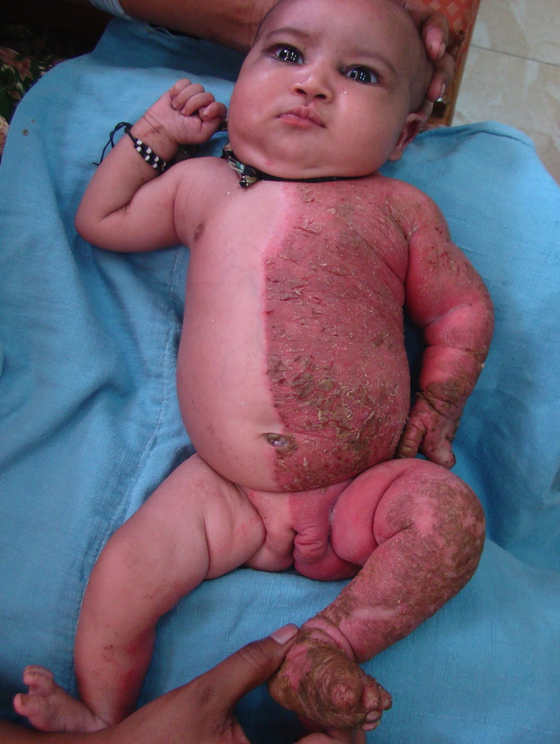
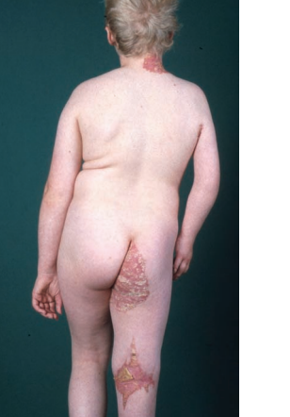
Child syndrome
Congenital hemidysplasia icthysiform nevus limb defect
NSDHL gene defect
Hypoplasia/aplasia of limb
Heart and kidney affected

Slide 24
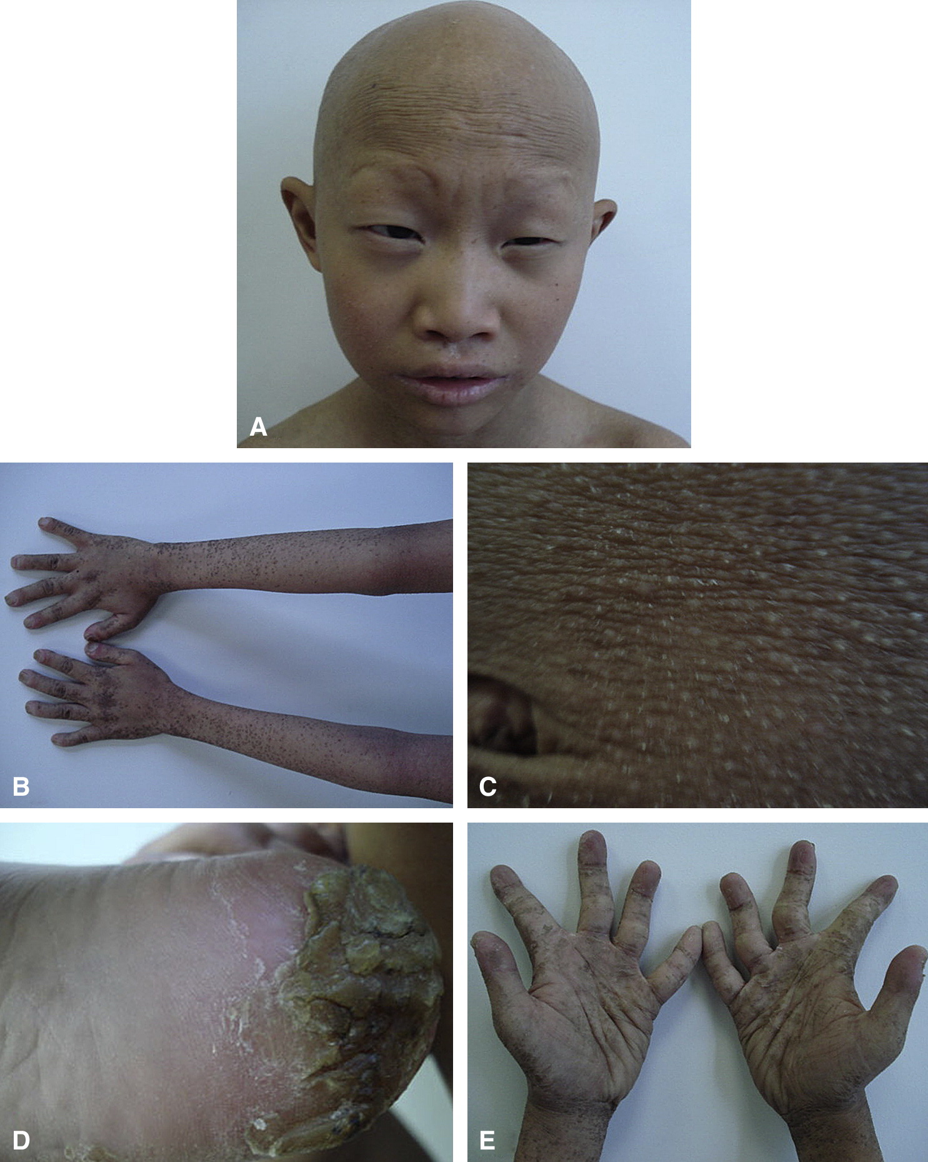
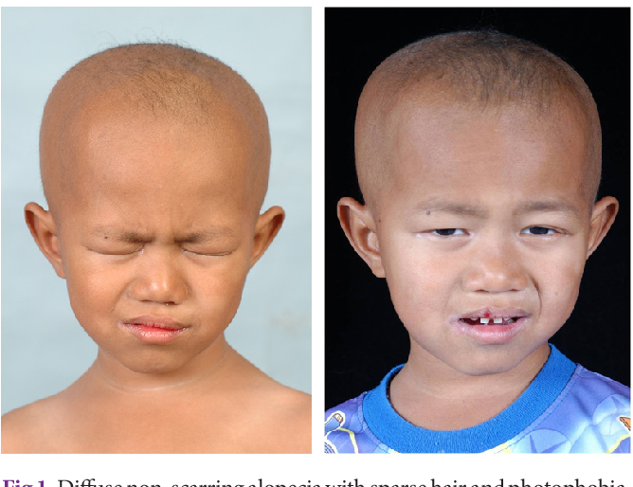
ifap

Slide 25
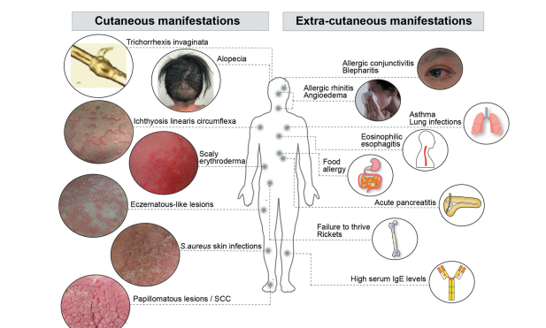
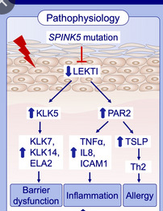
Exfoliative disorders
Netherton
AR

Slide 26
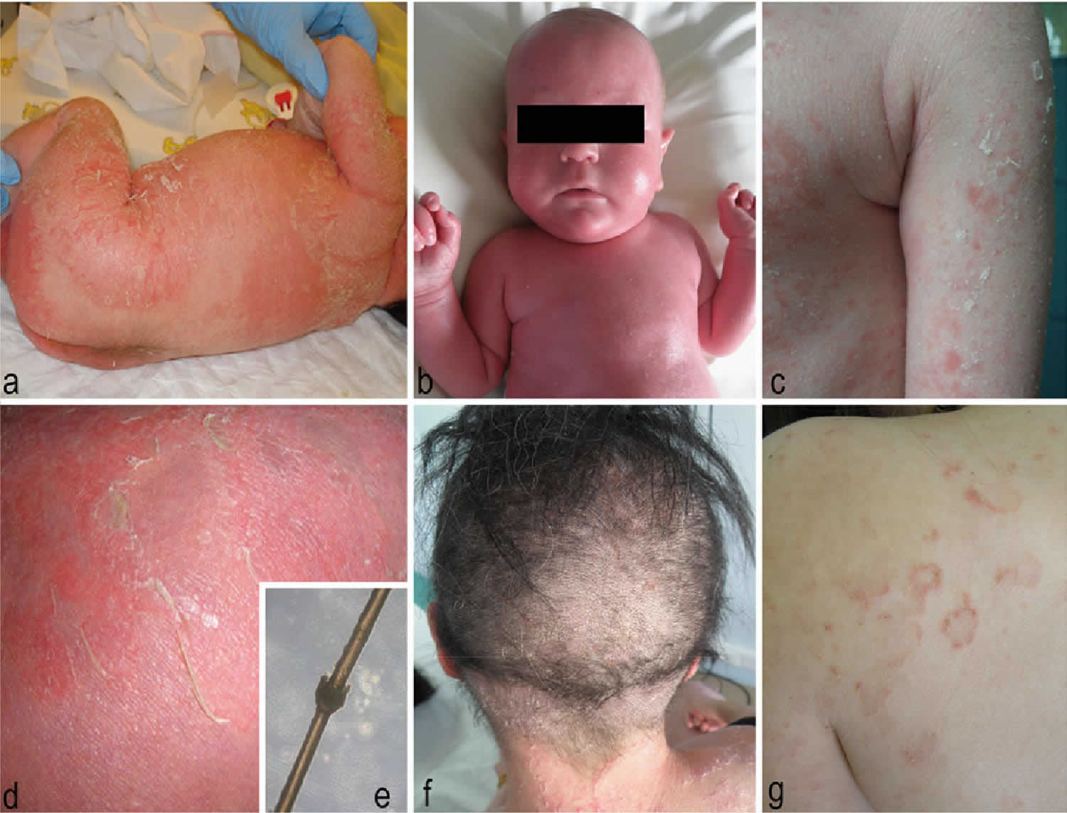

Slide 27
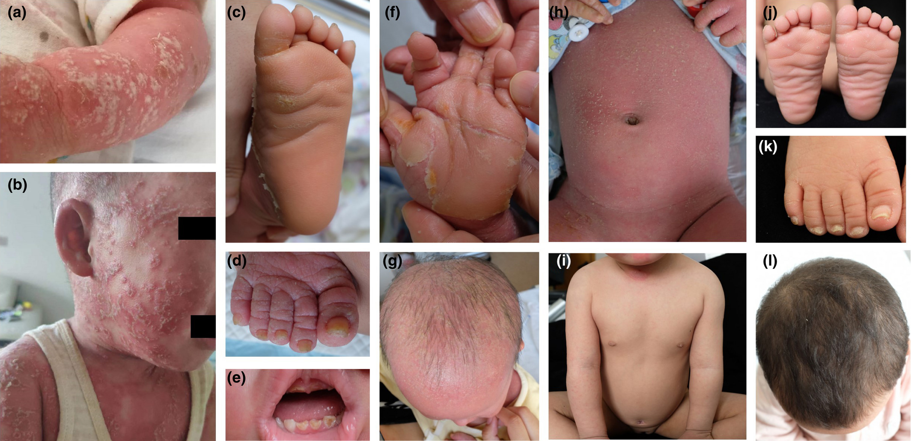
Sam –severe dermatitis multiple allergies metabolic wasting syndrome
AR
Target antigen is desmoglein 1
Also included as peeling skin syndrome with netherthon

Slide 28
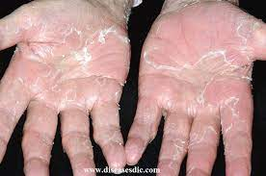
Peeling skin syndrome
Type A
Type B-corneodesmosomes
Acral type

Slide 29
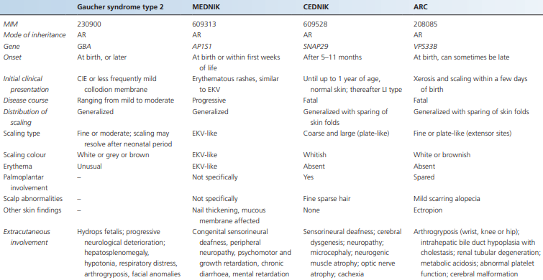
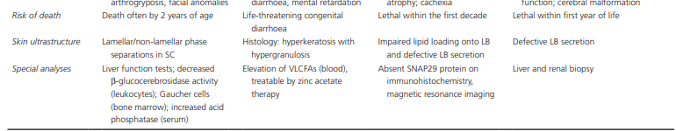
Neuro icthyotic

Slide 30
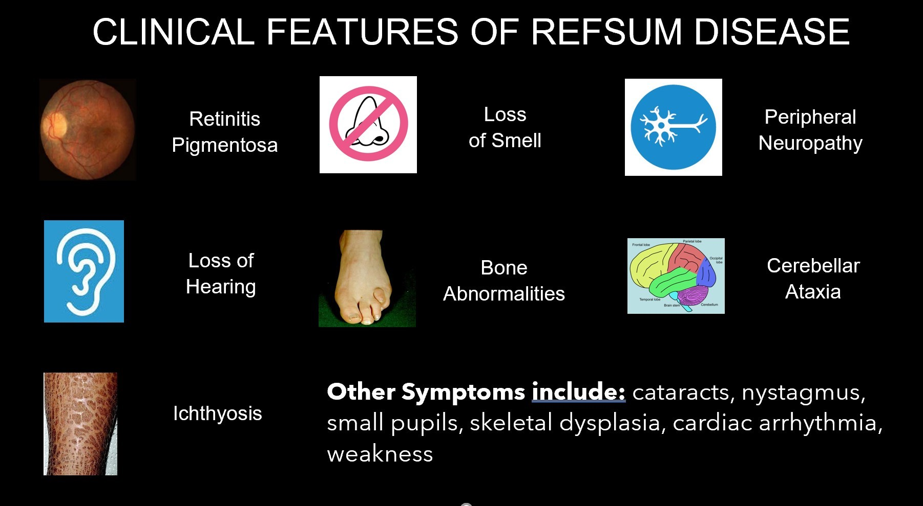
Refsum disease
AR
accumulation of phytanic
acid in plasma and tissues

Slide 31
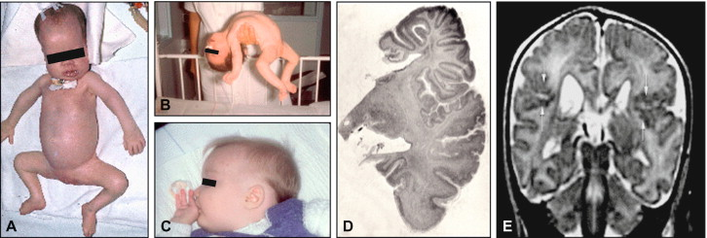

Slide 32
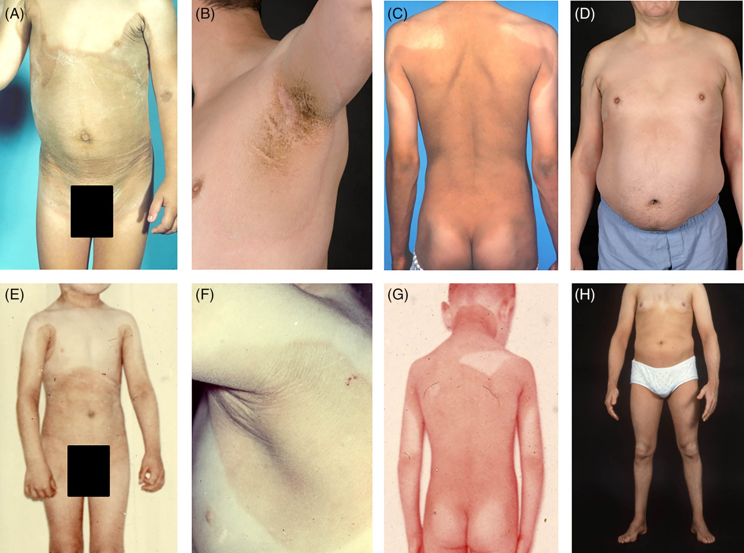
Sjogren Larsson synd
Icthyosis,spastic diplegia and MR
Fatty acid dehydrogenase def resulting in accumulation
of fatty aldehydes and fatty alcohol in tissue also
secreate large amounts of LTB4 in urine

Slide 33
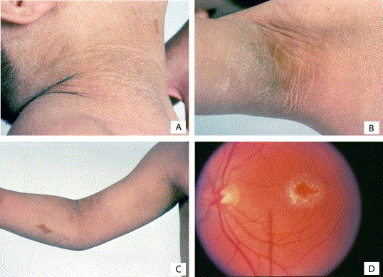
Retinoids,bezofibrate and physiotheraphy

Slide 34
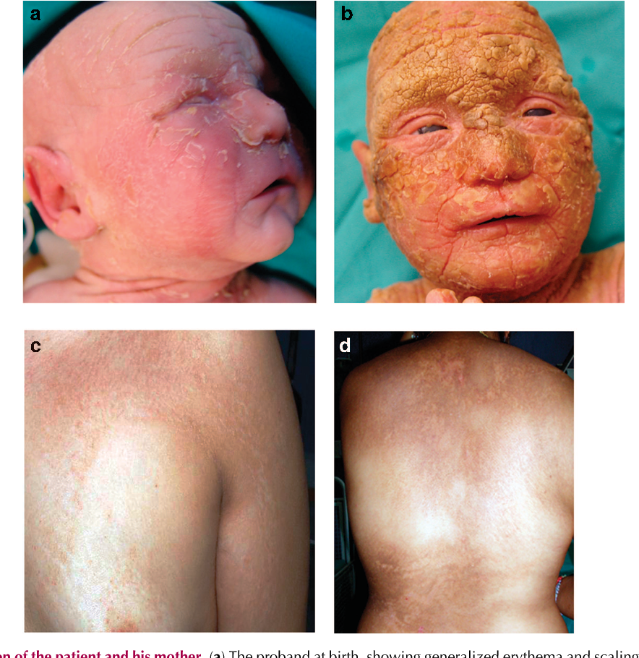
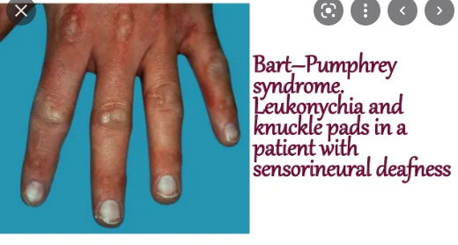
others-DEAFNESS
Connexin /GJB2 mutations
KIDS
keratosis,icthyosis and deafness
HID-HYSTRIX LIKE ICTHYOSIS DEAFNESS
BART PUMPHERY SYNDROME

Slide 35
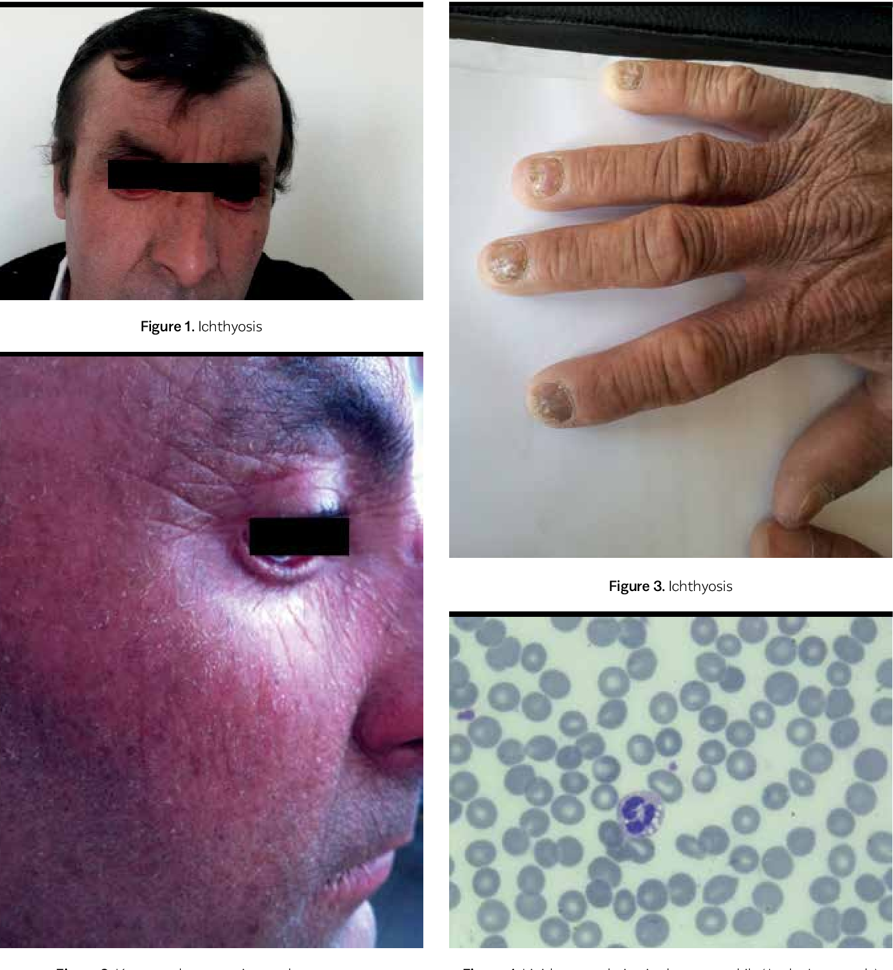
Chananrin Dorfman syndrome
Chanarin-Dorfman syndrome is a condition in which fats
(lipids) are stored abnormally in the body. Affected individuals
cannot break down certain fats called triglycerides, and these
fats accumulate in organs and tissues, including skin, liver,
muscles, intestine, eyes, and ears
Lipid droplets in leukocytes(JORDAN anamoly)

Slide 36
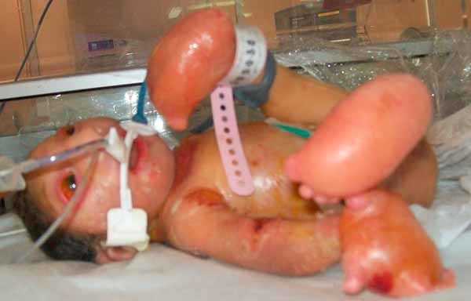
Neu laxova syndrome
autosomal recessive trait.
The syndrome is characterized by severe growth delays
before birth (intrauterine growth retardation); low birth
weight and length
microcephaly), sloping of the forehead, widely spaced eyes
(ocular hypertelorism), and other malformations, resulting
in a distinctive facial appearance. NLS is also typically
characterized by abnormal accumulations of fluid in
tissues throughout the body (generalized edema)

Slide 37
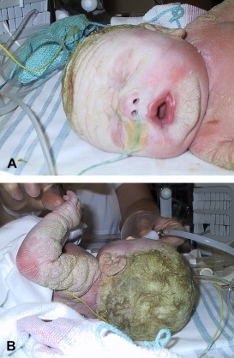
ips

Slide 38
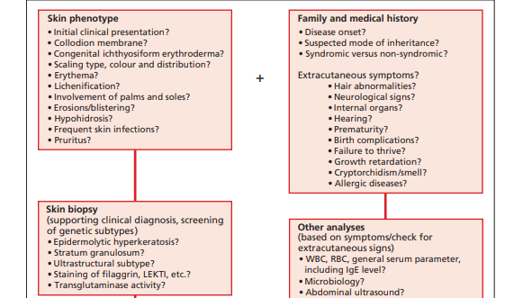

Management of colloidan baby
Collodion baby as well as HI should be regarded as dermatological emergencies and require an interdisciplinary approach

Slide 39

INVESTIGATIONS

Slide 40
These neonates are best taken care of in a neonatal intensive care unit.
Collodion babies should be placed in a high humidity incubator with close monitoring of body temperature. Typically, it is recommended to start with humidity in the range of 60–80%, and to decrease every 3–4 days in order to reach normal humidity conditions, so that the children can be transferred to an open crib
use bland ointments, e.g. a dexpanthenol containing ointment two to four times a day
Percutaneous absorption is very high and substances typically used in older children with ichthyosis, such as urea or lactic acid should be avoided in the first year of life.
Salicylic acid is contraindicated as it may result in metabolic acidosis and death within 72 h even when used in low concentrations such as 3%.

Slide 41
bathing
It has been shown that two handfuls of baking soda to a bath tub will raise the pH from 5.5 to 7.9
. It is conceivable that mild alkalinization of the skin raises the pH to an optimum for serine protease activity such as KLK5 and KLK7 . These serine proteases are required in normal desquamation for the dissolution of corneodesmosomes.
Other popular bath additives are wheat corn or rice starch or bran, e.g. in Netherton syndrome. Antiseptics as bath additives can become necessary, e.g. in KPI, to overcome bad odour

Slide 42

Patients with ARCI or KPI generally need to bath at least once a day. After soaking the skin for around 20–30 min, the patient or a parent can use a sponge, microfibre cloth or silk glove to rub the skin and thus provide mechanical scale removal as well as cleansing (i.e. removal of remaining ointment). This again may take another 20–30 min. Drying with a towel and the immediate application of ointments should be done while the skin is still wet
It is important to apply ointments twice a day so that the total time spent on body care for the average patient often is between 1 and 2 h/day

Slide 43
The application of tazarotene gel (not available in all European countries) has been recommended for the treatment and prevention of ectropion
A promising approach seems to be the topical use of n‐acetylcysteine for ARCI. n. It blocks cell‐cycle progression in the G1 phase and has an antiproliferative effect

Slide 44
Systemic treatment
options Retinoids such as acitretin or isotretinoin have been found to be helpful in ARCI and in some forms of KPI
Patients with CIE may respond less well to systemic retinoids – some even can get worse – and also they tolerate moisturizers such as lactic acid or urea less well
In patients with HI, the use of retinoids is warranted, even in newborns.
Patients suffering from EI due to KRT1 mutations have a strong risk of exacerbation of the disease when given retinoids, while those with KRT10 mutations may benefit when given a low dosage, e.g. up to 0.5 mg/kg body weight.
Likewise, superficial EI responds well to low retinoid doses

Slide 45
In Germany, there is a reluctance to use long‐term retinoid therapy in children mostly because of fear of interference with bone development, such as premature closure of the epiphyseal growth lines. Patients with ichthyosis may be treated when they are over the age of 16 or who have stopped growing significantly
growth toxicity for children. In women of child‐bearing age, a major advantage of isotretinoin over acitretin may be its short half‐life. While isotretinoin is cleared within several months, acitretin can persist in the body for up to 2 years because of conversion to etretinate, in particular when taken with alcohol .

Slide 46
Alitretion is rapidly cleared and in contrast to acitretin and isotretinoin binds to both types of nuclear retinoid receptors (i.e. RARs and RXRs)
A side effect of alitretinoin therapy may be hypothyroidism that can cause tiredness and it seems to be advisable to monitor thyroid‐ stimulating hormone (TSH) levels in these patients

Slide 47
Eye
. Severe ectropion has to be addressed to avoid complications such as corneal perforation . For severe cases, there are different methods for surgical corrective treatment of chronic ectropion . Basal cell carcinoma may be masquerading as chronic ectropion in LI

Slide 48
Ear
Importantly, children need to be examined by an otorhinolaryngologist. Often during early infancy, especially in BSI, the external ear canal has to be professionally cleared of horny material (every 4 weeks)
Hair
Treatment of the scalp poses special problems and requires washable preparations.

Slide 49
Hypohydrosis
A further issue is the inability to sweat (hypohidrosis) which often results in difficulties with thermoregulation, in particular in the summer time
oral retinoid treatment can normalize sweat gland function and markedly improve the quality of life
Musculoskeletal system
In many cases, in particular in infants and small children, physiotherapy is of enormous value, e.g. to treat flexural contraction

Slide 50
Super infections
Staphylococcus aureus and Trichophyton rubrum

Slide 51
Acquired icthyosis
Acquired cases are most often caused by an underlying disorder such as:
The most common ichthyosis‐ associated malignancy is Hodgkin disease,non‐Hodgkin lymphoma, cutaneous T‐cell lymphoma, lymphomatoid papulosis , multiple myeloma , breast, lung, cervix, renal cell or liver carcinoma, leiomyosarcoma, rhabdomyosarcoma and Kaposi sarcoma .
It was the presenting sign of myelodysplasia, followed on from bone marrow transplant or occurred with graft‐versus‐host disease
malnutrition or malabsorption (including coeliac disease and Crohn disease) , essential fatty deficiency and Shwachman syndrome (pancreatic insufficiency). Ichthyosis may be a presenting feature of inborn errors of metabolism, such as methylmalonic acidaemia,
primary hyperparathyroidism , autoimmune thyroiditis and diabetes, where it affects the shins . Ichthyosis may rarely occur with connective tissue diseases such as systemic lupus erythematosus , sarcoidosis , dermatomyositis without associated malignancy , systemic sclerosis/lupus overlap , the so‐called Haber syndrome and eosinophilic fasciitis

Slide 52
Infections. Ichthyosis has been noted in patients with leprosy , HIV infection with or without malignancies and human T‐cell lymphotropic virus type 1 (HTLV‐1)‐associated myelopathy
Drugs. The cholesterol‐lowering drugs, triparanol and nicotinic acid

Slide 53
THANK YOU

