Slide 1
HIV AND THE SKIN
DR.SAHAR MATEEN
FCPS II TRAINEE DERMATOLOGY
CHK

Slide 2
SALIENT FEATURES
HIV Infection
  Introduction
  Epidemiology
  Pathophysiology
  Clinical features
  Investigation and Management
Dermatological Manifestation
  Inflammatory dermatosis
  Infections(bacterial, viral, fungal and parasitic)
  Malignancies
  Others
  Immune reconstitution inflammatory syndrome
Notes:
My presentation is divided into two sections
First I will discuss about Hiv infection

Slide 3
INTRODUCTION
Enveloped RNA retrovirus
Principally infects CD4+ T lymphocytes and macrophages
In 1981, HIV was first identified as a causative agent of AIDS
Notes:
Its basic structure and virology will be described in pathophisiology

Slide 4
MODE OF TRANSMISSION
Introduction
Sexual contact
Blood or blood products
Vertically transmission
(pregnancy, birth or breast feading)
Notes:
World wide the major route of transmission is via sexual contact

Slide 5
EPIDEMIOLOGY
Global pandemic.
95% of cases occur in non-industrialized countries.
Women and children represent fastest growing subpopulation in developed world.
Notes:
A pandemic is the worldwide spread of a new disease.

Slide 6
CLADES (subtypes) OF HIV | PRIMARY GEOGRAPHICAL DISTRIBUTION
A | EAST,WEST AND CENTRAL AFRICA,EUROPE
B | USA,UK,AUSTRALIA
C | SOUTH AFRICA,INDIA ,CHINA
D | EAST AFRICA
A/E | SOUTH- EAST ASIA
F, G, H, J, K | CENTRAL AFRICA,CARIBBEAN, LATIN AMERICA

Slide 7
PATHOPHYSIOLOGY

Slide 8
Pathophysiology
Virology
Immunology

Slide 9
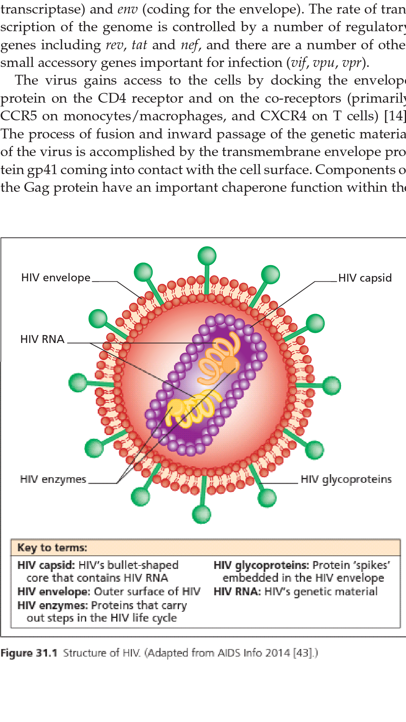

Slide 10
Pathophysiology
3 major structural genes
gag (code for nuclear protiens)
pol (reverse transcriptase)
env (envelop)
Regulatory genes (rev ,tat , nef )
Small acessory genes important for infection.

Slide 11
Pathophysiology
HIV-1 and HIV-2 are two main types.
World-wide HIV-1 is the commonest cause of AIDS.
HIV-2
  Causes immune deficiency and AIDS more slowly
  less infectious
  lower rates of sexual and vertical transmission.

Slide 12
Pathophysiology
HIV-1
NEW
(West Central Africa)
MAJOR
(Worldwide)
OUTLIER
(Cameroon)
A-D
F-H
J AND K
Notes:
Vast majority of hiv strains that are found worldwide and responsible for pandemic belong to M lineage

Slide 13
Binding of envelop protein (gp41) on CD4 receptors and co-receptors (CCR5 on macrophages and CXCR4 on T cells)
Gag protein leads to reverse transcription of genetic material within the host cell
Virally encoded enzyme( integrase) cleaves circular DNA and insert it into the host DNA
Notes:
1- inward passage of genetic material
2- formation of Dna from Rna
3- viral products of transcription are then transported to cytoplasm where viral Rna and proteins are assenbled around nuclear capsid antigen and buds from the cell surface
>10 to power 8 viral particles are released per day in untreated HIV patient

Slide 14
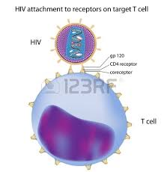
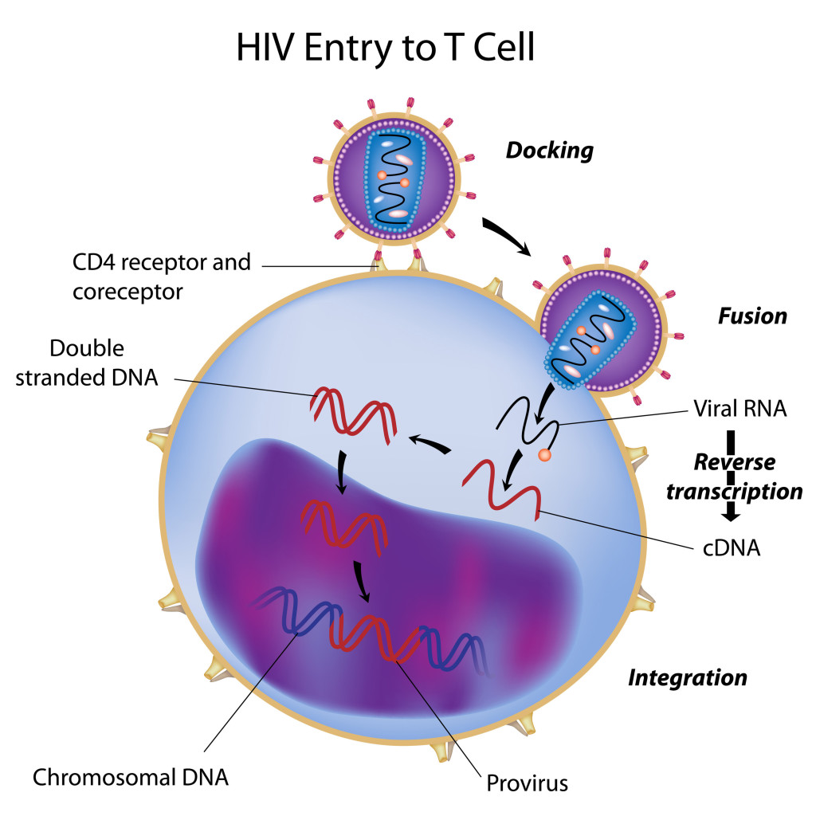
Pathophysiology

Slide 15
IMMUNOLOGY
Pathophysiology
Intrinsic Immunity
Cellular Immunity
Humoral Immunity
Notes:
Intrinsic immunity response is mobilized within hours of infection and include inflammation, non specific inflammation, activation of macrophages, natural killer cells and complement, release of cytokines.

Slide 16
Pathophysiology
SPECIFIC HUMORAL RESPONSES:
Neutralizing antibodies to envelope proteins.
Non-neutralizing antibodies to internal viral protiens.
Specific secretory IgA mucosal antibodies
NEUTRALIZING ANTIBODIES ARE USUALLY MEASURABLE BY 12 WEEKS AFTER INFECTION

Slide 17
Pathophysiology
Cellular Immunity
CD8 lymphocyte
Lysis of infected cells
Reduce viral replication
CD4 lymphocyte
TH1 response
TH2 response
TH1 specific cytokines: IL2,IFNgamma, TGF beta, IL12
TH2 specific cytokines: IL4, IL5, IL6, IL10
Notes:
CTLs are functional 5-10 days after infection.

Slide 18
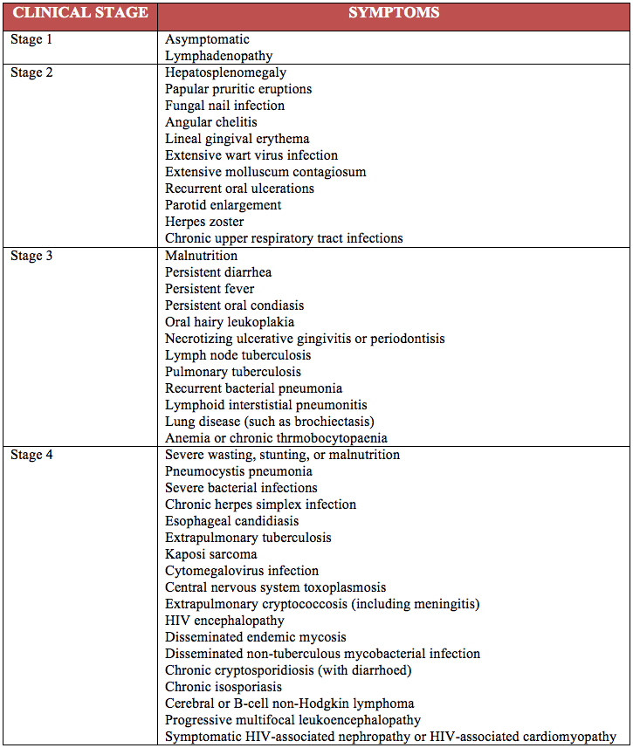

Slide 19
CLINICAL COURSE
Primary HIV Infection
Asymptomatic Infection
Minor HIV Associated disorders
Acquired Immunodeficiency Syndrome

Slide 20
PRIMARY HIV INFECTION
Symptomatic illness develop 1-6 weeks after exposure.
Usually lasts less that two weeks.
Infectious mononucleosis like illness
Seroconversion 2-12 weeks after development of symptoms
Notes:
Incubation period is usually 1-6 weeks and symptomatic illness lasts less than 2 weeks
Howeevr it can last for months
Symptoms and signs similar to IM like illness

Slide 21
Primary HIV Infection
Non-Dermatotologic Manisfestation | Dermatological Manifestation
Fever | Exanthem(75%)
Arthralgia/myalgia | Enanthem
Pharyngitis | Urticaria
Lymphadenopathy | Toxic erythema
Nausea/ Vomiting/Diarrhoea | Erythema multiforme
Bell’s palsy | Oro-pharyngeal candidiasis
Headache | Genito-crural intertrigo
Meningo-encephalitis | Oral and genital ulcers
Notes:
Symmetrical maculopapular rash on face, palms and soles

Slide 22
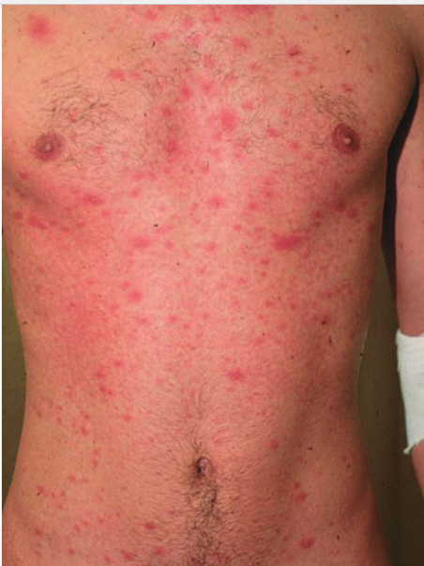
Primary HIV Infection
Notes:
Discrete erythematous maculo papular rash on anterior aspect of trunk in patient with primary HIV infection.

Slide 23
Primary HIV Infection
DIAGNOSIS:
  HIV RNA PCR
  p24 antigen detection
  Negative or equivocal HIV antibody test
  CBC:
  Lymphopenia, thrombocytopenia
  LFTS:
  Hepatic or cholestatic profile

Slide 24
ASYMPTOMATIC INFECTION
Persistent generalized lymphadenopathy ( less than 2 cm)
Decline CD4 count 50-150cells/year
MINOR HIV ASSOCIATED DISORDER
Weight loss
Chronic diarrhoea
Herpes Zoster
Bacillary angiomatosis
Oral hairy leukoplakia
Recurrent oropharyngeal and vaginal candidiasis

Slide 25
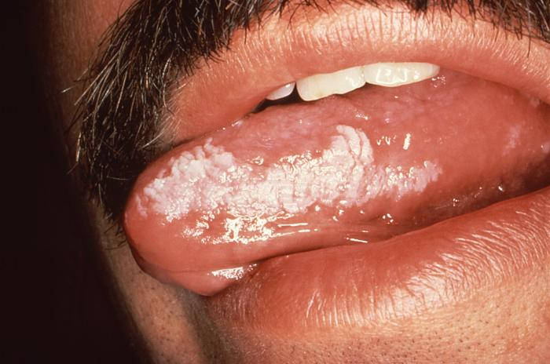

Slide 26
RAPID PROGRESSORS:
AIDS develop within 2-3 years after serocoversion
LONG-TERM NON PROGRESSOR:
AIDS develop after >10-15 years
Notes:
In the absence of treatment, the average time from seroconversion to the development of AIDS is 8–11.6 years, with a median time of approximately 10 years

Slide 27
ACQUIRED IMMUNODEFICIENCY SYNDROME
Development of specific opportunistic infections, cancers and severe manifestation of HIV itself.
CD4 count < 200*10^6/ L
The average CD4 T‐cell count for the most common AIDS‐defining conditions is in the range of 20–100 × 10^6/L.

Slide 28
AIDS
DEFINITIVE DIAGNOSIS (without lab evidence)
Candidiasis of esophagus, trachea, bronchi, lungs
Cyptococcus- extrapulmonary
Cryptosporidiosis-diarrhoea > 1 month
HSV- mucocutaneous ulcer >1 month esophagitis
Kaposi sarcoma < 60 years of age
Pneumocystis jirovicei pneumonia
Toxoplasmosis of brain
CMV- other than liver, spleen, lymph nodes

Slide 29
AIDS
DEFINITIVE DIAGNOSIS
(without lab evidence)
Candidiasis of esophagus, trachea, bronchi, lungs
Cyptococcus- extrapulmonary
Cryptosporidiosis-diarrhoea > 1 month
HSV- mucocutaneous ulcer >1 month esophagitis
Kaposi sarcoma < 60 years of age
Pneumocystis jirovicei pneumonia
Toxoplasmosis of brain
CMV- other than liver, spleen, lymph nodes
Lymphoma- brain
Mycobacteria - other than MTB,disseminated
Extra pulmonary MTB
Salmonella( non typhoid ) septicemia, recurrent
HIV wasting syndrome
CD4 lymphocyte count < 200

Slide 30
PREDICTORS FOR AIDS PROGRESSION
AIDS
Transmission risk group
Transfusion recipient > 7yrs
Haemophiliacs, I/V drug abuser>10yrs
Homosexual men> 10-12yrs
Age at onset of infection
16-24yrs ( median time 15yrs)
>35yrs (median time 6yrs)
Clinical indicators
Symptomatic primary HIV infection,oral thrush,
Oral hairy leukoplakia, herpes zoster, constitutional symptoms and weight loss

Slide 31
AIDS
CD4 T-cell count
Viral load
Extent of viral replication.
Genetic markers of progression
CCR5
HLA class I alleles
Notes:
CD4 T‐cell counts and their decline over time are very important predictors of disease progression. On average, the CD4 T‐cell count decreases by 40–80 × 106/L annually; an acceleration in CD4 T‐cell decline heralds progression of disease. A CD4 T‐cell count of <200 × 106/L is diagnostic of AIDS, and the median survival time in an untreated patient with a CD4 T‐cell count of <200 × 106/L is 38–40 months.
A single measurement of plasma RNA viral load early in infection is a powerful predictor of the subsequent risk of progression to AIDS and death. The combined measurement of CD4 T‐cell count and viral load is an extremely accurate method for assessing the prognosis of infected patients.

Slide 32
INVESTIGATIONS
AIDS
Sample:
  Serum
  Saliva
  Urine

Slide 33
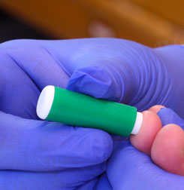
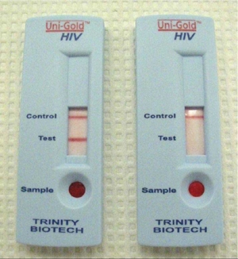
AIDS
Point of care or Rapid test:
Screen HIV antibodies
Requires confirmation by ELISA/ western blot test

Slide 34
AIDS
Essential Assay:
Fourth generation HIV-1/2 immunoassay (includes HIV-1 p24 antigen testing
HIV RNA polymerase chain reaction (PCR)
Notes:
PCR is more sensitive but p24 is widely used

Slide 35
AIDS
CD4 count
Hepatitis B surface antigen
Hepatitis C antibody
Syphilis serology
Cervical smear in women
Tuberculin skin test
STI screen
Serum cryptococcal antigen ( if CD4 count < 100)
CBC
Liver function test
Renal function test
Urine analysis
Notes:
Initial medical evaluation
According to the CD4 count or clinical stage of the disease and available resources

Slide 36
MANAGEMENT
Criteria for starting cART:
CD4 count <350*100^6/L
Stage 3 or 4

Slide 37
HIV Management
Nucleoside reverse transcriptase inhibitor
Non – Nucleoside reverse transcriptase inhibitor
Protease inhibitor
Integrase inhibitor
Fusion inhibitor
Standard regimen consist of combination of two nuceloside analogues and protease inhibitor
( cART)

Slide 38
HIV Management
Recommendation (BHIVA):
Tenofovir and emtricitabin/abacavir and lamivudine
&
Protease inhibitor (should be given with ritonavir)
Notes:
In low-mid income countries who recommend to use NNRTI in place of PI because they are cheaper, better tolerated.

Slide 39
DERMATOLOGICAL MANIFESTATIONS
OF HIV

Slide 40
Inflammatory dermatosis | Infections | Neoplasm/others
Atopic Eczema Erythroderma | Bacterial | Kaposi Sarcoma
Seborrhoeic dermatitis | Viral | Squamous cell carcinoma
Psoriasis | Fungal | Basal cell carcinoma
Granuloma annulare | Parasitic infection | Melanoma lymphoma
Eosinophilic folliculitis |  | Pruritis/Xerosis/ icthyosis
Pruritic papuplar eruption |  | Pigmentary disorders
Nodular prurigo |  | Coagulopathies
Drug eruptions

Slide 41
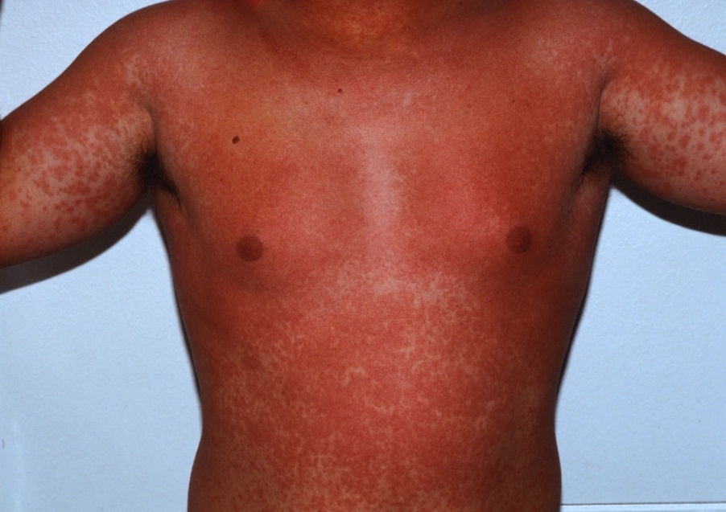
Inflammatory Dermatosis
ATOPIC ECZEMA
More common in children with HIV
Worsening or recurrence of disease in adults
Hyper IgE syndrome
ERYTHODERMA
May be a marker of primary HIV infection
Other causes of erythroderma should be considered
Notes:
However recent study has shown no increase risk of atopy in HIV infected children compared to general population

Slide 42
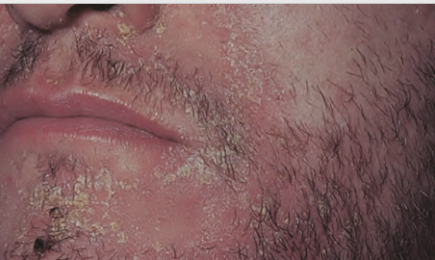
SEBORRHOEIC DERMATITIS
Inflammatory Dermatosis
Prevalance: 20-85% in HIV infected patients
More prevalant and earlier onset in homosexual and bisexual people
Increased severity if CD4 <100 * 10^6/L
Causative agent: Malassezia species
Notes:
If compared with iv drug abusers

Slide 43
Inflammatory Dermatosis
Seborrhoeic Dermatitis
PATHOPHYSIOLOGY :
Immune dysfunction
Neuroendocrine and sebotropic factors
keratinocyte stimulation
Notes:
Alter the host organism relationship

Slide 44
Inflammatory Dermatosis
Seborrhoeic Dermatitis
DIFFERENTIAL DIAGNOSIS:
Eczema
Psoriasis
Dermatophytosis

Slide 45
Inflammatory Dermatosis
Seborrhoeic Dermatitis
DIAGNOSIS:
Skin scraping
Skin biopsy
MANAGEMENT
Emollients
Topical steroids and antifungal
Topical pimecrolimus
Oral imidazoles
Notes:
To excluse tinea .
Skin biopsy may show hyperkeratosis, acanthosis, spongiosis, spotty keratinocyte necrosis, leukocytosis and subcorneal neutrophil infiltration. A deeper lymphocytic infiltration of sebaceous glands and a more perivascular neutrophilic (with occasional leukocytoclasis) and plasma cell infiltrate is seen in HIV compared with classic seborrhoeic dermatitis [10,13]. The histology may be very similar to psoriasis.

Slide 46
PSORIASIS
Inflammatory Dermatosis
Prevalance: 5% in HIV infected patients
CD4 –T cell producing IL-17 is central to pathogenesis
In HIV patients, psoriasis may be
  florid
  severe
  atypical
Psoriatic arthritis is common
Moderate to severe psoriasis (with or without arthritis) should be regarded as indication of cART

Slide 47
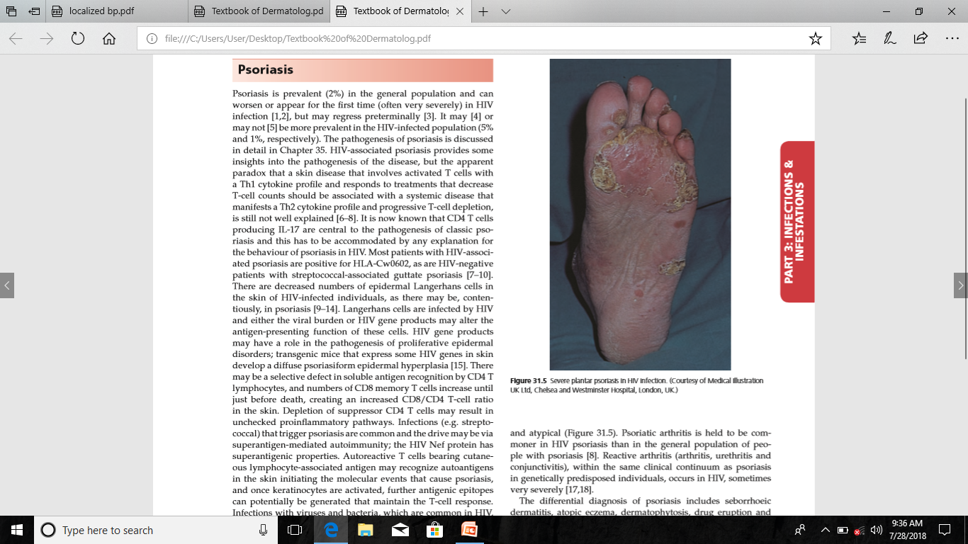
Inflammatory Dermatosis
Psoriasis

Slide 48
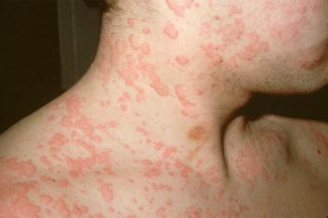
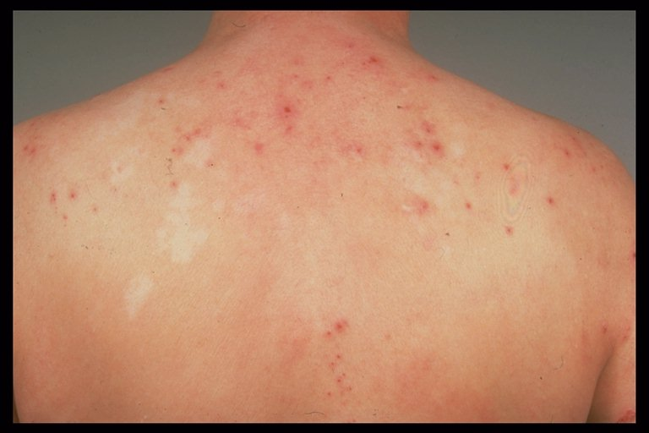
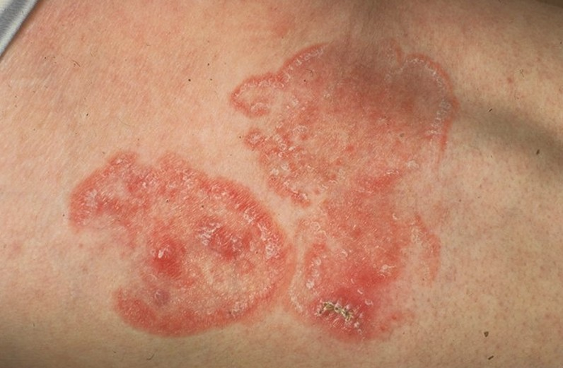
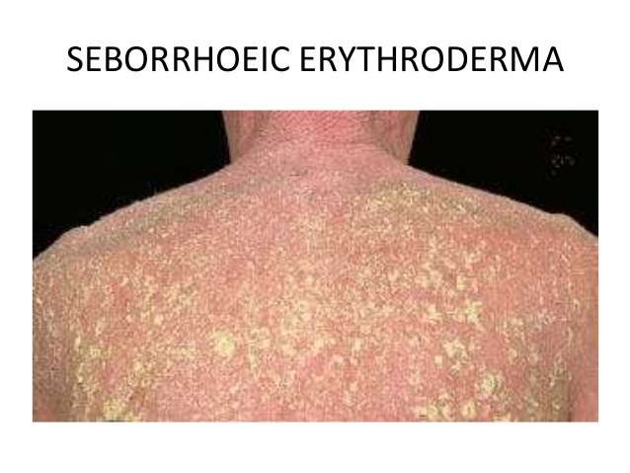
Inflammatory Dermatosis
Psoriasis
DIFFERENTIAL DIAGNOSIS:
Drug Eruption
Atopic Eczema
Mycosis Fungoides
Seborrhoeic Dermatitis

Slide 49
Inflammatory Dermatosis
Psoriasis
MANAGEMENT:
Phototherapy ( PUVA)
Retinoids (etritinate and acetretin)
Ciclosporin ( Generalized pustular and erytherodermic psoriasis)
Methotraxate should be avoided
Notes:
caution needs to be exercised alongside protease inhibitors with their retinoid‐like side effects of xerosis, cheilitis and paronychia
HIV infection contraindicates the use of antitumour necrosis factor‐α directed therapy in psoriasis. However, etanercept and infliximab have been deployed [7,20,34,35]. Daclizumab (anti‐CD25 IL‐2 receptor) has been given successfully to one patient with erythrodermic psoriasis [36].

Slide 50
Inflammatory Dermatosis
Psoriasis
HIV infection contraindicates the use of antitumour necrosis factor‐α directed therapy in psoriasis. However, etanercept and infliximab have been deployed
Daclizumab (anti‐CD25 IL‐2 receptor) has been given successfully to one patient with erythrodermic psoriasis [36].

Slide 51
EOSINOPHILIC FOLLICULITIS
Inflammatory Dermatosis
Presents as centripetal ( face, trunk) eruption of pruritic, erythematous, perifollicular papules and pustules.
CD4 T-cell count 250-300x10*6/L
Exacerbated by cART
Notes:
As part of IRIS

Slide 52
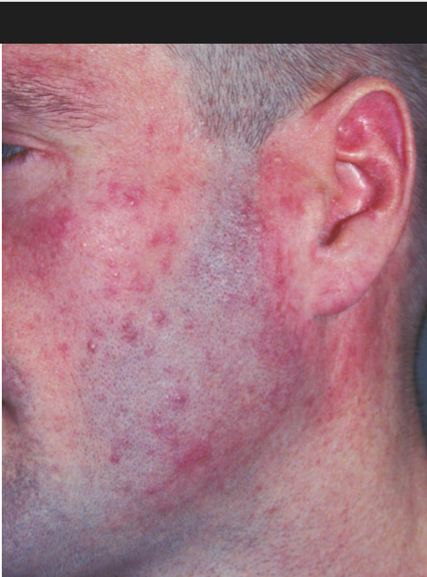
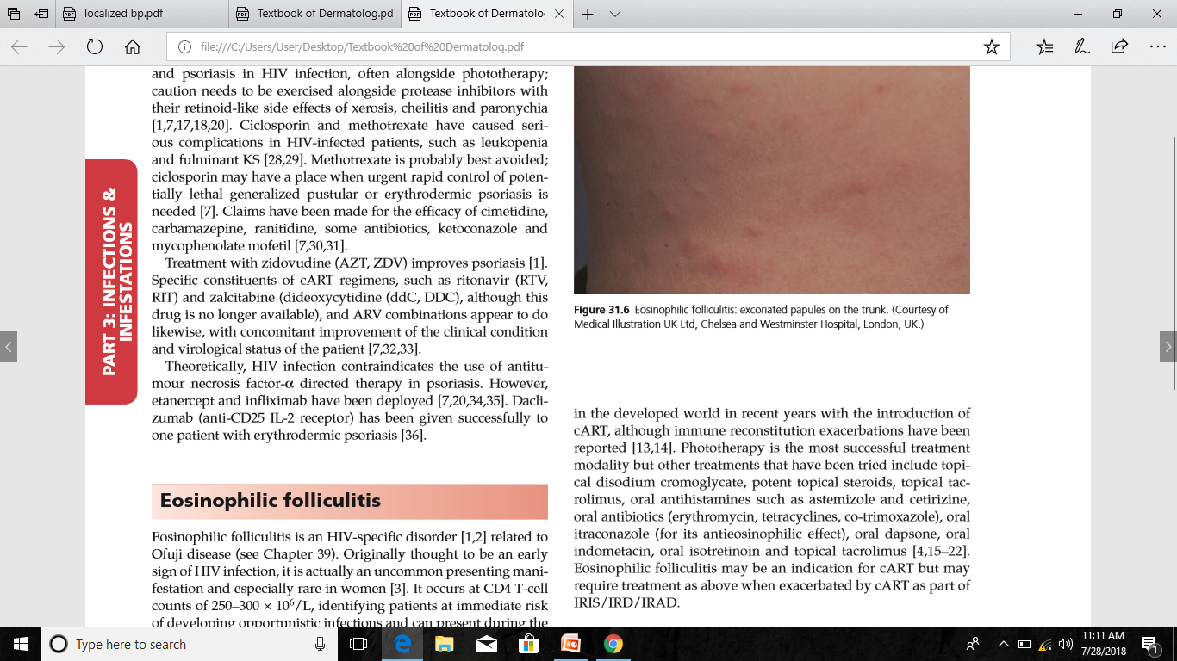
Inflammatory Dermatosis
Eosinophilic folliculitis
Notes:
Showing eosinophilic folliculitis after institution of cART

Slide 53
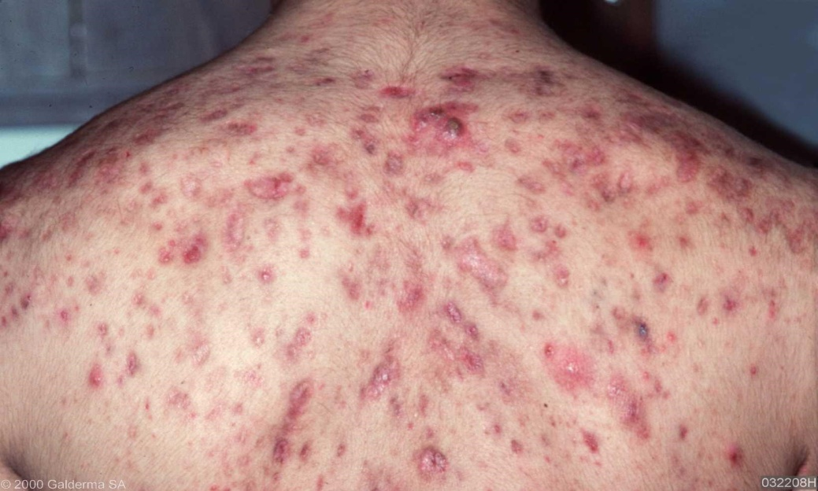
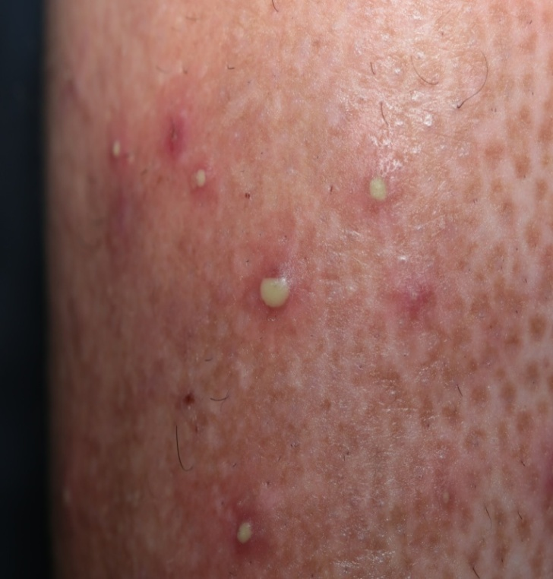
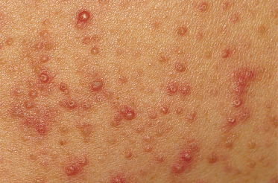
Inflammatory Dermatosis
Eosinophilic folliculitis
Acne Vulagaris
Bacterial Follliculitis
Seborrhoeic Follicuiltis

Slide 54
Inflammatory Dermatosis
Eosinophilic folliculitis
INVESTIGATION:
Histolopathology:
Degranulating eosinophils and mast cells in a perifollicular distribution
Periperal eosinophilia
Raised IgE levels

Slide 55
Inflammatory Dermatosis
Eosinophilic folliculitis
MANAGEMENT:
Phototherapy is the most successful treatment.
OTHERS:
  Topical disodium cromoglycate, potent steroids, topical tacrolimus
  Oral antibiotics ( erythromycin, tetracycline, co- trimoxazole)
  Itraconazole, Dapsone, Isotretinoin, Indomethacin, cART

Slide 56
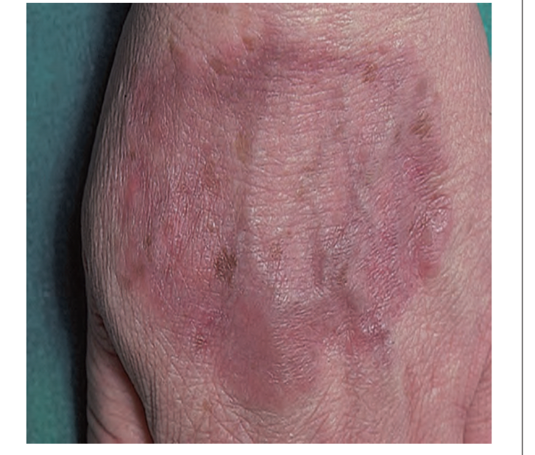
GRANULOMA ANNULARE
Inflammatory Dermatosis
Localized/generalized/diffuse /atypical (oral/perforating) forms.
Cultures are negative.
Variable response to cART.

Slide 57
PRURITIC PAPULAR ERUPTION
Inflammatory Dermatosis
Prevalance in HIV is 10-60%
Common in Asia and Africa
Sign of an advanced degree of immunosuppression
CD4 T-cell count is below 100- 200x10*6/L
( median 46x10*6/L).

Slide 58
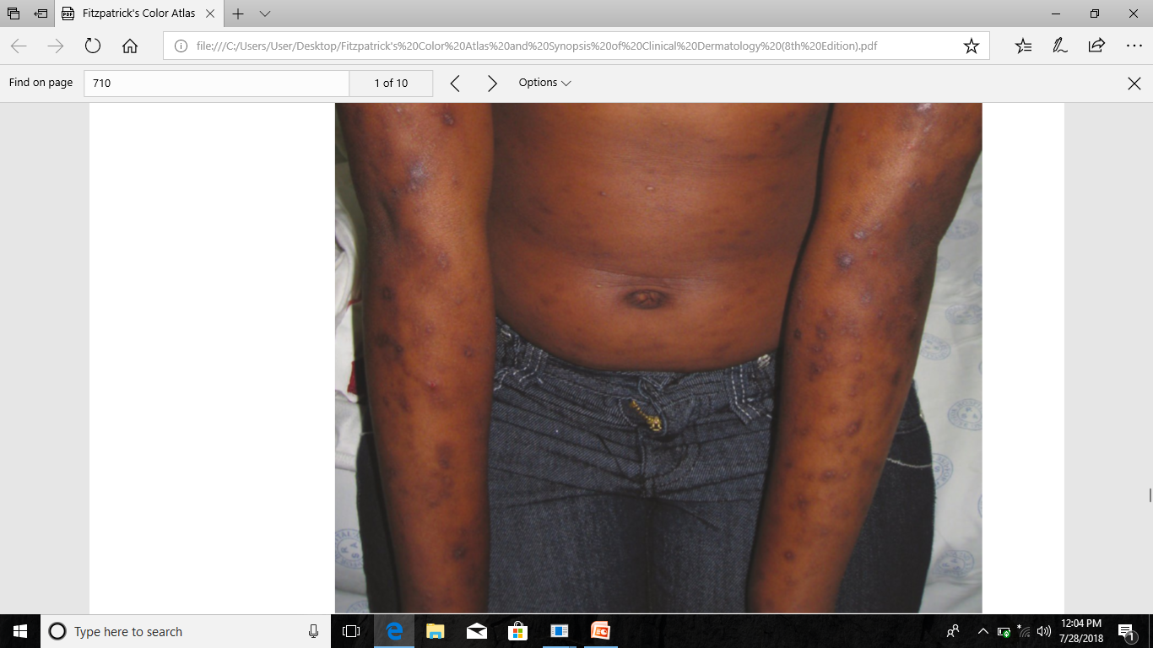
Inflammatory Dermatosis
PPE
CLINICAL FEAURES:
Presents as excoriated,erythematous,
urticarial papules
Scars scratching and infection

Slide 59
Inflammatory Dermatosis
PPE
DIFFERENTIAL DIAGNOSIS:
Nodular prurigo
Scabies
Pre bullous pemphigoid
Papulonecrotic tuberculid
Photodermatitis
Secondary syphilis
Onchodermatitis
Folliculitis ( eosinophilic, seborrhoeic, bacterial or acneform)

Slide 60
Inflammatory Dermatosis
PPE
MANAGEMENT:
Phototherapy the lynch pin.
Thalidomide
Pentoxifylline ( oxpentifylline)
Oral antihistamines

Slide 61
DRUG REACTION
( Non-ARV Drugs Associated )
Morbiliform toxic erythema
Erythema multiforme, SJS, TEN, DRESS
Fixed drug eruption
Erythroderma
Xerosis, cheilitis
Psoriasis
Oro-genital ulceration
Vasculitis
Flagellate erythema: Bleomycin
Acrocyanosis: Butyl nitrite
Eosinophilic folliculitis: Foscarnet
PPK : Glucan

Slide 62
ART Associated Drug Reaction
Drugs | Side Effects
All NRTI Zidovudine Stavudine Lamivudine | Pruritis, Exanthem, Urticaria Hyperpigmentaion of nails & mucosa Lipodystrophy Anaphylaxis, Allergic contact dermatitis
All Non- NRTI Nevirapine Rilpivirine | SJS, TEN Exfoliative dermatitis Cushingoid features
All PI Indinavir | Xerosis, Cheilitis, lipodystrophy, panniculitis, Tendon xanthomas Hyperpigmentation of nails &mucosa, curly hair , periungual pyogenic granuloma. Ingrown toe nail, paronychia

Slide 63
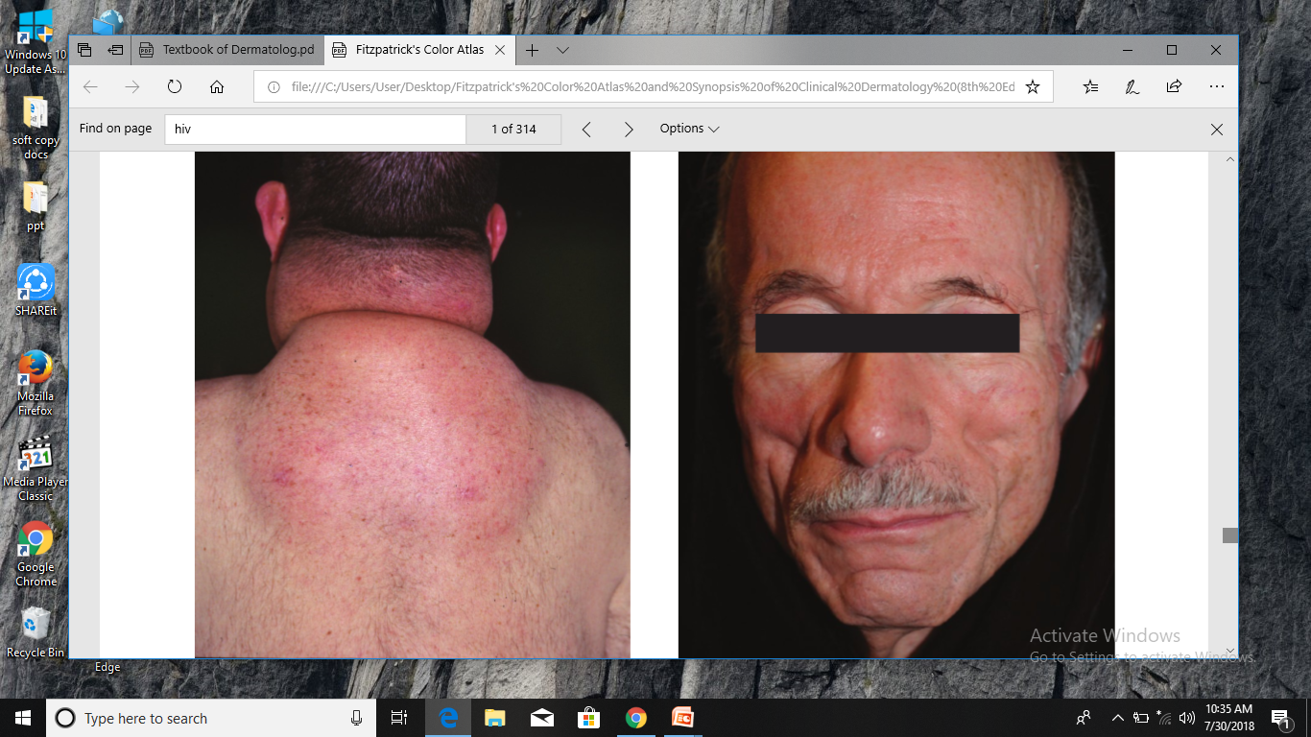
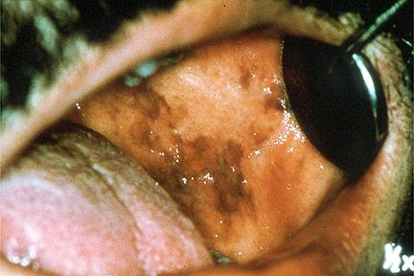

Slide 64
BACTERIAL INFECTION
Staphylococcus Aureus
Pseudomonas species
Escherichia Coli
Streptococcus Pyogenes
Bartonella Henselae
Syphilis
Mycobacterium
Commonest organisms

Slide 65
Bacterial Infections
STAPHYLOCOCCUS AURUES
( INCLUDING MRSA)
Can Manifest as:
Folliculitis
Impetigo
Ecthyma
Cellulitis
Abscesses
Botromycosis
Staphylococcal scalded skin syndrome
Toxic shock syndrome

Slide 66
Bacterial Infections
RISK FACTORS FOR MRSA INFECTION:
High risk sex
Injected drug use
Poor HIV control
CD4 count< 50*10^6/L
Log 10 HIV viral load copies/ml
Absence of co-trimoxazole prophylaxis
Prior MRSA infection
Recent hospitalization
Recent receipt of Beta- lactam antibiotics

Slide 67

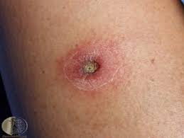
Bacterial Infections
Notes:
Clinical differentiation between staphylococcal folliculitis, Malassezia folliculitis, dermatophyte folliculitis, eosinophilic folliculitis, demodex folliculitis and acne vulgaris or rosacea may be very challenging and these entities may coexist.
It is a deep form of impetigo characterized by crusted lesion with ulceration

Slide 68
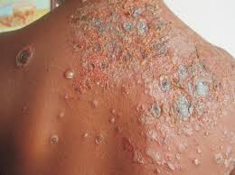
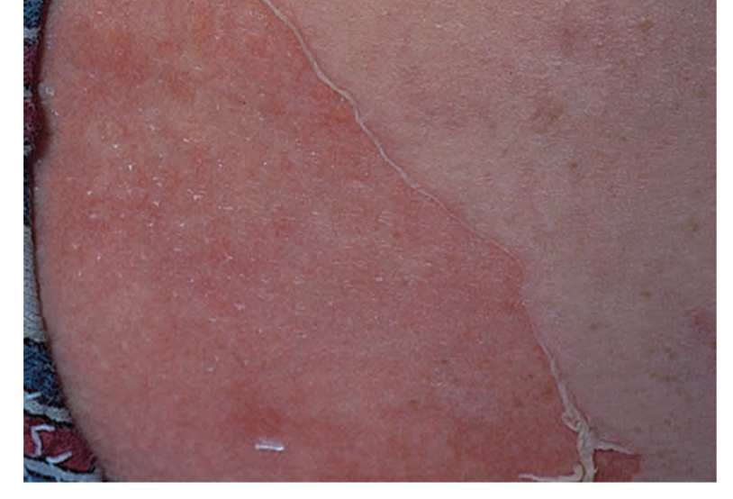
Bacterial Infections
Notes:
Bullous impetigo

Slide 69
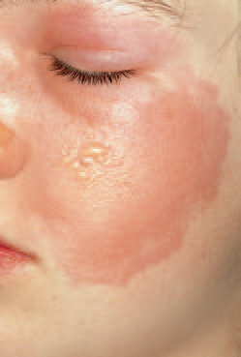
Bacterial Infections
STREPTOCOCCAL
INFECTION:
Erysipelas
  Common sites: legs, face
  sharp, raised borders
  Blistering may be seen
  Rarely caused by staph (MRSA)
Notes:
Erythematous indurated plaque with sharply defined border

Slide 70
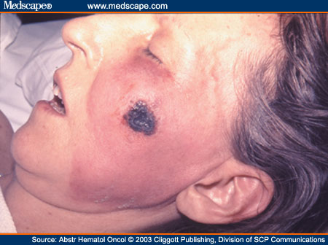
Bacterial Infections
PSEUDOMONAS
AERUGINOSA:
Ecthyma gangrenosum
  Red macule
  Hemorrhagic bullae
  High mortality
Panniculitis
Notes:
The characteristic lesions of ecthyma gangrenosum are haemorrhagic (bloody) pustules that evolve into necrotic (black) ulcers.

Slide 71
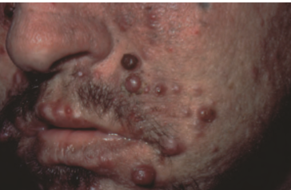
Bacterial Infections
BACILLARY
ANGIOMATOSIS:
Causative organism: Bartonella henselae
Characterized by purple, papular and nodular vascular lesions
Notes:
That resemble KS

Slide 72
Bacterial Infections
Bacillary angiomatosis
DIAGNOSIS:
Histopathology
  Lobular vascular proliferation with abnormal, enlarged epitheloid cells and prominent neutrophilic infiltrate with neutrophil debris
Warthin -Starring silver staining
Immunoperoxidase staining

Slide 73
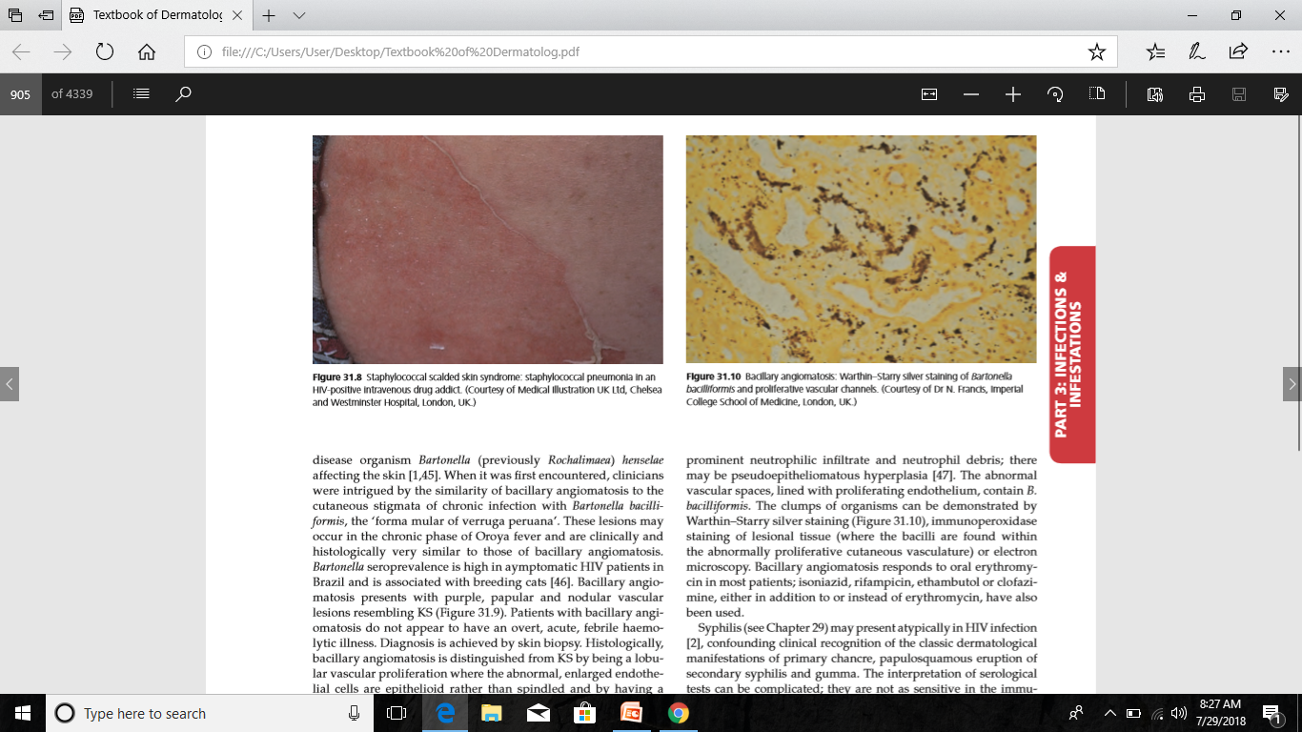
Bacterial Infections
Bacillary angiomatosis

Slide 74
Bacterial Infections
Bacillary angiomatosis
MANAGEMENT:
Erythromycin
Isoniazid
Rifampicin
Ethambutol
Clofazimine

Slide 75
Bacterial Infections
SYPHILIS (TREPONEMA PALLIDUM):
Chancre Primary syphilis
Papulosquamous eruption
Erythema Multiforme
Gumma Tertiary syphilis
Keratoderma
Leus maligna ( red necrotic nodules )
Nodular syphilis
Secondary syphilis
Notes:
Em in secondary syphilis
Resembling KS and lymphoma

Slide 76
Bacterial Infections
MYCOBACTERIUM TUBERCULOSIS:
Re-activation occurs early in HIV infection.
50% HIV patients are co - infected with tuberculosis
Characterisitc manifestation is tuberculous lymphadenitis
Notes:
HIV is the greatest risk for progression from latent to TB disease.
50% HIV pts r con infected with TB(2/3M aviam complex, 10% M tuberculosis).

Slide 77
Bacterial Infections
Mycobacterium TB
CUTANEOUS MANISFESTATION:
  Lupus vulgaris
  Scrofula
  Miliary tuberculosis of skin
  Palmoplantar keratoderma
  Keratotic papules or nodules
  Tuberculides
  Pilonidal sinus

Slide 78
Bacterial Infections
MYCOBACTERIUM AVIUM
INTRACELLULARE:
Occur at CD4 count < 50*10^6/L
Lesions are characterized by violaceous papules, nodules and ulcer
Notes:
Atypical mycobacterial skin disease in patients infected with HIV is usually due to Mycobacterium avium‐intracellulare
Occur as a part of disseminated infection.

Slide 79
VIRAL INFECTIONS
Herpes Simplex Virus
Varicella Zoster Virus
Human papilloma virus
Cytomegalovirus
Mollusca

Slide 80
Viral Infections
HERPES SIMPLEX:
Caused by HSV-1 and HSV-2
Ano-genital involvement is common
  Acute lesions Vesicullobullous
  Chronic lesions Eroded, Crusted, Ulcerative or Vegetative
Notes:
Although any site can be affected

Slide 81
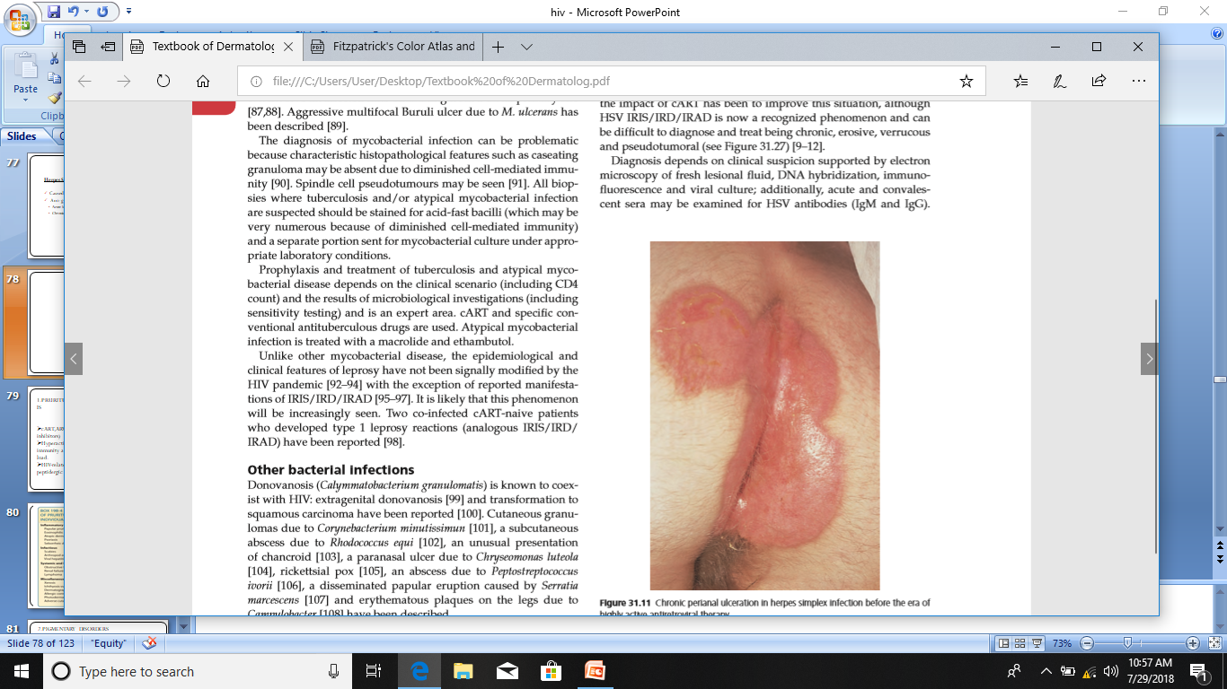
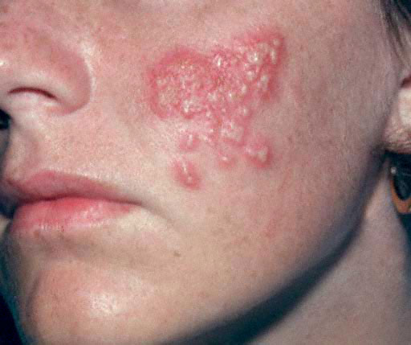
Viral Infections
HSV
Notes:
Perianal ulceration in patient with herpes simplex infection

Slide 82
Viral Infections
HSV
DIAGNOSIS:
Tzanck smear
Electron microscopy of fresh fluid.
PCR
Viral cultures
Skin biopsy

Slide 83
Viral Infections
HSV
TREATMENT:
Systemic antiviral therapy (acyclovir,famciclovir,valaciclovir)
I/V Vidarabine ( acyclovir resistant cases)
Foscarnet ( severe HSV-2 infection)
Notes:
Oral acyclovir 200mg 5 times a day for 5 or more days or 800 mg twice a day.

Slide 84
Viral Infections
VARICELLA - ZOSTER INFECTION:
VZV reactivation is frequent and severe.
Most common cutaneous manifestation of IRIS
Regarded as a predictor of HIV infection in African patients
Distribution of eruption is dermatomal
  Ophthalmic zoster Conjunctivitis, optic neuritis
  Sacral nerves Acute urinary retention, Hemorrhagic cystitis and constipation
Notes:
Vzv reactivation frequently accompanies HIV infection
Can be complicated by

Slide 85
Viral Infections
VZV
OTHER MANIFESTATION:
Non – bullous folliculitis
Chronic verrucous dermatomal form
Ecthymatous necrotic lesions (disseminated VZV infection)
Zoster encephalomyelitis
Pulmonary involvement

Slide 86
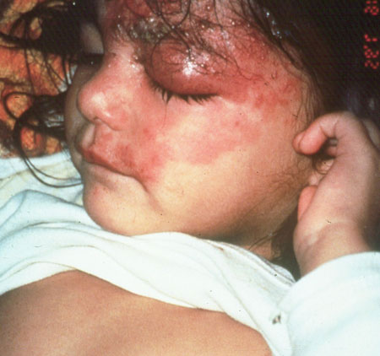
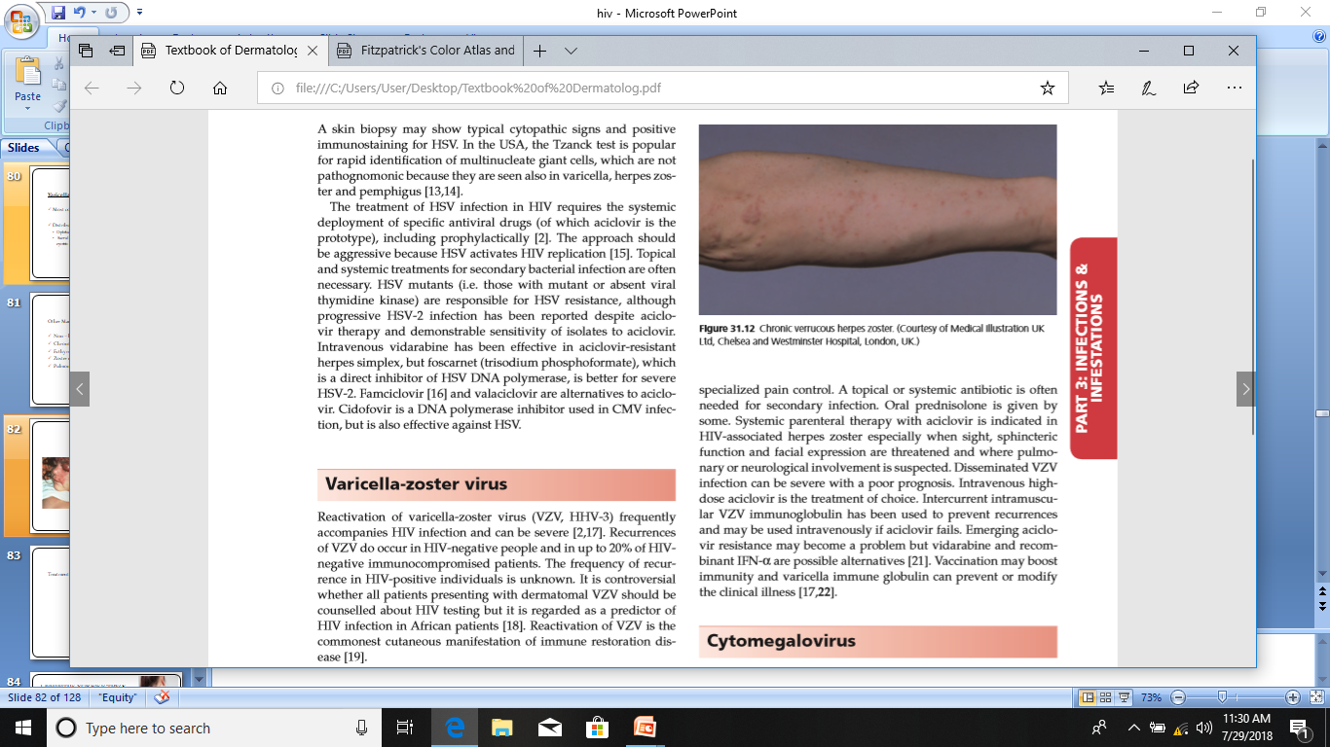
Viral Infections
VZV

Slide 87
Viral Infections
VZV
TREATMENT:
I/V acyclovir
Intercurrent intramuscular VZV immunoglobulin
Vaccination
For acyclovir resistant cases
  I/V Vidarabine
  Recombinant INF-alpha
  I/V immunoglobulin
Notes:
Systemic parenteral therapy with aciclovir is indicated in HIV‐associated herpes zoster especially when sight, sphincteric function and facial expression are threatened and where pulmonary or neurological involvement is suspected
To prevent recurrences

Slide 88
Viral Infections
CYTOMEGALOVIRUS:
CD4 count < 50*10^6/
Skin involvement is uncommon
Mortality is 85% in 6 months with skin involvement

Slide 89
Viral Infections
CMV
CLINICAL FEATURES:
Purpura
Papules
Nodules
Verrucous plaques
Painful ulcers
Nodular prurigo
Coagulopathies
Blindness
Dysphagia/Diarrhoesa
Encephalopathy
Adrenal disease

Slide 90
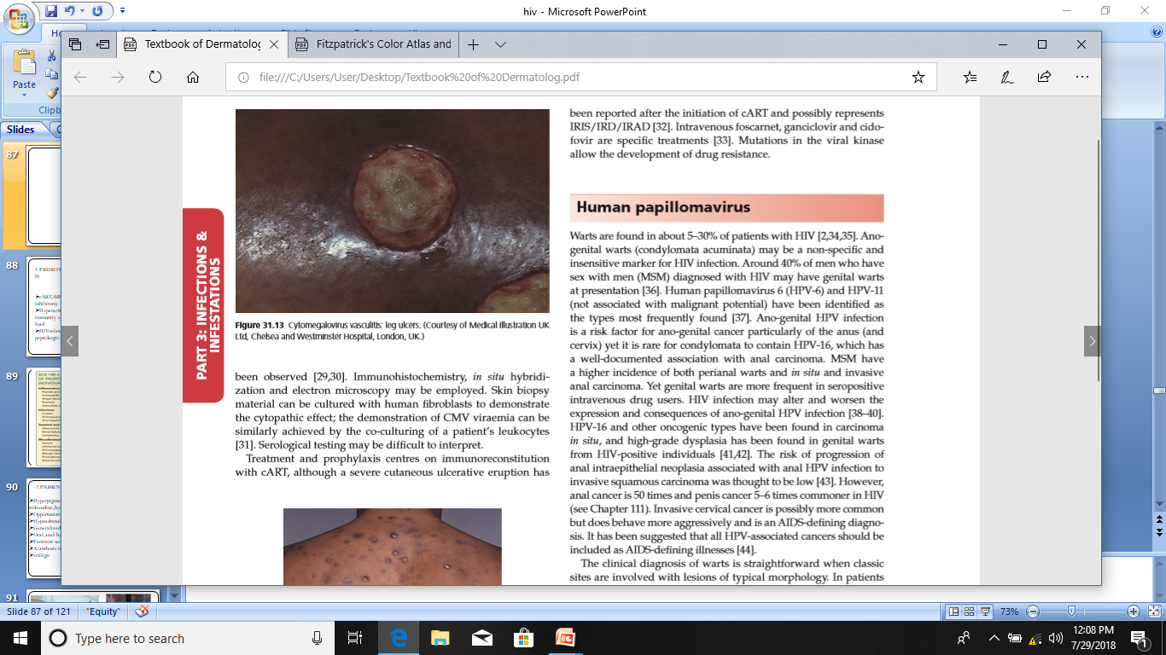
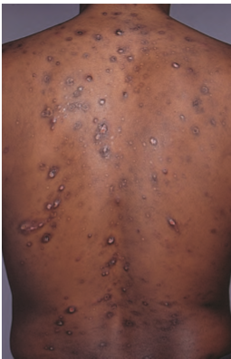
Viral Infections
VZV
Notes:
Leg ulcer
Nodular prurigo like eruption

Slide 91
Viral Infections
VZV
DIAGNOSIS:
Skin biopsy
  Dermal capillary neoangiogenesis
  Fibrinoid thrombi
  Necrotic endothelial cells
  Epidermal hyperplasia
  Acantholysis
  CMV inclusion in keratinocytes and endothelial cells
Notes:
Immunohistochemistry, in situ hybridization and electon microscopy

Slide 92
Viral Infections
VZV
TREATMENT:
I/V forcarnet
Ganciclovir
Cidofovir
Resistant cases:
  Vidaribine
  Interferon alpha

Slide 93
Viral Infections
HUMAN PAPILLOMA VIRUS:
5-30%
HPV-6 & HPV-11
Genital warts are more frequent in seropositive intravenous drug users.
Anal and penile cancer in males and cervical cancer in female
Notes:
The risk of progression to invasive carcinoma is low

Slide 94
Viral Infections
HPV
CLINICAL FEATURES:
Warts ( numerous, extensive, exuberant)
Bowen disease
Erythroplasia of Queyrat
Anal, penile and cervical cancer
Epidermodysplasia verruciformis ( HPV 1,2,5,6,16 & 52)

Slide 95
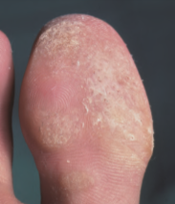
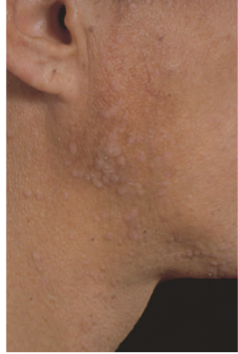
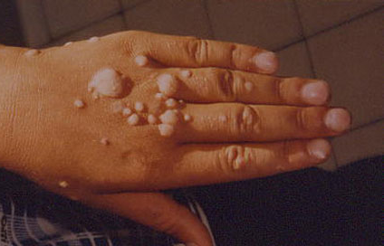
Viral Infections
HPV

Slide 96
Viral Infections
HPV
TREATMENT:
Topical imiquimod
Topical/Intravevous cidofovir
cART can lead to regression
Notes:
Conventional therapy often fails
Edv may not improve with cART

Slide 97
Viral Infections
MOLLUSCA:
Molluscipoxvirus (MCV 1 - 4)
  MCV-1 Pediatric infection
  MCV-2 HIV infected patients (60%)
Frequently seen in homosexual seropositive patients
Notes:
As compared to iv drug users

Slide 98
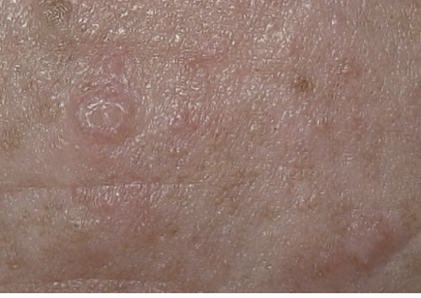
Viral Infections
MC
Several papular or larger nodular lesions ( face, neck)
Lack of central umblication/delling.
Florid ,extensive ,genital lesions with cellulitis reported.
Notes:
Flesh coloured papules and nodules on forehead

Slide 99
Viral Infections
MC
DIFFERENTIAL DIAGNOSIS:
Sebaceous hyperplasia
Syringoma
Warts
Crytococcosis
Histoplasmosis
Basal cell carcinoma

Slide 100
Viral Infections
MC
DIAGNOSIS:
Skin biopsy
TREATMENT:
Topical imiquimod
Topical cidofovir
I/V cidofovir
Electron beam therapy
Diphencyprone

Slide 101
FUNGAL INFECTION
Candidosis
Dermatophytosis
Histoplasmosis
Cryptococcosis

Slide 102
Fungal Infection
CANDIDOSIS:
Causative oragnism:
  Candida albicans
  Candida krusie
Oral candidosis Early stage of HIV
  Predicts AIDS in a median of 2 years
  Indication for prophylaxis for Pneumocystis jiroveci and cART

Slide 103
Fungal Infection
Candidosis
Oesophageal candidosis AIDS defining condition
  Common in homosexual patients
  Commenest presentation Pseudomembrane
Vaginal candidosis HIV women in USA

Slide 104
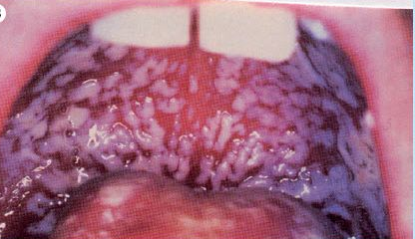
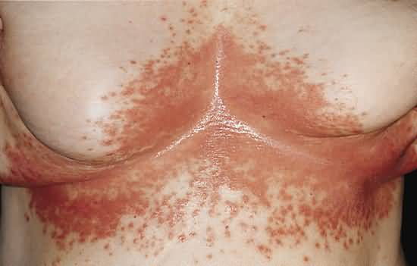

Slide 105
Fungal Infection
Candidosis
OTHER:
Paronychia
Onychodystrophy
Angular cheilitis
Intertriginous candidosis
IRIS
TREATMENT:
Single dose of oral fluconazole or oral miconazole

Slide 106
Fungal Infection
DERMATOPHYTOSIS:
More common in homosexual man
Causative organism: Tinea rubrum
Tinea eborum ( New species)
Notes:
Irrespective of HIV status
Psoriasis and yellow nail syndrome should be considered In differentials

Slide 107
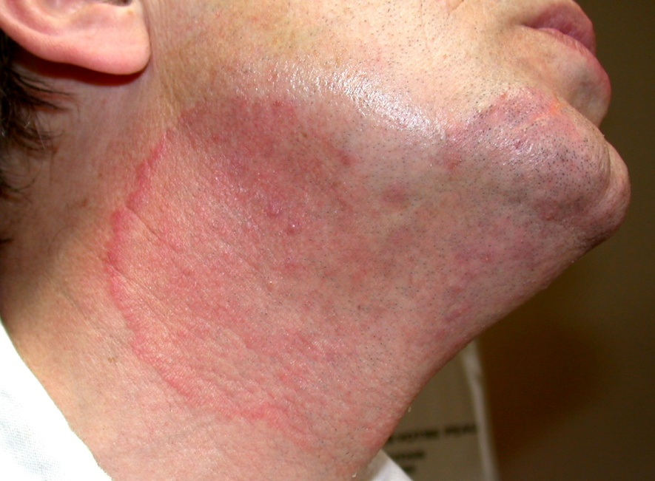
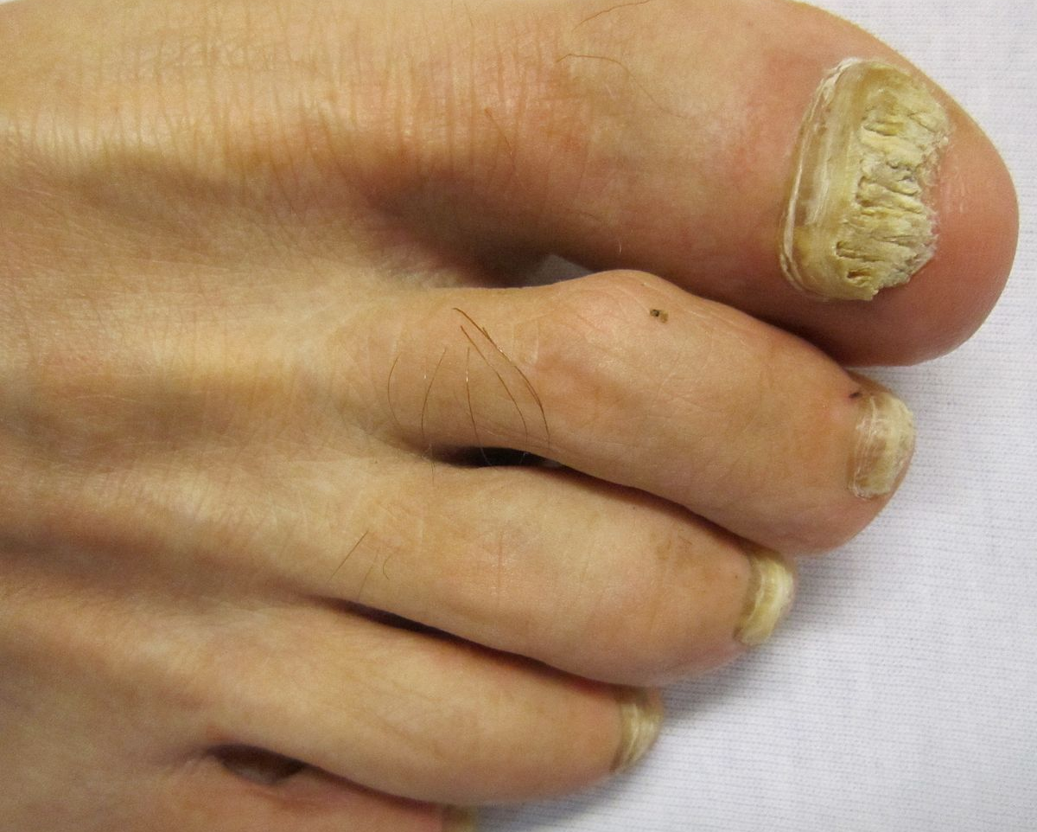
Fungal Infection
dermatophytosis
CLINICAL
PRESENTATION:
  Onychomycosis ( most frequent presentation)
  Widespread dermatophytosis
  Atypical tinea corporis
  Folliculitiis
  Invasive dermatophytosis
  ( Majocci granuloma)

Slide 108
Fungal Infection
Dermatophytosis
TREATMENT:
Oral terbonafine
cART

Slide 109
Fungal Infection
HISTOPLASMOSIS:
Extrapulmonary histoplasmosis is an AIDS defining condition
CD4 count < 200*10^6/L
Fever, lymphadenopathy, hepatospleenomegaly, lung disease and pancytopenia.
Notes:
Systemic presentation can mimic tuberculosis

Slide 110
Fungal Infection
Histoplasmosis
Skin may be the most frequent site of localized infection
2/3rd of patients have pulmonary involvement
Clinically presents as
  Macule
  Papule
  Plaque
  Crusted/eroded/ ulcerated papules or plaque
  Located on face and trunk
  Oral erosions and ulcers

Slide 111
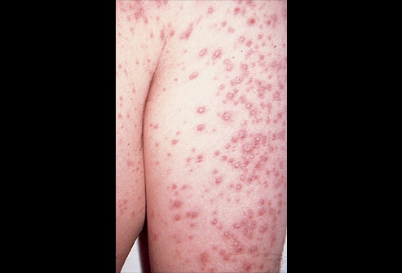
Fungal Infection
Histoplasmosis

Slide 112
Fungal Infection
Histoplasmosis
DIAGNOSIS:
Chest x-ray
Wright’s staining of a blood film(intracellular fungi)
Blood culture
Lymph node,liver or skin biopsy
Tzank cytology
Culture
Gomori methanamine silver stain of skin biopsy section

Slide 113
Fungal Infection
Histoplasmosis
TREATMENT:
cART
Itraconazole and /or amphotericin
Long-term itraconzole (sec. Prophylaxis)

Slide 114
Fungal Infection
CRYPTOCOCCOSIS:
Extrapulmonary cryotococcosis is an AIDS defining condition.
Affected sites:
  Brain
  Lung
  Skin

Slide 115
Fungal Infection
Cryptococcosis
CUTANEOUS MANIFESTATION:
  Papulonodular necrotizing lesion with central umblication
  ( most common)
  Herpetiform
  Lichenoid
  Acneform
  Rhinophyma
  Warty tumor foot
  Pseudofolliculitis
  KS like

Slide 116
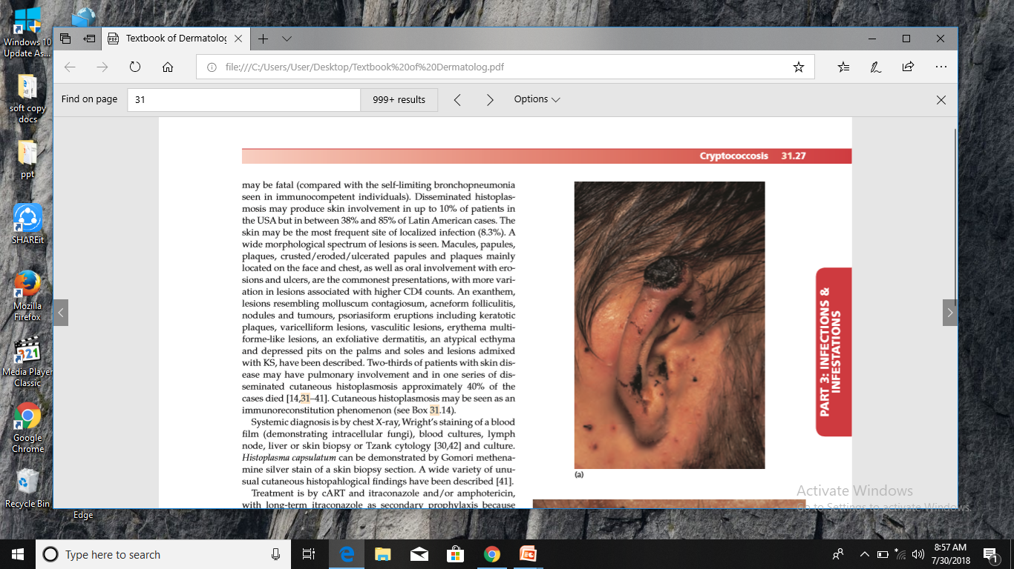

Slide 117
Fungal Infection
Cryptococcosis
DIAGNOSIS:
Skin biopsy for
  Mucicarmine staining ( cryptococcal capsule)
  Culture
  Tzank preparation

Slide 118
Fungal Infection
Cryptococcosis
TREATMENT:
Oral fluconazole ( primary & secondary prophylaxis)
Intravenous amphotericin

Slide 119
PARASITIC INFECTION
Cutaneous Manifestations are rare
Pneumocystis jivoreci Pneumonia Mass lesion in external auditory canal
Disseminated amoebiasis Anogenital ulceration, soleus muscle abscess, solitary papule of thigh.

Slide 120
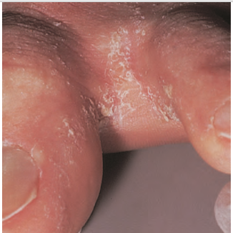
Parasitic infection
SCABIES:
Skin of head and neck is involved
Crusted scabies is localized to soles and genitals
Topical sulphur and oral ivermectin

Slide 121
NEOPLASMS
Kaposi Sarcoma
Melonoma
Non – Melanoma Skin cancer
Lymphoma

Slide 122
Neoplasm
KAPOSI SARCOMA:
AIDS defining condition
Encountered in HIV- negative homosexual men
HHV-8
Sexually transmitted
Notes:
Ks is being found at cd4 count of 300 *10^6/l

Slide 123
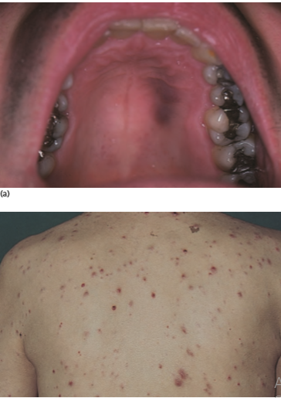
Neoplasm
KS
Characterized by purple patch, plaque or nodule, may ulcerate
Sites: Face, genitalia, oral mucosa, palate
Multiple, follow skin creases/ grouped/ linear/ koebnerize
May disseminate with gastrointestinal and pulmonary involvement

Slide 124
Neoplasm
KS
DIFFERENTIAL DIAGNOSIS:
Naevus
Histiocytoma
Lymphangioma
Bacillary angiomatosis
Pyogenic granuloma
Angioma
Cryptococcosis
Histoplasmosis
Leishmaniasis
Notes:
However psoriasis, lichen planus, lichen sclerosus, fixed drug eruption, erythroplasia of queyrat are included in the differntial diagnosis of genital lesions

Slide 125
Neoplasm
KS
DIAGNOSIS:
Skin biopsy
  Dilated irrugarly shaped vascular structure that are typically slit like
  Immunohistochemistry

Slide 126
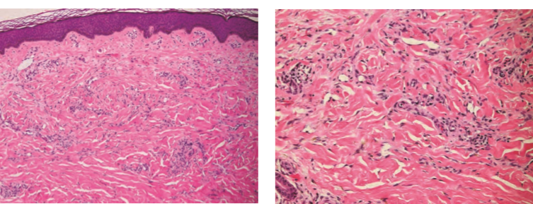
Neoplasm
KS
Notes:
Patch stage KS typically consist of horizontally arranged, irregular vessels that dissect through collagen and around adnexae. (b) Vessels are lined by endothelial cells that may be plump and hyperchromatic, with areas of erythrocyte extravasation and hemosiderin deposition .

Slide 127



Neoplasm
KS
Notes:
The histological fi ndings (a) are more exaggerated than those of patch‐stage KS, with deeper involvement, more prominent extension of spindled cells around vessels, erythrocyte extravasation.
Erythrocyte extravasation within slit‐like spaces is prominent
Immunohistochemical staining for the latent nuclear antigen‐1 of HHV‐8 is specifi c for KS

Slide 128

TIS STAGES OF KAPOSI SARCOMA

Slide 129
MANAGEMENT
Neoplasm
KS
LOCAL TREATMENT:
Cryotherapy
Radiotherapy
Topical retinoid: alitretinion
Topical antiviral: cidofovir, docosanol
Intralesional: IFN alpha, TNF alpha, vinca alkaloids
Surgery
Laser
Photodynamic therapy
Cosmetic camouflage
Notes:
Surgical options: curettage, cautery, infrared coagulation

Slide 130
Neoplasm
KS
SYSTEMIC TREATMENT:
cART
Isotretinoin
Cidofovir
Intravenous chemotherapy, e.g. anthracyclines such as liposomal daunorubicin, liposomal doxorubicin, bleomycin, paclitaxel, vincristine, etoposide
Imatinib mesylate (platelet‐derived growth factor/c‐kit receptor inhibitor)
Thalidomide, lenalidomide

Slide 131
RECOMMENDATIONS:
Neoplasm
KS
Early Stage KS
(T0)
Advanced stage KS
( T1)
cART and liposomal anthracycline
Anthracycline resistant KS
cART and paclitaxel
cART
Radiotherapy or
Liposomal anthracycline
Daunorubicin 40 mg/m2 every 14 days or Doxorubicin 20mg/m2 every 21 days
Paclitaxel 100mg/m2 every 14 days
Notes:
For rapidly progressive and disfiguring disease

Slide 132
NON- AIDS DEFINING CANCER
  Primary skin malignancies are the most frequent non – AIDS defining cancer
  Basal cell carcinoma
  Squamous cell carcinoma
  Melanoma
  Other non – AIDS defining cancers:
  Hodgkin lymphoma, Leukemia, liver, respiratory, anal, oropharyngeal, prostate cancers
Notes:
Ratio of scc to bcc is 1:7 in HIV patients

Slide 133

Neoplasm
SQUAMOUS CELL
CARCINOMA:
Predisposing factor: Sun exposure > Immunosuppression
Clinical Feature:
  Atypically
  Younger age
  Unusual sites ( digit ,nail folds)
  Aggressive, multifocal
  High mortality
Notes:
Conventional treatment protocol is followed
Treatment is excision followed by radiotherapy

Slide 134


Neoplasm
BASAL CELL CARCINOMA:
Younger age
Multiple,eruptive
Superficial type
Treatment: topical imiquimod
MELANONA
Normal naevi
Benign macules
Multiple naevoid lesions
Aggressive
Low CD4 count Poor prognosis
Notes:
Clinically different types: nodular, ulcerating, pigmented, sclerosing, and superficial.
Amelanotic nodule on left arm
Rodent ulcer on mandible with rolled margins

Slide 135
Neoplasm
LYMPHOMA:
Non- hodgkin B-cell lymphoma
Hodgkin disease (more advanced at presentation )
Multiple myeloma
Cutaneous T-cell lymphoma
HIV-associated cutaneous pseudolymphoma
  intense pruritus
  alopecia universalis
  weight loss
  eosinophilia

Slide 136
OTHER MANIFESTATION
Pruritis/ Xerosis/ Icthyosis | Primary manifestation of HIV Drug induced
Pigmentary Disorders | Generalized Hyperpigmentation Oral and anal hyperpigmentation (CD4 count <200*10^6) Acanthosis nigricans Vitiligo
Coagulopathies | Thrombocytopenic purpura Venous and arterial thrombosis

Slide 137


Slide 138
HAIR & NAIL CHANGES IN HIV
Hair Abnormalities | Nail Abnormalities
Alopecia/ Telogen Effuvium | Clubbing
Fine hair | Half and half nail
Eye lashes trichomegaly | Transverse ( Beaus) line
Alopecia areata and universalis | Leukonychia
 | Grey nails Blue nails
 | Longitudinal ridging and melononychia
 | Onycholysis/ Onychoschizia Onychomycosis
 | Yellow nail syndrome Periungual erythema
Notes:
Nail and hair changes associated with drugs

Slide 139
IMMUNE RECONSTITUTION INFLAMMATORY SYNDROME
It is paradoxical clinical worsening of existing opportunististic infection or the appearance of a new condition after initiating ART in HIV-infected patients
15-20%
CD4 count < 50 *10^6/L
Mortality rate is 5%
Notes:
It is higher when it complicates CNS infection
fatal outcomes may rarely occur, particularly when neurologic structures are involved.
First 2 months after starting therapy

Slide 140
MANAGEMENT:
Continue ART therapy
Treat opportunistic infection
Steroids
  Should not be given in patient with Kaposi sarcoma

Slide 141


