Slide 1
Histopathology
Dr Hira Muneer
Post graduate trainee
Dermatology Department SPH Quetta
Notes:
Apocrine glands:
They store their secretory product on the secreting cell's apical surface.
The portion pinches off from the rest of the cell to release the secretion.
For example- mammary glands that secrete milk
Exocrine gland:
Exocrine glands are comprised of an acinus and a duct with different cell types, respectively.
Exocrine glands secrete their products in the duct system, as happens in the case of enzymes, milk, sebum, or sweat.
Merocrine glands:
Merocrine gland is a type of exocrine gland in which the secretory products are released without resulting in any damage to the cell
These glands' secretions are produced on ribosomes connected to the rough endoplasmic reticulum.
The secretory products are processed, sorted, and packaged by the Golgi complex and then exocytosed from the cell in secretory vesicles.
Example - salivary gland
Holocrine glands:
In the cytoplasm of holocrine gland cells, a secretory product accumulates.
The secretory cell ruptures and becomes the secretory product as it grows.
Example - sebaceous gland of the skin

Slide 2
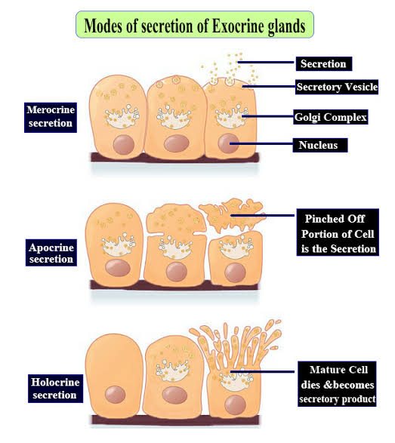
Notes:
Apocrine glands:
They store their secretory product on the secreting cell's apical surface.
The portion pinches off from the rest of the cell to release the secretion.
For example- mammary glands that secrete milk
Exocrine gland:
Exocrine glands are comprised of an acinus and a duct with different cell types, respectively.
Exocrine glands secrete their products in the duct system, as happens in the case of enzymes, milk, sebum, or sweat.
Merocrine glands:
Merocrine gland is a type of exocrine gland in which the secretory products are released without resulting in any damage to the cell
These glands' secretions are produced on ribosomes connected to the rough endoplasmic reticulum.
The secretory products are processed, sorted, and packaged by the Golgi complex and then exocytosed from the cell in secretory vesicles.
Example - salivary gland
Holocrine glands:
In the cytoplasm of holocrine gland cells, a secretory product accumulates.
The secretory cell ruptures and becomes the secretory product as it grows.
Example - sebaceous gland of the skin

Slide 3
Histology of sebaceous gland
Lobulated structures mostly connected to hair follicles
Distributed all over the skin with exception of palms, soles and dorsum of the feet
Have outer cuboidal or flattened, basophilic germinative cells that differentiate, move inward and accumulate intracytoplasmic lipid droplets, causing multivacuolation and indentations of nuclei
Excretory ducts are lined by keratinizing squamous epithelium

Slide 4
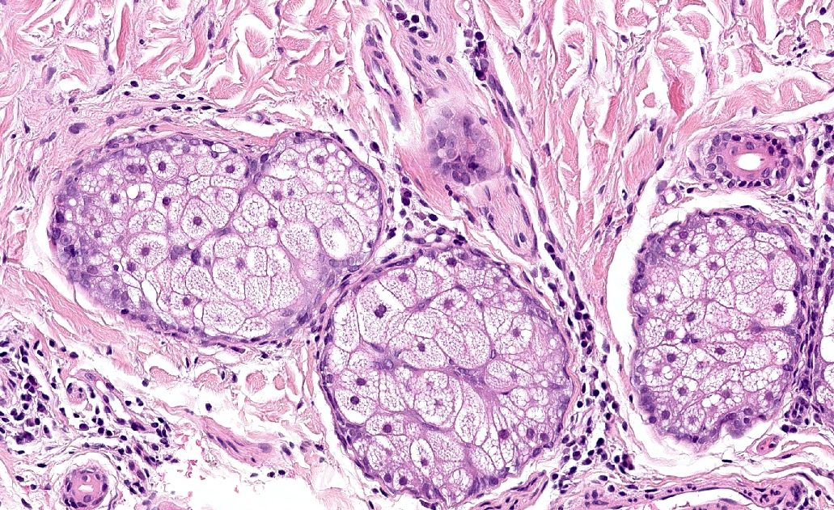
Notes:
Sebaceous gland: germinative cells are flattened and basophilic. Towards the center, cells mature and acquire a vacuolated cytoplasm. Shave biopsy; H&E; face.

Slide 5
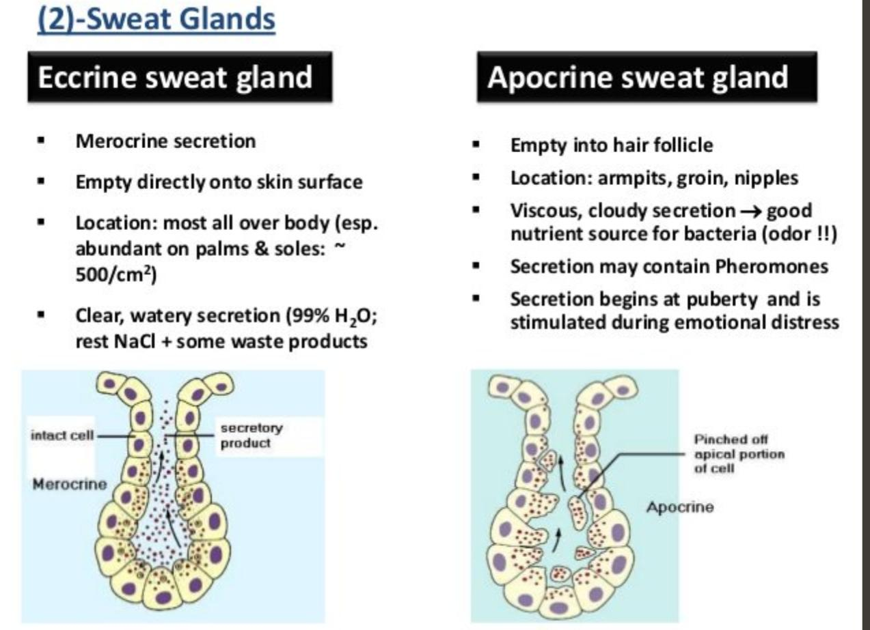

Slide 6
Eccrine Sweat glands
  2 components
    Secretory
      Located deep in the dermis or subcutis
      Has an outer layer of myoepithelial cells
      Also possesses an inner layer of large clear pyramidal cells (secrete water) and smaller darker cells (secrete glycoproteins, mostly line the luminal surface)
    Ductal
      Opens directly into the epidermis
      Composed of a double layer of basophilic cuboidal cells
      Luminal surface is lined by an eosinophilic cuticle
      Divided in 4 subunits: coiled secretory unit, coiled dermal duct, straight dermal duct, coiled intraepidermal duct (acrosyringium)

Slide 7
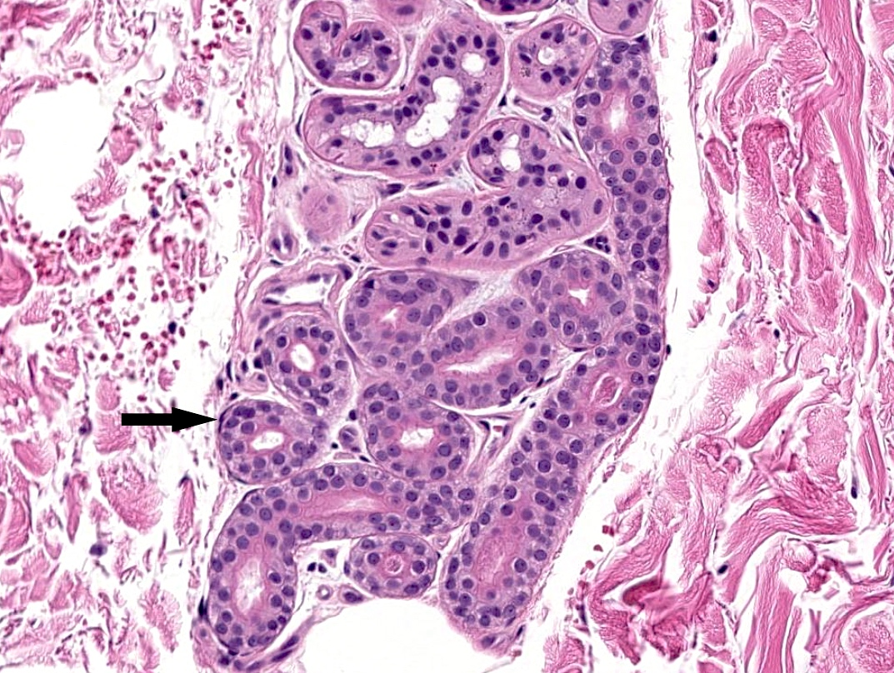
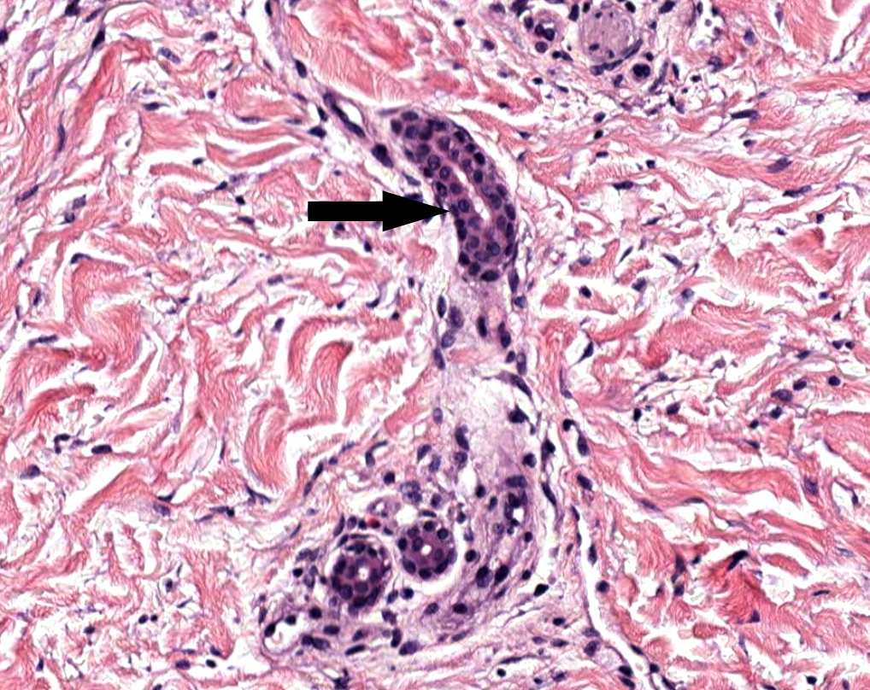
Notes:
Eccrine glands located in the deep reticular dermis and subcutaneous fat. Myoepithelial cell (arrow). Punch biopsy; H&E; trunk.
Coiled duct of an eccrine gland. Punch biopsy; H&E; trunk

Slide 8
Apocrine Sweat glandS
Apocrine sweat glands
  Empty into the follicle above the sebaceous duct
  Includes 2 components
    Secretory
      Located in the deep dermis or subcutis
      Possesses an outer layer of myoepithelial cells and an inner layer of cuboidal to columnar eosinophilic cells
      Shows luminal "decapitation" secretion
    Ductal
      Connects with the pilosebaceous follicle
      Composed by a double layer of cuboidal cells
      Histologically indistinguishable from eccrine ducts

Slide 9
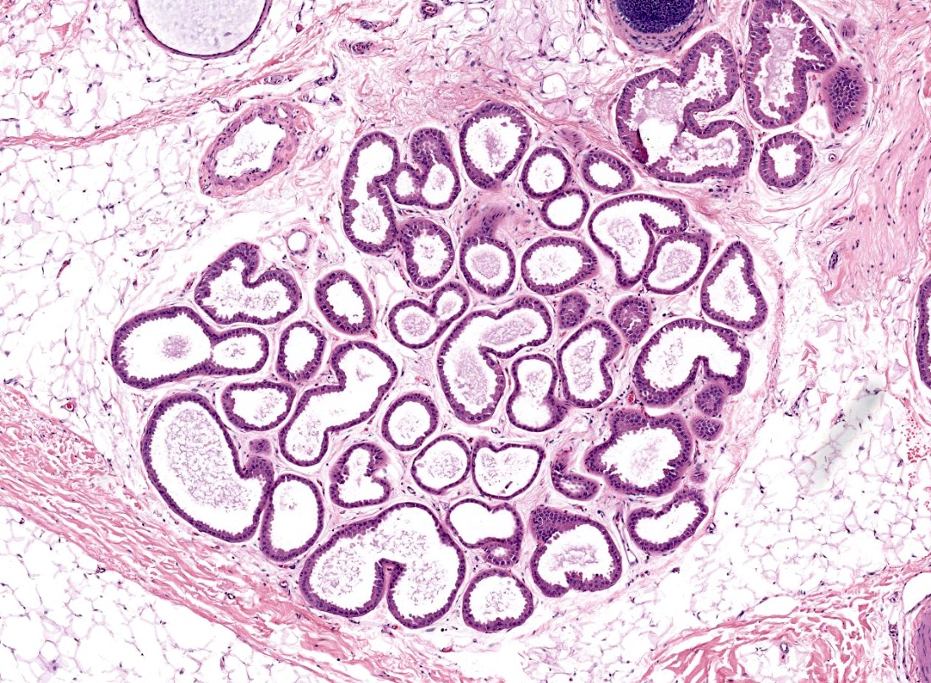
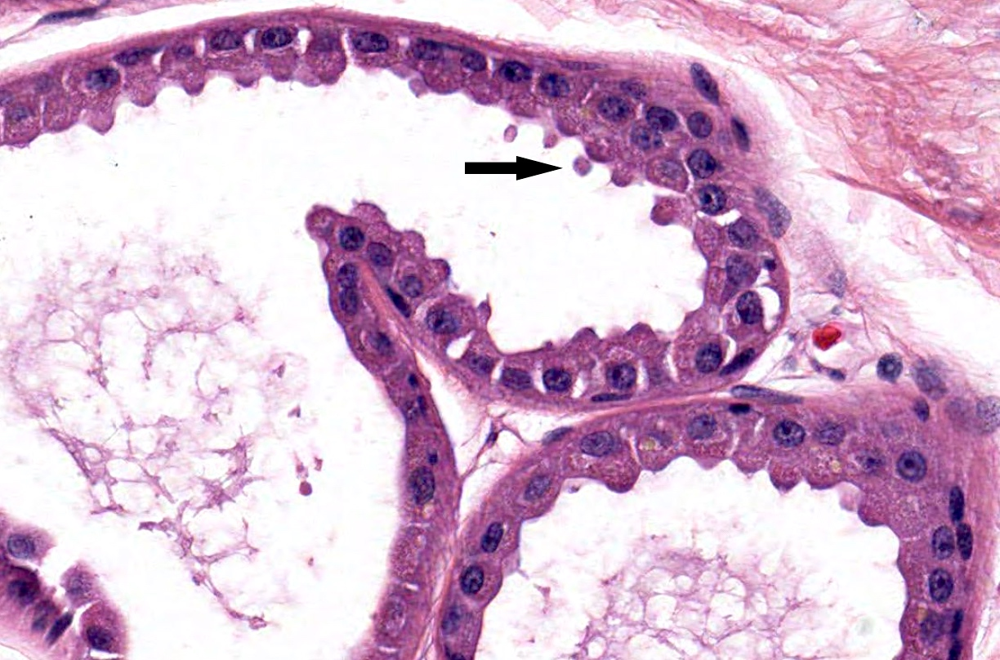
Notes:
Apocrine glands in the subcutaneous fat. Punch biopsy; H&E; axilla.
Apocrine gland with decapitation secretion. Punch biopsy; H&E; axilla.

Slide 10
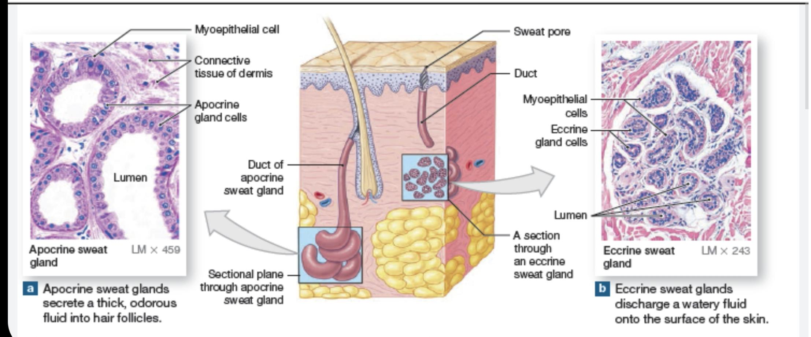

Slide 11
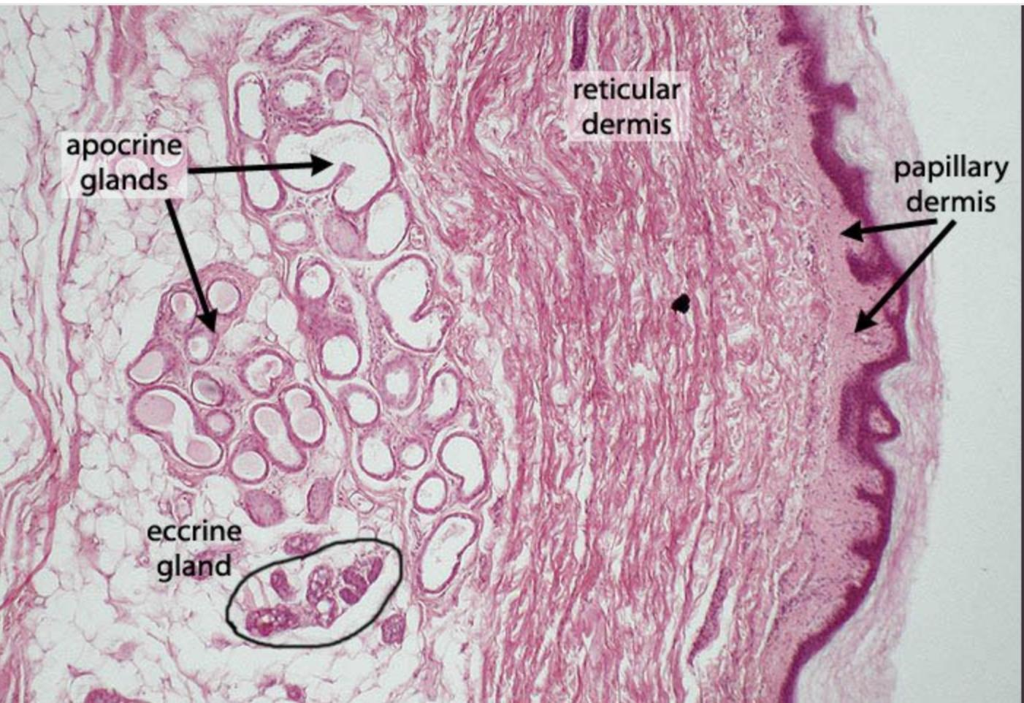
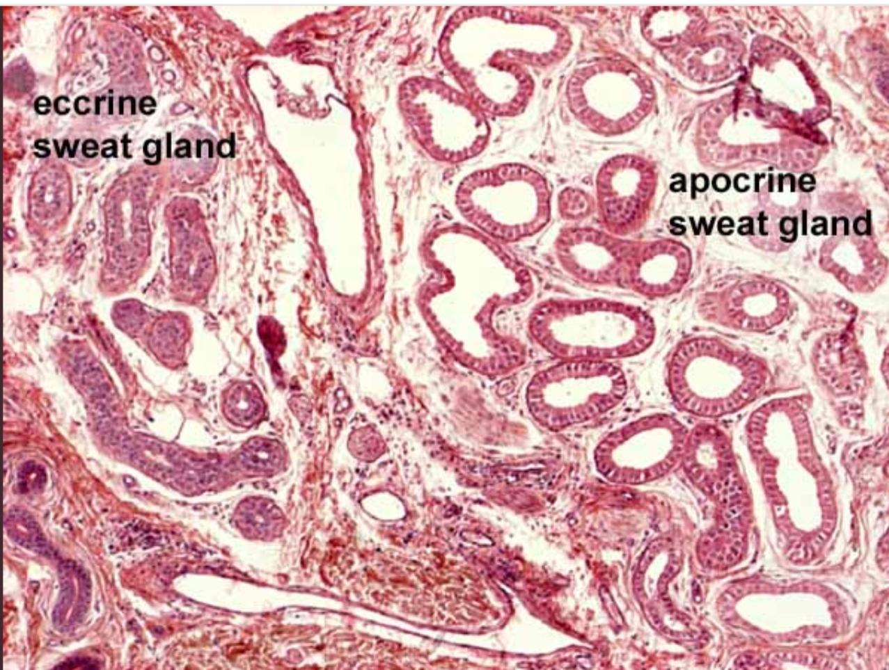

Slide 12
Sebaceous nevus
Congenital, organoid epidermal nevus on scalp and face
Yellow, greasy-appearing
“Cobblestone” texture
Hairless
Histology
Hamartoma composed of large sebaceous glands, heterotopic apocrine glands, defective hair follicles, acanthosis and epithelial papillomatosis

Slide 13
In infancy or early childhood
Immature and abnormally formed pilosebaceous units.
Mild acanthosis and mild papillomatosis.
During puberty
Lesions enlarge clinically as well as microscopically
Prominent sebaceous glands
Located deep in the dermis.
Increased number of sebaceous lobules and malformed ducts .
Immature vellus hairs
The epidermis becomes more papillated and acanthotic.
ectopic apocrine glands or eccrine hyperplasia.

Slide 14
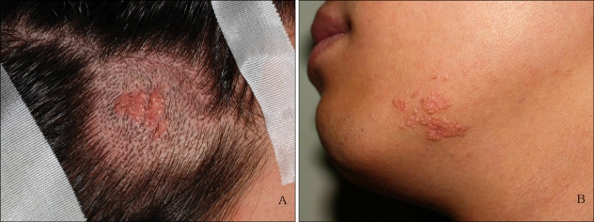

Slide 15
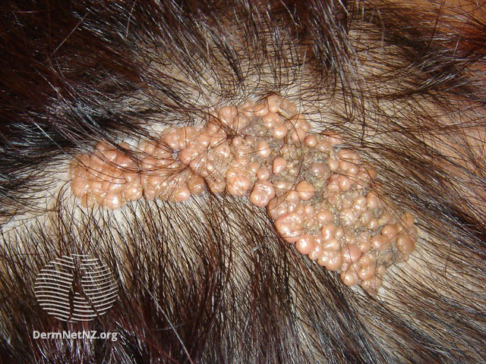

Slide 16
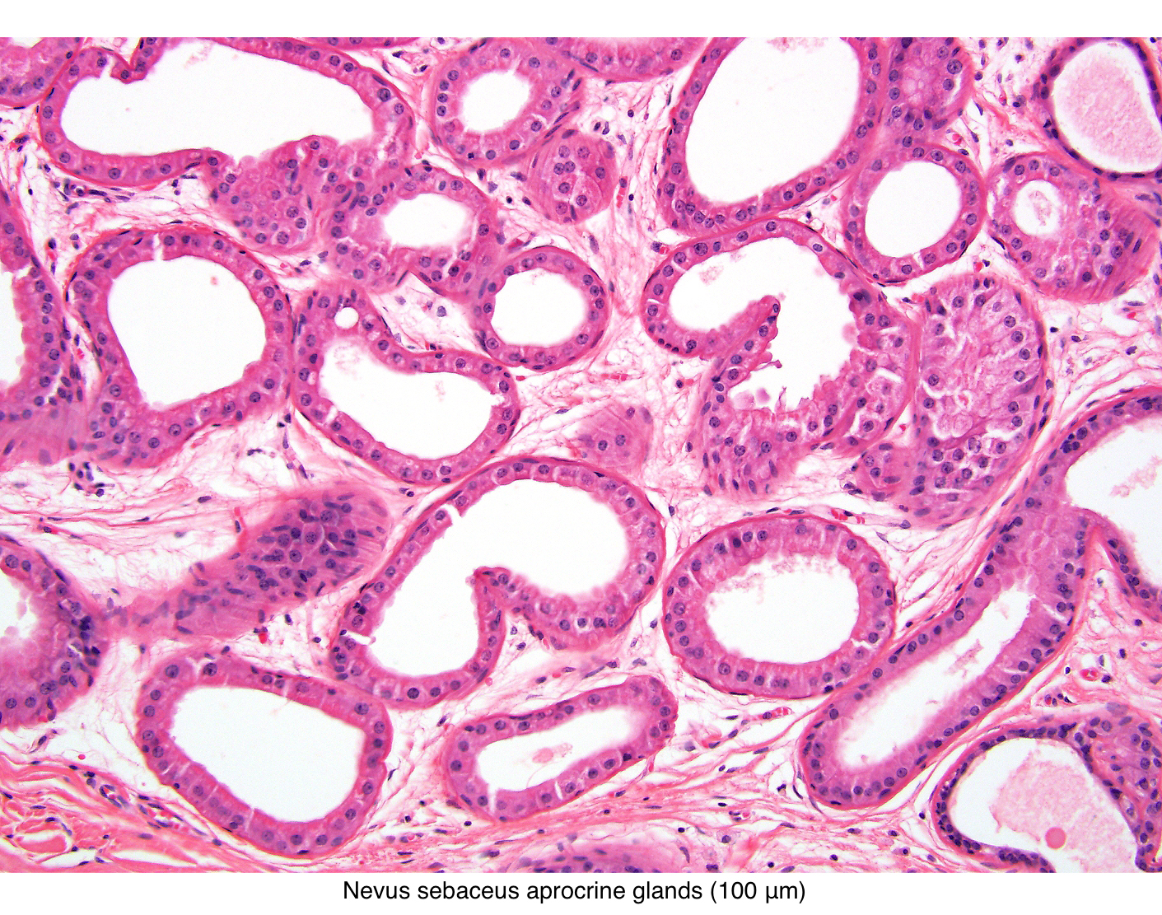
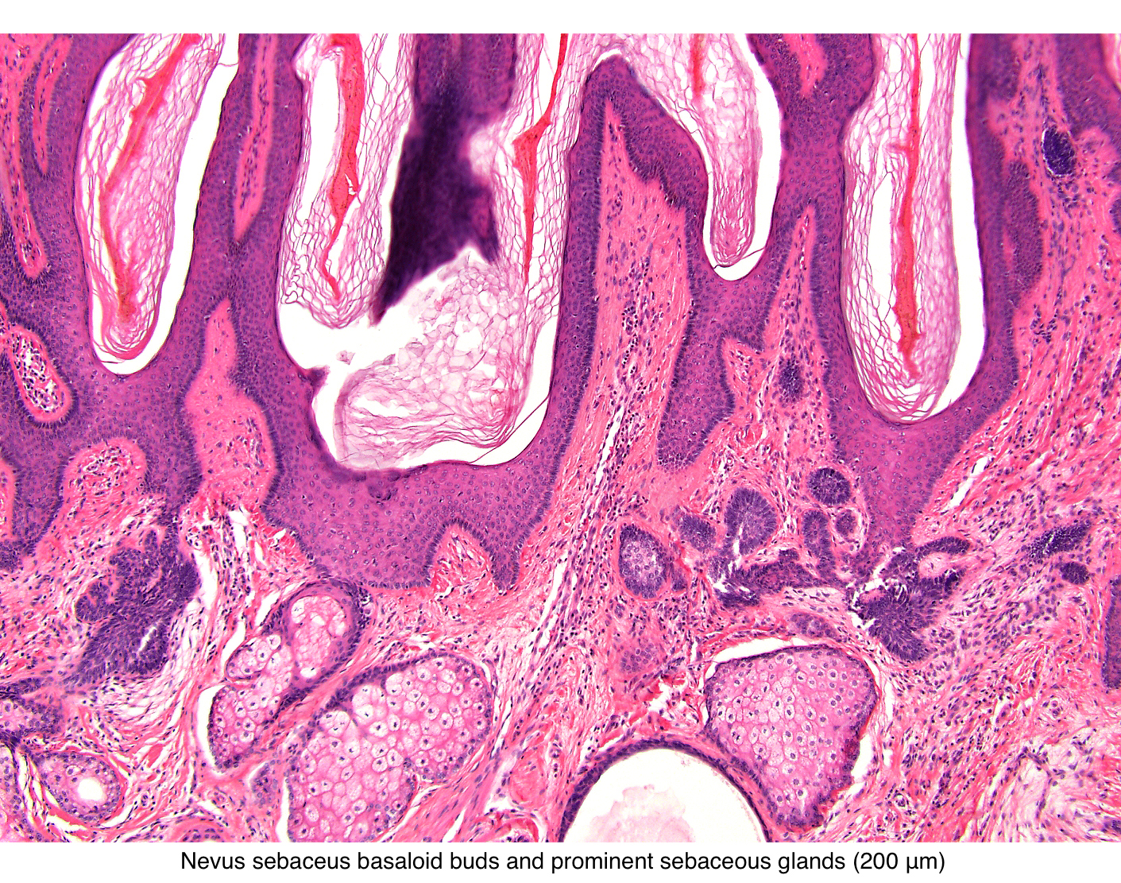

Slide 17
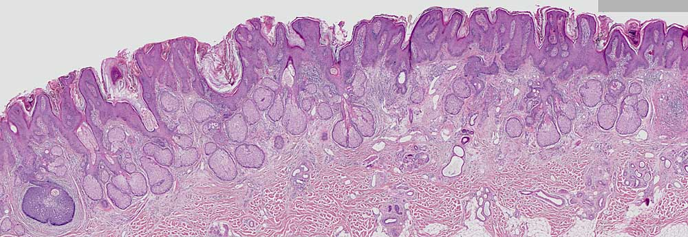
Acanthosis and papillomatosis. Increased number of sebaceous glands.

Slide 18
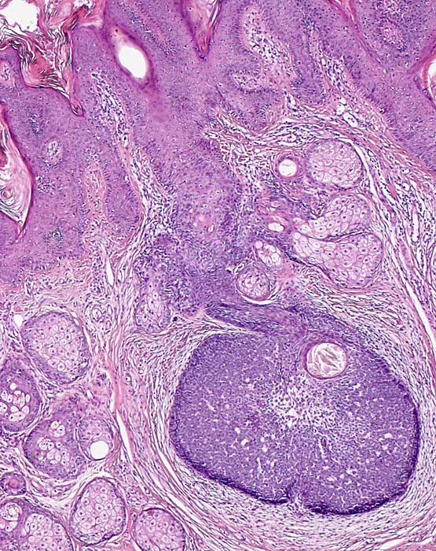

Slide 19
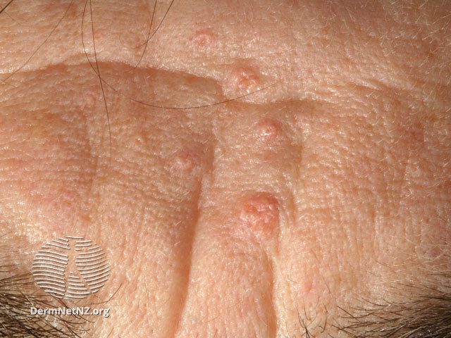
Sebaceous hyperplasia
Most common sebaceous gland lesion
Usually elderly patients on nose or cheeks
Umbilicated yellowish papules
Histology reveals expansion of normal lobular sebaceous gland architecture without thickening of peripheral germinative layer of seboblasts

Slide 21
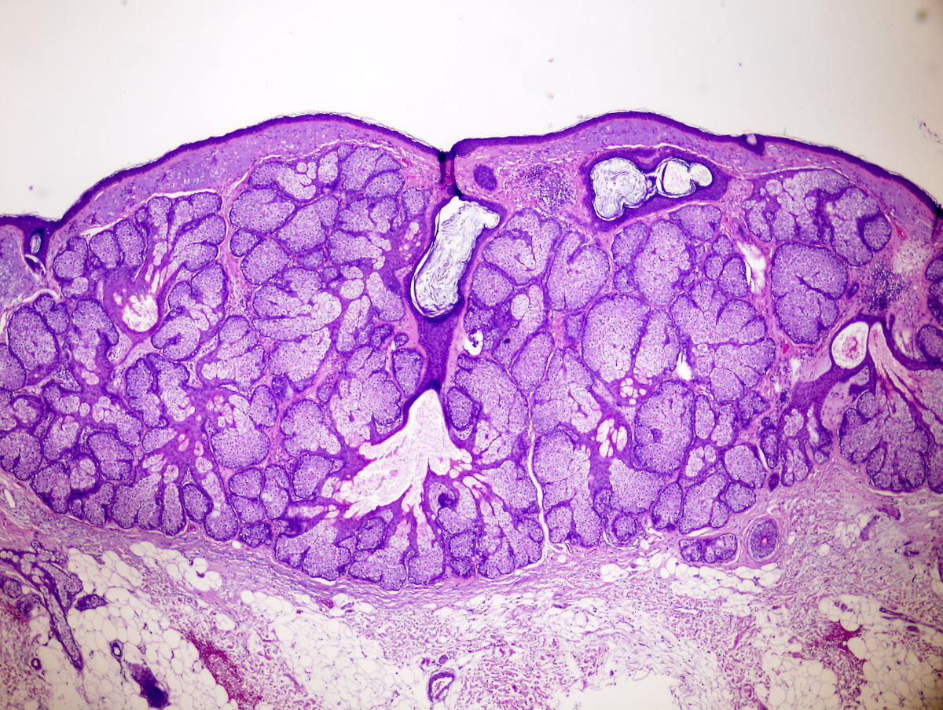

Slide 22
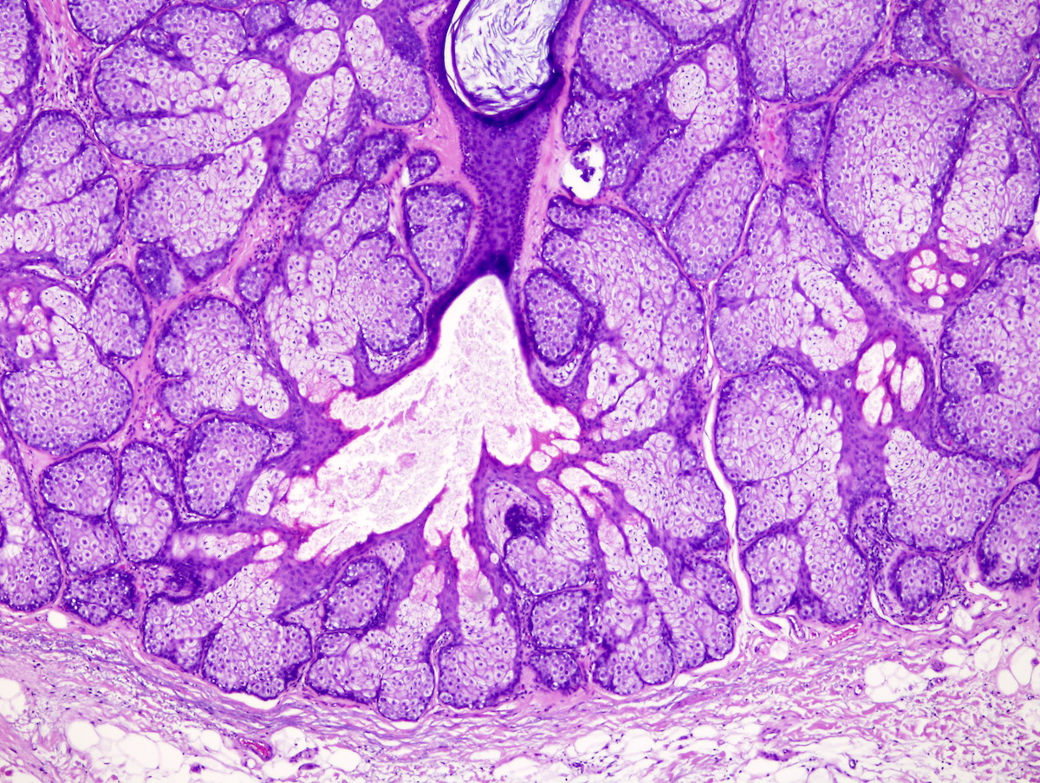

Slide 23
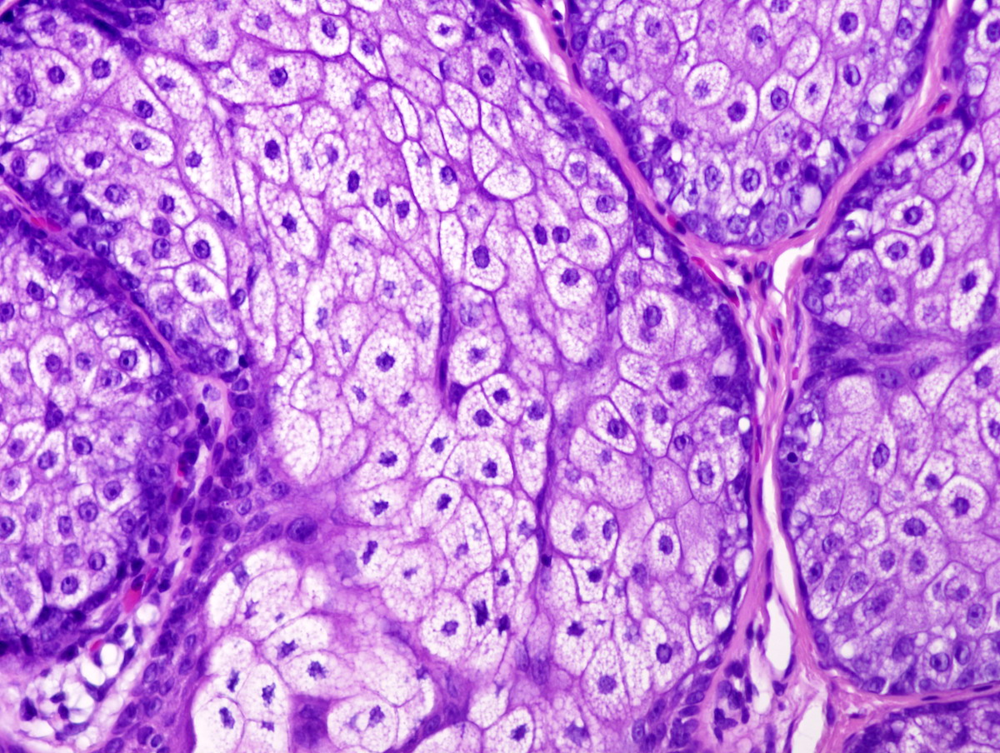

Slide 24
Sebaceous adenoma
Well circumscribed, multilobulated tumor
Increased number of basaloid germinative cells of more than 2 layers
basaloid germinative cells are usually at the periphery and the sebaceous cells are located centrally with intracytoplasmic vacoules
Well circumscribed, nodular growth of lobules consist of admixture of basaloid cells and mature sebocytes
Some lobules may communicate directly with the surface epithelium
Basaloid cells are composed of expanded germinative layer, with more than the normal 2 cell layers seen in mature sebaceous glands or sebaceous hyperplasia but still less than 50% of the tumor volume (> 50% is seen in sebaceoma / sebaceous epithelioma)
Increased mitotic activity is sometimes seen in the basaloid cell component
Notes:
Differential diagnosis
Sebaceous hyperplasia:
Hyperplastic sebaceous lobules
Located slightly higher in the dermis than normal
Individual lobules are increased in number but are not significantly different in size compared to normal
Basaloid layer is not expanded
Sebaceoma / sebaceous epithelioma:
Tumor consists of a random admixture of basaloid cells and mature sebocytes with loss of regular maturation that is seen in sebaceous adenoma
No nuclear pleomorphism and mitotic activity is generally sparse; however, it can sometimes be prominent
No peripheral palisading or cleft formation
Sebaceous carcinoma:
Significant nuclear pleomorphism, nucleolar prominence and conspicuous mitotic activity
Although in well differentiated variants, the tumor may have a smooth regular margin
Less well differentiated examples typically show an infiltrating border
Basal cell carcinoma with sebaceous differentiation:
Features of basal cell carcinoma with proliferation of palisading basaloid cells, retraction artifact and loose mucinous stroma
Within these nodules are foci of variable numbers of mature sebocytes
EMA- and BerEP4+ (Can J Ophthalmol 2014;49:326)
Trichoblastoma with sebaceous differentiation:
Papillary mesenchymal bodies are often present
Peripheral nuclear palisading and stromal induction are also generally present
Balloon cell melanoma:
Positive S100 protein, HMB45 or MART1
Other lesions with clear cell differentiation (e.g., metastatic renal clear cell carcinoma)

Slide 25
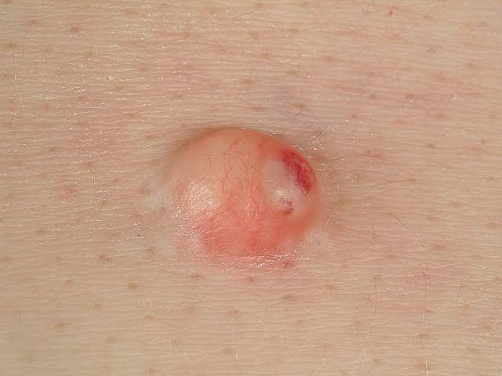
Clinically presents as a yellow or pink-tan papule or nodule
Notes:
Look at sebaceous hyperplasia on high power - Single layer of basaloid cells in periphery, likenormal sebaceous glandsIn sebaceoma and sebaceous adenoma, there is increase in basaloid cells within the lobules< 50 % of the lobules = Sebaceous adenoma.> 50 % = Sebaceoma (some books call these sebaceous epithelioma)

Slide 26
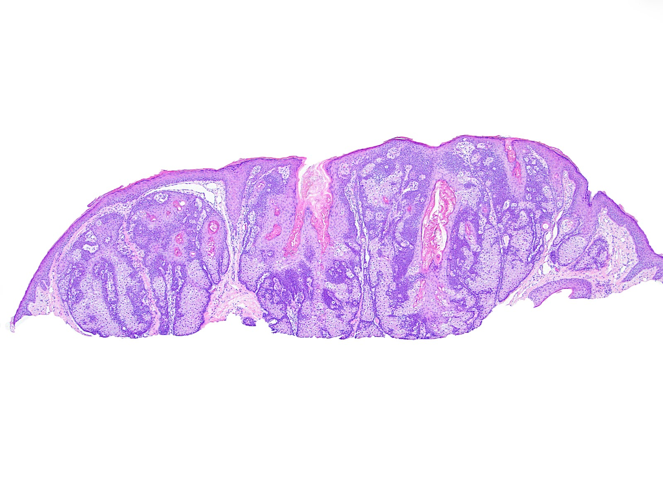
Notes:
Superficial basaloid lobular proliferation with peripheral dark areas and central light areas.
Lobules are well circumscribed, composed of > 50% well differentiated clear cells with surrounding basaloid cells that are > 2 cell layers. Many lobules open directly to the epidermis.

Slide 27
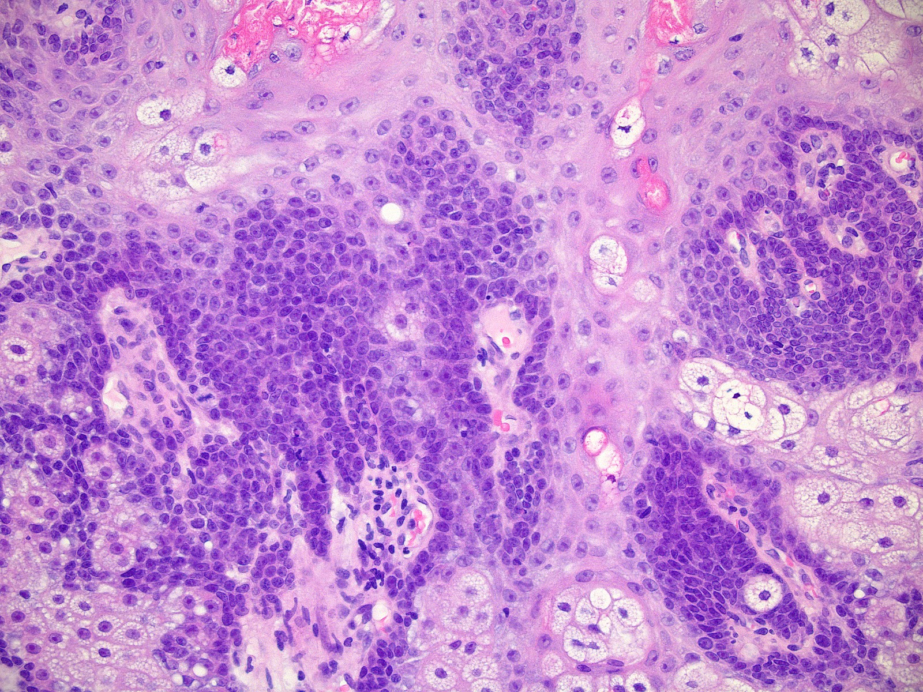
Notes:
Clear cells contain intracytoplasmic lipid vacuoles that indent on a centrally placed nucleus, which is characteristic of sebaceous differentiation. Mitotic activity is conspicuous in the surrounding basaloid cell layer but no significant atypia is appreciated.

Slide 28
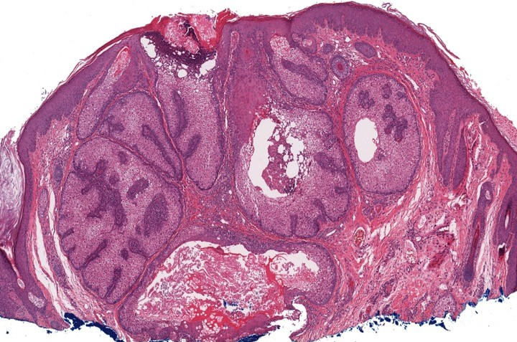
Notes:
Well circumscribed sebaceous neoplasm containing lobules of bland appearing mature adipocytes, which empty directly to the skin surface without associated hair follicles.

Slide 29
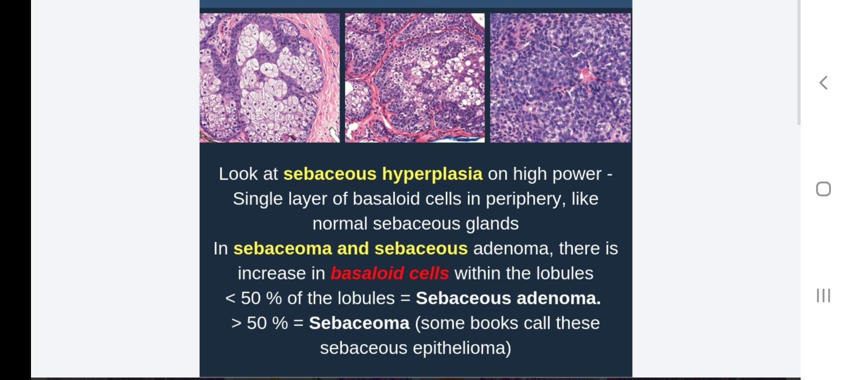

Slide 30


Slide 31
Apocrine HyDrocystoma
intradermal, moderately firm, dome-shaped, translucent, blue, bluish-black or purple cystic nodule up to 1 cm
multilocular cystic space within dermis
Fibrous pseudocapsule is often present
cystic spaces are lined by double layer of epithelial cells:
an outer layer of flattened vacuolated myoepithelial cells
an inner layer of tall columnar cells with eosinophilic cytoplasm ,basally round or oval vesicular nuclei
Decapitation secretion is present
adjacent to hyperplastic apocrine glands
Notes:
Eccrine and apocrine hidrocystomas may have similar clinical appearances and tend to be distributed throughout eyelid skin. However, the eccrine type usually does not involve eyelid margins whereas the apocrine type may. The eccrine type tends to produce watery secretions whereas the apocrine type tends to produce oily, foamy secretions. The types also may be differentiated by histopathologic examination. Eccrine hidrocystomas have a single cystic cavity, which contains no papillary projections and is lined by one or two layers of small, cuboidal epithelial cells that secrete into the glandular lumen. Apocrine hidrocystomas demonstrate multiple cystic spaces, papillary projections, and an outer wall of myoepithelial cells.

Slide 32
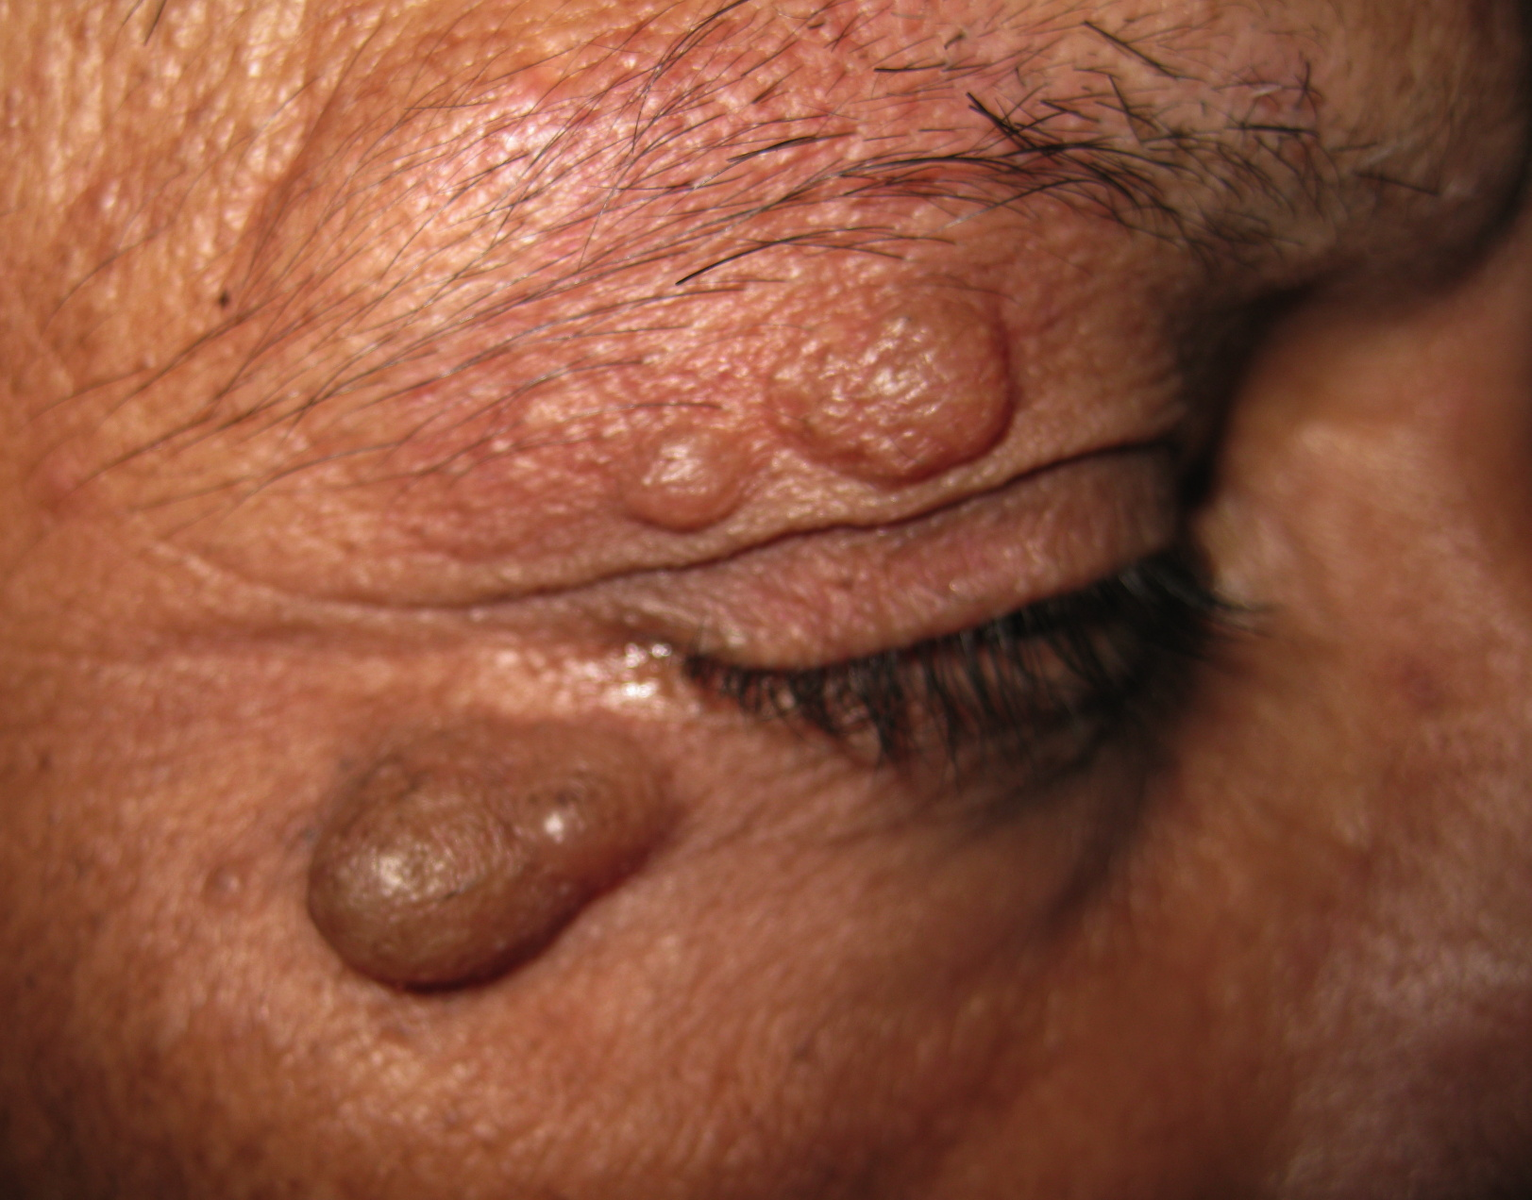
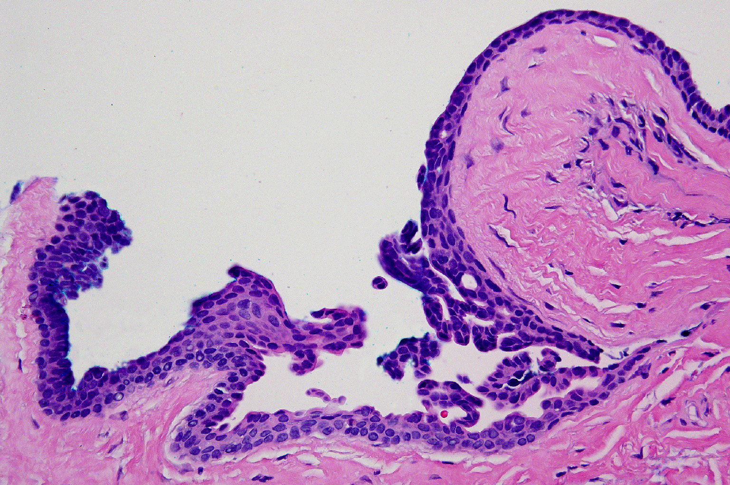
Notes:
Multiple, soft, fluctuant, translucent, skin-colored 1-2 cm nodules were present around the eyes: one on the left upper eyelid, two on the right lower eyelid, and two on the right upper eyelid.
There is a cyst lined by papillated epithelium of predominantly two cell layers. Luminal cells have eosinophilic cytoplasm and exhibit decapitation secretion.

Slide 33
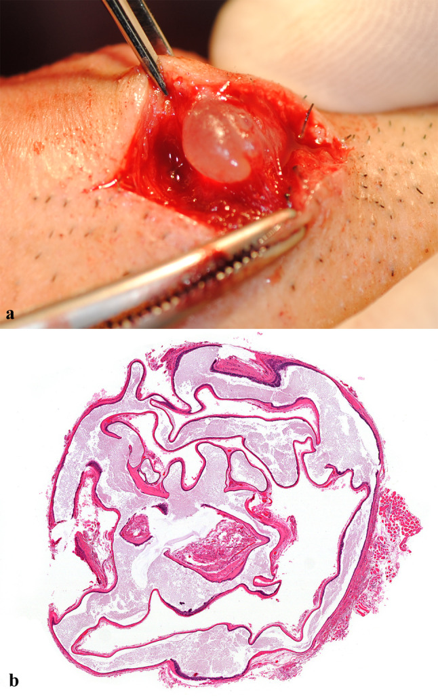
Notes:
Surgical and microscopic features of the lesion. a A cystic lesion with capsule preserved in subepidermis. b The survey view of the resected specimen shows an encapsulated multi-loculated solid cyst and irregular cystic space with eosinophilic fluids (

Slide 34
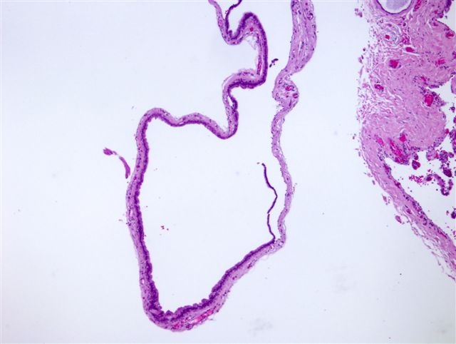
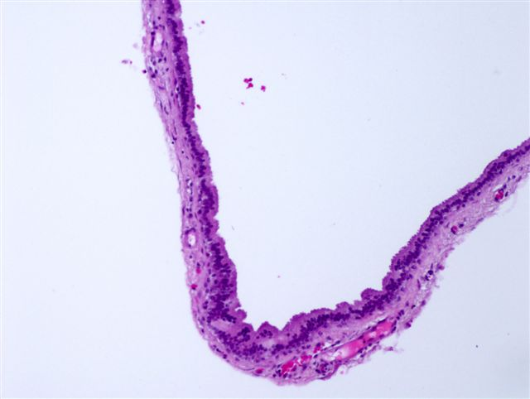

Slide 35
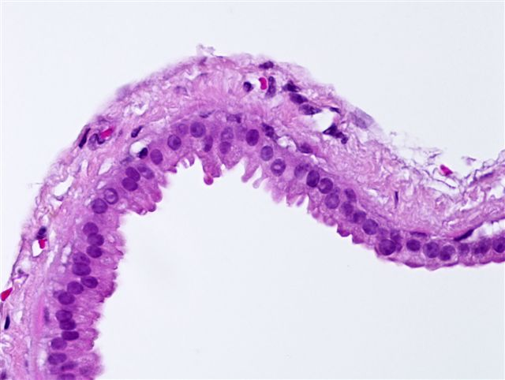

Slide 36
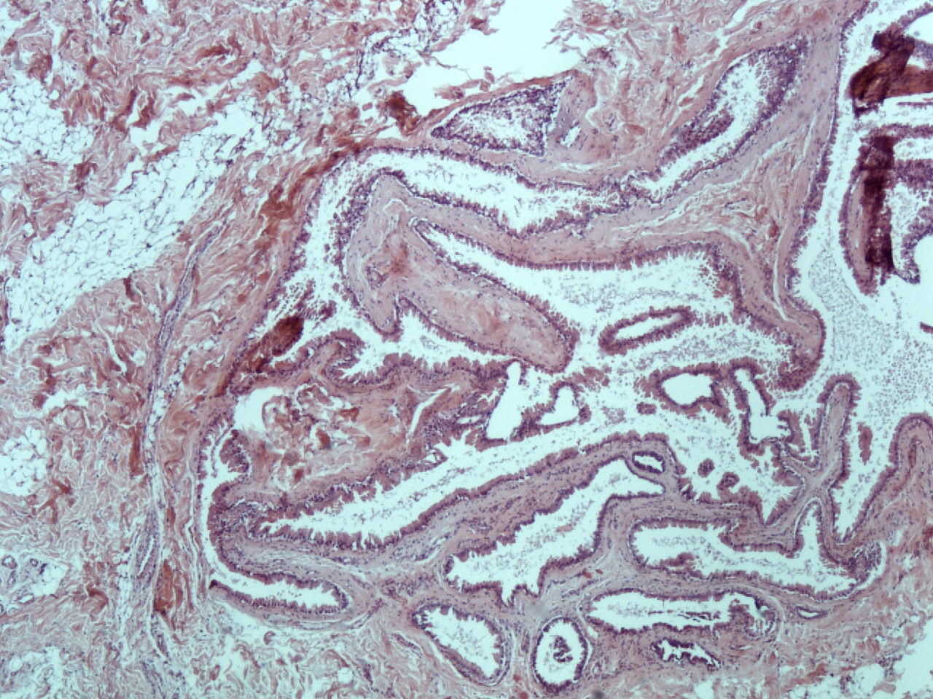

Slide 37
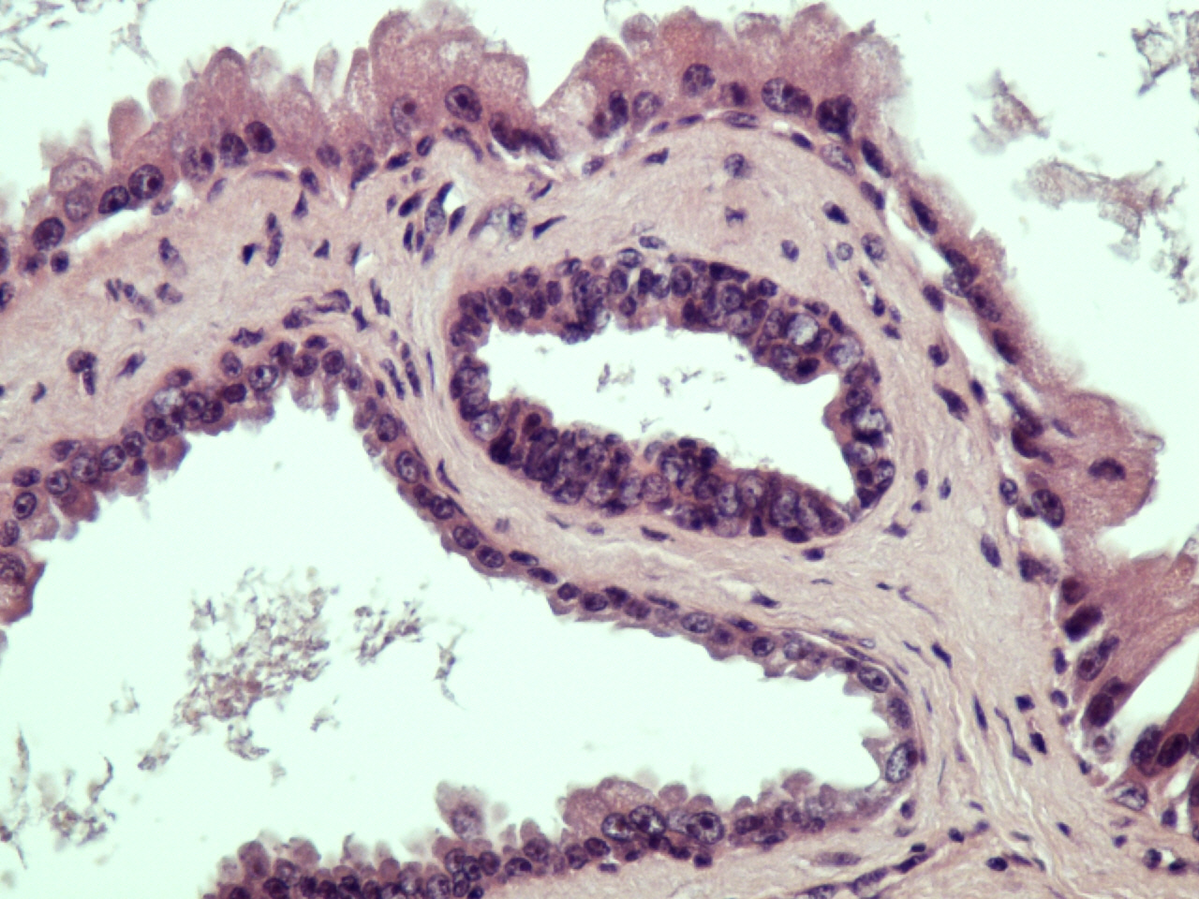

Slide 38
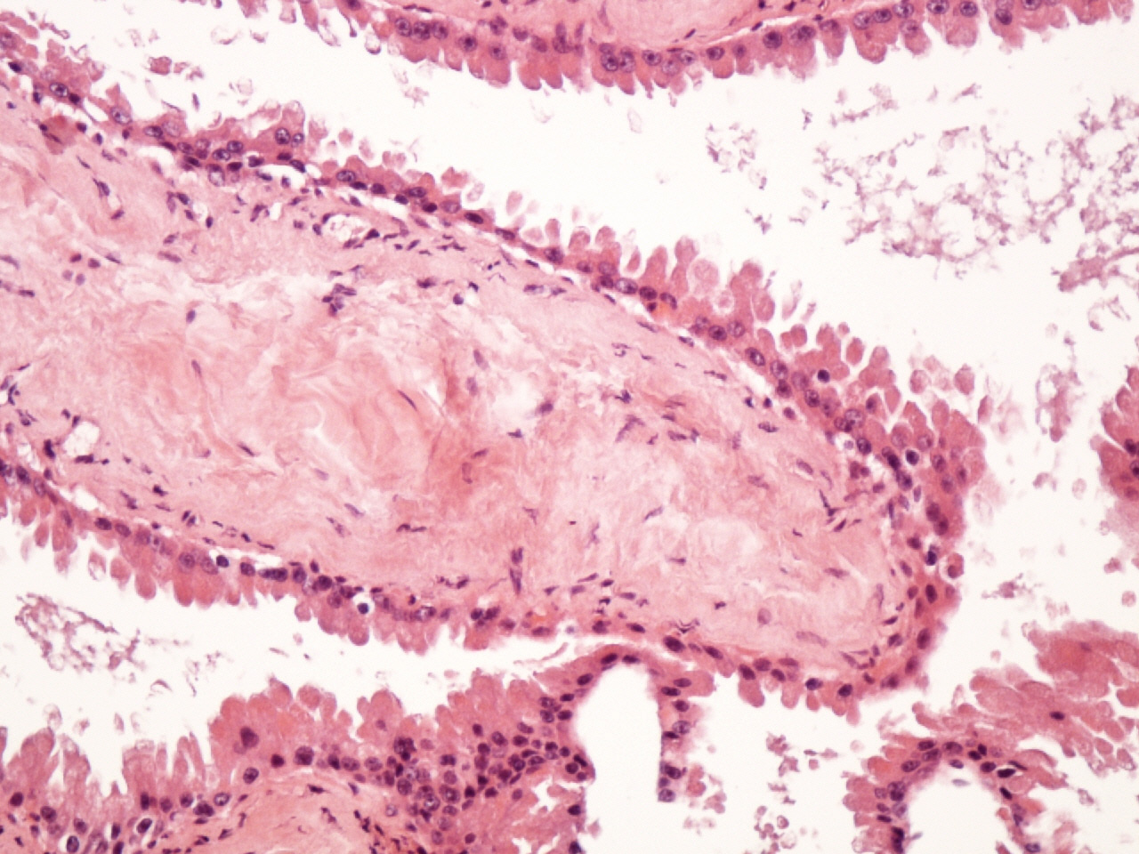

Slide 39
Eccrine hydrocystoma
cystic lesion( derived from cystic retention of native eccrine glands).
A cystic space occupies the dermis which may be unilocular .
The cystic space is lined by a thin epithelial layer consisting of 1–2 layers. The cells have slightly eosinophilic cytoplasm, which is bilaminar
Prominent luminal blebbing ('apocrine snouts') is absent.

Slide 40
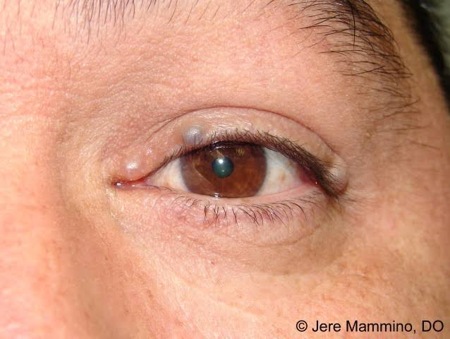

Slide 41
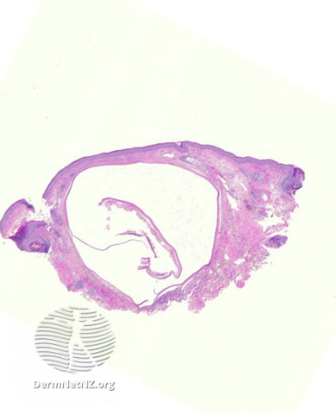

Slide 42
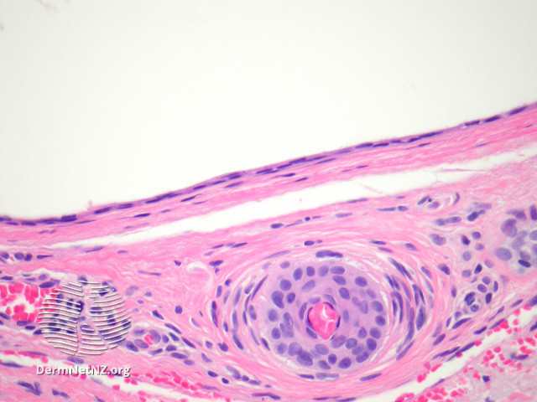

Slide 43
Clinical characteristics | Eccrine hidrocystoma | Apocrine hidrocystoma
Location | Face: periorbital, malar area | Face: eyelid (inner canthus)
Size | 1 to 6mm | 3 to 15mm
Color/consistency | Flesh-colored, translucent | Translucent, bluish-black
Number of lesions | Solitary or multiple (Robinson-type) | Solitary

Slide 44
Histologic characteristics | Eccrine hidrocystoma | Apocrine hidrocystoma
Cyst number | Unilocular | Often multilocular
Cyst lining | 2 layers of cuboidal epithelium | 1 to 2 layers: inner secretory and outer myoepithelial cells
Decapitation secretion | Absent | Present
Papillary projections | Absent | Present
S100 stain | Positive staining (solitary but not multiple, Robinson type) | No staining
PAS-positive granules | Absent | Present

Slide 45
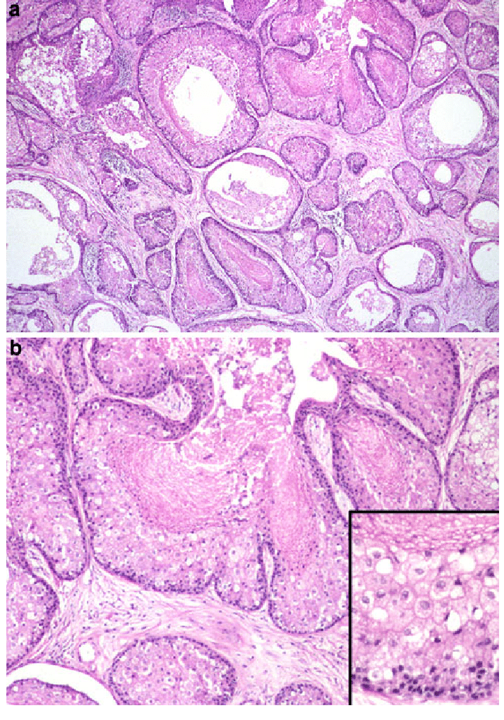
Notes:
Sebaceous adenoma is composed of variably-sized and shaped nests of sebaceous cells with areas of cystic change. b Higher power of a demonstrating vacuolated cytoplasm with central holocrine secretory material. Inset: High-power detail of sebaceous cyst lining

Slide 46
Thank you

Slide 47


