Slide 1


Slide 2
Cutaneous Histiocytosis
Dr. SANIA BUTT
PGR Derma

Slide 3
What are Histiocytes?
Cells of mononuclear phagocyte system
Common bone marrow progenitor cell (NM-CFU)
2 types
Professional phagocytes
APC (Langerhan cell)

Slide 4
Histiocytes (cont.)
Monocytes arising from NM-CFU migrate to tissues
In tissues, differentiate in histiocytes
LCs originate from fetal liver-derived monocyte precursors

Slide 5
Histiocytosis
Abnormal increase in num of specialized WBCs (histiocytes)
Mild to disseminated or life-threatening

Slide 6
Classification
Class I: Langerhans' cell histiocytosis
(Dendritic/Non-dendritic)
Class II: Non-Langerhans' cell histiocytosis (Dendritic/Non-dendritic)
Class III: Malignant histiocytosis

Slide 7
LCH
Dendritic
1.Letterrer-Siwe disease
2.Hand-schuller-Christian disease
3.Eosinophilic granuloma
4.Hashimoto-Pritzker disease
Non-Dendritic
Familial HLH
Secondary HLH

Slide 8
Letterer-Siwe disease | Hand-Schuller-Christian disease | Eosinophilic granuloma | Hashimoto-Pritzker disease
children(<2) Organs; bones, lung, liver, lymph nodes Skin; scalp, neck, armpits, groin & trunk May be Nails, palms & soles. Pinkish small papules/ blisters (crusted or infected) look like (cradle cap) | children aged 2–6 years very persistent Skin; Pinkish crusted papules. Mucosa; Ulcers in mouth or genitals Triad= Diabetes insipidus+ Bone lesions(skull) +Protruding eyes (rare) | School going children Usually single bone lesion Skin; less common, reddish-brown crusted papules | Congenital self-healing reticulohistiocytosis At birth Skin; widespread reddish-brown lumps → break down → crusts → heal spontaneously No other organs

Slide 9
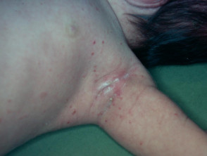
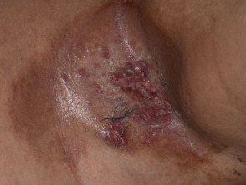
Letterer-Siwe disease

Slide 10
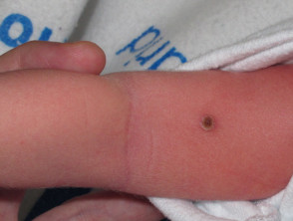
Hand-Schuller-Christian disease

Slide 11
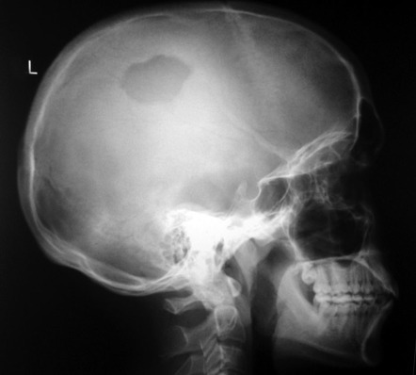
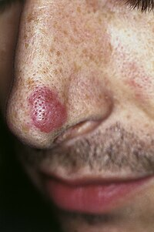
Eosinophilic granuloma

Slide 12
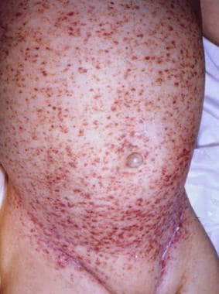
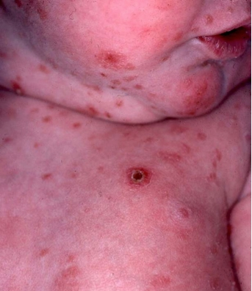
Hashimoto-Pritzker disease

Slide 13
Investigations
Blood tests
CBC with ESR, CRP
LFTs, RFTs, S/E
Coagulation studies
Skeletal Survey
Chest X-ray
Biopsy of involved site

Slide 14
Investigations (cont.)
MRI Brain (lytic skull lesions/ diabetes insipidus)
Water deprivation test
HRCT Chest, PFTs
USG Abdomen, Liver biopsy (if abnormal LFTs)

Slide 15
Histopathology of LCH
Partial effacement of lymph node, preservation of follicular centers
Granulomatous lesion
Infiltration of sinuses by Langerhans cells
Foci of necrosis in sinuses
Sinuses surrounded by rim of eosinophils

Slide 16
Treatment
------ Skin LCH in children
Skin-only LCH
1st Line: observation
2nd Line: Topical mid potency corticosteroid
3rd Line: UVB/ PUVA/ Topical tacrolimus or systemic (if severe)

Slide 17
Treatment (cont.)
Skin as part of low risk MS LCH
1st Line: Vinblastine/ prednisolone
2nd Line: Vincristine/ cytarabine ± prednisolone
3rd Line: Cladribine monotherapy
Skin as part of high risk MS LCH
1st Line: Vinblastine/ prednisolone
2nd Line: Cladribine with cytarabine/ clofarabine
3rd Line: HSCT

Slide 18
Treatment (cont.)
----- Skin LCH in adults
Skin-only LCH
Topical steroid/ imiquimod/ nitrogen mustard/ tacrolimus/ sirolimus or I/L steroid
UVB/ PUVA
Surgical excision
Radiation therapy
Systemic therapy

Slide 19
Treatment (cont.)
Skin-only LCH unresponsive to topical/ part of low-risk MS
1st Line:
MTX 20MG PO / SC per week
AZA 2mg/kg PO per day
Thalidomide 100mg PO
IFNα 6MU OD
Combination of IFNα & Thalidomide
Etoposide PO
Zoledronic acid 4mg IV 1-6 months (if multifocal bone)

Slide 20
Treatment (cont.)
2nd Line:
Cytarabine 100mg/m2 IV (days 1-5 every 4 weeks)
Etoposide 100mg/m2 IV (days 1-5 every 4 weeks)
Vinblastine/ prednisolone

Slide 21
Treatment (cont.)
Skin as part of high-risk MS LCH
1st Line: Cladribine/ vinblastine/ prednisolone
2nd Line: Clofarabine
3rd Line: Experimental targeted therapies

Slide 22
LCH-IV
International Collaborative Treatment Protocol for Children & Adolescents With LCH
Stratum I: 1st line tx for MS LCH pts & pts with SS LCH with multifocal bone or CNS-risk lesions.
Stratum II: 2nd line tx for non-risk pts (who fail 1st line or have reactivation).
Stratum III: Salvage tx for risk LCH (pts with dysfunction of risk organs who fail first-line therapy).

Slide 23
LCH-IV (Cont.)
Stratum IV: Stem cell transplantation for risk LCH (pts with dysfunction of risk organs who fail 1st line).
Stratum V: Monitoring & treatment of isolated tumorous & neurodegenerative CNS LCH.
Stratum VI: Natural history & management of other SS LCH (pts who do not need systemic therapy at time of diagnosis).

Slide 24
LCH-IV (Cont.)
Stratum VII (long-term follow up): All pts, regardless of previous therapy, will be monitored for reactivation or permanent consequences once complete disease resolution has been achieved & respective protocol tx has been completed.

Slide 25
Hemophagocytic lymphohistiocytosis
A life-threatening inflammatory syndrome
Hyperactivation of lymphocytes & histiocytes
Primary (familial) HLH/ Secondary HLH

Slide 26
Familial HLH | Secondary HLH
< 1 year Autosomal Recessive No evidence of malignancy | Adults Trigger: Infectious (EBV)/ Autoimmune/ Malignancy
Defects in cell-mediated cytotoxicity pathways | Dysregulated immune responses → lymphocyte & macrophage activation

Slide 27
Clinical Features of HLH
Persistent fever,
Hepatosplenomegaly,
Lymphadenopathy,
Neurologic abnormalities (eg, seizures, retinal hemorrhages, ataxia, altered consciousness/ coma)
Non-specific maculopapular rash

Slide 28
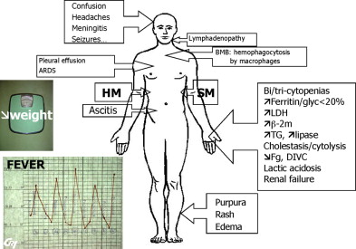

Slide 29
HLH-2004 criteria (updated 2007)
Molecular diagnosis of familial HLH / at least 5 of 8 criteria
1. Fever
2. Splenomegaly
3. Cytopenias (affecting at least 2 lineages in the peripheral blood)
  Hemoglobin < 90 g/L
  Platelets < 100 x 10⁹/L
  Neutrophils < 1.0 x 10⁹/L

Slide 30
HLH-2004 criteria (updated 2007)
4. Hypertriglyceridemia or hypofibrinogenemia
  Fasting triglycerides ≥ 265 mg/dL
  Fibrinogen ≤ 1.5 g/L
5. Documented hemophagocytosis in bone marrow, spleen or lymph nodes
6. Low or absent NK cell activity
7. Ferritin ≥ 500 μg/L
8. Soluble CD25 ≥ 2,400 U/mL

Slide 31
Treatment
Primary HLH
1st Line: High-dose Dexa, etoposide & CsA followed by HSCT
2nd Line: Combination of steroid, CsA & antithymocyte globulin
Salvage therapy: High dose steroid pulse &/ alemtuzumab

Slide 32
Treatment (cont.)
Secondary HLH
1st Line: Steroid ± IV Ig
2nd Line: Addition of etoposide/ CsA
If EBV, consider adding RTX
In MAS, consider addition of TNFi, IL-1i/ anti-IL-5 antibodies

Slide 33
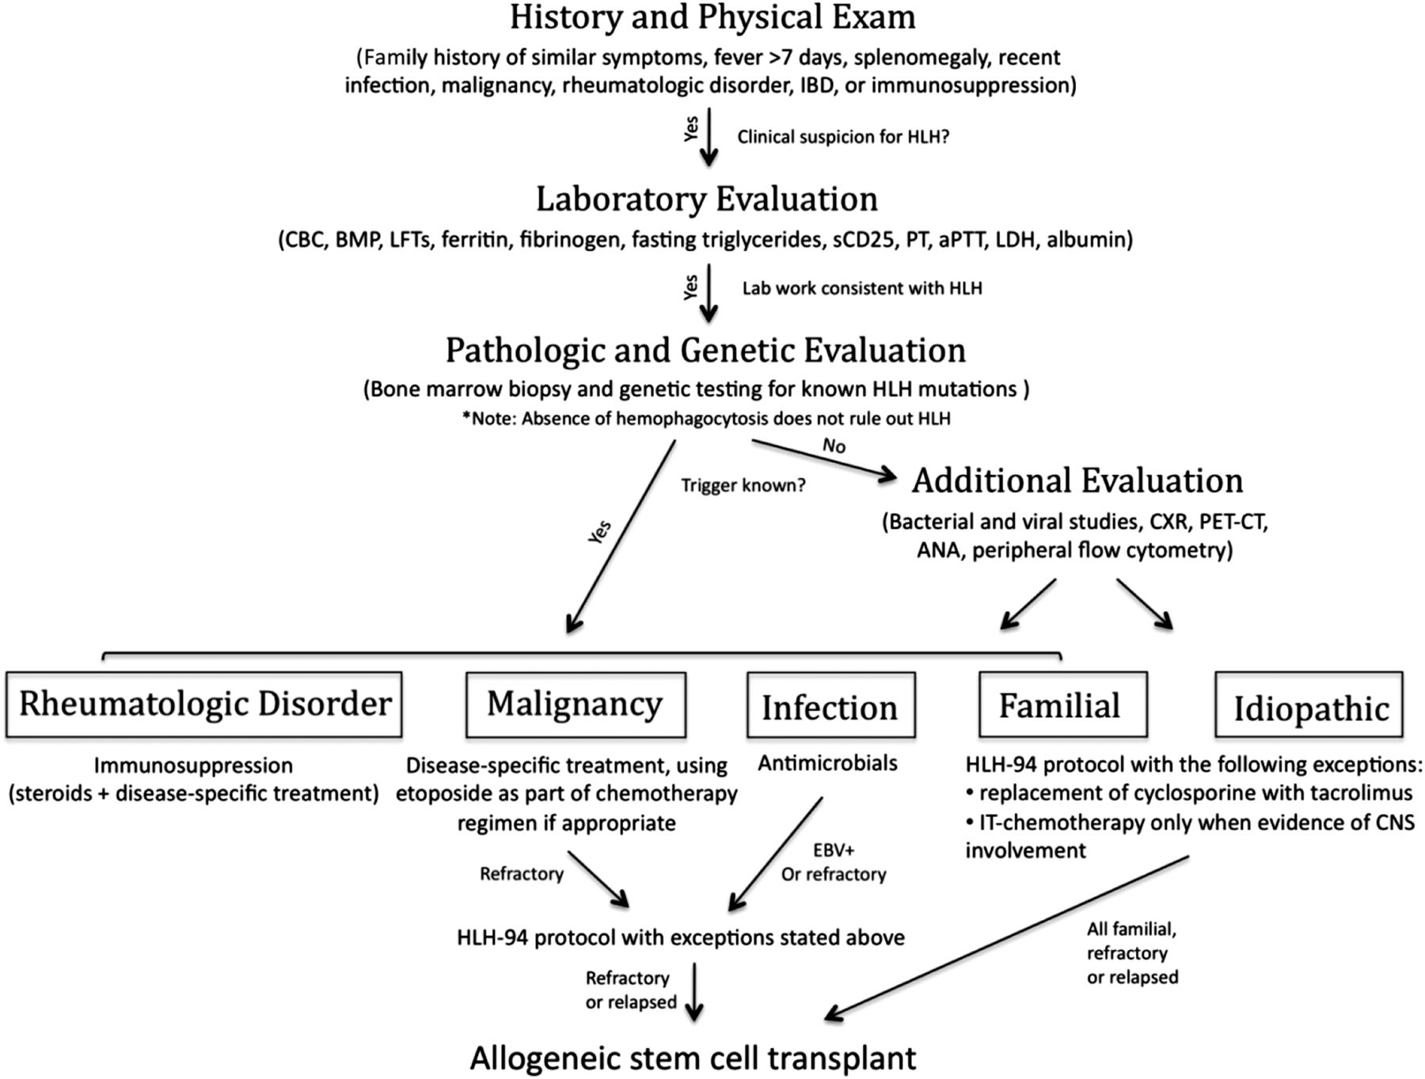

Slide 34
Non-LCHs
Dendritic
Mainly skin
1.JXG
2.BCH
3.GEH
4.Papular xanthoma
5.PNH
6.XD
7.DPX
Systemic predominate
1.ECD
Non-Dendritic
Mainly skin
1.Reticulohistiocytoma
2.Familial sea-blue histiocytosis
3.Hereditary progressive mucinous histiocytosis
4.Malakoplakia
5.NXG
Systemic predominate
1.MRH
2.SHML

Slide 35
Type | General | Etiology | Clinical features | Investigations | Treatment
Juvenile xanthogranuloma | Commonest, infancy (5 mo-1yr) M:F=12:1 | proliferation of factor XIIIa +ive dendritic cells, traumatic/ infectious stimuli | Single to multiple papules/ nodules, red yellow – yellow brown, rubbery | immunohistochemistry | Spontaneous resolution/ surgical excision
Benign cephalic histiocytosis | Benign, 2-66 months | Clinical milder variant of JXG | asymptomatic, erythematous, brown, macules/ papules/ nodules (cheeks → forehead, neck) | Electron microscopy: worm like cytoplasmic inclusions | Self-limiting

Slide 36
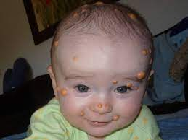
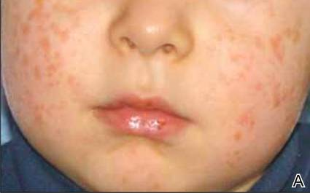
Juvenile xanthogranuloma
Benign cephalic histiocytosis

Slide 37
Type | General | Etiology | Clinical features | Investigations | Treatment
Generalized eruptive histiocytosis | Mainly adults | Reactive, cause not found | rapid onset of crops of asymptomatic small red-brown papules, symmetrical on face, trunk & arms | diffuse, dermal infiltration of monomorphic histiocytes + for CD68 & Ki-M1p | Self-limiting, UV light ±
Papular Xanthoma | Mostly Adults | Not known | Yellow or reddish yellow noncoalescent papules/ plaques | Densely distributed xanthometized macrophage interspersed by numerous Touton giant cells | Spontaneous resolution in children, Not effective in adults

Slide 38
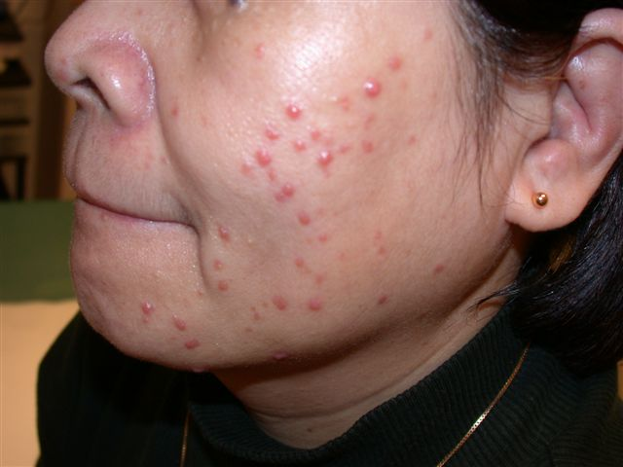
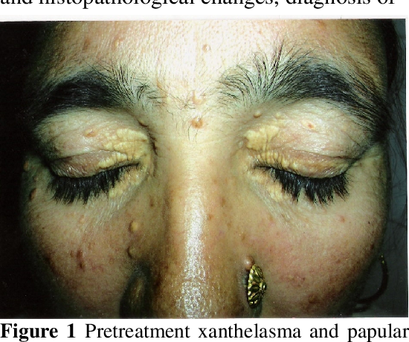
Generalized eruptive histiocytosis Papular Xanthoma

Slide 39
Type | General | Etiology | Clinical features | Investigations | Treatment
Progressive nodular histiocytosis | Benign, middle age to older | unknown | Aysmptomatic progressive yellow orange papules – skin color/ red orange nodules, may occur in mucosa | Xanthomatized & scalloped histiocytes in storiform pattern | No effective tx
Xanthoma disseminatum (Montgomery disease) | Male children, young adults | Pathological immune response by unknown inflammatory triggers | Red- yellow brown papules & nodules, confluent mainly on face & flexures, mucosal & systemic involvement | Inflammatory lipid laden foamy macrophages | 1st: CO2 laser 2nd: surgical excision/ dermabrasion Systemic— 1st: Chemotherpy 2nd: cladribine/ statins/ anti inflammatory

Slide 40
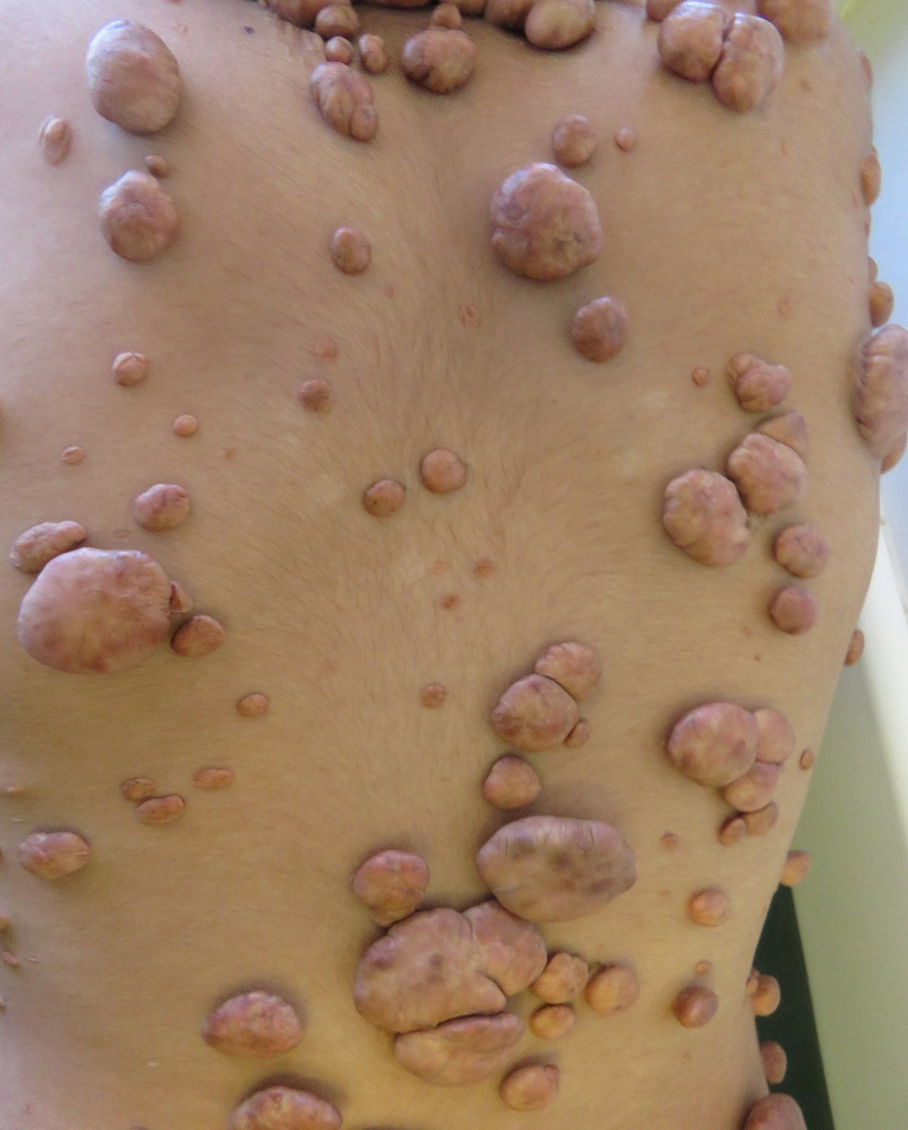
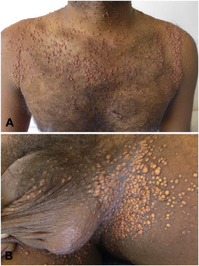
PNH Xanthoma disseminatum

Slide 41
Type | General | Etiology | Clinical features | Investigations | Treatment
Diffuse plane xanthomatosis | Adults | paraproteinaemia → anti lipoprotein antibodies → perivascular complexes | Multiple flat plaque- like xanthomatous lesions, S. lipids= N | Histo: both xanthomatous & inflammatory elements | Tx underlying disease, Excision, chemoabrasion, dermabrasion, ablative laser
Erdheim- Chester disease (uber lipoid granulomatose) | Adults (mean age 53), M:F = 33:26 | BRAF mutation/ RAS signaling pathway abnormality | Asymptomatic to fulminant organ failure, bone pain, constitutional, xanthoma like lesions | Xanthogranulomatous infiltration by lipid laden histiocytes within a mesh & surrounded by fibrosis X-ray: osteosclerosis | Worse prognosis, 60% mortality, IFN α, Imatinib/ Vemurafenib

Slide 42
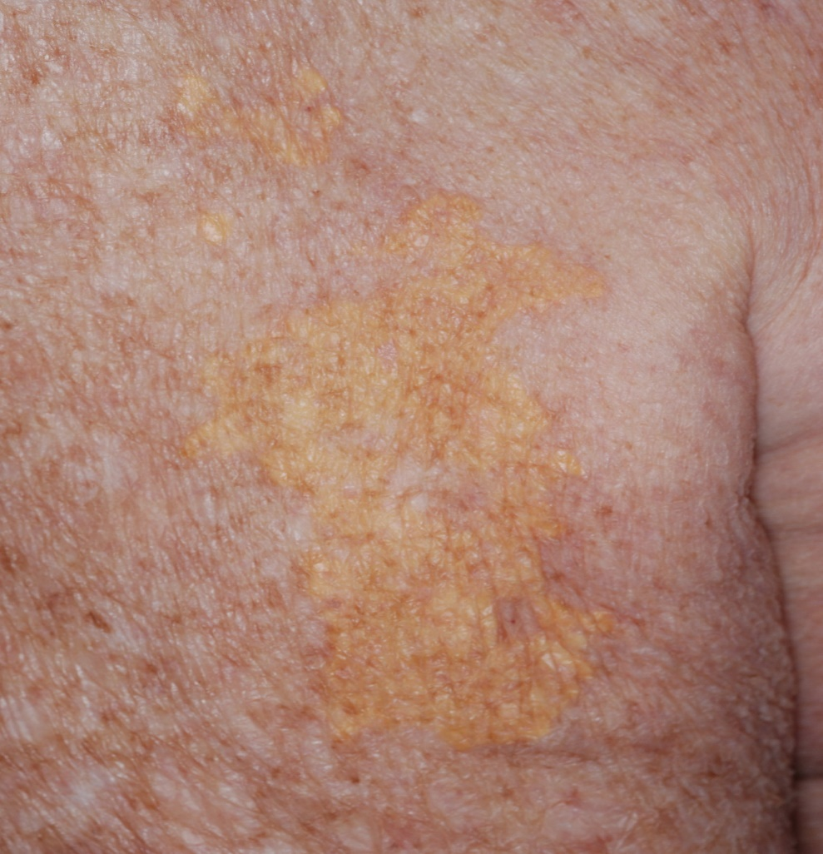
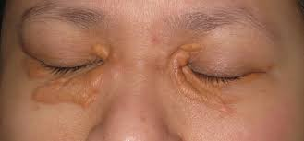
Diffuse plane xanthomatosis Erdheim- Chester disease

Slide 43
Type | General | Etiology | Clinical features | Investigations | Treatment
Reticulohistiocytoma | Young adult males | Non- neoplastic reactive process | Solitary, asymptomatic papule/ dome shaped nodules | Large epithelioid histiocytes with abundant glassy eosinophilic cytoplasm | Surgical excision
Familial sea-blue histiocytosis | Young adults (1- 83 years) | Autosomal recessive disorder | Patchy, irregular, brownish grey macules/ nodules (face, chest, shoulders) Macular discoloration, brain, heart, lung, liver may involve | Histiocytic infiltrates, cytoplasmic vacuoles & granules, granules: ‘sea blue’ with May- Gruenwald stain | No specific tx, Tx of ass lipid metabolism disorder may induce resolution

Slide 44
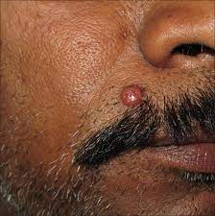
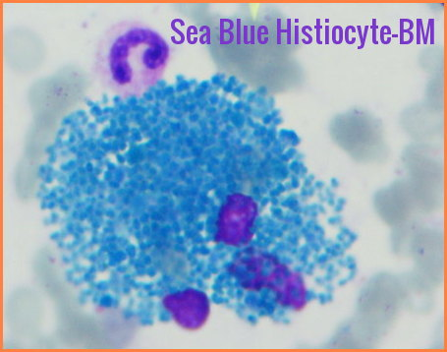
Reticulohistiocytoma Familial sea-blue histiocytosis

Slide 45
Type | General | Etiology | Clinical features | Investigations | Treatment
Hereditary progressive mucinous histiocytosis | Women, start in childhood | Autosomal dominant genodermatosis | Skin color to red brown papules affect nose, hands, forearms & thighs | Dendritic histiocytes with abundant lysosomal storage organelles, myelin & zebra bodies. Immunohistochemistry | Progressive, lesions increase throughout life, no spontaneous rx, no effective tx
Malakoplakia | Benign, Mean age 50 yrs | Unclear, chronic infection | Urinary tract & GIT, Skin: abscesses, sinuses, ulcers, tender nodules, grouped papules Mucosa may be | Hansemann cells: histiocytes with fine eosinophilic granules contain Michaelis- Gutmann bodies (basophilic inclusion bodies) | Self- limiting, Surgical excision superior to antibiotics

Slide 46
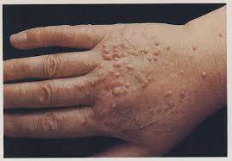
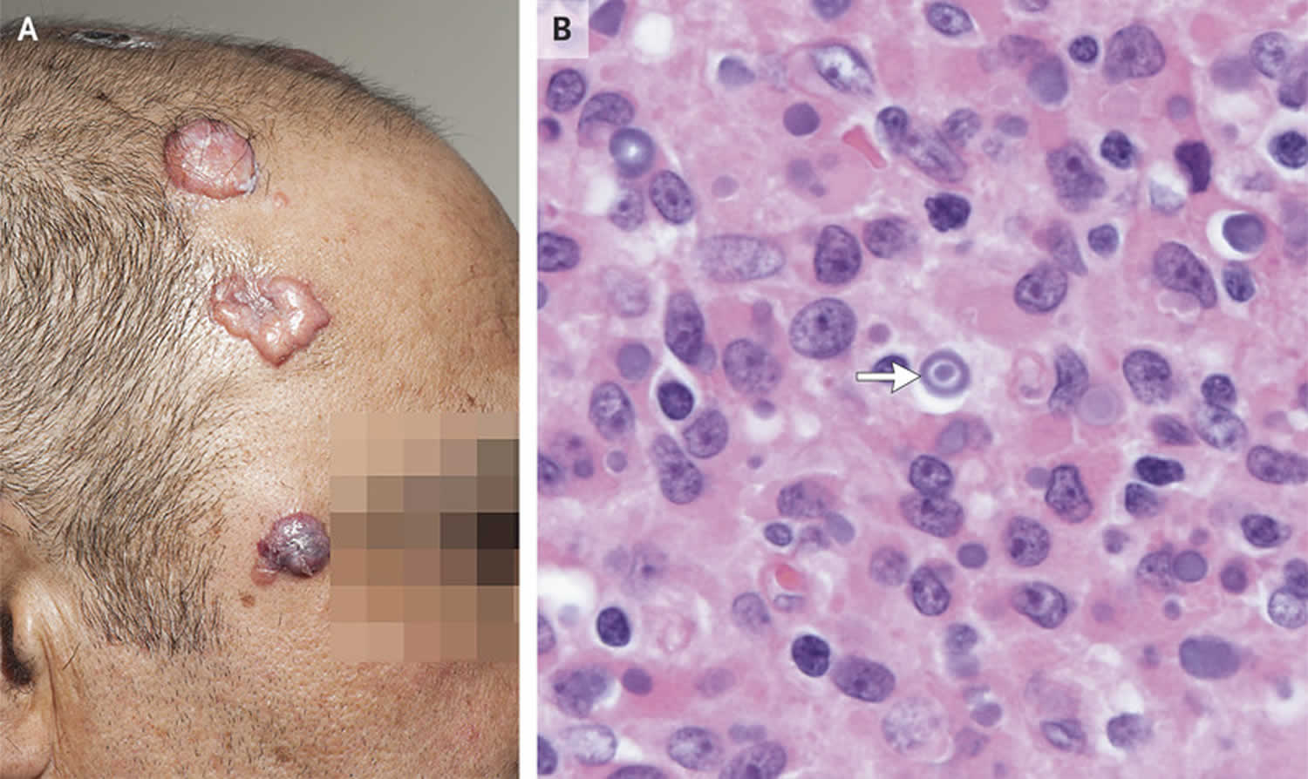
Hereditary progressive mucinous histiocytosis Malakoplakia

Slide 47
Type | General | Etiology | Clinical features | Investigations | Treatment
Necrobiotic xanthogranuloma | Rare, 20- 85 yr, E haematological malignancy | Unknown, Paraproteinaemia/ infectious trigger | Slowly progressive reddish yellow xanthomatous plaques/ nodules; infiltrative & destructive, mostly periorbital | Confluent granulomatous masses extending into S/C, hyaline areas of necrobiosis separating nodules | Alkylating (Melphalan) ± steroid, I/L steroid, high dose steroids, chlorambucil, IFN α, CYP, MTX, HCQ, AZA
Multicentric reticulohistiocytosis | Rare, E destructive arthritis, Middle aged adults, M:F= 3:1 | Unknown, Reactive | Skin & mucosal infiltration by mono- & multinucleated giant cells | Symmetrical polyarthritis then firm brown/ yellow papules & plaques more over extensors, nail dystrophy, mucosal, constitutional | Quiescent in 7-8yrs if no malignancy, tx underlyingMTX± steroid & biologic

Slide 48
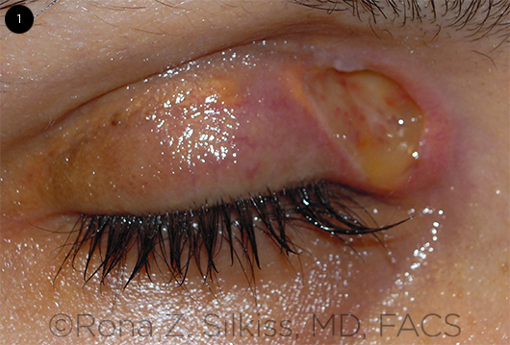
Necrobiotic xanthogranuloma

Slide 49
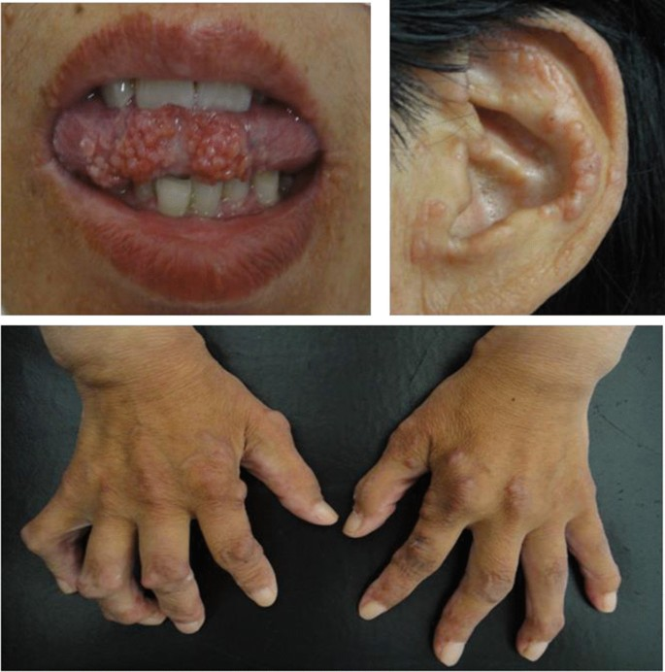
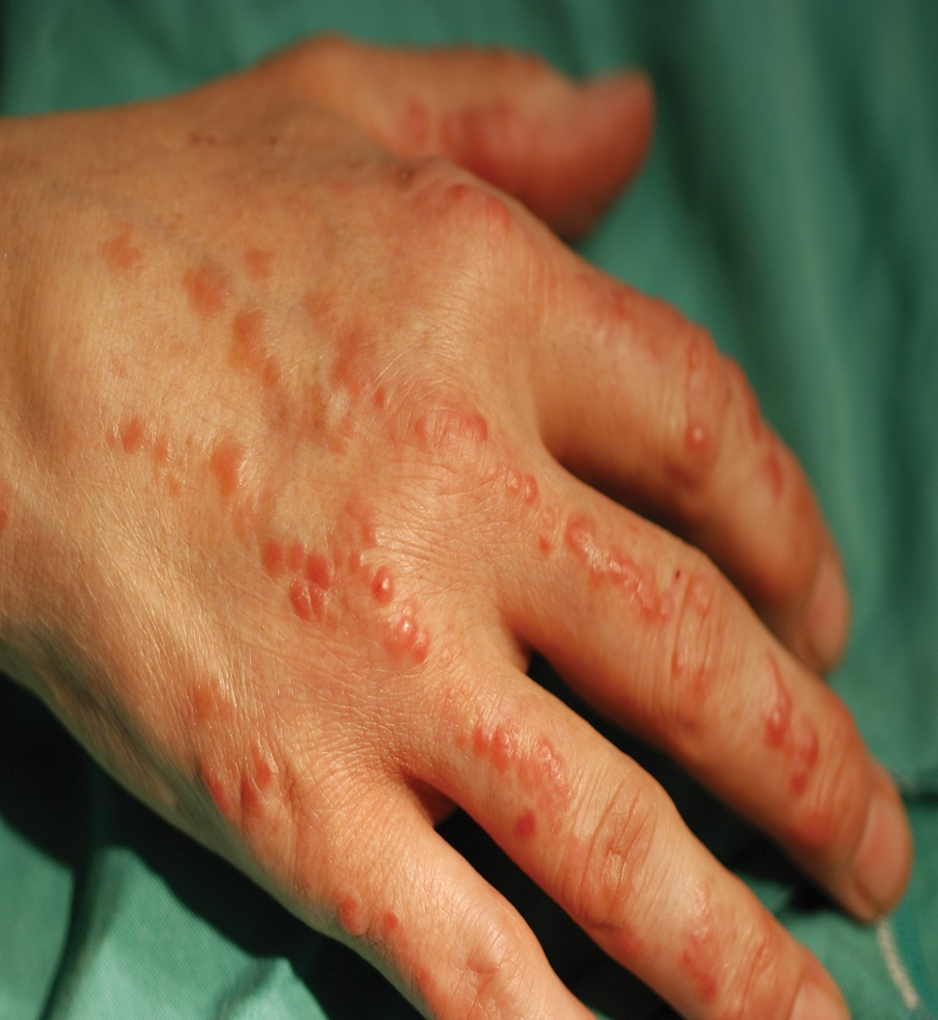
Multicentric reticulohistiocytosis

Slide 50
Type | General | Etiology | Clinical features | Investigations | Treatment
Sinus histiocytosis with massive lymphadenopathy (Rosai- Dorfman disease) | Rare, Young adults (mean age 20.6, birth to 74y) | Unknown, infectious/ malignant trigger aberrant activation of macrophage | B/L painless cervical adenopathy, constitutional, yellow/ violaceous macules/ papules/ nodules/ plaues, no predilection, isolated intracranial disease | Lymph nodes: massive sinus infiltration of large histiocytes admixed with lymphocytes & plasma cells Hallmark: emperiopolesis Anemia, gammopathy chest or head CT | Intracranial: excision/ surgical debulking, Systemic steroids, IFN α + chemotherapy, thalidomide/ acyclovir Rituximab

Slide 51
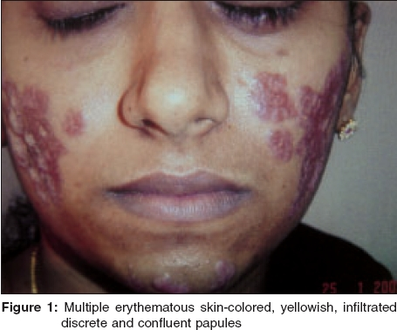
Rosai- Dorfman disease

Slide 52
Malignant Histiocytoses
Malignant Reticulohistiocytosis
True Histiocytic Lymphoma
Histiocytic Sarcoma

Slide 53
Type | General | Etiology | Clinical features | Investigations | Treatment
Malignant histiocytosis | Adults (median age 35y), M:F = 3.5:1 | Neoplastic proliferation of cells of monnuclear phagocyte system, t(5;6) | Acute fever, sweats, painful lymphadenopathy, hepatosplenomegaly, single/ multiple skin color to violaceous papulonodular lesions, | Infiltrate of histiocytic cells with varying degrees of atypia, non- cohesive | Conventional chemo & radiotherapy (start early) Bone marrow transplant
True histiocytic lymphoma | Rare, Median age 52yrs | Unknown, malignant neoplasm that may disseminate, Non-LCH | Constitutional, painless superficial lymphadenopathy, bone & GIT, localized bluish red tumors | Dermal infiltrative non- cohesive cells that are more diff than malignant histiocytosis, Immunophenotyping | Localized skin lesion: electron beam therapy. Chemo & radiosensitive

Slide 54
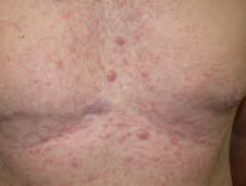
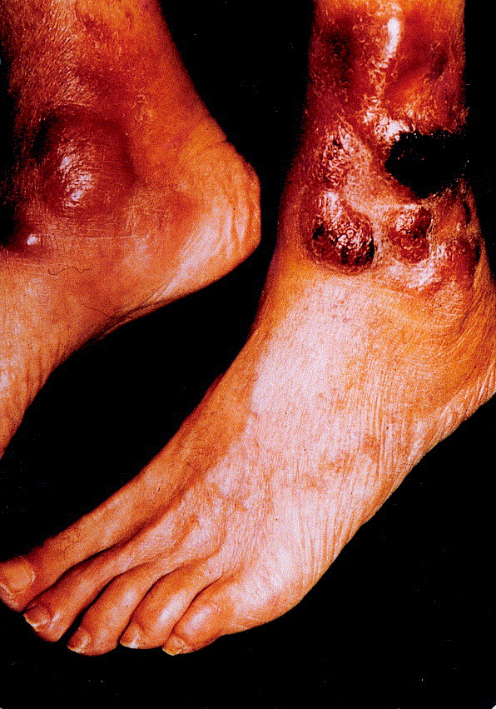
Malignant histiocytosis True histiocytic lymphoma

Slide 55
Type | General | Etiology | Clinical features | Investigations | Treatment
Histiocytic sarcoma | Extremely rare, non-LCH disorder, mainly adults (3mo- 89 yrs) | Unknown, Clonal Ig rearrangement | Skin, Lymph nodes, Thyroid, GIT, Kidney, Spleen, Testes, CNS. Maculopapular rash, areas of soft consistency or S/C nodules with central necrosis & ulcers | Genetic testing, Histology (perivascular & periadnexal dermal & S/C histiocytic infiltrate, polymorphic neoplastic cells), Immunophenotyping | Highly aggressive, localized: surg & radiotherapy. Combination of surg, radio & chemo; poor response

Slide 56
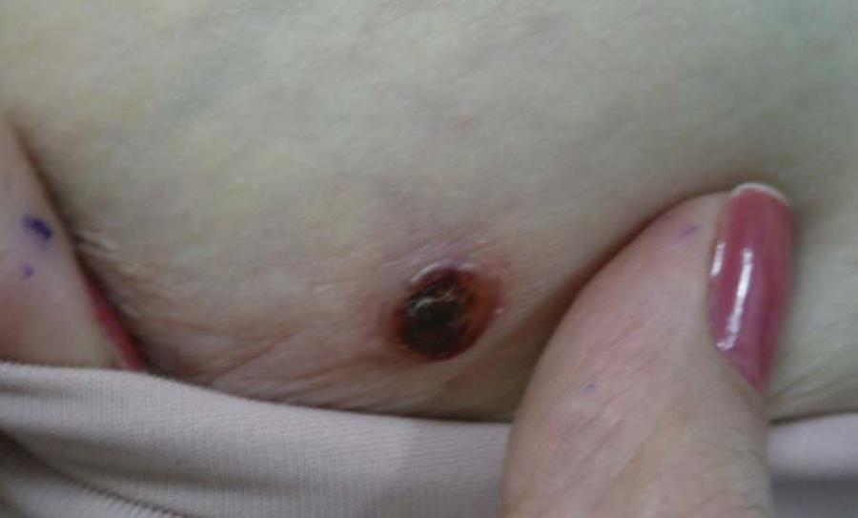
Histiocytic sarcoma

Slide 57


Slide 58


Slide 59
