Slide 1
Diagnosis of Skin Disease
بِسْمِ ٱللَّٰهِ ٱلرَّحْمَٰنِ ٱلرَّحِيمِ
Dr NIDA ARIF
trainee dermatology
Cmh bahawalpur

Slide 2
Learning objectives
Disease Definition
The History
Examination of skin
Description of skin lesion
Clinical microscopy, dermoscopy and other imaging systems
Fine‐needle aspiration of lymph nodes
Radiological and imaging examinations
Skin testing (prick and scratch, intradermal and patch testing)
Teledermatology

Slide 3
Disease Definition
Any harmful deviation from the normal structural or functional state of an organism, generally associated with certain signs and symptoms and differing in nature from physical injury.
A diseased organism commonly exhibits signs or symptoms indicative of its abnormal state.

Slide 4
The History
A careful, thorough and at times directed history is of paramount
importance to making an accurate diagnosis in dermatology.
The presenting complaint
Symptoms
Itch
Pain
Disfigurement
Duration
Evolution
Periodicity
General History

Slide 5
The History
Symptoms (Contd)
Medication
Diet
Family History
Occupation
Leisure Factors
Geographical Factors
Social and Psychological Factors

Slide 6
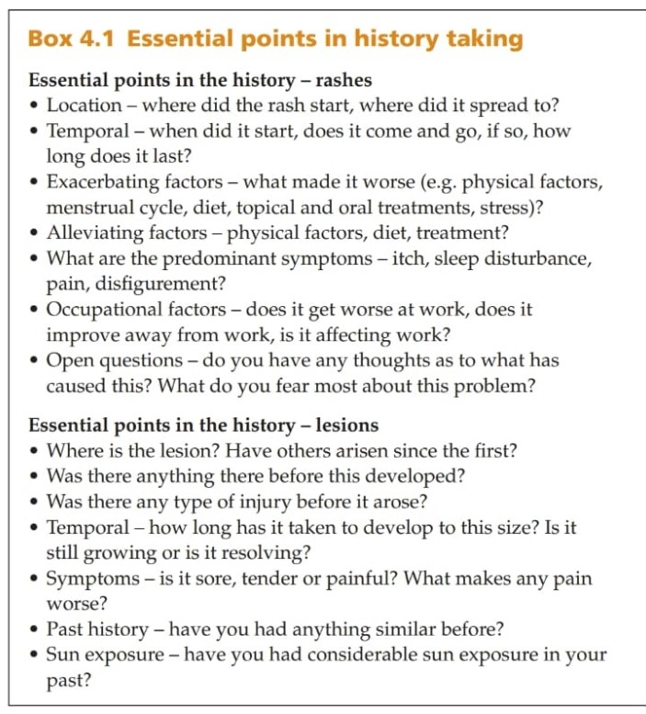

Slide 7
Examination of The Skin
The patient should always be examined in a good light, preferably
daylight, and with magnification of lesions.
Ideally, the entire skin should be examined in every patient.
In the examination of the skin, it is helpful to consider the morphology
of individual lesions, their overall pattern and spatial relationship to each other, and their body site distribution
Touching the skin is important in most instances.
Gloves should be worn for examination of the mouth, genital/perineal region, or in the case of infective or infected dermatoses.
Additional simple aids to clinical examination include use of Wood’s light, diascopy, dermoscopy, starch iodine testing to identify sweat duct orifices and hair microscopy.

Slide 8
Description of skin lesions
Sites Involved and their distribution
Anatomical Factors
Blood supply
Skin appendages
Type of skin
Neural
Developmental
Regional Variation and others
External Factors
Solar Exposure
Chemical Exposure
Infective

Slide 9
Distribution
Symmetrical
Asymmetrical
Flexural
Photo-distributed
Air-borne
Pattern and arrangment
Agminate
Grouped or clustered
Satellite
Confluent
Scattered
Spared
Erythroderma

Slide 10
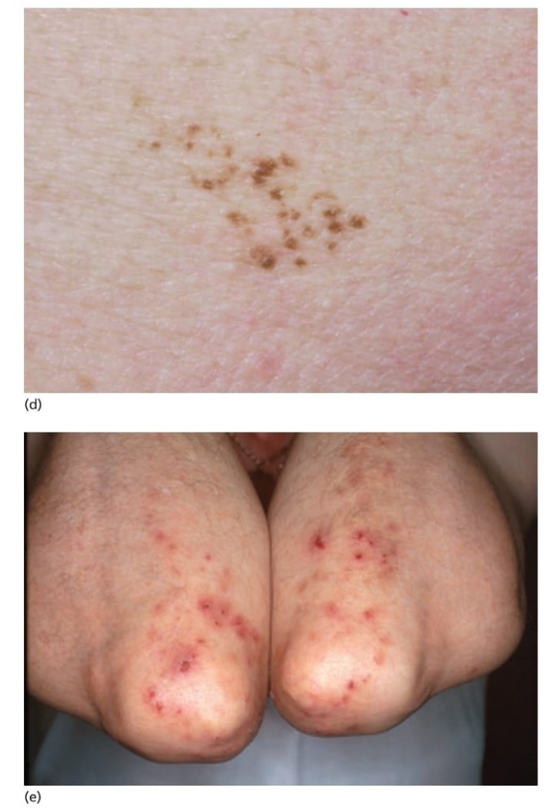
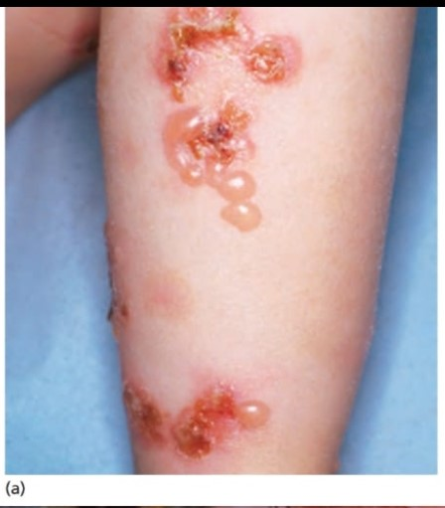
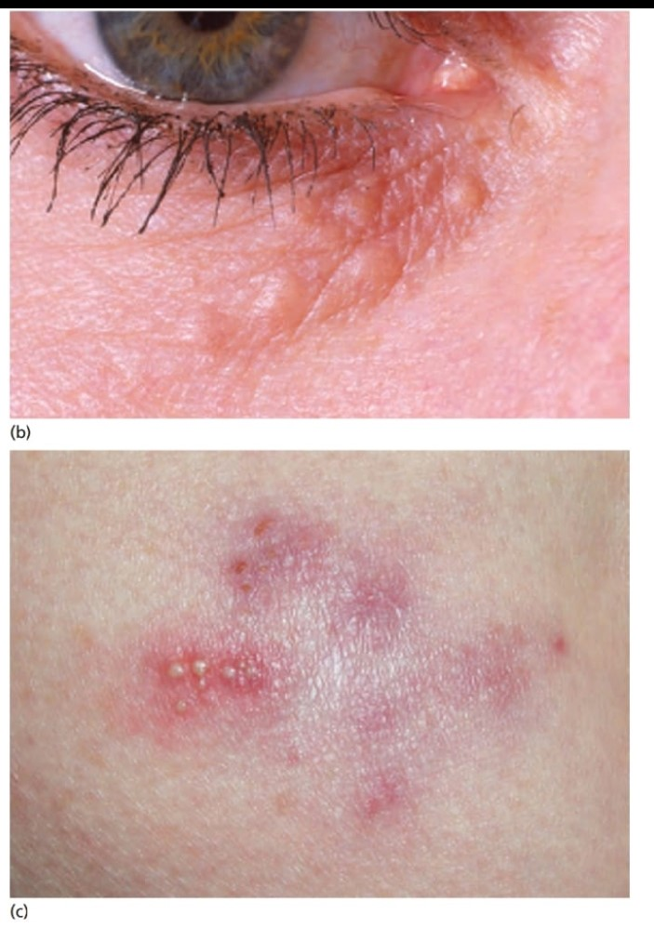
Characteristic grouping of lesions:
blisters in a ring like a ‘string of pearls’ in linear immunoglobulin A (IgA) bullous dermatosis;
(b) grouped papules on the lower lid in syringomas;
(c) grouped vesicopustules in herpes simplex on the buttock;
(d) pigmented papules in naevus spilus; (e) clustered lesions on the elbows in dermatitis herpetiformis.
•

Slide 11
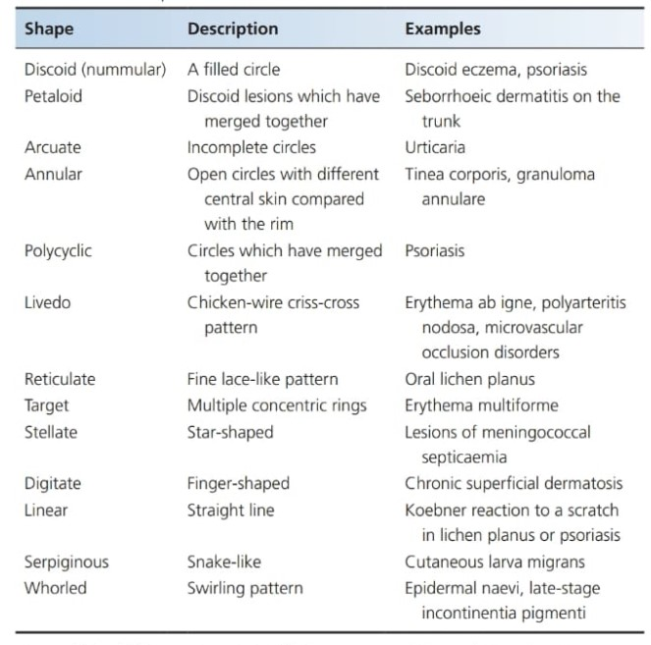
Description of skin lesions
Linear, sporotrichoid, annular, arcuate, polycyclic, livedoid and discoid lesions

Slide 12
Description of skin lesions
Individual Lesion
Erythema
Surface
Colour
Boader
Shape

Slide 13
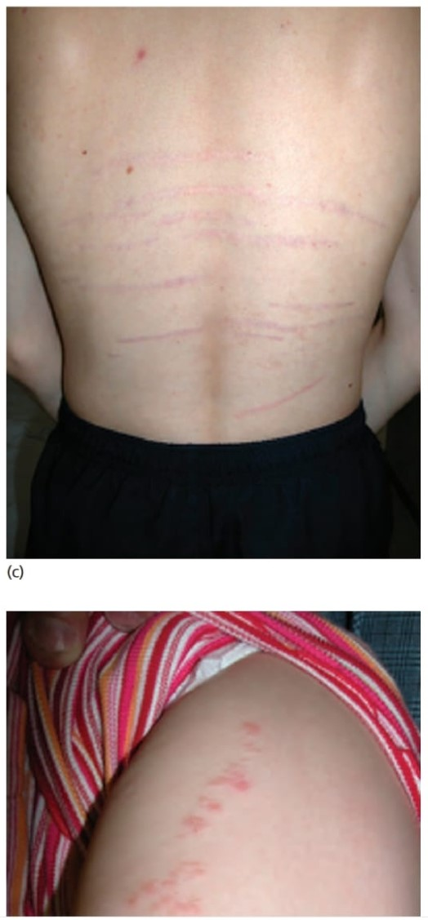
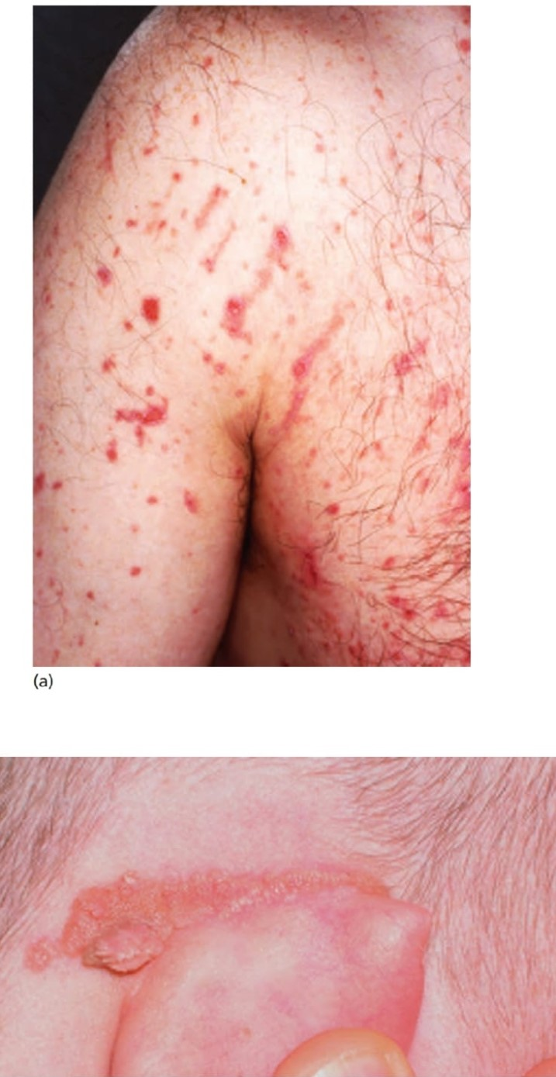
Examples of linear lesions:
‘strimmer’ phytophotodermatosis;
(b) linear epidermal naevus;
(c) growth striae;
(d) lichen striatus.

Slide 14
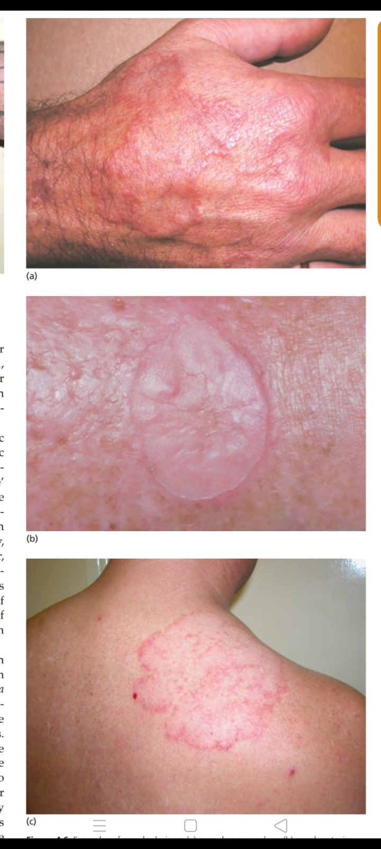
Examples of annular lesions:
granuloma annulare;
(b) porokeratosis;
(c) tinea corporis

Slide 15
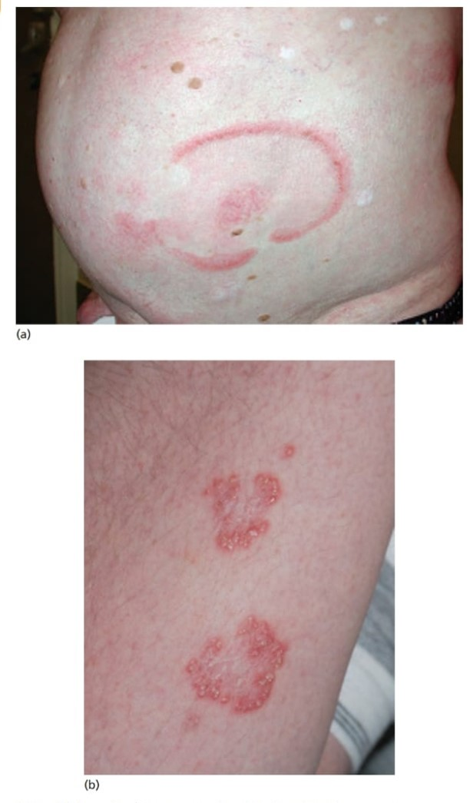
Examples of arcuate and polycyclic lesions:
(a) erythema annulare centrifugum;
(b) elastosis perforans serpiginosum

Slide 16
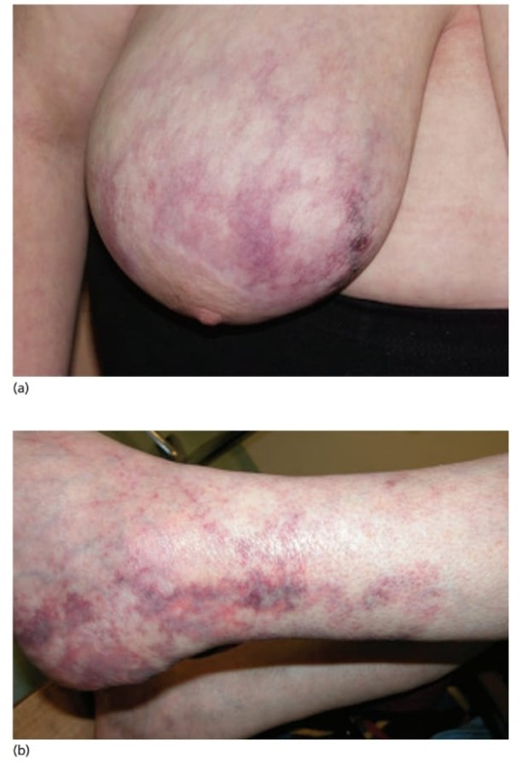
Livedoid lesions:
(a) diffuse dermal angiomatosis of the breast; (b) broken livedo reticularis in cutaneous polyarteritis nodosum.

Slide 17
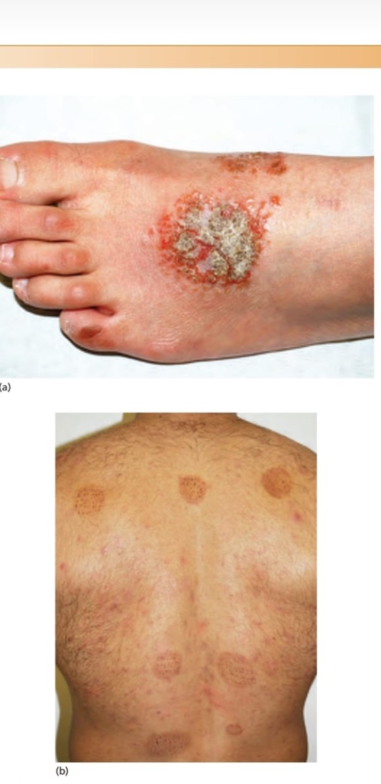
Discoid lesions:
discoid eczema;
(b) discoid hyperpigmentation and
unusual haemorrhagic lesions due to the practice of cupping.

Slide 18
Description of skin lesions
Palpation of the skin
Simple palpation
Blunt pressure
Linear Pressure
Squeezing or pinching
Strecting
Rubbing
Scratching and Picking

Slide 19
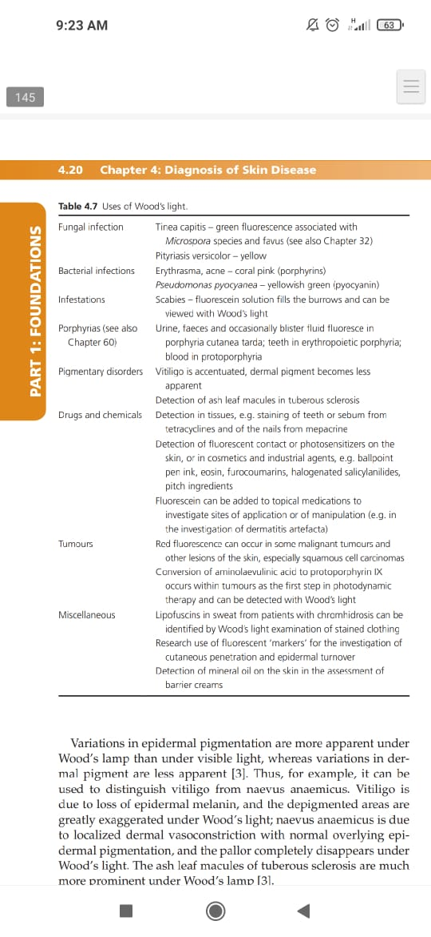
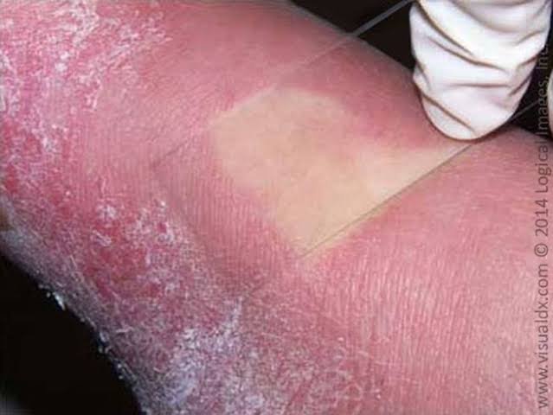
Description of skin lesions
Additional Clinical investigations
Diascopy Wood’s light

Slide 20
Clinical microscopy, dermoscopy and other imaging systems
Dermoscopy
Dermoscopy is a noninvasive, in vivo technique primarily used for the examination of pigmented skin lesions; however, it can also assist observers in assessing lesions with little to no pigmen.
Also known as dermatoscopy
Dermoscopy requires a high quality magnifying lens and a powerful lighting system (a dermatoscope). This allows examination of skin structures and patterns. There are several different lightweight, battery-powered hand-held devices. Convenient attachments allow video or still photography, including via smartphone.
Using dermoscopy, the pigmentation of the lesion is evaluated in terms of colour(s) and structure. Colours found in pigmented skin lesions include black, brown, red, blue, grey, yellow and white.

Slide 21
Clinical microscopy, dermoscopy and other imaging systems
Dermoscopy
Characteristics of the dermatoscopic structure of the skin lesions include:
Symmetry or asymmetry
Homogeny/uniformity (sameness) or heterogeny (structural differences across the lesion)
Distribution of pigment: brown lines, dots, clods and structureless areas
Skin surface keratin: small white cysts, crypts, fissures
Vascular morphology and pattern: regular or irregular
Border of the lesion: fading, sharply cut off or radial streaks
Presence of ulceration

Slide 22
Clinical microscopy, dermoscopy and other imaging systems
Spectrophotometric image analysis of pigmented lesions (SIAoscopy)
Spectrophotometric or spectral analysis of skin lesions refers to the use of a skin imaging device to help evaluate pigmented skin lesions (moles) and make it easier to identify and diagnose early stage malignant melanomas (skin cancers).
Spectrophotometric analysis is an advanced form of dermoscopy using a computer software program that calculates and extracts information about the cells and structures of the skin.
Dermoscopic devices work by using a powerful lighting system and high quality magnifying lens
SIAoscopy used to aid in the early detection and diagnosis of malignant melanoma

Slide 23
Clinical microscopy, dermoscopy and other imaging systems
Reflectance confocal microscopy
In dermatology, reflectance confocal microscopy (RCM) is a non-invasive imaging technique that enables in vivo visualisation of the epidermis down to the papillary dermis in real-time.
Resolution is almost comparable to conventional histology.
It has the advantage of allowing the clinician to do a “virtual biopsy” of the skin and obtain diagnostic clues while minimising unnecessary skin biopsies.
RCM is fast, pain free and result is immediate.
RCM uses diode laser as a source of monochromatic and coherent light
It is used to diagnose benign and malignant skin lesions such as melanoma,SCC,BCC.

Slide 24
Clinical microscopy, dermoscopy and other imaging systems
Other microscopic procedures
Simple light microscopy
Skin surface biopsy
Microscopy of skin scrapping

Slide 25
Fine‐needle aspiration of lymph nodes
FNA, also known as fine needle biopsy, is a procedure that may be used to biopsy cells in enlarged lymph nodes. A thin needle is inserted into the affected area and cells are removed for testing.

Slide 26
Radiological and imaging examinations
USG
MRI
Radioisotope scan
PET Scan
High resolution USG
Lymphoscintigraphy
Doppler assessment

Slide 27
Skin Testing
Patch test
Intradermal injections
Prick test
Scratch test
Modified prick test
Skin window technique
> Immediate weal test
> Delayed test

Slide 28
Teledermatology
Teledermatology is a subspecialty of dermatology and probably among the most popular applications of e-health and telemedicine. In this field, telecommuncation technologies are being used to transfer medical information over varying distances through audio, visual and data communication.

Slide 29
Refrences
Rook’s textbook of dermatology 9th edition
Dermnet NZ
Wikipedia

Slide 30
Thank you

