Slide 1
Dermatoses of external ear

Slide 2
Anatomy
1- auricle
2-external auditory canal
3-tympanic membrane

Slide 3
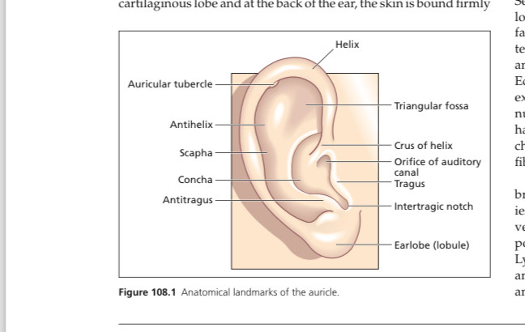

Slide 4
Auricle
Also called as pinna
Cartilaginous plate which is convoluted,elastic
Attached to head by fibrous ligaments and three muscles
Size vary between individuals
In humans it is mostly functionless
Numerous sebacous glands present
Fine vellous or terminal hair also present on helix

Slide 5
Blood supply is by superficial temporal and posterior auricular arteries
Venous drainage by posterior auricular and superficial temporal veins into external jugular vein and into internal jugular vein
Lymphatic drainage into superficial parotid,retroauricular and superficial cervical lymph nodes.
Nerve supply by 5,7,9,10 cranial nerves,greater and lesser auricular nerves

Slide 6
External auditory canal
Extends upwards in s shaped curve
Angle of curvature varies
Length is 2.5 cm
Outer third is cartilaginous
Anteroinferiorly there are 2 horizontal fissures in cartilaginous canal,the fissures of santorini. These can allow infection or tumor to pass beyond canal eg to parotid gland.
Plenty of sebaceous glands present.
Plenty of modified(ceruminous) glands present.

Slide 7
microbiology
Skin of external auditory canal supports growth of multiple bacterial species like staphylococcus epidermidis,corynebacterium,bacillus and staphylococcus aureus
Pseudomonas and fungi are not normally found

Slide 8
Cerumen
Combined product of sebaceous and apocrine glands.
Contains fatty acids,
Waterproofs external suditory canal,impedes bacterial growth or fungal growth
If wax becomes impacted it causes hearing loss,tinnitus,vertogi,pain,external otitis.May be removed by irrigation techniques or suction under direct vision.
cerumol,Sodium bicarbonate,olive oil,water are effective in removing it.

Slide 9
Chondrodermatitis nodularis
Inflammatory condition involving cartilage and skin resulting in firm nodule which can ulcerate
Benign
Painful
Most occur on helix and anti helix
Males are more affected
Pressure is predisposing factor
Common in middle aged and elderly,fair skinned
Associated with systemic sclerosis

Slide 10
Predisposing factors
1-pressure from sleeping on one side,head phones
2-solar radiation
3-exposure to cold,wind
4-systemic sclerosis,childhood dermatomyositis

Slide 11
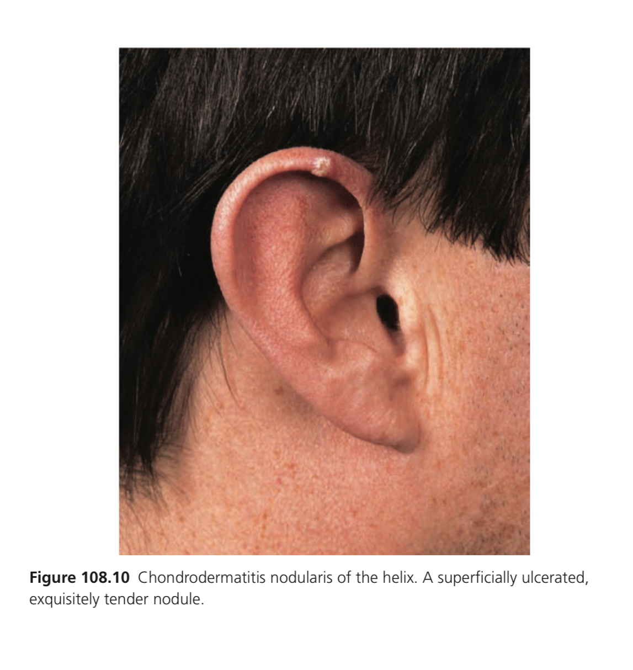

Slide 12
Lesion begins as globular or oval nodule 0.5-1 cm.
Surrounding skin is hyperaemic
Surface may be scaly or crusted concealing small ulcer
Differential diagnosis= BCC,SCC,actinic keratosis
course= if untreated it persists
investigations= biopsy

Slide 13
management
Relieve pressure over ear
First line= doughnut shaped pillow,protective hollowed out foam,moulded prosthesis,self adhering foam
Second line=intralesional corticosteroids eg triamcinolone 10 mg/ml,liquid nitrogen cryotherapy
Topical 2 % nitroglycerin
Surgery
Third line= photodynamic therapy,collagen injection,c02 laser

Slide 14
Pseudocyst
Non inflammatory fluid filled cavity within cartilage of ear
Uncommon
Due to trauma which can occur due to sports or rubbing due to atopic eczema,habit related twisting of ears,sleeping on hard pillows,wearing ear phones.
Common in young men
Cavity does not have epithelium lining and within cartilage there is eosinophilic amorphous material

Slide 15
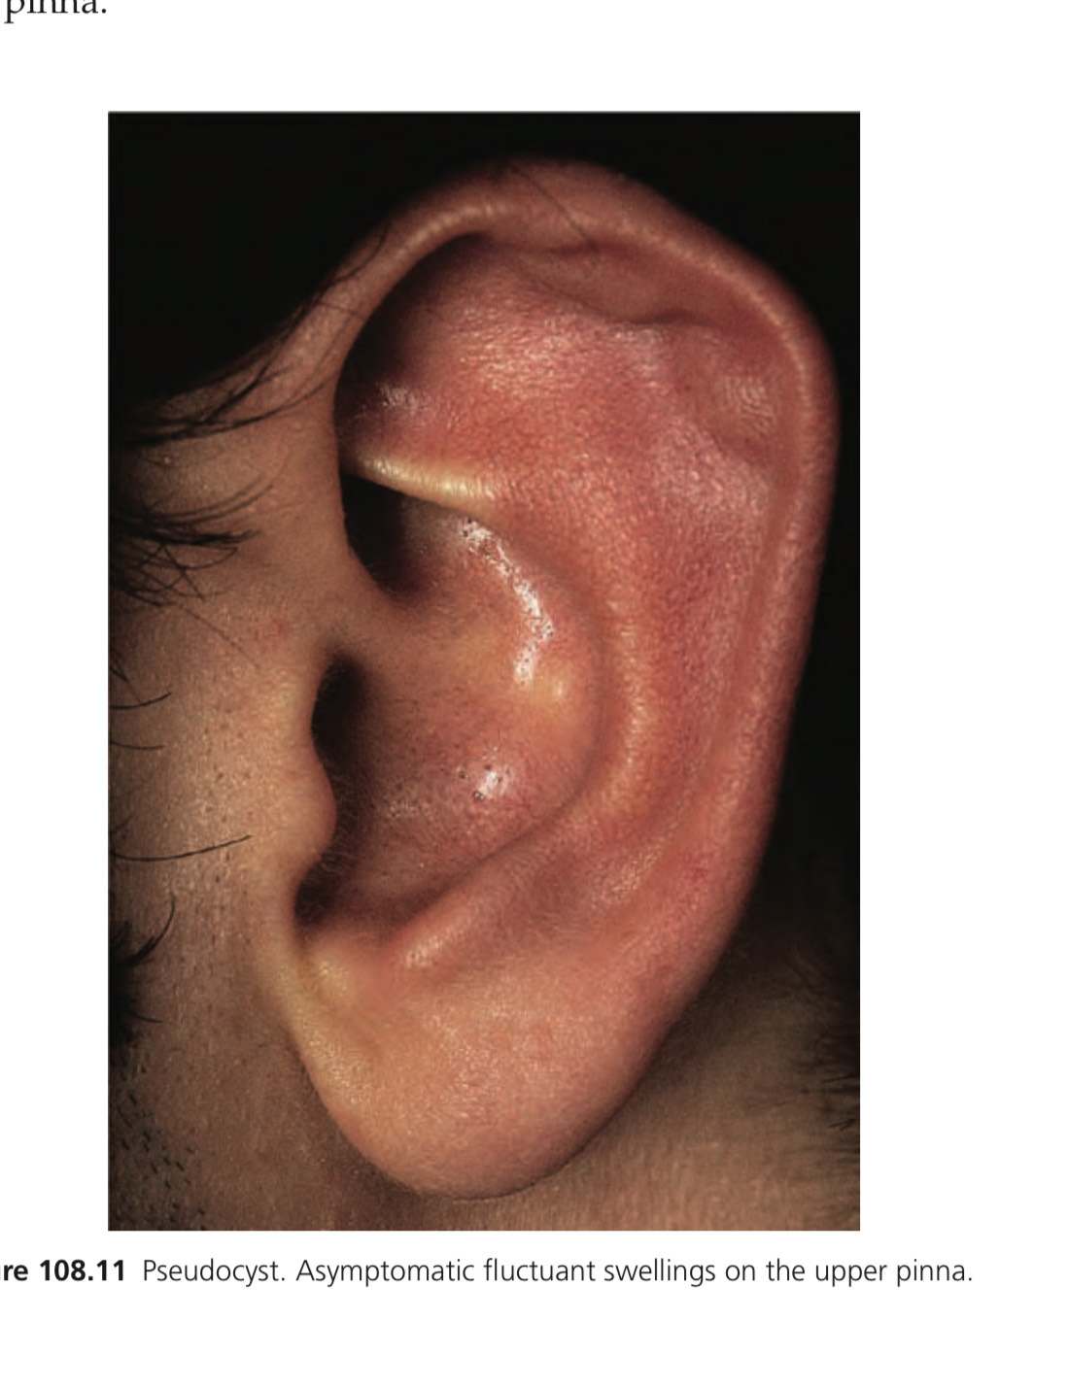

Slide 16
History=painless swelling appears over 1-3 month
presentation= fluctuant,non tender, yellow or clear fluid
dds= haematoma,cyts,tumors,perichondritis,
course=untreated may lead to fibrosis causing deformity
investigations= biopsy
management=aspiration,local pressure for 3 weeks eg bandage, deroofing anterior wall of cyst,intralesional steroid or fibrin,minocycline,TCA

Slide 17
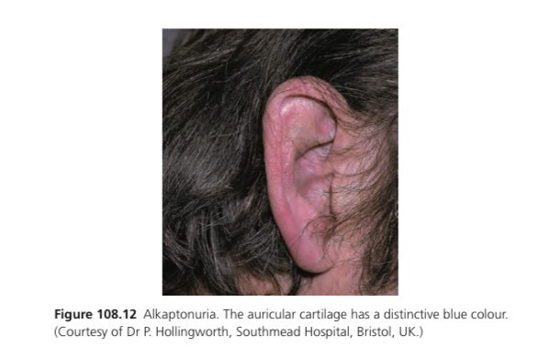
alkaptonuria
Bluish discoloration of ear cartilage due to oxidation of homogentisic acid.

Slide 18
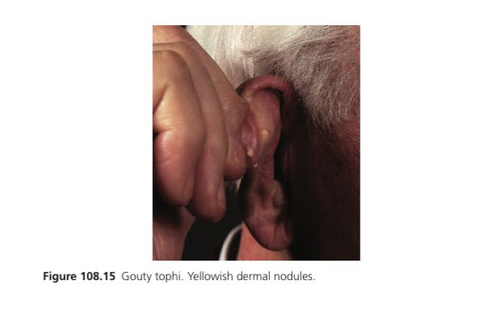
gout
Yellow nodules

Slide 19
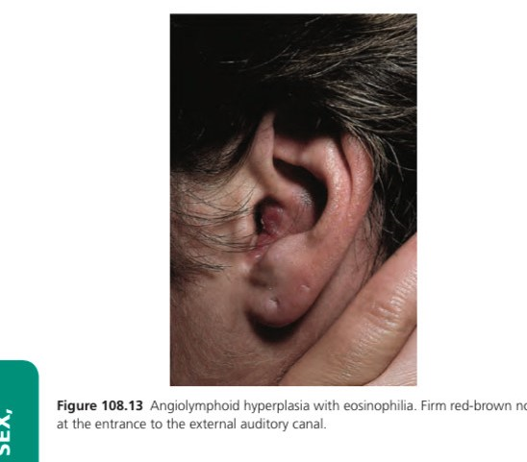
Angiolymphoid hyperplasia with eosinophilia
Red-brown papules or nodules
Can itch,painful,pulsatile.
Non malignant
Haemangioma

Slide 20
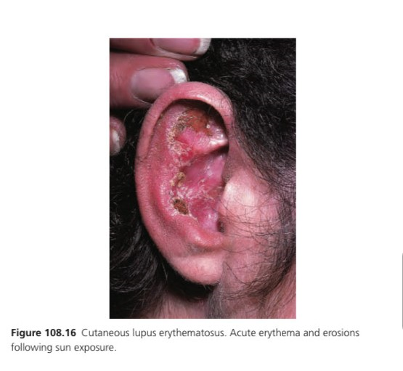
SLE
Erythematous patch with scaling.
Follicular plugging with scarring can occur.

Slide 21
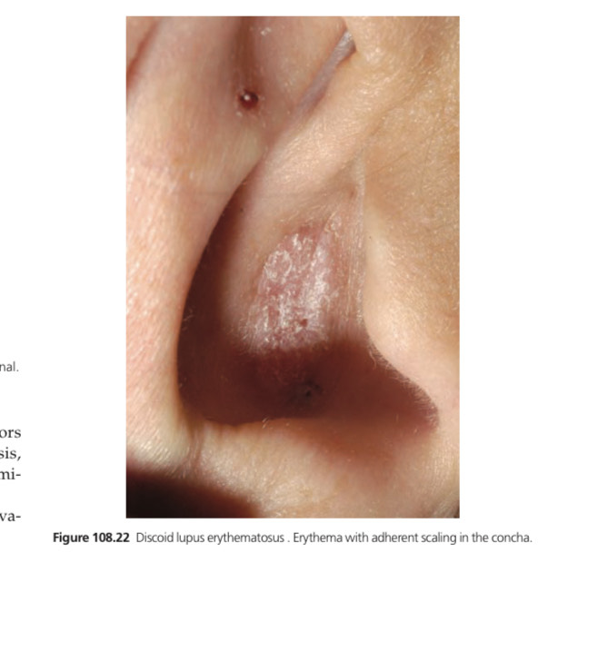
dle

Slide 22
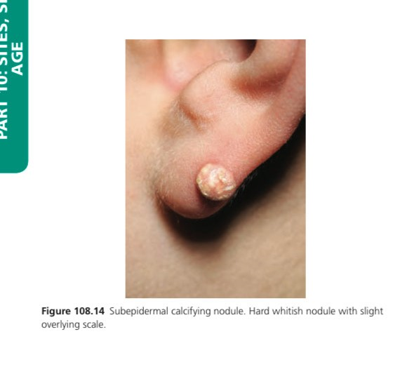
Subepidermal calcifying nodule
Calcium deposition
Degeneration of cartilage
In infants congenital nodular calcification of winer should be considered

Slide 23
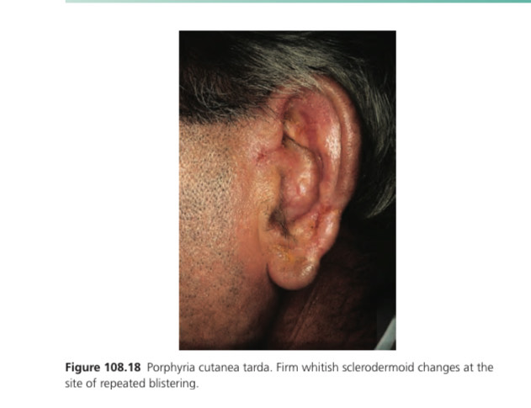
Porphyria cutanea tarda
Vesicles and bullae,scarring present
Hyperpigmentation,milia can be present

Slide 24
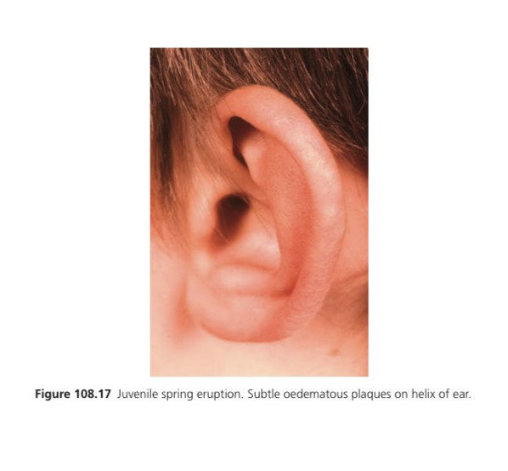
photodermatosis
Juvenile spring eruption a variant of PLE found in young boys

Slide 25
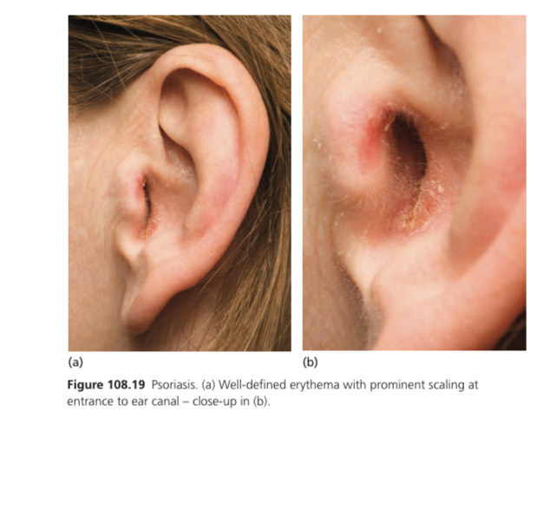
psoriasis

Slide 26
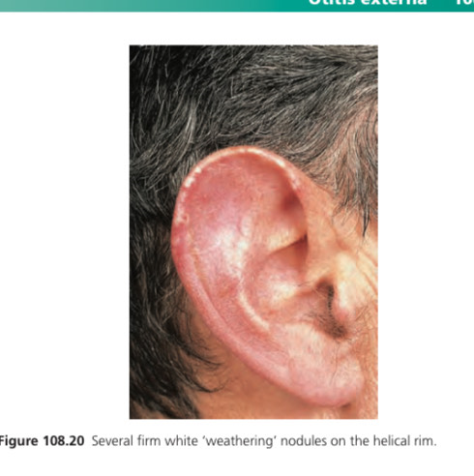
Weathering nodules
Asymptomatic
Increased in old men

Slide 27
TRAUMATIC CONDITIONS

Slide 28
Contusion and haematoma
Bruises occur due to blunt trauma
Common in contact sports such as boxing
In children physical abuse needs to be included
Repeated trauma may result in distorted nodular deformity known as cauliflower ear which is due to cartilage necrosis and fibrosis
treatment= aspiration by syringe,incision

Slide 29
Complications of ear piercing
Bacterial infection = gram positive cocci,when cartilage is pierced it causes bacterial infection with pseudomonas which causes perichondritis
sensitization= sensitization to nickel can occur. Even it can occur due to stainless steel studs,gold
Epidermoid cyst formation= implantation epidermoid cysts present as tender,inflammatory swellings
Keloids
Relapsing polychondritis

Slide 30
Measures to prevent complications
Do not do it in children,immunodeficient,valvular heart disease,sarcoidosis
Use nickel free ear rings
Iv catheter can be used to prevent reactions in metal sensitive individuals

Slide 31
Otitis externa
Inflammatory or infective condition of external auditory canal and adjacent pinna
Causes pain,itch,deafness,discharge
Acute and chronic forms present
Chronic OE persits for more than 2 months
Necrotizing OE is more invasive and serious infection

Slide 32
Clinical features
history=pain in ear,sensation of fullness,hearing loss,clear or purulent discharge,bluish green discharge if pseudomonas is cause
erythema or swelling,
macerated debris
hearing loss
traction on pinna causes pain
fever,malaise,regional lymphadenopathy present

Slide 33
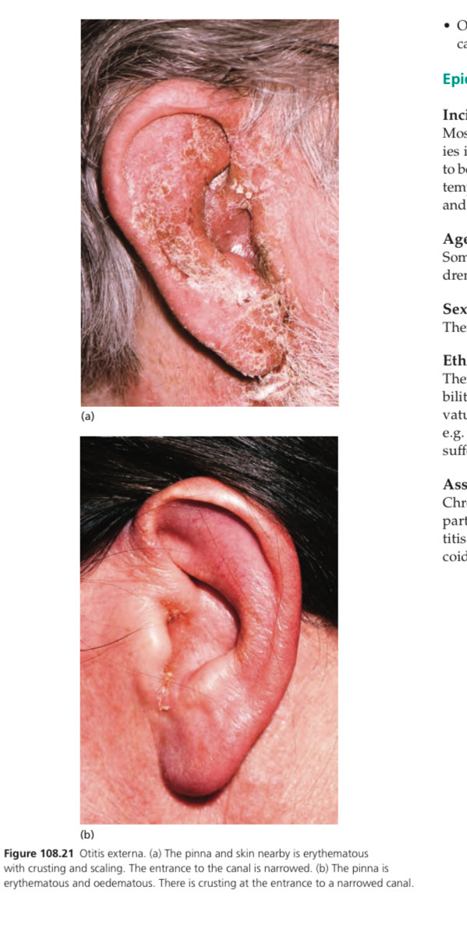

Slide 34
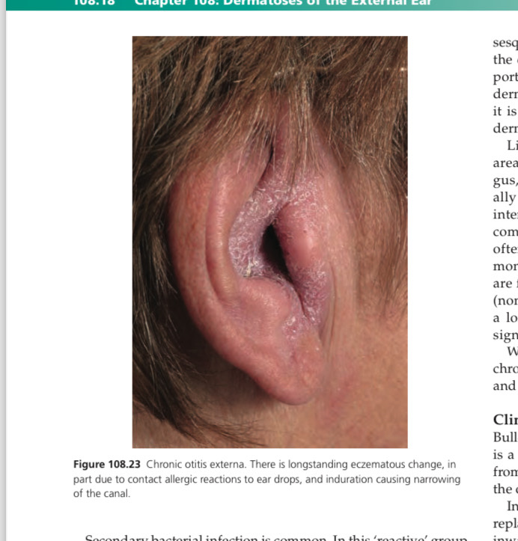

Slide 35
Associated diseases
Chronic OE :atopic eczema
seborrheic dermatitis
contact dermatitis
Psoriasis
DLE
Necrotizing OE:diabetes ,HIV,previous radiotherapy

Slide 36
Predisposing factors
Trauma like insertion of fingernails,hearing aid
Water retention :swimming,abundant hair,tortuous canal
Absence of ear wax from repeated water exposure, overzealous cleansing
Heat,humidity exacerbate it

Slide 37
Causative organisms
Pseudomonas aeoginosa is commonest
Staphylococcus aureus
aspergillus,candida,mucor

Slide 38
investigations=swab for bacterial sensitivities,microscopy,fungal culture
management= topical antibiotic plus steroid drops for 7 days or longer
Acetic acid drops
Ear drum should be visualized before giving aminoglycoside drops

Slide 39
Necrotizing otitis externa
Infection of ear canal that spreads to deeper structures and causes necrosis
Causes osteomyeltis and cranial nerve palsies
Occurs in diabetics,HIV
Commonest cause is pseuduomonas

Slide 40
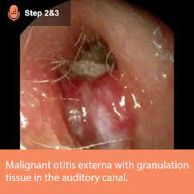

Slide 41


