Slide 1
arthropods
Dr Reesham Zulkiffal Bhatti

Slide 2
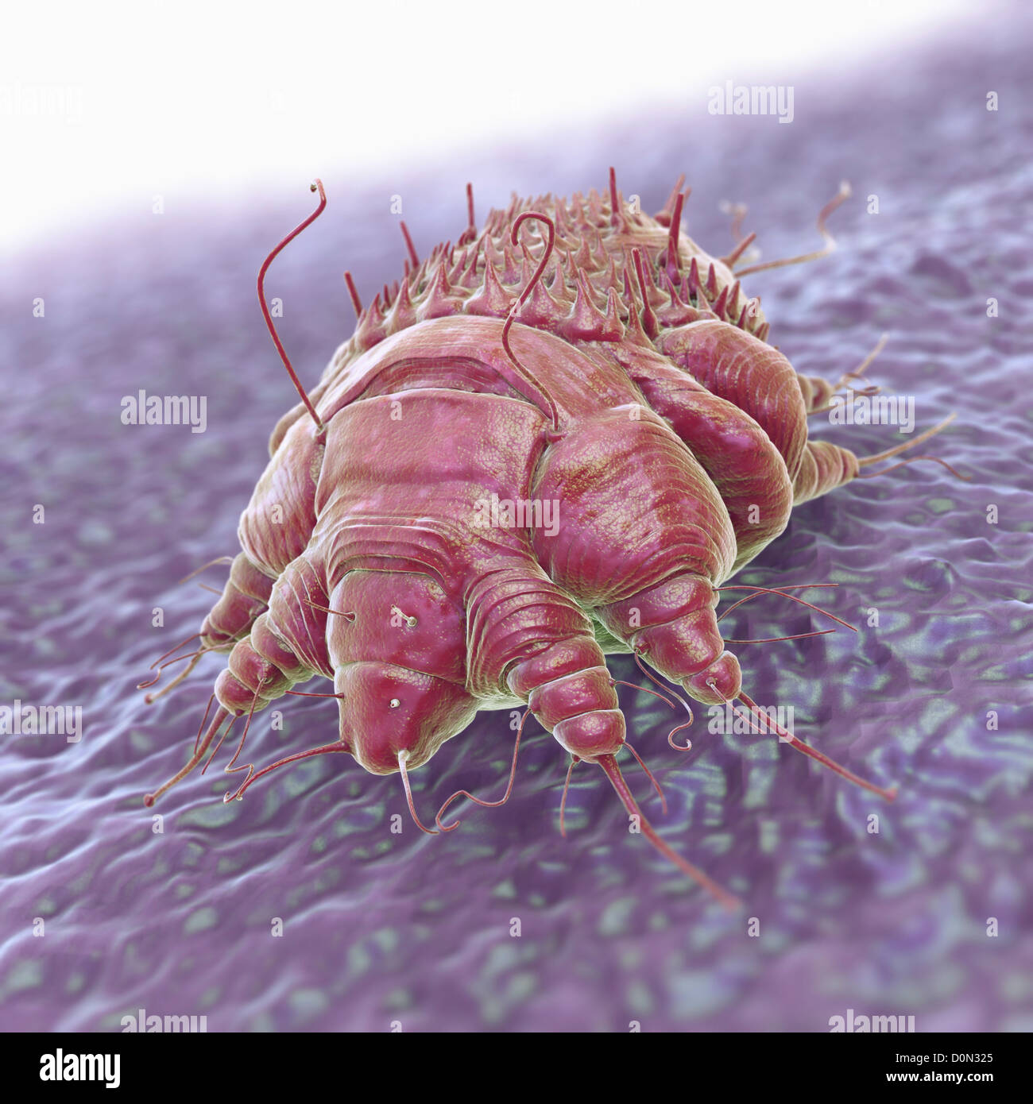
Arthropods
Definition
Life stages
Class
Groups
Notes:
DEFINITION: Arthropods are among the oldest animals. They are characterized by segmented bodies; paired, jointed appendages (legs and antennae); an exoskeleton; and a bilateral symmetry.
GROWTH: They can grow only by moulting.shedding of exoskeleton
LIFE STAGE: Usually, arthropods go through the following life stages: egg, larva or nymph and finally mature adult (male or female).
CLASS : The arthropod phylum is the most diverse of all the animal phyla, most of the species being in the class Insecta.
Arthropods can be divided into two groups: mandibulates with antennae and chelicerates without antennae. The mandibu- lates include insects, Chilopoda(centipede) and Diplopoda((millipede). The chelicerates include scorpions, spiders and mites.
8 phyla and 5 classes

Slide 3
Lice (phthiraptera)
Definition
Obligate ecto parasite
Classification:
Anoplura :
1) pedicuclus humanus
a)pediculus humanus capitis
b) pediculus humanus humanus
2) phtirus pubis
Mallophaga
Notes:
Lice are members of the order Phthiraptera. They are wingless, dorsoventrally flattened insects, which are obligate ectopara- sites( they are not able to comp life cycle without exploitation of host) of birds and mammals.
The Phthiraptera are highly host specific and spend their entire lives on the host. Members of the suborder Anoplura are blood‐sucking ectoparasites of mammals.
Anoplura blood sucking
Mallophaga chewing lice
phtrius pubis pubic or crab louse

Slide 4
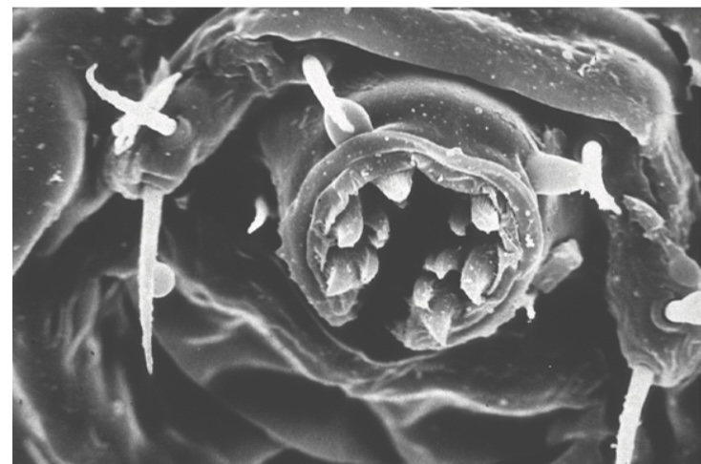
Anoplura (solengophages)
Solen (pipe) phagein (feed) = vessel feeders
Notes:
Vessel feeders and pool feeders
The Anoplura are vessel feeders (solenophages), introduc- ing their mouthparts directly into a blood vessel to withdraw blood [3,4]. The components responsible for probing the skin and piercing a blood vessel are a group of stylets, which are kept withdrawn within the head unless the insect is feeding. In the front of the head is a small snout‐like tube, the haus- tellum, which is soft, eversible and armed with teeth. When the louse is about to feed, the haustellum is everted and the buccal teeth rotated outwards (Fi

Slide 5
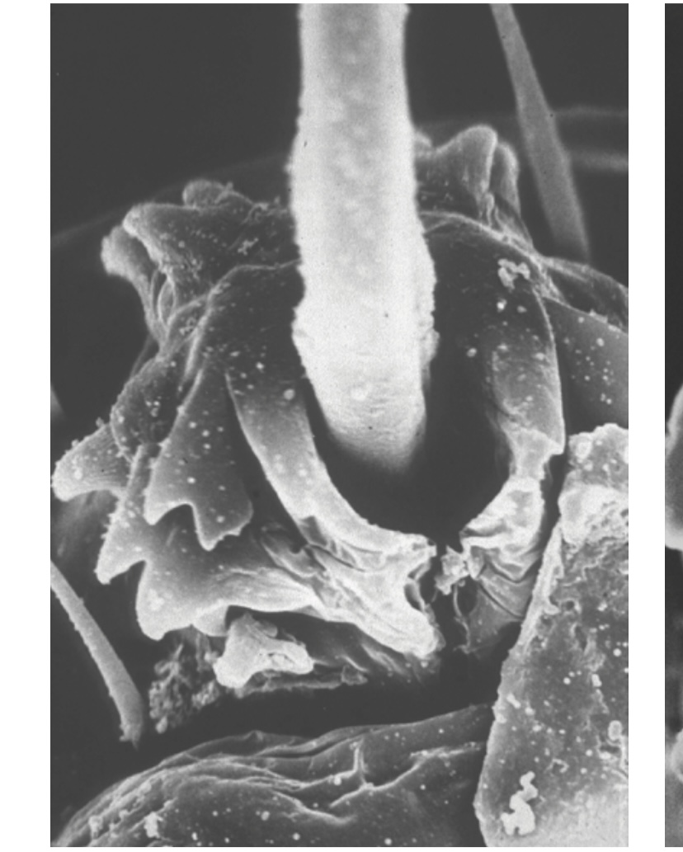
Notes:
The teeth cut into the epidermis and the haustellum is driven into the skin. It eventually comes to rest with the buccal teeth fully everted, anchoring the mouthparts

Slide 6
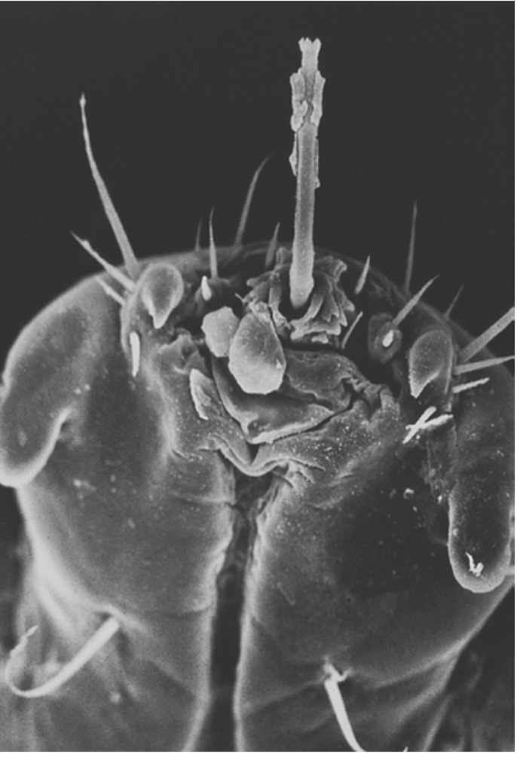
Notes:
Once fixed in the skin, a bundle of stylets is pushed forward through the opening in the haustellum by protractor muscles within the head of the louse (Figure 34.12c). The stylets are advanced into the dermis as a single bundle or fascicle, and probe for a small blood vessel.

Slide 7
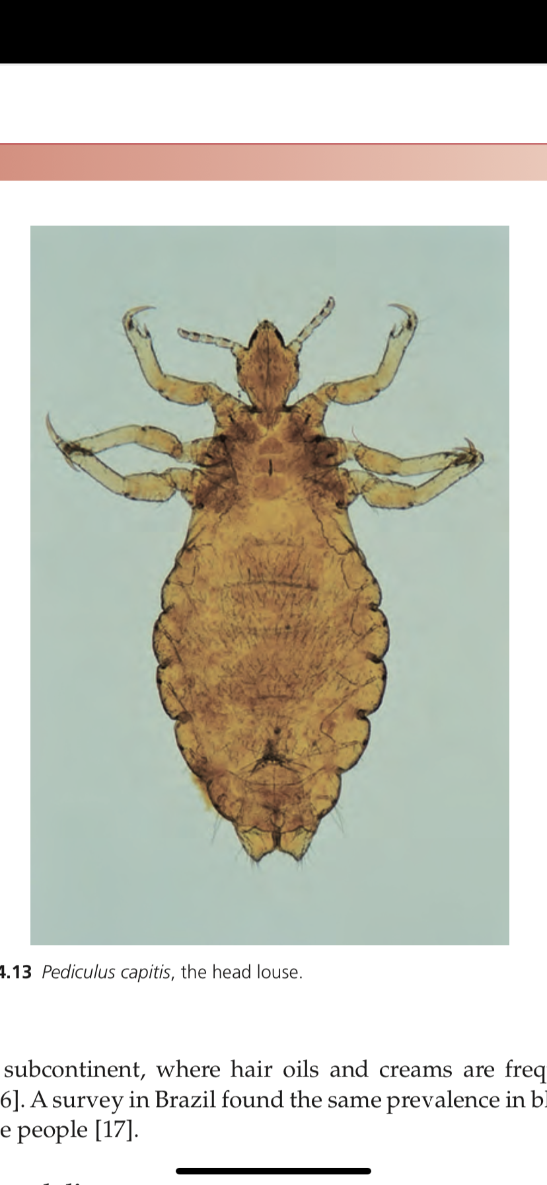
Head lice (pediculus capitis)
Incidence and prevalence
Developed and developing countries
Age/sex
3-11 years
Girls>boys
Longer hair = more louse
Ethnicity
Black americans
Black africans
Brazil
Indian subcontinent
Notes:
Incidence and prevalence [5,6,7]
The head louse has a worldwide distribution, and head louse infestation (pediculosis capitis) is common both in developed and developing countries. However, precise data on current prevalence are relatively sparse. The traditional perception of head lice as a parasitosis exclusively associated with schoolchildren of low socioeconomic status must now be challenged [8].
High rates of head louse infection have been reported from the USA, Canada and several other countries;
In the UK, prevalence is 2%, with an annual incidence of 37% [9]. In Australia, the reported prevalence in schoolchildren is 13%; in Brazil, a prevalence of 43% in a slum and 28% in a fishing village was shown in 2005 [10]; and in China, the prevalence is 14% (range of 0–52%) [11].
Head lice more in kids 3 to 11 and more in girls than boys.
Behaviour pat- terns in girls and boys at different ages probably influence rates of infection [12]. For example, in primary schools, children are organized into small groups around desks, and head to head contact is frequent. In addition, hair contact is probably more likely between girls than boys. Older children tend to be more independent, and more separated from their peers. The contri- bution of hair length to infection is debatable. Some studies have not shown any correlation between hair length and louse infection rates, but in others children with longer hair have had higher infection rates. A survey from Israel, in which detection of infection was by means of a louse comb, rather than direct visual inspection, found a significantly higher infection rate in children with long and medium length hair than in those with short hair [13].
Several authors have noted a low incidence of head louse infection in black Americans [14,15], although infection rates in black Afri- cans are high [5]. It has been suggested that the use of pomades (styling wax) Indian subcontinent, where hair oils and creams are frequently used [16]. A survey in Brazil found the same prevalence in black as in white people [17].
by black Americans provides an environment unsuited to establish- ment of infestation [14], but head lice are quite common in the Indian subcontinent, where hair oils and creams are frequently used [16]. A survey in Brazil found the same prevalence in black as in white people [17].

Slide 8
Associated diseases
Bartonella quintana
Acinetobactor baumanii
Notes:
Associated diseases
Head lice are not known to transmit any human pathogens. However, Bartonella quintana has been detected in the head lice of homeless individuals and Nepalese slum children [18,19]. In a study in Paris in 2008–09, Acinetobacter baumanii, but not B. quin- tana, was detected in 95 samples (33%) from a total of 288 DNA samples from adult head lice collected from the heads of school- children. The significance of the finding of A. baumanii in head lice is uncertain [20].
pathophysiology [2,7,21–23]
The adult female is a greyish white insect 3–4 mm long (Fig- ure 34.13). The male is slightly smaller. The claws on the legs are adapted for clinging to hair. During her lifespan of approxi- mately 40 days, the female lays an average of about seven eggs daily. The eggs are cemented to hair shafts with a chitinous cement material secreted by the female’s accessory glands [23] (Figure 34.14a). In temperate climates, in order to provide a suit- able temperature for incubation, the eggs are attached to hair close to the surface of the scalp. They are oval, flesh coloured and have a lid (operculum) capping the free end of the egg (Fig- ure 34.14b). The operculum is pushed off by the emerging louse nymph. Once the louse has emerged, the empty egg case or ‘nit’ appears white, and is easier to see than the intact eggs close to the scalp surface. Eggs hatch in about 8 days and, following

Slide 9
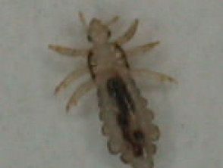
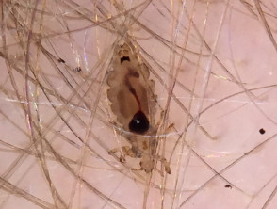
Pathophysiology
Female
Male
Life span
Number of eggs
Notes:
The adult female is a greyish white insect 3–4 mm long (Fig- ure 34.13). The male is slightly smaller. The claws on the legs are adapted for clinging to hair. During her lifespan of approxi- mately 40 days, the female lays an average of about seven eggs daily.

Slide 10
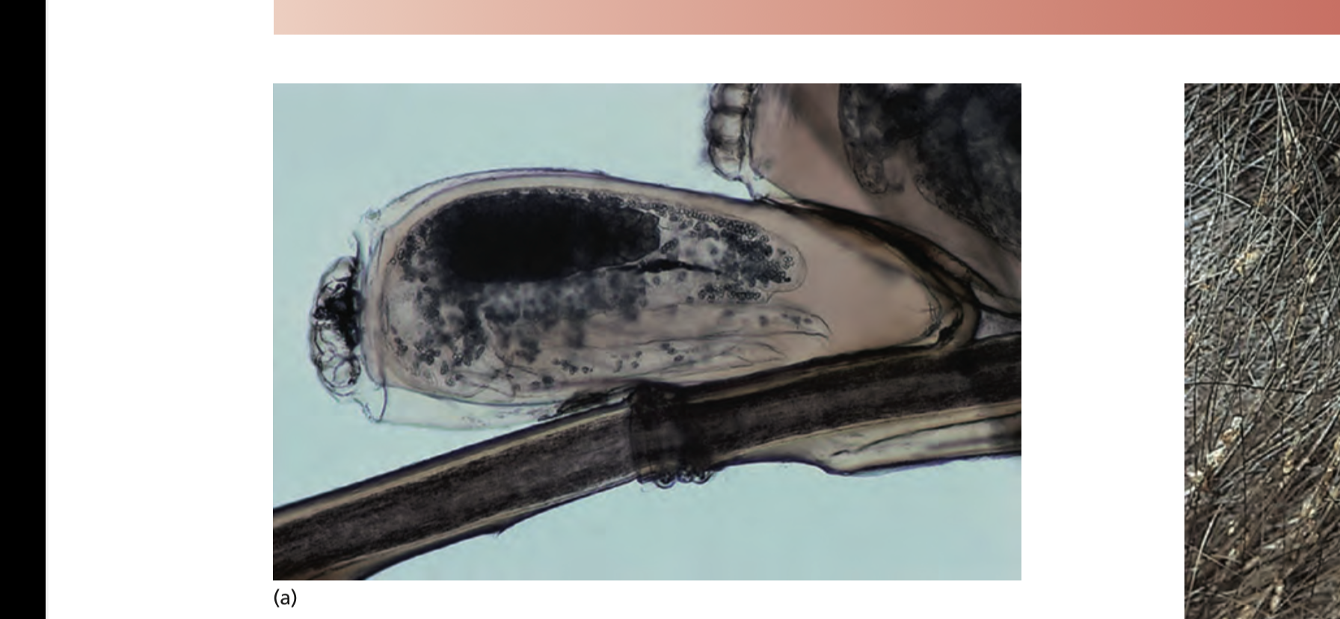
Citinous material
Eggs attachment
Notes:
The eggs are cemented to hair shafts with a chitinous (polymer of nitrogen containing poly saccharide making a tough protective covering) cement material secreted by the female’s accessory glands [23] (Figure 34.14a). In temperate climates, in order to provide a suit- able temperature for incubation, the eggs are attached to hair close to the surface of the scalp.

Slide 11
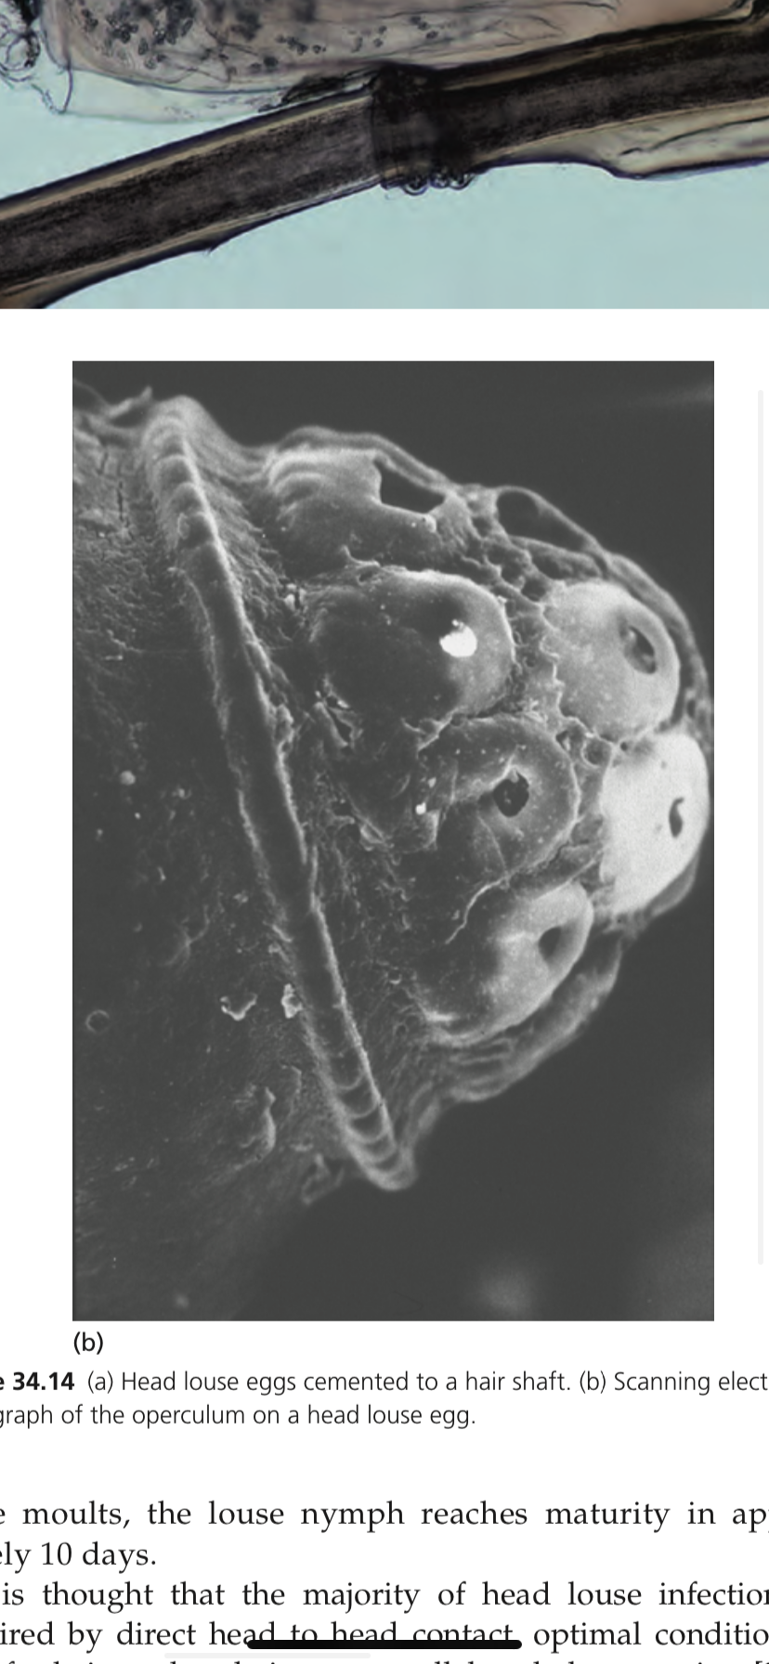
Operculum
Nit
Eggs hatch
Nymph
Louse spread
Notes:
They are oval, flesh coloured and have a lid (operculum) capping the free end of the egg (Fig- ure 34.14b). The operculum is pushed off by the emerging louse nymph. Once the louse has emerged, the empty egg case or ‘nit’ appears white, and is easier to see than the intact eggs close to the scalp surface. Eggs hatch in about 8 days and, following
three moults, the louse nymph reaches maturity in approxi- mately 10 days.
It is thought that the majority of head louse infections are acquired by direct head to head contact, optimal conditions for transfer being when hairs are parallel and slow moving [24]. In developing countries, spread of lice is encouraged by poverty, poor hygiene and overcrowding. Lack of hygiene alone does not encourage head louse infection.
There are conflicting opinions about the importance of fomites in transmission of head lice [25], and in practice the putative role of caps, scarves, combs and brushes is difficult to confirm or refute.

Slide 12
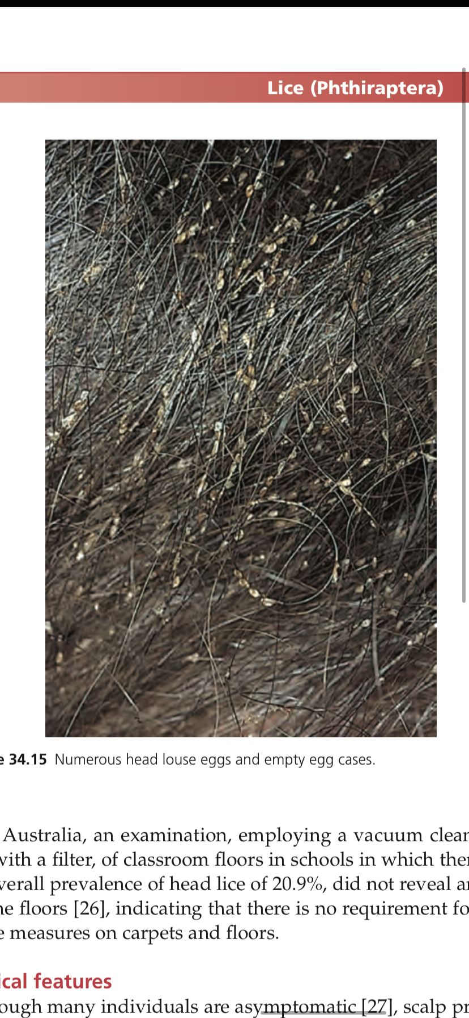
Numerous head louse and empty egg cases
Notes:
In Australia, an examination, employing a vacuum cleaner fit- ted with a filter, of classroom floors in schools in which there was an overall prevalence of head lice of 20.9%, did not reveal any lice on the floors [26], indicating that there is no requirement for anti‐ louse measures on carpets and floors.

Slide 13
Clinical features
Scalp pruritis
Sec bacterial infection
Scalp impetigo
Pruritic papules > nape of neck
Generalized pruritic eruption
Plica plonica
Nits/ pseudonits/ hair spray
Notes:
Although many individuals are asymptomatic [27], scalp pruritus is the characteristic manifestation of head louse infection. Second- ary bacterial infection may occur as a result of scratching, and con- comitant head louse infection must always be considered in cases of scalp impetigo. Pruritic papular lesions may occur on the nape of the neck, and occasionally a generalized non‐specific pruritic eruption develops [28]. In severe neglected cases, pus and exudate may produce matting of the hair – a state that has been termed ‘plica polonica’, from its prevalence in Poland in the early part of the 20th century. However, matting of the hair can occur in the absence of louse infection, and it has been suggested that this term should be discarded [29].
The empty egg cases (nits) occur in greatest density on the parietal and occipital regions (Figure 34.15). However, on naked‐ eye inspection, they may be confused with peripilar keratin casts (‘pseudonits’; hair muffs) [30,31] or dried globules of cheap hair lacquer. Cheap hair spray
Pseudonits: characterized by asymptomatic, minute, semifirm, tannish, discrete, freely movable, cylindrical masses, distributed along the scalp hairs.

Slide 14
Investigations
Detection of lice and nymphs
Reliable method of diagnosing
Detection combing
Notes:
Detection of adult lice and nymphs provides evidence of an ‘active’ infestation, whereas the presence of eggs and egg cases alone merely indicates that infection has occurred at some time.
The most reliable method of diagnosing current active infestation is by detection combing, which has been shown to be superior to direct visual examination of the hair and scalp [13,32,33,34]. This is an important criterion for several reasons:
1 Individuals who do not have evidence of active infestation should not receive chemical treatment [34].
2 Participants in clinical trials of pediculicides should have live lice present on the head before enrolment, not just eggs alone.
3 Children who do not have evidence of active infestation may be inappropriately excluded from school [34,35,36].

Slide 15
Principles of management
Safe, harmless, readily available, easy to use and inexpensive.
Repeat 7 to 10 days
Lotion and liquid > shampoo
Aqeous > alcoholic solutions
Treating family memebers
Removal of nits
Treatment success detection combing after 2 and 7 day interval
Infested material washed and bagged
Hair grooming aids discarded or decontaminated
Notes:
Principles of management [6,7,22,34,37,38–40]
The ideal treatment should be completely safe, free of harmful chemicals, readily available, easy to use and inexpensive. .
General guidelines for the use of chemical pediculicides have included advice to repeat treatment after 7–10 days [43] because of limited ovicidal activity,
and that lotion and liquid formulations are preferable to shampoos as the latter expose the insects to rela- tively low concentrations of insecticide with subsequent poor effi- cacy and which, in the long term, might favour the development of resistance.
Preparations with an aqueous basis are less likely to irritate an excoriated scalp than alcoholic solutions, do not irritate the bronchi of asthmatics and are not flammable. Sprays are not suitable for people with asthma.
Family members should be examined, and treated only if they show evidence of active infestation by the presence of live lice.
Nits may be removed with a fine‐toothed comb.
Treatment has most chance of success if it is applied or undertaken correctly and if all affected individuals in the household are treated simultaneously.
People should be advised to check whether treatment was successful by detection combing on day 2 after completing a course of treat- ment, and again after an interval of 7 days
All materials that touched the heads of infested persons, such as hats, scarves, bedding and cushions, must be thoroughly washed in hot water (50°C at least) [44]. Any infested materials kept in plastic bags for 3 days may be safely used.
Hair grooming aids, such as brushes, combs and curlers, should be discarded or decon- taminated with an insecticidal powder.

Slide 16
First line
Dimethicone
Bug busting
Isopropyl meristate
Cyclomethicone
Coconut or malathion
American academy of pediatrics
1% permethric or pyrethrin
Switch to malathion
Notes:
First line
In the UK, the choice of a particular treatment strategy will depend on age, individual or parent preference, cost and success or failure with previous treatments. There is limited evidence to support the effectiveness of each treatment option recommended. No option is clearly superior or inferior to the others in terms of effectiveness and there are advantages and disadvantages for each method, and no method can guarantee success. Treatment options include: dimethicone, bug busting, isopropyl meristate and cyclomethicone, coconut or malathion (http://cks.nice.org. uk/head‐lice last accessed October 2014). The 2015 American Academy of Pediatrics recommend the use of 1% permethrin or pyrethrin insecticide as first line therapy [74]. In case of therapeu- tic failure, before considering acquired resistance to insecticides other options should be discarded, e.g. low compliance, wrong formulation, insufficient regimen, reinfestation (Box 34.1). If resist- ance in the community has been proven or live lice are present 1 day after the completion of treatment, a switch to malathion may be necessary.
Pyrethroids are neurotoxins that modify louse voltage‐gated sodium channel (VGSC), causing spastic paralysis and death. Permethrin resistance in head lice is mostly conferred by the knockdown resistance (kdr) trait, conferred by three point muta- tions (M815I–T917I–L920F) in the VGSC α‐subunit gene [53]. The prevalence of kdr‐like louse alleles is not exactly known, but seems to be extremely variable, depending on the geographical area [54,55].
Coconut‐derived emulsion shampoo, ben- zyl alcohol lotion 5% and spinosad cream rinse may be used too [65–67], as well as isopropyl myristate and cyclomethicone together [68].

Slide 17
Second line
Wet combing
Dimethicone
Other topical agents
Notes:
Second line treatment depends on the first line used in the UK. In the USA, second line options include wet combing or treatment with dimethicone or other topical agents, depending on the availability of the agents in the country.
WET COMBING :method has been promoted as a treat- ment for head lice. The technique involves ordinary shampooing of the hair, followed by the application of generous amounts of conditioner, and combing using a fine‐toothed comb to remove lice. This procedure is repeated every 4 days for 2 weeks [56–60]. Shaving the head is usually not acceptable because of psychosocial impact.
Dimethicone lotion (4% long‐chain linear silicone in a vola- tile silicone base) [61–63] blocks the outer respiratory tract of lice and therefore water excretion, which causes physiological stress and death
Other readily available occlusive substances such as oils and margarine have been suggested but information on effectiveness is anecdotal. In one study that examined vinegar, isopropyl alco- hol, olive oil, mayonnaise, melted butter and petroleum jelly, the use of petroleum jelly caused the greatest egg mortality, allowing only 6% to hatch [69].

Slide 18
Third line
Ivermite
Notes:
Ivermectin if available (depending on the country) should be the last choice, whether topical (for still‐infested persons) or oral (especially for mass treatment, off label).
It induces arthropod and nem- atode paralysis and death by interrupting neurotransmission, acting on glutamate‐gated or γ‐aminobutyric acid–gated chlo- ride channels. In a recent cluster‐randomized controlled trial of patients with head lice refractory to insecticides, a single oral dose of ivermectin 400 μg/kg repeated within 7 days achieved higher louse‐free rates on day 15 than 0.5% malathion (95.2% versus 85.0%) and their household members (92.4% versus 79.1%) [71]. This is an ‘off‐label’ use of such dosage of ivermectin and its safety in patients with head louse infestation remains unknown. Topi- cal ivermectin has shown greater efficacy than placebo in a recent

Slide 19
Causes of therapeutic failure
Non‐compliance
Resistance
Inappropriate instructions on head lice products or from health
professionals
High cost of products
Misdiagnosis
Psychogenic itch
Incomplete ovicidal activity
Inappropriate preparation (e.g. shampoo)
Insufficient dose–time, frequency and/or quantity of product
applied
Failure to retreat
Reinfestation
Live eggs not removed
Misunderstanding the instructions

Slide 20
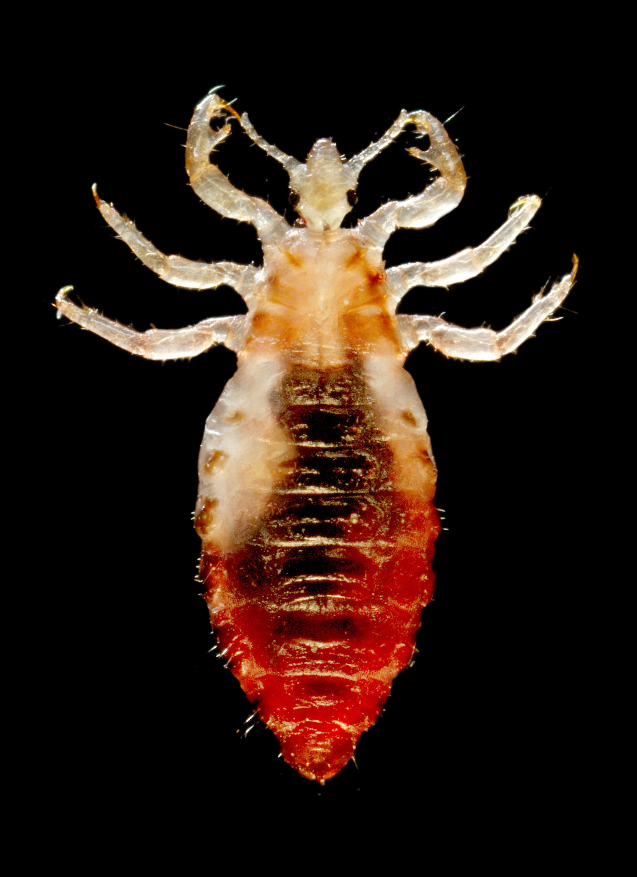
Clothing/body lice (pediculus corporis)
Incidence and prevelence
Poor socioeconomic conditions
Homeless
Refugee camps
Louse borne infectios diseases on the rise
Associated diseases
Epidemic thypus by Ricettsia prowazekii
Trench fever by bartonella quintana
Notes:
Because body lice are associated with poor socioeconomic condi- tions, with infestation occurring only when clothes are not changed or washed regularly (pediculosis vestimenti), indigent, homeless and refugee‐camp populations are predominantly affected. Body louse prevalence is underestimated in more developed countries and, as the number of homeless people increases, louse‐borne infectious diseases are also on the rise.
The first is the epidemic typhus, caused by Rickettsia prowazekii (see Chap- ter 26). Symptoms include headache, fever, confusion and rash. The disease usually becomes epidemic in populations living in poor crowded conditions. A huge outbreak of epidemic typhus (and trench fever but not relapsing fever) occurred in 1995–97 in Burundi, first affecting prison inmates, then more than 45000 camp refugees
Trench fever is related to Bartonella quintana. The disease was first recognized during World War I. Symptoms include fever, myalgias, headache, meningoencephalitis, chronic adenopathies(large or swollen lymph nodes) and transient maculopapular exanthema, but may be asymptomatic. Endocarditis may sometimes occur [78]. Home- less people with chronic alcoholism are at ris

Slide 21
Pathophysiology
Identical to head louse except slighlty larger
Habitat
Eggs
Seams favoured site
Thrives in lack of hygiene
High themperature and iron
Number of lice varies from individual to individual
Notes:
pathophysiology
Size: This louse is almost identical in appearance to the head louse, except that it is usually slightly larger, and its development is simi- lar.
Habitat:
Its natural habitat is the clothing of its host, and it only visits the skin to feed.
Its eggs are cemented to clothing fibres, with a prefer- ence for clothing close to the skin.
Seams are a favoured site for ovi- position.
It thrives in situations where normal hygiene is lacking.
The clothing louse and its eggs will not survive high‐temperature washing and ironing,
and it is intolerant of temperature changes in its environment.
It is therefore a parasite of individuals whose clothing is rarely changed or washed. The number of lice and eggs on the clothing varies greatly. In most infected individuals, the population is small, but in some there may be thousands of lice.

Slide 22
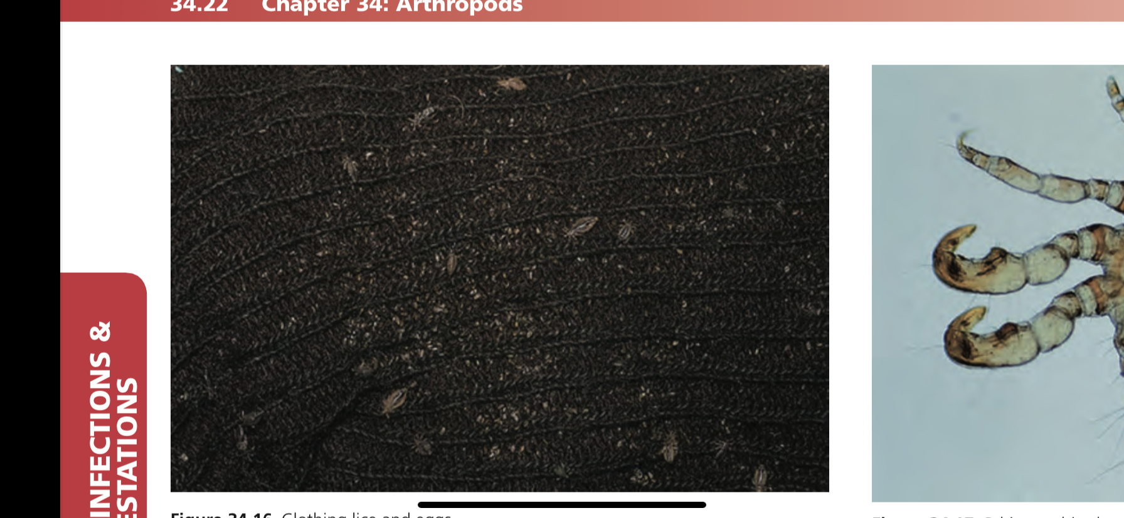
Clothing lice and eggs

Slide 23
Clinical features
Itching
Salivary antigens
Sensitized
Excoriations
Bacterial infections
Vagabonds disease
Notes:
In most infected persons, itching is the principal complaint. Pru- ritus is the result of sensitization to louse salivary antigens. Others,
who have not become sensitized or have acquired tolerance to the bites, are asymptomatic. The body is often covered in excoriations, and there may be secondary bacterial infection. In those who have harboured clothing lice for long periods of time the skin is often hyperpigmented (so‐called ‘vagabonds’ disease’; morbus erro- rum), and this is probably a post‐inflammatory phenomenon. Lice and eggs should be sought in the clothing (Figure 34.16).
Body louse infestation is also known as vagabond disease, and individuals who have an infestation for many years can develop a condition termed vagabond skin. The skin becomes thickened and darkened after years of bites and subsequent rubbing and excoriations.

Slide 24
Management
Antibiotics
Decontaminate bed clothing
Pyrethoids or malathion 8-24 hrs
Ivermite
Fumigation
Infested material bagged
Notes:
Management [6]
Unlike the other forms of louse infestation, the lesions caused by body lice are the main focus of treatment. Antibiotics are needed to treat louse‐borne infectious disease.
Bed linens and clothes should be systematically decontaminated, and this action suffices for some physicians.
Others recommend thorough washing of the body with soap followed by application of pyrethrins/pyrethroids or mala- thion for 8–24 h.
Recently, ivermectin (3 doses of 12 mg each, given at 7‐day intervals) was shown to reduce the number of body lice infesting a population of homeless men.
Such treatment may be effective in limiting the viability of body lice in patients living in an institution or routinely returning to a treatment centre or shelter [80]. Depending on the geographical location of the infested indi- vidual and his or her contact with other similarly infested individ- uals, the physician should consider the possibility of louse‐borne disease.
Infested furniture, mattresses and box springs should be discarded or fumigated to destroy lice and nits. Infested materials sealed in plastic bags may be used safely after 3 days.

Slide 25
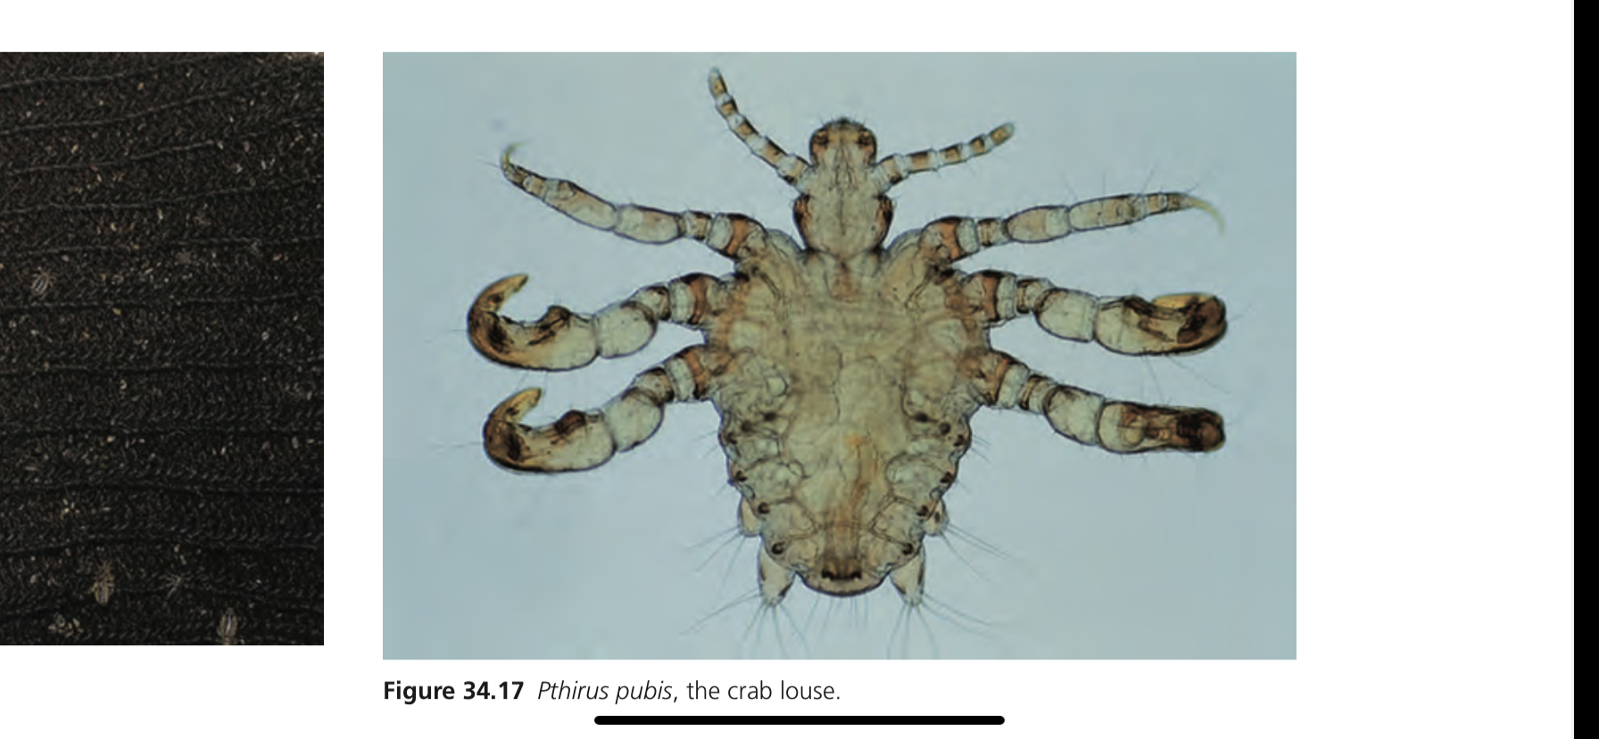
Crab lice (phthiriasis pubis)
EPIDEMIOLOGY:
Sexually transmitted
Sexually active adults
Reported in GUM clinics
Brazillian wax
Other STIs screening
Notes:
EPIDEMEOLOGY:
Crab lice are transmitted by close physical contact, usually sex- ual, and infection with these lice occurs most frequently among
sexually active young adults. It is standard practice in genito‐uri- nary medicine (GUM) clinics to monitor prevalence rates of sexu- ally transmitted infections, including crab lice. A marked decline in the number of female cases in one department in the UK led to the suggestion that waxing of pubic hair, particularly the fashion known as the ‘Brazilian’, was an important factor responsible for the decline [81]!
Because many patients with crab louse infection who attend GUM clinics are found to be suffering from other sexually trans- mitted infections [82,83], screening for these is indicated.

Slide 26
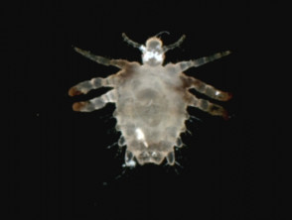
Pathophysiology
Appearance
Squat
Pincer like claws
Notes:
pathophysiology
The crab louse is quite distinctive in appearance (Figure 34.17) and habits from Pediculus. Its body is squat, and the second and third pairs of legs carry heavy, pincer‐like claws. When static, the crab louse uses these huge claws to grip adjacent hairs close to the skin surface (Figure 34.18). Its eggs are squat and bulging compare to Pediculus. They are light brown in colour and, like those of the head louse, are cemented to the hair of the host (Figure 34.19). It is adapted to living in hair of a particular density. Scalp hair, except at the scalp margins, is too dense, but the crab louse will colonize

Slide 27
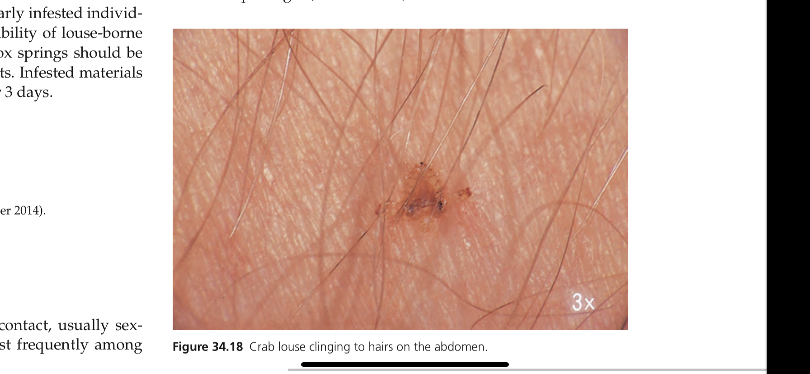
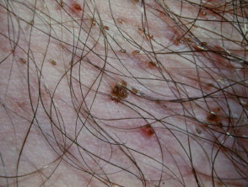
Crab louse adherent to abdominal hair
Notes:
When static, the crab louse uses these huge claws to grip adjacent hairs close to the skin surface (Figure 34.18). Its eggs are squat and bulging compare to Pediculus.
They are light brown in colour and, like those of the head louse, are cemented to the hair of the host (Figure 34.19). It is adapted to living in hair of a particular density.
Scalp hair, except at the scalp margins, is too dense, but the crab louse will colonize axillary hair, eyebrows, eyelashes, beard hair and hair on the trunk and limbs, in addition to pubic hair.
It is mainly sedentary, but becomes active at night when the host is sleeping [84].
It moves by transferring its grip from one hair to another.
The crab louse has difficulty moving when taken from its host, whereas head and clothing lice are quite mobile off the host.

Slide 28
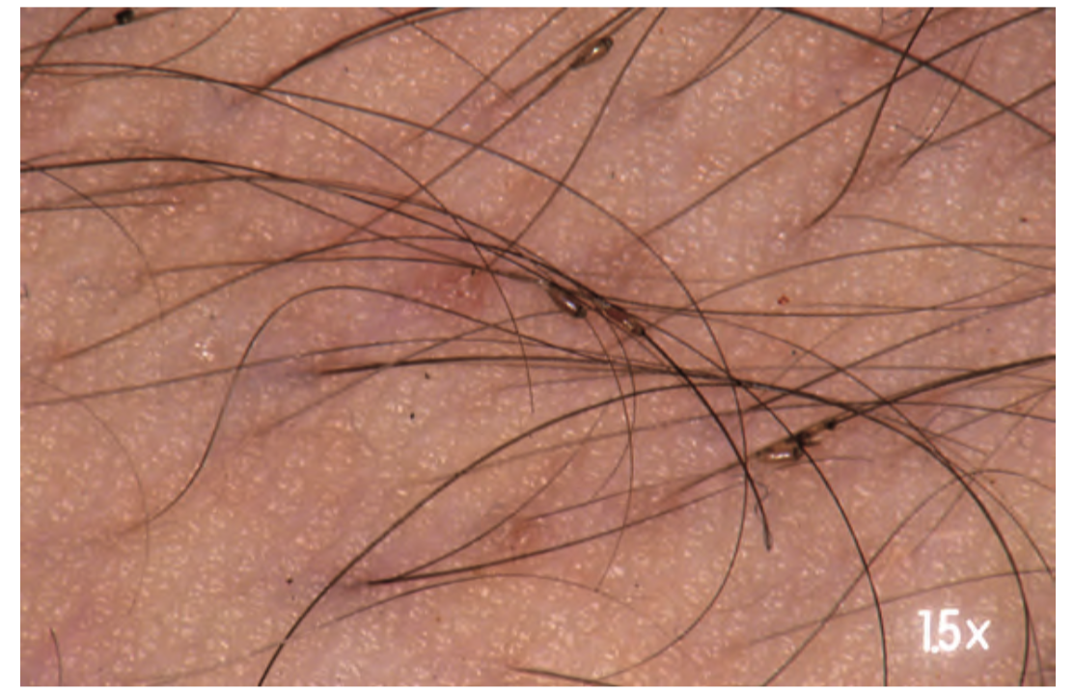
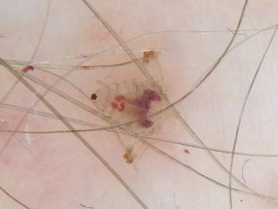

Slide 29
Clinical features
Itching evening and night
Lice close to skin surface
Eggs attached to shaft
Louse feaces
Colonise other places
Inappropriate use of steriods
maculae caeruleae
Bullous lesions
Indicative of sexual abuse in kids
Notes:
Itching, mainly in the evening and at night, is the principal symp- tom.
Close inspection of affected areas will reveal lice grasping hairs close to the skin surface, and louse eggs attached to the hair shafts.
Louse faeces are often visible as rust‐coloured speckles on the skin and hair, and the underclothes may be spotted with altered blood.
When crab lice are discovered on the pubic area, other hairy areas of the body should be examined, as these lice may colonize eyebrows, eyelashes (Figure 34.20), beard, axillae, areolar hair and the scalp margins [85,86].
In heavy infections in men, the hair on the trunk and limbs may be extensively colonized. A case has been reported in which the presence of an enormous population of lice was attributed to inappropriate use of topical steroids [84].
Blue‐grey macules (maculae caeruleae) are occasionally seen on the skin [87], but their precise pathogenesis is unknown.
Bullous lesions attributed to crab lice have been reported [88,89].
In children, crab lice may colonize the eyelashes and scalp [90]. Infection in children is usually acquired by close physical contact with infected parents. As an isolated finding, it is not indicative of sexual abuse, although this may occasionally occur [91].

Slide 30
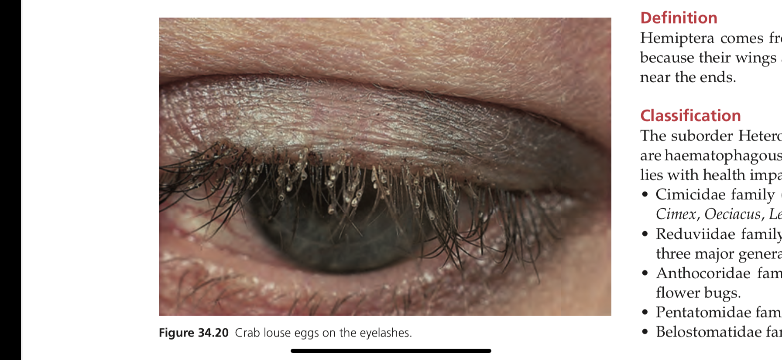
Crab louse on eye lashes

Slide 31
Management
Insecticides same as pediculosis capitis
Treat all hairy areas
Shaving
Eyebrows – 5% permethrin or petroleum jelly
Oral ivermite
Sexual contact examined and treated
Wash bedding and clothing
Child abuse
Screen STIs
Treatment failure
Notes:
Management [92,93]
Pubic lice are treated with the same insecticidal creams or lotions as pediculosis capitis, with a second application after 7–10 days as the products have a poor ovicidal activity.
Resistance to pyrethrins has been shown [94].
All hairy areas of the body should be treated at the same time.
Shaving is sometimes necessary when nits are plentiful.
Infestati
ons of the eyelashes should be treated with permethrin 5% cream (washed off after 10 min) or only with petrolatum (applied twice a day for 8–10 days), followed by mechanical removal of the nits [95–97].
Oral ivermectin has been used by some authors [98].
As in other louse infestations, all sexual contacts should be exam- ined and treated when necessary.
Bedding and clothes should be washed in hot water (50°C). Prepubertal children presenting with pubic louse infestations should be evaluated with regard to pos- sible child abuse [91].
Treatment failure is usually a result of an untreated hairy area or reinfestation from an untreated sexual con- tact. I
n addition, patients should also be screened for associated sexually transmitted disease.

Slide 32
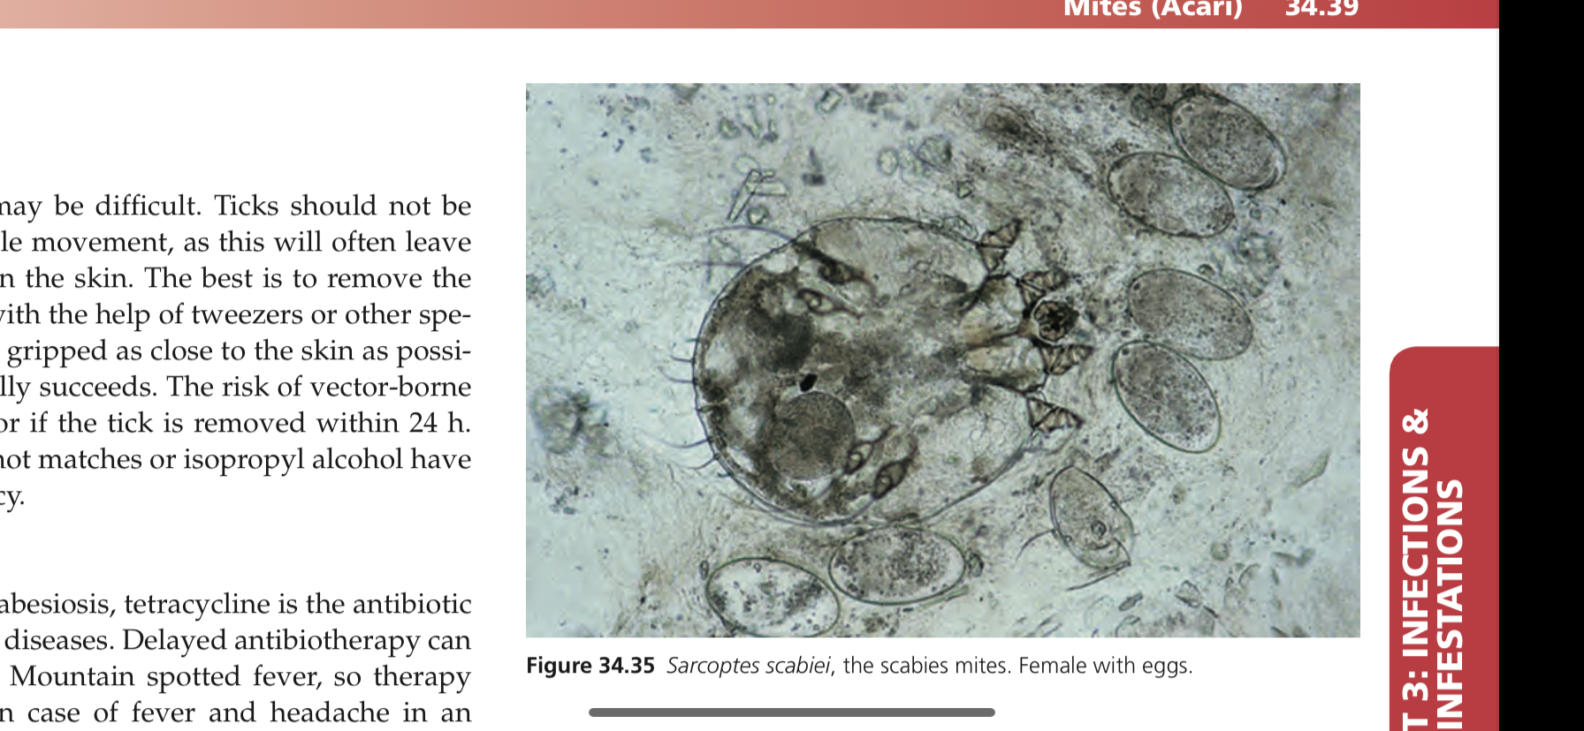
Family sarcoptidae: human classical scabies
Definition
Sarcoptes scaiei
Notoedres cati
Intoduction and general discription
Ectoparasite
Female mite size
Colour
Legs
Bristles
Copulation
Eggs
Lifespan
Notes:
definition
Scabies in humans and other animals is caused by mites of the family Sarcoptidae, whichincludes Sarcoptes scabiei, the scabies mite, and Notoedres cati, a mange mite of cats.
The Sarcoptes causing scabies in humans and sarcoptic mange in many other animals are physiological variants of a single species, S. scabiei. Their host specificity is not complete, but they usually survive for only a short period on another host.
introduction and general description [1–7,8,9–11]
ECTOPARASITE: Scabies is an ectoparasitic infection caused in humans by the Sarcoptes scabiei var. hominis.
SIZE: The adult female measures approx- imately 0.4 mm long by 0.3 mm broad, and the smaller male 0.2 mm long by 0.15 mm broad.
COLOUR: The body is creamy white and is marked by transverse corrugations, and on its dorsal surface by bristles and spines.
LEGS: There are four pairs of short legs; the anterior two pairs end in elongated peduncles tipped with small suckers.
BRISTLES : In the female, the rear two pairs of legs end in long bristles (setae) (Figure 34.35),
whereas in the male bristles are present on the third pair and peduncles with suckers on the fourth.
COPULATION: occurs in a small burrow excavated by the female. The burrow is not confined to the stratum corneum, but is inclined downwards into the epidermis.
EGGS: Approximately 40–50 eggs are laid by each female during a lifespan of 4–6 weeks.
LIFESPAN: Eggs hatch after 3–4 days into larvae, which dig new burrows closer to the skin

Slide 33
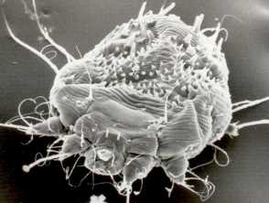
Adult mites
Life cycle
Prefernce of site
No of mites
Concerns
Notes:
surface.
ADULT MITES; There, the larvae mature into adult mites in about 4 days.
The adults may then either stay in that host or be scratched off and transmitted to a new host.
Adult females can live in the host for up to a month.
LIFE CYCLE: The life cycle lasts around 14–21 days.
PREFERNCE OF SITE: The mites show a preference for certain sites in which to burrow, and appear to avoid areas with a high density of pilosebaceous follicles.
NO OF MITES: The average number of adult female mites on an individual suffer- ing from the common form of scabies is about 12 [10,11]. Only in crusted scabies are large numbers of mites present.
CONCERNS; Individually, pruritus represents a nuisance. The risk of contagiousness, impe- tiginization, psychosocial impact and potential associated sexu- ally transmitted diseases constitute a concern.

Slide 34
Incidence and prevalence
100-300 million people affected
High incidence rates with 2 world wars
Herd immunity
Prevalence in poor countries
Notes:
Incidence and prevalence
Scabies affects around 100–300 million people worldwide, but accurate figures of its prevalence are difficult to obtain [12]. A study by Downs et al. [17] on data collected in the UK between 1967 and 1996 showed a high incidence of scabies in the late 1960s and early 1970s, a drop during the 1980s and a rise throughout the 1990s. A Danish study, which assessed data collected between 1900 and 1975 [18], showed incidence rates in the 1960s and 1970s similar to those in the UK study, and high incidence rates during the two World Wars. However, a rise in incidence started 2 years prior to hostilities on both occasions. Data from records kept in Edinburgh, UK, also showed rises in incidence associated with the World Wars, but coinciding precisely with their onset [19].
Several other studies have noted a seasonal variation [20,21]. A proposed explanation for the cyclical fluctuations in prevalence in developed countries is the ‘herd immunity’ theory [13,22]. This suggests that an epidemic of scabies confers a degree of immu- nity, so that a further epidemic will not occur until a new, suscep- tible population has arisen.
However, the persistent high levels of
scabies in many underdeveloped countries, without any marked cyclical variation, are evidence against this view. Many factors have been suggested to determine the epidemiology of scabies in impoverished communities, including social attitudes, population movements, malnutrition, lack of access to health care, inadequate treatment and deficient hygiene but so far these assumptions have not been substantiated [23].

Slide 35
Age ,sex ratio and ethnicity
All age groups
Nursing homes
30% carehomes/hospitals
Mothers > father
Ethnicity depends on customs and social factors
Whites and hawaiians than japanese and filipinos
Notes:
Age
Scabies occurs in all age groups. However, it becomes frequent in the elderly in residential and nursing home environments. In a questionnaire survey of dermatologists in UK hospitals, reported in 2000 [24], respondents estimated that approximately 30% of all cases of scabies they encountered occurred in institutions such as care homes and hospitals.
Sex ratio
The overall sex incidence is probably equal, even if mothers are more frequently affected than fathers in families.
Ethnicity
Whereas all ethnic groups are susceptible, there are some differ- ences which are probably related to customs and social factors rather than inherent susceptibility. Some reports suggested that black Americans appeared less susceptible [26,27], but this was disputed [28]. In a study of a multiracial population in Hawaii [29], scabies was far more frequent in white people and Hawaiians than in Japanese and Filipinos, and this was thought to be related to family size and social customs.

Slide 36
Pathophysiology
Transmission
Prolonged hand holding
Sexual contact
Survival away from host
Pruritis due to allergic sensitivity
Type of hypersensitivity
igE levels
genetic predisposition to disease severity
Notes:
TRANSMISSION: Scabies is usually transmitted by close physical contact, such as prolonged hand‐holding or the sharing of a bed. It is often sug- gested that fertilized female mites are responsible for transmission, although there is no firm evidence to support this contention, but it seems unlikely in view of their relatively small numbers and incli- nation to remain within their burrows.
SURVIVAL AWAY FROM CONTACT : Away from the host, scabies mites survive for 24–36 h at room conditions (21°C and 40–80% relative humidity) [32], and live mites have been demonstrated in dust samples collected in the homes of infected patients
PRURITIS DUE TO LLERGIC SENSITIVITY Allergic sensitivity to the mite or its products appears to play an important role in determining the development of lesions other than burrows, and in producing pruritus.
TYPER OF HYPERSENSITIVITY Evidence suggests that both immediate and delayed‐type hypersensitivity are involved .significantly elevated levels in many indi- viduals [35–37].
IGE LEVELS : Susceptibility or resistance to S. scabiei infection shows some genetic predisposition. This is hypothesized to correlate suscep- tibility to sever disease with the dominance of an IgE‐driven Th2 response or resistance to the infestation by an interferon‐γ domi- nated Th1 response. This may be modulated by cytokine regu- lation in the skin and other immunological control mechanisms [38]. Recent developments in scabies mite biology have shown that scabies can now be considered to be a complex interaction between host, parasite and their associated microbiomes. Animal and in vivo models of infestation should facilitate a better under- standing of these host–parasite interactions, which is critical to improving the treatment of scabies [39,40].

Slide 37
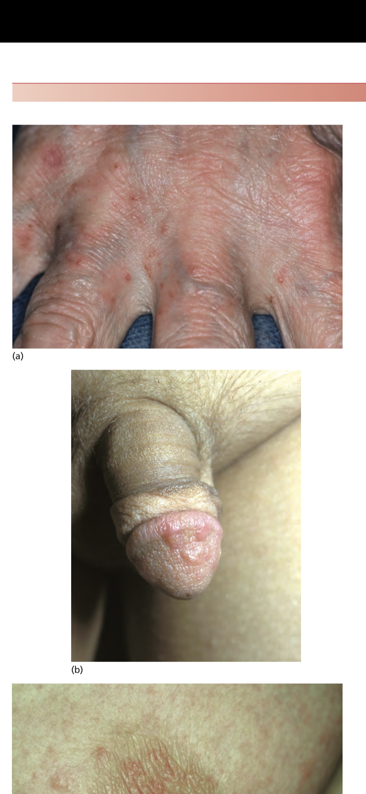
Clinical features
Face spared
Worse at night
Warm temp
Finger webs
Location
Typical lesions
Secondary lesions
Notes:
Itching is the most obvious manifestation of scabies, usually spar- ing the face in adult classic scabies. It is generally worst at night and when the patient is warm. The onset occurs 3–4 weeks after the infection is acquired. Reinfection of a previously cured indi- vidual, however, may provoke immediate symptoms [14]. Typical locations of lesions are the finger webs (Figure 34.36a),
LOCATION: ypical locations of lesions are the finger webs (Figure 34.36a), the flexor surfaces of the wrists, the elbows, the axillae, the buttocks and genitalia (Figure 34.36b) and the breasts of women (Figure 34.36c).
The typical lesions of scabies are burrows (Figure 34.36d,e), which appear as slightly raised brownish tortuous lesions. Inflammatory pruritic papules or nodules, sometimes surmounted by burrows, on the male genitalia are characteristic.
SEC LESIONS: Nodules are intensely itchy, and may persist for weeks or months after the scabies has been effectively treated [14]. Secondary lesions are not specific. They include excoriations, eczematization (Figure 34.36f) and impetiginization, and may occur anywhere.

Slide 38
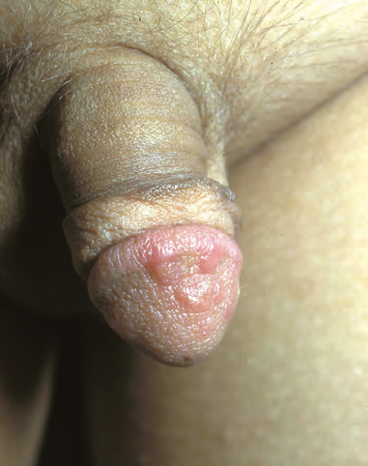
Purpuric papules and nodules on penis
Notes:
The genitalia of males should be therefore systematically examined once scabies is sus- pected as these lesions may provide an important diagnostic clue if burrows are absent or difficult to find.

Slide 39
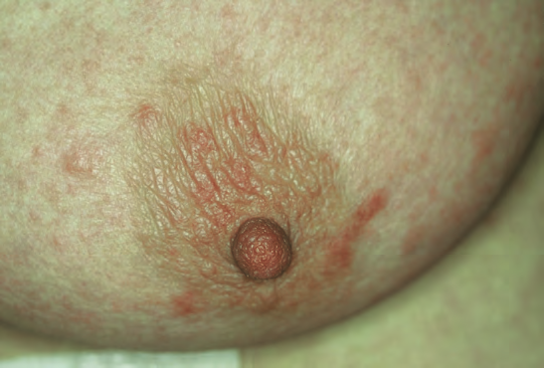
Papular lesions on the nipples and areaola

Slide 40
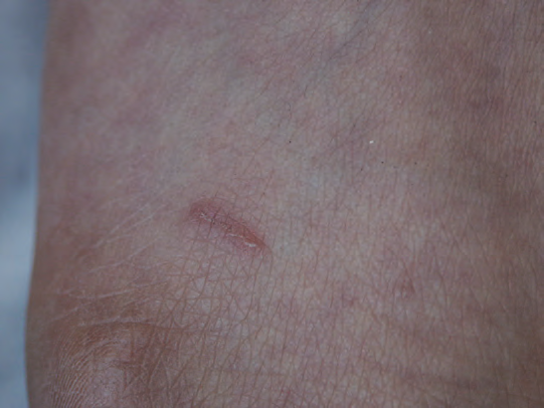
A typical linear burrow with a vesicle at the end

Slide 41
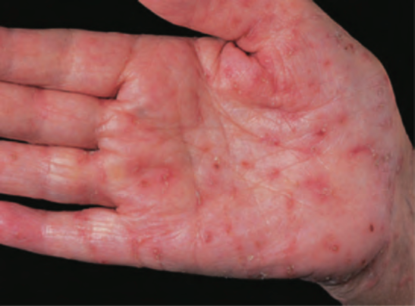
Numerous scabies burrows on the palm

Slide 42
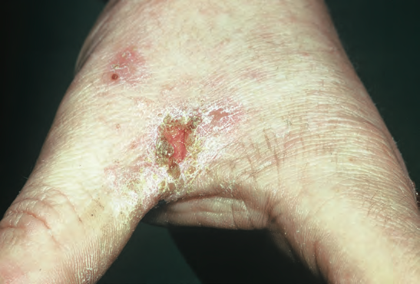
Chronic pruritis of scabies causing eczema due to scratching

Slide 43
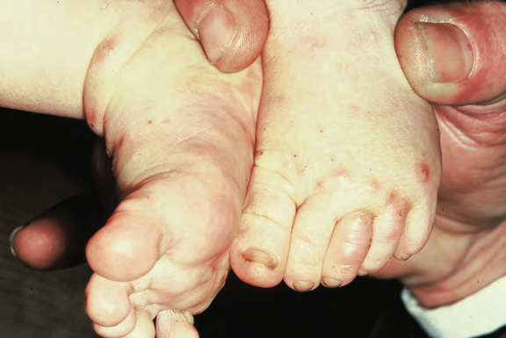
Clinical variants
Notes:
Scabies in an infant. Localization on the sole is not atypical in this form of scabies, nor is involvement of the face, scalp and palms.

Slide 44
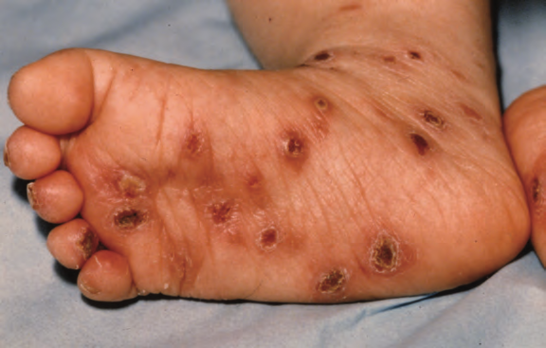
Foot of an infant with scabies superinfection presenting as impetigo

Slide 45
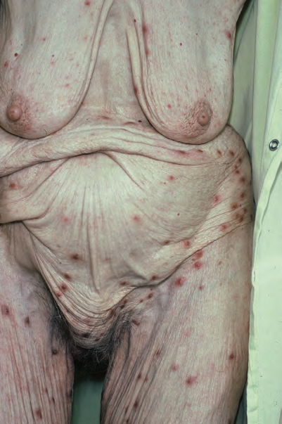
Atypical papular scabies in an elderly woman mistaken for senile pruritis

Slide 46
Complications
Eczematization
Scabies incognito
Sec infections
Sec impetigo
Glomerulonephritis
Notes:
Complications
In addition to these primary manifestations, secondary features may occur, and can confuse the clinical picture. Eczematous
changes are common, and may be widespread and severe. The inappropriate use of topical steroids may further modify the clinical picture to mimic other dermatoses (see section on crusted scabies below) – so‐called ‘scabies incognito’ [16]. Secondary infection, manifest as folliculitis or impetigo, may also be severe and extensive. In the tropics and subtropics, where nephritogenic strains of β‐haemolytic streptococci may be responsible for sec- ondary impetigo, haematuria‐related glomerulonephritis occurs as a complication of scabies [43].

Slide 47
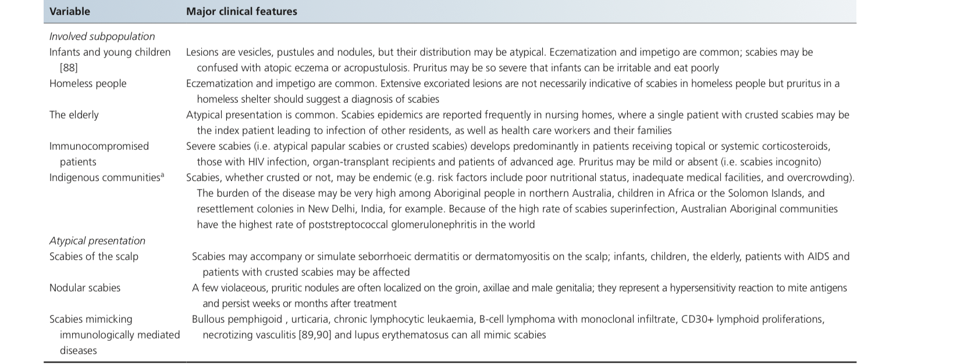

Slide 48
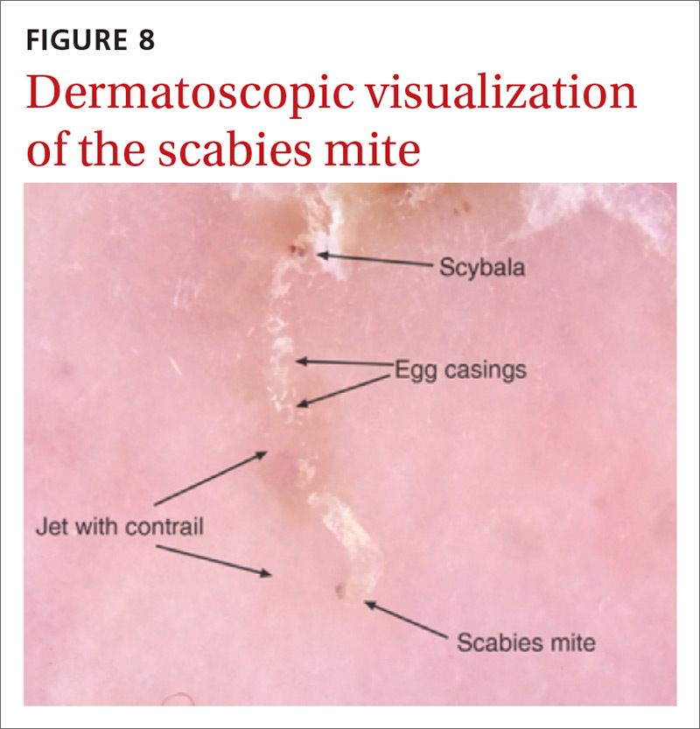
Investigations
History
Location genitals men, breast women
Microscopy burrows
Dermoscopy
Jet with contrail
Adhesive tape test
Skin biopsy
Confocal microscopy
Notes:
investigations [12,16,44,45,46]
The typical history of pruritus with nocturnal exacerbations, the presence of contact cases within the family and the distribution of the eruption of inflammatory papules, should suggest the diag- nosis. The presence of genital lesions in men or breast nodules in women is strongly suggestive. Absolute confirmation can only be made by the discovery of burrows and/or microscopic examina- tion.
A burrow is gently scraped off the skin with a blunt scalpel, and the material placed in mineral oil on a microscope slide. The presence of mites, eggs, fragments of egg shells or scybala con- firms the diagnosis. Failure to find mites is common and does not rule out scabies [12,46]. Parasitological confirmation of the diagno- sis should be made in all cases if possible. It is essential in cases of crusted scabies or scabies in health care settings.
Dermoscopy is useful for detecting burrows and visualizing their contents, the mite in its burrow resembling a ‘jet‐with‐contrail’ (40× magnification) [47]. More recently, it was shown that low‐ magnification (10×) standard handheld dermoscopy could be a valuable tool for diagnosing common scabies [48]. At low magni- fication, the circumflex accent‐like image (as the French letter ‘ô’) represents the head and the two pairs of front legs of the mite. It has been shown that sensitivity of this technique was 91% and specificity 86% [49].
Dermoscopy is less time‐consuming than skin scraping procedure because it allows a quick screening of a large number of sites.
It causes less discomfort for the patient, so it is also better accepted [49]. However, the use of dermoscopy is limited by the cost of the dermoscope and the sensitivity may decrease in inexperienced hands.
Adhesive tape test may be useful in particular situations. After firmly applying the adhesive side of the tape onto an appropri- ate skin lesion of patients, the tape is pulled off and transferred directly onto a slide for microscopy, affixing the adhered sepa- rated part of the corneal skin. This tape method is simple and may be useful for diagnosis of severe scabies infestation in long‐term nursing units [50]. However, its sensitivity is low [51].
These new methods (dermoscopy and adhesive tape test) may increase the sensitivity of skin scraping tests and limit false nega- tive results [49,51]. However, comparing the accuracy of different tests for diagnosing scabies remains elusive without a criterion standard [52,53].
A skin biopsy may confirm the diagnosis of scabies if a mite or parts can be identified. However, in most cases, the histology shows non‐specific features, with epidermal spongiosis, papillary oedema, and superficial and deep perivascular inflammatory cell infiltrates with numerous eosinophils [54]
dermoscopy enables the visualization both of the burrow and the mite itself

Slide 49
management
Indication for therapy
Close contacts
Patient education
Avoid physical contact
Treatment options
Topical
Permethrin (most effective)
Lindane
Benzyl benoate
Esdepallethrin
Crotamiton
Ppt sulphur
Oral
Ivermite
Notes:
Indication for therapy
Treatment should be prescribed to the patient and close physical contacts, even without pruritus or cutaneous lesions.
Patient education
Patients should be advised to avoid close physical contact until they and their household members and sexual partners have been treated. A detailed verbal and written information about scabies infestation should be given to the patient [64].
Treatment options
Topical and oral products are available although rigorous stud- ies to guide their use are lacking. Topical treatment includes per- methrin, lindane, benzyl benzoate, esdepallethrine (bioallethrin), crotamiton and precipitated sulphur. Topical scabicides have neu- rotoxic effects on mites.
Table 34.7 summarizes the doses and side effects of common agents used in scabies management.
It is not known if oral or topical treatment is more advantageous for improved efficacy, tolerance or convenience [61,65–67]. Despite the varied methodological quality of trials, a recent meta‐analy- sis suggested that topical permethrin is the most effective [61]. In one recent trial in which two doses of permethrin were compared with a single dose of ivermectin, only a small and non‐significant advantage was observed with permethrin (93 versus 86%) [68].
These results are in contrast to other trials in which day 14 efficacy was reported to range from 26 to 100% [69–71]. Chhaiya et al. [70] also examined topical application of 1% ivermectin, and found it to be more effective than a single dose of oral ivermectin.
Oral ivermectin interrupts the γ‐aminobutyric acid induced neurotransmission of many parasites including mites, but is not licensed for use in scabies in most countries.
It is given at 200 μg/ kg as a single dose in patients >2 years of age and >15 kg. A second dose is necessary 7–14 days later due to the lack of ovicidal action of the drug [12,63]. Because ingestion of food increases the bio- availability of ivermectin by a factor of 2 [72], taking it with food might enhance the penetration of the drug into the epidermis. Iver- mectin is apparently a safe drug with a low incidence of adverse effects. Many of the reported adverse effects have occurred in indi- viduals given ivermectin for the treatment of filariasis, in whom serious reactions were thought to be related to death of the para- sites [73]. A report suggesting a pattern of excess deaths in elderly
people in a residential unit, who were given ivermectin to control a scabies outbreak, raised concerns about its safety [74]. However, the conclusions of this report were challenged [75,76], and other authors’ findings regarding its safety are reassuring [77,78]. It has been suggested that conditions disturbing the blood–brain barrier integrity such as young mammals may allow the drug enter the central nervous system [79–81]. Therefore some authors consider the drug must be contraindicated in children less than 5 years of age or under 15 kg, and during lactation. However, it appears to be safe in children [82–84] and its use in pregnant women is discour- aged in the USA but possible in France [85,86].
Finally, permethrin or ivermectin may be used for the treat- ment of classical scabies. If permethrin is not available, benzyl benzoate may be used. Oral ivermectin is more expensive and not licensed in most countries; however, this agent may be preferred for patients who cannot tolerate topical therapy or are unlikely to adhere to a therapeutic regimen [12,63]. In classical scabies, the combination of topical therapy and oral ivermectin has never been compared with either treatment alone. Table 34.8 presents strate- gies of treatment according to the clinica

Slide 50
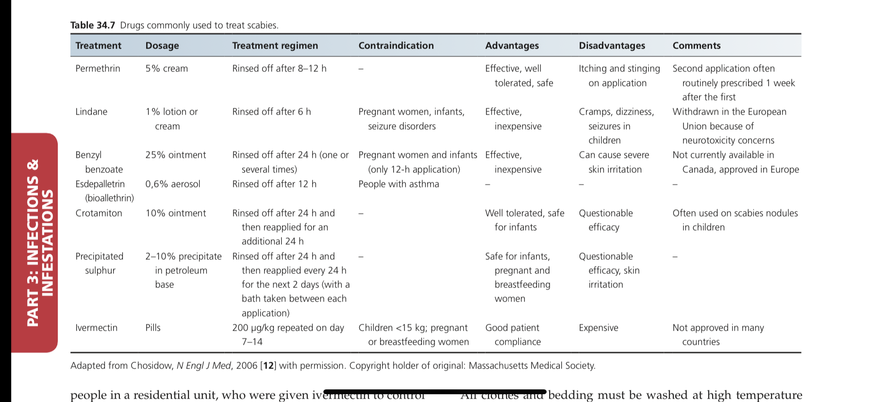
Notes:
people in a residential unit, who were given ivermectin to control a scabies outbreak, raised concerns about its safety [74]. However, the conclusions of this report were challenged [75,76], and other authors’ findings regarding its safety are reassuring [77,78]. It has been suggested that conditions disturbing the blood–brain barrier integrity such as young mammals may allow the drug enter the central nervous system [79–81]. Therefore some authors consider the drug must be contraindicated in children less than 5 years of age or under 15 kg, and during lactation. However, it appears to be safe in children [82–84] and its use in pregnant women is discour- aged in the USA but possible in France [85,86].
Finally, permethrin or ivermectin may be used for the treat- ment of classical scabies. If permethrin is not available, benzyl benzoate may be used. Oral ivermectin is more expensive and not licensed in most countries; however, this agent may be preferred for patients who cannot tolerate topical therapy or are unlikely to adhere to a therapeutic regimen [12,63]. In classical scabies, the combination of topical therapy and oral ivermectin has never been compared with either treatment alone. Table 34.8 presents strate- gies of treatment according to the clinica

Slide 51
Additional measures
STIs
Application of top treatment
Treat face of babies
Don’t wash hands during application
Wear gloves while applying on others
Wash clothes
plastic bags
Insecticidial products
Notes:
Examination and laboratory investigation to search for sexually transmitted infection should be performed as scabies is considered to be a sexually transmitted disease [60].
Topical treatment must be applied to the entire skin surface, including the scalp, all folds, groin, navel and external genitalia, as well as the skin under the nails. Treating the face of babies is essen- tial because transmission may occur by breastfeeding. This may be not necessary in adults with classical scabies. Hands should not be washed during therapy, otherwise the treatment should be reap- plied. If topical treatment is applied by another person, it is recom- mended that this person wears protective gloves
All clothes and bedding must be washed at high temperature (>50°C) or must be kept in a plastic bag for up to 72 h. Materials or fomites that cannot be washed should be treated with insecticidal products. The time course for the eradication of parasites after treatment is unknown. However, it is possible that patients receiv- ing oral ivermectin remain contagious longer than those receiving topical therapies [12,63].

Slide 52
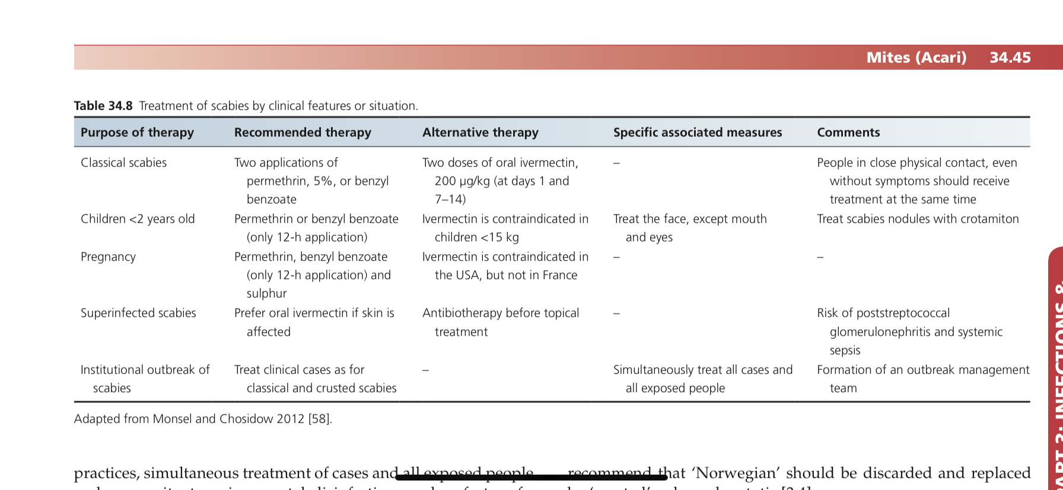
Special treatment consideration

Slide 53
Follow up
Itching persists several weeks
Use emolliants
Reinvestigate after 4 weeks
Notes:
Itching may persist several weeks after scabies, and this should be clearly explained to the patient. Emollients may be helpful in cases of cutaneous irritation. The persistence of itching after 4 weeks should be reinvestigated (Table 34.9).

Slide 54
Family sarcoptidae: human crusted scabies
Synonyms and inclusions
• Norwegian scabies
Definition:
Severely debilitating
Millions of mites
Notes:
introduction and general description
The appellation ‘Norwegian’ derives from the description in Nor- way by Danielssen and Boeck [1] of a type of scabies in which huge numbers of mites were present in lepers. von Hebra referred to this as ‘scabies Norvegica Boecki’ [2]. As others, we strongly
recommend that ‘Norwegian’ should be discarded and replaced by ‘crusted’ or hyperkeratotic [3,4].
Crusted scabies is a rare and severely debilitating form of the disease, characterized by the infestation of up to millions of mites and the development of hyperkeratotic skin crust. An undiag- nosed case of crusted scabies may be the source of an outbreak of common scabies.

Slide 55
Pathophysiology
Inadeguate immune response to mite
Higher morbidity
People affected:
Mentally retarted
Dementia
Down syndrome
Immunosupressed
Biological agents
HIV
HTLV-1
Topical steriods and pimecrolimus
Ausrtralian aboriginal people
Notes:
pathophysiology [5,6]
In common scabies, there are few mites, probably because scratch- ing destroys the burrows.
IMMUNE RESPONSE: Crusted scabies occurs in people with an inadequate immune response to the mite, allowing them to multi- ply.
HIGHER MORBIDITY: It is a severe disease with a significantly higher morbidity than ordinary scabies.
PEOPLE AFFECTED: Patients who are mentally retarded or suffer from dementia may develop crusted scabies [7], and Down syndrome is a fre- quent association [3,8]. The reason for this association with mental abnormality is not completely understood, but lack of apprecia- tion of pruritus may be important.
IMMUNOSUPRESSED: Crusted scabies may develop in patients who are immunosup- pressed, either as a result of disease [9–11] or therapy [11–14],
BIO AGENT: including with infliximab and tocilizumab [15,16]. In recent years, there have been numerous reports of its occurrence in patients with HIV infection, and it has been reported in immune recon- stitution inflammatory syndrome [17] and it is also an indicator of human T‐cell lymphotrophic virus (HTLV‐1) infection [18–20]. Crusted scabies has also resulted from the use of topical steroids [21] and pimecrolimus [22].
AUSTRALIAN: Crusted scabies sometimes occurs in otherwise healthy indi- viduals [23,24], and in northern Australia, where crusted scabies is a problem in the Aboriginal population, 42% of a series of 78 patients had no identifiable risk factors [25].

Slide 56
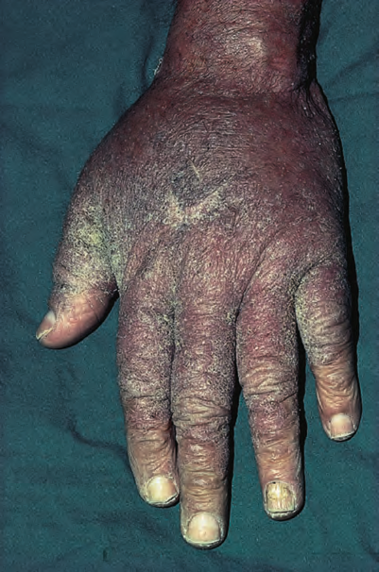
Large warty crusts on hands due to crusted scabies

Slide 57
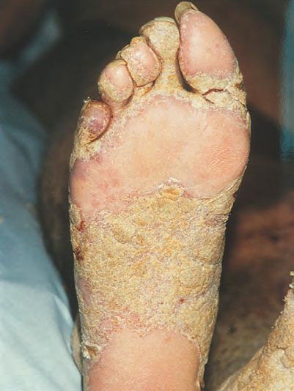
Crusted scabies on food with dystrophic nails
Thickened and fissured
Masses or horny debris accumulation
Notes:
and the palms and soles may be irregu- larly thickened and fissured. The nail apparatus is frequently affected, with masses of horny debris accumulating beneath thickened and discoloured nails (Figure 34.38d)

Slide 58
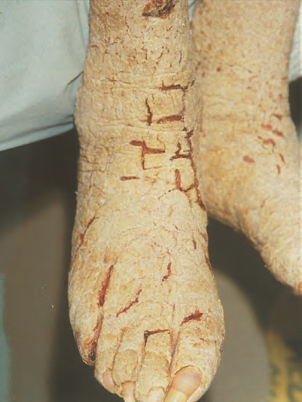
Crusted scabies

Slide 59
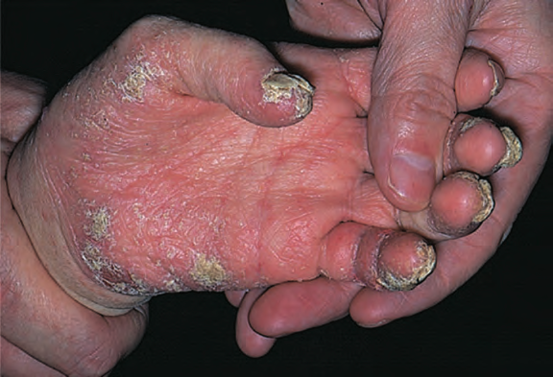
Grossly dystrophic nails in crusted scabies

Slide 60
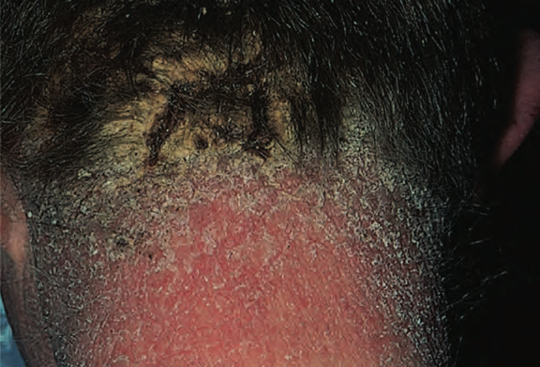
Severe scalp involvement in crusted scabies

Slide 61
Differential diagnosis
Hyperkeratotic eczema
Psoriasis
Darier disease
Contact dermatitis
Langerhan cell histocytosis
Notes:
The extent of the erythroderma and the warty plaques varies greatly, and either may predominate. Crusted scabies may be localized, affecting only the scalp, face, fingers, toenails or soles [28]. Itching is often absent or slight, but may occasionally be severe. Generalized lymphadenopathy is present in some cases, and blood eosinophilia and elevated IgE levels are common.
Crusted scabies may masquerade as hyperkeratotic eczema, psoriasis, Darier disease [29], contact dermatitis [30] and Langer- hans cell histiocytosis [31].
The diagnosis is readily confirmed by examination of scrapings, which will be teeming with mites and eggs.

Slide 62
Management
Hospitalization
Contacts treated
Keratolytic agents
Nails cut short and burshed scabicidal agent
Topical and oral therapy
2 tests 3 days apart become negative
Ivermite 3 to 7 doses
Notes:
General principles
Hospitalization and isolation of the patient are required to manage crusted scabies because of the risk of transmission to people in physical contact.
All individuals in contact should be treated.
A keratolytic agent such as a salicylic acid preparation should be used to treat hyperkeratosis.
Nails should be cut short and brushed with a scabicidal agent [34].
Expert consensus rec- ommends combining topical and oral therapy [35], although this has never been evaluated.
Topical scabicide application should be repeated until two parasitological tests 3 days apart become negative.
The administration schedule of ivermectin should be based on the severity of infection [40]; between three and seven doses have been proposed [27]. However, Currie et al. [41] reported evidence of resistance to ivermectin in two patients who had received multiple doses for recurrences of crusted sca- bies. Recently, a simple clinical grading scale to aid in the man- agement of patients with crusted scabies has been proposed and may be useful [42].

Slide 63
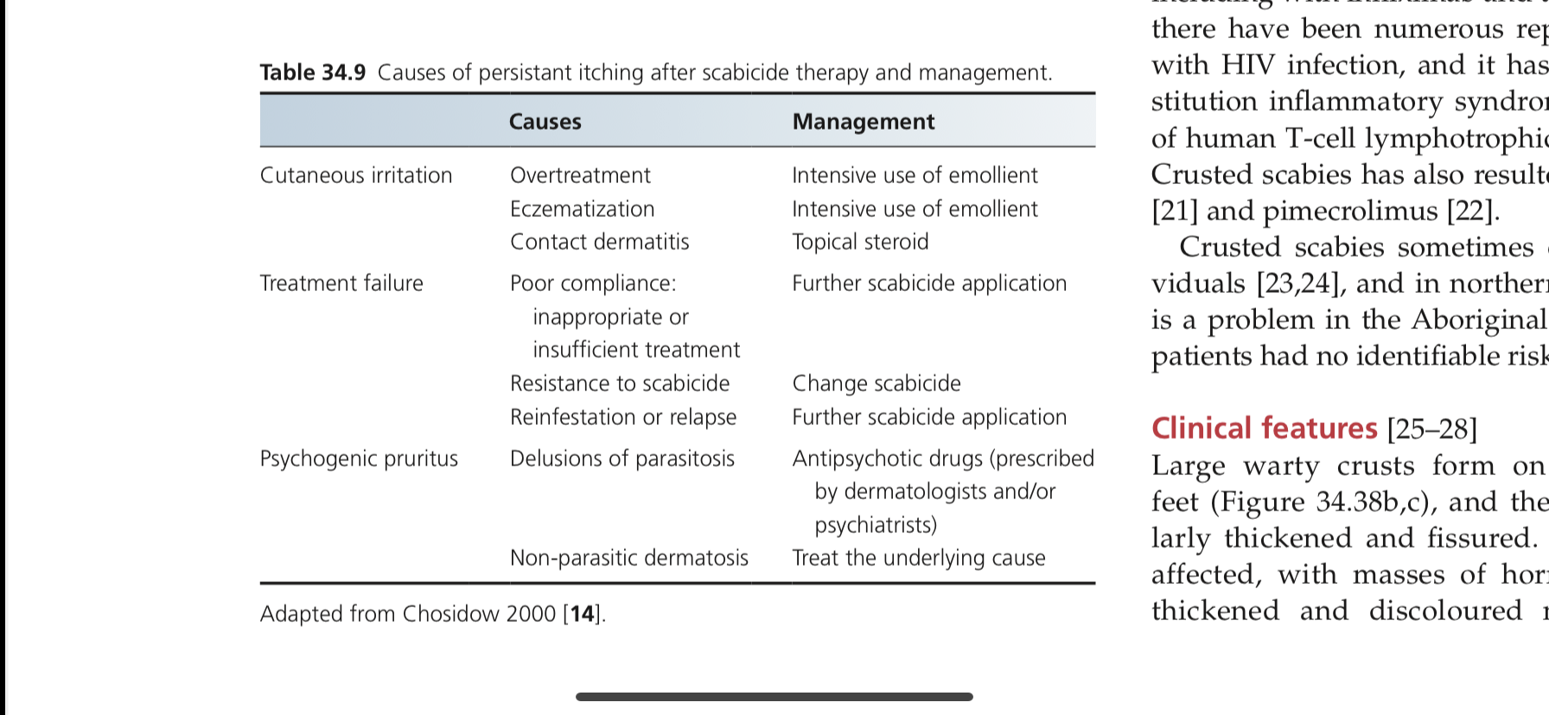
Causes of presistant itching after scabicidal therapy and management

Slide 64
Thankyou!

