Slide 1


Slide 2
Q. A 10 years old girl seen in outpatient department of dermatology with recurrent attacks of swelling of peri orbital, labial and genital areas for last 1 year. There was history of abdominal pain and dyspnea during the attack but no itching. Physical examination revealed reticulate erythema on her trunk.
(MCPS 2017)
What is your diagnosis?
What is the cause of this condition?
How will you treat this case?

Slide 3
Recurrent angio-edema without Weals
Dr Mehak Younis
PGR Dermatology
SZH

Slide 4
Angio-oedema
deep, localized and self‐limiting swelling of
the skin and submucosal tissues due to a temporary increase in vascular permeability resulting from vasoactive mediators.
Known historically as Quincke’s oedema or angioneurotic oedema

Slide 5
Angio-oedema with weals
  Falls within spectrum of spontaneous or inducible urticarias resulting from mast cell degranulation
Angio-oedema without weals
  May be a presentation of uncommon but very imp bradykinin‐induced angio‐
  oedemas, including hereditary angio‐oedema (HAE)

Slide 6
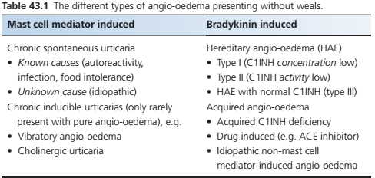

Slide 7
Introduction and general description
Involves the subcutaneous and submucosal tissues, rather than the dermis.
Site : Almost any part of the body may be involved. Most common sites
  Lips
  Eyelids
  Genitalia
due, in part, to the laxity of the dermal and subcutaneous tissues at these sites.

Slide 8
Introduction and general description
Tongue and pharynx (much less common in mast cell mediator-induced angioedema).
Individual lesions may be single or multiple
May appear suddenly.
Itching is often absent.

Slide 9
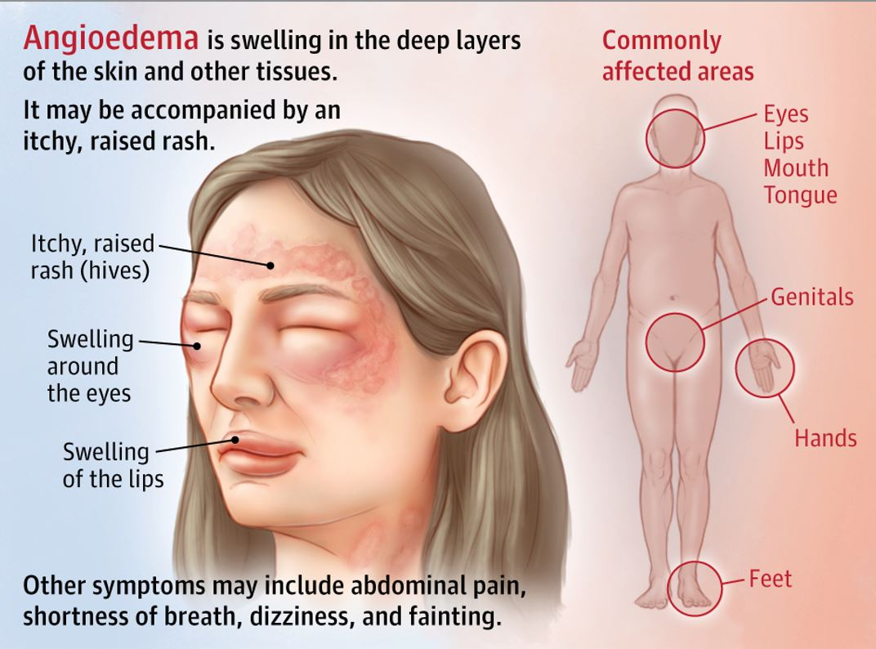

Slide 10
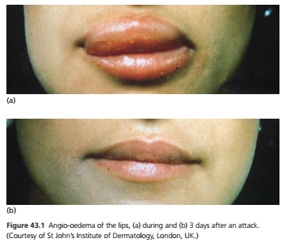

Slide 11
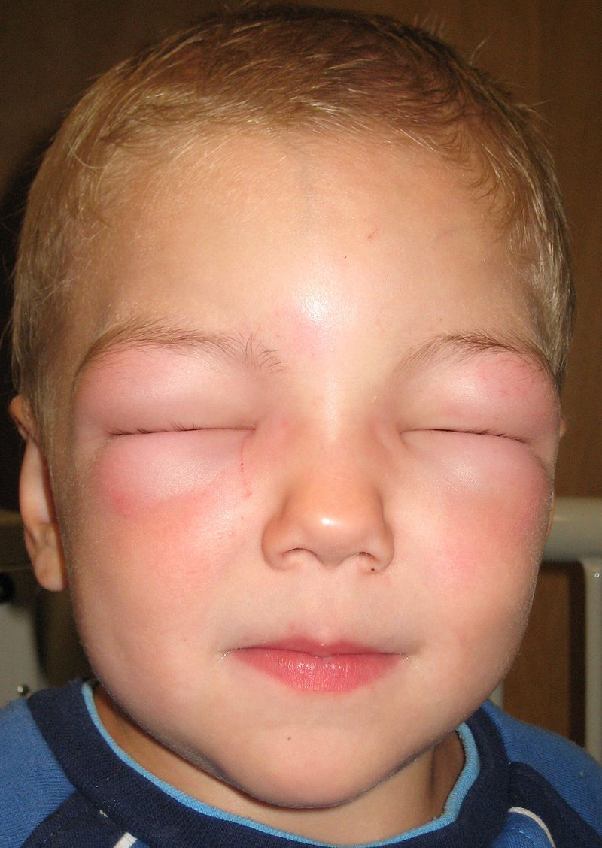

Slide 12
Mast cell mediator-induced angio-edema
Angio-oedema without weals is mainly spontaneous.
Less than 10% of patients with chronic spontaneous urticaria develop angioedema alone.
Delayed pressure urticaria weals are often deep and may resemble angioedema.

Slide 13
ACE inhibitor‐induced angio‐oedema
ACEi may cause angio-oedema by inhibiting ACE resulting in reduced bradykinin metabolism.
Most cases develop within 3 weeks, but can occur at any time, even more than 10 years after starting.
Class effect seen with all ACEi and occasionally with ARBs.
Affects predominantly face and oropharynx
Symptoms may be severe, and laryngeal involvement may be life threatening.

Slide 14
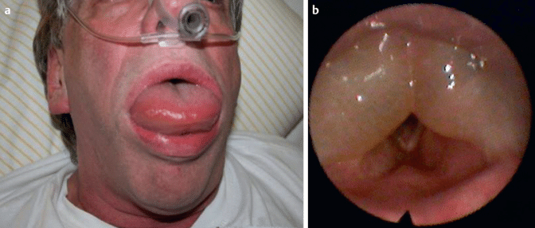

Slide 15
Hereditary angio-oedema
Rare disorder.
Less than 2% of all cases of angio-oedema without weals.
Family history is usually,but not always, apparent.
25% of cases result from de novo mutation of gene controlling C1INH (SERPING1).
Spontaneous urticaria can also occur in HAE patient as an exceptional case.

Slide 16
Hereditary angio-oedema
Divided into 3 types
  Type I : reduced C1INH
  Type II : normal or raised levels of C1INH that is functionally inactive
  Type III: normal levels of immunochemical and functional C1INH.
  Diagnosis is defined by a family history of recurrent
  angio‐oedema without weals in more than one generation with normal C1INH .

Slide 17
 | Mast cell mediator induced angio-oedema | HAE | ACE inhibitor induced angio-edema
INCIDENCE | Commenest, 10% of pts with spontaneous urticaria | 1:50,000 population | 1% of patients on treatment
Age | Any age, more often in 4th or 5th decade of life | First attack by age of 15 years (>75%) May be in adult life | Older people requiring antihypertensive therapy
Sex | More common in women | No sex bias for HAE types I and II, Type III in women | More common in women
Associated Diseases | Thyroid autoimmunity | Weak association with autoimmune diseases like sjogren syn and SLE.

Slide 18
Pathophysiology
Mast cell mediator-induced angio-oedema
  mast cell degranulation (as evidenced by their response to anti-histamines)
  Functional auto antibodies
  Infections
  Food intolerance
  Stress
  Idiopathic (idiopathic non mast cell mediator-induced)
    Angio-oedema resembles C1 INH deficiency
    No family history
    No response to H1 antihistamines

Slide 19
ACE inhibitor‐induced angio‐oedema
ACE inhibitors mainly inhibit kininase II resulting in an increase in bradykinin.
Several other enzymatic pathways involved.

Slide 20
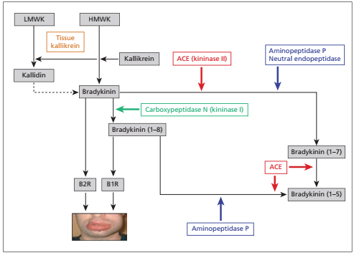

Slide 21
Hereditary angio-oedema
Autosomal dominant
C1 esterase inhibitor is present either in reduced amount (type 1) or in an inactive form (type 2) .
C1INH is a natural inhibitor of
  Activated first component of complement
  Kallikrein
  Fibrinolytic and co agulation system

Slide 22
Hereditary angio-oedema
Attacks are triggered by stimuli that activate hageman factor and hence consume deficient inhibitor.
C2, C4, and CH50 are always low during, after and usually between attacks, or in symptomless carriers.
C4 may be used as an initial screening test.
Some evidence that H.pylori destabilizes HAE.

Slide 23
Angio-oedema due to acquired C1INH deficiency
Two types
  Type 1 is due to continuous activation of complement by lymphoproliferative disease, including paraproteinaemia due to increased catabolism of C1INH.
  Type II is due to autoantibodies that recognize C1INH and inactivate it without triggering its target proteases.
  Both forms will have reduced antigenic and functional C1INH levels.

Slide 24
Clinical features
Mast cell mediator-induced angio-oedema
Presentation is same as angio‐oedema that presents in patients with spontaneous urticaria who also exhibit weals.
Oro‐pharyngeal involvement is unusual.
laryngeal oedema is exceptional.
Abdominal angio‐oedema does not
occur.

Slide 25
ACE inhibitor‐induced angio‐oedema
Swellings are confined to the face and oro‐pharynx.
Larnygeal angio‐oedema may occur and may be fatal without prompt recognition and treatment.
Abdominal symptoms are rare.

Slide 26
Hereditary angio‐oedema
Clinical picture of HAE usually facilitates strong suspicion of the diagnosis before laboratory confirmation.
Recurrent swellings of the skin and mucous membranes throughout life.
Often associated with nausea, vomiting, colic and urinary symptoms.
Attacks may occur regularly every few days
or weeks, or may be less frequent.

Slide 27
Abdominal symptoms may occur in the absence of skin changes and cause great diagnostic diffculty.
Pharyngeal, laryngeal and even bronchial involvement, are especially significant and dominate the prognosis.
skin and mucosal lesions are often solitary and
may be painful.
Seldom itch
they may occur spontaneously or after trauma; dental trauma and intubation

Slide 28
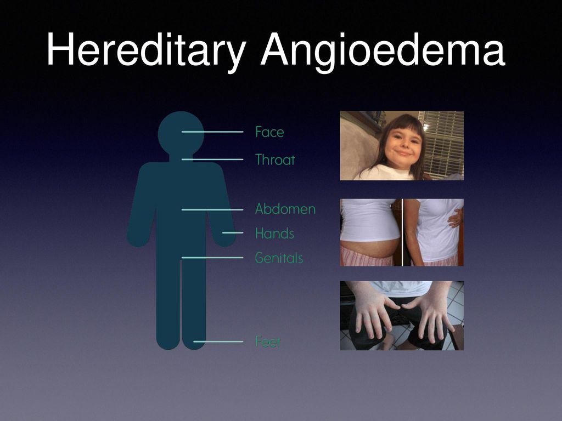

Slide 29
Weals do not occur, but many patients
exhibit a rather distinctive reticulate erythema, perhaps with minimal oedema, which occurs prodromally.
Some patients have a relatively minor disability and may improve over many years.
Before the advent of modern therapy, over 20% of patients used to die of respiratory obstruction before early middle age, and fatalities are still
at risk of occurring

Slide 30
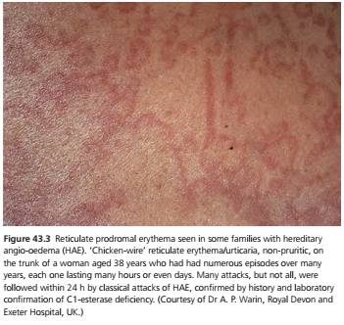

Slide 31
Clinical variants
Systemic capillary leak syndrome (syn. Clarkson syndrome)
Rare syndrome
Dramatic recurrent episodes of exudation of ﬂuid into various organs and may involve
the skin.
Angio‐oedema has been reported.
A severe shock‐like state may ensue and the eventual mortality is high.
An immunoglobulin G (IgG) paraproteinaemia.

Slide 32
Episodic angio-oedema with eosinophilia(syn.Gleich syndrome)
Recurrent episodes of angio‐oedema
Pyrexia
blood eosinophilia
infiltration of the dermis with eosinophils
no evidence of systemic involvement or progression to a cardiomyopathy.(hypereosinophilic syn)
Each episode resolves with prednisolone treatment.
During an attack, elevated serum levels of interleukin (IL)‐5 and IL‐6.

Slide 33
Differential diagnosis
Oro‐facial granulomatosis
Dermatitis (especially of the eyelids)
Cellulitis
Idiopathic scrotal oedema.

Slide 34
Disease course and prognosis
Chronic mast cell mediator‐induced angio‐oedema usually lasts for several months to years
Spontaneous resolution is the rule
ACE inhibitor‐induced angio‐oedema remits after discontinuation of the drug but may take up to 6 months to subside after stopping.
The reason for this is unknown.

Slide 35
Disease course and prognosis
HAE is lifelong
with variations in activity
  environmental factors
  Lifestyle
  drugs (especially exogenous oestrogens and ACE inhibitors)
  endogenous factors (e.g. puberty
  and pregnancy)
Main risk of HAE is suffocation and death
Treatment of the underlying B‐cell lymphoproliferative disorder may lead to resolution of type 1 acquired C1INH defciency.

Slide 36
Investigations
CBC/white blood cell differentials
CRP
C4 complement level
Functional C1INH
C1q
CH50
Autoantibodies to C1INH
SERPING 1 gene
Paraproteins/IgG paraproteinemia in cap.leak syn
S/IL-5 and IL-6 increase in Gleich syn

Slide 37
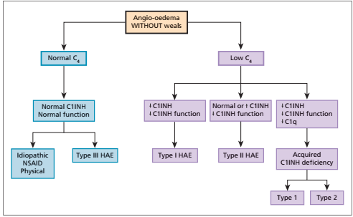

Slide 38
Management
Mast cell mediator‐induced angio‐oedema
same as for chronic spontaneous urticaria patients with weals. (except that oro‐pharyngeal lesions may occur and
cause great distress )
Non‐sedating, second‐generation H1 antihistamines are the first line treatment.
should be used on daily basis until spontaneous remission.
Higher than standard doses (up to fourfold) may be required to achieve sufficient protection.
Omalizumab (anti‐IgE )
  For the use of antihistamine refractory cases of chronic spontaneous urticaria
  should be considered as third
  line therapy.
Emergency treatment with epinephrine

Slide 39
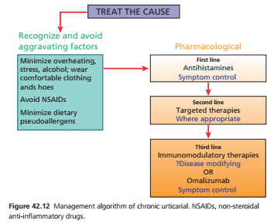

Slide 40
Bradykinin induced angio-oedema
Emergency treatment
Icatibant(BR2 antagonist)
  Treatment of choice
  Given by S/C injection
  Similar efficacy to C1INH concentrate
Purified plasma-derived C1INH (pdC1INH)
  20u/kg body weight bolus IV infusion
  Primary treatment for oro-facial and laryngeal oedema and abdominal colic

Slide 41
Emergency treatment
  Self administration by patients at first sign of an attack is now encouraged because of rapid resolution of symptoms and less risk of progression
  Symptom relief should be seen within 30–90 min of infusion but it may take 6–8 h for complete resolution.
Recombinant C1INH (transgenic rabbits’ milk)
Ecallantide (Kallikrein inhibitor)
FFPs containing C1INH

Slide 42
Prophylaxis
Short‐term prophylaxis of hereditary angio‐
oedema
Plasma‐derived C1INH concentrate
  should be given shortly before medical procedures involving trauma, especially dental work or intubation during general anaesthetic .
  For minor procedures just ensure availability of C1INH
Anabolic steroids
Plasmin inhibitors

Slide 43
Prophylaxis
Long‐term prophylaxis of hereditary angio‐
oedema
Plasma‐derived C1INH concentrate
  Pts with frequent attacks
  Twice weekly IV infusion (1000units)
Tranexamic acid
  2 to 4.5g daily
  C/I in pts with past history of thrombosis or inherited thrombophilia

Slide 44
Attenuated androgens/anabolic drugs.
  Danazole,stanozolol
  Stimulate production of the deficient inhibitor by liver
  Androgenic side effects include acne,hirsutism and menstural irregularities in women
  Dose :
  Danazol 100-200mg daily
  stanozolol 1.0-1.5mg daily
  Monitoring
    Lfts , FLP, liver USG every 2 year to screen for hepatocellular adenomas

Slide 45
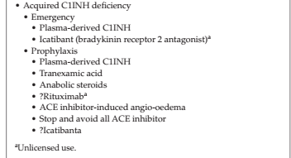

Slide 46


Slide 47
Q. A 10 years old girl seen in outpatient department of dermatology with recurrent attacks of swelling of peri orbital, labial and genital areas for last 1 year. There was history of abdominal pain and dyspnea during the attack but no itching. Physical examination revealed reticulate erythema on her trunk.
(MCPS 2017)
What is your diagnosis?
What is the cause of this condition?
How will you treat this case?

Slide 48
Q. A 02 year old child develops severe colicky abdominal pain along with watery diarrhea after a dental procedure. This is accompanied by a non-pruritic painless swelling over the lips and eyelids as well as hoarseness of voice.
(MCPS 2016)
What is your diagnosis?
What blood tests will you perform for confirmation?
What is acute management of this condition?

Slide 49
Q. A 12 year old boy has presented to you with recurrent painful swelling of his hands, feet and genitalia for few months. Last episode was also associated with difficulty in breathing and swallowing. His father also had this kind of problem since his childhood.
(FCPS 2016)
What lab investigations you’ll order?
What prophylactic measures will you advice to prevent recurrence?
Give pathogenesis of this disease?

Slide 50


