Slide 1


Slide 2
Acquired disorders of hair
Dr danyal sajjad
Resident dermatology
CMH Abbottabad

Slide 3
Learning objectives
To know
About hair cycle
How to Approach the patient with hair loss
About Non scarring and scarring hair loss
About excessive hair growth

Slide 4
Outline
Types of hair
Anatomy of hair
Hair cycle
Approach to the patient with hair loss
Non scarring hair loss
Scarring hair loss
Hypertrichosis
Hirsutism
References

Slide 5
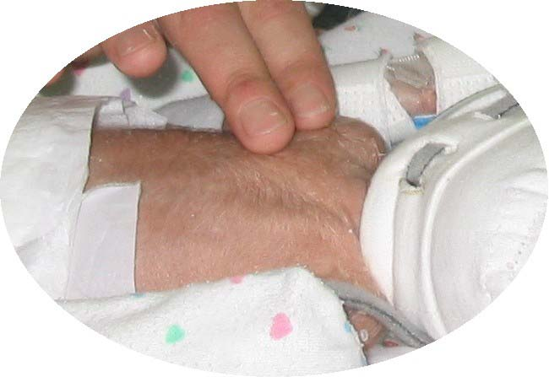
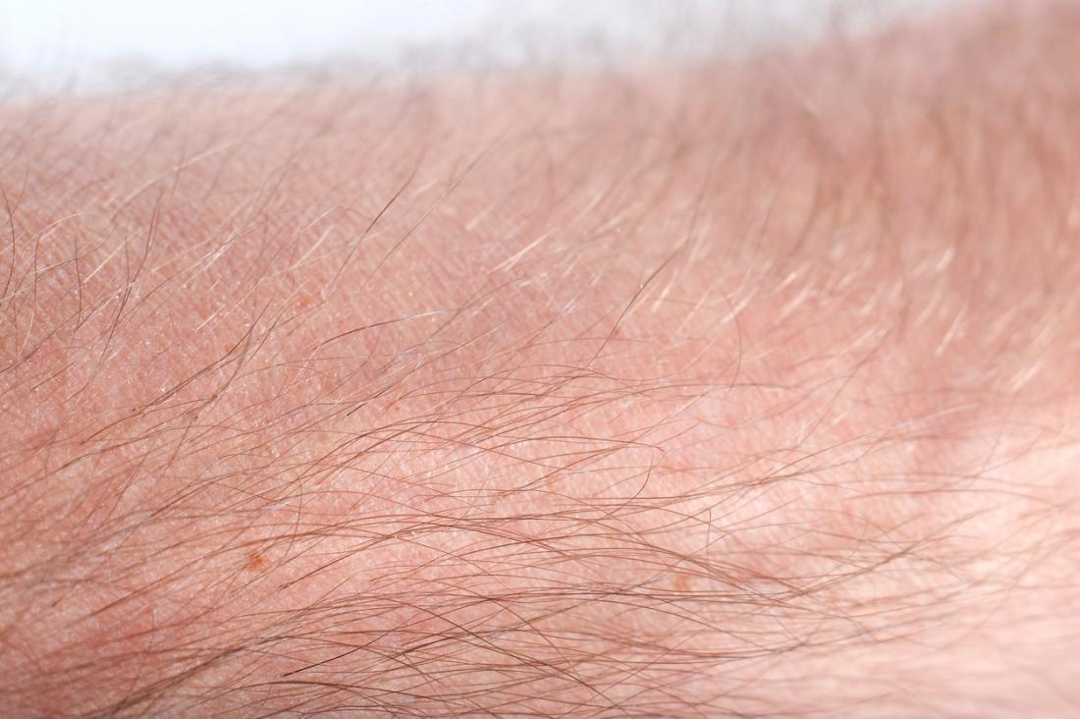
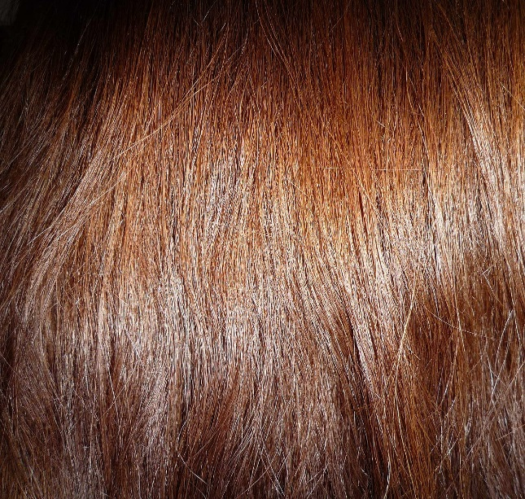
Types of hair
Prenatal: lanugo | Postnatal: vellus | Postnatal: terminal
Fine | Short | Longer
Soft | Soft | Coarser
Unmedullated | Unmedullated | Medullated
Unpigmented | Pigmented | Pigmented
Shed in utero (8th – 9th months of gestation) | 2 cm long

Slide 6
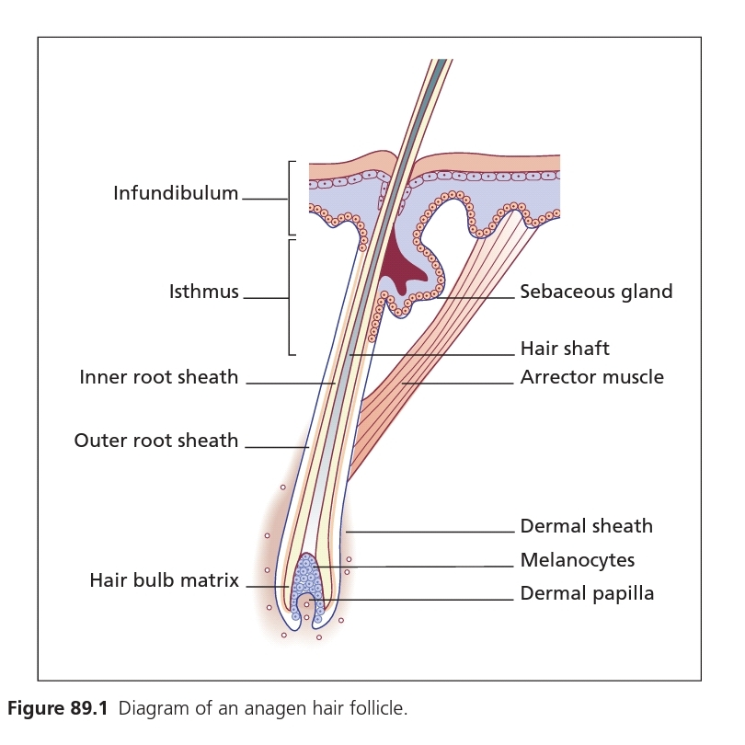
Anatomy of Hair Follicle
Hair
  Keratinized product of hair follicle
  Tube-like structure continuous with epidermis
Follicles
  Sloped in dermis
Arrector pili – oblique muscle
  Papillary dermis (DEJ) → mid-region of follicle wall
Sebaceous gland

Slide 7
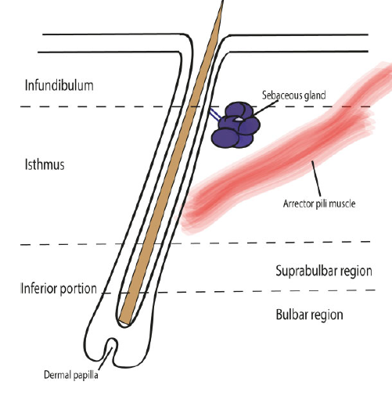
Anatomy of Hair Follicle
Upper part – relatively constant
  Infundibulum
  Isthmus
Lower part – repeated episodes of regression & regeneration during hair cycle
  Hair bulb
  Supra bulbar region

Slide 8
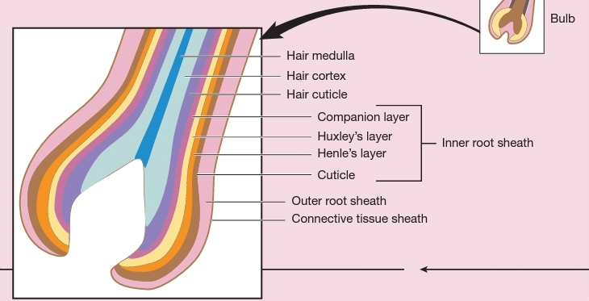

Slide 9
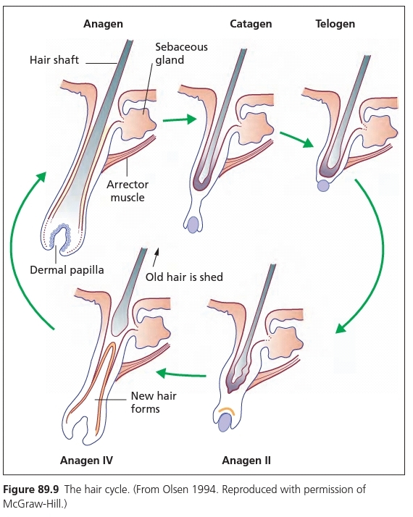

Slide 10
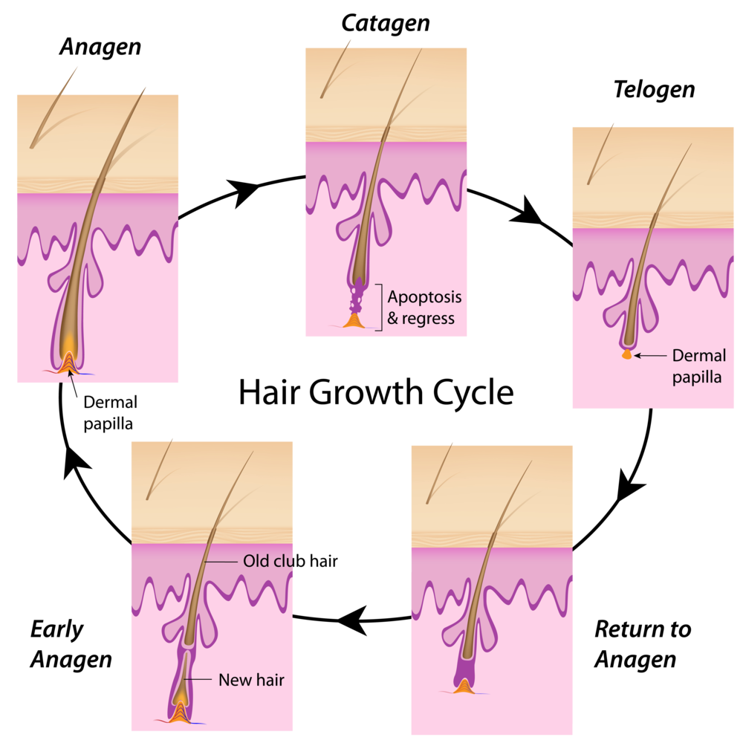
Hair Cycle
Repetitive sequence of growth & rest of hair follicles
Anagen – active hair growth period
  Its duration → length of hair
  Continue for several years
  80-90% hair follicles at any one time
  Onset: mitotic activity in epithelial cells of dermal papilla

Slide 11
Hair Cycle
Catagen – involutionary phase
  Lower part of follicle involutes by apoptosis
  Base of follicle moves upward & lie just below level of arrector insertion

Slide 12
Hair Cycle
Telogen
  Period between completion of follicular regression
  & onset of next anagen phase
  Club hair lies within epithelial sac
Exogen
  Club hair shed via an active process
Kenogen
  Scalp follicles remain in state of latency
  Prolonged period after club hair is shed

Slide 13
Anagen (growth stage)
80-90%
Catagen (degenerative stage)
2-3%
Telogen (resting stage)
10-15%
Hair growth cycle

Slide 14
Approach to the patient with hair loss

Slide 15
history
Presenting complaints
Background information
family history of hair thinning/loss patterned hair loss
Female pattern hair loss – hormonal disturbance
  Enquire about regularity of menstrual periods
  Presence of hirsutes
  Other signs of androgenization
  Contraception
Hair shedding – telogen effluvium
  Severe psychological stress
  Physical illness
  New medications
  Dieting
  Weight loss
Hair shedding/thinning
  Recession of hairline
  Patches of hair loss
Itching, pain at affected area

Slide 16
Clinical examination
Visual assessment of pattern & extent of hair loss
Does the patient have clinically evident hair loss?
Is hair loss diffuse or patchy?
Is it occurring in a distinctive distribution (such as seen in pattern hair loss or frontal fibrosing alopecia)?
Patchy hair loss
  Assess for patent follicular ostia or whether these are lost
    Key feature in scarring conditions
Scalp inflammation
  Perifollicular erythema
  Follicular hyperkeratosis
  Plugged hair follicles
  Pustules
  Swellings

Slide 17
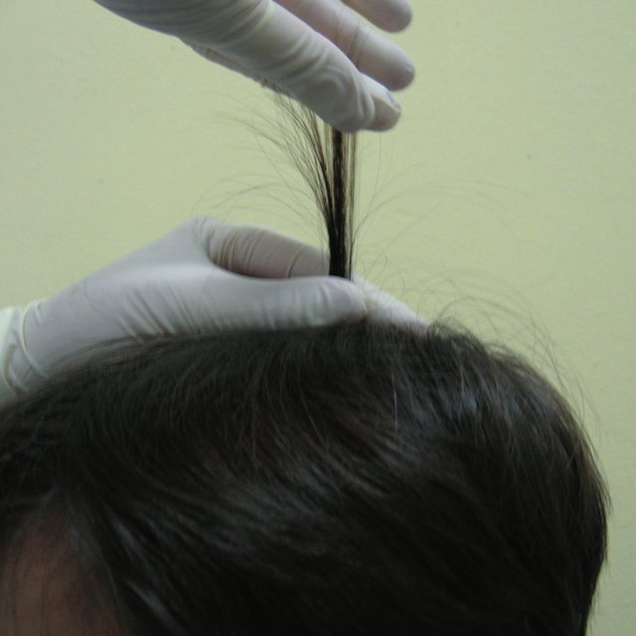
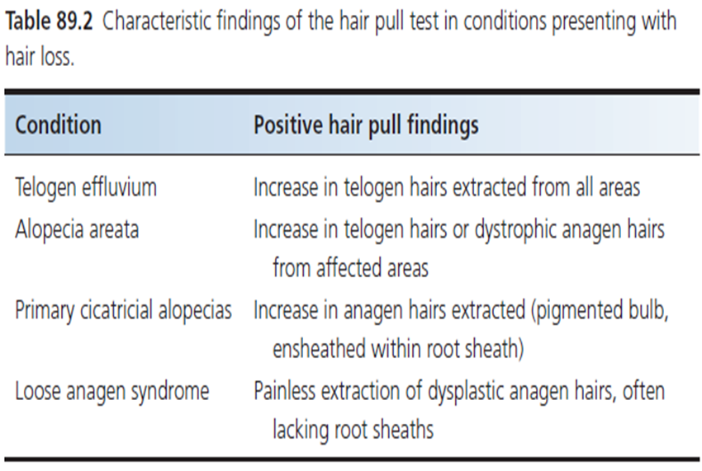
Hair Pull Test
Assess hair shedding in generalized hair loss
  60 hair is gathered between thumb & forefinger of non‐dominant hand
  With dominant hand the strands of hair are loosely twisted to remove stray hairs
  Hairs are grasped between dominant thumb & forefinger near scalp
  Gentle traction is applied in a smooth, gradual manner, away from the scalp
  Number & type of hairs extracted → clues to underlying diagnosis

Slide 18
Modified Hair Pull Test
Used to assess the hair breakage – shaft abnormality
With the non‐dominant hand, grasping a small group of hairs near to the scalp
Dominant hand pulls them as described before
  If they break or snap → brittleness & hair breakage shaft abnormality

Slide 19
Trichogram
Forced pluck of hair that includes the hair roots
Analysed under a microscope to calculate the percentage of hairs in telogen & anagen phases

Slide 20
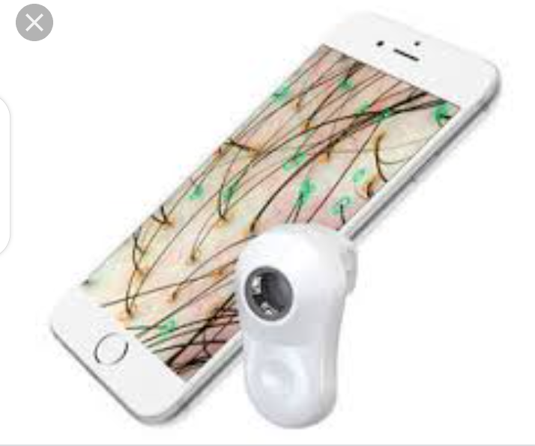
Trichoscopy
Confirms or highlights clinical signs
Yellow dots-AA
Black dots & broken hairs-AA
Variable hair fiber diameter-FPHL
Follicular hyperkeratosis-LPP
Arborizing vessels-DLE
Tufting & inflammation-FD

Slide 21
Children with Hair Loss
History
  Pattern of hair at birth
  How this changed during 1st year of life
  H/O teeth & nail development
  Heat intolerance (anhidrosis) – ectodermal dysplasia
Failure of hair to grow beyond certain length → hair shaft abnormality
  Breakage -- Monilethrix
  ↑ in hair loss -- loose anagen syndrome
  ↓ growth phase -- short anagen syndrome
Patches – absent hair follicle → aplasia cutis
Acquired patches – tinea capitis

Slide 22
Clinical photography
Microscopy
Scalp biopsy

Slide 23
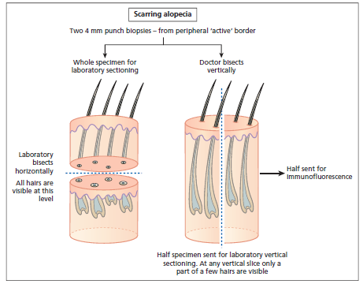
Scalp biopsy
Scarring alopecia
Two 4 mm punch biopsies
Scarring alopecia
  Biopsy is sectioned vertically
  Horizontally

Slide 24
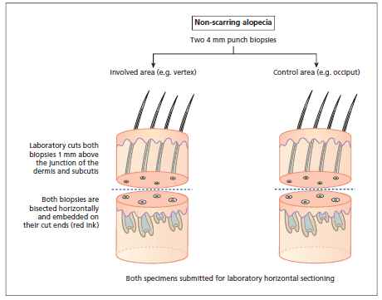
Scalp biopsy
Non-scarring alopecia
Two 4 mm punch biopsies
Both biopsies – sectioned horizontally
  All follicles seen → 30-40 hairs/4 mm punch
  Sections taken at different levels from bulb to isthmus & infundibulum

Slide 25
Orientation of the punch biopsy in the direction of hair growth

Slide 26
Acquired disorders of hair
Increase hair loss
Non scarring
Scarring
Increase hair growth

Slide 27
Non-scarring disorders of hair growth

Slide 28
Non scarring alopecia
Androgenetic alopecia
Telogen effluvium
Alopecia areata

Slide 29
Pattern hair loss / androgenetic alopecia
Pattern hair loss is the most common type of progressive balding
• Occurs through the combined effect of:
  • Genetic predisposition
  • Action of androgen on scalp hair follicles
• In males, pattern/extent of hair loss varies from bitemporal recession, to frontal and/or vertex thinning, to loss of all hair except that along the occipital and temporal margins

Slide 30
ETIOLOGY AND EPIDEMIOLOGY
ETIOLOGY Combined effects of androgen on genetically predisposed hair follicles
Genetics:
(1) autosomal dominant and/or polygenic
(2) inherited from either or both parents
AGE OF ONSET
• Men: May begin any time after puberty, as early as the second decade; often fully expressed in 40s
• Women: Later, in about 40% occurs in the sixth decade

Slide 31
CLINICAL MANIFESTAtiON
SKIN FINDINGS
Scalp skin is normal
In young women, look for signs of virilization (acne, excess facial or body hair)

Slide 32
HAIR Hair in areas of pattern hair loss becomes finer in texture (shorter in length and reduced diameter)
In time, hair becomes vellus and eventually atrophies completely
DISTRIBUTION
• Men usually exhibit patterned loss in the frontotemporal and vertex areas
• Women including those who are endocrinologically normal, also lose scalp hair according to the male pattern, but hair loss is far less pronounced
Often, hair loss is more diffuse in women, following the pattern described by Ludwig

Slide 33
SYSTEMIC FINDINGS
In young women with AGA, look for signs of virilization (clitoral hypertrophy, acne, and facial hirsutism)
However, most women with pattern hair loss are endocrinologically normal

Slide 34
Hamilton–Norwood scale for grading male pattern hair loss

Slide 36
Female (Ludwig classification)

Slide 37
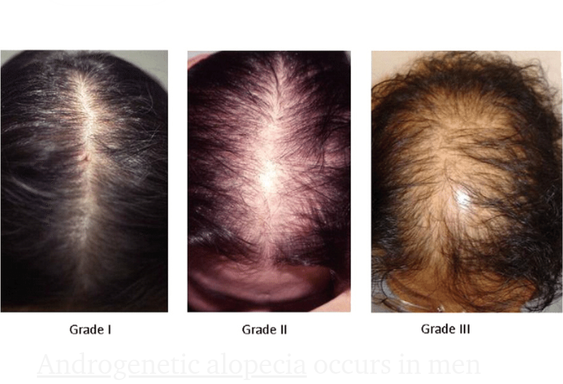
Female (Ludwig classification)

Slide 38
associations
Male patterned hair loss – coronary artery disease ( several studies reported)
Female patterned hair loss – hyperaldosteronism, hypertension, hyperandrogenism, polycystic ovary disease, elevated cholesterol and increased risk of late onset diabetes

Slide 39
investigations
Investigations in men
Investigations in female pattern hair loss
unnecessary in men with AGA unless there is diagnostic uncertainty
Notes:
Fasting lipids and glucose …coz association with diabetes and elevated cholestrol

Slide 40
management
As pattern hair loss is not life‐threatening and the morbidity is variable, most people do not seek treatment
Before a patient embarks on therapy he or she should be counselled carefully and made aware of the requirement for maintenance therapy for sustained effect

Slide 41
Management options
Camouflages and wigs
Medical management
Surgical management

Slide 42
Medical management
Management of male pattern baldness
Management of female pattern hair loss
Minoxidil lotion ( 2% , 5%)
5 alpha reductase inhibitor ( finasteride, dutasteride)
Minoxidil lotion ( 2% , 5%)
Anti androgens
Cyproterone acetate, spironolactone
Notes:
Minoxidel… vasodilator ( inc terminal hair) headach, local irritation, inc hair on temples
Cyproterone acetate, 50-100mg/day( 1st 10 daysof menses, lassitude, weight gain, breast tenderness, loss of libido, depression)
spironolactone 50-300mg/day( menses irregularities, breast tenderness, fatigue,post menopausal bleeding)

Slide 43
Surgical management
Hair transplant
Excising the balding skin(scalp reduction) and rotational flaps are now less widely used

Slide 44
“Myths’’ vs “realities” about androgenetic alopecia

Slide 45
Myth vs reality
Myth : Male pattern baldness is from mother’s side
Reality : Multiple genetic studies have been done and they show that genes involved can come from either side of the family
Myth : I can’t have androgenetic alopecia because no one else in my family has it
Reality : Multiple genes are involved, you may have just inherited the combination of genes needed for it,
you may have a distant relative with it

Slide 46
Myth vs reality
Myth : My parents have thinned hair, but at older age
Reality : androgenetic alopecia tends to start earlier in subsequent generations
Myth : Taking hormones will help
Reality : testosterone and progesterone can worsen it
no consistent evidence that estrogen will help its reversal
some women have elevated androgens due to medical conditions, treating them can help

Slide 47
Telogen effluvium

Slide 48
Definition and introduction
Telogen effluvium describes an increase in the shedding of telogen club hairs due to premature termination of the anagen phase of the hair cycle
Premature conversion of anagen hair to telogen
Shedding occurs 3-6 months after the event, though sometimes as soon as possible

Slide 49
pathogenesis
1. Immediate anagen release is a short‐onset effluvium where follicles are stimulated to leave anagen and enter telogen prematurely, resulting in increased hair shedding at the end of telogen, approximately 2–3 months later
Secondary to stress such as severe illness and drug induced hair loss
2. Delayed anagen release is the cause of postpartum hair loss
During pregnancy, anagen duration is prolonged and hair cycling into telogen is reduced

Slide 50
pATHOGENESIS
3. Short anagen syndrome is caused by shortening of the duration of anagen
4. Immediate telogen release results from premature exogen
Telogen follicles may remain empty for weeks
An empty telogen follicle is called kenogen
Drugs such as minoxidil can precipitate exogen, and this explains the temporary increase in hair shedding commonly noticed 4–6 weeks after commencement of minoxidil therapy for hair loss
5. Delayed telogen release occurs after prolonged telogen followed by transition to anagen
It occurs in animals with synchronous hair cycles during shedding of their winter coats
It may occur seasonally in some humans

Slide 51
Acute telogen effluvium
Acute telogen effluvium is an acute‐onset scalp hair loss that occurs 2–3 months after triggering event
Triggers
High fever, surgical trauma, sudden starvation or haemorrhage
No trigger can be found in one third of cases
The functional mechanism of shedding is immediate anagen release
Unless the trigger is repeated, spontaneous complete regrowth occurs within 3–6 months.

Slide 52
Telogen gravidarum
Telogen gravidarum refers to the telogen hair loss seen 2–3 months after childbirth
It is an example of delayed anagen release
It is universal but variable in severity and is often subclinical
Most cases of telogen gravidarum resolve

Slide 53
Chronic telogen effluvium
Chronic diffuse telogen hair loss refers to telogen hair shedding persisting for longer than 6 months
It can be idiopathic or secondary to variety of causes

Slide 54
Causes
Thyroid disorders ( both hypo and hyperthyroidism)
Iron deficiency anemia
Acrodermatitis enteropathica or acquired zinc deficiency
Crash dieting
Malabsorption
Metabolic disturbances ( Liver disorders, CKD)
Drugs

Slide 55
Diffuse alopecia in association with hypothyroidism.

Slide 56
Acquired zinc deficiency resulting from prolonged parenteral feeding and inadequate zinc supplementation
Hair loss and photosensitivity caused by systemic
lupus erythematosus

Slide 57
Drug induced telogen effluvium
Hair loss starts usually after 6-12 weeks after instigation of treatment
If a particular drug is suspected, testing involve stopping the drug for at least 3 months
Regrowth following discontinuation and recurrence on re-exposure
Retinoids
Anticoagulants
ACE inhibitors
Beta blockers
Levodopa
Lithium
Bromocriptine
Cimetidine

Slide 58
Management
Withdrawal of the trigger / treatment of the underlying cause will arrest hair shedding within 3 months
Full recovery may take 6 months

Slide 59
Alopecia areata

Slide 60
Introduction
Alopecia areata is a common, chronic, autoimmune, inflammatory disease that causes non‐scarring hair loss
It has genetic predisposition and environmental triggers
The nails may also be affected
The severity ranges from small patches of hair loss, which usually recover spontaneously, to complete alopecia where the prognosis for hair regrowth is poor

Slide 61
Associated diseases
Several autoimmune diseases including thyroiditis, lupus erythematosus, vitiligo and psoriasis
Atopic eczema
Down syndrome

Slide 62
Pathophysiology
There is abundant evidence that alopecia areata is an autoimmune disease
Increased frequency of other autoimmune disease
Increased frequency of organ‐specific autoantibodies
Infiltration of hair bulbs by activated T‐lymphocytes
Genetic associations with several autoimmune diseases, particularly with genes of the major histocompatibility complex (MHC)

Slide 63
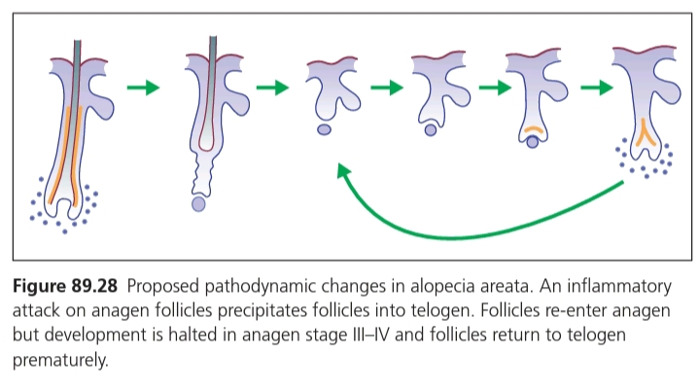

Slide 64

Environmental factors
Triggered by
Infections
Psychological stress

Slide 65
Sites of Predilection
Scalp most commonly affected
Any hair-bearing area: Beard, eyebrows, eyelashes, pubic hair
• Alopecia areata (AA): Solitary or multiple areas of hair loss
• AA totalis (AAT): Total loss of terminal scalp hair
• AA universalis (AAU): Total loss of all terminal body and scalp hair
• Ophiasis: Bandlike pattern of hair loss over periphery of scalp

Slide 66
Clinical features
The characteristic initial lesion of alopecia areata is a circumscribed, hairless, smooth patch
The skin within the bald patch appears normal or slightly reddened
Short, easily extractable broken hairs, known as exclamation mark hairs, are often seen at the margins of the bald patches during active phases of the disease

Slide 69
Ophiasis pattern of Alopecia areata
Alopecia areata universalis

Slide 70
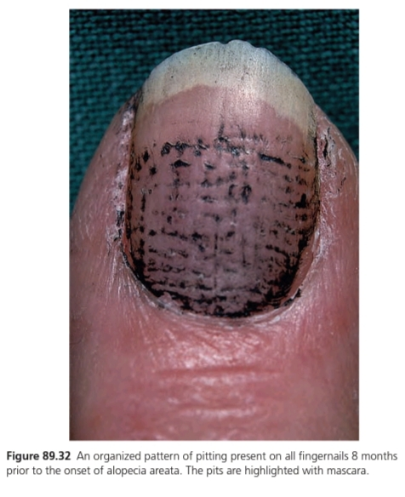
NAIL FINDINGS
Fine pitting of dorsal
nail plate
Trachyonychia
Onychomadesis

Slide 71
Investigations
Diagnosis is clinical and straight forward
In case of diagnostic uncertainty skin biopsy for histopathology can be done
Other tests include
Fungal culture
Serology for lupus erythematosus
Serology for syphilis

Slide 72
Disease course and prognosis
The potential for regrowth of hair is retained, 34-50% recover within a year
Spontaneous remission occurs in up to 80% of patients with limited patchy hair loss of short duration (less than one year)
In 14-25% patients hair loss progresses to involve all of the scalp (alopecia totalis) or the entire skin surface (alopecia universalis), Recovery is unusual, less than 10%.
The concurrence of atopic disease is associated with poor prognosis

Slide 73
Management
Counselling of the patient are of paramount importance
Psychological support from the dermatologist, family, and support groups ( The National Alopecia Areata Foundation, http://-www.naaf.org/ )

Slide 74
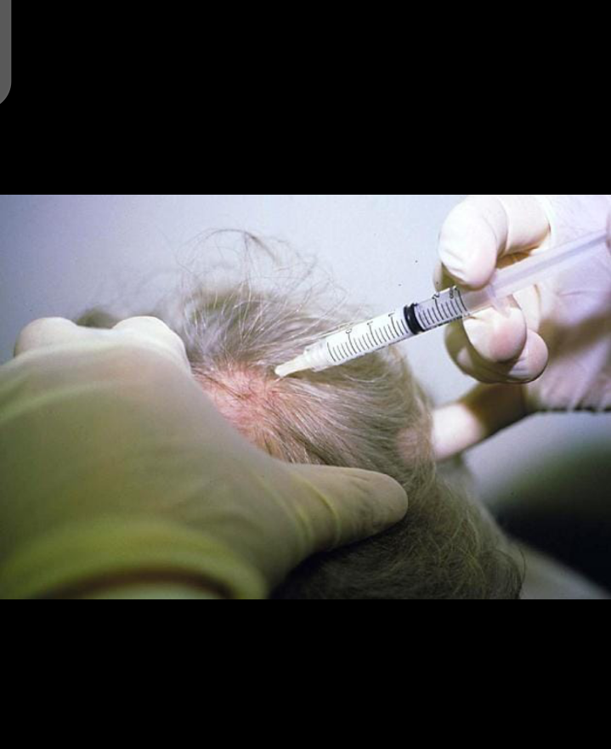
Management
First line
Limited patchy alopecia
1. Potent topical corticosteroids
2. Intralesional steroids (Multiple)
3. Other treatments are topical minoxidil
and anthralin (uncertain benefits)
Notes:
Triamcinolone 5-10mg/ml by fine needle in upper subcutous. Local atrophy is recover within few months.

Slide 75
Management
Second line
Extensive and rapidly progressive alopecia areata
Oral corticosteroids long term daily treatment (e.g oral prednisolone 40 mg/day tappered over 6 weeks)
High dose pulsed corticosteroids

Slide 76
Management
Third line
Contact immunotherapy is the most effective and best documented treatment for alopecia areata
Allergens used are dinitrochlorobenzene (DNCB), squaric acid dibutyl ester (SADBE) and diphenylcyclopropenone (DPCP)
Contact allergen competes for CD4 cells attracting them away from the perifollicular region
Photochemotherapy ( PUVA) claiming success rates of up to 60–65%
Systemic cyclosporine at doses of 4–6 mg/kg/day has been shown to have a beneficial effect in some patients with alopecia areata

Slide 77
Management
Other treatment options are
  Methotraxate
  Dapsone
  Biological agents
  Platelet rich plasma

Slide 78
Management
Persons with extensive scalp involvement such as AAT may prefer to wear a wig or hairpiece
Makeup applied to eyebrows is helpful
Eyebrows can be tattooed

Slide 79
Scarring disorders of hair growth
Cicatricial alopecia

Slide 80
introduction
Patchy hair loss in which there is permanent destruction of hair follicles (thus loss of hair regrowth potential) followed by fibrous tissue replacement caused either by a disease affecting the follicles themselves (primary cicatricial alopecia) or by an external process (secondary cicatricial alopecia)
Any hair bearing skin may be affected although cicatricial alopecia most commonly presents on the scalp

Slide 81
Scarring vs non scaRring Alopecia
 | Non-scarring hair | Scarring hair loss
Incidence | More common
Erythema/scaling/pustules | -/+ | +
Atrophy | absent | present
Loss of follicular openings | absent | present
Tufted hair | absent | present
Course | Regrowth occurs | No regrowth
Prognosis | favourable | Unfavourable

Slide 84
Follicular LiChen planus
Idiopathic inflammatory disease that may affect the skin, hair and nails
Three variants of follicular lichen planus are recognized
Classic lichen planopilaris (LPP)
Frontal fibrosing alopecia (FFA)
Graham‐Little syndrome

Slide 85
Classic Lichen planopilaris
LPP may or may not be associated with lichen planus of the skin or mucosa
Most commonly affects middle-aged women
Manifestations in scalp: Perifollicular erythema ± hyperkeratosis
Violaceous discoloration of scalp
Prolonged inflammation results in scarring alopecia

Slide 86
Scarring alopecia caused by lichen planus showing active lesions
More advanced lichen planus showing follicular plugs and scarring.

Slide 87
Perifollicular erythema in association with scale. B Later stage showing scarring with loss of follicular openings, but significantly less erythema

Slide 88
Low‐power photomicrograph showing follicular
plugging and a periappendageal inflammatory infiltrate.
Base of the hair follicle showing hydropic degeneration of the basal layer and a lichenoid mononuclear cell infiltrate

Slide 89
Management
Potent topical corticosteroids
Intra lesional corticosteroids
Oral corticosteroids
Cyclosporin
Hydroxychloroquin
Acetretin

Slide 90
Frontal fibrosing alopecia
Recession of the frontal hairline is the cardinal feature
In contrast to androgenetic alopecia the frontal hairline
recedes in a straight line rather than bitemporally and
sideburns are commonly lost
Loss of eyebrows is an early and near universal finding

Slide 91
Management
Variety of treatments are used, including topical and intralesional corticosteroids, hydroxychloroquine, doxycycline and finasteride, but there is no convincing evidence that any is effective

Slide 92
Graham Little syndrome
Features
Management
Cicatricial alopecia of the scalp
Loss of pubic and axillary hair without clinically evident scarring
Keratosis pilaris
Corticosteroids ( potent topical and oral )
HCQ has also been used

Slide 93
Chronic cutaneous lupus erythematosus
Areas of erythema and scaling with follicular plugging extend irregularly across the scalp and produce scarring
Symptoms may include pruritus, burning or scalp tenderness, Inflammatory activity is most pronounced centrally within the area of alopecia
The “carpet tack” sign may be elicited with retraction of scale revealing keratotic spikes that correspond to follicular openings on undersurface

Slide 94
Notes:
Discoid lupus erythematosus. (a) Low‐power photomicrograph showing
follicular plugging, superficial and deep perivascular and periappendageal lymphocytic
infiltrate. (b) High‐power photomicrograph showing the hydropic degeneration of the basal
layer and the mononuclear cell infiltrate. (c) Higher‐power photomicrograph showing the
hydropic degeneration of the basal layer

Slide 95
Management
First line
Photoprotection
Potent topical corticosteroids
I/L triamcinolone
Oral prednisolone(1mg/kg)
Second line
Antimalarials (HCQ 200-400 mg/day)
Retinoids

Slide 96
Third line
Thalidomide
Oral vit E
Oral Gold
Dapsone
Cyclophosphamide
MTX
Cyclosporin
Clofazamine
Topical pimecrolimus

Slide 97
pseudopelade of Brocq
Idiopathic, chronic, slowly progressive patchy cicatricial alopecia
End stage of all non inflammatory scarring alopecias and a variety of initially inflammatory disorders
Commonly affects middle aged and older women

Slide 98
Clinical features
Discrete, smooth, skin or pink-colored irregularly shaped areas of alopecia without follicular hyperkeratosis or perifollicular inflammation
Single hairs may persist in the otherwise hairless patch

Slide 99
Diagnostic criteria for pseudopelade
of Brocq
Clinical criteria
• Irregularly defined and confluent patches of alopecia
• Moderate atrophy (late stage)
• Mild perifollicular erythema (early stage)
• Female : male ratio 3 : 1
• Long course (more than 2 years)
• Slow progression with spontaneous termination possible
Histological criteria
• Absence of marked inflammation
• Absence of widespread scarring (best seen with elastin stain)
• Absence of significant follicular plugging
• Absence, or at least a decrease, of sebaceous glands
• Presence of normal epidermis (only occasional atrophy)
• Fibrotic streams into the dermis
Direct immunofluorescence
• Negative (or only weak IgM on sun‐exposed skin)

Slide 100
Management
The alopecia is irreversible and does not respond to topical or intralesional corticosteroids
No treatment is known to arrest progression
If the disfigurement is considerable and no active inflammatory changes are present autografting from unaffected to scarred scalp may be considered

Slide 101
Central centrifugal cicatricial alopecia
Lymphocytic primary cicatricial alopecia
Primarily affecting African women
It remains unclear which of the following contribute most to its formation: chemical processing, heat, traction or other traumas

Slide 102
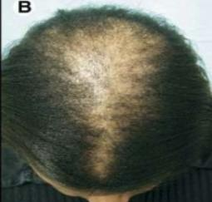
Clinical presentation
Patients may complain about itching, tenderness and pins and needle sensations
Presents as skin colored patch of scarring alopecia on the crown gradually progressing centrifugally to parietal areas
May be clinical evidence of inflammation at the advancing margins

Slide 103
Management
Potent topical corticosteroids may arrest progression
Doxycycline or minocycline is useful in inflammatory cases with pustules
Minoxidil hair spray
Wig

Slide 104
Folliculitis decalvans and tufted folliculitis
Folliculitis decalvans uncommon, progressive, painful, purulent folliculitis that may involve any hair‐bearing site
Although most common on the vertex of the scalp
Staphylococcus aureus may be grown from the pustules
Tufted folliculits occurs when the infundibular epithelium of damaged follicles heal with the formation of a large, common infundibulum
Up to 30 hairs may emerge through a common dilated pore like a toothbrush

Slide 105
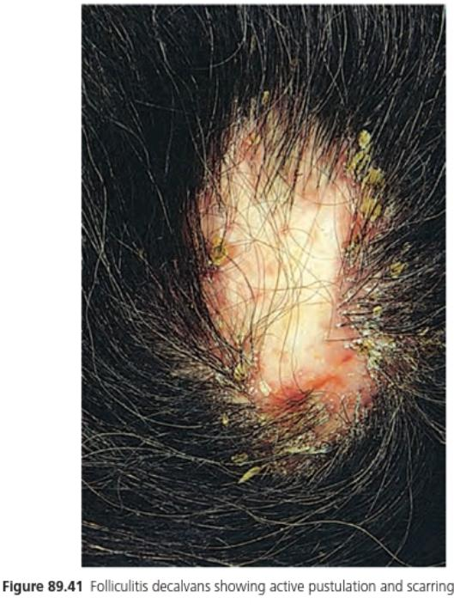
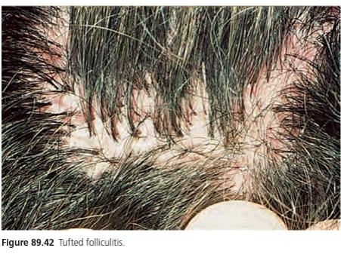

Slide 106
histopathology
Follicular abscesses with a dense perifollicular polymorphonuclear infiltrate and scattered eosinophils and plasma cells
Foreign‐body granulomas occur in response to follicular disruption, which is succeeded by scarring

Slide 107
Management
Aim of treatment is to eradicate staph. aureus from the scalp
Topical and systemic antibiotics
For prolonged remission rifamipicin should be used in addition to clindamycin, ciprofloxacin or doxycycline
For Tufting – tar shampoos and topical keratolytics
Other measures include laser depilation, surgical excision

Slide 108
Artefactual alopecia
Cosmetic alopecia
Traction alopecia
Medical trauma hair loss
Notes:
Cosmetic… heated tongs- bubble hair, overuse of chemical treatment such as relaxers
Traction… sustained pulling on hair roots, associated with headach, reversible in early stages, once follicles have lost then its permanent
Medical trauma… forcep delivery, surgery, embolization procedures

Slide 109
trichotillomania
Behavioral disorder characterized by compulsive hair pulling
Bizarre pattern of hair loss
Hair is plucked most frequently from one frontoparietal region
Hair are not lost completely within the affected area (in contrast with alopecia areata)
Hairs of different length

Slide 110
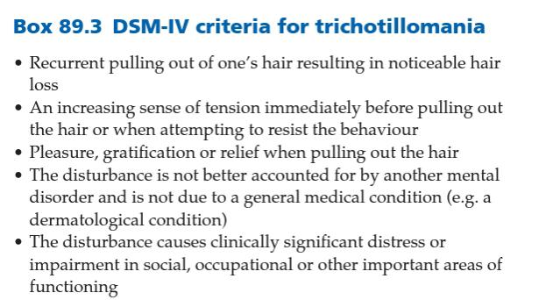
Notes:
Diagnostic and statistical manual of mental disorder

Slide 112
Management
Psychiatrist or clinical psychologist review
Behavioural therapy aimed at habit reversal, pharmacotherapy with SSRIs

Slide 113
Abnormalities of hair shaft

Slide 114
Abnormalities of hair shaft
Structural defect with increased fragility
Structural defect without increased fragility
1. Monilithrix
2. Pili torti
3. Netherton syndrome
4. Trichorexis nodosa
5. Trichothiodystrophy
1. Pili annulati
2. Wooly hair
3. Uncomable hair syndrome
4. Loose anagen hair syndrome
5. Trichostasis spinulosa
6. Pili multigemini
7. Weathering of the hair shaft
8. Bubble hair

Slide 115
Structural defect with increased fragility

Slide 116
Monilethrix
Hair loss or broken hairs
Follicular keratosis(nape + occiput)
Hair shaft
Beaded + break off easily
Eliptical nodes of 0.7-1 mm
Separated by interenodes

Slide 117
Pili torti
Hairs are flattened and at irregular intervals completely rotated through 180° around their long axis
Can occur isolated or part of the syndrome
Menkes syndrome
Bjornstad syndrome
Crandaal syndrome
Notes:
Wide veriety of presentation, brittle hairs, may break off at 5 cm or grow longer, circumscribed baldness. Can improve with transition from childhood to adulthood

Slide 118
Netherton syndrome
Rare AR disorder characterized by
Gene involved
SPINK5
Congenital icthyosis
Hair shaft abnormalities
Atopic diathesis

Slide 119
Clinical features
Skin symptoms
Erythroderma at birth, gradually evolves into milder form icthyosis linearis circumflexa
Exfoliative scaly dermatitis with an incomplete advancing double edge of peeling scale
Atopic eczema
Hair
Short, dry, lusterless, brittle
Eyebrows and lashes sparse or absent
Trichorrhexis invaginata – protrusion of distal part of the hair shaft into the cup shape of its proximal part

Slide 120
Congenital ichthyosiform erythroderma
Ichthyosis linearis circumflexa.

Slide 121
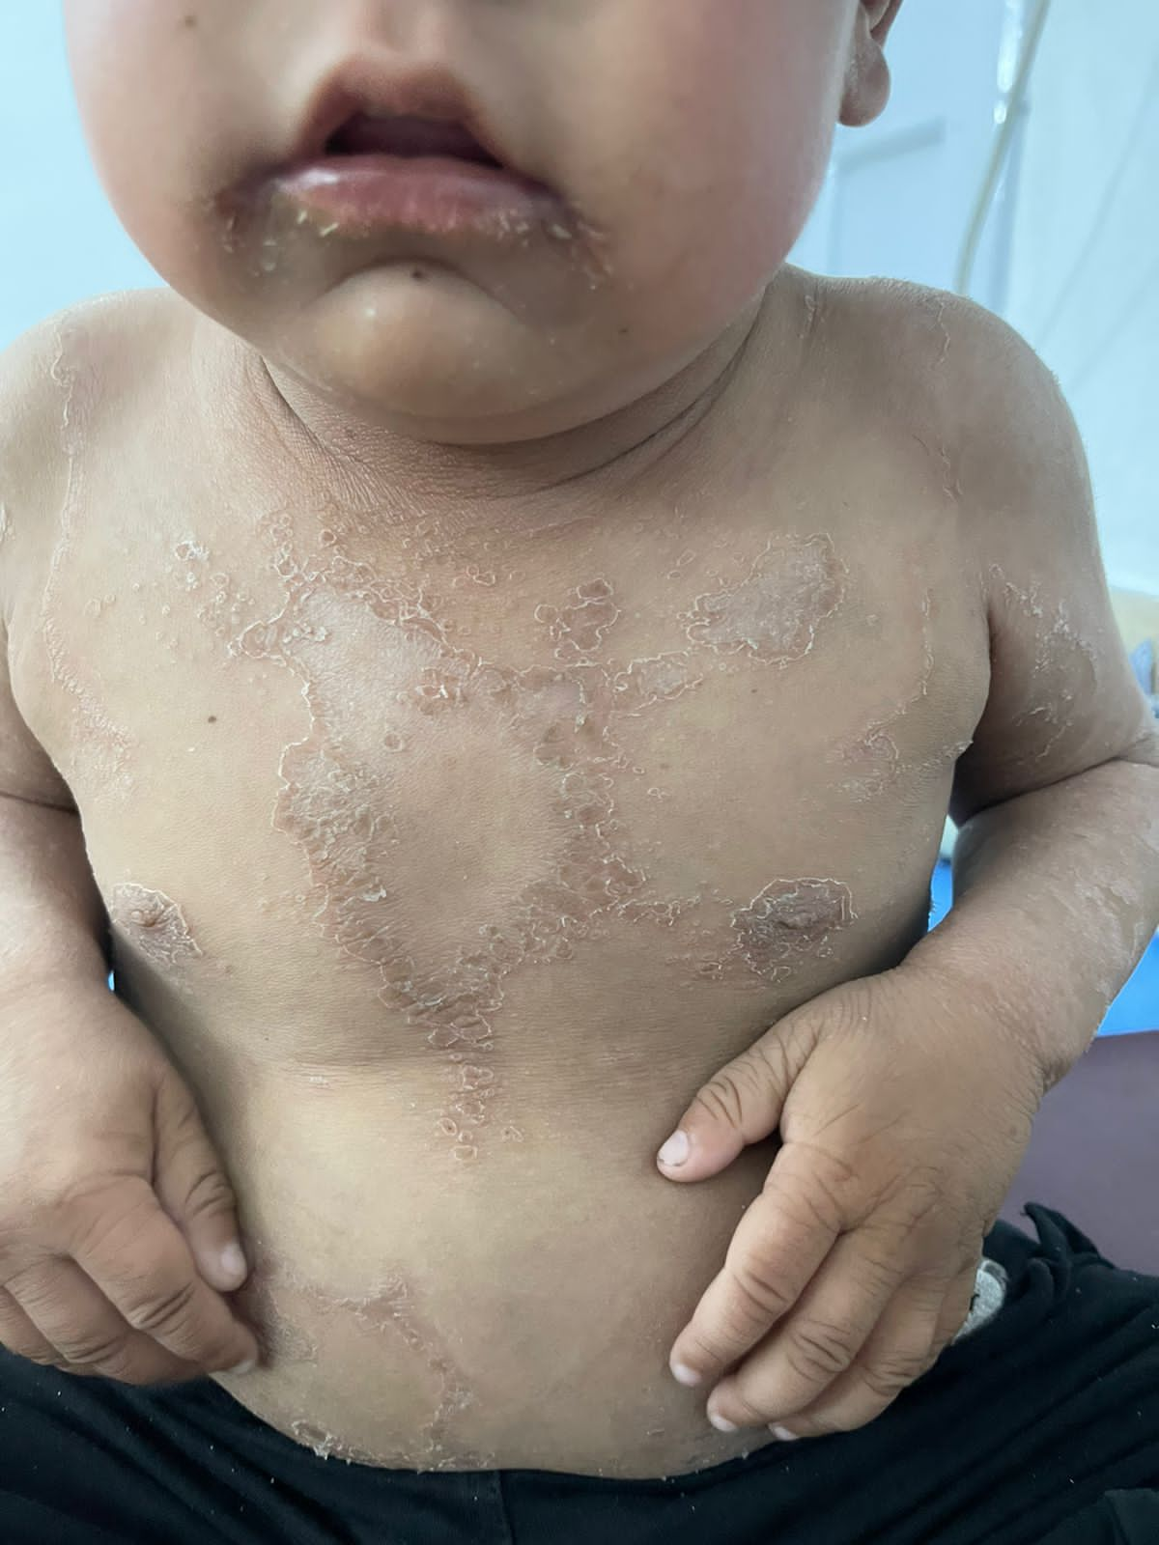
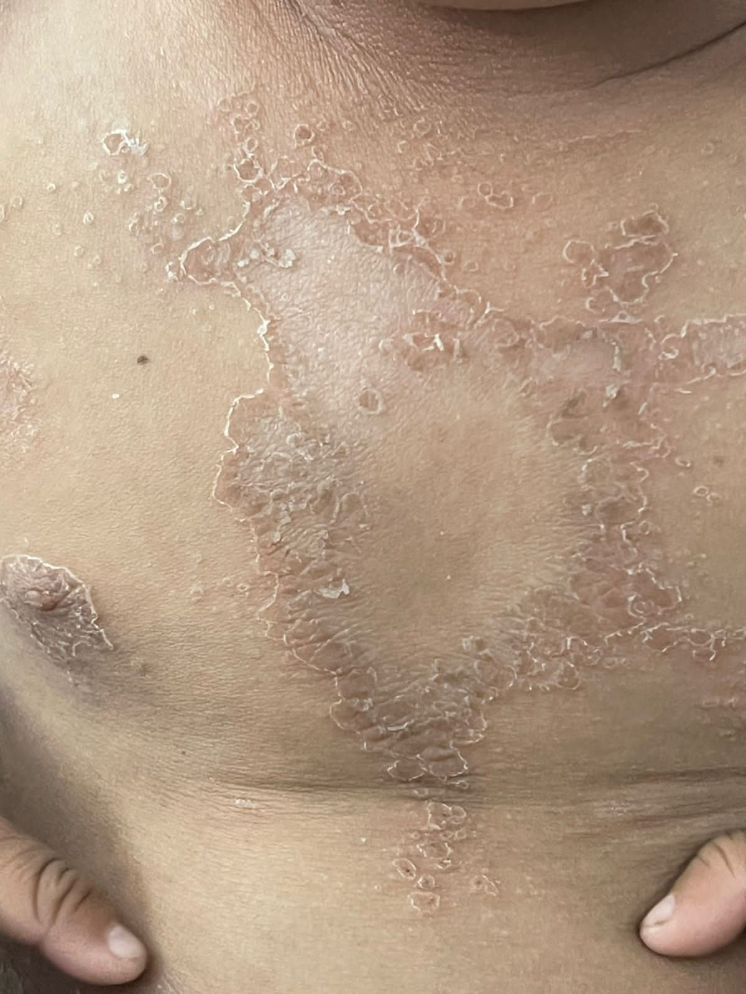

Slide 122
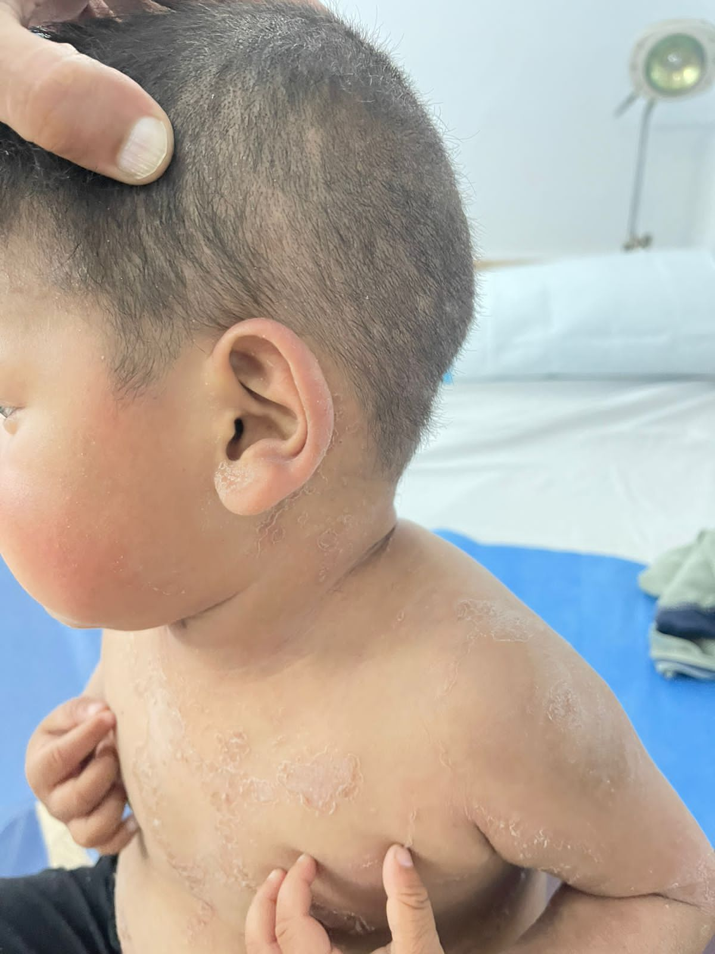
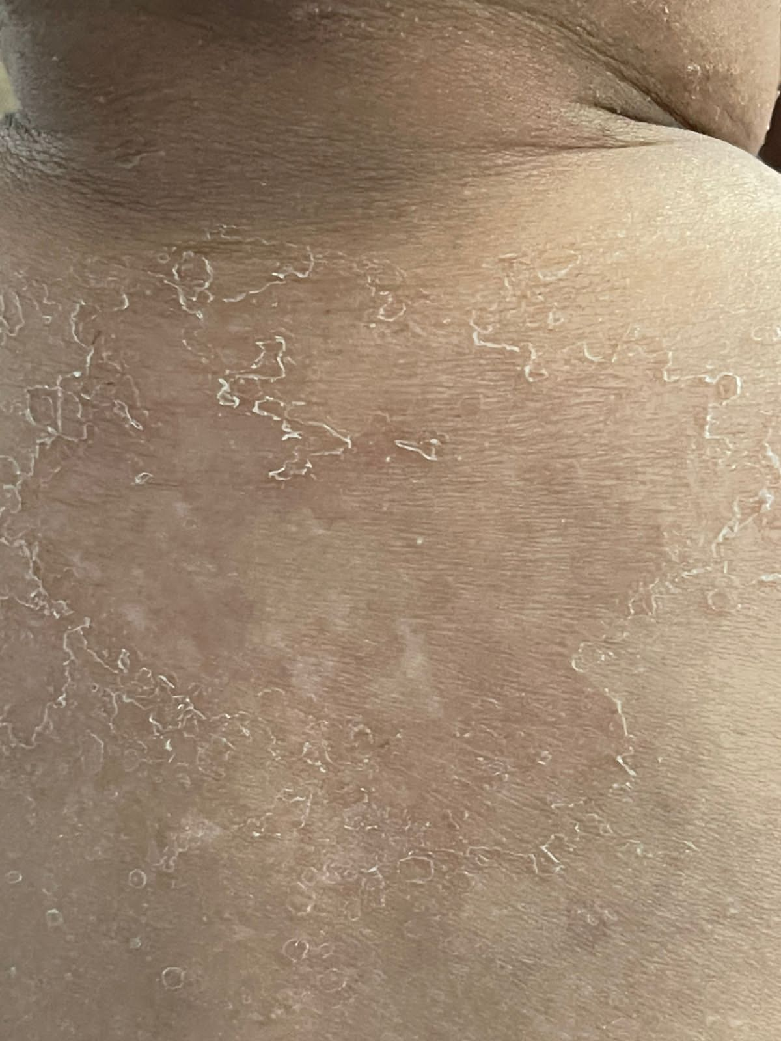

Slide 123
investigations
Cut the hair at scalp surface and examine under light microscopy trichorrhexis invaginata
SPINK5 sequence analysis

Slide 124
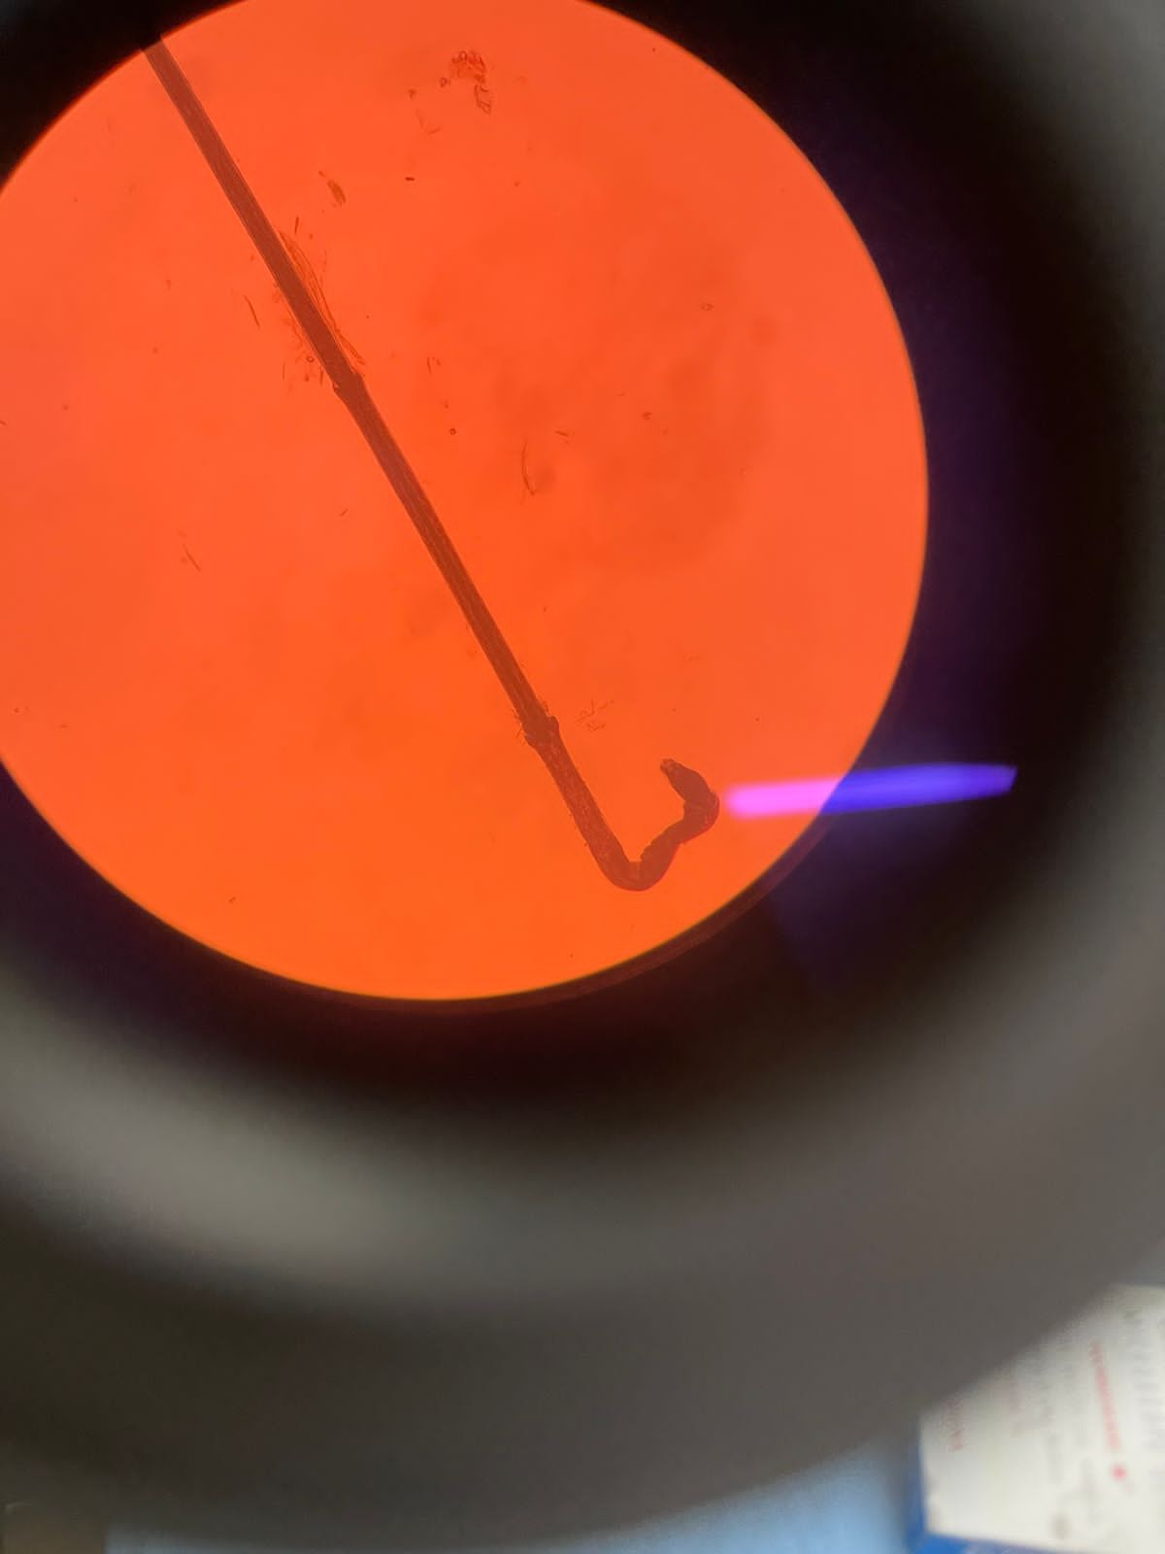

Slide 125
Management
1. No effective therapy
2. Impaired barrier function : major issue
regular bathing
Emollients (50/50 WSP/LP)
Topical antibiotics
Topical anti inflammatory immunomodulators ( tacrolimus 0.05 – 0.1%)
3. Food allergies to fish, nuts should be prevented by dietry restrictions
4. IVIG therapy
5. Anti TNF alpha monoclonal antibodies

Slide 126
Trichorrhexis nodosa
Distictive response to injury
Causes:
1. Injury:
Combing
Hair follicle transplantation
Scratcing (pubic hairs)
Cumulative effects: (summer recurrences)
Shampooing, Brushing, Sunlight
2. Metabolic deffect:
Argininosuccinic Aciduria (+ mental retardation)
Biotinidase deficiency
 3. Familial form:
Isolated hair defect by birth
Notes:
Short, brittle, lusterless hairs, breaks off easiy leading to circumscribed patch of hair loss
Arginosuccinase deficiency

Slide 127
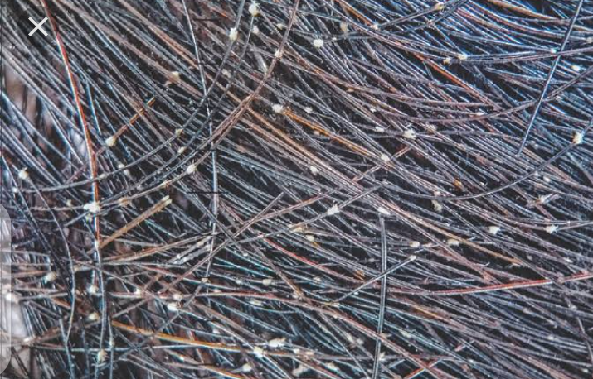
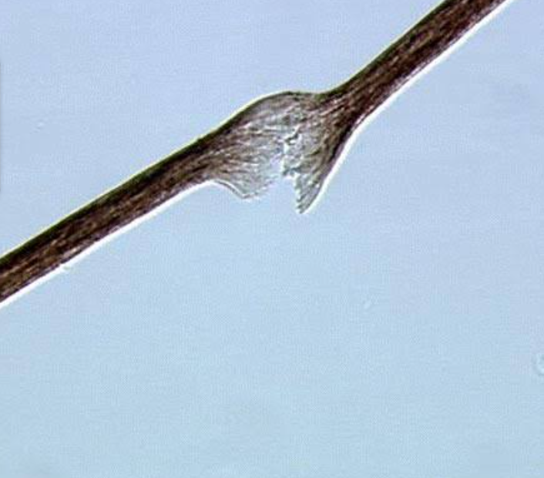
Notes:
Polarized light examination shows splaying of cortical fibers from transverse fracture of hair fiber

Slide 128
Management
Excessive physical and chemical trauma must be avoided

Slide 129
trichothiodystrophy
Brittle hair due to low sulphur content
Variable degree of alopecia
Lamellar icthyosis
Dytrophic nails
Mental or physical retardation
alternating bright and dark zones

Slide 130
Structural defect without increased fragility

Slide 131
1. Pili annulati
2. Wooly hair
3. Uncombable hair syndrome
4. Loose anagen hair syndrome
5. Trichostasis spinulosa
6. Pili multigemini
7. Weathering of the hair shaft
8. Bubble hair

Slide 132
Woolly hair
More or less tightly coiled hair occurring over all or part of the scalp
Autosomal dominant woolly hair
Autosomal recessive woolly hair
Woolly hair naevus
Acquired woolly hair (Retinoids, valproate )

Slide 133
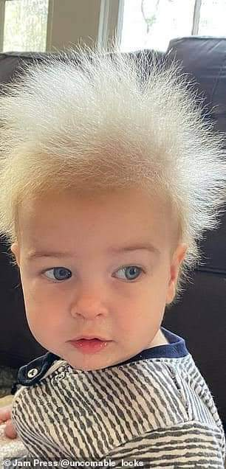
Uncombable hair syndrome
Disorderly appearance of hair totally resist all efforts to control it with brush or a comb
Autosomal dominant
No treatment known, oral biotin has been suggested
Features often diminish with adulthood
Notes:
Often silvery blonde colour

Slide 134
Loose anagen hair syndrome
Loosely anchored and easily pulled from the scalp
Microscopy of plucked hair
Ruffling of the cuticle adjacent to the anagen bulb ( ‘floppy sock’)
Management
Gentle hair grooming and reassurance that the defect usually
resolves spontaneously with age
Notes:
Cause…insufficient amount of inner root sheath in the anagen

Slide 135
Trichostasis spinulosa
Normal age‐related phenomenon (easily overlooked)
Successive telogen hairs are retained in predominantly sebaceous follicles
Most common on nose and face

Slide 136
Closely resemble comedones
Dermoscopy can help in assessing the extent: comedo‐like lesions are prominent and in some cases a tuft of hairs may be seen projecting through the horny plug
Management
Keratolytic preparations – little value
Topical retinoic acid (most effective)
Depilatory wax
Specialized cleaning pads
Laser treatments

Slide 137
Pili multigemini
Developmental defect of hair follicles that fuse
Multiple hairs emerge through a single pilosebaceous
Occur mainly on face (along the lines of the jaw)
Tufts of hair may be seen emerging from a few or many follicles.

Slide 138
Bubble hair
Hair Damage with direct heat
Faulty hair appliance
LM/ EM →gas filled bubbles in hair
Management
  Trim damaged hair
  Replace appliance

Slide 139
Excessive growth of hair

Slide 140
Excessive growth of hair
Hypertrichosis
Hirsutism
Excessive hair growth (density, length) beyond accepted limits of normal for age, race and sex
Excessive hair growth (women) in androgen-dependent hair patterns

Slide 141
hypertrichosis
Congenital generalized
Congenital localized
Acquired generalized
  Malignant
  Non-malignant
Acquired Localized

Slide 142
Congenital Generalized
Cornelia de Lange syndrome
  Mental retardation
Fetal Alcohol syndrome
  Physical / mental retardation
Winchester syndrome
  Joint destruction/ short stature
  Corneal opacities
Hurler syndrome/ Mucoploysaccharidosis
Berardinelli Syndrome
  Lipodystrophy/hyperlipidemia
  hepatomegaly

Slide 143
Congenital localized
Conenital localized hypertrichosis of specific anatomical site
Naevi
  Becker
  Congenital melanocytic naevi
  Plexiform neurofibromas
Lumbosacral hypertrichosis

Slide 144
Hypertrichosis cubiti - Multiple terminal hairs on both elbows in a child
Becker nevus

Slide 145
Acquired Generalized hypertrichosis
Malignant
  Breast, gastrointestinal tract or lungs
The hair may grow rapidly up to 2.5cm/week or may be more than 10cm long
Non-Malignant
  Drugs
  Hypothyroidism
    Children
    Back /extensors
  Eating disorders
    Bulimia/ anorexia
  Dermatomyositis
  Epidermolysis bullosa

Slide 146
HYPERTRICHOSIS DUE TO DRUGS
Antibiotics
• Streptomycin
Anti-inflammatory drugs
• Benoxaprofen, Corticosteroids
Vasodilators
• Diazoxide
• Minoxidil
• Prostaglandin E1
Diuretics
• Acetazolamide
Anticonvulsants
• Phenytoin
Immunosuppressives
• Cyclosporine • Mycophenolate mofetil
Psoralens
• Methoxypsoralen • Trimethylpsoralen
Antiseptic agents
• Hexachlorobenzene
Chelators
• Penicillamine
Other
• Interferon-α
• Fenoterol
• EGFR inhibitors (e.g. cetuximab,
panitumumab, erlotinib, gefitinib)

Slide 147
Acquired Localized hypertrichosis
Porphyria
Graves disease
Topical drugs
  Corticosteroids, latanoprost, minoxidil
Trauma/ chronic rubbing
Facial hypertrichosis in a woman due to porphyria cutanea tarda
Notes:
Ltanooprost used for glaucoma

Slide 148
hisrsutism

Slide 149
introduction
The presence of terminal hair in a male pattern in women is referred to as hirsutism
Apparent after puberty
Ectopic androgens → any age
Associated with PCOS and endocrine disturbances

Slide 150
Pathophysioogy
In non pregnant females, majority of androgen is bind to sex hormone binding gobulin, some to abumin, while 1% circulates freely which is active
Androgens secreted by adrenal glands and ovaries
Adrenal Androgens
  Androstenedione
  Dehydroepiandrosterone ( DHEA)
  Dehydroepiandrosterone sulfate ( DHEAS)
Ovarian Androgens
  Androstenedione (reproductive years)
  Testosterone (after menopause)

Slide 151
Clinical presentation
  Male pattern hair
  Seborrhea
  Acne
  Female pattern hair loss
  Cilnical Variants
    SAHA
    PCOs
    Ovarian tumors
    Congenital adrenal hyperplasia
    Acquired adrenocortical disease
    Idiopathic

Slide 152
Clinical variants
SAHA
  Seborrhea
  Acne
  Hyperandrogenism
  Androgenetic alopecia

Slide 153
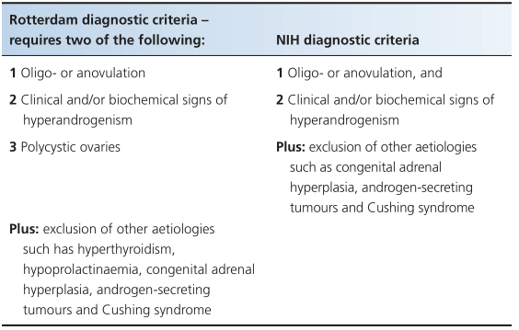
Hirsutism - PCOS
Polycystic ovarian syndrome
Notes:
10 or more follicles detected on ultrasound

Slide 154
Hirsutism - PCOS
Laboratory investigations
  ↑LH
  ↑LH:FSH
  ↑testosterone / androstenedione / estradiol
  Hyperinsulinaemia in 50% of women (obese / non obese)
    ↓SHBG ↑Ovarian testosterone

Slide 155
Hirsuitism – Ovarian tumors
Hirsutism, amenorrhea, oligomenorrhea, alopecia, clitoromealy and deepening of voice occurs in ovarian tumours
Testosterone levels exceed double the upper limit of normal

Slide 156
Hirsuitism – CAH
A defect in cortisol synthesis results in redistribution of the precursors to other pathways, which results in overproduction of the other hormones
21 hydroxylase enzyme deficiency defective cortisol production increase ACTH leading to accumulation of presursors and excessive production of androgens virilization

Slide 157
Hirsutism – variants
Acquired Adrenocortical disease
Adenoma/carcinoma
Virilization + cushings → CA
Idiopathic Hirsuitism
Idiopathic hirsutism is the diagnostic label given to those hirsute women in whom no overt underlying endocrine disorder can be detected

Slide 158
Classification of severity

Slide 159
Investigations of hirsutism

Slide 160
Management
Physical method of hair removal
Topical medications
Oral drug therapy

Slide 162
REFERENCES
ROOK’S TEXTBOOK OF DERMATOLOGY (Ninth edition)
FITZPATRICK’S COLOR ATLAS AND SYNOPSIS OF CLINICAL DERMATOLOGY (seventh edition)
MEDSCAPE
DERMNET NZ ( http://dermnetnz.org)

Slide 163
THANKS!
ANY QUESTIONS?

