Slide 1
Xanthomas and Abnormalities of Lipid Metabolism and Storage
Dr Asfa Ahmed

Slide 2
XANTHOMAS
Greek ‘xanthos’ meaning yellow
subcutaneous lipid deposits
macrophages loaded with cholesterol and cholesterol esters (‘foam cells’)
secondary to disorders of lipid metabolism

Slide 3
Types of xanthomas
Tendon xanthoma
Tuberous xanthoma /Tubero‐eruptive xanthoma
Eruptive xanthoma
Dyslipidaemic plane xanthomas:
  Xanthelasma
  Plane xanthoma
  Palmar xanthoma
Non-inherited
  verruciform
  disseminated xanthomas
Histiocytic disorders

Slide 4
Tendon xanthoma
subcutaneous nodules or papules in relation to tendon
most frequently seen in familial hypercholesterolaemia (FH) and secondary hypercholesterolaemia seen in prolonged cholestasis
cerebrotendinous xanthomatosis and sitosterolaemia
Notes:
in which the tendon xanthomas are not associated with raised serum cholesterol levels

Slide 5
Clinical features
attached to the extensor tendons over the knuckles and in the Achilles tendon
can usually be moved from side to side
contain collagen in addition to foamy macrophages and so feel quite hard

Slide 6
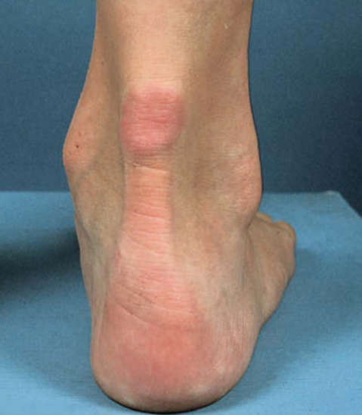

Slide 7
Investigations
lipid profile (where an LDL cholesterol level of ≥4.9 mmol/L may indicate FH)
liver funtion tests

Slide 8
Management
Tendon xanthomas sometimes improve with cholesterol reduction, but do not tend to resolve completely
painful, this symptom improves with LDL cholesterol reduction.

Slide 9
Tuberous xanthoma

Slide 10
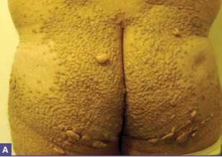
Definition
firm, yellow‐red nodules that occur over sites of pressure, commonly the elbows,knees and buttocks
Where a central tuberous xanthoma is surrounded by several smaller lesions it may be termed a ‘tubero‐eruptive xanthoma’.
Associated diseases
type III hyperlipoproteinaemia

Slide 11
Clinical features
usually over the extensor aspects of the elbows and knees
can develop into quite exuberant exophytic lesions several centimetres in diameter and height
heels and plantar surfaces of the feet,bone marrow
painless
can be itchy

Slide 12
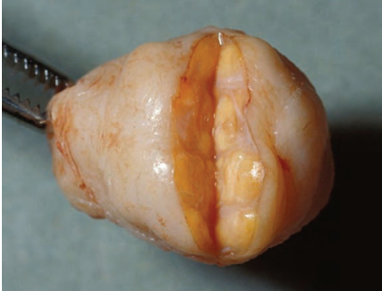
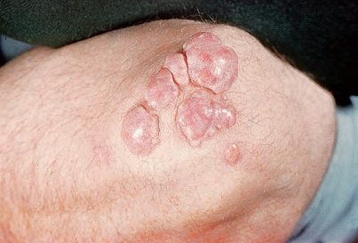
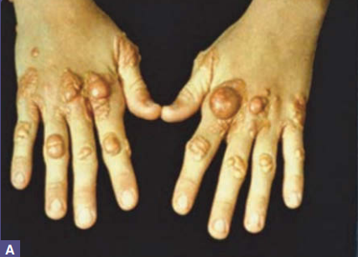

Slide 13
Investigations
lipid profile
apolipoprotein E (ApoE) genotyping
lipid electrophoresis
ultracentrifugation.
Management
treatment of the combined dyslipidaemia

Slide 14
Eruptive xanthoma

Slide 15
Eruptive xanthomas
appear as multiple small papules over extensor surfaces
Associated diseases
  hypertriglyceridaemia
  Types I and V dyslipidemia
  aggravated by underlying diabetes, obesity, excessive ethanol intake, and drugs such as retinoids, estrogen therapy, and protease inhibitors

Slide 16
Clinical features
yellow papules 2–5 mm in diameter arising on an erythematous base
over extensor surfaces, particularly the buttocks, back, legs and arms
pruritic
foamy macrophages contain triglycerides as well as cholesterol
almost always accompanied by lipaemia retinalis
Notes:
, a creamy yellow discoloration of the retinal blood vessels, and a lipaemic appearance of blood or serum samples.

Slide 17
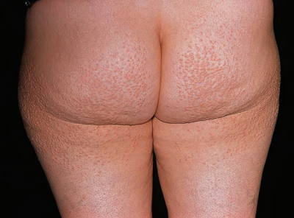

Slide 18
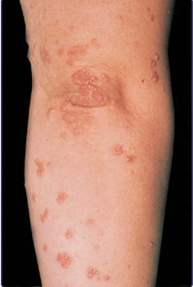
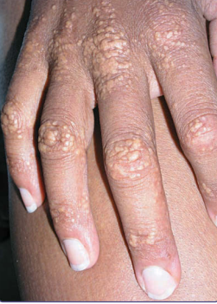

Slide 19
Investigations
fasting lipids (especially triglycerides)
Serum glucose
Management
resolve within 2 weeks or so of the normalization of triglyceride levels

Slide 20
Dyslipidaemic plane (planar) xanthoma

Slide 21
Dyslipidaemic plane (planar) xanthoma
Xanthelasmas/ xanthelasma palpebrarum
plane xanthomas
palmar xanthomas /xanthoma striatum palmare
Notes:
(xanthelasma palpebrarum

Slide 22
Xanthelasma
plane xanthomas that develop around the eyes
Associated diseases
  FH
  type III hyperlipoproteinaemia
  chronic cholestasis (especially primary biliary cirrhosis)

Slide 23
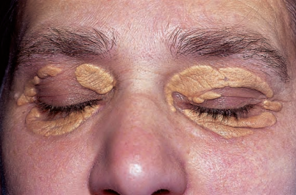
Clinical features
upper eyelids and the area around the medial canthus
soft on palpation
pale yellow to yellow‐orange in colour.

Slide 24
Complications and co‐morbidities
coronary heart disease
Investigations
full lipid profile
liver function tests.

Slide 25
Management
cosmetic problem
surgical excision
Electrocautery
topical trichloracetic acid
silver nitrate
Lasers
Recurrence common
If LDL cholesterol levels are high, then treatment to lower the LDL cholesterol (e.g. with a statin)

Slide 26
Plane xanthoma
flat, smear‐like lesions that can occur anywhere on the body
Associated diseases
  homozygous familial hypercholesterolaemia

Slide 27
Clinical features
wide based, flat and macular
may develop into raised plaques
occur anywhere on the body

Slide 28
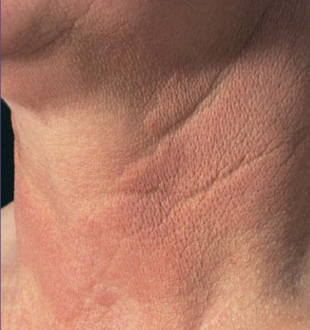

Slide 29
Differential diagnosis
Diffuse plane normolipidaemic xanthomatosis often associated with paraproteinemia or an underlying systemic disorder, usually of the haematological or lymphoproliferative type. Lipid levels are normal.
Necrobiotic xanthogranuloma is a rare, chronic, progressive histiocytosis that is strongly associated with haematological malignant conditions.

Slide 30
Investigations
full lipid profile
serum electrophoresis
autoimmune screen
bone marrow examination if necessary
Management
respond well to treatment of the dyslipidaemia.

Slide 31
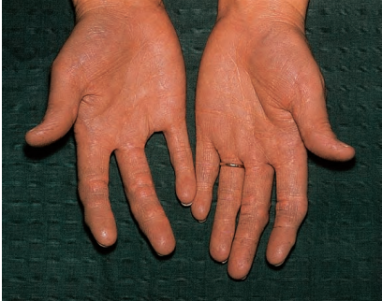
Palmar xanthoma
orange‐yellow lipid deposition running along the palmar creases, and flexor creases of the wrists

Slide 32
Investigations
full lipid profile
fasting glucose
urine and electrolytes
liver function tests
thyroid‐ stimulating hormone levels
ApoE genotyping
lipid electrophoresis or ultracentrifugation
Management
treatment of the causes of the type III hyperlipoproteinaemia.

Slide 33
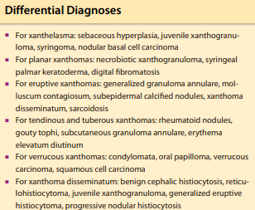
Notes:
oral mucosal involvement with lesions appearing in polypoid or sessile forms.27 Cutaneous lesions are largely limited to the perineum and scrotum in males, and are associated with the CHILD (congenital hemidysplasia with ichthyosiform erythroderma and limb defects) syndrome or epidermolysis bullosa. Xanthoma disseminatum involves xanthoma formation and histiocyte proliferation within common mucocutaneous sites, but also can involve visceral organs, ocular structures, the CNS, and the skeletal

Slide 34
Dyslipidemias

Slide 35
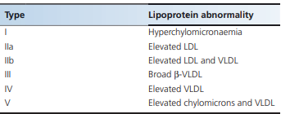
Classification of dyslipidemias
WHO classification
Fredrickson classification
based on the class of lipoprotein
present in excess
this requires plasma ultracentrifugation or lipoprotein electrophoresis,
does not include disorders characterized by low levels of high‐density lipoprotein (HDL) cholesterol or secondary dyslipidaemias,
not a diagnostic classification.

Slide 36
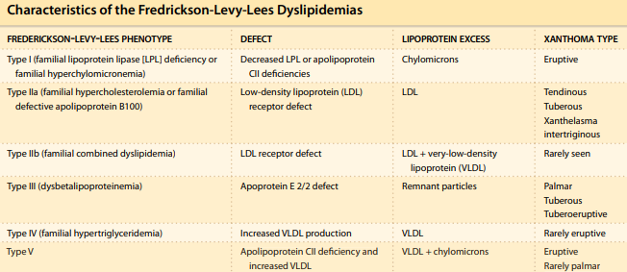

Slide 37
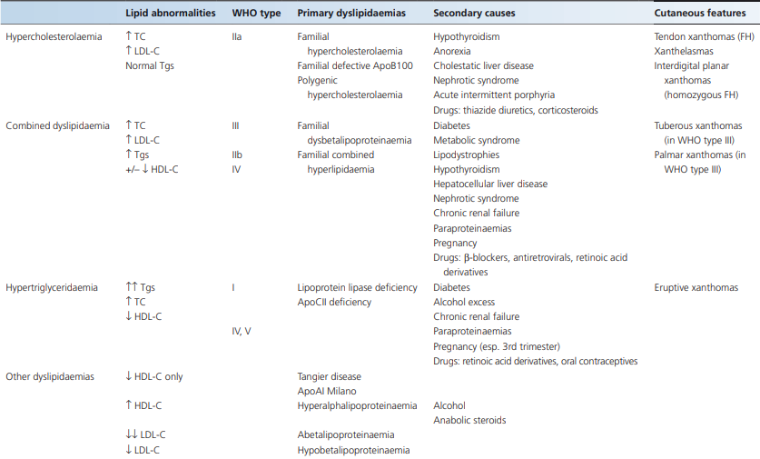
Working classification

Slide 38
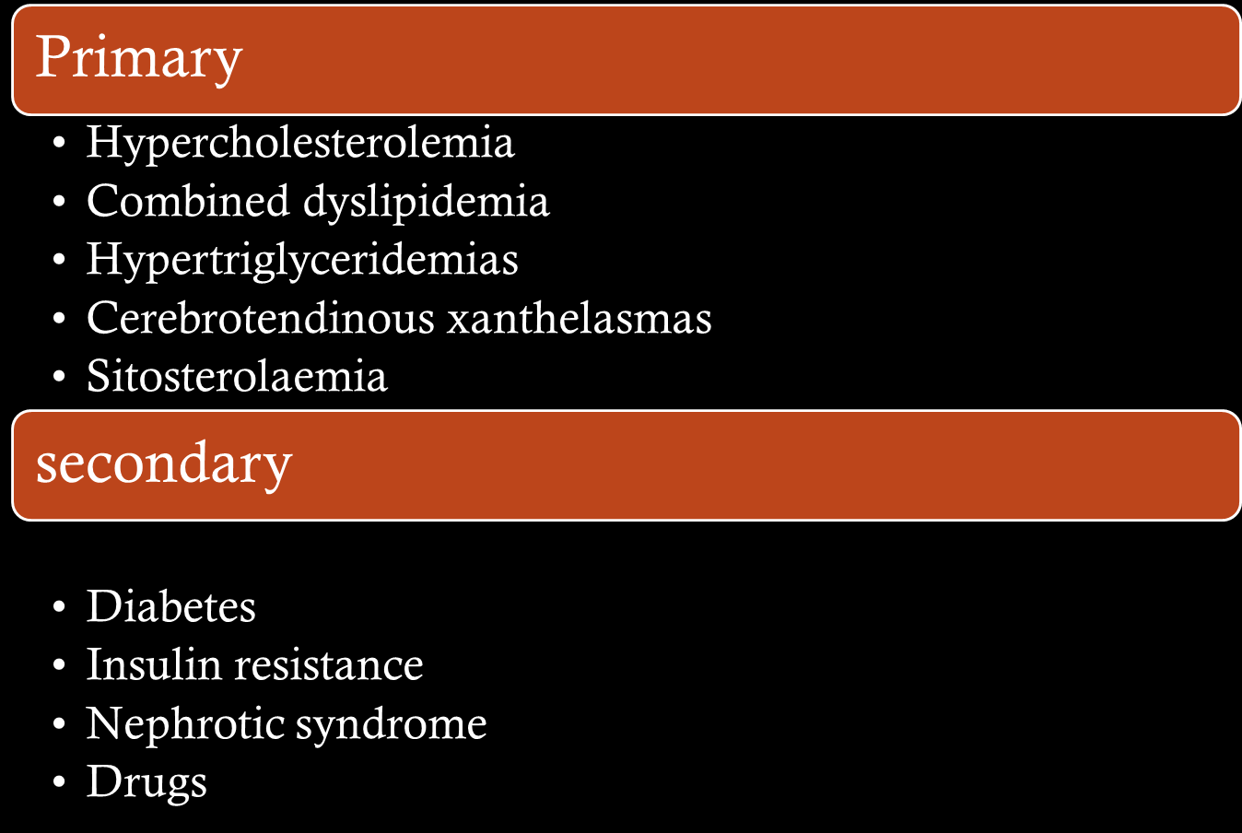
Dyslipidemas

Slide 39
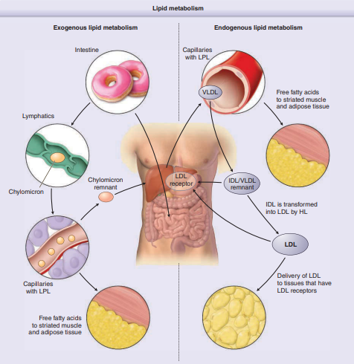
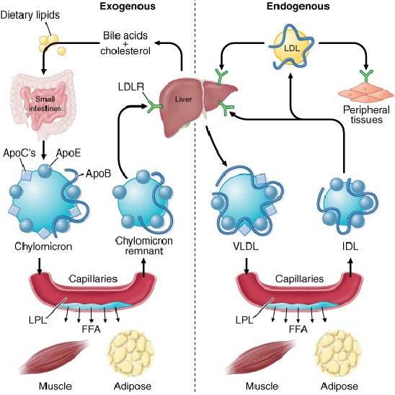
pathogenesis
Notes:
Overview of lipid metabolism with an emphasis on exogenous and endogenous pathways. The exogenous pathway consists of triglycerides in the intestines packaged into chylomicrons in the intestinal enterocytes. Capillary lipoprotein lipase (LPL), which requires apoCII as a cofactor, hydrolyzes the triglycerides and releases fatty acids for uptake by various tissues. The remaining chylomicron particle, called a chylomicron remnant, is recycled by the liver in a process that requires apoE as a ligand for the low-density lipoprotein (LDL) receptors in the liver. The endogenous pathway involves the hepatic production of very-low-density lipoprotein (VLDL) and the delivery of free fatty acids to peripheral tissues. Similar to chylomicron metabolism, LPL hydrolyzes triglycerides and releases fatty acids for peripheral tissue uptake. VLDL remnants are called intermediate-density lipoproteins (IDLs). IDLs may be removed from circulation via the LDL receptor or be transformed into LDL by hepatic lipase (HL) in the liver. LDL may bind to the LDL receptor for clearance or deposit within luminal walls

Slide 40
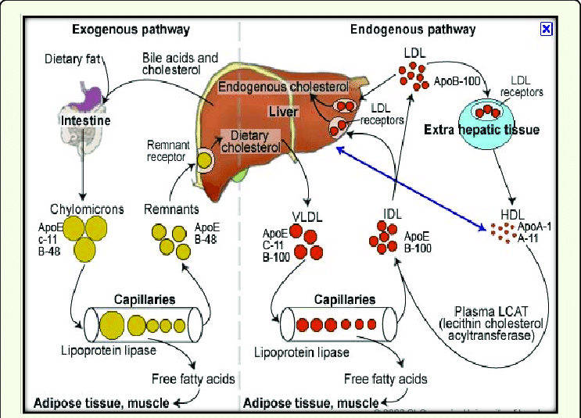

Slide 41
Histology
eruptive xanthomas-lymphoid cells, histiocytes, neutrophils, and, frequently, free lipid in the dermis
Tuberous xanthomas-foam cells and cholesterol clefts
Tendon xanthomas are histopathologically similar to tuberous xanthomas,fibrosis
Xanthelasmas-foam cells,striated muscle, vellus hair, and/or a thinned epidermis, indicative of the superficial location

Slide 42
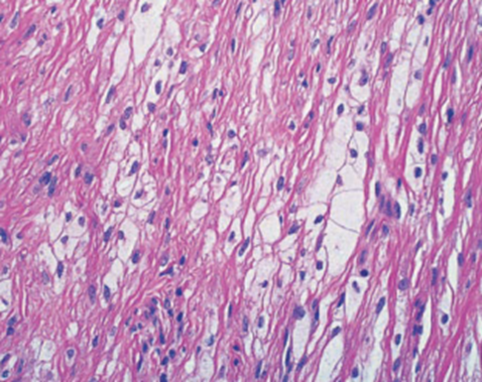

Slide 43
Management
Lifestyle modification
  Exercise
  Smoking cessation
  Diet
  Weight management
Statin therapy
  rosuvastatin 20 mg or 40 mg or atorvastatin 40 mg or 80 mg daily
Adjuvant therapy
  Ezitimibe
  Fibrates
  Omega 3 fatty acids
  lomitapide
PCSK9 INHIBITORS
PROCEDURES
  Biopsy
  Surgery
  ApoB LIPOPROTEIN PHERESIS AND PLASMAPHERESIS
COUNSELING AND SCREENING
  Genetic screening and family screening

Slide 44
PRIMARY DYSLIPIDAEMIAS: HYPERCHOLESTEROLAEMIA
Familial hypercholesterolaemia
type11a
autosomal co‐dominant condition
High total and LDL cholesterol, slightly low HDL cholesterol and normal triglyceride concentrations
Frequent tendon xanthomas (especially of the Achilles tendons)
Premature onset of cardiovascular disease (CVD)

Slide 45
Epidemiology
Homozygotes number about one in 1 × 10^6 in white populations
Heterozygotes occur at a frequency of about one in 500 in most white populations

Slide 46
Pathophysiology
mutations in their LDL receptor
defective clearance of VLDL from the circulation with consequent increased conversion to LDL, and impaired clearance of LDL
• Type 1 mutations prevent receptor synthesis.
• Type 2 mutations impair transport of the receptor from the endoplasmic reticulum to the Golgi.
• Type 3 mutations affect receptor binding of circulating LDL.
• Type 4 mutations prevent clathrin‐mediated receptor clustering and internalization. •
Type 5 mutations interfere with receptor recycling from the endosome.
Type 1 mutations tend to result in a complete absence of LDL receptor activity (‘receptor negative’), while the other classes of mutations usually cause markedly reduced but not completely absent activity (‘receptor defective’).

Slide 47
Clinical features
present in childhood in homozygotes and become more common with age
This frequency has been much reduced by the earlier introduction of effective cholesterol‐lowering medication
Planar and tuberous xanthomas

Slide 48
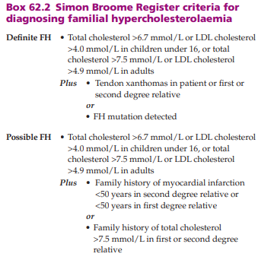
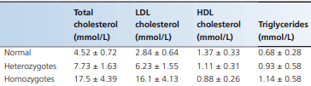

Slide 49
Differential diagnosis
hypercholesterolaemia with total and LDL cholesterol levels similar to those seen in FH homozygotes but without any tendon xanthomas
‘pseudo familial hypercholesterolaemia’

Slide 50
Complications and co‐morbidities
coronary heart disease as early as their teens.
supravalvular aortic stenosis.
myocardial infarction

Slide 51
Investigations
Lipid concentrations
Genetic cascade screening

Slide 52
Management
Statins
Ezetimibe
mipomersen, an antisense oligonucleotide directed against ApoB100 mRNA
Lopitamide, an inhibitor of microsomal triacylglycerol transfer protein, both of which suppress the production of VLDL

Slide 53
PRIMARY DYSLIPIDAEMIAS: COMBINED DYSLIPIDAEMIA
Type III hyperlipoproteinaemia
palmar and tuberous xanthomas
early‐onset CVD and peripheral vascular disease
increase in small VLDL and intermediate‐density lipoprotein (IDL) and a decrease in LDL
Incidence and prevalence
one and 10 in 10 00

Slide 54
Pathophysiology
characteristic lipoprotein electrophoretic pattern that is the gold standard diagnostic test
broad‐β migrating band, rather than the usual pre‐β band
increase in plasma total cholesterol and triglycerides
underlying defect is an abnormal ApoE
Notes:
the apolipoprotein in remnant lipoproteins that mediates their binding to the LDL receptor and the LDL receptor‐related protein
. There are three common isoforms of ApoE: ApoE2, ‐E3 and ‐E4, each differing by one amino acid: E2 E3 E4 Residue 112 Cysteine Cysteine Arginine Residue 158 Cysteine Arginine Arginine ApoE2 homozygosity represents the commonest abnormality associated with type III hyperlipoproteinaemia; its cysteine at residue 112 is within the receptor binding domain of the protein and its cysteine at residue 158 affects salt bridges within the protein and thereby the conformation of the receptor binding domain. Very occasionally other ApoE mutations are associated with type III hyperlipoproteinaemia, many of which severely reduce ApoE‐mediated receptor binding and can cause the disorder in heterozygotes

Slide 55
Environmental factors
excessive caloric intake
increased alcohol consumption
Obesity
type 2 diabetes
metabolic syndrome
hypothyroidism
postmenopausal oestrogen deficiency

Slide 56
Clinical features
Palmar xanthomas
Tuberous xanthomata
Lipaemia retinalis
Eruptive xanthomas over buttocks

Slide 57
Complications and co‐morbidities
coronary artery and peripheral arterial disease
Gout
lipoprotein glomerulopathy
Notes:
, manifesting as proteinuria or the nephrotic syndrome

Slide 58
Management
treatment of any contributing lifestyle factors or diseases
screening for obesity, diabetes and hypothyroidism, and treated accordingly
Dietary advice
exercise

Slide 59
PRIMARY DYSLIPIDAEMIAS: HYPERTRIGLYCERIDAEMIAS
Type I hyperlipoproteinaemia
autosomal recessive condition
accumulation of chylomicrons alone due to a deficiency of lipoprotein lipase (LPL)
Incidence and prevalence
rare
one per million

Slide 60
Pathophysiology
deficiency of LPL
Some cases result from ApoCII deficiency
Clinical features
eruptive xanthomas

Slide 61
Complications and co‐morbidities
Acute pancreatitis
hepatomegaly and splenomegaly

Slide 62
Investigations
elevated levels of serum triglycerides, often greater than 20 mmol/L
Total cholesterol levels elevated
Blood, serum or plasma will appear milky and a creamy layer will separate on top of the sample if centrifuged or allowed to stand for some hours.
Management
strict restriction of all dietary fats to 20–25 g per day
Good control of diabetes, weight reduction, alcohol restriction and a review of all other medications
Infusions of fresh frozen plasma in those with ApoCII deficiency who present with acute pancreatitis.
specialist lipid clinics
Eruptive xanthomas respond to lowering of the triglycerides

Slide 63
Type V hyperlipoproteinaemia
accumulation of VLDL as well as chylomicrons
Incidence and prevalence
one in every 5000–10 000.

Slide 64
Pathophysiology
LPL deficiency
Combined with
  Obesity
  poor diabetic control
  alcohol consumption
  pregnancy
  drugs (oral contraceptives, highly active antiretroviral therapy, β‐blockers and thiazide diuretics being the main offenders)
  hypothyroidism
  lipodystrophy
  renal failure

Slide 65
Clinical features
Acute pancreatitis
eruptive xanthomas
hepatosplenomegaly
lipaemia retinalis
hyperuricaemia, glucose intolerance and hepatic steatosis
Investigations
Samples will show some milkiness with the separation of a creamy layer (made up of chylomicrons) after standing or centrifugation, but the serum or plasma will be opaque representing the presence of VLDLs
Lipids markedly elevated

Slide 66
Management
The treatment of type V hyperlipoproteinaemia is exactly as for type I
Fibrates are more effective

Slide 67
Type IV hyperlipoproteinaemia
VLDL accumulate but without any increase in chylomicrons
Pathophysiology
increased production of VLDLs by the liver

Slide 68
Investigations
fasting triglycerides of less than 6 mmol/L and most less than 10 mmol/L
Management
Lifestyle modification
statins

Slide 69
Cerebrotendinous xanthomatosis
autosomal recessive condition
rare cause of tendon xanthomas and xanthelasmas
Epidemiology
Presentation occurs during childhood or early adult life
Pathophysiology
defect in sterol‐27‐hydroxylase with consequent increased production of cholestanol and 7‐hydroxycholesterol, which accumulate in the plasma and throughout the body

Slide 70
Clinical features
tendon xanthoma and xanthelasma
myelin destruction leading to mental retardation, seizures, spasticity and ataxia; peripheral neuropathy results from similar pathology in the peripheral nervous system.
Early‐onset cataracts, diarrhoea and premature osteoporosis
increased risk of CVD
Investigations
Plasma cholesterol levels are normal
Management
chenodeoxycholate reduces plasma cholestanol concentrations and improves the neurological manifestations of the disease.

Slide 71
Sitosterolaemia
rare autosomal recessive cause of tendon and tuberous xanthomas
Pathophysiology
mutations in the genes ABCG5 or ABCG8 , which encode the proteins sterolin‐1 and sterolin‐2 in enterocytes and hepatocytes
Sterolin‐1 and sterolin‐2 act together to form a lipid transporter that is thought to facilitate immediate excretion of any plant sterols absorbed across the small intestinal brush border.
much greater absorption of plant sterols into the body, principally β‐sitosterol but also sitostanol, campesterol and stigmasterol.

Slide 72
Sitosterolaemia
Clinical features
impaired growth, anaemia, thrombocytopenia and arthritis and are at risk of premature CVD
tendon and tuberous xanthomas
Investigations
serum plant sterol concentrations
Management
ezetimibe reduces plant sterol levels effectively

Slide 73
SECONDARY DYSLIPIDAEMIAS

Slide 74
Secondary dyslipidaemia and diabetes
type 1 diabetes frequently have quite high HDL cholesterol levels and abnormalities in LDL and VLDL
type 2 diabetes -normal total and LDL cholesterol levels, increased triglyceride and reduced HDL cholesterol concentrations
statins should be considered for all people with diabetes over the age of 40, and in younger patients with other CVD risk factors
type 2 diabetes,can cause marked hypertriglyceridaemia (with type IV or V hyperlipoproteinaemia) with clinical features, including eruptive xanthomas, lipaemia retinalis and acute pancreatitis.
type III hyperlipoproteinaemia in those with the appropriate genetic background (usually homozygosity for ApoE2)
eruptive, tuberous or planar xanthomas
  fasting glucose and/or and HbA1c should be requested along with the lipid profile and other appropriate tests.

Slide 75
Secondary dyslipidaemia due to chronic cholestasis
in primary biliary cirrhosis, and the presence of xanthelasmas -bilirubin and an alkaline phosphatase
Longstanding cholestasis is associated with hypercholesterolaemia due to the accumulation of an abnormal lipoprotein, lipoprotein X
dyslipidaemia and the xanthomas improve with the relief of biliary obstruction
Hepatocellular liver disease leads abnormal HDL secondary to progressive deficiency of lecithin‐cholesterol acyl transferase with mild hypertriglyceridaemia

Slide 76
Secondary dyslipidaemia and the nephrotic syndrome
Nephrotic syndrome is complicated by hypercholesterolaemia or a combined dyslipidaemia
Xanthomas are not a frequent feature and the dyslipidaemia resolves if the nephrotic syndrome responds to therapy.
Chronic renal failure leads to hypertriglyceridaemia

Slide 77
Secondary dyslipidaemia due to drugs
Alcohol - hypertriglyceridaemia
Corticosteroids- increase total LDL and HDL cholesterol levels
Ciclosporin - increases LDL cholesterol levels, inhibits cytochrome P450 3A4
Retinoic acid derivatives- hypertriglyceridaemia
Full lipid profile on any pre‐ treatment blood tests and to repeat this several weeks

Slide 78
Thankyou

