Slide 1
Vasculitis
DR HAJRA Saeed
Pgr dermatology

Slide 2
Cutaneous vasculitis is inflammation of the blood vessel walls, usually resulting in palpable purpura.
Vasculitis can be classified by etiology or by caliber of the vessel involved.
Vasculitis is usually a multisystem disorder that presents in a myriad of ways.
Diagnosis is based on a detailed history and careful examination.

Slide 3
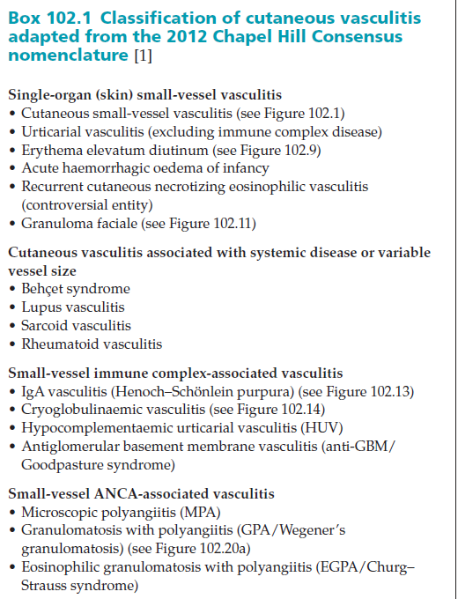
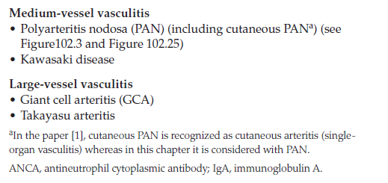

Slide 4
Cutaneous small‐vessel vasculitis producing palpable purpura

Slide 5
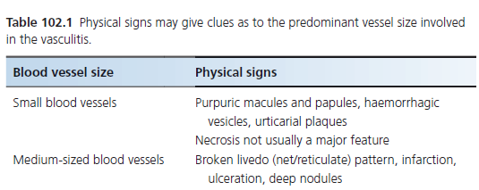
Ulcerated necrotic lesions in a livedo distribution suggestive of medium‐vessel disease.

Slide 6
Areas in the history of a patient with cutaneous vasculitis that may give clues
indicating systemic disease
• Weight loss, fatigue, fever
• Arthralgia, myalgia, arthritis
• Dry eyes, dry mouth
• Red eye, eye pain, vision loss
• Nasal or sinus congestion
• Ear pain
• Oral/nasal ulcers
• Chest pain/dyspnoea
• Abdominal pain, blood in faeces
• Blackouts, weakness, fits

Slide 7
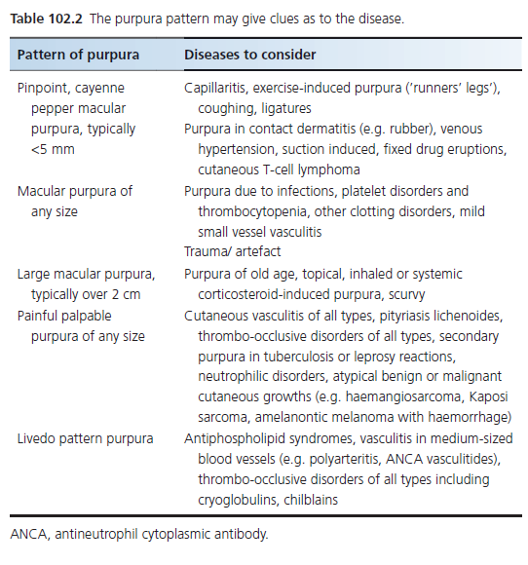

Slide 8
Investigations
The ’vasculitis screen’ is dependent on the history and examination findings.
In acute vasculitis with an obvious infection or drug trigger, investigations may be minimal.
The purposes of investigation are threefold:
to look for
(i) complications of vasculitis
(ii) causes of vasculitis
(iii) differential diagnoses of vasculitis, such as thrombo‐occlusive disorders

Slide 9
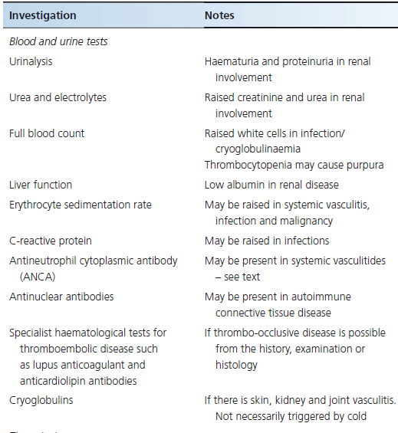

Slide 10
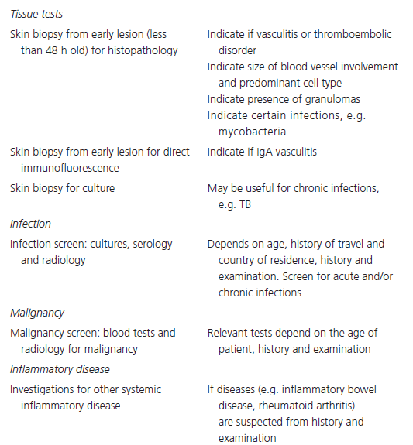

Slide 11
Single Organ
Small Vessel Vasculitis

Slide 12
Cutaneous small‐vessel vasculitis
Most common type of vasculitis in dermatology.
CSVV is a single‐organ vasculitis and therefore by definition does not have systemic manifestations
The presence of three of the following five criteria for CSVV:
(i) age greater than 16 years at disease onset
(ii) history of taking a medication at onset that may have been a precipitating factor
(iii) the presence of palpable purpura
(iv) the presence of a maculopapular rash
(v) a biopsy demonstrating granulocytes around an arteriole or venule

Slide 13
Attempt to establish etiology (idiopathic in 50%)
Drugs 10-15%
Infections 15-20%
Diseases associated with immune complexes 15-20%
Malignancy 5%
Idiopathic 50%

Slide 14
Clinical Features
The skin lesions of CSVV typically arise as a simultaneous ’crop’, usually resolve within several weeks or a few months although approximately 10% of patients will have recurrent disease.
The major cutaneous manifestation of CSVV is palpable purpura, ranging in size from 1 mm to several centimeters.
May progress to a wide array of lesions including papules, nodules, vesicles, plaques, bullae or pustules, with secondary findings of ulceration, necrosis and post‐inflammatory hyperpigmentation.
Lesions typically occur in areas prone to stasis, commonly including the ankles and lower legs and typically sparing intertriginous regions.
CSVV is often asymptomatic, although pruritus, pain or burning may be experienced, as well as systemic symptoms including fever, arthralgia, myalgia and anorexia.

Slide 15
a) Vesicles in a dependent
area on the foot. (b) Purpura on the thighs; there was similar involvement on the
lower legs. (c) CSVV progressing to blistering

Slide 16
Treatment
General Measures
If a triggering agent is identified, such as a drug or infection, it should be removed or treated.
Efforts to minimize stasis, such as use of compression hosiery and the elevation of dependent areas
Use of non‐steroidal anti‐inflammatory drugs (NSAIDs) and antihistamines
First Line
Oral prednisolone 30–80 mg once daily, tapered over 2–3 weeks
No data support the use of topical corticosteroids or antibiotics in CSVV unless TLC is high

Slide 17
Second line
Colchicine 0.6 mg twice daily has been shown to be of benefit
Dapsone 50‐150 mg daily may be advantageous in the treatment of CSVV
Third line
In patients with disease refractory to the above therapies
Cytotoxic agents e.g. azathioprine (1–2 mg/kg/day) and methotrexate (15–25 mg/week)
The use of ciclosporin (2.5–4 mg/kg/day) and cyclophosphamide is almost never indicated for purely cutaneous disease.

Slide 18
Erythema elevatum diutinum
A rare, chronic, cutaneous eruption, most commonly in adults
Characterized by fibrosing plaques with histological evidence of leukocytoclastic vasculitis
Associated with autoimmune diseases such as rheumatoid arthritis, coeliac disease, inflammatory bowel disease and type 1 diabetes
Also associated with infections, including Streptococcus, hepatitis, syphilis and HIV

Slide 19
Clinical Features
Lesions are red‐violaceous, red‐brown or yellowish papules, plaques or nodules, most commonly occurring in a symmetrical fashion over the dorsa of the hands, knees, buttocks and Achilles tendons
They may also be painful
Lesions may last from 5 to 35 years, with crops of new lesions developing every few weeks to months
EED and Sweet syndrome are both described as neutrophilic dermatoses
Sweet syndrome lesions are acute, more often asymmetrical and located on the arms, face and neck
By contrast, EED lesions are chronic, symmetrical and classically located over the dorsum of the hands and knees, buttocks and Achilles tendons
Fibrosis seen in lesions of EED correlates with the clinical chronicity
The demonstration of ANCA in EED has been suggested to be of some diagnostic value

Slide 20
Erythema elevatum diutinum. (a) On the hands. (b) Early non‐fi brotic
lesions at a typical site on the knee.

Slide 21
Treatment
First line
Dapsone is usually effective in EED, although relapse on stopping may occur.
Second line
Niacinamide has also been used with good effect.
High potency topical, or intralesional, corticosteroids may minimize the size of lesions in patients with limited disease; 5% topical dapsone gel has been described as effective.
Third line
Other therapies used for CSVV may also be effective in treating patients with EED.

Slide 22
Granuloma Faciale
Characterized by asymptomatic cutaneous nodules occurring primarily on the face
Limited to the skin, without any systemic manifestations
Commoner in males
GF is considered to be a histological variant of leukocytoclastic vasculitis with a predominantly EOSINOPHILIC infiltrate

Slide 23
Clinical Features
The nodules or plaques are soft and red‐brown . They are smooth, with prominent follicular orifices and telangiectatic surface, most commonly occurring on the face
Lesions of GF never ulcerate
They are almost always asymptomatic, but some may describe itching , burning and pain

Slide 24
Granuloma faciale. (a) Reddish brown plaque on the nose (b) Close up of a facial plaque.

Slide 25
Therapeutic ladder for granuloma faciale
Topical corticosteroids
Topical tacrolimus 0.03% or 0.1%
Intralesional corticosteroids
Cryosurgery +/- intralesional corticosteroids
Clofazimine
Dapsone
Surgical excision
Laser treatments of various types

Slide 26
SMALL VESSEL IMMUNE COMPLEX ASSOCIATED VASCULITIS

Slide 27
IgA Vasculitis / Henoch Schonlein Purpura
Tetrad of HS Purpura
Palpable purpura
Arthritis
Renal glomerular involvement
Gastrointestinal involvement

Slide 28
Henoch–Schonlein purpura
Diseases of the childhood. Peak incidence b/w ages of 4 and 6 years.
Criteria by the European League Against Rheumatism and the Pediatric Rheumatology Society for classifying childhood‐onset vasculitis.
The presence of any one of the following four features in the presence of palpable purpura satisfies a classification of IgA vasculitis:
(i) diffuse abdominal pain
(ii) any biopsy demonstrating predominant IgA deposition;
(iii) any acute arthritis or arthralgia;
(iv) renal involvement in the form of hematuria or proteinuria.

Slide 29
Etiology and Pathogenesis
Streptococcal infections predispose to IgA vasculitis, and antistreptolysin O titre positivity confers a 10‐fold risk of IgA vasculitis,
IgA is thought to be key in the pathogenesis of HSP. Increased levels of IgA in the serum (in 50% with active disease), circulating immune complexes containing IgA, and the deposition of IgA in blood vessel walls and in the renal mesangium are associated with IgA vasculitis .
In IgA vasculitis, IgA1 rather than IgA2 is the main IgA subclass deposited in skin lesions.

Slide 30
Clinical features
Classic findings of purpura, arthralgia and abdominal pain.
The cutaneous findings are typically erythematous, urticarial papules, which may evolve within 24 h into palpable purpura with hemorrhage. Urticaria, vesicles, bullae and necrotic ulcers may develop.
A retiform pattern within lesions is characteristic, but not always present.
Typically involves the extensor aspects of the limbs (especially the elbows and knees) and buttocks in a symmetrical fashion.

Slide 31
IgA vasculitis. (a) Hemorrhagic vesicles present on the hand.
(b) Vasculitis extending onto the arms.

Slide 32
Diagnosis
IgA vasculitis is a clinical diagnosis, with confirmation by direct immunofluorescence and routine histology.
Perivascular IgA deposits are characteristic of IgA vasculitis and can help to distinguish it from other vasculitides including CSVV, granulomatosis with polyangiitis, eosinophilic granulomatosis with polyangiitis and microscopic polyangiitis.
No laboratory tests are specific for IgA vasculitis.

Slide 33
Treatment
Treatment is supportive. Usually self‐limiting
Systemic glucocorticoid treatment may be effective in the treatment of abdominal pain, arthritis and nephritis
Prednisolone 1 mg/kg/day for 2 weeks, tapering over a further 2 weeks

Slide 34
Hypocomplementaemic urticarial vasculitis
HUV is defined as vasculitis affecting small vessels (i.e. capillaries, venules or arterioles), accompanied by
Urticaria
Hypocomplementemia
Circulating anti‐C1q antibodies
Associated glomerulonephritis, arthritis, obstructive pulmonary disease and ocular inflammation are common
Very rare , commoner in females, may be associated with SLE.

Slide 35
Clinical features
Cutaneous lesions of UV are erythematous indurated weals that may contain purpuric foci; persistent urticarial lesions lasting for longer than 24 h
Angio‐oedema and macular erythema may also occur.
Livedo reticularis, nodules and bullae may be evident, and may also contain purpuric foci.
Patients may have constitutional symptoms.

Slide 37
Diagnosis
If urticarial lesions last for longer than 24, then they are not ordinary urticaria (except delayed pressure urticaria) and a skin biopsy should be considered.
Pain rather than itch, or the presence of purpura, also suggests urticarial vasculitis.
History, physical examination and laboratory studies, including C3, C4 and antinuclear antibody, should help to establish the extent of disease and to exclude underlying disease (e.g. hepatitis C) and to evaluate for SLE.
Some patients may demonstrate an elevated erythrocyte sedimentation rate (ESR), hypocomplementaemia, a low‐titre positive antinuclear antibody and haematuria.

Slide 38
Treatment
First line
The majority of patients respond to systemic corticosteroids.
Second line
Drugs that have been shown to be effective for the treatment of urticarial vasculitis include dapsone (100–200 mg once daily), colchicine (0.6 mg twice to three times daily) and hydroxychloroquine (200 mg once to twice daily).
Third line
For patients with refractory disease, there is limited evidence for the use of cyclophosphamide or mycophenolate mofetil.
Some patients require oral antihistamines for the control of angio‐oedema and urticaria‐like lesions, in addition to therapies directed at the vasculitis

Slide 39
Cryoglobulinaemic vasculitis
Characterized by the presence of circulating cryoglobulins; the accompanying vasculitis that affects the small vessels is due to cryoglobulins deposited as immune complexes.
Also effects the joints, peripheral nerves and kidneys.
Eosinophilic periodic acid–Schiff (PAS) positive globular immune complex deposits and PAS‐negative intraluminal fibrin deposits can be visualized.
About 80% of cases are secondary to hepatitis C infection.
Other common associations are Sjogren syndrome and B‐cell lymphoproliferative disorders.

Slide 40
Clinical Features
Palpable purpura, the commonest presenting feature, is nearly universal.
Myalgia, headache, fever and weight loss are common.
Sensorimotor neuropathy and mononeuritis multiplex are both commonly documented.
Renal involvement is usually in the form of membranoproliferative glomerulonephritis, and presents with nephrotic range proteinuria.
The Raynaud phenomenon may be seen in patients with associated connective tissue disease.

Slide 42
Diagnosis
Cryoglobulinemic vasculitis should be distinguished from other causes of CSVV because corticosteroid therapy, although sometimes necessary in the short term, may in the longer term worsen the underlying infection that is present in the majority of cases.
Clinically, head and neck involvement, significant livedo, acrocyanosis, Raynaud phenomenon or larger vessel occlusion are all more suggestive of type I cryoglobulinemia.
A low complement C4 level with a near normal C3 is nearly universal. Rheumatoid factor is positive in high titers.
Evidence of viral hepatitis should be looked for.
Inflammatory markers will be elevated.
Urine analysis can range from normal to nephrotic range proteinuria.

Slide 43
Treatment
Treatment will depend on the underlying cause.
In patients with hepatitis C infection, the treatment should be coordinated with a hepatologist and will need a combination of glucocorticoids, antiviral therapy and immunomodulatory agents.
Interferon a in combination with ribavirin is beneficial, but relapses are common, necessitating long‐term treatment.
Rituximab may be of benefit in this group of patients.

Slide 44
SMALL VESSEL ANCA ASSOCIATED VASCULITIS

Slide 45
Microscopic polyangiitis
Necrotizing systemic vasculitis, with few or no immune deposits, predominantly affecting small vessels.
Necrotizing crescentic glomerulonephritis is very common and pulmonary capillaritis often occurs.
MPA is part of a group of conditions termed ANCA‐associated vasculitis (AAV). The other two conditions in this group are granulomatosis with polyangiitis (GPA) and eosinophilic granulomatosis with polyangiitis (EGPA).
They are united by their association with antibodies directed against proteinase 3 (PR3) and myeloperoxidase (MPO).
Phenotypically, MPA and GPA are very similar in presentation, with the prime difference being the absence of granulomatous inflammation in MPA.
ANCA has a prime role in the pathogenesis, causes vasculitis by activating an oxidative burst.

Slide 46
Clinical Features
Constitutional symptoms, including fever, weight loss, myalgia and arthralgia. These may be present for several weeks before the onset of the pulmonary and renal disease.
About 40% of patients have palpable purpura on dependent skin sites upon presentation. Mouth ulcers, necrotic lesions on the fingers or toes, splinter hemorrhages and livedo reticularis can all be present.
However the presence of nodules and livedo reticularis is commoner in polyarteritis nodosa.

Slide 47
Differential Diagnosis
MPA should be distinguished from other ANCA‐associated vasculitides and polyarteritis nodosa.
The diagnosis of MPA can be made only in the absence of cardinal features of EGPA and GPA.
Similarly the absence of blood, protein or red cell casts in the urine leads away from the diagnosis of MPA.

Slide 48
Investigations
Anemia of chronic disease and laboratory markers of an acute phase response predominate.
Urine analysis of most patients will have a blood and protein leak to varying extents.
ANCA directed against PR3 or MPO are present in nearly all patients.
Chest X‐ray followed by computed tomography (CT) scanning identifies alveolar hemorrhage or pulmonary fibrosis.
Histopathology is the gold standard for diagnosis and when possible the kidneys should be biopsied on suspicion of MPA.

Slide 49
Management
Immunosuppressive therapies, including oral or intravenous glucocorticoids, are the mainstay of treatment.
Remission induction
Pulsed intravenous cyclophosphamide (15 mg/kg every 2–3 weeks) or daily oral cyclophosphamide (2 mg/kg/day) form along with oral prednisolone in a dose of 1 mg/kg/day, to a maximum of 60 mg/day.
Intravenous methylprednisolone can be added to speed up the induction of remission at the commencement of cyclophosphamide. Standard practice would be to add 1 g intravenously per day for 3 days
Refractory disease
Rituximab 375 mg/m 2 per week for 4 weeks is superior to pulsed intravenous cyclophosphamide.

Slide 50
Management
Remission maintenance
• Post‐cyclophosphamide . Due to the cumulative toxicity of cyclophosphamide, azathioprine (2 mg/kg/day) is preferred to maintain remission.
• Post‐rituximab . In patients where rituximab is used to induce remission, current thinking suggests that rituximab should be used at 4–6‐monthly intervals over the long term as a remission maintenance agent.

Slide 51
Granulomatosis with polyangiitis
Wegener’s granulomatosis
Granulomatosis with polyangiitis is a triad of
Necrotizing granulomatous inflammation usually involving the upper and lower respiratory tract, and
Necrotizing vasculitis affecting predominantly small to medium vessels (e.g. capillaries, venules, arterioles, arteries and veins)
Necrotizing glomerulonephritis
A potentially life threatening disease, average age of onset 50-59 years.
Etiology is the same as Microscopic polyangiitis . ANCA has a prime role in the pathogenesis, causes vasculitis by activating an oxidative burst.

Slide 52
Presentation
The most common cutaneous manifestation of GPA is palpable purpura on dependent skin sites, digital infarcts, tender subcutaneous nodules, papules, vesicles and petechiae, as well as non‐specific ulcers or pyoderma gangrenosum‐ like lesions may occur.
Oral ulcers are the second most common mucocutaneous sign of GPA.
The upper respiratory tract is commonly affected, with otitis, epistaxis, rhinorrhea and sinusitis as frequent presenting features.
A saddle nose deformity may result from necrotizing granulomas of the nasal mucosa. Lower respiratory signs and symptoms include cough, dyspnea, chest pain and hemoptysis.

Slide 53
Granulomatosis with polyangiitis. (a) Cutaneous infarction. (b) Digital infarction

Slide 54
Diagnosis
Destructive upper respiratory involvement and severe glomerulonephritis are unusual in EGPA, which typically has asthma and eosinophilia, along with paranasal polypoidal involvement. MPA has predominant renal involvement and is more likely to be associated with MPO ANCA.
Up to 80% of patients will have positive C-ANCA. Those few with no ANCA reactivity may well have localized GPA and a better diagnosis.
Almost any chest X-ray change may represent GPA, with the exception of hilar adenopathy.

Slide 55
The European Vasculitis Society Classification of severity of AAV
• Localized . Upper and/or lower respiratory tract disease without
any other systemic involvement or constitutional symptoms.
• Early systemic . Any, without organ‐threatening or life‐threatening
disease.
• Generalized . Renal or other organ‐threatening disease; serum
creatinine <500 μmol/L.
• Severe . Renal or other vital organ failure; serum creatinine
>500 μmol/L.
• Refractory . Progressive disease unresponsive to glucocorticoids
and cyclophosphamide.

Slide 56
Disease course and Prognosis
Remission can be achieved in up to 90% of patients.
At 2 years, the relapse rate is between 18% and 40%.
Untreated GPA has a 1‐year mortality of 83%;
The survival of treated disease at 1 year is >80%.
End‐stage renal disease occurs in 7% at 12 months, rising to 14% at 5 years and 23% at 10 years

Slide 57
Management
First line
Localized disease can be treated with methotrexate (15–25 mg/week) in conjunction with oral prednisolone 1 mg/ kg/day tapering to about 15 mg/day at 3 months.
Non‐localized disease, cyclophosphamide forms the mainstay of treatment. Cyclophosphamide can be used in a daily oral 2 mg/kg/day dose for 6 months or as pulsed intravenous 15 mg/kg/pulse every 2–3 weeks for six pulses. Oral prednisolone in a dose of 1 mg/kg/day, to a maximum of 60 mg/day, is commonly used as an adjunct to cyclophosphamide, with the aim of reducing the dose to 15 mg/ day at 3 months. At the physician’s discretion, intravenous methylprednisolone can be added to speed up the induction of remission at the commencement of cyclophosphamide. Standard practice would be to add 1 g intravenously per day for 3 days.
In patients with severe renal disease, plasmapheresis may have a role in saving the kidney

Slide 58
Second line
Patients with contraindications to cyclophosphamide can be treated with rituximab 375 mg/m2 per week for 4 weeks instead.
Third line
Patients with refractory disease to cyclophosphamide and glucocorticoids can be treated with rituximab 375 mg/m 2 per week for 4 weeks. 15‐Deoxyspergualin and intravenous immunoglobulin have a role in refractory and persistent disease.
Remission maintenance
Due to the cumulative toxicity of cyclophosphamide, azathioprine (2 mg/kg/day) is preferred to maintain remission.

Slide 59
Eosinophilic granulomatosis with polyangiitis (Churg-Strauss syndrome)
Characterized by an eosinophil‐rich and necrotizing granulomatous inflammation, often involving the respiratory tract
Necrotizing vasculitis predominantly affecting small to medium vessels.
There is an association with asthma and eosinophilia.
ANCA is more frequent when glomerulonephritis is present.

Slide 60
Clinical Features
Three phases of EGPA are recognized:
1 The first phase, which may continue for years, consists of asthma with allergic rhinitis and nasal polyps. The asthma typically begins in adulthood in contrast to allergic asthma.
2 The second phase is that of rising peripheral and tissue eosinophilia.
3 The third phase is the predominately vasculitic phase of EGPA, which may affect almost all organ systems, including the cutaneous, cardiac, pulmonary, nervous, gastrointestinal, renal, genito‐urinary and musculoskeletal systems.
Cardiac involvement is the primary cause of death in patients who do not respond to conventional corticosteroid therapy

Slide 61
Relatively subtle vasculitis on the legs in eosinophilic granulomatosis
with polyangiitis. The patient also had eosinophilia and rapidly developed a
mononeuritis multiplex.

Slide 62
Diagnosis
The ACR 1990 criteria for the classification of EGPA from other vasculitides needed four of the following six features:
(i) asthma;
(ii) eosinophilia greater than 10% on a differential white blood cell
count;
(iii) mononeuropathy (including multiplex) or polyneuropathy;
(iv) non‐fixed pulmonary infiltrates on chest X‐ray;
(v) a paranasal sinus abnormality;
(vi) a biopsy demonstrating extravascular eosinophils

Slide 63
Investigations
Peripheral blood eosinophilia is a requisite for the diagnosis of EGPA.
Inflammatory markers will be raised and IgE is often elevated.
ANCA directed against MPO or PR3 is positive in 30% of patients. Renal involvement is more likely in ANCA‐positive patients.
Chest radiographs demonstrate infiltrates.
CT scans of the paranasal sinuses are often abnormal and demonstrate mucosal thickening.
The gold standard remains a biopsy of the affected organ.

Slide 64
Management
Remission induction
Localized disease
Prednisolone 1 mg/kg/day may be enough to induce remission for most patients with EGPA. About 10% of patients will not result in remission. A further 35% will suffer a relapse.
In patients without organ‐ or life‐threatening involvement the addition of methotrexate 20–25 mg/week should be considered.
Systemic disease
Intravenous pulsed cyclophosphamide 15 mg/kg/pulse at 2–3‐weekly intervals (six pulses) with oral prednisolone 1 mg/kg/day (maximum 60 mg) is the currently preferred regimen for these patients.
Refractory disease
Rituximab
Remission maintenance is the same as discussed before.

Slide 65
Polyarteritis Nodosa
Necrotizing arteritis of medium or small arteries without glomerulonephritis and without vasculitis in the arterioles, capillaries or venules. It is not associated with ANCAs.
Peak age is 40-60 years.
Infections hepatitis B virus, Epstein–Barr virus, HIV, cytomegalovirus infections and coxsackie B4.
Streptococcal infections [ 18 ], erythrovirus (parvovirus B19) and Mycobacterium fortuitum have been reported in association with cutaneous arteritis.
Minocycline has been reported to induceclassic PAN‐like vasculitis.

Slide 66
Clinical Features
Dermal or subcutaneous nodules are most commonly located on the distal lower extremities near the malleoli and may extend proximally to the thighs, buttock, arms or hands.
Patients may report tenderness associated with the nodules, which may ulcerate or more commonly demonstrate necrotizing livedo reticularis, also referred to as retiform purpura.
Gangrene of the digits can ultimately occur, most commonly in children with cutaneous arteritis, but this finding should trigger an aggressive search to exclude systemic features of PAN.
Histological evidence of medium‐sized artery vasculitis if possible. Biopsies should be from symptomatic organs.

Slide 67
Cutaneous polyarteritis nodosa. (a) Erythematous lesions on the leg.
(b) Nodules and ulceration on the leg

Slide 68
Treatment
There should be screening for infection. If associated with hepatitis B infection, antiviral therapies form the focus of treatment in combination with immunosuppressive treatment.
First line
Non‐steroidal anti‐inflammatory drugs and salicylates can be an effective treatment for symptoms of cPAN. High‐dose corticosteroids followed by tapering of the dosage over 3–6 months may occasionally be necessary for some patients.
Second line
Treatment with a combination of cyclophosphamide and corticosteroids.
For patients with hepatitis B‐associated PAN, the recommendation is to start with high‐dose corticosteroids for 2 weeks, followed by antiviral treatment and plasma exchange.
Third line
Use of rituximab in refractory disease.

Slide 69
Kawasaki disease
An arteritis associated with the mucocutaneous lymph node syndrome and predominantly affecting medium and small arteries, in infants and young children.
Thought to be the commonest cause of acquired heart disease in children. Prompt diagnosis with treatment with aspirin and intravenous immunoglobulins reduces heart complications.
Thought to be due to an intense inflammatory response to an unidentified infectious agent in genetically susceptible hosts.

Slide 70
History
Acute febrile stage: Patients present with at least 5 days of fever, irritability, vomiting, anorexia, cough, diarrhea, runny nose, weakness and abdominal and joint pain, lasting up to 2 weeks.
Second phase: lasting 4–6 weeks when the risk of death from coronary aneurysms is greatest,
Convalescent phase: lasting up to 3 months and characterized by a reduction in the ESR and C‐reactive protein (CRP) levels to normal. Larger aneurysms may expand leading to myocardial infarction.

Slide 71
Presentation
The fever is typically spiking and unresponsive to paracetamol
There is acral and perianal erythema and acral edema
Bilateral conjunctivitis with anterior uveitis
Fissured lips and a strawberry tongue
Cervical lymphadenopathy, typically a single large cervical node

Slide 72
Classification of Severity
The Harada score has been used in some countries as an indication for intravenous immunoglobulin therapy. Four of following seven criteria are needed:
(i) white blood count >12 000/ mm;
(ii) platelet count <35 × 10 4 /mm;
(iii) CRP >3; (iv) haematocrit <35%;
(v) albumin <3.5 g/dL;
(vi) age <12 months
(vii) male sex

Slide 73
Management
First line
Intravenous immunoglobulin and aspirin should be given early. Aspirin 100 mg/kg/day is given initially until the fever has settled and is then reduced to 3–5 mg/kg/day for 6–8 weeks in those with no cardiac abnormality, but longer in those with coronary aneurysms. All children should receive IVIg, usually given as a single dose of 2 g/kg over 12 h.
Second line
For children who remain febrile 36 h after the first dose of IVIg, a further dose of 2 g/kg can be given. Patients who are unresponsive to IVIg can be treated with high‐dose prednisolone 2 mg/kg/day, which should be tapered after normalization of the CRP.

Slide 74
Large Vessel Vasculitis
Giant Cell arteritis
Takayasu arteritis

Slide 75
Thank you!

