Slide 1
Topical Drug Delivery
Chapter 13

Slide 2
Skin barrier function
At the macroscopic level, the skin consists of two principal components:
Epidermis
Dermis.

Slide 3
Epidermis
Thickness: only 0.1 mm
Consist of a stratified epithelial membrane
At the outermost surface of the epidermis, the cells are terminally differentiated creating the stratum corneum (SC) , the thickness of which is only about 0.01 mm.
Also contains melanocytes, Langerhans cells and Merkel cells
Avascular, therefore transfer of material across this tissue layer occurs by passive diffusion only

Slide 4
Dermis:
Thickness 1mm
Has connective tissue, consisting of collagen and elastic fibres in an aqueous glycoprotein gel.
Has mechanoreceptors of touch and heat, hair follicles, sweat and apocrine glands, sebaceous glands, lymphatic vessels and a rich microcirculation.

Slide 5
SC is often compared to a ‘brick wall’, with the corneocytes representing the bricks and the intercellular lipids the cement.
Corneo‐desmosomes act as bridges holding corneocytes together until their controlled enzymatic degradation towards the SC surface provokes desquamation of the outer cell layer.
It is the SC that represents the skin’s principal resistance to molecular diffusion either from the ‘inside–out’, as in the case of water, or from the ‘outside–in’ with respect to topically contacting drugs or other foreign substances

Slide 6
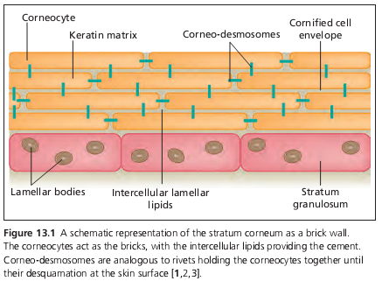

Slide 7
The effectiveness of the SC to limit transepidermal water loss (TEWL) is demonstrated easily by measuring the rate of water ‘escape’ across the skin as the outer layers of corneocytes are progressively removed by adhesive tape stripping, with TEWL increasing by about an order of magnitude once the barrier has been fully deranged

Slide 8
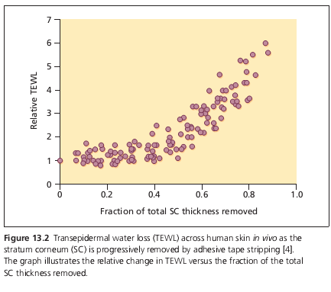

Slide 9
The typical, normal value of TEWL across the skin of a human at rest is in the order of 0.5 mg/cm2/h.
Given that the surface area of skin in an adult male will approach 2 m2, this means that the amount of water lost passively across the skin assuming no active sweating – is between 200 and 300 mL/day.

Slide 10
Penetration pathways: mechanisms of percutaneous absorption
The ‘brick and mortar’ model of the SC immediately presents two potential pathways for penetration across the barrier
Transcellularly, involving the most direct route.
Intercellularly, a tortuous route constraining transport uniquely to the lipid ‘cement’ between the bricks.

Slide 11
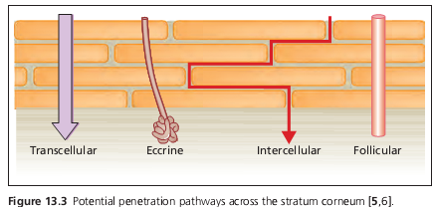

Slide 12
As no active transport mechanisms across the SC have been identified, therefore percutaneous absorption involves passive diffusion
The molecules will follow the path of least resistance across the barrier.
At face value, The transcellular route appears most attractive: it has the largest surface area and volume available for transport and the path length is short (c. 0.01 mm). The intercellular lipid domains comprise only about 15% of the SC volume and, the path length around the cells is closer to 0.5 mm (i.e. 50 times longer than transcellularly)

Slide 13
However, a combination of elegant analytical chemistry, electron microscopy and biophysics research in the 1980s and early 1990s has led to a consensus that the intercellular route is, in fact, the dominant pathway.
The water permeability through the SC was highly correlated with the conformational order of the intercellular lipid domains: as the lipids became progressively disordered by increasing temperature, the permeation of water increased .
The conclusion from these data was that the path of diffusion for water through the SC was via the intercellular lipids.

Slide 14
Topical drug formulations used to treat dermatological disease
Recognize that the ‘ideal’ vehicle:
(i) elicits no pharmacological effect
(ii) solubilizes the drug
(iii) releases the drug with appropriate kinetics
(iv) is chemically and physically stable
(v) is cosmetically appealing
(vi) is non‐allergenic and non‐irritating

Slide 15
Hydrocarbon‐based formulations
For chronic skin disease, these formulations are preferred for their occlusive and protective properties. However, while useful as emollients, the value of these vehicles as topical release systems is limited by poor drug solubility.
These anhydrous formulations are usually rather inelegant, sticky, greasy, white or off‐white ointments, providing high occlusion of the skin.
They are typically used to treat psoriasis, chronic eczema and mycosis, involving small areas of application to dry or very dry skin.

Slide 16
Polar gel formulations
These are more elegant single phase systems. They are usually water‐ and/or alcohol‐based (hydrogel, hydro‐alcoholic gel) with low or no lipid content.
the gels are transparent to opaque semi‐solid gels, rapidly absorbed, non‐greasy, non‐occlusive and may elicit a skin ‘cooling’ effect upon application.
These gels are used to treat acne, acute eczema, rosacea and allergic skin conditions are applied to small areas of oily or inflamed skin (e.g. on the face).

Slide 17
3.Creams
Are disperse systems and represent the majority of aqueous‐based topical formulations.
The readily adjustable properties of these vehicles have led to their wide application in dermatological therapy.
Creams require ‘emulsifiers’ (i.e. surfactants) to stabilize the mixture of oil and water phases
Water acts as either the outer, continuous phase (oil‐in‐water, o/w emulsion) or the inner, discontinuous phase (water‐in‐oil, w/o emulsion).

Slide 18
The continuous lipid phase typically comprises triglycerides or waxes. These white to off‐white emulsions have a high lipid‐replenishing effect and are applied to broad areas of normal to dry skin, treating diseases such as psoriasis, chronic eczema and mycosis.
DISCONTINUATION PHASE:(water‐in‐oil, w/o emulsion) blend easily with SC lipids, improving the bioavailability of lipid‐soluble drugs and moisturizing the skin via a modest occlusive effect.

Slide 19
4 Other disperse systems for specific applications
Sprays
Foams
Lacquers, most typically used in treating diseases of the nail.

Slide 20
Assessment of topical drug bioavailability and bioequivalence between formulations
Bioavailability may be defined as the ‘rate and extent to which the drug is absorbed from the formulation and becomes available at the site of action’.

Slide 21
Bioequivalence is ‘the absence of a significant difference in the rate and extent to which the active ingredient in pharmaceutical equivalents or pharmaceuti-cal alternatives become available at the site of drug action when administered at the same molar dose under similar conditions in an appropriately designed study’.

Slide 22
For new chemical entities, their approval as drug products requires the successful demonstration of safety and efficacy in a series of increasingly detailed clinical trials.
With respect to the commercialization of bioequivalent, generic drug products for oral delivery, the accepted approach is relatively straightforward and is principally based on matching blood level profiles (rate and extent of absorption)
For topical drug products, a clinical trial is essentially the only route for the approval of a generic product or for the replacement of an already approved dermatological product that has appreciable compositional changes

Slide 23
Conclusions
Skin barrier function is principally determined by the SC.
Most compounds are constrained to transport via the lipid‐filled intercellular domain of the barrier.
To improve the quality of topical dermatological therapy it is essential to create better formulations that contain lower drug loads but which deliver a greater proportion of that load.

Slide 24
Chap 14
Clinical Pharmacology
Its deals with the actions, mechanisms Of action, uses, adverse effects and fate of drugs in humans.

Slide 25
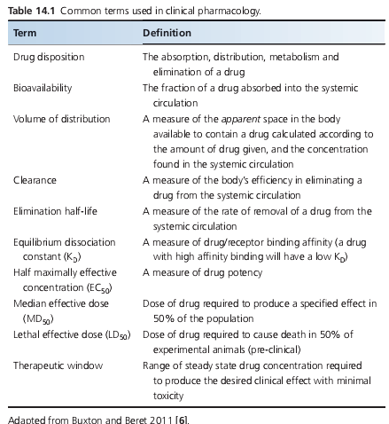

Slide 26
Pharmacokinetics
what the body does to the drug
A: absorption
D: distribution
M: metabolism (biotransformation)
E: elimination

Slide 27
LINEAR PHARMAKOKINETICS (1ST ORDER KINETICS):
Dose independent
most small molecule drugs
Pharmakokinetics parameters are constant
NON-LINEAR PHARMAKOKINETICS :
Dose dependent
biological drugs
Pharmakokinetics parameters are dose dependent

Slide 28
Absorption
Absorption describes the movement of a drug from its site of administration to the central compartment, and is critically dependent on the route of administration used:
1 Topical
2 Oral
3 Parenteral

Slide 29
Topical
In skin disease, a topical approach is often preferred as it allows direct application of the drug to the diseased area
Not all drugs can be effectively delivered in a topical form
The decision as to whether a topical or systemic approach is required will depend on the nature, extent, site and severity of disease.

Slide 30
Oral
Convenient for patients
bioavailability is highly variable and dependent on drug characteristics (e.g. lipophilicity, pH), concomitant food intake (e.g.chelation of tetracyclines by calcium in milk) and rate of gastric emptying.
Enteric‐coated preparations are useful for drugs that cause significant gastric irritation, such as prednisolone.

Slide 31
Parenteral
1.Intravenous 2.Intramuscular 3.Subcutaneous
Therapeutic proteins have very limited oral bioavailability due to intestinal enzymes and poor permeability across the intestinal mucosal membrane barrier, and are almost exclusively administered via parenteral routes (for example rituximab or infliximab)

Slide 32
Distribution
The volume of distribution of a drug is mainly determined by :
physicochemical properties (such as charge and lipophilicity),
protein‐bindingcapacity
the degree to which it is subject to active transport mechanisms.

Slide 33
Preferential accumulation of drugs in certain tissues may also be of clinical relevance. For example, retinoids tend to preferentially accumulate in adipose tissue so that dosing may need alteration in obese patients.

Slide 34
Metabolism
Drug metabolism is traditionally described as occurring in two phases.
Phase I reactions: catalysed by cytochrome P450s (CYPs), flavin‐containing mono‐oxgenases and epoxide hydrolases, and lead to oxidation, reduction or hydrolysis of the drug. Usually this results in a loss of drug function, but for some drugs (so‐called pro‐drugs), it results in drug activation (e.g. mycophe-nolate mofetil is an ester pro‐drug, which is hydrolysed to biologically active mycophenolic acid by plasma esterases).

Slide 35
Phase II reactions catalyse conjugation of the phase I product with a second molecule (sulphate, glucuronic acid, glutathione,acetyl group, methyl group). This inactivates potentially toxic phase I metabolites, and also facilitates drug elimination as a consequence of improved water solubility and increased molecular weight.

Slide 36
Excretion
Drugs are eliminated from the body either unchanged or as drug metabolites, with the kidney being the principle site of drug and drug metabolite elimination.
Renal function is therefore a critical factor in determining drug bioavailability and potential toxicity, and when reduced due to age, disease or concomitant therapy (e.g. non‐steroidal anti‐inflammatory drugs (NSAIDs), diuretics) becomes a very common source of adverse drug reactions.

Slide 37
Pharmacodynamics
Pharmacodynamics is the study of the biochemical and physiological effects of drugs and their mechanisms of actions
what the drug does to the body

Slide 38
Most drugs work by interacting with a specific cellular macromolecule (drug target or drug receptor).
This drug–receptor interaction is the initiating event in a multistep process that ultimately alters tissue function and depends on two key principles:
(i) the affinity and specificity of drug/receptor binding
(ii) the intrinsic activity of receptor‐bound drug to activate the receptor

Slide 39
Molecular mechanisms underlying drug action
Extracellular mechanisms
Transmembrane
Intramembrane

Slide 40
Extracellular mechanism
A number of drugs act outside the cell to affect cellular function, typically in one of two ways:
Alter the activity of extracellular enzymes involved in the synthesis or degradation of endogenous signalling molecules.
By directly interacting with the endogenous ligand to prevent binding to its site of action .

Slide 41
Transmembrane mechanisms
Hydrophilic drugs cannot easily access the cell and so rely on membrane bound receptors to exert their action
These fall into five broad categories:

Slide 42
G‐protein‐coupled receptors
Couple to a family of heterotrimeric GTP binding regulatory G proteins. Following ligand binding, G proteins signal to various effector proteins which then leads to a cascade of intracellular events via second messenger systems and ultimately a drug effect.

Slide 43
2.Receptors linked to intracellular enzymes
They have an extracellular binding domain directly coupled in some way to enzymatic activity within the cell so that, on ligand binding, consequent enzymatic activity initiates and amplifies the intracellular signals and feedback responses by changing the phosphorylation status of the cellular proteins.

Slide 44
3.Transmembrane receptors without enzyme‐linked activity
They include Toll‐like receptors, fundamental components of innate immune signalling, which on ligand binding ultimately recruit interleukin‐associated kinases and downstream pathway signalling via the nuclear factorκB (NF‐κB)pathway.

Slide 45
4.Ion channels
Facilitate the flux of cations and anions across the impermeable plasma cell membrane to maintain electrochemical gradients critical to excitable cells such as nerves and muscles as well as non‐excitable cells, to trigger biochemical and secretory cell function.

Slide 46
4.Membrane‐bound transporters
Play a key role in drug pharmacokinetics as they determine drug entry to and elimination from cells, but are also drug targets, particularly those used in neuropsychiatric disorders (e.g. the transporter SERT ( SLC6A4) is responsible for the uptake and clearance of serotonin in the brain, and the target for selective serotonin reuptake inhibitors).

Slide 47
Intracellular mechanisms
Some small molecule drugs diffuse or are actively transported into the cell to access intracellular drug targets. There are two main types:
1. Nuclear hormone receptors. EXAMPLE: sex hormones, cortisol, thyroid hormones and vitamin D receptors.
2. Intracellular enzymes..examples: ciclosporin, tacrolimus and pimecrolimus

Slide 48
Drug toxicity and Adverse effects
Drug toxicities can be classified in 5 broad categories based on the underlying mechanism.

Slide 49
1.On target drug toxicity
Toxicity following modulation of the primary, pharmacological target.
Sources of this type of event include deliberate or accidental dosing error, alterations in the pharmacokinetics of the drug (e.g. due to liver or kidney disease or to interactions with other drugs) .

Slide 50
2.Off target toxicity
Results from the interaction of a drug with targets other than the intended therapeutic targets, for example the H1‐receptor antagonist terfenadine also inhibits a cardiac potassium channel which led to fatal cardiac arrhythmias and ultimately drug withdrawal

Slide 51
3.Biological activation of drugs
Biological activation of drugs to toxic metabolites capable of binding to proteins, DNA and small molecules such as glutathione
(GSH) is an increasingly recognized mechanism of drug toxicity. Paracetamol‐induced hepatic necrosis is a classic example of this.

Slide 52
4. Allergic reactions
Extend from type I to type IV reactions,are not dose related and are generally unpredictable.

Slide 53
5.Idiosyncratic drug reactions
They are very rare, significant adverse effects and historically describe events for which no obvious mechanism is apparent.

Slide 54
Factors that affect therapeutic outcome
Drug choice and medical decision making
Clinical factors that affect drug pharmacokinetics and pharmacodynamics
Drug interactions
Patient adherence to treatment
Medication errors
Pharmacogenetics and personalized medicine

Slide 55
Drug choice and medical decision making
Before initiating any therapeutic measures, a comprehensive assessment of the patient is essential
Multiple factors determine the relationship between the dose of any particular drug and outcome and thus therapy needs to be carefully and precisely tailored to the needs and clinical circumstance of each patient.

Slide 56
Clinical factors that affect drug pharmacokinetics and pharmacodynamics
1. Age :
Drug pharmacokinetics and pharmacodynamics are altered in the very young and in older people
Systemic exposure to topically applied therapies is more likely in infants and children compared with adults. During infancy, this relates in part to the presence of a thinner stratum corneum.
Ageing is associated with a number of progressive physiological changes including cutaneous atrophy, reduction in lean body mass, 40% reduction in hepatic blood flow, reduced activity of hepatic enzyme activity(especiallyCYP phase I) and reduced renal function

Slide 57
2. Conception, pregnancy and lactation
Any drug exposure prior to, during or after conception can result in an adverse fetal outcome.
Drug exposure during the embryonic period (week 2to week 9) carries the greatest risk of fetal malformation as this is when organogenesis occurs.
Thalidomide, acitretin and isotretinoin are notable examples of drugs with specific, known risks of teratogenicity

Slide 58
Drug interactions
A drug’s effect may be significantly altered by the co‐administration Of another drug with a consequent impact on efficacyand/or induction of toxicity.
Co‐therapy with erythromycin or itraconazole, both potent inhibitors of CYP3A, can therefore lead to significantly increased levels of ciclosporin, whereas phenytoin, a potent inducer of CYP3A, may reduce ciclosporin levels.

Slide 59
Patient adherence to treatment
Non‐adherence to treatment is very common but few patients will declare it to health care professionals voluntarily and assessment is best approached in a non‐judgemental way.
It arises for multiple and complex reasons that fall into two main overlapping categories: 1.unintentional 2. intentional non‐adherence.
Factors that may improve adherence include providing clear written and verbal communication and using the simplest dosing schedule possible. practical demonstration of where and how to apply topical treatments

Slide 60
Medication errors
The steps involved between writing a prescription and the patient Receiving the medicine are multiple, and each is subject to potential error.
Certain types of medication are subject to frequent medication errors
(i) drugs with a narrow therapeutic index and/or where the therapeutic dose is close to the toxic dose (e.g. chemo- therapeutic agents, anticoagulants, narcotics)
(ii) drugs with an unusual dosing schedule that patients may easily confuse (e.g.once‐weekly methotrexate)
(iii) drugs requiring intravenous administration where the speed of infusion or extravasation of Drug into tissue can lead to problems

Slide 61
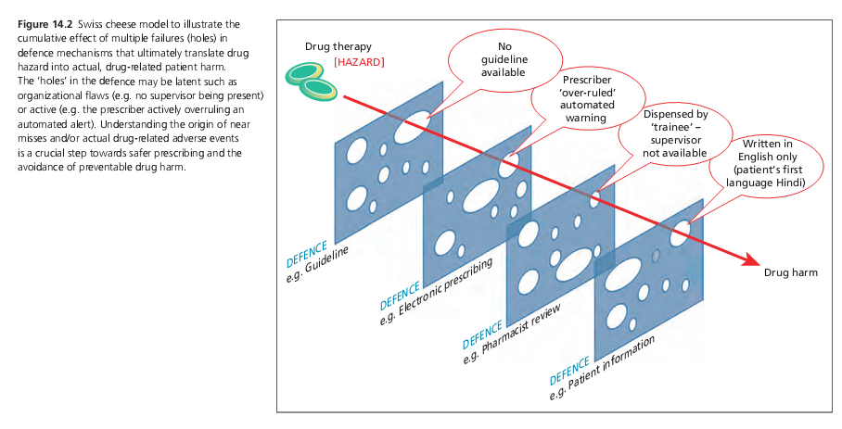

Slide 62
Pharmacogenetics and personalized medicine
Personalized medicine can be defined as giving the right drug to the right patient at the right time, and offers an opportunity to optimize efficacy, minimize adverse effects and save money.

Slide 63
Pharmacogenetics: Genes encoding drug‐metabolizing enzymes, transporters and drug targets may all be subject to functionally relevant polymorphisms and are estimated to account for 15–30% of interindividual variation in drug response.
Interindividual variation in drug‐metabolizing enzyme activity has historically been described in terms of phenotypic variants (e.g. fast and slow ‘acetylators’, slow and fast ‘metabolizers’).

Slide 64
The polymorphic enzyme thiopurine methyltransferase (TPMT), which catalyses a key step in azathioprine metabolism Three common single nucleotide polymorphisms (SNPs) associated with the loss of enzyme function have been identified and linked to the risk of bone marrow suppression due to excess accumulation of biologically active thioguanine nucleotides.
it allows the identification of a small subset of people in whom a drug is absolutely contraindicated due to the risk of developing a severe adverse reaction – one in 300 individuals are homozygous for loss‐of‐function TPMT gene variants and show complete absence of TPMT enzyme activity with consequent predictable, potentially fatal, bone marrow aplasia on exposure to azathioprine.
Second, it identifies a further subset of patients who May benefit from a drug but who might, without prior dose adjustment, have had to discontinue it – 10% of the population carry one loss‐of‐function TPMT gene variant and although at risk of bone marrow suppression with standard dosing, tolerate azathioprine if the dose is reduced.

Slide 65
THANKYOU ☺

