Slide 1
Structure and Functions of Skin
Colonel Dr. Aamir Habib

Slide 2
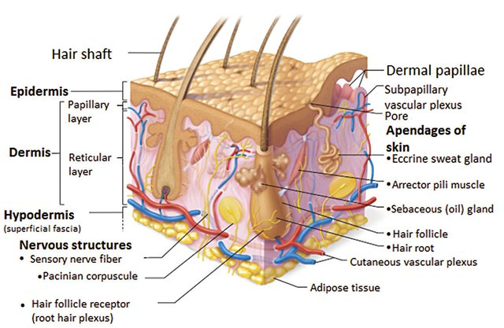
Skin
Skin is the largest organ of the body.
With a surface area of around 2 square meter
accounting for 16% to 20% of the total body weight

Slide 4
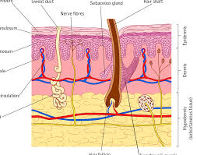
Structure of Skin
composed of
  epidermis
  dermis
  and adipose tissue (the hypodermis)

Slide 5
The accessory structures include
  Hair
  a large variety of glands
  and sensory receptors.

Slide 6
Epidermis
The outer layer of skin
consists of stratified squamous epithelium
The hair follicles, sebaceous glands, apocrine glands and sweat glands are derived from the epidermis and extend into the dermis.
The nails are made up of keratinizing cells that contain hard keratin

Slide 7
Epidermis
The epidermis contains four major resident cell populations
  Keratinocytes
  Melanocytes
  Langerhans cells
  and Merkel cells

Slide 8
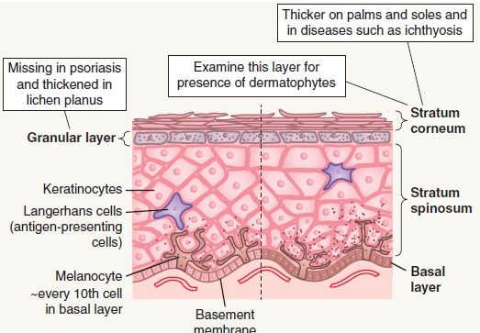
Keratinocyte – Predominant population
Keratonocytes are the major population
They originate in a stem-cell pool situated in the Basal layer
cells that leave this pool undergo maturation as they migrate upward, ultimately forming the laminated stratum corneum

Slide 9
Epidermis
The human epidermis averages 50 microns in thickness
with a surface density of approximately 50,000 nucleated cells/mm2.
Under basal conditions, differentiated keratinocytes require about two weeks to exit the nucleated compartment and an additional two weeks to move through the stratum corneum.
(A total of 28 days)

Slide 10
Keratinocytes have the capacity to increase rates of proliferation and maturation to levels far greater than this, when stimulated to do so by injury, inflammation or disease

Slide 11
Melanocytes
Melanocytes elaborate pigment melanin, which plays a major role in protecting the skin from UV radiation.

Slide 12
Melanosomes
Melanosomes, with their complement of melanin, are produced by melanocytes and then transferred by excretion and phagocytosis into nearby keratinocytes, where they assume their preferred location above the nucleus

Slide 13
Langerhans cells
Members of the third major resident epidermal population, are Langerhans cells
These are antigen presenting cells
After activation, these cells traffic out of the epidermis towards regional lymph nodes, where they play a critical role in antigen presentation during the induction and regulation of immunity

Slide 14
Merkel cells
Merkel cells are found in the basal layer of the epidermis
They contain neuroendocrine peptides within intracytoplasmic granules

Slide 15
Startum corneum
The outermost cell layer of epidermis
Its cells are corneocytes or squames.
Corneocytes are dead, dried-out hard cells without nuclei.
The semipermeable laminated surface aggregate of differentiated (keratinized) squamous epithelial cells serve as a physiologic barrier to chemical penetration and microbiologic invasion from the environment as well as a barrier to fluid and solute loss from within

Slide 16
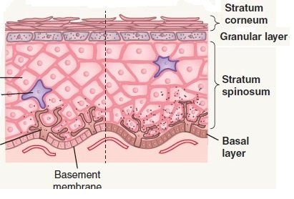
Stratum granulosum (granular layer)
Cells contain basophilic granules.
From these waxy material is secreted into the intercellular spaces

Slide 17
Stratum spinulosum
(spinous, spiny or prickle cell layer)
Intercellular bridges called desmosomes link the cells together.
The cells become increasingly flattened as they move upward.

Slide 18
Stratum basale (basal layer)
Columnar (tall) regenerative cells form basal layer
As the basal cell divides, a daughter cell migrates upwards to replenish the layer above

Slide 19
Dermoepidermal junction
The undersurface of the epidermis and the dermoepidermal junction undulate, with ridges of the epidermis (rete ridges) projecting into the dermis
The parts of the dermis in between these rete ridges form the dermal papillae

Slide 20
Dermal–epidermal interface
The boundary between epidermis and dermis
It consists of a specialized aggregation of attachment molecules, collectively known as the basement membrane
It includes various protein structures linking the basal layer of keratinocytes to the basement membrane (hemidesmosomes) and the basement membrane to the underlying dermis (anchoring fibrils).
The basement membrane has an important role in making sure the epidermis sticks tightly to the underlying dermis
This structure is of considerable interest because a variety of diseases originate from genetic defects in its composition;
it also may serve as a target of autoimmune attack.

Slide 21
Dermis
Beneath the epidermis, a vascularized dermis provides structural and nutritional support
It is composed of glycosaminoglycan gel held together by a collagen- and elastin-containing fibrous matrix

Slide 22
Dermis
The dermis is composed of a supporting matrix (ground substance) of polysaccharides and proteins
within the supporting matrix there are two types of protein fibers: the collagen and the elastic fibres
Dermis has many cellular constituents including fibroblasts, mast cells, histiocytes, macrophages and lymphocytes
The dermis has a rich blood supply
There is a network of nerves in the skin consists of sympathetic autonomic fibers and sensory nerve endings

Slide 23
Collagen
• Type I – main constituent of reticular dermis; also present in papillary dermis
– Big, thick eosinophilic bundles
• Type II – major component of cartilage
• Type III – present in large quantities in papillary dermis and in newly formed scar tissue and fetal dermis
– Smaller bundles and less eosinophilic than type I collagen
• Type IV – basement membrane collagen
• Type V – in fetal membranes and vascular tissue
• Type VI – in neurofibromas
• Type VII – anchoring fibrils

Slide 24
Dermis
The normal cells in the dermis include:
  Mast cells. These contain granules packed with histamine and other chemicals, released when the cell is disturbed.
  Vascular smooth muscle cells. These allow blood vessels to contract and dilate, required to control body temperature.
  Specialised muscle cells. For example, myoepithelial cells are found around sweat glands and contract to expel sweat.

Slide 25
Dermis
Fibroblasts. These are cells that produce and deposit collagen and other elements of the dermis as required for growth or to repair wounds. A resting fibroblast has very little cytoplasm compared with an active cell and appears to have a ‘naked’ nucleus.
Immune cells. There are many types of immune cell. The role of tissue macrophages (histiocytes) is to remove and digest foreign or degraded material (this is known as phagocytosis).
There are also small numbers of lymphocytes in the normal dermis.

Slide 26
Subcutis
The subcutis is the fat layer immediately below the dermis and epidermis. It is also called subcutaneous tissue, hypodermis or panniculus

Slide 27
Functions of Skin

Slide 28
Functions of Skin
• Providing a physiological barrier against the external environment.

Slide 29
Functions of Skin
• Maintaining fluid balance by restricting water loss through the skin.

Slide 30
Functions of Skin
Forming an innate immune defence against bacteria, fungi and viruses through keratinocyte-derived endogenous antibiotics, defensins and cathelicidins
Langerhans cells have a primary role in epidermal immune surveillance.

Slide 31
Functions of Skin
Supporting thermoregulation: vasodilatation or vasoconstriction of the blood vessels in the deep and superficial plexuses help to regulate body temperature.
Eccrine sweat glands, found at all skin sites, also play a role in heat control.

Slide 32
Functions of Skin
• Providing insulation and trauma protection:
subcutaneous fat limits excessive heat loss and shields internal structures from physical trauma.

Slide 33
Functions of Skin
Fat also has an endocrine function, releasing the hormone leptin, which acts on the hypothalamus to regulate hunger and energy metabolism.

Slide 34
Functions of Skin
Vitamin D production on sun exposure
Exposing 20% of skin for 20 minutes daily produces enough Vitamin D to meet our requirement

Slide 35
• Performing a psychosocial function:
The appearance of human skin and its associated structures, especially scalp hair, has a major impact on self-image and thus on interpersonal relationships.

Slide 36
Protection from ultraviolet (UV) radiation through production of melanin from melanocytes.

