Slide 1
Soft-Tissue Tumours and Tumour-like Conditions
Brig. Dilawar Abbas

Slide 2
Soft-Tissue Tumours and Tumour-like Conditions
Fibrous and myofibroblastic tumours
Fibrohistiocytic tumours
Vascular tumours
Lymphatic tumours
Tumours of perivascular cells
Peripheral neuroectodermal tumours
Tumours of muscle
Skeletal muscle tumours
Tumours of fat cells
Tumours of uncertain histogenesis
Ossifying lesions in the dermis

Slide 3
Fibrous and myofibroblastic tumours
Fibrous papule of the face
Storiform collagenoma
Pleomorphic fibroma
Acquired digital fibrokeratoma
Nodular fasciitis
Fibro-osseous pseudotumour of the digits
Ischaemic fasciitis
Superficial acral fibromyxoma
Fibrous hamartoma of infancy
Calcifying fibrous tumour/pseudotumour
Calcifying aponeurotic fibroma
Dermatomyofibroma
Angiomyofibroblastoma

Slide 4
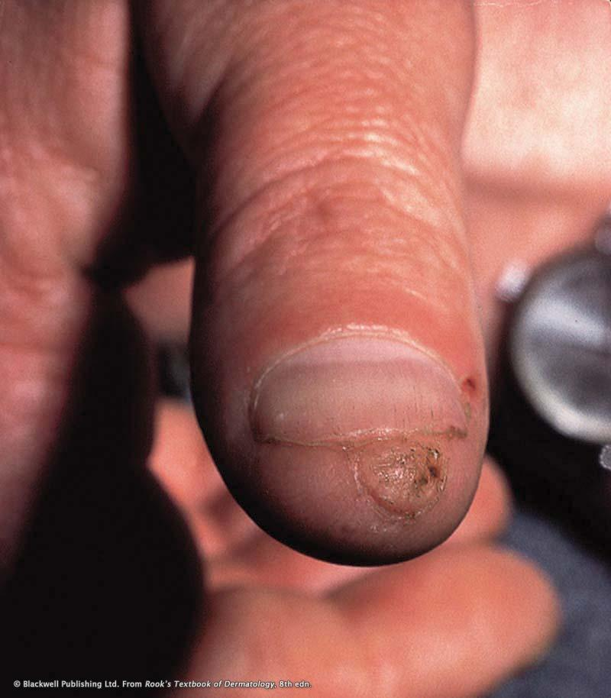

Slide 5
Fibrohistiocytic tumours
Giant cell tumour of tendon sheat
Fibrous histiocytoma (dermatofibroma)
Medallion-like dermal dendrocytic hamartoma
Hemosiderotic fibrohistiocytic lipomatous lesion
Angiomatoid fibrous histiocytoma
Plexiform fibrous histiocytoma
Atypical fibroxanthoma
Malignant fibrous histiocytoma
Myxofibrosarcoma
Low-grade fibromyxoid sarcoma

Slide 6
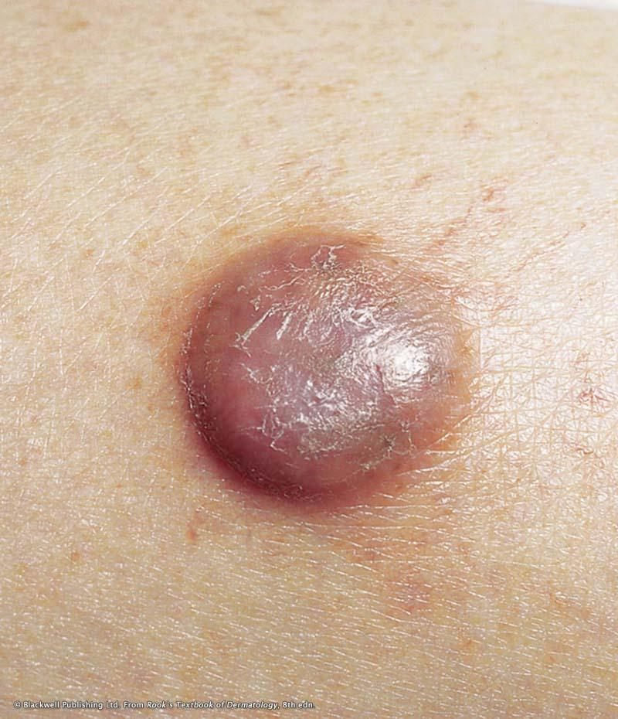

Slide 7
Vascular tumours
Reactive vascular lesions
Benign vascular tumours
Vascular tumours of intermediate malignancy
Malignant vascular tumours

Slide 8
Reactive vascular lesions
Intravascular papillary endothelial hyperplasia
    a form of organizing thrombus in which endothelial cells line hyalinized papillae.
Reactive angioendotheliomatosis
    a multifocal proliferation of clusters of capillaries lined by plump endothelial cells with little or no cytological atypia
Glomeruloid haemangioma
    a distinctive multifocal vascular proliferation that occurs in association with POEMS syndrome (polyneuropathy, organomegaly, endocrinopathy, M protein and skin changes) or with multicentric Castleman's disease

Slide 9
Benign vascular tumours
Lobular capillary haemangioma (pyogenic granuloma)
Cirsoid aneurysm
Epithelioid haemangioma
Cutaneous epithelioid angiomatous nodule
Acquired elastotic haemangioma
Hobnail haemangioma
Microvenular haemangioma
Sinusoidal haemangioma
Spindle cell haemangioma
Symplastic haemangioma

Slide 10
Vascular tumours of intermediate malignancy
Kaposiform haemangioendothelioma
Giant cell angioblastoma
Retiform haemangioendothelioma
Papillary intralymphatic angioendothelioma
Kaposi's sarcoma

Slide 11
Malignant vascular tumours
Angiosarcoma
Epithelioid haemangioendothelioma
Epithelioid angiosarcoma

Slide 12
Lymphatic tumours
Progressive lymphangioma
Atypical vascular proliferation after radiotherapy

Slide 13
Tumours of perivascular cells
Myopericytoma
Glomus tumour
  A tumour of the myoarterial glomus, composed of vascular channels surrounded by proliferating glomus cells

Slide 14
Peripheral neuroectodermal tumours
Neuromuscular hamartoma
Multiple mucosal neuromas
Amputation stump neuroma
Morton's neuroma
Solitary circumscribed neuroma
Schwannoma
Solitary neurofibroma
Plexiform neurofibroma
Diffuse neurofibroma
Perineurioma

Slide 15
Peripheral neuroectodermal tumours
Dermal nerve sheath myxoma
Cellular neurothekeoma
Granular cell tumour
Meningothelial heterotopias
Glial heterotopic nodules
Epithelial sheath neuroma
Pigmented neuroectodermal tumour of infancy
Malignant peripheral nerve sheath tumour
Clear cell sarcoma
Peripheral primitive neuroectodermal tumour

Slide 16
Tumours of muscle
Congenital smooth muscle hamartoma
Leiomyoma
Leiomyosarcoma

Slide 17
Skeletal muscle tumours
Rhabdomyosarcomatous congenital hamartoma
Rhabdomyoma
Cutaneous rhabdomyosarcoma

Slide 18
Tumours of fat cells
Lipoma, angiolipoma and hibernoma
Lipoblastoma and lipoblastomatosis
Spindle cell and pleomorphic lipoma
Atypical lipomatous tumour
Liposarcoma

Slide 19
Tumours of uncertain histogenesis
Superficial angiomyxoma
Digital myxoma
Dermal non-neural granular cell tumour
Perivascular epithelioid cell tumour (‘PEComa’)
‘Aggressive’ angiomyxoma
Epithelioid sarcoma

Slide 20
Ossifying lesions in the dermis
Osteoma cutis
Cutaneous calculus
Progressive osseous heteroplasia

Slide 21
very common and easy to diagnose
dermatofibromas
capillary and cavernous haemangiomas
lipomas
fibroepithelial polyps

Slide 22
relatively more infrequent tumours
glomus tumour
Leiomyoma
Angiosarcoma
Kaposi’s sarcoma

Slide 23
Most other cutaneous soft tissue tumours display no distinctive clinical features and they are removed by dermatologists and surgeons without a specific clinical diagnosis other than that of cyst or lipoma

Slide 24
The great majority of soft tissue tumours that involve the skin primarily are benign but they can pose serious problems in histological differential diagnosis and may not uncommonly mimic malignancy.
Contrariwise, malignant or more commonly low-grade malignant tumours may focally mimic a benign process.
An erroneous histological diagnosis may lead to over-treatment or under-treatment in both instances with important repercussions for the patient.

Slide 25
Cutaneous soft tissue tumours that are part of syndromes and often provide a diagnostic clue.
Cutaneous soft tissue tumours that can simulate malignancies and are often misdiagnosed as such.
Low-grade malignant or malignant cutaneous soft tissue tumours that although rare are often associated with high morbidity and mortality

Slide 26
von Recklinghausen’s disease
multiple endocrine neoplasia syndrome type IIb
Cowden’s disease
Carney complex

Slide 27
Carney complex
autosomal dominant
cutaneous, cardiac and mammary myxomas
multiple lentigines (cutaneous and mucocutaneous)
blue naevi
endocrine overactivity (Cushing syndrome, sexual precocity and acromegaly)
Rarely patients develop a very unusual tumour called psammomatous melanotic Schwannoma. This lesion mainly affects the paravertebral sympathetic chain but can exceptionally be seen in the skin.
The relevance of making an early diagnosis based on the skin signs is, that patients often die from embolism from the cardiac myxomas unless these are detected and treated early.

Slide 28
Cowden’s disease
autosomal dominant
multiple tricholemmomas
acral keratoses
palmar pits oral fibromas.
The importance of the diagnoses resides in the fact that there is often association with breast (present in up to 50% of female patients with the disease) and thyroid carcinomas, and benign tumours of the breast, thyroid and ovaries amongst others.

Slide 29
Benign cutaneous soft tissue tumours that can simulate malignancy clinically or histologically
Dermatofibroma
Aneurysmal benign Dermatofibroma
atypical fibroxanthoma
Cellular ‘neurothekeoma’
Epithelioid angiomatous nodule

Slide 30
Low-grade malignant or malignant soft tissue tumours often associated with high morbidity or mortality.
The concept of low-grade or borderline malignancy has only been used in soft tissue pathology in the last two decades.
tumours with a variable rate of local recurrence and a low but definite risk of metastatic spread.
tumours in which it is difficult to predict clinical behaviour accurately based on histological appearances.

Slide 31
dermatofibrosarcoma protuberans
atypical fibroxathoma
inflammatory myxohyaline tumor of distal extremities (acral myxoinflammatory fibroblastic sarcoma).

Slide 32
dermatofibrosarcoma protuberans
The rate of local recurrence is up to 58% unless wide excision is performed. The metastatic rate is less than 1%
The fibrosarcomatous variant - 15% rate of systemic metastases

Slide 33
Atypical fibroxanthoma
a rapidly growing tumour in sun-damaged skin of elderly patients, particularly males
Ultraviolet radiation-induced p53 mutations have been observed in these lesions
The clinical appearances are often highly suggestive of a malignant process and the histological features indicate a highly malignant tumour.
the clinical behaviour is paradoxical with a low rate of local recurrence and an almost negligible metastatic rate
The existence of AFX in non sun-damaged skin of young patients is doubtful and these tumours probably represent examples of the pseudosarcomatous variant of FH.

Slide 34
Atypical fibroxanthoma
The histological diagnosis of AFX is always a diagnosis of exclusion.
One should always make sure that a spindle cell melanoma, a spindle cell squamous cell carcinoma and a leiomyosarcoma have been ruled-out by the appropriate immunohistochemical stains.
The final histological diagnosis makes a big difference with regards to treatment and prognosis as melanoma has a more aggressive behaviour, squamous cell carcinoma has an intermediate behaviour and AFX generally has a very benign behaviour.

Slide 35
Inflammatory myxohyaline tumour of distal extremities
often superficially located
The age range is wide but most patients are middle-aged adults
The great majority of tumours present on hands, feet and ankles but some may occur on lower legs and arms and occasionally involve other sites.
Tumours are subcutaneous, slowly growing and may measure up to 4 cm. Histologically, they mimic an inflammatory process with nodules displaying myxoid or hyaline change. Cellularity varies and tumour cells are obscured by a prominent inflammatory cell infiltrate with frequent neutrophils. Large atypical cells with a ganglion-like or Hodgkin or Reed-Sternberg-like appearances are seen. Tumour cells stain variably for CD68 and CD34.

Slide 36
Malignant soft tissue tumours
rarely affect skin
cutaneous involvement is often the result of direct extension by deep-seated tumours.

Slide 37
Cutaneous leiomyosarcoma
presents mainly in the limbs of young adults with predilection for males
often painful.
The rate of local recurrence after incomplete excision is high but metastatic spread is almost non-existent.
There was a general belief for many years, that these tumours have a very aggressive behaviour. This theory was supported by earlier series with a high metastatic rate. In these series however, deeper subcutaneous lesions with a more aggressive behaviour were included as cutaneous tumours. Purely dermal lesions however, are considerably less aggressive.

Slide 38
Cutaneous angiosarcoma
occurs almost always in three settings
in the face and scalp of elderly patients, particularly males (idiopathic variant),
as a late complication of radiation therapy
secondary to long-standing lymphoedema of any cause (Stewart-Treves syndrome).

Slide 39
Cutaneous angiosarcoma
present as bruise-like areas and bluish red papules and nodules.
The prognosis is very poor particularly in the idiopathic variant, with a 5-year survival rate of 12%.
Response to radiotherapy and chemotherapy is poor.
The only chance of improving survival is early surgical treatment but this is often not achieved because of the multifocality of the tumours.
Most patients die of extensive local disease or metastatic spread.

Slide 40
Cutaneous angiosarcoma
AS developing after radiotherapy presents many years after treatment.
The histological diagnosis is usually not difficult except in small biopsies and in poorly differentiated tumours. The latter might require immunohistochemistry for confirmation of the diagnosis.
It is worth remembering that a number of benign vascular tumours can mimic AS and therefore one should suspect a diagnosis of AS in the wrong clinical setting.

Slide 41
Myxofibrosarcoma
occurs mainly in the subcutaneous tissue (up to 60% of cases) of middle-aged adults with a slight predominance in males.
Secondary involvement of the dermis is common and patients can present primarily to a dermatologist.
displays a spectrum of histological appearances based on cellularity, degree of cytological atypia and degree of myxoid change.
High-grade lesions are very cellular and pleomorphic, show only focal myxoid change and have a tendency to spread to lymph nodes.
Low grade lesions have a high rate of local recurrence but a low metastatic rate.
A recurrent tumour can show progression to a higher grade and adequate surgical excision is of paramount importance.
The overall 5 year survival is around 60%.

Slide 42
Epithelioid sarcoma
a highly malignant rare tumour of uncertain histogenesis.
presents mainly in adolescents and young adults with predilection for males. the distal extremities. Typical lesions present as ulcerated and painful single or multiple lesions. The lesions often have a sporotrichoid distribution and can be confused clinically with an infective process. This presentation is due to spread of the tumour through neurovascular bundles and fascial planes. This growth pattern is responsible for the multiple recurrences and the difficulties in achieving control of the disease other than with radical surgery. Although the 5 year survival rate is up to 50%, most patients die eventually of metastatic disease. Histologically, tumours can resemble a granulomatous process but this resemblance is only superficial and cytological atypia is prominent in most cases. The immunohistochemical profile of this tumour is very useful to confirm the diagnosis.

