Slide 1
Soft Tissue Augmentation (fillers)
Dermatology Department
PAF Hospital
Islamabad

Slide 2
References
Rooks Textbook of Dermatology 09th Edition, Ch # 157
Fitzpatrick's Dermatology in General Medicine 8th Ed
Bolognia Dermatology
Facial Danger Zones_ Staying safe with surgery, fillers, and non-invasive devices 1st Edition

Slide 3
LAYOUT
Introduction
Indications
Techniques
Fillers Types
Common injection errors and how to avoid them
Danger areas of the Face
Adverse reactions and their treatment
Fillers and different skin types

Slide 4
Introduction
Botulinum toxin initially overshadowed dermal filler
Excellent way to restore the contours of youthfulness to an aging face
The ideal characteristics of a filler include:
(1) biocompatibility with a low incidence of adverse events
(2) simplicity of preparation, storage and injection
(3) affordability with long-lasting effects

Slide 5
Indications
To diminish & efface skin wrinkles/folds
Improving skin quality
Volumizing lip / cheek augmentation
HIV-associated lipoatrophy
Acne Scars
“SMART” filling, filling the areas that will have the most visual impact

Slide 6
Procedures
Nasolabial folds
Marionette lines
Lip augmentation
Elevating oral commissures
Vertical lip lines
Glabellar frown lines
Forehead wrinkles
Tear through deformity
Sunken upper eyelids
Lateral brow lift
Sunken temples
Nonsurgical rhinoplasty
Medical midface hallowing
Cheek bone augmentation
Sunken cheeks
Chin augmentation
Mental crease
Jawline rejuvenation
Earlobe rejuvenation
Acne scars
Aging hands
Facial volumnizing

Slide 7
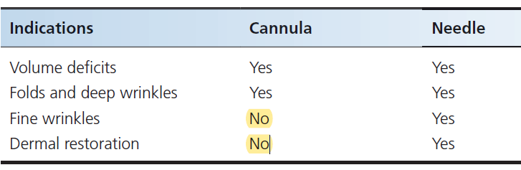
Needles versus cannula
Based on personal preference of injector
Cannula.. Lessor bruising, less vascular injury, useful for large volume injections, pre-periosteal and subcutaneous plane
Needle.. Precise control / more superficially

Slide 8
Needle 30 G
Cannula

Slide 9
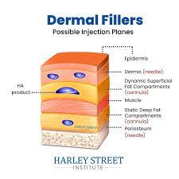
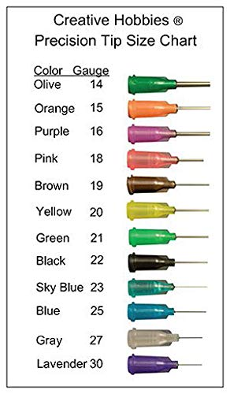

Slide 10
Techniques
Linear / threading: product is inserted in a line or thread as the needle is moving, anterograde and retrograde
Depot: small amounts of product deposited in a dersired plane
Serial puncture: a.k.a string or pearls injection, multiple closely spaced depot injections are placed in a linear fashion

Slide 11
4. Fanning: single entry point, needle is fanned in multiple directions, product is placed by retrograde injection
5. Cross hatching: multiple linear threads are placed in a X shaped fashion
6. Grid: linear threads intersecting at right angles
7. Ferning: needle is fully inserted, product injected in a retrograde fashion, needle is directed to each side of central tract, product placed in small quantities like branches of a fern

Slide 12
Threading
(Retrograde)
DEPOT
FANNING
Cross-hatching
(Grid like pattern)
Push-ahead
(Anterograde)

Slide 13
Fillers Types
Biodegradable fillers
  ‘Inert’ fillers (HA, Calcium hydroxylapatite, Human/Porcine/Bovine Collagen, Alginates)
  Collagen‐stimulating fillers: poly‐L‐lactic acid
Non-Biodegradable fillers
  Single substance products (Silicones, Polyacrylamides, Polyalkylamide)
  Multiple substance products (combination fillers)
      PMMA & bovine collagen, HEMA and ethylmethacrylate microspheres suspended in HA

Slide 14
Biodegradable fillers
Currently dominated by hyaluronic acid (HA) products.
a) Collagen‐stimulating fillers = collagen stimulation is a major feature for the efficacy like PLLA
b) ‘Inert’ fillers = some collagen stimulation might occur but has no proven real clinical relevance,
  Hyaluronic acid products
  Calcium hydroxylapatite (CaHa) = not mainstay of Rx
  Alginates
  Human/porcine/bovine collagen = not available in market

Slide 15
1. HYALURONIC ACID products
Introduced in 2003
Polysaccharides normally found in connective tissue of the body
Originally made from animals like roosters, now synthetic
Premixed with lidocaine
27-30 gauge needle is used for accurate placement
Topical anesthetic or regional block is required
Can be used anywhere on the face
Mild to moderate folds and wrinkles
Plane of insertion: deep dermis, superficial subcutaneous and pre periosteal
Superficially seen through skin as blue appearance.. Tyndall effect

Slide 16
Longevity is 6-12 months
low allergenic potential (no skin test required), an improved safety profile
Can cause vascular occlusion and compression
ability to reverse effects with the use of hyaluronidase
room storage
Restylane/Perlane/Juvederm Ultra, Juvederm UltraPlus and Belotero, Voluma
Vary in concentration of HA, particle size, cross‐linkage, gel consistency and hardness

Slide 17
BEFORE
AFTER

Slide 18
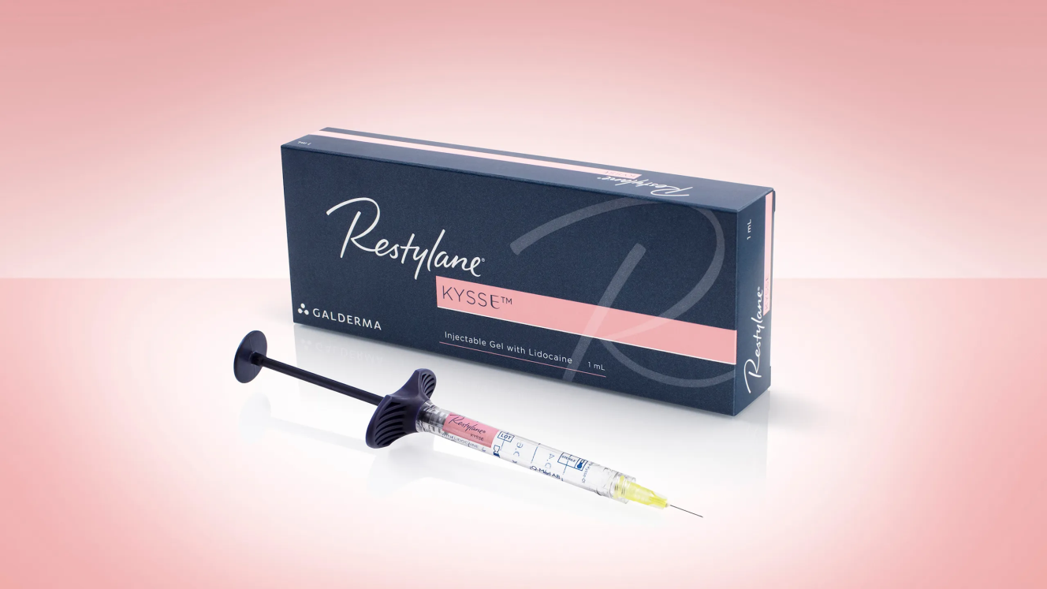
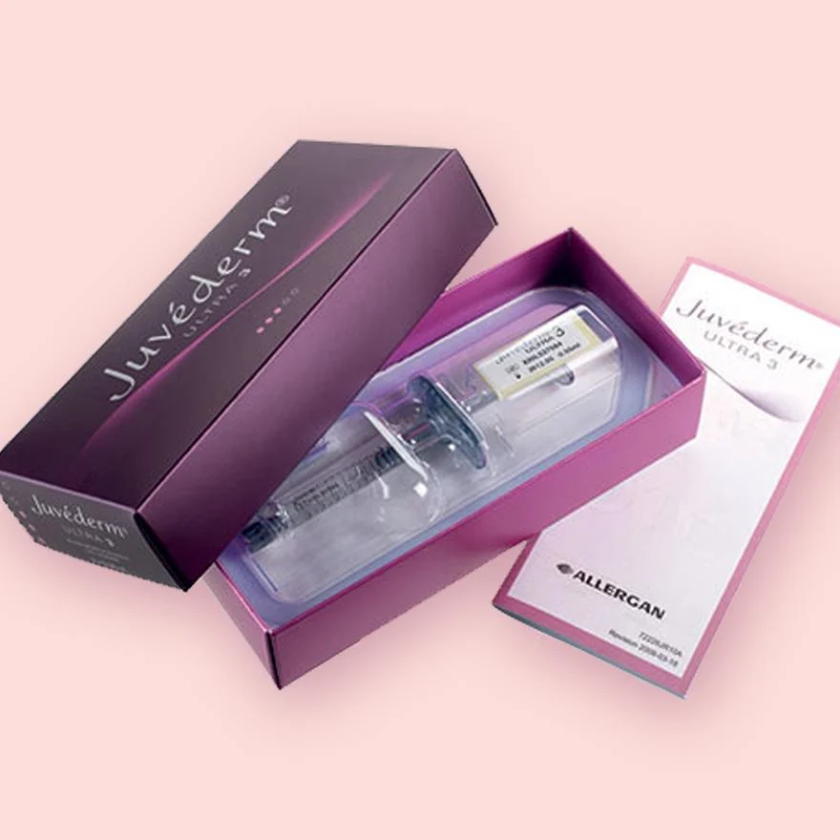

Slide 19
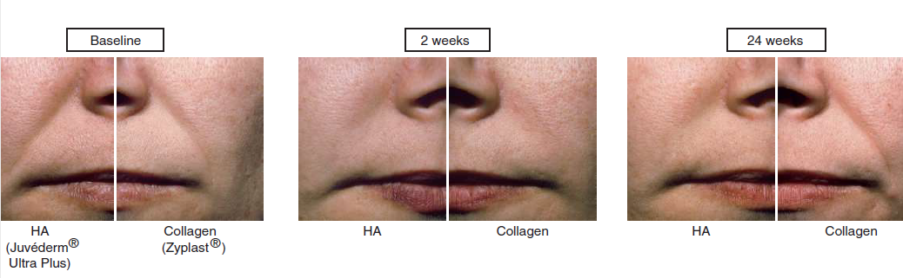
Hyaluronic acid fillers available at the end of 2013 have been subjected to randomized, blinded trials with objective outcome criteria through;
Wrinkle Severity Rating Scale (WSRS)
Global Aesthetic Improvement Scale (GAIS)
Five‐point Wrinkle Assessment Scale (WAS)

Slide 20
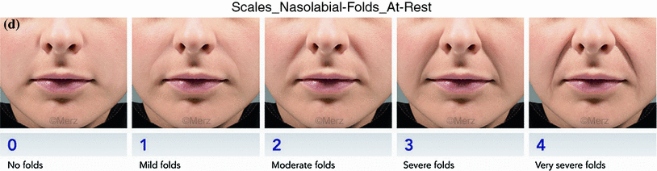
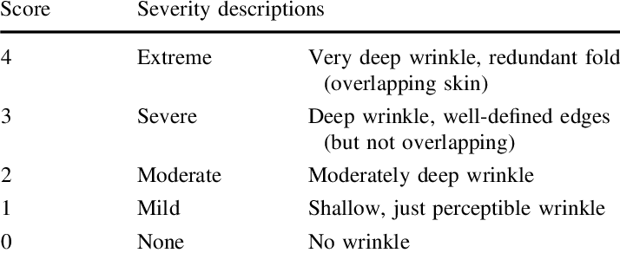
Five‐point Wrinkle Assessment Scale (WAS)

Slide 21
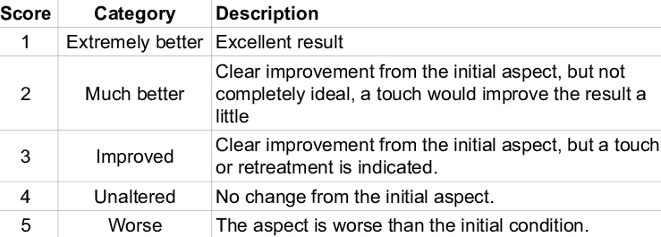
Wrinkle Severity Rating Scale (WSRS)

Slide 22
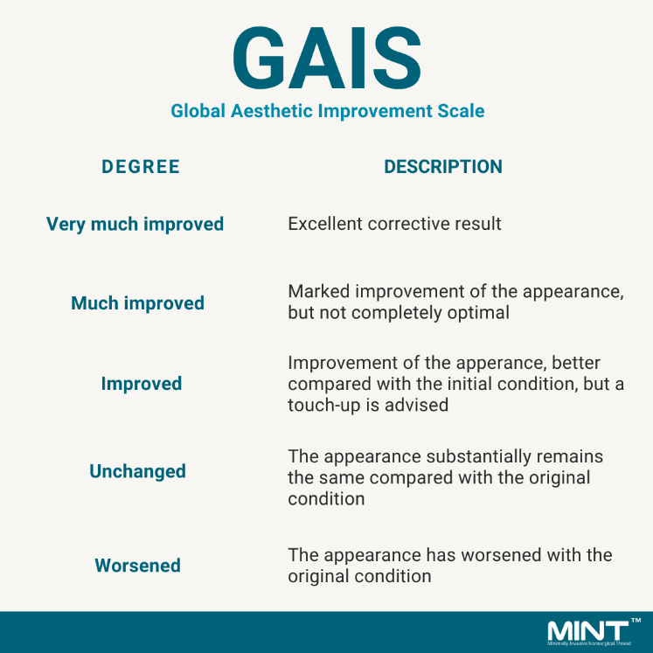

Slide 23
2. Calcium hydroxylapatite
Biostimulatory filler of CaHA spheres suspended in an aqueous gel
Mixed with 2% lidocaine prior to injection
27 gauge needle or cannula
Topical and regional blocks needed
Moderate to severe folds and wrinkles
Not to be used around the eyes and lips
Subdermal and periosteal planes
Radiopaque and can be seen on X ray and CT scans

Slide 24
Uses = Treatment of deep folds, nipple reconstruction, nasal reconstruction, jawline, malar augmentation
S.E. = Nodules (especially in lips and periorbitally), misplacement with demarcation of product, arterial occlusion even blindness
No antidote available
Longevity is 6–18 months
Radiesse

Slide 25
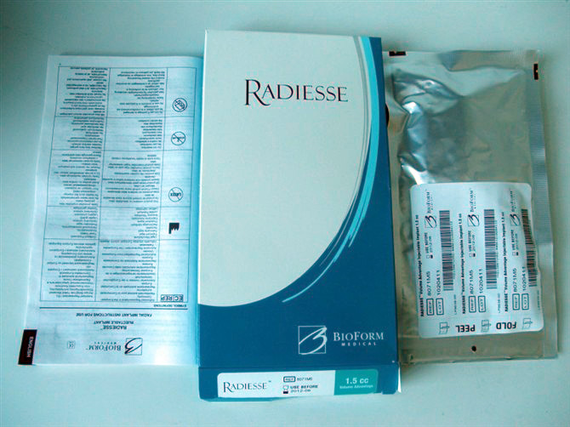
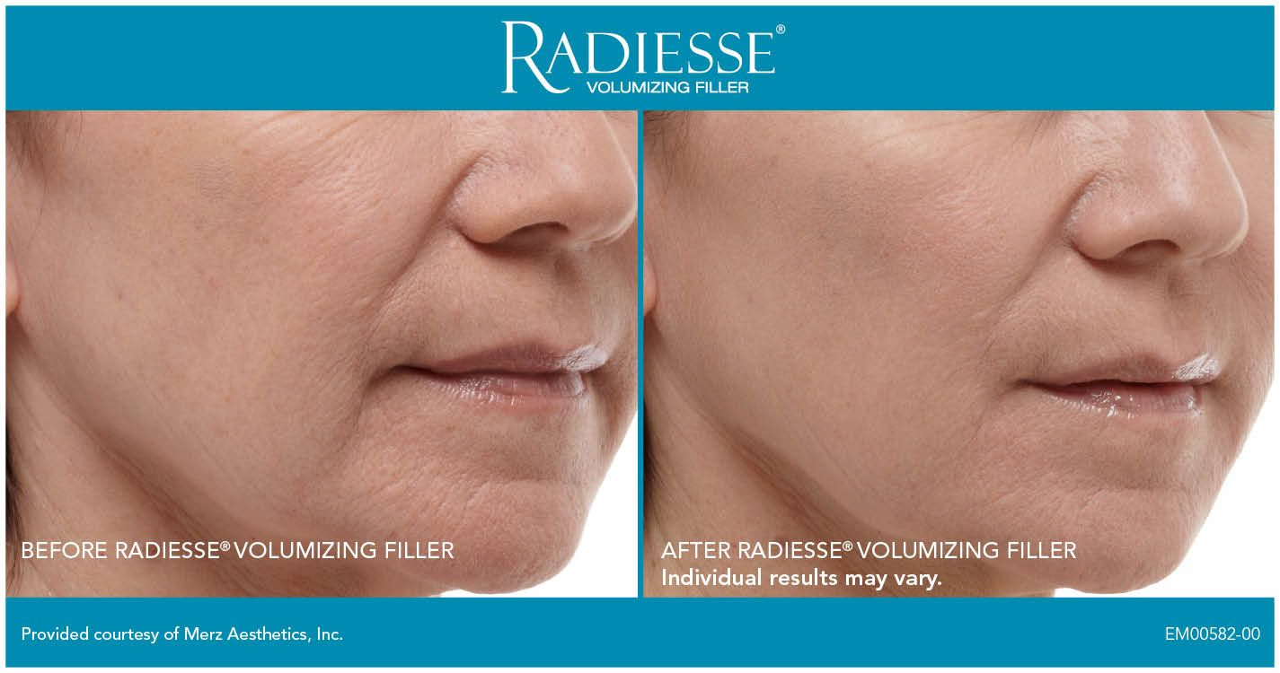

Slide 26
3. Alginates
Available by the end of 2009
Derived from brown algae
No antidote available
Erythema, hematomas, nodule formation
Easy to inject
Removed from market

Slide 27
4. Collagen (Human\Bovine\porcine)
HUMAN COLLAGEN = CosmoDerm non‐cross‐linked formulation used in the treatment of superficial lines
CosmoPlast cross linked used primarily in the treatment of more pronounced wrinkle
BOVINE COLLAGEN = Zyplast, Zyderm
PORCINE COLLAGEN = Evolence
Removed from market

Slide 28
Collagen‐stimulating fillers
(poly‐L‐lactic acid)
Bio stimulatory filler
Composed of lyophilized crystals of PLLA
Resuspended in water prior to use
5-8cc of distilled water and 1-2cc of 1-2% lidocaine
Avoid shaking, foam formation causes clogging of needle
Multiple treatment sessions usually 3-5 needed 4-8 weeks apart
Until significant collagen produced
Maintenance boosts of 1-2 vials every 1-3 years required
25-26 gauge needle or cannulas
Topical and regional anesthesia

Slide 29
Restore volume of face post lipoatrophy from aging and HIV medication
Improves deep folds and lines
Subdermal and preperiosteal plane
Nodules and granuloma formation if injected too superficially or too concentrated
Massage the inj area for 5 mins 5 times a day for 5 days
Longevity is 2 years or longer

Slide 31
NON-Biodegradable fillers
  a) Single substance products (Silicones, Polyacrylamides, Polyalkylamide)
  b) Multiple substance products (combination fillers)
      (PMMA) & bovine collagen, (HEMA) and ethylmethacrylate microspheres suspended in HA

Slide 32
SILICONE
Permanent filler
Treatment of scars, HIV lipoatrophy, lips, deep folds
Clear, oily, colorless liquid
Disastrous Effects = Local chronic inflammation, infection, migration, extrusion, ulceration & silicone granuloma formation
Removal of the injected silicone is difficult, Rx wide tissue resections & reconstructions

Slide 33
Polymethylmethacrylate
Permanent filler
Composed of PMMA microspheres 20% suspended in a bovine collagen gel
Thick gel, refrigerated, allow syringe to come to room temperature prior to injection
26 gauge needle or cannula
Topical or regional block needed
Used for nasolabial folds, marionette lines, mid face and cheeks
80% correction done on first sitting and 20% on second sitting
4-6 weeks apart

Slide 34
Donot over correct
Results improve with time
Skin test required 1 month before treatment to R/O bovine collagen allergy
Not used around eyes, lips
Plane is subdermal and pre periosteal plane
Preferred in men
Avoid in filter naïve people

Slide 35
Autologous Fat Transfer (AFT)
Pan-facial filling, esp periorbital area
Longevity 5 years or longer
Filler of choice with collagen vascular disease or allergic reactions to collagens or HA
For fat harvesting = outer thighs and hips in F, flanks in M

Slide 36
Platelet rich plasma (PRP)
Patient’s own platelets and fibrin and is used as an injectable filler to stimulate collagenases
Good to moderate improvement in lower eyelid wrinkles and skin tone after 3 injection sessions (compared to saline control)

Slide 37
Common injection errors and how to avoid them
Using permanent materials where there is no antidote
Using products without good clinical data
Using products without local anesthetics
Using deep injection fillers too superficially (G Prime rating)
Poor disinfection before injections
Disregard of anatomy

Slide 38
Danger areas of the Face
1. Glabellar region
2. Temporal region
3. Perioral region
4. Nasolabial region
5. Nasal region
6. Infraorbital region

Slide 39
General Safety Principles
• Use reversible fillers (i.e., hyaluronic acid).
• Use epinephrine or ice for vasoconstriction.
• Use small syringes (0.5 to 1 mL) and inject in small increments.
• Use small needles (27 G or smaller).
• Use cannulas when appropriate.
• Use anterograde–retrograde injection.
• Use constant, steady, slow motion.
• Use low-pressure injection; injections requiring high pressure indicate danger and/or inappropriate location.
• Use caution when injecting in areas of previous trauma, as tissue planes may be scarred and obscured.
• Be aware of pertinent anatomy of the vascular danger zones.
• Have a filler rescue kit available at all times (hyaluronidase, aspirin, nitroglycerin ointment).

Slide 40
1– Glabellar Region

Slide 42
2 – Temporal Region

Slide 43
3 – Perioral Region
no deeper than 3 mm from the skin or vermilion,

Slide 44
4 – Nasolabial Region

Slide 46
5 – Nasal Region

Slide 47
6 – Infraorbital Region

Slide 48
Adverse reactions and their treatment
Most complications are minor.. Bruising, swelling and lumpiness
Avoided by through knowledge of the facial anatomy and understanding filler properties

Slide 49
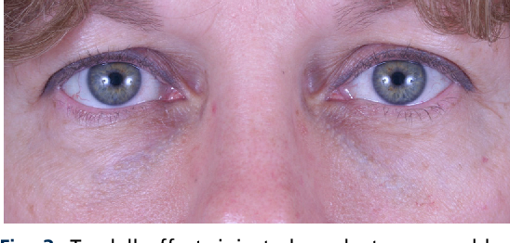
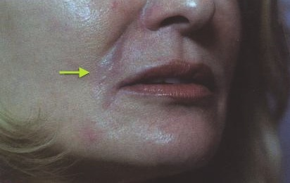
1. Tyndall Effect:
Lower face.. 20 gauge needle, puncture pool of product
Product expressed via this tract
Lower lids.. Can cause a lot of bruising
Hyaluronidase 20-50 units
20 units = 0.1ml

Slide 50
2. Herpetic outbreak:
flare up when placed in lips
Valtex 500mg 3 days before continued for 1 week (prophylaxis)
Oral and topical acyclovir for treatment
3. Nodules / lumpiness:
clumps of product, t/m massaging, warm compress and hyaluronidase
4. Granulomas:
reactions to product, can occur several months after injection, t/m kenalog inj, oral methyprednisolone, oral antibiotics, 5-FU, excision

Slide 51
5. Delayed hypersensitivity:
erythema of skin, weeks to months, t/m oral floroquinolones, macrolides upto 6 weeks, avoid NSAIDs
6. Vascular compromise :
intravascular injection, vasospasm, external compression
Immediate blacnhing of skin seen
t/m stop inj immediately, warm compress, massage area, hyaluronidase, topical nitroprusside, aspirin PO

Slide 53
Haematoxylin and eosin staining of a hyaluronic acid plus methacrylate (DermaLive) filler implant showing characteristic polygonal structures immersed in a granulomatous reaction.

Slide 54
Complication
Prevention and management strategies
Injection site reactions
(erythema, swelling, pain, bruising)
Nodules, beading, and Tyndall effect
Infection
Avoid anticoagulants as aspirin, Consider cannulas, Smaller needles, Ice application, Intense pulsed light or vascular lasers can be used to treat bruising
Avoid superficial placement; inject smoothly, Treat with massage, hyaluronidase (if HA filler), or aspiration/excision
Pre-cleanse the skin with an antimicrobial agent, e.g. chlorhexidine, Consider incision and drainage and/or antibiotics

Slide 55
Complication
Prevention and management strategies
Hypersensitivity
Delayed nodules:
• Inflammatory/immune-mediated (hypersensitivity)
• Biofilm-related
• Infectious
• Foreign body granuloma
Avoid injection in patient with known sensitivity, Skin test for bovine collagen in the case of Bellafill® Hypersensitivity after HA resolves spontaneously, but consider treatment with tacrolimus ointment, intralesional corticosteroids, intralesional hyaluronidase, I\D
Pre-cleanse, InD/or biopsy. Hyaluronidase (if HA filler) or surgical excision. Oral broad-spectrum antibiotics for 2–6 weeks e.g. clarithromycin, minocycline. For non-infectious etiologies, consider topical, oral or intralesional corticosteroids; intralesional 5-fluorouracil; oral immunosuppressants; or laser therapy

Slide 56
Fillers and different skin types
Filler studies have been conducted on skin types I to III
No known differences in cases of immunological reactions
Darker skin may react with more hyperpigmentation to inflammation IV to VI
POST PROCEDURE CARE; Ice application, Avoid manipulation of treated area, avoid strenuous activity, avoid extremes of temperatures, massage for PLLA and CaHa

Slide 57
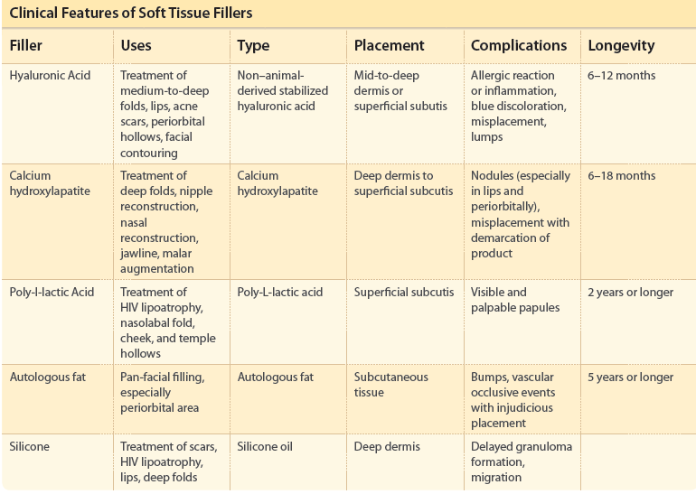

Slide 58
THANK you

