Slide 1
Skin and winter season effects
Dr. Romana Shaikh
Postgraduate trainee
Dermatology Department

Slide 2
OUTLINES
Physiological reactions to cold
Classification of skin cold injuries
Perniosis
Acrocyanosis
Erythrocyanosis
Livedo Reticularis
Raynaud’s Phenomenon

Slide 3
Physiological reactions to cold
Central thermoregulation centers in hypothalamus.
Immediate vasoconstriction response to cold temperature.
Counter- current exchange mechanism.
“Hunting reaction” of Lewis, to prevent necrosis.
The rate of tissue freezing impacts the nature of cold injury. Slow freezing results in extracellular formation of ice whereas fast freezing tends to produce intra-cellular ice.

Slide 4
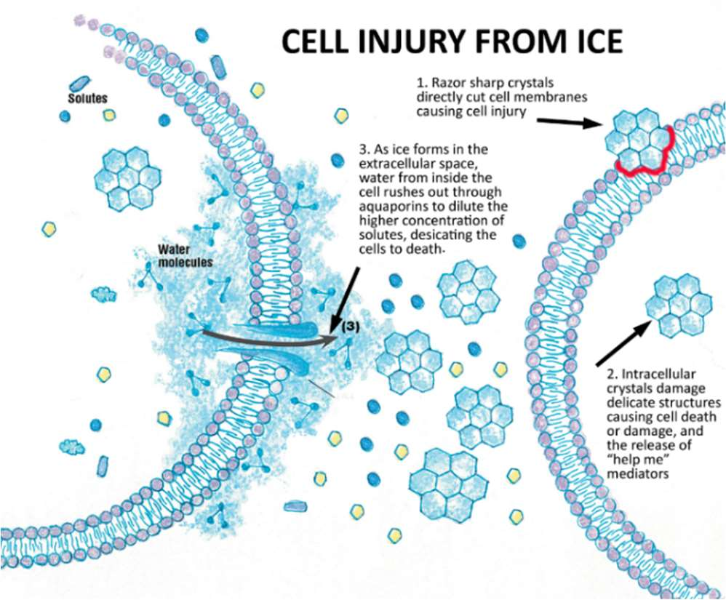

Slide 5
Classification of skin cold injuries
Diseases of cold exposure:
  Frost bite
  Trench foot
Diseases of abnormal susceptibility to cold:
  Raynaud’s phenomenon
  Livedo Reticularis
  Perniosis
  Acrocyanosis
  Erythrocyanosis
  Cryoglobulinaemia
  Cold haemolysis
  Cold urticaria
  Cold erythema
  Cold panniculitis
  Neonatal cold injury

Slide 6
Perniosis (chilblains)
Localized inflammatory lesions on acral skin caused by continued exposure to cool temperatures.
Lesions are cold-induced and affect areas of skin vulnerable to cold exposure i.e digits, nose and ears.
Genetic predisposition.
Female preponderance (79%).
Associations: Poor nutrition (low BMI), Anorexia nervosa and systemic diseases, mostly LE and hematological malignancy.

Slide 7
Pathophysiology: Cold causes constriction of small arteries and veins but a protective physiological reflex intermittently dilates the blood vessels to prevent skin ischaemia. Persistent or prolonged vasoconstriction due to an abnormal vascular reaction to cold may result in hypoxaemia and inflammation to produce chilblains.

Slide 8
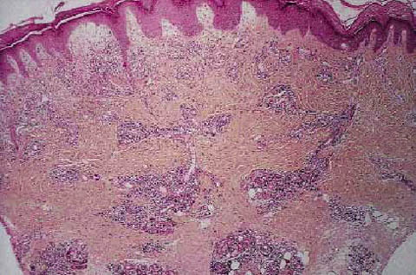
Histopathology

Slide 9
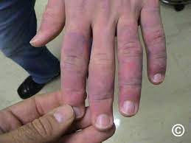
Clinical features
Single or multiple, burning, erythematous to violaceous macules, edematous papules, plaques, and nodules.
Complain of itching, burning, or pain.
In severe cases, blistering and ulceration may occur.
Spontaneous resolution after 2–3 weeks.

Slide 10
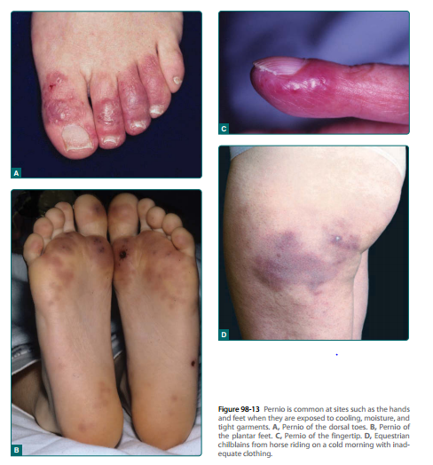

Slide 11
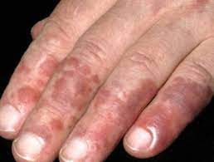
Chilblain LE (hutchinson lupus)
Form of cutaneous LE that presents in a similar way to idiopathic perniosis.
Erythrocyanotic papules, located on the fingers and toes, developin cold weather and tend to persist, in some cases becoming ulcerated.
Chilblain LE may be accompanied by discoid LE or other forms of cutaneous LE.
Upto 20% of patients with chilblain LE develop systemic LE.

Slide 12
Clinical variants of perniosis
Papular perniosis
  Resembling erythema multiforme can occur at all times of the year,
  Usually in crops on the sides of the fingers,
  Often superimposed on a background of acrocyanosis.
‘Equestrian panniculitis’
  Young women riding horses for several hours daily during winter.
  Indurated red-to-violet tender plaques develop on the lateral calves and thighs.
  For prophylaxis, experienced riders usually wear baggy riding pants that provide insulation and are not tight enough to compromise the circulation.
Chronic perniosis
  Presence of arterial disease or prolonged cold exposure, irreversible changes of fibrosis, lymphoedema and hyperkeratosis may occur

Slide 13
Investigations
Detailed history, review of systems, and physical examination.
Lab workup:
  Complete blood count with peripheral smear,
  Serum protein electrophoresis,
  Antinuclear and extractable nuclear antigen antibodies,
  Rheumatoid factor,
  Cold agglutinins, and
  Antiphospholipid antibodies.
  N.B. These should be conducted only if the history and physical suggest a possible underlying systemic disease.

Slide 14
Differentials:
  Granuloma Annulare
  Peripheral vascular insufficiency
  Vasculitis
Prognosis: depends on underlying cause.

Slide 15
Management
Prevention through the use of adequate, loose, insulating clothing and appropriate warm housing and workplace.
Once pernio occurs, treatment is symptomatic with rest and warmth.
Other conservative measures include
smoking cessation and application of a midpotency topical steroid up to twice daily until lesions resolve.
Associated systemic diseases, if present, should be treated.
Second-line therapy for pernio consists of the addition of a calcium channel blocker, such as nife-dipine 20 to 60 mg/day.
Third-line and alternative management options include aspirin, pentoxifylline, nicotinamide, topical minoxidil, topical nitroglycerin, and tacrolimus ointment.

Slide 16
Covid-19 and Perniosis
Many cases of chilblain-like changes on the toes ('COVID-toes') have been reported as a late manifestation in children and young adults after a mild illness suspected of being due to the novel coronavirus SARS-CoV-2.
Many reported patients had no recent exposure to cold, and a robust antiviral interferon response has been postulated to induce changes in the small blood vessels.
However, the development of chilblain-like lesions in the absence of exposure to damp cold or secondary causes, should be suspected as being related to SARS-CoV-2 infection

Slide 17
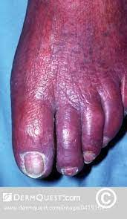
Acrocyanosis
Blue to violaceous acrocyanosis, a bilateral dusky mottled or confluent red to blue discoloration of the hands, feet, nailbeds, and some-times the face.
Typically in adolescence, female preponderance.

Slide 18
Pathophysiology
Chronic vasospasm of small cutaneous arterioles or venules with a secondary dilation of the capillaries and subpapillary venous plexus has been postulated.
Stasis in the papillary loops with aneurysmal dilation at the tips redistributes blood flow to the subpapillary venous plexus.
The blood flow may be compromised by altered erythrocyte flexibility, increased platelet adhesiveness, and other plasma viscosity factors.

Slide 19
Idiopathic
Secondary causes:
  Hypoxaemia, often due to lung disease or smoking
  Connective tissue diseases
  Neoplasms
  Eating disorders and malnutrition
  Haematological disorders
  Drugs and toxins
  Atopic dermatitis
  Heritable diseases
  Infancy
  Buerger disease
  Atrophic rhinitis
  Psychiatric/psychological reasons.

Slide 20
Clinical Features
Idiopathic acrocyanosis usually starts in adolescence and persists into adult life.
Changes may be transient after cold exposure but usually persist during the winter and even throughout the summer months.
There is a painless mottled duskiness of both hands in the presence of normal peripheral pulses.

Slide 21
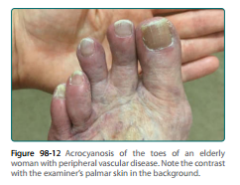

Slide 22
Differentials:
  Raynaud phenomenon,
  Arterial occlusion and
  Venous occlusion.
Investigations:
  Investigations for secondary cause.
  Capillaroscopy
  Duplex vascular ultrasound
Management:
  No effective medical treatment.
  No benefit of vasodilator therapies.
  Stop culprit drug in drug induced.
  Treat underlying cause in secondary acrocyanosis.

Slide 23
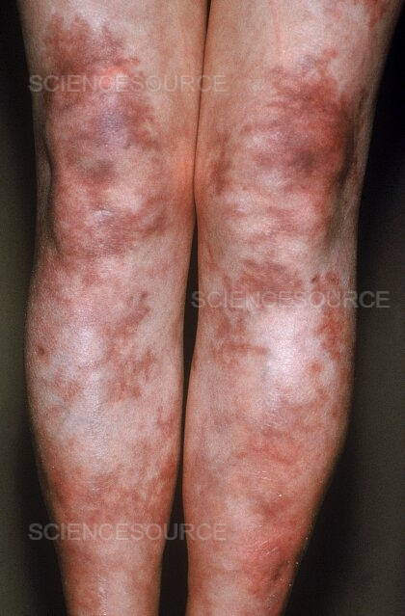
Erythrocyanosis
Persistent, dusky erythema occurring at sites with a thick layer of underlying subcutaneous fat, such as the thighs and lower legs, less commonly on the buttocks and arms.
Most commonly in adolescent girls and middle‐aged women.

Slide 24
Pathophysiology
Hypothesized that the subcutaneous fat in these sites acts to insulate the superficial vessels from the warmth of the underlying blood supply, thus rendering them susceptible to cold exposure.
It is exacerbated by cold and therefore usually more prominent during the winter.

Slide 25
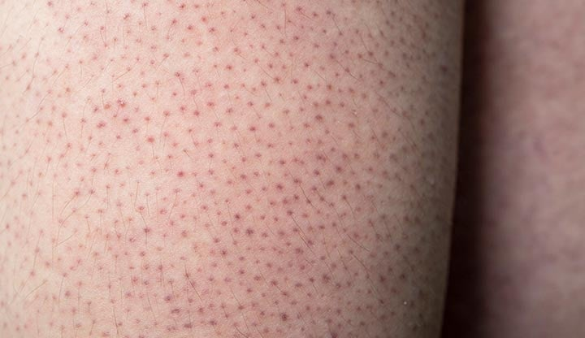
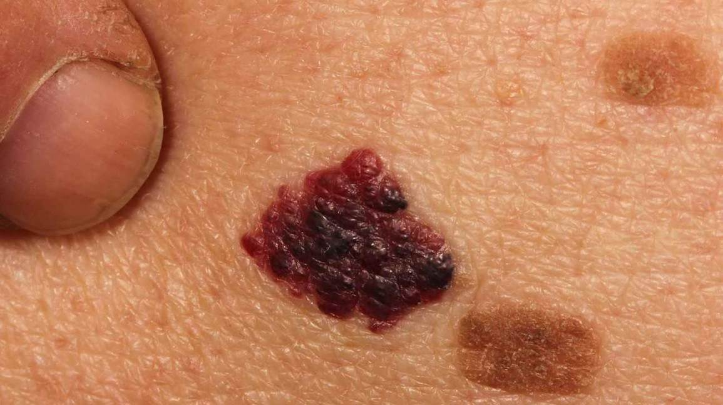
Clinical features
Characterized by dusky discoloration of the skin and maybe accompanied by keratosis pilaris, angiokeratomas and telangiectases.
Area is cold to touch.
Oedema and fibrosis may be seen as chronic manifestations of erythrocyanosis.

Slide 26
Prognosis: The disorder may persist indefinitely but spontaneous improvement can occur in adolescent patients.
Management: Warm clothing, exercise, weight reduction and elastic support hosiery maybe helpful. Vasodilators are of limited value.

Slide 27
Livedo reticularis
Livedo is an ischemic dermopathy characterized by a violaceous reticular or “net-like” mottling of the skin.
Livedo reticularis is a primary disorder affecting young to middle-aged females that is benign. The livid conical discoloration is symmetric, reversible, and uniform.
Livedo racemosa is a secondary disorder that is pathologic and permanent. The livid conical discoloration is asymmetric, irreversible, and “broken.”

Slide 28
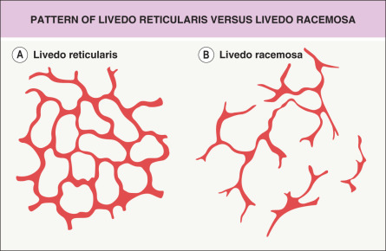

Slide 29
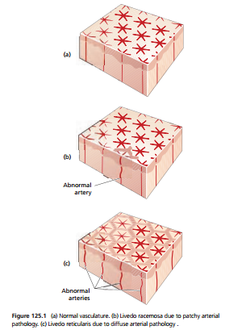
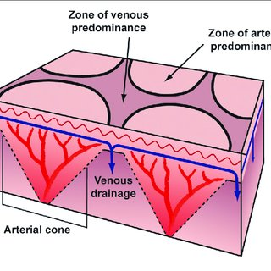
Pathophysiology

Slide 30
Clinical features
In livedo reticularis, a symmetric, fishnet-like red or purple mottling surrounds a pallorous conical core.
This discoloration is aggravated by cold exposure and may completely dissipate with warming.
The livid rings are most pronounced on the lower extremities yet the abdomen and upper extremities can be affected.

Slide 31
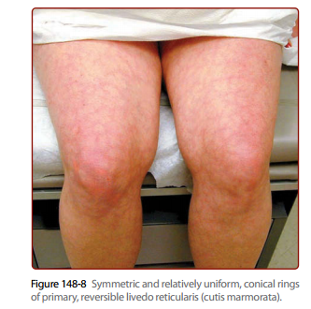

Slide 32
The discoloration of livedo racemosa is asymmetric, irregular, and “broken”.
Although it may improve with warming, it does not resolve completely.
Attendant skin manifestations of livedo racemosa may include purpura, nodules, macules, ulcerations, and/or atrophie blanche-type scarring.
In both livedo reticularis and racemosa, the skin is palpably cool.

Slide 33
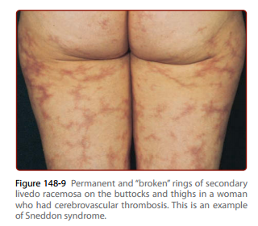

Slide 34
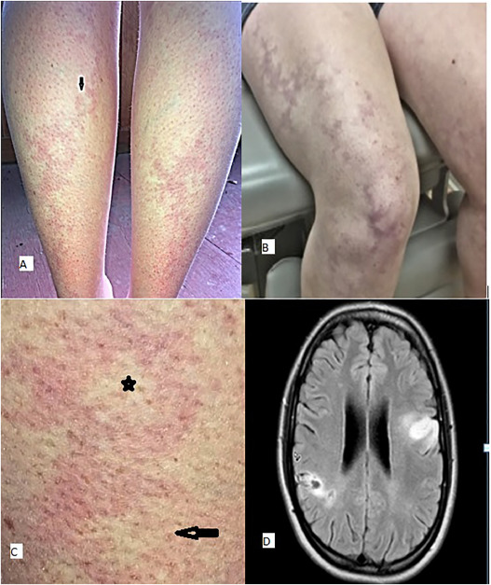
Sneddon syndrome

Slide 35
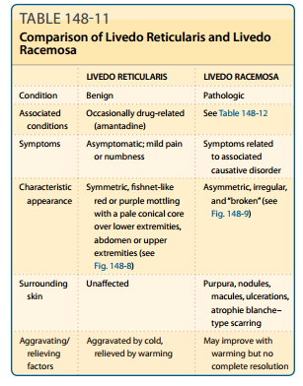

Slide 36
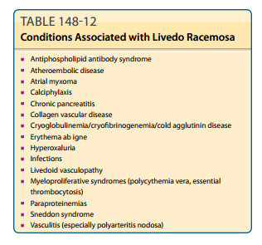

Slide 37
Clinical variants
Physiological Livedo Reticularis:
  “cutis marmorata”
  transient cyanotic mottling of the skin occurs as a physiological response to cold exposure and disappears with warming
  resolves during the first year of life
Congenital Livedo Reticularis:
  Cutis marmorata telangiectatica congenita
  rare developmental defect, present at birth, characterized by a red‐purple vascular network
  asymmetrical, typically on a limb
  persistent and enhanced bycold, cryingand exercise
  Gradually resolves, with most improvement occurring during the first 2 years of life.

Slide 38
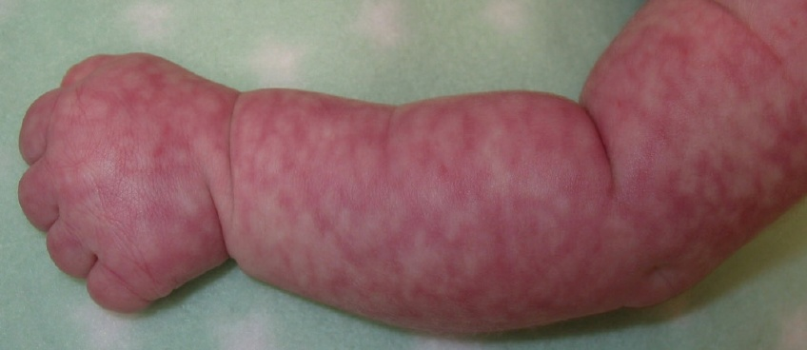
Physiological Livedo Reticularis

Slide 39
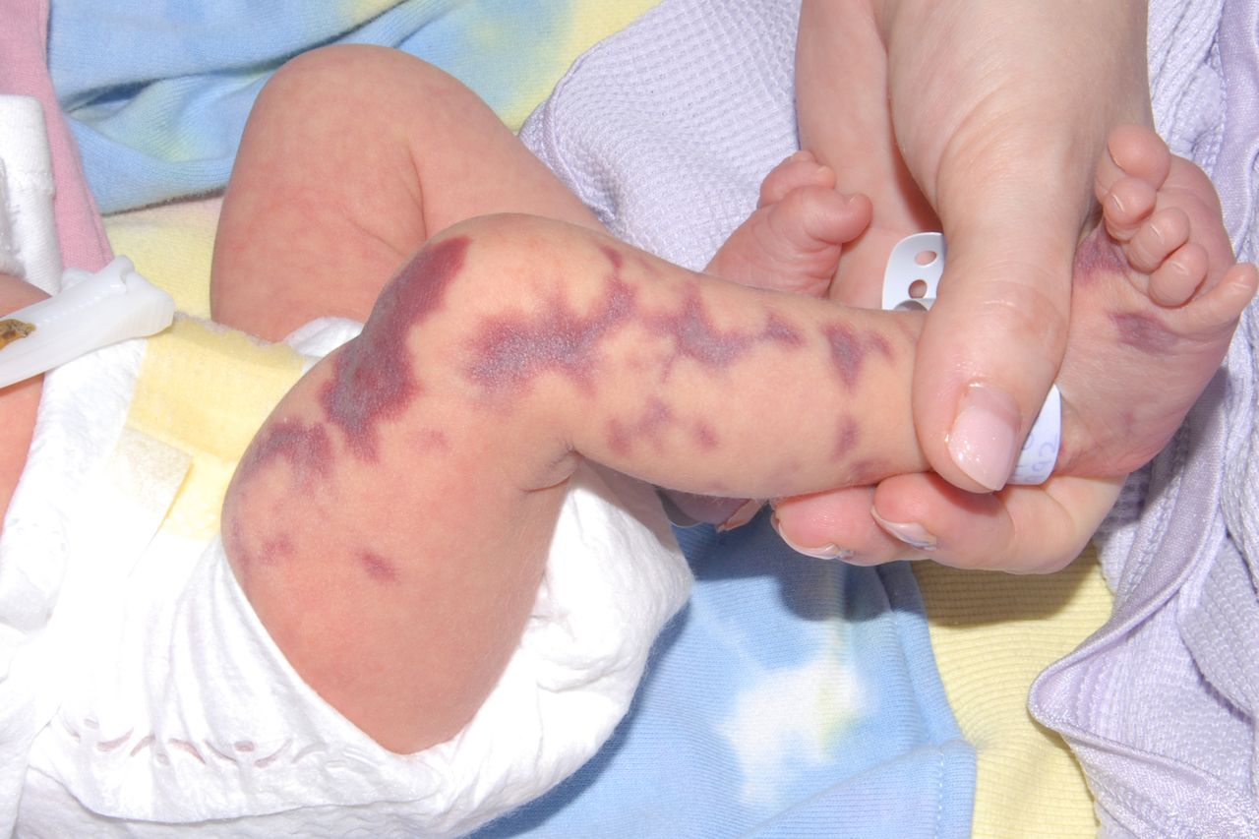
Congenital Livedo Reticularis

Slide 40
Cont:
Acquired Idiopathic Livedo Reticularis:
  predominantlyin young adult and middle‐aged women.
  Mild degrees are harm-less, while more severe cases are associated with ulceration, usually in the winter.
  The mottling is at first transient and occurs on
  exposure to cold.
  Permanent livedo may develop with time.
  Tingling and numbness of the skin, and sometimes oedema, maybe present.

Slide 41
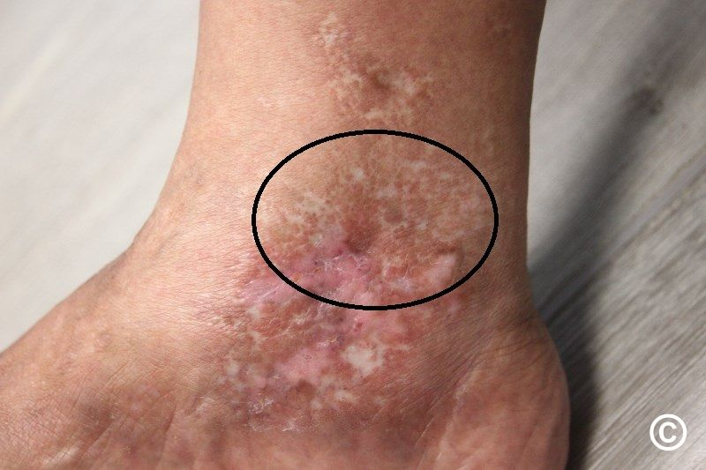

Slide 42
Investigations
Thrombophilia screen,
Autoimmune screen,
Full blood count,
Metabolic panel and
Serum protein electrophoresis.
Further investigations such as ultrasound and echocardiography may be required to look for sources of emboli.

Slide 43
Management
Cold avoidance.
Vasodilator therapy may be tried in the patient who is socially inhibited by the cosmetic appearance of the disorder.
The symptoms may improve spontaneously with age.
Patients with livedo racemosa should be treated for underlying cause.
Patients with livedo racemosa and the antiphospholipid antibody syndrome with thrombosis require anticoagulation.

Slide 44
Raynaud’s phenomenon
Episodic digital ischaemia occurring in response to cold or emotional stimuli.
Characterized by sequential colour changes: white (pallor), blue (cyanosis) and red (rubor).
Pallor is essential for the diagnosis.
Primary Raynaud phenomenon (also called Raynaud disease) is idiopathic and occurs as an isolated innocuous disorder.
Secondary Raynaud phenomenon occurs in association with underlying diseases, or is caused by physical factors or drugs.

Slide 45
Criteria for the diagnosis of primary Raynaud phenomenon
  Intermittent attacks of discoloration of the extremities
  No evidence of organic peripheral arterial occlusion
  Symmetrical or bilateral distribution
  Exclusion of any disease, occupation, trauma or drug ingestion that could give rise to vasospastic abnormalities
  Absence of immunological abnormalities
  Commoner in female sex, age under 25 years
  History of cold intolerance since childhood
  Normal nail fold capillaries

Slide 46
Causes of secondary Raynaud's include:
Connective tissue diseases: scleroderma, lupus, rheumatoid arthritis and Sjogren's syndrome.
Diseases of the arteries: Atherosclerosis, buerger disease
Carpal tunnel syndrome: The pressure causes numbness and pain in the hand that can make the hand react more to cold temperatures.
Repeated actions or vibration. Typing, playing piano or doing movements like that for long periods can cause overuse injuries. So can using vibrating tools, such as jackhammers.
Smoking. Smoking narrows blood vessels.
Injuries to the hands or feet. Examples include a wrist fracture, surgery or frostbite.
Certain medicines. These include beta blockers for high blood pressure, some migraine medicines i.e triptans, certain cancer medicines, OCPs and some cold medicines.

Slide 47
Genetic susceptibility.
The age of onset is usually under 40 years, but it may occur over this age.
Female:male is 5:1.

Slide 48
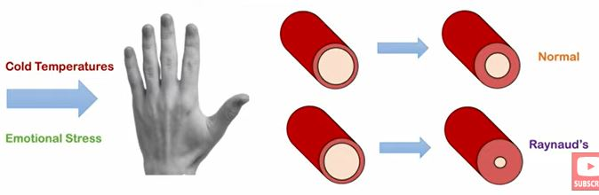
Pathophysiology
In primary Raynaud phenomenon the vascular changes are considered to be functional.
In contrast, in secondaryRaynaud phenomenon there are structural vascular changes, most clearly delineated in patients with systemic sclerosis.
Severeintimal hyperplasia consisting of collagen deposits is often associated with intravascular thrombi, which can completely occlude the lumen.

Slide 49
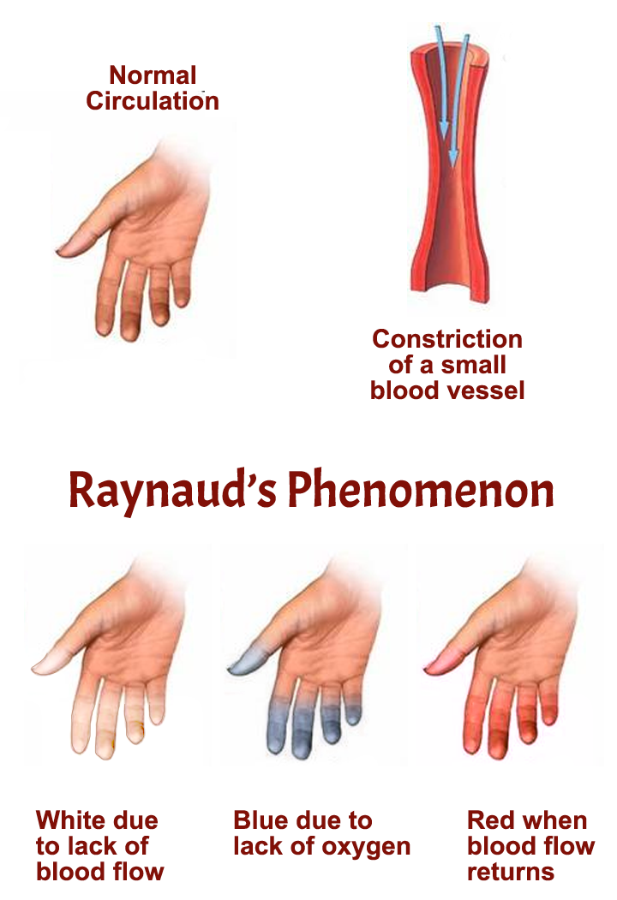

Slide 50
Clinical features
Fingers and toes are classically affected, attacks may involve nose, earlobes, tongue and nipples.
A typical attack consists of sudden pallor of one or more digits,followed after a few minutes by cyanosis or sometimes by erythema.
In primary Raynaud phenomenon the condition is usually symmetrical and involves several digits.
In secondary Raynaud phenomenon only one or a few digits are affected and asymmetry is not unusual.

Slide 51
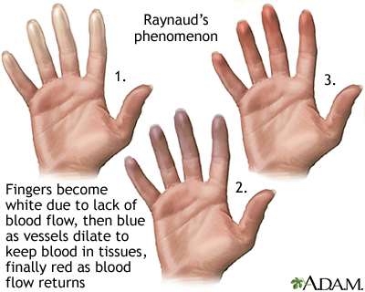

Slide 52
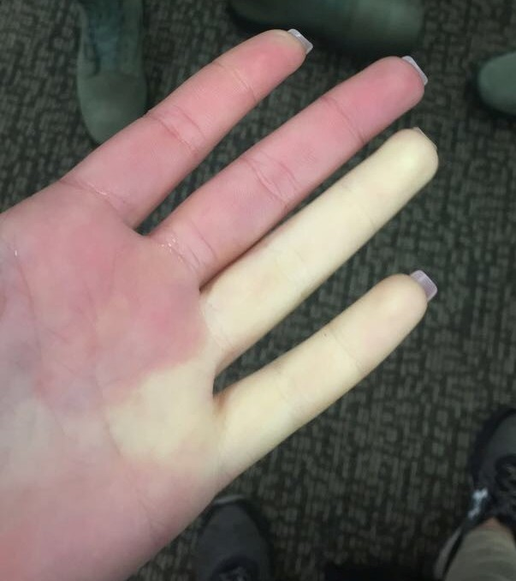

Slide 53
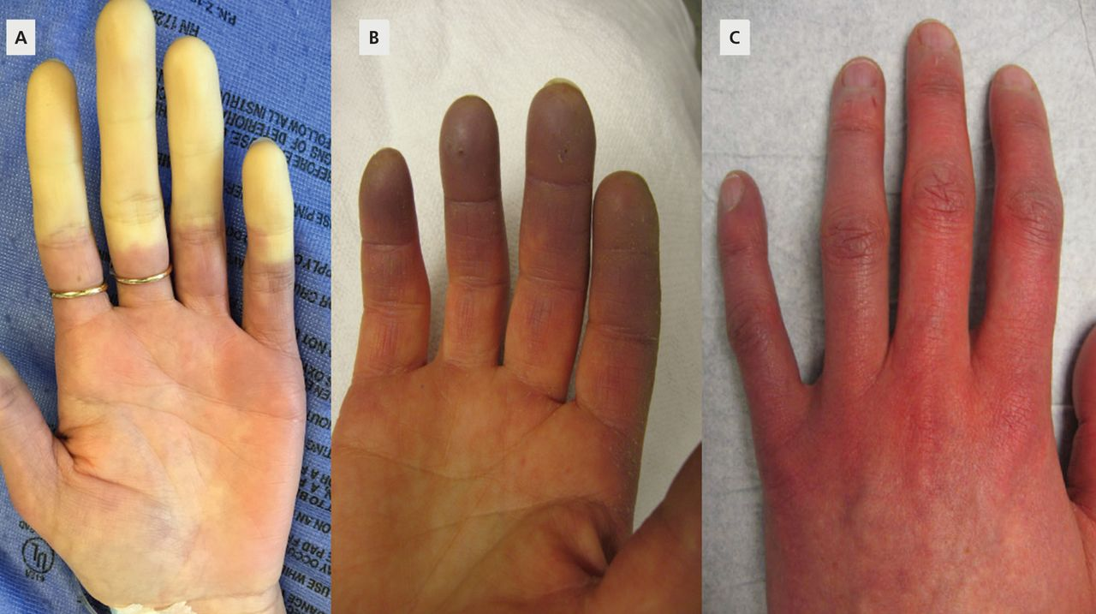

Slide 54
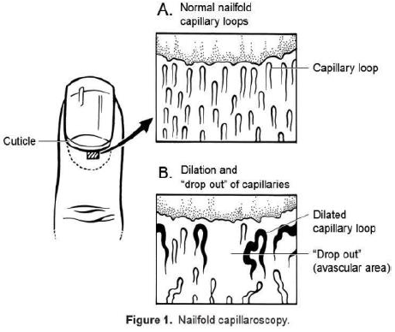
Cont:
Episodes may occur infrequently or many times each day.
Severe cases, which are usually of the secondary type, maybe complicated by telangiectases of the nail fold, thinning and ridging of the nail, and atrophy or sclerosis of the fingers (sclerodactyly).
Skin necrosis is extremely rare in primary Raynaud phenomenon but not uncommon in secondary Raynaud phenomenon and may result in destruction of the digits.

Slide 55
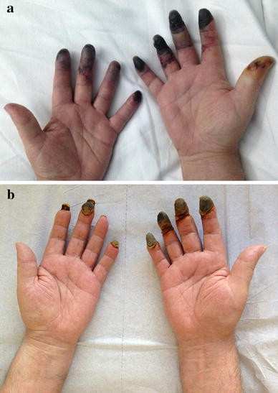

Slide 56
Differential diagnosis
Acrocyanosis,
Hand–arm vibration syndrome,
Heavy metal intoxication,
Ergot intoxication,
Thoracic outlet syndrome and cervical rib, and
Buerger disease and other arterial diseases.

Slide 57
Management
Conservative management includes taking measures to keep the hands and feet warm and reducing cold exposure and also emotional stress.
Firstline:
  Calcium‐channel antagonists can be useful in decreasing the frequency, duration and severity of attacks.
  Recommended doses of nifedipine range from 30 to 180 mg daily and for amlodipine between 5 and 20 mg daily.

Slide 58
Second line:
  Sildenafil 50 mg twice daily demonstrated significant improvement in mean attack rates and duration
  Sildenafil is a phosphodiesterase inhibitor and acts by increasing the vasodilatory effect of both nitric oxide and prostacyclin.
Thirdline
  Intravenous infusion of vasodilatory prostaglandins can reverse ischaemic complications in Raynaud phenomenon.
  Iloprost, a prostacyclin analogue.
  Bosentan, an endothelin receptor antagonist.
  Losartan, angiotensin II receptor antagonist.
  Topical glyceryl trinitrate, a nitric oxide donor.
  Botulinum toxin A, injected into the hand, can also cause vasodilatation.

Slide 59


Slide 60


