Slide 1
Skin Disorders of the Hematopoietic and Immune Systems
Dr kanwal b. khan
Pgt dermatology

Slide 2
Introduction
Skin diseases and symptoms which develop secondarily to underlying malignant or benign disease of the haematopoietic system

Slide 3
Skin manifestations of the Hematopoietic systems
Haematological malignancies are neoplasms which originate from cells in the haematopoietic tissue of the bone marrow, lymph nodes or thymus.
Lymphoproliferative malignancies → lymphocytes or their precursors
Myeloid malignancies → one or more non‐lymphoid cell types.

Slide 4
Categories of cutaneous manifestations of hematological neoplasms
Lesion → Direct infiltration of skin by malignant cells or products (paraproteins)
Lesion → Indiret infiltration by the Underlying malignancy (paraneoplastic)
Lesion → Treatment of hematological malignancy (immunosuppression)

Slide 5
Skin Disorders caused by infiltration of skin by neoplastic cells
Leukemia Cutis
Lymphomatous skin infiltration
Plasma cell disorders
Extramedullary Hematopoeisis

Slide 6
Leukemia Cutis
Infiltration of the skin by myeloid or lymphoid neoplastic leukocytes resulting in clinically identifiable cutaneous lesions
Develop after or concurrently with the diagnosis of myeloid disorder
Most common in Myeloid tumors esp. in AML & CMML
PATHOPHYSIOLOGY: Homing of malignant cells to the skin may depend on specific chemokine receptors (CR4,ICAM1)

Slide 7
CLINICAL FEATURERS:
single or multiple monomorphic nodule
violaceous, dark‐red or haemorrhagic
Commonly on leg, arms, face
Increased predilection …… Trauma/
Inflammation site
May be asymptomatic papules/maculopapular rash

Slide 8
DIFFERENTIALS:
Granuloma Annulare
Rosacea
Jessner’s Lymphocytic Infiltration
PATHOLOGY:
Myeloid neoplasms → Superficial & deep skin infiltration by tumour cells

Slide 9
DIAGNOSIS:
Immunohistochemistry → CD43, CD68 & lysozyme
Histopathology → Monomorphic small lymphocytes with aberrant marker pattern(CD 20, 5, 43)
PROGNOSIS:
AML → Variable
CLL → Poor if increased blast cells (Richen’s syndrome)

Slide 10
TREATMENT:
Treatment of underlying leukemia
Supportive care skin lesion
Radiotherapy → Focal leukemic skin infiltrates

Slide 11
Lymphomatous Skin Infiltrates
HODGKIN LYMPHOMA:
Skin involvement is very rare
Indication of Stage IV
Reed-Sternbeg cell, CD 30, CD45 +ve

Slide 12
Skin Infiltration in Plasma cell Disorders
Most common malignancy
>10% malignant plasmacytic cells in the bone marrow and an associated monoclonal gammopathy
Early stage → <10% plasmacytic cells + Monoclonal gammopathy → MGUS
Cutaneous involvement rare.

Slide 13
Cuatneous lesions: Firm, Violaceous papules & nodules on trunk > scalp & face
Histopathology…Diffuse or nodular aggregates of lymphoplasmacytic cells ….CD 79a & CD138 +ve
Multiple Myeloma → CD 19, CD 20 -ve
Waldernstrom macroglobulinemia → CD19 & CD20 +ve

Slide 14
Extramedullary Haematopoiesis
Formation of cellular blood components outside the bone marrow.
Commonly → Spleen
Rarely → Skin
May accompany thalassemia,sickle cell anemia or thrombocytopenic purpura
Clinical Features: erythematous or violaceous papules, nodules, tumours and ulcers
D/D → Leukemia Cutis

Slide 15
Histopathology → polymorphous dermal infiltrate of myeloid and erythroid cell precursors, often with the presence of dysplastic megakaryocytes
Can occur in infants as a response to in-utero infection like TORCH infection
Generalized haemorrhagic, purpuric eruption → ‘blueberry muffin baby’

Slide 16
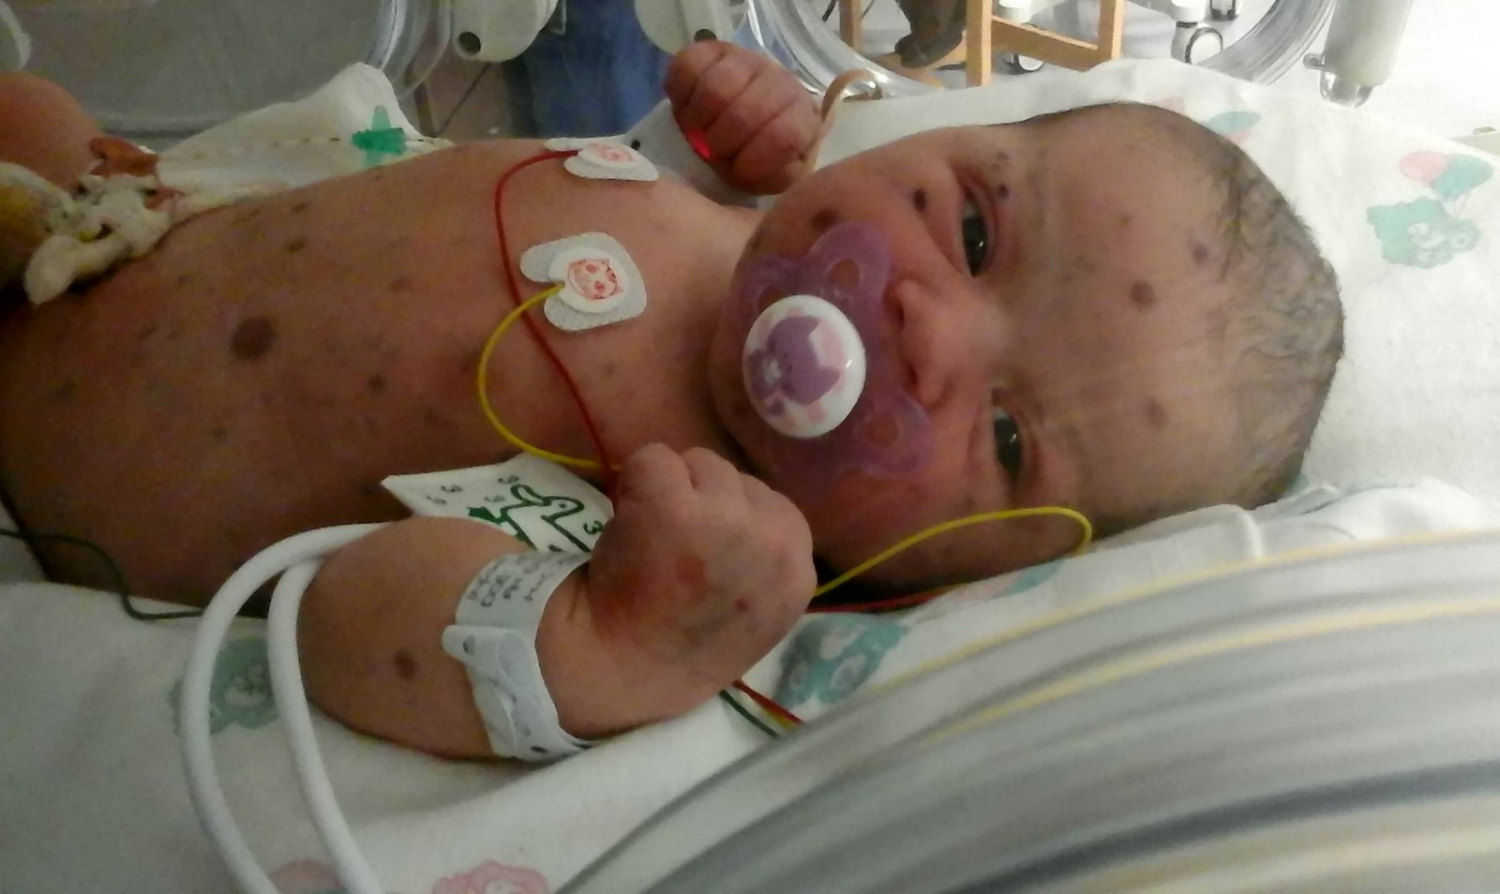


Slide 17
IMMUNOGLOBULIN DEPOSITION DISORDERS OF THE SKIN
Circulating abnormal immunoglobulins produced by neoplastic plasma cells in MGUS, multiple myeloma or Waldenström macroglobulinaemia may accumulate in the skin.
Macroglobulinaemia cutis,
Amyloid light‐chain (AL) amyloidosis
Type I cryoglobulinaemia

Slide 18
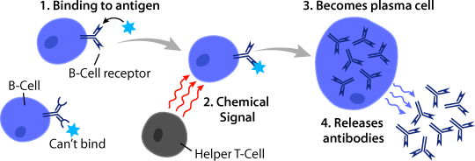

Slide 19
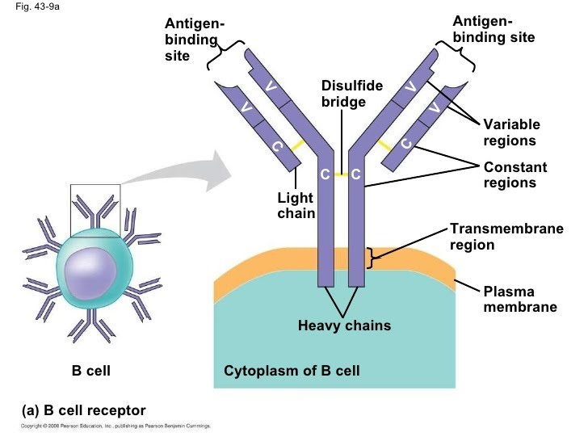

Slide 20
Macroglobulinaemia Cutis
Deposition of IgM paraproteins in the skin
Two distinct patterns of disease
Ig Mstorage papules : Flesh coloured papules on extensors
PAS +ve
IgM+ve on DIF
2) Immunobullous macroglobulinaemia cutis:Rarely IgM show affinity for plasma membrane…..blistering(paraprotein DEJ → DIF
Rx: Rituximab
Chemotherapy

Slide 21
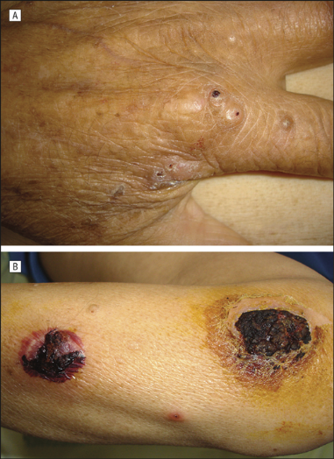

Slide 22
Primary systemic or amyloid light-chain amyloidosis
Abnormal processing and degradation of the variable portion of monoclonal light chains (life threatening condition)
90% of patients have a monoclonal gammopathy
Median survival without treatment is 12–18 months.
Multiple organ involvemenet:
Nephrotic syndrome,
Renal failure
Congestive heart failure
Peripheral neuropathy

Slide 23
Skin symptoms are common:
Purpura and ecchymoses (perioral and periorbital)
Waxy papules and plaques with sclerodermatous or bullous change
Macroglossia
Patchy alopecia
Generalized oedema

Slide 24
Treatment:
Multidisciplinary team
High‐dose melphalan
Autologous haematopoietic stem cell transplantation
Oral melphalan with dexamethasone

Slide 25
Type 1 Cryoglobulinaemia
Microvascular deposition of abnormal monoclonal immunoglobulins that can precipitate out at low temperatures.
Microvascular occlusion in the skin and other tissues.
Purpura, cutaneous ulceration, infarction, cold urticaria, Raynaud phenomenon, livedo reticularis and inflammatory macules and papules
Follicular spicules of the nose → Myeloma associated cryoglobulinemia

Slide 26
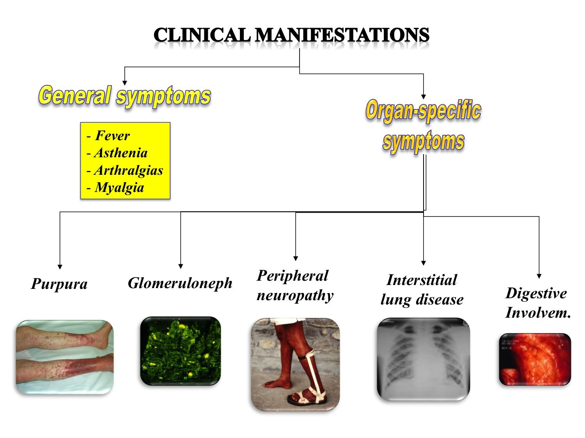

Slide 27
Hyperviscosity syndrome with neurological, ocular, rhino‐ontological and renal involvement
May cause ….multiorgan failure so prompt therapy is needed
DIAGNOSIS:
Direct measurement of cryoglobulins in serum
Skin biopsy → intravascular PAS‐positive hyaline material
TREATMENT
steroids

Slide 28
Paraneoplastic Conditions associated with hematological malignany
…. Paraneoplastic syndromes may be associated with haematoloogic malignancies
…Diagnostic screening is important
Drug intake at the time of disease onset should be determined, as some drug reactions may mimic the paraneoplastic conditions

Slide 29
Sweet Syndrome
Acute febrile neutrophilic dermatosis
Idiopathic, Drug-Induced(azathioprine,cytarabine,GCSF,NSAIDS,tetracyclins,clindamycin,acyclovir) or Paraneoplastic
Paraneoplastic → 20% of cases and associated with haematological neoplasms (myeloid leaukemias)
Hypersensitivity reaction to tumour antigens or an autoinflammatory,
IL‐1 mediated process

Slide 30
CLINICAL FEATURES:( variable)
Acute fever & arthralgia
Tender, erythematous or violaceous papules and nodules
Paraneoplastic → extracutaneous sites
Mucosal lesions, neurological (parkinsonism) and ophthalmological complications (optic neuritis, chorioretinitis)

Slide 31
CLINICAL VARIANTS:
Acute necrotizing variant → oedematous erythematous plaques
Isomorphic Sweet syndrome → site of trauma such as radiation field/ surgery scars.
Subcutaneous Sweet syndrome → overlapping with pyoderma gangrenosum and presents with tender nodules on buttocks and lower extremities and resolve spontaneously
Neutrophilic dermatosis of the dorsal hands → localized variant, associatyed with haematological neoplasms

Slide 32
DIFFERENTIALS:
Other neutrophilic paraneoplastic conditions (neutrophilic eccrine hidradenitis, pyoderma gangrenosum)
Vasculitis
Erythema elevatum diutinum
Infectious neutrophilic panniculitis
Panniculitic id reaction
Early erythema nodosum
Leukaemia cutis
Drug-induced sweet syndrome

Slide 33
Neutrophilic dermatosis of the dorsal hands presenting in an 80‐yearold
patient subsequently found to have a (MALT) lymphoma.

Slide 34
Pyoderma gangrenosum
Neutrophilic dermatosis
Four clinical types:
Classical ulcerative type
Bullous
Pustular
Vegetative type
20-60% of cases → associated with a haematological malignancy
The bullous variant → associated with haematological neoplasms
Development of PF IN patient with myeloproliferative disorder ….neg. prognostic factor,e.g,1 yr mortality of patient with AML and PG is 75% after appearance of skin lesions.

Slide 35
Bullous pyoderma gangrenosum

Slide 36
Neutrophilic eccrine hidradenitis
Paraneoplastic neutrophilic dermatosis
90% patients …underlaying haematological malignancy esp.AML
Hodgkin and nonhodgkin lymphoma
OTHER ASSOCIATED FACTORs
.Drugs(cytarabine,decitabine,vincristine,antibiotics antivirals)
.Infections(staphylococcal,HIV)

Slide 37
CLINICAL FEATURES
infiltrated erythematous papules and plaques …mainly face
other sites ….upper trunk,thighs and palmoplanter skin
TREATMENT
. (spontaneous resolution)
. Discontinue offending drug
. NSAIDS and steroids

Slide 38
Figure 148.7 Neutrophilic eccrine hidradenitis affecting the palm.

Slide 39
PARANEOPLASTIC PEMPHIGUS
Strongest association with nonhodgkin lymphoma F/B CLL and
thymoma
Untreated patients ……90% mortality rate two years after diagnosis
TREATMENT
1.Underlaying disease
2.Rituximab and CD20 monoclonal antibodies

Slide 40
Scleromyxoedema
Generalized cutaneous mucinosis …..increased mucin synthesis and deposition following fibroblast proliferation.
.In absence of thyroid diseases …….increased incidence in monoclonal gammopathies (MM,MGUS).
CLINICAL FEATURES…
. Firm papular erruptions specially on face,ears dorsal hands
TREATMENT…
. IV immunoglobulins
.Steroids
. Plasmapharesis

Slide 41
Figure 148.9 Scleromyxoedema in patient with MGUS (monoclonal gammopathy of
undetermined signifi cance

Slide 42
SCLEREDEMA
Skin thickening disorder ……woody induration and non -pitting
oedema
SITES
Face and neck with subsequent spread to scalp and upper trunk
TYPES
1.Classical ….. Febrile illness
2.Diabetes associated
3.Paraneoplastic scleredema (25%)…… monoclonal gammopathy or B cell lymphoma.Doesnt resolve spontaneously

Slide 43
Figure 148.10 Scleredema in a patient with MGUS (monoclonal gammopathy of
undetermined signifi cance)

Slide 44
TREATMENT
.PUVA
.IVIG
.UVA1
.Extracrporeal photophoresis

Slide 45
NECROBIOTIC XANTHOGRANULOMA AND NORMOLIPAEMIC XANTHOMA
May represent paraneoplastic condition without coexisting hyperlipidemia.
.80…90 % association with monoclonal gammopathy
CLINICAL FEATURES…
.Present as firm nodules,papules or plaques in periorbital areas often with ulceration,crusting and telangiectasias
TREATMENT OPTIONS
.Surgical excision
.Systemic steroids and IVIG

Slide 46
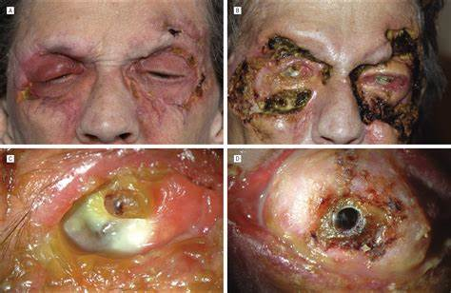

Slide 47
Syndromes associated with Haematological Malignancies And Skin
1.Schnitzler syndrome
2.POEMS syndrome
3.AESOP syndrome
4.TEMPI syndrome
5.Neurofibromatosis type 1
6.Rare syndromes

Slide 48
Schnitzler syndrome
Autoinflammatory skin disorder occuring in context of a monoclonal paraprotienemia
Typically IgM rarely IgG
AGE …40..60 yrs
C.F…Recurrent urticarial rash with systemic symptoms
Labs…rRaised TLC ,ESR and CRP
TREATMENT…
.MILD….Colchicine,NSAIDS or HCQ
.SEVERE/NONRESPONDERS…IL-1 antagonist(anakinra)
TREATMENT IS OBLIGATORY AS UNTREATED CASES….AA Amyloidosis

Slide 49
Figure 148.11 Urticaria in Schnitzler syndrome in a patient with MGUS (monoclonal
gammopathy of undetermined signifi cance).

Slide 50
POEMS Syndrome
(Polyneuropathy,Organomegally,Endocrinopathies,Mprotien and Skin changes)
Other features…oedema,ascites,pleural effusion,osteosclerotic bone changes,thrombocytosis.
SKIN changes…hyperpigmentation,eruptive hemangiomas,hypertrichosis,acrocyanosis,leukonychiaclubbing,facial flushing
Raised VEGF and Proinflammatory cytokines
Diagnostic criteria

Slide 51
Table 148.6 Diagnostic criteria for POEMS syndrome.
Major criteria(mandatory)
Polyneuropathy
Monoclonal gammopathy
Major criteria(others)
Castleman disease
Osteoclastic lesions
Minor criteria
Organomegaly
Extravascular vol.overload(ascites,oedema,P.E)
Elevated serum or plasma VEGF
Endocrinopathy
Skin changes
Papilloedema
Thrombocytosis or polycythemia
Diagnosis: two major mandatory criteria and one additional major criterion and one
minor criterion.

Slide 52
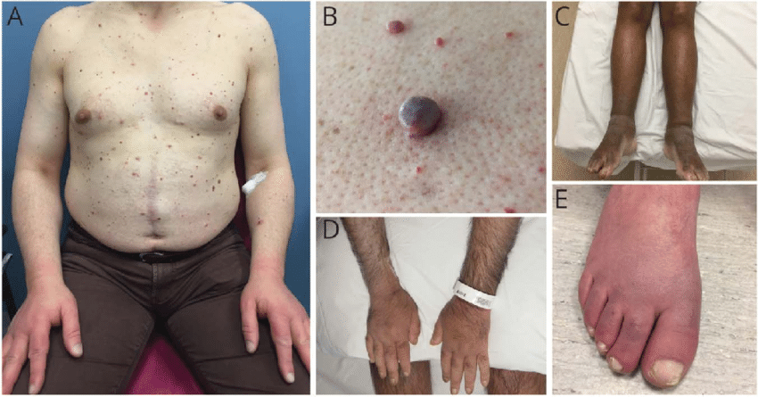

Slide 53
Chronic diease… Mean survival …14 yrs
TREATMENT ….
.Underlaying paraprotienemia and plasma cell disorder.
.Radiotherapy …plasmacytoma
.other regimen..Bortezomeb,lenalinomide, hematopoitic stem cell
transplantation

Slide 54
AESOP(Adenopathy and Extensive Skin Patch Overlaying a Plasmacytoma)
Clinical Features….
Slowly growing violacous skin patches or plaques (mostly
overlaying a solitary plasmacytoma of bone)
Enlarged regional lymph nodes
.BIOPSY…
cutaneous patch overlaying plasmacytoma …increased
dermal mucin and vascular hyperplasia

Slide 55
Figure 148.12 AESOP syndrome (adenopathy and extensive skin patch overlying a
plasmacytoma): presternal red‐brown patch overlying sternal plasmacytoma.

Slide 56
Neurofibromatosis Type 1
Over 10% children with juvenile MML…NF 1
Risk of leukemia in child with NF1 ….200-500 times
Association of CML ..more pronounced with NF1 and juvenile xanthogranulomas...Additional 20 to 30 fold
Skin manifestations…
Multiple cafe-au-lait patches and atleast 1 juv. xanthogranuloma

Slide 57
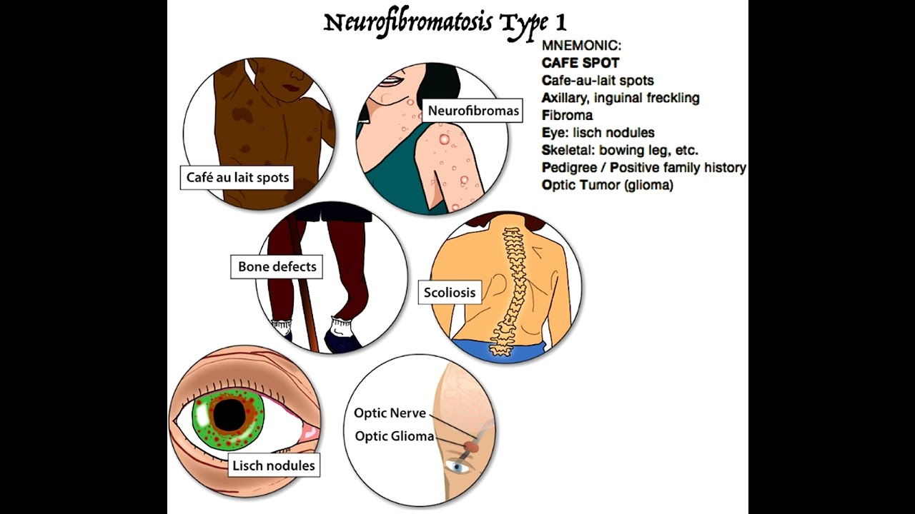
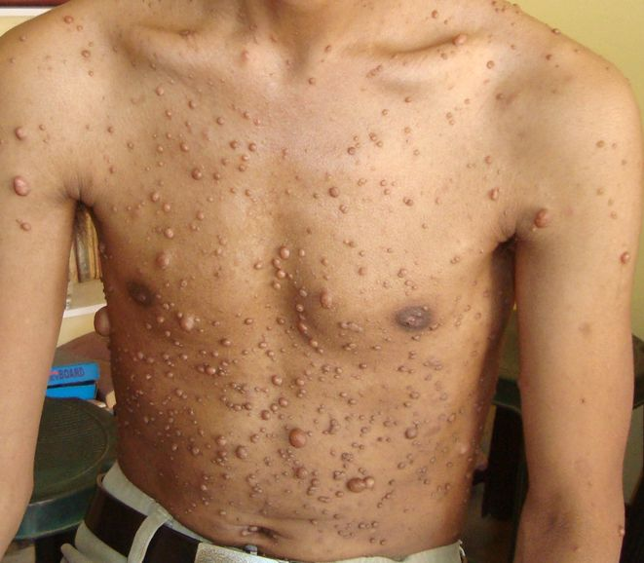

Slide 58
SKIN IN IDIOPATHIC LYMPHADENOPATHIES
KIKUCHI –FUJIMOTO disease
. Benign rare condition of unknown cause
. Histiocytic and T cell response to infectious agent(EBV)
.Clinical features
. Painful cx lymphadenopathy,fever(leukocytosis)previously well pt.
.Skin related…heterogenous…papules ,plaques,acne or EM like
.Mostly…face and trunk

Slide 59
Figure 148.14 Kikuchi–Fujimoto syndrome in a 37‐year‐old South Asian female patient
who presented with a 6‐day history of malaise, sweating, pyrexia and painful left‐sided
cervical lymphadenopathy associated with an eruption of ulcerated papules on the face
and macules resembling the Janeway lesions of bacterial endocarditis on the toes (inset

Slide 60
DIAGNOSIS ..excisional biopsy of affected L.N
Proliferative,necrotic or xanthogranulomatous changes.
.COURSE OF DISEASE
resolve spontaneously within 3-4 months
.TREATMENT
. Not generally required
.Severe cases..high dose steroids and IVIG

Slide 61
KIMURA DISEASE
Benign ch.inflammatory condition
Younger Asian males(32 yrs)
C.F…B/L cx lymphadenopathy,fever common.
DERMATOLOGIC..subcutanous. Masses esp. around head and neck or non specific…itch,eczema or urticaria’’
.Raised eosinophils and IgE
RENAL involvement has a PROGNOSTIC significance (12-16%..nephrotic syndrome)

Slide 62
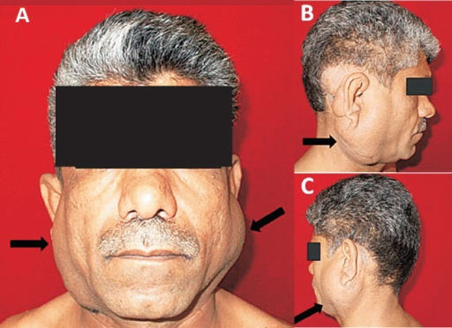

Slide 63
CHRONIC relapsing course
Treatment ..no effective but options r
.radiotherapy
.local excision
.steroid and ciclosporin

Slide 64
SKIN MANIFESTATIONS IN PRIMARY IMMUNODEFICIENCIES

Slide 66
Figure 148.15 Chronic mucocutaneous candidosis
in a 6‐year‐old boy with involvement of (a) the
tongue and (b) the fi ngernails and (c) severe
hyperkeratosis of the scalp.

Slide 67
ANEMIAS AND HAEMOGLOBINOPATHIES
.Pallor of skin…peripheral vasoconstriction due to reduced oxygen supply

Slide 68
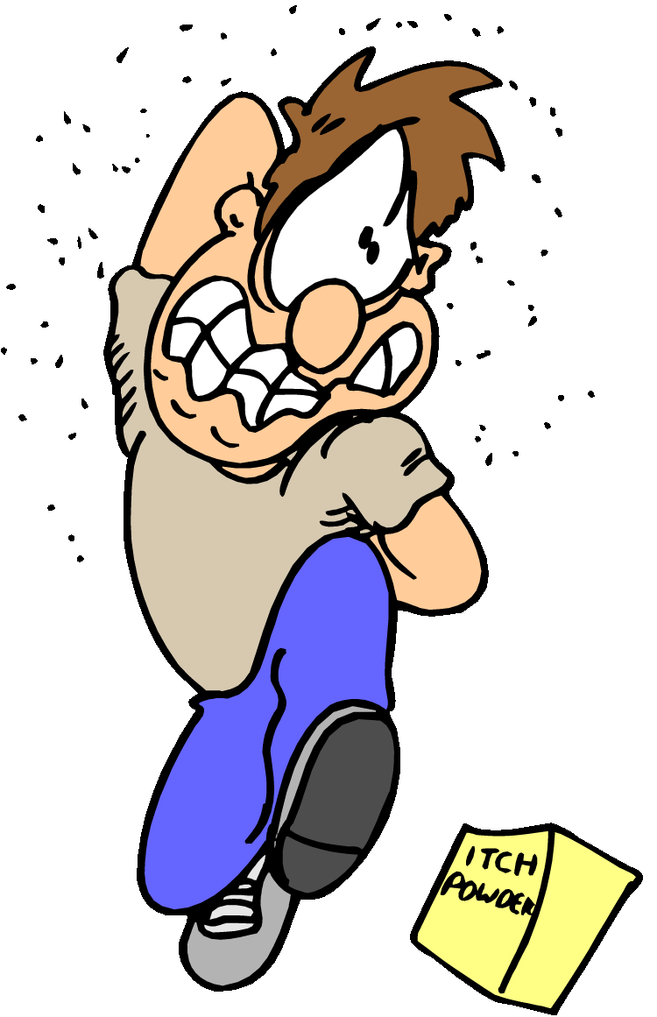
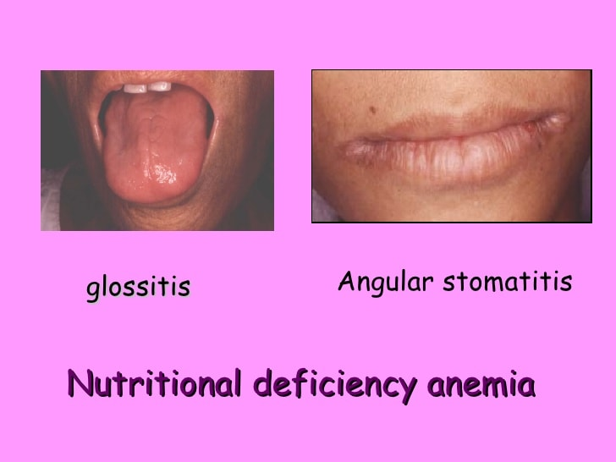
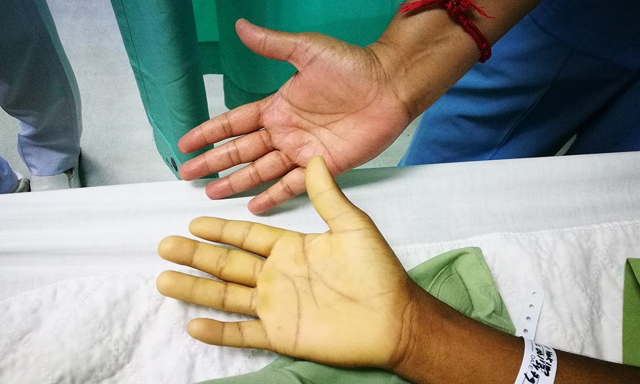
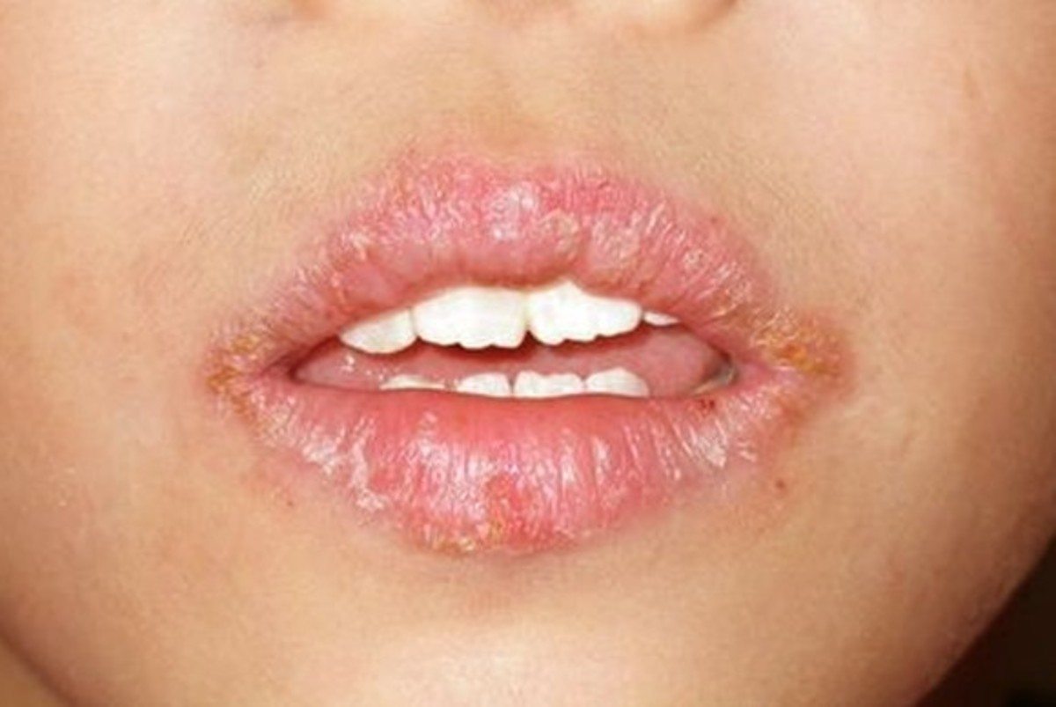
Anemia signs

Slide 69
TRANSFUSION REACTIONS WITH SKIN INVOLVEMENT
Acute aller.RXN
Urticaria,angio-oedema and erythema occurring during or immediately after transfusion
Transfusion assoc.GVHD
Erhthema,maculopapular rash 2-30 days after transfusion
Post-transfusion purpura
Thrombocytopenic purpura within 2 weeks after transfusion

Slide 70
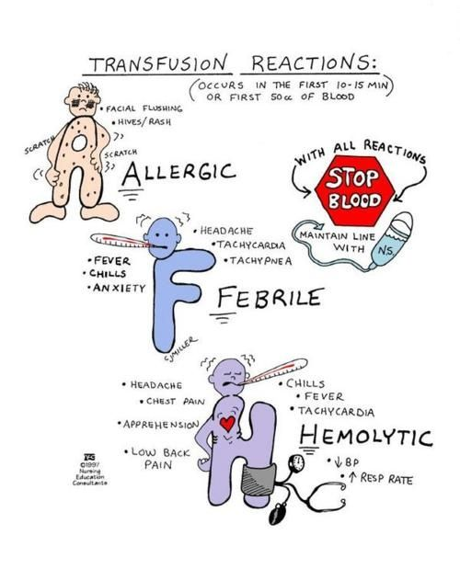

Slide 71


