Slide 1
Sexually Transmitted Infections(STI’s)

Slide 2
Classification
Bacterial
  Chancroid
  Gonorrhea
  Chlamydia
  Syphlius
Viral
  Adenovirus
  Viral Hepatitis(Hepatitis B virus)
  Herpes Simplex Virus
  Human Papilloma Virus
  Kaposi’s sarcoma
Parasite
  Pubic lice
  Scabies
Protozoal
  Trichomoniasis

Slide 3
Gonorrhoea

Slide 4
Gonorrhoea is caused by bacteria Neisseria gonorrhoeae
The common sites of infection are
  Mucous membranes of the urethra
  Endocervix
  Rectum
  Pharynx
  Conjunctiva

Slide 5
Transmission
Sexual contact with infected person
Vertical transmission

Slide 6
Clinical features
The incubation period is on average 1-5 days.
Gonorrhoea is asymptomatic in 10–15% of men and in up to 80% of women.
MALES Painful urination (dysuria) Urethral discharge (often mucopurulent) Testicular discomfort and swelling due to epididymo-orchitis Anal discomfort and discharge due to proctitis) | FEMALES Increased vaginal discharge Lower abdominal pain which may be due to pelvic inflammatory disease (PID) Dysuria Tender peri-urethral glands and Bartholin glands Anal discomfort and discharge Pharyngeal infection

Slide 7
Complications
Ascending infection in females
  pelvic inflammatory disease (endometritis, salpingitis, tubal-ovarian abscess)
  Scarring of the female upper genital tract can lead to chronic pelvic pain, ectopic pregnancy and infertility.
Ascending infection in males
  painful inflammation and swelling of the epididymis and the testicles (epididymo-orchitis).

Slide 8
Pregnancy and neonatal infection
  Miscarriage
  preterm delivery
  postpartum endometritis
  neonatal conjunctivitis,rarely bacterial sepsis.
Conjunctival infection
  Adult conjunctivitis can occur from auto-inoculation
  Scarring
  permanent visual impairment and blindness.

Slide 9
Disseminated gonococal infection
results from the spread of the bacteria to the joints and other tissues.
It occurs in 0.5–3% of infected individuals.
Symptoms
  Tenosynovitis
  Skin lesions
  Polyarthralgia and oligoarthralgia, or purulent arthritis
  Constitutional symptoms (such as fever, chills and malaise).

Slide 10
Risk factors are :
• Female.
• Men who have sex with men.
• Pregnancy.
• Menstruation.
• Systemic lupus erythematosus.
• Complement deficiency.
• Intravenous drug use.
• HIV infection.
Very rare complications of gonococcal infection include meningitis, endocarditis, osteomyelitis and vasculitis

Slide 11
Investigations
Microscopy
  Gram-stain and visualisation of gram-negative diplococci are appropriate in men with urethral discharge (sensitivity 90–95%) and are recommended in people with rectal symptoms
  not recommended in women (due to low sensitivity of 20–50% on endocervical and urethral specimens) or for pharyngeal specimens.

Slide 12
Investigations
Culture
specimen collection from appropriate sites(endocervical, urethral, rectal, and pharyngeal areas) and then inoculation onto agar plates that are selective for Neisseria gonorrhoea.
Neisseria gonorrhoea requires special conditions (a CO₂-enriched atmosphere) and rapid transport to a laboratory to ensure the viability of the organisms.
The advantage of culture is that it can provide antimicrobial susceptibility testing and confirmatory testing.
Notes:
(which is important as this organism rapidly develops resistance to many antibiotics

Slide 13
Investigations
Nucleic acid amplification tests
  PCR
  Strand displacement assay
  Transcription mediated amplification assay
For women, a vaginal or endocervical specimen are equally sensitive.
For men, first-pass urine is preferred.
High sensitivity and are often combined with one or two other STI tests (eg, for chlamydia or trichomoniasis).
Self-collection of samples is possible and the results can be available sooner than with culture.
NAATs do not routinely provide information about the sensitivity of gonococcus to antibiotics.
Notes:
Nucleic acid amplification tests (NAATs) are increasingly available.
Rectal and pharyngeal specimens are considered depending on sites of sexual contact.

Slide 14
Treatment
The treatment of uncomplicated gonorrhoea should be started as soon as possible to prevent further complications.
The recommended empirical regime for the treatment is ceftriaxone 500 mg by intramuscular injection plus azithromycin 1 g orally.
Sexual activity should not take place until treatment is completed and until all recent sexual contacts have been tested and treated appropriately.
Notes:
The addition of azithromycin is important, as dual therapy is thought to limit the emerging resistance that is beginning to occur with ceftriaxone alone. Azithromycin will also treat a concurrent chlamydia infection.

Slide 15
Uncomplicated infection
First line
• Ceftriaxone 500 mg IM + azithromycin 2 g PO
Second line
• Ceftriaxone 500 mg IM
• Spectinomycin 2 g IM + azithromycin 2 g PO
(spectinomycin does not clear pharyngeal gonorrhoea)
• Cefixime 400 mg PO + azithromycin 2 g PO (significant
treatment failure reported)
Third line
• Refer to sensitivity data for local laboratory test results
for bacterial isolate antimicrobial resistance
• Ciprofloxacin 500 mg PO
• Azithromycin 2 g PO

Slide 16
Complicated infection
Gonococcal epididymoorchitis
• Ceftriaxone 500 mg IM + azithromycin 2 g PO single
doses, followed by doxycycline 100 mg PO twice daily
for 10–14 days
Gonococcal PID
• Ceftriaxone 500 mg IM + azithromycin 2 g PO single
doses, followed by doxycycline 100 mg PO twice daily +
metronidazole 400 mg twice daily for 14 days
Gonococcal conjunctivitis
• Irrigate eye
• Azithromycin 2 g PO single dose + ceftriaxone 500 mg
IM once daily for 3 days

Slide 18
Genital chlamydia infection

Slide 19
caused by the bacterium Chlamydia trachomatis with its serotypes D–K. It is often just called 'chlamydia'.

Slide 20
Risk factors include:
  age less than 25 years old
  New or multiple sexual partners
  Inconsistent use of condoms.

Slide 21
Chlamydiae are obligate intracellular parasites and cannot be cultured on artificial media.
They exhibit a unique, two‐stage developmental cycle with two forms:
• An extracellular, infectious elementary body (EB).
• An intracellular, replicative reticulate body (RB).
Normal cervix with mucoid discharge demonstrating ectopy.
This cycle begins when infectious, metabolically inert EBs attach
to and stimulate uptake by the host cell. The internalized EB
remains within a host‐derived vacuole, termed an inclusion, and
differentiates into a larger, metabolically active RB. The RB multiplies by binary fission, and after 8–12 rounds of multiplication, the
RBs differentiate to EBs asynchronously. At 48–72 h post‐infection,
EB progeny are released from the host cell to initiate another cycle
C. trachomatis strains A–K primarily infect squamocolumnar
epithelial cells.

Slide 22
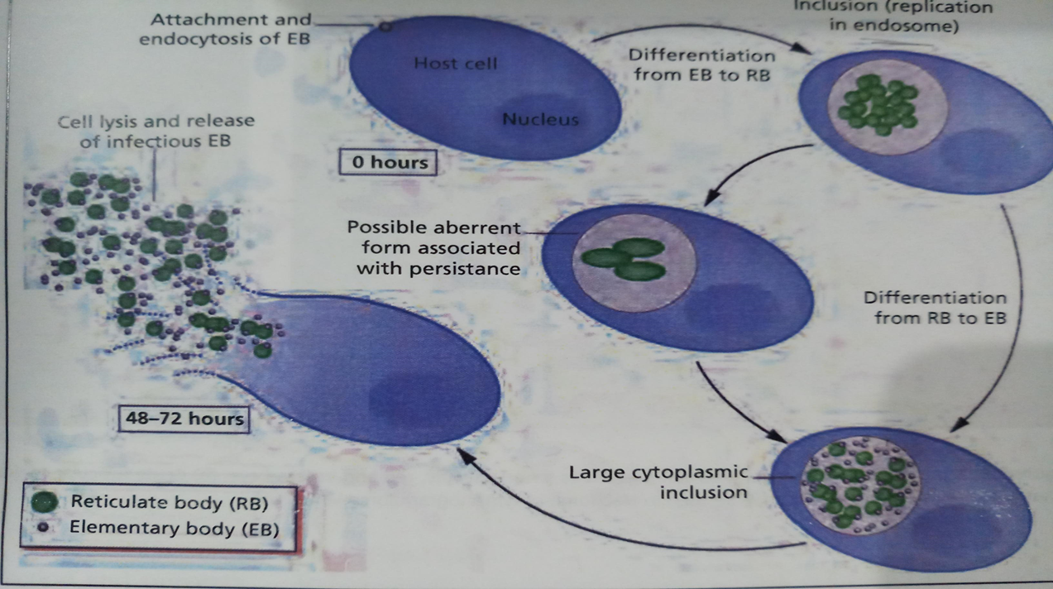

Slide 23
Clinical features
In men,
Discharge from the urethra
Urethral irritation
Pain on urination
Testicular swelling or pain.
In women,
Abnormal vaginal discharge
Pain on urination
Abnormal vaginal bleeding (eg, bleeding between periods or after sex)
Lower abdominal pain
Dyspareunia (painful sex)

Slide 24
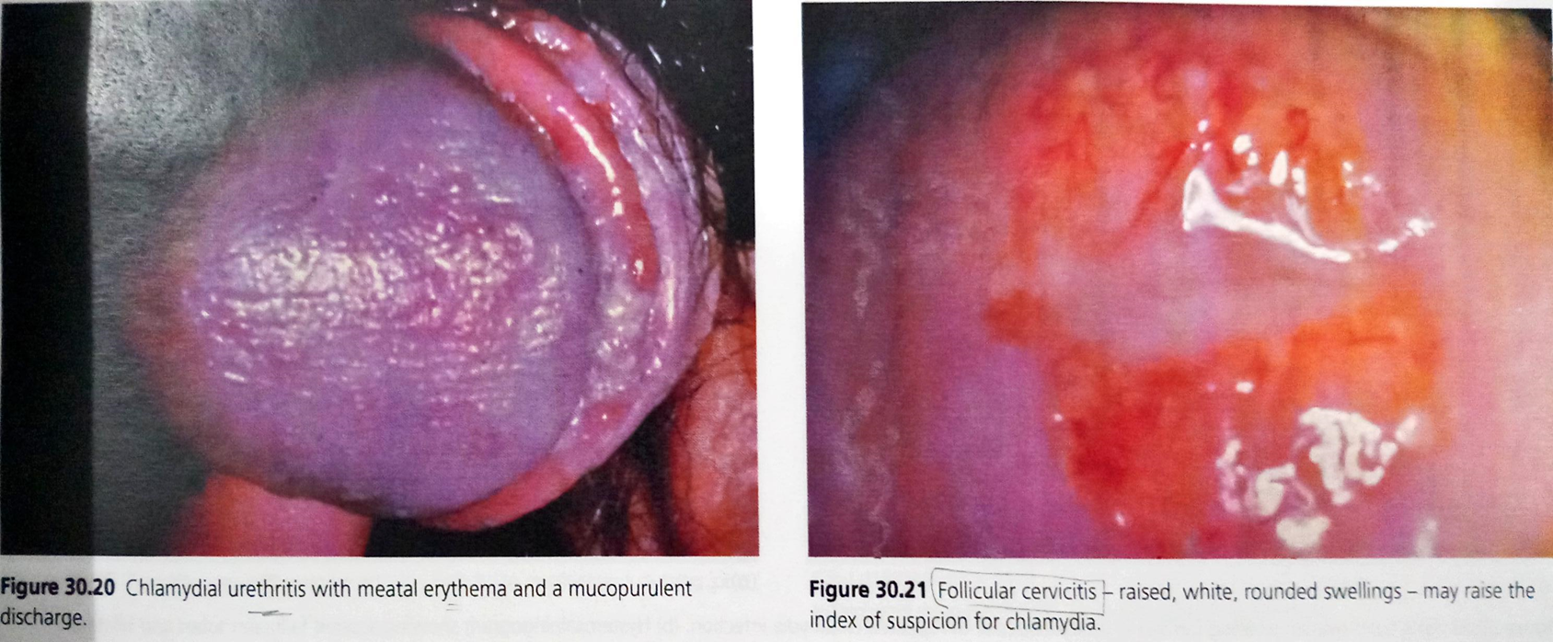

Slide 25
Complications
In men
Rectal chlamydia infection
Epididymo-orchitis
Sexually acquired reactive arthritis
Perihepatitis (rare in men)
Chronic pain syndrome
Sexually acquired conjunctivitis
Balanitis (rash affecting glan penis)
Infertility.

Slide 26
In women
Rectal chlamydia infection
Pelvic inflammatory disease
Tubal infertility
Ectopic pregnancy
Sexually acquired reactive arthritis
Sexually acquired conjunctivitis
Perihepatitis syndrome (Fitz-Hugh-Curtis syndrome)
Chronic pelvic pain
A triad of reactive arthropathy, conjunctivitis, and urethritis.
Mother-to-child transmission can result in chlamydial conjunctivitis and pneumonia in newborn babies

Slide 27
Investigations
Microscopy:Iodine stained inclusion bodies are seen.
Chlamydia nucleic acid amplification tests (NAATs) — chlamydia NAATs
Enzyme immunoassays (EIAs).
Chlamydia cultures have a low sensitivity (60–80%)

Slide 28
Treatment
Uncomplicated infection
First line
• Azithromycin 1 g stat (including in pregnancy)
Second line
• Doxycycline 100 mg b.d. for 7 days
Third line
• Ofloxacin 200–300 mg b.d. for 7 days
• Amoxicillin 500 mg four times a day for 7 days (pregnancy only)

