Slide 1


Slide 2
Severe Cutaneous Adverse Reactions to Drugs
Dr.Sana Aslam
Resident Dermatology

Slide 3
Learning Objectives
What are different types of SCAR
Pathophysiology
Clinical presentation of SCAR
How to manage

Slide 4
OUTLINE
Acute generalized exanthematous pustulosis
Drug reaction with eosinphilia and systemic symptoms
Exfoliative erythema
SJS/TEN

Slide 5
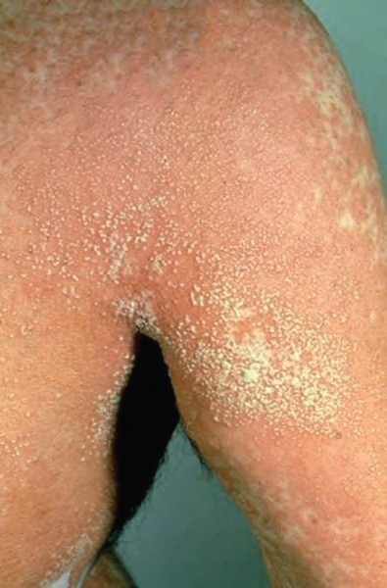
Acute generalized exanthematous pustulosis
Synonyms
Exanthemic pustular psoriasis
Toxic pustuloderma
Pustular drug reaction

Slide 6
AGEP
Sheets of non-follicular sterile pustules
Localized to major flexures
Response to drug
Short latency (2-5 days)
Self -limiting
Resolves without sequeale

Slide 7
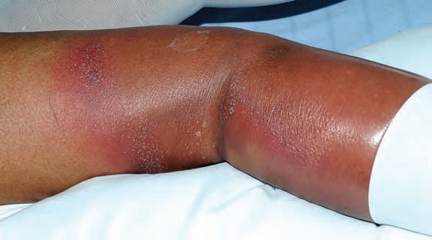
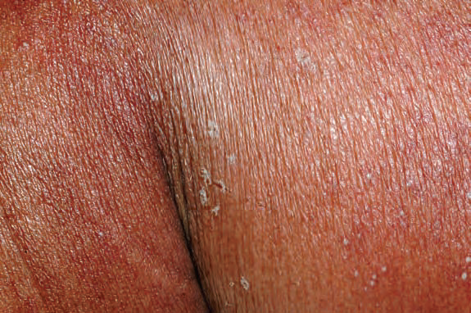

Slide 8
AGEP
Epidemiology
Age : more prevalent in adults
Sex : females are more affected
Associations
Drugs ……….90%
Infections ……mycoplasma pneumoniae , CMV Parvovirus B-19

Slide 9
AGEP
Drugs
Aminopencillins
Quinolones
Chloroquine and HCQ
Sulphonamides
Terbinafine
Diltiazem

Slide 10
Pathophysiology
Exposure to drug
IL-8 production
Neutrophilic chemotaxis
Drug specific CD4 AND CD8-T CELLS
Sterile pustules formation

Slide 11
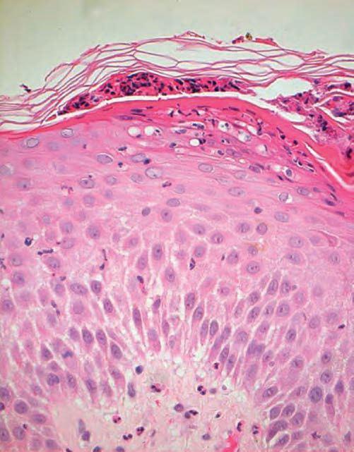
Histopathology

Slide 12
Diagnostic criteria
Appearance of hundreds of sterile non‐follicular pustules at flexural sites
Histopathological changes of spongiosis and epidermal pustule
Fever >38°C
Blood neutrophil count >7 × 109/L
Acute evolution

Slide 13
Differential diagnosis
Pustular psoriasis
Subcorneal pustular dermatosis
DRESS with pustules

Slide 14
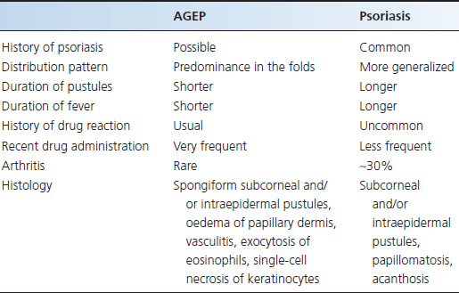

Slide 15
Investigations
Skin biopsy
CBC
LFTs
RFTs
CRP

Slide 16
Management
Removal of culprit drug
Topical therapy
Emolients
Corticosteroids
Systemic therapy
Oral corticosteroids ……..extensive disease or systemic upset
Empiric antibiotic ………suspected infection

Slide 17
Drug reaction with eosinophilia and systemic symptoms
DRESS is characterized by
Cutaneous features……….rash of variable morphology
Systemic upset………haematological and solid organ disturbance

Slide 18
DRESS
Epidemiology
Age……..mean age of onset 48yrs
Sex ………females slightly more affected
Associations
Drugs
HIV

Slide 19
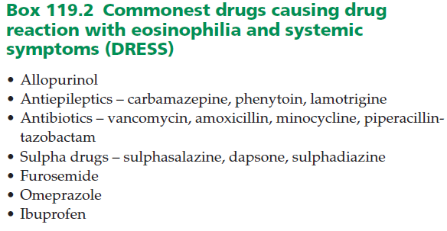
DRESS

Slide 20
Pathophysiology
DRUG EXPOSURE
Drug specific T cell reaction
Haptenization
Pharmocological interaction
p-i concept
Viral reactivation

Slide 21
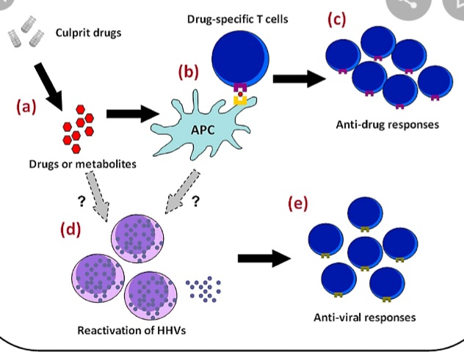

Slide 22
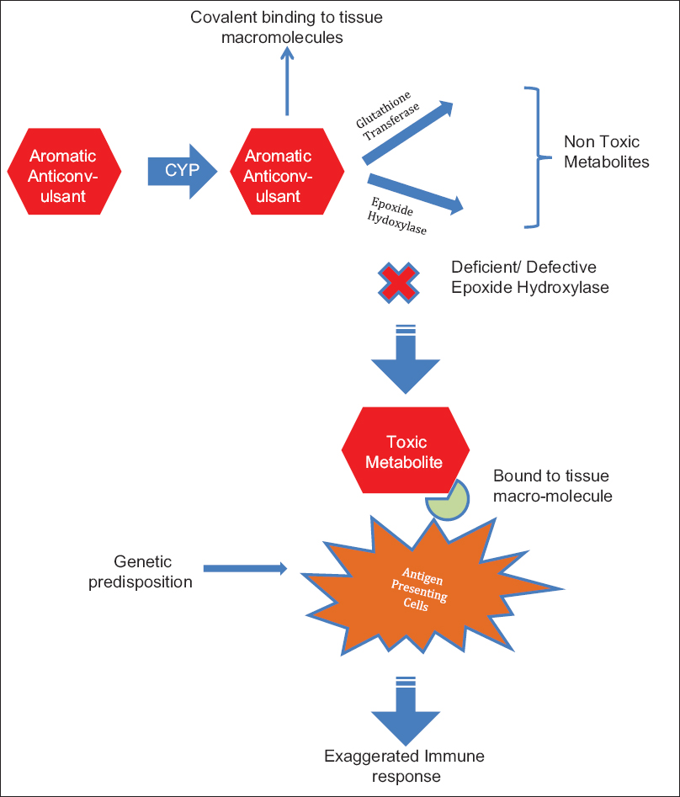

Slide 23
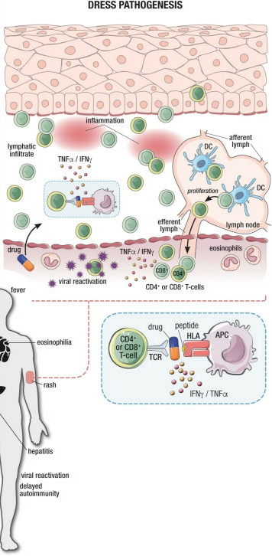

Slide 24
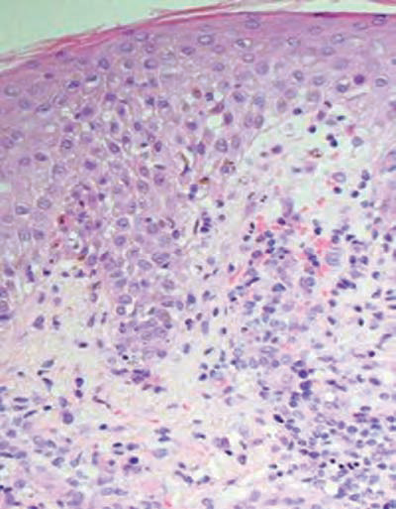
Histopathology

Slide 25
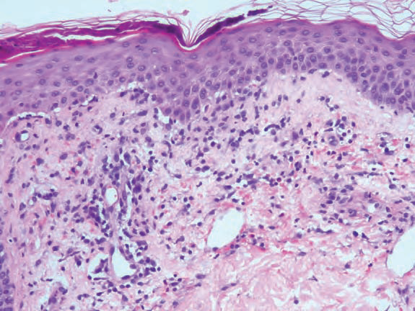
Histopathology

Slide 26
Clinical fatures
History
Prolonged latency …… 2-6 weeks
Prodromal phase
Presentation
Rash
Fever
Lymphadenopathy
Systemic upset……one organ system and haematological disturbance

Slide 27
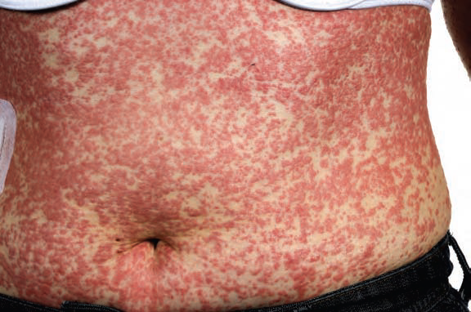

Slide 28
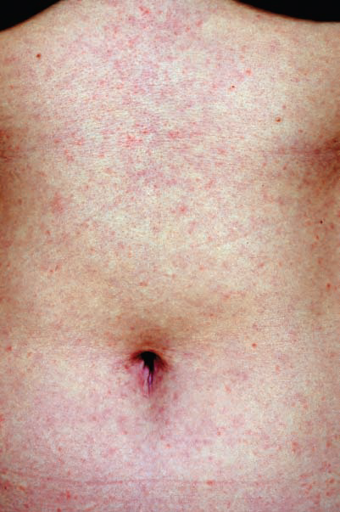

Slide 29
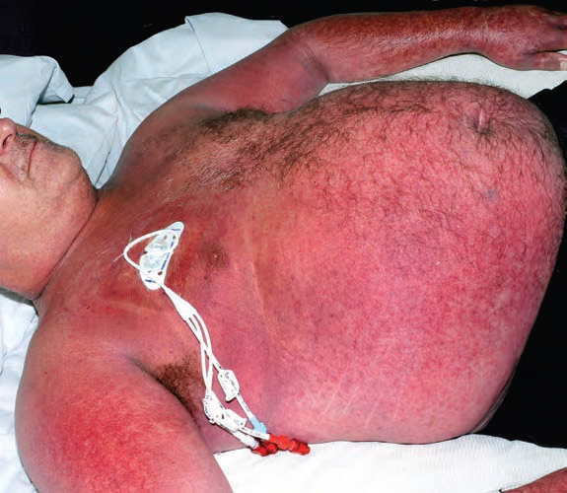

Slide 30
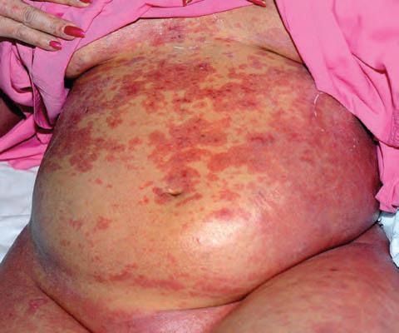

Slide 31
Clinical features
Lymphadenopathy ……. Atleast two sites
Haematologiacal abnormalities
Eosinophilia
Lymphocytosis
Atypical lymphocytes
Pancytopenia , leukopenia, thrombocytopenia

Slide 32
Clinical features
Liver
Hepatocellular and obstructive picture
Mild and transient hepatitis …. ALT ≤ 250iU/L
Fulminant hepatic failure
Primary cause of mortality
Renal
Hematuria ,proteinuria and urinary eosinophils
Renal failure rare
Notes:
LIVER …… atypical target lesions ,purpura ,minocycline ,dapsone ,phenytoin bad prognostic markers RENAL ;ALLOPURINOL

Slide 33
Clinical features
Cardiac involvement
Pericarditis and myocarditis
Acute necrotizing eosinophilic myocarditis
Pulmonary involvement
Pleuritis , pleural effusion ,acute interstitial pneumonitis
Notes:
ANEM HIGHER MORTALITY 50% echo……. reduced EF ,pericardial effusion

Slide 34
Clinical features
CNS
Headache ,seizures ,cranial nerve palsies
Limbic encephalitis , SIADH
GIT
Bloody diarrhea
Endoscopy…..ulcerative colitis

Slide 35
Clinical features
Endocrine
Hypo- or hyperthyroidism
Pancreatitis……..pacreatic insufficiency
type 1 diabetes

Slide 36
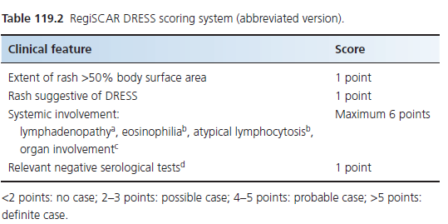
Diagnostic criteria
Notes:
Lymphnoadenopathy 2 sites gretaer than 1cm eosinophilia 10-19% 1 greater than 20 % 2 points atypical lymphocytes 1 liver transaminases or bilirubin greater than 2 times ULN on 2 occasions or GGT ,AST ,ALPO4 greater than 2 ULN on 1 occasion
Cardiac echocardiographic findings
Renal 1.5 times of creatinine maximum 2 points for solid organ
Negative serology hep A,B ,C mycoplasma pneumoniae ,S.ANA , blood culture negative

Slide 37
Poor prognostic factors
EM like reactions
Allopurinol , minocycline
High viral titres
Eosinophilia , pancytopenia and thrombocytopenia
Tachypnea , tachycardia , coagulopathy and GI bleeding

Slide 38
Differential diagnosis
Sepsis /infection
AGEP
SJS/TEN
Eczema
Cutaneous lymphoma

Slide 39
Investigations
CBC , peripheral smear
LFTs , RFTs , URE , PT/INR , CK-MB
S.ANA ,TFTs
Viral serology
Mycoplasma serology
Cultures
Chest X-ray ,ECG , Echocardiography
CT/MRI/EEG /CSF analysis

Slide 40
Management
Identify and exclude culprit drug
General management
Definitive mangement
1st line corticosteroids
2nd line ……ciclosporin or IVIG
3rd line ……..plasmapharesis cyclophosphamide ,rituximab

Slide 41
Generalized exfoliative dermatitis
Drug induced erythroderma
Pruritis , erythema and scaling
›90% BSA
Primary………..short latency
Associated with DRESS ……….latency upto 12 weeks
Constitutional symptoms
Lymphadenopathy , organomegaly and high output cardiac failure

Slide 42
DRUGS
Anticonvulsants: carbamazepine,phenytoin, phenobarbitol
Antibiotics : pencillins ,cephalosporins, vancomycin
NSAIDs
Allopurinol
Lithium
Acitretin
Omeprazole
Heavy metals

Slide 43
Complications
Hypothermia
Fluid and electrolyte imbalance
Sepsis
High output cardiac failure
Post inflammatory dyspigmentation

Slide 44
Management
Withdrawl of offending drug
General management
Specific : Topical and systemic corticosteroids

Slide 45
Stevens-johnson syndrome/toxic epidermal necrolysis
Synonym: Lyell syndrome
Severe mucocutaneous reactions usually to drugs , characterized by
Blistering and epithelial sloughing

Slide 46
SJS/TEN
Rare, acute, serious, and potentially fatal skin reaction
Characterized by epidermal loss and multisite mucositis, accompanied by systemic disturbance
May proceed to multiorgan failure
Carries an appreciable mortality during the acute illness
Survivors often develop significant long term sequelae.

Slide 47
Epidemiology
Age: all ages
Sex: female to male being 2:1
Associated diseases:
Infections: HIV ,Mycoplasma pneumoniae
SLE

Slide 48
DRUGS
Allopurinol
Anticonvulsants (Carbamazepine, Lamotrigine, Phenobarbital, Phenytoin)
Nevirapine
Oxicam non steroidal anti-inflammatory drugs
Sulfamethoxazole and other sulfa antibiotics
sulfasalazine

Slide 49
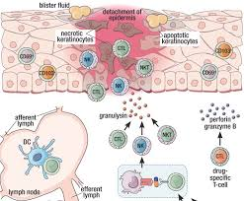

Slide 50
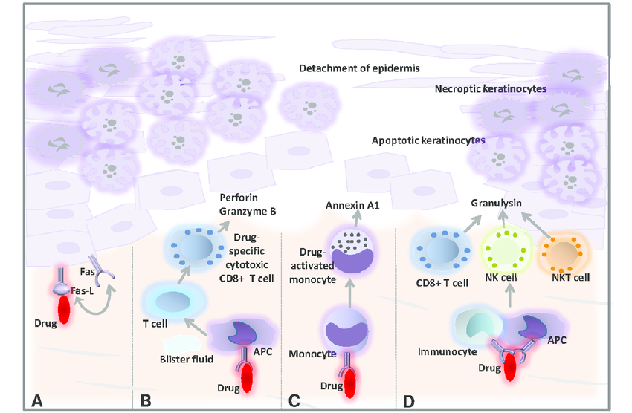

Slide 51
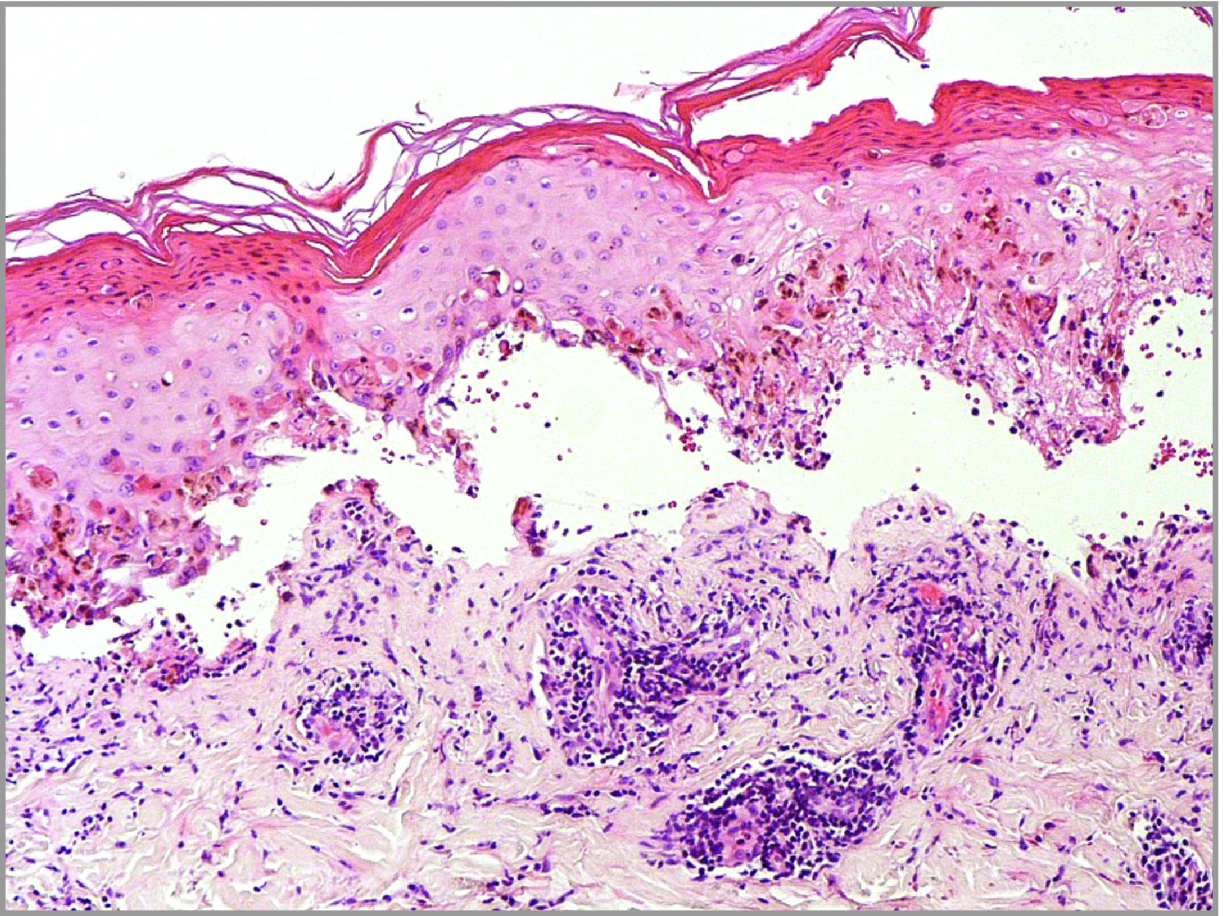

Slide 52
Clinical features
Latent period …………7-10 days but may range from 5-28 days
Prodrome………fever,malaise ,flu like illness
Rash ……… face and chest commonly involved
Mucosal involvement occur before, after or simultaneously with the dermatosis

Slide 53
Skin lesions
Atypical targets or purpuric macules on the face, upper torso and proximal limbs
Palms and soles involvement is often prominent
Vesicles or fluid filled blisters develop within lesional skin
Positive Nikolsky sign
Epidermal detachment produces areas of denuded dermis

Slide 54
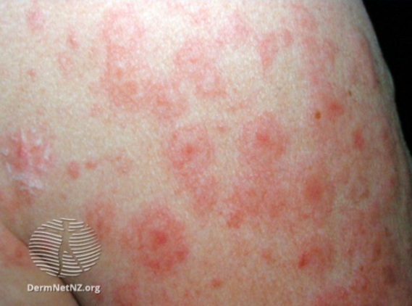
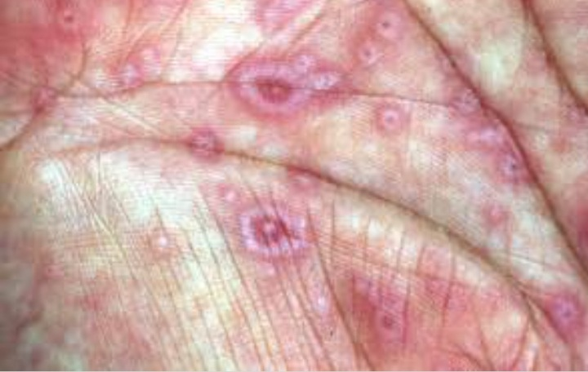

Slide 55
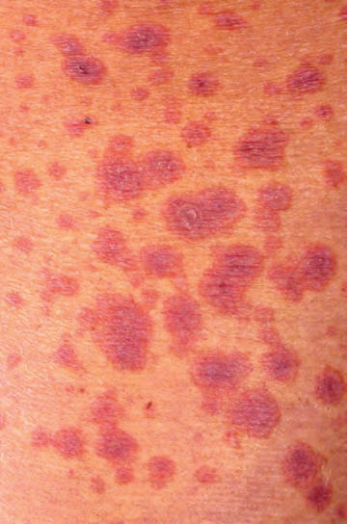
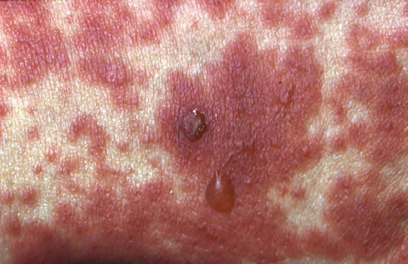

Slide 56
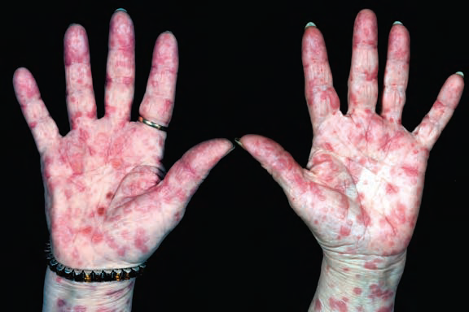
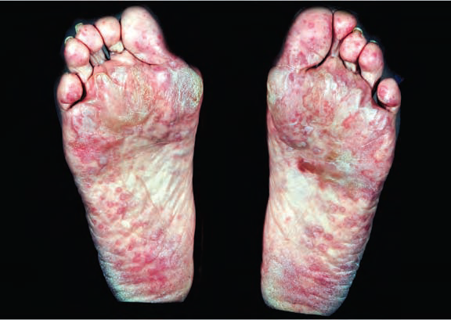

Slide 57
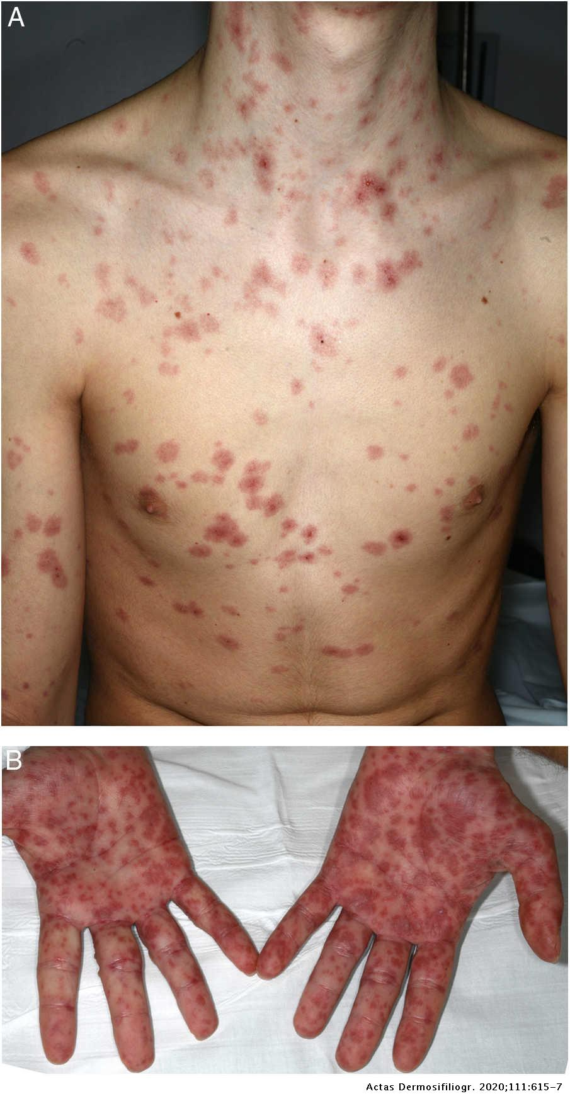

Slide 58
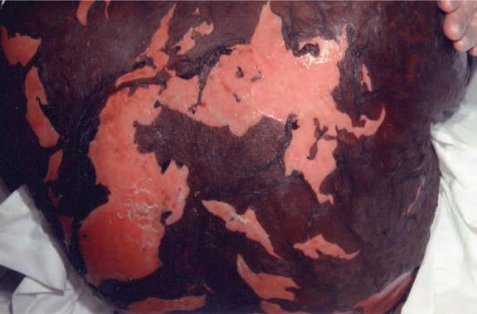
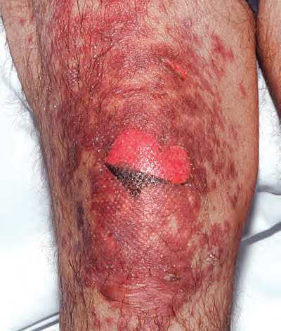

Slide 59
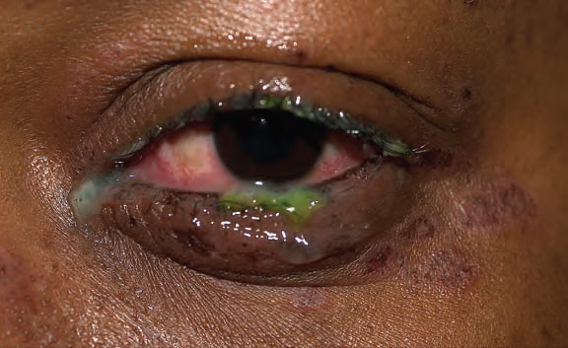
Mucosal involvement
Eyes: conjunctivitis, corneal ulceration– red, sore, sticky, photosensitive eyes.

Slide 60
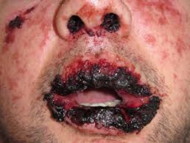
Oral involvement: —Adherent hemorrhagic crust

Slide 61
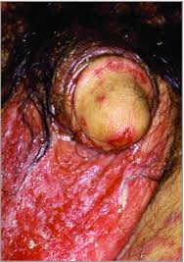
Urogenital tract:( erosions ulcers) pain and urinary dysfunction (dysuria or retention)

Slide 62
Systemic involvement
Pulmonary : Dyspnea , hemoptysis , tachypnea , increased bronchial secretions
Fibreoptic bronchoscopy : diffuse loss of bronchial epithelium
GIT : diarrhoea

Slide 63
Differential diagnosis
Erythema multiforme major
Pemphigus vulgaris
Mucous membrane pemphigoid
Bullous pemphigoid
Paraneoplastic pemphigus
Bullous lupus erythematosus
Generalised bullous fixed drug eruption
Staphylococcal scalded skin syndrome

Slide 64
EMM | SJS
Typical target lesions or Raised atypical target lesions | Flat atypical target lesions
Extremities /acral sites predominantly iinvolved | Torso commonly involved
Herpes simplex virus common aetiological agent | Drugs

Slide 65
CLASSIFICATION OF SEVERITY
SJS | Overlap SJS/TEN | TEN with spots | TEN without spots
Epidermal detachment less than 10% BSA | Detachment of 10-30% BSA | Detachment greater than 30% BSA | Detachment greater than 30% BSA
Widespread purpuric macules or flat atypical targets | Widespread purpuric macules or flat atypical targets | Widespread purpuric macules or flat atypical targets | Loss of large epidermal sheets without purpuric macules or target lesions

Slide 66
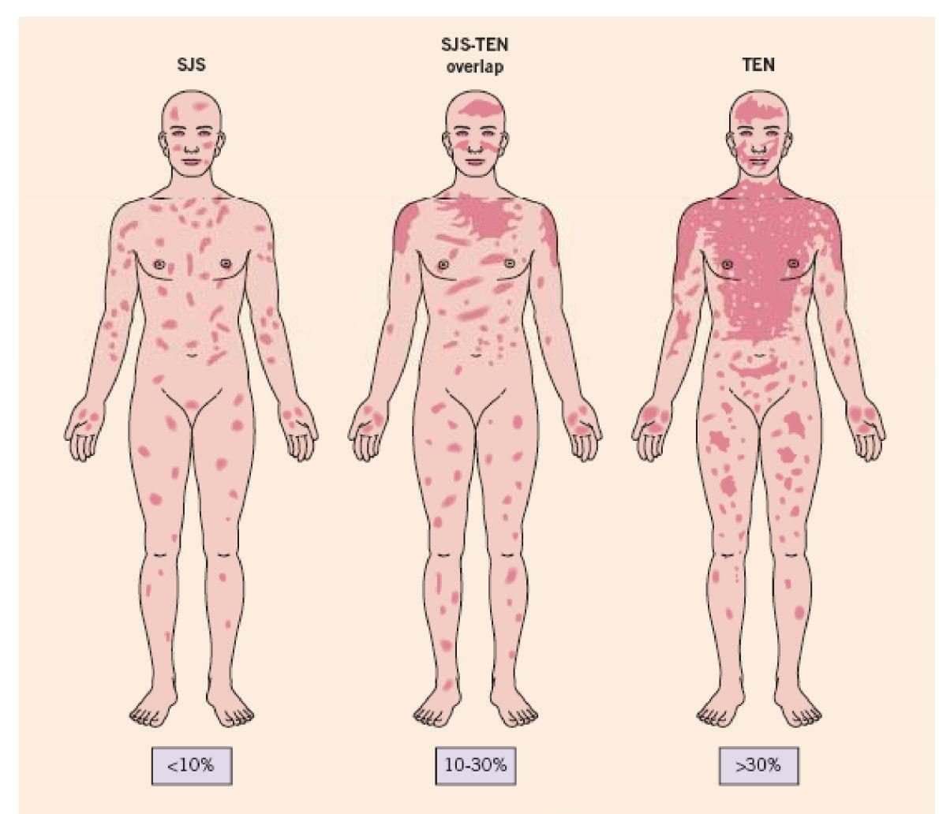

Slide 67
COMPLICATIONS
ACUTE COMPLICATIONS
LONG TERM COMPLICATIONS
Hypothermia
Dehydration
Infections
Acute kidney injury
Hyperglycemia
Abnormal LFTs
Hypoalbuminemia
Bronchial erosions
Airway obstruction
Septicaemia
Post inflammatory dyspigmentation
Sjogrens like symptoms
Bronchiolitis obliterans
Esophageal strictures
Ocular sequelae
Vaginal and introital adhesions
Notes:
Mortality rate is upto 10% for SJS and 30% for TEN COMBINED MORTALITY 22%

Slide 68
SCORTEN
• Age greater than 40 years
• Presence of malignancy
• Heart rate >120 beats/min
• Epidermal detachment >10% of BSA at admission
• Serum urea >10 mmol/L
• Serum glucose >14 mmol/L
• Bicarbonate level <20 mmol/L

Slide 69
Predicted Mortality
0……………….. 1.2%
1………………… 3.9%
2………………… 12.2%
3………………… 32.4%
4………………… 62.2%
5…………………. 85.0%
6…………………. 95.1%
7 ………………….98.5%

Slide 70
Investigations
Skin biopsy
CBC
LFTs
RFTs
Bicarbonate
Glucose
Coagulation studies
Mycoplasma serology
ESR ,CRP
ANA , Complement levels

Slide 71
Management
Cessation of suspected causative drug
Intensive care unit / burns unit care
Pressure relieving mattress
Nutritional and fluid replacement by IV and nasogastric routes
Temperature maintenance (25-28 degree celsius)
Pain relief
Sterile handling

Slide 72
SKIN CARE
Avoid sources of skin trauma (sphygmomanometer cuffs, adhesive ecg leads, adhesive tapes etc)
Daily cleansing by gentle irrigation with warm sterile water or weak solution of chlorhexidine (1/5000)
Frequent applications of greasy emollient such as 50%WSP with 50% LP

Slide 73
CONTD….
Topical antibiotics on sloughed or crusted areas
Dressings will help control pain and accelerate re-epithelialization

Slide 74
EYES, MOUTH AND GENITAL CARE
Daily assessment by an opthalmologist
Frequent eye drops/ointments (antiseptics, antibiotics, corticosteroids)
Frequent mouthwashes, topical steroids
Frequent emollients and if ulcerated intravaginal steroid ointment to prevent adhesions, catheterization to prevent strictures

Slide 75
ADDITIONAL SUPPORTIVE MEDICATION
Gastric protection with a proton pump inhibitor
Prophylactic anticoagulation with LMWH
To prevent neutropenic sepsis, recombinant human G-CSF
Antibiotics in presence of clinical signs of infection

Slide 76
SPECIFIC MANAGEMENT
Systemic corticosteroids (prednisolone0.5-1mg/kg or IV methylprednisolone 500mg for 3 days)
IVIG (0.5-1gm/kg daily for 3-4 days)
Ciclosporin ( 3-4 mg/kg daily for 10 days )
Plasmapheresis
TNF-alpha inhibitors

Slide 77


