Slide 1
SYPHILIS
DR. SHIFA
PGR DERMA

Slide 2
DEFINITION
AKA Great imitator or Great pox
Sexually transmitted disease caused by treponema pallidum subsp.pallidum
T. pallidum was identified in 1905 by Schaudinn and Hoffmann
Occurs in sexually active individuals,mostly young adults or newborns in case of congenital syphilis
Prevelant in all races
Strongly associated with other STIs
Two modes of transmission:
  Sexual contact
  Transplacental transmission

Slide 3
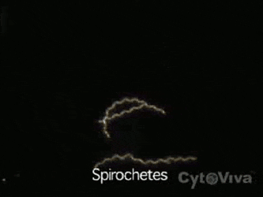
MORPHOLOGY
  Dark‐field microscopy shows corkscrew organism with close and very regular coils.
  Length: 6 to 15 μm . There are between eight to 20 coils.
  Actively motile due to its flagellate morphology, with pathognomonic movements.
  Treponemes can also be demonstrated by the direct fluorescent antibody method, and by rapid immunofluorescent staining (RIS) of smears from lesions.

Slide 4
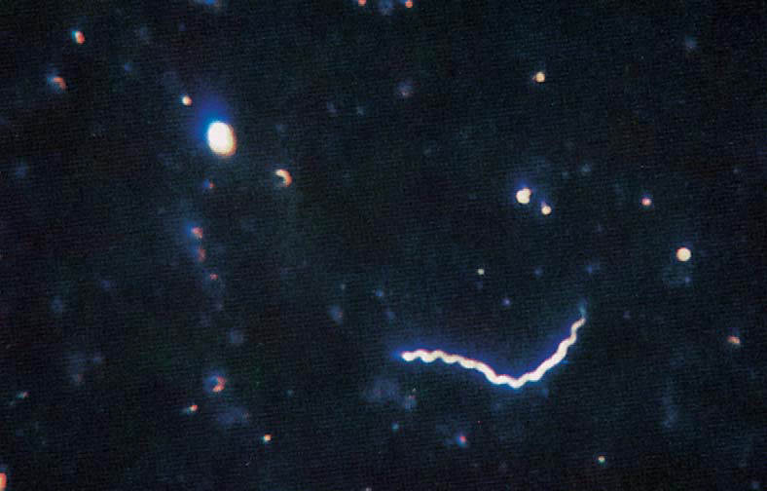
Treponema pallidum showing typical morphology.

Slide 5
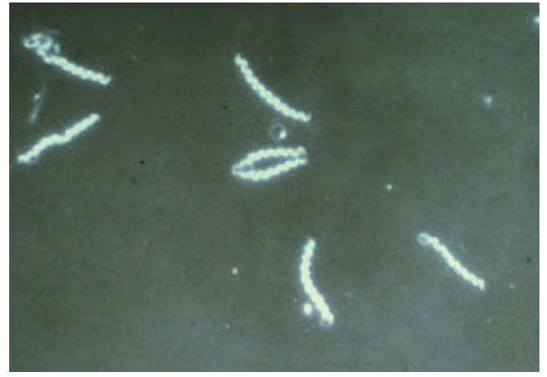
Immunofluorescent image of Treponema pallidum.

Slide 6
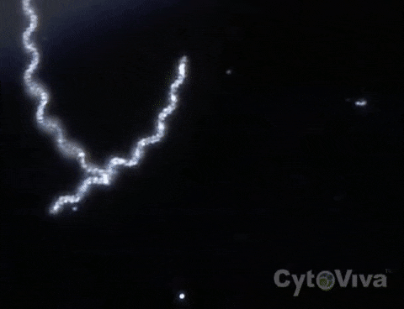
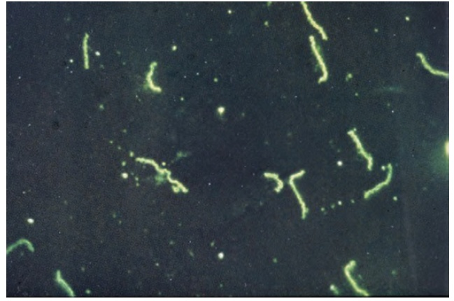
Treponema pallidum on dark ground microscopy.

Slide 7
MICROBIOLOGY
  The organism is microaerophilic, Gram negative bacilli.
  It cannot be cultured on artificial media.
  Grows slowly, at 33–35°C, with a doubling time of 30–36 h.
  The outer membrane lacks LPS and contain poorly immunogenic transmembrane proteins.

Slide 8
HISTOPATHOLOGY
H/P findings in early and late syphilis are same
Perivascular infiltrate of lymphocytes and plasma cells, accompanied by intimal proliferation of both arteries and veins (endarteritis obliterans)
Organisms can be seen by levaditi”s silver stain, by the flourescent antibody technique.
Endothelial swelling in dermal blood vessels
Psoriasiform hyperplasia of the epidermis with spongiosis and multifocal interface change associated with lymphocytes and plasma cells.

Slide 9
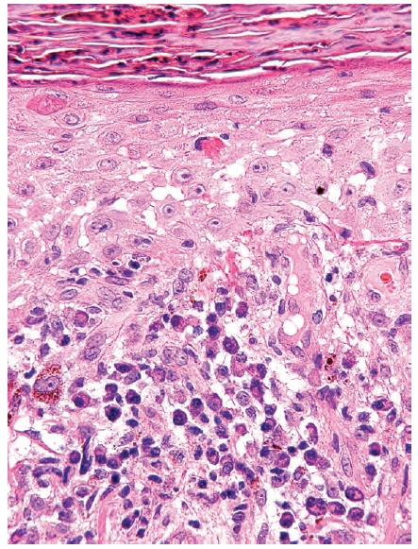
Secondary syphilis showing psoriasiform hyperplasia of the epidermis with spongiosis and interface change with abundant plasma cells.

Slide 10
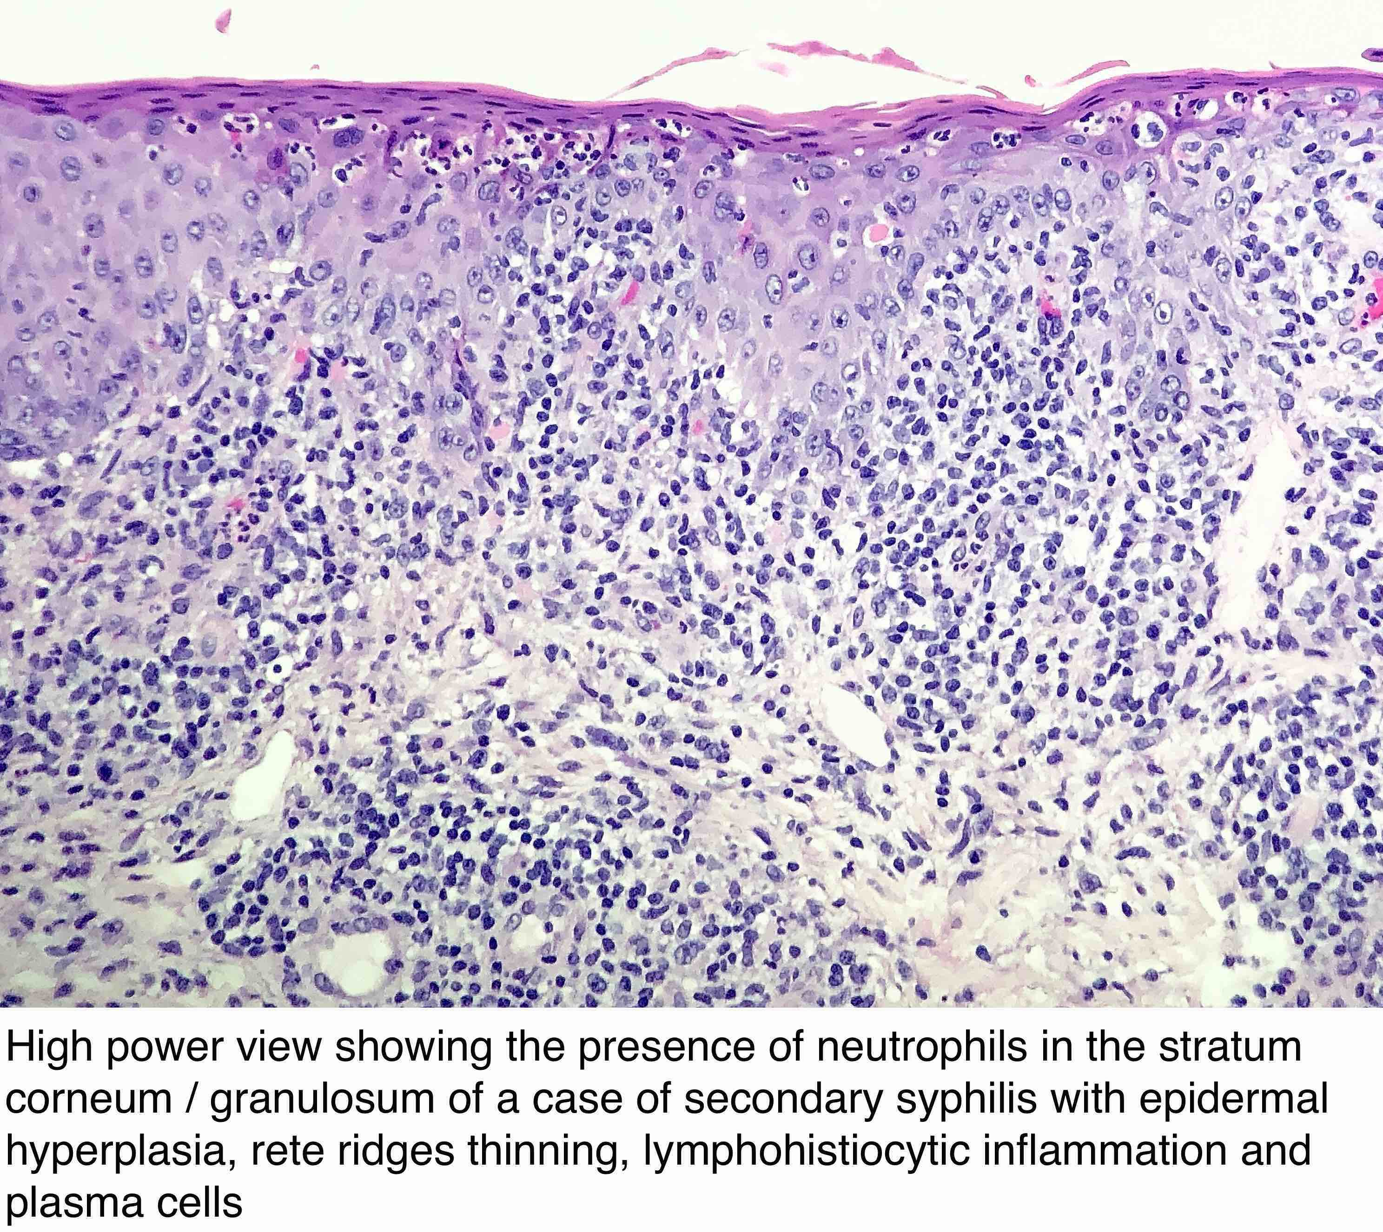

Slide 11
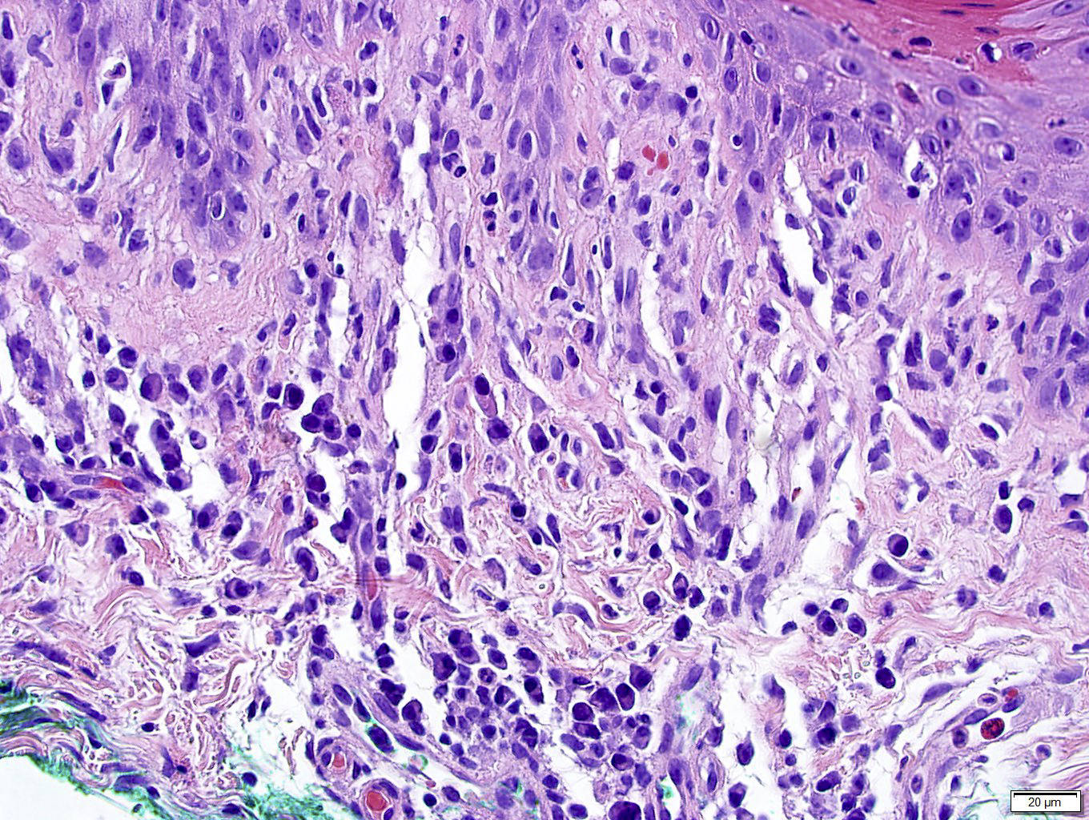

Slide 12
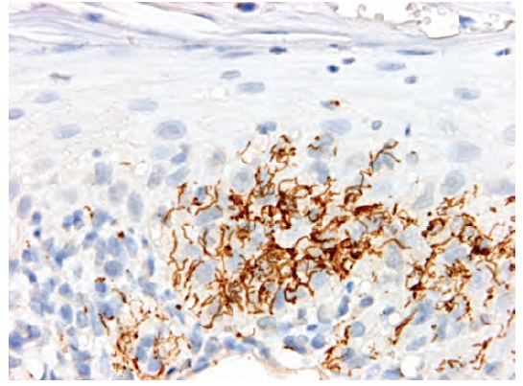
Secondary syphilis. Immunohistochemistry shows numerous spirochaetes within the epidermis.

Slide 13
HISTOPATHOLOGY
GUMMA
Histologically the gumma is a granuloma.
Endarteritis obliterans and necrotic areas are pronounced
Spirochetes are not demonstrable in these lesions
There will be central necrosis, similar to caseous necrosis with histiocytes, fibroblasts and epitheliod cells
HEUBNER ARTERITIS
In Cardiovascular and meningovascular syphilis
Lymphocytes and plasma cell infiltration of the vasa vasorum and adventitia of large and medium sized vessels
Occlusion of vas vasorum leads to medial necrosis and fibroblast proliferation

Slide 14
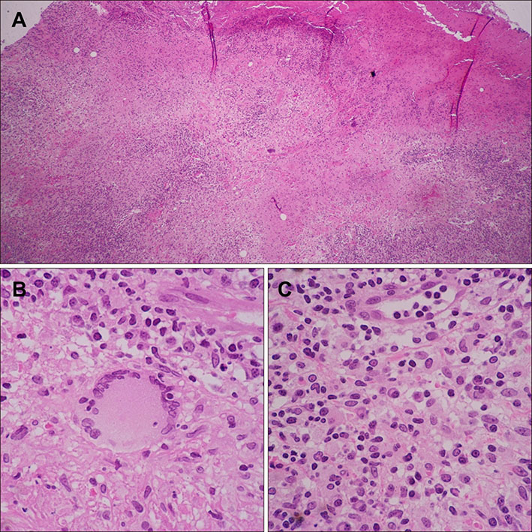
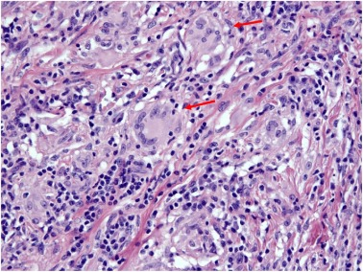

Slide 15


Slide 16
STAGES OF SYPHILIS
PRIMARY
SECONDARY
LATENT (EARLY AND LATE)
TERTIARY

Slide 17
NATURAL HISTORY
  Primary and secondary stages are contagious, lasting between 2-4 years. Latent period after the primary and secondary stage is usually 5 to 50 years.
  Only 25-30% of patients in late latent stage end up with late, chronic, crippling or killing manifestations.

Slide 18
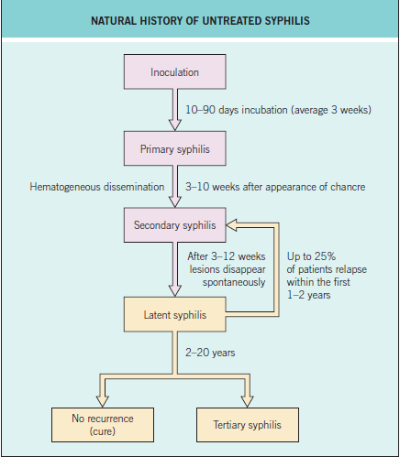

Slide 19
VARIOUS MILESTONES
Incubation period : 9-90 days
Primary sore appear : 3 wks
Unilateral inguinal lymphadenopathy : 4 wks
Bilateral inguinal lymphadenopathy : 5 wks
Reactive reaginic serological tests : 6 wks
Macular rash : 8 wks
Papular lesions : 3 months
Condylomas : 6 months

Slide 20
SPREAD
SEXUAL TRANSMISSION
Associated with other STI.
In an unprotected sexual encounter chances of spread to partner is one in three.
Incident increased since 2000 in homosexuals and person infected with HIV.
NON-SEXUAL SPREAD
By blood transfusion
In deep inoculation, as by accidental puncture or in transfusion, no primary lesion appears. This is called Syphilis d’emblee.
By Placental transmission

Slide 21
PRIMARY SYPHILIS
  The primary chancre(Hunterian chancre)appears at the site of initial treponemal invasion of external genitalia(or other mucous membranes)
  Papule progress to Ulcer
  Painless, indurated ulcer with regular edges.
  Single or may be multiple in number

Slide 22

  Extragenital chancre may also occur
  As a rule, it heals spontaneously in 3-8 wks, leaving regularly edged, slightly depressed, depigmented atrophic scar.
  Relapsing primary chancre is called Chancre Redux
  Kissing ulcers – hourglass in shape

Slide 23
PRIMARY SYPHILIS
      Genital and perianal chancre fol by inguinal L.N swelling (rubbery , not fixed)
      Penis – glans, near frenulum, prepuce
Condom chancre – near hilt
Ext urinary meatus & pubic – urethritis with serous discharge
Acquired phimoses
Lymphangitis dorsalis penis – 2mm indolent string
MSM – anus, rectum (itch, bleed after defecation)
Females – cervix
Vulvar chancre – labia maj/min, around urethral orifice, clitoris, postcommisure as irreg fissure, vulval edema

Slide 24
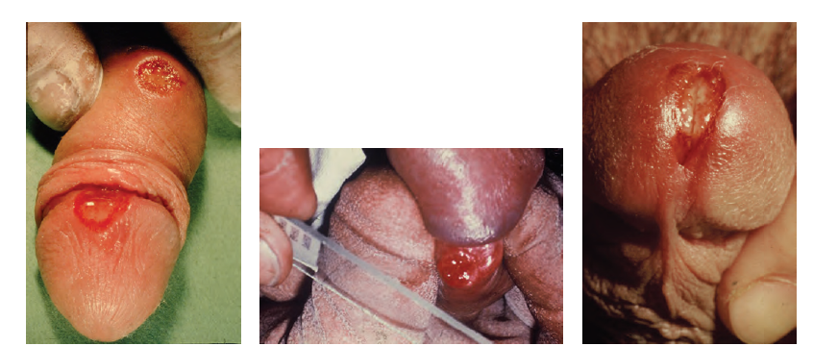
Penile chancres. (a) Primary syphilis showing chancres on the glans and shaft of the penis. (b) Taking specimens for dark ground microscopy from a penile chancre on the coronal sulcus –. (c) A penile meatal chancre, which may be mistaken for meatitis associated with urethritis.

Slide 25
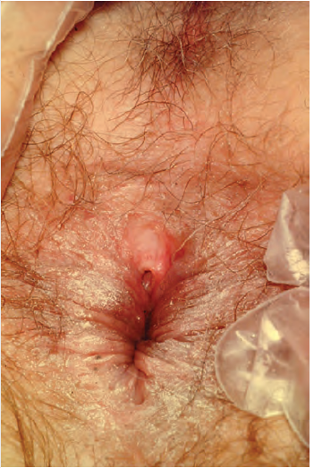
Perianal lesions in syphilis

Slide 26
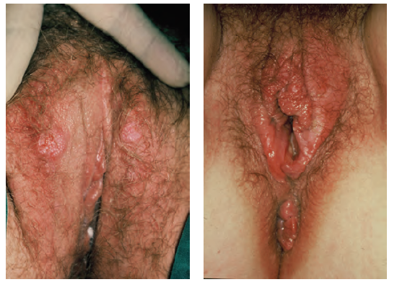
(a) Bilateral early chancres of the labia majora. (b) Chancre of the fourchette with surrounding oedema. This patient also had accompanying gonorrhoea, genital Chlamydia and trichomoniasis causing the accompanying vulvo‐vaginitis. This illustrates how STIs frequently occur as multiple infections in the same patient.

Slide 27
CLINICAL FEATURES

Slide 28
D/Ds of primary syphilis
STIs
Genital herpes
Chancroid
Lymphogranuloma venereum
HPV infection
Granuloma inguinale
INFLAMMATORY CONDITIONS
Plasma cell balanitis
Behcet disease
DERMATOSIS
LP
Lichen sclerosis
NEOPLASIA
Bowen disease
Squamous carcinoma

Slide 29
SECONDARY SYPHILIS
  This stage is characterized by generalized manifestations occurring on the skin and mucous membranes. Serological tests are always positive in immunocompetent persons.
  Rashes (Syphiloderm) in secondary syphilis have three common features
    The rashes do not itch.
    The rashes are coppery red.
    The lesions are symmetrically distributed
  Constitutional symptoms of fever,headache,bone and joint pains are more pronunced at night.

Slide 30
CLINICAL FEATURES OF SECONDARY SYPHILIS
MACULAR SYPHILIDE(ROSEOLAR RASH)
Earliest generalized syphilide
Symmetrical coppery red, round and oval spots
Do not scale or itch
Fading roseola sometimes leave a pattern of depigmented spots on a hyperpigmented background(Leukoderma syphiliticum).It is most commonly located on back or sides of the neck and was known as necklace of venus.

Slide 31
CLINICAL FEATURES

Slide 32
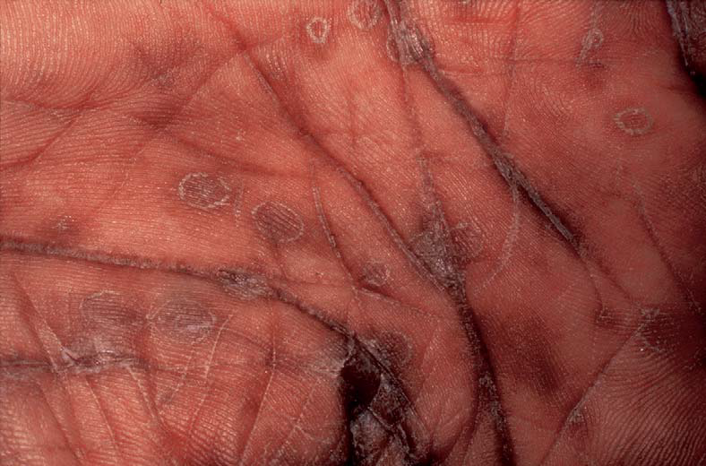
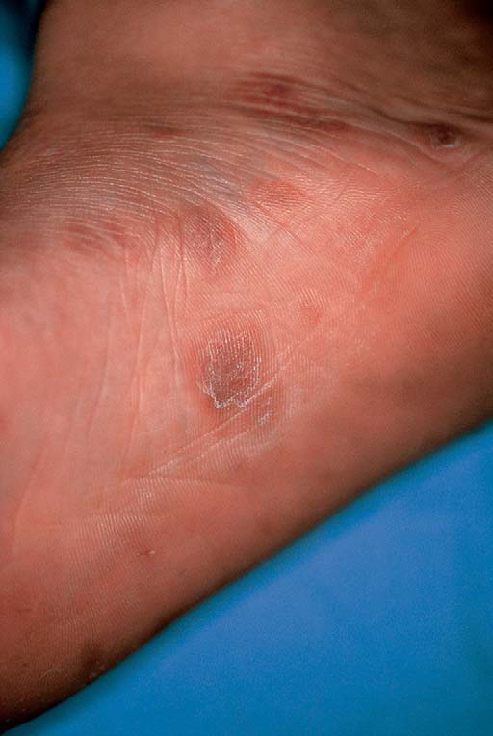

Slide 33
CLINICAL FEATURES
Syphilitic leukoderma showing depigmentation at sites of healed secondary lesions on the neck and upper back.

Slide 34
SECONDARY SYPHILIS
  PAPULAR SYPHILIDE
    The papule is the basic lesion of secondary syphilis, seldom exceeding 0.5 cm in diameter
    Clinical picture of the lesions varies widely
    Early lesions are maculopapular with a generalized distribution all over the body
    The typical papule is firm and round, with a thin layer of scale which is quickly shed. This is the typical papulosquamous syphilide
    Psoriasiform papules of the palms and soles are common in black people

Slide 35
SECONDARY SYPHILIS
  Papular syphilide
    At genital areas, small eroded papules flush with the skin or hypertrophic, coalesced papules (condylomata lata) are seen.
    Sometimes, the papules form a line along the hair margin, the corona veneris.
    A corymbose syphilide is one with a large central papule surrounded by small satellite papules.
    Atypical facial plaques or ulcerated nodules(lues maligna)are more common with co-existing HIV infection.

Slide 36
SECONDARY SYPHILIS
SYPHILITIC ALOPECIA
Moth eaten alopecia
SYPHILITIC PARONYCHIA
ORAL LESIONS
Snail-track ulcers
Syphilitic tonsillitis
GENERALIZED LYMPHADENOPATHY
In 50% of secondary cases
Nodes are painless, discrete and rubbery.

Slide 37
CLINICAL FEATURES

Slide 38
CLINICAL FEATURES

Slide 39
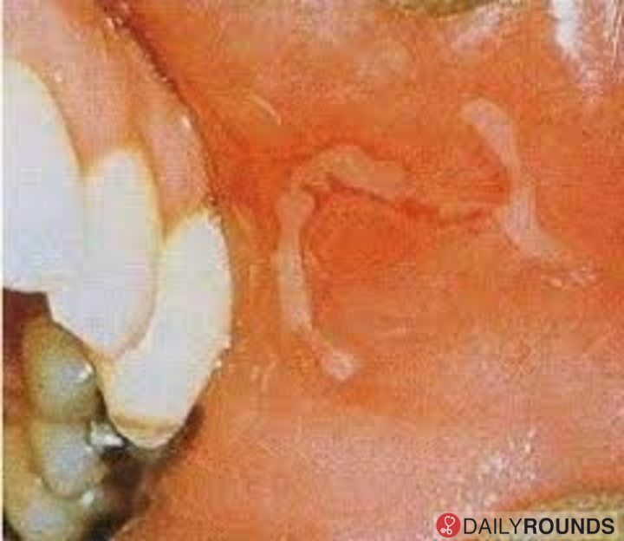
CLINICAL FEATURES

Slide 40
SECONDARY SYPHILIS
Neurological involvement
  CNS involvement can be seen. CSF may show raised cell count and increased protein. Serological tests maybe positive in the CSF
  The patient may complain of headache only.
  Occasionally, meningitis may present as paralysis of one or more cranial nerves.
OTHER SYSTEMIC FEATURES:
Panuveitis, periostitis, joint effusions, glomerulonephritis, hepatitis, gastritis and myocarditis.

Slide 41
SECONDARY SYPHILIS
  The lesions of secondary syphilis resolve spontaneously in a variable time period and most patients enter the latency stage within the first year of infection.
  In some, especially the immunocompromised, there is recurrence of primary or secondary lesions, especially with mucosal and anogenital manifestations.

Slide 42
D/Ds OF SECONDARY SYPHILIS
Dermatosis
Seborrhoeic dermatitis
Drugs
Systemic drug eruption
Infections
Infectious mononucleosis
Pityriasis rosea
Psoriasis
Lichen planus
Mycosis
SJS
Scabies
Genital herpes

Slide 43
LATENT SYPHILIS
No clinical stigmata of active disease
Positive serological tests
Occur within 1 yr of infection
Vertical transmission of infection may occur
Sexual transmission is less likely
Criteria for dx of latent syphilis
  Absence of active,early,late or congenital syphilis
  CSF must be normal
  Chest X-ray must also be normal
  Positive(reactive) serological tests for syphilis must be confirmed by examination of second specimen.

Slide 44
TERTIARY SYPHILIS
1/3 pts with untreated syphilis enter this stage
After a period of latency of up to 20yrs, manifestations of late syphilis occur
Rare nowadays(happenstance antibiotic therapy)
Skin, bones, cardiovascular and neurological involvement

Slide 45
NODULAR SYPHILIDE
    Protruding,firm coppery red nodules
    Larger than 0.5cm
    Nodules appear in groups with tendency to circinate arrangement
    Healing central – extends peripheral
    Serpiginous – noduloulcerative lesion coverd by crusts
    Extensor surfaces of arms, back, face
    Symptomless
    Heals with finely wrinkled central scarring(cigarette paper)

Slide 46
GUMMATA
Characteristic lesions of late syphilis appear 3-10 yrs after infection and consist of granulomas or gummata
Painless and size varies from 2-10 cm
Commonly affects Scalp,face,sternoclavicular areas of chest and lateral calf
Mostly originate in subcutaneous tissues and appear as cutaneous plaques or nodules
Tendency for central necrosis and ulceration and for peripheral healing with tissue-paper scarring
Can affect bone and muscles
Central necrotic tissue may turn into a slimy,stringy mass(gumma)
A punched-out appearance is characteristic

Slide 47
CARDIOVASCULAR SYPHILIS
Typical lesion is Aortitis affecting ascending aorta
10-30 yrs after infection
May be asymptomatic and detected as dilatation of ascending aorta on CXR
Aortic valve incompetence, left ventricular failure or aneurysm formation

Slide 48
NEURO SYPHILIS
Asymptomatic neurosyphilis
Meningeal neurosyphilis
Meningovascular syphilis
Gummatous neurosyphilis
Parenchymatous syphilis or general paralysis of insane
Tabetic neurosyphilis

Slide 49
D/Ds OF TERTIARY SYPHILIS
Lupus vulgaris
Lupus erythematosis
Leukaemic infiltrations
Neoplasia
Chronic venous ulcer
Bazin disease

Slide 50
INVESTIGATIONS
Dark field microscopy
Molecular amplification tests
  PCR
  RNA Amplification
Serological tests
  Reaginic or Standard non-treponemal tests
  Specfic treponemal antigen tests

Slide 51
NON-TREPONEMAL TESTS
Quantitative
Use to monitor treatment response
Detect IgM and IgG antibodies to lipoidal material released from damaged host cells and to lipoidal like antigens of T.pallidum.
Titres highest in secondary stage, and it may spontaneously become negative in late latent syphilis
4 types
  VDRL
  RPR
  USR(unheated serum reagin)
  Trust (toludine red unheated serum test)

Slide 52
SPECIFIC TREPONEMAL TESTS
Qualitative
Does not monitor response to treatment
Positive lifelong
Used to differentiate true positive from false positive in non-treponemal antibody tests
Types
    TPI(T. pallidum immobilization) test
    Fluorescent treponemal antibody absorption test
    Treponema pallidum haemagglutination test(TPHA)
    Treponemal enzyme immunoassay(EIA)

Slide 53
FALSE POSITIVE REAGIN TESTS
ACUTE
Malaria
Leprosy
Typhus
Viral pneumonia
Infectious mononucleosis
Filiariasis
Lyme disease
Pregnancy
Narcotic addiction
CHRONIC
SLE
Rheumatoid arthritis
Polyarteritis nodosa
dysgammaglobulinaemias

Slide 54
TREATMENT
Treatment of choice is Benzathine penicillin G
Benzathine penicillin G is use in all stages of syphilis except neurosyphilis.
Penetration of aqueous procaine penicillin and benzathine penicillin into CSF is poor so for neurosyphilis high dose of crystalline benzylpenicillin G plus Probenecid,should be considered.
Doxycycline,erythromycin and chloramphenicol are use in pts allergic to penicillins.

Slide 55
TREATMENT RECOMMENDATIONS FOR EARLY SYPHILIS
First line
  Benzathine penicillin G 2.4 MU I.M single dose or x2( day 1 and 8)
  Procaine penicillin G 0.6 MU IM once daily for 10 days
Second line
  Doxycycline 100 mg twice daily orally for 14 days
  Erythromycin 500mg four times daily orally for 14 days
  Azithromycin 500mg daily orally for 10 days
  Ceftriaxone 500 mg daily IM for 10 days

Slide 56
TREATMENT RECOMMENDATIONS FOR LATE SYPHILIS
First line
  Benzathine penicillin G 2.4 MU I.M weekly x3(day 1,8 and 15)
  Procaine penicillin G 0.6 MU I.M daily for 17 days
Second line
  Doxycycline 200mg twice daily orally for 28 days
  Amoxicillin 2 g three times daily orally plus probenecid 500mg four times daily orally for 28 days

Slide 57
TREATMENT RECOMMENDATIONS FOR NEUROSYPHILIS
FIRST LINE
  Procaine penicillin 2g I.M daily plus Probenicid 500mg orally QID for 17 days
  Benzylpenicillin 18-24 MU daily ,given as 3-4 MU I.V every 4h for 17 days
SECOND LINE
  Doxycycline 200mg orally twice daily for 28 days
  Amoxicillin 2g orally three times daily plus probenicid 500mg orally 4 times daily for 28 days

Slide 58
THANK YOU!

