Slide 1
SQUAMOUS CELL CARCINOMA AND ITS PRECURSORS
Dr. Rabia Nadeem

Slide 2
LEARNING OBJECTIVES
To know about the predisposing factors and the precursor lesions of SCC
How to diagnose
Complications and morbidities associated with SCC
How to manage the condition

Slide 3
OUTLINE
Introduction
Actinic keratosis
Arsenical keratosis
Bowen disease
SCC
Keratoacanthoma and associated syndromes

Slide 4
INTRODUCTION
Non-melanoma skin cancer (NMSC) most common human cancer
Encompasses BCC and SCC
Both derived from epidermal keratinocytes
Rarely metastasize
Actinic keratoses and bowen disease are premalignant lesions, show some of the histological features similar to that of SCC

Slide 5
ACTINIC KERATOSES
Hyperkeratotic lesions occurring on chronically light-exposed adult skin
Focal areas of abnormal proliferation and differentiation
Carries a low risk of progression to invasive SCC
Field cancerization: subclinical lesions in an area of photodamaged skin, which strengthens the case to treat the whole field rather than the individual AK

Slide 6
EPIDEMIOLOGY
Prevalence of AK influenced by
Amount of ambient UV radiation (UVR)
Proportion of susceptible individuals
Age structure of the population and
Time spent in outdoor occupations and recreations
Age: more common in the elderly (60-80)
Sex: preponderance in men

Slide 7
ASSOCIATED DISEASES
Other UVR-induced skin cancers
SCC
BCC
In situ melanoma and
Invasive melanoma

Slide 8
PATHOPHYSIOLOGY
TP53 mutations
P16 mutations (G1-S phase)
Causative organism: HPV
Environmental factors: direct relationship between AK and chronic sun exposure
Iatrogenic phototherapy, ionizing radiation and sunbed usage
Chemicals from coal distillation

Slide 9
PREDISPOSING FACTORS
Fair-skinned people
Excessive exposure to UVR
Red hair and blue eyes
Organ transplant recipients (OTR) on chronic immunosuppression
Ionizing radiation or radiant heat
Workers exposed to pitch and other products of coal distillation

Slide 10
PATHOLOGY
Solar elastosis and disordered epidermal keratinocyte maturation with cytological atypia
Typical lesion shows hyperkeratosis, parakeratosis and hypogranulosis
Lesional keratinocytes reveal loss of polarity, nuclear crowding, nuclear hyperchromatism, pleomorphism and nucleolar prominence
Epidermal mitotic activity is increased with occasional dyskeratotic cells
Acrosyringia uninvolved creating funnel shaped columns of orthokeratosis
Papillary vessels irregularly increased
Variably dense lymphoid infiltrate beneath the lesion
Plasma cells in lesions from scalp and lips (actinic cheilitis) and in ulcerated lesions

Slide 11
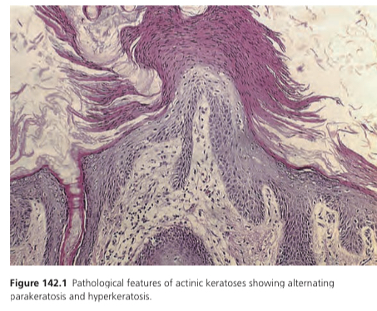

Slide 12
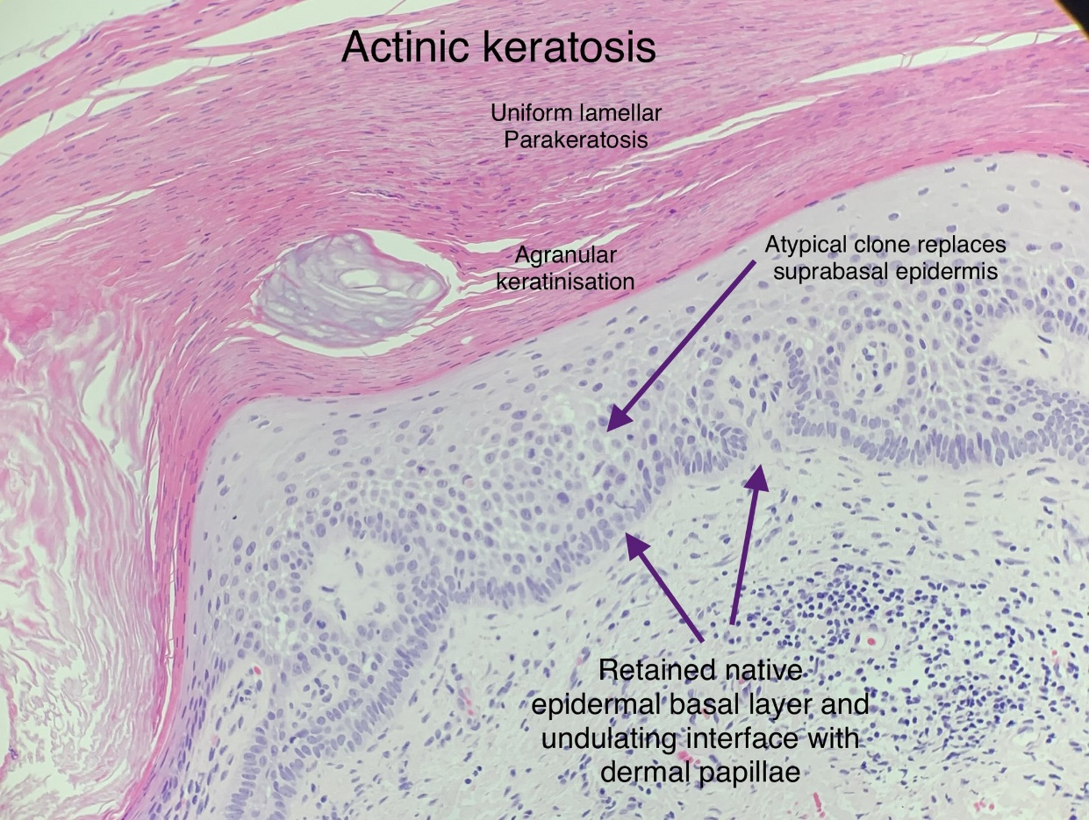
HISTOPATHOLOGY

Slide 13
HISTOLOGICAL VARIANTS
Atrophic (face)
Hypertrophic
Lichenoid (face)
Acantholytic
Pigmented (sun exposed areas) differentiate from SK by dermoscopy
Bowenoid

Slide 14
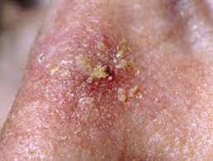
CLINICAL FEATURES
Asymptomatic rough scaly areas on light-exposed areas
Relapsing-remitting course
Can range from 1mm to 2cm in size
Lesions may be multiple
Skin palpation, a sensitive way of detecting the characteristic roughness associated with the smaller lesions

Slide 15
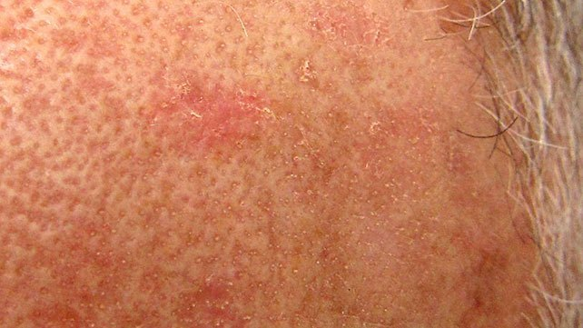
Later dry ,rough, adherent and often yellow or brown colored scale
Adherent scale difficult to pick off, revealing a hyperaemic base with punctate bleeding points
Edge usually sharply demarcated and the reddening is confined to the area immediately below the area of abnormal scaling
Associated field change

Slide 16
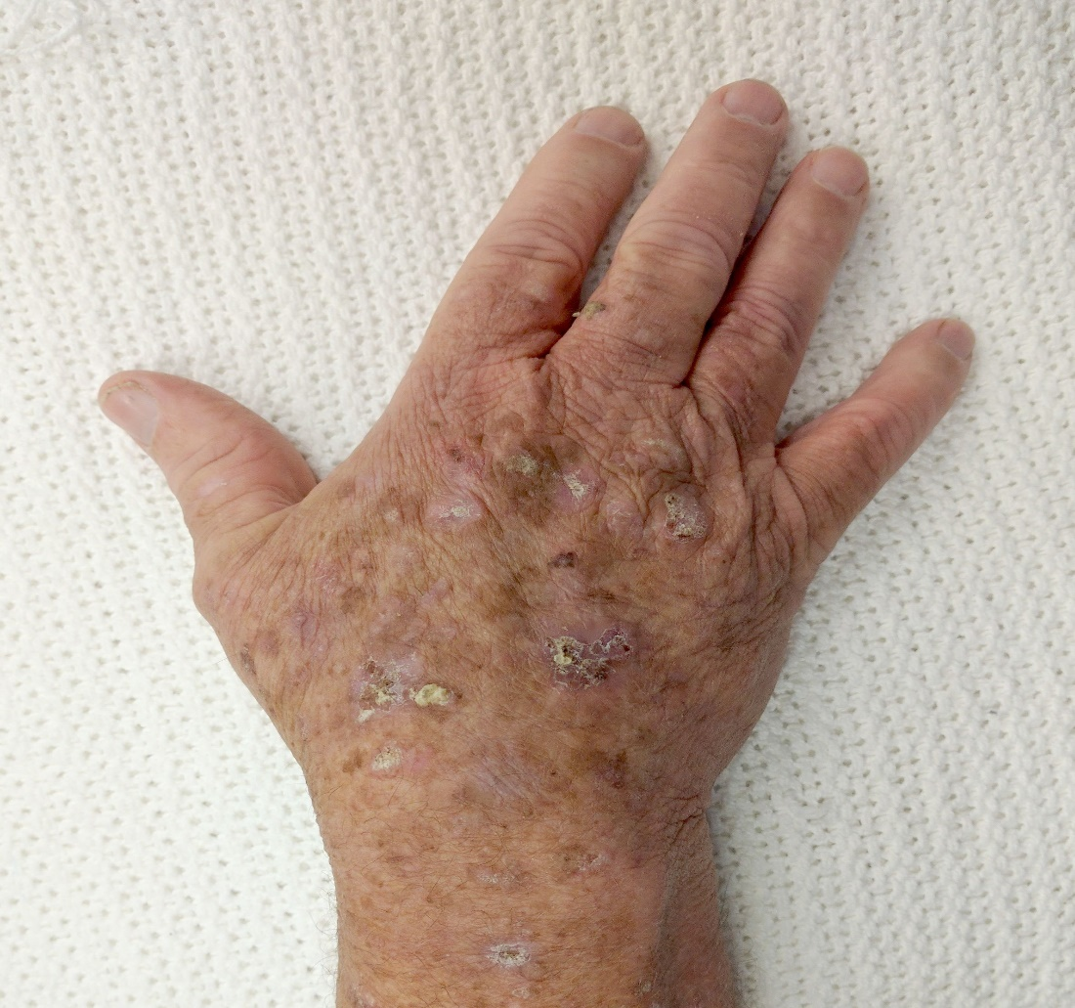
THICK AK

Slide 17
COMPLICATIONS AND CO-MORBIDITY
Local pruritus and discomfort
Cosmetic nuisance
High risk of concurrent SCC,BCC, in situ melanoma and invasive melanoma

Slide 18
HIGH-RISK CLINICAL FEATURES OF AK
Presence of one or more of these features may increase the risk of progression to SCC
Multiple thick AKs
Past history of non melanoma skin cancer
Extensive actinic damage
Patient immunosuppressed
Tender enlarging lesion(s)

Slide 19
INVESTIGATIONS
Clinical diagnosis
Skin biopsy to exclude SCC,BCC or Bowen disease

Slide 20
MANAGEMENT
Thorough explanation of the nature, natural history and risks associated with the presence of these lesions
Education regarding signs and symptoms of skin malignancy
Asymptomatic with low-risk disease and thin AKS--- no treatment reasonable option
Simple emollients and sunblock

Slide 21
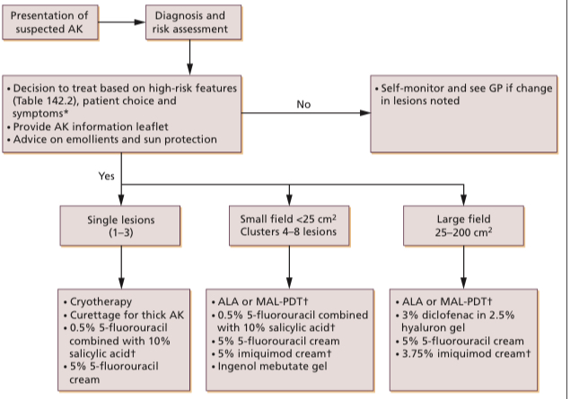
MANAGEMENT ALGORITHM

Slide 22
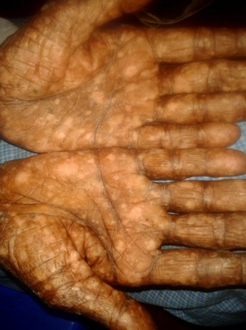
ARSENICAL KERATOSIS
Corn-like punctate keratosis caused by arsenic
Characteristically affects palms and soles
May progress to SCC
Arsenic absorbed into the bloodstream predominantly via contaminated drinking water
Incidence higher in older individuals
DNA repair system compromised by arsenic exposure (TP53)

Slide 23
PREDISPOSING FACTORS
Nutritional deficiencies such as retinol, calcium, fiber, folate, iron, riboflavin, thiamin, and vitamins A, C and E
Chronic liver disease and smoking
UVR and arsenite act synergistically to enhance mutagenesis
Arsenical keratoses tend to occur on light protected areas such as palms and soles

Slide 24
CLINICAL FEATURES
Skin lesions appear a few years after exposure and usually progress through stages
Progression begins with hyperpigmentation of the skin (melanosis) in a raindrop pattern
Often accompanied by multiple hypopigmented areas (leucomelanosis)

Slide 25
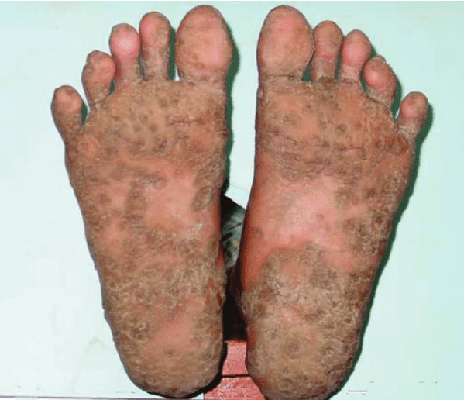
CONTD…
Keratoses usually begins on palms and soles resembling corns
Fingers, back of hands and more proximal extremities may be involved
Induration, inflammation and ulceration occur when the lesion becomes malignant
No elastotic degeneration of upper dermis

Slide 26
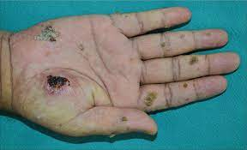
ARSENICAL KERTAOSES WITH SCC

Slide 27
INVESTIGATIONS
Sampling of the drinking water
Blood and spot urine tests
Hair and nail samples
Skin biopsy

Slide 28
MANAGEMENT of AK
Smoking cessation
Well-balanced diet
3% diclofenac and 2.5% hyaluron gel
Imiquimod cream 5%
5% 5FU cream with or without 10% salicyclic acid
PDT and MAL-PDT
Cryotherapy, curettage and cautery for solitary or few keratoses
Acitretin ( second line) with or without keratolytic agents for multiple keratoses and associated bowen disease
Dermabrasion and TCA peels ( third line)

Slide 29
Management of Arsenical keratosis
First line: cryotherapy, retinoids oral and topical
Second line: imiquimod cream 5%

Slide 30
BOWEN DISEASE
A form of intraepidermal (in situ) SCC
Characterized by a persistent, non-elevated, red, scaly or crusted plaque
Small potential for invasive malignancy
More common in patients over the age of 60 years
More frequent in women

Slide 31
PREDISPOSING FACTORS
Arsenic exposure
Immunosuppression following solid-organ transplant
Haematological malignancies
HIV
Therapeutic and other ionizing radiation
Skin injury or chronic inflammation such as lupus vulgaris and chronic lupus erythematosus

Slide 32
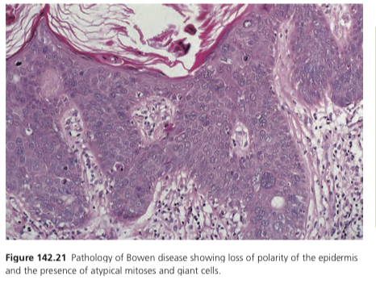
HISTOPATHOLOGY
Full-thickness epidermal dysplasia
Parakeratosis and acanthosis
Loss of granular layer(not always the case)
Disordered differentiation with loss of epidermal polarity (full thickness atypia)
Intraepidermal portion of cutaneous adnexae generally affected (pagetoid spread)
Spreads out laterally and leaves the basal layer intact (eyeliner sign)
Cells keratinize prematurely
Dermal-epidermal junction remains distinct
Dense inflammatory cell infiltrate in the papillary dermis

Slide 33
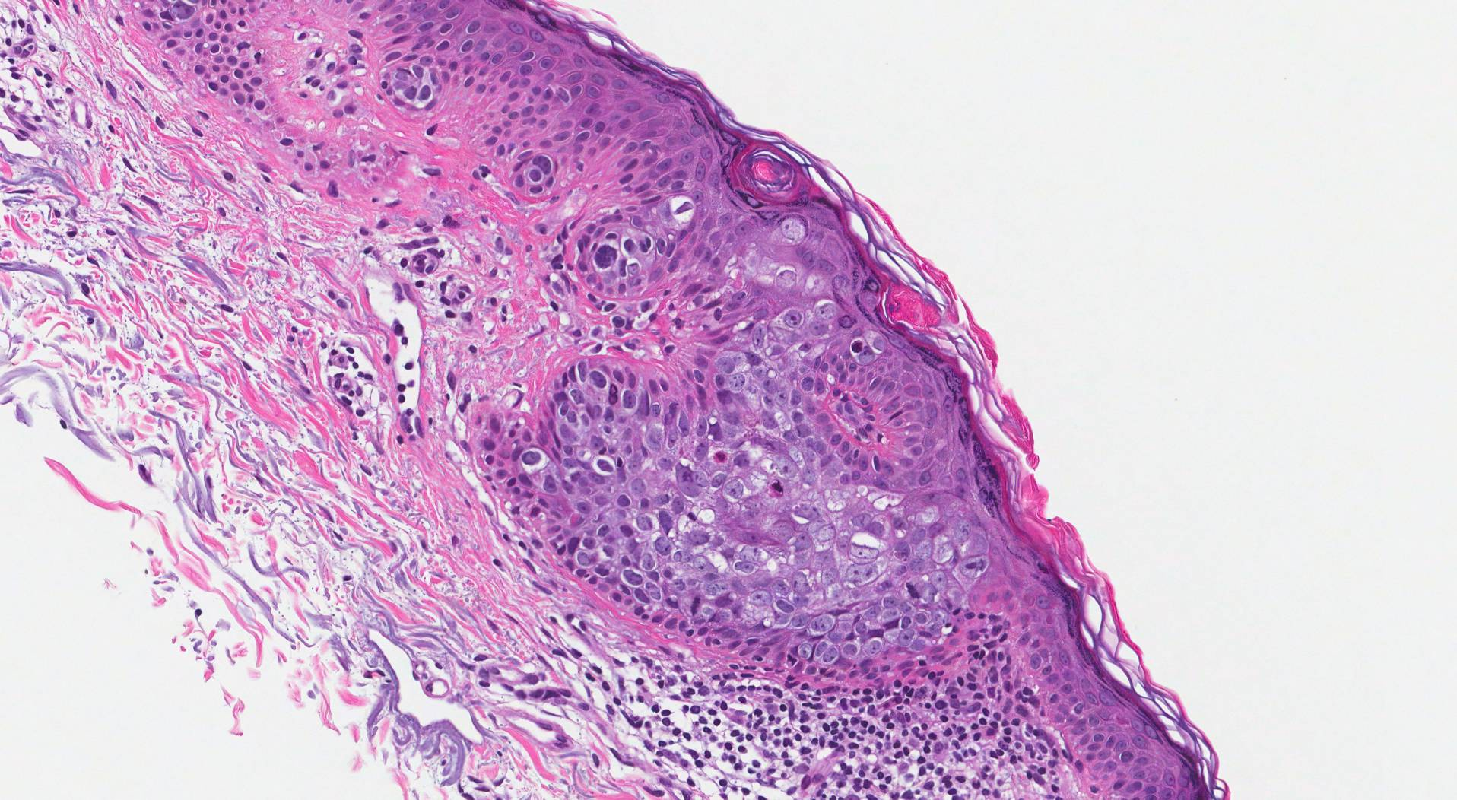
This picture shows large atypical tumour cells filling the epidermis and replacing the normal squamous cells.

Slide 34
CAUSATIVE ORGANISMS
HPV16 and HPV18--- commoner in anogenital Bowen disease
HPV16 also implicated in palmoplantar and periungal lesions

Slide 35
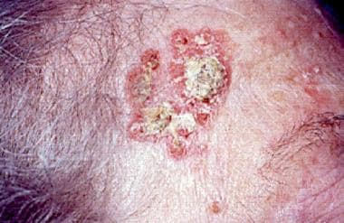
CLINICAL FEATURES
Usually solitary but in 10-20% may be multiple
Can occur on any body site
Increased incidence on head and neck
Can occur on the perianal skin, subungual region, palm and soles and rarely on mucosal surfaces

Slide 36
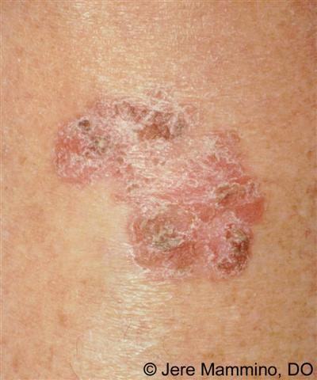
CONTD…
Asymptomatic small red and slightly scaly area gradually enlarges in somewhat irregular fashion
White or yellowish scale detached without much difficulty
Reveals a moist, reddened and a granular surface, but without producing bleeding

Slide 37
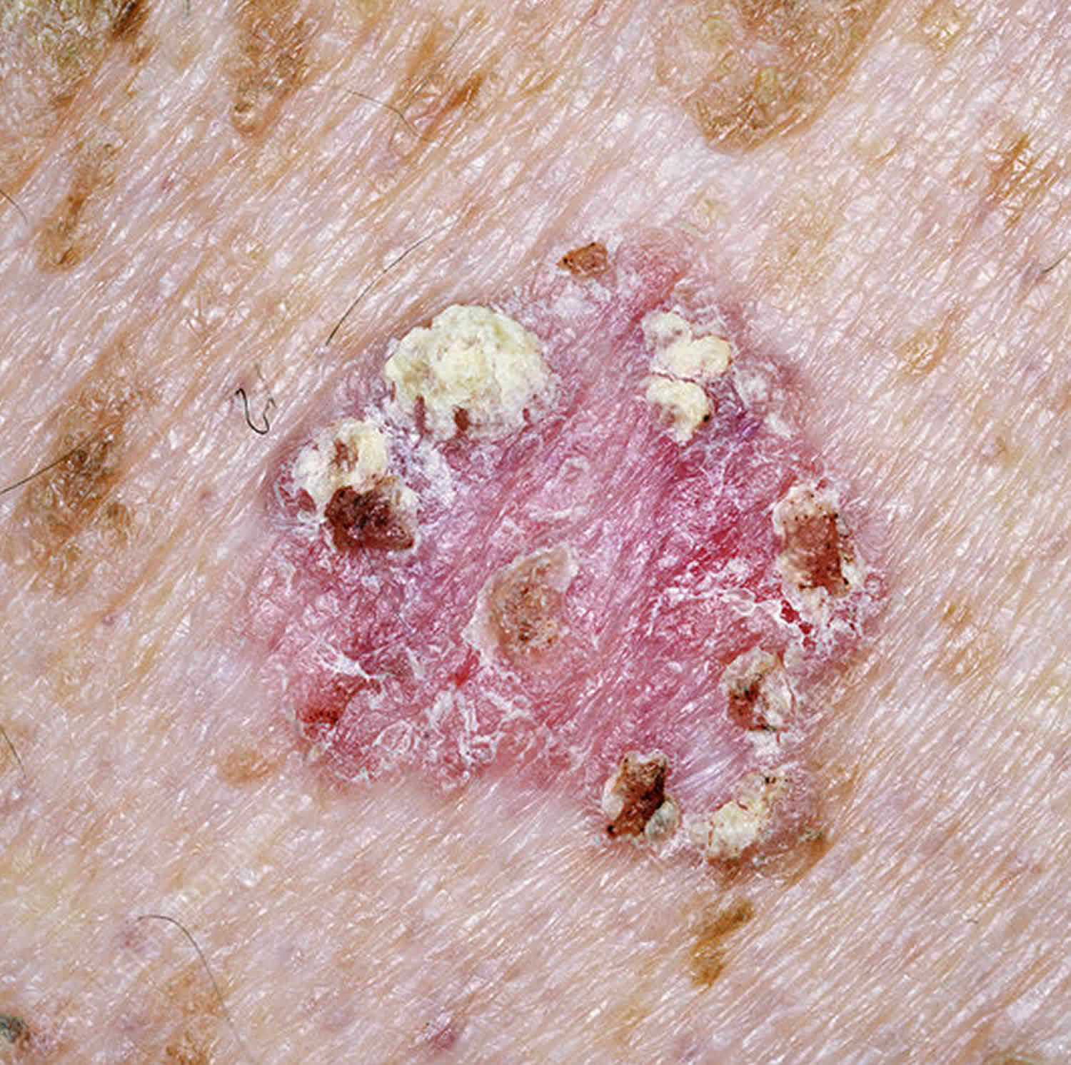
BOWEN DISEASE

Slide 38
Differentials
SK
BCC
SCC
Psoriais
Lichen simplex and discoid dermatitis (pruritis)
Bowenoid papulosis

Slide 39
COMPLICATIONS AND CO-MORBIDITIES
Persistent with a low lifetime risk of malignant transformation of about 3-5%
Malignant transformation results in an invasive SCC, which may metastasize if left untreated
Perianal and subungual Bowen disease, surgery with wide excision due to the recurrent nature
Nail unit disease--- digital amputation and Mohs micrographic surgery

Slide 40
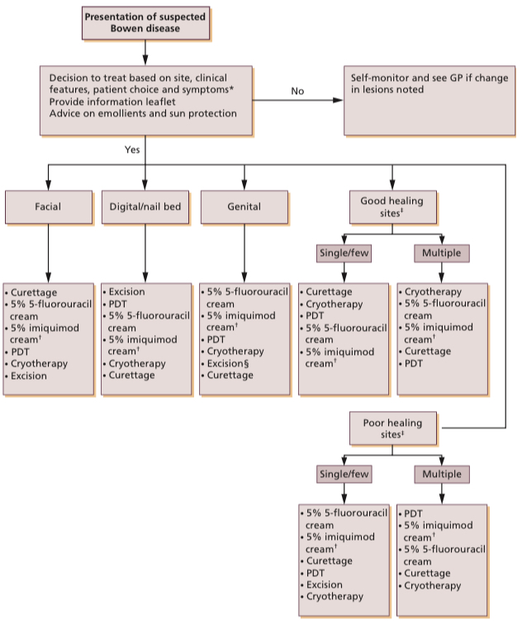
MANAGEMENT ALGORITHM

Slide 41
SQUAMOUS CELL CARCINOMA
Malignant tumor arising from epidermal keratinocytes or its appendages
Second commonest skin cancer after BCC
Predominantly a disease of white populations
Strongly associated with advanced stage
Twice common in men

Slide 42
PATHOPHYSIOLOGY
Tp53 mutations via activation of EGFR receptor
P16 mutations (S1-S phase)
NOTCH receptor mutation

Slide 43
ETIOLOGY
Ultraviolet B radiation
Radiation therapy
Arsenic
Coal tar
PUVA therapy
Industrial carcinogens
HPV infection

Slide 44
PREDISPOSING FACTORS
Immunosuppression in OTRs or patients on azathioprine or ciclosporin
Normal ratio of BCC:SCC reversed
Fitzpatrick skin type 1 and 2
HIV
Haematological malignancies
Uncommon complication of longstanding chronic ulceration and postradiation
Underlying conditions, hidradinitis suppurativa, morphoea, CDLE, lichen sclerosus, hailey-hailey disease, albinism, vitiligo, dystrophic EB
Old burn scars
SCCs of oral cavity secondary to Oral LP, Smoking, alcohol,tobacco

Slide 45
HISTOPATHOLOGY
Hallmark of invasive SCC– extension of atypical keratinocytes beyond the basement membrane and evasion of the dermis
Atypical keratinocytes– hyperchromatic, pleomorphism, atypical mitosis
HPV has E6 protein that can inhibit apoptosis by UVR hence, accumulation of mutations

Slide 46
Histologic variants of SCC
Classic
Acantholytic
Spindle cell
Desmoplastic
Basaloid
Verrucous
Pseudovascular
Follicular

Slide 47
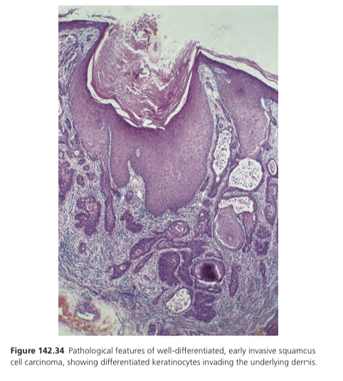
Well-differentiated SCC
Irregular islands of squamous epithelioid cells invading the dermis
Central keratinization, forming the so-called squamous pearls
Intraepidermal micro abscess

Slide 48
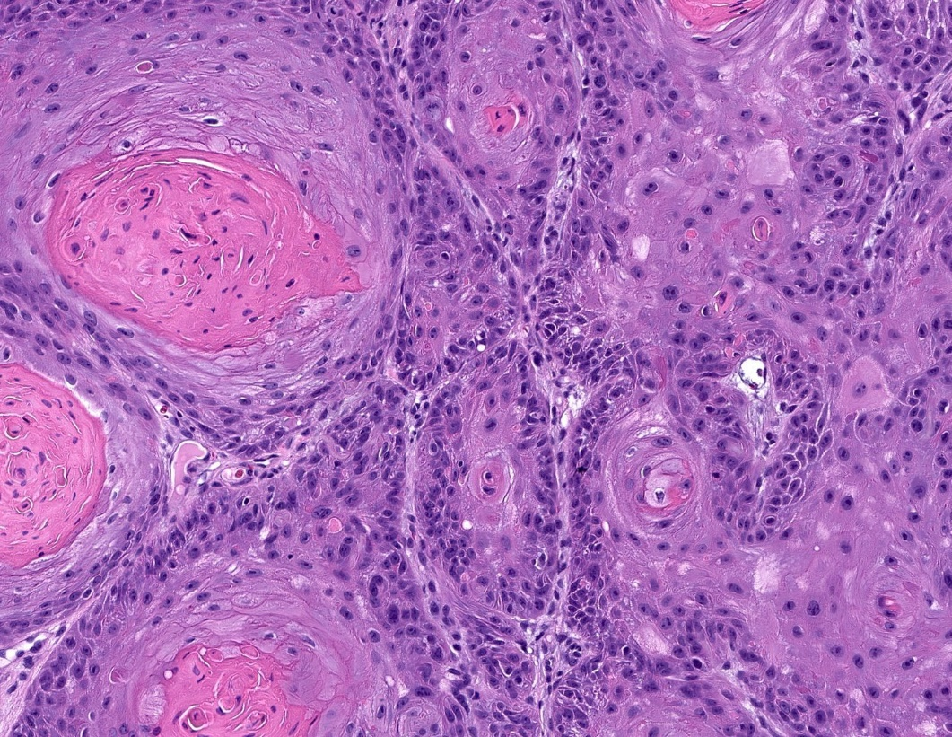
Well differentiated SCC:
Epithelium shows marked keratinization and minimal nuclear pleomorphism

Slide 49
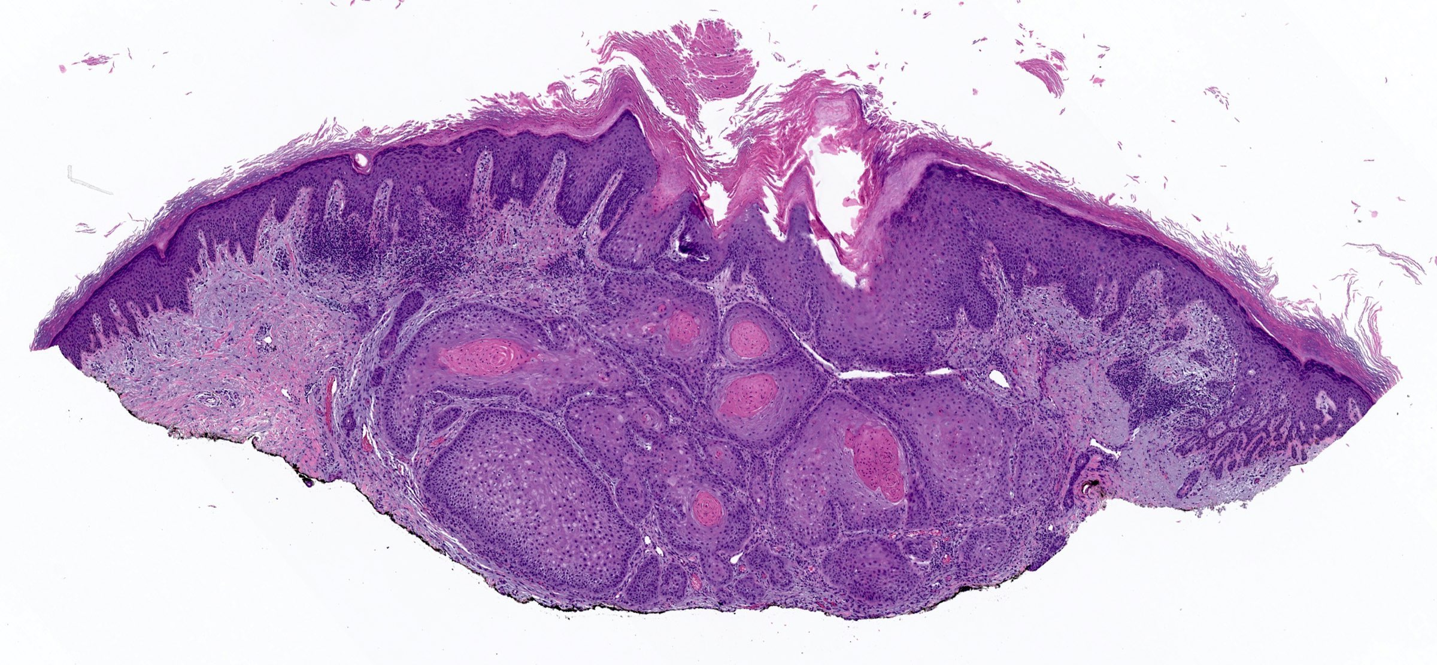
Invasive well differentiated SCC keratinizing tumour infiltrating into the dermis.

Slide 50
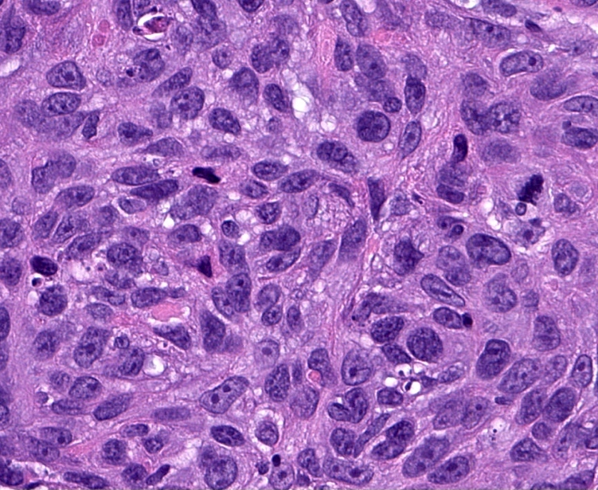
Moderately differentiated SCC there is more obvious pleomorphism but the squamous nature of the tumor is still apparent.

Slide 51
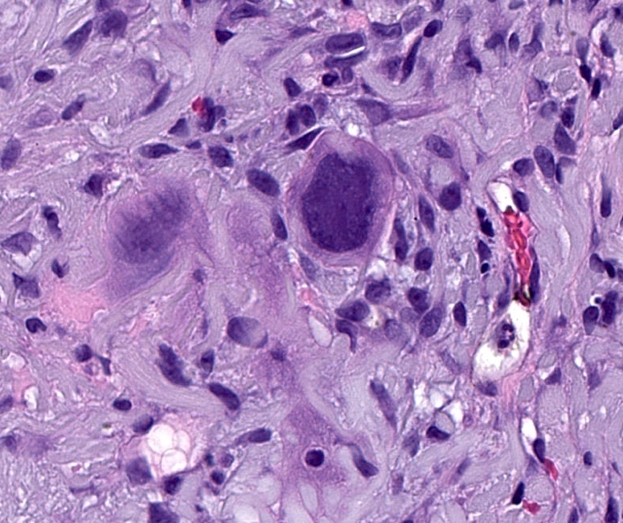
Poorly differentiated SCC
There is marked nuclear pleomorphism and keratinization is not obvious.

Slide 52
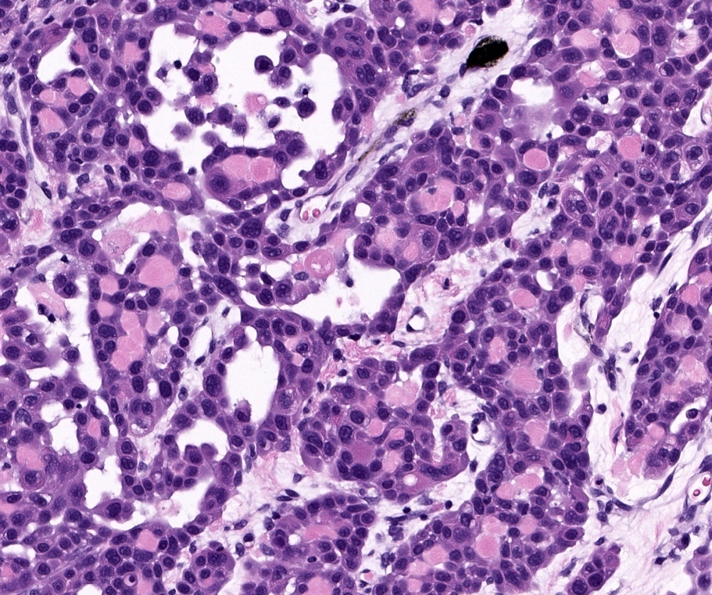
Acantholytic type SCC
Tumor cells show pseudoglandular feature due to acantholysis

Slide 53
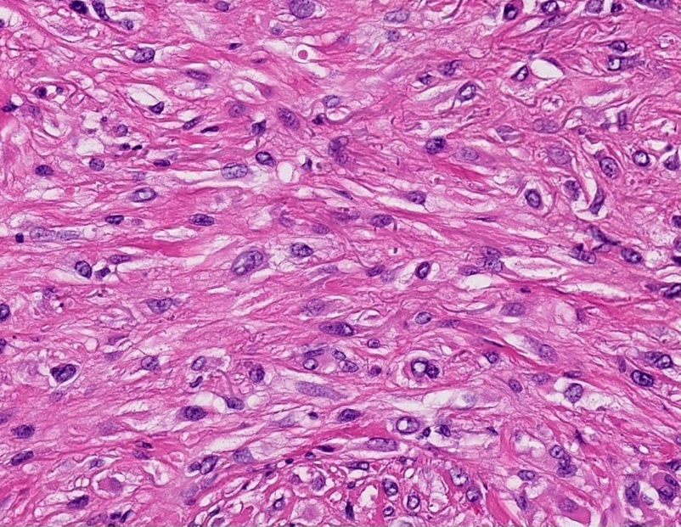
Spindle cell type SCC
Tumor cells in fibrotic stroma show spindle shape without obvious keratinization

Slide 54
CLINICAL FEATURES
Most common site--- most exposed to the sun
Back of the hands and forearms, upper part of the face and esp in males, on the lower lip and pinna
Slow evolution than Keratoacanthoma but faster than BCC
Induration– first clinical evidence of malignancy
Area may be plaque like, verrucous, tumid or ulcerated
Surrounding skin shows evidence of actinic damage
On mobile structures such as lip or genitalia, presenting sign may be a fissure or small erosion or ulcer which fails to heal and bleeds recurrently

Slide 55
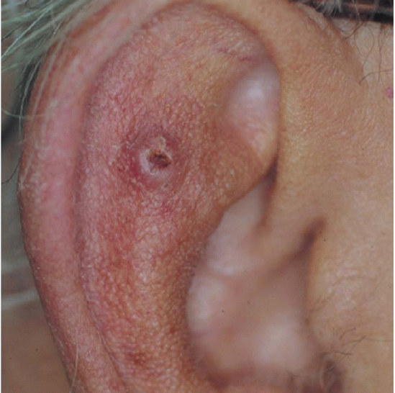
Firm, flesh colored or erythematous keratotic papule or plaque is most common

Slide 56
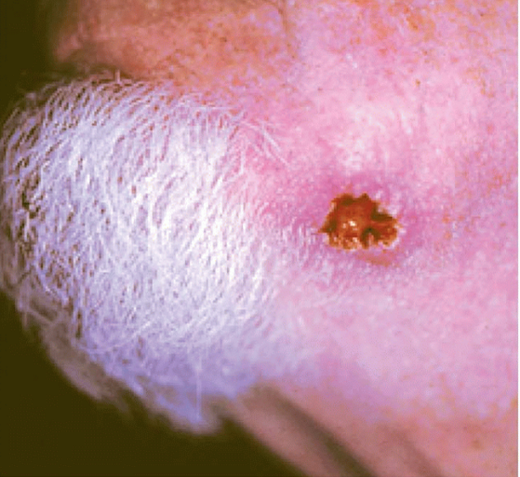
Ulcerated SCC

Slide 57
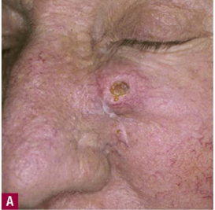
Infiltrative SCC

Slide 58
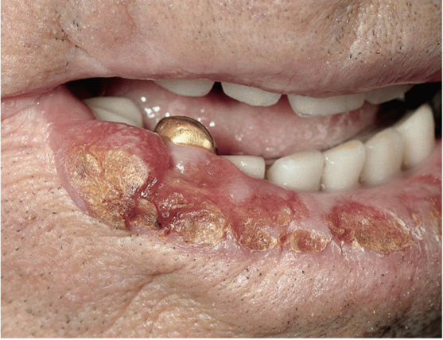
SCC of lower lip

Slide 59
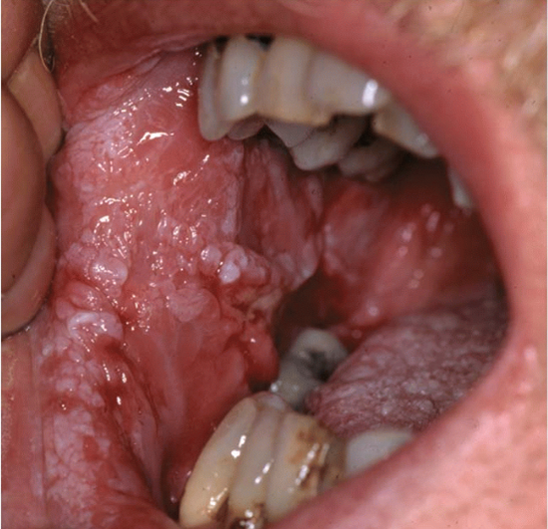
Verrucous carcinoma of oral mucosa

Slide 60
CLINICAL VARIANTS:
Epithelioma Cuniculatum
Usually on foot
Well differentiated
Rarely metastasizes
Exophytc, hyperkeratotic
Can leave malodrous discharge
HPV 11 and 16

Slide 61
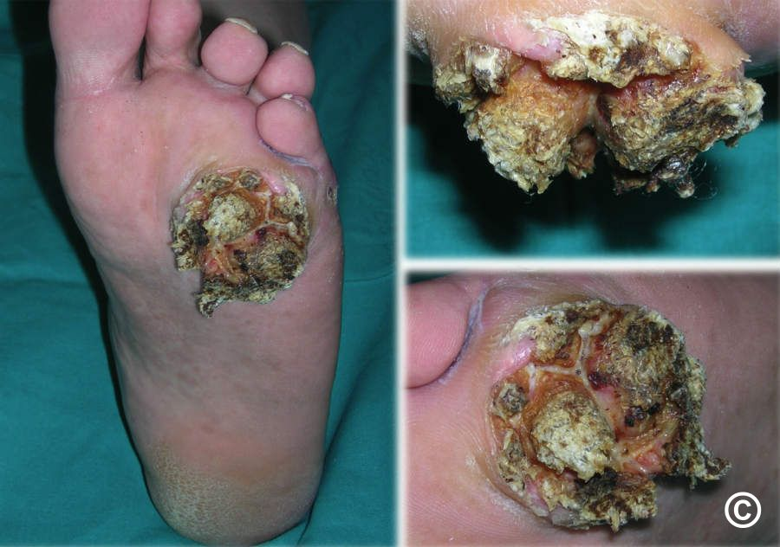
Epithelioma Cuniculatum

Slide 62
DIFFERENTIAL DIAGNOSIS
Keratoacanthoma- regress spontaneously, grow fast, leave a scar
Inflammatory ulcer or granuloma
Amelanotic melanoma
BCC
Viral warts- tend to be multiple
Seborrhoeic keratosis- pigmented and no induration

Slide 63
CLASSIFICATION OF SEVERITY
SCC has a low rate of metastasis of about 5%
Low grade tumors carry an excellent prognosis
Risk of metastasis increases significantly in high risk features

Slide 64
HIGH RISK FEATURES OF PRIMARY SCC
Clinical features
Tumor diameter >20mm
SCC on ear
Immunosuppression
Recurrent SCC
Pathological features
Tumor thickness >4mm
Tumor extension beyond dermis into or through subcutaneous fat
Perineural invasion
Poorly differentiated
Desmoplastic subtype

Slide 65
Discriminating prognostic indicators and risk of local recurrence, nodal metastases and disease specific death based on the number of high risk factors present
High risk features
Diameter>2cm
Perineural involvement
Poorly or undifferentiated tumor
Involvement beyond fat
Stage
T1 | No high risk features | 3%
T2A | 1 high risk feature | 13%
T2B | 2-3 high risk features | 76%
T3 | 4 of 4 high risk features | 100%

Slide 66
COMPLICATIONS AND CO-MORBIDITIES
Generally progress by local invasion if left untreated leading to metastasis
Scarring secondary to surgical excision or skin grafting

Slide 67
DISEASE COURSE AND PROGNOSIS
Excellent prognosis in the absence of high-risk features and following definitive treatment
Potential for local invasion and to develop metastases with high risk features

Slide 68
FOLLOW-UP RECOMMENDATIONS
In the absence of high risk features: regular hospital follow-up after one visit
High-risk SCC: 2-year period with longer follow-up for those on immunosuppression or those with multiple tumors

Slide 69
INVESTIGATIONS
Skin biopsy
Reflectance confocal microscopy
High-resolution optical coherence tomography
MRI (imaging of choice in detecting PNI)
CT scans
No indication for performing sentinel lymph node biopsy in SCC
US and FNAC are sensitive for detecting metastasis to parotid lymph nodes

Slide 70
MANAGEMENT
Thorough explanation of the diagnosis and signs to observe for any future tumors
Sun-avoidance and protection information
Aim of the treatment is to ensure complete removal and destruction of the primary tumor and to prevent metastases

Slide 71
7 treatment modalities for SCC
Standard surgical excision
Mohs micrographic surgery- high risk
External radiotherapy Brachytherapy
Adjuvant radiotherapy
Curettage and electrodessication- low risk
Cryotherapy
PDT

Slide 72
LOW-RISK SCC
For low-risk tumors--- curettage and cautery is an option
PDT, Lasers, Intralesional 5-fluorouracil, interferon alpha,and topical 5% imiquimod or 5-fluorouracil cream in concentrations of 5%, 10% and 20% --- insufficient evidence

Slide 73
HIGH-RISK SCC
For high-risk tumors--- surgical excision first therapeutic choice then MMS
A clinical peripheral margin of 6mm recommended when excising high-risk SCCs
4mm – 90% clearance rate

Slide 74
SECOND LINE
Radiotherapy
Where surgery is contraindicated or in elderly patients with multiple co-morbidities
Contraindicated in previously irradiated sites and for genodermatoses predisposing to skin cancer
Adjuvant radiotherapy: effective therapeutic option in decreasing the risk of tumor progression when an SCC has been excised with closed or involved margins or where there are specific high risk features such as PNI

Slide 75
SECONDARY PREVENTION
Reducing sun exposure
Regular follow-ups
Systemic retinoids or sirolimus esp in OTRs, XP
Smoking cessation
Decrease alcohol consumption

Slide 76
KERATOACANTHOMA
Rapidly evolving tumor of the skin
Composed of keratinizing squamous cells originating in pilosebaceous follicles
Resolves spontaneously if untreated
Recently been classified as well-differentiated SCC (Keratoacanthomatous type)

Slide 77
EPIDEMIOLOGY
Incidence higher in immunosuppressed and in places with high levels of UVR
Age: most frequent in middle life
Sex: males affected about three times more than females

Slide 78
PREDISPOSING FACTORS
Sun exposure
Contact with tar and mineral oil
Infection or trauma
Immunosuppressed patients
Drugs: sorafenib, vemurafenib and dabrafenib, vismodegib

Slide 79
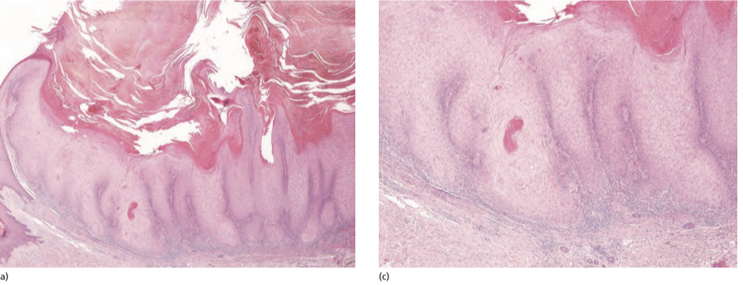
HISTOPATHOLOGY
Exoendophytic growth pattern that evolves into a symmetrical central structure containing keratin
Peripheral epidermal lipping
Endophytic component composed of curving or blunt epithelial downgrowths
Frank dermal invasion or solid growth of atypical cells is not a feature
Mild cytological atypia with mature keratinocytes towards the center of the lesion
Abrupt transition between maturing and proliferating cells

Slide 80
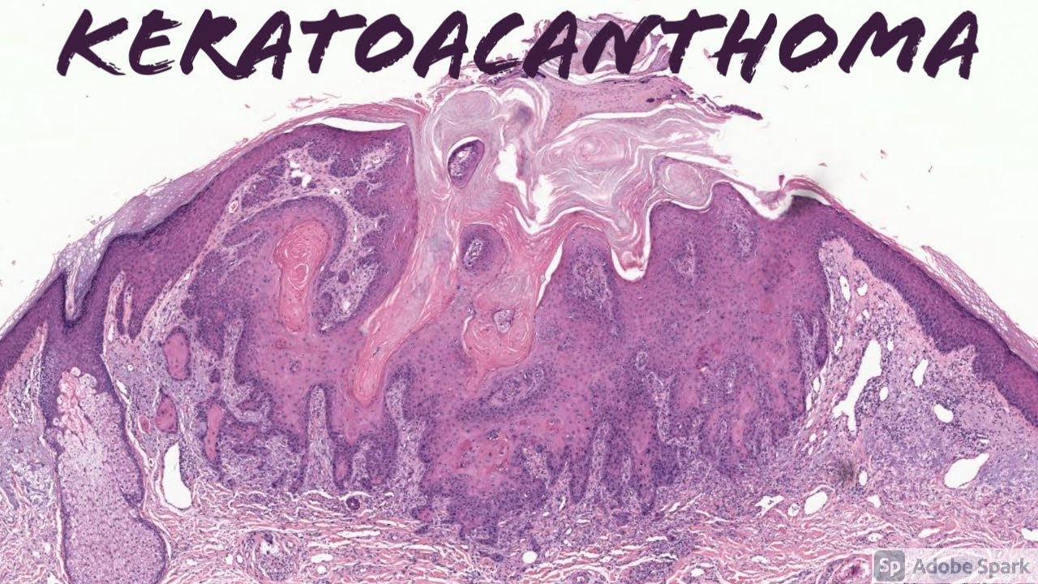

Slide 81
CLINICAL FEATURES
KAs do not have a precursor lesion
Evolve in three clinical phases: proliferative, maturing and resolving
First evidence of KA– firm, rounded, flesh-colored or reddish papule which may resemble MC or keratotic a viral wart
Then a rapid growth phase
No infiltration at the base
Epidermis over the nodule smooth and shiny
Lesion skin-colored to red with telengiectasias just beneath the surface
Center contains a horny plug or is covered by a crust which conceals a keratin-filled crater

Slide 82
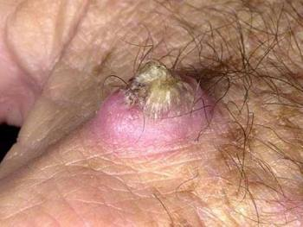
CONTD…
With maturation the accumulating keratin expands the outermost part making the edge overhang the base
Keratin may project like a horn or may soften and break down
Spontaneous healing usually take about three months

Slide 83
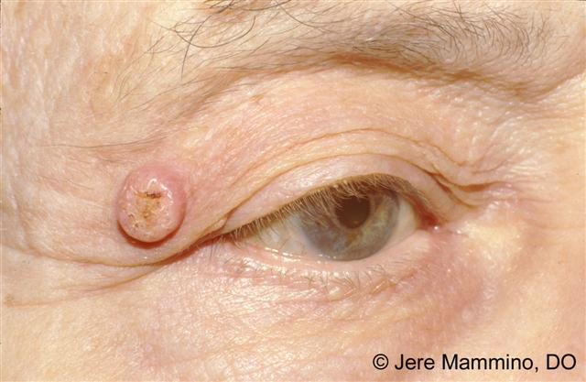
PRESENTATION
Most frequently affected area central part of the face: nose, cheeks, eyelids and lips
Lesions have occurred subungaly, on the vermilion of lips and on the buccal mucosa
Usually solitary , multiple and recurrent in immunosuppressed or those exposed to pitch or tar
Recurrence specially after curettage or excision more frequently in lesions on the lips and fingers and when treatment is carried out in early stages
Recurrence may happen after spontaneous resolution

Slide 84
COURSE AND PROGNOSIS
Typically resolves spontaneously
Can recur within the scar infrequently
Immunosuppressed may develop further KAs

Slide 85
MANAGEMENT
Advice on high factor broad spectrum sunscreen
Solitary lesions or small lesions less than 2cm in diameter---curettage and cautery
Larger lesions over 2cm in diameter, subungal lesions and where diagnosis is not clear--- surgical excision recommended
Radiotherapy– if patients refuse surgery
5% 5-fluorouracil cream
Topical 5% imiquimod cream
KA due to vemurafenib, systemic retinoids (acitretin) 25mg on alternate days along with IL fluorouracil
PDT

Slide 86
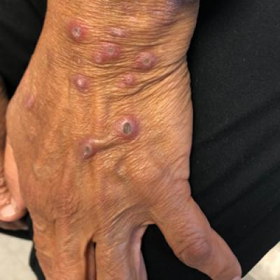
GRZYBOWSKI SYNDROME
Generalized eruptive keratoacanthoma
Rare condition
Numerous small KAs develop abruptly and may persist for several months
Spontaneous regression may occur, which leads to atrophic scars
Mucosal surfaces may be affected as well

Slide 87
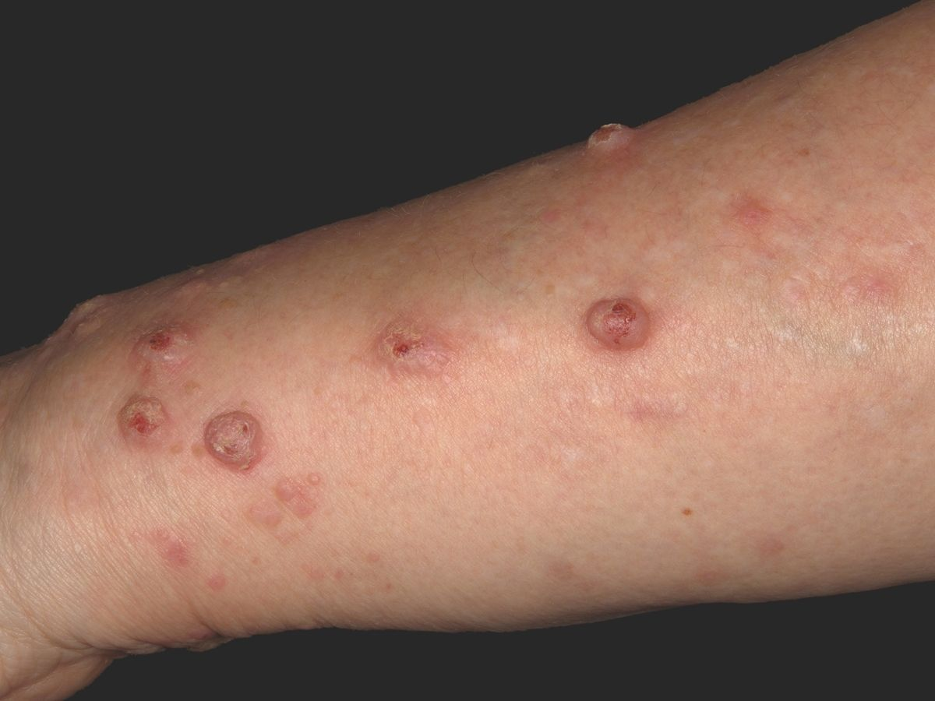
CONTD…
Associated findings include severe pruritus, Koebner like reaction, mask-look facial appearance, ectropion, and hoarseness due to nodules on the larynx
Oral retinoids (acitretin) 10-25mg to control the development of new tumors
Other options include isotretinoin, methotrexate,IL corticosteroids and cyclophosphamide

Slide 88
THANK YOU

