Slide 1
SLE

Slide 2
Qno 1: what is the most specific antibody in sle?
Qno 2: what is high titer and low titer?
Qno 3: what is difference b/w lupus specific and non specific lesions?
Qno 4: What are the causes of black nail in Sle?
Qno 5: Diagnostic criteria for Rowell syndrome?

Slide 3
What is the most specific antibody in sle?
  Anti Smith is the most specific antibody in sle, it is positive in only 30%. It is not used for monitoring of disease. Disease monitoring is done by serial antidsDNA levels.
What is high titres and low titres?
  Usually, the results of the ANA test is reported in titers and patterns. The titer gives information about how many times the lab technician diluted the blood plasma to get a sample of ANAs. Each titer involves doubling the amount of test fluid, so that the difference between a titer of 1:640 and 1:320 is one dilution. A titer above a certain level then qualifies as a positive test result. ANA titers may increase and decrease over the course of the disease; these fluctuations do not necessarily correlate with disease activity. Thus, it is not useful to follow the ANA test in someone already diagnosed with lupus.(Ref: john Hopkins lupus centre)

Slide 4
Difference between lupus specific and lupus nonspecific lesions?
  Lupus specific lesions are those which hv histopathological findings of lupus like interface dermatitis e.g butterfly malar rash of lupus, scle lesions, chronic dle, dle alopecia scarring. Which nonspecific ones do not hv histopathological findings of lupus eg facial edema, photosensitivity, raynaud, non scarring alopecia etc Ref: rooks
Causes of black nail in lupus?
  In African Americans, it may be bcz of melanin deposition which is physiological. It can also be due to drugs given in sle like antimalarials. Rarely has been reported in association with methotrexate, cyclophosphamide as well.Ref: rooks

Slide 5
Diagnostic criteria of rowell?
Major
  1. Sle, scle, dle lesions
  2. Em like lesions with or without mucosal involvement
  3. Speckled ana
Minor
  1. Chilblain lupus
  2. Anti ro, anti la positive
  3. RA antibody positive 3 major and 1 minor is necessary fr diagnosing rowell syndrome

Slide 6
1..what are vasculopathic changes in sle
2 what are differnce b/w joint of sle and r.a
3..what is jaccourd arthropathy
4..what us rhupus?
5..diff b/w lungs involvement is sle and s.s

Slide 7
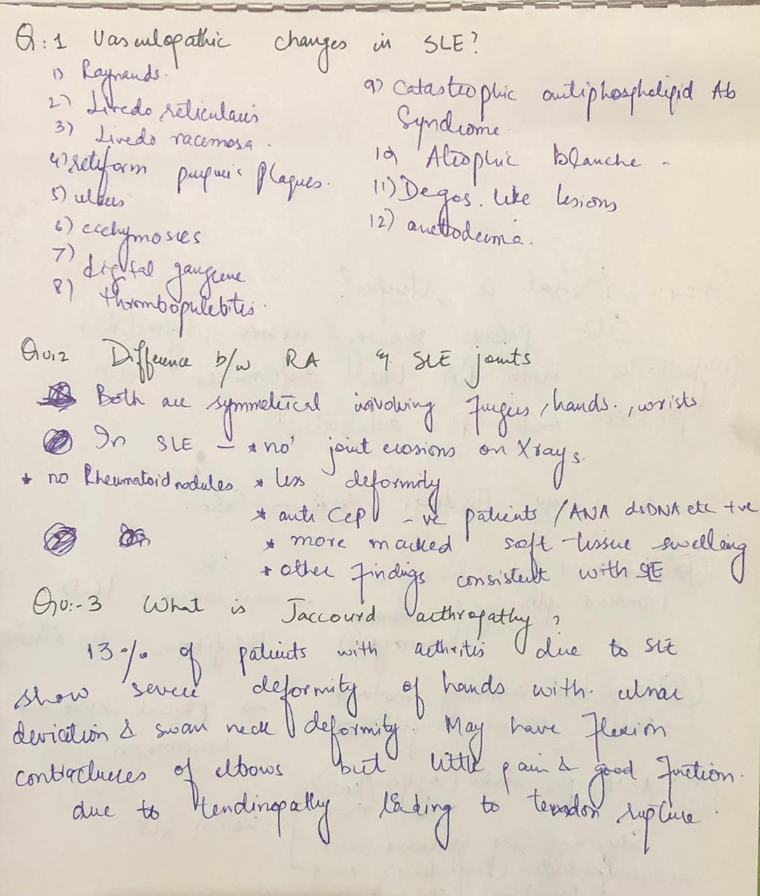

Slide 8
Q1: What are nail findings in SLE?
  Nail fold erythema
  Splinter Hemorrhages
  Red Lunula
  Nail fold hyper keratosis
  Nail ridging onycholysis
  Onychomedesis
  Dischromia
  Punctate and striate leukonychia
  Telengiectasias and eryhthema of nail fold.
Q2: What are causes of blistering in SLE?
  i. Subepidermal bullae due to severe liquefactive degeneration of basal layer
  ii. Bullous SLE
  iii.SLE associated autoimmune bullous diseases like DH, pem eryhthmatosis, EBA, IGA disease, pseuso porphyria.

Slide 9
Q3: How is drug induced SLE different from other types?
Less common in black people •
Occurs in Older age •
Renal, CNS and other involvement less common•
Anti-histone antibody positive •
Anti-DSDNA antibodies negative •
Serum compliment normal

Slide 10
Q4: Significance of anti-ribosomal P antibody?
  Anti-ribosomal P antibody is associated with lupus nephritis (Class V GN). If anti-ribosomal P antibody + Anti DsDNA positive →Class V GN + Prolifferative GN
Q5: What is ANA negative SLE?
By using rat or mouse liver, 5 – 10% ANA-.
By using Hep-2 cells 2% ANA-.
Clinical Features →
  Non scaring malar flush, oral ulceration, photo sensitivity or papulo squamous lesions on face, trunk, arms. Less frequent arthritis serositis and hematological involvement.
Patient may have:
  • Anti RO+ 60%
  • Anti LA+ 33%
  • SS DNA 25%10% patients may eventually become ANA+.
Treatment:
  • Topical therapy
  • Steroids
  • HCQ

Slide 11
Q.1. Diseases in which ANA is positive?
Q.2. Why ESR is not reliable in SLE?
Q.3. Indication of Renal biopsy in SLE?
Q.4. How can we differentiate between steroid induced psychosis and psychosis due to neurolupus?
Q.5. Role of anti malarial HCQ in covid- 19 infection?

Slide 12
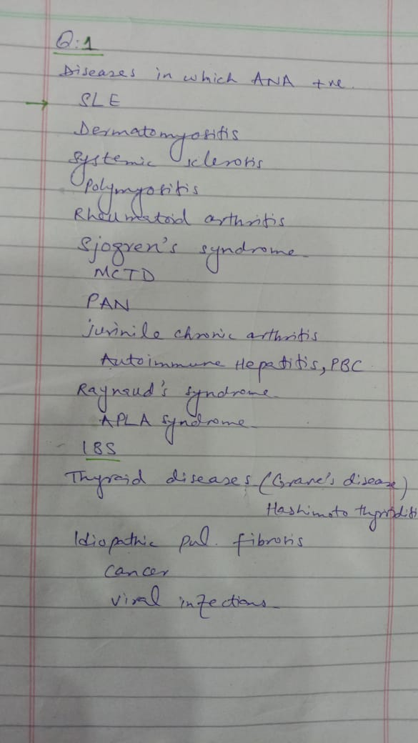
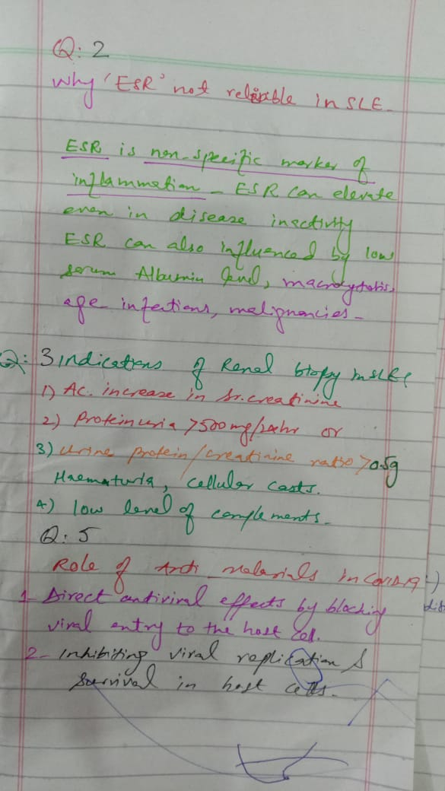

Slide 13
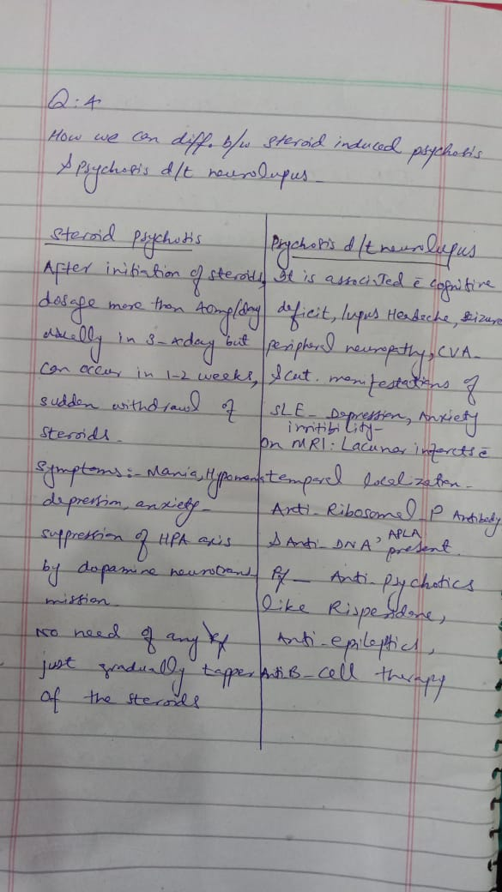

Slide 14
1. what happpen with SLE if pt become pregnant??
2. What are complications of SLE?
3. What are diff pattern of ANA?
4. What is rescue therapy??
5 what is belimumab its MOA sude effects contra indication and dosage in DLE??

Slide 15
Q1:Sle in pregnancy
  Fertility is normal if renal function is good clinical remission or minimal lupus activity in 6 months before conception lower the chance of significant flare and indicate an uncomplicated pragnancy and a live birth active lupus nephritis pose greatest risk in pragnancy outcomes in lupus20% risk of pre eclampsia 1/3rd have pre term dilivery another 3rd have c section Feotal death is due to immune complex deposition on basement membrane of trophoblast
Q2:Sle complications
  1:arthralgia, rheumatoid like deformity 25%,rarely erosive symmetrical polyarteritis with RA like deformities called rhupus
  2:myopathy
  3:bony changes(a vascular necrosis of long bones, osteoporosis)
  4:cardiovascular disease
  5:lungs(transient pleurisy, pleural thickening, effusion, shrinking lung syndrome)
  6:renal (v imp in assessing prognosis) classification of lupus nephritis in attached pic
  7:cns:neurological and psychiatric menifestations due to inflamation and thrombo embolic events
  8:complications of pragnancy already mentioned

Slide 16
Q3:patterns of ANA
  1:homogeneous (common and in Sle and in drug induced sle
  2:speckled(in Sle, mctd and scle
  3:neucleolar(systemic sclerosis and scle4:peripheral(in Sle with renal involvement
Q4:balimumab it's MOA, side effects and dose
  Balimumab is fully human IgG recombinant monoclonal antibody which act on b lymphocytes activating factor. B lymphocyte activating factor is a Co stimulator for b cell survival and function it prevents b cell apoptosis
Side effects
  Nausea, vomiting, fever, hypersensitivity reaction on infusion, upper respiratory tract infection, Urinary tract infection, multifocal leukoencephalopath and psychosis
  Dose:10mg per kg iv monthly
  Available in pak in 200mg/ml vial
Q5:what is rescue therapy
  Is therapy also known as salvage therapy is a form of therapy given after an ailment does not respond to standard therapy
Examples :
  eculizumab as rescue therapy in lupus nephritis related thrombotic microangiopathy and pladmapheresis as rescue therapy in Sle related diffuse alveolar damage

Slide 17
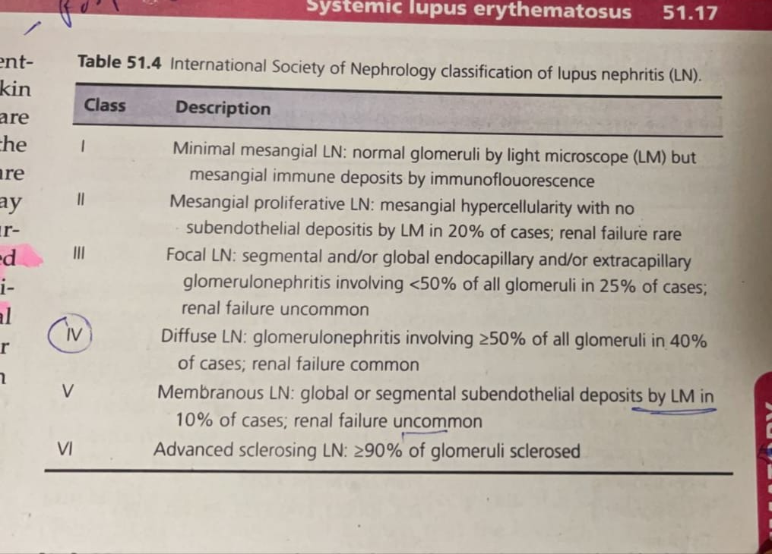

Slide 18
1. How will you differentiate hand findings between SLE and dermatomyositis?
2. What are the different ANA staining patterns with their relevance?
3.what are the different types of anemia in SLE?
4a. Are immunoglobulins and complement present in uninvolved skin in DLE? What about SLE?
4b. What are the DD of subepidermal bullae with neutros?
5. What are the main you bone changes you can find in SLE?

Slide 19
1. Difference b/w hand findings of SLE and DM
  SLE rash spares DIP, PIP and MTP joints... but gottron's papules of DM pathogonomically involve them
  SLE... vasculitis lesions,. EM like, chill blain LeDM... Mechanic's hands, vasculitic ulcers..
2. ANA staining patterns
  Homogeneous
  Speckled
  Peripheral
  Nucleolar
3. Causes of Anemia in SLE
  Anemia of chronic disease, Iron deficiency, haemolytic anemia, drug induced myelotoxicity, anemia of CKD

Slide 20
4
  a. Immunoglobulins are absent in uninvolved skin in DLE but present in SLE4
  b. DDS of subepidermal bulla with neutrons Bullous SLE,. DH, LAD, Sweet syndrome, inflammatory type of EBA
5. Bone changes in SLE
  Avascular necrosis of bones
  Osteoporosis
  Increased risk of fracture

