Slide 1
Purpura and Flushing
Maj:Sakina Sadiq

Slide 2
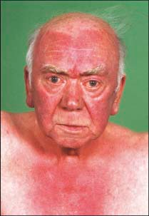
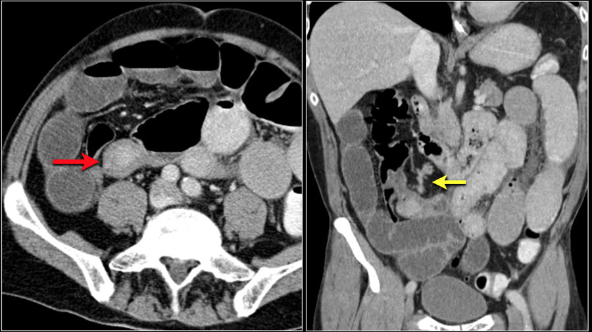
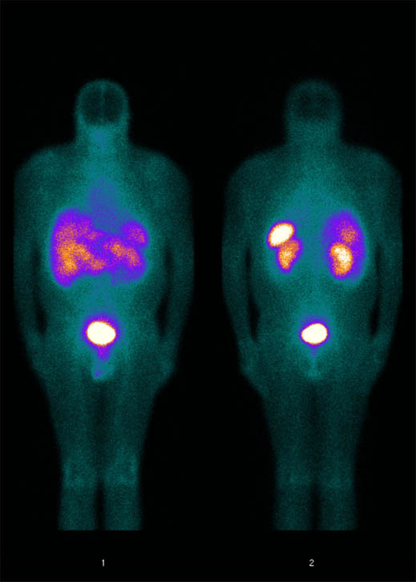

Slide 3
Introduction
Flushing and blushing are the result of transient cutaneous vasodilatation - usually physiological in nature.
A blush signifies a psychosocial response to an experienced emotion, whereas a flush is a thermoregulatory response to increased body temperature.
Clinical features useful in defining the diagnosis include the environmental setting in which the vascular reaction occurs, the extent and pattern of cutaneous involvement, and whether sweating or other systemic symptoms accompany the vasodilatation.
Understanding of the mechanisms by which these cutaneous reactions occur has increased, but treatment options remain limited.

Slide 4
Physiology
Physiological transient vasodilatation plays an integral role in thermoregulation. This sympathetically mediated process is regulated by cutaneous arteriovenous anastomoses – the superficial venous plexus, located at the juncture of the papillary and reticular dermis, and the deep horizontal plexus, located at the juncture of the deep reticular dermis and panniculus

Slide 5
Physiology
Reflex cutaneous vasodilatation in response to an increase in core body temperature involves an initial abolition of the active vasoconstrictor tone that is dominant in normal circumstances. As body heating continues, active vasodilator neural activity to the cutaneous arterioles is enhanced, causing rapid increases in skin blood fl ow, which is usually coincident with the onset of sweating. Overall, this active vasodilator system is responsible for 80–95% of the increase in skin blood fl ow that accompanies heat stress. During normothermic conditions, with the body at rest, total skin blood fl ow is approximately 200–500 mL/min. With full active vasodilatation,skin blood fl ow can dramatically increase to 8 L/min

Slide 6
Physiology
Neural control of cutaneous vasodilatation involves cotransmission by sympathetic cholinergic nerves, with the release of acetylcholine and one or more cotransmitters, such as substance P (and/or neurokinin‐1 receptors), vasoactive intestinal peptide (VIP) and pituitary adenlylate cyclase activating peptide (PACAP)
This neurally mediated increase in blood fl ow in turn releases nitric oxide (NO) from endothelial cells, which, along with prostaglandins released from local keratinocytes, sustain these vasodilatory effects

Slide 7
Pathophysiology of flushing
Abnormal, non‐thermoregulatory fl ushing may result from circulating agents that act directly on the vascular smooth muscle, or may be mediated by vasomotor autonomic innervation. Vasoactive mediators can be external or internal. External mediators include those found in food or drugs .
Specifically, foods containing tyramine, histamine, higher chain alcohols, monosodium glutamate, aldehyde, nitrites and sulphites, may be associated with flushing .
Internal vasoactive mediators include neuropeptides (e.g. substance P, tachykinins, kallikrein, kinins, neurotensin, neuropeptide K, VIP, gastrin‐related peptide, motilin), catecholamines (e.g. epinephrine, norepinephrine, dopamine), hormones (e.g. oestrogens, adrenocorticotrophic hormone, corticotrophin‐releasing hormone, calcitonin), histamine and prostaglandins.
Neurally activated flushing may be associated with sweating (‘wet flushing’) whereas flushing due to circulating vasoactive mediators does not usually involve sweating, and is referred to as ‘dry flushing’ . A notable exception to this pattern of associated sweating is the carcinoid syndrome.

Slide 11
Blushing
Often precipitated by anxiety, emotion or psychological upset.
Starts on the lateral cheeks and spreads rapidly to involve the entire malar region. Frequently, ‘skip’ areas of pallor can be observed within the erythematous blush, with sparing of the area around the mouth giving the impression of ‘circumoral pallor’. The blush may spread to the forehead and the sides of the neck. The ears characteristically develop an intense erythema, involving primarily the helix and antihelix.
Blushing is not usually associated with facial sweating, but there may be accompanying palmar hyperhidrosis and tremor. Because of the tendency to blush in certain social circumstances and their perception that the blush is more marked than it is, individuals may develop a degree of ‘anticipatory anxiety’ before they venture into these situations

Slide 12
Flushing
Patients with frequent flushing complain of sudden intense reddening of the face, neck and chest, representing an exaggeration of the normal response to vigorous exercise or temperature change.
A flush may evolve in a similar manner to a blush, but often has a more widespread distribution extending to the anterior chest and sometimes the abdomen, particularly the epigastric region.
Localized facial sweating may be a feature of flushing. Menopausal women sometimes refer to the sudden onset of flushing and sweating that can occur as a ‘drenching flush’. In a minority of

Slide 13
Flushing
Patients with carcinoid syndrome can experience associated diarrhoea and wheezing.
Flushing associated with itch can be seen in patients with mastocytosis. Exertional flushing can sometimes be seen in patients with cholinergic urticaria. Flushing after a warm bath is occasionally reported in patients with polycythaemia. Flushing localized to the nose has been reported as a prodrome to migraine attacks. Men following surgery for prostate cancer may experience postsurgical flushing, particularly if they receive postsurgical oestrogen therapy.
The ‘dumping syndrome flush’ is a combination of flushing, tachycardia and sweating experienced by some patients after gastric surgery.

Slide 14
Menopause
The ‘hot flush’ - attributed to hypothalamic thermoregulatory dysfunction associated with fluctuations in estrogen levels. Rising feeling of intense heat, profuse sweating and diffuse facial flushing; this may be followed by shivering; typical episodes last from 3 to 5 min and may occur up to 20 times/ day
In the late menopausal transition period, at which stage an interval of ≥60 days of amenorrhoeais likely to have occurred
FSH ,AMH, Inhibin B
For postmenopausal women with moderate‐to‐severe vasomotor symptoms (and)no history of breast cancer or cardiovascular disease),short‐term (2–3 years) oestrogen therapy is the treatment of choice
For women with moderateto‐ severe hot fl ushes in whom oestrogen is contraindicated or not well tolerated, or for women who have stopped oestrogen and are experiencing recurrent symptoms but wish to avoid resuming oestrogen, therapy with gabapentin, SNRI or SSRI may be considered

Slide 15
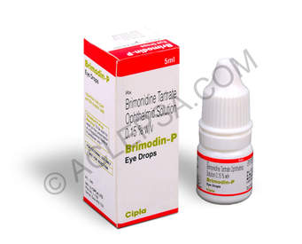
Rosacea
Neuroinflammatory mediators - play a role
Genes of vasoregulation and neurogenic inflammation are up regulated .
Activation of nociceptive nerve fibres contributes to skin sensitivity in these patients, and that axon reflexes augment flushing in most severe symptoms
Subgroup – longstanding predisposition to frequent flushing with specific triggers such as spicy food, moving to warm environment, etc.
Not all patients with rosacea flush
Telangiectasia, fixed facial erythema, papules and pustules , phymatous and ocular rosacea, signs of photo-damage, and increased skin sensitivity
Skin biopsy may be required to rule out other causes of facial erythema
Avoidance of exacerbants, Skin care regime,Daily application of sunblock
Topical brimonidine

Slide 16
Carcinoid syndrome
Carcinoid tumours arise from enterochromaffi n cells; they can release many different polypeptides (e.g. kallikrein, bradykinin), biogenic amines (e.g. serotonin, histamine) and prostaglandins
CS is typically caused by metastatic tumours of the midgut (jejunum, ileum,appendix, ascending colon). Hepatic metastases result in downstream release of tumour products, thereby bypassing the portal circulation and avoiding hepatic metabolism. CS due to foregut tumours (bronchial, gastric, duodenum, thymus) is less common. However, as their products are released directly into the systemic circulation, these tumours can result in CS in the absence of metastases. Hindgut tumours (distal colon, rectum, genitourinary) are usuallyhormonally inactive and therefore rarely cause CS

Slide 17
Carcinoid syndrome
The main secretory products of carcinoid tumours are serotonin, histamine, tachykinins, kallikrein and prostaglandins.
Serotonin does not cause flushing, but results in increased intestinal secretion and motility(diarrhoea), and increased fibroblast growth (cardiac valvular fibrosis)
Histamine can be produced by primary gastric carcinoids, and causes atypical flushing and pruritus
Bradykinin (a product of kallikrein cleavage action) is a potent vasodilator and may result in flushing in some carcinoid patients.
Prostaglandins E and F stimulate intestinal motility and fluid secretion in the normal gastrointestinal tract Some carcinoid tumors secrete tachykinins ( substance P, neurokinin A, neuropeptide K) which may contribute to flushing and diarrhoea

Slide 18
Carcinoid syndrome
The flush associated with classic CS (due to midgut carcinoids) begins suddenly and lasts from 30 s up to 30 min. The face, neck and upper chest may flush red to violaceous, with an associated mild burning sensation. Severe flushes are accompanied by hypotension and tachycardia. As the disease progresses, the episodes may last longer and the fl ushing may be more diffuse and cyanotic

Slide 19
Carcinoid syndrome
The flushes associated with gastric carcinoid tumors are atypical, and tend to be red‐brown, patchy, sharply demarcated, with bizarre gyrate or serpiginous patterns that may resolve centrally; usually associated with an intense pruritus In patients with the bronchial carcinoid variant, the flushes can be very severe and prolonged, lasting hours to days. Atypical flushing may be associated with tremor, disorientation, lacrimation, salivation, edema (including peri orbit ally)
Most flushing episodes occur spontaneously, but they may be provoked by eating, drinking alcohol, defecation, emotional events, palpation of the liver, and anesthesia

Slide 20
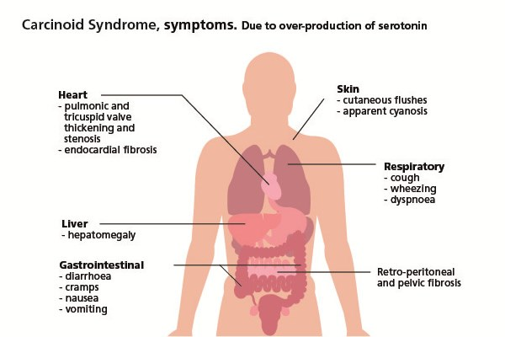

Slide 21
Carcinoid syndrome
Flushing is the most common symptom (occurring in 85% of patients with CS). Associated symptoms include secretory diarrhea, hypotension, tachycardia, abdominal cramping, sweating and bronchospasm.
As the disease progresses, valvular heart disease (right‐sided fi brosis, tricuspid and pulmonary valves),venous telangiectasia, leonine facies and pellagra (diversion of dietary tryptophan for the increased production of serotonin) may occur

Slide 22
Carcinoid syndrome-Investigations
24‐h urinary excretion of 5‐HIAA (5‐HIAA is the end product of serotonin metabolism; generally not useful in foregut and hindgut tumours, as these cannot convert 5‐HT to serotonin)
Urinary serotonin (may be of value in the rare patient with a foregut carcinoid in whom CS is suspected; DOPA decarboxylase in the renal parenchyma converts 5‐HTP to serotonin)
Chromogranin A (appropriate tumour marker for patients with an established diagnosis in order to assess disease progression, response to therapy or recurrence after surgical resection)
Imaging studies of abdomen and pelvis; CT, MRI and SRS (octreoscans) are the primary imaging used to identify carcinoid tumours
Echocardiogram for patients with clinical evidence of carcinoid heart disease or if major surgery is being planned

Slide 23
Treatment
Somatostatin analogues (e.g. octreotide ) provide effective symptomatic control. Prophylactic preoperative subcutaneous or intravenous administration of octroetide is recommended for patients with CS undergoing surgery for metastatic disease
Hepatic resection for patients with liver metastases; can provide long‐term symptomatic relief of CS symptoms; useful in resect able disease, benefits need to be weighed in unrespectable disease

Slide 24
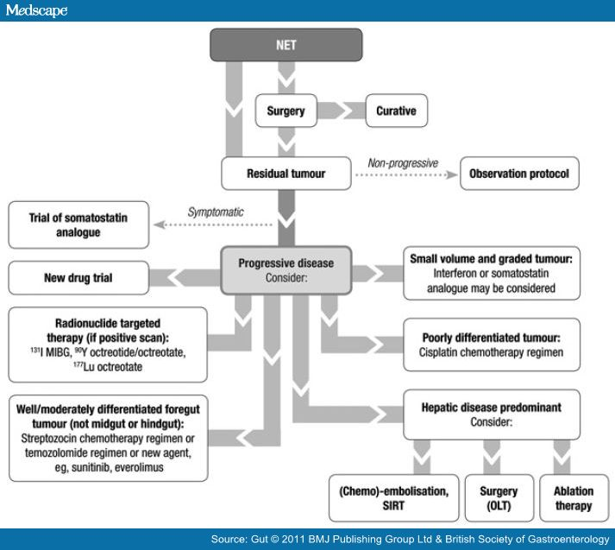

Slide 25
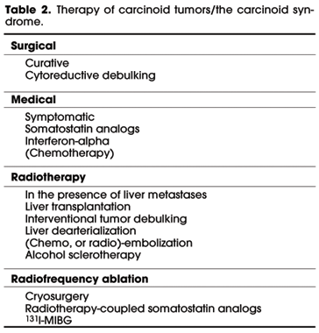

Slide 26
Carcinoid Crisis
Carcinoid crisis is a life‐threatening form of CS that results from the release of an overwhelming amount of biologically active tumour products; it may be triggered by tumour manipulation (e.g. biopsy, surgery) or by anaesthesia. It is less commonly reported after chemotherapy,hepatic arterial embolization or radionuclide therapy, mostly in patients with markedly elevated serum serotonin or urine 5‐HIAA

Slide 27
Mastocytosis
Mast cell accumulation in at least one tissue with both chronic and episodic mast cell mediator release; mediators that may cause increased vaso permeability and vasodilatation include histamine, cysteinyl leukotrienes (LTC4, LTD4, LTE4), prostaglandins (PGD2) and platelet‐activating factor
Sudden onset; features may be similar to that of an allergic or anaphylactic reaction; often with identifiable triggers such as narcotics, opioids, NSAIDs, systemic anaesthesia, exercise, massage, alcohol, infection,Hymenoptera sting

Slide 28
Mastocytosis
Skin findings: urticarial pigmentosa, diffuse cutaneous mastocytosis, isolated mastocytoma(s), or telangiectasias (TMEP)
Associated pruritus, blister formation, Darier sign
Acute release of mediators: pruritus, hypotension, syncope, abdominal pain, nausea, vomiting, diarrhea, fatigue, headache, collapse
Chronic mediator release: cachexia, chronic Gastrointestinal symptoms, diffuse musculoskeletal pains, tissue remodelling and organ fi brosis; weight loss, neuropsychiatric symptoms; lymphadenopathy,splenomegaly,anaemia, eosinophilia; osteopaenia, osteoporosis

Slide 29
Investigations
Skin biopsy (with histopathological staining with Giemsa and/or immunohistochemical staining for tryptase and c‐k it ) for cutaneous mastocytosis; this will not provide information about systemic involvement but may help to classify cutaneous disease
Complete blood count with differential
Liver function tests (including serum aminotransferases and alkaline phosphatase)
Serum tryptase
Metabolites of mast cell activation (24‐h urine for N ‐methyl histamine and 11‐β‐ prostaglandin F2) may be measured
Bone marrow biopsy and aspiration

Slide 30
Management
Avoidance of triggers
Antihistamines: H1 antihistamines (e.g. cetirizine, fexofenadine, hydroxyzine, doxepin) alone may be ineffective; combined blockade of H1 and H2 receptors prevents the vasodilatory effects of histamine
Ketotifen has been reported to have both mast cell stabilizing and H1 antihistamine properties, but is sedating
Aspirin (up to 650 mg twice daily) may be usedto control fl ushing, but should be used with extreme caution and only in patients known to tolerate NSAIDs
Cromolyn
Steroids (oral and topical)
Psoralen and ultravioletA therapy for urticarial pigmentosa
Laser therapy for TMEP
Epinephrine autoinjector (e.g.Anapen®) for patients with anaphylaxis

Slide 31
Management
Patients with evidence of systemic mastocytosis ,or those with unexplained anaphylaxis or hypotension, should be referred to the appropriate specialties for further investigation and management

Slide 32
Phaeochromocytoma
Catecholamine‐secreting tumours that arise from chromaffi n cells of the adrenal medulla; release of catecholamines (epinephrine, norepinephrine, dopamine) and other vasomediators (VIP, calcitonin gene‐related peptide, adrenomedullin) episodically into the systemic circulation
Flushing of the face,neck, chest and trunk;paroxysmal attacks last15 min to hours; usually occur spontaneously but may be triggered by deep abdominal palpation, diagnostic procedures (e.g.colonoscopy), induction of anaesthesia, surgery, with certain foods or beverages containing tyramine or with certain drugs (e.g. MAO inhibitors)

Slide 33
Phaeochromocytoma
Hypertension (60% have sustained hypertension; 40% experience hypertension only during attacks); tachycardia; headaches, hyperhidrosis, piloerection; palpitations, a sense of impending doom, chest pain or abdominal pain associated with nausea and vomiting,pallor, weakness and collapse
24‐h urine fractionated catecholamines and metanephrines
Plasma fractionated metanephrines
Radiological tests Biochemical confirmation of the diagnosis should be followed by radiological evaluation to locate the tumour. About 10% are extra-adrenal, but 95% are within the abdomen and pelvis
CT/MRI
MIBG scintigraphy.
If abdominal and pelvic CT or MRI is negative in the presence of clinical and biochemical evidence of phaeochromocytoma,the diagnosis should be reconsidered. If it is still likely, then 123‐IMIBG Scintigraphy may be done
FDG‐PET more sensitive than 123‐I‐MIBG and CT/MRI for detection of metastatic disease

Slide 34
Phaeochromocytoma
Avoid precipitants (e.g.glucagon, histamine,metoclopramide)
Combined α‐ and β‐adrenergic blockade to control blood pressure and prevent intraoperative hypertensive crises
Adrenalectomy
Check for cutaneous stigmata of neurofibromatosis

Slide 35
Anaphylaxis
Mast cell and basophil vasoactive mediators release
Typically within minutes of exposure to trigger (if known); rarely presents with flushing alone
Urticaria , angio edema, hypotension, bronchospasm, rhinitis, chest pain, headache, tachycardia, collapse
Plasma histamine and tryptaseC4, C1, C1q levels
Test for C1 esterase inhibitor deficiency
During the anaphylactic episode, either IV or IM epinephrine (the latter via EpiPen® (0.3 mg) or 0.3–0.5 mL of 1 : 1000 dilution) should be administered into either the anterolateral thigh muscles or the deltoid muscle every 5 min, asnecessary, to control blood pressure and symptoms

Slide 36
Acute alcohol sensitivity
ADH2, ALDH2 and CYP2E1 are important enzymes for the catalysis of the conversion of ethanol to acetaldehyde and to acetate in humans. Genetic polymorphisms have been reported in these enzymes. Between 40 and 80% of several Asian groups have been found to be deficient in ALDH2. The accumulation of acetaldehyde following the ingestion of alcohol triggers catecholamine release from the adrenal medulla and sympathetic nerves
Unpleasant sensation following alcohol ingestion ,Palpitations, headache, vomiting and sweating
An ethanol patch test may be a useful initial investigation
Alcohol avoidance
Research suggests that polymorphisms in alcohol dehydrogenase activity may increase an individual’s susceptibility to esophageal and oropharyngeal cancer

Slide 38
Investigations
A thorough history, with particular emphasis on precipitating or exacerbating factors, drug usage and food intake, and a detailed review of systemic symptoms including queries relating to anxiety and stress, is essential in the evaluation of an individual who presents with a complaint of excessive flushing.
It may be useful for the patient to keep a record of flushing episodes, detailing possible triggers and associated symptoms such as headache, abdominal pain, wheeze, diarrhoea or chest pain. Patients who flush after alcohol intake can be tested by an ethanol patch test. In individuals deficient of the enzyme alcohol dehydrogenase an area of erythema develops in the tested skin.

Slide 39
Investigations
If an underlying systemic disorder is suspected, a detailed history and clinical examination should help to direct further workup.
Initial investigations should include a full blood count, renal,liver profiles, urinalysis, 24 h urine for 5‐ hydroxyindoleacetic acid (5‐HIAA) (carcinoid syndrome), 24 h urinary fractionated metanephrines (phaeochromocytoma), serum tryptase, 24 h urine histamine and bone marrow examination (mastocytosis). Radiological imaging, when required, should be dictated by the underlying working diagnosis

Slide 40
Management
Management of the flushing patient should be tailored to the individual and guided by the underlying cause . However, most flushing patients will benefit from general guidance on managing the flush, such as identification of potential triggering factors (e.g. work environment, temperature, foods, alcohol, drugs) and their avoidance; information on histamine‐releasing foods and medication; and advice on cooling techniques and temperature regulation .
The management of blushing should encompass a comprehensive explanation of the psychosocial nature of the problem and its relationship to anxiety as well as reassurance of the lack of disease association and the possibility of spontaneous improvement in younger patients with time.
When blushing is associated with social withdrawal or excessive anxiety,consider referral for psychological counselling and cognitive behavioural therapy. Biofeedback techniques may be useful in these patients.

Slide 41
Management
Topical α‐adrenoreceptor agonists, which produce cutaneous vasoconstriction, have shown early promising results in the treatment of fl ushing associated with rosacea.
Brimonidine tartrate is a highly selective α2 ‐adrenoreceptor agonist used in ophthalmic solution for the treatment of open‐angle glaucoma. Topical brimonidine tartrate gel 0.5% has been shown in controlled prospective RCT to reduce facial erythema after single and repeated once‐daily applications. No major adverse events were noted in this trial, and tolerability was good .
Case reports of other α‐adrenoreceptor agonists (e.g. oxymetazoline 0.05% solution, and xylometazoline 0.05% solution; applied to the skin in their nasal decongestant formulations) showed a reduction of facial erythema over several hours in patients with erythematotelangiectatic rosacea

Slide 42
Management
Low‐dose β‐blocker therapy may be useful in some patients with either fl ushing or blushing. Nonselective β‐blockers decrease sympathetic activity, thereby resulting in vasoconstriction.
In addition,their anxiolytic effects may reduce the anxiety that contributes to blushing in some of these patients. Both propranolol (30–120 mg/day) and carvedilol (titrated from 3.25 mg three times a day to 25 mg/day) have been shown to reduce flushing episodes in patients with rosacea

Slide 43
Management
Other drugs reported to be helpful in certain subgroups include aspirin , antihistamines and clonidine .
The evidence of efficacy of these medications is lacking, and the potential toxicity of these agents should be considered before prescribing.
Laser techniques such as pulsed dye laser, intense pulsed light and potassium‐titanyl‐phosphate laser may be useful for the treatment of telangiectasia and erythema. Endoscopic transthoracic sympathectomy has been shown to be helpful in some patients with intractable fl ushing or blushing, but long‐term side effects such as compensatory hyperhidrosis are common, and more serious complications may occasionally occur .
Botulinum toxin A,which acts presynaptically to abolish the release of all transmitters selectively from cholinergic nerves, has been used with success to treat neck and anterior chest wall flushing

Slide 45
Complications
Patients who are subject to frequent blushing may begin to avoid situations in work or social interactions that they associate with triggering the skin reaction.
This may lead to social reclusion and in severe cases clinical depression and suicide risk. Patients who experience severe flushing reactions can experience profound tiredness and lethargy afterwards.
Women who experience postmenopausal flushing often complain of sleep disturbance and debilitating fatigue.

Slide 46
Prognosis
Young patients who present with frequent blushing often show a mild degree of social phobia and these patients tend to improve spontaneously with age.
If the blushing persists after the mid twenties the likelihood of spontaneous improvement seems to diminish.
Patients with flushing reactions tend to have a chronic course if the cause is undetermined or if treatment is ineffective

Slide 48
Thank you

