Slide 1
Premature ageing syndromes
Dr Zarghoonah Sajid

Slide 2
General features of ageing ?

Slide 3
poikiloderma
photosensitivity & pigmentation
sclerodermatous changes (
alteration of the subcut fat
skin laxity & wrinkling
  systemic ageing, malignancy, dvelopmental & neurological impairment & premature death (extracutaneous)

Slide 4
Werner syndrome
Bloom syndrome
Xeroderma pigmentosum
Progeroid laminopathies & related conditions
Hutchinson–Gilford progeria syndrome
Mandibulo‐acral dysplasia with type A & type B Lipodystrophy
Cutis laxa

Slide 5
Werner Syndrome
Rare , AD , Japan(3 in 1 million)
Manifests at puberty
Face , extremities … MC sites
Ulceration around ankle & elbows + ageing features
Beaking of nose , sparse grey hair , short stature with slender limbs
  Risk of early Arteriosclerosis, DM , osteoporosis, HTN & hypogonadism, Malignancies , cataracts , retinal degeneration.

Slide 6
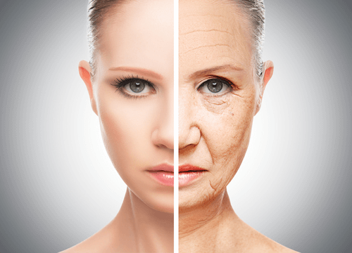

Slide 7
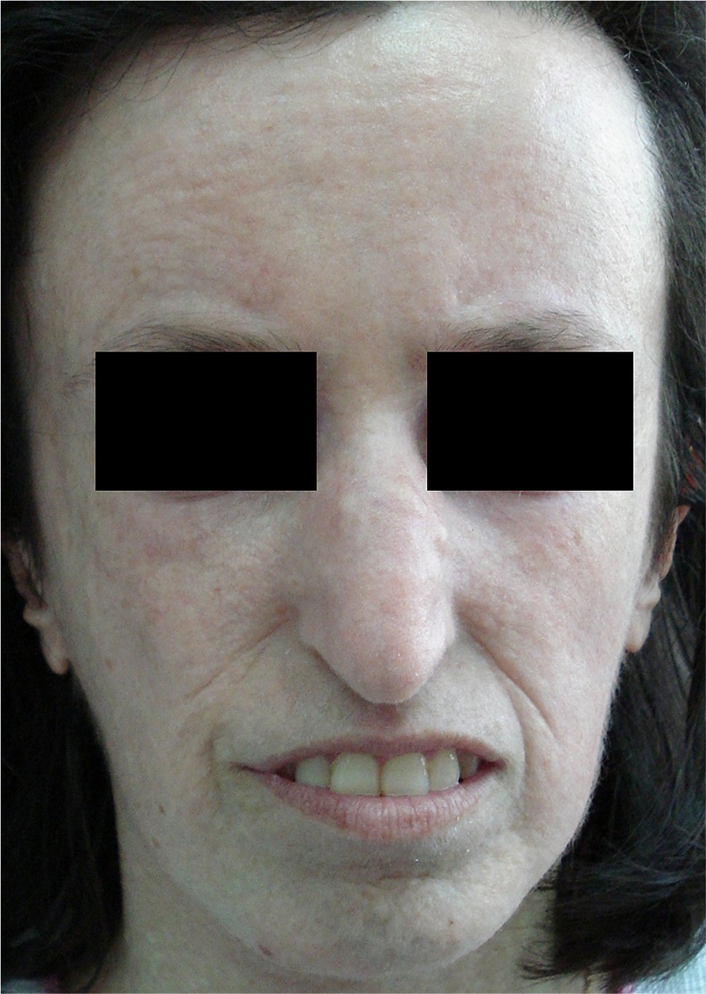
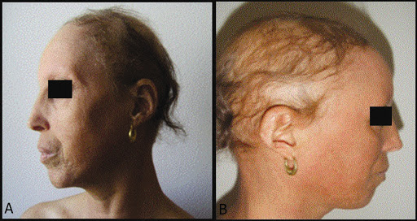

Slide 8
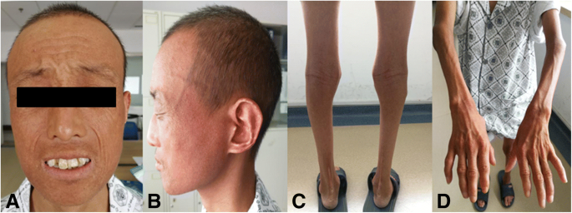

Slide 9
Life span … mid-fifties with death usually d/t malignancies
TREATMENT :
Treat complications
MAP kinase inhibitors & Rapamycin

Slide 10
BLOOM SYNDROME :
Rare , AR disorder
Photosensitivity
Telangiectatic facial erythema
Pre‐ and postnatal growth deficiency
Distinctive facies
Abnormal immune responses
Predisposition to malignancy

Slide 11
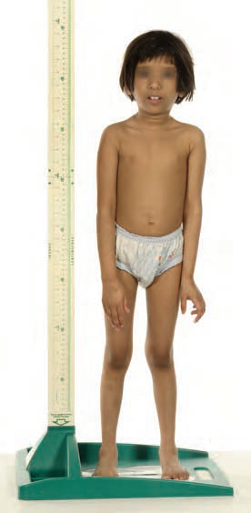
Narrow , cylinderical facies , prominent nose , small jaw
Long limbs with large hands & feet
Cafe‐au‐lait patches,
Clinodactyly, syndactyly,
Congenital heart disease
Annular pancreas
High‐pitched voice
B & T cell immune def
Testicular atrophy
Normal neurological

Slide 12
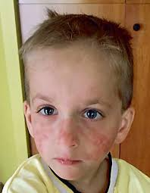
Red macules or plaques, mild scaling in butterfly distribution
Margins of eyelids, forehead, ears, dorsa of hands & forearms +/-
Photoagravation … Bullae , bleeding and crusting of lips

Slide 13
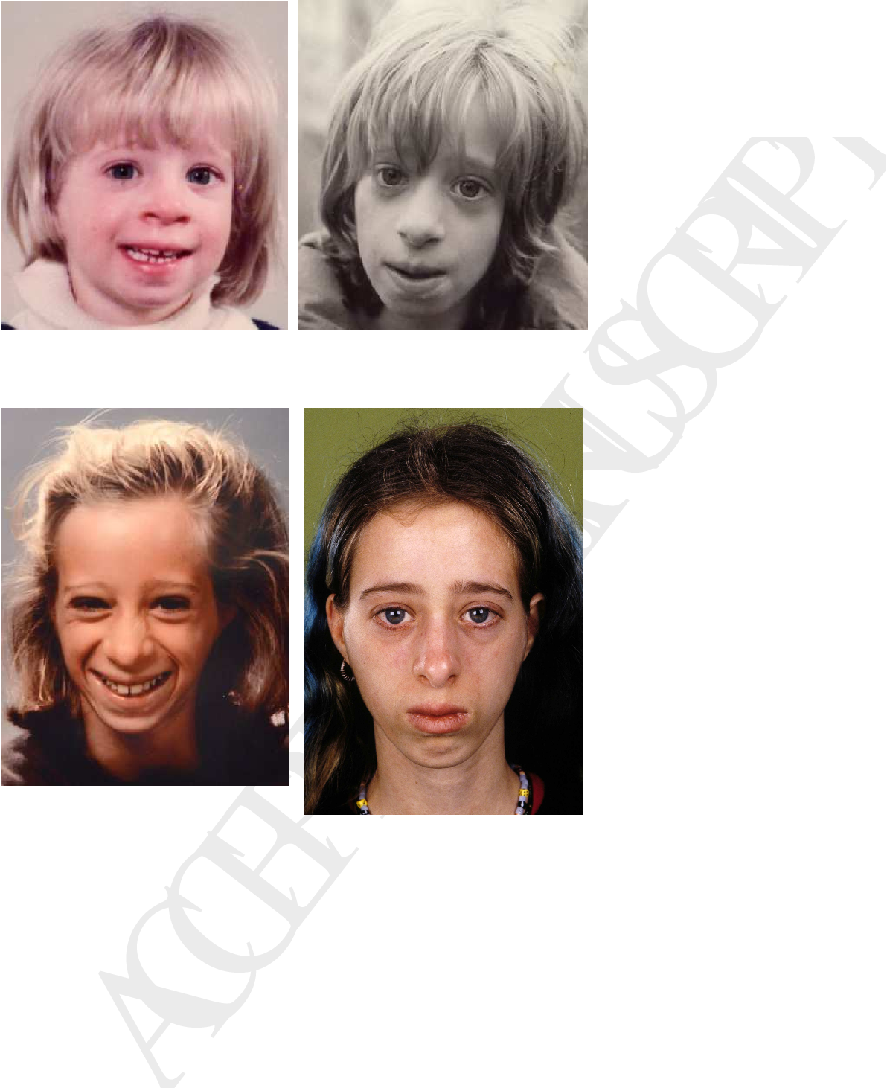
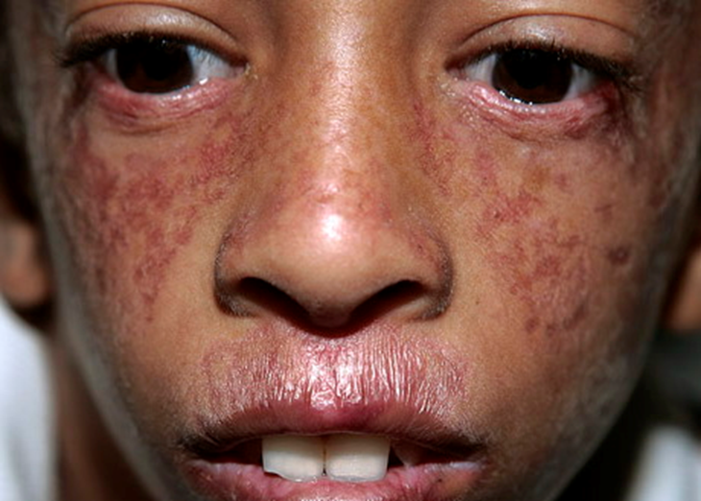
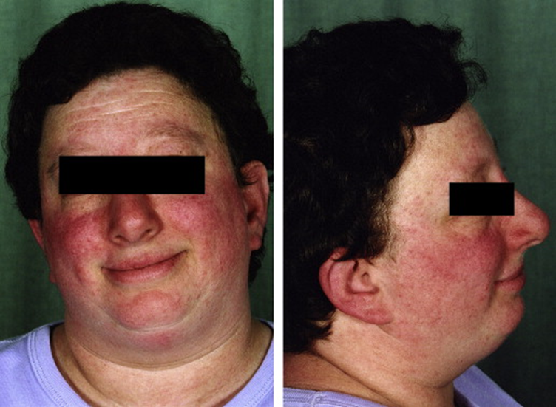

Slide 14
Life span … 2nd or 3rd decade , mostly internal malignancies (150-300 times inc risk)
MANAGEMENT :
Minimize sun exposure , use of high-factor sunscreen
Screening & management of diabetes & malignancies
Avoid ionizing radiation & alkylating agents

Slide 15
Progeroid laminopathies :
Accumulation of unmodified prelamin A within nuclei
Progeroid features
Cardiomyopathy
Muscular dystrophy
Peripheral neuropathy
Lipodystrophy
AD & AR

Slide 16
Hutchinson-gilford progeria syndrome
AD … 1 in 4 million live births
Failure to thrive
Premature ageing in early childhood
Normal intellectual & motor development
No immunodeficiency
No predispostion to malignancy

Slide 17
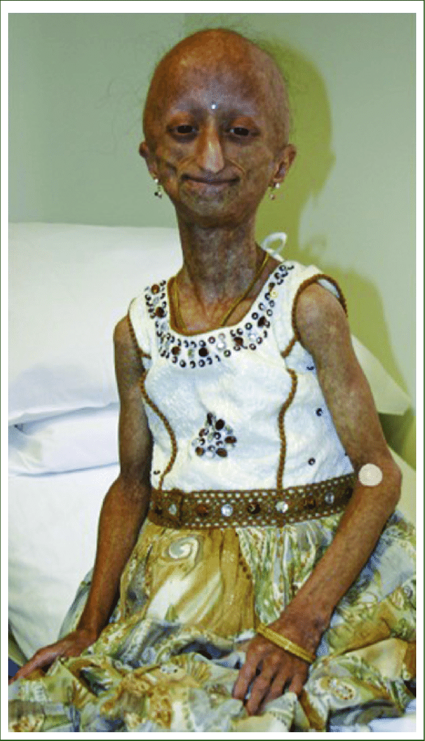
Distinctive facies
Absent earlobes +/-
Dystrophic nails
Trunk & limbs ++
Joint contractures
Short clavicle , pear shaped chest , sloping shoulders
Osteolysis of distal phalanges , delayed closure of ant fontanelle
Late primary dentition & overcrowding , partial failure of sec dentition
Incomplete sec sexual development

Slide 18
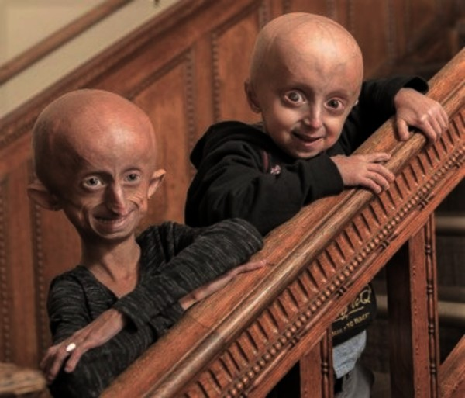

Slide 19
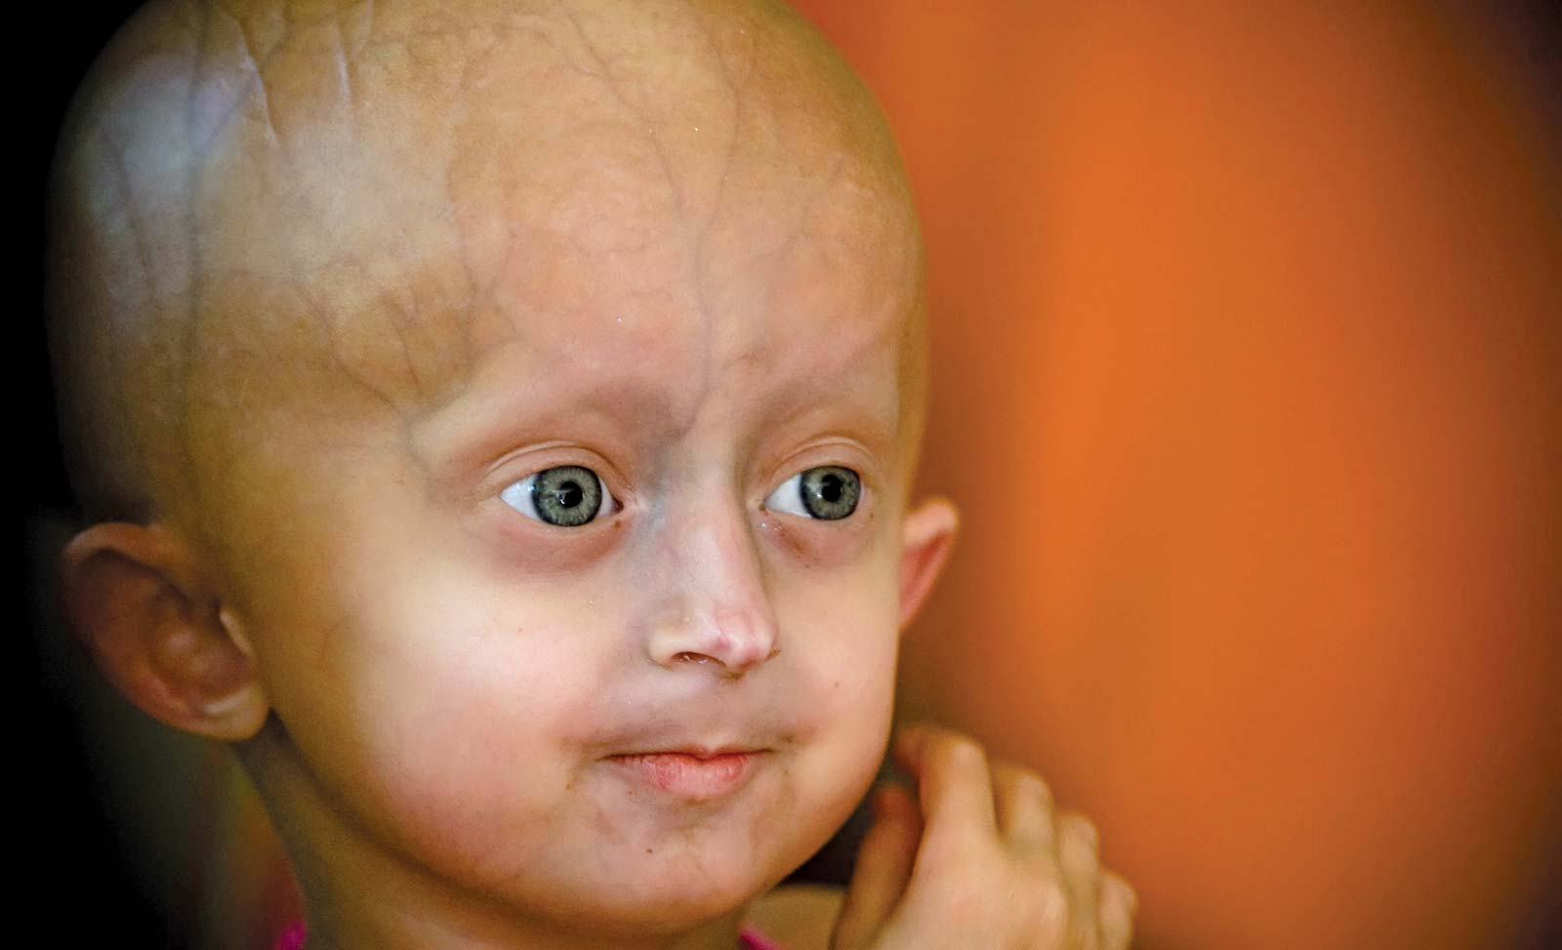
Small receding mandible
Pointed tip & narrow bridge nose
Large head
Prominent scalp veins
Prominent eyes
Thin lips , surr cyanosis+/-
Alopecia (totalis)

Slide 20
Life span … around 6-20 yrs with mean age 13 yrs , mainly d/t MI , cardiac failure or stroke
MANAGEMENT :
Dx monitoring (6-12 monthly) , preventive measures , Rx complications
Low dose aspirin
Statins if required
Pravastatin, lonafarnib & zolendronate, rapamycin( prevent mutations +/-)

Slide 21
Mandibulo Acral dysplasia with Lipodystrophy
AR
Growth delay
Skeletal abnormalities
Lipodystrophy
Pigmentary skin changes
Stiff joints, sclerotic, clacified acral skin & alopecia

Slide 22
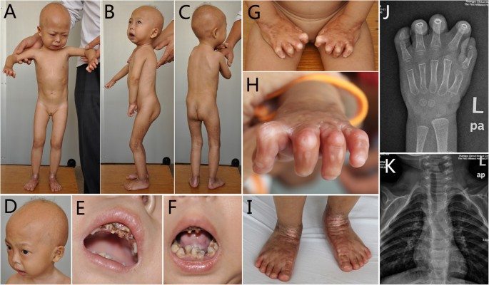

Slide 23
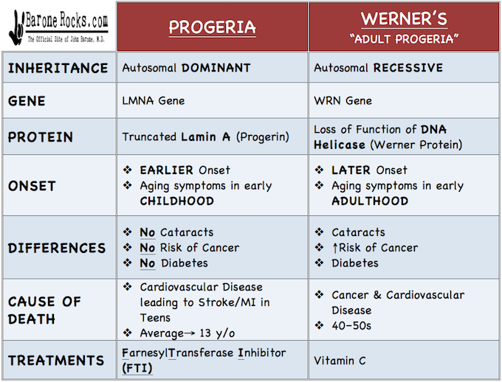

Slide 24
Disorder | Inheritance | Clinical Features | Treatment
XP | AR Diff site of impairment in global genomic nucleotide excision repair (GG-NER) | Early-onset lentigines (typically by 2 years of age) • BCC,SCC (9 yrs) & melanoma (22 yrs) • Photophobia, keratitis, corneal opacification, and vascularization • Hyporeflexia, deafness, seizures • Median lifespan 37 yrs •Mortality d/t malignancy & neuro Involvement. | Photoprotection Oral calcium and vitamin D Cryotherapy, topical 5-fluorouracil and imiquimod, Electrodesiccation and curettage, and surgical excision

Slide 25
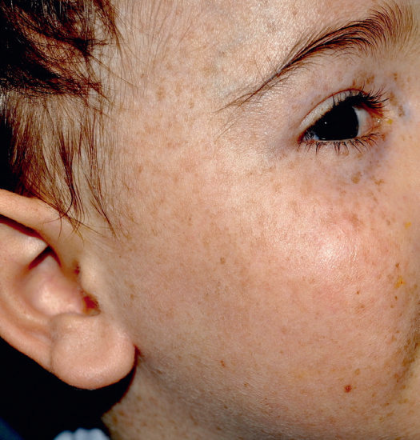

Slide 26
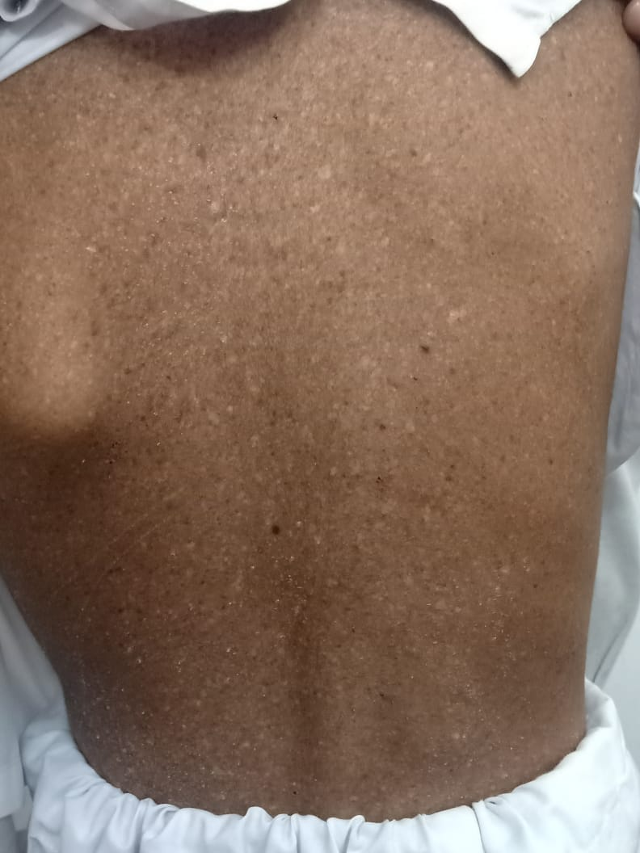
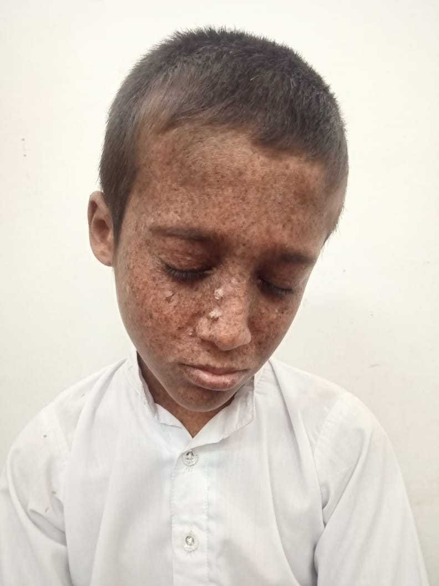

Slide 27
Disorder | Clinical Symptoms | Treatment
Cockayne Syndrome | Pigmented macules, thinned skin, alopecia, clubbing of nails, acral edema, sunken eyes, deafnes, prominent ears, dental caries • Hypogonadism, stooped posture, joint cont, cachectic dwarfism, microcephaly • Calcification of basal ganglia, demyelination , pigmentary retinal degeneration, osteoporosis • No increase in malignancies in “pure” CS | Photoprotection and Symptomatic treatment

Slide 28


Slide 29
Disorder | Clinical Symptoms | Lab Findings
Trichothiodystrophy | PIBIDS: Photosensitivity, ichthyosis, brittle hair, intellectual impairment, decreased fertility, short stature Microcephaly, receding chin, protruding ears No increase in malignancies | Hair shaft: alternating light and dark bands (“tiger tail banding”), trichoschisis, trichorrhexis nodosa-like changes, “ribboning” • Reduction of cysteine-rich matrix proteins and low sulfur content in hair shafts

Slide 30
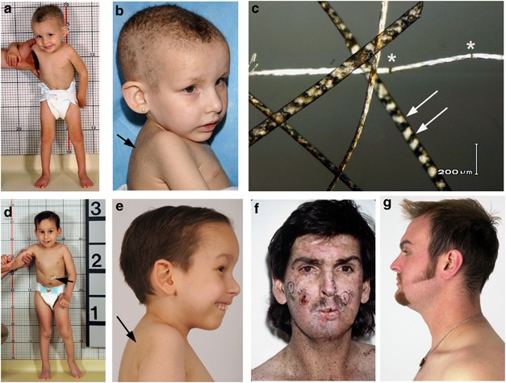

Slide 31
Cutis Laxa :
Lax skin
Developmental delay
Neurological involvement ( in AR form)
GI & Genito-urinary diverticula
Inguinal hernias
Emphysema, aortic aneurysm , aortic or mitral valve prolapse
Inc. vascular fragility ( cause of early death)

Slide 32
Occipital horn syndrome (OHS) :
Lax skin, joint laxity,
Inguinal hernias
Tortuous blood vessels
Intellectual impairment
Calcification on occipital bone
Menke disease :
Severe neurological involvement
Death in early childhood
Mild laxity
Sparse , kinky hair

Slide 33
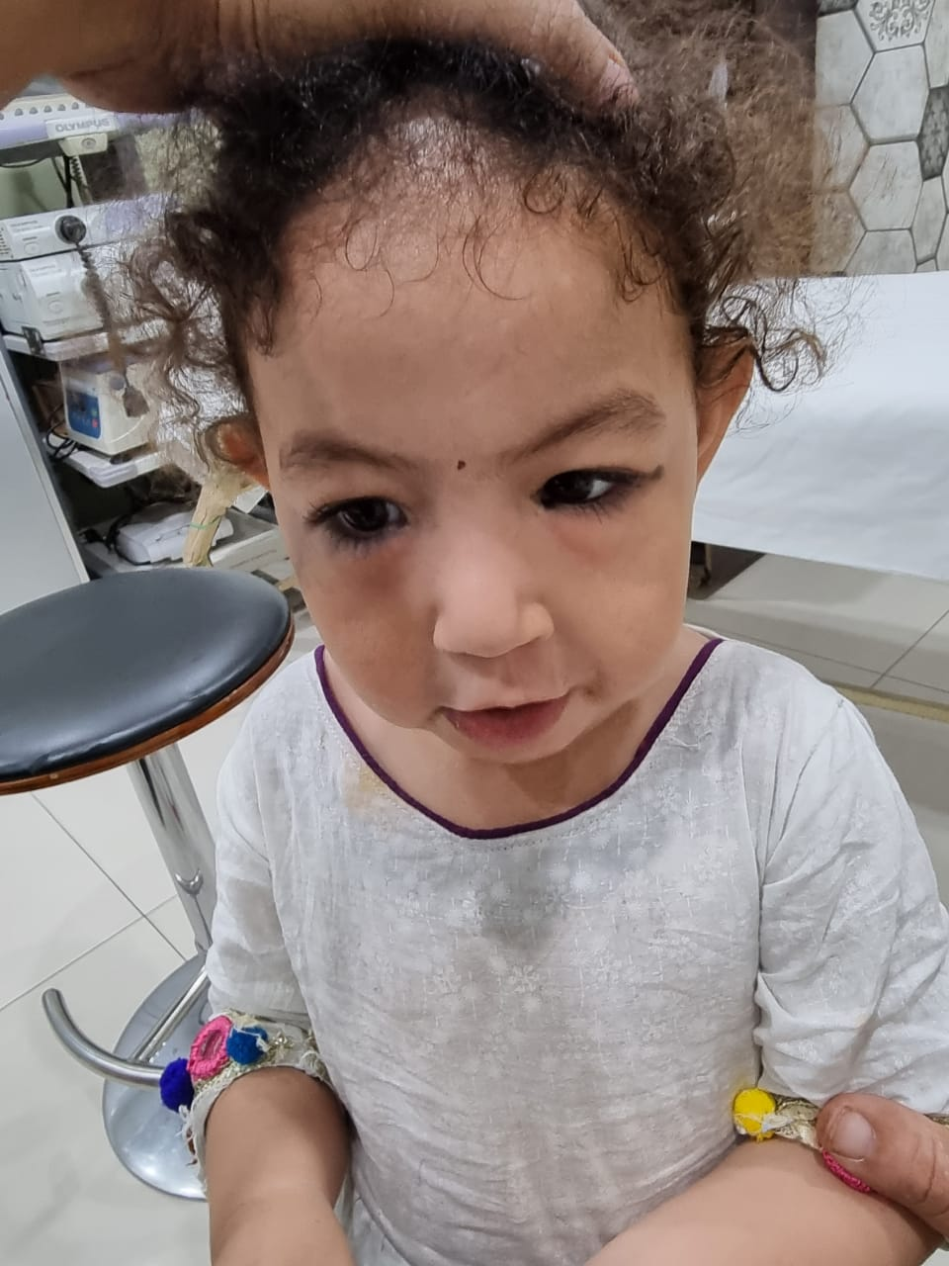
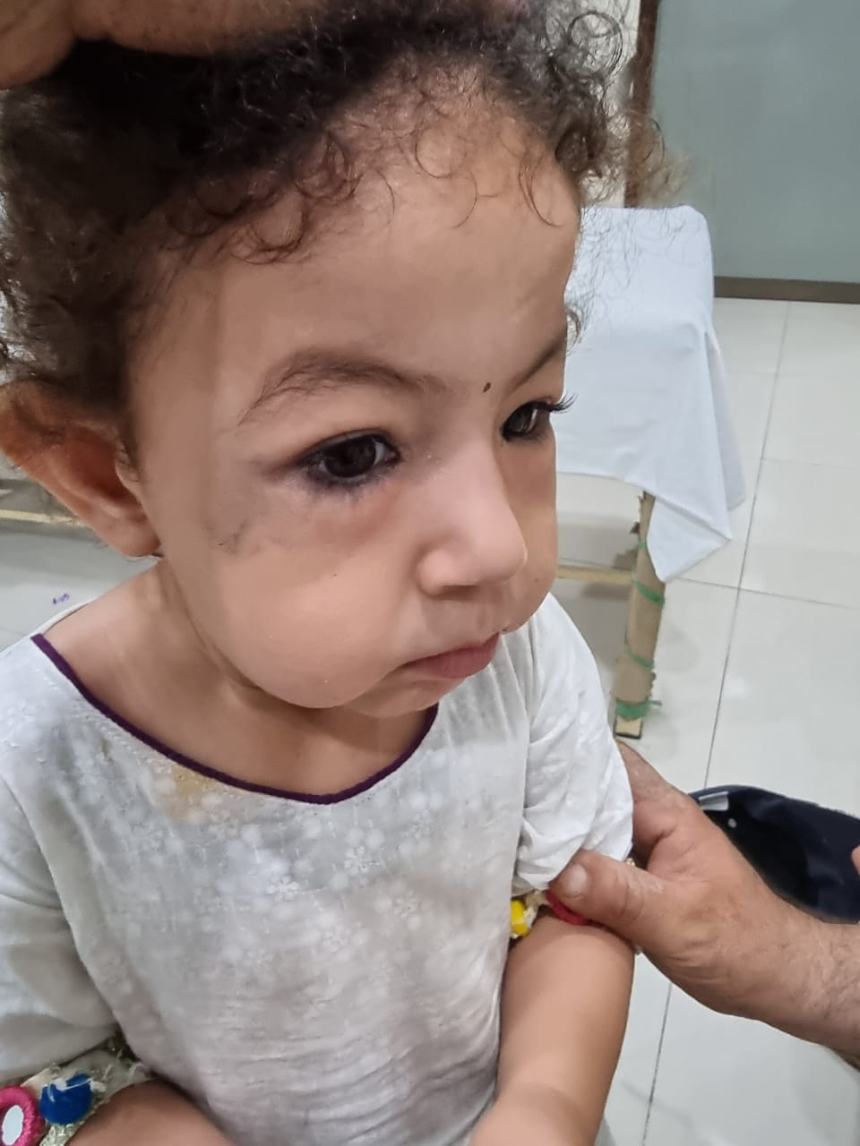

Slide 34
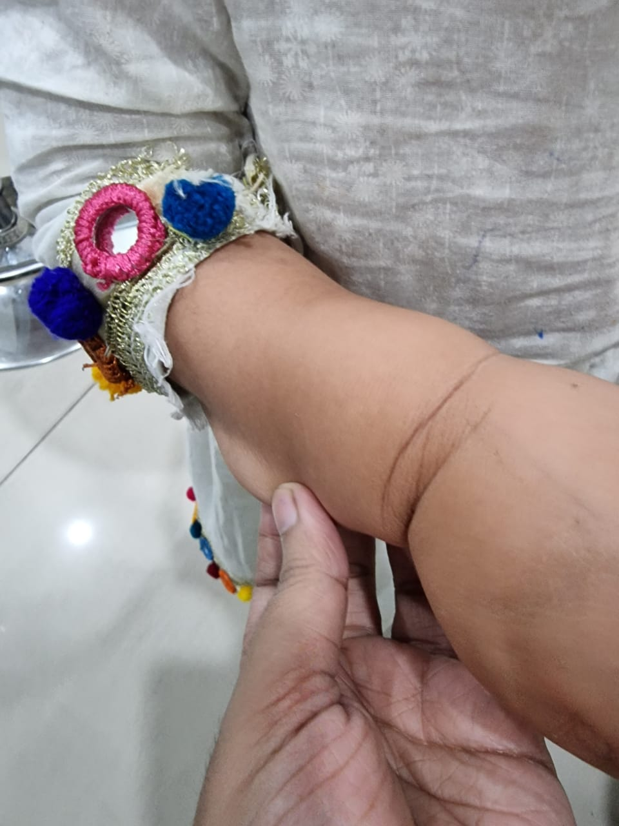

Slide 35



