Slide 1
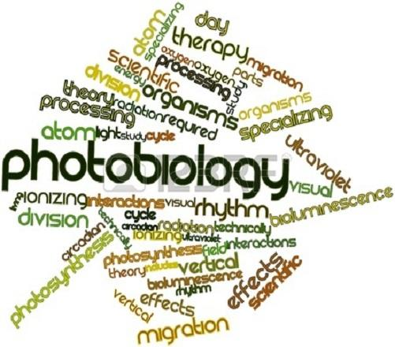
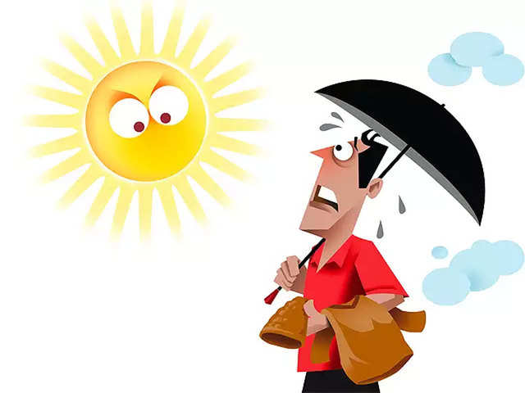
Photobiology of skin
DR HAMNA HAFEEZ

Slide 2
Learning objectives
Name bands within the electromagnetic spectrum
Describe effects of light on the skin
Describe the response of the skin to UVR
Define skin phototypes
Describe photo protective measures

Slide 3
What is photobiology?
It is the study of the effects of ultraviolet (UV) and visible radiation on life.
Here we will focus on the photobiology of normal skin.
This is important because the skin is the body’s interface with the environment
solar ultraviolet radiation (UVR) is probably our most important natural environmental hazard.

Slide 4
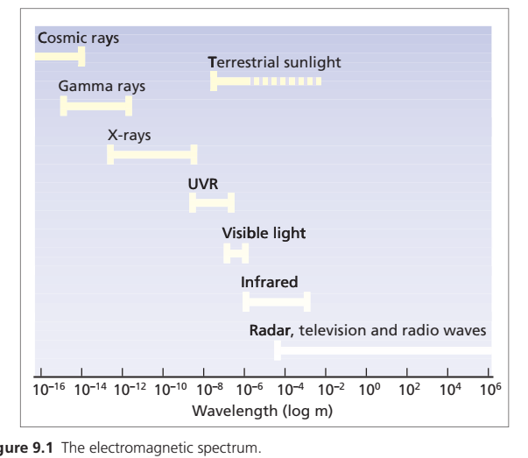

Slide 5
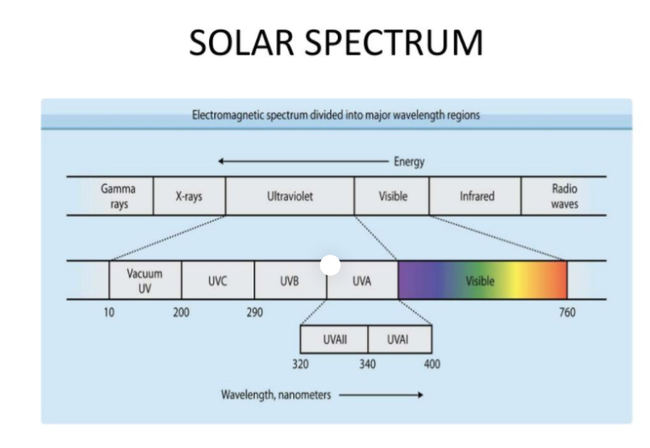

Slide 6
UVR
Ultraviolet and visible radiation, is energy released during the transition of a molecular electron from a higher energy outer molecular orbital to a less energetic inner one.
Each such emission is known as a photon
300‐nm photon has energy of 6.63 × 10–19 J, where 1 J is defined as the work required to accelerate 1 kg over 1 m in 1 s to a velocity of 1 m/s in a frictionless environment .

Slide 7
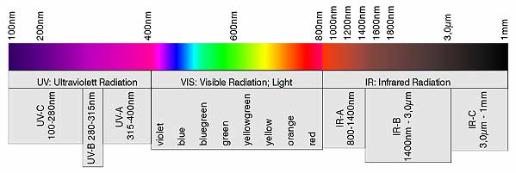
UVR
Ultraviolet radiation is, by convention, divided into three subcategories officially:
• UVC (200–280 nm) (does not reach the earth )
• UVB (280–315 nm) (10%)
• UVA (315–400 nm) (90%)
UVA-1 (340-400)
UVA-2 (315/320 -340)

Slide 8
Measurement of UVr
Dosimetry is the measurement of UVR.
Two types
        Physical dosimetry { contains sensors that respond to particular wavebands. The amount of such energy incident on a surface is known as the radiant exposure or fluence (j/m²)}
        Rate of incidence or intensity = W/m²
        Biological dosimetry : skin is the sensor and measurement outcome is MED ( minimal erythema dose) and this response is checked 24h after exposure .

Slide 9
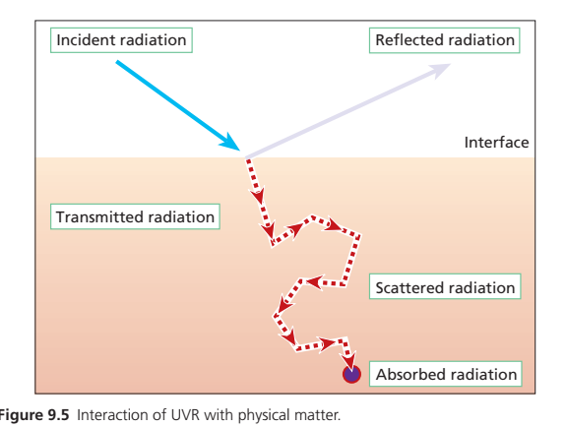
Interaction of UVr with the skin
(physicochemical aspects)
UVR incident on the skin may be:
Reflected
Refracted
Absorbed
Scattered
Transmitted
Produce fluorescence

Slide 10
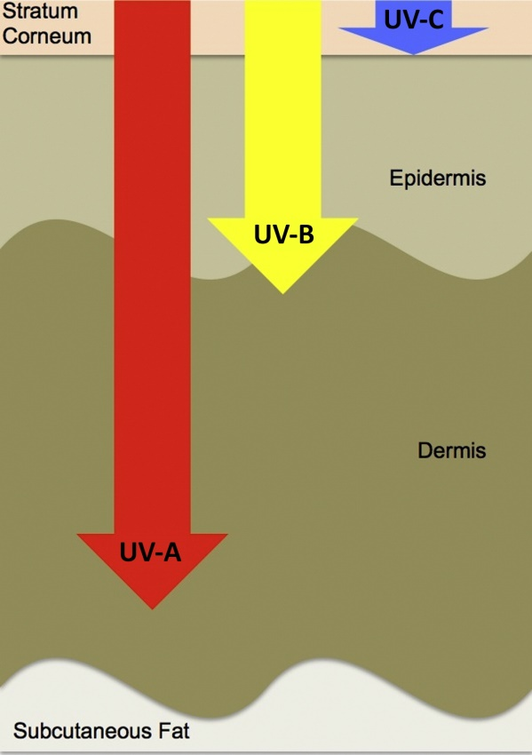

Slide 11
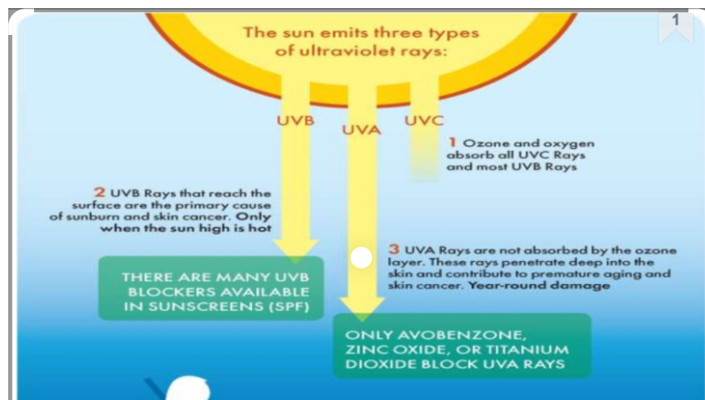

Slide 12
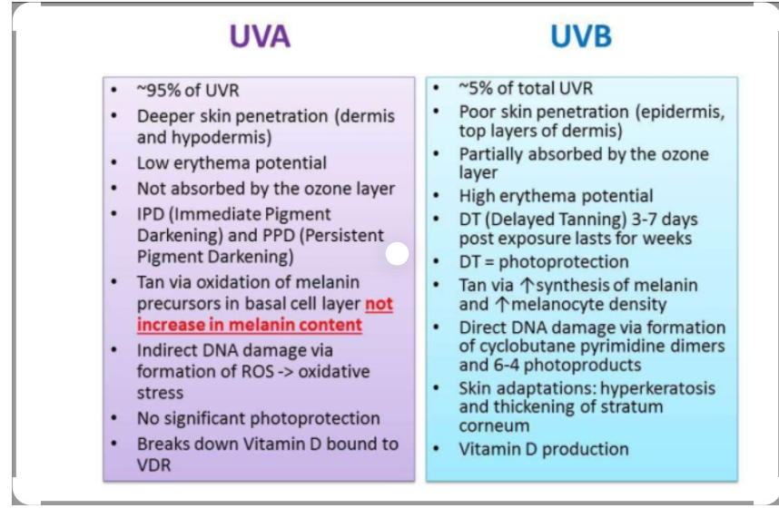

Slide 13
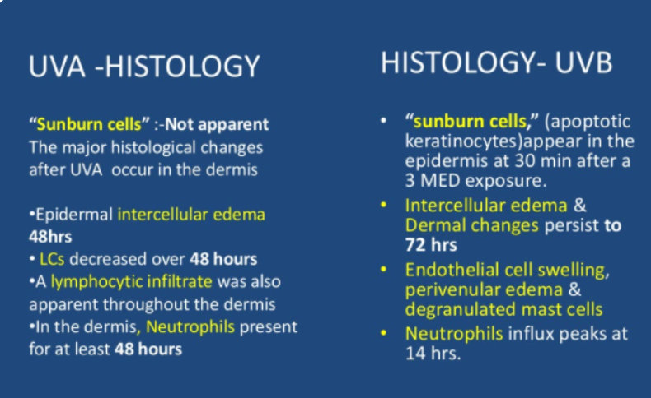

Slide 14
Artificial sources of UVR
Although UVR’s principle source is the sun, there are many man made sources of artificial UVR also.
Flourescent tubes ( phototherapy & tanning industry)
Halogen lights
Mercury vapor lamps
Xenon arc based
Woods lamp
Incandescent lights

Slide 15
Acute response of skin to UVR
The acute response of the skin to exposure to UVR has rapid onset (minutes to days) and short duration (hours to weeks).
Erythema
Tanning (IPD,PPD)
Melanogenesis
Immunemodulation
Vitamin D production

Slide 16
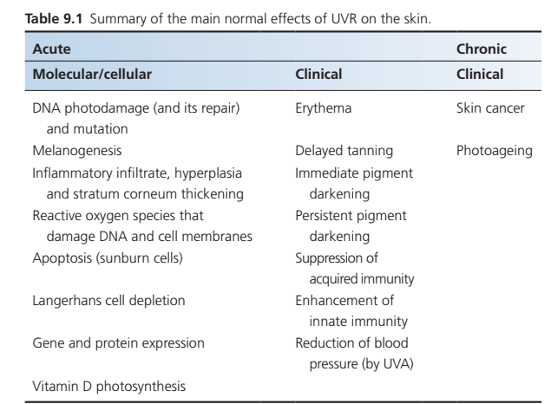

Slide 17
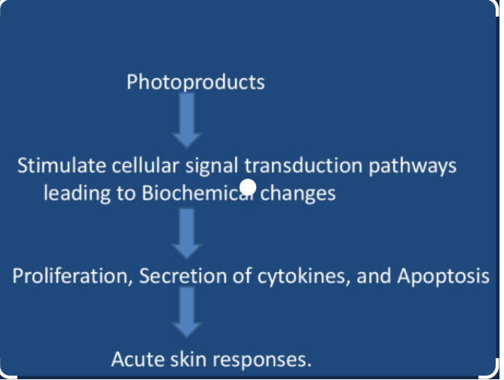
Acute skin responses to UVR

Slide 18
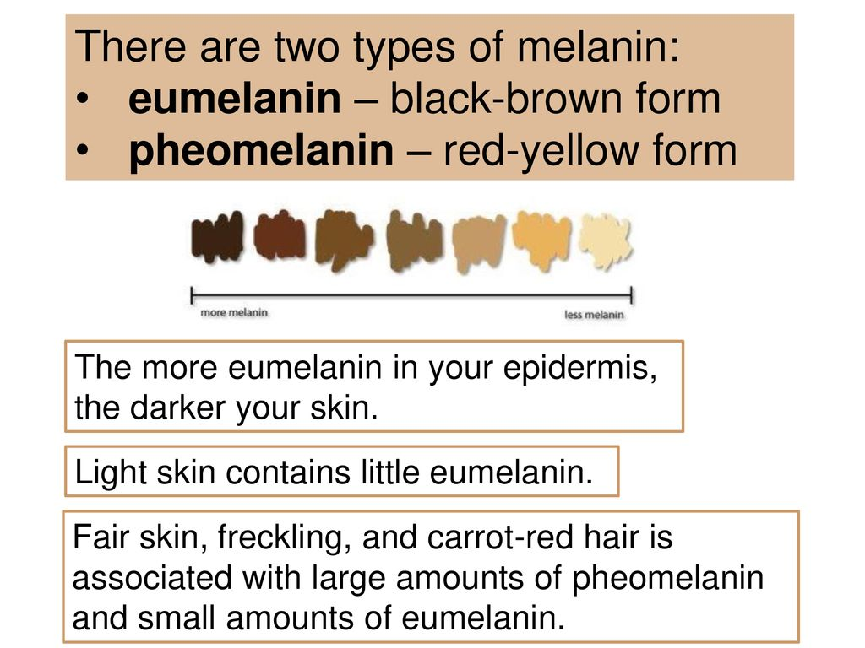

Slide 19
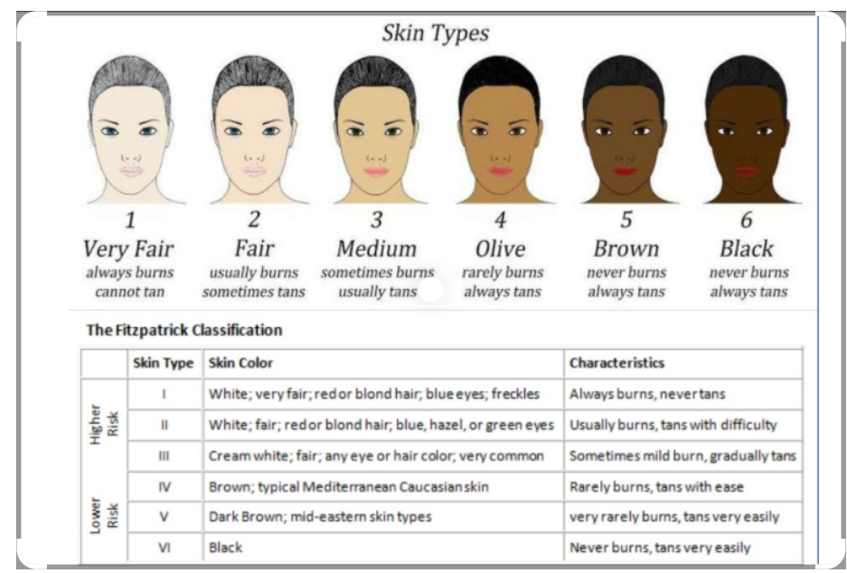

Slide 20
Erythema
The most obvious acute clinical effect is erythema, which is UVR‐ induced inflammation.
Typically with SSR/UVB, this is apparent after about 6 h and peaks at about 24 h and gradually resolves over a few days.

Slide 21
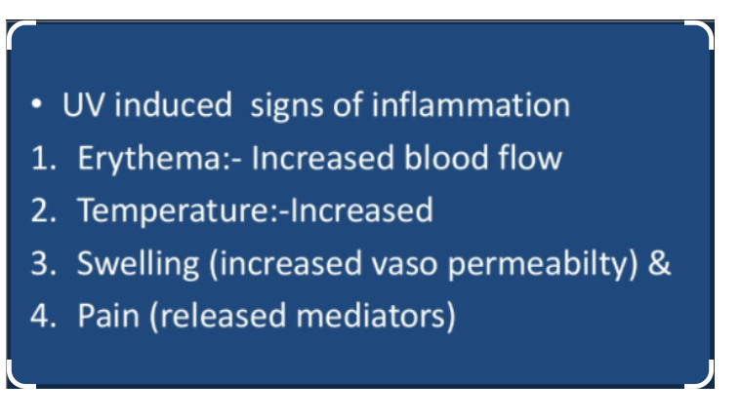

Slide 22
Tanning
Three ‘tanning’ processes occur in response to UVR, are listed below
• Immediate pigment darkening (IPD).
• Persistent pigment darkening (PPD).
• Melanogenesis or delayed tanning (DT).

Slide 23
Immediate pigment darkening
Immediate pigment darkening presents as a transient grey colour
due to immediate photo‐oxidation of existing colourless melanin precursors after exposure to UVA (action spectrum peak at 340 nm) and visible (400–500 nm) radiation.
IPD, which fades within 15 min, is induced at low UVA doses

Slide 24
Persistent pigment darkening
Persistent pigment darkening is a brown colour in response to higher UVA doses
peaking 2 h post‐irradiation and
lasting for 1–5 days.
PPD is not due to new melanin synthesis but rather to a more persistent oxidation of melanin precursors.
PPD is an end point that is used to assess UVA protection of sunscreens

Slide 25
Immunomodulation
UVR results in profound alterations of both local and systemic immune responses.
The immune changes are mainly mediated by cytokines released from epidermal cells, but also by neuropeptides released from sensory nerves in the skin.
Targets include urocanic acid, cellular DNA, cell membranes.
Neuropeptides may also play a role in the repair of cutaneous UV injury and in immunosuppression.

Slide 26
Immunomodulation
The function of antigen-presenting cells (Langherhan's cells) is reduced.
UV may cause apoptosis (cell self-destruction).
UVR prevents primary contact sensitisation to surface antigens.
It inhibits histamine release from mast cells.
Suppressor T cells may induce tolerance contributing to the eventual development of skin cancers.

Slide 27
Vitamin D
The production of vitamin D is the only established benefit of solar UVR exposure.
The skin chromophore for vitamin D synthesis is 7‐dehydrocholesterol (7DHC), also known a pro‐vitamin D.
It is converted to pre‐vitamin D by solar UVR, with an action spectrum that is similar to that for erythema in the UVB region

Slide 28
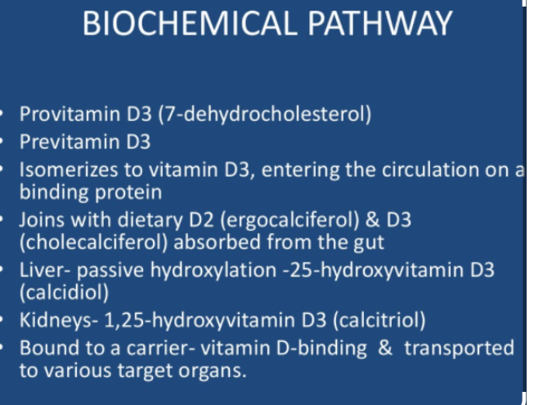

Slide 29
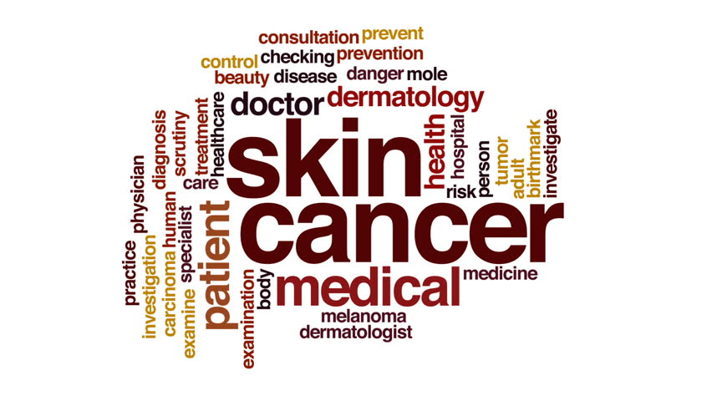
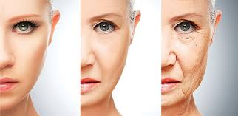
Chronic changes in skin due to uvr
Skin cancers
Photoaging

Slide 30
Skin cancer
Epidemiological data and body site studies have long supported an association between solar radiation exposure and skin cancer,
including basal cell carcinoma (BCC) and SCC, which are keratinocyte cancers, and malignant melanoma (MM), which is a cancer of the melanocyte.
Solar UVR exposure is also associated with actinic keratoses (AK) that are indicative of SCC risk.

Slide 31
Skin Cancers
Both BCC and SCC are among the most frequently occurring cancers in white‐skinned populations and are often referred to collectively as non‐melanoma skin cancers (NMSC)

Slide 32
cont
Uvr induces skin cancers by
DNA damage
Mutations
Immunosuspression
SCC is associated with low‐dose chronic uv exposure
whereas MM and probably BCC, are associated with intermittent high dose sunburning exposure.

Slide 33
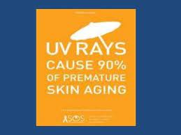
Photoaging
Skin ageing occurs as two distinct phenomena:
intrinsic chronological ageing in which changes are attributable to the passage of time, and
photoageing that is the superposition of structural and functional changes caused by chronic UVR exposure.

Slide 34
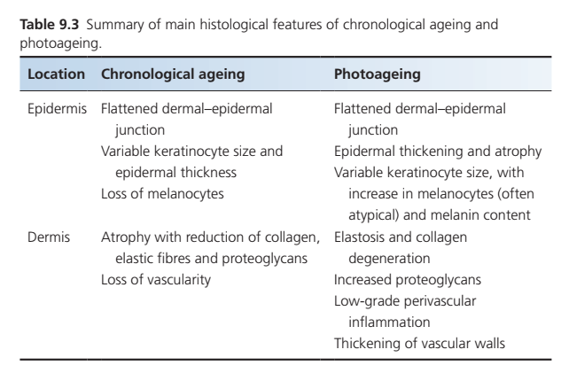

Slide 35
photoaging
includes:
Dry coarse leathery appearance
Loss of skin elasticity
Fine wrinkles
Dilated capillaries and easy bruising
Thin, transparent, fragile tissue
Actinic keratoses

Slide 36
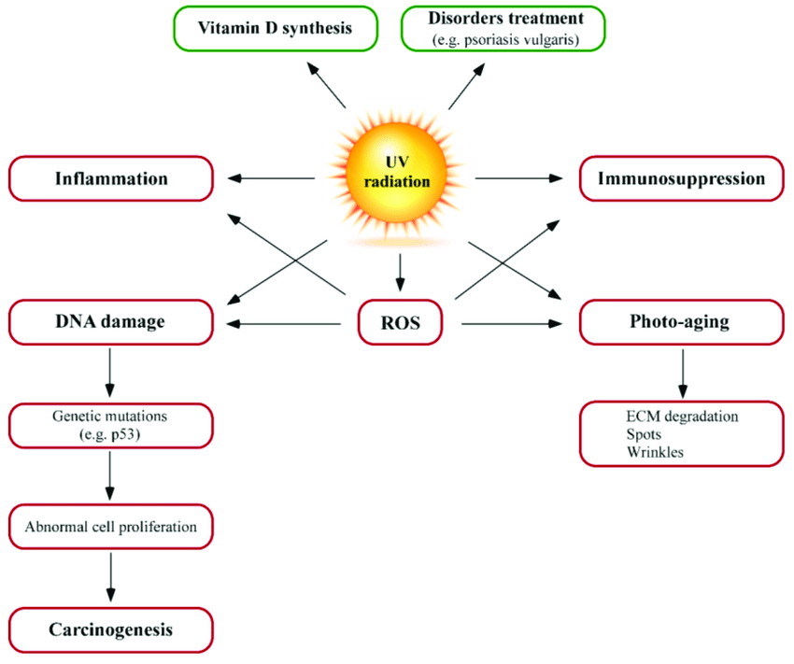

Slide 37
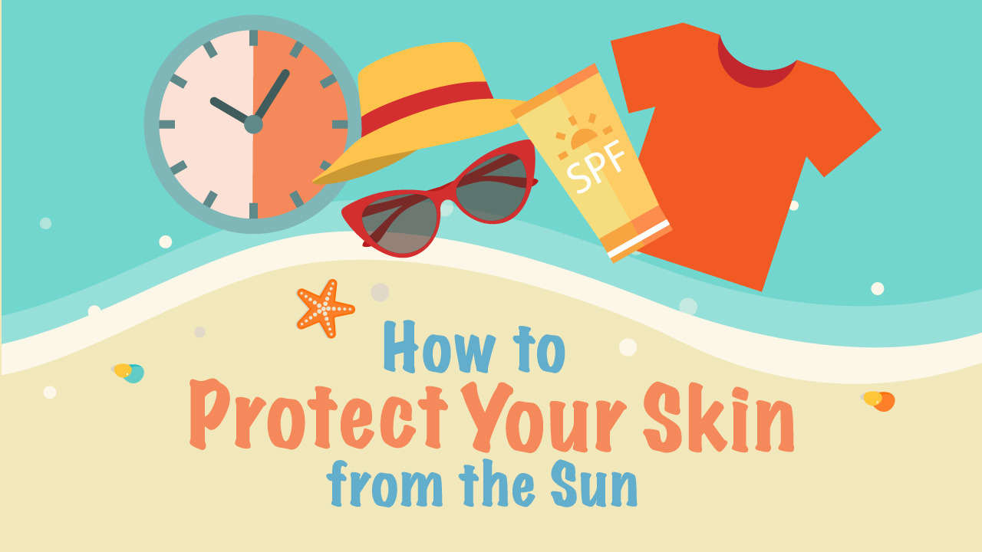
Using sunscreens
Clothing
Shade

Slide 38
Sunscreens
Sunscreens are topical formulations that contain agents that filter and/or scatter UVR.
In effect, UVR‐absorbing molecules are exogenous chromophores applied to the skin
A typical product contains a mix of organic filters with different absorption spectra as well as micropigments that may be physical (e.g. titanium dioxide) or organic.

Slide 39
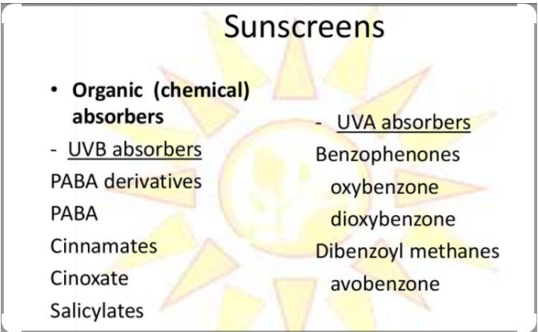

Slide 40
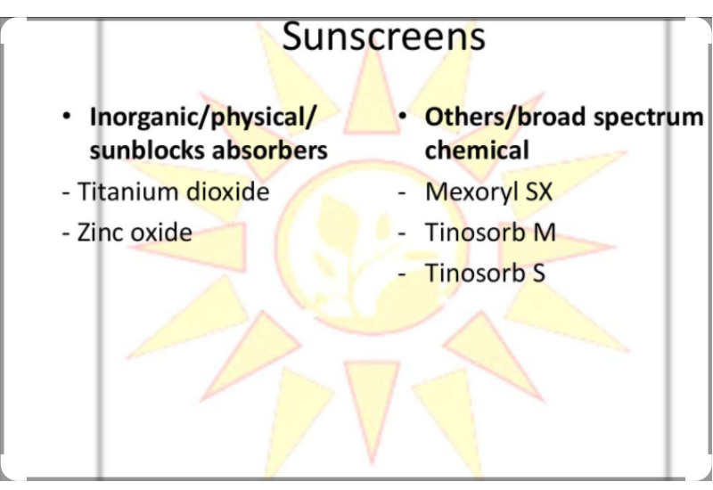

Slide 41
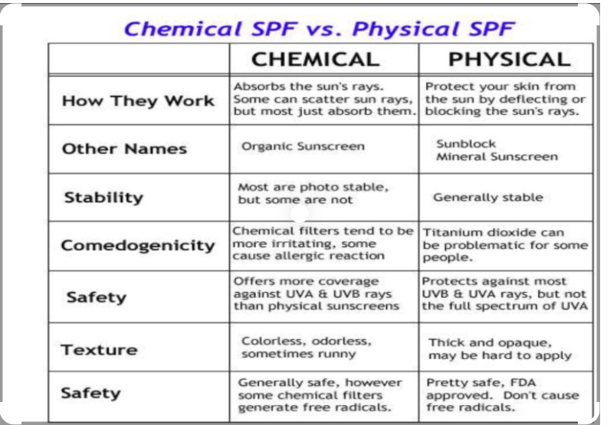

Slide 42
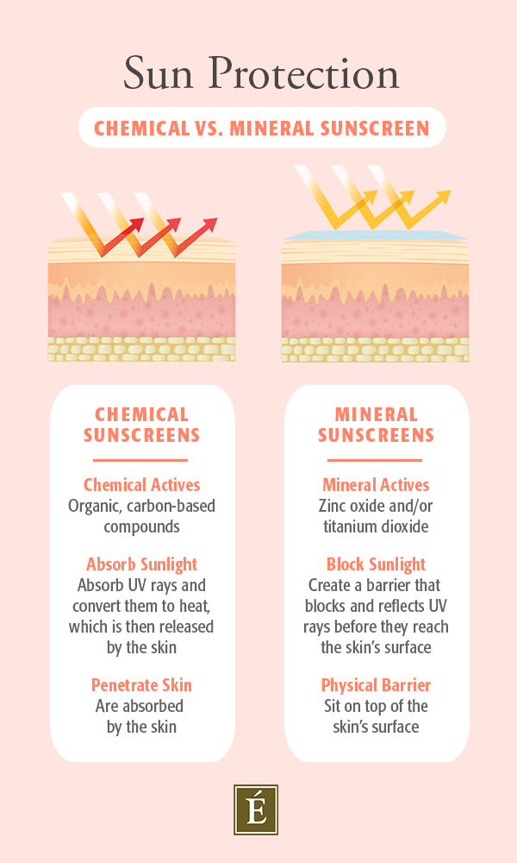

Slide 43
Continued
Sunscreens are designed and tested to prevent erythema and their main index of protection is the sun protection factor (SPF).
The SPF is calculated by the following formula: SPF = [24 h MED on protected skin]/[24 h MED on unprotected skin]

Slide 44
Reference sources
Rooks
Derm netnz
Ultraviolet Photobiology in Dermatology – PubMed

Slide 45
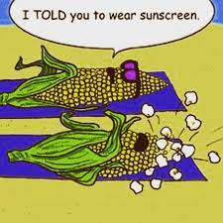
Thank you ! Any questions?

