Slide 1
Panniculitis

Slide 2
Anatomy and physiology of subcutaneous fat
Subcutaneous tissue (subcutis) is composed predominantly of fat cells supported in a connective tissue framework .
Subcutaneous fat is present almost universally over the body surface between the skin and the deep fascia and, in the normal state, constitutes about 10% of body weight.
Subcutaneous fat also acts as an insulating layer against heat loss and a protective cushion against external injury.
Subcutaneous fat also provides structural support to the overlying skin and has a cosmetic function.

Slide 3
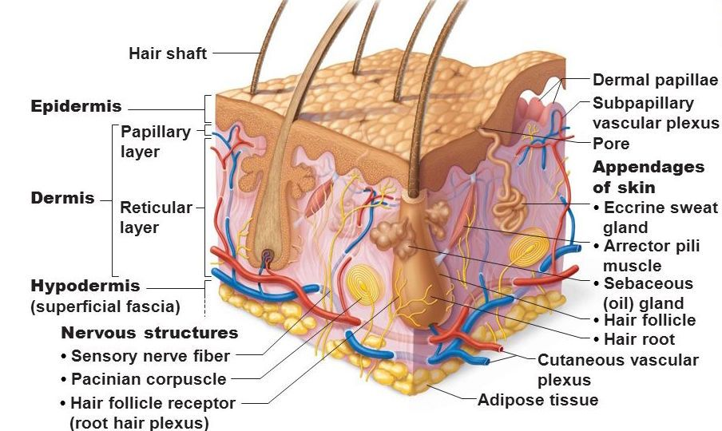

Slide 4
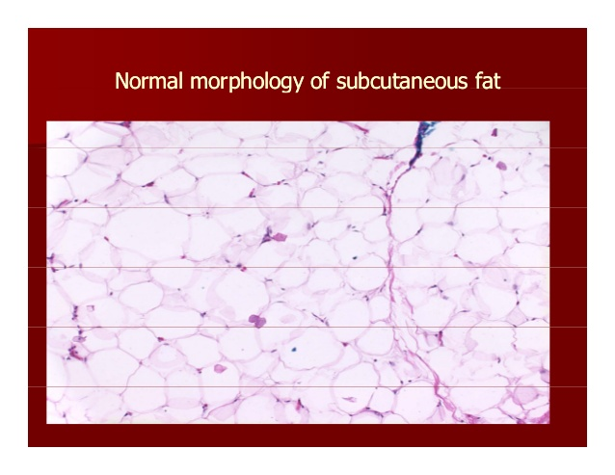

Slide 5
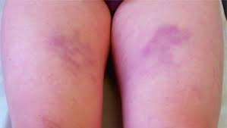
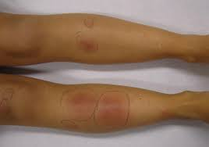
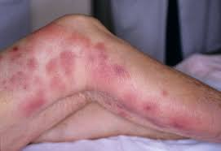
Panniculitis
Inflammatory diseases involving the subcutaneous fat comprise a heterogeneous group of disorders named generically panniculitis.

Slide 6
Classification of the panniculitides
Predominantly septal panniculitides
With vasculitis
Veins ( Superficial migratory thrombophlebitis)
Arteries (Cutaneous polyarteritis nodosa)
No vasculitis
Lymphocytes and plasma cells predominantly
With granulomatous infiltrate in septa (Necrobiosis lipoidica)
No granulomatous infiltrate in septa ( Deep morphoea)

Slide 7
Histiocytes predominantly (granulomatous)
With mucin in centre of palisaded granulomas (Subcutaneous granuloma annulare)
With fibrin in centre of palisaded granulomas (Rheumatoid nodule)
With large areas of degenerate collagen, foamy histiocytes and cholesterol clefts (Necrobiotic xanthogranuloma)
Without mucin, fibrin or degeneration of collagen, but with radial granulomas in septa (Erythema nodosum)

Slide 8
Predominantly lobular panniculitides
With vasculitis
Small vessels
Venules (Erythema nodosum leprosum) (Erythema induratum of Bazin)
Large vessels
Arteries (Erythema induratum of Bazin)
No vasculitis
Few or no inflammatory cells
Necrosis at the centre of the lobule (Sclerosing panniculitis)
With vascular calcification Calcific uraemic arteriolopathy(calciphylaxis)

Slide 9
Lymphocytes predominant
With superficial and deep perivascular dermal infiltrate (Cold panniculitis)
With lymphoid follicles, plasma cells and nuclear dust of lymphocytes (Lupus panniculitis)
Panniculitis associated with dermatomyositis
Neutrophils predominant
Extensive fat necrosis with saponification of adipocytes (Pancreatic panniculitis)
With neutrophils between collagen bundles of deep reticular dermis (α1‐antitrypsin deficiency panniculitis)
With bacteria, fungi or protozoa (Infective panniculitis)
With foreign bodies (Factitious panniculitis)

Slide 10
Histiocytes predominant (granulomatous)
No crystals in adipocytes (Subcutaneous sarcoidosis) (Traumatic panniculitis)
With crystals in histiocytes or adipocytes (Subcutaneous fat necrosis of the newborn)
Poststeroid panniculitis
Sclerema neonatorum
Gouty panniculitis
Fungal panniculitis due to zygomycosis, mucormycosis and aspergillosis

Slide 11
With cytophagic histiocytes (Cytophagic histiocytic panniculitis and subcutaneous panniculitis‐like T‐cell lymphoma)
With sclerosis of the septa (Sclerosing post‐irradiation panniculitis)
Panniculitis presents typically with:
Thickened and firm nodules and plaques
Erythematous or pigmented overlying skin
Pain and tenderness.
Sometimes, lesions resolve to leave localised subcutaneous atrophy (lipodystrophy)

Slide 12
Superficial migratory thrombophlebitis
STP is an inflammation and thrombosis of the superficial
veins which presents as painful induration with erythema
often in a linear or branching configuration forming cords.
Patients with STP should be appropriately investigated
to rule out hypercoagulable states, paraneoplastic
processes (Trousseau sign) and Behcet disease,
although by far the most common cause of STP
is chronic venous insufficiency of the lower limbs.
Varicosities and erythematous nodules with
linear arrangement involving the right lower extremity.

Slide 13
Primary and secondary hypercoagulable states that cause superficial thrombophlebitis
Primary hypercoagulable states
• Antiphospholipid syndrome
• Deficiencies of Protein C, Protein S Heparin co‐factor 2, Antithrombi III,Factor XII, Tissue plasminogen activator,Factor V Leiden.
Secondary hypercoagulable
Paraneoplastic superficial migratory thrombophlebitis (Trousseau syndrome),Behcet syndrome, Buerger disease,Pregnancy , HIV‐associated immune reconstitution syndrome (IRIS).
• Secondary syphilis
Infectious suppurative thrombophlebitis in children
• Oral contraceptive pills,Sepsis, intravenous injections or catheterizations
• Complications of venous sclerotherapy.

Slide 14
Histopathological features of superficial thrombophlebitis

Slide 15
Cutaneous polyarteritis nodosa
A cutaneous vasculitis of poorly understood
aetiology affecting subcutaneous arteries
and arterioles. It is strongly associated with
circulating antineutrophil cytoplasmic antibodies
with peripheral staining (p‐ANCA).
Clinical appearance of cutaneous polyarteritis
nodosa showing livedo reticularis of the lower
extremities with ulcerated nodules.

Slide 16
Scanning view of a punch biopsy showing involvement of a vessel of the septa of subcutaneous fat. (b) Higher magnification showing fibrinoid necrosis of the intima, giving a target‐like appearance to the involved arteriole.

Slide 17
Necrobiosis lipoidica
Necrobiosis lipoidica is an uncommon skin
condition in which degenerated dermal
collagen is surrounded by a granulomatous
inflammatory response to produce shiny,
red‐brown or yellowish plaques in the skin,
particularly on the shins.
Necrobiosis lipoidica showing yellowish
indurated plaques on the
anterior aspect of the legs in a
diabetic woman.

Slide 18
Scanning power showing involvement of the full thickness of the dermis and extension to the subcutaneous tissue throughout the septa.

Slide 19
Deep morphoea
A group of related diseases of poorly understood
aetiology affecting principally skin and
subcutaneous tissue and characterized by
Variable fibres, sclerosis and cutaneous atrophy
The lesions consisted of indurated,
hyperpigmented and slightly depressed plaques.

Slide 20
Scanning power showing sclerosis of the deeper reticular dermis and the septa of subcutaneous tissue. Note that the superficial and mid dermis were spared. (b)Thickened sclerotic collagen bundles with interstitial lymphocytes and plasma cells.

Slide 21
Subcutaneous granuloma annulare
Subcutaneous granuloma annulare is a rare
Clinicopathological variant of granuloma annulare,
characterized by subcutaneous nodules that may
appear alone or in association with the classical
dermal papular lesions.

Slide 22
(a) Scanning power showing the involvement of deeper dermis and subcutaneous mtissue. (b) There are several areas of degenerate collagen bundles surrounded by a palisade of histiocytes.

Slide 23
Rheumatoid nodule
Definition
Rheumatoid nodules are one of the extra‐articular
manifestations of rheumatoid arthritis.
They are usually found in proximity to joints or
extensor surfaces and other areas subjected
to mechanical pressure.

Slide 24
Clinical variants
Accelerated rheumatoid nodulosis (ARN) is the term used to describe
the development of new painful rheumatoid nodules in patients with chronic rheumatoid arthritis under treatment with methotrexate.
These new nodules develop preferentially on the hands, feet and ears.
It seems that there is an individual susceptibility to ARN, because it develops more frequently in patients with HLA‐DRB1 and seropositive rheumatoid arthritis.

Slide 25
Scanning power showing a diffuse replacement of subcutaneous tissue by a fibrotic process with scattered of degenerate collagen. (b) The eosinophilic fibrinoid areas are surrounded by a palisade of histiocytes.

Slide 26
Necrobiotic xanthogranuloma
Necrobiotic xanthogranuloma is a rare histiocytic
disorder which causes progressive destruction of the
involved cutaneous and extracutaneous tissues
It most commonly presents as multiple indurated
yellow‐red or violaceous plaques or nodules,
involving periorbital skin.
A plaque with yellowish hue involving the scalp.

Slide 27
(a) Scanning power showing diffuse involvement of the entire thickness of the dermis and extension to subcutaneous tissue. (b) Areas of degenerate collagen with abundant cholesterol clefts.

Slide 28
Erythema nodosum
Erythema nodosum is the most common panniculitis.
The process usually shows an acute onset and self‐limited course.
It is clinically characterized by the sudden eruption of several erythematous, tender, non‐ulcerating nodules and plaques, typically located on the shins.
The condition normally resolves spontaneously without ulceration, scarring or atrophy, but recurrent episodes are common.

Slide 29
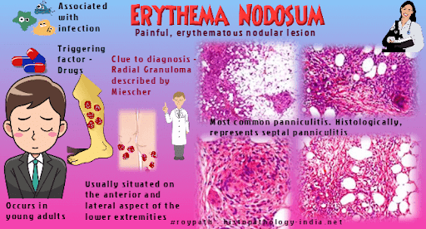

Slide 30
Aetiological factors in erythema nodosum
Infections
Bacterial infections Atypical mycobacterial infections,Borrelia burgdorferi infections ,Boutonneuse fever,Brucellosis ,Campylobacter infections,Cat‐scratch disease ,Chancroid .
Viral infections Cytomegalovirus,Epstein–Barr virus infection,Hepatitis B,Hepatitis C,Herpes simplex,HIV infection,Infectious mononucleosis,Measles.
Fungal infections Aspergillosis ,Blastomycosis ,Coccidioidomycosis ,Dermatophytes,Histoplasmosis,Sporotrichosis.
Protozoal infections Amoebiasis ,Ascariasis ,Giardiasis,Hydatidosis.
Drugs Acetaminophen ,Actinomycin‐D ,Aminopyrine,Amiodarone,Amoxicillin. Bromides,Busulfan ,Cabergoline,Capecitabine ,Carbamazepine,Carbenicillin.

Slide 31
Clinically, the eruption is quite characteristic
and consists of a sudden onset of symmetrical,
bilateral, tender, erythematous,warm nodules
and raised plaques usually involving the shins
ankle and knees.
Characteristic eruption of erythema nodosum
with lesions in different stages of evolution
involving the anterior aspect of the legs of an
adult woman. Some early lesions consist of bilateral
erythematous nodules and plaques, whereas later
stage lesions show a bruise‐like appearance.

Slide 32
(a) Scanning power showing a mostly septal panniculitis with thickened connective tissue septa of the subcutis. (b) The infiltrate at the septa is mostly composed of neutrophils interstitially arranged between collagen bundles

Slide 33
Management
Most cases of erythema nodosum regress spontaneously in 3–4 weeks, but relapses are common.
Aspirin, as well as several other nonsteroidal anti‐inflammatory drugs, such as indometacin 100–150 mg daily or naproxen 500 mg daily are helpful for pain and for hastening resolution.
In more persistent cases, potassium iodide 400–900 mg daily or saturated solution of potassium iodide, 2–10 drops in water or orange juice three times per day, may be administered.
Some patients have responded to a course of colchicine, 0.6–1.2 mg twice a dayand to hydroxychloroquine in a dosage of n200 mg twice a day.
Recently, cases of erythema nodosum have responded to treatment with anti‐TNF biological agents including etanercept ,adalimumab andinfliximab

Slide 34
Erythema nodosum leprosum
Erythema nodosum leprosum is a type II leprosy
reaction which is characterized by a necrotizing
vasculitis involving small to medium‐sized vessels
of the deep dermis and subcutis.
Acute onset of erythematous nodules involving
the left upper extremity in a patient with
lepromatous
leprosy

Slide 35
(a) Scanning power showing dense nodular infiltrates in the dermis and a mostly lobular panniculitis.Some of the small capillaries of the fat lobule show fibrin deposits and neutrophils involving their vessel walls

Slide 36
Erythema induratum of Bazin
Erythema induratum is a chronic recurrent
reactive disorder characterized
by subcutaneous nodules located
preferentially on the posterior
aspects of the lower legs of adult women

Slide 37
Vascular involvement in erythema induratum
• Small venules of the fat lobule (46.5% of cases)
• Both large veins of the connective tissue septa and small venules
of the fat lobule (12.8% of cases)
• Only large veins of the connective tissue septa (11.8% of cases)
• Large veins and arteries of the connective tissue septa and small venules of the fat lobule (9.9% of cases)
• Large veins and arteries of the connective tissue septa (8.9% of cases)
• No evidence of vasculitis (9.9% of cases)

Slide 38
Histopathological features of an early lesion of erythema induratum. Scanning power showing a mostly lobular panniculitis.

Slide 39
Sclerosing panniculitis
Sclerosing panniculitis is a relatively common
form of long‐term chronic panniculitis associated
with chronic venous insufficiency and typically
affecting the lower extremities of middle aged or
elderly women. This is manifested as a diffuse
sclerosis and pigmentation of the skin and
subcutaneous tissue lipodermatosclerosis
Late‐stage sclerosing panniculitis showing
depressed hard areas withwoody induration
involving the lower legs

Slide 40
Calcific uraemic arteriolopathy
(calciphylaxis)
Calcific arteriolopathy (calciphylaxis) is strongly
associated with end‐stage chronic kidney
disease and renal transplantation, particularly
in diabetics, though a small proportion of cases
arise in the absence of renal disease.
Calciphylaxis involving the penis in a patient
with end‐stage renal disease.

Slide 41
Scanning power view showing involvement of the vessels of deeper reticular dermis. (b) Calcification of the vessel walls and occlusion of the vascular lumin

Slide 42
Cold panniculitis
Cold panniculitis is a form of injury to
subcutaneous fat induced by exposure to cold,
either environmental [1] or as cold objects
applied to the skin (e.g. ice packs)
Neonatal and infantile cold panniculitis
Neonates are particularly susceptible to cold
panniculitis.
Cold panniculitis in adults
Adult patients with cold panniculitis are
typically obese and predominantly female.
The most commonly affected areas are the
lateral upper thighs and gluteal region.

Slide 43
Lupus panniculitis
Lupus panniculitis is characterized by a destructive
inflammationof subcutaneous fat. Clinically, lesions
consist of indurated plaques which resolve with
localized lipoatrophy. Depending on the intensity
of inflammation a patient may first present with
lipoatrophyrather than induration.
The overlying skin may show changes of
chronic cutaneous lupus erythematosus
. The face, upper arms, upper trunk, breasts,
buttocks and thighs are most
commonly affected.

Slide 44
Scanning magnification showing a predominantly lobular panniculitis. (b) Dense lymphoid aggregations at the interphase between the fat lobule and the thickened septa.

Slide 45
Dermatomyositis‐associated panniculitis
Panniculitis is less frequent in dermatomyositis than in lupus erythematosus and systemic sclerosis.
In a series of 55 adult patients with dermatomyositis and cutaneous lesions
studied histopathologically, panniculitis was only found in five cases Panniculitis has also been described in juvenile dermatomyositis
When the inflammation settles it leaves areas of lipoatrophy.

Slide 46
Pancreatic panniculitis
Clinically, cutaneous lesions of pancreatic
panniculitis consist of tender, erythematous
or red‐brown nodules that may spontaneously
ulcerate, draining an oily brown, sterile and
viscous material that results from liquefactive
necrosis of adipocytes.
Pancreatic panniculitis in an alcoholic male
Nodular lesions, many of
them ulcerated around the ankles.

Slide 47
Disorders associated with pancreatic panniculitis
Acute or chronic pancreatitis
• Pancreatitis secondary to alcohol abuse• Pancreatitis secondary to trauma• Pancreatitis secondary to cholelithiasis• Pancreatic pseudocyst • Acute fatty liver of pregnancy and pancreatitis.
Malignancy
• Acinar cell pancreatic carcinoma • Islet cell pancreatic carcinoma• Acinar cell pancreatic cystadenocarcinoma • Liver carcinoma.
Postprocedural
• Following renal or simultaneous pancreas and kidney transplantation,After endoscopic retrograde cholangiopancreatography.
Pancreatic anomalies
• Vascular pancreatic fistulas,Pancreas divisum.

Slide 48
A group of ‘ghost’ adipocytes surrounded by neutrophils is seen at the periphery of the fat lobule

Slide 49
Alpha‐1 antitrypsin deficiency panniculitis
Alpha‐1 antitrypsin deficiency is a genetic
disorder that manifests as pulmonary emphysema
liver cirrhosis and, rarely, ascutaneous panniculitis
It is characterized by low serum levels of α1‐antitrypsin
Panniculitis associated with α1‐antitrypsin deficiency.
Necrotic ulcers exudate oily material that result from
necrotic adipocytes

Slide 50
Scanning power showing involvement at the septa and the periphery of the fat lobules. (b) Neutrophilic infiltrate and nuclear dust but no evidence of vasculitis.

Slide 51
Infective panniculitis
Several bacterial and fungal infections may
cause panniculitis as their main clinical
Manifestation
Sporotrichoid arrangement of
subcutaneous nodules, several of them
ulcerated and draining serous or oily
discharge in an immunocompromised
patient.

Slide 52
Factitious panniculitis
Factitious or artefactual panniculitides result from
external injuryto subcutaneous fat.
Panniculitis on the anterior abdominal
wall secondary to subcutaneous
glatiramer acetate injections for
the treatment of multiple sclerosis

Slide 53
Panniculitis at the sites of injections of medications
Pethidine
• Pentazocine
• Methadone
• Povidone
• Gold salts (aurothioglucose)
• Phytonadione (vitamin K1)
• Glatiramer acetate for the treatment of multiple sclerosis
• Tetanus antitoxoid vaccination and antihepatitis vaccines
• Hyposensitization vaccination with vaccines containing aluminium
IFN‐β
• Granulocyte colony‐stimulating factor

Slide 54
Histopathological features of panniculitis secondary to subcutaneous glatiramer acetate injections for the treatment of multiple sclerosis. (a) Scanning power showing a mostly lobular panniculitis. (b) Numerous lymphoid aggregates are seen at the periphery of the fat lobules.

Slide 55
Neutrophilic lobular panniculitis
Neutrophilic lobular panniculitis incorporates a range of different
panniculitides in which the fat lobule infiltrate is mostly composed
of neutrophils
• Alpha‐1 antitrypsin deficiency panniculitis
• Pancreatic panniculitis
• Factitious panniculitis
• Neutrophilic lobular panniculitis/subcutaneous Sweet syndrome
• Neutrophilic/pustular panniculitis of rheumatoid arthritis
• Erythema nodosum‐like lesions of Behcet disease
• Bowel bypass dermatosis
• Iatrogenic

Slide 56
Neutrophilic lobular panniculitis showing erythematous plaques and nodules on the back of an adult woman

Slide 57
Subcutaneous sarcoidosis
Minimal dermal involvement is acceptable
for a histopathological diagnosis of subcutaneous
sarcoidos, but subcutaneous sarcoidosis is
considered a specific clinicopathological variant
of sarcoidosis involving exclusively the subcutaneous
fat and should be differentiated from nodular
dermal lesions of sarcoidosis with deep extension
into the subcutaneous tissue.

Slide 58
Small non‐caseating granulomas involving the fat lobule.

Slide 59
Traumatic panniculitis
Traumatic panniculitis refers to damage of
subcutaneous tissue induced by physical and
chemical agents. The physical injuries
may be from trauma, cold, electricity or
chemicals

Slide 60
Lipoatrophic panniculitis of the ankles in childhood
Many of the reported patients with lipoatrophic
panniculitis of the ankles are children with
antinuclear antibodies, autoimmune
conditions or both, so that this disorder has
been included unde rconnective tissue
panniculitis, together with morphoea,
lupus panniculitis and dermatomyositis

Slide 61
Subcutaneous fat necrosis of the newborn
The pathogenesis of this disorder is unknown. In many cases,perinatal complications are recorded, such as Rh factor incompatibility,meconium aspiration, umbilical cord prolapse, placenta praevia, birth asphyxia, seizures, congenital heart disease, intestinal perforation, hypothermia, sepsis, anaemia, obstetric trauma,gestational diabetes, pre‐eclampsia or maternal abuse of drugs.
Clinically, the lesions consist of multiple symmetrically distributed indurated, smooth, non‐pitting mobile subcutaneous erythematous or violaceous nodules or plaques that appear in the first few weeks of life.
The most common locations are the shoulders and buttocks.

Slide 62
Subcutaneous fat necrosis of the newborn. Erythematous and violaceous plaques involving the shoulders, arms and buttocks

Slide 63
Scanning power showing a lobular panniculitis. (b) The fat lobule is replaced by histiocytic infilterate with some multinucleated giant cells.

Slide 64
Poststeroid panniculitis
Poststeroid panniculitis is a rare panniculitis of children and infants on prolonged systemic corticosteroid treatment, and is related to a rapid decrease or a sudden withdrawal of steroid therapy.
The disorders for which treatment with high doses of corticosteroids have been administered are varied, including rheumatic fever, leukaemia, nephrotic syndrome, acute exacerbation of chronic obstructive pulmonary disease, erythema nodosum leprosum, autoimmune enteropathy, Sjögren syndrome and brain tumours.

Slide 65
Sclerema neonatorum
Sclerema neonatorum is an uncommon
condition which typically affects gravely
ill, preterm neonates in the first week of life
It manifests as a diffuse hardening of skin and
subcutaneous tissue such that the skin cannot
be pitted or picked up and pinched into a fold
Sclerema neonatorum in a newborn with generalized
woody induration of the skin

Slide 66
Scanning power showing necrosis of the entire fat lobules and thickened connective tissue septa. (b) An entire fat lobule is replaced by granular detritus and the cellular structures of the adipocytes are no longer evident

Slide 67
Gouty panniculitis
Panniculitis is a very uncommon complication
of tophaceous gout
The usual clinical presentation consists of
painful ulcerating nodule on the lower legs
Gouty panniculitis. Ulcerated nodules on the
lower legs of a patientwith hyperuricaemia

Slide 68
Fungal panniculitis due to zygomycosis, mucormycosis and aspergillosis
A predominantly lobular panniculitis with fine needle‐shaped refractile crystals within adipocytes has been described in subcutaneous fungal infections including zygomycosis , mucormycosis,and aspergillosis.
The presumed urate crystals are similar to those found in gouty panniculitis but the mechanism by which they are formed is unknown.

Slide 69
Cytophagic histiocytic panniculitis and subcutaneous panniculitis‐like T‐cell lymphoma
The term cytophagic histiocytic panniculitis
was introduced to describe a rare entity
characterized by the development of
subcutaneous nodules containing lobular
infilterates of macrophages which had
phagocytosed lymphocytes, erythrocytes
and nuclear Debris.
Subcutaneous pannicultis‐like T‐cell lymphoma.
Erythematous plaquesinvolving the anterior
aspects of the lower extremities.

Slide 70
Sclerosing postirradiation panniculitis
Sclerosing postirradiation panniculitis is a rare
clinicopathological variant of panniculitis that
appears months or years after radiotherapy in
the irradiated skin.
Sclerosing postirradiation panniculitis showing
a depressed and indurate nodule on the
previously irradiated area of the skin.

Slide 71
How is panniculitis diagnosed?
Panniculitis is diagnosed and classified by a combination of clinical features, biopsy findings and microbiological culture. Sometimes other investigations are necessary (such as chest X-ray in erythema nodosum and alpha-1 antitrypsin levels).
The histopathology may show the inflammation to be lobular, septal or mixed, with or without vascular damage, and predominantly neutrophils, lymphocytes or granulomatous.

Slide 72
Treatment of panniculitis
Treat the underlying cause, if known (eg, stop a medication, treat an infection)
Rest and elevate the affected area
Compression hosiery (18–25 mm Hg pressure if these can be tolerated)
Pain relief using anti-inflammatory medications such as aspirin, ibuprofen or diclofenac
Systemic steroids (oral or injected) to settle the inflammation
Anti-inflammatory antibiotics including tetracycline or hydroxychloroquine
Potassium iodide
Surgical removal of persistent or ulcerated lesions.

Slide 73
Prognosis
The outcome depends on the underlying cause of the inflammation. After an inflammatory phase of weeks to months, panniculitis often settles down. It may recur. Some forms of panniculitis do not leave a mark, but destructive forms of panniculitis tend to leave a permanent dent in the skin

